Slide 1
The Sensitivity of Facial Analysis Algorithms to Race and Gender
Mohammed Zeerak

Slide 2
Motivation
Face detection is used in many sectors and industries
Bias introduces many unfair consequences to individuals
Growing area of research
Notes:
Detecting faces has been an interesting topic of research within the computer vision field. With the rise of processing power and machine learning, it is only in the last decade that there has been advancements such that face detection is seeing practical use within many industries. The increase in use of face detection, has brought an increase in the number of problems associated with it
The most important of these being, that face detection accuracy is dependant on factors unique to an individual such as race and gender, This results in a bias. This bias could have negative and unfair consequences to those who are treated with more inaccuracy by the algorithms.
This is a growing area of research and many large organizations are trying to reduce and understand the bias present. With the growing concerns behind the use of these technologies, its important for this bias to be researched and understood so that it can be mitigated and trust can be regained

Slide 3
Aims
The aims of the project were to:
Provide quantifiable results
Evaluate a set of face detection algorithms which differ in structure
Analyse results to understand if and why there exists a bias
Notes:
This project intends to provide quantifiable results and research into the algorithms
This would be done through evaluating 4 face detection algorithms which differ in structure and design.
The results would be analysed to help assist in understanding if and why their exists a bias towards race and gender

Slide 4
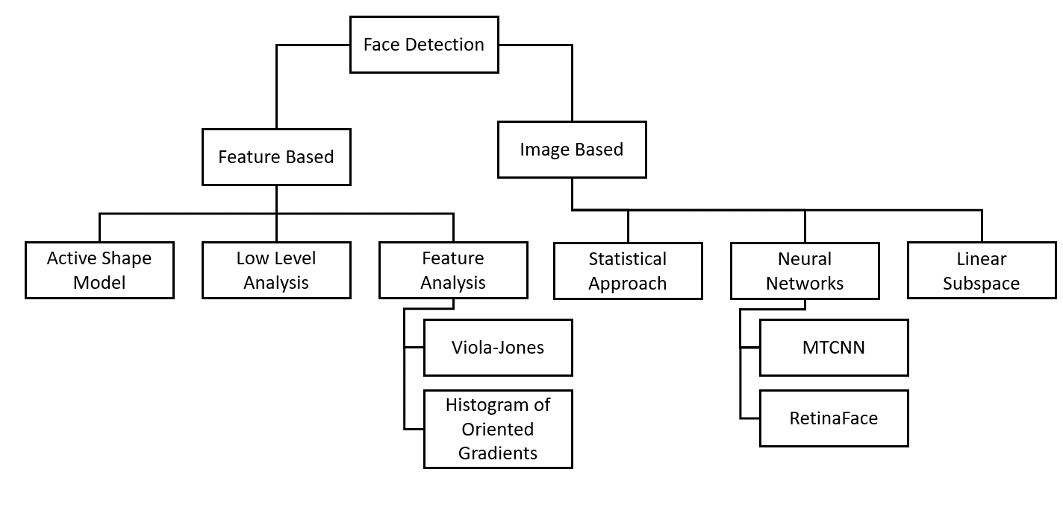
Algorithms
The algorithms chosen for this project were:
Viola-Jones
Histogram of Oriented Gradients (HOG)
Multi-Task Cascaded Convolutional Neural Networks (MTCNN)
RetinaFace
Figure 1: Algorithms categorised
Notes:
These were chosen to represent the variety of the comuter visions scene with their different appraioches to face detection. The violjones and HOG algorithms were early feature based detectors,w herewas the mtcnn and retina face were modern cnn methods.

Slide 5
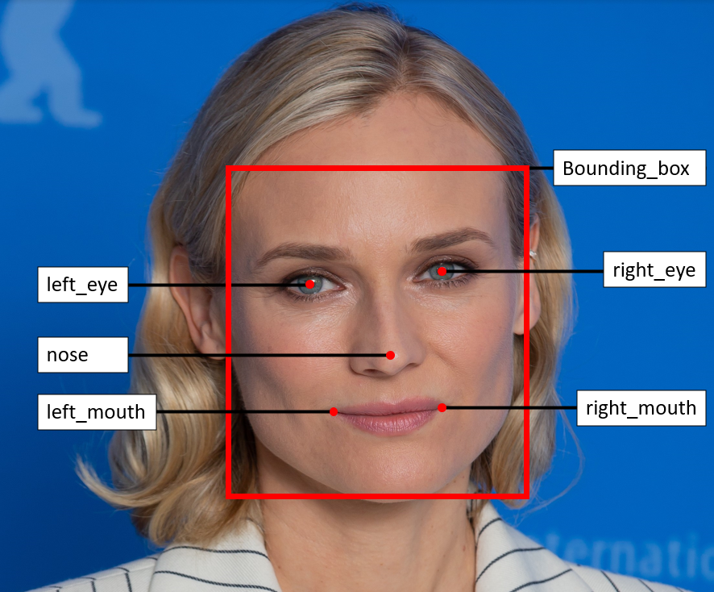
5025 Dataset
Motivation
Compile a set of images that the algorithm could evaluate to see assess if there was difference in accuracy between races and genders
Design choices
Pre-existing or Novel
Dataset diversity
Collation of Images
Technical Details
Annotations
Limitations
Figure 2: Bounding Box Annotations
Notes:
A dataset was compiled that would be used to evaluate the performance of the algorithms against different genders and races to understand if a bias was present
A novel dataset was created to be used instead of using a preexisintg one, because it allowed for more control over the chaactersics of the images in the dataset
The dataset had to be diverse for valid evaluation therefore diversity wasn’t retained to a single race but instead multiple races by using the idea of representaiton. Representation considered how well a race was represented in other datasets. By intepreting race not as discrete races but as a continuous spectrum, allowed multiple races to be categorised into each group. This ensured the dataset was diverse with multiple races and genders, whilst maintaining each groups ability to be evaluated against the algorithms to see if a bias was present with race and gender.
The images were collated of celebrities through google images. These were cropped and aligned to reduce any variance and Images that were of neutral expression and pose were specifcailly chosen
The dataset consisted of 48 distinct faces. Each image had a width of 300. This was decided by using the smallest width image and resizing every other image to match its width whilst maintaining the same aspect ratio. There were 24 represented faces and 24 underrepresented faces. Both these groups contained an equal number of males and females at 12 each
The images were annotated manually through the use of make sense.ai an online annotation tool
The limitations of the dataset included the small size of the dataset which would increase the margin of error in the results. The variance of the images was also a limiting factor as it was difficult to ensure every image had the same characteristics
.
Throughout the course of the project it was realised that a dataset would be required to evaluate the performance of the algorithms. The motivation was to obtain a dataset that had an evenly distributed number of different races and genders such that the accuracy of the algorithm could be compared between the different groups within the dataset. This annotated dataset was called the 50-25 dataset
Due to previous research being completed on understanding the bias within facial analysis algorithms, there existed datasets that contained faces of varying gender and race along with annotations labelling these aspect
However there is a lack of response in requesting many of these datasets which reduces their viability.To allow for more control of every aspect of the dataset, a novel one was created instead of using a prexiting one
To ensure the dataset was diverse and valid for evaluating if a bias was present, the judgement was made that the two factors of race and gender would be combined evenly into two categories, represented and underrepresented faces. These categories better described the different races and genders that could be effected by bias, whilst maintaining two distinct groups. Gender was limited to males or females, and was split equally between the two categories. Race however wasn’t limited the same way. Looking towards a specific race or by extension skin tone, would result in many groups in the dataset. To overcome this, race was generalised by using the idea of representation. Representation would consider how well a race was represented in the available datasets, and it would be placed in the corresponding group. This allowed for multiple races to be categorised in the dataset under the two groups. Underrepresented faces were faces considered to be underrepresented in benchmark datasets, which resulted in African American, South Asian and East Asian faces present. Whereas represented faces contained those of mainly European and American Caucasian faces, which are prevalent as the majority of faces in benchmark datasets. By considering race not as discrete races but as a continuous spectrum, allowed multiple races to be categorised into each group. This ensured the dataset was diverse with multiple races and genders, whilst maintaining each groups ability to be evaluated against the algorithms to see if a bias was present with race and gender.
The images couldve been collated from multiple sources. These being google images, preexisting datasets or manually capturing images. The latter wasn’t viable due to the ongoing Covid-19 pandemic. The second option would’ve been to comb through the datasets that were available and specifically select faces belonging to a specific race or gender, such that there was an even distribution. The problem with this was that many of the datasets were not labelled with race or gender which when combined with their large number of images, made it difficult to automatically or manually extract images of specific race and gender from them. The option of google images was chosen to collate dataset photos.
s. When choosing the photos, it was ensured that they were of creative commons licence and that the photos had relatively little factors that would impact them in comparison to others. These factors included expression, illumination, shadows, occlusion and pose, as described I
The dataset consisted of 48 distinct faces. Each image had a width of 300. This was decided by using the smallest width image and resizing every other image to match its width whilst maintaining the same aspect ratio. There were 24 represented faces and 24 underrepresented faces. Both these groups contained an equal number of males and females at 12 each
To allow for evaluation of the data set by the algorithms, a ground truth was required. The ground truth would consist of annotations of the 5 landmarks and bounding box present for a face. The 5 landmarks consisted of the 2 eye landmarks, the nose landmark and the 2 mouth edge landmarks. The bounding box annotations were the x,y coordinates denoting the top left corner of the bounding box, along with the corresponding height and width in pixels. Make sense .ai was an online annotation tool that was used to manually annotate the dataset
Limitations incluced The size of the as reducing the number of images meant that the accuracy of the average results would suffer, as well as introduce a larger error margin. Images were selected to reduce variance but due to the selection method, it was difficult for every image to be standardised. Variance within the dataset consisted of slight pose variation in which some faces were not fully frontal facing (figure 4.5) as well as expression (figure 4.4) and occlusion due to facial hair (figure 4.3). These variables of the images were difficult to control and would impact the robustness of the results, whens looking for a bias

Slide 6
Evaluation
Evaluation Strategy
Execute algorithm against dataset of underrepresented and represented faces
Compare predicted coordinates to ground truth coordinates
Normalise to produce accuracy metric called “Error Difference”
Metrics
Error Threshold Graph
Intersection over Union Bounding Boxes Histogram
Landmark Error Threshold Histogram
Average Error Difference Table
Qualitative Image
Notes:
To understand if a bias existed within the range of algorithms, they were evaluated against the 5025 dataset and the resulting coordinate predictions were compared to the ground truth coordinates for each image.
If the algorithm was more accurate for one group over the other, then there would exist a bias.
The difference between ground truth and predicted landmarks was normalised with the distance between the eyes for each face to produce the accuracy metrics called error differences.
This metric was used to create the set of histograms and graphs.
The accuracy measure was calculated using the difference between the ground truth coordinates and the algorithms predicted coordinates. This was done by taking the euclidean distance between the predetermined ground truth and the predicted coordinates by the algorithms. This distance value on its own is not useful as a comparison metric, as although each image has the same width, every face still has a different size within the image. To combat this discrepancy, each distance value for a face is normalised by the euclidean distance between the ground truth eye landmarks for the face.
Errir threghsiod graoh descbred the number of errors at different magnnutes between groups
IOU bb which show the distribution of overlap accuracy between both groups for every algorithm
These histograms show the the distribution of error difference for each of the 5 landmarks, across both groups and every algorithm.
The average values fo each of the erorr difference across each landmark and group
Results of the predicitons imposed onto the image with ground truth

Slide 7
Results
Notes:
For the HOG algorithm after the 3 threshold there were more errors for underrepresented faces than represented faces. This difference in accuracy indicated the existence of bias
The MTCNN algorithm shows that the underrepresented faces have more errors than represented faces at every threshold. At its largest difference there are 15 more errors for underrepresented faces. A major bias is present.
The Retina face algorithm shows no real difference between the number of errors at every threshold for both groups, they both perform similarly. This indicated there being no apparent bias.
The histogram of error difference for hog showed the underrepresented faces performing worst for the mouth landmarks.
The represented faces perform slightly better than the underrepresented for the eye landmarks and the underrepresented faces perform better for the nose landmark
The histogram of error difference for MTCNN showed that at every landmark the underrepresented faces performed worst than the represented faces. However for the nose landmark the performance of both groups was similarly bad. The mouth landmarks were where the underrepresented faces performed the worst overall.
The retina face histograms show that both groups performed similarly across all landmarks.
The largest difference was at the left mouth landmark but this was still small compared to other algorithms
There was no obvious difference apparent.
The average results of the mouth landmarks for hog showed the largest difference, with underrepresented faces performing worst. However the represnetf faces had a worst performance for the nose and right eye landmark.
For MTCNN, the averages of all landmarks were worst for underrepresented faces with the biggest difference for the left eye, and mouth landmarks
The retina face algorithm showed differences of small magnitudes indicating similar performance between groups. The largest difference was the right mouth landmark performing worst for underrepresented faces.
The bounding box histograms showed that for the HOG algorithm the performance of represented faces was less accurate in general, however there was a larger number of underrepresented faces at the lowest accuracy.
MTCNN showed very accurate and similar performance between both groups, and Retinaface showed underrepresented faces performing better but the difference was small between the groups
ViolaJones showed the underrepresented group performing worst, with a large number of inaccurate bounding boxes and a low number of accurate bounding boxes

Slide 8
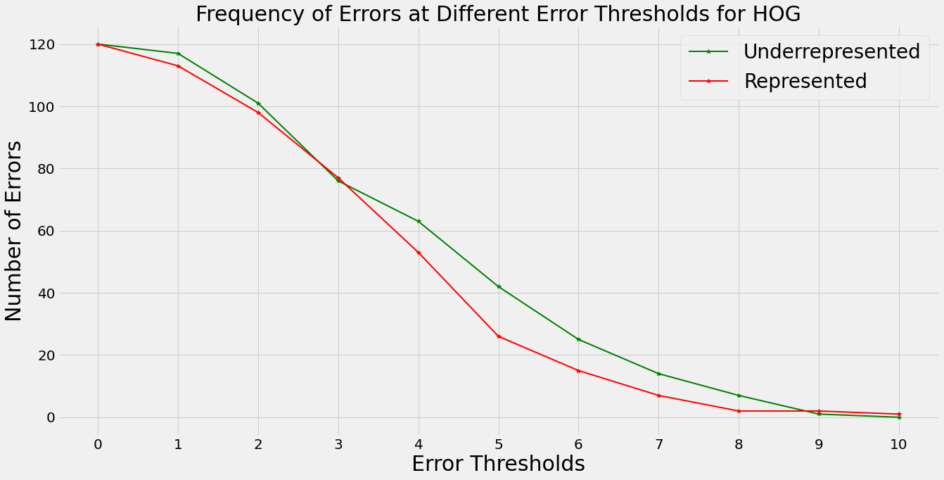
Frequency of Errors at Thresholds
There is a similar performance between both groups up to the 3 error difference threshold.
Underrepresented faces perform worst after 3 error threshold.
Evidence of bias.
Figure 3: Frequency of Errors at Error Thresholds for HOG
Notes:
For the HOG algorithm after the 3 threshold there were more errors for underrepresented faces than represented faces. This difference in accuracy indicated the existence of bias
The MTCNN algorithm shows that the underrepresented faces have more errors than represented faces at every threshold. At its largest difference there are 15 more errors for underrepresented faces. A major bias is present.

Slide 9
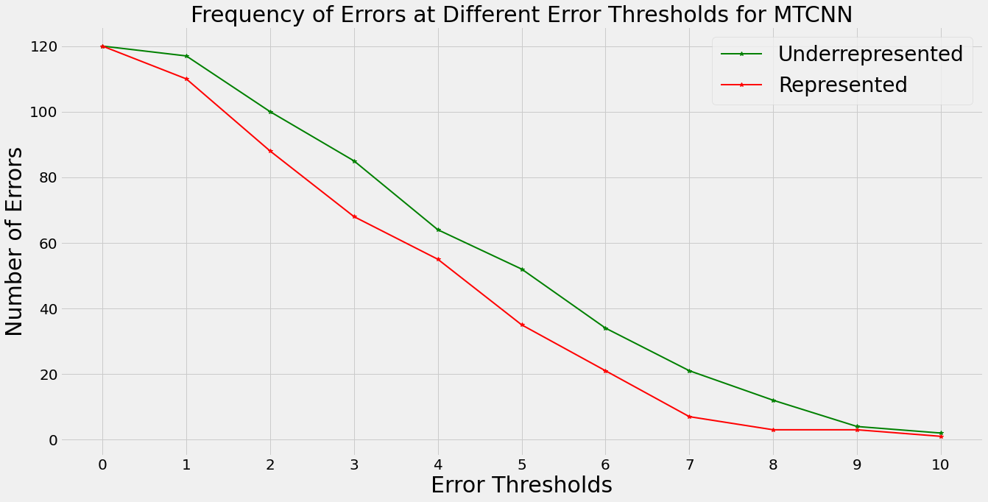
Frequency of Errors at Thresholds
Underrepresented faces perform worst at every threshold.
Represented faces have consistently lower errors.
Difference of around 15 errors at 5 threshold
Evidence of bias.
Figure 4: Frequency of Errors at Error Thresholds for MTCNN
Notes:
The MTCNN algorithm shows that the underrepresented faces have more errors than represented faces at every threshold. At its largest difference there are 15 more errors for underrepresented faces. A major bias is present.

Slide 10
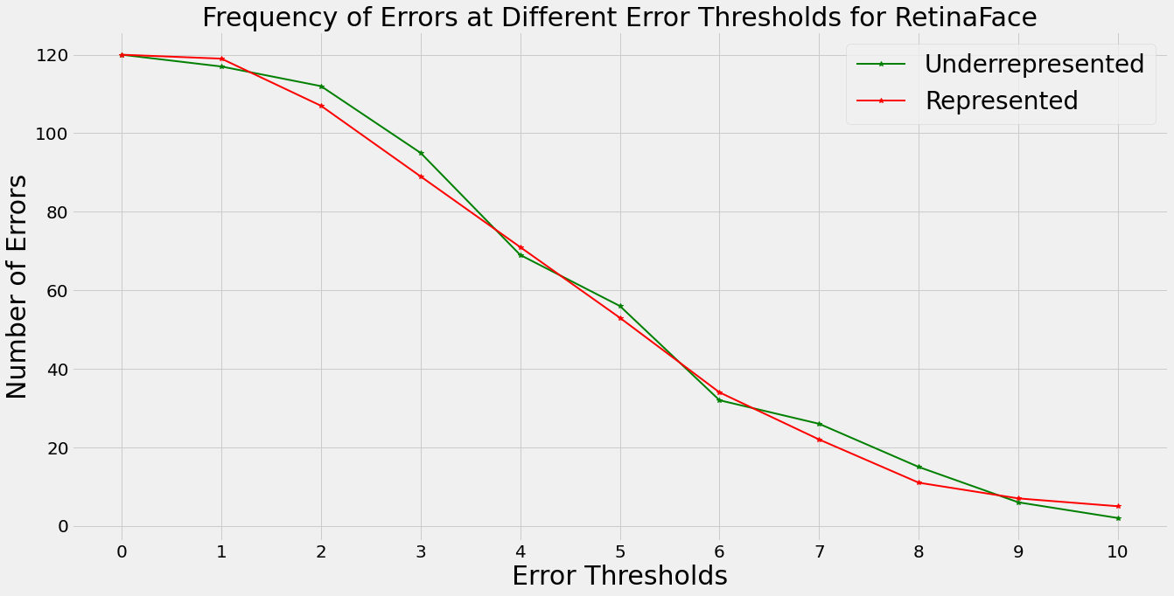
Frequency of Errors at Thresholds
Underrepresented faces and represented faces perform similarly.
No outstanding difference present.
Evidence of no bias.
Figure 5: Frequency of Errors at Error Thresholds for RetinaFace
Notes:
The Retina face algorithm shows no real difference between the number of errors at every threshold for both groups, they both perform similarly. This indicated there being no apparent bias.

Slide 11
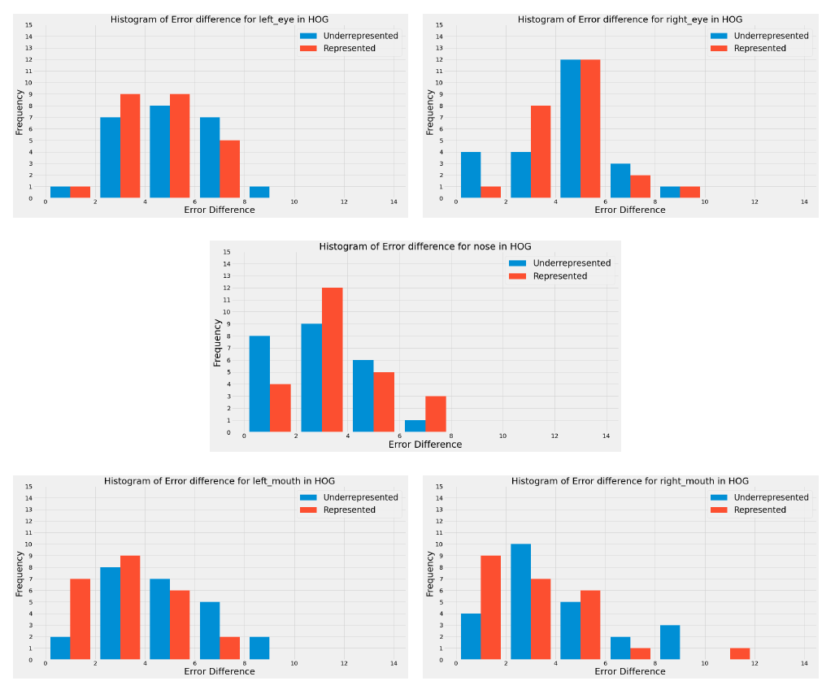
Histogram of Error Difference for each Landmark
Left and right mouth show higher number of small errors for represented faces and a higher number of large errors for underrepresented faces.
Represented faces perform slightly better for eye landmarks with more errors of a small magnitude.
Underrepresented faces perform better for the nose landmark with more small errors.
Figure 6: Histograms of Error Difference for HOG
Notes:
The histogram of error difference for hog showed the underrepresented faces performing worst for the mouth landmarks.
The represented faces perform slightly better than the underrepresented for the eye landmarks and the underrepresented faces perform better for the nose landmark

Slide 12
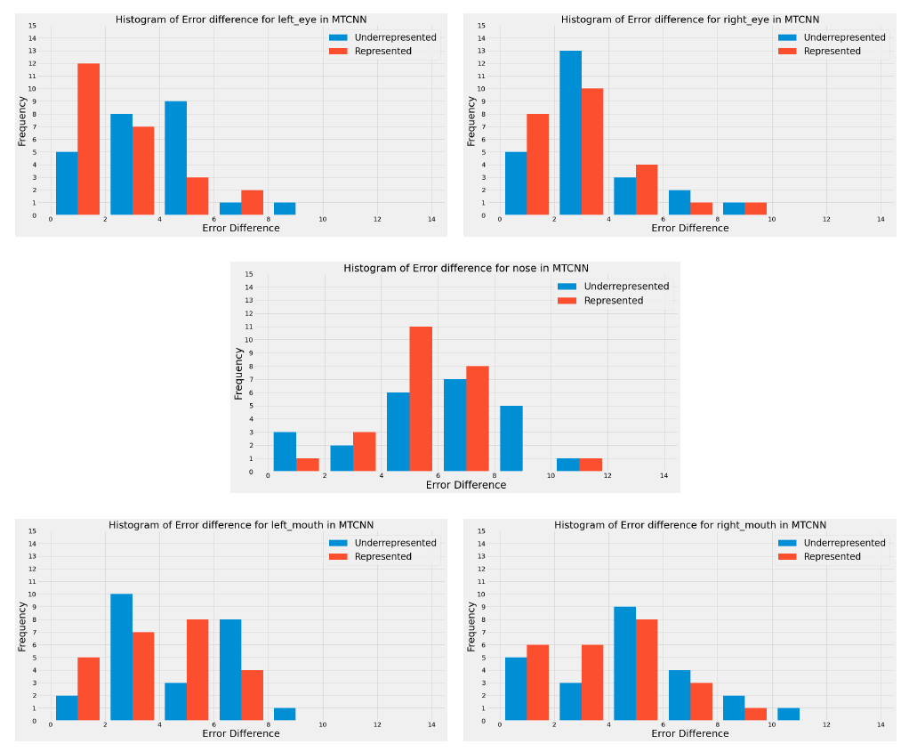
Histogram of Error Difference for each Landmark
Each landmark has more errors of a larger magnitude for underrepresented than represented faces.
Both represented and underrepresented perform poorly for the nose landmark.
The mouth landmarks are where the underrepresented group performs the worst.
Figure 7: Histograms of Error Difference for MTCNN
Notes:
The histogram of error difference for MTCNN showed that at every landmark the underrepresented faces performed worst than the represented faces. However for the nose landmark the performance of both groups was similarly bad. The mouth landmarks were where the underrepresented faces performed the worst overall.

Slide 13
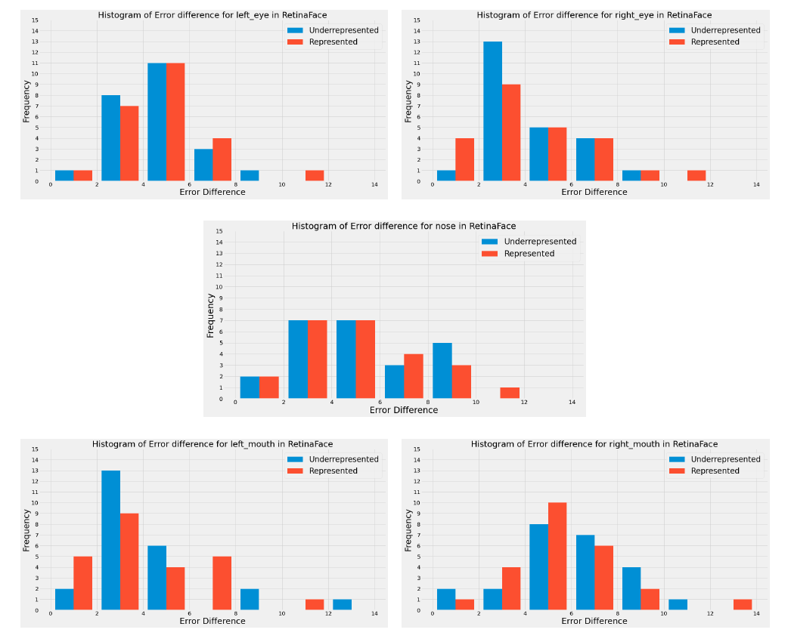
Histogram of Error Difference for each Landmark
Underrepresented faces and represented faces perform similarly across all landmarks.
Largest difference between groups at left mouth landmark under the 2 threshold.
No obvious difference between the groups in the landmarks.
Figure 8: Histograms of Error Difference for RetinaFace
Notes:
The retina face histograms show that both groups performed similarly across all landmarks.
The largest difference was at the left mouth landmark but this was still small compared to other algorithms
There was no obvious difference apparent.

Slide 14
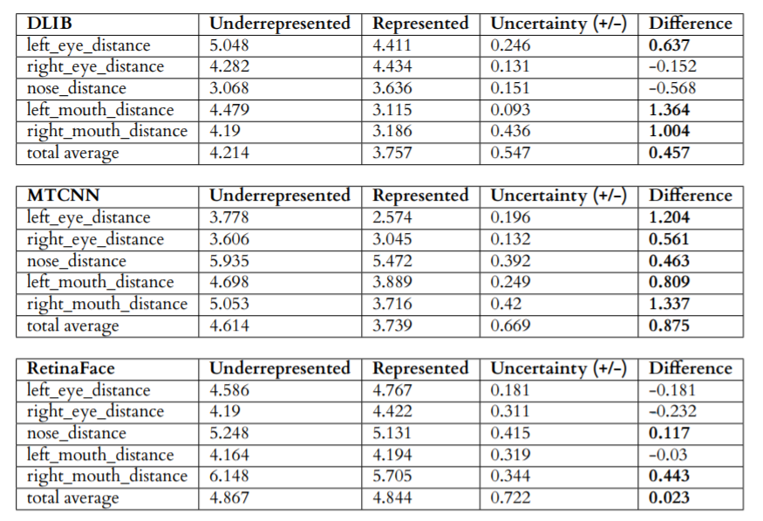
Average Difference
HOG
Mouth landmarks show largest difference between groups with underrepresented performing worst.
Nose and right eye landmark perform slightly worst for represented faces.
MTCNN
All landmarks perform worst for underrepresented faces, with biggest difference at left eye, and mouth landmarks.
RetinaFace:
Represented group performs worst for left eye, right eye and left mouth landmarks.
Underrepresented group performs worst for nose and right mouth landmark, with right mouth showing the largest difference between all landmarks.
Figure 8: Average Error Difference for Groups
Notes:
The average results of the mouth landmarks for hog showed the largest difference, with underrepresented faces performing worst. However the represnetf faces had a worst performance for the nose and right eye landmark.
For MTCNN, the averages of all landmarks were worst for underrepresented faces with the biggest difference for the left eye, and mouth landmarks
The retina face algorithm showed average differences of small magnitudes indicating similar performance between groups. The largest difference was the right mouth landmark performing worst for underrepresented faces.

Slide 15
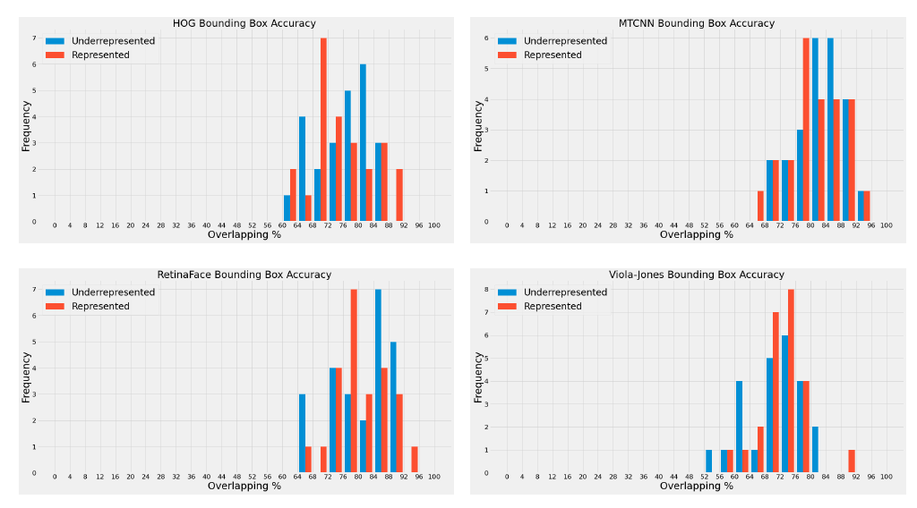
Bounding Box Overlap Histogram
HOG
Represented faces perform worst in general, however larger number of underrepresented faces at low accuracy extreme.
MTCNN
Performance between both groups is very accurate with little difference.
RetinaFace
Underrepresented faces perform better overall but the difference is small and the performance is average for both groups.
Viola-Jones
Underrepresented group performs with a larger number of low accuracy overlap.
Larger number of high accuracy represented faces than underrepresented faces.
Figure 9: Bounding Box Accuracy Histogram for Algorithms
Notes:
The bounding box histograms showed that for the HOG algorithm the performance of represented faces was less accurate in general, however there was a larger number of underrepresented faces at the lowest accuracy.
MTCNN showed very accurate and similar performance between both groups, and Retinaface showed underrepresented faces performing better but the difference was small between the groups
ViolaJones showed the underrepresented group performing worst, with a large number of inaccurate bounding boxes and a low number of accurate bounding boxes

Slide 16
Discussion

Slide 17
Viola-Jones and HOG
Performance is worst for underrepresented faces than represented faces, indicating slight bias.
Feature extraction
The difference in intensity between faces.
Lack of underrepresented training data
Dataset wasn’t fair.
119 out of the 135 images for the HOG predictor were of represented faces.
Resulted in lack of training with underrepresented faces.
Notes:
Both the DLIB and Viola-Jones algorithms showed a slight bias. Through analysis of these algorithms It was found that the feature representation the algorithms extracted from the image were based on relative intensity. This meant that faces of varying brightness i.e different skin tones, could cause the features to be extracted differently. By relying on brightness values the algorithms introduced bias. Although the datasets also had a part to play for the lack of accuracy. This is seen by the HOG landmark predictor which was trained on a dataset of 135 images in which only 16 images were of underrepresented faces. Therefore by being trained on a lack of underrepresented data meant the algorithm would have trouble predicting landmarks when it came to underrepresented faces.
The reduction in perfomanc for the viola-jones algirhtinm could come from its feature representation. By using features that are based on image brightneess,. It would mean that the differing brightness In the images could result in
Its filter was created manually through the use of specific haar-like features. This feature representation is the core of the algorithm and is where the slight bias observed could be introduced. The haar-like features work by looking at the difference in regions of pixel intensity in the image. This helps the algorithm classify what features are being observed and if a face is detected. By using the difference in pixel intensities, the algorithm is looking directly at the difference in regions of brightness in an image. In represented faces of a lighter skin tone, this difference in brightness could be exaggerated and be easier for the classifier to understand. Where as in underrepresented darker skin toned faces, the difference between areas of intensity could be harder for the algorithm to distinguish as haar-like features
there is a lack of information behind what images were used for the training of the algorithm. Therefore its viable that the bias could be introduced through the training data as well. An assumption can be made that because algorithm is one of the foundational methods in computer vision. That the goal early on in research wasn’t to ensure fairness in the results but instead to just generate valid results. Therefore an unbiased dataset was probably not considered and in turn would be partly responsible for the slight bias seen

Slide 18
MTCNN
Show worst performance across all landmarks in threshold histograms for underrepresented faces.
No handcrafted filters
Dataset Bias
MTCNN uses WIDER FACE for face classification and CelebA for landmark localisation.
As evident from bounding boxes, face classification is strong, but landmark localisation isn’t.
CelebA dataset
Sampling Bias present which results in inaccurate predictions.
Notes:
The MTCNN showed worst performance for underrepresented faces indicating a bias. The algorithm doesn’t use handcrafted feature descriptors like the HOG and Viola-Jones algorithm therefore, its difficult to say that the bias exists within how the algorithm functions but instead its more likely the bias exists within how the algorithm was trained.
Data bias isn’t a new concept within the field computer vision and machine learning. Its when there exists a weighting or bias within the data that a model is trained with, which results in the models behaviour itself being weighted or biased
MTCNN uses WIDER FACE for face classification and CelebA for landmark localisation, and As evident from bounding boxes, the bias lies in the landmark localisation
The CelebA dataset has an inherent sampling bias present which is why the algorithm couldn’t predict landmark correctly for underrepresented faces, as the majority of faces it was trained with were represented. This is because the celeba dataset uses celebrities faces. Taking an example of Hollywood, its generally understood that there is a lack of minority representation Santhanam (2015). This is something that will therefore be reflected in a dataset such as the CelebA dataset. This lack of underrepresented faces is why the bias is present
Although the dataset is annotated well in terms features in the image, most of the annotations don’t specify attributes related to race. Instead they relate to attributes like if the face has glasses on or if it is wearing a hat, some of these attributes are seen in figure 7.2. This means that CelebA’s annotations don’t reflect human diversity well, as they fail to consider races, resulting in a biased set of annotations.
. A more particular reason for the algorithm performing negatively is due to the inherent sampling bias introduced by using celebrities faces. Taking an example of Hollywood, its generally understood that there is a lack of minority representation Santhanam (2015). This is something that will therefore be reflected in a dataset such as the CelebA dataset, which contains famous celebrities. It means the algorithm is better trained to handle represented faces than it is underrepresented faces because it wasn’t trained using underrepresented faces, which results in failure to accurately identify features for them and behave with a bias.

Slide 19
RetinaFace
Similar performance between groups, evidence of no apparent bias present
Representative dataset
WIDER FACE categories.
Feature Pyramid Network
Up-sampling and down-sampling of reconstructed layers could reduce the complexity that introduces bias.
Detector can make predictions for images it is better trained for.
Notes:
This algorithm shows very consistent results in terms of the performance of both groups. Looking at the experiments its clear that a bias doesn’t exist within the Retinaface algorithm, as the number of errors for represented and underrepresented faces is very similar at every threshold.
This lack of bias comes from the dataset the algorithm is trained with. The WIDER FACE dataset consists of different event categories like students, voters or weddings, and has 1000 to 3000 images from the internet pertaining to these categories. This results in less of a sampling bias because the images aren't directly related to celebrities in which there would be an inherent bias present. The spread of categories helps include many different backgrounds and identities ensuring a fairer dataset
The lack of bias could also come from the feature pyramid network. The FPN used by the algorithm, up samples and down samples the images feature maps. This sampling reduces the complexity of the images. This means that features in images that could result in a bias have their complexity reduced, and the algorithm can make predictions on simpler feature maps it is better trained for.
. The FPN works by generating feature maps from the original image which contain rich semantic data, but less resolution as the number of maps increase. This creates the pyramid structure. The higher resolution maps are not used for object detection as they contain less semantic information. meaning it would be inefficient to make predictions using these. Instead the upper layers are used for face detection. FPN allows a way to reconstruct higher resolution layers from the rich semantic layers to allow for better predictions. However due the upsampling and downsampling of the feature maps, alot of the precise information can be lost. This means that when the layers are reconstructed, detail surrounding landmarks can be less precise making the algorithm not only perform inaccurately but perhaps with less bias. This could be due to the complexity of certain landmarks on underrepresented faces that could introduce bias in the original image are reduced in accuracy, therefore allowing the detector to make predictions on simpler images it is better trained for.

Slide 20
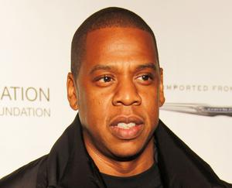
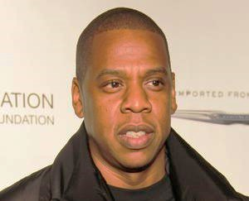
Altering Images to Assess Dataset Bias
From the 3 algorithms the MTCNN showed the largest bias.
Goal was to alter poor performing underrepresented faces to be similar to represented faces, to see if algorithm could generate more accurate predictions.
Altering Contrast
The faces chosen were based on worst performance for mouth landmarks (>7 error difference).
Contrast was altered as this reduced difference between the brightest and darkest parts of the image, resulting in a lighter skin tone and the shadows becoming less pronounced.
Figure 10: Original Image
Figure 11: Contrast Altered Image
Notes:
7.00 From the 3 algorithms it is clear to see that the MTCNN algorithm showed the most bias with its underrepresented faces performing worst compared to the represented faces. This bias seems to exist through the dataset the algorithm is trained on. For the next set of experiments, the focus was to see what factor in the underrepresented faces caused them to perform worst than the represented faces, and if the faces could be augmented such that the performance of the MTCNN algorithm could be improved
To do this a subset of the dataset was used which had errors larger than a magnitude of 7 for the left and right mouth landmarks. These images were chosen because the mouth landmarks were the worst performing landmarks for the MTCNN algorithm. From this subset of 11 faces, 2 were represented males, 3 were underrepresented males and 6 were underrepresented females. The factor decided upon was altering the contrast of the images so that the subset of images more closely resembled the contrast of the represented faces. Through doing this the difference between the brightest and darkest parts of the image were reduced, this resulted in a lighter skin tone on the faces and the shadows became less pronounced

Slide 21
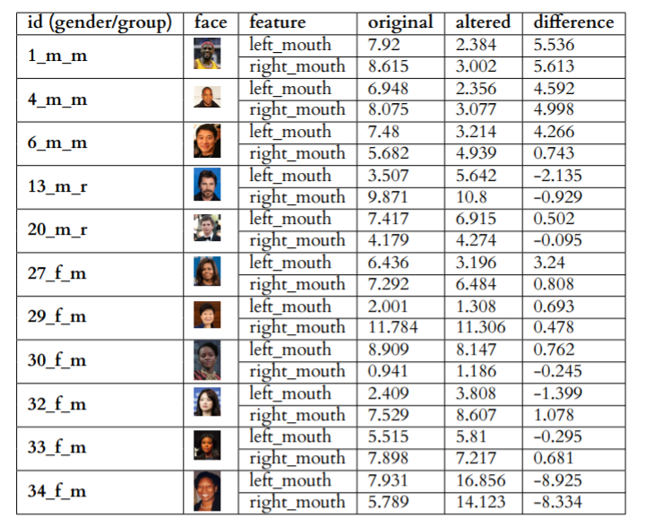
Altering Images to Assess Dataset Bias
Running this back through algorithm generated interesting results:
The 3 underrepresented male faces showed improvement on both landmarks .
Out of the 6 underrepresented female faces:
2 showed improvement on both landmarks.
3 showed improvement on a single landmark.
1 performed worst on both landmarks.
The results conclusive for males were less so for females.
Figure 12: Altered Contrast Results
Notes:
The results conclusive for males were less so for females, although it is still evident that changing the contrast did overall have a positive influence in the algorithms performance. This further emphasises that a bias does exist within the data the algorithm was trained on as by augmenting a subset of the images to resemble closer to the represented faces, the algorithm was able to provide a better performance for the majority of them.

Slide 22
Dataset Bias
Knowing that dataset bias is a large factor to why algorithms perform in a biased way, I looked into how dataset bias was introduced and why it hasn’t been mitigated.
Sampling Bias
Inherent bias in collating images of celebrities.
Sampling bias is difficult to avoid because it can be introduced indirectly.
Benchmark Dataset Bias
Labelled Faces in the Wild.
Doesn’t evaluate race and gender bias.
Algorithms continue to use biased datasets because of occlusive accuracy metrics.
Notes:
Knowing that dataset bias is a large factor to why algorithms perform in a biased way, I looked into how dataset bias was introduced and why it hasn’t been mitigated
Sampling bias is introduced through the collation method of datasets. Its difficult to avoid as it can indirectly be introduced even when the goal is to create a fair dataset.
This is evident with the PPB dataset, where there is a fair distribution of races and genders, however due to sampling politicians, there exists an age bias. Sampling with any specific category results in a bias with another.
The benchmark datasets bias comes from using datasets like LFW which don’t evaluate race and gender. Therefore algorithms that show a bias are being evaluated as accurate even when they are not. This is an occlusive metric and is a reason why bias still exists, because it is not being caught and mitigated by these benchmark datasets.
There is an inherent sampling bias present in many datasets. These datasets created consist of images collated from the internet of celebrities and other popular faces. This introduces an inherent bias because by sampling from celebrities, then there will be a larger proportion of represented faces as proportionally there are less celebrities belonging to minorities
This is why its exhibited in many datasets such as the CelebA (Liu et al. (2015)), VGGFace2 (Cao et al. (2018)) and PubFig (Kumar et al. (2009)) datasets. Specifically looking at the popular evaluation dataset, VGGFace2. It consists of 3.31 million images. The images were collated from Google image search and contain varying pose, age and most importantly ethnicity. From the 3.31 million images, there are only 9131 distinct faces. These distinct faces were chosen from an initial list of 500,000 public figures from the the Freebase knowledge graph. The list was reduced in size by removing those names which didn’t have enough credible photos along with them. This meant that the list then consisted of only those public figures who garnered the most fame. This was weighted towards represented faces more than underrepresented faces as looking at popular figures in terms of actors in Hollywood movies, there are more represented actors than their are underrepresented actors by a massive margin (Santhanam (2015)). Therefore its reasonable to assume that even though this dataset looks to include more ethnicities, it still has proportionally much more represented faces which results in biased training
Sampling bias is difficult to avoid looking at The PPB dataset from Buolamwini and Gebru (2018), looks to reduce bias for race and gender by using images of parliamentary members around the world. They succeed in reducing this bias present in the dataset but indirectly introduce another bias. Since all the faces are of parliamentary members, there is a large age bias present, as the dataset doesn’t contain any young faces. This shows the difficulties in using any specific category to create a dataset, as sampling bias can easily and indirectly be introduced. This is one of the main reasons bias is introduced into algorithms because there are not enough unbiased datasets available due to sampling bias.
The Labelled Faces in the Wild dataset (Sagonas et al. (2013)) is a popular dataset amongst algorithms and frameworks as it is a benchmark dataset used to evaluate accuracy and robustness. A reason for its popularity is that it contains faces of differing pose and expression as well as varying shadows. An assumption would be that a popular dataset used to evaluate the robustness of face detection performance "in the wild" would be representative of the real world, but in reality this dataset has many issues. These being that the data set lacks representation of minorities as well as women, kids and the elderly. Benchmark datasets like this are a large reason to why bias exists within face detection and face detection algorithms because although they aren’t being used to train the algorithms directly, they are being used to evaluate them. Meaning that problems of bias that exist within algorithms are being evaluated against a dataset that doesn’t consider bias. This results in high accuracy scores for bias algorithms and indicates to others that the algorithms are accurate. This is occlusive to the real underlying issues and indirectly increases the bias present. This is because there is no evaluation of the bias, so algorithms continue to use the same biased datasets, without ever having to worry about their accuracy scores.

Slide 23
Summary and Future Work
This project evaluated 4 algorithms against a novel dataset consisting of represented and underrepresented faces, to investigate if a bias was present. It was found that differing levels of bias were present. Analysing the algorithms, made evident that the bias existed through the datasets the algorithms were trained on, and the design of the algorithms.
Proposed future work
Expand on face detection field by evaluating other algorithms with differing features.
Evaluate the algorithms on a larger dataset comprising of an evenly distributed number of represented and underrepresented faces.
Retrain the MTCNN algorithm using a fairer dataset to evaluate if there is any improvement against reducing the bias present.
Notes:
This project evaluated 4 algorithms against a novel dataset consisting of represented and underrepresented faces, to investigate if a bias was present. It was found that differing levels of bias were present. Analysing the algorithms, made evident that the bias existed through the datasets the algorithms were trained on, and the design of the algorithms. It was shown that the older feature based algorithms of HOG and Viola-Jones introduced bias through their design as well as their training data, where as the modern mtcnn and Retina Face algorithm introduced bias or lack of bias due to their training data. This however wasn’t exclusive as components of the algorithm in Retinaface like the FPN helped reduce bias. Dataset bias was explored and it was found that its introduction and lack of mitigation came from the bias present in sampling and bench mark datasets
Proposed future work includes, expanding on the range of algrihtms, expanding the size of the dataset and retraining the CNN algothims to see if a fair dataset would ensure a fairer result

Slide 24
Bias Existence
The results indicated a bias existing within the MTCNN, and to a lesser extent the HOG and Viola-Jones algorithms. Looking at reasons for bias, its clear that it comes from two factors.
The design of the algorithm
Feature descriptors.
The training data used by the algorithms
Modern CNN methods rely entirely on annotated training data to create filter.
Notes:
The results indicated a bias existing within the MTCNN, and to a lesser extent the HOG and Viola-Jones algorithms. Looking at reasons for bias, its clear that it came from two factors.. The design of the algorithms and the training data the algorithms trained on. The bias with design of the algorithm is specifically apparent for the older HOG and ViolaJones algorithms that use feature descriptors. The dataset bias is present In all the algorithms but especially the modern image-based MTCNN algorithms

