Slide 1
Distributed Systems 1: Hands-on Labs
davide.vecchia@unitn.it
timofei.istomin@unitn.it

Slide 2
Hands-on Labs
What will we (you) do?
Implement some distributed algorithms seen in class
We together during the labs
You in groups as the course project
Learn a different programming model (Actor-based)
Deepen the knowledge of Java

Slide 3
http://akka.io

Slide 4
What actors provide
Multi-threading without low-level concurrency constructs (threads, shared memory, locks)
Network Transparency: explicit communication among remote objects as with local ones
Unlike hidden remoting approaches, e.g., RPC/RMI
Elastic scalable architecture
We will not go there

Slide 5
Actor Model
A (distributed) program consists of Actors
Actors encapsulate state and behaviour
They interact by sending messages to each other
Does it remind you of anything?

Slide 6
Is it different from OOP?
A program consists of Objects
Objects encapsulate state and behaviour
They interact by calling each other’s methods
This is fine unless there are threads or network

Slide 7
Control flow in OOP
A promise of a (correct) object:
Its state remains correct after any method call
Preserves certain internal invariants

Slide 8
OOP with threads
What if we add threads?
Why do we need threads?
Multiple threads are working on the same variables simultaneously
We’ll get race conditions, cache problems
Objects don’t hold their invariants and therefore break their main promise

Slide 9
Working with threads
Synchronisation mechanism are used to avoid race conditions and other problems:
Memory barriers
Locks
Condition variables, etc.
… but they are tricky, don’t eliminate thread blocking and create other problems:
Deadlocks: some threads might get stuck forever waiting for each other
Thread contention: locks are expensive and in some cases can become a bottleneck creating “traffic jams” in the system
It gets even more complicated in distributed programs

Slide 10
OOP with multithreading
The original idea
The reality

Slide 11
The Actor Model
Send messages to objects (actors) instead of calling their methods
Don’t wait till the object completes the task
Sending a message is non-blocking
No return value
If the actor is busy at the moment, the message is queued

Slide 12
An actor
Variables
Message queue
handler1
handler2
Messages
…
Dispatcher
handlerN

Slide 13
Actor System
Variables
Message queue
handler1
handler2
…
Variables
Dispatcher
handlerN
Message queue
handler1
handler2
…
Dispatcher
handlerN
There are many actors in the system
They communicate by sending messages to each other

Slide 14
Guarantees
Actors may be running in parallel in different threads or even on different computers
It is guaranteed that no actor is running in more than one thread at a time
No race conditions, no locks needed
Message queues are FIFO
Messages might be lost
Message send operation is non-blocking

Slide 15
Remote actors?
The message-passing semantics is natural for remote communications
Therefore, actors may reside on different computers and communicate using the same primitives as with local actors
all messages should be serializable
Actor-based programs can be very scalable and easy to deploy on a cluster
even without changing the program code

Slide 16
Akka
AKKA is a Java and Scala framework implementing the Actor Model
We will use the Java version
Code, tools and documentation: https://doc.akka.io/docs/akka/current/index-classic.html
Other implementations of the Actor Model exist, e.g., Erlang: http://erlang.org

Slide 17
Ensuring encapsulation
Java cannot automatically ensure proper encapsulation of actors
Some discipline is required on the programmer side!
General rule: make sure no object (variable) is accessible from multiple actor instances, e.g.:
Don’t send references to mutable objects in messages. Send copies instead
Don’t use non-final static variables in the actor class nor other classes accessible from the actor
Don’t use threads that may access internals of an actor (There’s no need for threads! Actors are all you need)

Slide 18
Akka messages
Akka messages are user-defined serializable Java objects
public class Hello implements Serializable{
private final String msg;
public Hello(String msg) { this.msg = msg;
}
}
String is immutable
Final!
Common practice: define your messages as inner classes of the Actors that will receive these messages
E.g.: Receiver.java

Slide 19
Akka messages
Send copies for mutable object (ArrayList).
public class JoinGroupMsg implements Serializable {
private final List<ActorRef> group;
public JoinGroupMsg(List<ActorRef> group) {
this.group = Collections.unmodifiableList(
new ArrayList<>(group));
}
}
Would new ArrayList<>(group) be enough?
What about Collections.unmodifiableList(group) ?

Slide 20
Actor constructors
class MyActor extends AbstractActor {
// internal variables can be defined here
private int id;
// constructor
public MyActor(int id) {this.id = id;}
// Actor “properties”
// (used by the system to create actors)
static public Props props(int id) {
return Props.create(
MyActor.class,
() -> new MyActor(id));
}
}
Calls to the constructor

Slide 21
Initialisation
public static void main(String[] args) {
// Create an actor system named "helloakka"
final ActorSystem system =
ActorSystem.create("helloakka");
// Create an actor
final ActorRef myactor = system.actorOf(
MyActor.props(352),
”actor352");
}
Constructor parameters go here
The actor class that we want to create
Actor reference
New actor name, unique in the actor system

Slide 22
Actor reference
To protect actors from unauthorized access the system does not reveal direct Java references to the actor objects
Instead, you can use an ActorRef object associated with an actor to send messages to it
ActorRef objects can be passed inside messages to other actors
ActorRef works both locally and remotely

Slide 23
Sending messages
Hello m = new Hello(“Hi there!”);
myactor.tell(m, getSelf());
Destination actor reference
Sender reference: can be null

Slide 24
Handling incoming messages
@Override
public Receive createReceive() {
return receiveBuilder()
.match(Message1.class, this::onMessage1)
.match(Message2.class, this::onMessage2)
.match(Message3.class, this::onMessage3)
.build();
}
private void onMessage1(Message1 msg) {...}
private void onMessage2(Message2 msg) {...}
private void onMessage3(Message3 msg) {...}
Define the mapping between incoming message classes and the methods of the actor
Define the “reaction” upon reception in private methods of the actor, for each message type

Slide 25
Useful methods of an actor
Abstract (for you to define, if needed)
void preStart() – called after the actor has been initialized but before processing any messages
Defined (for internal Actor use)
getSelf() – get ActorRef of myself
getSelf().path().name() – get my name
getContext().system().scheduler().schedule() – schedule an action in the future
getSender() – get the reference to the current message sender

Slide 26
Scheduling a future action
Preferred way: schedule a message in the future (maybe even a message to self)
It is possible to schedule a runnable instead, but this is not recommended!
The runnable may not access Actor’s variables otherwise race condition may happen
Cancellable timer = getContext().system().scheduler().schedule(
Duration.create(1, TimeUnit.SECONDS),
Duration.create(1, TimeUnit.SECONDS),
receiver, new Hello("Hi there!”)
),
getContext().system().dispatcher(),
getSelf());

Slide 27
Example
Let’s look at the example together
Open Java source files located in the hello/src/main/it/unitn/ds1 directory, using a text editor or an IDE
To run it from the command line, go to hello directory and type gradle run

Slide 28
Exercise: Causal Delivery
We’ll create a toy group chat application
There will be a group of actors that send chat messages to the whole group (multicast)
For simplicity: all the actors will run locally
The chat system should guarantee the property of causal delivery:
Nobody can deliver a reply to a message M before delivering the message M itself

Slide 29
Why reordering is possible?
Fine, thanks
How are you?
Fine, thanks
How are you?

Slide 30
Simulating a group chat
We will create several pairs of “chat users” that will be talking on different “topics”
We’ll start from having only one pair
We will create a number of “listeners” that see all the messages but don’t participate in the talks
To check that the system preserves the message order we need to know the right order ourselves!
To do so, we will put a sequence number into every message in a conversation
But we will NOT use these sequence numbers inside the “chat system” to preserve the ordering
That would be cheating.

Slide 31
Chat timeline
Msg 0 topic 1
Msg 2 topic 1
0: topic 1
Msg 1 topic 1
1: topic 1
Replies after it receives Msg 0 topic 1
Msg 0 topic 2
2: topic 2
Msg 1 topic 2
3: topic 2
4: listener
All messages are sent to everybody (multicast)
Chatters reply on their topic only, incrementing the sequence number

Slide 32
Chat history
At the end we will print the chat histories of all participants in the order of message delivery
The system is correct if all messages on the same topic are always in the order of sending
Messages on different topics might be swapped
Listener1: T1:0 T1:1 T2:0 T1:2 T2:1 T2:2
Listener2: T1:0 T1:1 T1:2 T2:0 T2:1 T2:2

Slide 33
Before we start…
Before we start with vector clocks, complete a simpler exercise
Open the multicast example
Let’s look at the code together
Compile it
Run and check the output
Exercise: add more pairs of chatters to the system

Slide 34
Emulating network delays
We emulate random network delays with this code:
private void multicast(Serializable m) {
Collections.shuffle(group);
for (ActorRef p: group) {
if (!p.equals(getSelf())) {
p.tell(m, getSelf());
try {
Thread.sleep(rnd.nextInt(10));
}
catch (InterruptedException e) {
e.printStackTrace();
}
}
}
}
Within 10 ms
Never use Thread.sleep to schedule activities in the future!

Slide 35
Reordering…
Fine, thanks
How are you?
Fine, thanks
How are you?

Slide 36
How it should work
How are you?
Fine, thanks
Buffer
Fine, thanks
How are you?

Slide 37
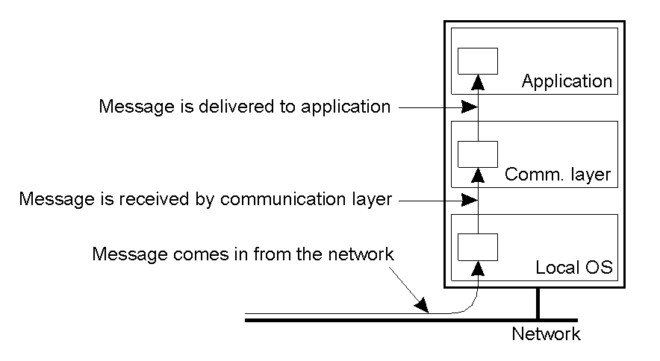
Delivering a message
We’ll make a distinction between receiving and delivering a message.
You might have already seen this with TCP:
messages might be received out-of-order;
but TCP buffers them and delivers them in order to the application.

Slide 38
Reading
https://doc.akka.io/docs/akka/current/guide/actors-motivation.html
https://doc.akka.io/docs/akka/current/guide/actors-intro.html

Slide 39
Vector clock for “Bulletin Board”
Each process i has an array V_{i} where V_{i}[j] denotes the number of events that process i knows have taken place at process j.
In this application “events” refers to the sending of a message.
Thus if V_{i}[j] = 6 then i knows that j has sent 6 messages.

Slide 40
Vector clock for “Bulletin Board”
Just before S sends a message, it does the following:
V_{S}[S] = V_{S}[S] + 1;
This is basically saying that the number of messages process S has sent is incremented by one.
It includes V_{S} into the outgoing message.

Slide 41
Vector clock for “Bulletin Board”
Message m (from S) is delivered to R iff both the following conditions are met:
V_{S}[S] = V_{R}[S]+1
Meaning that m is the next message that R was expecting from process S
V_{S}[i] ≤ V_{R}[i] for all i ≠ S
Meaning that at the moment of sending m the sender S did not see more messages than the receiver R did.
Otherwise the message is buffered

Slide 42
Vector clock for “Bulletin Board”
Before delivering a message from process S, process R updates its own vector clock with the timestamp V_{S} from the message:
for k = 1 to n do
V_{R}[k] = max( V_{R}[k], V_{S}[k] );

Slide 43
Delivering buffered messages
Each time a message is delivered (and therefore the local vector clock is updated), go through the messages on hold to check if now they can be delivered as well.

Slide 44
An example execution
[0,0,0]
[0,0,1]
[0,1,1]
[0,1,1]
[0,0,1]
[0,1,1]
[0,0,0]
[0,0,1]
[0,1,1]
[0,0,1]
[0,1,1]
[0,0,0]
[0,0,1]

Slide 45
Implementation hints
// message buffer
private List<ChatMessage> buffer =
new ArrayList<>();
private void updateLocalClock(ChatMsg m) {...}
private boolean canDeliver(ChatMsg incoming) {...}
// find a message that can be delivered
// now and remove it from the buffer
private ChatMsg findDeliverable() {...}

Slide 46
Implementation hints
In sendChatMsg(), increment the vector clock element of the current actor
In onChatMsg(ChatMsg msg):
If cannot deliver msg, add it to the buffer
Otherwise, deliver it, as well as all other messages from the buffer that can be delivered now
Update local clock before delivering a message

Slide 47
Java hints
import java.util.Iterator;
// iterate over the message buffer
Iterator<ChatMsg> I = buffer.iterator();
while (I.hasNext()) {
ChatMsg m = I.next();
}
// Remove the current element
I.remove();

Slide 48
Java hints
import java.util.Arrays;
// print an array
Arrays.toString(this.vc)

