Slide 1


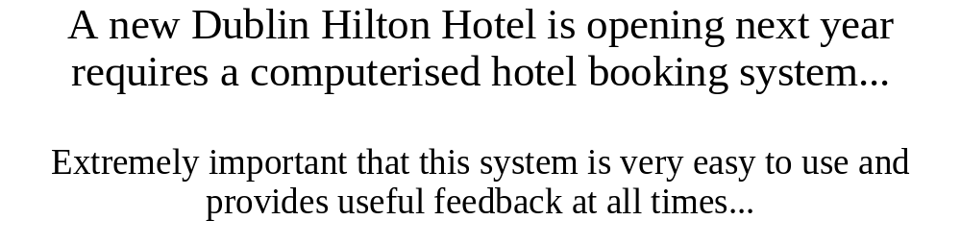
Hotel Booking System

Slide 2
Solution
Our Solution incorporates all the below technologies.
Database - Microsoft Access
GUI - Web Browser (Fire Fox 2.0, IE7, etc.)
  Web Pages - Java Server Pages (JSP) specifications from Sun Microsystems, allowing Java Code
Web Server - Apache Tomcat Web Container

Slide 3
Database
  The system must be backed up to a database
  Two levels of users
    Administrators: who are allowed access to all of the system’s functionality including administrative functions
    Ordinary Users: who are not allowed access to any of the administrative functions of the system.
  Administrative Function: allows the system administrator to specify the details of the rooms in the hotel, ie. text descriptions of the rooms, the number of each type of room (i.e. single, double, twin, etc.), whether rooms are smoking or non-smoking, seasonal price of rooms etc.

Slide 4
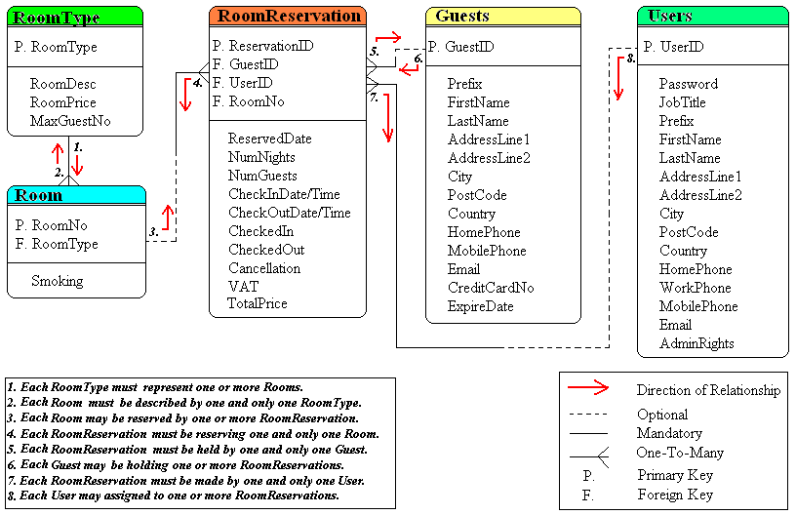
ER Diagram

Slide 5
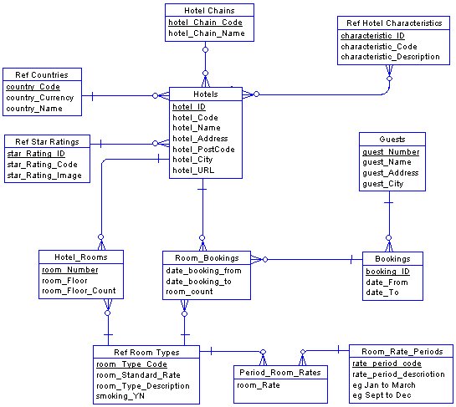
Data Model

Slide 6
GUI
  Java Server Pages (JSP) are normal HTML with Java code pieces embedded in them.
  The JSP compiler is used to generate a Servlet from the JSP page, like PSP, PHP and ASP.
    Example: <H1>Today is:</H1> <%= new java.util.Date() %>
  The Servlet(s) controls the content or appearance of Web pages.
    This allows for greater freedom in the GUI design.
    It also allows small programs that are specified in the Web page and run on the Web server to modify the Web page before it is sent to the user who requested it.
    JSP technology = Servlet application program interface (API).

Slide 7
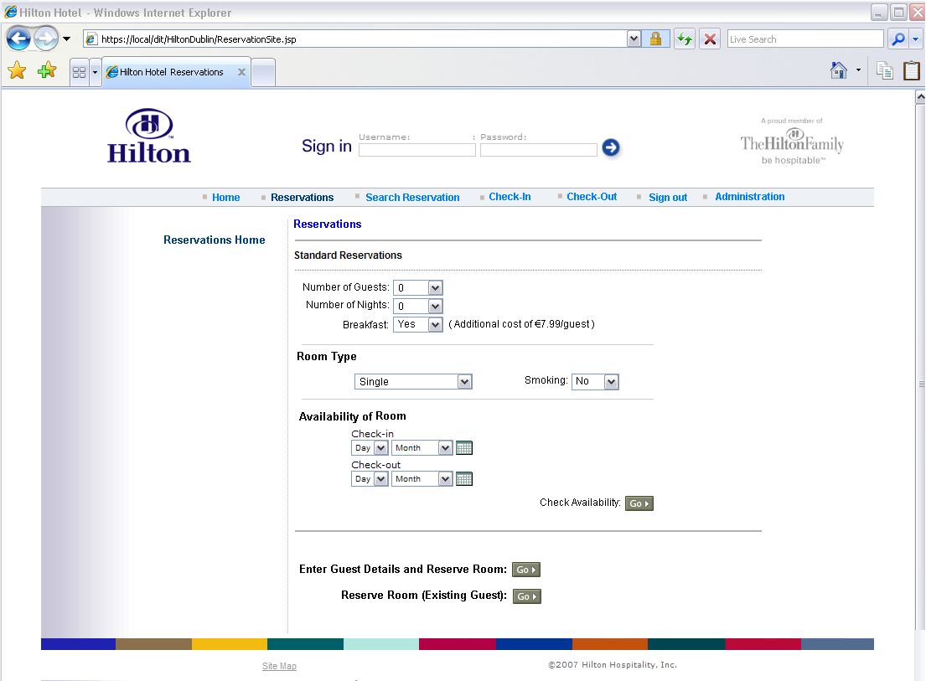
GUI Reservations Mock-up

Slide 8
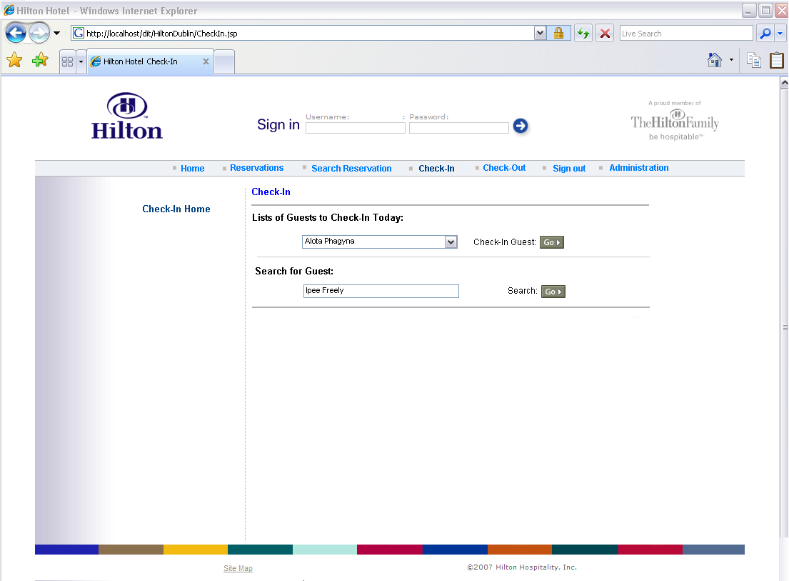
GUI Check-In Mock-up

Slide 9
Front-end Functions
Reservation: Specifies a guest name, room type, arrival date, and departure date and allocates that guest a room.
Cancellation: Specifies a guest name and cancels any reservations that that guest has.
Check in: Specifies a guest name, allocates that guest a room if they have a reservation and records within the system that the guest’s room is occupied.
Check out: Specifies a room number or a guest name and releases that room and calculates a guest’s final bill.

Slide 10
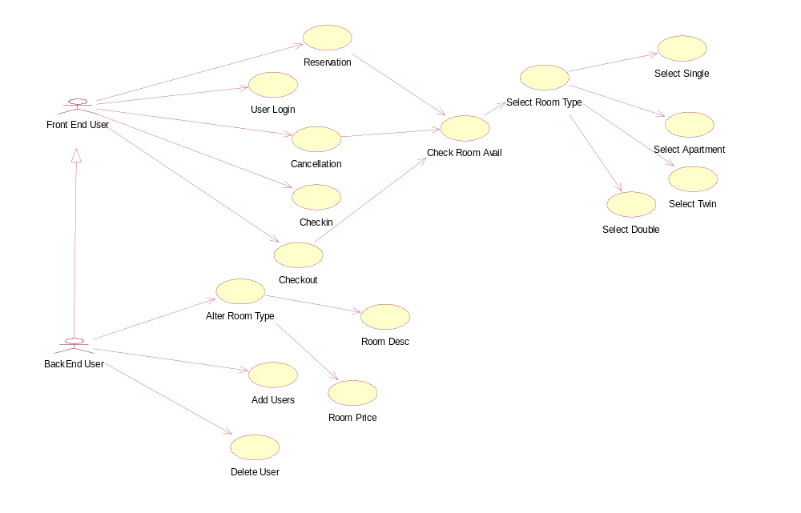
Use Case

Slide 11
Back-end Functions
Pricing
  Able to change the price, Reduce / Increase, Seasonal Rates, etc.
Room Description
  Able to change room description, etc.
Add /Delete a User
  User can be added or deleted, etc.
Room Type
  Room types are allocated e.g. Double,Single,Twin or Apartment.

Slide 12
Use Case

Slide 13
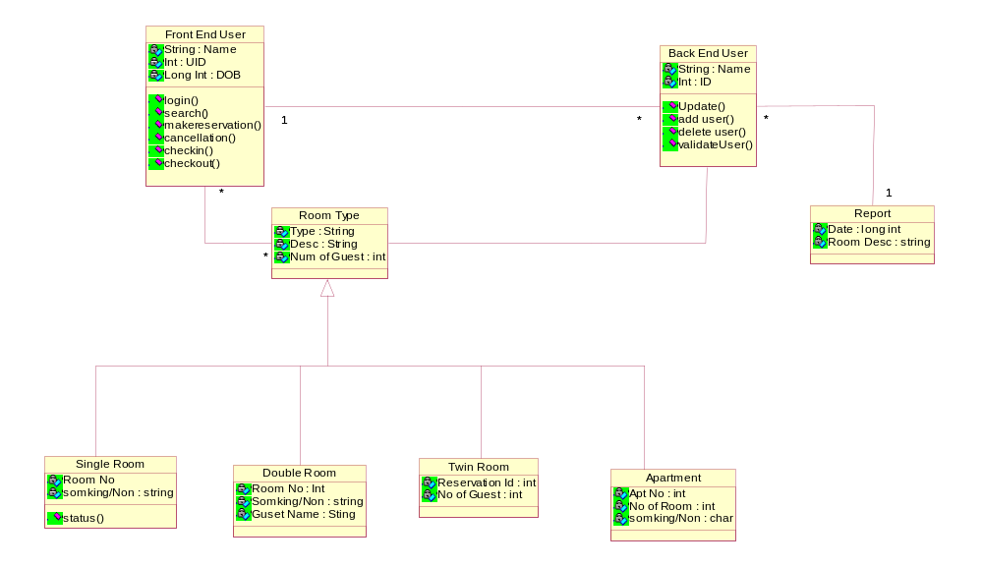
Class Diagram

Slide 14
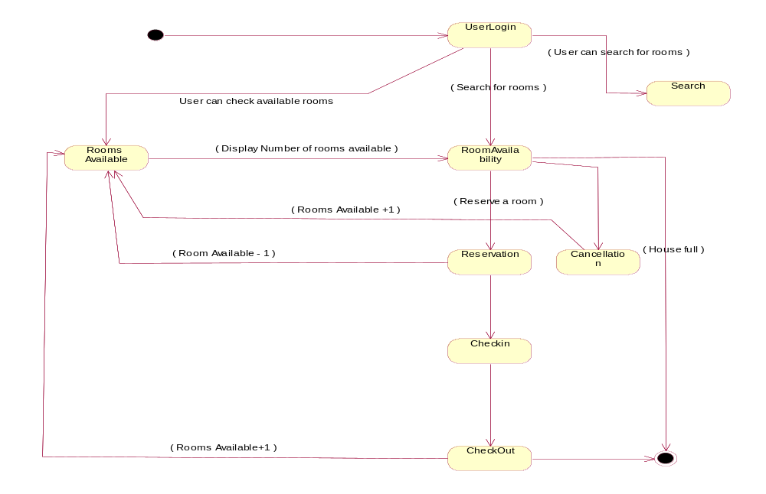
Transition Diagram

Slide 15
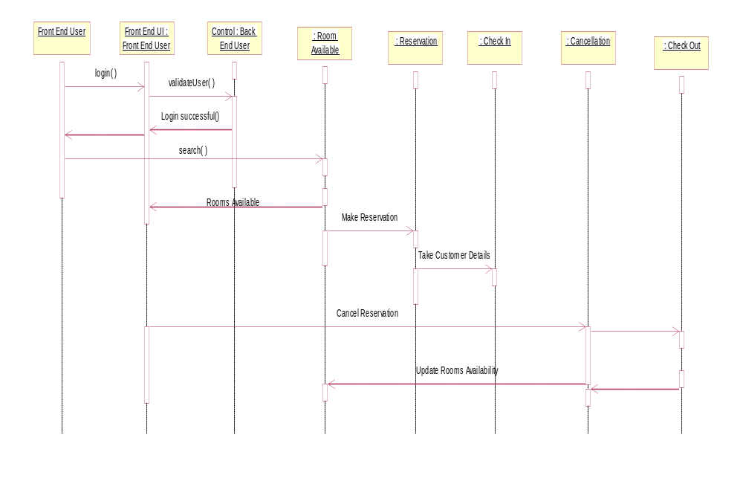
Interaction Sequence Diagram

Slide 16
CONCLUSION
User friendly Interface
    - For fills brief is its ease of use, no extra training required.
Microsoft Access Database
    Easy to use and update for all levels of computer skills.
Any Questions?

