Slide 1

Anchor
The Memory Layer That Actually Remembers
Product Walkthrough • Feature Overview • Comparison with Memorae.ai

Slide 2
Anchor
Agenda
• What is Anchor, and why it exists
• Complete screen-by-screen walkthrough (13 screens)
• Feature list: capture, memory, tasks, reminders, lists, calendar, briefings, chat, admin, billing
• Head-to-head comparison with Memorae.ai
• What's next on the roadmap
2 / 0

Slide 3
Anchor
What is Anchor?
Anchor is a memory-layer SaaS that sits above every app a person already uses. You text it, email it, or talk to it the way you'd message a friend — and it turns that into reminders, tasks, lists, and searchable memory automatically.
Capture anywhere
Understand, don't just store
Remember and remind
Built as a real SaaS
WhatsApp, Telegram, email, voice notes, photos, and the web app itself.
AI extracts tasks, reminders, and tags from raw messages automatically.
Recurring reminders actually fire back to you on WhatsApp/Telegram, on schedule.
Role-based admin panel, 3 paid plans, and Stripe-ready billing from day one.
3 / 0

Slide 4
Screen-by-Screen Walkthrough
Every screen in Anchor, captured live from the running application

Slide 5
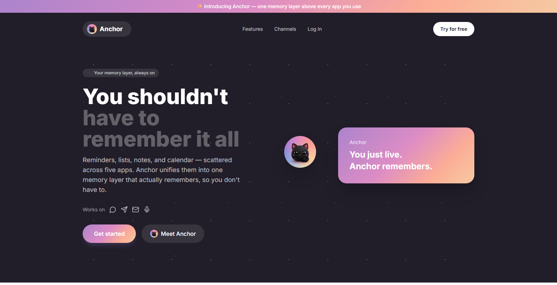
1. Public Homepage
Screen 1 of 13

Slide 6
Anchor
Screen 1 of 13
Public Homepage
The marketing front door — dark, starry hero in Anchor's own pastel gradient.
• Hero messaging: “You shouldn't have to remember it all” — states the core pain point in one line.
• Brand mascot: The Anchor cat appears in the nav, hero, and CTA sections, mirroring how Memorae uses its own mascot throughout its site.
• Channel row: Shows WhatsApp, Telegram, Email, and Voice icons — proof of multi-channel capture before the user even signs up.
• Feature grid: Memories, Reminders, Lists, Calendar, Daily Briefing, and Chat are previewed below the fold with real copy, not placeholders.
• Call to action: “Get started” and “Meet Anchor” both route straight into the real login flow.
1 / 13

Slide 7
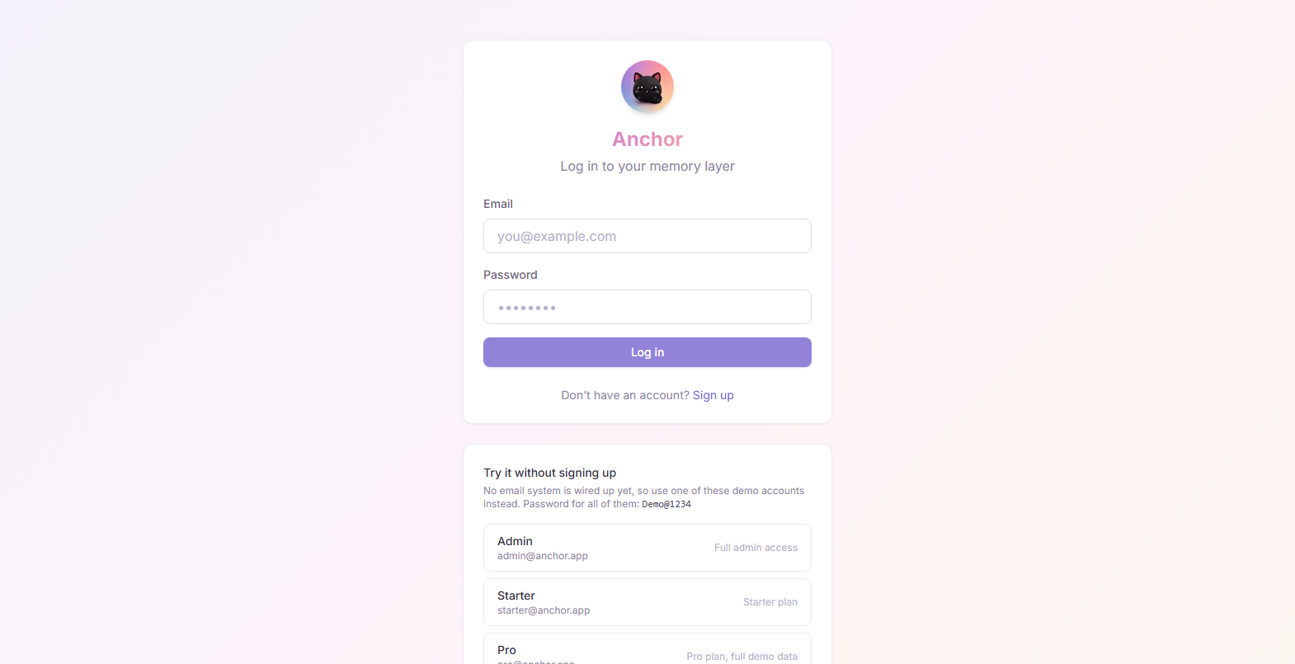
2. Login / Sign Up
Screen 2 of 13

Slide 8
Anchor
Screen 2 of 13
Login / Sign Up
Real authentication, plus zero-friction demo access since no email system is wired up yet.
• Real auth: Email + password login and signup against a live NestJS API, hashed with argon2id.
• Demo accounts: Four one-click demo logins — Admin, Starter, Pro, and Ultimate — so anyone can explore every plan tier instantly.
• Role-aware redirect: Logging in as Admin routes to the Admin panel; every other role lands on the Dashboard.
• Password shown in-page: Demo@1234 is displayed directly on screen — there's nothing to look up separately.
2 / 13

Slide 9
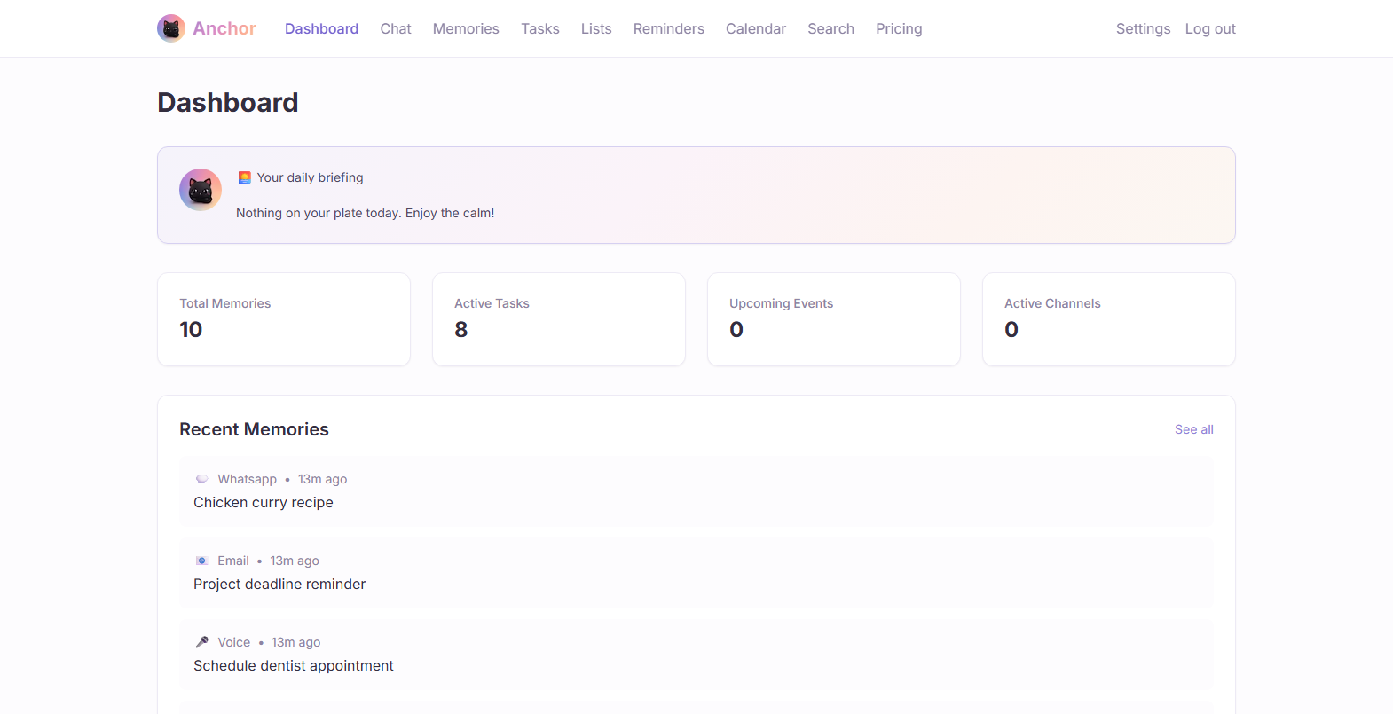
3. Dashboard
Screen 3 of 13

Slide 10
Anchor
Screen 3 of 13
Dashboard
The daily home screen — an AI-written briefing plus a snapshot of everything active.
• Daily briefing card: Auto-generated summary of what's due, overdue, and on the calendar today — the same message that gets pushed to WhatsApp/Telegram every morning.
• Live stats: Total memories, active tasks, upcoming events, and active channels, pulled from the real database.
• Recent memories feed: The last things captured across every channel, with source icon and relative timestamp.
• Quick actions: One-click shortcuts into creating a task or jumping to search.
3 / 13

Slide 11
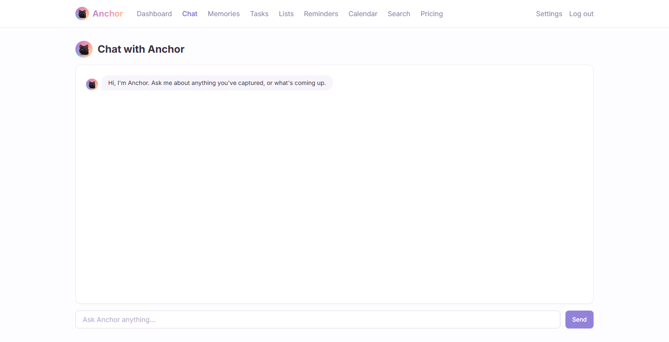
4. Chat with Anchor
Screen 4 of 13

Slide 12
Anchor
Screen 4 of 13
Chat with Anchor
A conversational assistant that answers using the user's own captured memory — not a generic chatbot.
• Context-aware: Before replying, the backend pulls relevant past memories and today's due tasks and feeds them to the AI as context.
• Own mascot as avatar: The cat avatar appears next to every assistant message, matching how Memorae anchors its identity to its own mascot.
• Real backend: Routes through apps/api → apps/ai → OpenAI chat completions — not a scripted demo.
• New capability: This entire feature did not exist before this build; it was added specifically to reach feature parity with Memorae's chat assistant.
4 / 13

Slide 13
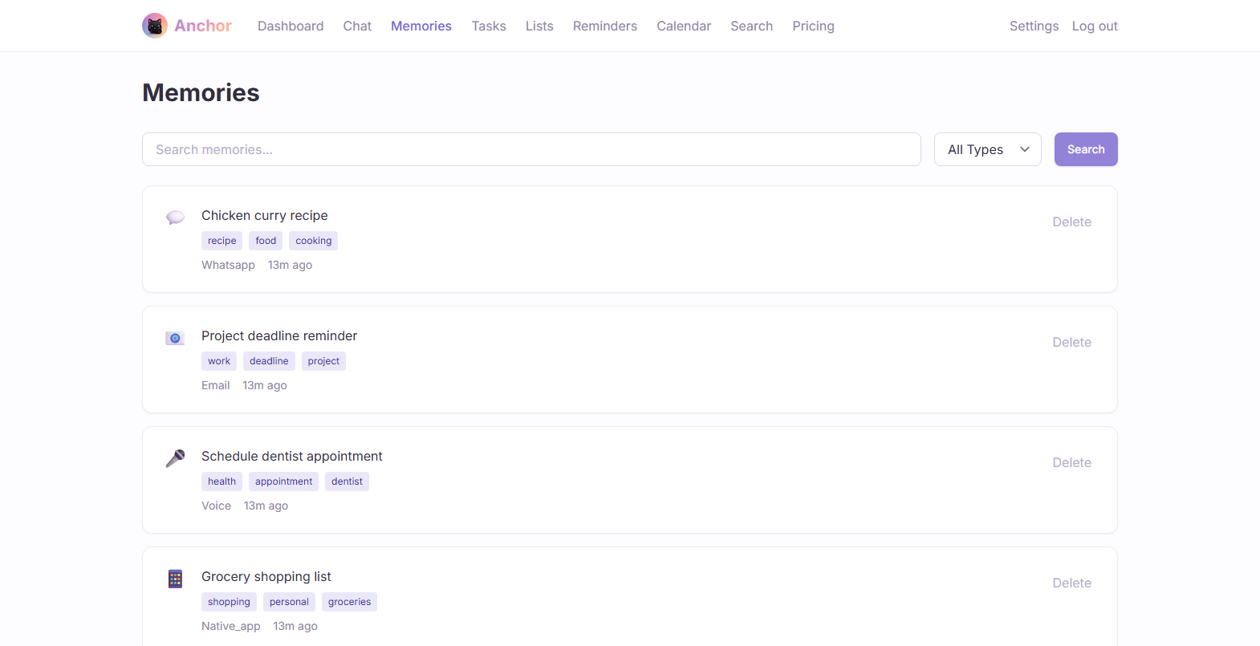
5. Memories
Screen 5 of 13

Slide 14
Anchor
Screen 5 of 13
Memories
The unified capture inbox — every note, message, and voice memo, searchable in one place.
• Multi-source: Each entry shows exactly where it came from — WhatsApp, Email, Voice, or the native app.
• Auto-tagging: AI assigns descriptive tags (e.g. “recipe”, “deadline”, “appointment”) at capture time.
• Type + text filter: Search box and a type dropdown narrow results without leaving the page.
• Hybrid search under the hood: Combines vector similarity and PostgreSQL full-text search, merged and ranked server-side.
5 / 13

Slide 15
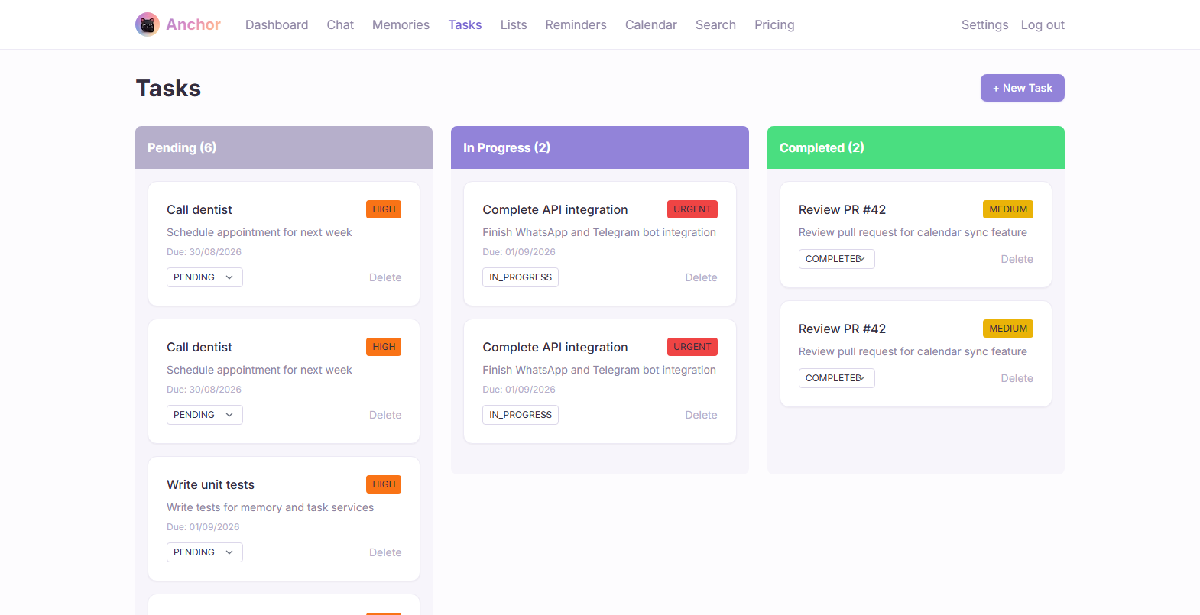
6. Tasks
Screen 6 of 13

Slide 16
Anchor
Screen 6 of 13
Tasks
A Kanban board that fills itself — tasks are often created automatically from captured messages.
• Three columns: Pending, In Progress, and Completed, with live counts per column.
• Priority badges: URGENT / HIGH / MEDIUM shown as color-coded chips pulled straight from the data.
• AI-authored tasks: Messages containing phrases like “need to” or “deadline” are parsed by AI into a structured task automatically.
• Inline status changes: Drag-free status dropdown and delete, no page reload required.
6 / 13

Slide 17
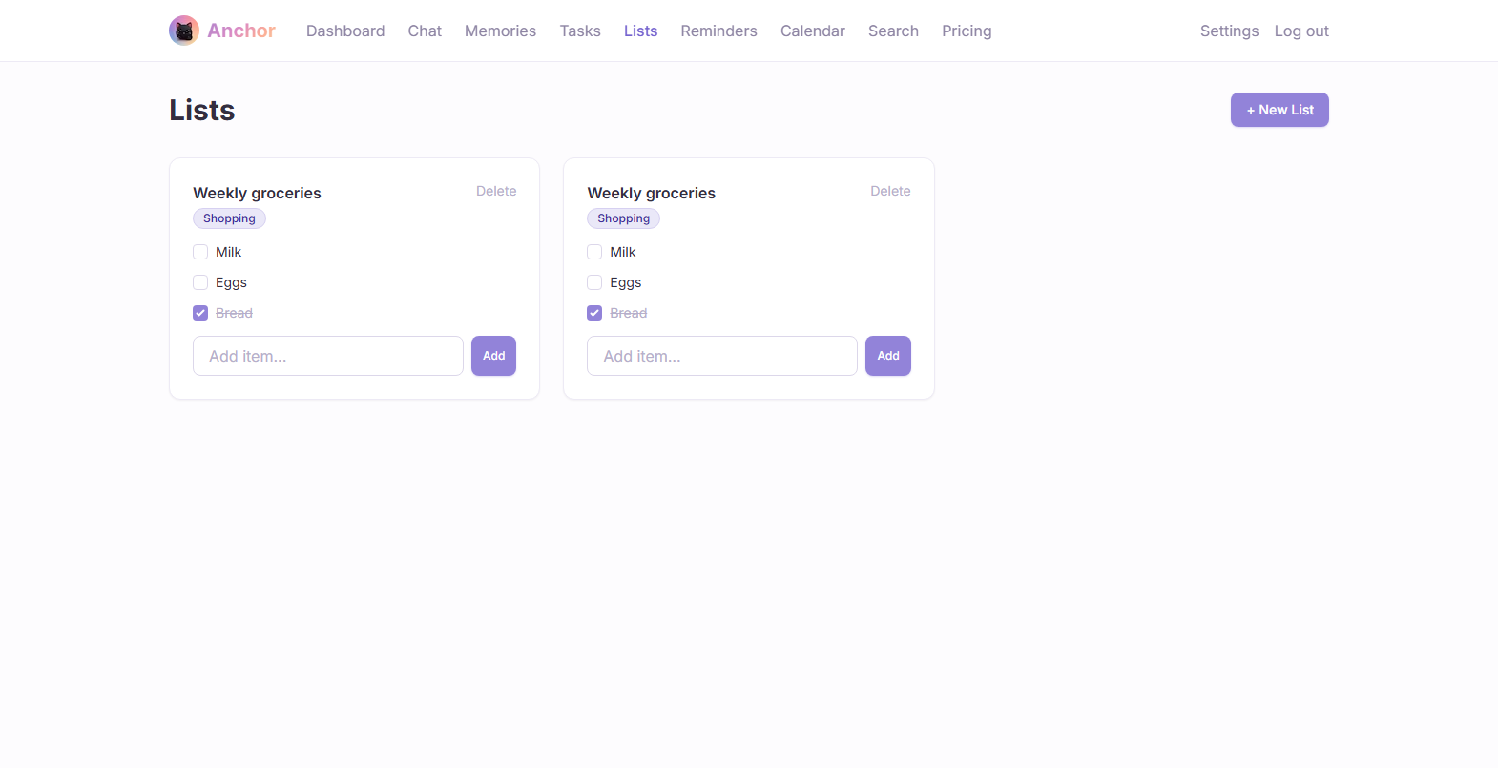
7. Lists
Screen 7 of 13

Slide 18
Anchor
Screen 7 of 13
Lists
Shopping, to-do, and idea lists — built to match Memorae's list feature, and built from scratch this cycle.
• List types: TODO, SHOPPING, IDEAS, and CUSTOM, shown as a colored badge on each list.
• Checkable items: Tick items off inline; completed items get a strikethrough.
• New this build: Lists did not exist in Anchor before — the whole model, API, and UI were added specifically to close the gap with Memorae.
• Fast add: Add an item and press Enter — no modal, no page transition.
7 / 13

Slide 19
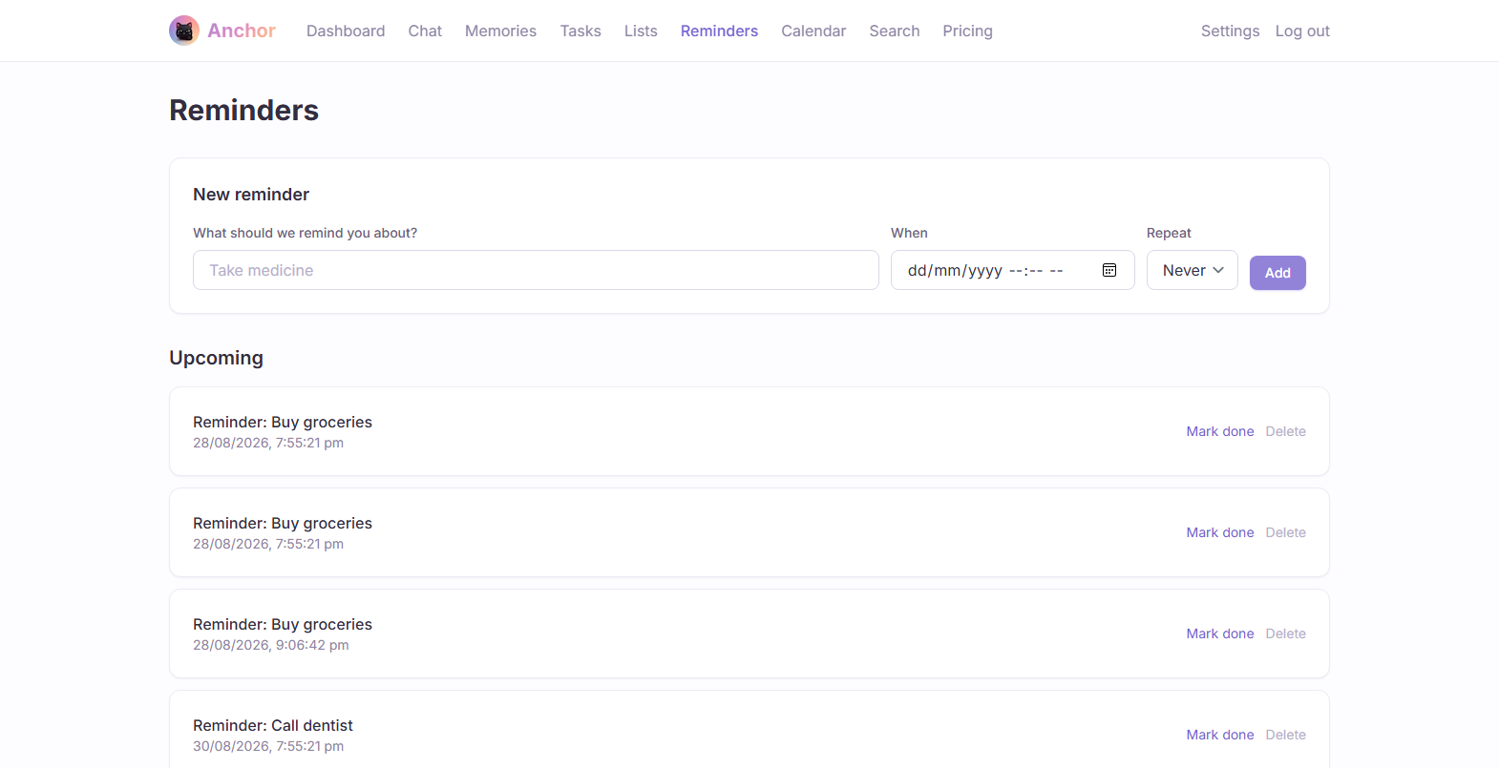
8. Reminders
Screen 8 of 13

Slide 20
Anchor
Screen 8 of 13
Reminders
Reminders that actually fire — delivered back to WhatsApp or Telegram on schedule, not just stored.
• Real scheduling: One-off or recurring (daily / weekly / monthly), created from a simple inline form.
• Actual delivery: A server-side cron job checks every minute for due reminders and sends them over the user's connected channels.
• Natural-language capture: Texting “remind me to call mom tomorrow at 5pm” creates a real, scheduled Reminder — not just a task.
• Upcoming vs completed: Reminders are grouped so the list stays readable as it grows.
8 / 13

Slide 21
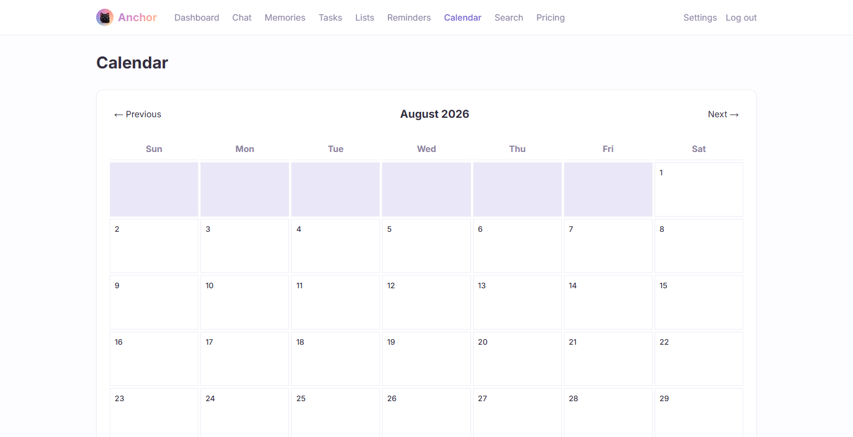
9. Calendar
Screen 9 of 13

Slide 22
Anchor
Screen 9 of 13
Calendar
A month view unifying events from every connected calendar.
• Google & Outlook sync: Calendar connections pull events into one unified month grid.
• Click-through detail: Selecting a day reveals its full event list below the grid.
• Color-coded by provider: Google and Outlook events are visually distinguished at a glance.
• Gap vs. Memorae: Apple/iCloud calendar sync is not yet supported — called out honestly rather than hidden.
9 / 13

Slide 23
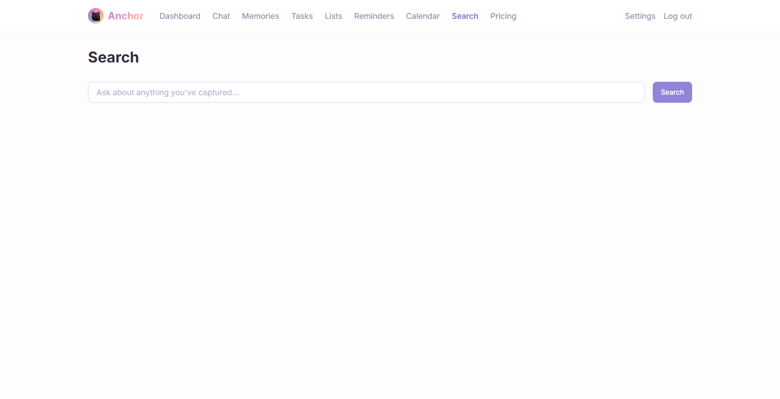
10. Search
Screen 10 of 13

Slide 24
Anchor
Screen 10 of 13
Search
One search box across everything ever captured — phrased as a question, not just keywords.
• Natural query box: “Ask about anything you've captured” — designed for conversational queries, not exact-match keywords.
• Hybrid ranking: Same vector + full-text merge used by Memories, exposed here as a dedicated destination.
• Source-aware results: Each result shows its origin channel and how long ago it was captured.
10 / 13

Slide 25
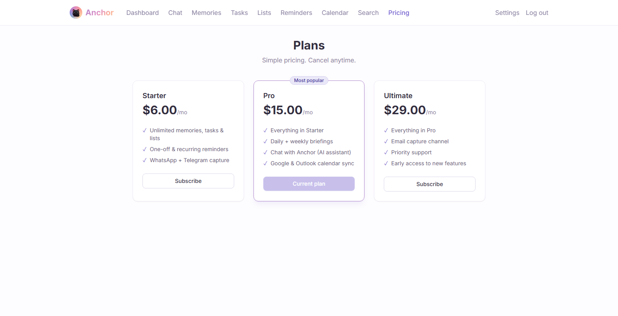
11. Pricing
Screen 11 of 13

Slide 26
Anchor
Screen 11 of 13
Pricing
Three paid tiers — Starter, Pro, and Ultimate — with a real (demo-mode) checkout flow.
• No free tier: Starter $6/mo, Pro $15/mo, Ultimate $29/mo — by explicit design, all paid from day one.
• Real Stripe plumbing: Built on the actual Stripe SDK; runs in demo mode (instant activation) until a merchant account is connected — no rework needed later.
• Current-plan awareness: The page knows which plan the logged-in user already has and disables that card.
• “Most popular” highlight: Pro is visually emphasized, matching standard SaaS pricing-page conventions.
11 / 13

Slide 27
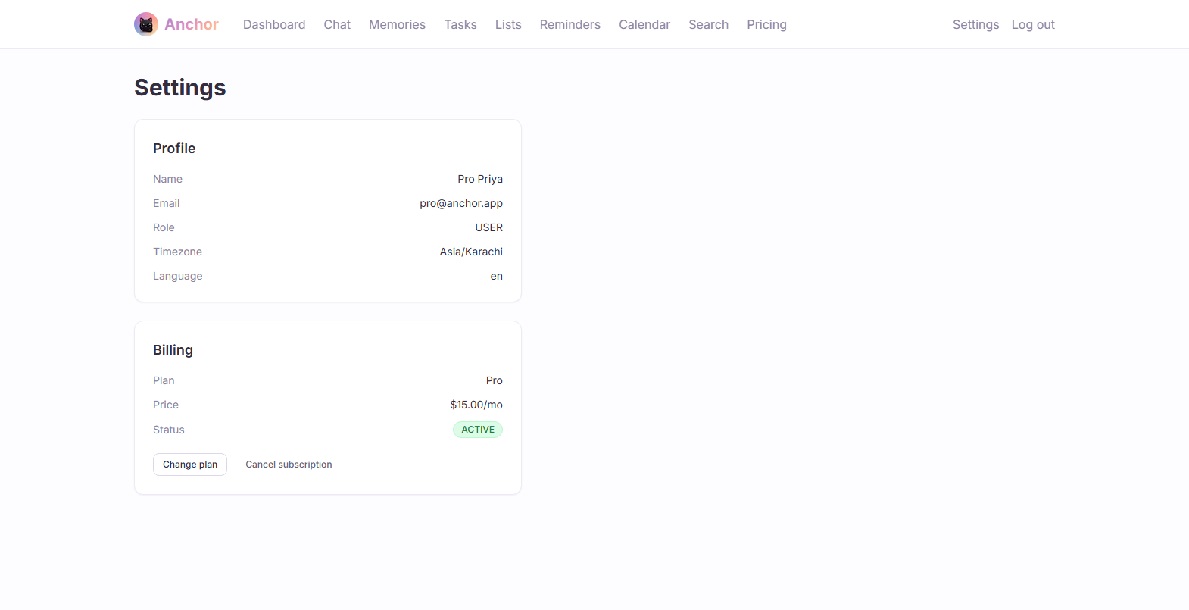
12. Settings
Screen 12 of 13

Slide 28
Anchor
Screen 12 of 13
Settings
Profile and billing management in one place.
• Profile panel: Name, email, role, timezone, and language at a glance.
• Billing panel: Current plan, price, and live subscription status (Active / Canceled / Past Due).
• Self-service actions: “Change plan” links to Pricing; “Cancel subscription” works immediately against the live API.
12 / 13

Slide 29
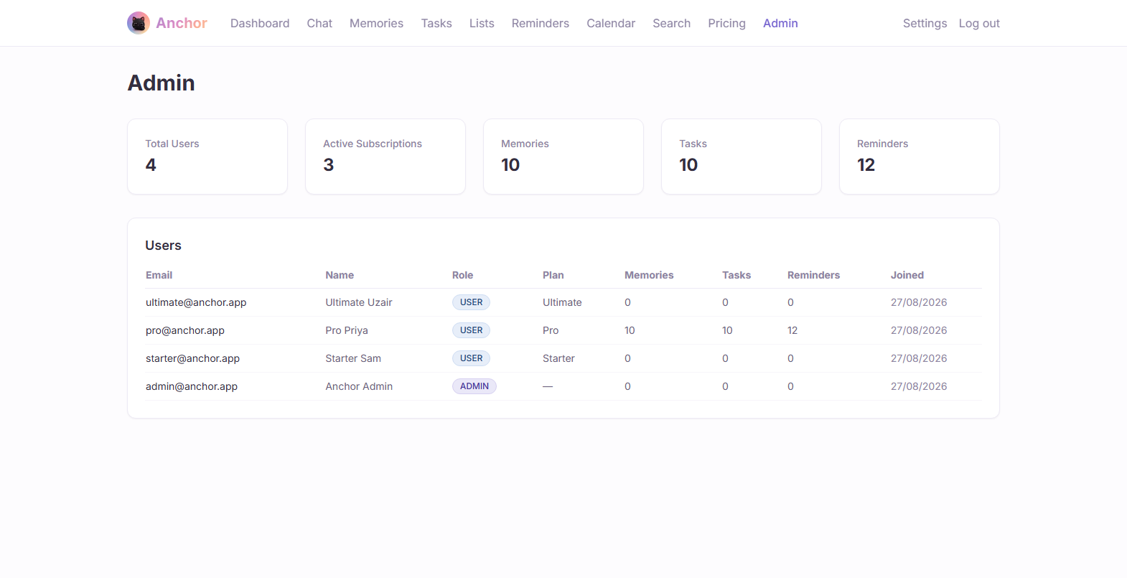
13. Admin Panel
Screen 13 of 13

Slide 30
Anchor
Screen 13 of 13
Admin Panel
Full platform oversight — a capability Memorae's own product does not expose publicly.
• Role-gated: Guarded end-to-end by a real UserRole (USER/ADMIN) and a global RolesGuard — not just hidden UI.
• Platform stats: Total users, active subscriptions, and aggregate memories/tasks/reminders across the whole system.
• Full user table: Every user's plan, role, and usage counts in one sortable view.
• SaaS-readiness signal: Demonstrates Anchor is built as an operable business, not just a consumer app.
13 / 13

Slide 31
Anchor vs. Memorae.ai
A direct, honest feature comparison

Slide 32
Anchor
Feature Comparison (1 of 2)
Feature | Memorae.ai | Anchor
WhatsApp / Telegram / Email / Voice capture | ✓ | ✓
Photo capture (description + OCR) | ✓ | ✓
One-off & recurring reminders | ✓ | ✓
Reminder delivery back to chat channels | ✓ | ✓
"Remind me to..." message → real scheduled reminder | ✓ | ✓
Lists (shopping / to-do / ideas) | ✓ | ✓
Notes / memory capture, search & tagging | ✓ | ✓
Google & Outlook calendar sync | ✓ | ✓
Apple / iCloud calendar sync | ✓ | ✗

Slide 33
Anchor
Feature Comparison (2 of 2)
Feature | Memorae.ai | Anchor
Daily briefing | ✓ | ✓
Weekly briefing | ✓ | ✓
Conversational AI chat assistant | ✓ | ✓
Web dashboard unifying everything | ✓ | ✓
"Share with friends" / collaboration | ✓ (reported buggy) | ✗ (not built yet)
Role-based Admin panel | Not public | ✓
Paid subscription tiers | ✓ (3 tiers) | ✓ (3 tiers, no free tier)
Own distinct brand identity & mascot | ✓ | ✓
Stripe billing integration | ✓ (live) | ✓ (built, demo mode until merchant account)
✓ = present ✗ = not yet built. Gaps are stated honestly rather than glossed over.

Slide 34
Anchor
Where Anchor Differentiates
• Operable as a business, not just a product: A real role-based Admin panel with platform-wide stats and user oversight — Memorae does not expose this.
• Own visual identity end-to-end: A custom 7-color pastel palette and an original mascot, applied consistently across marketing site, app, and chat — not a clone of Memorae's look.
• Reminder pipeline built for reliability: A dedicated cron-driven delivery service with recurrence math, separate from the task system, so “remind me” never gets silently downgraded to a to-do.
• Billing built ahead of the merchant account: The entire Stripe checkout/webhook/subscription lifecycle is implemented now, running in demo mode, so going live later is a config change, not a rebuild.
• Honesty over polish: Known gaps (Apple Calendar, sharing/collaboration) are tracked and stated plainly rather than hidden behind vague marketing copy.
0 / 0

Slide 35
Anchor
What's Next
• Connect a live Stripe merchant account flips billing from demo mode to real payments with no code changes required.
• Apple / iCloud calendar sync close the last calendar gap versus Memorae.
• Sharing & collaboration let users send reminders or lists to another person.
• Mobile app an Expo/React Native client already scaffolded in the monorepo, ready to build out.
• Production database move off the local dev Postgres instance onto a managed, backed-up production database.
0 / 0

Slide 36
Thank you
Anchor — the memory layer that actually remembers.

