Slide 1
The Profit Leak
Diagnostic
How 28 Products Are Bleeding $643K Out of a $35M Catalog
Zeeshan Akram · E-commerce Profit Analyst
DataCo Supply Chain Dataset · 180,519 transactions · 3 years
THE PROFIT LEAK DIAGNOSTIC
01 / 10

Slide 2
The Verdict
This catalog generates $35.2 million in revenue. On paper, that looks like a healthy business. It isn't.
$35.2M
84.5%
28
100%
$643K
Total Revenue
Profit From 8 Products
Dead-Weight Products
First Class Late Rate
Exposure If Core 8 Slip
180K+ orders, 3 years
Out of 118 total
Just 2.2% of revenue
Every single order
17% of total profit
01
Every product in this catalog has recorded at least one loss-making order. There is no clean SKU in here.
02
Just 8 products generate 84.5% of all profit. The other 110 are operational noise riding on their back.
03
28 products generate only 2.2% of revenue while still consuming real warehouse space and customer service hours.
04
First Class shipping arrives late on every single order. Standard Class, the cheapest tier, is the most reliable shipping method in the catalog.
05
Revenue and profit moved sideways for nearly three years, then collapsed together in the same month. That is what happens when a fragile supply chain finally runs out of room.
Revenue is not the issue here. Mistaking revenue for business health is.
THE PROFIT LEAK DIAGNOSTIC
02 / 10

Slide 3
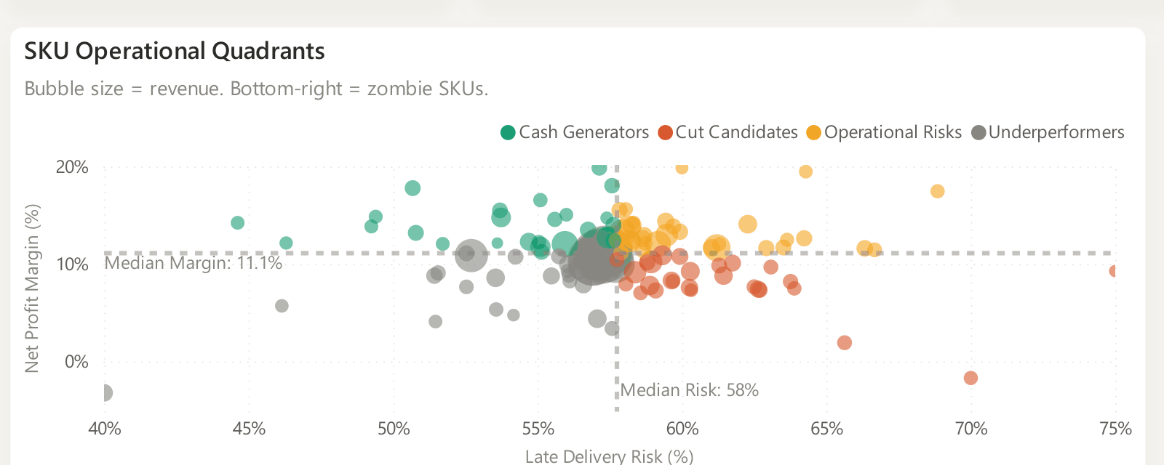
Where Your Profit Actually Comes From
Every product in the catalog is scored on two things that matter: how much margin it keeps, and how often it fails to deliver on time. That split sorts the whole catalog into four groups.
Cash Generators
Good margin, low risk. The products worth protecting.
Operational Risks
Decent margin, but failing on delivery often enough to threaten it.
Underperformers
Margin already thin, even before anything goes wrong.
These boundaries are not arbitrary. They are set at the catalog's own median margin and median delivery risk, so every product is judged against its real peers.
Cut Candidates
Weak margin and high delivery failure. 28 products, 24% of the catalog.
THE PROFIT LEAK DIAGNOSTIC
03 / 10

Slide 4
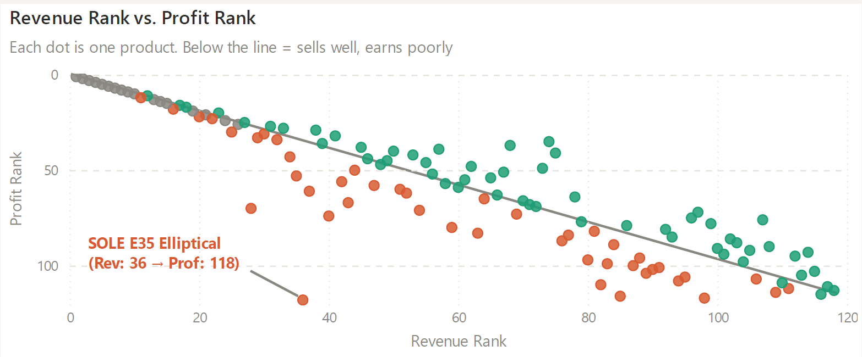
The Revenue Trap: Products That Sell Well and Lose Money
The SOLE E35 Elliptical ranks 36th out of 118 products by revenue. In profit, it ranks dead last. It loses money on every order while showing up as a respectable mid-tier seller on any standard sales report.
This is not one unlucky product. 44 products in this catalog follow the same pattern: strong revenue, weak or negative profit.
44
products show this exact pattern. If decisions in this business are made off a revenue leaderboard, they are being made off the wrong list entirely.
SOLE E35 and SOLE E25 Ellipticals are net negative across their entire three year history. Not one bad order. Three years of losing money every time they sell.
THE PROFIT LEAK DIAGNOSTIC
04 / 10

Slide 5
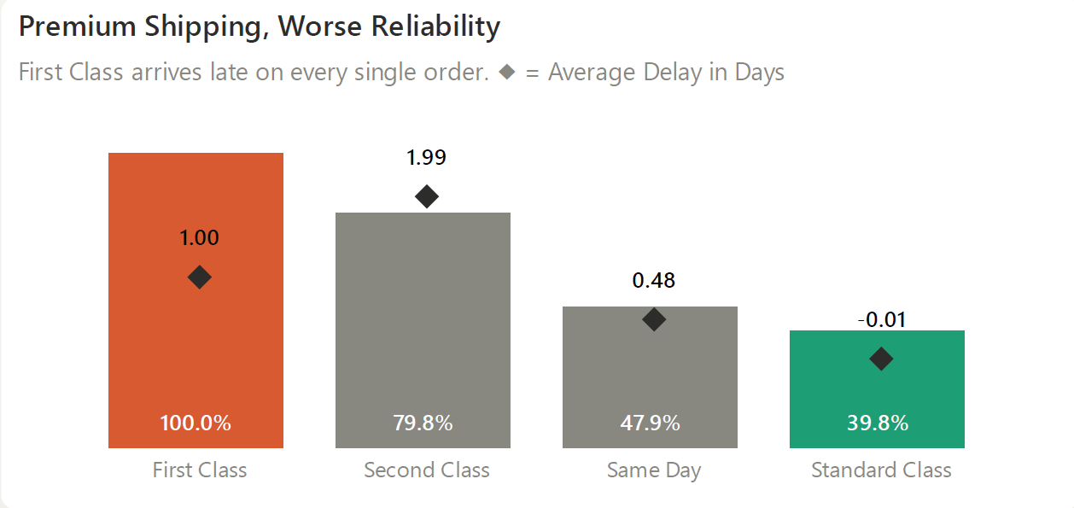
The Cost of Premium Shipping
100%
of First Class orders arrive late. Every order, every time.
Standard
the cheapest tier available, is the most reliable shipping method in the entire catalog.
Customers paying the most for speed are getting the worst experience this business offers. That is not a logistics footnote. It is a refund risk and a trust problem sitting quietly inside the fulfillment numbers.
THE PROFIT LEAK DIAGNOSTIC
05 / 10

Slide 6
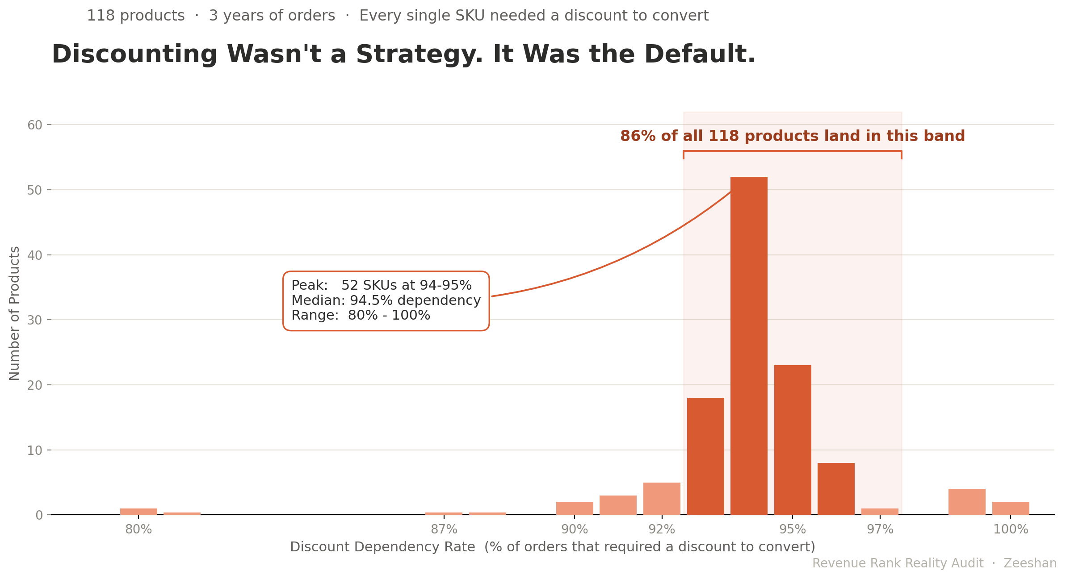
The Discounting Illusion
93–97%
Zero
94.4%
18.5%
of orders need a discount to sell, across almost the entire catalog
statistically confirmed link between discount depth and margin
of orders from the top 4 products still require a discount
of those discounted top-seller orders still lose money
The top of this catalog is not winning on merit. It is winning on subsidy, and there is no quick pricing fix waiting to be pulled.
THE PROFIT LEAK DIAGNOSTIC
06 / 10

Slide 7
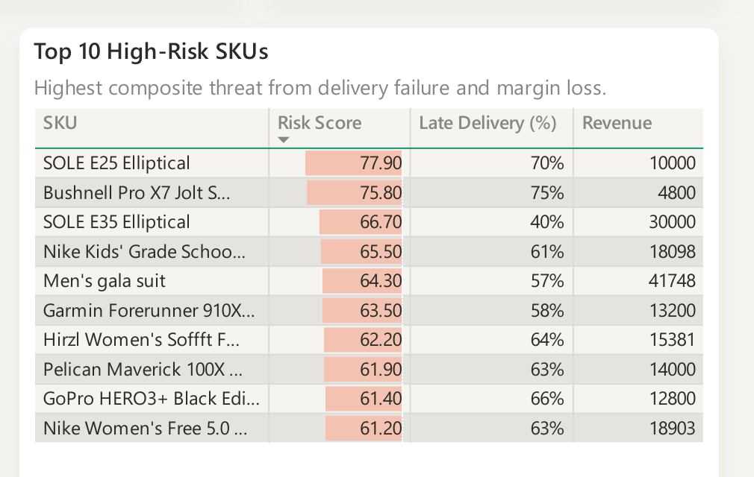
The Risk Score: One Number Per Product
Every product gets one combined score, built from three signals: how often it fails to deliver, how dependent it is on discounting, and how far its profit rank has drifted from its revenue rank.
On its own, none of these three signals reliably predicts which products are heading for trouble. Combined into one score, it does. The score is checked against actual outcomes across the catalog, not based on a guess about which SKUs look risky.
The value of this score is not retrospective. It flags a weakening product while it is still making sales, before the damage shows up as a quarter of disappointing revenue with no obvious cause.
THE PROFIT LEAK DIAGNOSTIC
07 / 10

Slide 8
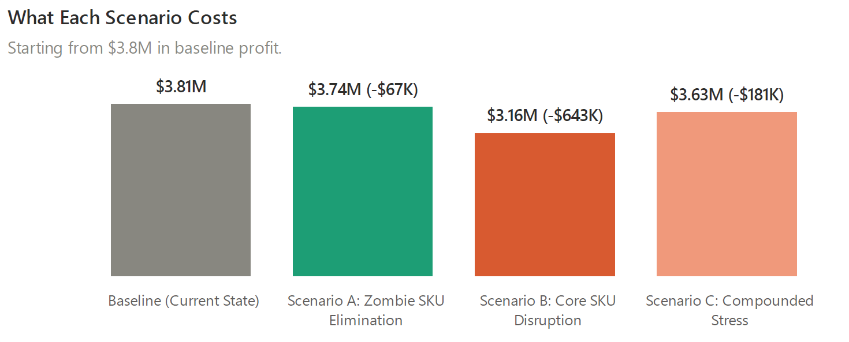
What Happens If Nothing Changes
LOWEST RISK
LARGEST EXPOSURE
ALREADY HAPPENING
Cutting the 28 Weak Products
A Disruption to the Core 8
Letting Conditions Compound
Costs $67,000 in profit and frees up roughly a quarter of operational bandwidth. Low risk, fast return, almost no downside.
Costs $643,000. This is the single largest financial exposure sitting inside this business today.
More discounting and more late deliveries cost an additional $181,000 in margin erosion. This is already the direction the data is moving.
THE PROFIT LEAK DIAGNOSTIC
08 / 10

Slide 9
Data Rigor & Methodology
This audit is built on 180,519 real order line transactions spanning three years of operating history, loaded into a structured PostgreSQL warehouse and checked for data quality at every stage before a single chart was built.
1
2
3
Established in SQL
Re-tested in Python
Reported plainly either way
Every number above was first established in SQL as ground truth, before anything was charted.
Each number was then independently reproduced and statistically tested in Python to confirm it holds up and is not just noise in the dataset.
Findings were only treated as confirmed once they passed hypothesis testing at a 95% confidence threshold. Where a relationship did not hold, such as discount depth and margin, that absence was reported as plainly as the findings that did hold.
Nothing in this report is a guess dressed up as a conclusion.
THE PROFIT LEAK DIAGNOSTIC
09 / 10

Slide 10
What To Do Next
Let's Talk About Your Store
1
Cut the 28 underperforming products now.
Cost: $67,000 in profit. Return: a quarter of operational bandwidth freed immediately. The fastest, lowest risk move available in this entire audit.
I run this exact diagnostic for e-commerce operators who need to know which SKUs are actually driving growth and which ones are quietly bleeding cash.
2
Protect the core 8 products like they are the business.
Because they are. Lock in supplier terms, prioritize their fulfillment, and stop touching their pricing without a clear reason.
EMAIL
3
Fix First Class shipping or pull it off the menu.
zeeshanakramds@gmail.com
A shipping tier that fails 100% of the time is not a minor operational hiccup. It is an active liability sitting on every order placed through it.
LINKEDIN
linkedin.com/in/zeeshan-akram-ds
BOOK A CALL
calendly.com/zeeshanakram/data-diagnostic
THE PROFIT LEAK DIAGNOSTIC
10 / 10

