Slide 1
BIG DATA WITH HADOOP
Penguins on Hadoop
HDFS, Hive, WebHDFS ELT and PySpark on one dataset
DATASET
STACK
344 penguins, 8 columns
Hadoop · Hive · Spark

Slide 2
01
HDFS command line
Pipeline
02
Hive table and HiveQL
03
WebHDFS + Pandas ELT
04
PySpark application
05
Findings

Slide 3
03/16
01
HDFS
Create the folder, download, put, list.

Slide 4
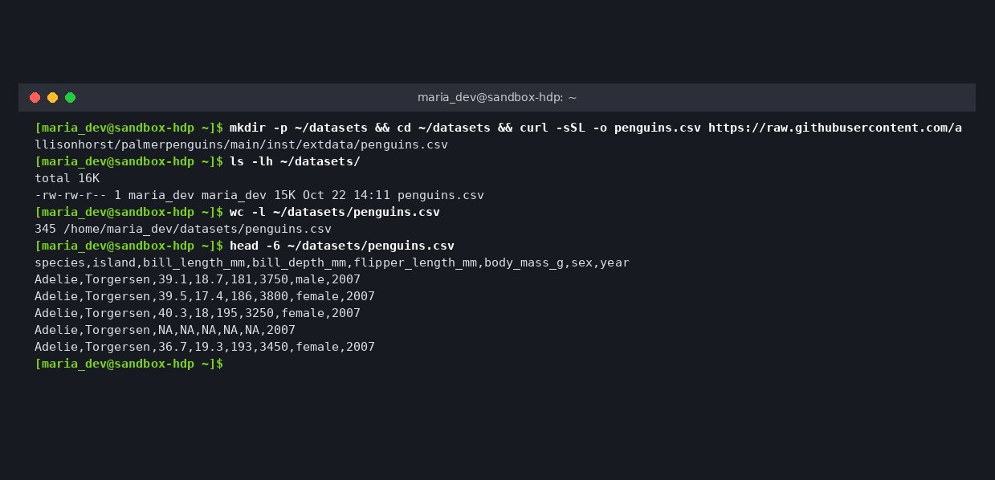
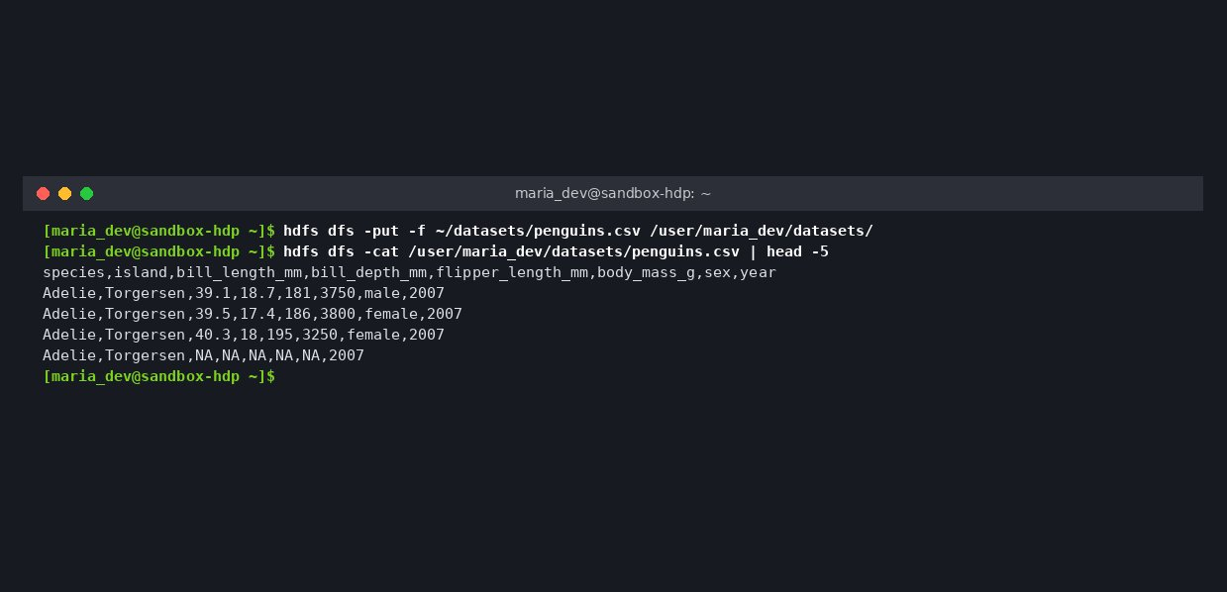
04/16
Dataset downloaded to the VM
Download and put
Copied into HDFS

Slide 5
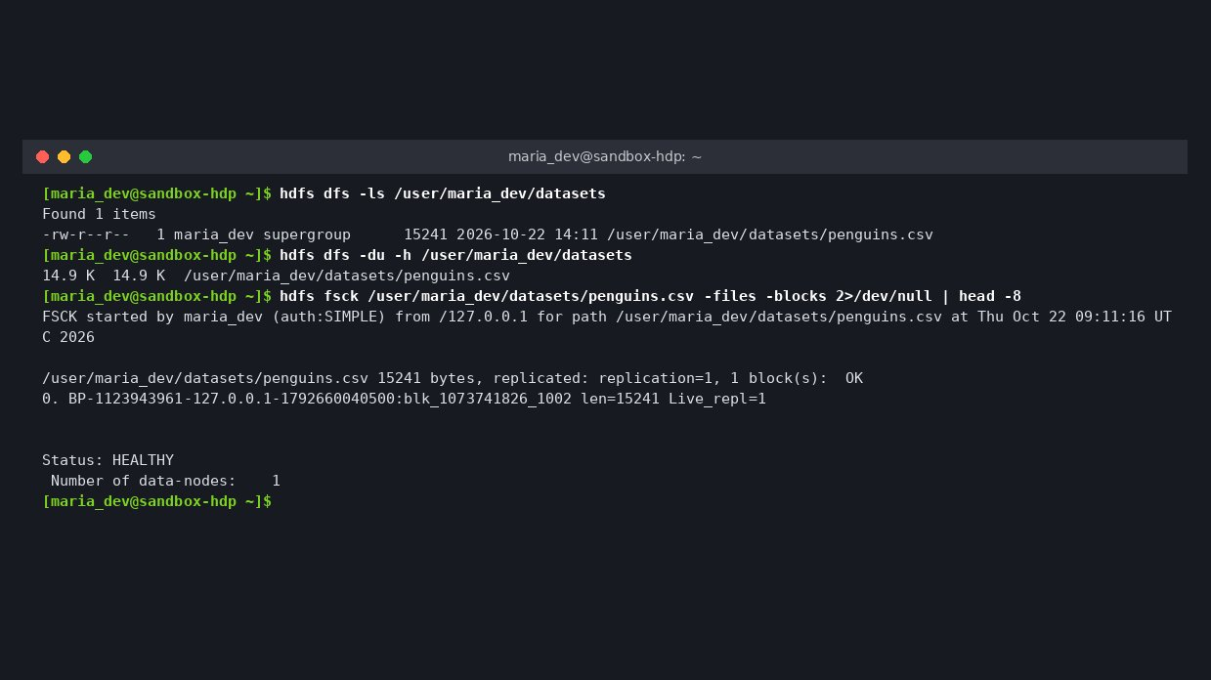
05/16
Data lands in HDFS
penguins.csv copied into /user/maria_dev/datasets and verified healthy.
Notes:
Commands: hdfs dfs -mkdir -p, curl download, hdfs dfs -put -f, hdfs dfs -ls. fsck shows 1 block, HEALTHY.

Slide 6
06/16
02
Hive
penguins_db.penguins_raw with NA mapped to NULL.

Slide 7
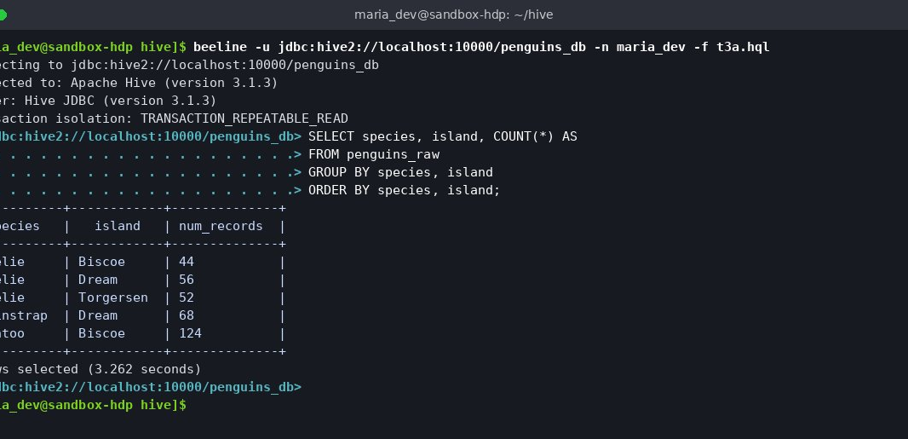
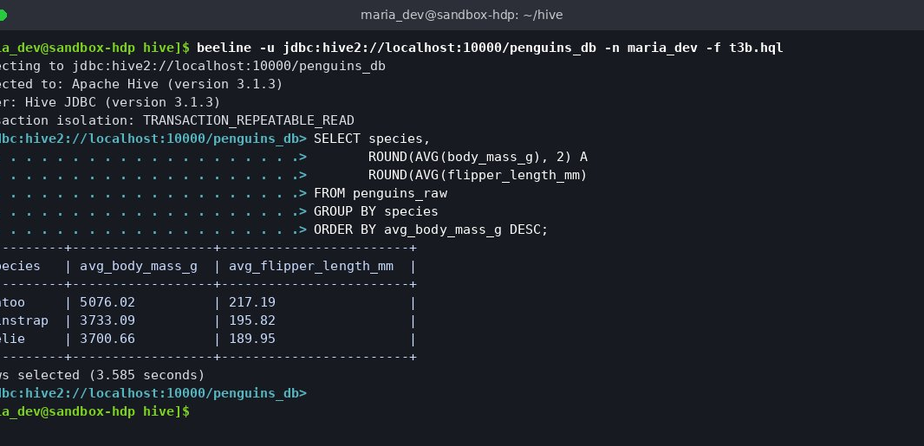
07/16
Records by species and island
HiveQL results
Average mass and flipper
Notes:
Gentoo 124 on Biscoe, Chinstrap 68 on Dream, Adelie on all three islands. Gentoo average 5076 g, 217 mm.

Slide 8
08/16
Missing values
2
2
2
11
bill_length_mm
flipper_length_mm
body_mass_g
sex
Notes:
From Hive query 3c using SUM(CASE WHEN ... IS NULL).

Slide 9
09/16
03
ELT
Jupyter reads HDFS through WebHDFS InsecureClient.

Slide 10
10/16
Cleaning steps
DROP
IMPUTE
TIDY
CONVERT
2 rows with no measurements removed (344 to 342)
Numeric gaps filled with species median
Missing sex set to unknown
body_mass_kg added, file uploaded to datasets/clean in HDFS

Slide 11
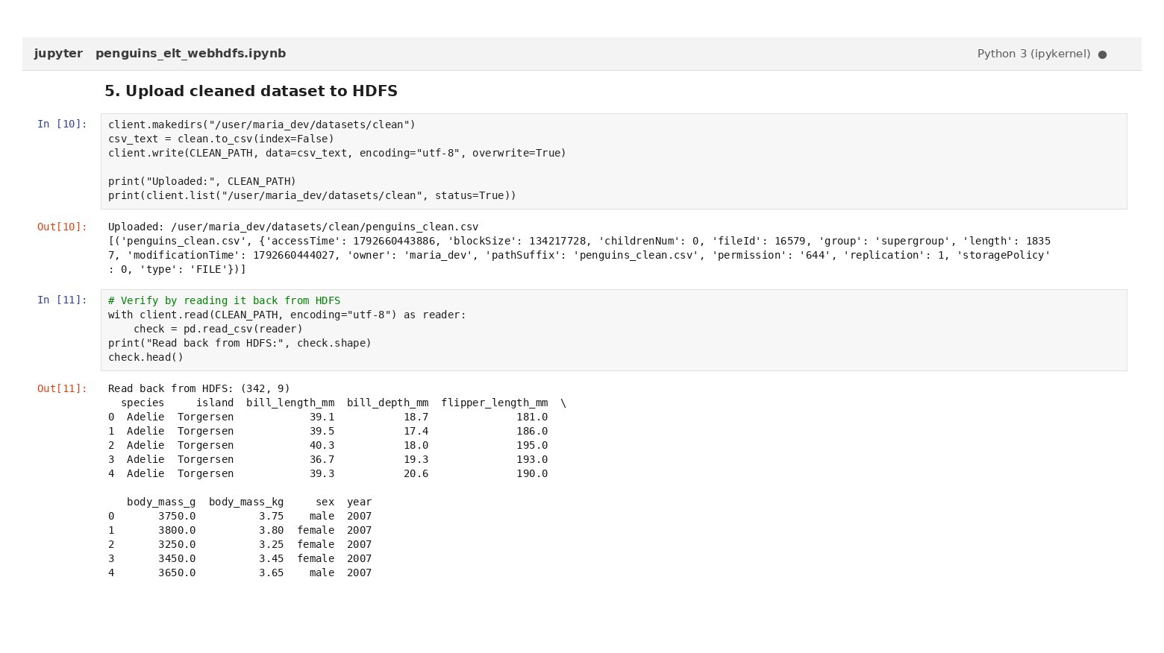
11/16
Clean data back in HDFS
Notebook uploads the cleaned file and reads it back to verify.

Slide 12
12/16
04
PySpark
spark-submit reads, filters, sorts, caches and writes JSON.

Slide 13
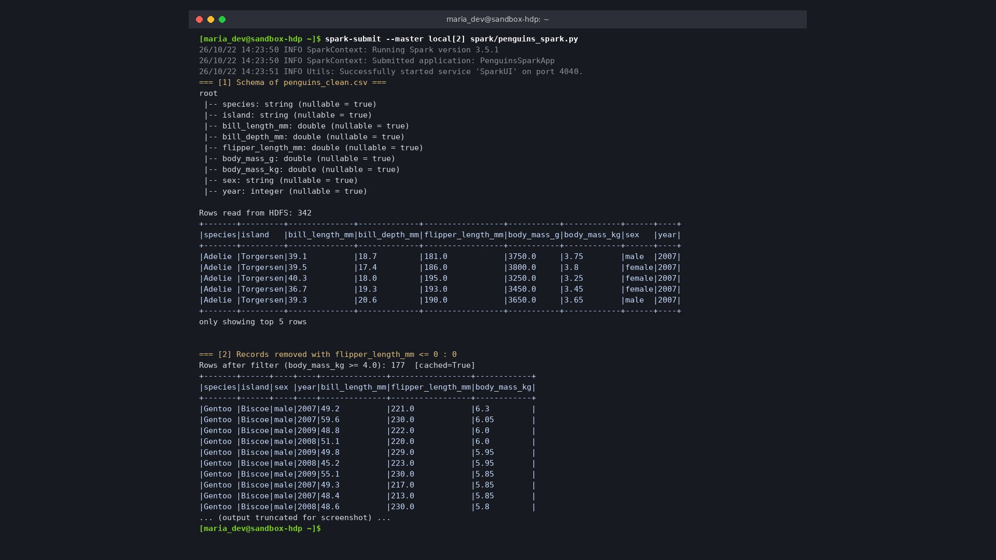
13/16
Spark job output
Schema printed, 177 heavy penguins kept, cached and saved partitioned by species.

Slide 14
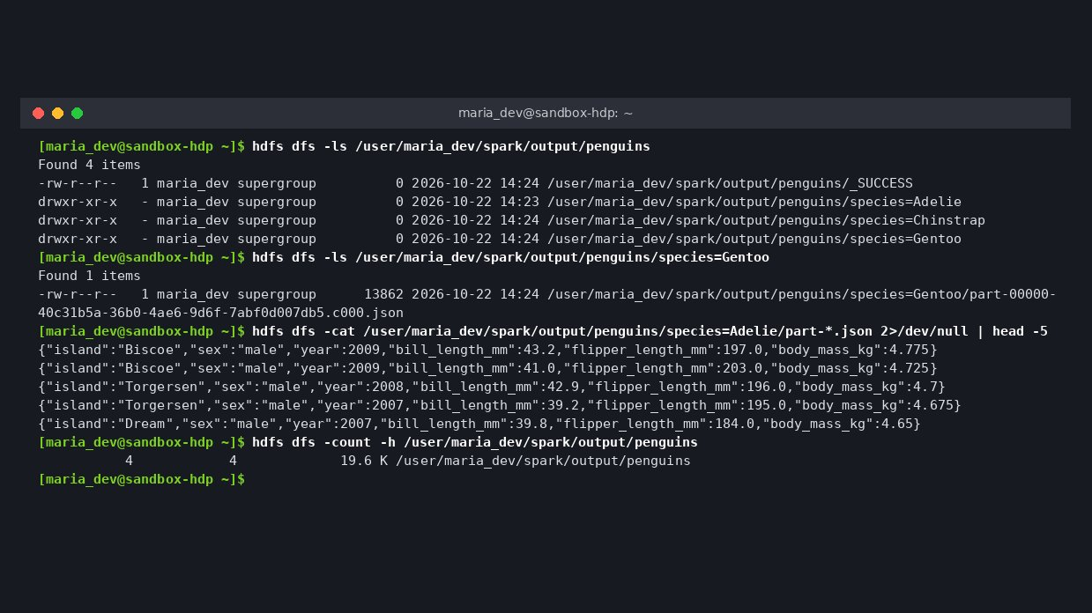
14/16
Partitioned JSON
species=Adelie, Chinstrap and Gentoo folders under spark/output/penguins.

Slide 15
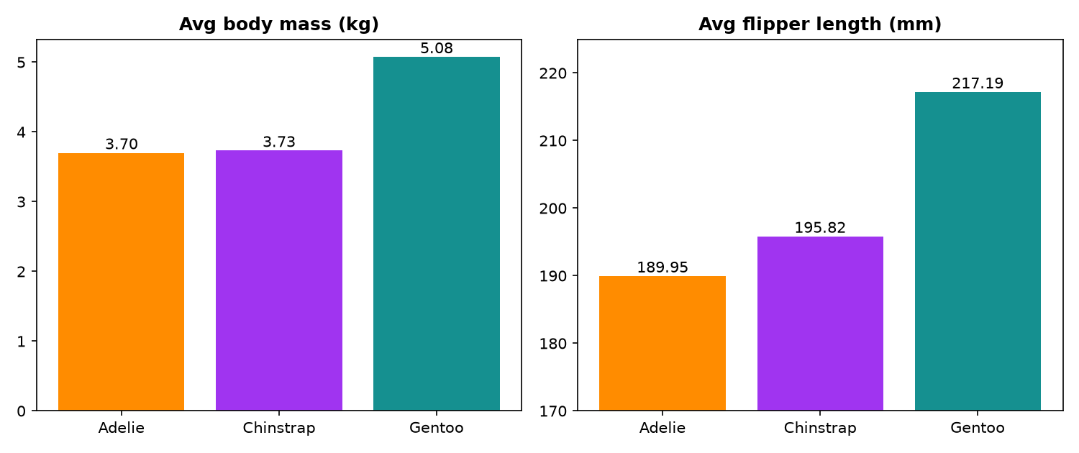
15/16
What the data says
Gentoo are the heaviest at 5.08 kg with 217 mm flippers.

Slide 16
16/16
Pipeline runs end to end
Every stage reads from and writes back to HDFS, so each step can be re-run alone.
CODE
EVIDENCE
GitHub repository
Report with screenshots

