Slide 1
Asymptotic Notations

Slide 2
Content
Asymptotic Analysis & Asymptotic Notation
Worst Case O (Big Oh) Notation
Best Case Ω (Omega) Notation
Average Case Θ (Theta) Notation

Slide 3
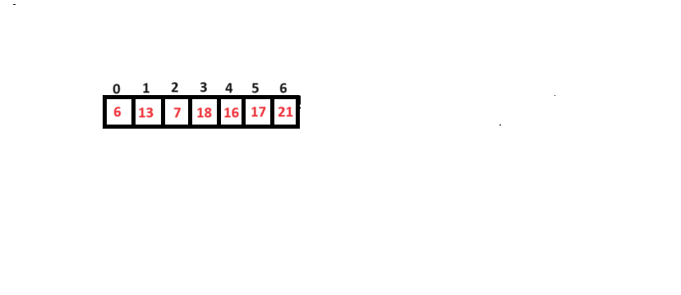
Types of Algorithm Analysis
Best Case :
The Minimum amount of time taken by an algorithm on input size n is called Best time case Analysis.
It executes in minimum number of steps
Generally it denoted by Omega(Ω) Notation
X=6 here 6 find in 1comparsion on index 0 Ω(1)

Slide 4
Worst Case :
The Maximum amount of time taken by an algorithm on input size n is called Worst time case Analysis.
It executes in maximum number of steps
Generally it denoted by Big Oh (O) Notation
X=21 here 21 find in 7comparsion on index 6 O(n)

Slide 5
Average Case :
The Average amount of time taken by an algorithm on input size n is called Average time case Analysis.
It executes in Average number of steps
Generally it denoted by Theta(Θ) Notation
X=18 that present on the 3rd index describe below
n+1/2 = Θ(n+1/2) = Θ(n)

Slide 6
Asymptotic Notation
Asymptotic Notation is used to describe the Running time of an Algorithm that how much time of an algorithm takes with a given input.
There are 3 different Notations
Big oh() Notation
Omega (Ω) Notation
Theta (Θ) Notation

Slide 7
Big Oh (O) Notation :
This Notation O(n) is formal way to express the upper bound of an algorithm running time.
It measure the Worst case time complexity or the Longest amount of time an algorithm can possibly take to complete.

Slide 8
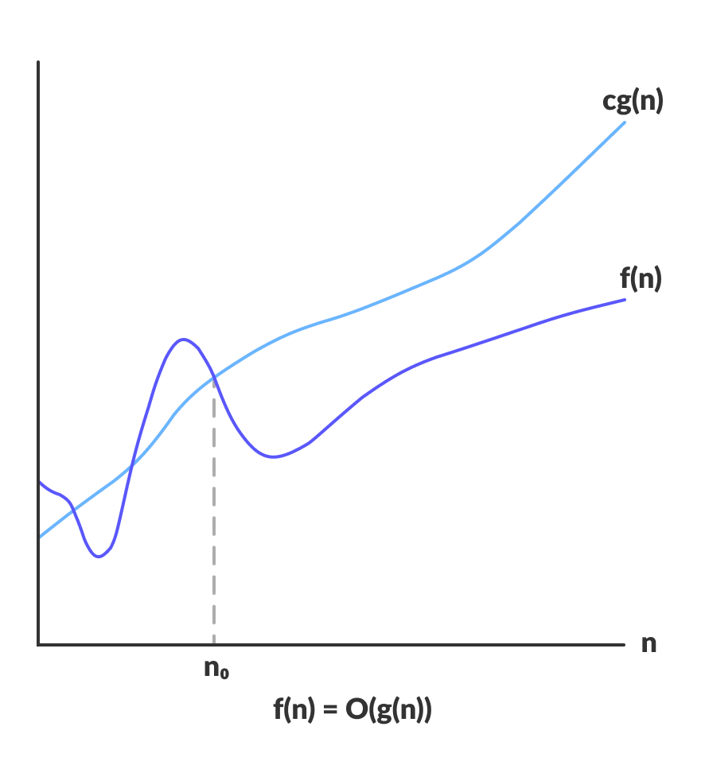
The function f(n) = O(g(n)) if and only if there exists +ve constants c and no such that f(n)<=c*g(n) for all n where n>no

Slide 9
2n+10<=3n
Prove that 2n+10=O(n)
f(n) <=c*g(n)
2n+10<=n
2n+10<=3n
If we put no=10,n=11 then
2n+10<=3n which means c=3
n | f(n) | g(n)
1 | 12 | 3
2 | 14 | 6
3 | 16 | 9
4 | 18 | 12
5 | 20 | 15
10 | 30 | 30
11 | 32 | 33

Slide 10
Prove that 2n² +17 = O(n²)
f(n) <=c*g(n)
2n²+17<= n²
2n²+17<= 3n²
If we put n=5 then
2n²+17 <= 3n² which means c=3
n | f(n) | g(n)
1 | 19 | 3
2 | 25 | 12
3 | 35 | 27
4 | 49 | 48
5 | 67 | 75

Slide 11
Omega (Ω) Notation :
This Notation Ω(n) is formal way to express the lower bound of an algorithm running time.
It measure the Best case time complexity or the Smallest amount of time an algorithm can possibly take to complete.

Slide 12
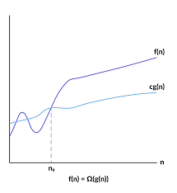
The function f(n) = Ω(g(n)) if and only if there exists +ve constants c and no such that f(n)>=c*g(n) for all n where n>no

Slide 13
Prove that 3n+2= Ω(n)
f(n) >=c*g(n)
3n+2>=n
3n+2>=3n
If we put n=1 then
3n+2>=3n which means c=3
n | f(n) | g(n)
1 | 5 | 3
2 | 8 | 6
3 | 11 | 9

Slide 14
Prove that 5n² +3n-3= Ω(n²)
f(n) >=c*g(n)
5n² +3n-3 >= n²
5n² +3n-3 >= 5n²
If we put no =1,n=2 then
5n2 +3n-3 >= 5n2 which means c=5
n | f(n) | g(n)
1 | 5 | 5
2 | 23 | 20
3 | 69 | 45

Slide 15
Prove that 100n+5= Ω(n²)
f(n) >=c*g(n)
100.n+5>= cn2
Hence this is not possible and 100n+5>= cn2 , for n>=no is not true for any
Combination of c and no
Hence so 100n+5 Ω(n2)

Slide 16
Theta (Θ) Notation :
This Notation Θ(n) is formal way to express the Both the lower bound & upper bound/Tight bound of an algorithm running time.
It measure the Average case time complexity or the Average amount of time an algorithm can possibly take to complete.

Slide 17
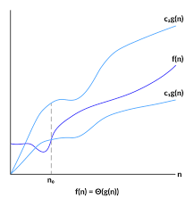
The function f(n) = Θ(g(n)) if and only if there exists +ve constants c1, c2 and no such that c1*g(n)<= f(n)<= c2*g(n) for all n where n>no

Slide 18
Prove that 2n+6= Θ(n)
c1*g(n)<= f(n)<= c2*g(n)
n<=2n+6<=n
2n<=2n+6<=3n
If we put n=6 then
2n<=2n+6<=3n which means
c1=2,c2=3
n | g(n) | f(n) | g(n)
1 | 2 | 8 | 3
2 | 4 | 10 | 6
3 | 6 | 12 | 9
4 | 8 | 14 | 12
5 | 10 | 16 | 15
6 | 12 | 18 | 18
7 | 14 | 20 | 21

Slide 19
Prove that 20n²+8n+5= Θ(n²)
c1*g(n)<= f(n)<= c2*g(n)
n²<= 20n²+8n+5<=n²
20n²<= 20n²+8n+5<=21n²
If we put n=9 then
20n²<= 20n²+8n+5<=21n²
which means c1=20,c2=21
n | g(n) | f(n) | g(n)
1 | 20 | 33 | 21
2 | 80 | 101 | 84
3 | 180 | 209 | 189
4 | 320 | 357 | 336
5 | 500 | 545 | 525
6 | 720 | 773 | 756
7 | 980 | 1041 | 1029
8 | 1280 | 1349 | 1344
9 | 1620 | 1697 | 1701

Slide 20
Thank You

