Slide 1

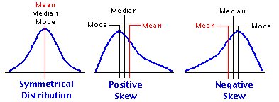
Day 2: Core statistics 101
UDM Msc course in education & development
2013
NicholasSpaull@gmail.com – www.nicspaull.com/teaching

Slide 2
Introduction
What are statistics?
  “the practice or science of collecting and analysing numerical data in large quantities”
Why do we need descriptive statistics?
  When we look at large amounts of data, there is very little “face value” information. If you had a dataset listing the income of 10,000 people and someone asked you if the income of the group was high or low it would be difficult to answer that question without using summary statistics (mean, median, mode etc.).

Slide 3
Types of Data
Data
Categorical
Numerical
Discrete
Continuous

Slide 4
Types of Data
Data
Categorical
Numerical
Discrete
Continuous
Examples:
Marital Status
Political Party
Eye Color
(Defined categories)
Examples:
Number of Children
Defects per hour
(Counted items)
Examples:
Weight
Voltage
(Measured characteristics)

Slide 5

Collecting Data
Primary Sources
Data Collection
Secondary Sources
Data Compilation
Print or Electronic
Observation
Survey
Experimentation

Slide 6
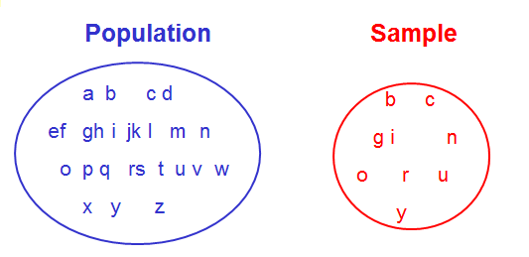
Sampling
What is a sample?
  A sample is “a small part or quantity intended to show what the whole is like”
Why do we use samples rather than the population?

Slide 7

Descriptive Statistics
Collect data
  e.g., Survey
Present data
  e.g., Tables and graphs
Characterize data
  e.g., Sample mean =

Slide 8
Measures of Central Tendency
Central Tendency
Mean
Median
Mode
Midpoint of ranked values
Most frequently observed value

Slide 9
Mean
The most common measure of central tendency
Mean = sum of values divided by the number of values
Affected by extreme values (outliers)
0 1 2 3 4 5 6 7 8 9 10
0 1 2 3 4 5 6 7 8 9 10
Mean = 3
Mean = 4

Slide 10
Median
In an ordered array, the median is the “middle” number (50% above, 50% below)
Not affected by extreme values
0 1 2 3 4 5 6 7 8 9 10
0 1 2 3 4 5 6 7 8 9 10
Median = 3
Median = 3

Slide 11
Finding the Median
The location of the median:
  If the number of values is odd, the median is the middle number
  If the number of values is even, the median is the average of the two middle numbers
Note that is not the value of the median, only the position of the median in the ranked data

Slide 12
Mode
A measure of central tendency
Value that occurs most often
Not affected by extreme values
Used for either numerical or categorical (nominal) data
There may be no mode
There may be several modes
0 1 2 3 4 5 6 7 8 9 10 11 12 13 14
0 1 2 3 4 5 6
No Mode
Mode = 9

Slide 13
Review Example
Five houses on a hill by the beach
House Prices:
$2,000,000
500,000
300,000
100,000
100,000

Slide 14
Review Example: Summary Statistics
House Prices:
$2,000,000
500,000
300,000
100,000
100,000
Sum $3,000,000
Mean: ($3,000,000/5)
= $600,000
Median: middle value of ranked data
= $300,000
Mode: most frequent value
= $100,000

Slide 15
Mean, median, mode and range
Mean = the average value
Median = the middle value in an ordered list of data
Mode = the most common value
Range = difference between highest and lowest value
Example: If we calculated the height of a class and we found:
In cm: 160, 162, 164, 164, 165, 165, 165, 180, 190
Mean = (160+160+162+163+164+164+165+165+165+180+190)/9 = 167
Median = 160+160+162+163+164+164+165+165+165+180+190 = 164
Mode= 160+160+162+163+164+164+165+165+165+180+190 =165
Range= 190 – 160 =30
If you are still confused about how to calculate the mean, median and mode,
watch this 4min video on YouTube: http://www.youtube.com/watch?v=k3aKKasOmIw

Slide 16
Which measure of location is the “best”?
Mean is generally used, unless extreme values (outliers) exist
Then median is often used, since the median is not sensitive to extreme values.
  Example: Median home prices may be reported for a region – less sensitive to outliers

Slide 17
Range
Simplest measure of variation
Difference between the largest and the smallest values in a set of data:
Range = X_{largest} – X_{smallest}
Example:
0 1 2 3 4 5 6 7 8 9 10 11 12 13 14
Range = 14 - 1 = 13

Slide 18
Disadvantages of the Range
Ignores the way in which data are distributed
Sensitive to outliers
7 8 9 10 11 12
7 8 9 10 11 12
Range = 12 - 7 = 5
Range = 12 - 7 = 5
1,1,1,1,1,1,1,1,1,1,1,2,2,2,2,2,2,2,2,3,3,3,3,4,5
Range = 5 - 1 = 4
1,1,1,1,1,1,1,1,1,1,1,2,2,2,2,2,2,2,2,3,3,3,3,4,120
Range = 120 - 1 = 119

Slide 19
Getting from the real world to a distribution
When we collect data from the ‘real world’ we need to then represent it in numerically and graphically useful ways. This is where graphical analysis and numerical statistical analysis are helpful.
Say we went into one classroom and observed 22 students with the following reading and mathematics scores.
To help understand the distribution of performance in this class we will calculate the mean, median and mode and also create a histogram of the data. (Do UDM Tut1)
  UDM Tutorial 1 – Mean, median, mode
student_id | reading_score | math_score
1 | 508 | 483
2 | 437 | 454
3 | 378 | 454
4 | 355 | 469
5 | 388 | 353
6 | 378 | 439
7 | 399 | 439
8 | 437 | 454
9 | 447 | 469
10 | 355 | 454
11 | 399 | 424
12 | 490 | 483
13 | 437 | 469
14 | 419 | 353
15 | 516 | 535
16 | 456 | 439
17 | 525 | 522
18 | 447 | 353
19 | 437 | 454
20 | 456 | 454
21 | 456 | 424
22 | 551 | 454

Slide 20
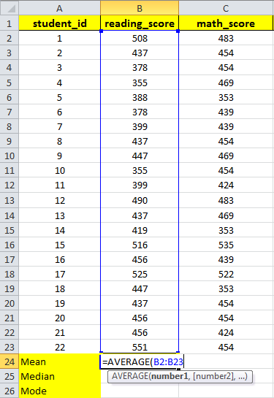
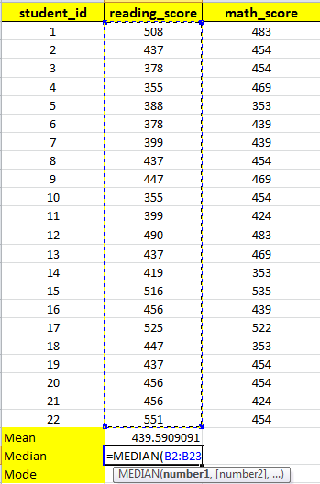
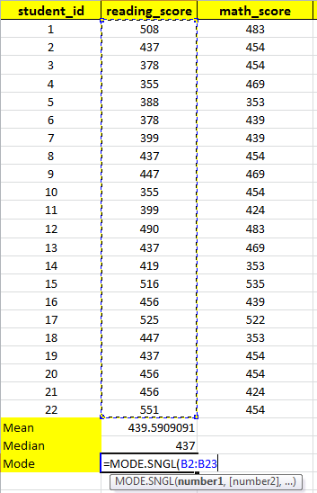
Mean Median Mode

Slide 21
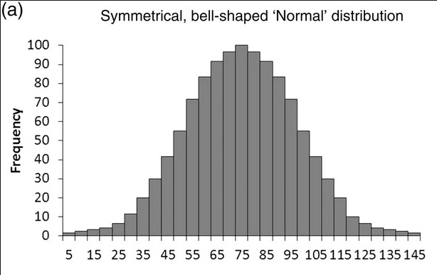
The normal distribution
In a perfect normal distribution the mean, median and mode are equal to each other – 75 here.

Slide 22
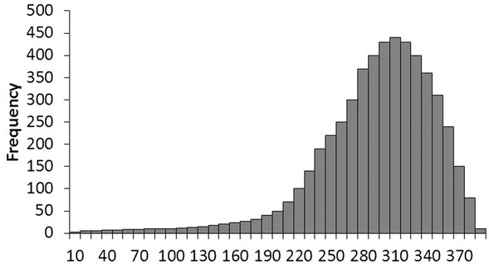
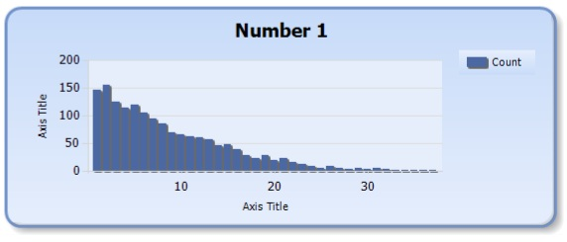
Skewness
Negative/Left skew →
TIP: To remember if it is positive skew or negative skew, think of the distribution like a door-stop. Does the door touch the positive side or the negative side of the distribution?
← Positive/Right skew

Slide 23
Shape of a Distribution
Describes how data are distributed
Measures of shape
  Symmetric or skewed
Left-Skewed
Symmetric
Right-Skewed
Mean < Median
Mean = Median
Median < Mean

Slide 24
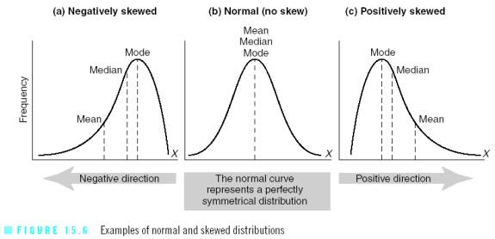
Positive and negative skew

Slide 25
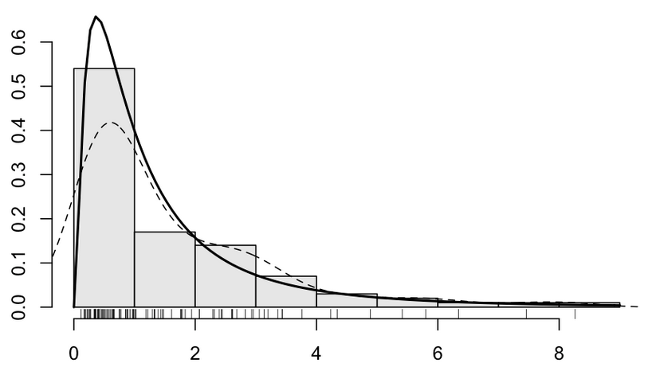
Example question
For this graph will:
  The mean > mode?
  The median < mean?
  The mean = mode?
  The mean = median?

Slide 26
Example question
For this graph will:
  The mean > mode?
  The median < mean?
  The mean = mode?
  The mean = median?
The “highest” point in the distribution is always the mode…

Slide 27
Exploratory Data Analysis
Box-and-Whisker Plot: A Graphical display of data using 5-number summary:
Minimum -- Q1 -- Median -- Q3 -- Maximum
Example:
25% 25% 25% 25%

Slide 28
Shape of Box-and-Whisker Plots
The Box and central line are centered between the endpoints if data are symmetric around the median
A Box-and-Whisker plot can be shown in either vertical or horizontal format
Min Q₁ Median Q₃ Max

Slide 29
Distribution Shape and Box-and-Whisker Plot
Left-Skewed
Symmetric
Right-Skewed
Q1
Q2
Q3
Q1
Q2
Q3
Q1
Q2
Q3

