Slide 1
DIGITECH / DIGITAL TWIN CHALLENGE 2026
GlucoTwin India
An explainable digital twin for two-hour early warning of glucose excursions
HISTORICAL EHR + LIVE-LIKE WEARABLE STREAM → RISK ESTIMATE
Prototype uses synthetic data only. Research demonstration, not a medical device.
Zeeshan Ali Sheikh · Team DigiTech
DIGITECH · GLUCOTWIN INDIA · DIGITAL TWIN CHALLENGE 2026
01

Slide 2
01 · THE PROBLEM
From isolated readings to a changing patient state
The challenge is to fuse historical context with a dynamic stream and forecast one concrete outcome.
INDIA · DIABETES CONTEXT
THE CARE GAP
OUR NARROW SCOPE
90 million
A lab value is a snapshot.
Forecast a synthetic glucose threshold crossing within two hours.
Glucose and daily context change hour by hour.
estimated adults aged 20–79 living with diabetes in 2024
A forecast needs time-aligned signals.
A proof-of-concept, not a diagnosis or treatment engine.
IDF Diabetes Atlas, 11th ed. (2025)
Source: IDF Diabetes Atlas (2025); WHO Diabetes Fact Sheet. Statistics are context, not model-training data.
DIGITECH · GLUCOTWIN INDIA · DIGITAL TWIN CHALLENGE 2026
02

Slide 3
02 · PROBLEM STATEMENT
A forecast that is specific enough to test
The model only forecasts new threshold crossings when the current simulated glucose is below the threshold.
1
2
3
4
Twin state
Forecast
Review
Human decision
Patient profile + latest stream
P(crossing ≥180 mg/dL in 2h)
Check signal and context
Clinician remains in control
180 mg/dL is a prototype label chosen for this simulator — not a universal clinical alert threshold.
DIGITECH · GLUCOTWIN INDIA · DIGITAL TWIN CHALLENGE 2026
03

Slide 4
03 · FEATURE FUSION
Two streams make one patient-specific state
Static data explains baseline context; dynamic signals show what is changing now.
STATIC / EHR
DYNAMIC STREAM
Historical / patient context
Hourly observations
Age, BMI and diabetes duration
CGM value, trend and variability
HbA1c and hypertension flag
Meal carbs + steps/activity
Heart rate, HRV and sleep
Synthetic adherence factor
Time since meal + stress proxy
TIME ALIGNMENT · FEATURE WINDOW AT TIME t · NO FUTURE DATA INPUTS
DIGITECH · GLUCOTWIN INDIA · DIGITAL TWIN CHALLENGE 2026
04

Slide 5
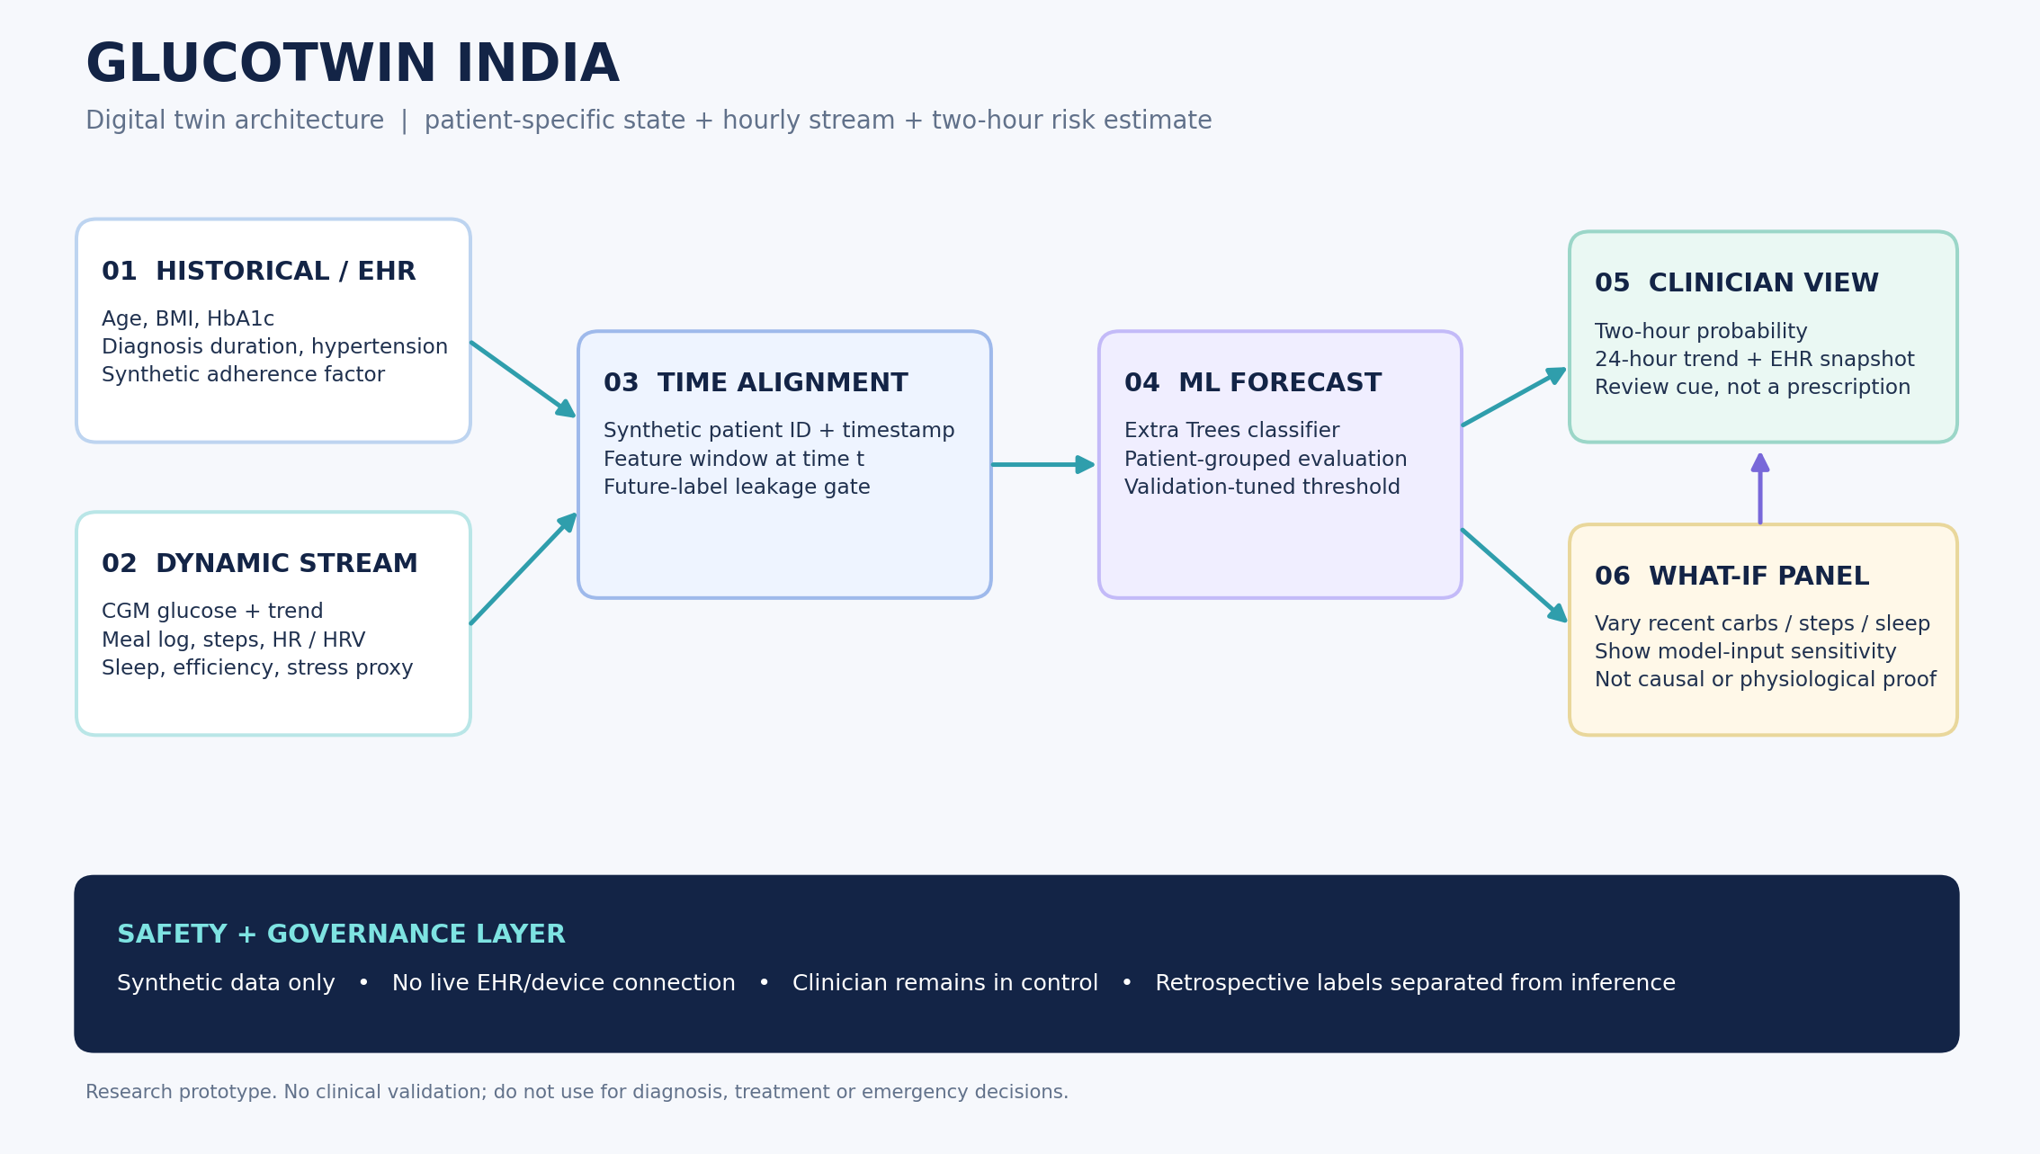
04 · SYSTEM DESIGN
A transparent path from synthetic data to review
Architecture keeps inference-time features separate from retrospective outcome labels.
DIGITECH · GLUCOTWIN INDIA · DIGITAL TWIN CHALLENGE 2026
05

Slide 6
05 · DATA AND TARGET
Reproducible simulation — no patient data required
The simulator generates patient-specific trajectories and labels each timestamp from the following two hours.
What is generated?
Target construction
240 synthetic patient profiles
At time t, use only current and past features.
14-day timeline; last 2 hours are label context
Positive label: either t+1h or t+2h reaches ≥180 mg/dL.
80,160 rows total across the full stream
Meals, activity, HR/HRV, sleep and CGM-like values
Rows already ≥180 mg/dL are excluded from the early-warning target and surfaced separately.
Future glucose is used only to create the retrospective label. It is not included in FEATURE_COLUMNS.
DIGITECH · GLUCOTWIN INDIA · DIGITAL TWIN CHALLENGE 2026
06

Slide 7
06 · AI/ML APPROACH
Patient-level evaluation to reduce leakage
An Extra Trees baseline estimates probability; the operating threshold is tuned on validation data only.
MODEL
SPLIT BY PATIENT ID
THRESHOLD
Extra Trees
F2 tuned
Train · 153 patients
Nonlinear tabular baseline
Validation threshold chosen to emphasise recall for an early-warning demo; false alerts remain a trade-off.
Validation · 39 patients
Validation threshold tuned for F2
Test · 48 patients
Global feature importance
No patient can appear in more than one split. Metrics are estimates on a synthetic domain only.
DIGITECH · GLUCOTWIN INDIA · DIGITAL TWIN CHALLENGE 2026
07

Slide 8
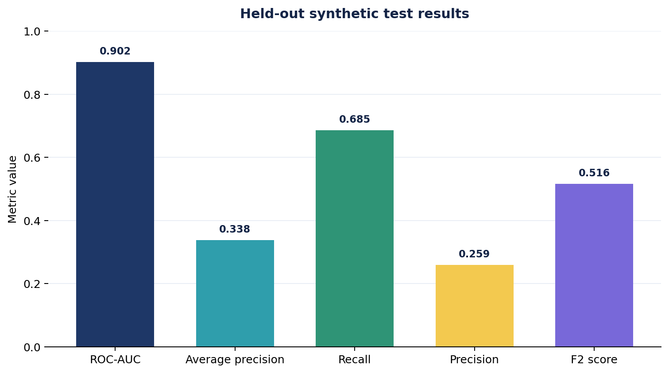
07 · MEASURED RESULTS
Held-out synthetic test results
These numbers are computed by the included training script; they are not clinical performance claims.
AT THE SELECTED THRESHOLD
68.5%
recall
25.9%
precision
High recall comes with false alerts.
Test set: 48 held-out patients, 15,184 eligible hourly rows. Positive event prevalence ≈ 4.5% overall.
DIGITECH · GLUCOTWIN INDIA · DIGITAL TWIN CHALLENGE 2026
08

Slide 9
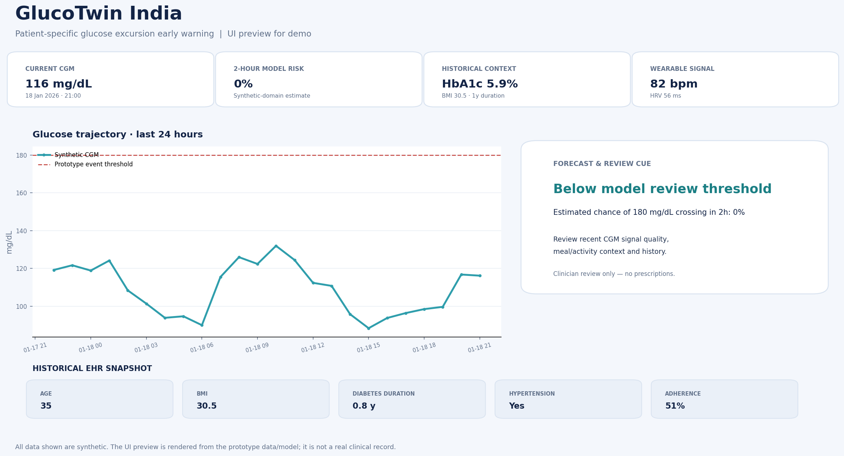
08 · PROTOTYPE
A clinician-facing, patient-specific dashboard
The UI connects the probability to a 24-hour trend, EHR context and a safe review workflow.
Visual preview rendered from the included synthetic data and trained model. The repository includes the working Streamlit application.
DIGITECH · GLUCOTWIN INDIA · DIGITAL TWIN CHALLENGE 2026
09

Slide 10
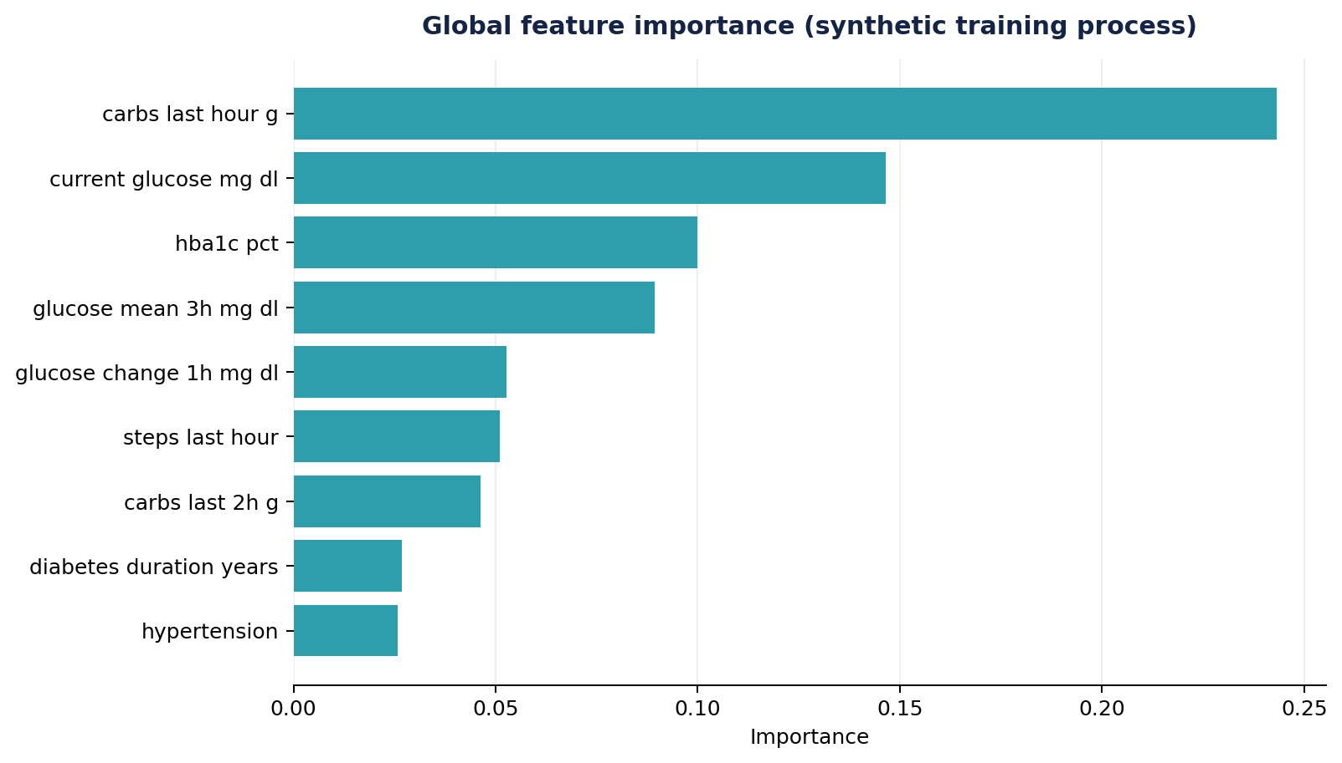
09 · EXPLAINABILITY & INTERACTION
Let reviewers explore sensitivity without claiming causality
The what-if panel changes model inputs; it does not simulate full human physiology or prove that an intervention causes a safer outcome.
WHAT-IF INPUTS
Carbs last hour
Steps last hour
Sleep last night
Forecast updates when the scenario is applied.
Global feature importance ≠ causality or a local explanation.
DIGITECH · GLUCOTWIN INDIA · DIGITAL TWIN CHALLENGE 2026
10

Slide 11
10 · RESPONSIBLE AI
Guardrails are part of the design
The prototype is deliberately positioned as a research demo and clinician review aid, not an automated decision maker.
WHAT IT DOES
WHAT IT DOES NOT DO
WHAT COMES NEXT
Joins two synthetic data streams
Use real patient records or devices
External, governed datasets
Estimates one narrowly scoped event
Diagnose or recommend medication
Calibration + subgroup evaluation
Shows metrics and data lineage
Prove clinical efficacy or causality
Clinician workflow and safety review
Synthetic data only · Not validated for real-world use · Never use to make diagnosis, treatment or emergency decisions.
DIGITECH · GLUCOTWIN INDIA · DIGITAL TWIN CHALLENGE 2026
11

Slide 12
11 · CONCLUSION
A small digital twin — end to end
GlucoTwin India demonstrates the complete challenge loop: patient state → hourly stream → forecast → clinician review.
01
02
03
04
FUSE
FORECAST
EXPLAIN
KEEP HUMAN
Historical + dynamic data
Two-hour event probability
Model results + limits
Clinician makes decisions
Next milestone: evaluate on governed real-world data with clinical partners before any real deployment.
Thank you · DigiTech · GlucoTwin India
DIGITECH · GLUCOTWIN INDIA · DIGITAL TWIN CHALLENGE 2026
12

Slide 13
APPENDIX · SOURCES
Context sources and reproducibility
Claims about public-health context are sourced; all model data and evaluation in this repo are synthetic.
International Diabetes Federation — Diabetes Atlas, 11th Edition (2025)
https://diabetesatlas.org/media/uploads/sites/3/2025/10/IDF_Diabetes_Atlas_11th_Edition_2025_WEB.pdf
India estimate: 90.0 million adults aged 20–79 living with diabetes in 2024.
World Health Organization — Diabetes Fact Sheet
https://www.who.int/news-room/fact-sheets/detail/diabetes
Overview of diabetes, complications, detection and management.
Digital Twin Challenge 2026 — Unstop / Happiest Health
https://unstop.com/hackathons/crp-digital-twin-challenge-2026-happiest-health-1757873
Challenge scope, two data streams and repository/video submission checklist.
Implementation artefacts, generated metrics and limitations are available in the public repository README and docs.
DIGITECH · GLUCOTWIN INDIA · DIGITAL TWIN CHALLENGE 2026
13

