Slide 1

PROJECT TITLE –
Healthcare Analytics For Doctor Visit_TIRTC
TIRTC PROJECT SUBMISSION
Student Name : ZEESHAN ALI SHEIKH
AICTE STU ID : STU69f200fb9d16a1777467643

Slide 2

PROBLEM STATEMENT
The Challenge
People differ in how often they visit a doctor. Health conditions, illness burden, age and access to healthcare may be related to these differences.
The Data Gap
Raw records do not show the main patterns clearly until they are checked, summarized and compared using data analysis.
Project Goal
Using the supplied dataset to explore doctor visits and identify descriptive relationships with health and personal factors.

Slide 3
PROJECT DESCRIPTION
This project analyses a dataset containing information about individuals, health conditions, healthcare support and the number of doctor visits recorded.
Key Objectives
Inspect the dataset structure and check its data quality.
Explore the distribution of doctor visits and illness scores.
Compare visit patterns with chronic conditions and numerical variables.
Use charts and summary statistics to interpret the observed patterns.
ANALYSIS WORKFLOW
01
Load & inspect
Shape, columns, data types and summary statistics.
02
Check data quality
Count missing values and review column completeness.
03
Explore distributions
Visit frequency, illness counts, gender and income ranges.
04
Compare groups
Mean visits by illness score, gender and chronic status.
05
Interpret relationships
Correlation and scatterplot analysis, with cautious interpretation.

Slide 4

WHO ARE THE END USERS?
HEALTHCARE SERVICE PLANNERS
PUBLIC HEALTH RESEARCHERS
Use aggregate patterns to frame questions about service demand and health needs.
Explore how illness burden, reduced activity and chronic conditions relate to visits.
HEALTHCARE & INSURANCE ANALYSTS
STUDENTS & DATA PRACTITIONERS
Review descriptive differences by recorded healthcare-support indicators.
Practice data profiling, group comparisons, visualization and responsible interpretation.
Appropriate use: aggregate exploration and education. The dataset alone does not support diagnosis or causal claims.

Slide 5

Technology Used
Tools used for Data Preparation, Analysis And Visualisation
Python 3 — Programming language for data analysis.
Google Colab — Writing and running analysis code.
Pandas — Loading, inspecting, grouping and summarizing the dataset.
NumPy — Numerical operations and calculations.
Matplotlib and Seaborn — Charts and Statistical Visualization.
CSV file — Source data for all reported findings.
Analysis flow:
Load → Inspect → Check quality → Explore → Compare → Visualize → Interpret

Slide 6
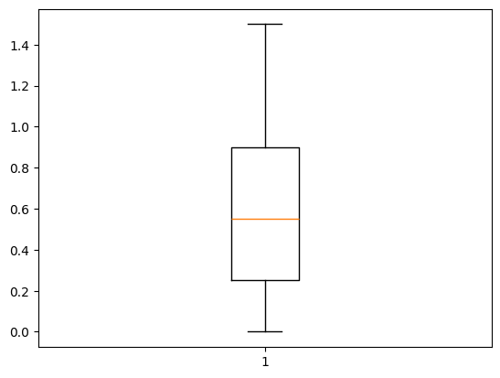
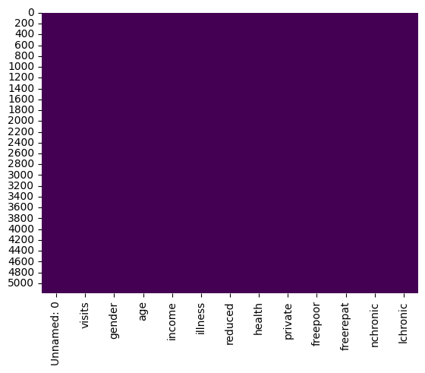
RESULTS
https://github.com/zeeshanalisk/Healthcare-Analytics-for-Doctor-Visits-TIRTC

Slide 7
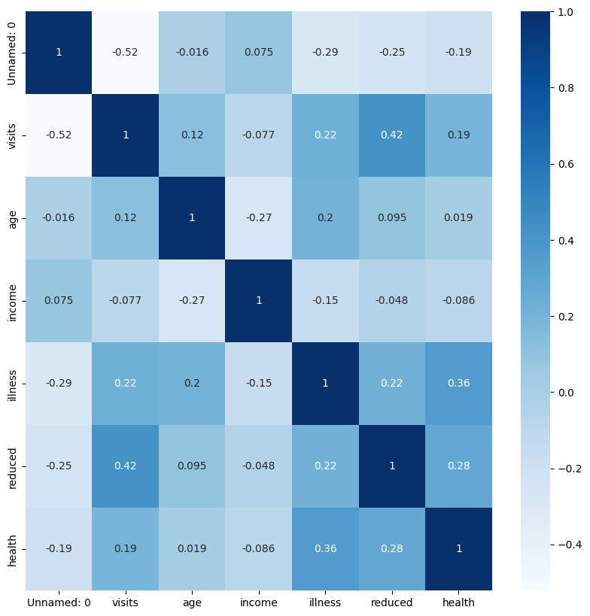
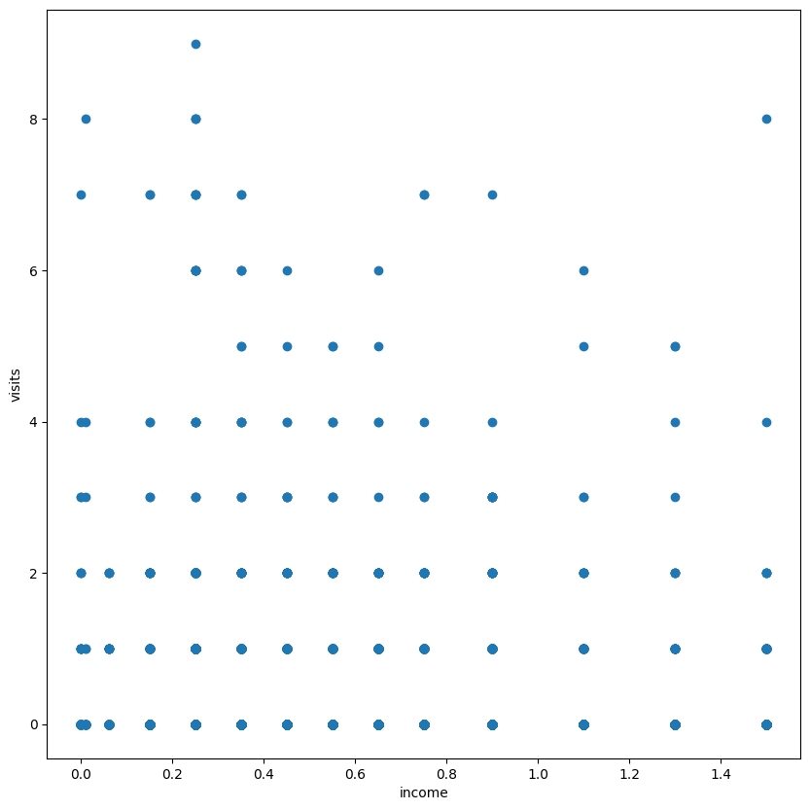
RESULTS
https://colab.research.google.com/drive/10vGuPkeHhszNCrWL3-2D1G4KOPCS4UYk?usp=sharing

Slide 8
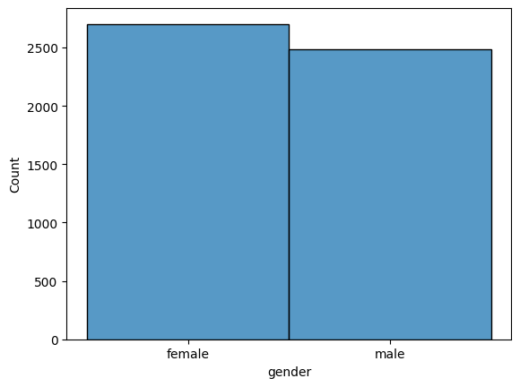
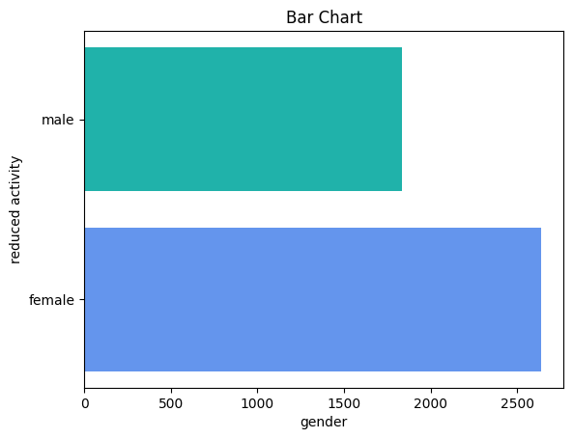
RESULTS
GitHub Project Link

Slide 9
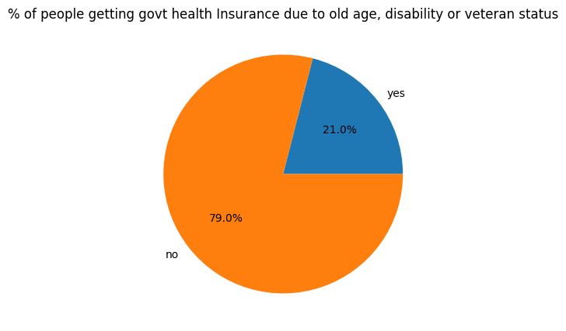
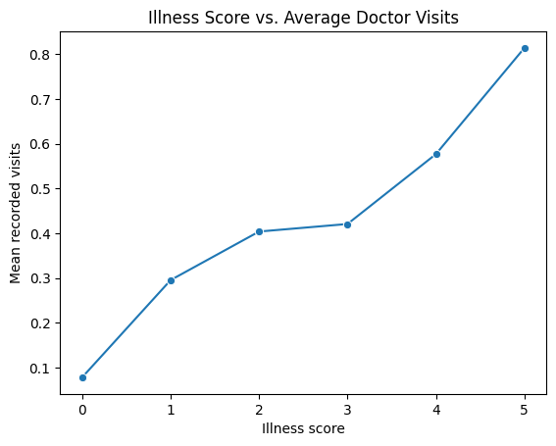
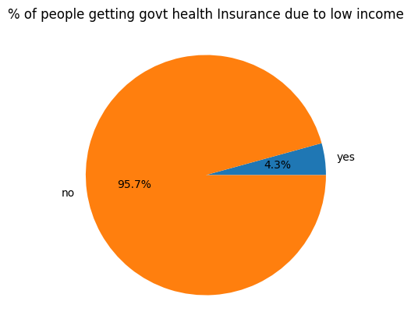
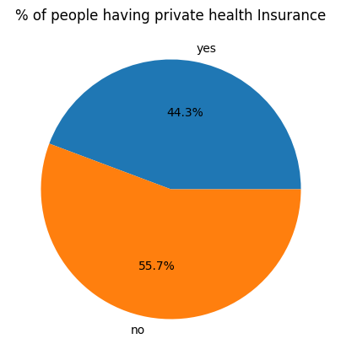
RESULTS
Google Colab Source Code

Slide 10
Thank you
.
.

