Slide 1
Working with dates and times
datetime
Christopher Harrison | Content Developer
Susan Ibach | Technical Evangelist
Notes:
<number>

Slide 2
We spend a lot of time thinking about deadlines and schedules
How many days do I have until my birthday?
When is my project due?
Notes:
<number>

Slide 3
To solve these problems with computers we need to store and manipulate dates and times
Notes:
<number>

Slide 4
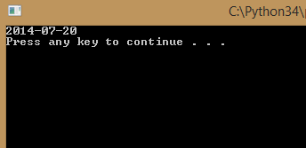
If I want to know how many days until my birthday, first I need today’s date
The datetime class allows us to get the current date and time
#The import statement gives us access to
#the functionality of the datetime class
import datetime
#today is a function that returns today's date
print (datetime.date.today())
Notes:
<number>

Slide 5
You can store dates in variables
import datetime
#store the value in a variable called currentDate
currentDate = datetime.date.today()
print (currentDate)
Notes:
<number>

Slide 6
Displaying current date and time

Slide 7
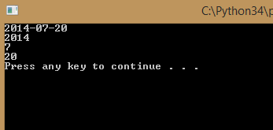
You can access different parts of the date
import datetime
currentDate = datetime.date.today()
print (currentDate)
print (currentDate.year)
print (currentDate.month)
print (currentDate.day)
Notes:
<number>

Slide 8
Using Date functions to access date parts

Slide 9
Date formats

Slide 10
What date does 2/5/2014 represent?

Slide 11
But what if you want to display the date with a different format?
Welcome to one of the things that drives programmers insane!
Different countries and different users like different date formats, often the default isn’t what you need
There is always a way to handle it, but it will take a little time and extra code
Notes:
<number>

Slide 12
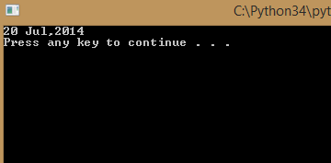
In Python we use strftime to format dates
import datetime
currentDate = datetime.date.today()
#strftime allows you to specify the date format
print (currentDate.strftime('%d %b,%Y'))
Notes:
<number>

Slide 13
What the heck are %d %b and %Y?
%d is the day of the month
%b is the abbreviation for the month
%Y is the 4 digit year
Notes:
<number>

Slide 14
Here’s a few more you may find useful
%b is the month abbreviation
%B is the full month name
%y is two digit year
%a is the day of the week abbreviated
%A is the day of the week
For a full list visit strftime.orgstrftime.org
Notes:
<number>

Slide 15
Formatting dates

Slide 16
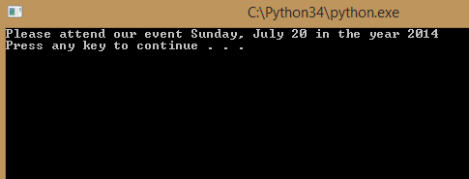
Could you print out a wedding invitation?
“Please attend our event Sunday, July 20 in the year 1997”
import datetime
currentDate = datetime.date.today()
#strftime allows you to specify the date format
print (currentDate.strftime
('Please attend our event %A, %B %d in the year %Y'))
Notes:
<number>

Slide 17
So… what if I don’t want English?
In programmer speak we call that localization
Did I mention working with dates can be challenging?
By default the program uses the language of the machine where it is running
But… since you can’t always rely on computer settings it is possible to force Python to use a particular language
It just takes more time and more code. We won’t go into that now, but if you need to do it check out the babel Python library http://babel.pocoo.org/http://babel.pocoo.org/
Notes:
<number>

Slide 18
Let’s get back to calculating days until your birthday, I need to ask your birthday.
birthday = input ("What is your birthday? ")
print ("Your birthday is " + birthday)
What datatype is birthday?
string
if we want to treat it like a date (for example use the datetime functions to print it in a particular format) we must convert it to a date
Notes:
<number>

Slide 19
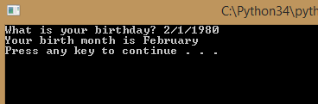
The strptime function allows you to convert a string to a date
import datetime
birthday = input ("What is your birthday? ")
birthdate =
datetime.datetime.strptime(birthday,"%m/%d/%Y").date()
#why did we list datetime twice?
#because we are calling the strptime function
#which is part of the datetime class
#which is in the datetime module
print ("Your birth month is " + birthdate.strftime('%B'))
Notes:
<number>

Slide 20
Asking a user for a date value

Slide 21
But what if the user doesn’t enter the date in the format I specify in strptime?
birthdate = datetime.datetime.strptime(birthday,"%m/%d/%Y")
Your code will crash so…
Tell the user the date format you want
birthday = input ("What is your birthday? (mm/dd/yyyy) ")
Notes:
<number>

Slide 22
Dates seem like a lot of hassle, is it worth it? Why not just store them as strings!
You can create a countdown to say how many days until a big event or holiday
nextBirthday = \
datetime.datetime.strptime('12/20/2014','%m/%d/%Y').date()
currentDate = datetime.date.today()
#If you subtract two dates you get back the number of days
#between those dates
difference = nextBirthday - currentDate
print (difference.days)
Notes:
<number>

Slide 23
Dates seem like a lot of hassle, is it worth it? Why not just store them as strings!
You can tell someone when the milk in their fridge will expire
currentDate = datetime.date.today()
#timedelta allows you to specify the time
#to add or subtract from a date
print (currentDate + datetime.timedelta(days=15))
print (currentDate + datetime.timedelta(hours=15))
Notes:
<number>

Slide 24
You will be amazed how often you need to work with dates!
If datetime doesn’t have what you need, check out the dateutil library (for example you might want to know the number of years between two dates instead of number of days)
Notes:
<number>

Slide 25
Working with time

Slide 26
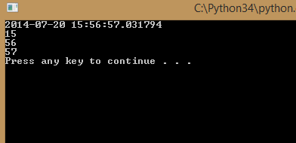
What about times?
It is called Datetime, so yes, it can store times.
import datetime
currentTime = datetime.datetime.now()
print (currentTime)
print (currentTime.hour)
print (currentTime.minute)
print (currentTime.second)
Notes:
<number>

Slide 27
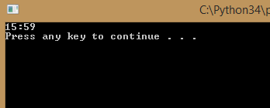
Just like with dates you can use strftime() to format the way a time is displayed
import datetime
currentTime = datetime.datetime.now()
print (datetime.datetime.strftime(currentTime,'%H:%M'))
%H Hours (24 hr clock)
%I Hours (12 hr clock)
%p AM or PM
%m Minutes
%S Seconds
Notes:
<number>

Slide 28
Working with times

Slide 29
Your challenge
Ask a user to enter the deadline for their project
Tell them how many days they have to complete the project
For extra credit, give them the answer as a combination of weeks & days (Hint: you will need some of the math functions from the module on numeric values)
Notes:
<number>

Slide 30
Congratulations!
You can now format dates and times
Notes:
<number>

