Slide 1
Pandas
Dr. Noman Islam

Slide 2
Getting Started

Slide 3
Introduction
It contains data structures and data manipulation tools designed to make data cleaning and analysis fast and easy in Python.
Pandas is designed for working with tabular or heterogeneous data.
NumPy, by contrast, is best suited for working with homogeneous numerical array data.

Slide 4

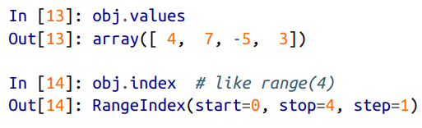
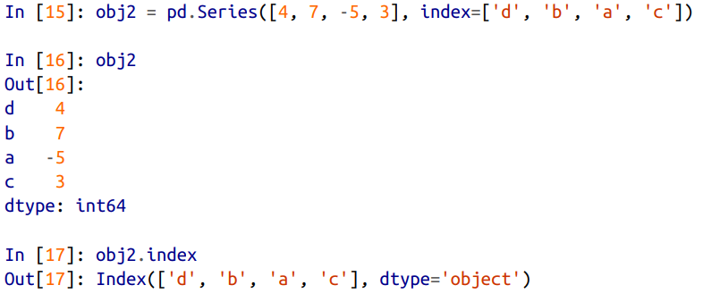
Series

Slide 5
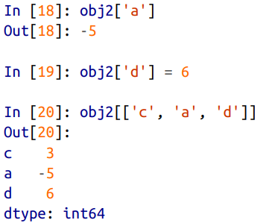
Using indexes to access data

Slide 6
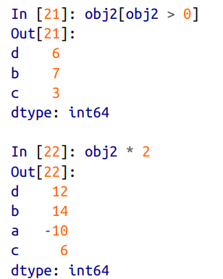

Filtering

Slide 7
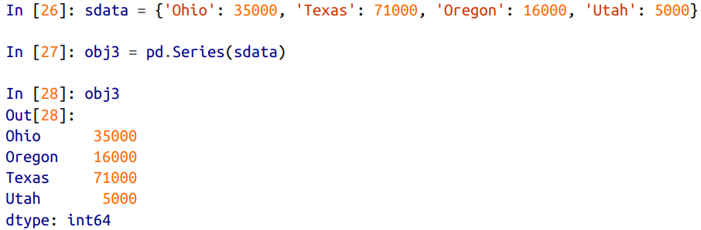
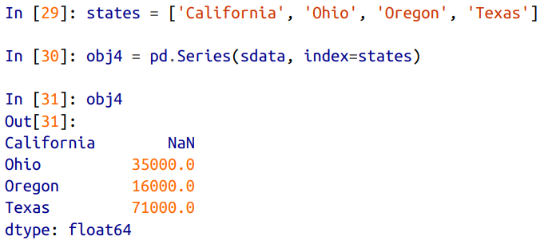
Creating series from dictionary

Slide 8
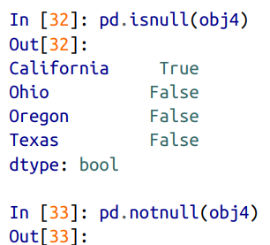
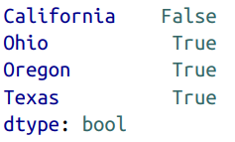
Checking for null values

Slide 9
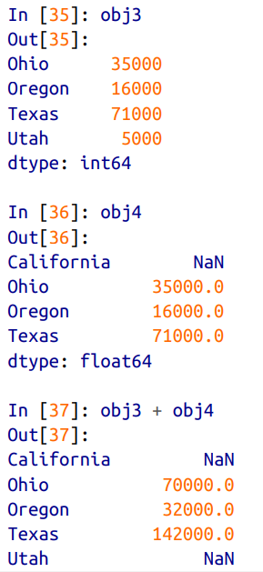
Joining two series

Slide 10
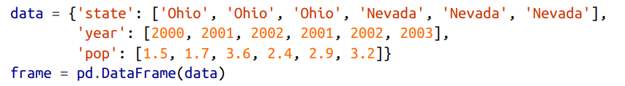
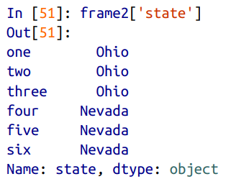
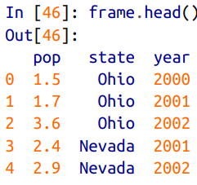
Dataframe

Slide 11
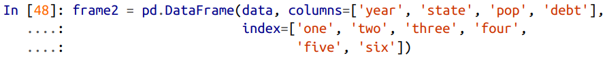
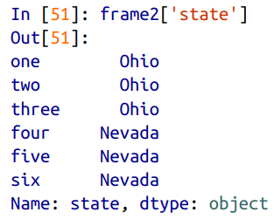
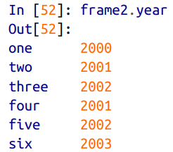
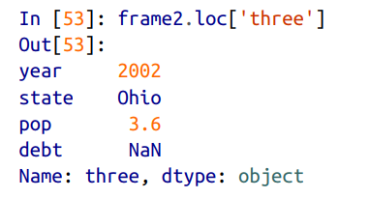

Slide 12
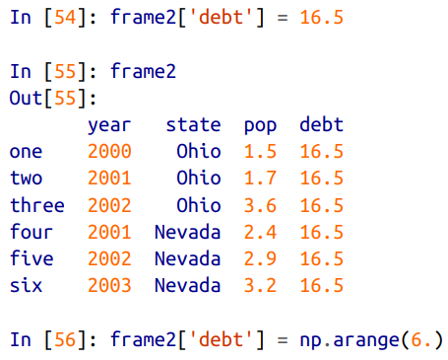
Modifying column values

Slide 13
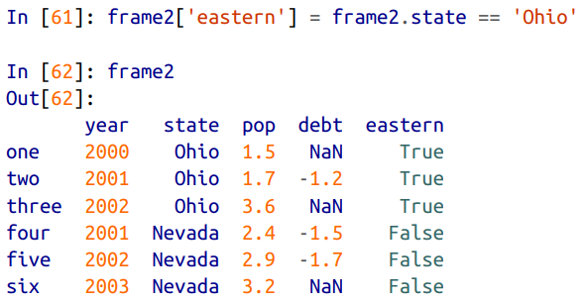
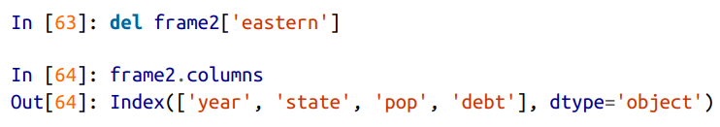
Adding / deleting a new column

Slide 14
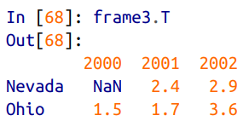
Transpose a dataframe

Slide 15
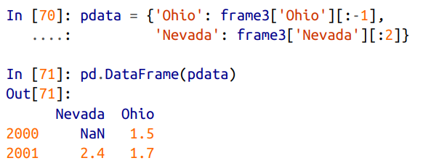
Slicing in dataframe

Slide 16
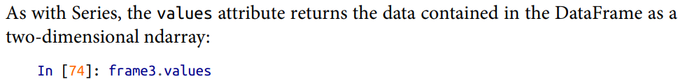
Values attribute

Slide 17
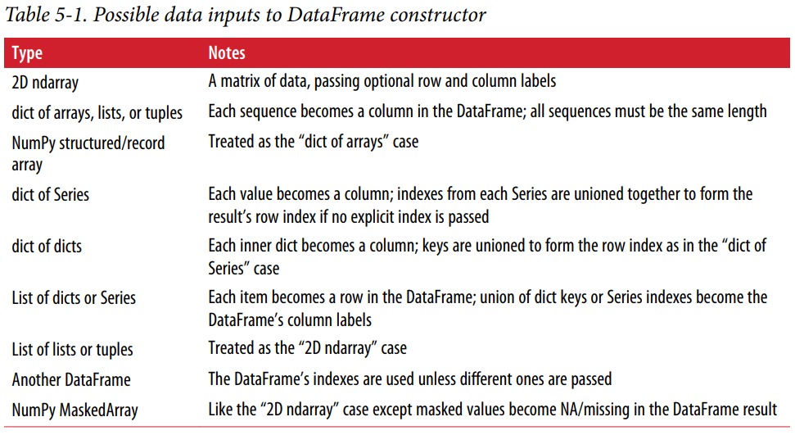

Slide 18
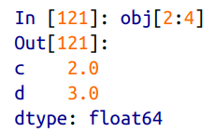
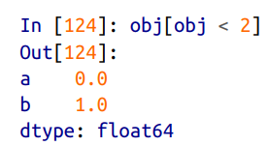
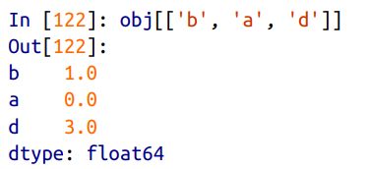
Indexing, selection and filtering

Slide 19
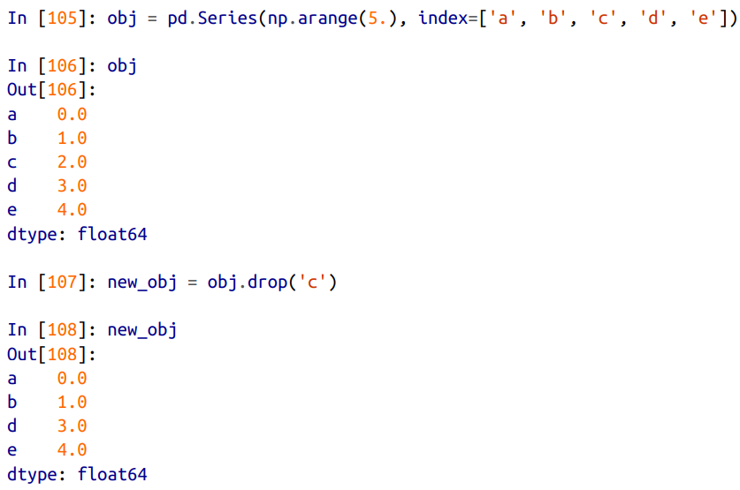
Dropping entries from axis

Slide 20
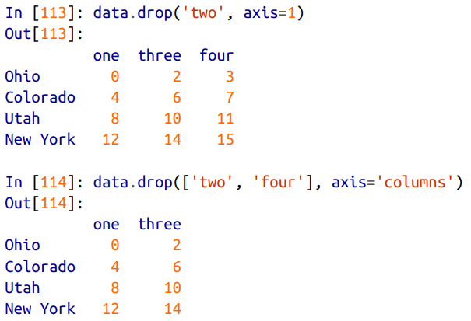
Axis parameter

Slide 21

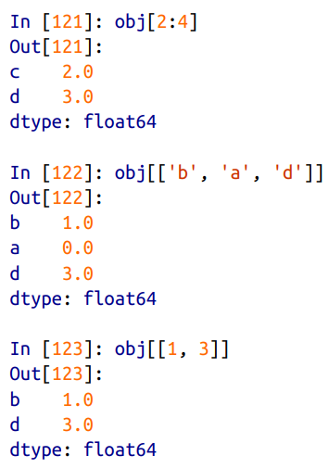

Indexing and slicing

Slide 22
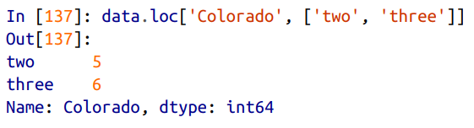
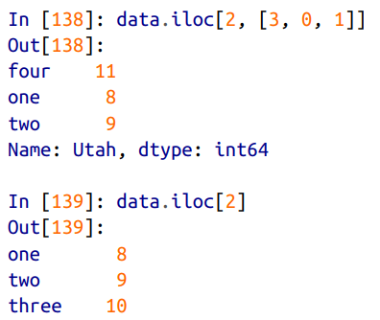
Selection with loc and iloc

Slide 23
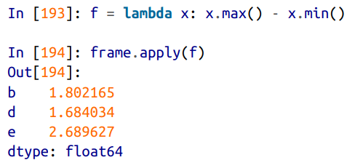
Apply function

Slide 24
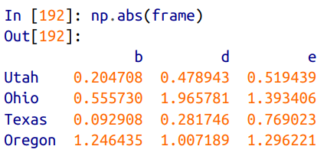
Function application and mapping

Slide 25
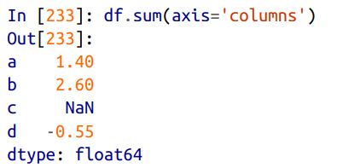
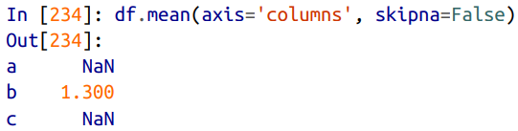
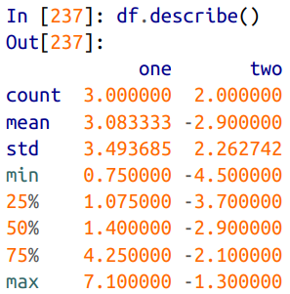
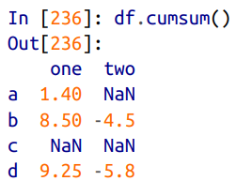
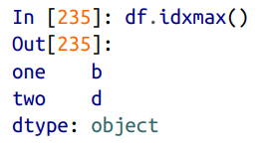
Descriptive statistics

Slide 26
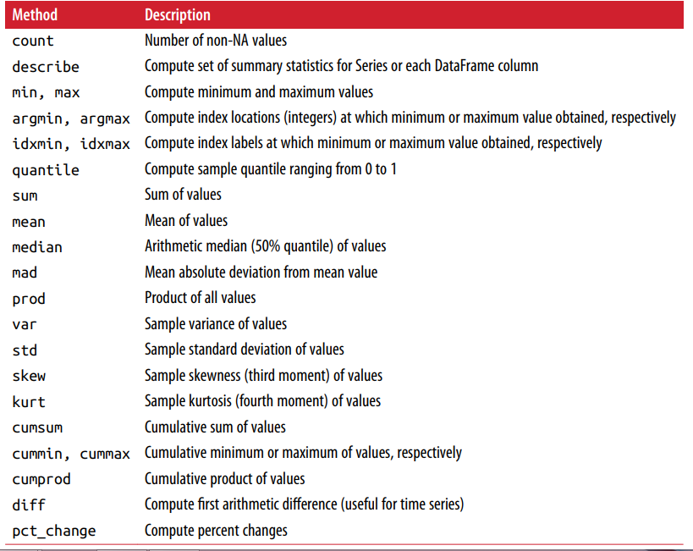

Slide 27
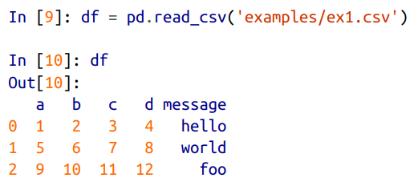
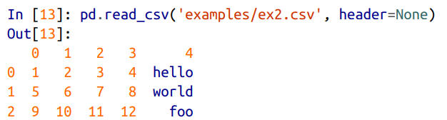
Reading and writing data

Slide 28
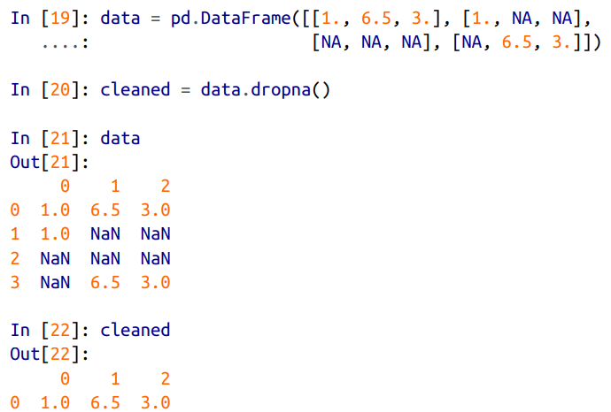
Filtering out missing values

Slide 29
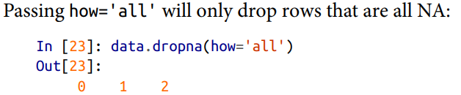

Slide 30

Filling missing data

Slide 31
Data Loading, Storage, and File Formats

Slide 32
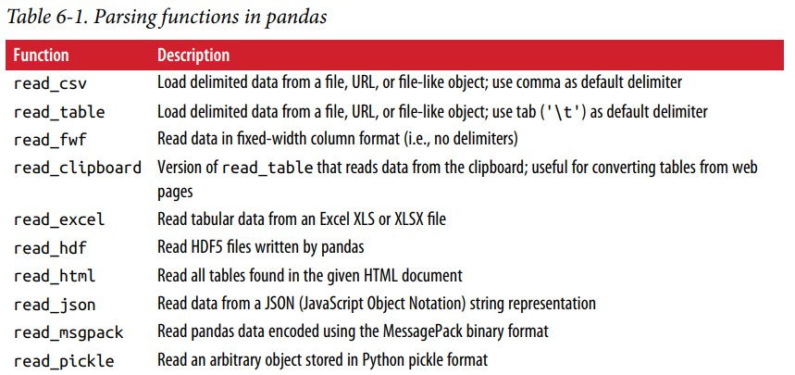
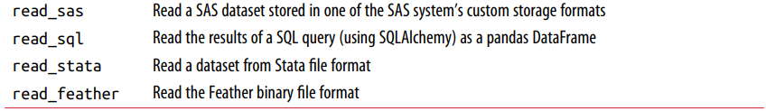
Reading data in pandas

Slide 33
Optional arguments
Indexing Can treat one or more columns as the returned DataFrame, and whether to get column names from the file, the user, or not at all. Type inference and data conversion This includes the user-defined value conversions and custom list of missing value markers.
Datetime parsing Includes combining capability, including combining date and time information spread over multiple columns into a single column in the result.
Iterating Support for iterating over chunks of very large files.
Unclean data issues Skipping rows or a footer, comments, or other minor things like numeric data with thousands separated by commas.

Slide 34
Examples
df = pd.read_csv('examples/ex1.csv')
pd.read_table('examples/ex1.csv', sep=',')
pd.read_csv('examples/ex2.csv', header=None)
pd.read_csv('examples/ex2.csv', names=['a', 'b', 'c', 'd', 'message'])
names = ['a', 'b', 'c', 'd', 'message']
pd.read_csv('examples/ex2.csv', names=names, index_col='message')

Slide 35
Passing regular expression as separator
result = pd.read_table('examples/ex3.txt', sep='\s+')
Skipping rows
pd.read_csv('examples/ex4.csv', skiprows=[0, 2, 3])

Slide 36

Handling null values

Slide 37
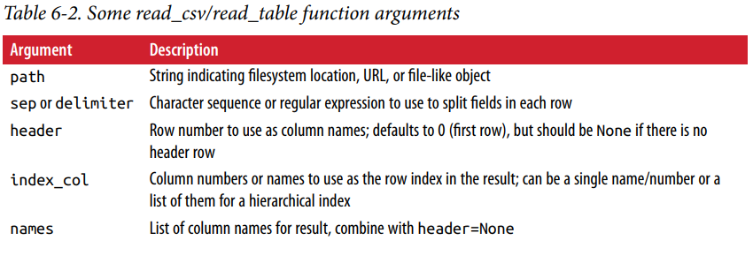

Slide 38
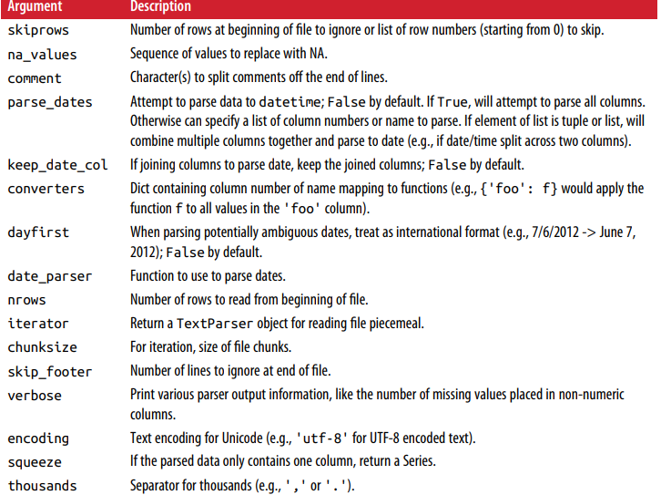

Slide 39
Reading text file in pieces

Slide 40
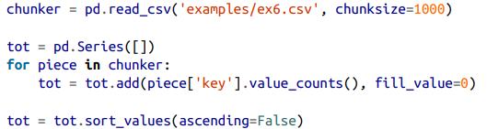
Iterating over chunk

Slide 41

Writing file

Slide 43


Working with delimited format

Slide 44
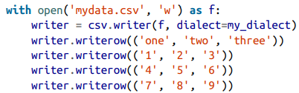
Writing csv data

Slide 45
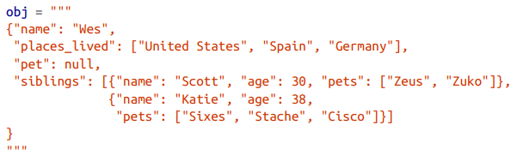
JSON format

Slide 46
The pandas.read_json can automatically convert JSON datasets in specific arrange‐ ments into a Series or DataFrame
The default options for pandas.read_json assume that each object in the JSON array is a row in the table

Slide 47

Web scraping
The pandas.read_html function has a number of options, but by default it searches for and attempts to parse all tabular data contained within tags.

Slide 48


Slide 49
Saving in binary format

Slide 50

HD5 format

Slide 51

Excel format

Slide 52


Interacting with Web API

Slide 53


Slide 54


Interacting with database

Slide 55



Slide 56


Slide 57
Data Cleaning and Preparation

Slide 58

Handling missing data

Slide 59


Slide 60



Slide 61
dropna options
With DataFrame objects, things are a bit more complex. You may want to drop rows or columns that are all NA or only those containing any NAs. dropna by default drops any row containing a missing value
Passing how='all' will only drop rows that are all NA
To drop columns in the same way, pass axis=1
df.dropna(thresh=2)

Slide 62
Filling In Missing Data
Calling fillna with a constant replaces missing values with that value
Calling fillna with a dict, you can use a different fill value for each column
df.fillna({1: 0.5, 2: 0})
fillna returns a new object, but you can modify the existing object in-place:
_ = df.fillna(0, inplace=True)

Slide 63




Slide 64


Slide 65
Removing Duplicates
data.duplicated()
Relatedly, drop_duplicates returns a DataFrame where the duplicated array is False
You can specify any subset of them to detect duplicates
data.drop_duplicates(['k1'])
duplicated and drop_duplicates by default keep the first observed value combina‐ tion. Passing keep='last' will return the last one

Slide 66


Map

Slide 67
Replace
data.replace(-999, np.nan)
data.replace([-999, -1000], np.nan)
data.replace([-999, -1000], [np.nan, 0])
data.replace({-999: np.nan, -1000: 0})

Slide 68


Map with index

Slide 69
Other index methods
data.rename(index=str.title, columns=str.upper)
data.rename(index={'OHIO': 'INDIANA'}, columns={'three': 'peekaboo'})
data.rename(index={'OHIO': 'INDIANA'}, inplace=True)

Slide 70
Discretization and binning
Let’s divide data into bins
ages = [20, 22, 25, 27, 21, 23, 37, 31, 61, 45, 41, 32]
bins = [18, 25, 35, 60, 100]
cats = pd.cut(ages, bins)
Lets see the code for each data and categories:
cats.codes
cats.categories
What are the counts for each category?
pd.value_counts(cats)

Slide 71
Making the left side a close interval
pd.cut(ages, [18, 26, 36, 61, 100], right=False)
Providing your own group names:
group_names = ['Youth', 'YoungAdult', 'MiddleAged', 'Senior']
pd.cut(ages, bins, labels=group_names)

Slide 72
Detecting and filtering outliers
data.describe()
Suppose you wanted to find values in one of the columns exceeding 3 in absolute value:
col = data[2]
col[np.abs(col) > 3]
To select all rows having a value exceeding 3 or –3, you can use the any method on a boolean DataFrame:
data[(np.abs(data) > 3).any(1)]
Here is code to cap values outside the inter‐ val –3 to 3
data[np.abs(data) > 3] = np.sign(data) * 3

Slide 73
Permutation and random sampling
Calling permutation with the length of the axis you want to permute produces an array of integers indicating the new ordering:
df = pd.DataFrame(np.arange(5 * 4).reshape((5, 4))
sampler = np.random.permutation(5)
df.take(sampler)
To select a random subset without replacement, you can use the sample method on Series and DataFrame:
df.sample(n=3)

Slide 74
To generate a sample with replacement (to allow repeat choices), pass replace=True to sample:
choices = pd.Series([5, 7, -1, 6, 4])
draws = choices.sample(n=10, replace=True)

Slide 75
Data Wrangling: Join, Combine, and Reshape

Slide 76
Hierarchical Indexing
In many applications, data may be spread across a number of files or databases or be arranged in a form that is not easy to analyze.
This chapter focuses on tools to help combine, join, and rearrange data.
Hierarchical indexing is an important feature of pandas that enables you to have multiple (two or more) index levels on an axis.
Somewhat abstractly, it provides a way for you to work with higher dimensional data in a lower dimensional form.

Slide 77




Example

Slide 78



Slide 79

data.unstack()
data.unstack().stack()
With a DataFrame, either axis can have a hierarchical index:

Slide 80

Names for indexes
The hierarchical levels can have names

Slide 81

Reordering and Sorting Levels
The swaplevel takes two level numbers or names and returns a new object with the levels interchanged

Slide 82

sort_index, on the other hand, sorts the data using only the values in a single level

Slide 83
Summary statistics
frame.sum(level='key2')
frame.sum(level='color', axis=1)

Slide 84
Combining and Merging Datasets
pandas.merge connects rows in DataFrames based on one or more keys. This will be familiar to users of SQL or other relational databases, as it implements database join operations.
pandas.concat concatenates or “stacks” together objects along an axis.
The combine_first instance method enables splicing together overlapping data to fill in missing values in one object with values from another.

Slide 85
Merge
pd.merge(df1, df2)
pd.merge(df1, df2, on='key')
pd.merge(df3, df4, left_on='lkey', right_on='rkey')
By default merge does an 'inner' join; the keys in the result are the intersection, or the common set found in both tables.
Other possible options are 'left', 'right', and 'outer'.
The outer join takes the union of the keys, combining the effect of applying both left and right joins

Slide 86


Slide 87
To merge with multiple keys, pass a list of column names
A last issue to consider in merge operations is the treatment of overlapping column names.
Merge has a suffixes option for specifying strings to append to overlapping names in the left and right DataFrame objects

Slide 88


Slide 89

Merging on index
In some cases, the merge key(s) in a DataFrame will be found in its index. In this case, you can pass left_index=True or right_index=True (or both) to indicate that the index should be used as the merge key

Slide 90
Join method
DataFrame has a convenient join instance for merging by index.

Slide 91

Concatenating Along an Axis
pd.concat([s1, s2, s3])
pd.concat([s1, s2, s3], axis=1)
pd.concat([s1, s4], axis=1, join='inner')
pd.concat([s1, s4], axis=1, join_axes=[['a', 'c', 'b', 'e']])

Slide 92
Combining Data with Overlap
np.where(pd.isnull(a), b, a)
Series has a combine_first method, which performs the equivalent of this operation along with pandas’s usual data alignment logic
With DataFrames, combine_first does the same thing column by column, so you can think of it as “patching” missing data in the calling object with data from the object you pass

Slide 93


Slide 94


