Slide 1

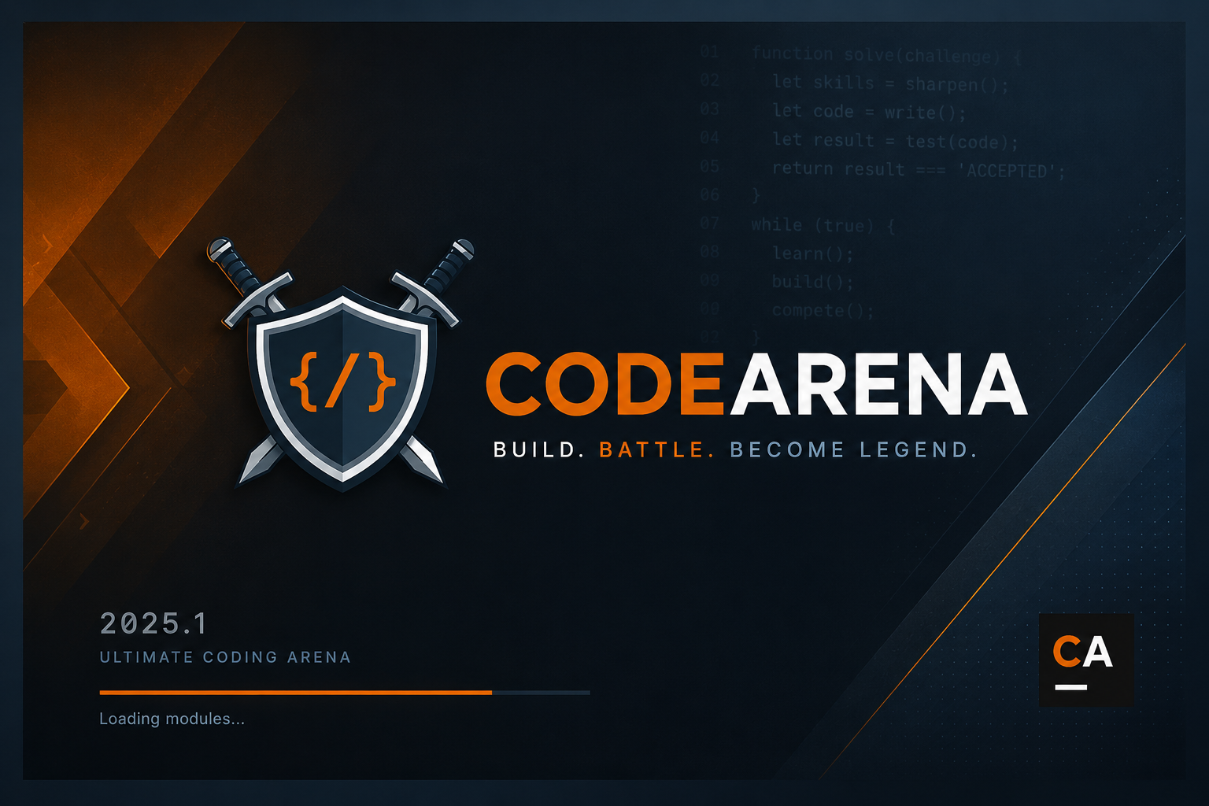
CODEARENA
Software Design & Analysis Project Demo
Local coding arena
with judge, battles, badges, squads and admin tools
Developed by Zeeshan Azeem, Sharjeel Ali Khan and Abdul Kabeer
JavaFX
SQLite
Judge
Tests
Desktop UI
Local data
ProcessBuilder
JUnit
no web layer
schema + seed
Java + Python
service + judge
CodeArena | Software Design and Analysis Demo
01

Slide 2
PROJECT SNAPSHOT
CodeArena is a complete local competitive-coding desktop system.
The project is designed as a practical Software Design and Analysis implementation.
Application type
Local JavaFX desktop application
What makes it demo-worthy
Primary users
Coders, guests and admin
End-to-end flow from login to judged submission
SQLite with schema + seed initialization
Admin tools for users, problems, tests and submissions
Persistence
Gamified profile with charts and badges
Judge
Local ProcessBuilder execution
Multiple battle modes and squad support
Clean package separation and automated tests
Main modules
Problems, submissions, battles, squads, badges, admin
CodeArena | Software Design and Analysis Demo
02

Slide 3
PROBLEM AND OBJECTIVES
The project turns manual coding practice into a structured local arena.
Manual checking is slow; online judges are too broad for a classroom desktop project.
Problem addressed
Design goals
Students need fast feedback on code without external hosting.
Layered architecture: UI, service, DAO, model, judge, util.
Teachers/admins need a way to manage problems and test cases.
Local SQLite persistence with reproducible seed data.
Progress should be visible through XP, badges and leaderboards.
Safe judge execution with timeouts and cleanup.
Competition should be possible locally through battle modes.
Attractive JavaFX UI with dark/light themes.
CodeArena | Software Design and Analysis Demo
03

Slide 4
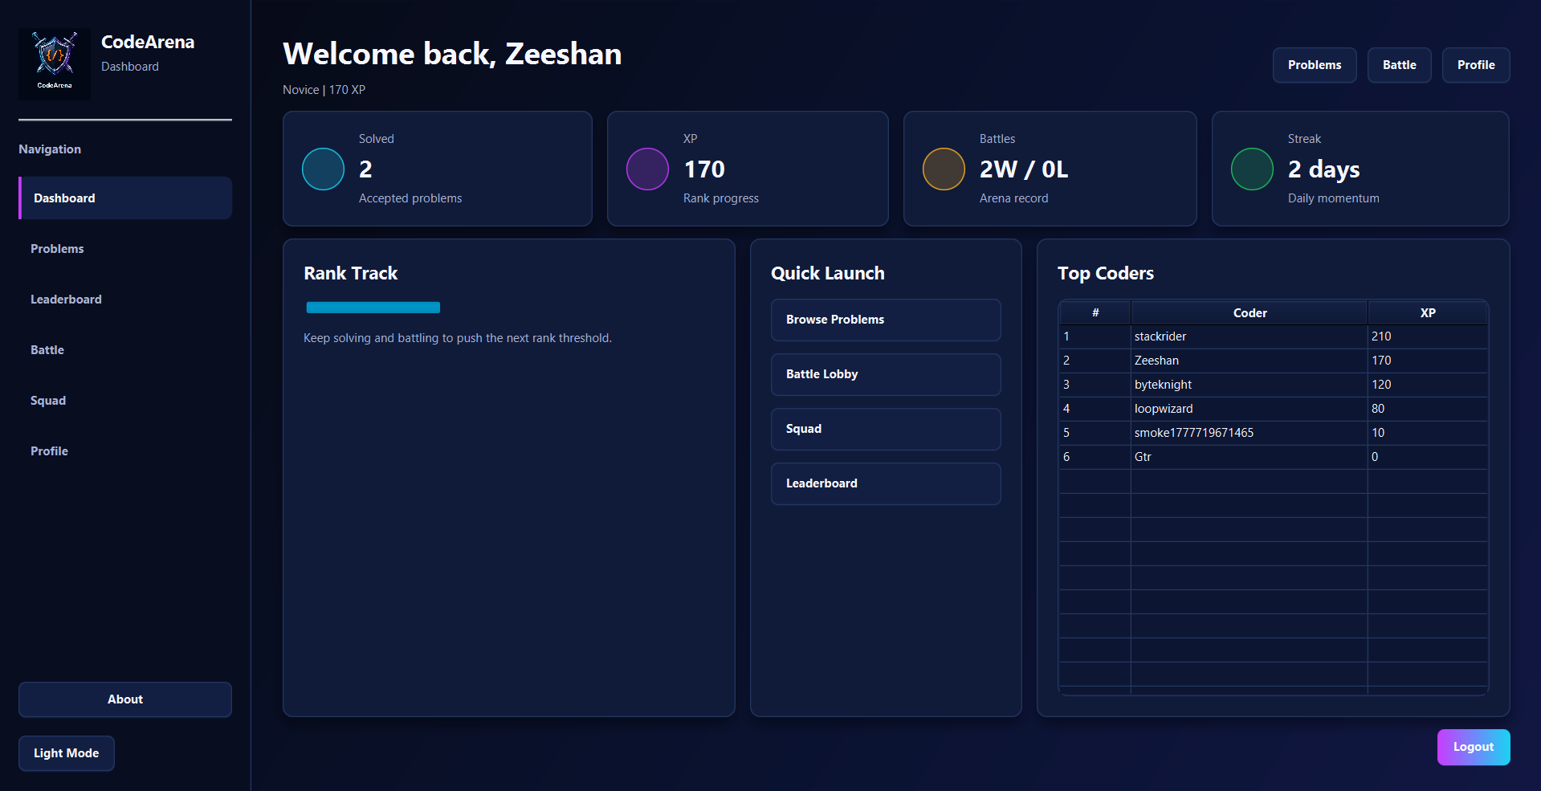
USE CASES
The system covers the full coder, guest and admin workflow.
Main flows map directly to application screens and services.
Primary use cases
Register / login
Browse and solve problems
Run and submit code
Earn XP and badges
Start or join battles
Create or join squads
Admin manage users, problems and submissions
CodeArena | Software Design and Analysis Demo
04

Slide 5
FEATURE MAP
CodeArena combines practice, competition, progress and administration.
The features are grouped around the real demo journey.
Practice
Judge
Progress
Problem list, details, samples, code editor and submissions
Java/Python execution, verdicts, runtime and cleanup
XP, ranks, streaks, profile charts and badges
Competition
Community
Admin
1v1, random 1v1, free-for-all and battle records
Squads, member lists and squad leaderboard
Users, problems, test cases, submissions and analytics
CodeArena | Software Design and Analysis Demo
05

Slide 6
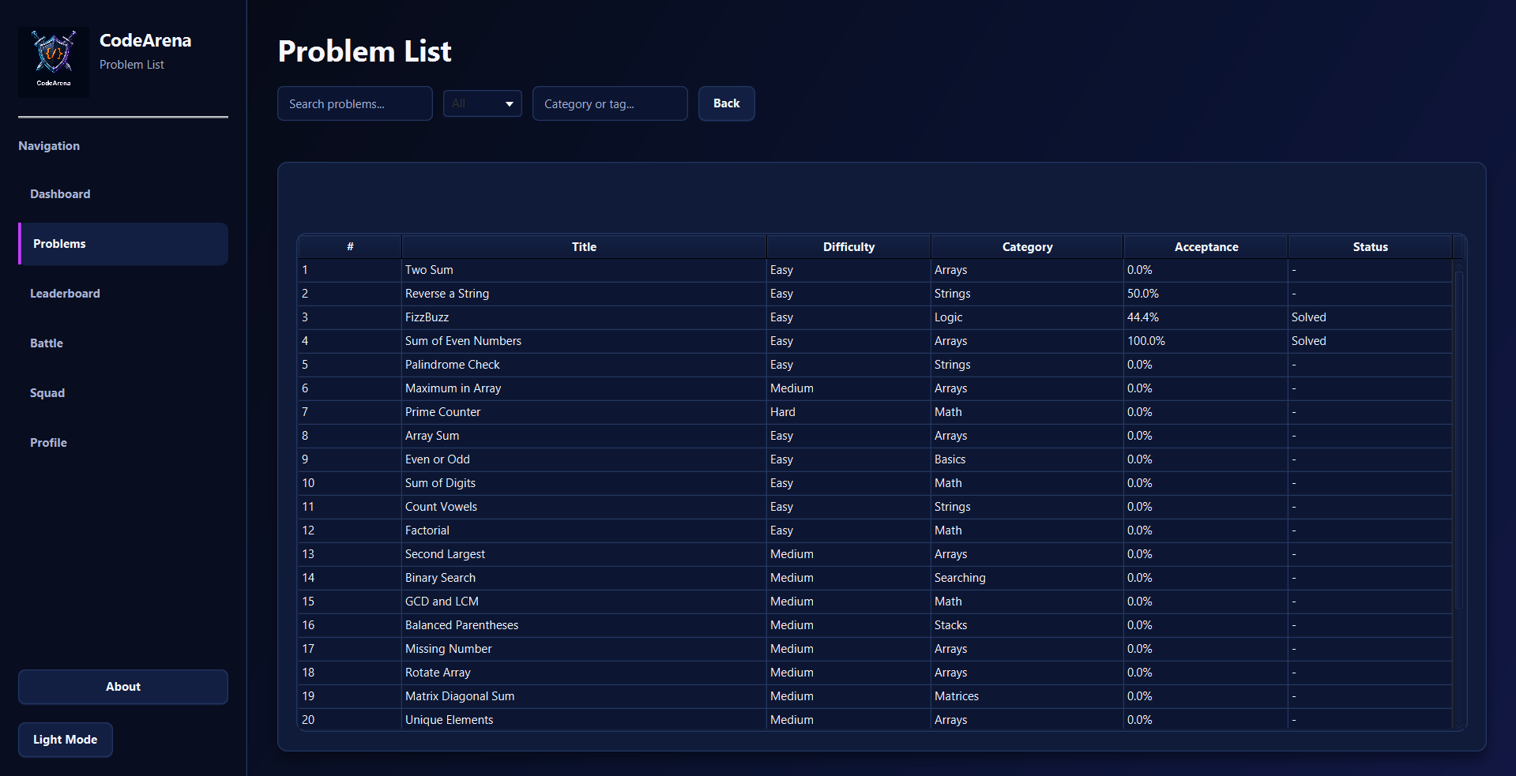
ARCHITECTURE
Layered packages keep UI, business logic, SQL and judging responsibilities separate.
This is the central design argument for the project.
Package responsibilities
ui: JavaFX screens and navigation
service: business rules and workflow coordination
dao: SQL and SQLite access
model: domain entities and enums
judge: local compile/run execution
util: session, persistence, XP and helpers
CodeArena | Software Design and Analysis Demo
06

Slide 7
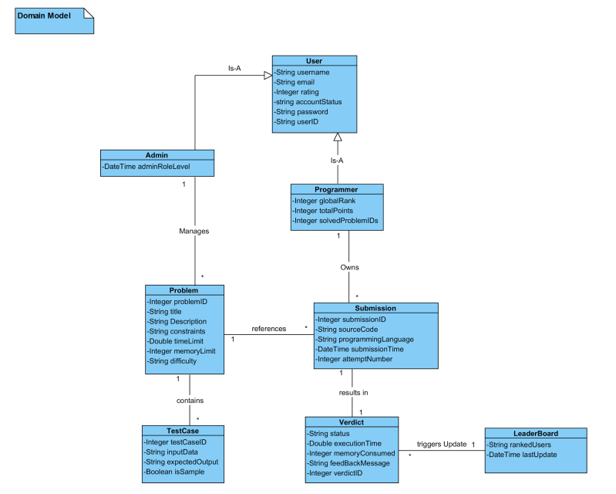
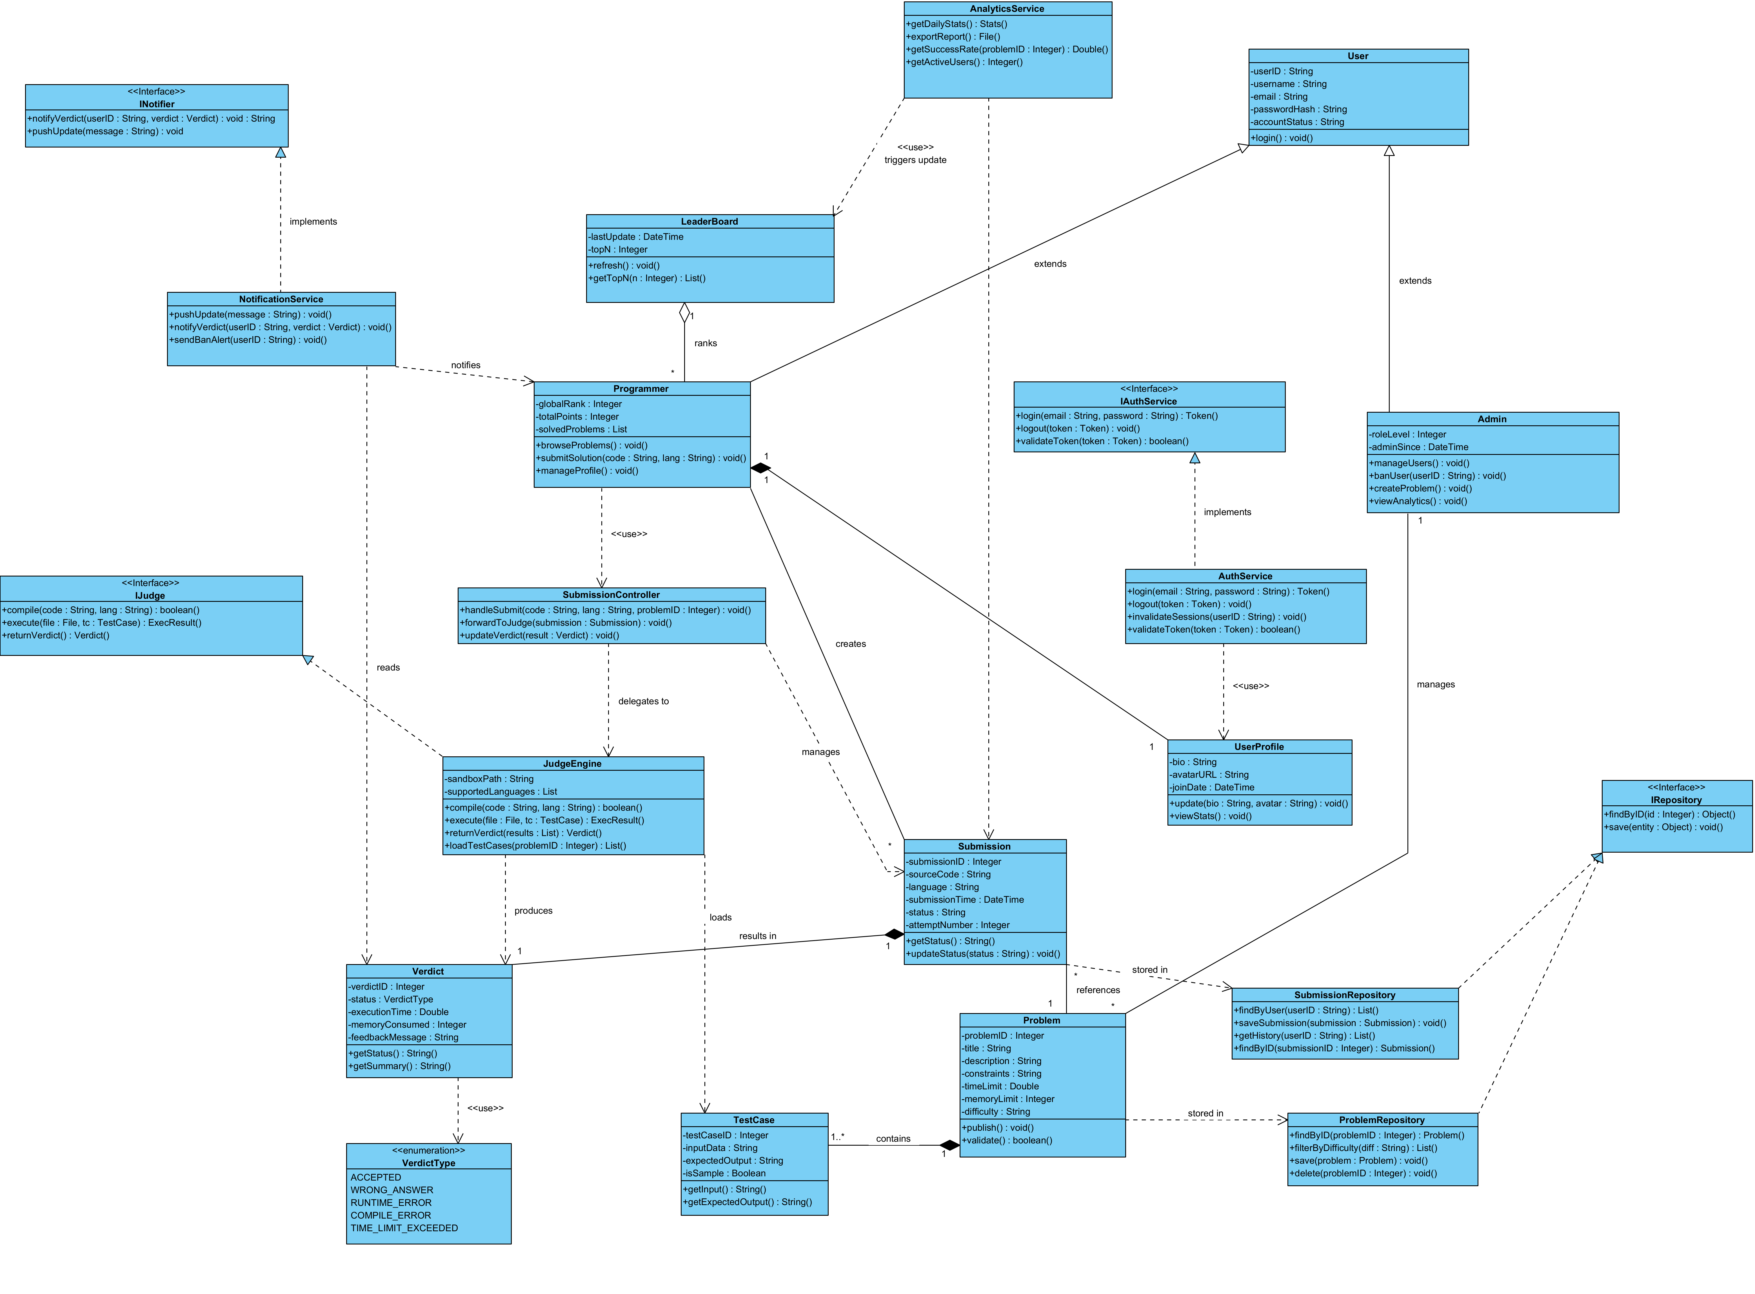
DESIGN MODELS
Domain and class diagrams show the object structure behind the application.
Models are backed by DAOs and coordinated through services.
Missing image
Missing image
Domain model
Class diagram
CodeArena | Software Design and Analysis Demo
07

Slide 8
DATABASE AND LOCAL JUDGE
Persistence and judging are local, reproducible and testable.
The application can recreate schema and seed data on startup.
01
02
03
04
05
Submit
Persist
Execute
Verdict
Progress
User writes Java/Python code in editor
Submission object is stored via DAO
Judge creates temp sandbox and runs tests
AC / WA / CE / RE / TLE result is saved
XP, badges and battle results are updated
SQLite data: users, problems, test cases, submissions, badges, battles, squads | Judge temp files live under OS temp and are cleaned after execution
CodeArena | Software Design and Analysis Demo
08

Slide 9
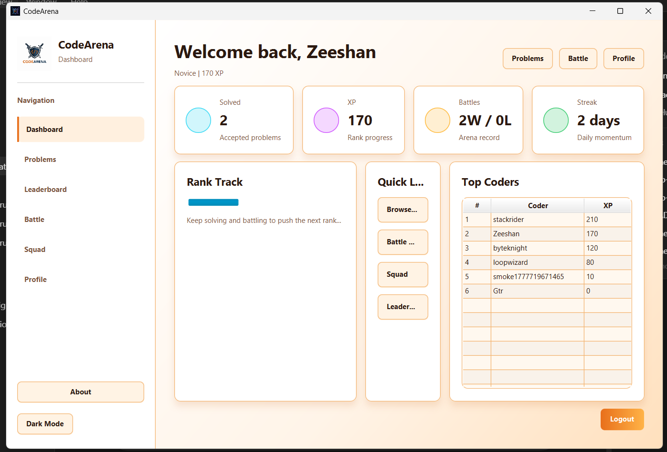
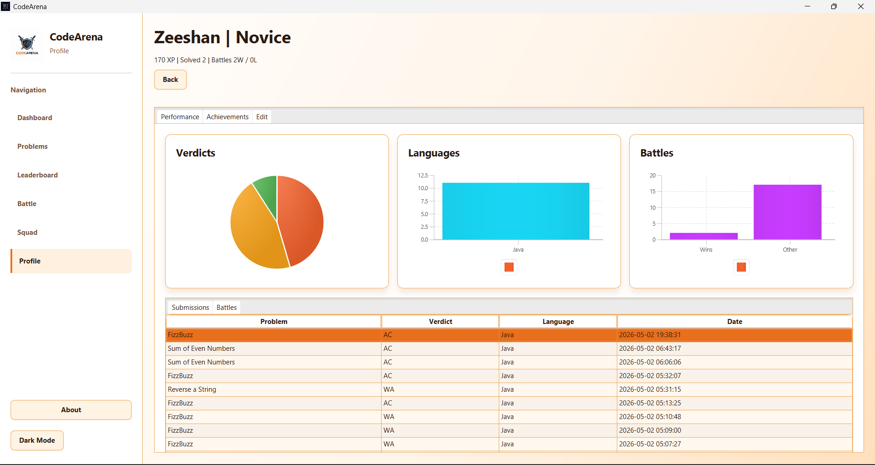
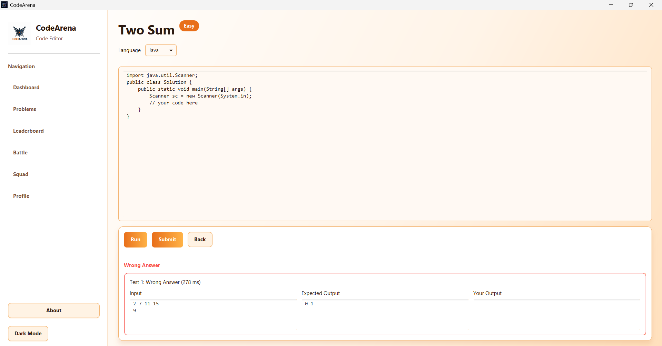
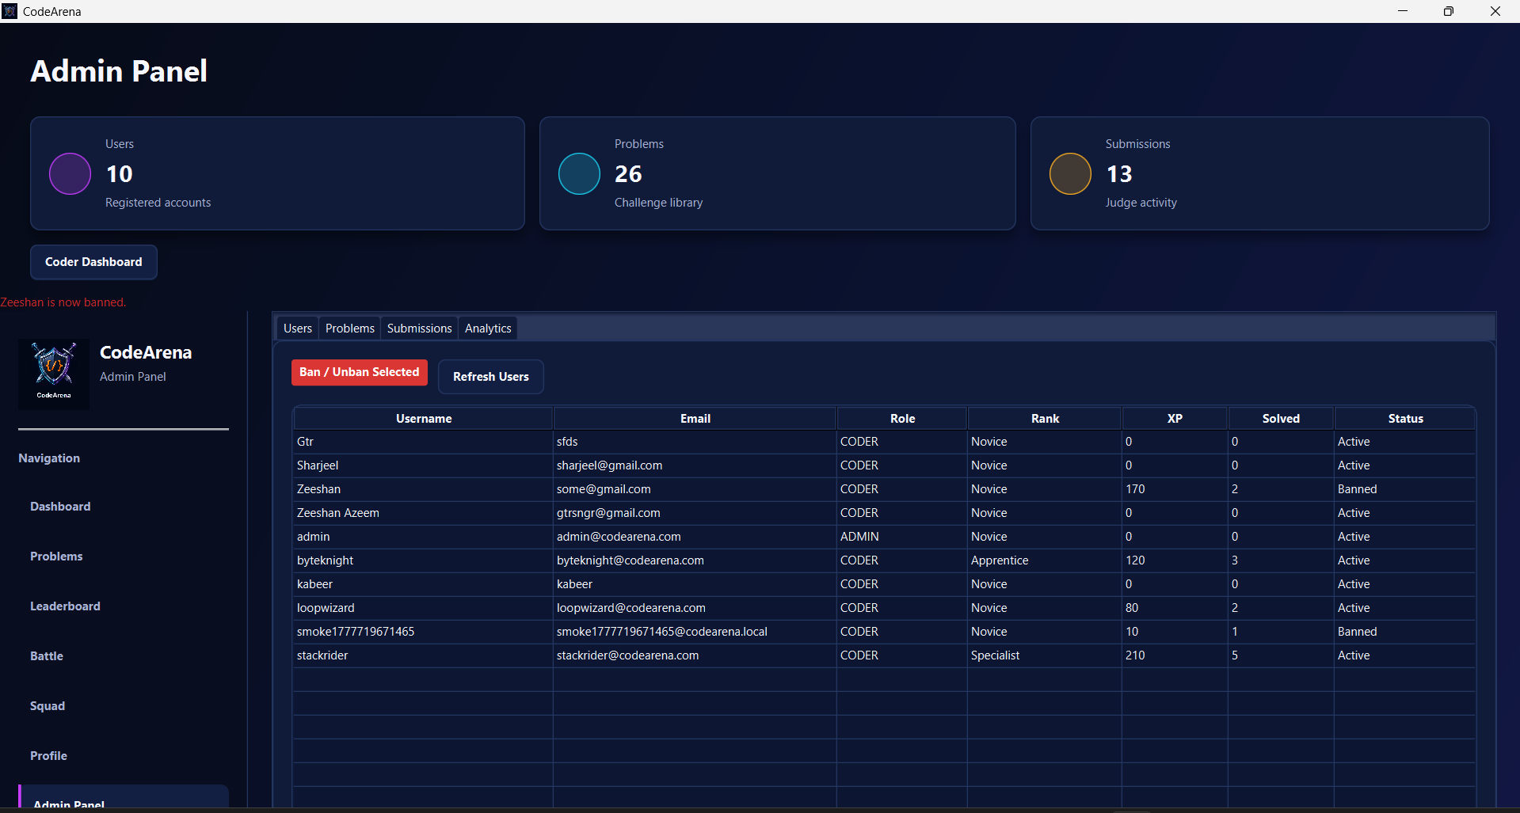
USER INTERFACE SHOWCASE
The demo experience is visual: dashboard, profile analytics, admin tools and code execution.
Screenshots are taken from the current JavaFX application.
Coder dashboard
Profile performance
Code editor and judge output
Admin panel
Splash screen
CodeArena | Software Design and Analysis Demo
09

Slide 10
PROGRESS AND COMPETITION
The application turns solving into a visible progression loop.
Badges, XP, ranks and battles make the system more than a basic judge.
Progress loop
Solve problems to earn XP
Accepted verdicts unlock badges
Battle wins update records
Squad XP creates team competition
Profile charts make progress visible
XP
Badges
Battles
Squads
rank progress
achievements
arena record
team layer
Novice to higher ranks
skill milestones
wins / losses
combined XP
CodeArena | Software Design and Analysis Demo
10

Slide 11
ADMIN PANEL
Admins control the content and moderation layer of the arena.
This is a major use case beyond login/register.
Admin capabilities
View and ban/unban users
Create, edit and delete problems
Manage sample and hidden test cases
Review and delete submissions
View analytics and success rates
Switch back to coder dashboard
CodeArena | Software Design and Analysis Demo
11

Slide 12
TESTING AND VALIDATION
Automated tests protect the critical backend behavior.
The tests use a separate SQLite database and do not touch the demo database.
ServiceIntegrationTest
Auth, filters, admin validation, badges, progress, squads
JudgeEngineIntegrationTest
Java AC/WA/CE/RE/TLE, Python checks, sandbox cleanup
PersistenceInitializationTest
Fresh database schema + seed loading
TestDatabase
Shared reset helper using target/test-data/codearena-test.db
Verification command: mvn -q test | Latest suite passed during final project cleanup
CodeArena | Software Design and Analysis Demo
12

Slide 13
LIVE DEMO FLOW
A clean demo should follow the user journey, then show admin control.
Recommended route: 7 minutes plus questions.
01
Splash screen -> Login
Presentation tip
02
Coder dashboard overview
Do not spend too long on login/register.
03
Browse problem and open detail
Focus on judge, profile progress, battles, admin and tests.
04
Run sample code in editor
Keep the report open only as backup evidence.
05
Submit and inspect verdict
06
Open profile charts and badges
07
Show battle/squad screen
08
Switch to admin panel and manage data
CodeArena | Software Design and Analysis Demo
13

Slide 14
SUBMISSION SUMMARY
CodeArena is ready as a Software Design and Analysis project demo.
The application demonstrates implementation, design artifacts, documentation and testing.
Complete JavaFX desktop app
Layered package architecture
SQLite persistence and seed setup
Local Java/Python judge
Gamified profile and badges
Battles and squads
Admin panel
JUnit tests
Full Word report and diagrams
Thank you
Questions and demo walkthrough
CodeArena | Software Design and Analysis Demo
14

