Slide 1
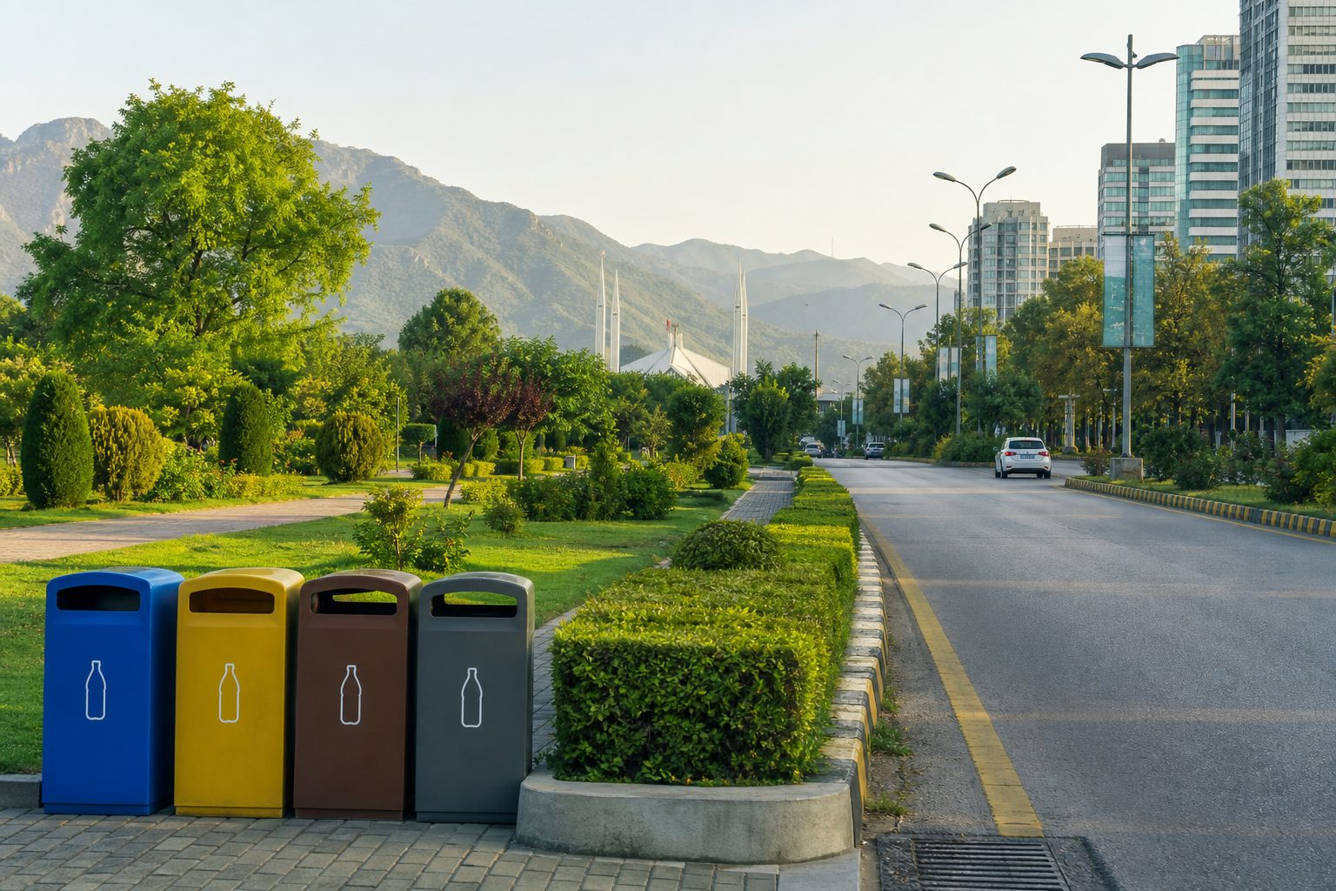
RING GREEN PAKISTAN · 4TH SESSION
German Waste Management System
Mülltrennung & Pfand
Welcome. Learn how Germany sorts waste as a resource — and how Pakistan can adapt it at home, in streets, and in law.
OBJECTIVE 01
OBJECTIVE 02
SPEAKER
Understand every German bin + Pfand loop
Map a 4-phase Pakistan adaptation roadmap
Ring Green Pakistan · Session Facilitators
RING GREEN PAKISTAN · 4TH SESSION
01 / 18

Slide 2
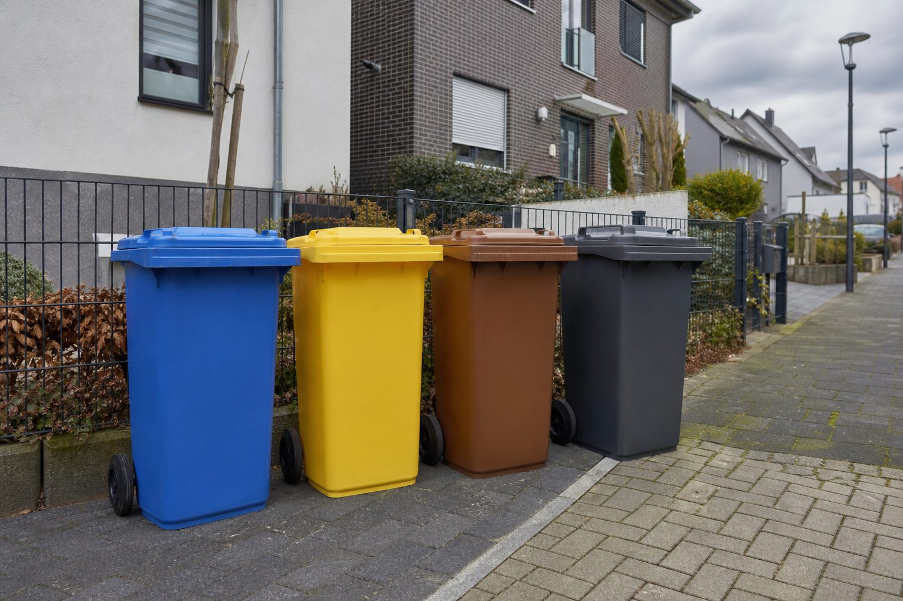
MÜLLTRENNUNG — WHY GERMANY LEADS
Germany treats waste as a resource — not leftover dirt
69%+
98%
Municipal waste recycled. Europe’s leader by household discipline.
Pfand bottle return. Deposit makes returning natural.
THE CORE PHILOSOPHY
• Waste is a raw material sitting in the wrong place.
• Sorting is mandatory at home — the kitchen is the first factory.
• Colour is the UI: Blue / Yellow / Brown / Gray + Glass + Pfand.
• The 4-bin RNO standard keeps streams uncontaminated.
RING GREEN PAKISTAN · 4TH SESSION
02 / 18

Slide 3
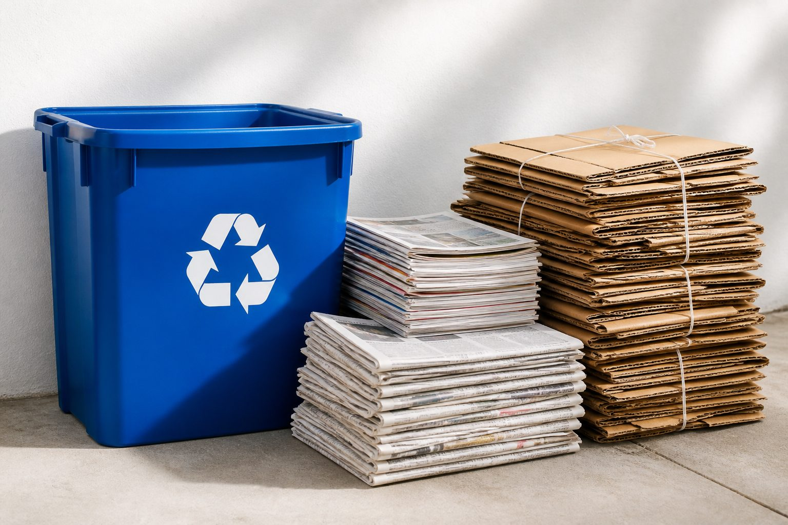
BLUE BIN — PAPER & CARDBOARD
Blue Bin — Paper & Cardboard
Clean fibre only. Grease and food kill the recycling loop.
ALLOWED
FORBIDDEN
• Clean paper & newspapers
• Magazines & catalogues
• Flattened cardboard boxes
• Envelopes (windows OK in most cities)
• Dirty pizza boxes (grease / cheese)
• Used tissues & kitchen paper
• Waxed / coated paper
• Wet or food-stained fibre
Key rule: flatten every cardboard box. Volume, not weight, fills the communal bin.
RING GREEN PAKISTAN · 4TH SESSION
03 / 18

Slide 4
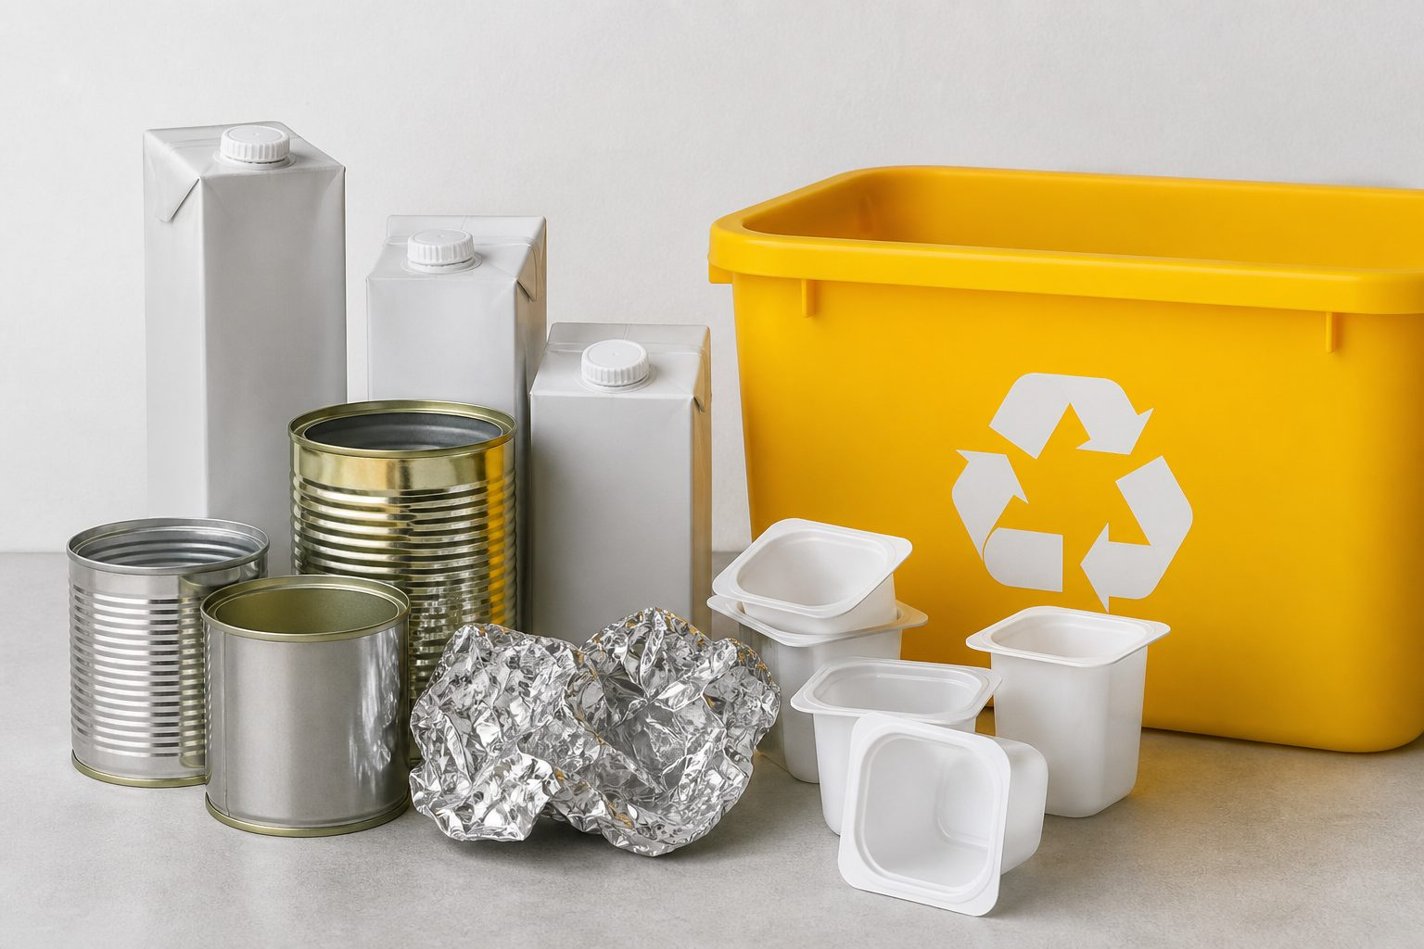
YELLOW BIN / YELLOW BAG — PACKAGING
Yellow Bin / Yellow Bag — Packaging
Plastic, metal, composite. Spoon-clean — do not waste water rinsing.
ALLOWED
FORBIDDEN
• Yogurt cups (plastic packaging)
• Tin cans (metal)
• Aluminium foil if mostly clean
• TetraPak / milk cartons
• Food-filled packs
• Pfand bottles/cans with DPG logo (return to supermarket)
• Dirty diapers or residual waste
• Do not waste litres of water rinsing empty packs
Spoon-clean rule: scrape, don’t rinse litres of water. DPG-logo bottles go to the Pfandautomat, not the yellow bag.
RING GREEN PAKISTAN · 4TH SESSION
04 / 18

Slide 5
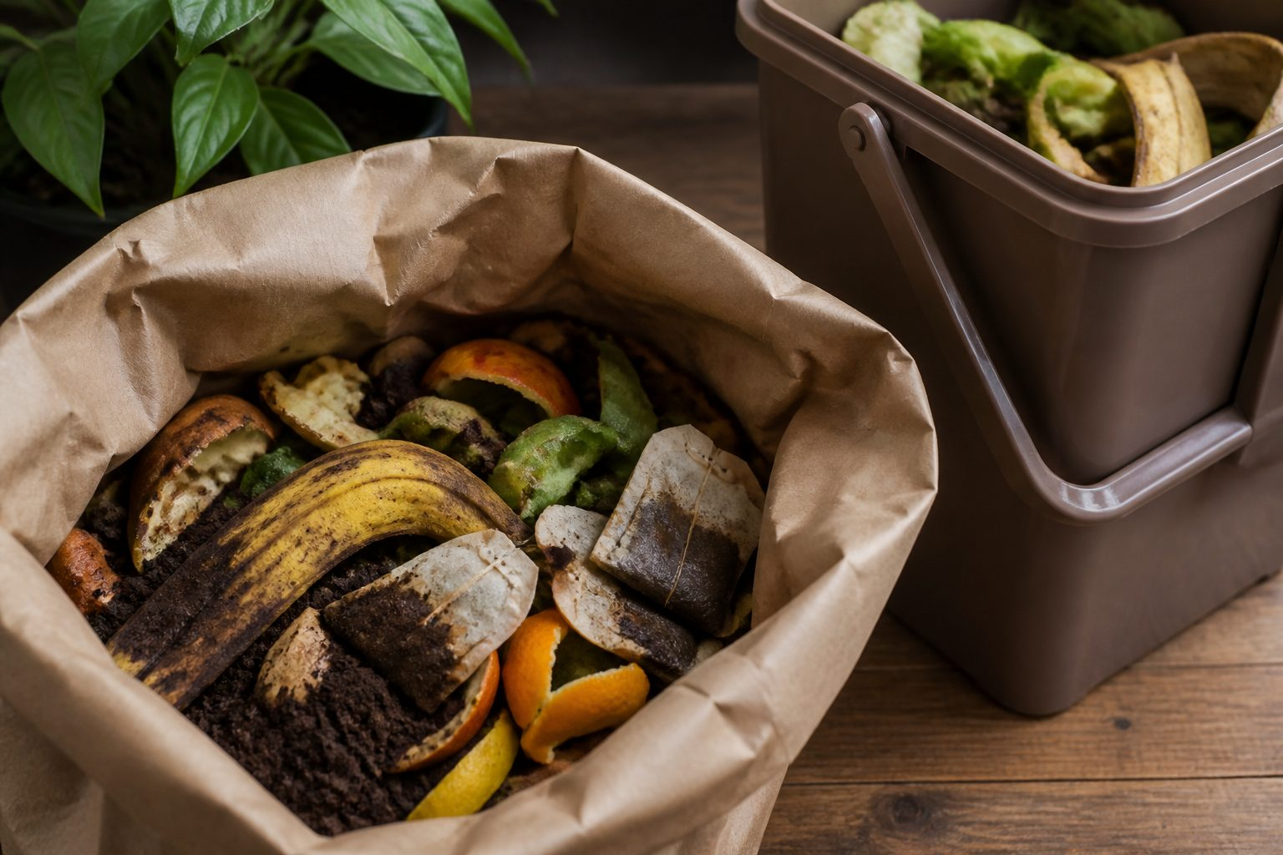
BROWN BIN — ORGANIC / BIOTONNE
Brown Bin — Organic / Biotonne
Kitchen and garden leftovers become compost and biogas.
ALLOWED
FORBIDDEN
• Fruit & vegetable peels
• Food scraps
• Coffee grounds & tea bags
• Garden trimmings
• Plastic bags — even “compostable” bio-plastic
• Use newspaper or paper bags only
• Glass, metal, packaging
• Residual sanitary waste
Environmental value: kitchen → Biotonne → municipal composting + biogas power. Organic waste is fuel and fertiliser.
RING GREEN PAKISTAN · 4TH SESSION
05 / 18

Slide 6
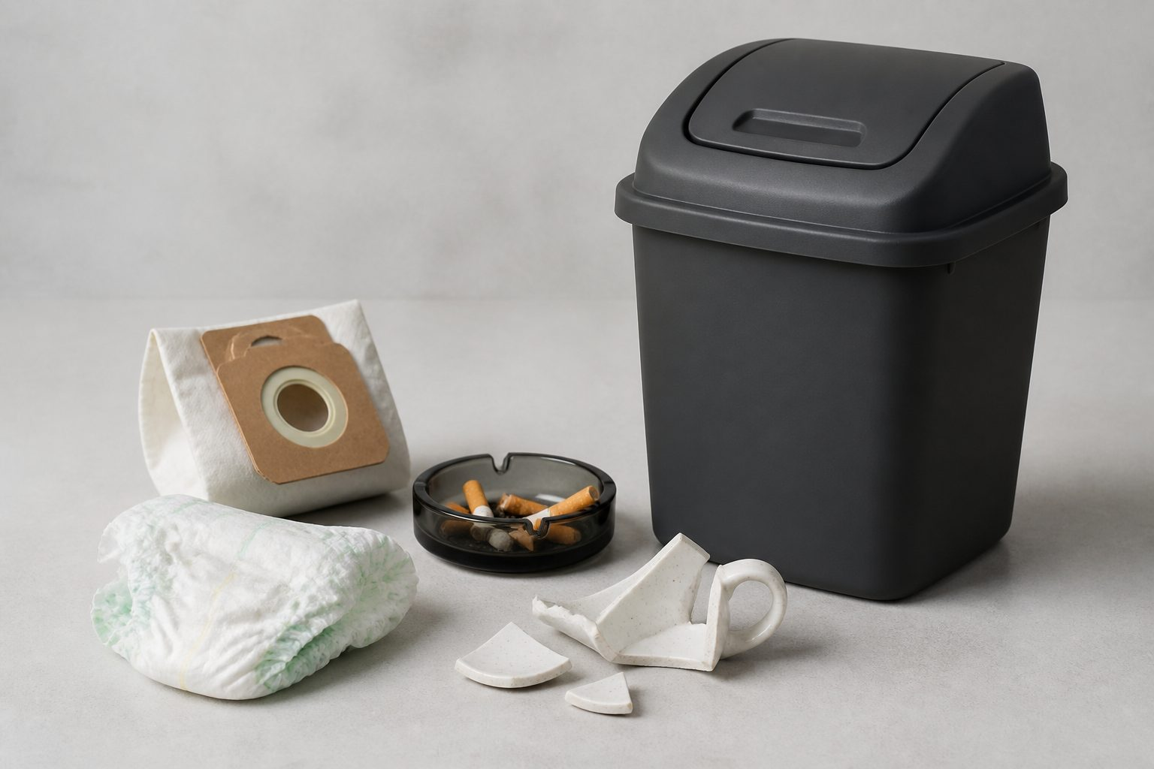
GRAY BIN · RESTMÜLL
Black / Gray Bin — residual waste only
ALLOWED (NON-RECYCLABLES)
FINAL DESTINATION
• Vacuum bags
• Ash & cigarette butts
• Diapers
• Broken ceramics
• Sanitation items
• Dirty mix that cannot be recycled
Incineration → district heating
Restmüll is burned in controlled plants. Heat warms homes. A full gray bin is treated as a sorting failure, not a normal week.
Golden rule: keep this bin as empty as possible by using the other streams first.
RING GREEN PAKISTAN · 4TH SESSION
06 / 18

Slide 7
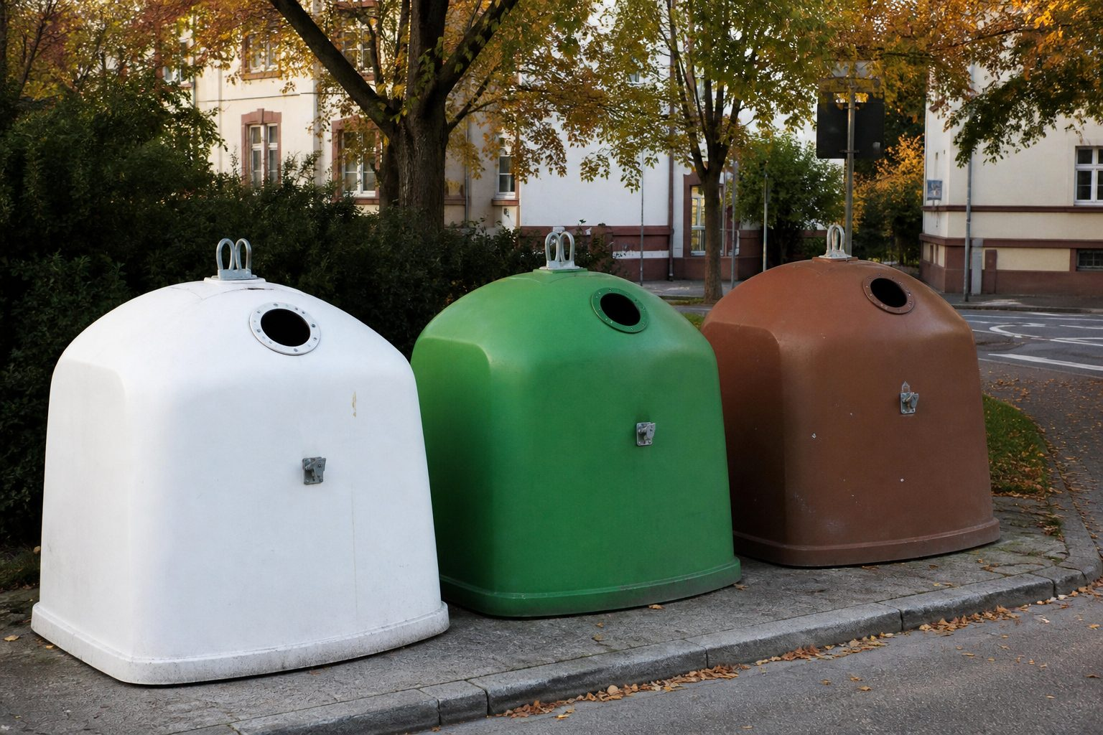
GLASCONTAINER
Street glass igloos — sort by colour, not by brand
White · Weißglas
Green · Grünglas
Brown · Braunglas
Clear bottles and jars. Colour contamination ruins the melt.
Green plus blue and other mixed colours in most cities.
Brown beer and ordinary household brown bottles.
HOUSEHOLD VS SPECIAL GLASS
• Jam jars, sauce bottles, ordinary drink glass → igloo
• Medical / pharma vials → Restmüll or hazardous stream
• Pyrex / heat-resistant cookware → Restmüll (different melting point)
• Quiet hours: weekdays daytime only. No Sundays, no nights.
RING GREEN PAKISTAN · 4TH SESSION
07 / 18

Slide 8
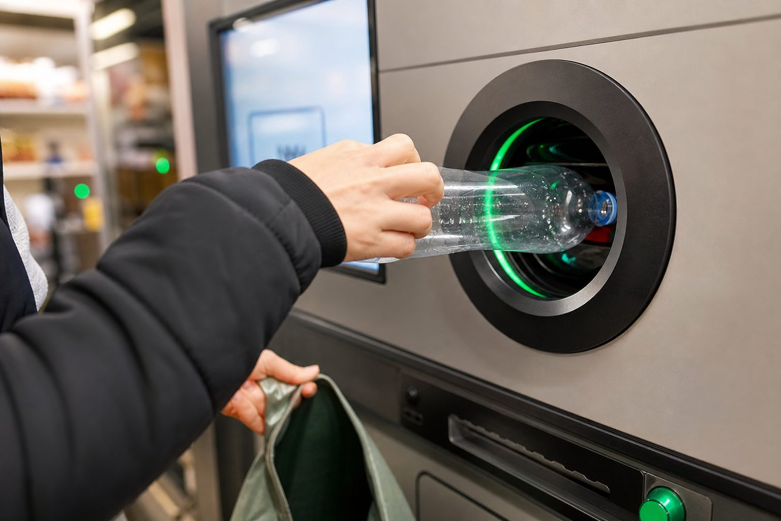
PFAND · DEPOSIT-REFUND
The Pfand loop — 98% of bottles come home
1. Customer pays deposit
2. Uses the drink
3. Pfandautomat at supermarket
4. Cash / voucher back
SINGLE-USE · EINWEG
€0.25
PET bottles & cans with the DPG logo.
MULTI-USE · MEHRWEG
€0.08 – €0.15
Heavy plastic or glass beer/water bottles, reused up to 50 times.
RING GREEN PAKISTAN · 4TH SESSION
08 / 18

Slide 9
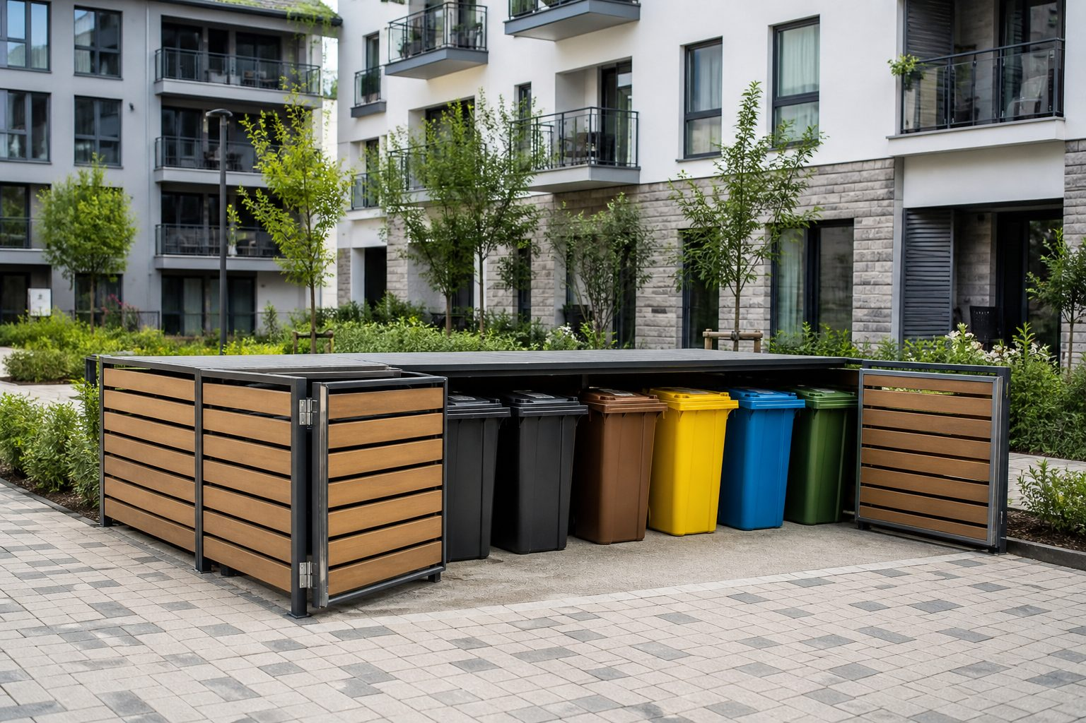
APARTMENT BUILDINGS
One neighbour’s lazy sorting becomes everyone’s bill
HOW IT WORKS
Multi-family houses share a central bin yard. Collection is a building service, not a private hobby.
SHARED RESPONSIBILITY
If 1 tenant mis-sorts, the municipality can charge higher non-sorted fees to the whole building. Landlord spreads cost via Nebenkosten — or warns the renter.
Repeat violations damage the residential record, risk lease termination, or trigger municipal citations.
RING GREEN PAKISTAN · 4TH SESSION
09 / 18

Slide 10
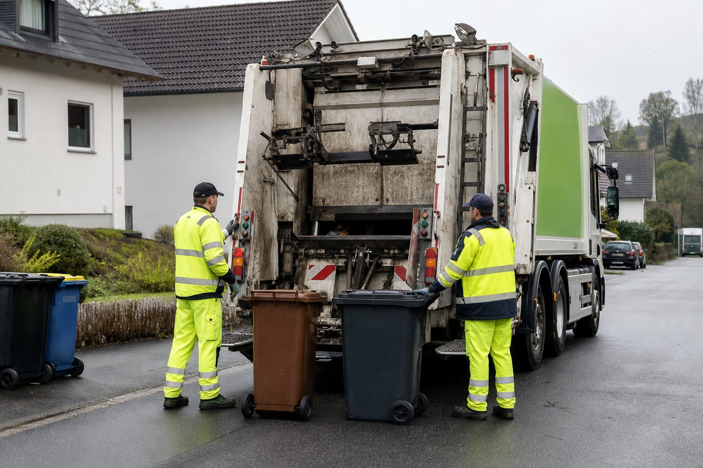
MONITORING · LAWS · FINES
The state watches the bin — and will leave it standing
GOVERNMENT MECHANISM
• Waste inspectors — Mülldetektive
• Abfallkalender pickup calendar by street
• Separate trucks per stream
COLLECTION RULES
Wrong materials → warning sticker and no collection until re-sorted.
Illegal dumping (Sperrmüll / Wildmüll): fines €50 up to €2,500+ by federal state.
RING GREEN PAKISTAN · 4TH SESSION
10 / 18

Slide 11
WASTE JOURNEY
Five steps from kitchen to circular re-entry
1
2
3
4
5
Source separation
Bin placement
Specialized pickup
Sorting & Pfand
Circular re-entry
Kitchen caddies: paper, packaging, organic, residual.
Curbside on the Abfallkalender day only.
Dedicated trucks per stream. No mixed lorry.
Optical plants + reverse vending machines.
Compost, pellets, glass remelt, bottle refill.
If step 1 fails, steps 3–5 become expensive theatre. Pakistan’s work begins in the kitchen.
RING GREEN PAKISTAN · 4TH SESSION
11 / 18

Slide 12
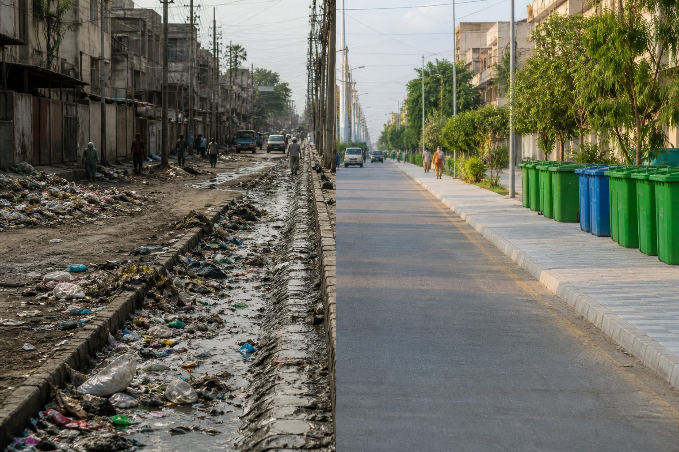
PAKISTAN · CURRENT REALITY
We already collect — mixed, late, and often burning
Mixed dumping
Open burning
Everything in one bag. Plastic/glass value dies on contact with wet waste.
Neighbourhood piles become toxic smoke — a hospital invoice.
Landfills & nullahs
Informal risk
Unorganized dumps and drain blockages. Monsoon turns trash into floods.
Kabbadiwalas work without PPE in contaminated heaps.
RING GREEN PAKISTAN · 4TH SESSION
12 / 18

Slide 13
HOW PAKISTAN ACHIEVES THIS
Four phases — do not copy Germany’s 4 bins on day one
01 Two-bin home
02 Community hubs
03 Formalize kabbadi
04 Local Pfand
Green = organic/wet. Blue = dry recyclables. Master two streams before four.
Neighbourhood collection points (Lyari/Karachi-style pilots) with scheduled pickup.
Scrap dealers into official centres: ID, fair rates, PPE, clean buy-back.
Small cash refund for PET at kiryana stores. Rs 5–10 trains the same muscle as €0.25.
RING GREEN PAKISTAN · 4TH SESSION
13 / 18

Slide 14
BENEFITS IF WE APPLY THIS
What Pakistan gains when sorting becomes normal
ENVIRONMENTAL
ECONOMIC
• Cleaner streets and parks
• Unclogged drains → less monsoon flooding
• Less open burning → cleaner air
• Jobs in formal sorting units
• Compost revenue for agriculture
• Recyclate sales instead of imports
HEALTH
ENERGY
• Fewer dengue / malaria vectors
• Less toxic fume exposure
• Safer work for waste pickers with PPE
• Biogas from organic biomass
• Lower landfill methane
• Waste-to-energy potential
RING GREEN PAKISTAN · 4TH SESSION
14 / 18

Slide 15
IF WE DO NOT APPLY THIS
The punishment of not sorting is already here
Monsoon flooding
Soil & groundwater
Polythene jams drains. Cities drown on modest rain because gutters are landfills.
Open dumps leach into wells and fields. Slow, then permanent.
Health budget
Land value & tourism
Dengue wards, asthma, diarrhoea — the poor pay first.
Burning heaps destroy neighbourhood prices and visitor appeal.
Germany’s ticket is €50–€2,500. Pakistan’s ticket is flooded homes, dengue, and a generation that thinks filth is normal.
RING GREEN PAKISTAN · 4TH SESSION
15 / 18

Slide 16
PAKISTAN POLICY · FINES & REWARDS
Enforcement on one side, incentives on the other
PENALTIES IF THE RULE IS APPLIED
INCENTIVES IF A COMMUNITY APPLIES
• Fines on commercial markets that sweep mixed waste into streets or nullahs.
• Household citations for dumping in public plots / drains.
• Repeat building/lane fees when a street keeps mixing streams.
• Refuse to collect unsorted commercial bins until separated (sticker method).
• Utility-bill discounts or local rebates for high-recycling neighbourhoods.
• Official buy-back rates at formal kabbadi centres — cash for clean PET.
• School sorting drills in Ring Green clubs and board curriculum.
• Volunteer hours counted as civic credit for youth programmes.
RING GREEN PAKISTAN · 4TH SESSION
16 / 18

Slide 17
ACTION CHECKLIST · MEMBERS
Start this week — not after a by-law
01 Sort at home today
02 Protect the drain
Two bags: organic scraps vs dry plastics/paper/metal. Teach the cook and the youngest sibling.
No wrapper in the gali nala. A blocked drain is a shared flood.
03 Ask for bins
04 Show up
Advocate UC / municipal colour bins at the chowk and the school gate.
Cleanup drives. One kabbadi contact as the lane’s buy-back point.
RING GREEN PAKISTAN · 4TH SESSION
17 / 18

Slide 18
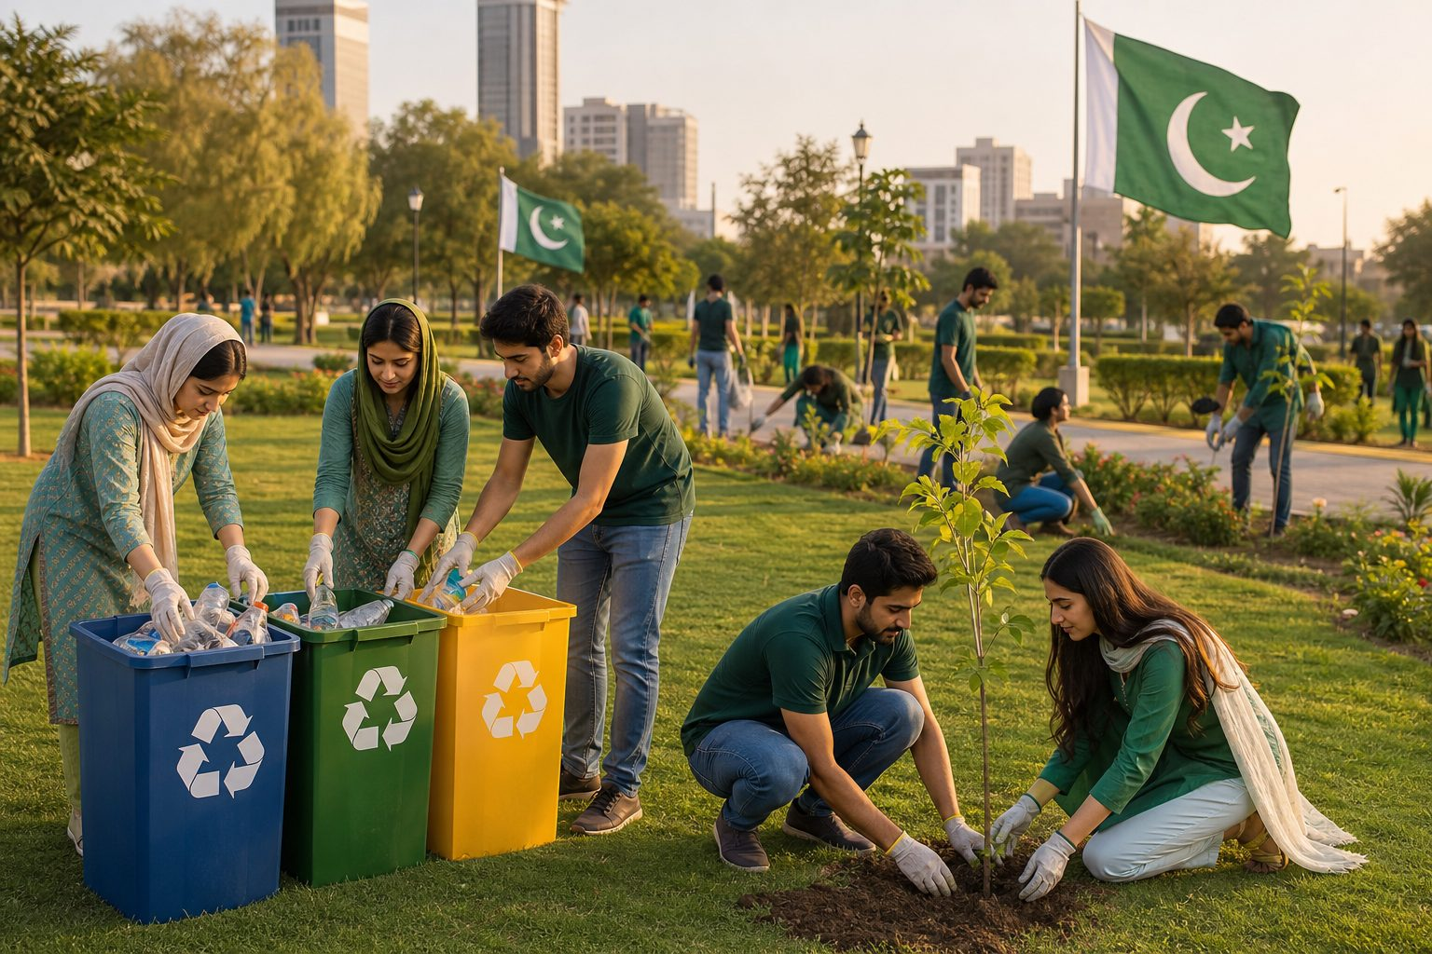
RING GREEN PAKISTAN
Building a sustainable future
Small daily actions lead to country-wide transformation. Let’s make Pakistan clean and green.
Q&A
CONNECT
THANK YOU
Bins, Pfand, and your gali pilot
@RingGreenPakistan
4th Session · Mülltrennung & Pfand
RING GREEN PAKISTAN · 4TH SESSION
18 / 18

