Slide 2

Goodreads Spoiler Detection
Project by,
DATAJAM
Zeeshan Ahmed Pachodiwale
Neha Parakh
Jasmine Akkal

Slide 3
Goodreads Spoiler Detection
Project by,
DATAJAM
Zeeshan Ahmed Pachodiwale
Neha Parakh
Jasmine Akkal

Slide 4
Project Overview and Goals
The Project aims at identifying and presenting various approaches for detecting critical plot twists (spoilers) in reviews of entertainment products like movies and books.
The goodreads dataset is used for analysis.
Project aims to deliver a model that can detect spoilers in reviews and notify users
Demo application for demonstrating the use case for the model. The application has an input interface for providing reviews and an output interface for identifying spoilers.

Slide 5
Dataset - Goodreads
Project Overview and Goals
The data used is the good reads review dataset
The Project aims at identifying and presenting various approaches for detecting critical plot twists (spoilers) in reviews of entertainment products like movies and books.
The dataset is an extract of concentrated reviews in English
The goodreads dataset is used for analysis.
It has fine grained spoiler annotations at sentence level along with book and user info.
Project aims to deliver a model that can detect spoilers in reviews and notify users
The dataset has over 1.3M English book reviews across 25K books and 19K users where each book/user has at least one associated spoiler review.
Demo application for demonstrating the use case for the model. The application has an input interface for providing reviews and an output interface for identifying spoilers.

Slide 6
Dataset - Goodreads
The data used is the good reads review dataset
It contains 1.3 Million reviews with 1
It has fine grained spoiler annotations at sentence level along with book and user info.
The dataset has over 1.3M English book reviews across 25K books and 19K users where each book/user has at least one associated spoiler review.

Slide 7
Project Architecture
Goodreads Dataset
Evaluation
Data Preprocessing
Training Data
Model Building and
spoiler detection
Test Data
Model Selection

Slide 8
Data Analysis
The dataset contains 1.3M reviews
The reviews have been further split into sentences with classification of each sentence as either a spoiler or non-spoiler.
It contains around 90k sentences that contain spoilers and 1.4M sentences that do not. The dataset is pretty imbalanced.
The dataset also contains the following features,
Review ratings
User ID
Book ID
Review ID
Timestamp

Slide 9
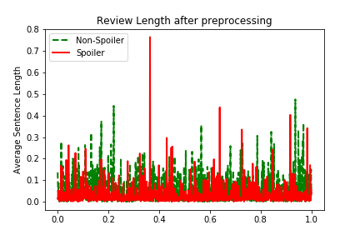
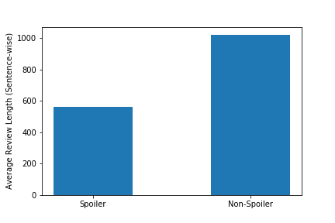
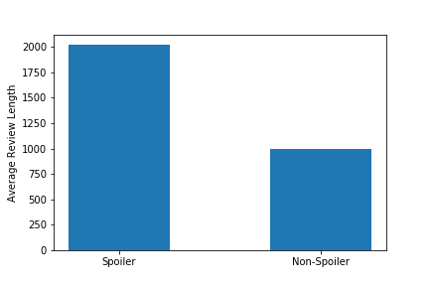
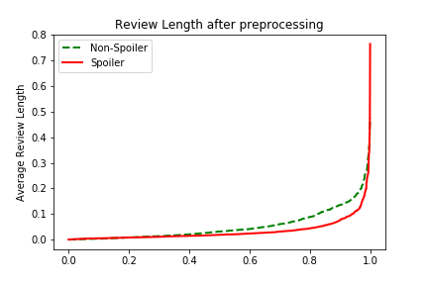
Data Analysis
- Review Length
The dataset contains 1.3M reviews
The reviews have been further split into sentences with classification of each sentence as either a spoiler or non-spoiler.
It contains around 90k sentences that contain spoilers and 1.4M sentences that do not. The dataset is pretty imbalanced.
The dataset also contains the following features,
Review ratings
User ID
Book ID
Review ID
Timestamp
Average Sentence Length
Average Length of reviews

Slide 10

Item Specificity
A term specific to a book such as mystical location or characters can be important in revealing the plot details.
We formulate methods to effectively identify the specificity of each word
Popularity: defines how popular a term is for a given book. Can be calculated using,
TF_{w,i} = $\frac{|Cw i|}{|Ci|}$
Uniqueness: defines a measure to show how often this word is seen in the entire dataset. Can be calculated as
IDF_{w} = log($\frac{\left|I\right|+ ∈}{\left|Iw\right|+ ∈}$)

Slide 11
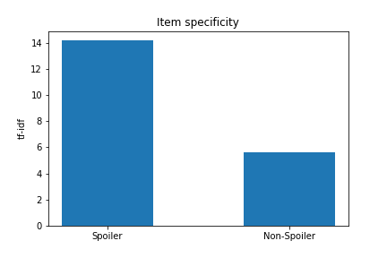
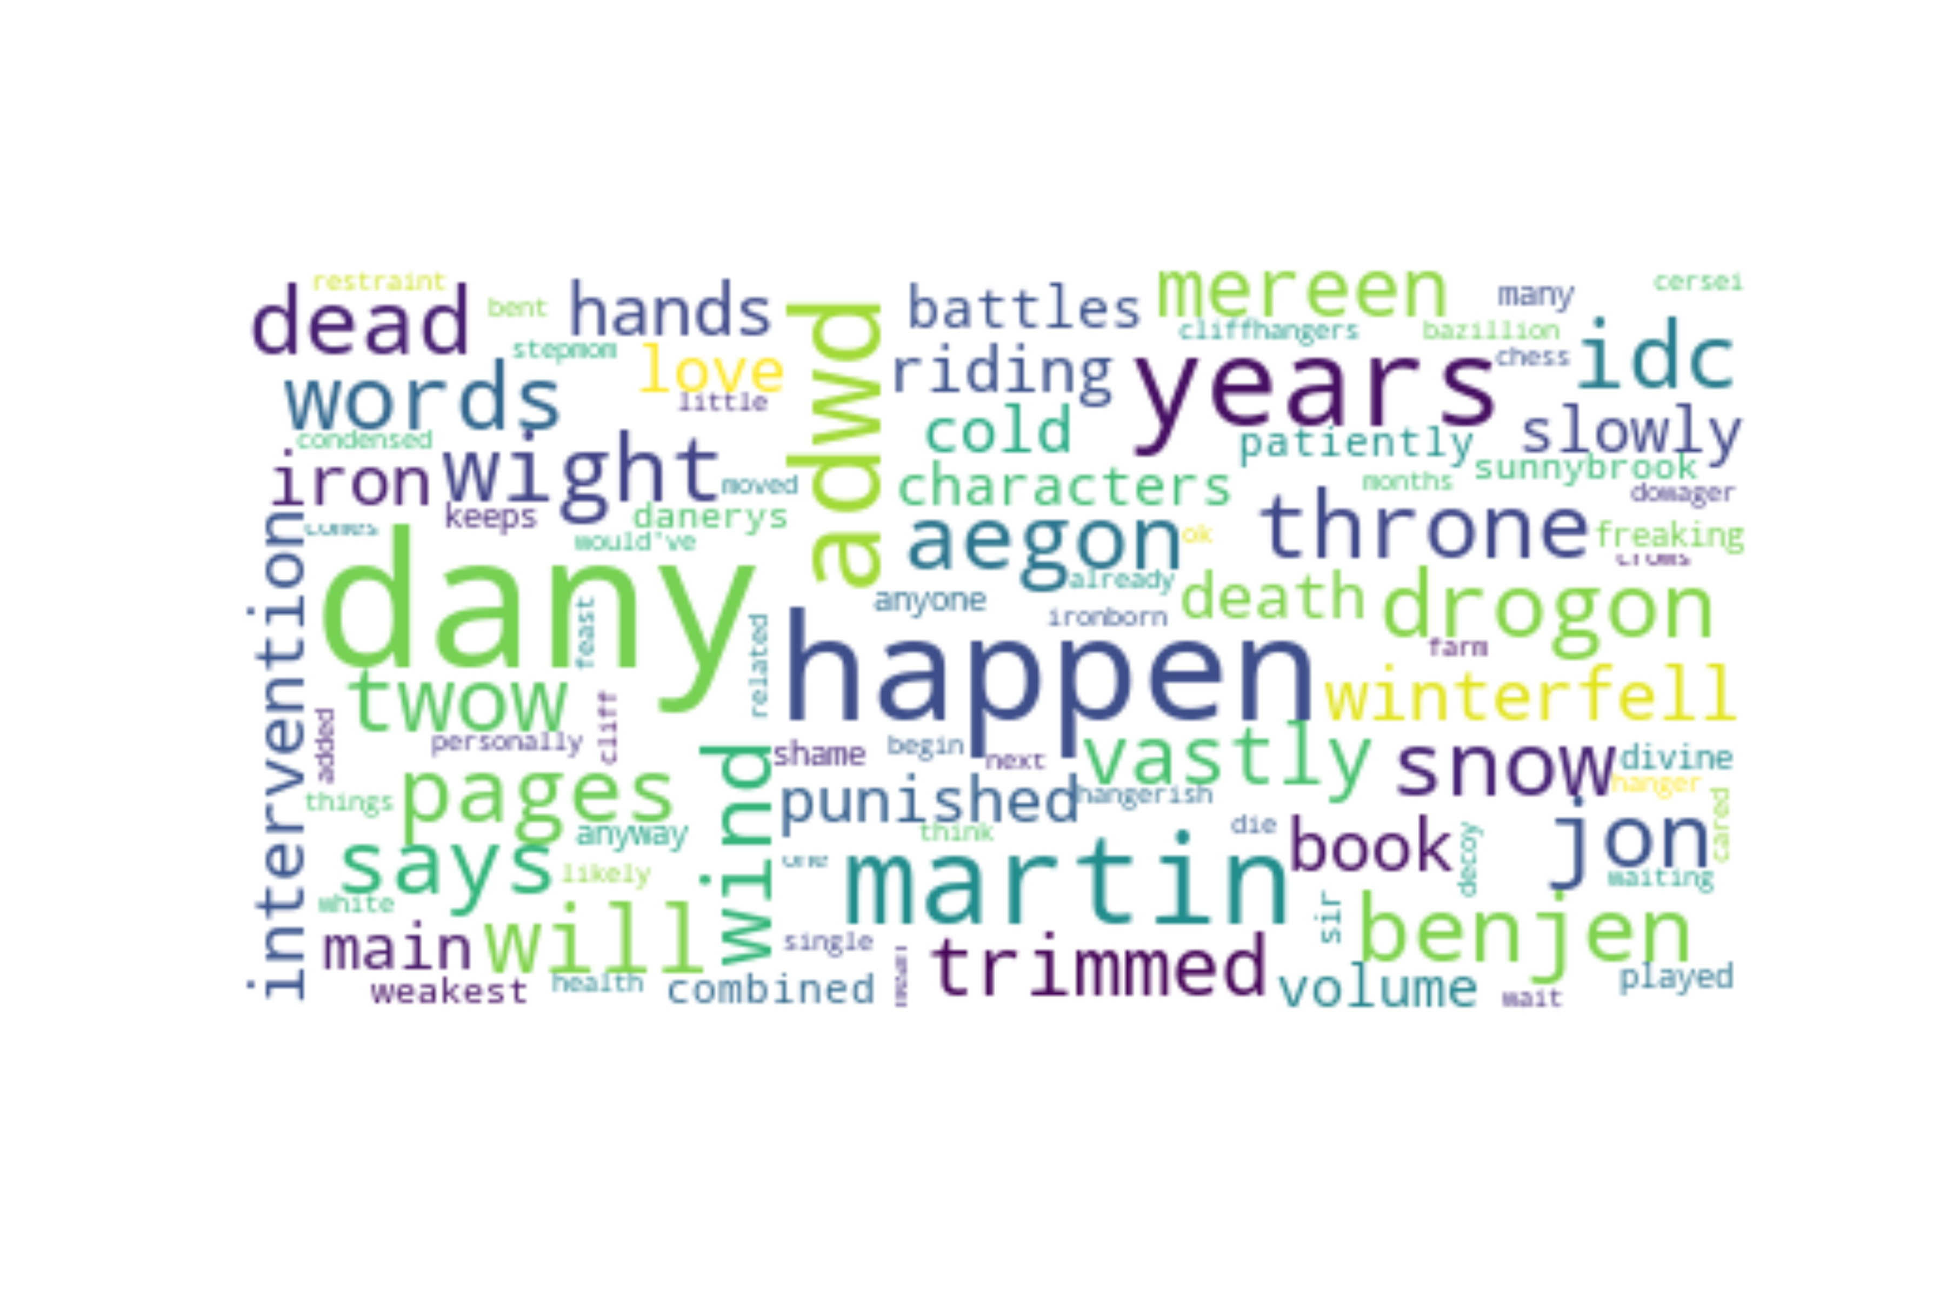
Item Specificity
A term specific to a book such as mystical location or characters can be important in revealing the plot details.
We formulate methods to effectively identify the specificity of each word
Popularity: defines how popular a term is for a given book. Can be calculated using,
TF_{w,i} = $\frac{|Cw i|}{|Ci|}$
Uniqueness: defines a measure to show how often this word is seen in the entire dataset. Can be calculated as
IDF_{w} = log($\frac{\left|I\right|+ ∈}{\left|Iw\right|+ ∈}$)

Slide 12
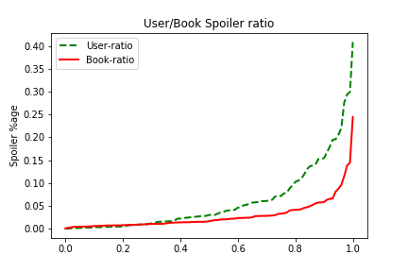
Other Measures

Slide 13
Project Architecture
Goodreads Dataset
Evaluation
Data Preprocessing
Training Data
Model Building and
spoiler detection
Test Data
Model Selection

Slide 14
Data Preprocessing
Since the dataset is massive, we chose pyspark for handling the data.
In order to train the model, each of the documents from the dataset had to be converted into some form of number.
We used two main approaches in converting these documents into vectors,
Bag of words Model
Skip-gram model
These vectors can then be used as input to the model for classification purposes.

Slide 15
Bag of words
In this model, text (for eg. a sentence ) is represented as a bag of its words.
Each word is identified as a unique term and each document is represented by a series of values representing whether a term is present in the document or not.
Grammar, or even the word order is disregarded.
This is one of the most commonly used methods for text classification.

Slide 16
Bag of words
In this model, text (for eg. a sentence ) is represented as a bag of its words.
Each word is identified as a unique term and each document is represented by a series of values representing whether a term is present in the document or not.
Grammar, or even the word order is disregarded.
This is one of the most commonly used methods for text classification.
bag
1
0
0
….
of
0
1
0
….
words
0
0
1
….
bag words
1
0
1
….

Slide 17
Word2Vec
In this model, text is represented as a vector of predefined length.
Each word is represented using the vector where each of the dimensions have a specific value.
Word vectors are positioned in such a way that words that share common contexts in the corpus are located close to each other.
The technique is utilized to find word embeddings.
This is most commonly used methods of text classification that involve Deep learning techniques.

Slide 18
Word2Vec
In this model, text is represented as a vector of predefined length.
Each word is represented using the vector where each of the dimensions have a specific value.
Word vectors are positioned in such a way that words that share common contexts in the corpus are located close to each other.
The technique is utilized to find word embeddings.
This is most commonly used methods of text classification that involve Deep learning techniques.
dog
0.5
0.05
0.12
….
cat
0.46
0.24
0.009
….
truck
0.002
0.69
0.005
….
pets
0.75
0.001
0.003
….

Slide 19
Other techniques
The dataset was cleaned using the following techniques,
Stop word removal
Stemming
Lemmatization
Removing Punctuations
Techniques like the n-gram model were also tried. Due to large amounts of data, this technique did not prove to be very effective.

Slide 20
Project Architecture
Goodreads Dataset
Evaluation
Data Preprocessing
Training Data
Model Building and
spoiler detection
Test Data
Model Selection

Slide 21
Model Selection
The output of the model is a going to be binary indicating whether a given sentence is a spoiler or not.
In order to achieve this, we choose the following two approaches:
Classification: The model here would classify the given input into 0 and 1
0 indicating non-spoiler and 1 indicating a spoiler
Clustering: This is unsupervised learning, where the model tries to cluster the given corpus into two different clusters. The information obtained from these clusters is then used with supervised learning techniques to get the classified output.

Slide 22
Algorithms Selected
Random Forest Classifier
Naïve Bayes Classifier
Logistic Regression
LDA (Latent Dirichlet Allocation)
These model were trained on data processed from both the data processing techniques mentioned earlier.

Slide 23
Project Architecture
Goodreads Dataset
Evaluation
Data Preprocessing
Training Data
Model Building and
spoiler detection
Test Data
Model Selection

Slide 24
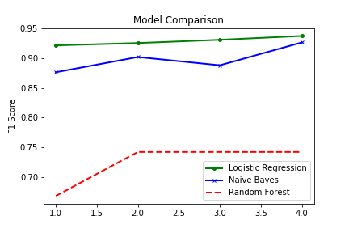
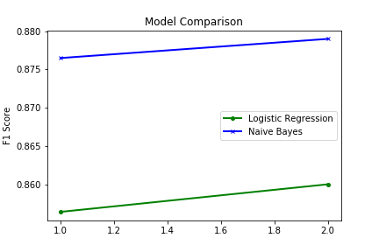
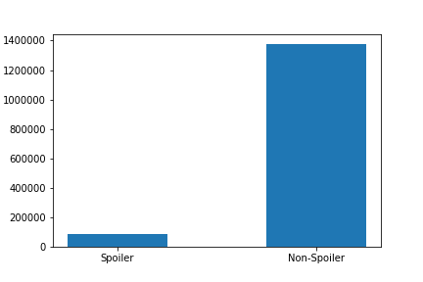
Model Evaluation
Results
Since the data was highly imbalanced, we used the F1 metric for evaluating the model.
Trained on data processed
using bag of words model
Trained on data processed
using word2vec

Slide 25
Demo Time

