Slide 1
Rashedul Islam
(Guest lecture, stat545)
PhD Candidate in Bioinformatics, UBC (2014-present)
PhD thesis: Epigenetic dysregulation of human lymphoid leukemias
Bioinformatician, Jute Genome Project, Bangladesh (2012-13)
BSc in Genetic Engineering & Biotechnology, Bangladesh (2006-11)
4th October, 2018

Slide 2
Data analytics
Question
1
Answer
2
Data
Insight
- data analysis: taking action and finding answers
- opinions Vs. data -> data wins

Slide 3
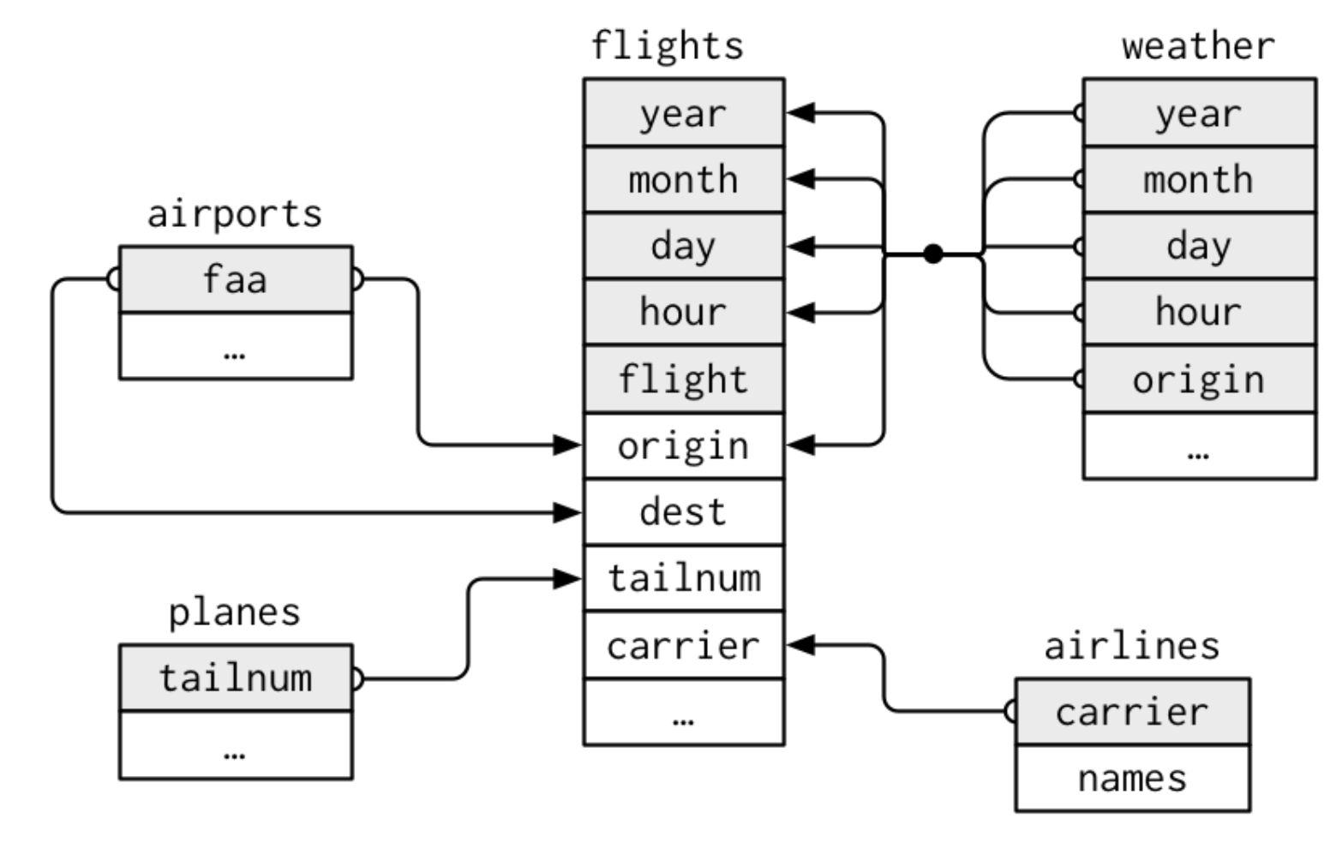
Relational data (e.g., `nycflights13`)
Source: R for Data Science

Slide 4
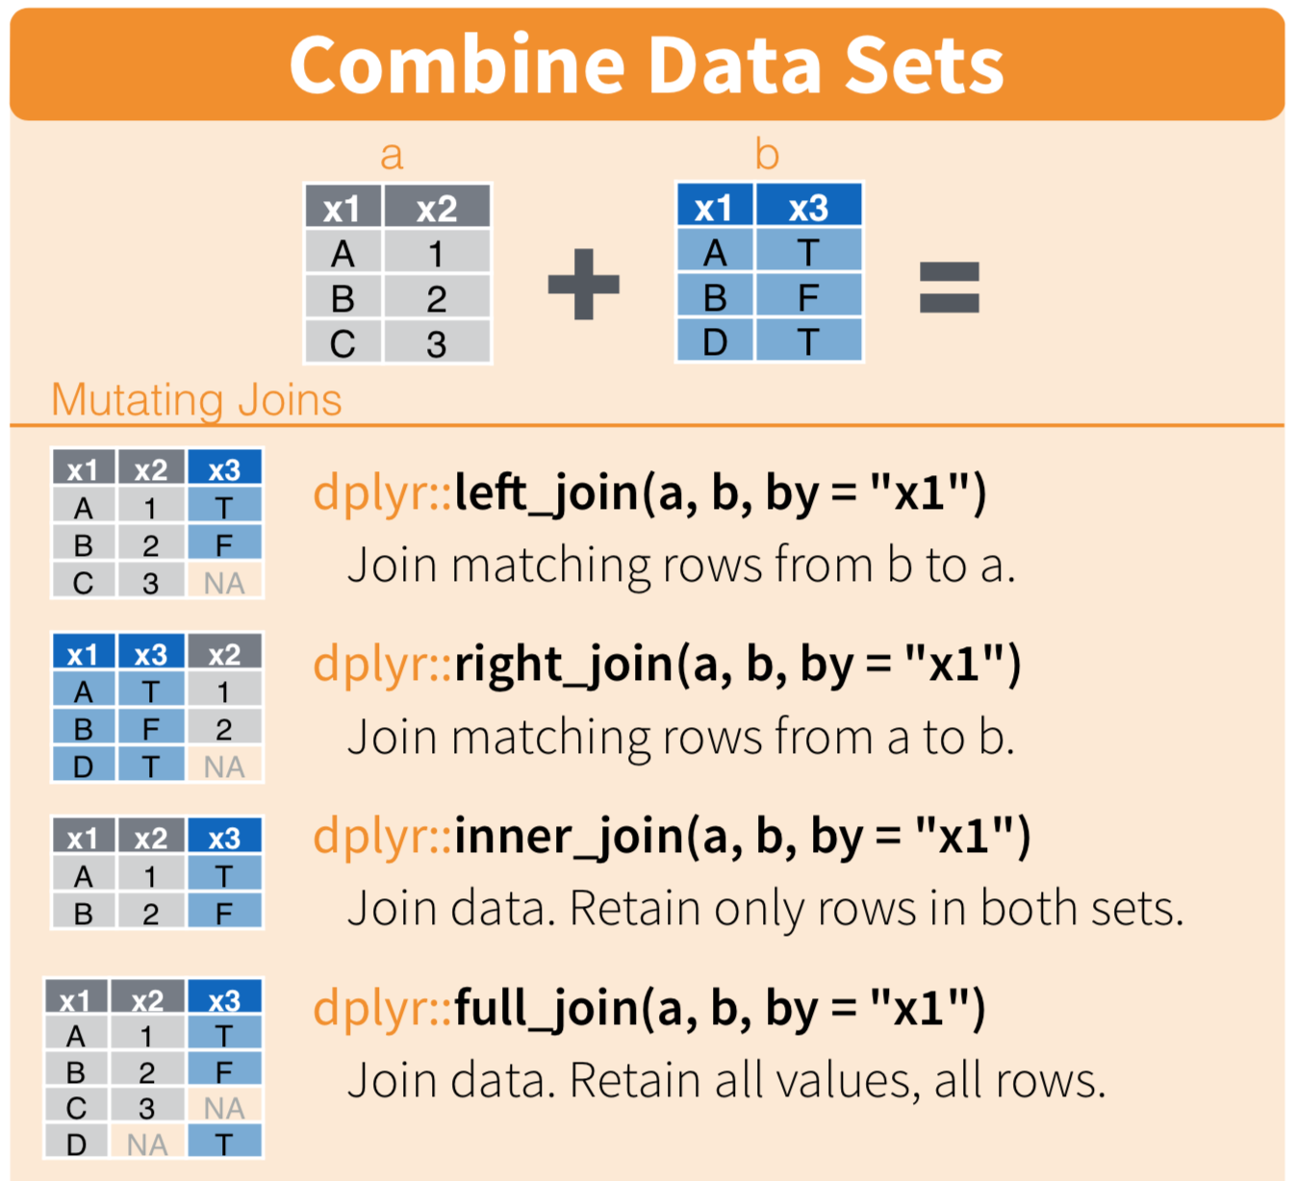
Mutating Joins
Source: Data Wrangling Cheatsheet - RStudio

Slide 5
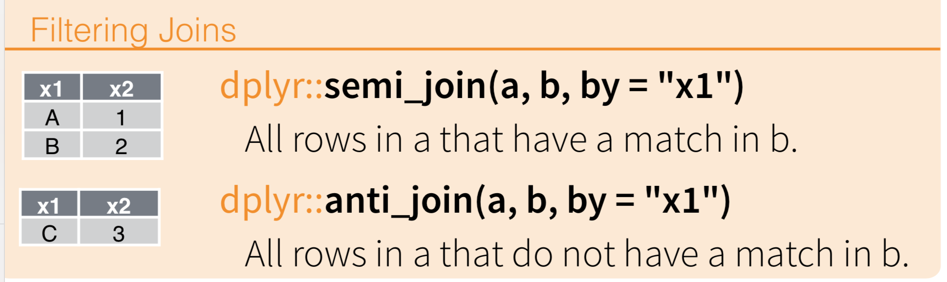
Filtering Joins
Source: Data Wrangling Cheatsheet - RStudio

Slide 6
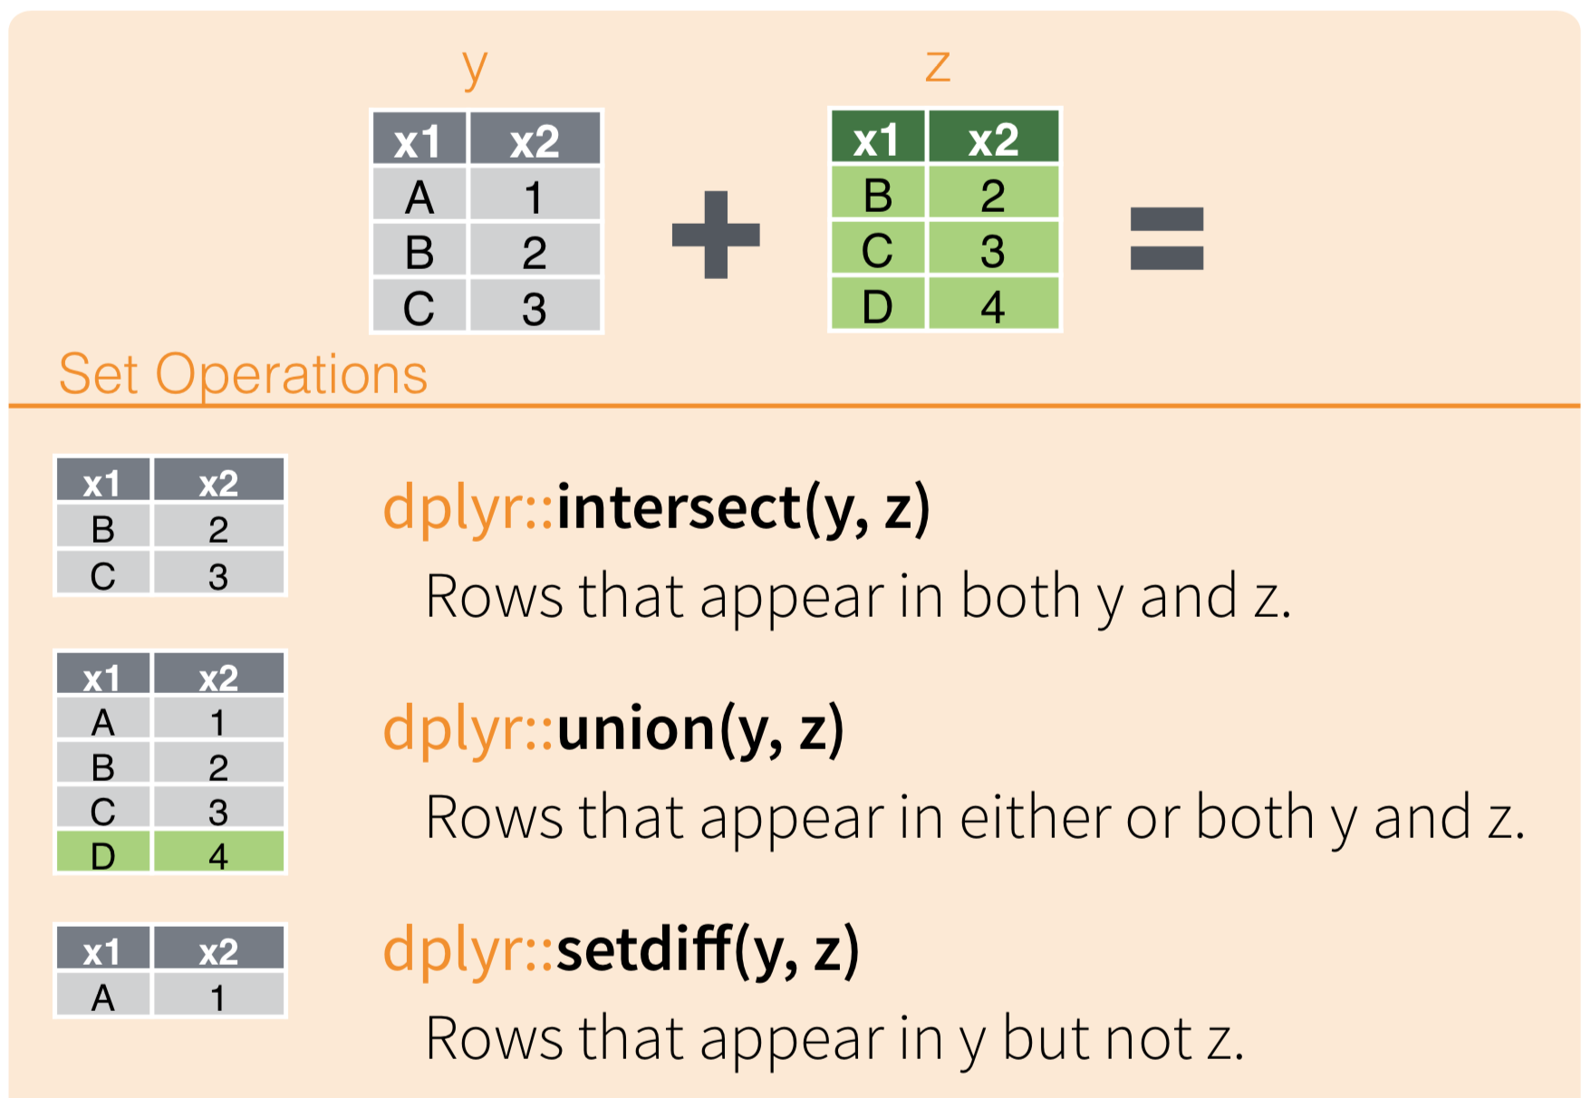
Set Operations
Source: Data Wrangling Cheatsheet - RStudio

Slide 7
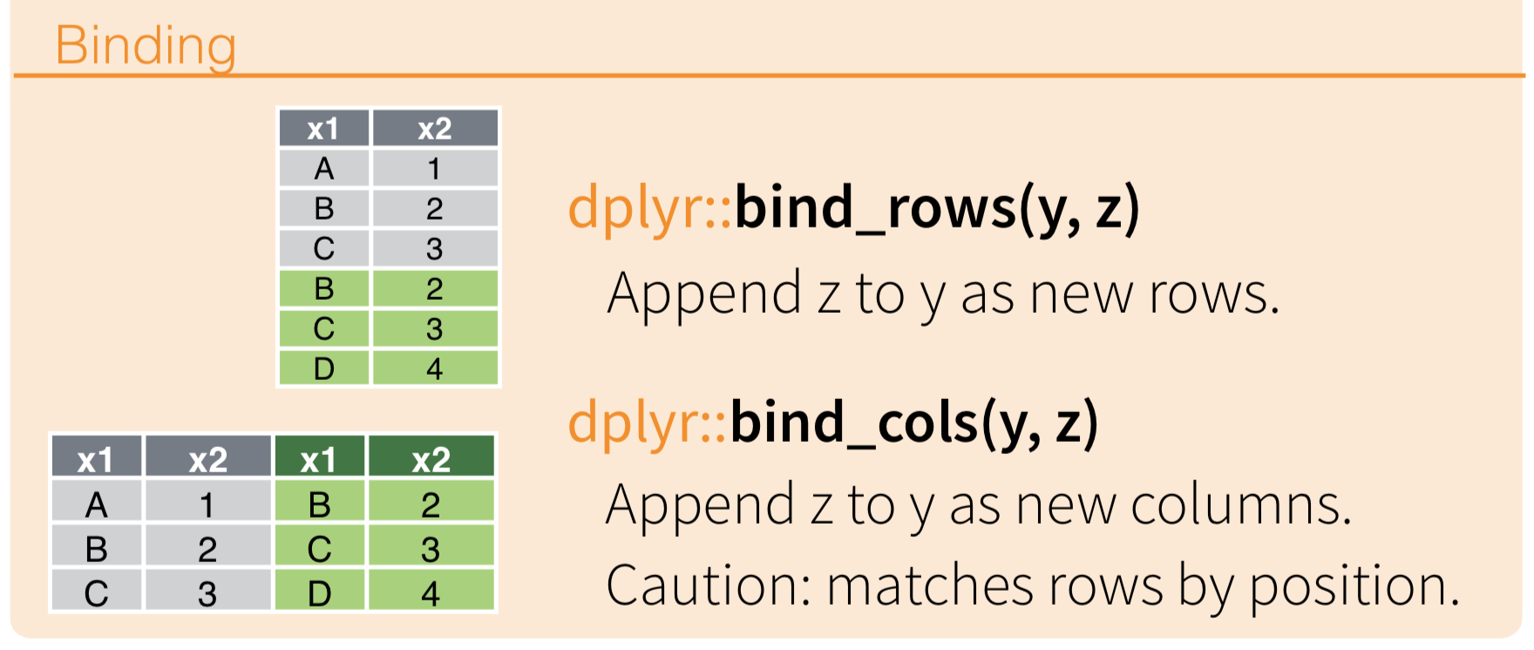
Binding data sets
Source: Data Wrangling Cheatsheet - RStudio

