Slide 1
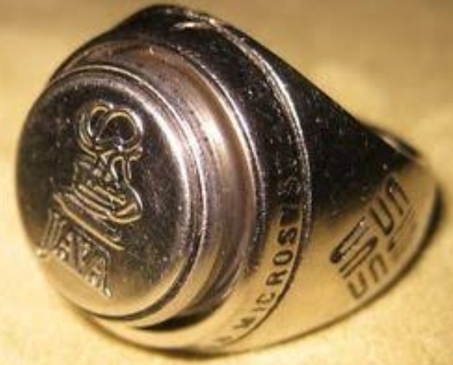
ISAP seminar on JAVA RING
Name : MOHAMMAD ZEEYAN
USN :1SU17CS019
Branch: Computer science and Engineering

Slide 2
INDEX
INTRODUCTION
JAVA RING COMPONENTS
WORKING
SECURITY
ADVANTAGES
DISADVANTAGES
APPLICATION
CONCLUSION
REFERENCES

Slide 3
INTRODUCTION
A java ring is a finger ring that contains a small microprocessor with built-in capabilities for the user.
The java Ring is a stainless-steel ring, 16-millimetres (0.6 inches) in diameter, that houses a 1-million-transistor processor, called an ibutton.

Slide 4
JAVA RING COMPONENTS
Java Virtual Machine(JVM).
RAM.
ROM.
Real-time clock.
ibutton.
Blue dot receptor.

Slide 5
JAVA VIRTUAL MACHINE
The java virtual machine is the piece of software that recognizes the java language and translate byte code.
This byte code transmitted to system which is connected to the
Java ring via blue dot receptor.
Java virtual machine is stored in the ROM.

Slide 6
RAM
Java ring contains 134Kb of non-volatile random access memory.
This non-volatile random access memory offers high read/write speed.
The NVRAM ibutton memory can be erased or rewritten.

Slide 7
ROM
The java ring contains 32Kb of ROM.
A special kind of operating system called E-commerce operating system which is based on java.
This operating system handles all the operation which is happening in the ibutton.

Slide 8
REAL TIME CLOCK
In the java ring real time clock gives the exact time of the day.
The real time clock continuously run up to more than 10 year by the energy provided the lithium backup.
In addition, the frequency of the processor clock is not constant ranges from 10 to20MHz.
This aspect prohibits hackers in obtaining the information from ibutton.

Slide 9
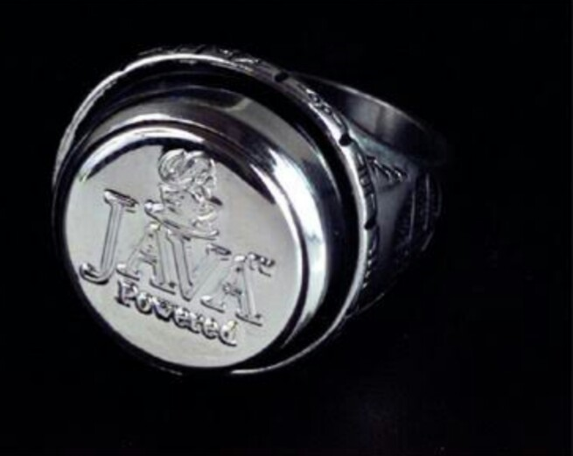
iBUTTON
The ibutton is a mechanical packaging standard they places a one wire component inside a stainless steel button.
ibutton consists of one million transistors.
Each ibutton has a unique and unalterable address.

Slide 10
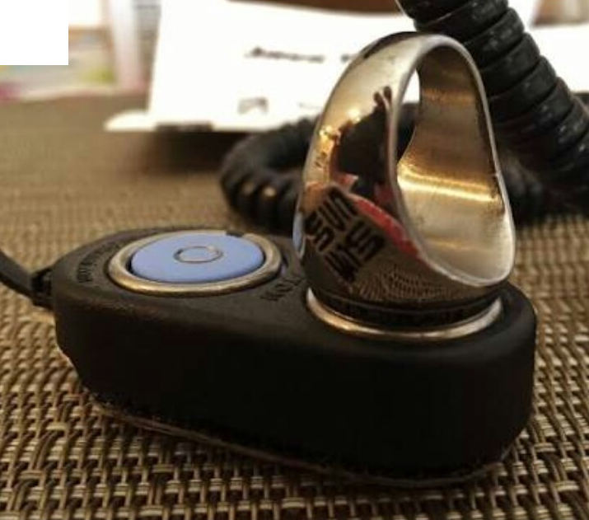
BLUE DOT RECEPTOR
Blue dot receptor is ibutton reader that provides a connection between ibutton to pc communication.
Transformation of information is done by momentary touch.

Slide 11
WORKING
Java ring is programmed with the applets according to our application.
Applets are the small application that is designed to run on the another application system.
User simply presses the signet of the java ring against the blue dot receptor and system connected to the receptor performs the required task.

Slide 12
CONTINUED…
Information is transferred between your ibutton and a PC with a momentary contact at up to 142kbs.

Slide 13
SECURITY
Barrier substrate and the triple-layer metal construction techniques employed in the silicon fabrication effectively deny access to the data stored in the NVRAM.
If any attempt is made to penetrate these barriers, the NVRAM data is immediately erased.
Java rings are authorized through personal identification numbers (PINs) so that no one can steal a person’s ring and use that ring.

Slide 14
ADVANTAGES
A very easy and convenient way for users.
More secure than using passwords.
Portable.
Provides authentication to users which is crucial for many applications.
Easier for administrator to maintain the security infrastructure.

Slide 15
DISADVANTAGES
The cost of implementing the system is high.
It needs a high level tools and method in order to program application efficiently, reliability, security.
iButton has a limited processor capacity and memory, which means an individual might need to carry more than one java ring.

Slide 16
APPLICATION
Providing security.
Personalized services.
Access control.
Time and attendance.
Gaming systems.

Slide 17
CONCLUSION
Java ring is highly durable because of its secure stainless packing. It is used in personal computing.
The ibutton form factor permits attachment to a wide variety of personal accessories that includes rings, watchbands, key fobs and wallets so the user can select variation that suits his or her lifestyle.

Slide 18
REFERENCES
www.Wikipedia.org
www.javaworld.com
www.google.com

Slide 19
Thank you

