Slide 1



SIM Realisasi
KANTOR KERJA SAMA DAN URUSAN INTERNASIONAL
Project brief for the IO Director and programmers
26 October 2026
Notes:
SIM Realisasi records every activity that carries out one of PCU's MoUs and MoAs, has KUI verify the mobility ones, and turns the verified data into the RENSTRA indicators and the International Awards rankings. This deck walks through the project brief: what it does, how the process runs, what it counts, how it is built, and what we need to decide.

Slide 2
One place to report, verify and count every realization
OVERVIEW
SIM Realisasi records each activity that carries out a PCU MoU or MoA, has KUI verify the mobility ones, and computes the RENSTRA indicators and International Awards from verified data only, with semester reports that never change after they are frozen.
333
449
53
5
kegiatan in the live demo, AY 2025/2026 and 2026/2027
RENSTRA 1.1 students, Setahun 2025/2026
RENSTRA 1.1 students so far, YTD 2026/2027
indicators: 1.1, 1.1.a, 1.1.b, 1.19.S1, 1.19.S4
Figures from the imports into the SIM Kerjasama Supabase project on 3–4 Oct 2026. The data is a generated demo set over the real agreements and units, not real activities yet.
Notes:
The live install already runs inside the SIM Kerjasama Supabase project. The numbers here come from demo data generated over real SIM Kerjasama agreements and units, so they show the system working end to end, not real reporting yet.

Slide 3
From scattered reports to numbers we can defend
WHY
Today
With SIM Realisasi
Realizations arrive as reports, emails and spreadsheets from each unit.
Counting inbound and outbound students and international activities needs manual reconciliation every semester.
Last semester's numbers can shift when late reports arrive.
Nobody can show which agreements were actually used.
Each academic unit reports its own kegiatan on one page, with IA, IR and participants.
Student numbers are checked against BAAK; no student is counted twice across units.
The database computes every number from verified data and freezes each semester on its cutoff.
Every report downloads as Excel and drills down to the kegiatan behind it.
Notes:
Left is how realizations are collected today. Right is what changes: the unit reports once, BAAK confirms the students, the database does the counting, and frozen semesters stay frozen.

Slide 4
Six terms the whole system is built on
CORE IDEAS
Kegiatan
Kerja sama
Renewal chain
One realization of one agreement, documented by exactly one IA and one IR. A multi-round programme reports one kegiatan per round.
The single MoU or MoA the kegiatan implements, chosen from SIM Kerjasama documents valid on the kegiatan dates.
An agreement plus all its renewals. 1.19.S4 counts chains, so a renewal mid-year is counted once.
Jenis Kegiatan
Mobility kegiatan
Snapshot
The Agenda Kerjasama list. KUI decides per agenda whether it is mobility and whether it counts for 1.19.S1.
Needs participants and one PDF of transcripts, poster and documentation; verified by KUI. Others are verified on submit.
The frozen indicator values of a semester, with the IDs of every record behind them and the settings used.
Notes:
These six terms appear on every screen and in every rule. The most important: one kegiatan is one IA and one IR, linked to exactly one agreement, and only mobility kegiatan go through KUI verification.

Slide 5
Who can do what
USERS AND ACCESS
Action | Unit (submitter) | KUI (IO Admin) | Pimpinan (viewer)
Create, submit and revise kegiatan | Own unit | On behalf of a unit | —
Delete a draft | Only drafts they created | Any draft | —
See kegiatan | Own and co-unit | All | Verified only
See participant names and the mobility PDF | Own | Yes | No
Verify mobility, decide duplicate students | — | Yes | —
Settings, calendar, Jenis rules, targets, freeze | — | Yes | —
Dashboard, Awards, non-personal Excel | Own unit | Yes | Yes
Excel with student data (logged) | Own unit | Yes | No
Every KUI account (Kepala Kantor, Head and Staff of Partnership and Global Alliance) is an IO Admin. Accounts come from SIM Kerjasama; only Unit Akademik submit. Enforced in the database, not only hidden in the UI.
Notes:
Access is enforced by row-level security and by permission checks inside every SQL function. Personal data follows UU PDP 27/2022: every export with student names is logged.

Slide 6


Business process
Part one
Two BPMN models: one kegiatan from the unit to the numbers, and what the system does on its own schedule.
Notes:
The two diagrams that follow are the Bizagi-style BPMN models from docs/bpmn. The .bpmn files open in Bizagi Modeler through File, Import, BPMN.

Slide 7
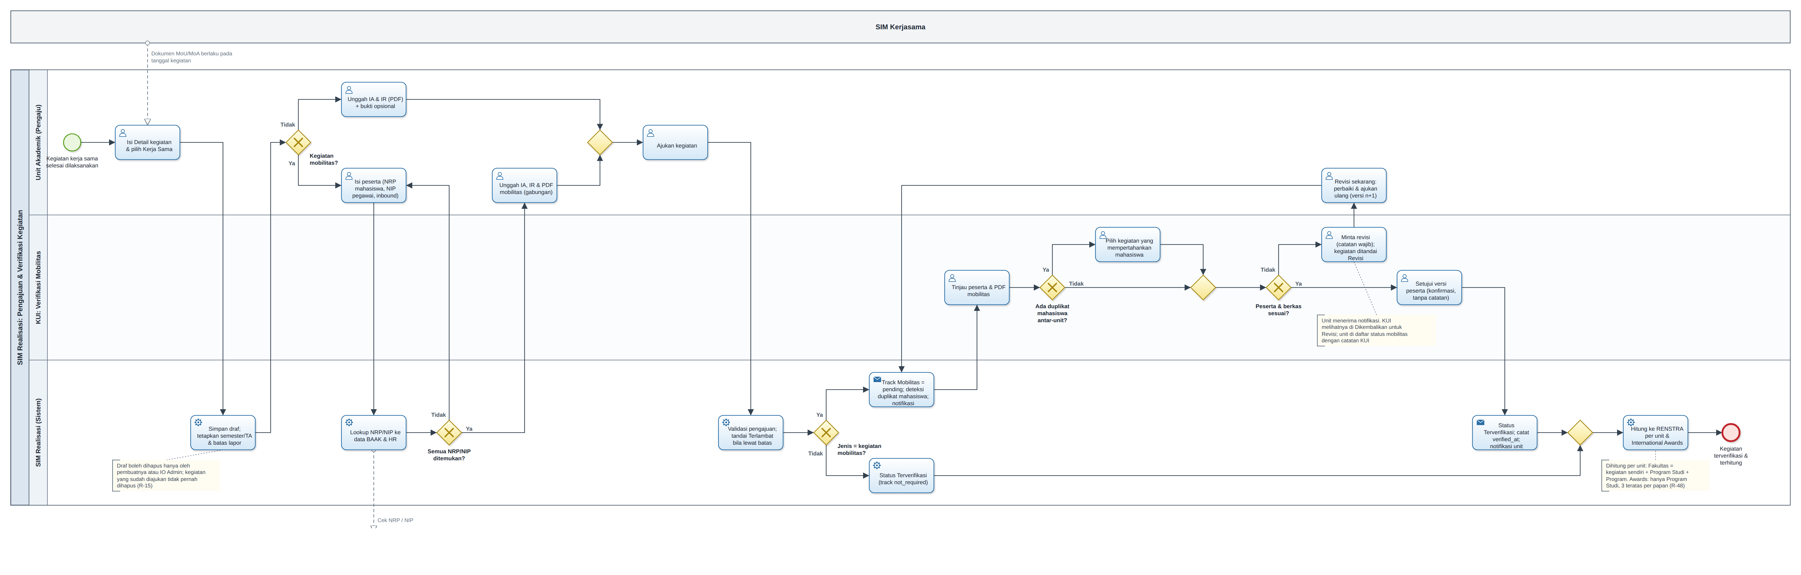
From the unit's report to a verified kegiatan
PROCESS 1 · PENGAJUAN & VERIFIKASI KEGIATAN
Non-mobility kegiatan are verified the moment the unit submits.
Mobility kegiatan wait for KUI, who checks participants and decides duplicate students.
Nothing is rejected a wrong submission returns to the unit as a Revisi.
Notes:
Read left to right. The unit fills in the detail and one agreement, adds participants and files, and submits. Non-mobility kegiatan are verified at once. Mobility kegiatan go to KUI, who checks the participants and the combined PDF, decides any student claimed by two units, and either approves with a simple confirmation or sends it back with a note. The full-size diagram is in the brief.

Slide 8
Report, check, verify, revise, count
PROCESS 1 IN FIVE STEPS
1
2
3
4
5
Report
Check
Verify
Revise
Count
Unit
Sistem
KUI
Unit
Sistem
Detail, one valid agreement, participants (NRP, NIP, inbound), IA and IR. A draft is deletable only by its creator or KUI.
Looks up every NRP and NIP in BAAK and HR, checks required fields, flags Terlambat after the deadline.
Reviews participants and the PDF; for a student claimed by two units, picks the kegiatan that keeps them.
Gets a notification and a Revisi flag with KUI's note; uses Revisi sekarang to resubmit a new version.
Terverifikasi: counted in RENSTRA per unit and in Awards; frozen at the semester cutoff.
Approval is a plain confirmation without a note; a revision request always needs one. Approval stays blocked while a duplicate student is undecided.
Notes:
The same flow as the diagram, in five steps. The colour dot under each step shows the lane: blue for the unit, amber for KUI, teal for the system.

Slide 9
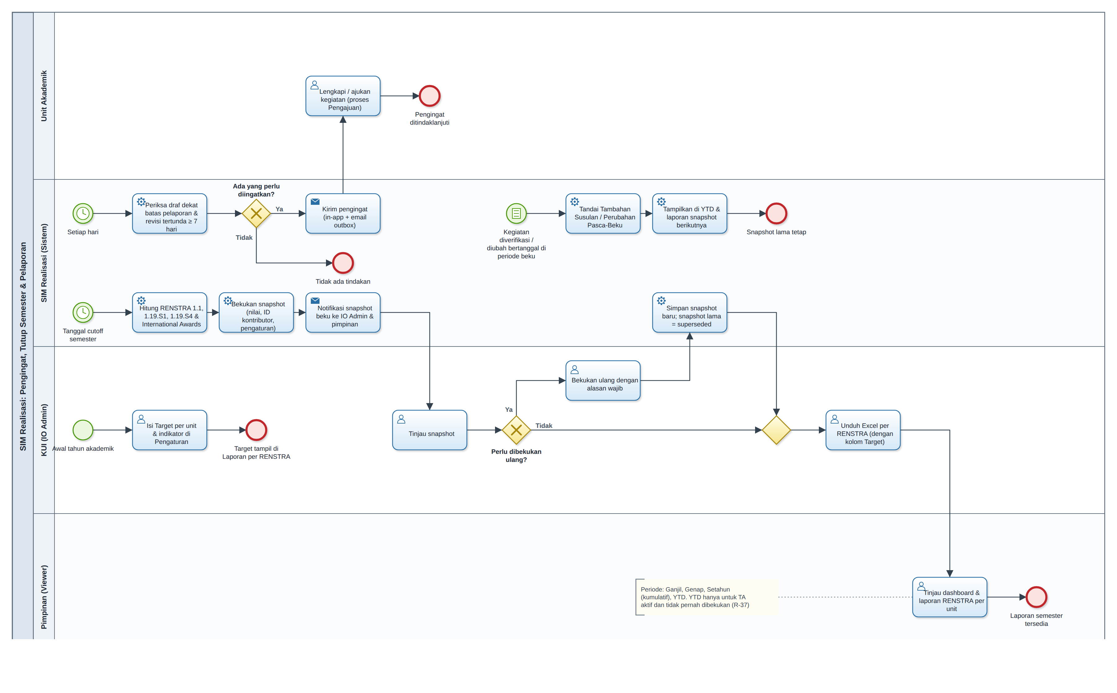
What runs on the system's own schedule
PROCESS 2 · PENGINGAT, TUTUP SEMESTER & PELAPORAN
Every day
Reminders for drafts near the deadline and for revisions untouched for 7 days.
Start of the academic year
KUI sets a target per unit and indicator in Pengaturan.
Semester cutoff
End + 30 days: compute, freeze, notify. Re-freeze needs a reason; the old snapshot stays.
Late data
Kegiatan dated in a frozen window show as Tambahan Susulan in the next report.
Notes:
Four independent starts. Daily reminders; the yearly target setting; the semester cutoff that freezes a snapshot; and late data, which never changes a frozen number but appears in the next report.

Slide 10
RENSTRA and International Awards
Part two
Only verified kegiatan count, by start date, per unit: a Fakultas includes its Program Studi and Programs.
Notes:
In the app the indicators are called RENSTRA. Since Revisi V.2 every count is reported per unit and rolled up the unit tree.

Slide 11
Three indicators, five numbers
RENSTRA INDICATORS
1.1
1.19.S1
1.19.S4
Students inbound and outbound
International kegiatan with partners
Share of MoU and MoA realized
(NRP, kegiatan) pairs from the approved participant list of verified mobility kegiatan.
Split as 1.1.a Inbound and 1.1.b Outbound.
Same student, two units, overlapping dates: counted once, for the kegiatan KUI kept.
Verified kegiatan whose Jenis counts for S1 and whose agreement has a foreign partner.
The domestic count is shown alongside.
Renewal chains with at least one verified IA in the year, over chains active in that window.
Chains signed within 6 months of the cutoff are excluded and listed; auto-renewed chains always count.
Notes:
1.1 counts students per kegiatan; a student in two kegiatan of one unit counts twice, but two units claiming the same student on overlapping dates count once, for the unit KUI chose. 1.19.S1 counts international kegiatan. 1.19.S4, internally still coded 1.19.24, is the share of agreements actually used, counted by renewal chain.

Slide 12
How the numbers are cut and shared
PERIODS, AWARDS AND REPORTS
Ganjil
Genap
Setahun
YTD
Ganjil start to end; read from its frozen snapshot.
Genap start to end, as of the full-year freeze.
Academic-year start to end; the full-year snapshot.
Year start to today; only for the active year, never frozen.
International Awards
Reports and Excel
Ranks Program Studi only; each student credited to their own Program Studi.
Boards: Inbound, Outbound Dalam Negeri, Outbound Internasional, Inisiatif Internasional.
Only the top 3 of each board, ties at rank 3 kept.
One report per indicator; preview and Excel come from the same query.
Per-unit table with a Target column, then the kegiatan, then students where allowed.
No Info sheet; the export log records who exported what.
Notes:
Four period cut-offs apply to the dashboard, charts, reports and every export. Awards rank Program Studi only and show the top three. Each RENSTRA report has a Target column that KUI fills in per unit and year.

Slide 13
Data model and architecture
Part three
One database shared with SIM Kerjasama. Business rules live in SQL, so screens, Excel and snapshots never disagree.
Notes:
This part is mainly for the programmers. The ERD and data dictionary are in the ERD artifact; the architecture follows.

Slide 14
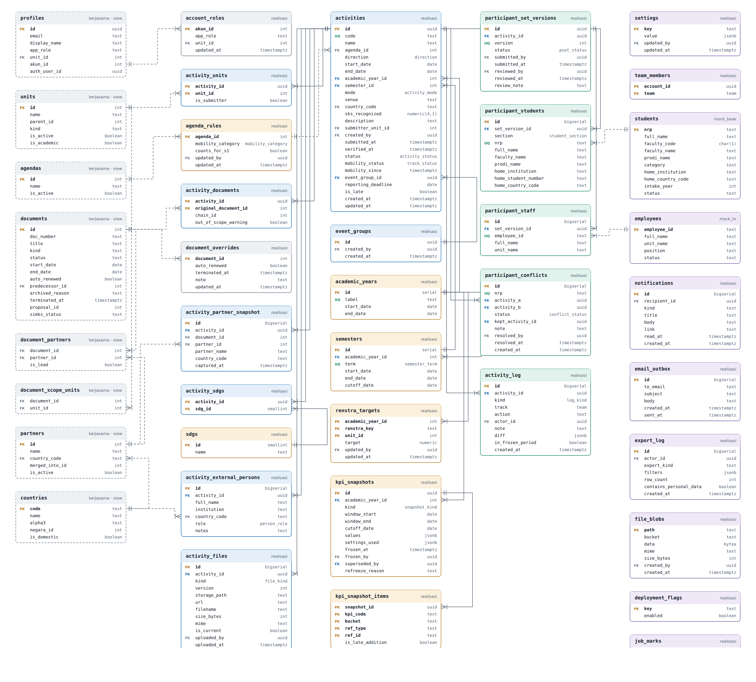
40 tables and views, 33 relationships
DATA MODEL
SIM Kerjasama views
units, documents, partners, accounts — read only
Kegiatan
the activity, its agreement, files, SDGs, guests
Peserta & verifikasi
participant versions, duplicates, Update Log
Kalender & RENSTRA
years, semesters, rules, targets, snapshots
Operasional & mock
settings, notifications, exports, BAAK/HR mocks
One kegiatan, one agreement, one current IA and IR
One approved participant list per kegiatan
Nothing submitted is ever deleted
Notes:
Grey dashed boxes are read-only views over SIM Kerjasama; SIM Realisasi never writes SIM Kerjasama tables. The newest table is renstra_targets, one target per indicator, unit and year. Open the ERD artifact to search every table and column.

Slide 15
One database, two systems
ARCHITECTURE
Supabase · simks-partnership · one Postgres database
Next.js 15
App Router pages
Server actions
Excel export (exceljs)
Rate-limited lookups
SQL as role authenticated
realisasi
kerjasama
Browser
30 tables, 3 views
166 SQL functions
RLS on every table
pg_cron jobs 01:00 WIB
8 read-only views
Unit, KUI, Pimpinan
UI in Bahasa Indonesia
public · SIMKS
never written
Business rules live in SQL. BAAK and HR sit behind two lookup functions, so production swaps the function body and nothing else.
mock BAAK/HR
until PSI connects
Notes:
The Next.js app is a thin, role-aware layer. Every rule, from status to RENSTRA math, is SQL inside the realisasi schema, so the screen, the Excel file and the frozen snapshot always agree. SIM Kerjasama data is read through eight views and never written.

Slide 16
Tested at every layer before it ships
BUILD, TEST, DEPLOY
17
15
6
166
SQL test suites
Vitest files
Playwright journeys
SQL functions
status, indicators, snapshots, access, adapter, Awards
unit roll-up, workbooks, formats
submit, autosave, verify, reports, security
checked by the deploy fingerprint
Run locally
Deploy check
npm install
npm run db:reset
npm run dev
functions 166 · columns 317 · policies 25
scripts/db-deploy-supabase.sh or the SQL Editor files in supabase/deploy
Notes:
Every deploy prints a fingerprint of functions, columns and policies; it must match the rehearsed values. Read docs/spec/Rules.md for behaviour and docs/CONTRACTS.md for interfaces before changing anything.

Slide 17
Status and decisions
Part four
Where the project stands, and what we need from KUI to move from demo to real reporting.
Notes:
The last two slides: the timeline so far, then the decisions and follow-ups.

Slide 18
From mockup to a live install in three weeks
TIMELINE
1 Oct
2 Oct
1–4 Oct
3 Oct
5–18 Oct
Mockup v1.0
Revisi V.1
Live install
Revisi V.2
Round 2 & targets
Full prototype on dummy data.
One-page form, Mobility-only verification, Awards.
Inside simks-partnership; 333 demo kegiatan.
RENSTRA per unit, 1.19.S4, Awards by Program Studi.
KUI as admins, Revisi flag, top 3, Target RENSTRA.
Still to run on the live install: the Target RENSTRA patch (adds renstra_targets) and the Awards speed-up patch. Until then the Target column is empty live and Awards are slower, with the same results.
Notes:
The design documents PRD, Architecture and Schema still describe v1.0; Rules.md is current and should be the reference until they are updated.

Slide 19
What we need to go live
NEXT STEPS
Decisions needed from KUI
Technical follow-ups
How BAAK and HR data will be connected, and who at PSI owns it.
The official mobility category and 1.19.S1 flag per Jenis Kegiatan.
Official 2026/2027 semester cutoff dates.
Whether outbound students need a transcript snapshot.
The go-live date; history starts there.
Run the two pending patches on the live install.
Replace the demo role switcher with SIM Kerjasama's login.
Connect real BAAK/HR lookups; move files to Supabase Storage.
Update PRD, Architecture and Schema to Rules.md.
Remove the demo data before units start reporting.
Notes:
The left column needs decisions from the Director; the right column is work the programmers can schedule. Removing the demo data before go-live keeps the first frozen semester clean.

Slide 20
Thank you
The full brief
Project brief claude.ai/artifact/9Qu7aabbaBA1KsbxS2Tqa4
Data model claude.ai/artifact/TjJ3NDdH3S5Yi5CSGuxTyL
Sources docs/overview · docs/bpmn · docs/erd
Notes:
The brief page has the full-size diagrams, the searchable data dictionary and a Director or Programmer view. Both links are private until shared from the page's Share menu.

