Slide 1
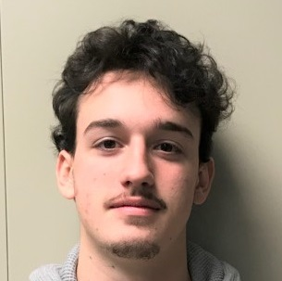
Edward Auttonberry
for full-stack developer role

Slide 2
Edward Auttonberry
for full-stack developer role

Slide 3




Topics Covered
Education and Certifications
Introduction
Skills and Experience
Soft Skills
Notes:
Fiancee is from Saudi Arabia

Slide 4
Topics Covered
Education and Certifications
Introduction
Skills and Experience
Soft Skills
Notes:
Fiancee is from Saudi Arabia

Slide 5
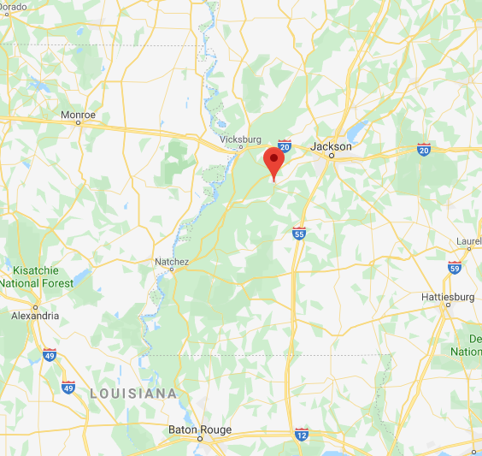
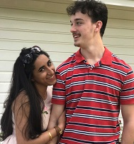
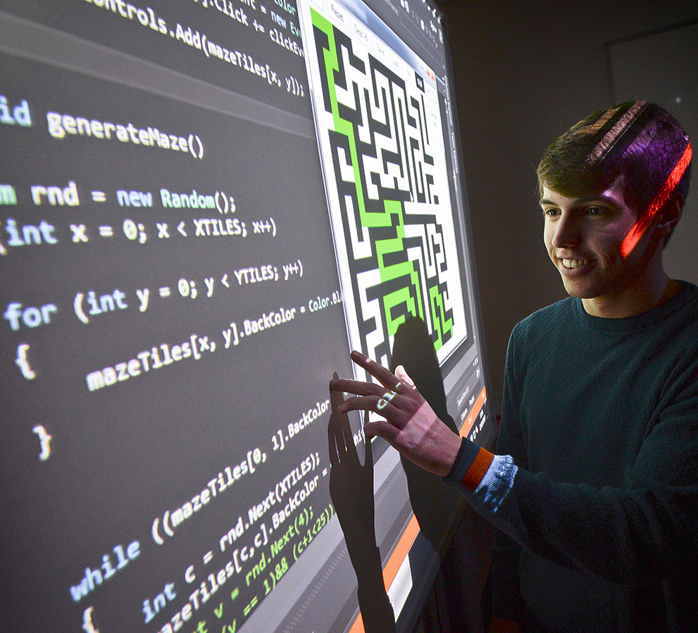
Introduction
Notes:
Fiancee is from Saudi Arabia

Slide 6
Introduction
Notes:
Fiancee is from Saudi Arabia

Slide 7
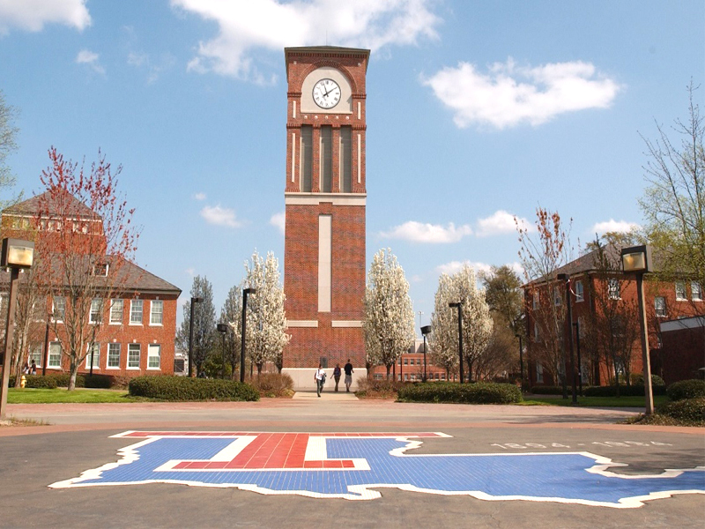
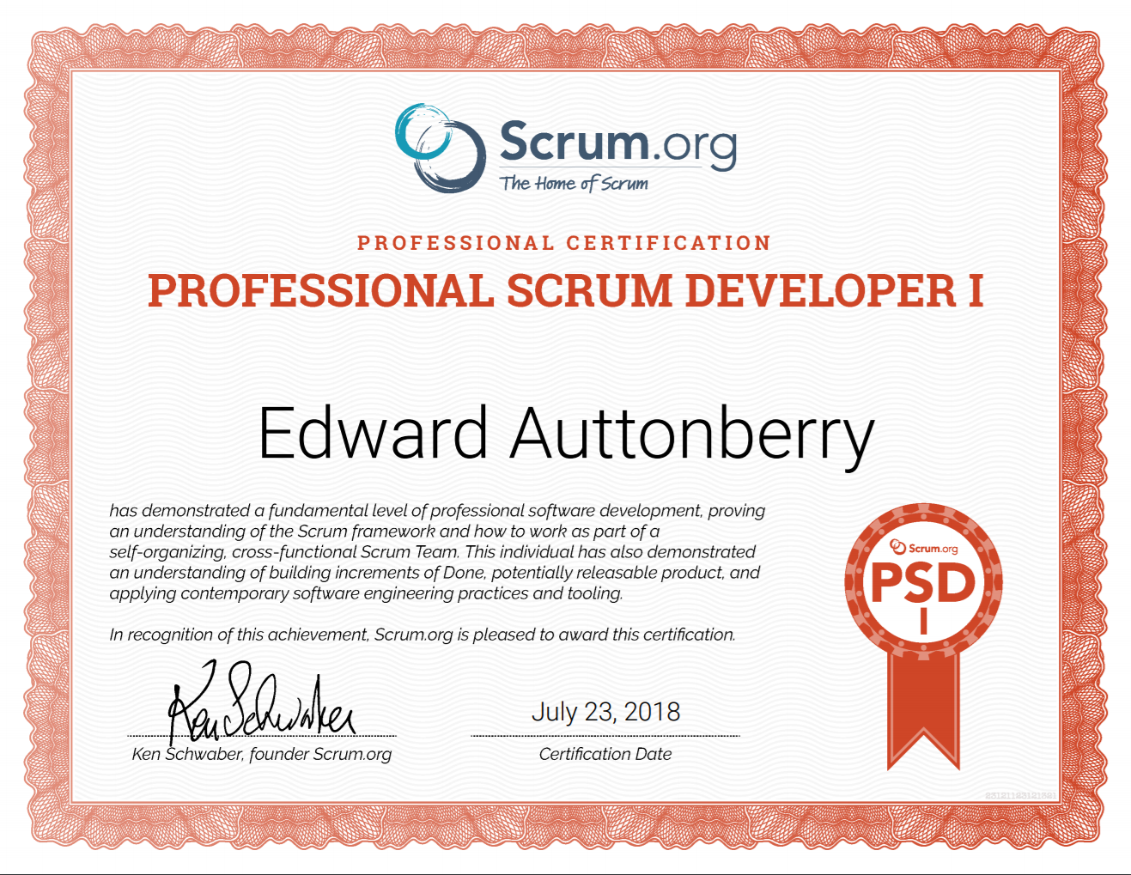
Education & Certifications
Notes:
Fiancee is from Saudi Arabia

Slide 8
Education & Certifications
Notes:
Fiancee is from Saudi Arabia

Slide 9
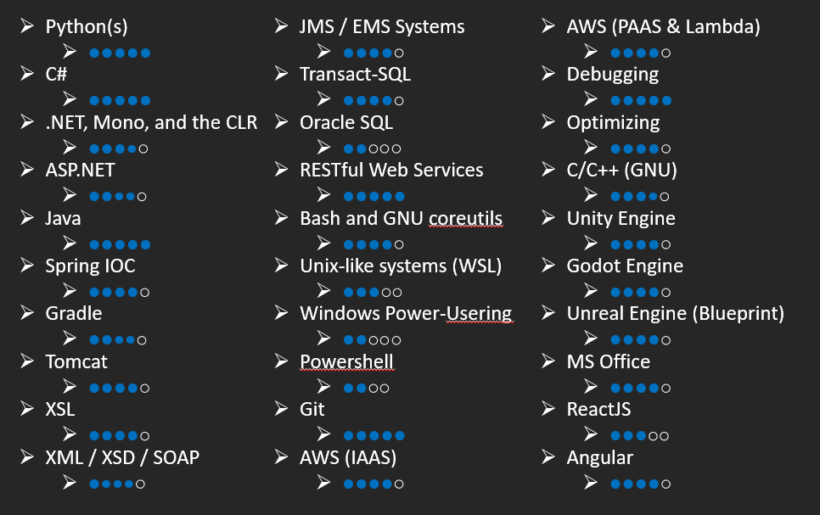
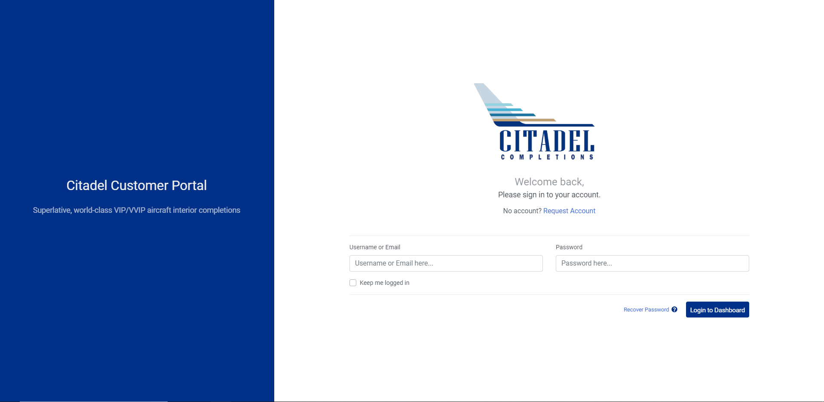
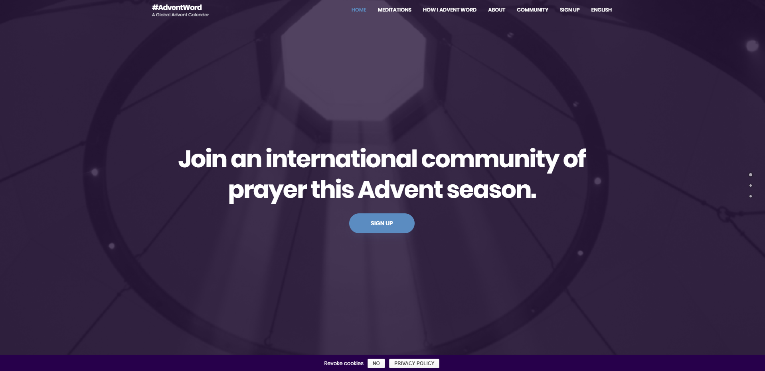
Skills & Experience
customer.citadelcompletions.com
adventword.org
Notes:
Fiancee is from Saudi Arabia

Slide 10



Soft Skills
Notes:
Fiancee is from Saudi Arabia

Slide 11
Soft Skills
Notes:
Fiancee is from Saudi Arabia

Slide 12
Thank You
https://gw.auttonberri.es

