Slide 1

Dynaboard
The Case for R&D

Slide 2




Outline
Who?
What?
Why?
W=hy!

Slide 3
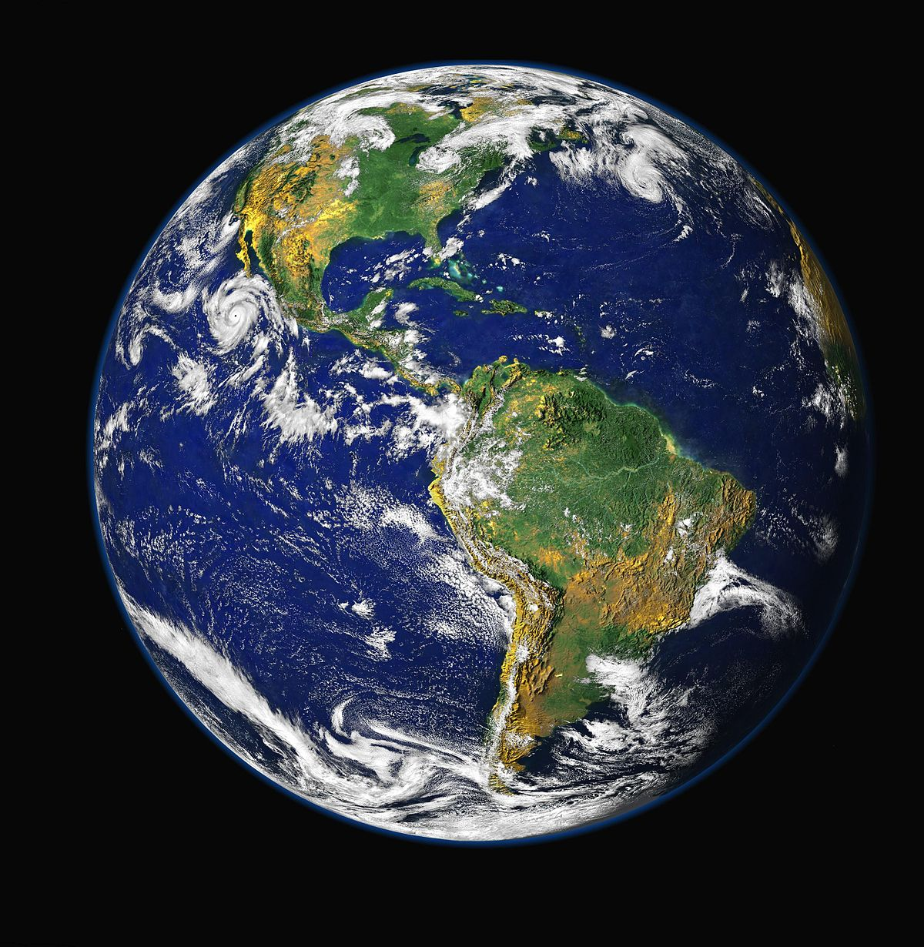
Who?
Translators, Immigrants, and Polyglots
46,951,595
This Photo by Unknown Author is licensed under CC BY-SA

Slide 4
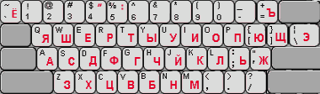
Courtesy of @yurinnick via Medium.com

Slide 5
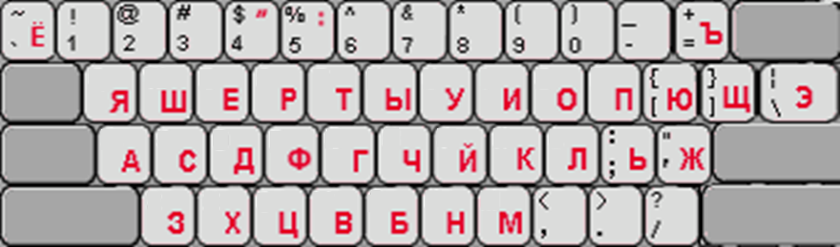

Slide 6
What?
The Dynaboard

Slide 7
Why?
“This would be really cool. I want this.”
- Dr. Andre Timofeyev

Slide 8
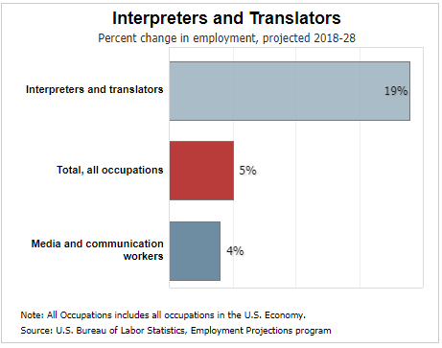
Why?
Occupational Outlook Handbook:
https://www.bls.gov/ooh/media-and-communication/interpreters-and-translators.htm

Slide 9
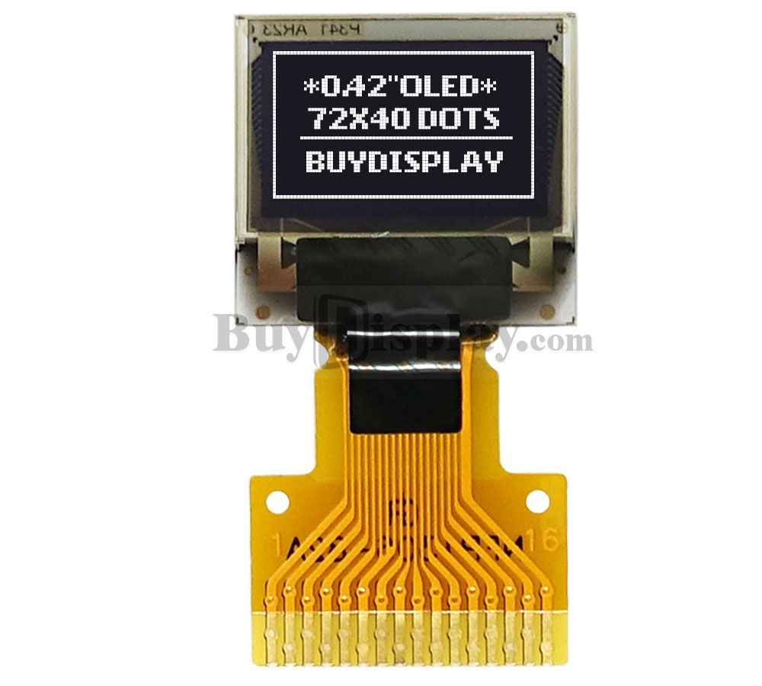
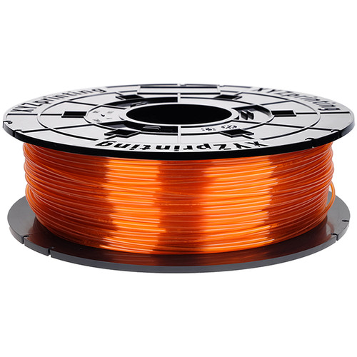
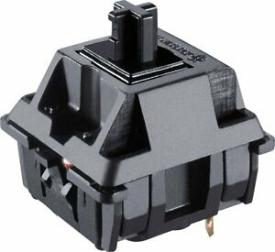
Why?
buydisplay.com
cherrymx.de
bhphotovideo.com
US$1.18
US$0.90
US$0.06
(at 1.63g per cap)
US$139.1
to manufacture board
65 Character, Command, and Arrow Keys
US$2.14
per cap
=
x
=

Slide 10
Let’s transform global communication.
Questions?

