Slide 1
AAYAT-AP-PREP · CYBERSECURITY
INTRODUCTION TO SECURITY
Topic 1.1: Understanding Social Engineering
Social engineering attacks manipulate people rather than machines, using psychological pressure such as intimidation and urgency to persuade a target to reveal information, open an attachment, or follow a link. This topic examines how those tactics are recognized, why they work, and what they cost their victims.
3 learning objectives · College Board AP Cybersecurity Course Framework
Notes:
Cover slide for Topic 1.1: Understanding Social Engineering. Social engineering attacks manipulate people rather than machines, using psychological pressure such as intimidation and urgency to persuade a target to reveal information, open an attachment, or follow a link. This topic examines how those tactics are recognized, why they work, and what they cost their victims.

Slide 2
TOPIC 1.1
Learning Objectives
Analyze Risk
Recognize the common indicators that a message or interaction is a social engineering attempt.
1.1.A
Analyze Risk
Explain how social engineering tactics persuade a victim to carry out the action an adversary wants.
1.1.B
Analyze Risk
Describe the consequences a victim may face after a successful social engineering attack.
1.1.C
Objectives paraphrased from the AP Cybersecurity Course Framework (College Board, AP Career Kickstart).
Notes:
Read each learning objective aloud and connect it to the exam skill category before starting the topic.

Slide 3
TOPIC 1.1 · CONCEPT MAP
Social Engineering Lifecycle
01
02
03
04
RECONNAISSANCE
ESTABLISH TRUST
EXPLOIT / MANIPULATE
EXIT & CLEAN
Gathering public OSINT, social media mapping, identifying targets.
Initiating contact, building a credible pretext to bypass suspicion.
Weaponizing psychological triggers (urgency, authority) for action.
Retracting footprints, leaving no traces, executing payload silently.

Slide 4
TOPIC 1.1 · CONCEPT MAP
Psychological Exploit Loop
01
02
03
04
05
TRIGGER EVENT
COGNITIVE LOAD
CRITICAL BYPASS
MALICIOUS ACTION
EXPLOIT SUCCESSFUL
User receives high-stress warning, spoofed message or emergency alert.
Time constraints & high anxiety bypass normal logical auditing pathways.
User relies on System 1 fast heuristics, obeying displays of authority.
Victim clicks compromised links or inputs sensitive login credentials.
System breached, logs deleted, credentials captured by adversary.

Slide 5
TOPIC 1.1
The Big Idea
A con artist doesn't pick the lock — they convince you to open the door yourself. Social engineering doesn't target a flaw in the software; it targets the trust and helpfulness people naturally extend to one another.
Hold onto this picture — we'll come back to it as the mechanics get more technical.
Notes:
Big-idea framing for Topic 1.1. Open with this analogy before the mechanics: "A con artist doesn't pick the lock — they convince you to open the door yourself. Social engineering doesn't target a flaw in the software; it targets the trust and helpfulness people naturally extend to one another." Ask students for their own version of the analogy before moving on.

Slide 6
01
The Human Interface as the Weakest Perimeter
Topic 1.1
Notes:
Transition to part 1 of the topic. Pause here for questions before continuing.

Slide 7
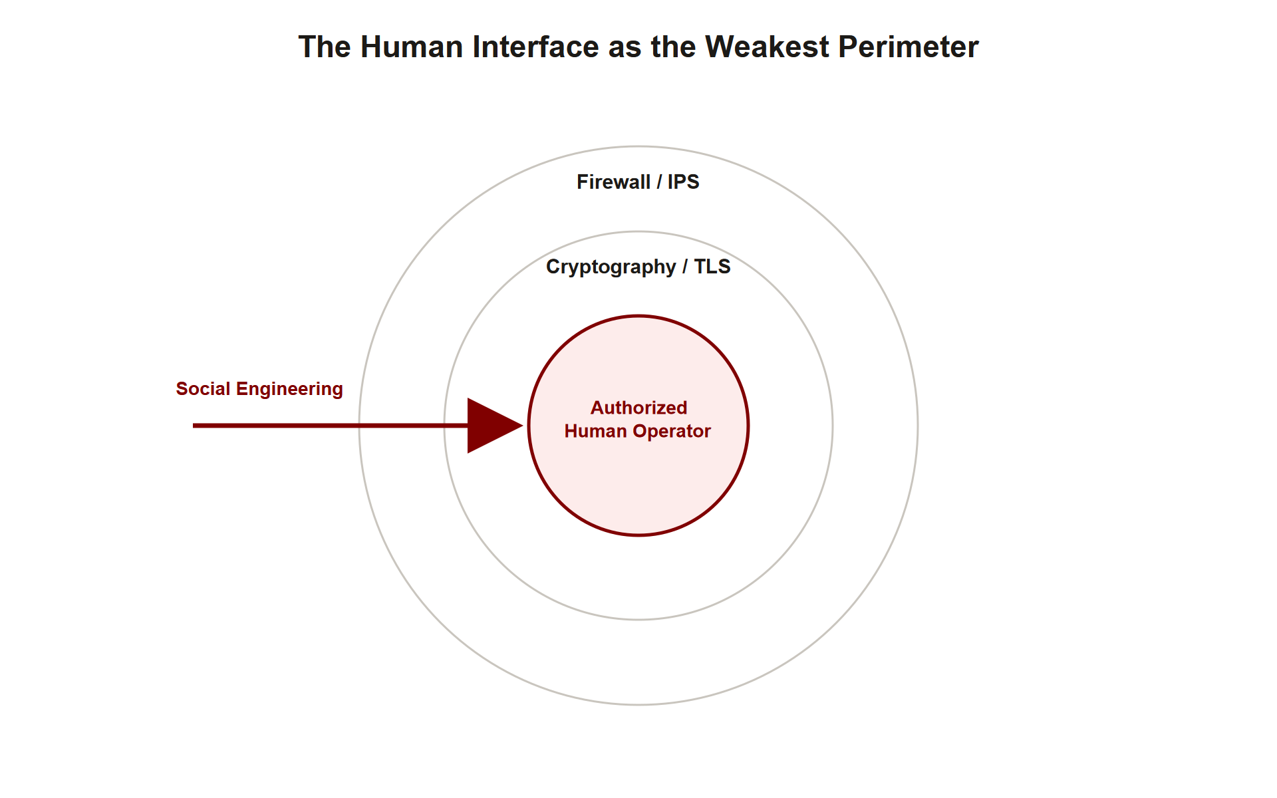
TOPIC 1.1 · 1.1.1.a.1
The Human Interface as the Weakest Perimeter
Definition: Social engineering is the systematic exploitation of human cognition to bypass administrative, physical, and logical controls
Target: Not the cryptography or firewall, the trusted operator who is authorized to execute commands
Assumption attacked: Technical defenses assume the human issuing a command has uncompromised intent and has verified the request
MITRE ATT&CK mapping: Tactic TA0001 (Initial Access), technique T1566 (Phishing)
Scale: Verizon DBIR 2024, phishing is the initial access vector in roughly 36% of all breaches
Human Perimeter Layers
Notes:
Traditional security engineering pours enormous effort into hardening cryptographic primitives, tightening firewall rulesets, and deploying intrusion prevention systems. Every one of these controls rests on a silent assumption: that the person authorized to operate the system is acting deliberately and has verified what they are being asked to do. Social engineering attacks that assumption directly.
Rather than defeating a lock, the attacker convinces the person holding the key to open the door. Kevin Mitnick, who popularized the term in The Art of Deception (2002), argued that it is almost always cheaper to manipulate a human than to break a well-implemented cipher. This is why social engineering is treated in academic security as a structured exploit against human decision-making, not a grab-bag of con tricks.
Throughout Unit 1 you will see this theme repeat: the strongest technical control in the world fails if a human can be persuaded to hand over a credential, approve a transfer, or install an update. Understanding the psychology is therefore foundational, not peripheral.

Slide 8
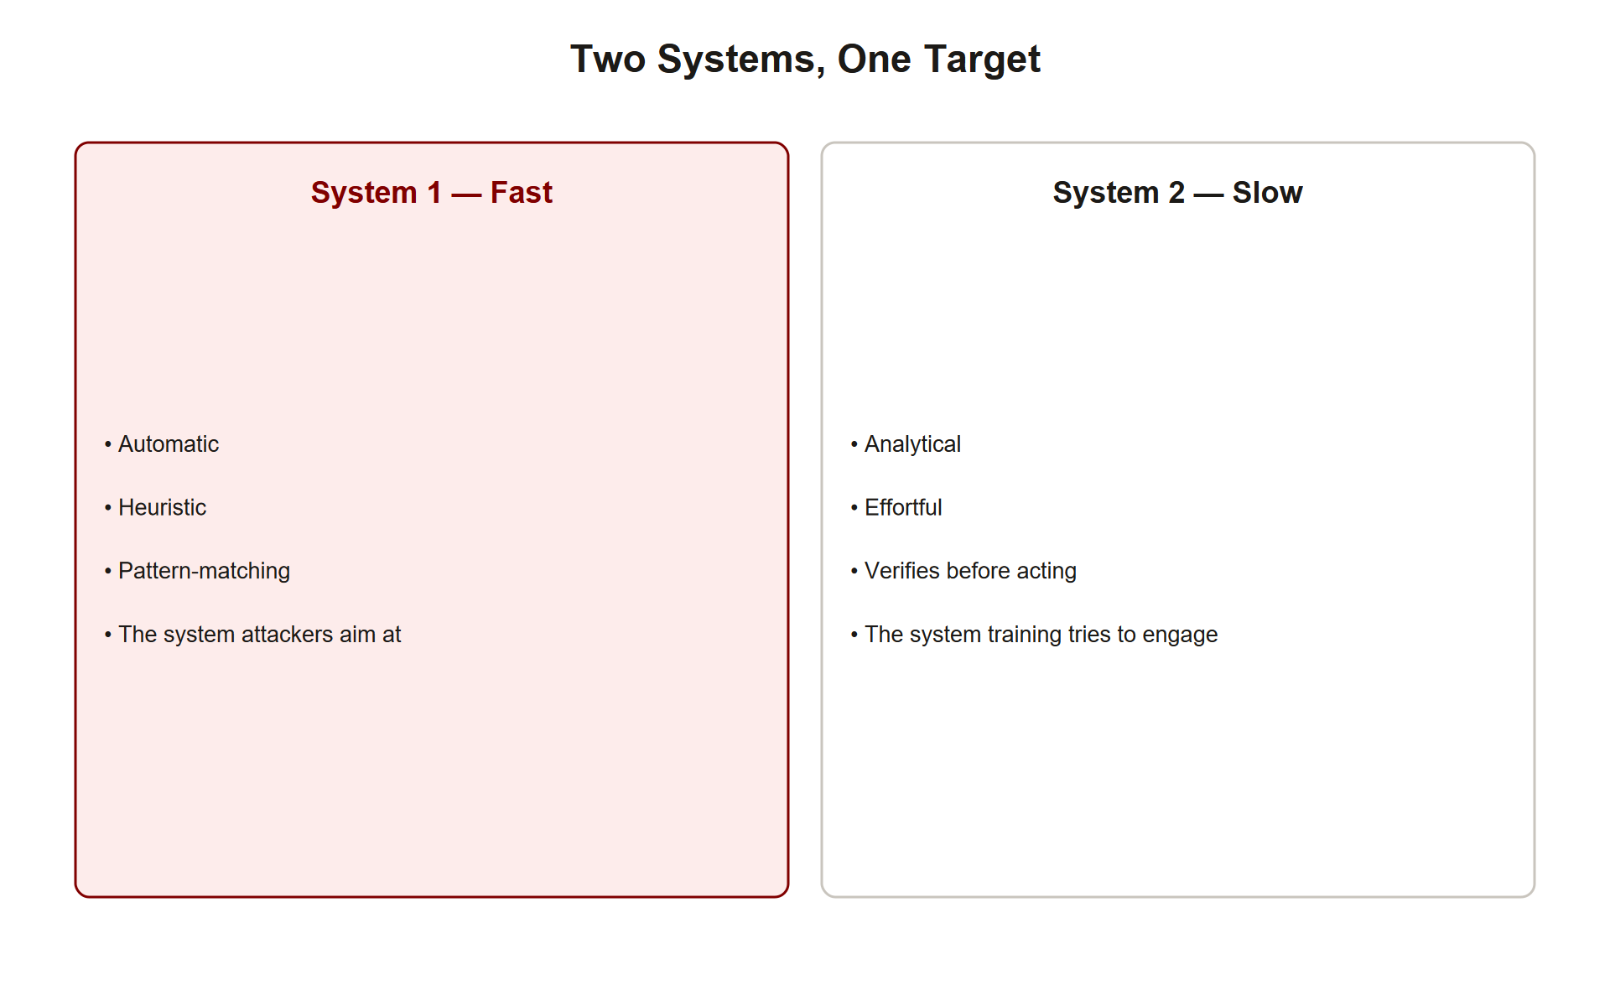
TOPIC 1.1 · 1.1.1.a.2
?
Kahneman's Dual-Process Theory as an Attack Surface
System 1: Fast, automatic, effortless, emotional, runs on evolutionary heuristics (mental shortcuts)
System 2: Slow, deliberate, effortful, logical, performs verification and critical reasoning; metabolically expensive
Vulnerability: System 1 is efficient but highly susceptible to cognitive biases and logical fallacies
Attack goal: Force the victim to decide with System 1 before System 2 can engage
Source: Kahneman, Thinking, Fast and Slow (2011); Nobel Prize in Economics, 2002
Dual Process Attack
Notes:
Daniel Kahneman modeled human cognition as two interacting systems. System 1 is the gut reaction: when a ball flies toward your face you flinch without conscious calculation. System 2 is the effortful reasoner you engage to multiply 17 × 24 or to check whether a URL is genuine. System 2 is accurate but slow and easily fatigued, so the brain defaults to System 1 whenever it can.
Social engineering is engineered to keep the victim in System 1. If an attacker can trigger fear, urgency, curiosity, or greed, the target's limited working memory is consumed by the emotional stimulus and the deliberate verification that System 2 would perform never happens. The victim reacts instead of reasoning.
This is why the entire discipline of security awareness training reduces, at its core, to one instruction: slow down. Recognizing that a 'ball has been thrown' and deliberately handing control to System 2 is the single most effective personal defense against manipulation.

Slide 9
TOPIC 1.1 · 1.1.1.b.1
?
Cialdini's Six Principles of Persuasion
Authority: Comply with perceived figures of power, spoofed corporate hierarchy, legal threats, technical jargon
Urgency (Scarcity): Time pressure restricts deliberation, 'account suspended in 15 minutes'
Consensus (Social Proof): 'Other executives have already approved this', fake peer behavior
Reciprocity: A small unsolicited favor creates a subconscious obligation to comply
Liking: Shared interests and rapport (scraped from social media) lower skepticism
Commitment & Consistency: A small 'yes' first (foot-in-the-door) makes a later big 'yes' feel consistent
Notes:
Robert Cialdini, in Influence (1984, rev. 2007), catalogued six universal levers of compliance that make humans say 'yes.' Social engineers use these as an engineering toolkit, selecting whichever lever best fits the pretext.
Note that the AP exam uses both the popular and formal names: Urgency is listed under Scarcity , and Social Proof is listed as Consensus , memorize both terms for each. Real attacks usually combine several principles simultaneously. A classic wire-fraud email stacks Authority (it's from the CEO), Urgency (do it before end of day), and Consistency (we discussed this yesterday).
The commitment-and-consistency lever deserves special attention because it underlies the foot-in-the-door technique documented by Freedman and Fraser (1966): an attacker first asks you to confirm something harmless, like your employee number, then escalates to a password reset. Having already cooperated once, refusing feels inconsistent.

Slide 10
TOPIC 1.1 · 1.1.1.b.2
Pretexting: Building a Believable Story
Pretext: A fabricated but plausible scenario that justifies the attacker's request
Classic example: 'New employee on their first day' who forgot their password and needs a reset
Why it works: A sympathetic, normal-sounding context disarms suspicion and satisfies the helpdesk's helpfulness
Legal status: Prohibited under the Gramm-Leach-Bliley Act (financial data); violates NIST SP 800-50 verification requirements
OSINT-fueled: Details harvested from LinkedIn, org charts, and job postings make the pretext specific and credible
Notes:
A pretext is the narrative wrapper around a malicious request. Rather than baldly asking 'give me the admin password,' the attacker constructs a scenario in which that request seems natural: they are the new hire locked out on day one, the auditor who needs access before a deadline, or the IT technician resolving an outage.
Pretexting weaponizes helpfulness. Helpdesk staff are trained and incentivized to solve problems quickly; a well-built pretext makes granting the request feel like good customer service rather than a security violation. The more specific the details, a real manager's name, a genuine project, correct internal jargon, the more the pretext bypasses skepticism.
Because the details come from open-source intelligence (OSINT), defense against pretexting is partly about limiting what an organization publicly exposes, and mostly about enforcing verification procedures that a good story cannot talk its way around.

Slide 11
TOPIC 1.1 · 1.1.1.b.2b
?
Anchoring and Loss Aversion: Two More Cognitive Levers
Anchoring: The first number or claim presented disproportionately shapes all subsequent judgment
Attack use: 'Your account shows $4,200 in unauthorized charges' anchors the victim's fear before any verification
Loss aversion: Kahneman & Tversky, losses are felt roughly twice as intensely as equivalent gains
Attack use: 'Failure to act TODAY forfeits your refund permanently' frames inaction as a guaranteed loss
Relation to Cialdini: These two biases sharpen why Urgency/Scarcity messaging is so consistently effective
Notes:
Beyond Cialdini's six named principles, two specific cognitive biases from Kahneman and Tversky's original prospect-theory research explain why urgency works as well as it does. Anchoring describes how the first figure or claim a person encounters becomes a disproportionate reference point for everything that follows, a fabricated '$4,200 unauthorized charge' figure anchors the victim's fear response before any fact-checking occurs, and all subsequent reasoning happens in the shadow of that anchor.
Loss aversion, from Kahneman and Tversky's 1979 prospect theory, is the empirical finding that people weigh a potential loss roughly twice as heavily as an equivalent gain. Framing an action as preventing a loss ('your refund will be forfeited') is measurably more motivating than framing the identical action as securing a gain ('claim your refund'). Social engineers exploit this asymmetry by phrasing almost every pretext in loss terms, losing access, losing money, losing a job, rather than gain terms.
These two biases do not replace Cialdini's Urgency/Scarcity principle; they explain its underlying psychological mechanism at a level of precision the AP exam occasionally probes directly.

Slide 12
TOPIC 1.1 · 1.1.1.c.1
The Reconnaissance Phase: OSINT
OSINT: Open-Source Intelligence, gathering from public sources: LinkedIn, GitHub, job posts, WHOIS, news, social media
Purpose: Map the org chart, identify high-value targets, and find personal details for rapport and pretext
Tools: Maltego, theHarvester, Shodan (internet-connected devices), FOCA (document metadata)
Timeframe: Professional actors spend days to weeks on recon before sending a single message
Defensive angle: Job postings often reveal internal software, security tools, and team structure
Notes:
Sophisticated social engineering begins long before any email is sent. In the reconnaissance phase, the attacker builds a dossier of the target organization using entirely public information. LinkedIn reveals who reports to whom; a job posting for a 'Splunk administrator with CrowdStrike experience' quietly discloses the company's SIEM and EDR stack; conference talks and podcasts provide audio and video of executives.
The output of recon is what makes spear-phishing (targeted) far more dangerous than generic phishing (mass). With a real name, a real project, and a real reporting relationship, the attacker can craft a message that survives scrutiny. OSINT is a legitimate professional discipline, journalists, investigators, and defensive red teams use the same tools and frameworks (see osintframework.com).
For defenders, the lesson is dual: reduce unnecessary public exposure, and assume any public detail can and will be used against the organization.

Slide 13
TOPIC 1.1 · 1.1.1.c.1b
OSINT Tradecraft: From Job Posting to Target Profile
Source chain: Job posting -> tech stack; LinkedIn -> org chart; press release -> project names; GitHub -> internal tool names
theHarvester: Aggregates emails, subdomains, and employee names from search engines and public sources in one pass
Output artifact: A target dossier, name, role, manager, current project, and writing style
Ethical line: Identical tooling is used defensively by red teams; the distinction is authorization, not technique
Defensive counter: Minimize job-posting detail; run periodic OSINT self-audits on the org's own footprint
Notes:
Reconnaissance is rarely glamorous, it is patient aggregation of small public facts into one usable profile. A job posting seeking a 'Splunk administrator with CrowdStrike Falcon experience' silently reveals the SIEM and EDR stack. A LinkedIn 'promoted to Senior Financial Analyst, reporting to Jane Doe (CFO)' post reveals both a target and their reporting line. A GitHub commit history reveals internal repository and service names that make a later pretext sound like insider knowledge.
Tools like theHarvester automate the aggregation step: given a domain, it queries search engines, certificate transparency logs, and public APIs to return employee emails, subdomains, and hostnames in one report. None of this individually is sensitive, but combined it produces exactly the dossier a pretext needs, a real name, a real manager, a real current initiative.
The same workflow is run legitimately by red teams and journalists, which is why the ethical distinction in this discipline is always authorization and disclosed scope, never the tool itself.

Slide 14
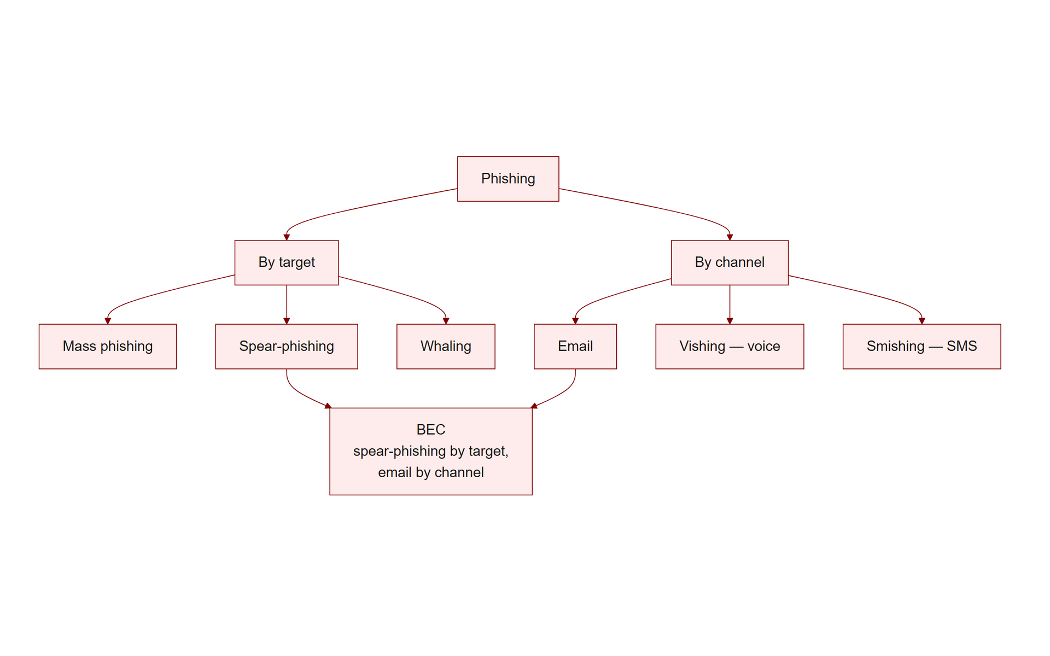
TOPIC 1.1 · 1.1.1.c.2
Phishing, Spear-Phishing, Whaling, Vishing, Smishing
Phishing: Mass, untargeted fraudulent messages, 'Dear Customer', wide net
Spear-phishing: Targeted at a specific person/org using OSINT, personalized and credible (T1566.001)
Whaling: Spear-phishing aimed at C-suite executives ('big fish')
Vishing: Voice phishing over the phone, adds real-time pressure and social instinct (T1566.004)
Smishing: Phishing via SMS text messages
BEC: Business Email Compromise, impersonating an executive to authorize fraudulent transfers or data release
Phishing Taxonomy
Notes:
Phishing is a family of attacks distinguished by targeting and channel. Generic phishing casts the widest possible net and relies on volume, even a 0.1% success rate is profitable at millions of messages. Spear-phishing narrows to a specific victim using reconnaissance, trading volume for credibility. Whaling narrows further to executives, whose approval unlocks large payments.
The channel matters too. Vishing (voice) introduces real-time conversational pressure that email cannot: the victim feels obligated to respond immediately and cannot easily pause to verify. Smishing exploits the trust and brevity of text messages, where truncated URLs hide their destination.
Business Email Compromise (BEC) is the financially dominant category. The FBI's IC3 attributes billions in annual losses to BEC, in which an attacker impersonates a trusted executive or vendor to redirect a wire transfer or extract sensitive data.

Slide 15
02
Why SMTP Is Trusting by Design
Topic 1.1
Notes:
Transition to part 2 of the topic. Pause here for questions before continuing.

Slide 16
TOPIC 1.1 · 1.1.2.a.1
Why SMTP Is Trusting by Design
SMTP: Simple Mail Transfer Protocol, defined in RFC 5321, the internet's mail-delivery postal service
Designed 1982: Built for reliable delivery, not authentication, no native way to verify the sender
Envelope vs. message: RFC 5321 defines the transport envelope; RFC 5322 defines the message content the user reads
Ports: 25 (server-to-server), 587 (client submission)
Consequence: Any server can claim to send on behalf of any domain, spoofing is trivial without add-on controls
Notes:
Email predates most modern security thinking. SMTP was standardized in 1982 (RFC 821, now RFC 5321) in an era when the network was small and every host was assumed cooperative. As a result, the protocol has no built-in mechanism to prove that the sender is who they claim to be. It moves messages reliably and asks no questions about identity.
Crucially, SMTP separates two layers. The envelope (RFC 5321) is what mail servers use to route the message and return bounces, the reader never sees it. The message (RFC 5322) contains the headers and body the mail client displays, including the visible From: line. These two standards were written independently and SMTP never enforces that they agree.
This split is the root vulnerability behind virtually all email spoofing. The bolt-on frameworks SPF, DKIM, and DMARC exist precisely to retrofit sender authentication onto a protocol that was never designed for it.

Slide 17
TOPIC 1.1 · 1.1.2.a.1b
STARTTLS: Confidentiality Without Authentication
STARTTLS: Upgrades a plaintext SMTP connection to an encrypted TLS channel mid-session
What it guarantees: Confidentiality (eavesdroppers cannot read the message) and integrity in transit
What it does NOT guarantee: Sender identity, a fully encrypted session can still carry a spoofed From: header
Opportunistic by default: Many MTAs fall back to unencrypted delivery if STARTTLS negotiation fails
MTA-STS (RFC 8461): A newer standard that lets domains mandate TLS and refuse plaintext fallback
Notes:
STARTTLS is a command that upgrades an existing plaintext SMTP connection to an encrypted TLS session partway through the handshake, rather than requiring encryption from the very first packet. Once negotiated, everything that follows, including the DATA payload containing the visible From: header, travels encrypted and cannot be read or tampered with by anyone monitoring the network path.
The critical exam distinction is that STARTTLS solves confidentiality and in-transit integrity, not authenticity. A perfectly encrypted TLS tunnel can carry a message whose RFC 5322 From: header is completely spoofed, encryption protects the pipe, not the truthfulness of what travels through it. This is exactly why the spoofed transcript studied earlier shows 'STARTTLS' succeeding immediately before the forged From: header is written.
Because classic STARTTLS is opportunistic, a receiving server that fails to negotiate TLS will often silently deliver the message in plaintext anyway, the newer MTA-STS standard (RFC 8461) lets a domain publish a policy demanding TLS and refusing insecure fallback, closing that downgrade gap.

Slide 18
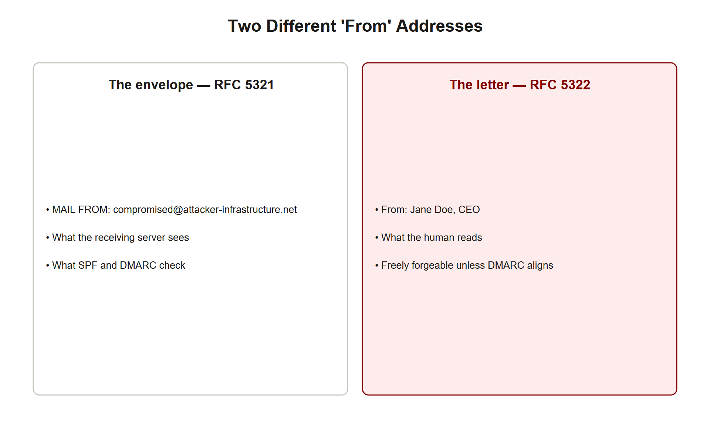
TOPIC 1.1 · 1.1.2.a.2
?
The RFC 5321 / RFC 5322 Split, The Core Spoofing Vulnerability
Envelope sender (RFC 5321): The MAIL FROM / Return-Path, used to route bounces; invisible to the user
Header sender (RFC 5322): The visible From: field rendered by the mail client (Gmail, Outlook)
The gap: SMTP never enforces that these two match
The exploit: Attacker sets MAIL FROM to a domain they control (passing basic checks) but writes CEO@company.com in the visible From:
Result: The victim sees a trusted name; the actual delivering server is attacker-controlled
Envelope Header Split
Notes:
Think of an SMTP email as a letter in an envelope. The envelope (RFC 5321) carries the routing address the post office uses; the letter inside (RFC 5322) carries the return address the recipient reads. The postal system only inspects the envelope. Your inbox only shows you the letter.
An attacker exploits this by putting an address they legitimately control in the envelope MAIL FROM, which may satisfy a naive SPF check, while writing "Jane Doe, CEO" <jane.doe@company.com> in the RFC 5322 From: header. Your mail client displays 'Jane Doe, CEO,' and nothing in the visible interface reveals that the message was actually delivered by attacker-infrastructure.net .
This is why SPF alone is insufficient and why DMARC was invented: DMARC ties authentication back to the visible From: header, closing the gap between what the servers checked and what the human actually sees.

Slide 19
TOPIC 1.1 · 1.1.2.a.3
Reading a Spoofed SMTP Session Transcript
EHLO: Attacker's server introduces itself as mail.attacker-infrastructure.net
MAIL FROM: compromised-account@attacker-infrastructure.net, the real (envelope) sender
From: header: 'Jane Doe, CEO' — the SPOOFED visible sender
Payload: Urgent wire-transfer request with a lookalike link (portal-verification-victim-corp.net)
Tell: Envelope domain and visible From: domain do not match
Notes:
The transcript below is a real-shaped SMTP dialogue. Read it the way a mail server does: the client (C) issues commands, the server (S) responds with numeric codes. Notice that STARTTLS encrypts the channel, encryption protects confidentiality in transit but does nothing to authenticate the sender's identity.
The decisive lines are MAIL FROM (the envelope, attacker-controlled) and the later From: header inside DATA (the spoofed CEO). Everything the finance analyst will see in their inbox comes from that DATA block; the incriminating envelope line is discarded before display. The embedded link points to a lookalike domain, a separate deception layer covered later.
Being able to trace which line the server routes on versus which line the human reads is exactly the analytical skill AP questions probe.

Slide 20
TOPIC 1.1 · 1.1.2.b.1
SPF: Sender Policy Framework (RFC 7208)
What it is: A DNS TXT record listing IPs/CIDR blocks authorized to send mail for a domain
Check target: The receiving MTA extracts the domain from the RFC 5321 MAIL FROM and queries its SPF record
Syntax: v=spf1 ip4:192.0.2.0/24 include:_spf.google.com -all
Qualifiers: -all (HardFail, reject) / ~all (SoftFail, flag) / ?all (Neutral)
Key limitation: SPF validates ONLY the envelope domain, never the visible From: header
Notes:
SPF lets a domain owner publish, in DNS, the list of servers permitted to send email on that domain's behalf. When a message arrives, the receiving Mail Transfer Agent reads the envelope MAIL FROM domain, looks up that domain's SPF TXT record, and checks whether the connecting server's IP is authorized.
The final qualifier sets the enforcement stance. -all (HardFail) instructs receivers to reject unauthorized senders; ~all (SoftFail) delivers but flags them; ?all is neutral. The include: mechanism recursively pulls in a provider's authorized ranges (e.g., Google Workspace), and SPF caps the recursion at 10 DNS lookups.
SPF's fatal gap, emphasized on the previous slides, is that it authenticates the envelope domain only. A message can pass SPF for the attacker's domain while still displaying a spoofed corporate From: address, which is exactly why DMARC is required to complete the picture.

Slide 21
TOPIC 1.1 · 1.1.2.b.1b
Practice: Tracing an SPF Include Chain to Its 10-Lookup Limit
Rule: RFC 7208 caps SPF evaluation at 10 DNS lookups (include, a, mx, ptr, exists mechanisms all count)
Exceeding the limit: The record is treated as a PermError, SPF fails closed for legitimate senders too
Common cause: Nesting many third-party include: statements (marketing platform + CRM + payroll + helpdesk)
Fix pattern: Flatten includes into direct ip4/ip6 ranges, or consolidate senders behind one relay
Exam angle: A legitimate email failing SPF is not always an attack, misconfiguration is a common false positive
Notes:
SPF's include: mechanism lets a domain delegate authorization recursively to a third party's own SPF record, but RFC 7208 caps the total number of DNS lookups triggered during evaluation at 10, specifically to prevent denial-of-service via unbounded recursion. Every include , a , mx , ptr , and exists mechanism consumes one lookup from that budget, and nested includes chain further lookups underneath each one.
Consider a record like v=spf1 include:_spf.google.com include:sendgrid.net include:mailchimp.com include:helpdesk-vendor.com -all . If Google's own SPF record itself nests three more includes, and the CRM vendor's nests two more, the evaluation can quietly exceed 10 lookups. RFC 7208 mandates that once the limit is exceeded, the result is a PermError , which most receivers treat as a fail, meaning a completely legitimate marketing email can bounce.
This is a genuinely common production incident, and the AP exam sometimes tests whether students correctly attribute an SPF failure to misconfiguration rather than assuming every SPF fail indicates an active attack. The fix is to flatten deeply nested includes into direct IP ranges or consolidate outbound mail through fewer relays.

Slide 22
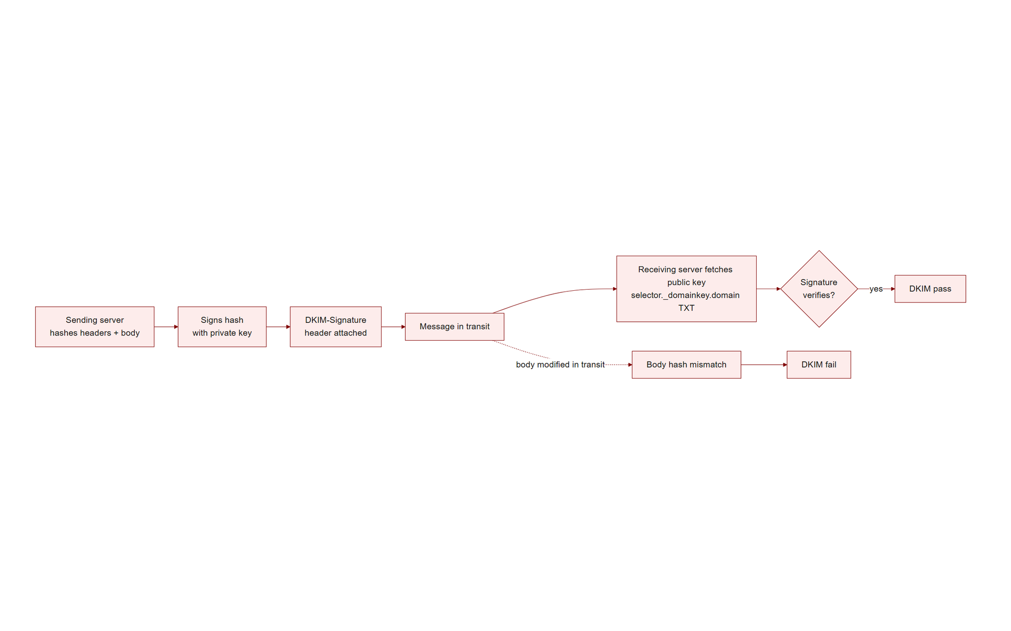
TOPIC 1.1 · 1.1.2.b.2
DKIM: Cryptographically Signing Email (RFC 6376)
What it does: The sending server signs selected headers + body with its private key; the signature rides in a DKIM-Signature header
Verification: Receiver fetches the public key from DNS (selector._domainkey.domain) and verifies the signature
Guarantees: Origin authenticity (came from the domain) and integrity (not altered in transit)
Algorithms: RSA-SHA256 or Ed25519; body hash (bh=) and signature (b=) are Base64
Survives forwarding: Unlike SPF, the signature travels with the message
Dkim Sign Verify
Notes:
DKIM adds a cryptographic seal to email. Before sending, the mail server computes a hash of a defined set of headers and the body, signs that hash with its private key, and attaches the result as a DKIM-Signature header. The receiving server retrieves the matching public key from the sender's DNS, located via the selector ( s= ) at selector._domainkey.domain.com , and verifies the signature.
A valid signature proves two things: the message genuinely originated from a server holding that domain's private key (authenticity), and not a single signed character was altered in transit (integrity). If an attacker modifies the body, the recomputed body hash ( bh= ) will not match and verification fails.
Canonicalization ( c=relaxed/relaxed ) normalizes whitespace and line endings so that benign reformatting by intermediate relays does not break the signature. Because the signature is embedded in the message itself, DKIM, unlike SPF, survives forwarding.

Slide 23
TOPIC 1.1 · 1.1.2.b.2b
Simulating DKIM Signature Verification in Python
Goal: Model, in simplified code, how a receiver checks a DKIM signature against a body hash
Steps: Hash the canonicalized body -> compare to the bh= value -> verify the signature over the headers
Tamper detection: Changing a single byte of the body changes the hash completely (avalanche effect)
Real implementation: Uses RSA/Ed25519 signature verification, not a plain hash comparison, simplified here for clarity
Takeaway: DKIM failure means the message was altered, misconfigured, or never actually signed by the claimed domain
Notes:
Real DKIM verification uses full asymmetric-signature cryptography (RSA-SHA256 or Ed25519), but the core logic, hash the body, compare it to the value the sender committed to, is straightforward to model directly. The simulation below computes a SHA-256 hash of a message body and compares it against a stored bh= value, exactly mirroring the first check a real DKIM verifier performs before it even touches the signature ( b= ) itself.
Run it once with the original body and once with a single character changed. Because cryptographic hash functions exhibit the avalanche effect, altering even one byte produces a completely unrelated hash, so the body-hash check fails immediately and the receiver knows the message was tampered with in transit, this is exactly what would happen if an on-path attacker tried to modify a legitimately DKIM-signed email.
In production, a full verifier additionally fetches the sender's public key from DNS at selector._domainkey.domain.com and cryptographically verifies the b= signature over the canonicalized headers, which proves the hash itself was produced by the legitimate private-key holder rather than by an attacker.

Slide 24
TOPIC 1.1 · 1.1.2.b.3
?
DMARC: Tying It All Together (RFC 7489)
Role: Binds SPF/DKIM results to the visible RFC 5322 From: header via 'alignment'
Requirement: Pass SPF OR DKIM, AND the authenticated domain must align with the visible From: domain
Policy (p=): none (monitor) / quarantine (spam folder) / reject (drop)
Alignment (adkim/aspf): s = strict (exact match) / r = relaxed (subdomains allowed)
Reporting (rua): Aggregate XML reports of authentication results sent to the domain owner
Notes:
DMARC is the keystone that fixes SPF and DKIM's blind spot. Neither SPF nor DKIM, by itself, checks the address the human actually sees. DMARC introduces alignment : to pass, a message must (1) pass SPF or DKIM, and (2) have the authenticated domain match the domain in the visible From: header.
The domain owner publishes a policy telling receivers what to do with messages that fail alignment: p=none merely monitors and reports, p=quarantine diverts to spam, and p=reject drops the message at the gateway. Alignment can be strict (exact domain match) or relaxed (subdomains count). Aggregate reports ( rua ) give the owner visibility into who is sending as their domain, legitimate and malicious alike.
With DMARC at p=reject , the CEO-spoofing attack from earlier fails: the attacker's message may pass SPF for its own domain, but that domain does not align with the victim-corporation.com shown in the From:, so the receiver rejects it.

Slide 25
TOPIC 1.1 · 1.1.2.c.1
A Phishing Indicator Scoring Script
Idea: Combine multiple weak signals into one risk score rather than trusting any single check
Signals: envelope/From mismatch, lookalike domain, urgency keywords, mismatched link host, external banner
Output: A numeric score mapped to allow / flag / quarantine
Principle: Defense-in-depth, no one indicator is decisive, but the combination is
Runnable: Inspect and modify the weights to see how the verdict changes
Notes:
Secure Email Gateways do not rely on a single test; they aggregate many indicators into a composite risk score. The Python below is a simplified model of that logic. It inspects an email represented as a dictionary and adds weighted points for each suspicious signal: an envelope domain that differs from the visible From: domain, a From: domain that is a lookalike of a trusted brand, urgency language, and a link whose host does not match the claimed sender.
The pedagogical point is the philosophy, not the exact weights. A legitimate urgent email from an aligned domain scores low; the CEO-wire-fraud message, mismatched envelope, lookalike link, urgency, accumulates a high score and is quarantined. Adjust the weights and rerun to see how tuning changes the false-positive/false-negative balance.

Slide 26
TOPIC 1.1 · 1.1.2.c.1b
Detecting Lookalike Domains with Edit Distance
Problem: 'bigbank.com' vs 'blgbank.com' differ by one character but read nearly identically at a glance
Levenshtein distance: The minimum number of single-character edits (insert/delete/substitute) between two strings
Detection rule: Flag any inbound sender domain within a small edit distance of a protected brand domain
Complementary signal: Cross-reference with domain age from WHOIS, lookalikes are usually freshly registered
Limitation: Homoglyph attacks (Cyrillic 'а' vs Latin 'a') defeat simple character-edit distance entirely
Notes:
Typosquatted lookalike domains are engineered to survive a fast human glance: swapping a single letter ('bigbank.com' to 'blgbank.com'), adding a hyphen ('secure-bigbank.com'), or appending a plausible subdomain-looking suffix. Levenshtein (edit) distance gives detection systems a precise, computable way to flag these: it counts the minimum number of single-character insertions, deletions, or substitutions needed to turn one string into another.
A Secure Email Gateway or brand-protection service maintains a list of protected domains and computes the edit distance of every inbound sender domain against that list; anything within a distance of one or two triggers a review or automatic quarantine. Combining this with a WHOIS domain-age lookup sharpens the signal further, since legitimate business domains are typically years old while lookalike domains are frequently registered within the prior 30 days specifically for a single campaign.
The technique has a known blind spot: homoglyph attacks substitute visually identical characters from a different alphabet (a Cyrillic 'а', U+0430, instead of Latin 'a', U+0061) which read as zero edit distance to a human eye but require Unicode-aware normalization, not plain character comparison, to catch.

Slide 27
03
Case Study: The 2016 DNC / Podesta Breach (APT28)
Topic 1.1
Notes:
Transition to part 3 of the topic. Pause here for questions before continuing.

Slide 28
TOPIC 1.1 · 1.1.3.a.1
Case Study: The 2016 DNC / Podesta Breach (APT28)
Actor: APT28 / Fancy Bear, attributed to Russian military intelligence (GRU Unit 26165)
Vector: Spear-phishing emails mimicking Google security alerts ('unauthorized login attempt')
Lure: A 'Change Password' button resolving to a lookalike domain harvesting live credentials
Failure chain: Non-MFA accounts + a staffer typo ('legitimate' instead of 'illegitimate')
Impact: 50,000+ emails exfiltrated and leaked, with major geopolitical consequences
Notes:
In 2016, APT28 targeted Democratic National Committee and Clinton campaign staff, including chairman John Podesta. The emails impersonated Google security warnings claiming someone had tried to access the account from abroad, urging the target to 'Change Password.' The button led to a lookalike domain styled to match Google's login page. Once credentials were entered, they were captured in real time.
Because the accounts lacked multi-factor authentication, stolen passwords were sufficient to log in and exfiltrate over 50,000 emails. The incident is also a textbook case of the human chain failing: an aide forwarded the email for verification, and the responder meant to type 'illegitimate' but wrote 'legitimate,' so Podesta clicked. The email had been partially vetted, so System 2 skepticism never re-engaged.
The technical takeaways, lookalike domains, credential harvesting, and the necessity of phishing-resistant MFA, recur throughout modern breach reports.

Slide 29
TOPIC 1.1 · 1.1.3.a.2
?
Case Study: The 2020 Twitter Vishing Hijack
Vector: Vishing, attackers phoned employees posing as IT support about a 'VPN update'
Technique: A real-time phishing proxy captured credentials AND the TOTP one-time code
Why OTP failed: The proxy relayed the live code to the real portal inside the 30-second window
Impact: 130 high-profile accounts hijacked; $110,000+ in crypto scam proceeds in minutes
Lesson: TOTP is not phishing-resistant; FIDO2/WebAuthn is
Notes:
In July 2020, attackers used OSINT to map Twitter's internal support structure, then phoned employees impersonating IT staff and directing them to update their VPN configuration on a lookalike portal. The portal acted as a real-time man-in-the-middle: as the employee typed their username, password, and then their TOTP code, the proxy forwarded each to the genuine Twitter login before the 30-second code expired.
This is the crucial lesson about time-based one-time passwords: they defeat replay of yesterday's password, but they do not defeat a live proxy relaying today's code in real time. The attackers reached the internal admin dashboard, seized 130 verified accounts, and ran a cryptocurrency doubling scam.
The defense is domain-bound, phishing-resistant authentication, FIDO2/WebAuthn, where the hardware key refuses to sign a challenge from the wrong origin, making real-time proxying cryptographically impossible.

Slide 30
TOPIC 1.1 · 1.1.3.a.3
?
Case Study: Ubiquiti Networks Business Email Compromise ($46.7M)
Vector: Business Email Compromise (BEC), no malware, purely impersonation of a real executive-approval chain
Technique: Attackers used spoofed/lookalike domains and internal-sounding language to authorize wire transfers
Scale: Approximately 17 separate fraudulent wire transfers over several weeks in 2015, totaling $46.7 million
Detection gap: No single transfer was large enough alone to trigger automatic review thresholds
Recovery: Roughly $8.1 million recovered through law enforcement and international cooperation, the rest was lost
Notes:
Ubiquiti Networks, a networking hardware manufacturer, disclosed in 2015 that finance employees had been deceived by a Business Email Compromise scheme into wiring approximately $46.7 million to overseas accounts controlled by attackers. Unlike the Podesta or Twitter incidents, this attack involved no credential harvesting or account takeover at all, the impersonation happened entirely through spoofed or lookalike sender domains combined with internally plausible language mimicking real approval workflows for a corporate subsidiary's overseas transactions.
The attack's structure exploited a specific weakness in financial controls: each individual transfer was kept below the dollar threshold that would trigger secondary manual review or additional executive sign-off, so seventeen transfers accumulated over several weeks before the fraud was discovered. This 'stay under the threshold' pattern recurs across BEC cases and is a specific control-design lesson distinct from the technical email-spoofing mechanics covered earlier.
Ubiquiti ultimately recovered only about $8.1 million of the total loss through law enforcement cooperation, illustrating that post-incident recovery in international wire fraud is partial at best, prevention (DMARC, callback verification, transaction-pattern monitoring) is far cheaper than remediation.

Slide 31
04
WebAuthn / FIDO2: Phishing-Resistant MFA
Topic 1.1
Notes:
Transition to part 4 of the topic. Pause here for questions before continuing.

Slide 32
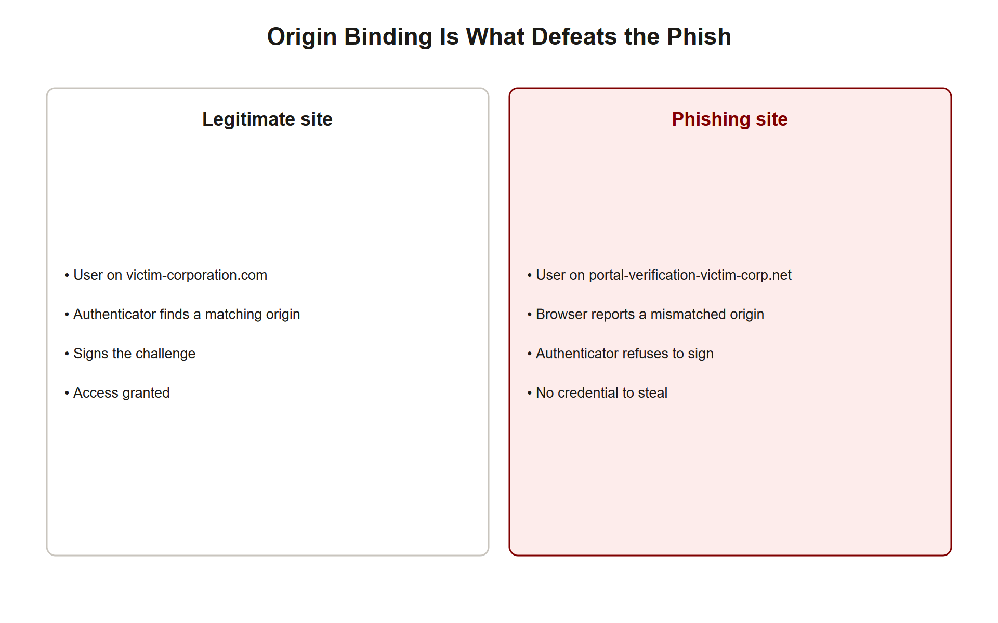
TOPIC 1.1 · 1.1.4.a.1
WebAuthn / FIDO2: Phishing-Resistant MFA
Standard: W3C WebAuthn (Level 2, 2021), part of FIDO2, hardware keys (YubiKey, Titan) or platform passkeys
Core property: Domain-origin binding, the private key signs only challenges from the exact registered origin
Effect: On a lookalike site, the browser detects the origin mismatch and the authenticator refuses to sign
Beats: Real-time phishing proxies (the 2020 Twitter attack), credential replay, and password theft
Guidance: NIST SP 800-63B recommends FIDO2 as the gold standard for high-risk accounts
Webauthn Origin Binding
Notes:
WebAuthn replaces (or supplements) passwords with asymmetric cryptography anchored to a physical authenticator. During registration, the browser records the site's origin and the authenticator stores a private key that will only ever sign challenges bearing that exact origin. The matching public key is held by the server.
The security payoff is decisive against phishing. If a user is lured to portal-verification-victim-corp.net instead of victim-corporation.com , the browser passes the fake origin to the authenticator, which finds no matching credential for that origin and refuses to sign. There is nothing for a real-time proxy to relay, because the signed data cryptographically includes the origin. This is why FIDO2 would have stopped both the Podesta credential harvest and the Twitter proxy attack.
Organizations should migrate high-risk and privileged accounts away from SMS and TOTP toward hardware-backed WebAuthn, which is the only widely deployed MFA that is genuinely phishing-resistant.

Slide 33
TOPIC 1.1 · 1.1.4.a.1b
Passkeys: Making WebAuthn Usable at Consumer Scale
Passkey: A consumer-friendly implementation of WebAuthn credentials, synced across a user's devices via cloud account
UX shift: Replaces 'plug in a hardware key' with Face ID / Windows Hello / fingerprint, lowering adoption friction
Sync mechanism: Credentials are end-to-end encrypted and synced through the platform's cloud (Apple iCloud Keychain, Google Password Manager)
Still origin-bound: The underlying WebAuthn origin-binding guarantee is unchanged, only the key-storage UX differs
2023–2024 rollout: Apple, Google, and Microsoft all shipped passkey support across their major platforms
Notes:
Hardware security keys are cryptographically ideal but create real adoption friction: they cost money, can be lost, and require users to carry a physical object. Passkeys solve the adoption problem while preserving WebAuthn's core security property. Instead of a dedicated hardware token, the private key is generated and stored by the operating system's secure enclave and unlocked with a biometric (Face ID, fingerprint) or device PIN, no separate object to carry.
To work across a user's phone, laptop, and tablet, passkeys are synced through the platform's cloud account (Apple's iCloud Keychain, Google's Password Manager) using end-to-end encryption, so the platform provider itself cannot read the private key material even though it facilitates the sync.
Crucially for this topic, the origin-binding guarantee that defeats phishing proxies is identical whether the private key lives in a $30 USB hardware key or in an iPhone's secure enclave, passkeys are a usability improvement layered on the same WebAuthn cryptographic foundation studied earlier, not a weaker substitute for it.

Slide 34
TOPIC 1.1 · 1.1.4.a.2
Rolling Out DMARC: The Three-Phase Path to p=reject
Phase 1, p=none: Monitor only; collect aggregate reports to discover all legitimate senders
Phase 2, p=quarantine; pct=100: Route unaligned mail to spam while confirming no legitimate mail breaks
Phase 3, p=reject; pct=100: Drop all unaligned mail at the gateway, full enforcement
Why phased: Jumping straight to reject can block legitimate third-party senders (payroll, CRM, marketing)
Industry driver: Since Feb 2024, Google/Yahoo require DMARC for bulk senders (>5,000 msgs/day)
Notes:
Publishing p=reject on day one is dangerous: organizations almost always have legitimate third parties sending on their behalf, payroll processors, ticketing systems, marketing platforms, that are not yet SPF/DKIM aligned. Rejecting immediately would bounce real business mail.
The disciplined rollout is staged. Phase 1 ( p=none ) changes nothing about delivery but turns on aggregate reporting, revealing every source sending as your domain. Phase 2 ( p=quarantine ) begins diverting unaligned mail to spam while you confirm that all legitimate streams are properly authenticated. Phase 3 ( p=reject ) achieves full protection: spoofed mail is dropped at the gateway.
The February 2024 Google and Yahoo mandate, requiring valid DMARC for any domain sending over 5,000 messages per day, turned this from best practice into an operational necessity, roughly doubling adoption of enforcing policies within a year.

Slide 35
TOPIC 1.1 · 1.1.4.b.1
Mail Gateway Hardening and the External Banner
Secure Email Gateway (SEG): All mail passes through a filter (Proofpoint, Mimecast, IronPort) before reaching users
Display-name spoof detection: Flag messages whose display name matches an internal exec but originate externally
External banner: Inject 'CAUTION: external sender' warnings on all inbound mail from outside the org
URL rewriting: Re-evaluate links at click-time to catch URLs weaponized after delivery
Young-domain quarantine: Auto-hold mail from domains registered in the last 30 days
Notes:
Even with SPF, DKIM, and DMARC, a Secure Email Gateway provides essential additional layers. A common attack that DMARC does not fully address is display-name spoofing from a completely different domain, for example, a Gmail account whose display name is set to 'Jane Doe, CEO.' The SEG can detect that the display name matches a known internal executive while the sending domain is external, and flag or quarantine it.
External-sender banners are a cheap, high-value control: a persistent visual warning on every message from outside the organization re-engages System 2 precisely when an internal-impersonation attack tries to look internal. URL rewriting lets the gateway evaluate links at the moment of click, catching pages that were benign at delivery and turned malicious afterward. Quarantining mail from very newly registered domains blunts lookalike-domain campaigns, which typically use freshly bought domains.

Slide 36
TOPIC 1.1 · 1.1.4.b.1b
?
The Procedural Layer: Out-of-Band Callback Verification
Rule: Any request to change a payment destination, reset a credential, or move funds requires independent verification
Out-of-band: Verification must use a channel and contact method NOT supplied in the suspicious message itself
Correct practice: Call the known number on file, never the number listed in the email or text being verified
Why it beats even perfect deception: A flawless deepfake voice or email still cannot answer a callback to a number the attacker doesn't control
Cost: Adds friction and a few minutes of delay, the entire point, since delay re-engages System 2
Notes:
Every technical control studied so far can, in principle, be defeated by a sufficiently well-executed impersonation, a perfect deepfake voice clone, a flawlessly matched lookalike domain, or a compromised legitimate account. The procedural layer is designed to remain effective even in that worst case, because it does not depend on detecting that something is fake; it depends on independently confirming the request through a channel the attacker does not control.
The specific practice is out-of-band callback verification: before executing any credential reset, payment change, or fund transfer, the recipient calls the requester back using a phone number already on file in a trusted internal directory, never a number supplied in the email, text, or call being verified, since a supplied number is trivially attacker-controlled. If 'Jane Doe, CEO' emails asking for a wire transfer, verification means calling the CFO's known extension, not the phone number printed at the bottom of the suspicious email.
This single procedural rule is what neutralizes deepfake voice-cloning attacks, which have already been used in real BEC incidents to imitate an executive's actual voice on a phone call, technology that fools human perception entirely, but which still cannot answer a callback placed to a number the attacker never touches.

Slide 37
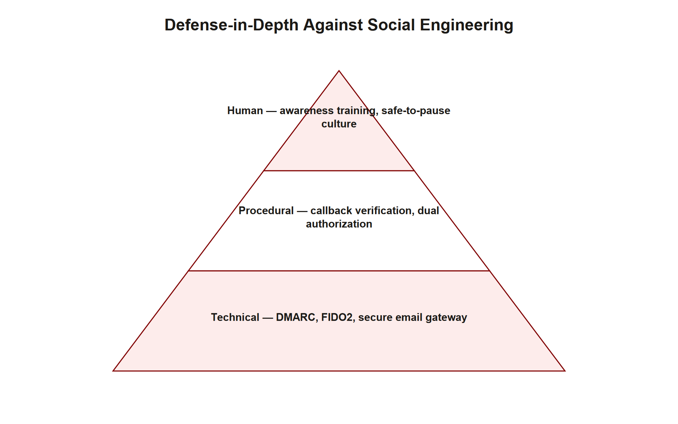
TOPIC 1.1 · 1.1.4.b.2
The Three-Layer Defense Hierarchy
Technical: DMARC p=reject, FIDO2/WebAuthn, SEG with lookalike-domain detection
Procedural: Mandatory callback verification for any credential or payment request, regardless of urgency
Human: Security-awareness training targeting Cialdini's six triggers specifically
Framework: NIST SP 800-50 defines the Security Awareness & Training (SA&T) program
Principle: No single layer stops social engineering, defense must be layered
Defense Hierarchy
Notes:
Because social engineering attacks the seam between technology and people, no single control is sufficient. Effective defense operates on three coordinated layers. The technical layer makes impersonation hard: DMARC at reject stops domain spoofing, FIDO2 stops credential phishing, and SEGs catch what slips through. The procedural layer defeats the attacks technology cannot: a policy requiring out-of-band callback verification for any payment or credential change means that even a perfect deepfake of the CEO cannot move money, because the analyst must call a known number first.
The human layer is the last line: training that teaches staff to recognize Cialdini's levers and to slow down and engage System 2 under pressure. Crucially, culture must make it safe to pause a suspicious request without career risk. Most organizations invest only in the human layer; genuine resilience requires all three.

Slide 38
TOPIC 1.1 · 1.1.4.b.2b
NIST SP 800-50: Structuring a Security Awareness & Training Program
Framework: NIST SP 800-50, 'Building an Information Technology Security Awareness and Training Program'
Awareness vs. training: Awareness changes attitude/attention ('notice it'); training builds a specific skill ('handle it correctly')
Program lifecycle: Needs assessment -> program design -> material development -> implementation -> post-training evaluation
Metric that matters: Report rate of simulated phishing (did they flag it?), not just click rate (did they fall for it?)
Culture requirement: Programs fail if employees fear punishment for reporting a mistake, so they hide it instead
Notes:
NIST SP 800-50 distinguishes awareness from training , a distinction the exam expects precisely: awareness activities (posters, short reminders, phishing-simulation debriefs) aim to keep security top-of-mind and recognize when something is off; training builds an actual procedural skill, such as correctly executing callback verification or correctly escalating a suspected incident. A mature program budgets for both, not just one.
The publication lays out a program lifecycle: assess what the organization's specific risk profile and skill gaps are, design a program targeted at those gaps (rather than generic content), develop the actual materials, implement them organization-wide, and then evaluate effectiveness, closing the loop back into reassessment.
The single most informative operational metric is not the click-through rate on simulated phishing emails, but the report rate: what fraction of employees who received the simulation actively flagged it to security, regardless of whether they also clicked. A high report rate alongside some clicks indicates a healthy culture where people notice and escalate; a low report rate combined with punitive responses to mistakes indicates employees are hiding errors instead of surfacing them, which is strictly worse for organizational security than the original mistake.

Slide 39
TOPIC 1.1 · 1.1.4.b.2c
Practice: Designing a Phishing Simulation Debrief
Scenario: Your simulated phishing email had a 22% click rate and only a 4% report rate this quarter
Diagnosis task: What does the gap between click rate and report rate suggest about program design?
Design task: Propose one change to the debrief process, and one change to organizational culture
Constraint: No individual public shaming, debriefs must be blameless per NIST SA&T guidance
Deliverable: A one-paragraph revised debrief message sent to staff who clicked
Notes:
Work this as a program designer, not just a test-taker. A 22% click rate paired with only a 4% report rate is a specific, diagnosable pattern: most employees who noticed something suspicious did not take the extra step of reporting it, and a meaningful fraction who clicked never realized anything was wrong at all. That combination points toward a program that has taught 'don't click' as an isolated rule without teaching 'and then report it' as the completing step, and possibly a culture where reporting a mistake carries a felt risk of embarrassment or discipline.
A credible design fix pairs two changes: first, revise the debrief message shown immediately after a simulated click so it explicitly walks the employee through the exact reporting mechanism (a one-click 'report phishing' button, or a specific address) rather than only saying 'you clicked a simulated phishing link'; second, make a visible, blameless policy statement, explicitly per NIST SP 800-50 guidance, that reporting a suspicious email or an accidental click is treated as a success story, never grounds for individual criticism, since punitive cultures measurably suppress future reporting.
The deliverable is not a punishment memo. It should read as encouragement: acknowledge the click happened, immediately explain the tell they can catch next time, and make the reporting path the single easiest next action to take.

Slide 40
05
Signature vs. Anomaly Detection of Phishing
Topic 1.1
Notes:
Transition to part 5 of the topic. Pause here for questions before continuing.

Slide 41
TOPIC 1.1 · 1.1.5.a.1
Signature vs. Anomaly Detection of Phishing
Signature-based: Match known-bad strings, sender IPs, and URL blocklists, fast, precise, but blind to novel attacks
Anomaly-based: Model normal mail flow and flag deviations, catches novel campaigns, more false positives
Example signature: SPF Check: FAIL for a specific known-malicious sender IP
Example anomaly: A sudden burst of external mail spoofing an executive's display name
SOC practice: Use both, signatures for the known, anomaly models for the unknown
Notes:
Security Operations Centers detect phishing with two complementary philosophies. Signature-based detection compares incoming mail against databases of known-bad indicators: malicious sender IPs, blacklisted URLs, known malware hashes, and specific header patterns. It is fast and produces few false positives, but it is fundamentally reactive, it cannot flag an attack whose indicators have never been seen before.
Anomaly-based detection instead learns a baseline of normal behavior (typical senders, volumes, and header patterns) and alerts on statistically significant deviations. It can catch a brand-new campaign, at the cost of more false positives that analysts must triage.
The mature answer, tested throughout this course, is to run both: signatures cheaply eliminate the known threats, freeing anomaly models and human analysts to focus on the novel and the ambiguous. This same signature-vs-anomaly framing returns in Topic 1.5 for malware and ransomware.

Slide 42
TOPIC 1.1 · 1.1.5.a.2
Reading the Indicator: SPF Check FAIL
Artifact: 'SPF Check: FAIL for Sender IP 203.0.113.12' on inbound mail to port 110 (POP3)
Meaning: The sending IP is not authorized in the envelope domain's SPF record
Not conclusive alone: Misconfigured legitimate senders also fail SPF, correlate with other signals
SOC action: Correlate with DMARC result, display-name checks, and URL reputation before verdict
Mitigation: Enforce DMARC and SEG rules; detection is logging, mitigation is blocking
Notes:
A log line reading SPF Check: FAIL for Sender IP 203.0.113.12 is an indicator of compromise, not a verdict. It means the connecting server's IP does not appear in the authorized-sender list published by the envelope domain. That is highly suspicious, but SPF failures also occur when a legitimate sender is misconfigured or when mail is forwarded, so an analyst correlates it with other signals before acting.
This distinction, detection versus mitigation, is central to security operations. Logging and alerting on the SPF failure is detection (the security camera). Enforcing a DMARC reject policy and gateway rules that actually drop the message is mitigation (the shield). A SOC rule that flags future SPF failures is a detective control; the DMARC/SEG configuration that blocks the mail is the preventive control.
Understanding which controls detect versus prevent, and never treating a single indicator as proof, is the analytical habit this unit builds.

Slide 43
TOPIC 1.1 · 1.1.5.a.2b
Reading a DMARC Aggregate (rua) Report
Format: Compressed XML sent daily/weekly to the address in the domain's rua= tag
Per-record fields: Source IP, message count, SPF result, DKIM result, and the disposition applied
Analyst task: Distinguish legitimate third-party senders (need an SPF include: added) from genuine spoofing attempts
Red flag pattern: High volume from an unrecognized IP with both SPF and DKIM failing and no legitimate business reason
Tooling: dmarcian, Postmark's DMARC Digests, and Google Admin Toolbox parse raw XML into readable dashboards
Notes:
DMARC's rua= tag directs every participating receiver (Gmail, Outlook, Yahoo, and others) to periodically email the domain owner a compressed XML aggregate report summarizing every message they saw claiming to be from that domain, regardless of whether it passed or failed. Each record lists the sending IP, an approximate message count, and the SPF and DKIM results plus the disposition (none/quarantine/reject) that was applied.
An analyst's job is to triage these records into two buckets. Some failing records represent legitimate business senders the domain owner simply forgot to authorize, a payroll vendor or CRM platform sending on the company's behalf without being included in the SPF record or configured with DKIM, and the fix is adding that vendor to the authorized list. Other failing records represent genuine impersonation attempts from infrastructure the domain owner has never heard of, sending in volumes with no plausible legitimate purpose.
Because raw DMARC XML is verbose and genuinely painful to read by hand, production teams almost always run it through a parsing service such as dmarcian or Google's Admin Toolbox, which renders the same data as a sortable dashboard highlighting which sending sources need to be authorized versus blocked.

Slide 44
TOPIC 1.1 · 1.1.5.b.1
?
Incident Response Walkthrough: Umbrella Corp
Scenario: Alert on endpoint 198.51.100.99; logs show traffic targeting email headers
Artifact: 'SPF Check: FAIL for Sender IP 203.0.113.12'
Task 1: Identify the threat mechanism exploiting human trust triggers
Task 2: Determine the configuration change, deploy DMARC/SPF gateway controls
Task 3: Document SOC rules to flag future SPF verification failures
Notes:
You are the analyst at Umbrella Corp. Frank reports an alert. Work the incident as a professional would. First, analyze : the SPF FAIL on inbound mail, combined with a request targeting a human, indicates an email-impersonation / phishing attempt exploiting cognitive trust triggers (authority + urgency). The spoofed sender is trying to satisfy header trust while the envelope betrays it.
Second, mitigate : harden the mail path. Publish/strengthen the SPF record, enforce DMARC alignment at p=reject , and configure the Secure Email Gateway to flag external mail bearing internal executive display names and to quarantine young lookalike domains. Roll out FIDO2 for accounts targeted by credential harvesting.
Third, detect going forward : write SOC rules that alert on repeated SPF verification failures from the same or related infrastructure, correlate them with DMARC failures and display-name anomalies, and feed confirmed indicators back into the signature blocklist.

Slide 45
TOPIC 1.1 · 1.1.5.b.1b
?
Incident Response Walkthrough #2: The Vishing Callback
Scenario: A help-desk technician receives a call: caller ID shows the CFO's real extension, voice sounds correct, requests an urgent password reset
Artifact: Call log shows the internal extension was spoofed via a compromised PBX trunk, not actually dialed by the CFO's handset
Task 1: Identify why caller ID and voice similarity are insufficient identity proof here
Task 2: Name the procedural control that should have stopped the reset regardless of how convincing the call was
Task 3: Propose one technical control for the phone system itself, mirroring DMARC's role for email
Notes:
Walk this incident the way a mature SOC would, extending the identify -> mitigate -> detect structure to a non-email channel. Identify: caller ID is a self-reported field, not a cryptographically verified one, the calling party's PBX/VoIP trunk can be configured to display any number, exactly analogous to the RFC 5322 From: header being self-reported and unauthenticated in SMTP. Voice similarity, even without an actual synthetic deepfake, is likewise not a verified identity credential over a phone line.
Mitigate: the specific control this incident calls for is the same procedural rule studied earlier, the technician should have refused to act on the call itself and instead placed an independent callback to the CFO's number on file in the internal directory, not simply trusted the caller ID display. No password reset for a privileged account should ever be completed on the basis of an inbound call alone, regardless of how legitimate it sounds.
Extend the analogy: just as SPF/DKIM/DMARC let email receivers cryptographically verify sender domains, telephony has an analogous emerging standard, STIR/SHAKEN (RFC 8224/8588), which cryptographically signs the calling number at the carrier level so spoofed caller ID can be flagged before it ever reaches the technician's phone.

Slide 46
TOPIC 1.1 · 1.1.5.b.2
?
Common Misconception: 'A Firewall Stops Phishing'
Belief: Installing a firewall eliminates social-engineering risk
Why students believe it: Firewalls filter border traffic, suggesting nothing bad can enter
Why it's wrong: Phishing arrives over legitimate ports (443/25) and targets the human, not the network
Correct model: Defense-in-depth adds DMARC, FIDO2, and human controls at the endpoint and inbox
Takeaway: Perimeter controls cannot inspect the intent of a person reading an email
Notes:
A firewall inspects and filters network traffic at the perimeter, and it is genuinely valuable, but it operates at the wrong layer to stop social engineering. A phishing email travels over the same ports (SMTP 25, HTTPS 443) as legitimate business communication. To the firewall, a spear-phishing message and a genuine invoice are indistinguishable packets on an allowed port.
More fundamentally, the target of social engineering is not the network but the human operating it. No border device can inspect whether the person reading an email will be persuaded to wire money. This is the 'overconfidence in a single control' fallacy: assuming one strong defense covers all threats.
The correct mental model is defense-in-depth positioned where the attack actually lands: authentication frameworks in DNS and the mail gateway, phishing-resistant MFA at login, and trained humans plus procedural checks at the inbox and the payment desk.

Slide 47
TOPIC 1.1 · 1.1.5.c.1
?
Synthesis: Vulnerability, Control, and Detection Working Together
Human trust triggers: The cognitive levers (Cialdini principles) attackers exploit to bypass verification
Email headers: The RFC 5322 fields (From:, Subject:) the client renders, the target of spoofing
DMARC/SPF gateway configurations: The preventive control that authenticates senders and blocks impersonation
SPF verification checks: The parsing/logging logic SOCs use to flag and alert on authentication failures
Vulnerability vs. threat: The weakness (trust triggers) vs. the active adversary exploiting it
Notes:
This slide consolidates the vocabulary the assessment uses precisely. The vulnerability is the set of human trust triggers, the biases and heuristics that let attackers bypass verification. The asset being protected is the email header trust that users rely on to judge a sender. The control is DMARC/SPF gateway configuration, a preventive mitigation that authenticates senders and enforces alignment. The detective process is SPF verification checking, the logging and alerting logic that flags failures.
Precision matters on the exam. Do not confuse a vulnerability (a weakness) with a threat (an active adversary), a mitigation (which blocks) with a detection (which logs), or authentication (proving identity) with encryption (protecting confidentiality). Each pairing is a favorite source of distractors.
Keep these mappings crisp and you can decode almost any scenario prompt into identify -> mitigate -> detect.

Slide 48
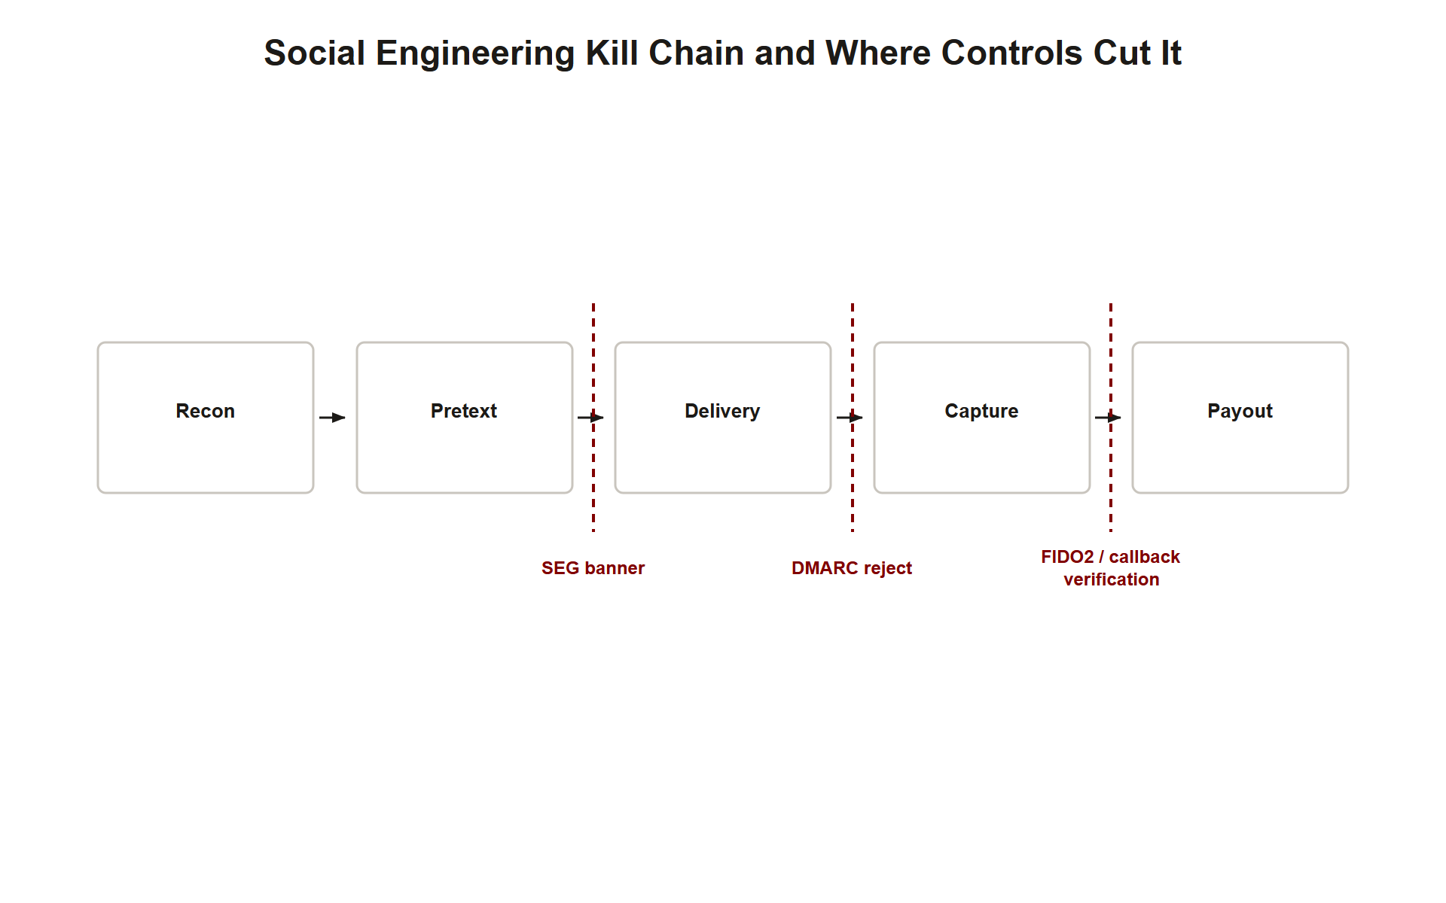
TOPIC 1.1 · 1.1.5.c.2
?
Synthesis: The Anatomy of a Complete Attack
1. Recon (OSINT): Map the org, pick a high-value target, gather personal detail
2. Pretext + principle: Craft a believable story leveraging Authority + Urgency
3. Delivery: Spoofed email (envelope/header split) or vishing call with a lookalike portal
4. Capture: Harvest credentials / real-time proxy the OTP / authorize a transfer
5. Defense collapse points: DMARC reject, FIDO2, callback verification each break the chain
Attack Chain Defenses
Notes:
A complete social-engineering attack is a chain, and defense means breaking any single link. Reconnaissance selects and profiles the target. A pretext supplies the story, powered by Cialdini's levers, and is designed to keep the victim in System 1. Delivery exploits a technical weakness, the SMTP envelope/header split for email, or a real-time proxy portal for vishing. Capture monetizes access: harvested credentials, relayed one-time codes, or an authorized wire transfer.
Map each defense to the link it severs. DMARC at reject breaks delivery for domain spoofing. A Secure Email Gateway banner re-engages System 2 at the pretext stage. FIDO2 breaks capture by making harvested or relayed credentials useless. Out-of-band callback verification breaks capture even against a flawless deepfake. Because attackers only need one link to hold, defenders deploy overlapping controls so that a single failure is not catastrophic.
This chain-and-links model is the durable takeaway of the entire subunit.

Slide 49
TOPIC 1.1 · 1.1.5.c.2b
Common Exam Distractor Patterns for Topic 1.1
Distractor 1: Confusing SPF ('who is authorized') with DKIM ('is this signed and unaltered')
Distractor 2: Claiming encryption (TLS/STARTTLS) proves sender authenticity, it proves confidentiality only
Distractor 3: Treating a single SPF failure as definitive proof of an attack rather than a signal requiring correlation
Distractor 4: Naming 'stronger passwords' or 'a firewall' as the fix for a human-layer social-engineering scenario
Distractor 5: Saying 'MFA' generically when the scenario specifically requires distinguishing phishing-resistant (FIDO2) from proxy-able (TOTP/SMS) MFA
Notes:
Across this topic's assessment items, a small number of distractor patterns recur so often they are worth memorizing as a checklist to actively watch for. First, SPF and DKIM answer different questions and examiners frequently swap them in wrong-answer choices: SPF authorizes which infrastructure may send (an IP-authorization check), while DKIM proves the specific message was signed by the claimed domain and unaltered (a cryptographic-signature check). Second, any answer choice implying that encryption in transit (TLS, STARTTLS) proves who sent a message is always wrong, encryption is a confidentiality property, entirely orthogonal to authentication.
Third, be suspicious of any answer treating one failed check as conclusive proof of an attack; real analysis correlates SPF, DKIM, DMARC, and behavioral signals together, since misconfiguration produces the same individual failure a genuine attack does. Fourth, whenever a scenario clearly describes a human being manipulated, a pretext, an urgent request, a spoofed identity, an answer naming a purely network-layer control (firewall, antivirus, stronger password policy) as the fix is a distractor; the correct answer must operate at the mail-authentication, MFA, procedural, or human-training layer.
Fifth, when a scenario specifically involves a real-time relay or proxy of a one-time code, a generic 'enable MFA' answer is insufficiently precise, full credit requires identifying that TOTP/SMS MFA remains proxy-able while only origin-bound FIDO2/WebAuthn resists it.

Slide 50
TOPIC 1.1 · 1.1.5.c.3
Exam Readiness Checklist for Topic 1.1
Can you name and identify all six Cialdini principles from a scenario (with dual names)?
Can you explain the RFC 5321 vs. 5322 split and why SPF alone fails to stop spoofing?
Can you distinguish SPF (authorization), DKIM (signature), and DMARC (alignment policy)?
Can you explain why TOTP is proxy-able but FIDO2 is phishing-resistant (origin binding)?
Can you structure an incident answer as identify -> mitigate -> detect with named controls?
Notes:
Use this checklist to self-assess before the assessment. Each item corresponds to a high-frequency question pattern for this topic. If you cannot confidently do all five, revisit the linked slides.
The two concepts most likely to earn or lose points are (1) the envelope/header split as the root cause of spoofing, stated with both RFC numbers, and (2) the reason FIDO2 defeats real-time phishing where TOTP does not, the phrase 'domain-origin binding.' Beyond those, expect a Cialdini-identification multiple-choice item and at least one 'defend against social engineering' response requiring the three-layer hierarchy (technical, procedural, human).
Finally, keep the detection-versus-mitigation distinction sharp: a logging/alerting rule detects; a DMARC reject or FIDO2 enrollment mitigates. Scenario prompts almost always ask for both, and mixing them up costs marks.

