Slide 1
AAYAT-AP-PREP · CYBERSECURITY
INTRODUCTION TO SECURITY
Topic 1.2: Suspicious Website Logins
Account takeover usually begins with a guessable password rather than a broken algorithm. This topic examines the observable signs of an online password attack, the habits that make guessing profitable for an adversary, and the practices that make authentication substantially harder to defeat.
3 learning objectives · College Board AP Cybersecurity Course Framework
Notes:
Cover slide for Topic 1.2: Suspicious Website Logins. Account takeover usually begins with a guessable password rather than a broken algorithm. This topic examines the observable signs of an online password attack, the habits that make guessing profitable for an adversary, and the practices that make authentication substantially harder to defeat.

Slide 2
TOPIC 1.2
Learning Objectives
Analyze Risk
Recognize the common signs that an account is the target of a password attack.
1.2.A
Analyze Risk
Explain how adversaries take advantage of weak authentication practices.
1.2.B
Mitigate Risk
Explain the measures that make authentication stronger.
1.2.C
Objectives paraphrased from the AP Cybersecurity Course Framework (College Board, AP Career Kickstart).
Notes:
Read each learning objective aloud and connect it to the exam skill category before starting the topic.

Slide 3
TOPIC 1.2 · CONCEPT MAP
Credential Harvesting Redirect
Victim Browser
Phishing Site
Legitimate Portal
1. Clicks link in spoofed email
2. Returns cloned login interface
3. Submits credentials (username/password)
4. Stores credentials in DB, redirects (HTTP 302)
5. Browser loads legitimate home page

Slide 4
TOPIC 1.2 · CONCEPT MAP
Credential Stuffing Flow
01
02
03
04
05
DATABASE LEAK
BOT SCRIPTING
TARGET ATTACK
RESULT FILTERING
ACCOUNT TAKEOVER
Adversary obtains cleartext or hashed credential lists from a prior breach site.
Attacker loads credentials into automated stuffing scripts (e.g. Sentry MBA).
Automation bot sends high-speed login requests to target portal (e.g. banking).
Script separates successful accounts (200 OK) from failed guesses (401 Unauthorized).
Attacker secures access, changes contact details, or drains financial balances.

Slide 5
TOPIC 1.2
The Big Idea
A spoofed login page is a fake teller's window set up right next to the real one at the bank. It looks identical to the customer standing in line — but the money, in this case your credentials, goes into a completely different vault.
Hold onto this picture — we'll come back to it as the mechanics get more technical.
Notes:
Big-idea framing for Topic 1.2. Open with this analogy before the mechanics: "A spoofed login page is a fake teller's window set up right next to the real one at the bank. It looks identical to the customer standing in line — but the money, in this case your credentials, goes into a completely different vault." Ask students for their own version of the analogy before moving on.

Slide 6
01
The Three Factors of Authentication
Topic 1.2
Notes:
Transition to part 1 of the topic. Pause here for questions before continuing.

Slide 7
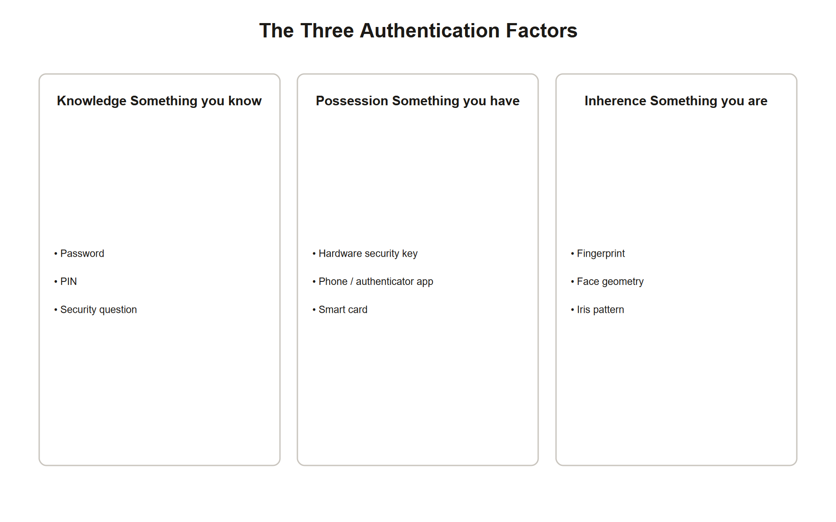
TOPIC 1.2 · 1.2.1.a.1
?
The Three Factors of Authentication
Knowledge: Something you know, passwords, PINs, passphrases, security questions
Possession: Something you have, hardware keys, smart cards, authenticator apps
Inherence: Something you are, fingerprints, facial geometry, iris, voice, typing rhythm
MFA rule: Combining two factors from the SAME category is not MFA, two passwords is still one factor
Irreversibility asymmetry: A stolen password can be changed; a compromised fingerprint cannot
Auth Factor Taxonomy
Notes:
Every authentication scheme in modern computing reduces to some combination of three canonical factor categories. Knowledge factors are shared secrets, a password, a PIN, the answer to a security question, and their defining weakness is that a secret provides zero protection once an attacker knows it. Possession factors are physical objects, a hardware security key, a smart card, a phone running an authenticator app, that are far harder to steal remotely because they require physical access or theft of a specific device.
Inherence factors are biometric: fingerprints, facial geometry, iris patterns, even behavioral signals like typing cadence. Biometrics are convenient because they cannot be forgotten, but they carry a unique irreversibility risk that knowledge factors do not: if a password database leaks, the fix is a password reset; if a fingerprint template leaks, the user cannot grow a new fingerprint.
True multi-factor authentication requires combining factors from at least two different categories. A password plus a security question is still purely knowledge-based and provides essentially no additional protection against a determined attacker who has already compromised one secret, a distinction the exam tests directly.

Slide 8
TOPIC 1.2 · 1.2.1.a.2
Why Offline Cracking Is the Real Threat Model
Online attack: Guessing passwords directly against a live login form, slow, loud, rate-limited
Offline attack: Attacker already has stolen hashes and cracks them on their own hardware with no rate limit
Why breaches change everything: Once hashes are exfiltrated, IDS/firewalls/rate-limiting no longer apply at all
Hardware: GPU clusters and ASICs can compute billions of hash attempts per second offline
Consequence: Password storage design (the hash function itself) matters more than login-page defenses once a breach occurs
Notes:
Two fundamentally different threat models exist for password attacks, and confusing them leads to weak defenses. An online attack tests guesses directly against a live login endpoint, where every attempt is visible to the server, subject to rate limiting, and can trigger account lockout or CAPTCHA, this is a slow, detectable attack surface that modern web applications defend well.
An offline attack begins after an attacker has already exfiltrated a database of password hashes, typically via a data breach. From that point forward, none of the server's live defenses apply at all, there is no rate limiter, no IDS, no lockout policy, because the attacker is no longer talking to the server. They run guesses entirely on their own hardware, and modern GPU clusters or purpose-built ASICs can attempt billions of candidate passwords per second against a weak hash function.
This asymmetry is why password storage, specifically, the choice of hash function, is a fundamentally more important control than any login-page rate limiter. A breach converts an online, defensible attack into an offline, essentially undefendable one unless the stored hash itself was deliberately engineered to be slow to compute.

Slide 9
TOPIC 1.2 · 1.2.1.b.1
?
Why Fast Hashes (MD5, SHA-1, SHA-256) Are Wrong for Passwords
Design intent: MD5/SHA-1/SHA-256 are optimized for speed, ideal for verifying file integrity, terrible for secrets
MD5: Cryptographically broken (2004 collision attack); a GPU computes ~68 billion MD5 hashes/second
SHA-1: Broken for collisions (Google's SHAttered, 2017); LinkedIn's unsalted SHA-1 was cracked within 72 hours
SHA-256: Not broken cryptographically, but still catastrophically fast, billions/second on consumer GPUs
Core problem: A hash function designed to be fast for legitimate verification is equally fast for an attacker's guesses
Notes:
MD5, SHA-1, and SHA-256 were engineered for a completely different job than password storage: verifying that a large file has not been corrupted or tampered with, where speed and low latency are the entire point. Computing a SHA-256 checksum of a multi-gigabyte file in milliseconds is a feature for integrity checking and a catastrophic liability for password storage, because an attacker verifying a guessed password against a stolen hash benefits from that exact same speed.
MD5 (1992) is additionally cryptographically broken in the collision-resistance sense, two different inputs can be found that produce the same hash, and a modern GPU can compute roughly 68 billion MD5 hashes per second, making any password hashed with it recoverable in practical time. SHA-1 (1995) suffered a similar fate: Google's 2017 SHAttered attack demonstrated a practical collision, and its speed on GPUs is comparable to MD5's, LinkedIn's 2012 breach, discussed later, used unsalted SHA-1 and was substantially cracked within 72 hours.
SHA-256 remains cryptographically unbroken as a general-purpose hash function, but it is still fundamentally the wrong tool for passwords: it computes so quickly that low-entropy passwords fall to brute force in milliseconds once the hash database is stolen. The fix is not a 'more secure' fast hash, it is a deliberately slow, key-stretching algorithm, covered next.

Slide 10
TOPIC 1.2 · 1.2.1.b.2
Salting: Defeating Rainbow Tables
Rainbow table: A precomputed lookup table mapping common strings to their hash outputs
Without salt: Identical passwords across different users produce identical hashes, one table cracks everyone
Salt: A random, per-user value combined with the password BEFORE hashing
Effect: Two users with password 'password123' get completely different stored hashes
Not secret: The salt is stored alongside the hash in plaintext, its value only needs to be unique, not hidden
Notes:
Because SHA-256('password123') always produces the exact same output, an attacker can precompute hashes for millions of common passwords once and store the results in a rainbow table, a reusable lookup structure that instantly reverses any unsalted hash matching a common password, regardless of which website or user it came from.
Salting defeats this by combining a random, unique value (the salt) with the password before hashing, so that hash(salt_A + "password123") and hash(salt_B + "password123") produce completely unrelated outputs even though the underlying password is identical. An attacker now needs a separate rainbow table for every distinct salt value in the database, with a properly random salt per user, this effectively forces the attacker back to computing hashes one guess at a time per account, exactly as if no precomputation had ever been possible.
A common misconception is that the salt itself must be kept secret. It does not, salts are stored in plaintext directly alongside the hash in the database. Their security value comes entirely from uniqueness and randomness, not secrecy; modern algorithms like bcrypt and Argon2id generate and embed a random salt automatically as part of their standard output format.

Slide 11
TOPIC 1.2 · 1.2.1.c.1
?
Credential Stuffing: Weaponizing Password Reuse
Definition: Replaying stolen username/password pairs from one breach against unrelated services
Exploits: The human habit of reusing the same password across multiple sites
Scale: Verizon DBIR 2024, credential stuffing accounts for roughly 24% of breaches
Distinct from brute force: Stuffing uses real leaked credentials, not guessed combinations
Automation: Botnets distribute attempts across thousands of IPs to evade per-IP rate limits
Notes:
Credential stuffing does not guess passwords, it replays passwords that are already known to be real, harvested from an entirely different, unrelated breach. If a user's LinkedIn password leaked in 2012 and that same user reused the identical password on their bank's website, an attacker's automated script trying that exact pair against the bank's login form has a real chance of success, entirely independent of the bank's own security posture.
The attack's effectiveness rests purely on human password-reuse behavior, which remains extremely common despite decades of security-awareness messaging. Because the credentials are drawn from real breach dumps rather than dictionary guesses, success rates per attempt are dramatically higher than classic brute force, and the Verizon Data Breach Investigations Report attributes roughly a quarter of all breaches to this technique.
Modern credential-stuffing campaigns are automated through botnets, networks of compromised machines, that distribute login attempts across thousands of source IP addresses, each making only a handful of attempts, specifically to stay under any single IP's rate-limiting threshold while still testing enormous credential lists in aggregate.

Slide 12
02
The WebAuthn Challenge-Response Sequence
Topic 1.2
Notes:
Transition to part 2 of the topic. Pause here for questions before continuing.

Slide 13
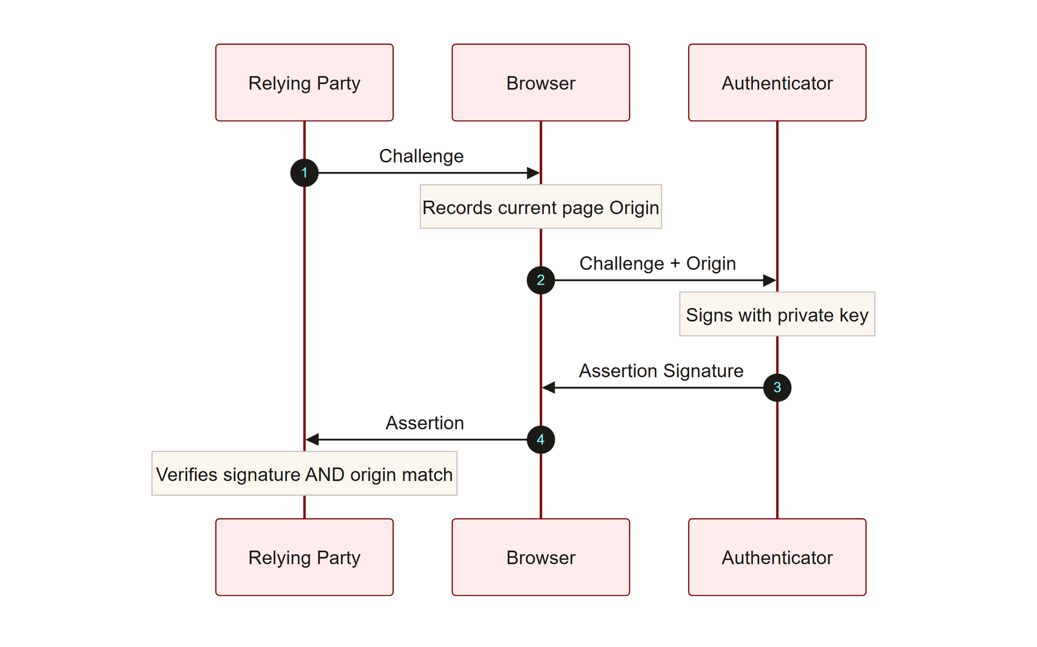
TOPIC 1.2 · 1.2.2.a.1
The WebAuthn Challenge-Response Sequence
WebAuthn: W3C browser API (part of FIDO2) enabling passwordless, phishing-resistant authentication
Roles: Client browser, physical/platform authenticator, and the Relying Party (the server)
Flow: Server issues a random challenge -> browser records the current page's origin -> authenticator signs both
Key property: ClientDataJSON embeds the browser-verified origin inside the signed data itself
Verification: Server checks the signature AND that the embedded origin matches the registered one
Webauthn Challenge Flow
Notes:
WebAuthn authentication is a three-party protocol: the client browser, a physical or platform authenticator (a hardware key or a device's secure enclave), and the Relying Party, the server verifying identity. The Relying Party begins by sending a fresh random challenge to the browser. Critically, the browser itself, not the website's JavaScript, records the actual origin (scheme, hostname, port) of the page currently loaded, and packages both the challenge and this browser-verified origin into a structure called ClientDataJSON .
The authenticator signs a hash of this combined data using the private key generated specifically for this Relying Party during registration. Because the private key never leaves the authenticator device, and because the signed payload embeds the actual origin the browser observed, the server can verify two things simultaneously with one signature check: that the correct private key was used, and that the request genuinely originated from the exact domain that registered the credential in the first place.
This is a fundamentally different trust model from passwords, which carry no cryptographic binding to the site they're being typed into, a password works identically whether typed into the real site or a perfect visual clone. WebAuthn's origin binding makes that clone-immunity possible.

Slide 14
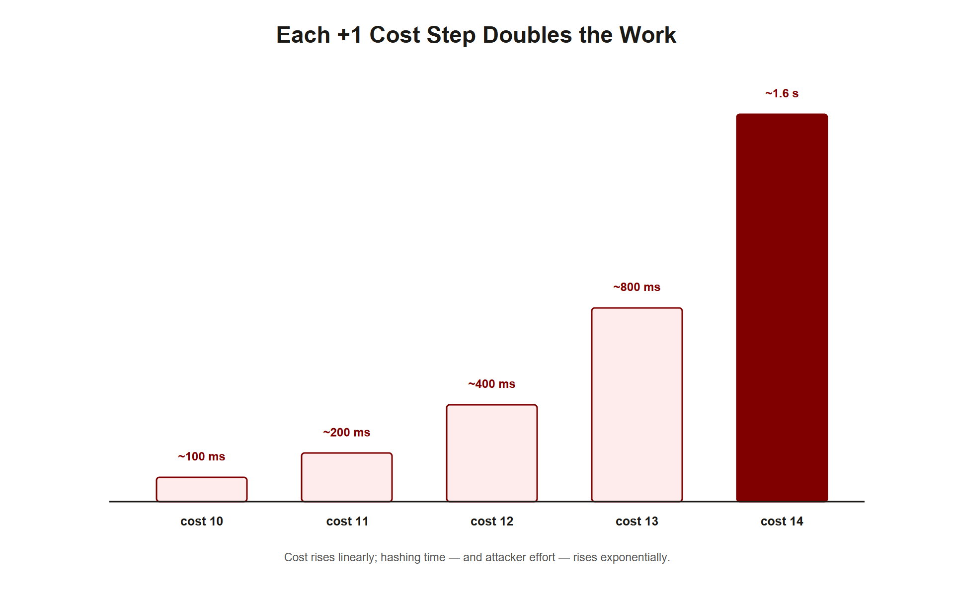
TOPIC 1.2 · 1.2.2.a.2
?
bcrypt: The Exponential Work-Factor Cost Parameter
Origin: Provos & Mazières (1999), based on the Blowfish cipher
Work factor (cost) C: Controls how many Blowfish key-schedule iterations run before returning a hash
Formula: Iterations = 2^C, each increment of C doubles computation time
Practical numbers: C=10 ≈ 100ms, C=12 ≈ 350ms, C=14 ≈ 1.4 seconds per hash
Future-adaptable: As hardware speeds up, simply raising C restores the original computational cost
Img 1.2.2 Bcrypt Workfactor
Notes:
bcrypt's defining feature is a single tunable cost parameter, C, that controls the number of iterations of its internal Blowfish-based key-setup routine. The relationship is exponential: total iterations equal 2 raised to the power of C, so each single increment of C doubles the time required to compute one hash. At C=12, the current OWASP-recommended minimum, the algorithm performs 4,096 iterations, taking roughly 350 milliseconds on typical server hardware.
350 milliseconds is imperceptible to a legitimate user logging in once. But for an attacker attempting to crack a stolen hash by trying a billion candidate passwords, that same 350ms per attempt multiplies into a computational cost that is millions of times larger than an equivalent fast hash like SHA-256 would require, turning what would be a milliseconds-scale offline attack into one requiring years or centuries of compute time.
The design was explicitly named 'future-adaptable' by its authors: because computing hardware reliably gets faster over time (historically following something like Moore's Law), a fixed-cost hash function becomes progressively weaker every year even without any flaw being discovered. bcrypt sidesteps this by letting administrators simply raise C as hardware improves, restoring the original real-world computational cost without changing the algorithm itself.

Slide 15
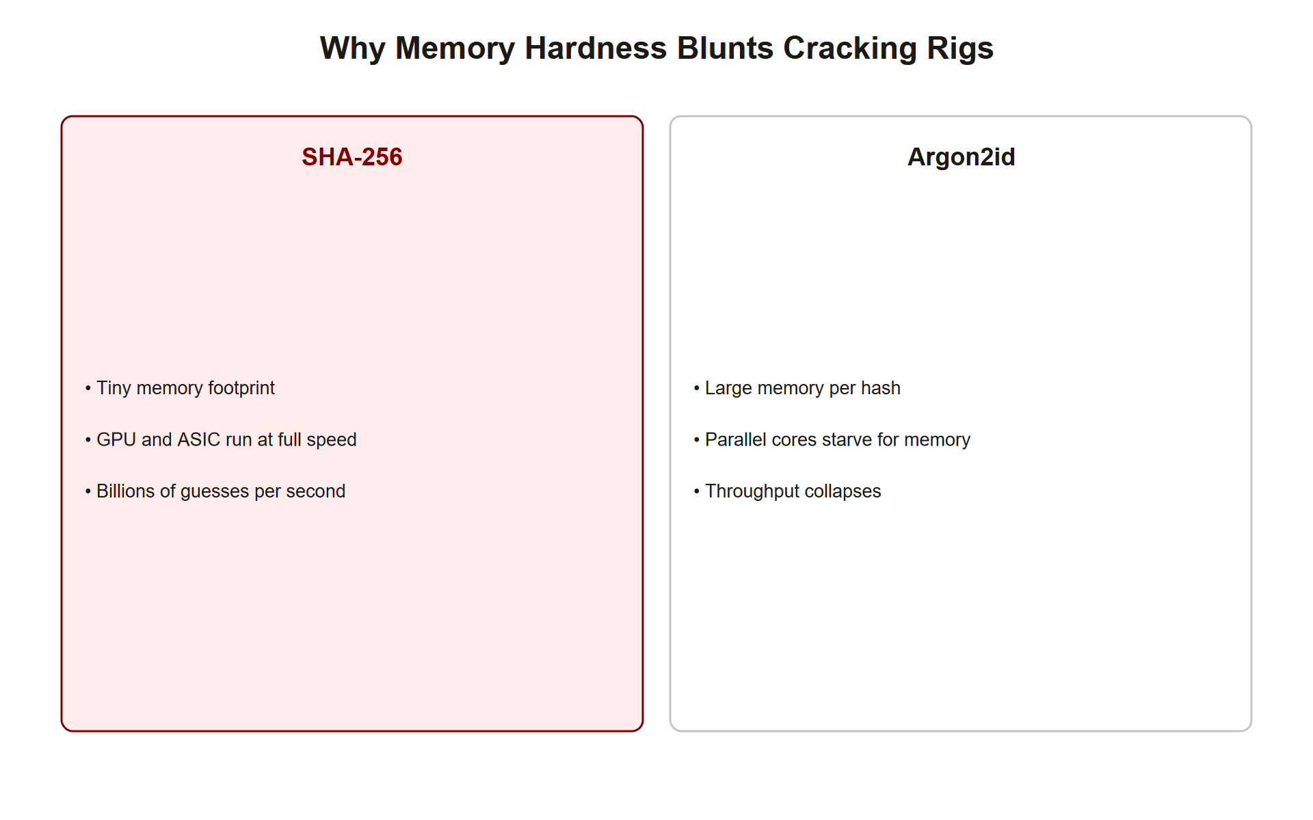
TOPIC 1.2 · 1.2.2.a.3
Argon2id: Memory-Hardness Against GPUs and ASICs
Winner: 2015 Password Hashing Competition; standardized in RFC 9106 (2021)
Three parameters: Memory cost (m, in KiB), Time cost (t, passes), Parallelism (p, threads)
OWASP 2024 recommendation: m=65536 (64MB), t=3, p=4
Memory-hardness: Requires large, pseudo-randomly-accessed memory blocks, GPUs have huge core counts but limited shared memory bandwidth
Effect on GPUs: A GPU that could run thousands of parallel SHA-256 attempts can run only a handful of parallel Argon2id attempts limited by RAM
Img 1.2.2 Argon2 Memory Hardness
Notes:
Argon2id, the hybrid variant of the algorithm that won the 2015 Password Hashing Competition, adds a defense that bcrypt lacks: deliberate memory-hardness. Where bcrypt's cost is purely a function of computation time, Argon2id additionally forces each hash attempt to allocate and repeatedly access a large block of memory, specified by the memory-cost parameter m in KiB, with the OWASP-recommended 65,536 corresponding to 64 megabytes per single hash computation.
This matters because of a structural weakness in GPU architecture: GPUs achieve their raw speed through thousands of small, simple cores, but those cores share a comparatively limited pool of memory bandwidth. A fast hash function like SHA-256 needs almost no memory per attempt, so a GPU can run thousands of parallel attempts limited only by core count. Argon2id's 64MB-per-attempt requirement means a GPU with, say, 8GB of onboard memory can run only a small handful of parallel attempts before exhausting available RAM, collapsing the GPU's core-count advantage entirely.
The time-cost parameter t (number of passes over the memory) and parallelism p (independent lanes within a single hash computation, not across different password guesses) round out the tuning surface. Because purpose-built ASICs are economical specifically when a computation needs little memory, Argon2id's memory-hardness also makes dedicated cracking hardware far less cost-effective to build than it would be against a purely compute-bound algorithm.

Slide 16
TOPIC 1.2 · 1.2.2.a.4
Practice: Simulating and Comparing Hash Costs
Goal: Feel the real time difference between a fast hash and a key-stretched one in code, not just in theory
Method: Time SHA-256 vs. a simulated iterated-hash loop standing in for bcrypt's work factor
Observation: The iterated version takes measurably, deliberately longer for the identical logical operation
Scaling insight: Multiply the per-hash time difference by a billion guesses to see why this matters at attack scale
Caveat: This is a pedagogical simulation, real bcrypt/Argon2id use purpose-built cryptographic internals, not a plain loop
Notes:
The code below is not a real bcrypt or Argon2id implementation, it is a simplified simulation designed to make the abstract 'work factor' concept viscerally concrete. It times a single SHA-256 computation against a loop that repeats hashing 2^12 = 4,096 times, mirroring bcrypt's iteration count at cost=12, and prints the ratio.
Run it and note that the single SHA-256 call completes in a small fraction of a millisecond, while the iterated version takes measurably longer, exactly the design goal. Now extrapolate: an attacker attempting one billion candidate passwords against a stolen SHA-256 hash database might finish in seconds to minutes on a single GPU; against a properly configured bcrypt or Argon2id database, the identical billion attempts could take years, because every single one of those billion guesses now individually costs the iterated computation time, not the instant one.
This is the entire practical argument for key-stretching in one demonstration: the defender pays the cost once per legitimate login (imperceptible), while the attacker pays it once per guess (existential), and a billion-guess attack multiplies that per-guess cost into an intractable total.

Slide 17
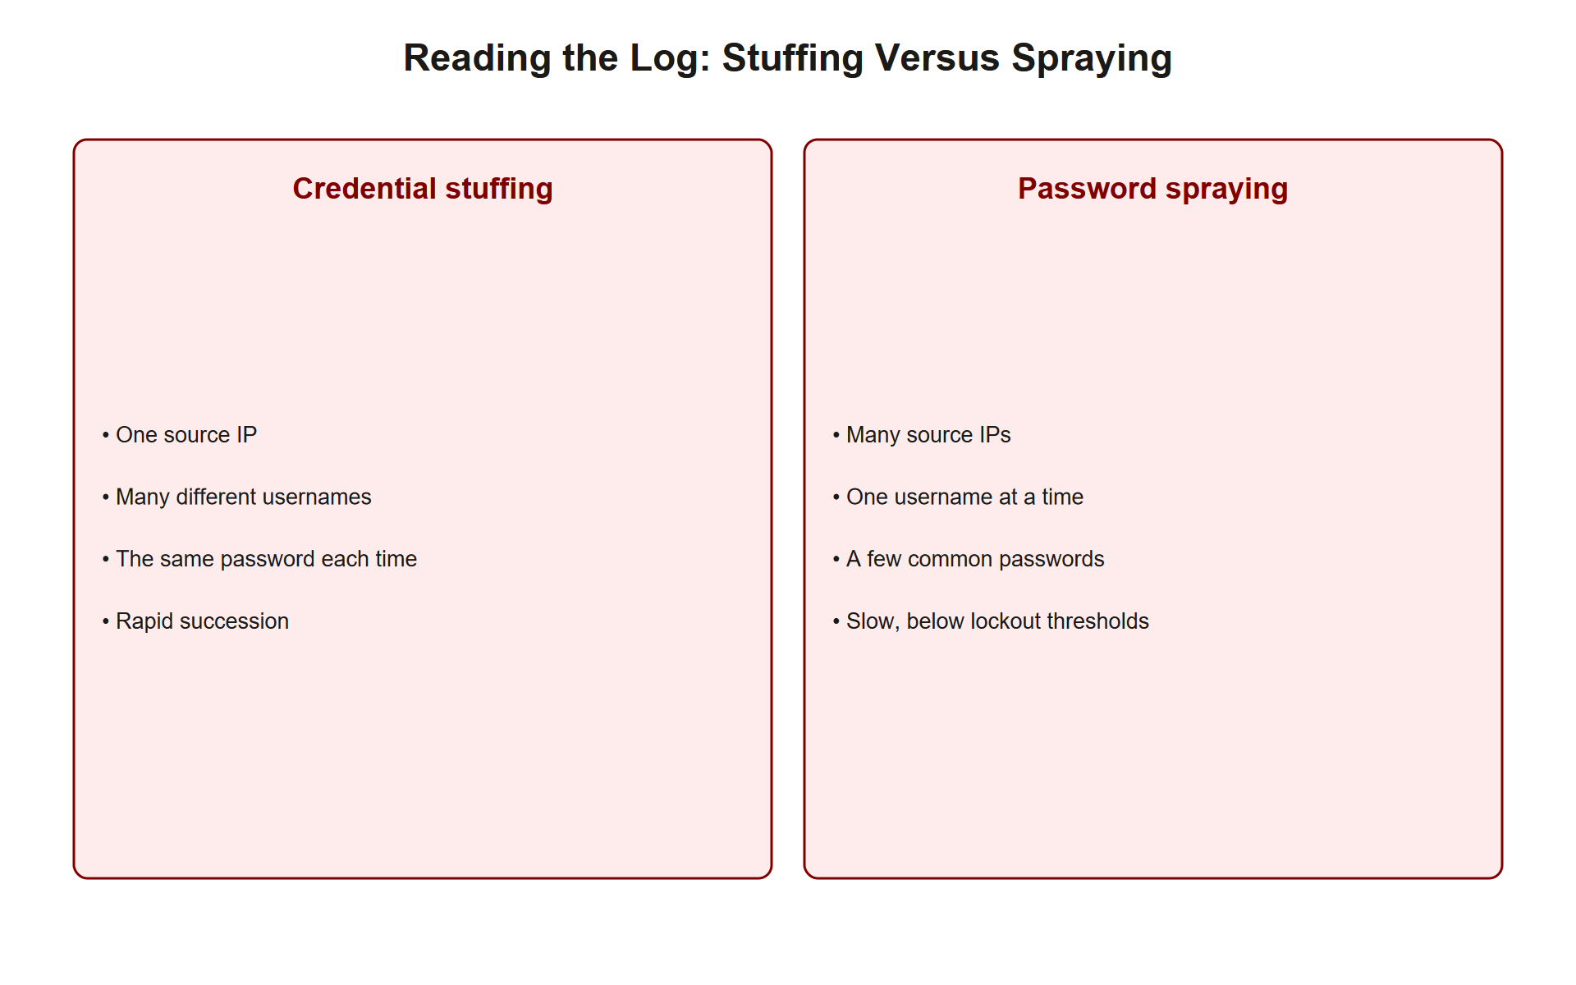
TOPIC 1.2 · 1.2.2.b.1
Auditing Logs for Credential Stuffing Patterns
Signal 1: High distribution, many different usernames attempted, not one account hammered repeatedly
Signal 2: Many distinct source IPs, each making only a few attempts, botnet distribution to dodge per-IP limits
Signal 3: Identical or near-identical User-Agent strings across requests, indicates scripted automation
Signal 4: Uniform timing between requests, programmatic delay rather than natural human variance
Analyst task: Correlate all four signals together; any single one alone can occur naturally
Img 1.2.2 Credential Stuffing Log
Notes:
Detecting credential stuffing in raw authentication logs is a pattern-recognition task across several independently weak signals. The signature pattern is a high volume of failed logins spread across many distinct usernames and many distinct source IP addresses, where no single IP or username individually crosses a naive rate-limiting threshold, this is precisely the distributed structure that a botnet is designed to produce.
Two secondary signals sharpen the diagnosis. Automation scripts frequently reuse the exact same User-Agent header across every request, since a bot rarely bothers to randomize this field unless specifically engineered to; real human traffic naturally shows far more device and browser diversity. Similarly, genuine human login attempts show natural timing variance, while scripted attacks often show suspiciously uniform intervals between requests, a fixed delay baked into the attack tooling.
No single signal alone is conclusive: a legitimate spike in traffic, a shared corporate NAT IP, or a common browser extension could each individually produce one of these patterns innocently. The analyst's actual skill is correlating multiple weak signals into a confident verdict, the same defense-in-depth-of-evidence principle introduced for phishing detection in Topic 1.1.

Slide 18
TOPIC 1.2 · 1.2.2.b.2
?
Have I Been Pwned and k-Anonymity Breach Checking
HIBP: Troy Hunt's aggregated database of over 14 billion breached credential records
NIST requirement: SP 800-63B recommends checking new passwords against known-breached password lists
Privacy problem: Naively sending a full password (even hashed) to a third-party API leaks it
k-anonymity solution: Send only the first 5 hex characters of the SHA-1 hash; receive all matching suffixes back
Result: The client locally checks its own full hash against the returned list, the full password never leaves the device
Notes:
NIST SP 800-63B recommends that authentication systems check candidate passwords against databases of previously breached credentials at registration and password-change time, rejecting known-compromised passwords outright regardless of how 'complex' they appear. Have I Been Pwned, maintained by security researcher Troy Hunt, is the most widely used such database, aggregating well over 14 billion breached account records.
Implementing this check naively would require sending the user's actual password, or even its full hash, to a third-party API, which is itself a serious privacy and security risk; a compromised or malicious API could harvest every password checked against it. HIBP's Pwned Passwords API solves this with k-anonymity: the client computes the SHA-1 hash of the candidate password locally, then sends only the first five hexadecimal characters of that hash to the API.
The API responds with every known breached hash suffix that shares that same five-character prefix, typically several hundred entries, and the client compares its own full hash locally against that returned list. The full password and its full hash never leave the user's device at all; only a broad, ambiguous five-character prefix is transmitted, shared by hundreds of thousands of other possible hashes, making it impossible for the API operator to determine which specific password was actually checked.

Slide 19
03
Case Study: The 2012 LinkedIn Unsalted SHA-1 Breach
Topic 1.2
Notes:
Transition to part 3 of the topic. Pause here for questions before continuing.

Slide 20
TOPIC 1.2 · 1.2.3.a.1
?
Case Study: The 2012 LinkedIn Unsalted SHA-1 Breach
Vector: Database compromise exposing password hashes for approximately 6.5 million accounts
Root cause: Passwords hashed with SHA-1 and NO salt, identical passwords produced identical hashes
Result: Rainbow tables cracked over 90% of leaked hashes within 72 hours
Hidden scale: Full scope (117 million accounts) wasn't disclosed until 2016, sold on dark markets for ~5 Bitcoin
Legacy: Accelerated industry-wide migration to salted, key-stretched hashing (bcrypt adoption surge)
Notes:
LinkedIn's 2012 breach is the canonical teaching case for why salting is non-negotiable. The exposed database stored user passwords hashed with plain SHA-1 and no per-user salt, meaning any two users who happened to choose the identical password, a very common occurrence given how few distinct passwords the general population actually uses, produced byte-for-byte identical stored hashes.
This allowed attackers to deploy precomputed rainbow tables covering common passwords once, and instantly recover any account whose hash matched, with no per-account computation required at all. Within 72 hours of the breach becoming public, security researchers and attackers alike had cracked over 90% of the leaked hashes, exposing widespread simple-password use and rampant password reuse across other services.
The full scope of the breach was dramatically understated at first disclosure. It emerged in 2016 that the true number of compromised accounts was not 6.5 million but 117 million, the additional 110 million records surfaced on dark web markets four years later, still enabling credential-stuffing attacks against users who had never changed their now-ancient but still-valid password.

Slide 21
TOPIC 1.2 · 1.2.3.a.2
?
Case Study: Colonial Pipeline (2021), A Single Reused Password
Vector: A legacy VPN account with no MFA, using a password leaked in an unrelated prior breach
Technique: Classic credential stuffing, the exact leaked password/username pair worked on the VPN
Result: DarkSide ransomware group encrypted operational systems; company paid a $4.4M Bitcoin ransom
Impact: Multi-day shutdown of the largest US refined-oil pipeline; regional gas shortages
Root cause: Absence of ANY single layered control, MFA, IP allowlisting, or anomaly detection, would have stopped it
Notes:
In May 2021, Colonial Pipeline, operator of the largest refined petroleum pipeline system in the United States, suffered a ransomware attack whose root cause traced back to a single compromised VPN account. Investigators determined the account's password had been exposed years earlier in a completely unrelated public data breach, and the employee had reused that same password for the company VPN.
The VPN account had no multi-factor authentication enabled, so possession of the correct password alone, obtained through straightforward credential stuffing against a public breach dump, was sufficient for the attacker to gain network access. From that foothold, the DarkSide ransomware-as-a-service group encrypted the company's billing and operational technology systems, forcing a complete multi-day operational shutdown and triggering fuel shortages across the US East Coast. Colonial ultimately paid a $4.4 million Bitcoin ransom, of which the FBI later recovered roughly $2.3 million.
The FBI's post-incident analysis is a textbook defense-in-depth failure case: the account had no MFA, the VPN enforced no geolocation or IP restrictions, and no behavioral anomaly detection flagged the anomalous login. Any single one of these three independent controls, a free authenticator app being the cheapest, would very likely have prevented the entire chain of national-scale consequences.

Slide 22
04
Choosing and Configuring a Password Hashing Algorithm
Topic 1.2
Notes:
Transition to part 4 of the topic. Pause here for questions before continuing.

Slide 23
TOPIC 1.2 · 1.2.4.a.1
Choosing and Configuring a Password Hashing Algorithm
2024 OWASP preference order: Argon2id first choice, bcrypt as a well-supported fallback
Argon2id config: m=65536 (64MB), t=3, p=4, 32-byte output, auto-generated salt
bcrypt config: cost factor >= 12 (roughly 350ms per hash)
Retire immediately: Any system still using MD5 or SHA-1/SHA-256 directly for password storage
Migration pattern: Re-hash with the new algorithm the next time each user successfully logs in (avoids a risky bulk re-hash of a live password database)
Notes:
Applying the prior mechanism slides operationally, OWASP's 2024 Password Storage Cheat Sheet recommends Argon2id as the first choice where the platform supports it, configured with a memory cost of 65,536 KiB (64MB), a time cost of 3 passes, and 4 parallel lanes, parameters chosen to balance real-world login latency against attacker cost. Where Argon2id is unavailable, bcrypt with a cost factor of at least 12 remains an excellent, battle-tested fallback used by default in many major web frameworks.
Any system still hashing passwords with MD5, unsalted SHA-1, or bare SHA-256 has a critical, immediately actionable finding: none of these are acceptable for credential storage regardless of any other compensating control, and migration should be treated as urgent.
Migrating a live system away from a legacy hash function presents a practical challenge: you cannot recover a user's plaintext password from its old hash to re-hash it with the new algorithm. The standard, low-risk migration pattern is lazy re-hashing, verify the user's password against the old hash one final time at their next successful login (since the plaintext is briefly available at that moment), then immediately compute and store a new hash using the modern algorithm, retiring the old hash for that account. Accounts that never log in again over time can be handled with a forced password reset.

Slide 24
TOPIC 1.2 · 1.2.4.b.1
?
Rate Limiting with the Token Bucket Algorithm
Token bucket: A bucket fills with tokens at a fixed rate; each request consumes one token
Burst tolerance: Unlike a flat per-second cap, the bucket allows short bursts up to its capacity
Applied to login: e.g., 5 tokens max, refilling 1 per minute, permits a few genuine mistypes, blocks sustained abuse
Dual-key tracking: Rate limit BOTH by source IP and by target username to catch both attack shapes
Escalation: Combine with exponential backoff and eventual CAPTCHA/lockout for repeated violations
Notes:
The token bucket algorithm models rate limiting as a bucket that continuously fills with tokens at a fixed rate and drains one token per incoming request; a request is only allowed through if a token is currently available, and requests are rejected or delayed once the bucket is empty. Its key advantage over a simple fixed-window counter is graceful burst tolerance: a user who mistypes their password twice in quick succession is not unfairly blocked, since the bucket can hold several tokens at once, while sustained high-volume abuse still drains the bucket and gets throttled.
For login endpoints specifically, effective configurations track two separate buckets simultaneously: one keyed by source IP (catching a single attacker hammering many accounts from one machine) and one keyed by target username (catching a distributed botnet credential-stuffing attempt against one specific high-value account from many different IPs). Relying on only one of these misses the other attack shape entirely, exactly the asymmetry credential stuffing is designed to exploit.
Rate limiting alone is rarely the final control; mature implementations pair it with exponential backoff (each successive failure imposing a longer delay before the next attempt is accepted) and, after repeated violations, a CAPTCHA challenge or temporary account lockout, escalating the friction imposed specifically on the party currently failing to authenticate.

Slide 25
TOPIC 1.2 · 1.2.4.c.1
?
NIST SP 800-63B: Modern Password Policy Guidance
Length over complexity: Minimum 8 characters (14+ for privileged accounts); maximum at least 64 to allow passphrases
No mandatory composition rules: Explicitly discourages required uppercase/number/symbol mixes
No mandatory periodic rotation: Forced regular password changes are no longer recommended
Breach-database screening: Compare new passwords in real time against known-compromised password lists
Why the reversal: Complexity rules produce predictable human substitutions ('password' -> 'P@ssw0rd!') attackers already anticipate
Notes:
NIST SP 800-63B's 2020 revision reversed decades of conventional password-policy wisdom based on empirical research into how humans actually respond to rules. Length, not composition complexity, is now the primary lever: a minimum of 8 characters (raised to 14 or more for privileged/administrative accounts), with systems required to accept passphrases up to at least 64 characters long, such as 'correct-horse-battery-staple.'
The guidance explicitly recommends against mandatory character-composition rules (forcing at least one uppercase letter, number, and symbol). Empirically, users facing these rules make highly predictable substitutions, 'password' becomes 'P@ssw0rd!', that attackers' cracking dictionaries already account for, so the actual entropy gained is minimal while user frustration (and consequent password reuse or write-it-down behavior) increases measurably. Mandatory periodic password rotation (forcing a change every 90 days, for instance) is similarly discouraged, since research shows users respond with minor, predictable increments ('Summer2024!' to 'Summer2025!') rather than genuinely new secrets.
In place of these older habits, NIST prioritizes real-time breach screening, checking candidate passwords against databases like Have I Been Pwned at registration and change time, as a far more effective use of the friction budget than arbitrary complexity or rotation requirements.

Slide 26
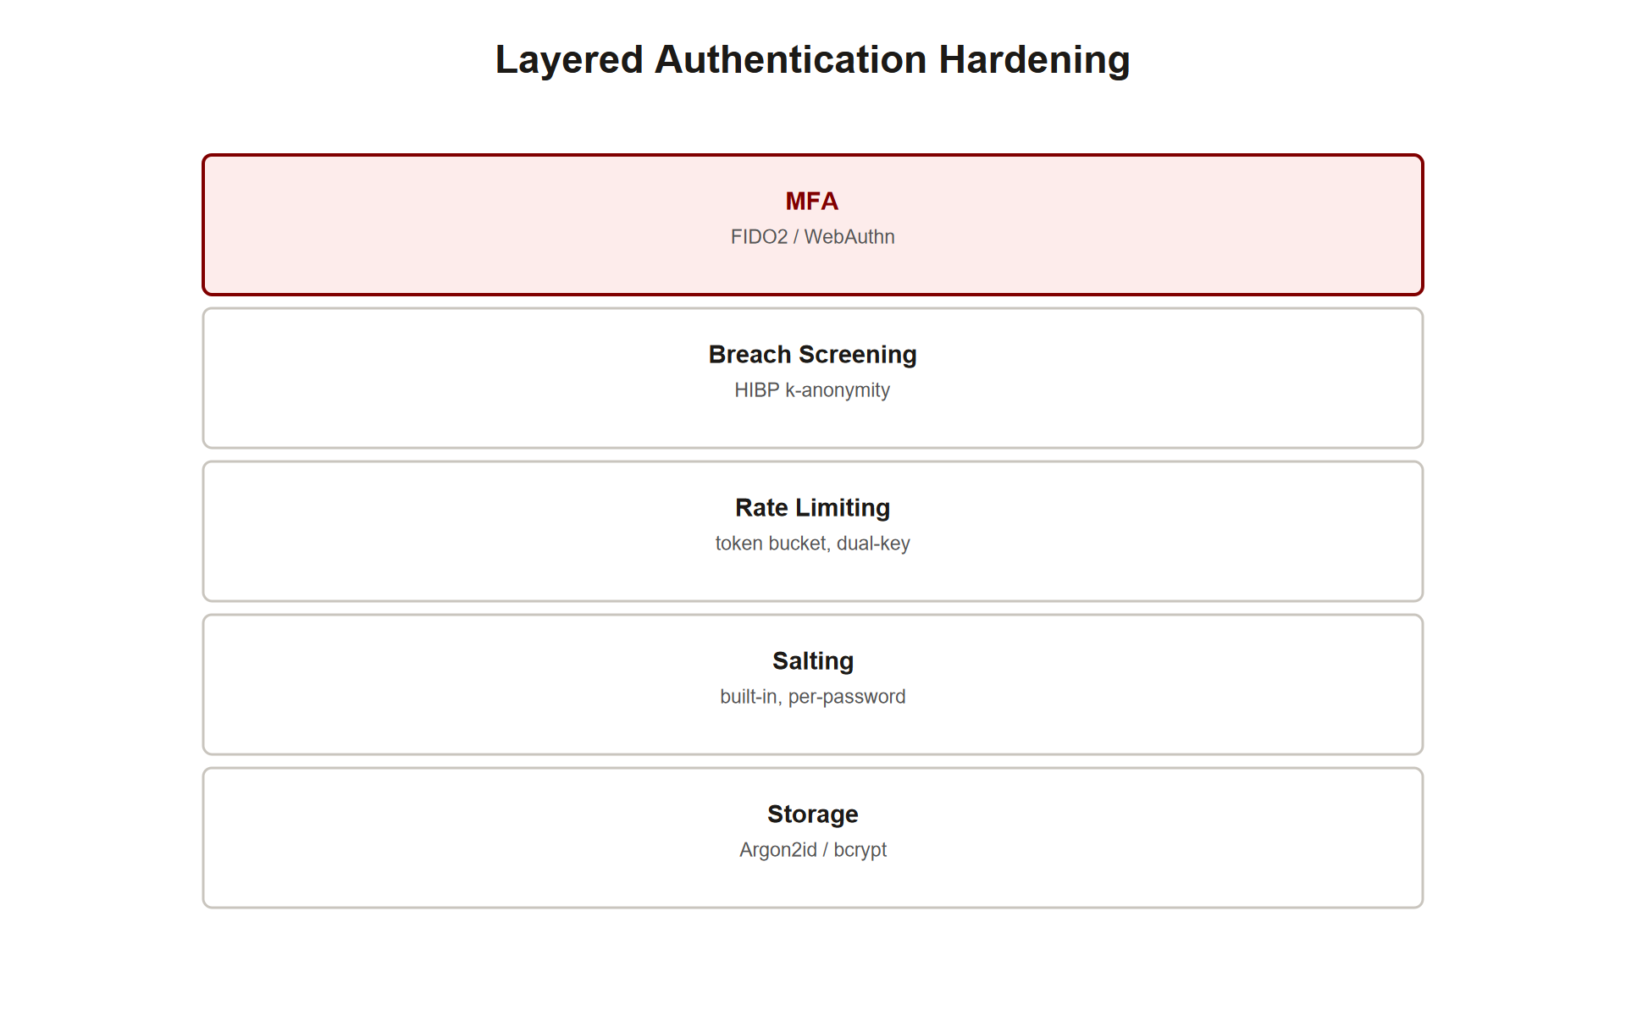
TOPIC 1.2 · 1.2.4.c.2
The Complete Authentication Hardening Stack
Layer 1, Storage: Argon2id or bcrypt, never MD5/SHA-1/SHA-256 directly
Layer 2, Salting: Automatic and built-in with modern algorithms; never reuse a salt
Layer 3, Rate limiting: Token bucket by both IP and username
Layer 4, Breach screening: Reject known-compromised passwords via HIBP-style k-anonymity check
Layer 5, MFA: TOTP minimum, FIDO2/WebAuthn for phishing resistance on high-value accounts
Auth Hardening Stack
Notes:
No single control from this topic is individually sufficient, and the AP exam's free-response questions on this material reward naming the full layered stack with an explicit mechanism for each layer, rather than one strong answer in isolation. Storage (Argon2id/bcrypt) protects against offline cracking if a breach occurs; salting, built into those algorithms automatically, defeats precomputed rainbow-table attacks; rate limiting defends the live login endpoint against both brute force and distributed credential stuffing.
Breach-database screening at registration and password-change time prevents users from choosing a password already known to be compromised elsewhere, directly closing the exact vulnerability that enabled the Colonial Pipeline incident. Multi-factor authentication is the final and arguably most decisive layer: even a perfectly guessed, stuffed, or cracked password is insufficient alone if a second independent factor is required, and FIDO2/WebAuthn specifically extends that protection to resist real-time phishing proxies, as covered in Topic 1.1.
Map each layer to the specific failure it catches when a scenario is presented: a weak-hash breach calls out storage; a rainbow-table crack calls out salting; a distributed login flood calls out rate limiting; a reused breached password calls out screening or MFA; a real-time phishing proxy calls out WebAuthn specifically over weaker MFA forms.

Slide 27
05
Detection vs. Mitigation for Authentication Attacks
Topic 1.2
Notes:
Transition to part 5 of the topic. Pause here for questions before continuing.

Slide 28
TOPIC 1.2 · 1.2.5.a.1
Detection vs. Mitigation for Authentication Attacks
Detection: Logging and alerting that an attack is occurring, does not stop it by itself
Mitigation: A control that actually blocks or reduces the impact of the attack
Example detection: A SOC alert rule firing on the credential-stuffing log pattern (high distribution, uniform UA)
Example mitigation: Rate limiting, MFA, and Argon2id/bcrypt storage that make the attack fail even if attempted
Scenario answers: Nearly always require both, name a detective control AND a preventive one
Notes:
As with Topic 1.1's phishing scenarios, precisely distinguishing detection from mitigation is a recurring exam requirement in authentication contexts. A detection control observes and reports that something suspicious is happening, a SOC rule that alerts when the four credential-stuffing signals (high username distribution, many IPs, identical User-Agent, uniform timing) co-occur is a detective control; it tells an analyst an attack is in progress but does not, by itself, stop a single login attempt.
A mitigation control changes the outcome of the attack itself. Rate limiting a login endpoint by IP and username actively blocks excess attempts; requiring MFA means a correctly guessed or stuffed password is insufficient to complete login; and storing passwords with Argon2id or bcrypt means that even a successful database breach yields hashes that resist offline cracking for a practically infeasible amount of time.
Scenario-based free-response questions in this unit almost always ask for both categories explicitly, a detective control that surfaces the incident for analyst review, and a preventive/mitigating control that reduces or eliminates the actual damage, and conflating the two, or naming only one, costs partial credit.

Slide 29
TOPIC 1.2 · 1.2.5.a.2
?
Incident Response Walkthrough: The Sunbelt Retail Login Spike
Scenario: Overnight spike of 40,000 failed logins across 12,000 distinct usernames from 3,000 distinct IPs
Artifact: Identical User-Agent string on every failed request; ~180ms uniform spacing between attempts
Task 1: Identify the attack category and justify it from the specific artifact evidence
Task 2: Name two mitigations, one that blocks the current attack, one that reduces future breach impact
Task 3: Propose one detective SOC rule to catch a recurrence earlier next time
Notes:
Work this incident using the identify -> mitigate -> detect structure established in Topic 1.1. Identify: the pattern, tens of thousands of failed attempts spread across a comparably large number of distinct usernames, sourced from thousands of distinct IPs, with an identical User-Agent string and suspiciously uniform request timing, matches the specific signature of automated, distributed credential stuffing rather than a targeted brute-force attack against one account, which would instead show many attempts concentrated on one username from few IPs.
Mitigate: two independent responses are warranted. Immediately, apply or tighten IP- and username-keyed rate limiting (token bucket) to actively throttle the ongoing flood, and consider temporarily requiring CAPTCHA or step-up verification for logins showing this signature. Separately and structurally, confirm that all stored credentials use Argon2id or bcrypt rather than a fast hash, and confirm MFA is enforced for all accounts, since these two controls determine how much damage a successful stuffing attempt could actually cause even if some individual login succeeds.
Detect going forward: configure a SOC alerting rule that fires whenever failed-login volume against distinct usernames exceeds a threshold within a short window while User-Agent diversity remains abnormally low, feeding confirmed incidents back into an IP-reputation blocklist for faster future recognition.

Slide 30
TOPIC 1.2 · 1.2.5.b.1
?
Common Misconception: 'A Complex Password Is Enough'
Belief: Choosing a long, symbol-heavy password fully protects an account on its own
Why it's wrong: Complexity does not protect against credential stuffing, phishing, or a weak server-side hash
Credential stuffing bypass: If the SAME complex password is reused and leaked elsewhere, complexity is irrelevant
Server-side bypass: A complex password hashed with MD5 on a breached server is still crackable at scale
Correct model: Password strength, uniqueness per site, storage algorithm, and MFA are four independent variables
Notes:
Users are frequently taught that choosing a sufficiently long, complex password is the single decisive security action available to them, but this significantly overstates what password strength alone can accomplish. Complexity meaningfully raises the cost of an online guessing attack or an offline crack against a properly salted, key-stretched hash, but it does nothing at all against credential stuffing if that same strong password is reused across multiple sites and leaked from just one of them, since the attacker already has the literal correct string and never needs to guess it.
Complexity is equally irrelevant to server-side storage failures entirely outside the user's control: an extremely complex password hashed with a fast, unsalted algorithm on a poorly engineered server can still be recovered via rainbow tables or brute force at scale, exactly as happened to some LinkedIn accounts in 2012 regardless of how strong the underlying password had been.
The accurate mental model treats password strength, password uniqueness across sites, the server's storage algorithm, and the presence of MFA as four largely independent variables, each defending against a different specific failure mode. A user can maximize the one variable fully within their control, never reusing a password, and enabling MFA wherever offered, while having zero influence over how a given service stores that password server-side.

Slide 31
TOPIC 1.2 · 1.2.5.b.2
?
Synthesis: Salt, Pepper, Work Factor, and Entropy Together
Salt vs. pepper: Salt is per-user and stored in plaintext; pepper is a single secret value shared across all hashes, kept outside the database
Hashing vs. encryption: Hashing is one-way (passwords); encryption is reversible with a key (data you need back)
Authentication vs. authorization: Authentication proves identity; authorization determines what that identity may do
Work factor vs. entropy: Work factor is a property of the hash algorithm (attacker cost per guess); entropy is a property of the password itself (number of guesses needed)
Detection vs. mitigation: Logging/alerting an attack vs. actually blocking or limiting its impact
Notes:
This slide consolidates the vocabulary pairs the assessment tests with precision. A salt is a per-user random value, stored in plaintext alongside its hash, whose job is uniqueness; a pepper is a related but distinct concept, a single secret value applied to every password in the system and stored separately from the database itself (often in application code or a secrets manager), adding protection specifically against a database-only breach that doesn't also expose the application's secret store.
Hashing and encryption are frequently confused: hashing is a deliberately one-way transformation appropriate for passwords, since the system only ever needs to verify a match, never recover the original; encryption is reversible given the correct key, appropriate for data the system genuinely needs to read back later, such as stored credit card numbers.
Authentication and authorization are sequential but distinct steps: authentication (the entire focus of this topic) proves that a user is who they claim to be; authorization, a separate downstream step, determines what actions that now-verified identity is permitted to perform. Work factor describes how expensive the hash algorithm itself makes each individual guess (a property of bcrypt/Argon2id configuration); entropy describes how many guesses are needed in the first place (a property of the password's own length and randomness), both matter, and confusing them is a common source of missed points.

Slide 32
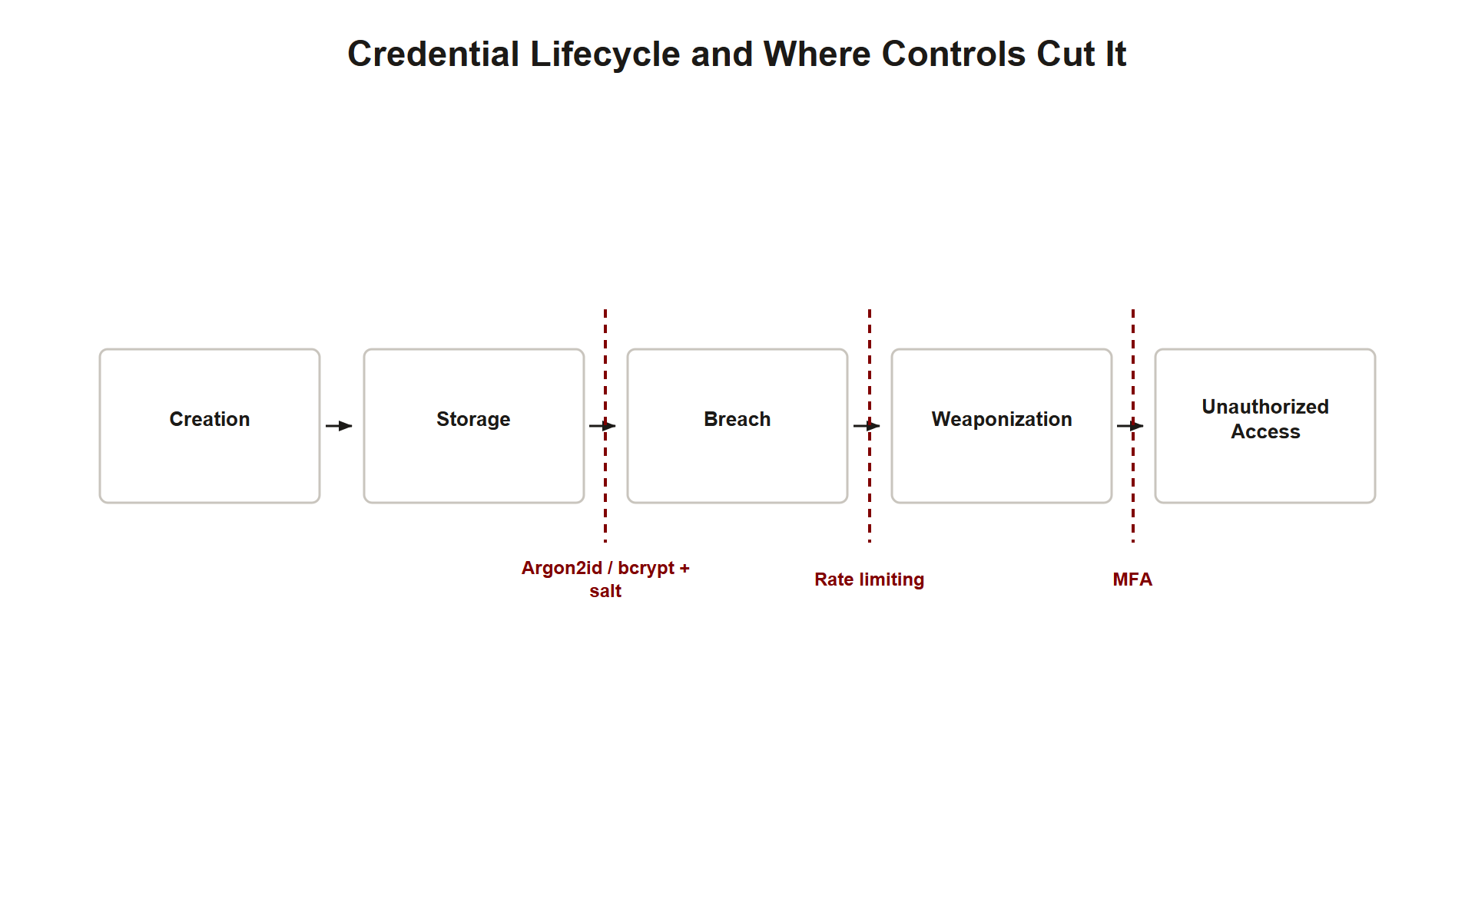
TOPIC 1.2 · 1.2.5.c.1
?
Synthesis: The Full Credential Lifecycle Attack Chain
1. Creation: A user chooses (or reuses) a password on Service A
2. Storage: Service A hashes and stores it, securely (Argon2id/bcrypt+salt) or insecurely (fast hash, no salt)
3. Breach: Service A is compromised; hashes are exfiltrated and, if weak, cracked offline
4. Weaponization: The recovered password/username pair is tested against unrelated Service B (credential stuffing)
5. Defense collapse points: Salting/Argon2id break step 3; rate limiting breaks step 4; MFA breaks the final login regardless
Credential Lifecycle Chain
Notes:
The Colonial Pipeline case study is best understood not as an isolated event but as the final link of a chain that began years earlier and elsewhere entirely. A password is created, often reused across multiple services out of human convenience. It is stored by whichever service the user registered with, either securely (salted, key-stretched) or insecurely (a fast, unsalted hash) depending entirely on that service's engineering choices, invisible to the user.
If that service is later breached, as LinkedIn was in 2012, the stored hashes are exfiltrated, and if storage was weak, offline cracking recovers the actual plaintext password within hours or days. That recovered username/password pair then becomes ammunition for an entirely unrelated attack years later and elsewhere: credential stuffing against any other service where the same user reused the same password, as occurred against Colonial Pipeline's VPN.
Mapping defenses to the specific link they sever clarifies why layered defense matters: strong storage (Argon2id/bcrypt with salting) at the original service prevents step 3 from ever succeeding even after a breach; rate limiting at the victim service slows step 4's automated attempts; and MFA at the victim service breaks the chain's final link entirely, rendering a perfectly correct stolen password insufficient on its own regardless of every earlier failure in the chain.

Slide 33
TOPIC 1.2 · 1.2.5.c.2
Exam Readiness Checklist for Topic 1.2
Can you explain why offline cracking makes hash algorithm choice more important than login-page rate limiting alone?
Can you state the bcrypt work-factor formula (2^C) and Argon2id's three tunable parameters?
Can you distinguish credential stuffing from brute force using specific log-pattern evidence?
Can you explain k-anonymity in the context of HIBP breach checking?
Can you structure an authentication incident response as identify -> mitigate -> detect with named controls?
Notes:
Use this checklist to self-assess before the assessment. Each item maps to a high-frequency question pattern for this topic. The two concepts most likely to determine full versus partial credit are (1) precisely explaining why key-stretched, memory-hard hashing (bcrypt/Argon2id) is necessary specifically because of the offline-cracking threat model, not merely as a generically 'stronger' algorithm, and (2) correctly distinguishing credential stuffing (reused real leaked credentials) from brute force (guessed combinations) using the specific log-pattern evidence, high username/IP distribution, identical User-Agent, uniform timing.
Beyond those, expect at least one item testing the salt-versus-pepper or hashing-versus-encryption vocabulary pairs precisely, and at least one free-response item requiring the full five-layer authentication hardening stack (storage, salting, rate limiting, breach screening, MFA) rather than a single named control.
Finally, keep the detection-versus-mitigation distinction sharp, exactly as in Topic 1.1: a SOC alert rule detects an ongoing credential-stuffing campaign; Argon2id, rate limiting, and MFA are what actually mitigate it. Scenario prompts almost always require naming both categories explicitly.

