Slide 1
AAYAT-AP-PREP · CYBERSECURITY
INTRODUCTION TO SECURITY
Topic 1.3: Public Network Sniffing
Wireless networks extend beyond the walls of the buildings that host them, and public ones invite adversaries of widely differing skill. This topic examines who conducts wireless attacks and why, the forms those attacks take, and the practical steps an individual can take to protect sensitive data on the internet and on Wi-Fi.
3 learning objectives · College Board AP Cybersecurity Course Framework
Notes:
Cover slide for Topic 1.3: Best Practices for Public Networks. Wireless networks extend beyond the walls of the buildings that host them, and public ones invite adversaries of widely differing skill. This topic examines who conducts wireless attacks and why, the forms those attacks take, and the practical steps an individual can take to protect sensitive data on the internet and on Wi-Fi.

Slide 2
TOPIC 1.3
Learning Objectives
Analyze Risk
Identify the kind of adversary behind a given cyberattack, considering skill level and motivation.
1.3.A
Analyze Risk
Identify the principal types of wireless cyberattack.
1.3.B
Mitigate Risk
Describe the actions an individual can take to better protect sensitive data when using the internet and Wi-Fi.
1.3.C
Objectives paraphrased from the AP Cybersecurity Course Framework (College Board, AP Career Kickstart).
Notes:
Read each learning objective aloud and connect it to the exam skill category before starting the topic.

Slide 3
TOPIC 1.3 · CONCEPT MAP
Evil Twin Attack Redirection
01
02
03
04
BROADCAST SSID
SIGNAL JAMMING
VICTIM CONNECTS
PACKET SNIFFING
Attacker sets up Wi-Fi Access Point spoofing a trusted network name (e.g. Cafe_WiFi).
Attacker deauthenticates victim from authentic AP to force reconnection.
Victim's client device automatically connects to the stronger rogue Evil Twin signal.
Rogue AP intercepts traffic, steals cleartext, and routes packets to the Internet.

Slide 4
TOPIC 1.3 · CONCEPT MAP
VPN Tunnel Logic
01
02
03
04
ENCRYPTION
UNTRUSTED TRANSIT
DECRYPTION
RESPONSE RETURN
VPN client on user device encrypts data packets before transmitting over wireless media.
Ciphertext traverses rogue or public Access Point; interceptors only sniff garbage data.
Secure VPN Server decrypts incoming packets and forwards to the target web servers.
VPN Gateway encrypts target response and tunnels it safely back to the client device.

Slide 5
TOPIC 1.3
The Big Idea
Sending data over an unencrypted public network is like having a private conversation through a shared megaphone in a crowded room. You may never see who's listening, but anyone nearby with the right receiver can hear every word.
Hold onto this picture — we'll come back to it as the mechanics get more technical.
Notes:
Big-idea framing for Topic 1.3. Open with this analogy before the mechanics: "Sending data over an unencrypted public network is like having a private conversation through a shared megaphone in a crowded room. You may never see who's listening, but anyone nearby with the right receiver can hear every word." Ask students for their own version of the analogy before moving on.

Slide 6
01
Why Wireless Erases the Physical Security Perimeter
Topic 1.3
Notes:
Transition to part 1 of the topic. Pause here for questions before continuing.

Slide 7
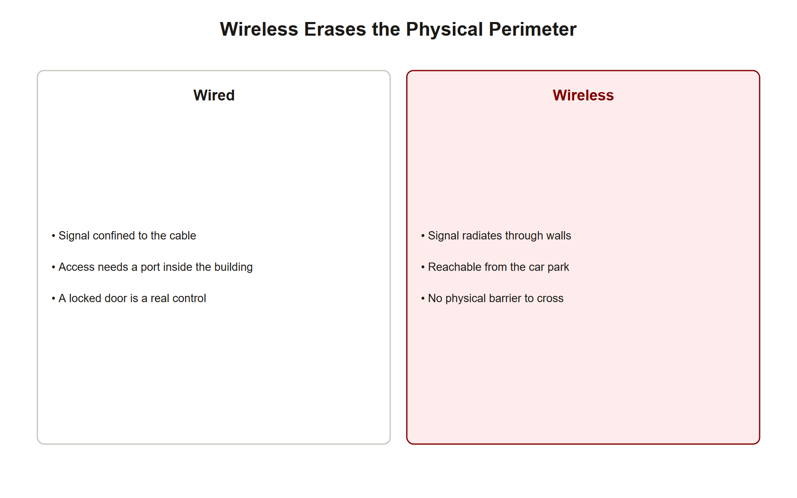
TOPIC 1.3 · 1.3.1.a.1
Why Wireless Erases the Physical Security Perimeter
Wired networks: Data frames constrained inside physical structures, cables, closed switching closets
Wireless (802.11): Frames travel as radio waves through shared open space, ignoring walls entirely
Consequence: Anyone within radio range can capture transiting frames using a NIC in monitor mode
No Layer 2 encryption on open networks: Frames on open hotspots travel completely in cleartext over the air
Core shift: Physical possession of a cable used to imply trust; radio waves make that assumption obsolete
Wireless Perimeter Erasure
Notes:
Wired Ethernet security has historically relied, in part, on physical constraint: an attacker needs a cable plugged into the same closed switching closet to intercept traffic. IEEE 802.11 wireless networks eliminate that constraint entirely by design, frames are broadcast as radio energy through open space, propagating through walls, floors, and building perimeters with no respect for the organizational boundary the network is meant to serve.
Any device within range can place its wireless network interface controller into monitor mode, a mode that captures every frame in the air rather than only frames addressed to that specific device, and inspect the raw 802.11 traffic with tools like Wireshark or aircrack-ng. On open public hotspots, cafes, airports, hotels, there is typically no encryption at all applied at the data-link layer, meaning every packet, including any credentials or session tokens a user's applications transmit without their own encryption, travels in cleartext directly over the airwaves.
This is the foundational shift this topic addresses: security models built around 'if you're inside our building, we trust you' do not translate to wireless environments, where 'inside the building' has no meaningful boundary at all.

Slide 8
TOPIC 1.3 · 1.3.1.a.2
?
SSID Trust: A Name With No Verification
SSID: The human-readable WiFi network name shown in a device's network list
Vulnerability: Any device can broadcast any SSID, the name itself carries zero cryptographic authentication
Auto-reconnect risk: Devices remember previously-joined SSIDs and can auto-connect to any AP broadcasting a matching name
Probe requests: Devices actively broadcast which remembered SSIDs they're searching for, leaking a device's network history
Mitigations shipped by vendors: Randomized MAC addresses, reduced probe disclosure on modern iOS/Android
Notes:
A client device decides which Access Point to trust based almost entirely on the SSID, the plain-text network name displayed in a WiFi selection list. Nothing about the SSID itself is cryptographically verified; any attacker with commodity hardware can configure their own access point to broadcast an identical name to a trusted network, and from the perspective of a typical client device, the two are indistinguishable at the moment of connection.
This becomes especially dangerous because devices are engineered for convenience: once a phone or laptop has joined a network named 'Airport_Free_Wifi' once, it remembers that name and will often auto-connect to any future access point broadcasting the identical SSID, with no further user interaction required. Compounding this, devices searching for remembered networks emit probe request frames, essentially broadcasting 'is my saved network X here?', which an attacker in range can passively observe to build a list of exactly which networks a specific target device trusts and has previously joined.
Modern mobile operating systems have partially mitigated this exposure: iOS and Android now randomize the device's MAC address during scanning and have reduced how much probe-request information is disclosed by default, but this is a mitigation of information leakage, not a fix to the underlying trust problem, the SSID itself remains fundamentally unauthenticated.

Slide 9
TOPIC 1.3 · 1.3.1.b.1
Adversary-in-the-Middle: The General Attack Position
AitM (formerly MITM): The attacker positions themselves between victim and destination, relaying all traffic
Victim's perspective: Appears to be talking directly to the legitimate server the whole time
Server's perspective: Appears to be talking directly to the legitimate client the whole time
Attacker's position: Sees, and can selectively modify, every packet passing through
Wireless instantiation: The Evil Twin access point itself IS the AitM position, no additional network step needed
Notes:
Adversary-in-the-Middle (the modern, inclusive-language successor to the older term Man-in-the-Middle) describes a general attack position, not a specific technique: the attacker inserts themselves logically between two communicating parties such that all traffic passes through their control point, while both legitimate parties remain unaware anything is unusual. The victim believes they are talking directly to the real destination server; the server believes it is talking directly to the real victim client; the attacker alone sees the full, unmodified conversation and can choose to log it, alter it, or selectively block portions of it.
In the wireless context specifically, achieving this position is unusually direct compared to many other AitM scenarios: once a victim's device associates with a rogue Evil Twin access point, that access point already sits at the exact network chokepoint required, every packet the victim sends or receives passes through the attacker's infrastructure by definition, since it is the actual access point relaying the connection.
This is why wireless AitM attacks are considered particularly dangerous: the attacker does not need to compromise a router somewhere mid-path or perform ARP spoofing on a shared local segment, simply getting the victim to associate with the rogue AP accomplishes full AitM positioning in one step.

Slide 10
TOPIC 1.3 · 1.3.1.b.2
?
SSL Stripping: The Downgrade, Not the Break
Key insight: SSL stripping does NOT break TLS cryptography, it prevents the upgrade to TLS from ever happening
Root cause exploited: Users type 'bank.com', not 'https://bank.com', the browser's FIRST request is often plain HTTP
Attacker technique: Proxy fetches the real HTTPS page, serves the victim a rewritten HTTP version instead
What the victim sees: No lock icon, http:// in the address bar, but studies show fewer than 17% check for it
What the server sees: A perfectly normal, fully-encrypted HTTPS session, the attack is invisible from that side
Notes:
SSL stripping, popularized by Moxie Marlinspike's 2009 SSLStrip tool, is frequently misunderstood as 'breaking encryption.' It does not, the underlying TLS cryptography is never attacked or weakened. Instead, it exploits a behavioral gap: most users type a bare domain name into their address bar rather than explicitly typing 'https://', meaning the browser's very first request to a site is often unencrypted HTTP, before any redirect to HTTPS occurs.
Positioned as an AitM proxy, for instance, operating an Evil Twin access point, the attacker intercepts this initial HTTP request, then independently establishes a fully legitimate, fully encrypted HTTPS connection to the real destination server on the victim's behalf. The attacker receives the real, secure page from the server, then rewrites every https:// link on that page to http:// before forwarding it down to the victim, ensuring the victim's browser never attempts to upgrade to HTTPS at all.
The result is asymmetric and nearly invisible: the destination server sees a completely ordinary, correctly encrypted HTTPS session and has no way to detect anything is wrong; the victim's browser shows a bare HTTP connection with no lock icon, but research cited in security literature indicates fewer than 17% of users actively check for the padlock indicator before submitting credentials, making the missing visual cue an unreliable defense in practice.

Slide 11
02
Anatomy of an Evil Twin Attack
Topic 1.3
Notes:
Transition to part 2 of the topic. Pause here for questions before continuing.

Slide 12
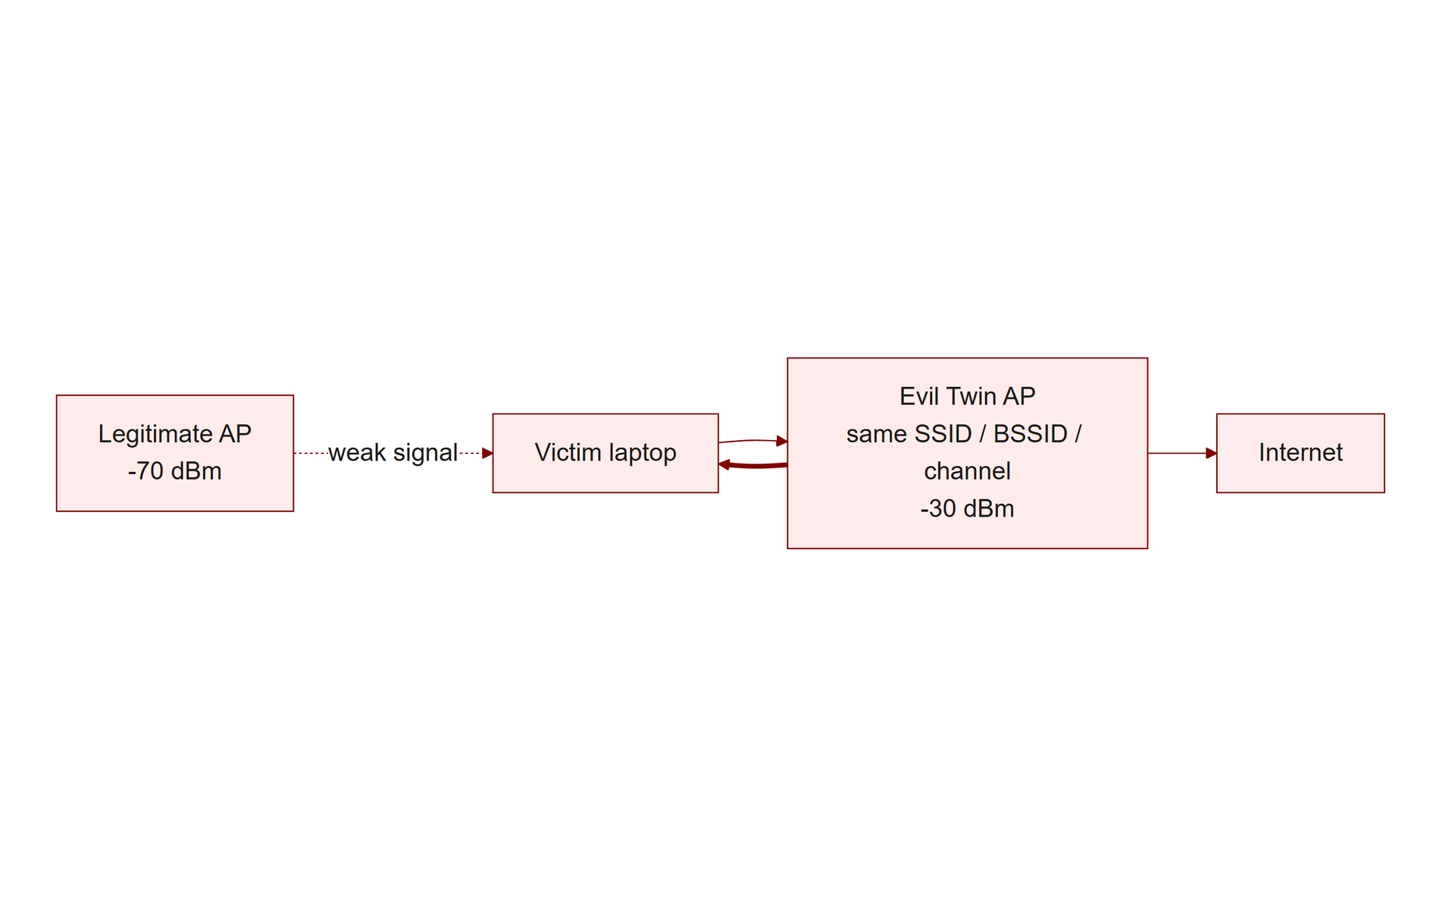
TOPIC 1.3 · 1.3.2.a.1
Anatomy of an Evil Twin Attack
Clone attributes: SSID (name), BSSID (AP's MAC address), and channel, all three matched to the real AP
RSSI boost: Attacker transmits at higher power (e.g., -30 dBm) than the legitimate AP (e.g., -70 dBm)
Client behavior: Devices automatically roam to whichever matching AP has the strongest signal
Forced transition: Spoofed deauthentication frames disconnect the victim from the legitimate AP first
Result: Victim connects to attacker's AP, believing it to be the original, unchanged network
Evil Twin Topology
Notes:
An Evil Twin attack clones every attribute a client device uses to identify a wireless network: the SSID (the human-visible name), the BSSID (the AP's underlying MAC address hardware identifier), and the operating channel. Because BSSIDs are just MAC addresses, and MAC addresses are software-configurable, an attacker's equipment can be set to present an identical hardware identity to the legitimate AP, making the rogue and real access points appear, from the client's perspective, to be genuinely the same network.
Client devices are engineered to automatically roam to whichever access point matching their remembered network offers the strongest received signal (RSSI). The attacker exploits this directly by transmitting at deliberately high power, commonly around -30 dBm, compared to a typical legitimate AP's -60 to -70 dBm at normal range, guaranteeing that any client evaluating both APs will prefer the rogue one purely on signal strength.
To force an already-connected victim off the legitimate AP and onto the rogue one, the attacker injects spoofed 802.11 deauthentication management frames, which (on networks not using Protected Management Frames) carry no cryptographic authentication at all and are trivially forged with the legitimate AP's MAC address as the apparent sender. The victim's device, unable to verify the frame's authenticity, disconnects immediately and then reconnects to whichever AP with the matching SSID currently has the strongest signal, the attacker's.

Slide 13
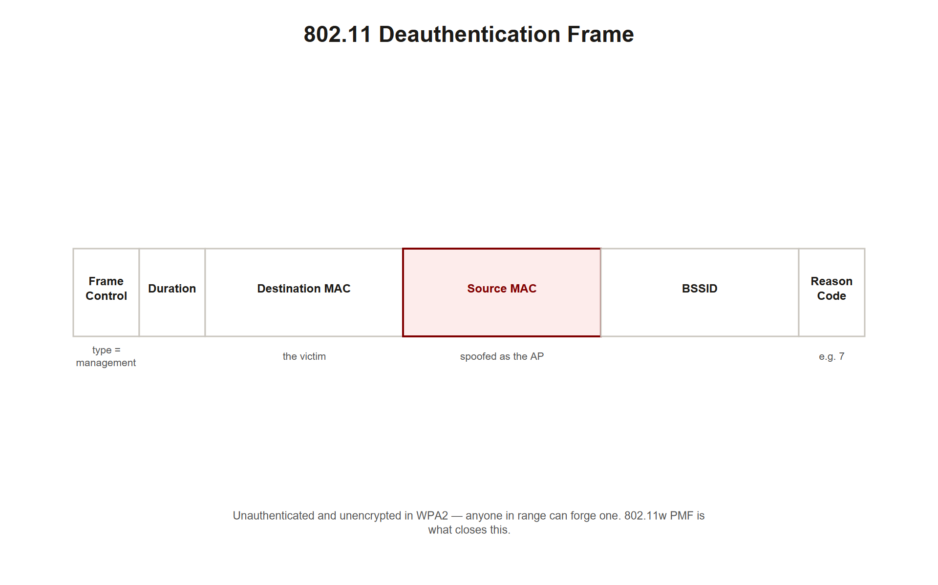
TOPIC 1.3 · 1.3.2.a.2
?
Reading a Spoofed 802.11 Deauthentication Frame
Frame type: Management frame, subtype Deauthentication (0x000c)
Pre-802.11w vulnerability: Management frames carry NO cryptographic signature at all
Spoofed fields: Transmitter, Source, and BSSID all forged to match the legitimate AP's real MAC
Reason code 0x0007: A common code used in real attack tooling ('Class 3 frame from nonassociated station')
Client cannot verify: Without PMF (802.11w), there is no way to distinguish a genuine disconnect frame from a forged one
Img 1.3.2 Deauth Frame
Notes:
The captured frame below shows exactly what a spoofed deauthentication frame looks like at the packet level. Its Type/Subtype field explicitly marks it as a Management frame carrying the Deauthentication subtype (0x000c), a command frame whose entire purpose is telling a specific receiving device to disconnect immediately. Critically, prior to the 802.11w Protected Management Frames amendment, this entire frame category carries no cryptographic signature whatsoever.
Every address field an attacker needs to forge, the Transmitter address, Source address, and BSSID, can simply be set to the legitimate access point's real MAC address, since nothing about the 802.11 frame format prevents an unauthorized device from writing an arbitrary value into these fields. The reason code (0x0007 in this capture) is cosmetic detail lending plausibility but is not itself verified by the receiving client in any meaningful way.
When the victim's network interface receives this frame, it has no cryptographic mechanism available to confirm the frame genuinely originated from the real access point rather than an attacker's injection tool, and it disconnects exactly as instructed. This single unauthenticated frame type is the entire technical foundation for forcibly disconnecting a victim in preparation for an Evil Twin reconnection.

Slide 14
TOPIC 1.3 · 1.3.2.a.3
Reading an SSLStrip Proxy Log
Step 1: Victim's browser sends a plain HTTP GET request (no encryption at all)
Step 2: Proxy silently upgrades ITS OWN connection to the real server to HTTPS
Step 3: Proxy strips the 'Secure' flag from cookies and rewrites https:// links to http:// in the response
Step 4: Victim's browser, now shown only http:// links, submits the login form over plain HTTP
Result: Credentials and the session cookie are both captured by the proxy in cleartext
Notes:
This proxy log captures an SSL stripping attack from the wire. The victim's browser issues an ordinary GET http://www.banking-portal.com/login , plain HTTP, no encryption. The attacker's proxy intercepts this and, on the victim's behalf, opens a completely legitimate encrypted HTTPS connection to the real banking server, which responds normally, including a Set-Cookie header correctly marked Secure (meaning the browser should only ever send it over HTTPS).
Before relaying this response down to the victim, the proxy performs two critical modifications: it strips the Secure flag from the cookie (so the browser will happily send it over plain HTTP later), and it rewrites every https:// link in the page body to http:// , ensuring the victim's browser never attempts to upgrade the connection on its own. When the victim then submits their login form, the resulting POST request travels over the same plain HTTP connection, and the proxy captures the username and password in cleartext, along with the now-unprotected session cookie.
The critical detail for exam purposes is what each party observes: the real banking server sees a normal, fully-encrypted session and has no way to detect the interception; the victim sees a working login page with no error message, simply lacking a padlock icon that most users never check.

Slide 15
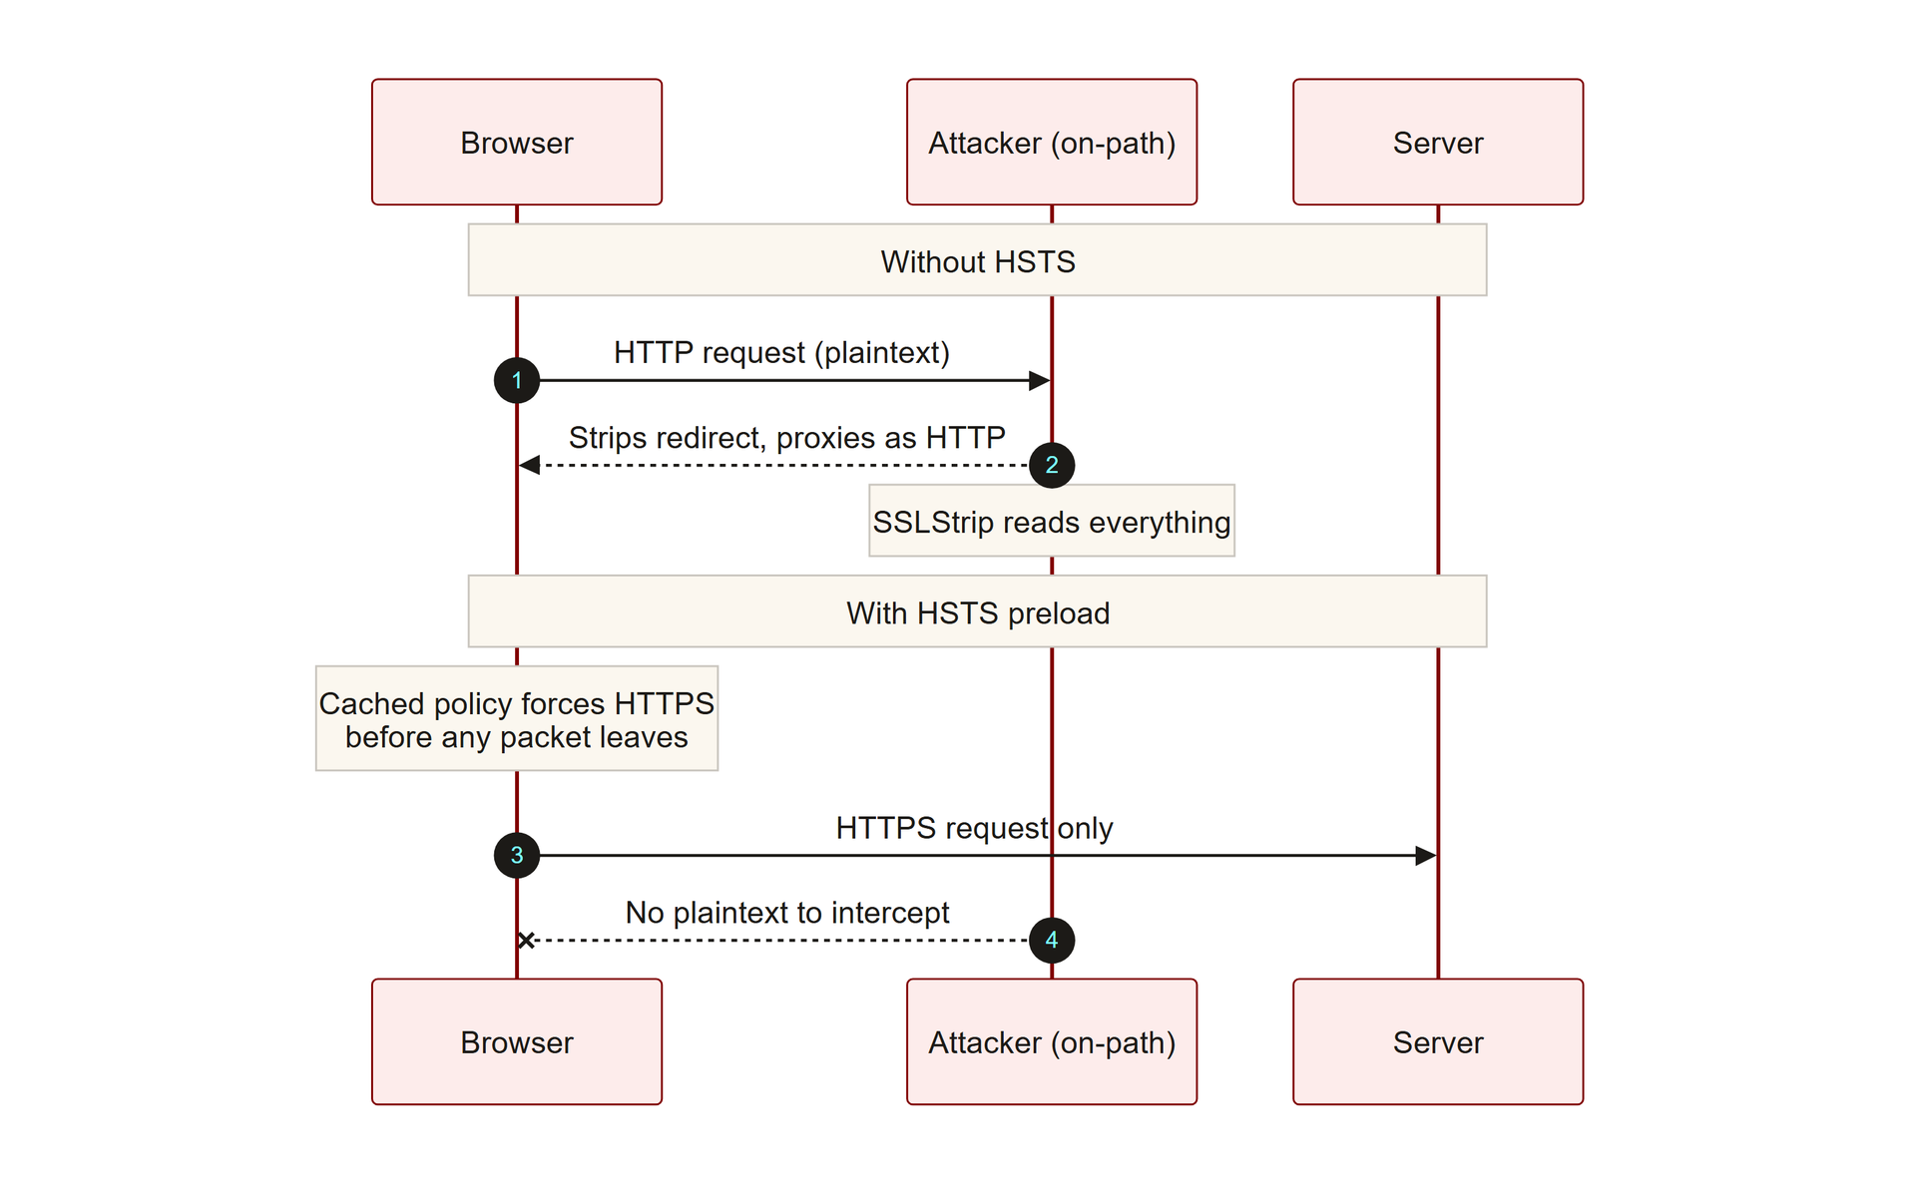
TOPIC 1.3 · 1.3.2.b.1
HSTS: Client-Cached Enforcement of HTTPS
RFC 6797 (2012): Instructs the browser to always upgrade requests to HTTPS for a domain, for a set duration
Header: Strict-Transport-Security: max-age=63072000; includeSubDomains; preload
max-age: How long (in seconds) the browser must enforce HTTPS, 63072000 = roughly 2 years
includeSubDomains: Extends enforcement to every subdomain of the protected domain
Critical limitation: Trust-On-First-Use (TOFU), a domain never visited before has no cached policy yet
Img 1.3.2 Hsts Flow
Notes:
HTTP Strict Transport Security directly closes SSLStrip's exploited gap by having the server instruct the browser, via a response header sent once over a genuine HTTPS connection, to remember that this domain must always be accessed over HTTPS from that point forward, for a specified duration. Once cached client-side, the browser will refuse to even attempt a plain HTTP connection to that domain, automatically rewriting any typed or linked http:// address to https:// before a single packet is sent, which means there is no initial cleartext request left for an SSLStrip proxy to intercept at all.
The max-age directive specifies the caching duration in seconds, the commonly recommended value of 63,072,000 seconds equals roughly two years, while includeSubDomains extends the same enforced policy to every subdomain of the protected domain, closing a gap that would otherwise let an attacker target an unprotected subdomain instead.
HSTS carries one structural limitation that the AP exam tests specifically: the Trust-On-First-Use problem. A browser can only enforce a cached policy for a domain it has previously visited over HTTPS and received the header from. On a user's genuinely first-ever connection to a given domain, no cached policy exists yet, and an SSLStrip attack positioned on that first connection can still succeed, which is precisely the gap the HSTS preload list, covered next, is designed to close.

Slide 16
TOPIC 1.3 · 1.3.2.b.2
?
The HSTS Preload List: Closing the First-Visit Gap
Problem solved: HSTS headers alone cannot protect a domain's very first visit (TOFU)
Solution: A domain list hardcoded directly into Chrome/Firefox/Safari source code, shipped with the browser itself
Requirement to join: Serve valid HTTPS everywhere, redirect HTTP to HTTPS, HSTS header with includeSubDomains+preload, max-age >= 1 year
Effect: The browser refuses ANY http:// connection to a preloaded domain, even before ever visiting it
Permanent commitment: Removal from the list is slow (6-12 months) and not guaranteed, this is a long-term decision
Notes:
The HSTS preload list solves the exact first-visit gap that a standard HSTS header cannot: since a browser can only cache a policy after receiving it once over HTTPS, there is no way for a header alone to protect a domain's genuinely first connection from a given user. The preload list sidesteps this entirely by hardcoding the enforcement policy directly into the browser's own source code, distributed and updated with every browser release, meaning the policy exists before the user ever makes their first request, closing the gap structurally rather than relying on a prior visit.
Submission (at hstspreload.org) requires meeting a specific bar: the domain must serve valid HTTPS across the board with no mixed content, redirect all HTTP traffic to HTTPS, and already be serving a correctly configured HSTS header with includeSubDomains , preload , and a max-age of at least one year. Once approved, Chrome (and, downstream, Firefox and Safari, which import Chrome's list) will refuse to make any plain HTTP connection to that domain at all, not merely upgrading it after the fact, but never attempting cleartext in the first place.
This protection comes with a genuinely permanent-feeling commitment: removal from the preload list, should an organization later need to serve HTTP again (during a migration, for instance), takes six to twelve months and is not guaranteed to succeed, since the change must propagate through browser release cycles across the entire installed base.

Slide 17
TOPIC 1.3 · 1.3.2.b.3
Practice: Simulating HSTS Enforcement Logic
Goal: Model, in code, the decision a browser makes when a user requests a URL
Inputs: The requested URL's scheme, the domain's cached HSTS status, and preload-list membership
Logic: Preloaded OR cached-HSTS domains silently get upgraded to HTTPS before any request is sent
Uncached, non-preloaded domains: The request goes out exactly as typed, including plain HTTP if that's what was entered
Takeaway: The vulnerability window is precisely 'first visit to an unpreloaded domain,' nothing more, nothing less
Notes:
The function below models exactly the decision logic a real browser applies before sending any request, distilled to its essential branches. If the requested domain is on the hardcoded preload list, or if the browser has a previously-cached, still-valid HSTS policy for that domain, the request is silently rewritten to HTTPS before a single packet leaves the device, there is no cleartext moment for an attacker to intercept in either case.
If neither condition holds, the domain has never set an HSTS header before, and isn't preloaded, the request proceeds exactly as the user typed it, including a bare HTTP request if that's literally what was entered in the address bar. This is precisely the narrow window SSLStrip depends on, and running the simulation with different combinations of inputs makes the boundary of that vulnerability window concrete rather than abstract.
Note that this model deliberately simplifies real browser HSTS-cache expiry logic (governed by the max-age countdown) into a boolean, but the core decision structure, preloaded or cached means forced HTTPS, otherwise respect the literal request, is exactly how production browsers behave.

Slide 18
TOPIC 1.3 · 1.3.2.c.1
?
DNS Hijacking on Hostile Networks
DNS: Translates domain names into IP addresses, the internet's phone book
Vulnerability: Standard DNS runs unencrypted over UDP port 53, anyone on the local network can intercept and modify queries
Hostile AP capability: A rogue Evil Twin can run its own DNS server and answer every query with the attacker's own IP
Effect: Traffic destined for a legitimate domain is silently redirected to an attacker-controlled server instead
Defenses: DNS over HTTPS (DoH, RFC 8484), DNS over TLS (DoT, RFC 7858), and DNSSEC signing
Notes:
Before any HTTP or TLS connection can be established, a client device must first resolve the destination domain name into an IP address via DNS. On an unencrypted network, including any Evil Twin access point the victim has joined, this resolution step is itself unprotected: DNS queries travel in plaintext over UDP port 53, and the access point operator (in this case, the attacker) sits directly in the path of every single one.
A hostile access point can run its own rogue DNS server and simply answer every query with whatever IP address it chooses, regardless of the domain actually requested. A victim's device, having no way to verify the authenticity of an unencrypted DNS response, accepts the attacker's answer and connects to whatever server the attacker specified, which might be a credential-harvesting clone, an SSLStrip proxy, or a malware-serving host, all before the user has typed a single character into any login form.
Two complementary categories of defense exist. DNS over HTTPS and DNS over TLS encrypt the query itself, so a rogue local DNS server can no longer read or tamper with it, since the query is wrapped in TLS or disguised as ordinary HTTPS traffic to a trusted resolver like Cloudflare's 1.1.1.1. DNSSEC instead adds cryptographic signatures to DNS responses themselves, allowing tampering to be detected even without full query encryption, though it does not by itself hide the query's contents.

Slide 19
03
Case Study: Dark Caracal (2017), Nation-State Wireless Espionage
Topic 1.3
Notes:
Transition to part 3 of the topic. Pause here for questions before continuing.

Slide 20
TOPIC 1.3 · 1.3.3.a.1
Case Study: Dark Caracal (2017), Nation-State Wireless Espionage
Attribution: Linked to the Lebanese General Directorate of General Security (GDGS)
Vector: Rogue Evil Twin APs deployed near targeted corporate offices and hotels
Escalation: Non-HTTPS/non-HSTS target traffic was SSL-stripped, then software update downloads were hijacked
Payload: Malicious installers replaced legitimate ones, deploying 'Pallas' and 'CrossRAT' surveillance implants
Consequence: Exfiltration of call logs, audio recordings, and documents from infected devices
Notes:
Dark Caracal, uncovered in 2017 by researchers at the Electronic Frontier Foundation and Lookout, demonstrates the full real-world attack chain this topic covers, escalated to a nation-state espionage campaign attributed to Lebanese state security. Operators physically positioned themselves near target corporate offices and hotels and deployed Evil Twin access points cloning the SSIDs of trusted local networks, relying on exactly the automatic-trust and signal-strength mechanisms described earlier.
Once targets associated with the rogue APs, the operation exploited the absence of HTTPS enforcement and HSTS on many target applications to execute SSL stripping successfully. Critically, the campaign escalated beyond simple credential theft: attackers intercepted software update downloads in transit, application updates and driver installers that devices routinely fetch and install with minimal user scrutiny, and substituted the legitimate installer for a malicious one carrying a surveillance implant.
The resulting malware, tracked as 'Pallas' and 'CrossRAT,' operated across Android, Windows, and iOS, silently exfiltrating call logs, audio recordings, and documents back to the attackers. This case demonstrates that wireless interception is not limited to simple credential harvesting, it can serve as the delivery mechanism for a full remote-access compromise when combined with a lack of code-signing verification on the intercepted downloads.

Slide 21
TOPIC 1.3 · 1.3.3.a.2
?
Case Study: DNS Hijacking / SSL Strip Proof-of-Concept Audit
Method: Researchers configured an Evil Twin hotspot with a rogue DNS server redirecting popular domains
Target gap exploited: Domains without strict HSTS enforcement had no cached or preloaded protection
Result: Users attempting email/banking logins were served downgraded HTTP pages with no browser security alert
Silent success: Because the domains weren't preloaded, browsers complied with the downgrade without warning
Industry impact: This proof of concept catalyzed a wave of HSTS preload-list registrations by major web applications
Notes:
A published security audit demonstrated the full attack chain covered in this topic as a controlled proof of concept rather than a malicious campaign, specifically to quantify real-world exposure. Researchers configured an Evil Twin access point with a rogue DNS server that answered queries for popular web services by redirecting them to an intermediate proxy running SSLStrip.
Users who connected to the hotspot and attempted to reach services like email or banking portals were served downgraded HTTP versions of those pages. Because the specific domains involved had not yet enrolled in the browser's HSTS preload list, and because a first-time connection cannot benefit from a cached HSTS header it has never received, browsers complied with the downgraded connection without displaying any security warning to the user at all, silently accepting exactly the attack this topic has described mechanically.
The proxy successfully captured live login credentials and active session cookies during the demonstration. Rather than remaining an academic curiosity, this proof of concept had measurable industry impact: it directly catalyzed a significant wave of major web applications submitting their domains to the HSTS preload list in the following period, treating preload registration as a baseline requirement rather than an optional hardening step.

Slide 22
TOPIC 1.3 · 1.3.3.a.3
?
Connection: KRACK (2017), A Protocol-Level Flaw, Not an Evil Twin
KRACK: Key Reinstallation Attack, published by Mathy Vanhoef (2017)
Distinction: Not an Evil Twin/AitM positioning attack, a cryptographic flaw in WPA2's 4-way handshake itself
Mechanism: Forces nonce reuse during the handshake, breaking the encryption's confidentiality guarantee
Scale: Affected virtually every WPA2-capable WiFi device on Earth at time of disclosure
Industry response: A primary driver behind IEEE developing WPA3 with the SAE key exchange
Notes:
KRACK, disclosed by Belgian researcher Mathy Vanhoef in the same year as Dark Caracal, is worth distinguishing carefully from every attack covered so far in this topic, because it is a fundamentally different category of vulnerability. Evil Twin, deauthentication spoofing, and SSL stripping all exploit a lack of authentication or verification at some layer, they do not break any actual cryptography, they simply position an attacker somewhere the victim mistakenly trusts, or bypass an upgrade step the victim never enforces.
KRACK is different: it is a genuine cryptographic protocol flaw discovered in WPA2's 4-way handshake itself, the mechanism by which a client and access point establish a shared encryption key even on a properly configured, legitimately password-protected network with no rogue AP involved at all. By manipulating the handshake's message retransmission behavior, an attacker could force the reuse of a cryptographic nonce, a value that must never repeat for the encryption's confidentiality guarantees to hold, effectively breaking the encryption of subsequent traffic on an otherwise correctly configured WPA2 network.
Because the flaw existed in the WPA2 protocol specification itself rather than in any single vendor's implementation, it affected essentially every WPA2-capable device in existence at disclosure, and hundreds of millions of devices remained unpatched for extended periods afterward. KRACK is widely cited as a primary motivating factor behind IEEE's development of WPA3, whose SAE key exchange (covered in the defense section) is specifically designed to be resistant to this class of handshake manipulation.

Slide 23
04
WPA3 and SAE: Fixing the Offline Dictionary Attack Problem
Topic 1.3
Notes:
Transition to part 4 of the topic. Pause here for questions before continuing.

Slide 24
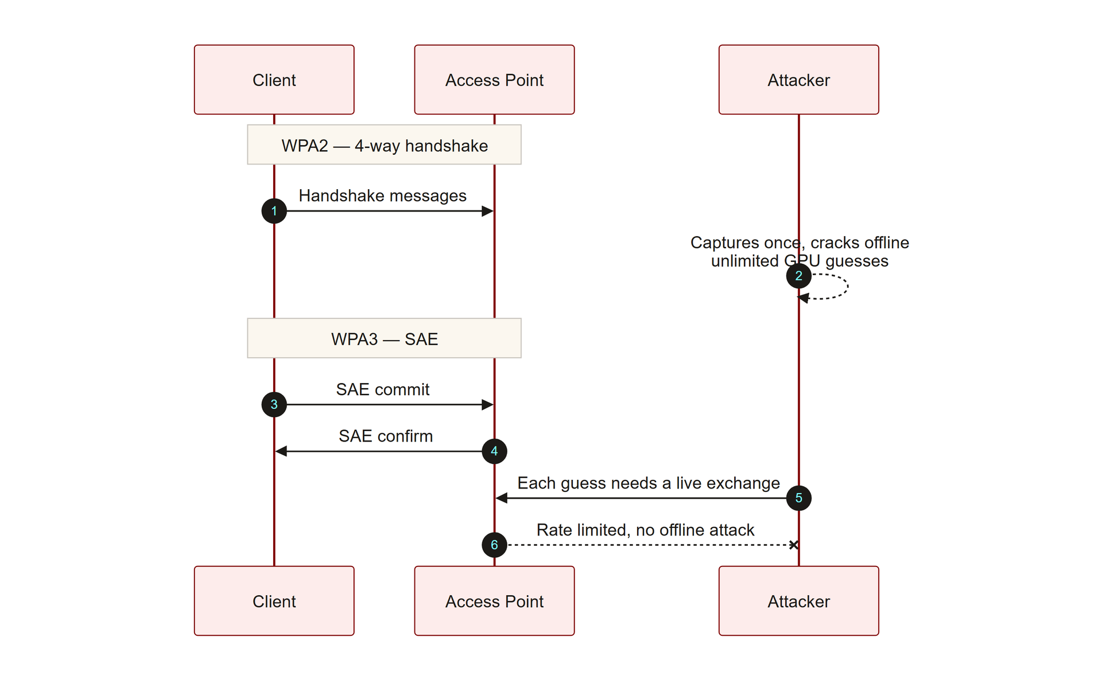
TOPIC 1.3 · 1.3.4.a.1
?
WPA3 and SAE: Fixing the Offline Dictionary Attack Problem
WPA2 weakness: 4-way handshake can be captured once, then brute-forced offline with no rate limit
SAE (Simultaneous Authentication of Equals): WPA3's replacement, based on the Dragonfly protocol
Key property: Requires ACTIVE, live participation from the AP for every single password guess
Effect: An attacker cannot capture a handshake and crack it offline, each guess must be attempted live and is rate-limitable
Bonus property: Forward secrecy, even a later-compromised password cannot decrypt previously captured traffic
Wpa2 Vs Wpa3 Handshake
Notes:
WPA2's fundamental authentication weakness is structural: an attacker only needs to capture the 4-way handshake once, a brief exchange that happens whenever any client joins the network, and can then take that captured data home and attempt password guesses entirely offline, using GPU-accelerated tools like hashcat at billions of attempts per second, with no rate limit imposed by the network at all, since the attacker is no longer interacting with it.
WPA3 replaces this handshake with Simultaneous Authentication of Equals, built on the Dragonfly key-exchange protocol, a zero-knowledge variant of Diffie-Hellman. The decisive design property is that SAE requires active, real-time participation from the actual access point for every single authentication attempt, there is no static, capturable handshake artifact that fully determines success or failure offline. An attacker attempting to guess the network password must interact live with the AP for every single guess, and the AP can apply rate limiting or lockout to that live interaction exactly as it would for any other online attack, closing the offline-cracking loophole entirely.
SAE additionally provides forward secrecy: each session derives its own unique, ephemeral encryption keys, so an attacker who later obtains the network password, through any means, still cannot retroactively decrypt wireless traffic they may have captured and stored from before that compromise. This directly contrasts with WPA2, where recovering the password after the fact does allow retroactive decryption of previously captured traffic.

Slide 25
TOPIC 1.3 · 1.3.4.a.2
802.11w Protected Management Frames: Closing the Deauth Gap
Problem addressed: Legacy management frames (including deauthentication) carry no cryptographic signature
802.11w (2009): Extends cryptographic integrity protection to management frames
Effect: A client can verify a deauthentication frame genuinely originated from the associated AP before disconnecting
WPA3 requirement: PMF is mandatory under WPA3 certification, not merely optional as it was under WPA2
Combined effect with SAE: WPA3 closes both the offline-cracking gap AND the spoofed-deauth gap simultaneously
Notes:
The 802.11w amendment, ratified in 2009 as Protected Management Frames (PMF), directly addresses the vulnerability exploited by every spoofed-deauthentication attack described earlier in this topic: the complete absence of cryptographic signing on management frames in the base 802.11 standard. With PMF enabled, deauthentication and disassociation frames are cryptographically signed using keys established during the client's original association, allowing the receiving device to verify that a disconnect instruction genuinely originated from the AP it is actually associated with, rather than from an attacker's injection tool forging the AP's MAC address.
Under WPA2, PMF support existed as an optional feature that many deployments simply never enabled, leaving the deauthentication vulnerability wide open in practice even on networks that had technically upgraded their encryption. WPA3 certification changed this by making PMF mandatory rather than optional, any device claiming WPA3 compliance must support and enable Protected Management Frames, closing the gap by default rather than relying on individual network administrators to opt in.
The combination of SAE (from the prior slide) and mandatory PMF together closes both of the major wireless-layer vulnerabilities covered in this topic simultaneously: SAE eliminates the offline-crackable handshake artifact, and PMF eliminates the unauthenticated deauthentication frame that was previously used to force victims off a legitimate AP in the first place, undermining the entire setup phase of an Evil Twin attack.

Slide 26
TOPIC 1.3 · 1.3.4.b.1
?
802.1X and EAP-TLS: Mutual Authentication Blocks Evil Twins Structurally
802.1X: Port-based network access control requiring authentication before network access is granted
EAP-TLS: The strongest EAP type, both client AND server present X.509 certificates
Mutual authentication: The client verifies the AP's server certificate, not just the other way around
Why Evil Twin fails here: A rogue AP cannot present a certificate signed by the trusted CA, since it lacks the real server's private key
Architecture: Supplicant (client) Authenticator (AP, pass-through) Authentication Server (RADIUS)
Notes:
Where SAE and PMF harden the wireless link layer itself, 802.1X with EAP-TLS attacks the Evil Twin problem at its structural root: the earlier-established fact that a client typically only verifies an SSID name, with no cryptographic verification of the AP's actual identity. EAP-TLS, the strongest variant of the Extensible Authentication Protocol, requires mutual authentication, both the client and the authentication server present X.509 digital certificates, and both sides verify the other's certificate against a trusted Certificate Authority before the connection is established.
This structurally defeats Evil Twin attacks in a way that SAE and PMF alone do not: even a perfectly cloned SSID, BSSID, and boosted-signal rogue AP cannot present a valid server certificate signed by the organization's trusted CA, because the attacker does not possess the corresponding private key. The client's EAP-TLS supplicant software will reject the connection outright the moment certificate verification fails, regardless of how convincingly the rogue AP has cloned every other visible attribute.
The architecture involves three roles: the supplicant (the client device attempting to connect), the authenticator (the access point itself, which acts purely as a pass-through relay for authentication messages and holds no independent trust decision), and the authentication server (typically a RADIUS server such as FreeRADIUS, Cisco ISE, or Microsoft NPS) which actually performs the certificate verification and grants or denies access.

Slide 27
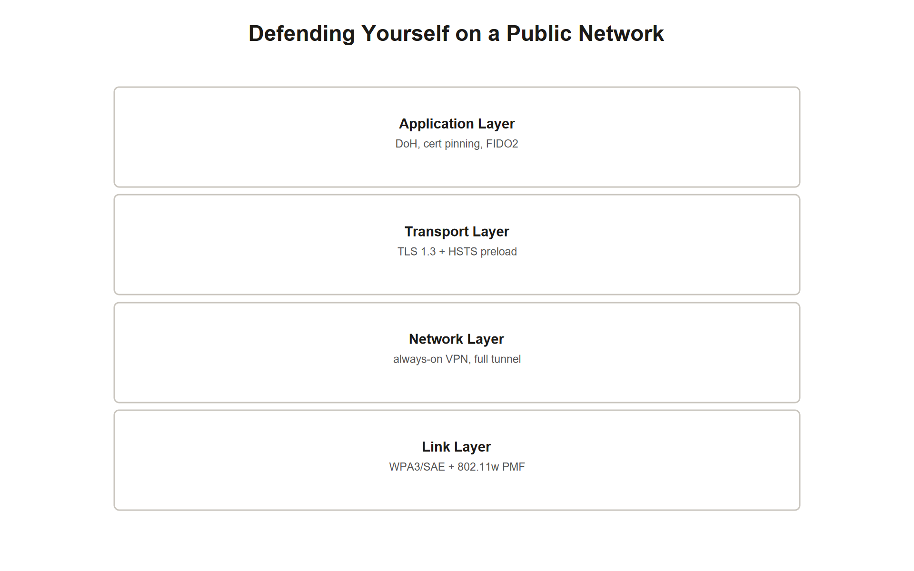
TOPIC 1.3 · 1.3.4.c.1
Client-Side Layered Defense: VPN, DoH, and the Four-Layer Stack
Layer 1 (Link): WPA3/SAE + 802.11w PMF, where the network itself is trusted/controlled
Layer 2 (Network): Always-On VPN in full-tunnel mode, encrypting egress before it hits any hostile AP
Layer 3 (Transport): TLS 1.3 minimum + HSTS preload, protects individual connections even if the VPN somehow fails
Layer 4 (Application): Certificate pinning, DoH, FIDO2/WebAuthn, defeats phishing even on a hostile network
Principle: Any single layer can fail on an untrusted public network; the others compensate
Four Layer Public Network Stack
Notes:
When an organization does not control the wireless infrastructure a device connects to, the defining condition of a public network scenario, the defense burden shifts almost entirely onto client-side, layered controls, since Layer 1 protections like WPA3/EAP-TLS require the AP itself to cooperate. The four-layer public-network defense stack addresses this directly. The link layer, where applicable (an organization's own or a trusted partner's WiFi), still benefits from WPA3/SAE and mandatory PMF as covered earlier.
The network layer is where public-network defense becomes most critical: an Always-On VPN, using a modern protocol like WireGuard or IPsec in full-tunnel mode, encrypts all outbound traffic before it ever reaches the potentially hostile access point at all, from the AP's perspective, it sees only opaque, encrypted VPN packets, regardless of whether the underlying application traffic would otherwise have been vulnerable to interception.
The transport layer provides a second, independent line of defense should the VPN somehow fail or not cover all traffic: enforcing TLS 1.3 as a minimum and registering domains on the HSTS preload list ensures individual connections remain encrypted and upgrade-enforced even outside the VPN tunnel. Finally, the application layer adds defenses that operate above the network entirely: DNS over HTTPS prevents local DNS hijacking regardless of network trust, certificate pinning detects even a validly-signed-but-wrong certificate, and FIDO2/WebAuthn (from Topic 1.1/1.2) defeats credential phishing even if every other layer were somehow bypassed.

Slide 28
05
Detecting Evil Twins: Wireless Intrusion Detection Signals
Topic 1.3
Notes:
Transition to part 5 of the topic. Pause here for questions before continuing.

Slide 29
TOPIC 1.3 · 1.3.5.a.1
Detecting Evil Twins: Wireless Intrusion Detection Signals
Signal 1: Duplicate SSID broadcasting from a different BSSID than the known-good AP inventory
Signal 2: Sudden RSSI anomaly, an AP with the trusted SSID appearing at an unexpectedly high signal strength
Signal 3: A burst of deauthentication frames immediately preceding client migration to a different BSSID
Tooling: Wireless Intrusion Prevention Systems (wIPS), e.g., Cisco Adaptive wIPS, maintain an inventory of authorized APs
Detection vs. mitigation: A wIPS alert detects the rogue AP; PMF/EAP-TLS actually prevent the client from being fooled by it
Notes:
Enterprise wireless environments defend against Evil Twin attacks partly through dedicated Wireless Intrusion Prevention Systems that maintain an authoritative inventory of every legitimate access point's SSID and BSSID pairing, continuously scanning the radio environment for deviations from that inventory. A duplicate SSID broadcasting from an unrecognized BSSID is an immediate, high-confidence indicator, since legitimate infrastructure changes are typically pre-registered in the wIPS inventory rather than appearing spontaneously.
A second signal is RSSI anomaly detection: because legitimate APs are physically fixed and their typical signal strength at various locations is well-characterized over time, a sudden appearance of an AP broadcasting the trusted SSID at an unusually high signal strength, exactly the boosted power an Evil Twin attacker uses to win client association, is itself a detectable statistical outlier worth investigating even before confirming a BSSID mismatch.
A third signal correlates directly with the attack's mechanics: a burst of deauthentication frames immediately followed by client devices migrating to a different BSSID is the observable fingerprint of the forced-disconnection technique covered earlier. It is worth being precise about roles here: a wIPS alert on any of these three signals is a detection control, informing security staff that a rogue AP is likely present, it does not, by itself, prevent any individual client from having already connected to it, which is why PMF and EAP-TLS (genuine mitigations) remain necessary as the actual preventive layer.

Slide 30
TOPIC 1.3 · 1.3.5.a.2
?
Incident Response Walkthrough: The Regatta Hotel Conference WiFi Incident
Scenario: Conference attendees report sudden disconnects, then reconnection to 'Regatta_Conference_WiFi'
Artifact: wIPS log shows a second BSSID broadcasting the identical SSID at -28 dBm vs. the legitimate AP's -65 dBm
Task 1: Identify the attack and the specific mechanism forcing the initial disconnection
Task 2: Name two mitigations, one immediately actionable, one requiring longer-term infrastructure change
Task 3: Describe the detective control that surfaced this incident in the first place
Notes:
Work this incident using the identify -> mitigate -> detect structure established across this unit. Identify: a second BSSID broadcasting an identical SSID at a dramatically higher signal strength (-28 dBm versus the legitimate AP's -65 dBm), combined with attendee reports of sudden disconnection immediately before reconnecting, matches the Evil Twin attack signature precisely, the disconnection was almost certainly forced via spoofed deauthentication frames exploiting the absence of Protected Management Frames, followed by automatic reassociation to whichever AP with the matching SSID offered the strongest signal.
Mitigate: two responses operate on different timescales. Immediately, conference IT staff should broadcast guidance instructing attendees to disconnect from the conference WiFi and rely on cellular data or a personal VPN until the incident is contained, and physically locate the rogue transmitter using signal-strength triangulation if portable wIPS equipment is available. As a longer-term infrastructure change, the conference network should be reconfigured to require WPA3 with mandatory 802.11w PMF at minimum, and ideally migrated to 802.1X/EAP-TLS with attendee-issued certificates for any future events, which would make this specific SSID-cloning attack structurally impossible regardless of signal strength.
Detect going forward: the specific mechanism that surfaced this incident, a wireless intrusion detection system flagging a duplicate SSID from an unrecognized BSSID, should be permanently deployed for all future conference deployments, with RSSI-anomaly alerting configured to flag any AP broadcasting a registered SSID at a signal strength inconsistent with its known, surveyed physical location.

Slide 31
TOPIC 1.3 · 1.3.5.b.1
?
Common Misconception: 'The Lock Icon Always Means I'm Safe'
Belief: Seeing a padlock icon or 'https://' in the address bar guarantees the connection is fully safe
Why it's wrong: The lock only confirms the CURRENT connection is encrypted, it says nothing about DNS resolution, prior redirects, or which server you're actually talking to
DNS hijacking bypass: A hijacked DNS query can send you to an attacker's server that itself serves valid HTTPS with its own certificate
Correct model: The lock confirms encryption-in-transit to WHATEVER server you connected to, not that the server is the one you intended
Layered defense needed: DoH/DoT, certificate pinning, and careful domain verification are still required alongside HTTPS
Notes:
A padlock icon in the browser's address bar is frequently treated by users as a universal 'this is safe' signal, but it certifies something much narrower: that the current connection to whatever server was actually reached is encrypted using a certificate that chains to a trusted Certificate Authority. It says absolutely nothing about whether DNS resolution correctly pointed to the intended legitimate server in the first place.
This gap is directly exploitable by the DNS hijacking technique covered earlier in this topic. An attacker's rogue DNS server on a hostile access point can redirect a domain lookup to an entirely attacker-controlled server, and if that attacker-controlled server itself obtains a valid HTTPS certificate for a lookalike domain (or, in more advanced scenarios, presents a certificate the victim's browser is tricked into trusting), the victim's browser will display a perfectly legitimate-looking padlock icon while communicating with a completely fraudulent destination.
The accurate mental model separates two distinct guarantees the lock icon does NOT provide: it does not verify that DNS resolution sent you to the intended server, and it does not verify that the domain in the address bar is actually the organization you believe it to be (a lookalike domain can still legitimately obtain its own valid certificate). Robust protection requires DoH/DoT to secure the resolution step itself, careful attention to the actual domain name displayed, and where available, certificate pinning that hardcodes an expectation of exactly which certificate a specific application should ever accept.

Slide 32
TOPIC 1.3 · 1.3.5.b.2
?
Synthesis: SSID Spoofing, Encryption, and Real Authentication
SSID vs. BSSID: SSID is the human-readable name (unauthenticated); BSSID is the AP's MAC address (also spoofable)
Encryption vs. authentication (again): An encrypted connection does not verify the identity of the party on the other end
Detection vs. mitigation: A wIPS alert detects a rogue AP; PMF/EAP-TLS actually prevent falling for it
Downgrade attack vs. cryptographic break: SSL stripping downgrades what's attempted; KRACK breaks the cryptography itself
Vulnerability vs. threat (recap): Unauthenticated SSID/deauth frames are the vulnerability; the attacker deploying an Evil Twin is the threat
Notes:
This slide consolidates the vocabulary pairs the assessment tests with precision for this topic. SSID and BSSID are frequently confused: the SSID is the human-readable, entirely unauthenticated network name; the BSSID is the access point's MAC address, a hardware-level identifier that is also spoofable, but which enterprise wIPS systems inventory specifically because it is somewhat harder for an attacker to guess correctly than the SSID alone (though not cryptographically impossible to clone).
The distinction between encryption and authentication reappears in this topic in a specific new form: an HTTPS connection with a valid padlock icon confirms encryption-in-transit but says nothing about whether the party on the other end is actually who the user believes it to be, particularly when DNS resolution itself has been compromised. Detection and mitigation remain sharply distinct: a wireless intrusion detection alert on a duplicate SSID is a detective control; 802.11w PMF and 802.1X/EAP-TLS are what actually prevent a client from being fooled by the rogue AP in the first place.
Finally, distinguish a downgrade attack from a genuine cryptographic break: SSL stripping never attacks TLS's math at all, it prevents the browser from attempting an upgrade, while KRACK is a true cryptographic protocol flaw that breaks WPA2's actual encryption guarantees on an otherwise correctly configured network. Precision across all four pairs is exactly what separates full credit from partial credit on this topic's scenario-based questions.

Slide 33
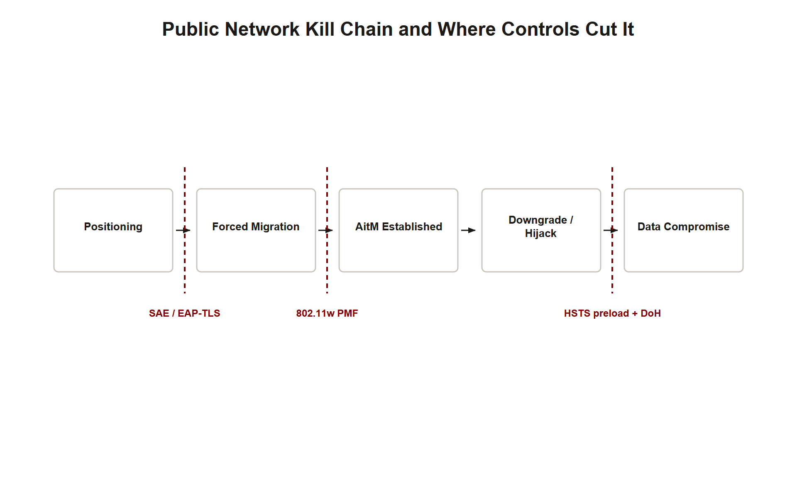
TOPIC 1.3 · 1.3.5.c.1
?
Synthesis: The Full Public-Network Attack Chain
1. Positioning: Attacker deploys a rogue AP cloning a trusted SSID/BSSID with boosted signal strength
2. Forced migration: Spoofed deauthentication frames disconnect the victim from the legitimate AP
3. AitM established: Victim connects to the rogue AP, giving the attacker full traffic-relay position
4. Downgrade/hijack: SSL stripping and/or DNS hijacking exposes cleartext credentials or redirects to fraudulent servers
5. Defense collapse points: PMF breaks link 2; SAE/EAP-TLS breaks link 1/3; HSTS preload and DoH break link 4
Public Network Kill Chain
Notes:
Every case study in this topic follows the identical five-link chain, and mapping a specific defense to the specific link it severs is exactly the skill the AP exam's free-response questions reward. Positioning begins the chain: an attacker deploys infrastructure cloning a trusted network's SSID, BSSID, and channel, boosting signal strength to win any future association contest. Forced migration follows, using unauthenticated deauthentication frames to disconnect an already-associated victim from the legitimate AP, exploiting the absence of Protected Management Frames.
Once the victim associates with the rogue AP, Adversary-in-the-Middle positioning is fully established, every packet the victim sends or receives now passes through attacker-controlled infrastructure. From that position, the attacker executes a downgrade or hijack: SSL stripping exploits the browser's first-request HTTP gap to harvest credentials in cleartext, while DNS hijacking can redirect any domain lookup to an entirely attacker-controlled server, producing the fraudulent access described in the case studies.
Mapping defenses precisely: mandatory 802.11w PMF under WPA3 breaks link 2 by making the deauthentication frame verifiable and rejectable; SAE and, more decisively, 802.1X/EAP-TLS mutual authentication break links 1 and 3 by making the rogue AP either impossible to leverage for password cracking or outright unable to present valid credentials at all; and HSTS preload registration combined with DNS over HTTPS breaks link 4 by removing both the cleartext-first-request gap and the unencrypted DNS query that SSL stripping and DNS hijacking respectively depend on. Because an attacker only needs every link intact to succeed, deploying overlapping defenses at multiple links, rather than perfecting just one, is what genuinely defeats this attack chain.

Slide 34
TOPIC 1.3 · 1.3.5.c.2
Exam Readiness Checklist for Topic 1.3
Can you explain why wireless networks fundamentally lack a physical security perimeter, unlike wired networks?
Can you walk through the full Evil Twin attack sequence: SSID/BSSID cloning, RSSI boosting, spoofed deauth?
Can you explain precisely why SSL stripping is a downgrade attack, not a cryptographic break of TLS?
Can you distinguish HSTS headers (protect returning visits) from the HSTS preload list (protects first visits too)?
Can you name the four-layer public-network defense stack (link, network, transport, application) with a specific control per layer?
Notes:
Use this checklist to self-assess before the assessment. Each item maps to a high-frequency question pattern for this topic. The two concepts most likely to determine full versus partial credit are (1) precisely explaining that SSL stripping is a downgrade of the browser's initial request behavior, never an actual break of TLS cryptography, and (2) correctly distinguishing a standard HSTS header (which only protects returning visits to a previously cached domain) from HSTS preload list membership (which protects even a genuinely first-ever visit by hardcoding the policy into the browser itself).
Beyond those, expect at least one item testing the SSID-versus-BSSID or downgrade-versus-cryptographic-break vocabulary pairs precisely, and at least one free-response item requiring the full four-layer public-network defense stack (link, network, transport, application layers) rather than a single named control such as 'use a VPN' alone.
Finally, keep the detection-versus-mitigation distinction sharp, exactly as in Topics 1.1 and 1.2: a wireless intrusion detection alert on a duplicate SSID or RSSI anomaly detects a likely Evil Twin; 802.11w PMF and 802.1X/EAP-TLS are what actually prevent a client from ever falling for it. Scenario prompts almost always require naming both categories explicitly.

