Slide 1
AAYAT-AP-PREP · CYBERSECURITY
INTRODUCTION TO SECURITY
Topic 1.4: AI-Augmented Cyberattacks
Generative models have lowered the cost of the work adversaries once did by hand: fluent phishing prose, cloned voices, automated reconnaissance, and assisted malware development. This topic examines how such tools augment attacks and what defenses remain effective against them.
2 learning objectives · College Board AP Cybersecurity Course Framework
Notes:
Cover slide for Topic 1.4: AI-Based Cybersecurity Attacks. Generative models have lowered the cost of the work adversaries once did by hand: fluent phishing prose, cloned voices, automated reconnaissance, and assisted malware development. This topic examines how such tools augment attacks and what defenses remain effective against them.

Slide 2
TOPIC 1.4
Learning Objectives
Analyze Risk
Explain how adversaries use AI-powered tools to augment their cyberattacks.
1.4.A
Mitigate Risk
Explain how individuals can protect themselves against several classes of AI-augmented attack.
1.4.B
Objectives paraphrased from the AP Cybersecurity Course Framework (College Board, AP Career Kickstart).
Notes:
Read each learning objective aloud and connect it to the exam skill category before starting the topic.

Slide 3
TOPIC 1.4 · CONCEPT MAP
AI-Augmented Cyber Kill Chain
01
02
03
04
05
AI OSINT SCRAPE
AUTO PRETEXTING
STEALTH DELIVERY
EXPLOITATION
EXFILTRATION
Automatic target profile mapping using NLP models across professional networks.
Deepfakes and LLM-crafted spear phishing emails constructed based on scraping.
AI modifies malware signature dynamically to evade traditional static antivirus scans.
Automated payload runs locally, identifying kernel paths and local weaknesses.
AI bot identifies high-value database files and exfiltrates them via steganography.

Slide 4
TOPIC 1.4 · CONCEPT MAP
AI Voice Cloning Vishing Attack Sequence
Social Media
AI Cloner Engine
Target Relative
Attacker
1. Scrapes video/audio clips
2. Extracts acoustic features
3. Generates synthesized cloned voice
4. Launches spoofed distress call (whaling / vishing)
5. Relative wires funds to “secure” account

Slide 5
TOPIC 1.4
The Big Idea
AI doesn't invent new kinds of crime — it gives one attacker a thousand different convincing disguises, and lets them try all of them at once, at a speed no human con artist ever could.
Hold onto this picture — we'll come back to it as the mechanics get more technical.
Notes:
Big-idea framing for Topic 1.4. Open with this analogy before the mechanics: "AI doesn't invent new kinds of crime — it gives one attacker a thousand different convincing disguises, and lets them try all of them at once, at a speed no human con artist ever could." Ask students for their own version of the analogy before moving on.

Slide 6
01
From Human-Limited to AI-Scaled Social Engineering
Topic 1.4
Notes:
Transition to part 1 of the topic. Pause here for questions before continuing.

Slide 7
TOPIC 1.4 · 1.4.1.a.1
From Human-Limited to AI-Scaled Social Engineering
Historical constraint: High-quality spear-phishing/vishing required a skilled human operator per attack
What changed: Generative AI automates personalization and scale simultaneously, no longer a tradeoff
LLMs: Generate grammatically flawless, context-aware phishing text in any language for fractions of a cent per message
Deepfakes: Generative neural networks synthesize convincing video/audio/image impersonations of specific real people
Net effect: The volume-vs-credibility tradeoff that limited social engineering for decades has largely collapsed
Notes:
Every social-engineering concept introduced in Topic 1.1, pretexting, Cialdini's persuasion principles, spear-phishing, historically operated under a hard constraint: producing a genuinely convincing, personalized attack required a skilled human to research the target and craft the message or call by hand. This limited attackers to a real tradeoff between scale (mass, generic phishing) and credibility (labor-intensive, highly targeted spear-phishing), since a human operator simply cannot personally craft thousands of individually convincing messages.
Generative AI collapses this tradeoff. Large language models can generate grammatically flawless, contextually appropriate phishing text personalized to a specific target's role, employer, and current events, in any language, at a marginal cost measured in fractions of a cent per message, removing the labor bottleneck that previously capped how many high-quality spear-phishing attempts a single attacker could produce.
Deepfakes extend this same capability from text into synthetic audio, video, and images: deep generative neural networks trained on a target's publicly available voice or video samples can produce new synthetic media convincingly replicating that specific person's appearance and voice, something no purely text-based attack could previously achieve. This topic examines both capabilities, LLM-scaled phishing and deepfake-based impersonation, as a unified shift in the threat landscape, building directly on Topic 1.1's psychological framework.

Slide 8
TOPIC 1.4 · 1.4.1.a.2
?
Deepfakes and the Statistical Nature of Biometric Verification
Passwords: Verified by exact binary matching, either the string matches or it doesn't
Biometrics: Verified by statistical similarity, a scanner computes a match SCORE against a threshold
The attack surface: A deepfake doesn't need to perfectly replicate a face/voice, only exceed the acceptance threshold
Why this works: A generative model trained on the same statistical distribution as real biometric data can score above threshold without being a perfect copy
Consequence: Biometric authentication has a fundamentally different (and more exploitable) failure mode than knowledge-based authentication
Notes:
Password-based authentication operates on exact binary matching: a submitted string either equals the stored (hashed) value or it does not, with no middle ground. Biometric authentication is architected completely differently, and this architectural difference is precisely what deepfakes exploit. A biometric scanner measures physical features, facial geometry, voice frequency characteristics, and computes a similarity score against a stored reference profile; if that score exceeds a configured acceptance threshold, identity is confirmed.
This threshold-based, statistical design means a deepfake does not need to be a flawless, indistinguishable replica of the target's actual face or voice, it only needs to be similar enough, according to the specific classifier being fooled, to score above whatever threshold that system enforces. Because generative models like GANs are explicitly trained to approximate the statistical distribution of real biometric data for a given target, their output can score highly on exactly the metrics a biometric classifier evaluates, without needing pixel-perfect or waveform-perfect replication.
This creates a fundamentally different and more exploitable failure mode than password theft. A password is either known or unknown to an attacker with no partial credit; a biometric system's acceptance threshold creates a continuous attack surface where 'close enough, statistically' becomes sufficient, and the two configurable error types, False Accept Rate (accepting an impostor) and False Reject Rate (rejecting a genuine user), trade off directly against each other as that threshold is tuned.

Slide 9
02
GAN Architecture: The Generator/Discriminator Minimax Game
Topic 1.4
Notes:
Transition to part 2 of the topic. Pause here for questions before continuing.

Slide 10
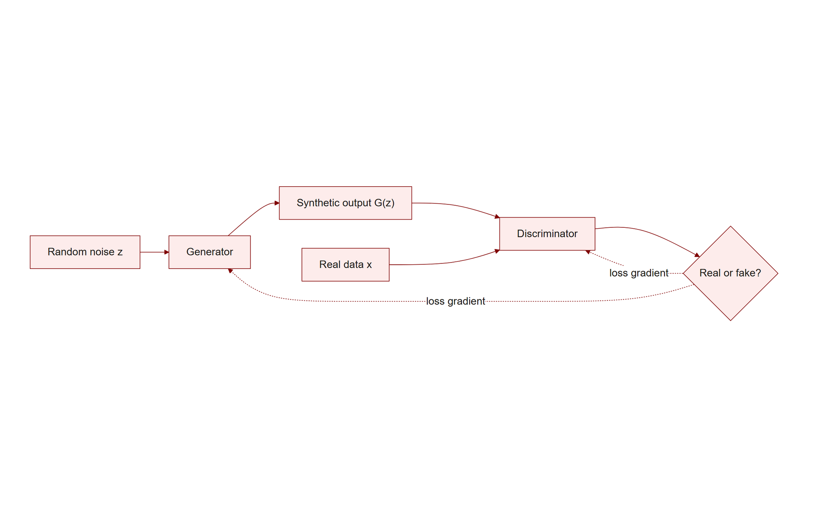
TOPIC 1.4 · 1.4.2.a.1
?
GAN Architecture: The Generator/Discriminator Minimax Game
Two networks: A Generator (G) creates synthetic samples; a Discriminator (D) classifies real vs. fake
Minimax objective: D maximizes correct classification; G minimizes D's ability to detect its fakes
Loss function: min_G max_D V(D,G) = E[log D(x)] + E[log(1 - D(G(z)))]
Training dynamic: G and D improve together, each pushing the other to get better, over thousands of iterations
Nash equilibrium: When G perfectly matches the real data distribution, D outputs 0.5 for everything, it genuinely cannot tell
Gan Minimax Architecture
Notes:
A Generative Adversarial Network, introduced by Goodfellow et al. in 2014, trains two neural networks in direct competition. The Generator (G) takes a random noise vector as input and attempts to produce synthetic data, a face, a voice sample, indistinguishable from real target data. The Discriminator (D) is a classifier that receives either genuine training data or G's synthetic output and attempts to correctly label which is which.
The two networks are trained under a minimax objective, formalized as $\min_G \max_D V(D,G) = \mathbb{E}_{x\sim p_{data}}[\log D(x)] + \mathbb{E}_{z\sim p_z}[\log(1-D(G(z)))]$. The Discriminator is optimized to maximize this value, correctly scoring real data highly and fake data low; the Generator is simultaneously optimized to minimize the same expression, specifically by producing fakes that push $D(G(z))$ as close to 1 (fooled into thinking it's real) as possible.
Training proceeds as an iterative arms race: as G's outputs improve, D must sharpen its discrimination ability to keep detecting them, and D's improved sensitivity in turn forces G to produce even more convincing output. At the theoretical Nash equilibrium, G's output distribution has converged so closely to the real data distribution that D can no longer distinguish them at all better than chance, outputting exactly 0.5 regardless of input, the point at which training has 'succeeded' in producing output statistically indistinguishable from genuine data.

Slide 11
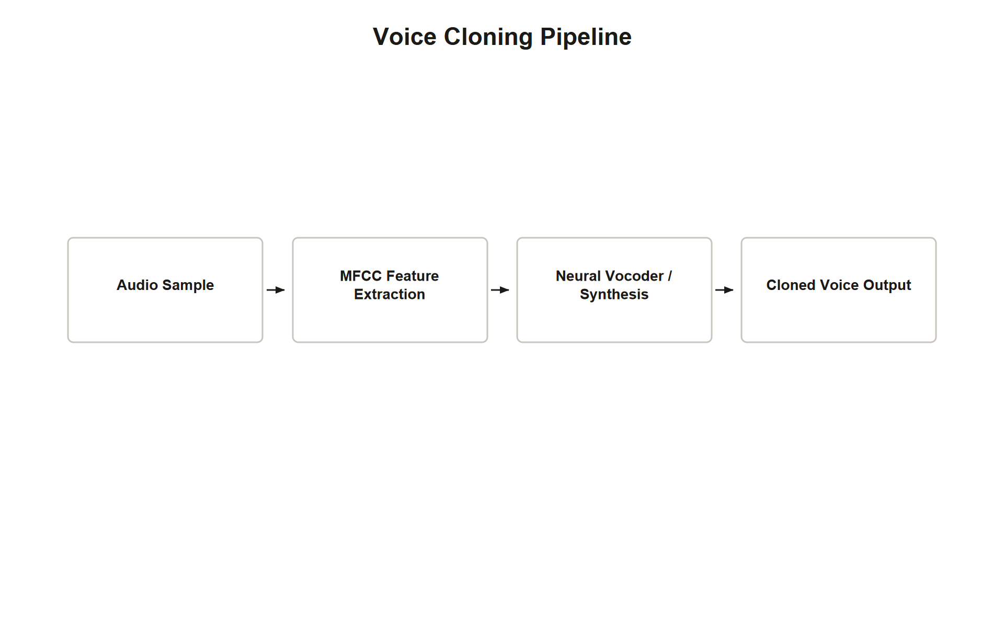
TOPIC 1.4 · 1.4.2.a.2
Voice Cloning: MFCC Feature Extraction and the Synthesis Pipeline
Step 1, Feature extraction: Target audio broken into frames; MFCCs capture the vocal tract's unique spectral envelope
Mel scale: A logarithmic frequency mapping matching human auditory perception: Mel(f) = 2595 log10(1 + f/700)
Step 2, TTS synthesis: A sequence-to-sequence model (e.g., Tacotron) maps input text to a spectrogram in the target's voice
Step 3, Vocoder reconstruction: A neural vocoder (e.g., WaveNet) converts the spectrogram into an audible waveform
Modern speed: Newer models (VALL-E) clone convincingly from as little as 3 seconds of source audio
Img 1.4.2 Voice Cloning Pipeline
Notes:
Voice cloning proceeds through a three-stage pipeline, each stage solving a distinct technical problem. Feature extraction begins by breaking target audio into short overlapping frames and computing Mel-Frequency Cepstral Coefficients for each frame, a representation that isolates the resonant characteristics of the speaker's specific vocal tract (their unique formant structure) from irrelevant recording-environment noise. The Mel scale underlying this transform, $\text{Mel}(f) = 2595\log_{10}(1 + f/700)$, maps raw frequency to a logarithmic scale matching how the human ear actually perceives pitch differences, humans distinguish a 100Hz-to-200Hz shift far more readily than an equivalent 1000Hz-to-1100Hz shift, and MFCCs are built around this same perceptual weighting.
With a compact MFCC-based profile of the target voice established, a sequence-to-sequence text-to-speech model (Tacotron and its successors are the canonical example) learns to map arbitrary input text directly to a spectrogram rendered in the target's specific vocal characteristics, the model has effectively learned 'what this input text would sound like if this specific person said it.'
The final stage, vocoder reconstruction, converts that abstract spectrogram representation into an actual audible waveform; neural vocoders like WaveNet generate this raw audio sample-by-sample, autoregressively conditioning each sample on everything generated before it, producing remarkably natural-sounding speech. The historical trend across this entire pipeline has been toward requiring less and less source audio: where early systems needed hours of target recordings, modern models like Microsoft's VALL-E can produce convincing clones from as little as 3 seconds of sample audio, meaning any public speech, podcast appearance, or company video already constitutes sufficient raw material for an attack.

Slide 12
TOPIC 1.4 · 1.4.2.a.3
Practice: Visualizing the Mel Scale's Logarithmic Compression
Goal: Make the Mel scale's logarithmic behavior concrete rather than abstract
Formula: Mel(f) = 2595 * log10(1 + f/700)
Key observation: Equal Hz differences produce very different Mel differences depending on the starting frequency
Perceptual meaning: This mirrors the fact that humans hear a 100Hz-to-200Hz jump as a much bigger change than 1000Hz-to-1100Hz
Why it matters for cloning: MFCCs built on this scale weight low-frequency vocal characteristics more heavily, matching what listeners actually notice
Notes:
The code below computes the Mel-scale value for a range of frequencies and compares equal-sized Hz gaps at different points on the frequency spectrum, making the logarithmic compression described in the mechanism slide directly observable rather than purely theoretical.
Running it reveals that a 100Hz gap near the low end of the spectrum (say, 100Hz to 200Hz) produces a substantially larger change in Mel-scale value than an identical 100Hz gap higher up the spectrum (1000Hz to 1100Hz), exactly mirroring the well-documented psychoacoustic fact that human hearing is far more sensitive to pitch differences at lower frequencies than at higher ones.
This is precisely why voice-cloning systems build their feature representation around the Mel scale rather than raw linear frequency: doing so ensures the model's learned features emphasize the frequency regions a human listener will actually notice discrepancies in, producing cloned audio that sounds convincing to the ear even if it isn't a mathematically perfect reproduction across the entire raw frequency spectrum.

Slide 13
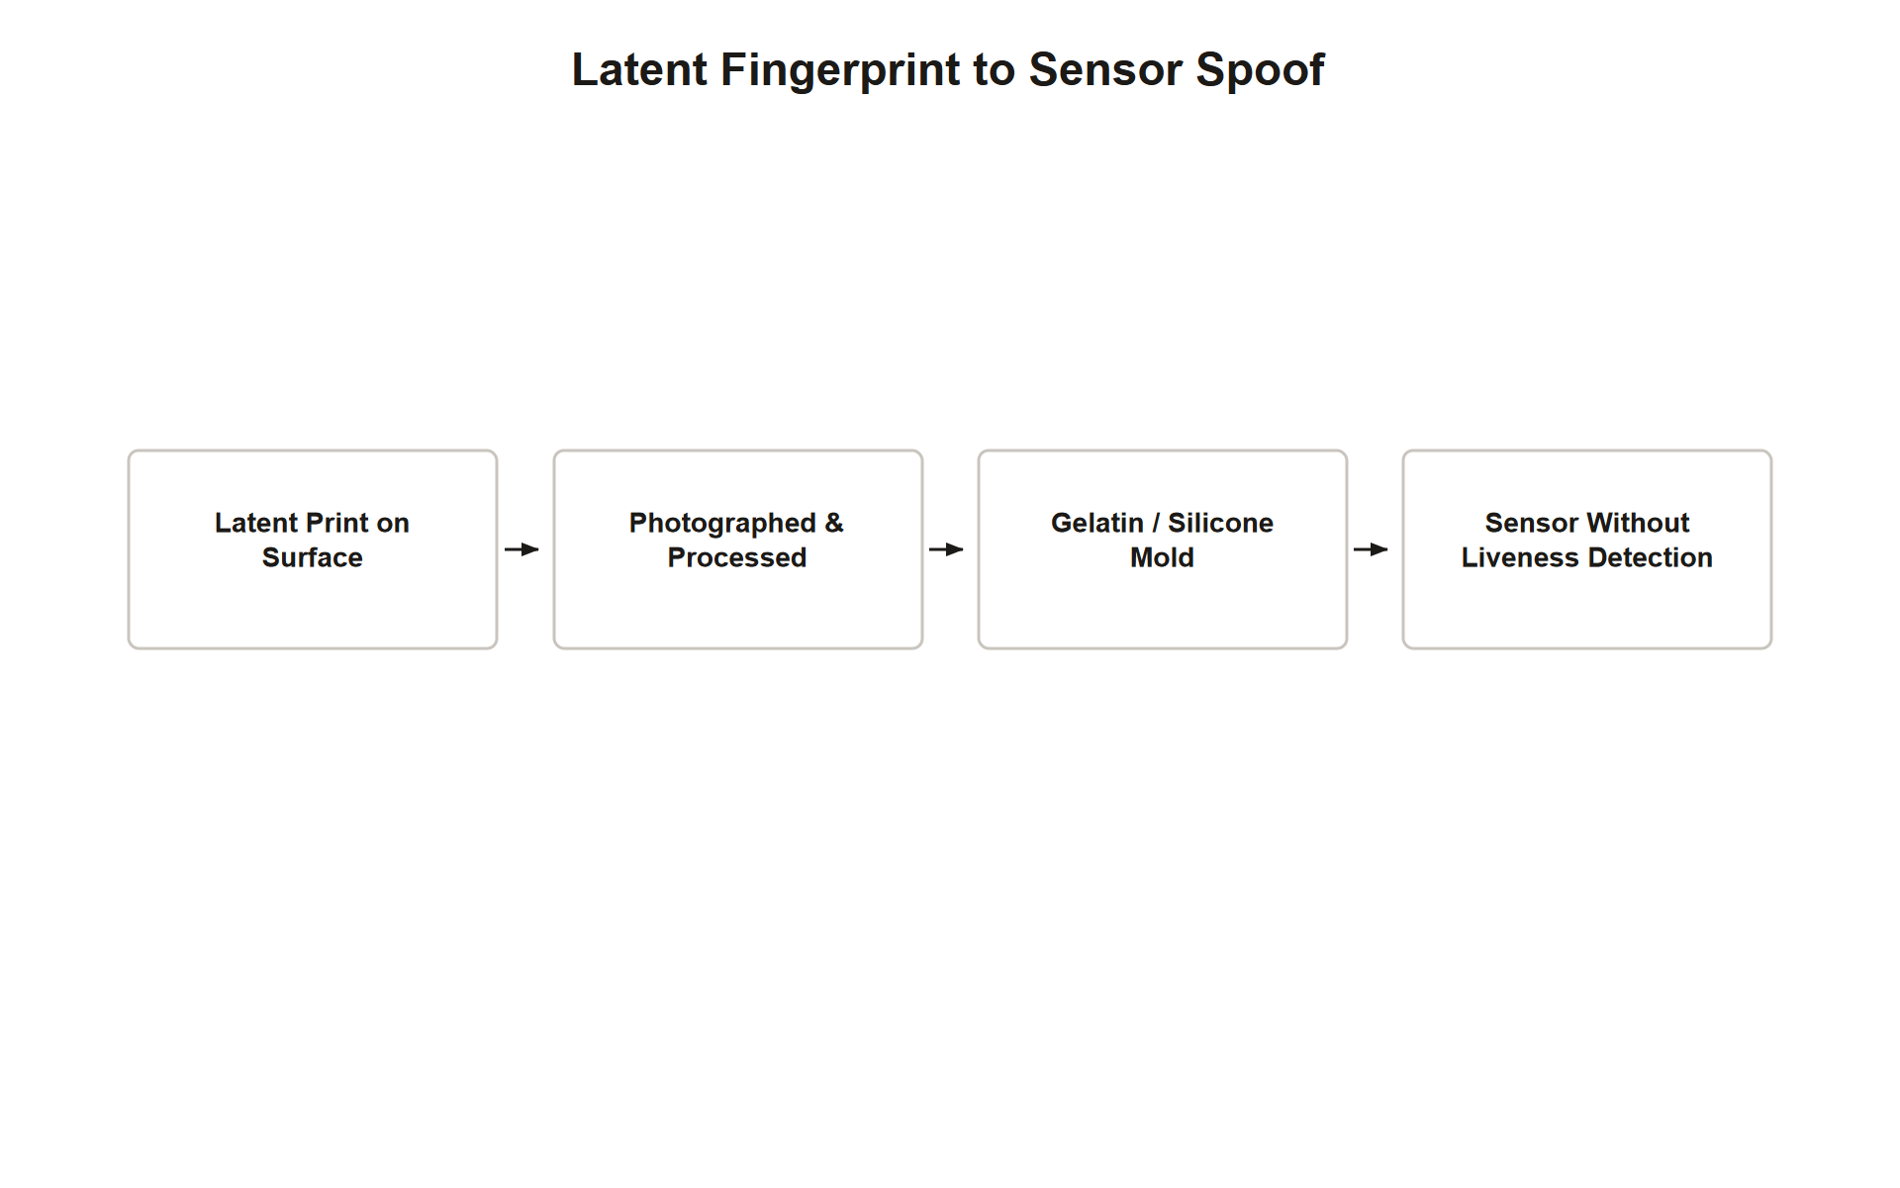
TOPIC 1.4 · 1.4.2.b.1
Biometric Fingerprint Spoofing from Latent Prints
Source material: Latent fingerprints, invisible oil/sweat impressions left on any touched surface
Harvesting: Photograph or dust the print, enhance digitally, reverse the ridge pattern for a mold
Fabrication: Cast a 3D replica using conductive gelatin or silicone to mimic skin's electrical properties
Target sensors: Optical (visual pattern match) and capacitive (electrical impedance/moisture) fingerprint scanners
Historical proof of concept: Krissler & Fiora (2014) demonstrated spoofing Apple Touch ID from a lifted fingerprint photograph
Img 1.4.2 Fingerprint Spoofing
Notes:
Fingerprint spoofing does not require any specialized access to a target, it exploits the simple physical fact that touching virtually any surface (a glass, a phone screen, a door handle) leaves behind a latent fingerprint: an invisible impression formed from the natural oils and sweat on human skin. An attacker photographs or physically dusts this impression, digitally enhances the resulting image to sharpen the ridge pattern, and uses it to fabricate a physical mold, commonly cast in conductive gelatin or silicone chosen specifically because these materials can approximate the electrical conductivity of living skin.
This fabricated artifact is then presented directly to the target sensor. Optical fingerprint sensors, which primarily analyze the visual ridge pattern, can potentially be fooled by a sufficiently detailed printed or molded reproduction of that pattern alone. Capacitive sensors are somewhat more demanding, since they measure the specific electrical impedance and moisture characteristics of living tissue rather than a purely visual pattern, which is precisely why attackers favor conductive gelatin, chosen specifically to mimic these electrical properties rather than a simple photograph or 3D-printed plastic mold.
This is not a hypothetical threat: security researcher Jan Krissler (known as 'Starbug') publicly demonstrated spoofing Apple's Touch ID sensor from a fingerprint lifted photographically from a glass surface as early as 2014, well before deepfake video and voice cloning became widely discussed, establishing that biometric spoofing as a general category predates the current generation of AI-driven synthetic-media attacks and remains a distinct, still-relevant threat vector alongside them.

Slide 14
TOPIC 1.4 · 1.4.2.b.2
?
Presentation Attack Detection (PAD) and the ISO/IEC 30107 Standard
PAD: Presentation Attack Detection, the discipline of detecting spoofed biometric artifacts before matching occurs
Three-part standard: ISO/IEC 30107-1 (framework), -2 (data formats), -3 (testing/reporting metrics)
APCER: Attack Presentation Classification Error Rate, how often attacks are wrongly accepted as genuine
BPCER: Bona-fide Presentation Classification Error Rate, how often genuine users are wrongly rejected
Compliance levels: Level 1 (basic) through Level 3 (detects sophisticated deepfakes/masks; required for government/border use)
Notes:
Presentation Attack Detection is the dedicated countermeasure discipline built specifically to catch spoofed biometric artifacts, whether a printed photo, a silicone fingerprint mold, or a played-back deepfake video, before the underlying matching algorithm even evaluates the artifact's similarity score. ISO/IEC 30107 formalizes this across three parts: Part 1 establishes shared terminology and a conceptual framework for what constitutes a presentation attack; Part 2 defines standardized data formats for recording PAD results; Part 3 defines the actual testing methodology and the metrics used to evaluate PAD system performance.
Those metrics quantify a tradeoff analogous to FAR/FRR from the earlier biometric-threshold discussion, but specifically for the liveness-detection layer: the Attack Presentation Classification Error Rate (APCER) measures how often a genuinely spoofed artifact is incorrectly classified as a live, authentic presentation, the error type an attacker directly benefits from, while the Bona-fide Presentation Classification Error Rate (BPCER) measures how often a real, live user is incorrectly flagged as a spoofing attempt, an inconvenience cost imposed on legitimate users.
The standard defines three escalating compliance levels: Level 1 provides basic detection of the crudest attacks (static photos, simple video replay); Level 2 catches more deliberate physical artifacts such as printed masks or molded fingerprints; Level 3 is designed to detect the most sophisticated attacks, including high-resolution real-time deepfakes and custom silicone masks, and is specifically required for government and border-control biometric deployments given the higher consequence of a successful bypass in those contexts.

Slide 15
03
Case Study: The 2019 UK Energy Firm Voice Clone Theft
Topic 1.4
Notes:
Transition to part 3 of the topic. Pause here for questions before continuing.

Slide 16
TOPIC 1.4 · 1.4.3.a.1
?
Case Study: The 2019 UK Energy Firm Voice Clone Theft
Vector: AI voice clone of the German parent company's CEO, trained on public speech recordings
Cialdini principles stacked: Authority (the CEO's own voice) plus Urgency (a one-hour deadline)
Result: The UK managing director transferred EUR 220,000 to a Hungarian supplier account
Detection: A suspicious call-back number on a THIRD call prompted verification with the real CEO
Root failure: Three procedural red flags (unusual number, unusual channel, extreme urgency) were overridden by voice realism
Notes:
In March 2019, the managing director of a UK-based energy firm received a phone call whose voice was, in accent, pitch, and speech pattern, indistinguishable from the real CEO of the firm's German parent company. The caller, an attacker using commercial AI voice-cloning software trained on the CEO's publicly available speech recordings, invoked both authority (impersonating the ultimate corporate decision-maker) and urgency (a strict one-hour transfer deadline with implied financial penalties for delay), directing an immediate EUR 220,000 wire transfer to a Hungarian supplier account. The director complied.
The fraud was only caught when the attackers called a second and third time: the director noticed the calls were now originating from an unfamiliar country code inconsistent with the CEO's usual number, and independently contacted the real CEO directly to verify, at which point the fraud was exposed, though the initial transfer had already been executed.
Post-incident analysis identified three distinct red flags that were present but overridden: the call came from an Austrian mobile number rather than the CEO's known German number; the CEO had never previously called directly to authorize financial transfers, which normally routed through the finance department as a matter of standing procedure; and the request carried an extreme, artificially compressed deadline. All three are classic social-engineering signatures independently of any AI involvement, but the voice's convincing realism was sufficient to keep the director's response in Kahneman's System 1 rather than triggering the System 2 verification that these red flags, on their own, should have prompted.

Slide 17
TOPIC 1.4 · 1.4.3.a.2
?
Case Study: The 2024 Hong Kong Deepfake Video Conference Heist
Vector: Pre-recorded deepfake video avatars of the CFO and multiple colleagues on a video call
Scale: $25 million USD across 15 separate transactions to offshore accounts, the largest known deepfake fraud as of 2024
Key detail: The deepfakes were NOT live-generated, pre-recorded avatar statements were played on a scripted timeline
Employee's position: The only genuinely live participant on an otherwise entirely fabricated video call
Combined attack chain: Spear-phishing invite (1.1) + deepfake video (1.4) + BEC paperwork + multi-jurisdiction money mules
Notes:
In February 2024, a finance employee at a multinational firm's Hong Kong branch received what appeared to be a legitimate invitation to a confidential video conference regarding a company acquisition, ostensibly from the UK-based Chief Financial Officer. Joining the call, the employee saw and heard the CFO along with several other apparently genuine colleagues, all engaged in a normal-seeming multi-party discussion, none of whom, investigation later revealed, were live participants at all.
The CFO's deepfake avatar instructed the employee to execute fifteen separate wire transfers totaling $25 million USD to various offshore accounts. Believing the video call to be authentic, the employee complied across all fifteen transactions. The fraud was discovered only days later when the employee happened to check with corporate headquarters directly, by which point the funds had already been distributed across multiple jurisdictions via money mule accounts, substantially complicating recovery.
A critical technical detail from the Hong Kong Police investigation distinguishes this case from a hypothetical live-generated deepfake stream: the attackers had pre-recorded the deepfake avatar statements for the CFO and each colleague using existing public video and audio footage from company events and investor briefings, then played these recordings during the call according to a pre-planned script, rather than generating video in real time. This is a meaningfully lower technical bar than live deepfake generation would require, and it explains how a multi-participant deepfake call at this scale was logistically achievable with 2024-era technology. The Hong Kong case combined four distinct attack techniques in sequence: an initial spear-phishing invitation (Topic 1.1), the deepfake video impersonation itself (this topic), standard BEC-style transfer paperwork to lend procedural legitimacy, and money-mule account structures across jurisdictions specifically to frustrate recovery efforts.

Slide 18
04
Multi-Spectral Biometric Liveness Detection
Topic 1.4
Notes:
Transition to part 4 of the topic. Pause here for questions before continuing.

Slide 19
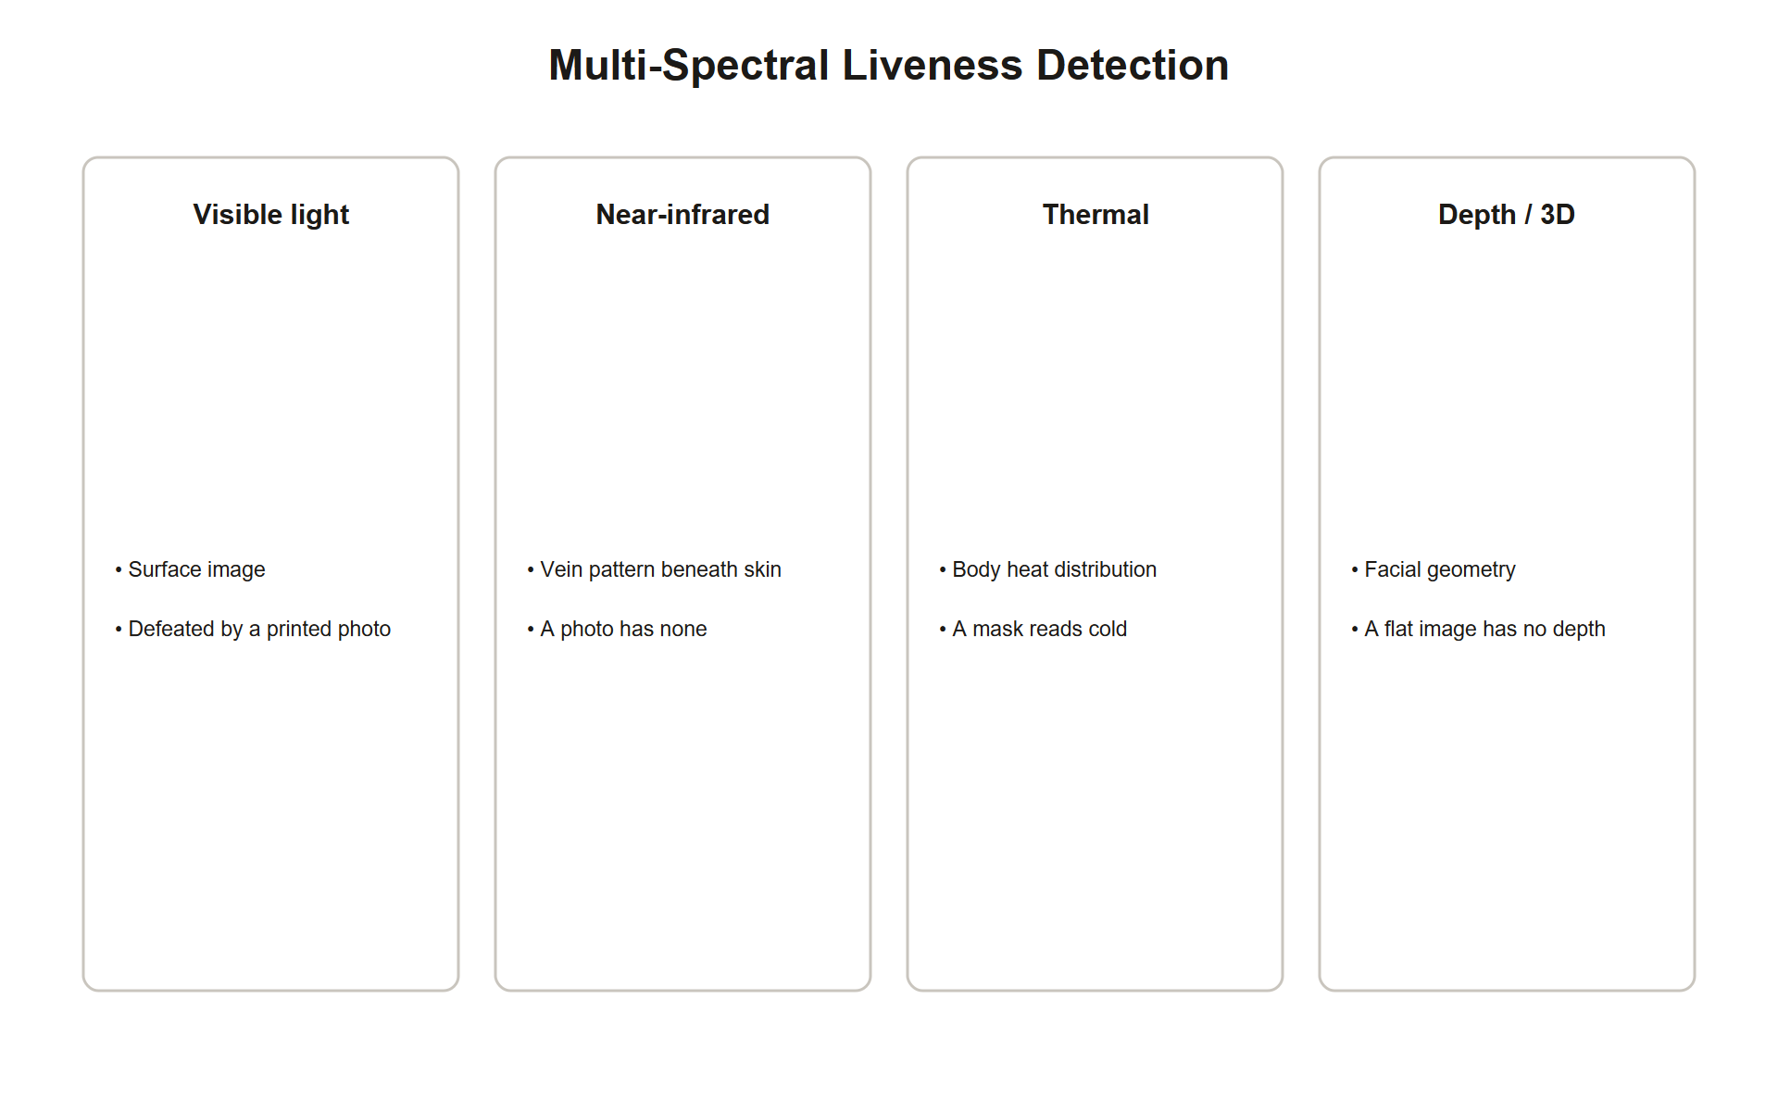
TOPIC 1.4 · 1.4.4.a.1
Multi-Spectral Biometric Liveness Detection
Beyond visible light: Near-infrared and short-wave infrared reveal properties invisible to a normal camera or screen
Vein pattern imaging: NIR light reveals subcutaneous blood vessel patterns, impossible to replicate on a photo, mask, or screen
Thermal/capacitive checks: Living tissue generates heat and has electrical properties silicone/gelatin molds cannot fully replicate
3D structured light: Captures actual depth maps, flat screens and 2D deepfake playback cannot produce true depth
Combined effect: A deepfake video or static mold reflects identically across all wavelengths; real skin does not
Multispectral Liveness Detection
Notes:
Where a standard camera or optical fingerprint reader only captures visible-light reflectance, precisely the domain deepfakes and molded artifacts are engineered to replicate convincingly, multi-spectral biometric systems capture additional physical properties that synthetic media and physical spoofing artifacts cannot easily reproduce. Near-infrared light penetrates a short distance into skin and is selectively absorbed by hemoglobin in blood vessels, revealing a unique subcutaneous vein pattern entirely invisible in ordinary photographs, video, or silicone molds, since none of these have actual blood vessels beneath a surface layer to absorb the infrared light differently.
Complementary checks target other physical properties equally hard to fake: thermal imaging detects the heat signature living tissue naturally generates, which a static photo, video playback on a screen, or an inert silicone mold does not replicate; capacitive sensing measures the specific electrical impedance and moisture profile of living human skin, distinct from gelatin or synthetic materials even when those materials are specifically chosen to approximate skin's conductivity.
3D structured-light imaging adds a further dimension: it captures actual depth information about the presented face or fingerprint, defeating both flat 2D deepfake video played on a screen and flat photographic prints, neither of which can produce a genuine depth map matching a real three-dimensional face or finger. Combined, these multi-spectral techniques exploit a structural limitation of both generative deepfakes and molded physical artifacts: both are fundamentally optimized to fool visible-light-based classifiers, and neither convincingly replicates the full physical reality of living tissue across every additional imaging modality simultaneously.

Slide 20
TOPIC 1.4 · 1.4.4.a.2
?
C2PA: Cryptographic Content Provenance for Media
C2PA: Coalition for Content Provenance and Authenticity, an open standard co-developed by Adobe, Microsoft, and others
What it does: Embeds a cryptographically signed manifest into media AT THE MOMENT OF CREATION
Manifest contents: Creation tool/software, timestamp, edit history, and whether content is AI-generated
Signing: The manifest is signed with the creator's private key using ECDSA, verifiable by anyone with the public key
Key limitation: Stripping the metadata (screenshot, re-encode) is trivial, C2PA proves provenance, not the absence of manipulation outside the chain
Notes:
Where multi-spectral sensing defends the moment of biometric verification itself, C2PA addresses a related but distinct problem: verifying whether a piece of media, an image, video, or audio file circulating independently of any live verification session, was genuinely created or manipulated as claimed. C2PA embeds a cryptographic manifest directly into the media file at the moment of creation, recording specific, verifiable facts: which software or camera produced it, a precise creation timestamp, a record of subsequent edits, and critically, whether the content was produced by a generative AI tool.
This manifest is cryptographically signed using the creating tool's or device's private key (commonly ECDSA), and that signature can be independently verified by anyone holding the corresponding public key, establishing a chain of custody analogous to DKIM's role in Topic 1.1, but applied to media provenance rather than email origin. Physical hardware is beginning to support this natively: certain camera models now sign photographs with C2PA manifests directly in-camera, at the moment of capture, before any software editing could occur.
C2PA carries a specific, important limitation that exam scenarios test directly: it proves provenance for content that carried a manifest and remained within the C2PA-aware ecosystem, it does not prove the absence of manipulation for content that never had a manifest attached, nor does it survive trivial evasion techniques like taking a screenshot of manipulated content or re-encoding a video, both of which strip the embedded cryptographic metadata entirely. C2PA is therefore best understood as raising the cost and reducing the plausible deniability of claiming authenticity for AI-generated content distributed through cooperating platforms, not as a universal detector capable of flagging every deepfake regardless of how it was distributed.

Slide 21
TOPIC 1.4 · 1.4.4.a.3
Practice: Verifying a Simulated Content Manifest
Goal: Model the core logic of C2PA manifest verification in simplified code
Steps: Recompute the content hash -> compare to the manifest's claimed hash -> verify the signature
Tamper scenario: Any modification to the underlying media changes its hash, breaking manifest verification
Missing-manifest scenario: Content with no manifest at all simply cannot be verified either way
Takeaway: Verification failure has two very different causes, active tampering vs. content that was never covered by C2PA at all
Notes:
The simulation below models the essential logic a C2PA verifier performs, simplified for clarity. Given a piece of content and an attached manifest, it recomputes the content's hash and compares it to the hash value recorded inside the manifest at creation time; a mismatch indicates the content has been altered since the manifest was generated.
Run it against three cases: unmodified content with its original manifest (verification succeeds), content that has been altered after the manifest was created (verification fails, correctly flagging tampering), and content with no manifest attached at all (verification cannot even be attempted, this is the more common real-world case for arbitrary content circulating online, and it is meaningfully different from a failed verification).
This distinction matters directly for how exam scenarios should be reasoned about: a C2PA verification failure due to hash mismatch is a strong, specific signal of tampering; the complete absence of any manifest is not evidence of tampering at all, it simply means the content was never within C2PA's chain of custody in the first place, and its authenticity must be assessed through entirely different means.

Slide 22
TOPIC 1.4 · 1.4.4.b.1
?
Procedural Defenses: Dual Control and Secret Verification Passphrases
Two-person authorization (dual control): No single individual can complete a high-value transaction alone
Out-of-band verification: Confirm any request through a channel the requester's message did not itself provide
Secret passphrases: Pre-agreed codewords exchanged at the START of sensitive calls, never communicated over email
Why passphrases specifically defeat AI cloning: A voice clone can say ANY word convincingly, but it cannot know an out-of-band secret it was never given
Rotation discipline: Passphrases should be rotated regularly and kept distinct per context (financial vs. IT vs. HR)
Notes:
Because deepfakes and voice clones specifically defeat the perceptual verification humans normally rely on (recognizing a familiar face or voice), the most reliable defenses against this specific attack category are procedural rather than purely technical, controls that do not depend on a human correctly detecting that something is synthetic at all. Dual control (also called two-person integrity) requires two independently authorized individuals to each verify and approve any transaction above a defined threshold, meaning an attacker's deepfake would need to simultaneously deceive two separate people through two separate verification paths rather than one, substantially raising the required sophistication and coordination of an attack.
Out-of-band verification, introduced in Topic 1.1 for BEC defense, applies with even greater force here: any request received via a video call, voice call, or email should be independently confirmed through a genuinely separate channel, calling a pre-registered phone number, for instance, rather than any contact information supplied within the suspicious communication itself.
Secret verification passphrases add a specific, remarkably cheap layer targeted precisely at this attack's core weakness: a pre-agreed codeword, exchanged and memorized entirely out-of-band (crucially, never communicated over email or any channel an attacker might have compromised), that must be stated correctly at the start of any sensitive call before substantive business is discussed. An AI voice clone can be made to say literally any word an attacker scripts it to say, but it has no access to a secret that was never given to the attacker in the first place, since the clone only replicates the target's voice characteristics, not their private knowledge. Best practice rotates these passphrases regularly and uses distinct phrases per context (financial approval versus IT administrative access versus HR matters) to limit the damage if any single passphrase is somehow compromised.

Slide 23
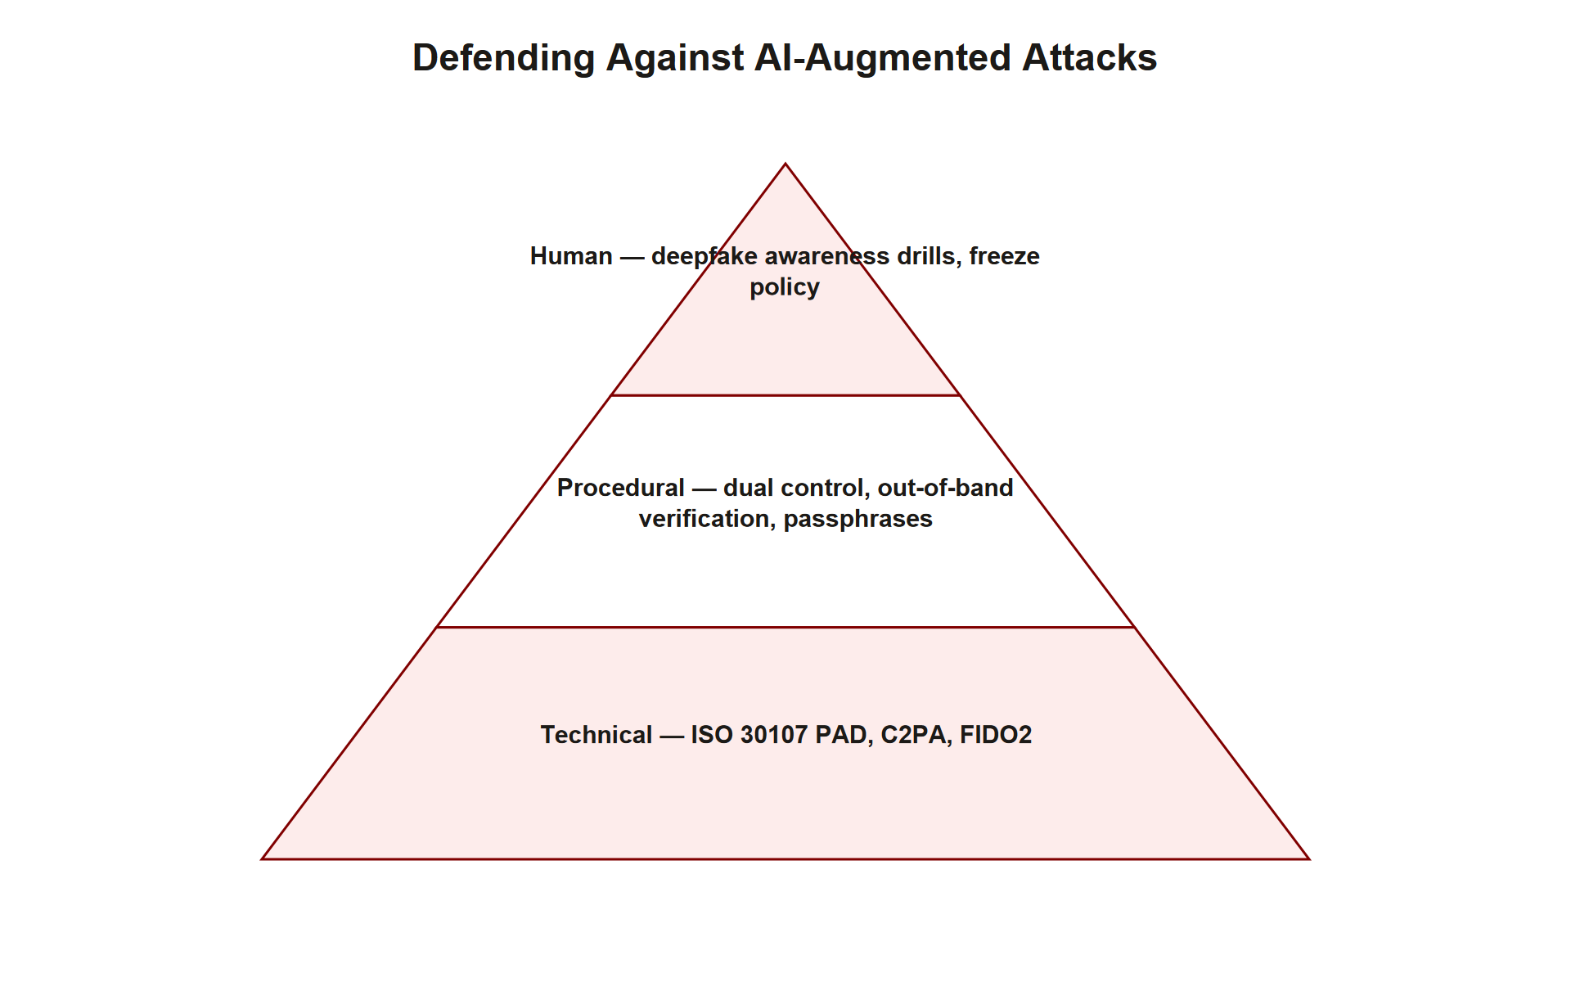
TOPIC 1.4 · 1.4.4.b.2
The AI Attack Defense Pyramid: Three Coordinated Layers
Technical: ISO/IEC 30107 PAD, C2PA content credentials, FIDO2/WebAuthn (also defeats voice-clone login attacks)
Procedural: Dual-control authorization, out-of-band verification, secret passphrases, no single-employee wire authority
Human: Awareness training with specific deepfake drills; a 'freeze policy' protecting any employee who halts a suspicious transfer
Observed gap: Most organizations invest almost entirely in layer 3 (human training) alone
Exam expectation: Full-credit answers name a specific mechanism from all three layers, not one layer alone
Ai Attack Defense Pyramid
Notes:
Mirroring the three-layer defense hierarchies established for social engineering (Topic 1.1) and authentication (Topic 1.2), defending against AI-powered attacks specifically requires coordinated controls across technical, procedural, and human layers, and no single layer is sufficient alone. The technical layer includes ISO/IEC 30107 Presentation Attack Detection for any system relying on biometric verification, C2PA content credentials for verifying media provenance where applicable, and, notably, FIDO2/WebAuthn, which defeats voice-clone-based fraud attempted against a login system specifically because origin-bound cryptographic authentication has no voice or video component for a deepfake to spoof in the first place.
The procedural layer, covered in the prior slide, includes dual-control authorization for high-value transactions, out-of-band verification through channels the suspicious request itself did not provide, and pre-agreed secret passphrases, controls specifically chosen because they remain effective even against a perfect, undetectable deepfake, since they don't depend on distinguishing real from synthetic media at all.
The human layer extends standard security-awareness training (NIST SP 800-50, from Topic 1.1) with drills specifically simulating deepfake and voice-clone scenarios, and critically, an explicit organizational policy protecting any employee who pauses or halts a suspicious transaction from career consequences, regardless of whether the request later turns out to have been legitimate, removing the incentive to comply under pressure rather than verify. The observed pattern across most real-world organizations, and the specific gap the AP exam expects students to identify, is that security investment concentrates almost entirely in this human layer (awareness training alone) while under-investing in the technical and procedural layers that remain effective even when human judgment is deceived.

Slide 24
05
Detection vs. Mitigation for AI-Powered Fraud
Topic 1.4
Notes:
Transition to part 5 of the topic. Pause here for questions before continuing.

Slide 25
TOPIC 1.4 · 1.4.5.a.1
Detection vs. Mitigation for AI-Powered Fraud
Detection: Flagging that content is likely synthetic or that a transaction pattern is anomalous
Mitigation: A control that prevents the fraud from succeeding regardless of whether detection occurred
Example detection: A C2PA manifest check or a PAD liveness-detection alert flagging likely synthetic media
Example mitigation: Dual-control authorization and out-of-band verification, which block the fraud even if detection fails or wasn't attempted
Why mitigation matters more here: AI-generated media quality keeps improving, making detection an ongoing arms race, not a solved problem
Notes:
As established across this unit, precisely distinguishing detection from mitigation remains a recurring exam requirement, and it carries particular weight in the AI-attack context because detection here is fighting an unusually fast-moving target. A detective control observes and flags that something is likely synthetic or anomalous, a PAD system flagging a liveness-detection failure, or a C2PA check reporting a broken or missing manifest, but does not, by itself, prevent a determined attacker's fraud from proceeding if the detection is bypassed, ignored, or simply not yet capable of catching the latest generation of synthetic media quality.
A mitigating control changes the outcome of the attack regardless of whether any detection occurred at all. Dual-control authorization and out-of-band verification succeed even against a perfect, completely undetectable deepfake, because they do not depend on distinguishing real from synthetic media in the first place, they simply require independent confirmation through a channel the attack could not have compromised.
This distinction carries unusual weight specifically in the AI-attack domain because generative model quality continues to improve rapidly, meaning any purely detection-based defense (a classifier trained to spot deepfake artifacts, for instance) faces an ongoing arms race against ever-more-convincing synthetic media, whereas procedural mitigations like dual control and passphrases remain effective regardless of how good the generative technology becomes, since their effectiveness never depended on detecting the fake in the first place.

Slide 26
TOPIC 1.4 · 1.4.5.a.2
?
Incident Response Walkthrough: The Meridian Logistics Voice-Clone Attempt
Scenario: A finance clerk receives a call, seemingly from the regional director, requesting an urgent vendor payment change
Artifact: Caller ID shows an unfamiliar international number; voice matches the director closely but slightly odd cadence
Task 1: Identify the likely attack category and the specific psychological/technical factors present
Task 2: Name two mitigations that would succeed regardless of whether the voice is confirmed synthetic
Task 3: Describe one detective control that should be deployed going forward
Notes:
Work this incident using the identify -> mitigate -> detect structure established across this unit. Identify: a call from an unfamiliar international number, requesting an urgent change to vendor payment details, with a voice closely matching a known executive but exhibiting a subtly unusual cadence, strongly suggests an AI voice-clone-based BEC attempt, combining Authority (impersonating the regional director) and Urgency (requesting an immediate change), the same Cialdini principles exploited in the 2019 UK energy firm case, now potentially delivered via synthetic voice.
Mitigate: two controls apply here regardless of whether the voice can be conclusively confirmed as synthetic or genuine. First, the clerk should decline to act on the call itself and independently call the regional director back using the number already on file in the company directory, never any number provided by or associated with the suspicious call, exactly the out-of-band verification principle established for BEC defense. Second, any vendor payment-detail change of this nature should already require dual-control sign-off under standing policy, meaning the clerk alone should never be able to complete such a change regardless of how convincing or urgent the request appears, structurally preventing a single deceived employee from completing the fraud.
Detect going forward: deploy a standing organizational policy requiring pre-agreed verification passphrases for any call involving a payment-detail change, and train the finance team specifically to recognize the pattern this scenario matches (unfamiliar number + unusual urgency + high-value financial change), feeding any near-miss incidents like this one back into security-awareness training as a concrete, organization-specific example for future drills.

Slide 27
TOPIC 1.4 · 1.4.5.b.1
?
Common Misconception: 'I Would Definitely Notice a Deepfake'
Belief: A person is confident they could personally detect a deepfake video or voice clone in real time
Why it's wrong: Modern generative models specifically optimize against exactly the artifacts humans learn to look for
Evidence: Both real-world case studies in this topic involved trained finance professionals, not naive victims
Deeper issue: Confidence in personal detection ability leads people to skip procedural verification they'd otherwise use
Correct model: Assume detection will eventually fail; rely on procedural controls that don't depend on detection at all
Notes:
A common and dangerous belief is that an individual, particularly one who has read about deepfakes or watched examples of poor-quality synthetic media, would reliably notice something 'off' about a sophisticated real-time deepfake or voice clone. This confidence is empirically unsupported and, worse, actively counterproductive: it is precisely the confidence that displaces the procedural verification habits (out-of-band callbacks, passphrases) that remain effective regardless of detection quality.
The technical reality is that GANs and modern voice-cloning models are explicitly trained in an adversarial process against a discriminator network optimized to detect exactly the kinds of artifacts (unnatural blinking, subtle audio-visual sync mismatches, unusual skin texture) that made earlier-generation deepfakes detectable to attentive humans. As covered in the Nash-equilibrium discussion of GAN training, the entire optimization objective is convergence toward output that is statistically indistinguishable from genuine media, meaning any detectable artifact is, by construction, something the training process is actively working to eliminate over successive iterations.
Both real-world case studies in this topic, the UK energy firm director and the Hong Kong finance employee, involved trained corporate professionals in high-stakes financial roles, not naive or inexperienced individuals, and both were deceived by the quality of the synthetic media presented to them. The correct mental model treats personal detection confidence as an unreliable, decaying asset that generative technology continues to erode, and instead structures defense around procedural controls, out-of-band verification, dual control, passphrases, specifically because their effectiveness does not depend on any individual's ability to spot a fake in the moment.

Slide 28
TOPIC 1.4 · 1.4.5.b.2
?
Synthesis: Matching Accuracy vs. Liveness vs. Provenance
FAR vs. FRR: False Accept Rate (impostor wrongly accepted) vs. False Reject Rate (genuine user wrongly rejected)
APCER vs. BPCER: The PAD-specific equivalents, attack wrongly accepted as live vs. genuine user wrongly flagged as an attack
Detection vs. mitigation (recap): Flagging likely-synthetic content vs. a control that blocks fraud regardless of detection
Provenance vs. authenticity: C2PA proves a specific chain of custody, not the absolute truthfulness of unlabeled content
Generative model vs. discriminative model: A GAN's Generator creates new data; its Discriminator classifies existing data as real/fake
Notes:
This slide consolidates the vocabulary pairs the assessment tests with precision for this topic. False Accept Rate and False Reject Rate describe the core biometric-matching tradeoff introduced early in the topic, FAR is the error type deepfakes and spoofing artifacts exploit (an impostor wrongly accepted), while FRR is the usability cost of tightening a threshold to reduce FAR (a genuine user wrongly rejected). The PAD-specific equivalents, APCER and BPCER, apply the same conceptual tradeoff specifically to the liveness-detection layer rather than the identity-matching layer itself, a subtle but exam-relevant distinction, since a system can have excellent identity-matching accuracy while still having poor presentation-attack detection, or vice versa.
Provenance and authenticity are frequently conflated: C2PA provenance verification confirms a specific, cryptographically signed chain of custody for content that carried a manifest from creation, it says nothing about the truthfulness or authenticity of content that never had a manifest attached in the first place, which describes the overwhelming majority of media actually circulating online.
Finally, within GAN terminology specifically, the Generator and Discriminator serve opposite roles that are easy to swap in memory: the Generator is a generative model, producing new synthetic samples from noise; the Discriminator is a discriminative model, classifying existing samples (real or generated) rather than creating anything itself. Precision across all four pairs is what separates full credit from partial credit on this topic's technical and scenario-based questions.

Slide 29
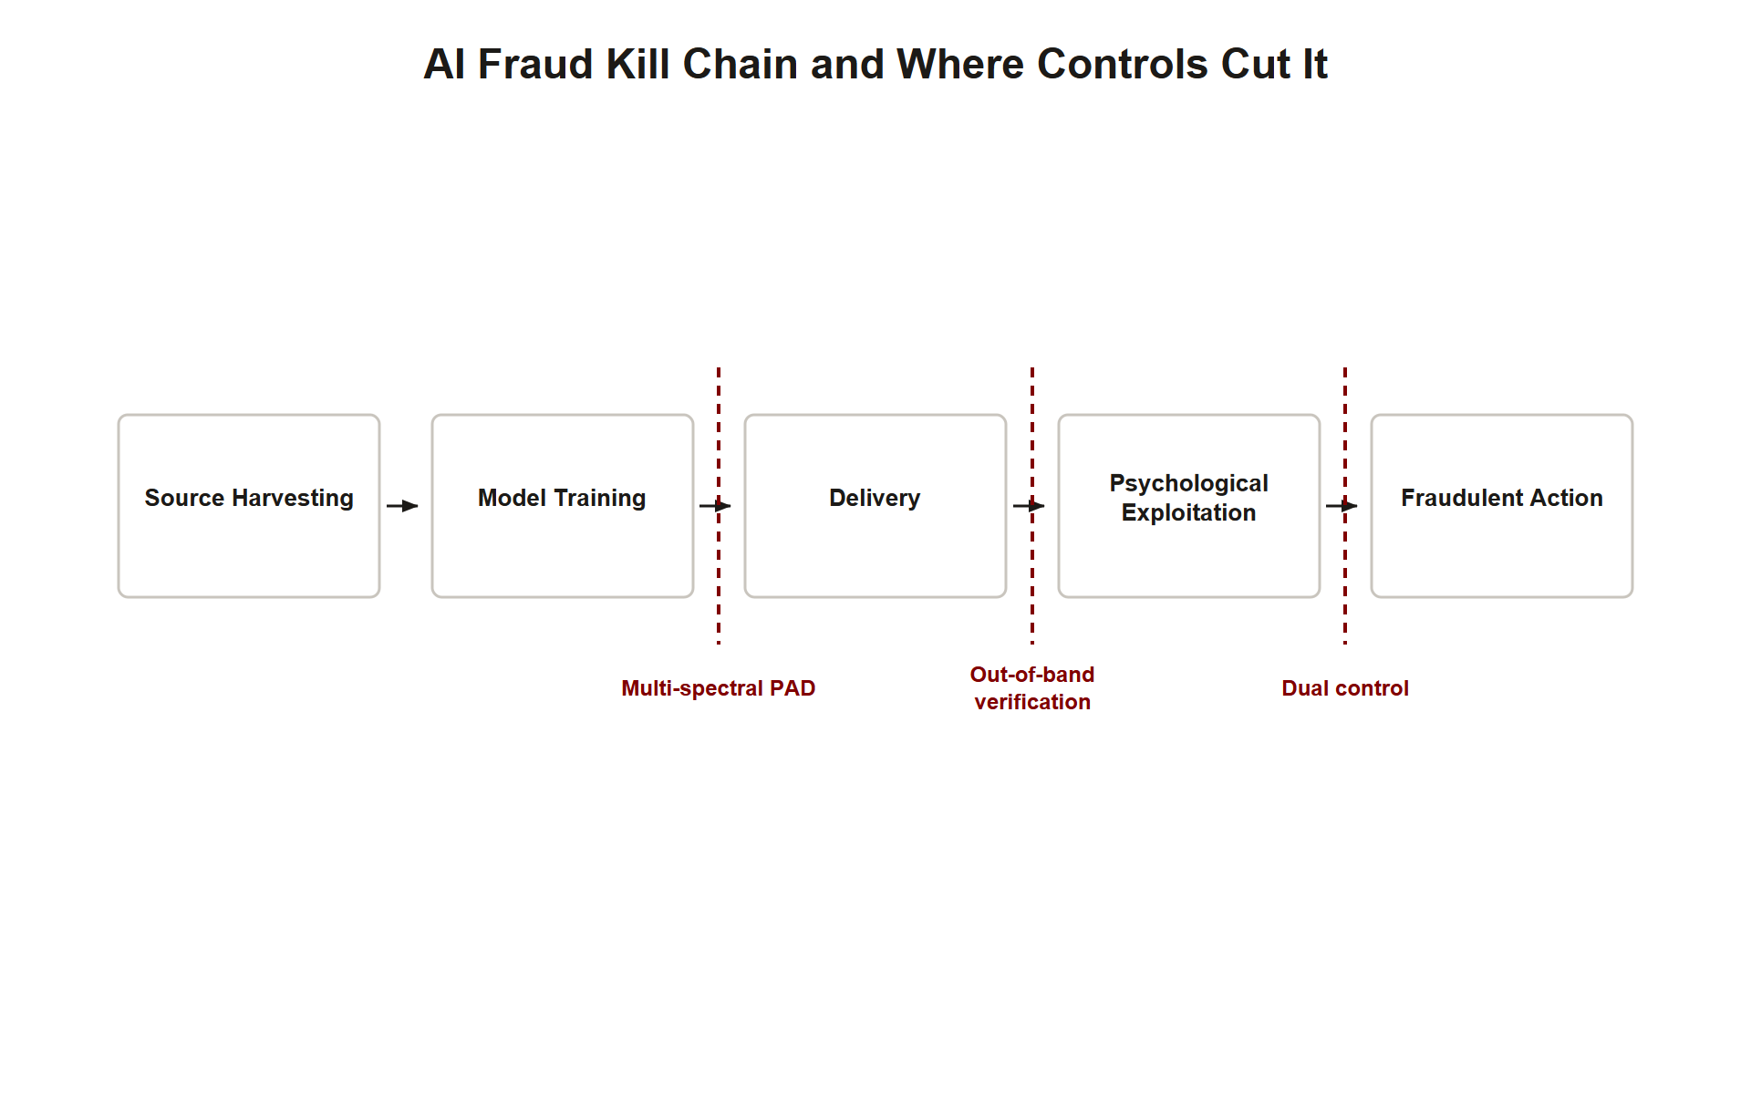
TOPIC 1.4 · 1.4.5.c.1
?
Synthesis: The Full AI-Enhanced Fraud Chain
1. Source harvesting: Attacker collects public audio/video of the target from speeches, interviews, company media
2. Model training: A GAN or voice-cloning pipeline is trained on the harvested media to produce a convincing synthetic replica
3. Delivery: The synthetic media is deployed via a phone call, video conference, or biometric-verification attempt
4. Psychological exploitation: Authority and Urgency (Cialdini) are stacked atop the synthetic media's realism
5. Defense collapse points: Multi-spectral PAD breaks link 3 for biometrics; out-of-band verification and dual control break links 3-4 regardless of media quality
Ai Fraud Kill Chain
Notes:
Both major case studies in this topic follow an identical five-link chain, and mapping specific defenses to the specific link they sever is exactly the analytical skill AP free-response questions reward. Source harvesting begins the chain: an attacker collects publicly available audio or video of the target, speeches, interviews, company-produced media, material that is, for any public-facing executive, often abundant and freely accessible.
Model training follows: this harvested media trains a GAN (for visual/video deepfakes) or a voice-cloning pipeline (MFCC extraction, TTS synthesis, vocoder reconstruction), producing a synthetic replica statistically convincing enough to exceed whatever verification threshold, human perceptual judgment or an automated biometric classifier, the attack targets. Delivery deploys this synthetic media through whichever channel the specific attack requires: a phone call, a multi-party video conference, or a direct biometric-verification bypass attempt.
Psychological exploitation layers Cialdini's principles atop the technical delivery precisely as in the case studies, Authority (impersonating a trusted executive) and Urgency (an artificial deadline) compound the synthetic media's realism to suppress System 2 verification. Mapping defenses precisely: multi-spectral liveness detection and Presentation Attack Detection sever link 3 specifically for biometric-verification attempts, since neither vein patterns nor thermal signatures can be faked by visible-light-optimized synthetic media; out-of-band verification, dual control, and pre-agreed passphrases sever links 3 and 4 simultaneously for the human-delivered attacks (voice/video calls), and critically, they do so regardless of how convincing the underlying synthetic media quality becomes, since their effectiveness never depended on detecting the fake at all.

Slide 30
TOPIC 1.4 · 1.4.5.c.2
Exam Readiness Checklist for Topic 1.4
Can you explain why deepfakes exploit the statistical, threshold-based nature of biometric verification specifically?
Can you describe the GAN Generator/Discriminator minimax game and what Nash equilibrium represents?
Can you distinguish FAR/FRR (identity matching) from APCER/BPCER (liveness/presentation-attack detection)?
Can you explain why out-of-band verification and dual control remain effective regardless of deepfake quality?
Can you structure an AI-fraud incident response as identify -> mitigate -> detect with named controls?
Notes:
Use this checklist to self-assess before the assessment. Each item maps to a high-frequency question pattern for this topic. The two concepts most likely to determine full versus partial credit are (1) precisely explaining why biometric verification's statistical, threshold-based design (rather than password-style exact matching) is specifically what deepfakes exploit, and (2) correctly identifying that procedural controls (out-of-band verification, dual control, passphrases) remain effective regardless of generative-media quality, while purely detection-based defenses face an ongoing arms race.
Beyond those, expect at least one item testing the FAR/FRR-versus-APCER/BPCER or provenance-versus-authenticity vocabulary pairs precisely, and at least one free-response item requiring the full three-layer AI-attack defense pyramid (technical, procedural, human) rather than a single named control such as 'train employees to spot deepfakes' alone.
Finally, keep the detection-versus-mitigation distinction sharp, exactly as across the rest of this unit: a PAD liveness-detection alert or a C2PA manifest check detects likely synthetic content; dual control, out-of-band verification, and passphrases are what actually mitigate the fraud regardless of whether detection succeeded. Scenario prompts almost always require naming both categories explicitly, connecting this topic's material back to the psychological framework established in Topic 1.1.

