Slide 1
AAYAT-AP-PREP · CYBERSECURITY
INTRODUCTION TO SECURITY
Topic 1.5: AI-Powered Threat Detection
Defenders face more daily events than any team can read. This topic examines how AI-powered tools assist in reviewing configurations, code, and detection rules, and how they sort the vast stream of network events so that human analysts can respond to genuine malicious activity quickly.
2 learning objectives · College Board AP Cybersecurity Course Framework
Notes:
Cover slide for Topic 1.5: Leveraging AI in Cyber Defense. Defenders face more daily events than any team can read. This topic examines how AI-powered tools assist in reviewing configurations, code, and detection rules, and how they sort the vast stream of network events so that human analysts can respond to genuine malicious activity quickly.

Slide 2
TOPIC 1.5
Learning Objectives
Mitigate Risk
Explain how defenders can use AI-powered tools to help protect networks, applications, and data.
1.5.A
Detect Attacks
Explain how AI-powered tools support faster and more accurate threat detection and response.
1.5.B
Objectives paraphrased from the AP Cybersecurity Course Framework (College Board, AP Career Kickstart).
Notes:
Read each learning objective aloud and connect it to the exam skill category before starting the topic.

Slide 3
TOPIC 1.5 · CONCEPT MAP
Collaborative Cloud AI Defense
Global Cloud Intel
Enterprise ML Server
Endpoint A
Local Firewall
Endpoint B

Slide 4
TOPIC 1.5 · CONCEPT MAP
AI Threat Detection Pipeline
01
02
03
04
TELEMETRY
PARSING
ML INFERENCE
DASHBOARD ALERT
Aggregates endpoint logs, Syslog, firewall events, and DNS queries.
Extracts vector features: IP distance, command syntax, rate frequency, packets.
Deep Neural Network calculates anomaly score based on trained normal baselines.
Triggers immediate SOC console alert if score exceeds 0.90 anomaly threshold.

Slide 5
TOPIC 1.5
The Big Idea
One analyst reading every log by hand is a single lifeguard watching a hundred pools. AI-assisted defense doesn't replace the lifeguard — it gives them a thousand tireless pairs of eyes, so a human only has to decide which splash is worth a closer look.
Hold onto this picture — we'll come back to it as the mechanics get more technical.
Notes:
Big-idea framing for Topic 1.5. Open with this analogy before the mechanics: "One analyst reading every log by hand is a single lifeguard watching a hundred pools. AI-assisted defense doesn't replace the lifeguard — it gives them a thousand tireless pairs of eyes, so a human only has to decide which splash is worth a closer look." Ask students for their own version of the analogy before moving on.

Slide 6
01
Why Human-Speed Response Fails Against Machine-Speed Threats
Topic 1.5
Notes:
Transition to part 1 of the topic. Pause here for questions before continuing.

Slide 7
TOPIC 1.5 · 1.5.1.a.1
Why Human-Speed Response Fails Against Machine-Speed Threats
Breakout time: Time from initial compromise to lateral movement, CrowdStrike 2023: 84 min (nation-state), 79 min (eCrime), 7 min fastest observed
Human SOC response: Detecting, investigating, escalating, and isolating a host typically takes 30-60+ minutes
The gap: When breakout time is faster than human response time, containment necessarily arrives too late
Autonomous ransomware: Worm-propagating variants (WannaCry, NotPetya) spread with zero user interaction required
Consequence: Initial containment must be automated; humans supervise and verify rather than perform the first response
Notes:
Every defense discussed in prior topics of this unit assumed a human analyst somewhere in the response loop, reviewing a SOC alert, verifying a suspicious call, deciding whether to quarantine a device. That assumption breaks down entirely against modern automated threats, where the relevant timescale is measured in seconds to minutes rather than hours. CrowdStrike's 2023 Threat Report measured 'breakout time', the interval between an attacker's initial foothold and the beginning of lateral movement across a network, at an average of 84 minutes for nation-state actors, 79 minutes for financially motivated criminal groups, and as little as 7 minutes for the fastest observed campaign that year.
A human Security Operations Center analyst's realistic response timeline, receiving an alert, investigating its validity, escalating to a decision-maker, and initiating containment, typically consumes 30 to 60 minutes at minimum under normal staffing, and considerably longer during off-hours or night shifts. When an attacker's breakout time is shorter than this human response window, by the time a human analyst would even begin meaningful action, the compromise has already propagated past the point that action could contain.
This gap is dramatically widened by autonomous, worm-propagating ransomware, malware engineered to spread laterally across a network entirely on its own, exploiting network-level vulnerabilities rather than requiring a user to click anything. Where traditional ransomware requires a human victim to open a malicious attachment on each additional machine, worm-propagating variants like WannaCry and NotPetya (covered in this topic's case studies) can encrypt or compromise an entire network of tens of thousands of machines in minutes, entirely without further human interaction anywhere in the chain. The only structurally viable answer is automating the containment decision itself: machine-speed detection must trigger machine-speed response, with human analysts positioned to supervise, verify, and refine the automated system rather than personally executing the first containment action.

Slide 8
TOPIC 1.5 · 1.5.1.a.2
?
Signature-Based EDR and Its Fundamental Blind Spot
Signature-based detection: Matches incoming code/traffic against a database of known-malicious byte patterns
Strength: Fast, highly accurate, essentially zero false positives for threats already in the database
Fatal limitation: A zero-day, by definition, has no existing signature, even perfect signature scanning cannot catch it
Concrete case: WannaCry had no signature for roughly 24 hours after the outbreak began, by which point 200,000 machines were infected
Structural fix: Anomaly-based behavioral detection flags suspicious BEHAVIOR rather than requiring a pre-known identity match
Notes:
Traditional Endpoint Detection and Response tooling has historically relied on signature-based detection: security vendors analyze malware samples, extract a unique identifying byte pattern or hash (the 'signature'), and distribute updated signature databases that endpoint agents check incoming files and processes against. This approach is fast, highly accurate, and produces essentially zero false positives for any threat already represented in the database, a legitimate strength for the enormous volume of previously-catalogued malware still circulating.
The approach carries one categorical, unfixable limitation: a zero-day exploit or novel malware variant, by definition, has never been seen before and therefore has no existing signature anywhere in any vendor's database. This is not a matter of insufficiently thorough signature libraries or slow update cycles, it is a structural property of the detection method itself. Even a hypothetically perfect, instantly-updated signature database cannot detect malware that has literally never been analyzed and catalogued before its first real-world deployment.
WannaCry is the concrete, measured illustration of this gap: no signature existed for it anywhere until roughly 24 hours after the global outbreak began, by which point over 200,000 machines across 150 countries had already been infected. The structural fix, covered in depth in this topic's technical section, is anomaly-based behavioral detection, rather than checking whether a file's identity matches a known-bad catalogue entry, these systems establish a statistical baseline of what normal system and network behavior looks like, and flag deviations from that baseline regardless of whether the specific malware causing the deviation has ever been seen before.

Slide 9
02
Z-Score: The Simplest Statistical Anomaly Detector
Topic 1.5
Notes:
Transition to part 2 of the topic. Pause here for questions before continuing.

Slide 10
TOPIC 1.5 · 1.5.2.a.1
?
Z-Score: The Simplest Statistical Anomaly Detector
Formula: z = (x - mu) / sigma, where mu is the historical mean and sigma is the standard deviation
Interpretation: z measures how many standard deviations an observed value sits from the historical baseline
Threshold: |z| > 3 conventionally flags a statistically significant anomaly (under 0.27% probability if normal)
Strength: Simple, fast, interpretable, ideal for single-dimensional metrics like connection counts
Key limitation: Assumes a roughly Gaussian distribution and cannot detect multi-dimensional anomalies across several metrics simultaneously
Notes:
The most basic quantitative anomaly-detection technique computes a Z-score for an observed event volume, expressed as $z = \frac{x - \mu}{\sigma}$, where $x$ is the currently observed value, $\mu$ is the historical mean of that metric under normal conditions, and $\sigma$ is its historical standard deviation. The resulting value expresses how many standard deviations the current observation sits from what has been historically typical.
A conventional threshold of $|z| > 3$ flags a statistically significant anomaly: under a normal (Gaussian) distribution, values this far from the mean occur with less than 0.27% probability by chance alone, making them a reasonable trigger for investigation. For example, a server that normally makes roughly 50 outbound connections per hour ($\mu=50$, $\sigma=8$) suddenly making 3,000 connections in an hour produces $z = (3000-50)/8 = 368.75$ — an almost astronomically improbable deviation under normal operating conditions, strongly suggestive of network scanning or mass data exfiltration.
Z-score analysis is valued for its simplicity, speed, and interpretability, making it a natural first-line check for straightforward single-dimensional metrics. Its limitation is equally important to understand: it assumes the underlying metric is roughly normally (Gaussian) distributed, which many real security metrics are not, and it cannot by itself detect a multi-dimensional anomaly, a scenario where CPU usage, file-write frequency, and network destination are each individually unremarkable but jointly represent a highly unusual combination. Detecting that kind of compound anomaly requires the multi-dimensional methods covered next, such as Isolation Forests.

Slide 11
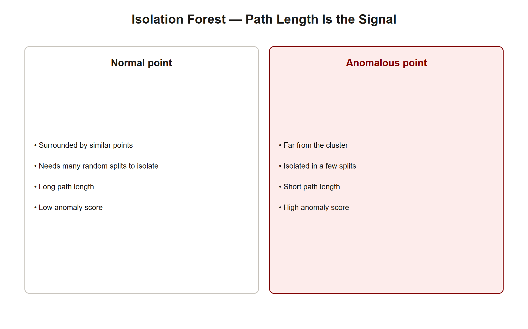
TOPIC 1.5 · 1.5.2.a.2
?
Isolation Forest: Isolating Anomalies by Random Partitioning
Core insight: Anomalies are RARE and DIFFERENT, so they can be isolated with very few random splits
Mechanism: Recursively partition the feature space with random splits; measure how many splits isolate each point
Path length h(x): Number of splits needed to isolate a specific point, short for anomalies, long for normal points
Anomaly score: s(x,n) = 2^(-E[h(x)]/c(n)), approaches 1 for highly anomalous points, 0.5 for typical points
Why it's used in security: O(n log n) training, handles high-dimensional streaming logs well, used by CrowdStrike Falcon, AWS GuardDuty
Isolation Forest Path Length
Notes:
Where a Z-score treats anomaly detection as measuring distance from a single-dimension mean, Isolation Forest (Liu, Ting, and Zhou, 2008) takes a fundamentally different, geometric approach suited to high-dimensional data like multi-feature security event logs. Its core insight is that anomalous data points are both rare and statistically distinct from the bulk of normal data, which means they can be isolated from the rest of the dataset using very few random partitioning splits, while a normal data point, surrounded by many similar neighbors, requires many more splits before it stands alone.
The algorithm builds a collection of trees by recursively selecting a random feature and a random split value within that feature's range, partitioning the dataset at each step. For any given data point $x$, its path length $h(x)$ is the number of splits required to isolate it in a specific tree; averaging this path length across the full forest of many such randomly-constructed trees produces $\mathbb{E}(h(x))$, a more stable estimate. The final anomaly score is computed as $s(x,n) = 2^{-\mathbb{E}(h(x))/c(n)}$, where $c(n)$ is a normalization constant based on the average path length expected in a balanced binary search tree over $n$ points.
This scoring function is calibrated so a score approaching 1.0 indicates a highly anomalous point (an unusually short average path length, quickly isolated), a score near 0.5 indicates a typical, unremarkable point (an average path length matching what's expected generally), and a score approaching 0.0 indicates an especially 'normal' point requiring an unusually large number of splits to isolate. Isolation Forest's linear-time $O(n\log n)$ training complexity and modest memory footprint make it particularly well suited to real-time, high-volume streaming security logs, exactly why it underlies behavioral detection in commercial products including CrowdStrike Falcon and AWS GuardDuty.

Slide 12
TOPIC 1.5 · 1.5.2.a.3
Practice: Computing and Interpreting Anomaly Scores
Goal: Make the abstract Isolation Forest scoring formula tangible with concrete numbers
Method: Compute s(x,n) for several sample path lengths against a fixed dataset size
Threshold interpretation: s > 0.7 typically triggers investigation; s > 0.9 typically triggers automated containment
Observation: Small differences in average path length can produce large differences in final anomaly score
Tuning tradeoff: Raising the action threshold reduces false positives but risks missing genuine attacks; lowering it does the opposite
Notes:
The code below directly implements the Isolation Forest anomaly-score formula, letting you compute and compare scores for several different average path lengths against a fixed dataset size, exactly mirroring how a real behavioral-detection engine would translate a computed path length into an actionable score.
Running it with a range of path lengths makes the practical thresholds from the ebook concrete: a path length near the dataset's expected average produces a score near 0.5 (unremarkable); a path length substantially shorter than average, the signature of a rare, isolated data point, pushes the score toward 0.9 or higher, the range production security systems typically use to trigger automated containment rather than merely flagging for human review.
This threshold choice embodies a direct operational tradeoff that real security teams must tune deliberately: setting the automated-containment threshold too low (accepting scores as low as 0.5 or 0.6 as sufficient) will trigger containment actions against legitimate but unusual administrative activity, disrupting business operations; setting it too high (requiring scores near 1.0) risks allowing a genuine attack with a merely elevated, but not maximal, anomaly score to proceed undetected until further, more damaging behavior accumulates enough signal to cross the higher bar.

Slide 13
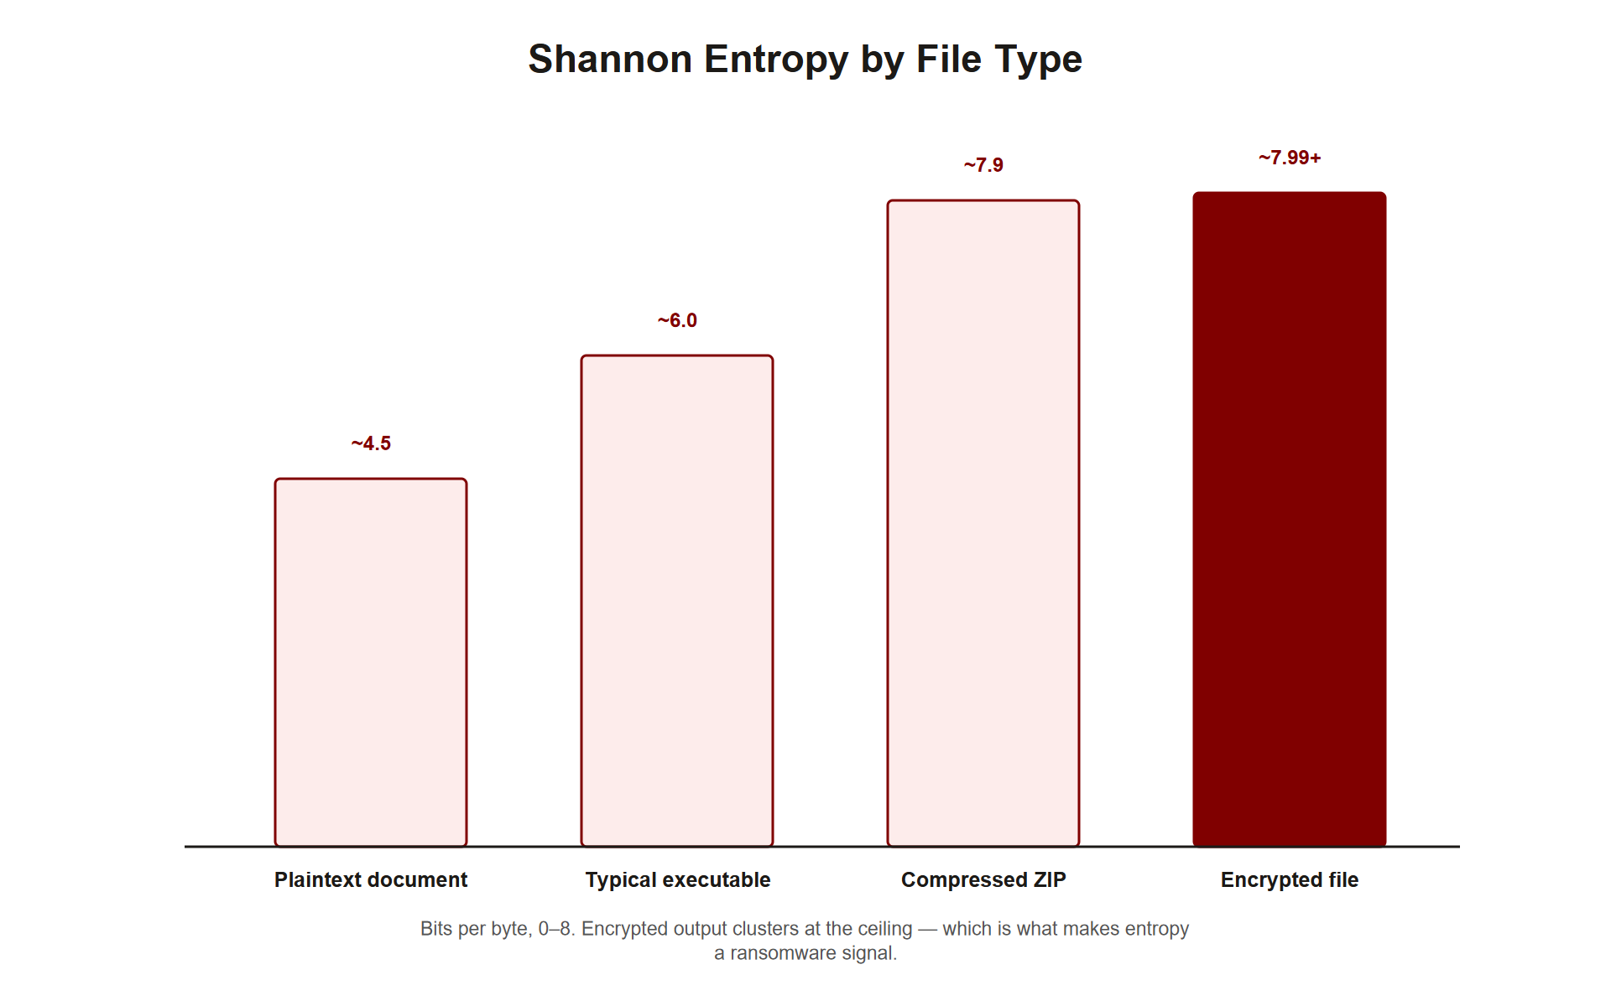
TOPIC 1.5 · 1.5.2.b.1
?
Shannon Entropy: Detecting Encryption at the File Level
Shannon entropy formula: H = -sum(p(x) * log2(p(x))) across all byte values in a file
Range: 0 (completely predictable/repetitive) to 8 bits (maximum randomness, since log2(256)=8)
Typical values: Plaintext documents ~4-5 bits; compressed ZIP files ~7.5 bits; AES-encrypted files ~7.9-8.0 bits
Detection signature: Rapid file open-write-rename cycles combined with entropy above ~7.2-7.8 bits within a short window
Key limitation: Legitimately compressed archives and media files (JPEG, MP4) also exhibit high entropy naturally
Img 1.5.2 Shannon Entropy Files
Notes:
Ransomware's defining, unavoidable behavior is encrypting a target's files, and strong encryption produces a specific, measurable statistical signature: near-maximal randomness in the resulting byte stream. Shannon entropy, defined as $H = -\sum p(x)\log_2 p(x)$ over the probability distribution of byte values in a file, quantifies exactly this randomness on a scale from 0 (completely predictable, highly repetitive data) to 8 bits (maximum possible randomness for a byte stream, since $\log_2(256) = 8$).
Different legitimate file types occupy characteristically different entropy ranges: a typical Word document or source-code file, containing structured language patterns and predictable formatting, measures roughly 4 to 5 bits; a compressed ZIP archive, having already had redundancy squeezed out by the compression algorithm, measures around 7.5 bits; a file encrypted with a strong modern cipher like AES-256, which is specifically designed to produce output indistinguishable from true randomness, approaches the theoretical maximum at roughly 7.9 to 8.0 bits.
EDR agents exploit this directly by monitoring file-system write events for a specific combined signature: a rapid sequence of file open-write-rename operations (the mechanical signature of a program systematically working through a directory encrypting each file) where the newly written content measures above a detection threshold, commonly set around 7.2 to 7.8 bits. This metric carries a well-known and important limitation, however: legitimately compressed archives and media files (JPEG images, MP4 video) also naturally exhibit high entropy as an ordinary consequence of their format, meaning entropy alone, without the accompanying behavioral context of rapid mass file rewriting, produces false positives on entirely benign activity like a user compressing files or saving a video.

Slide 14
TOPIC 1.5 · 1.5.2.b.2
The Ransomware Execution Sequence: VSS Deletion as a High-Confidence Signature
Step 1: Traverse the file system to locate high-value target files
Step 2: Read, encrypt in memory (typically AES-256 or ChaCha20), write back to disk
Step 3 (critical detection point): Delete Volume Shadow Copies BEFORE encryption to block free recovery
Specific command: vssadmin delete shadows /all /quiet, strongly associated with ransomware specifically
Sigma detection rule: Flag any host executing vssadmin + wmic shadowcopy + bcdedit recovery-disable within a 60-second window
Notes:
Ransomware follows a highly consistent operational sequence that defenders have learned to fingerprint precisely. After traversing the file system via standard OS APIs to locate valuable target files, the malware reads each file's contents, encrypts them in memory using a strong symmetric cipher (commonly AES-256 or ChaCha20), and writes the encrypted result back to disk, the stage that produces the high-entropy signature covered in the prior slide.
Critically, before this encryption phase even begins, nearly all modern ransomware first deletes Windows' Volume Shadow Copies, automatic point-in-time snapshots that would otherwise let a victim restore previous file versions for free, without paying any ransom. Because this specific action (destroying the free recovery path before beginning paid-recovery-dependent encryption) serves no purpose for any legitimate software, the specific command vssadmin delete shadows /all /quiet is treated by most EDR systems as an extremely high-confidence ransomware indicator on its own.
Production detection rules formalize this into a precise, combinable signature: a Sigma-format detection rule (an open, vendor-neutral rule format widely used across the SIEM/EDR industry) can specify that any single host executing vssadmin delete shadows , wmic shadowcopy delete (an alternative method accomplishing the same goal), and a recovery-disabling bcdedit command all within a 60-second window should trigger an immediate, automated host-isolation response, the specific combination and tight time window together produce a signature specific enough to warrant fully automated action rather than merely flagging for human review.

Slide 15
TOPIC 1.5 · 1.5.2.c.1
?
Automated Containment: A SOAR Playbook Walkthrough
SOAR: Security Orchestration, Automation, and Response, executes pre-approved response actions without waiting for a human
Trigger: An anomaly score exceeding the automated-response threshold (e.g., s > 0.9) fires the playbook automatically
Phase 1-2: Block inbound AND outbound network traffic, contains both incoming C2 commands and outgoing data exfiltration
Phase 3: Selectively allow DNS/AD traffic so the isolated host can still report status back to the SOC
Phase 4: Kill the identified malicious process directly, then notify the SOC via SIEM
Notes:
When an anomaly engine's behavioral score crosses the automated-response threshold, commonly around 0.9 on the Isolation Forest scale discussed earlier, a Security Orchestration, Automation, and Response (SOAR) platform executes a pre-approved containment playbook immediately, without waiting for any human decision in the loop, precisely because the breakout-time statistics from this topic's opening slides show that any human-mediated delay risks arriving too late.
A representative playbook proceeds in ordered phases. It first blocks all inbound network traffic to the affected host, severing any command-and-control channel an attacker might use to issue further instructions, and separately blocks all outbound traffic, preventing the host from exfiltrating stolen data or spreading laterally to additional machines on the network. Because total network isolation would also cut off the SOC's own visibility into the contained host, the playbook then selectively re-opens a narrow exception for DNS and Active Directory traffic specifically, allowing the isolated machine to continue reporting status back to security tooling even while fully quarantined from everything else.
Finally, the playbook directly terminates whatever process triggered the anomalous behavioral signature, commonly identified either by an unusually high CPU utilization pattern or by a process name matching known ransomware-related keywords, and logs the entire sequence of automated actions back to the SIEM, ensuring a human analyst has a complete, auditable record of exactly what the automated system did and why, ready for review even though no human decision gated any individual step.

Slide 16
03
Case Study: The May 2017 WannaCry Outbreak
Topic 1.5
Notes:
Transition to part 3 of the topic. Pause here for questions before continuing.

Slide 17
TOPIC 1.5 · 1.5.3.a.1
?
Case Study: The May 2017 WannaCry Outbreak
Exploit: EternalBlue (CVE-2017-0144), an NSA-developed exploit targeting SMBv1, leaked by the Shadow Brokers
Scale: Over 200,000 machines infected across 150 countries within 24 hours
Patch timeline: Microsoft's patch (MS17-010) was released a full two months before the outbreak
Containment: Researcher Marcus Hutchins discovered and registered a hardcoded kill-switch domain for $10.69
NHS impact: GBP 92 million in damages, driven by unpatched legacy systems and a completely flat, unsegmented network
Notes:
WannaCry, unleashed in May 2017, remains the canonical illustration of worm-propagating ransomware's speed. It exploited EternalBlue (CVE-2017-0144), a remote-code-execution vulnerability in the Windows SMBv1 file-sharing protocol originally developed by the NSA's Tailored Access Operations unit and subsequently leaked publicly by the Shadow Brokers hacking group. Critically, EternalBlue required no user interaction whatsoever, an open SMB port was sufficient for infection, exactly the kind of network-level, zero-click propagation that renders human-speed response structurally inadequate. Within 24 hours, over 200,000 machines across 150 countries were infected.
The outbreak's timeline underscores a recurring theme in ransomware case studies: this was not, technically speaking, a zero-day at the moment of the outbreak. Microsoft had released a patch (MS17-010) a full two months before WannaCry's release, meaning the vulnerability was known and a fix existed, the outbreak's scale reflects a patching and prioritization failure across the affected organizations, not merely an unstoppable novel threat.
Containment was ultimately achieved not through automated behavioral detection but through a stroke of reverse-engineering insight: security researcher Marcus Hutchins, analyzing WannaCry's code during the outbreak, discovered the malware checked whether a specific, oddly-named domain resolved before proceeding with infection, an anti-sandbox check the malware's authors had included, intending it to detect analysis environments. Hutchins registered the unregistered domain for $10.69, and WannaCry's spread halted globally almost immediately, though it did not reverse encryption on machines already infected. The UK's National Health Service suffered the outbreak's most consequential real-world impact, with hospitals losing access to patient records and ambulances being diverted, ultimately costing an estimated GBP 92 million, a post-incident review specifically attributed this to legacy medical-device systems that couldn't easily support the patch, an absence of automated patch deployment, and a completely flat, unsegmented network architecture that let the worm spread unchecked between machines once any single one was infected.

Slide 18
TOPIC 1.5 · 1.5.3.a.2
?
Case Study: The June 2017 NotPetya Campaign
Delivery: A compromised software-update mechanism for M.E.Doc, mandatory Ukrainian tax/accounting software
Disguise: Designed to look like Petya ransomware, but was actually a WIPER, the decryption ID was random and non-functional
Destruction mechanism: Overwrote the Master Boot Record and Master File Table, making recovery genuinely impossible
Collateral scale: Maersk, FedEx, Merck, and others infected via Ukrainian subsidiaries, estimated $10 billion in total damage
Recovery: Maersk rebuilt 45,000 PCs and 4,000 servers, saved only by one disconnected domain controller in Ghana
Notes:
NotPetya, released in June 2017, illustrates two distinct concepts this topic emphasizes: supply-chain-based delivery and the important distinction between ransomware and a wiper. The malware was distributed through a compromised update mechanism in M.E.Doc, Ukrainian accounting software effectively mandatory for tax filing in that country, attackers, attributed to the Russian GRU's Sandworm unit, had planted a backdoor in a legitimate software update months before triggering the actual destructive payload, exactly the trusted-distribution-channel exploitation pattern classified under MITRE ATT&CK's supply-chain-compromise technique.
Although NotPetya displayed a ransom note and Bitcoin payment demand designed to superficially resemble the earlier Petya ransomware, forensic analysis revealed it was in fact a wiper, malware engineered purely to destroy data irrecoverably, with no genuine path to recovery even for a paying victim. The 'decryption ID' NotPetya generated and displayed was random and structurally unrelated to any actual encryption key, meaning payment could never have led to file recovery under any circumstances; this detail is what distinguishes a wiper from ransomware in the strict technical sense, despite NotPetya's ransomware-style presentation.
NotPetya achieved this destruction by overwriting the Master Boot Record, the very first disk sector containing the code needed to boot the operating system at all, and the Master File Table, rendering affected machines both unbootable and unrecoverable through ordinary means. Although apparently intended primarily as a weapon against Ukrainian infrastructure, the malware spread indiscriminately to any organization running a Ukrainian subsidiary using M.E.Doc, ultimately causing an estimated $10 billion in global damage across companies including Maersk, FedEx, Merck, and Mondelez. Maersk's recovery is particularly instructive: the shipping company was forced to rebuild its entire global infrastructure, 45,000 PCs and 4,000 servers, from scratch, and was saved from total, permanent data loss purely by chance, because one domain controller in a Ghana office happened to be offline due to an unrelated power outage at the exact moment of infection, preserving an intact backup that would otherwise have been destroyed along with every other domain controller on the network.

Slide 19
04
NIST SP 800-61r2: The Four-Phase Incident Response Structure
Topic 1.5
Notes:
Transition to part 4 of the topic. Pause here for questions before continuing.

Slide 20
TOPIC 1.5 · 1.5.4.a.1
NIST SP 800-61r2: The Four-Phase Incident Response Structure
Phase 1, Preparation: Establish the IR team, tooling, playbooks, and communication plans BEFORE an incident occurs
Phase 2, Detection & Analysis: Identify that something is happening, scope its extent, and escalate appropriately
Phase 3, Containment, Eradication, Recovery: Stop the spread, remove the threat entirely, and restore normal operations
Phase 4, Post-Incident Activity: Document lessons learned and update defenses to prevent recurrence
Universal framework: Underlies SANS PICERL, ISO/IEC 27035, and CISA's incident-response guidance across the industry
Notes:
NIST SP 800-61r2 formalizes incident response into four sequential phases that every automated and human-driven containment action in this topic maps onto directly. Preparation occurs entirely before any incident: establishing a defined incident-response team, deploying and configuring the detection tooling (Isolation Forest models, entropy monitors, Sigma rules) covered in this topic's technical section, writing and testing containment playbooks, and establishing clear communication plans for who gets notified and when.
Detection and Analysis is the phase where the anomaly-scoring and entropy-monitoring mechanisms discussed earlier actually fire, identifying that an event is occurring, determining its scope (how many hosts, what kind of activity), and escalating to whatever level of response the situation warrants. Containment, Eradication, and Recovery is where the SOAR playbook covered earlier executes: isolating affected hosts to stop further spread, removing the malicious presence entirely (killing processes, cleaning persistence mechanisms), and restoring affected systems to normal operation from clean backups.
Post-Incident Activity, often the most neglected phase in practice, involves documenting what specifically happened and why, and using those lessons to close the gaps that allowed the incident in the first place, exactly the kind of review that, in the WannaCry NHS case, revealed an untested paper playbook nobody had actually read. This four-phase structure is not unique to NIST; it underlies the SANS Institute's PICERL framework, ISO/IEC 27035, and CISA's own incident-response guidance, making it close to a universal shared vocabulary across the security industry and a near-certain topic on professional certifications.

Slide 21
TOPIC 1.5 · 1.5.4.a.2
?
Zero Trust and Micro-Segmentation: Limiting Lateral Movement Structurally
Zero Trust principle: 'Never trust, always verify', no user, device, or network segment is trusted by default, even internally
Micro-segmentation: Divides the network into granular zones with strict access-control lists between them
Direct connection to NotPetya: Maersk's flat, unsegmented network is precisely why the malware spread to 45,000 machines
Mechanism: Even if ransomware compromises one segment, strict inter-segment ACLs prevent it from reaching others
NIST SP 800-207: Defines the formal Zero Trust Architecture, including Identity Provider, Policy Engine, and Policy Enforcement Point components
Notes:
NIST SP 800-207's Zero Trust Architecture formalizes a principle directly opposed to older perimeter-based security models: no user, device, or internal network segment should be trusted by default simply by virtue of being 'inside' the corporate network boundary, every access request must be independently authenticated, authorized, and continuously validated, regardless of its apparent internal origin.
Micro-segmentation is the specific network-architecture implementation of this principle most directly relevant to ransomware containment: rather than one large, flat network where any compromised machine can freely communicate with any other, the network is divided into granular zones, often per-workload or per-application, with strict, deliberately narrow access-control lists governing exactly which specific traffic is permitted between any two zones.
This directly addresses the specific structural failure identified in the NotPetya case study: Maersk's network was entirely flat, with no meaningful segmentation between zones, which is precisely why a single initial infection point was able to propagate to 45,000 machines and 4,000 servers globally. Under a properly micro-segmented architecture, even a successful ransomware compromise of one segment would be structurally prevented from reaching most other segments, since the strict inter-segment ACLs would block the specific lateral-movement techniques (SMB, RPC, credential-harvesting tools like Mimikatz combined with WMI/PsExec) that NotPetya and similar malware depend on to spread. The formal Zero Trust Architecture defined in NIST SP 800-207 specifies three coordinating components achieving this in practice: an Identity Provider enforcing strong authentication, a Policy Engine evaluating every access request against defined policy, and a Policy Enforcement Point that actually applies the resulting access decisions at the network layer.

Slide 22
TOPIC 1.5 · 1.5.4.b.1
?
Immutable Backups and the 3-2-1-1-0 Rule
WORM storage: Write Once, Read Many, data cannot be modified or deleted even by compromised domain admin credentials
Why this matters: Ransomware specifically targets and deletes backups FIRST to eliminate free-recovery leverage
3-2-1-1-0 rule (CISA extended): 3 copies, 2 media types, 1 offsite, 1 immutable, 0 unverified/untested backups
Cloud implementations: AWS S3 Object Lock, Azure Immutable Blob Storage, enforce retention even against admin-level deletion attempts
The Maersk lesson: Their survival depended on an ACCIDENTAL air-gap (one office's power outage), immutable backups formalize this into a deliberate design choice
Notes:
Because ransomware operators specifically target and destroy an organization's backup infrastructure as one of their first actions, recognizing that intact, restorable backups eliminate any leverage a ransom demand would otherwise have, modern backup strategy must assume that ordinary backup storage, reachable and modifiable by the same compromised credentials an attacker has already obtained, provides no real protection at all. WORM (Write Once, Read Many) storage addresses this directly: data, once written, cannot be modified or deleted for a defined retention period, regardless of what credentials, including a compromised domain administrator account, attempt to do so.
CISA's extended 3-2-1-1-0 backup rule operationalizes this into concrete practice: maintain 3 total copies of critical data, stored across 2 different media types (reducing the chance a single failure mode affects every copy simultaneously), with at least 1 copy stored offsite, at least 1 copy specifically configured as immutable (WORM-protected), and 0 unverified backups, meaning every backup must be periodically tested through an actual restore exercise, since an unverified backup that turns out to be corrupted or incomplete at the moment of a real incident provides no real protection despite its apparent existence.
Cloud providers now offer native implementations of this immutability guarantee: AWS S3 Object Lock and Azure Immutable Blob Storage enforce retention periods at the storage-service layer itself, structurally preventing deletion even by an account holding otherwise-full administrative privileges over the rest of the environment. The Maersk case study from this topic is instructive here precisely because their survival depended entirely on an unplanned accident, one Ghana office's domain controller happened to be offline due to an unrelated power outage at the exact moment of infection, preserving the only surviving intact backup purely by chance. Immutable, deliberately air-gapped backup architecture formalizes this same protective effect, an attacker-unreachable, unmodifiable backup copy, into a designed, reliable control rather than a fortunate accident.

Slide 23
05
The Complete AI-Driven Defense Stack for Ransomware
Topic 1.5
Notes:
Transition to part 5 of the topic. Pause here for questions before continuing.

Slide 24
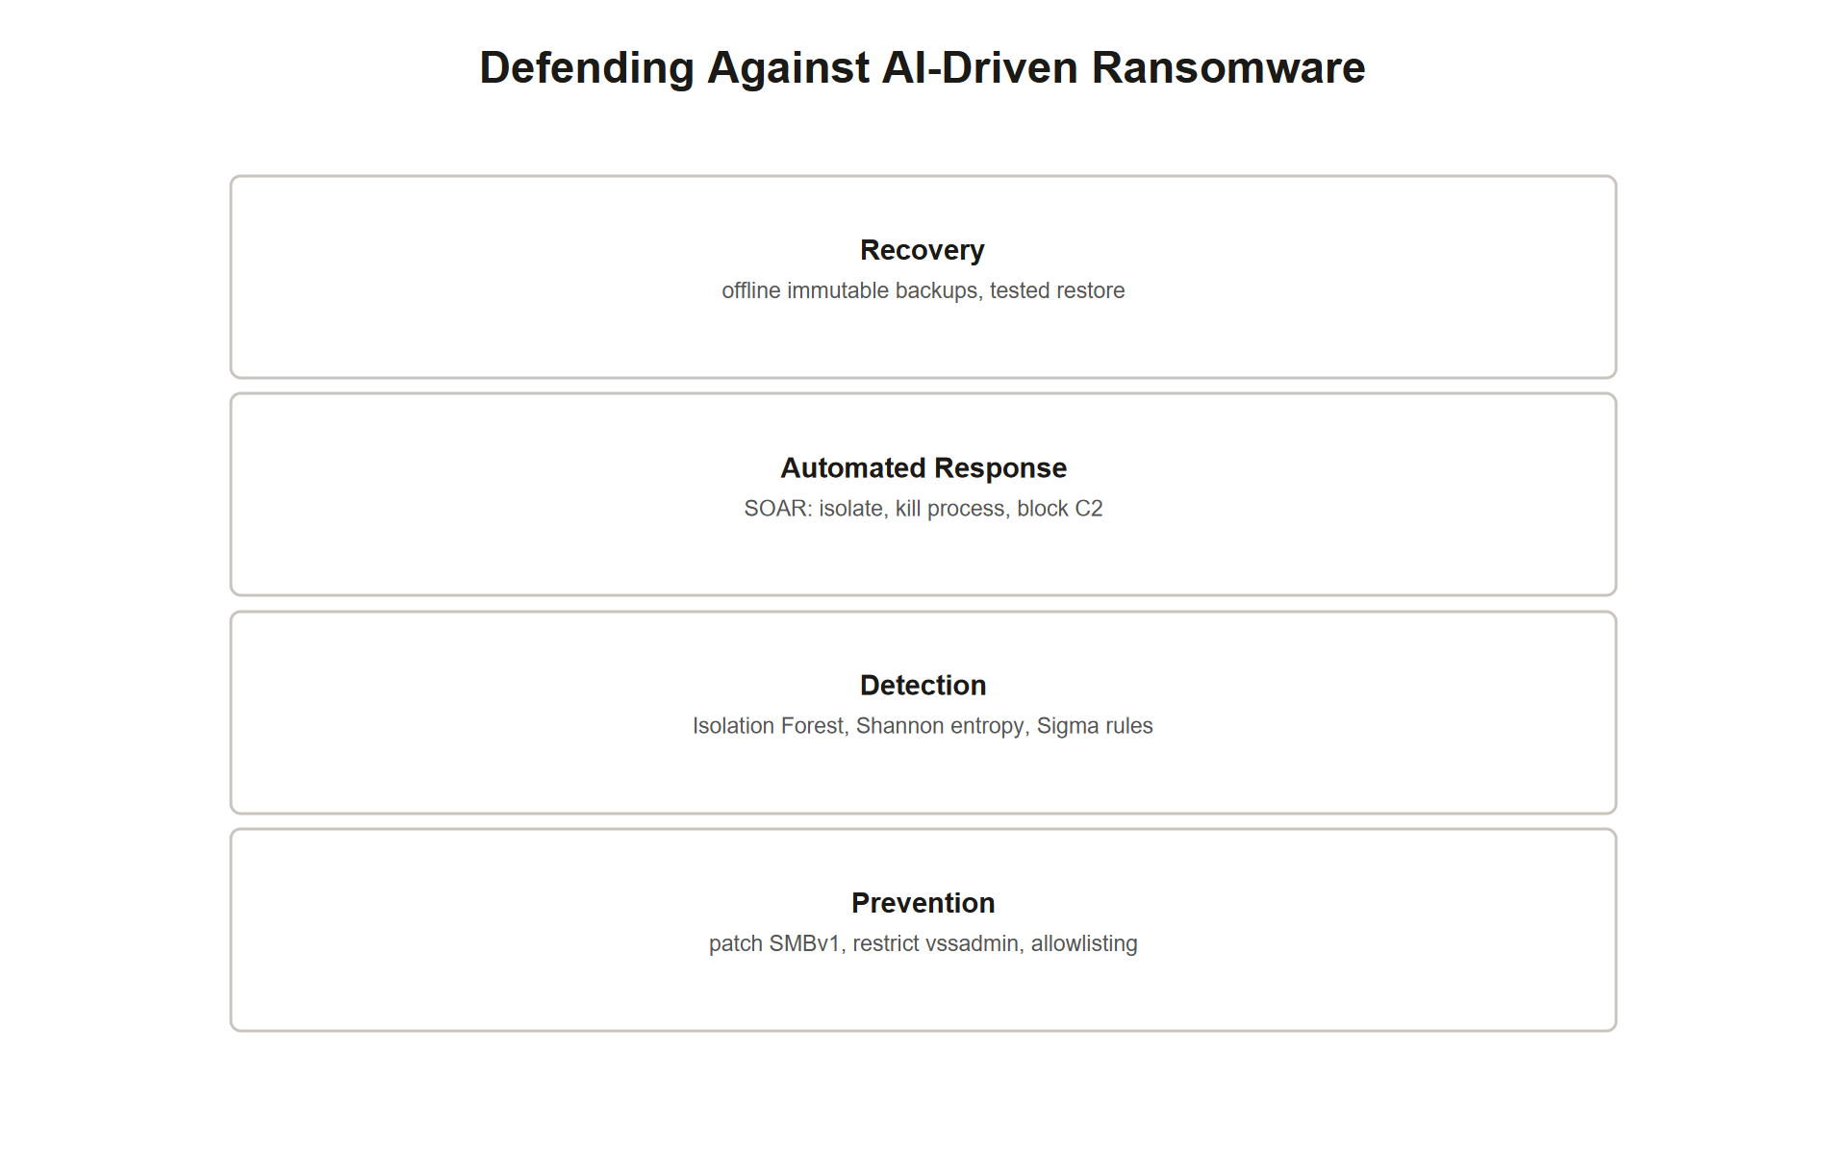
TOPIC 1.5 · 1.5.5.a.1
The Complete AI-Driven Defense Stack for Ransomware
Layer 1, Prevention: Patch SMBv1/SMBv2, restrict vssadmin execution for non-admin accounts, application allowlisting
Layer 2, Detection: Isolation Forest behavioral scoring, Shannon entropy thresholds, Sigma rule matching (VSS deletion sequence)
Layer 3, Automated Response: SOAR playbook triggers, network isolation, process termination, C2 IP blocking
Layer 4, Recovery: Immutable WORM backups (3-2-1-1-0), tested restore procedures, clean reimaging from a golden image
Threshold rule of thumb: Anomaly score s > 0.7 triggers investigation; s > 0.9 triggers fully automated containment
Ai Ransomware Defense Stack
Notes:
This topic's material assembles into a complete four-layer defense stack, and free-response questions typically reward naming a specific mechanism at each layer rather than a single strong answer in isolation. Prevention addresses the entry and early-execution vectors directly: patching known vulnerabilities like SMBv1 (the WannaCry vector) before an exploit is ever attempted, restricting which accounts can execute high-risk commands like vssadmin at all, and application allowlisting that blocks unrecognized executables from running in the first place.
Detection is the layer covered in greatest technical depth in this topic: Isolation Forest behavioral scoring flags multi-dimensional anomalies in process and network behavior; Shannon entropy monitoring flags the specific signature of active file encryption; Sigma rule matching flags the specific, near-deterministic command sequence (VSS deletion plus recovery-disabling commands within a tight time window) that precedes ransomware's encryption phase.
Automated Response is where detection converts into action without waiting for human mediation: a SOAR playbook triggers network isolation (blocking both inbound C2 and outbound exfiltration/spread), terminates the identified malicious process, and blocks any identified command-and-control infrastructure at the network level. Recovery closes the loop when prevention and detection have both failed: immutable, WORM-protected backups following the 3-2-1-1-0 rule ensure a clean restoration path exists regardless of what an attacker with even domain-admin-level access attempts, and periodically tested restore procedures combined with clean reimaging from a verified golden image ensure that recovery, when needed, is both fast and genuinely trustworthy. As a concrete operational rule of thumb tying detection to response, an anomaly score exceeding roughly 0.7 should trigger human investigation, while a score exceeding roughly 0.9 should trigger the fully automated containment playbook without waiting for that human review to complete.

Slide 25
TOPIC 1.5 · 1.5.5.a.2
?
Incident Response Walkthrough: The Vantage Manufacturing Ransomware Alert
Scenario: An Isolation Forest model flags a manufacturing-floor server with an anomaly score of 0.94
Artifact: Process logs show vssadmin delete shadows, wmic shadowcopy delete, and bcdedit recovery-disable all within 45 seconds
Task 1: Determine whether this warrants automated containment or human investigation, citing the specific threshold
Task 2: Name the specific SOAR playbook actions that should execute automatically
Task 3: Describe the recovery-layer control that determines whether this incident becomes a minor disruption or a catastrophic loss
Notes:
Work this incident using the identify -> mitigate -> detect/recover structure established across this unit, now applied to the automated-response domain specifically. Identify: an anomaly score of 0.94 exceeds the conventional automated-containment threshold of 0.9, and the specific process-log artifact, vssadmin delete shadows , wmic shadowcopy delete , and a recovery-disabling bcdedit command all executing within a 45-second window, matches precisely the high-confidence Sigma-rule signature for ransomware's pre-encryption shadow-copy-deletion phase, not merely a generic behavioral anomaly.
Mitigate (automated): given both the score exceeding threshold and the specific command signature matching, the SOAR playbook should trigger immediately and automatically, without waiting for human review: block all inbound network traffic to the host (severing any command-and-control channel), block all outbound traffic while preserving a narrow DNS/AD exception for continued SOC visibility, and terminate the identified anomalous process directly, logging every automated action taken to the SIEM for the human analyst's subsequent review.
Recover: the single factor determining whether this incident becomes a contained, minor disruption or a catastrophic, unrecoverable loss is whether the affected manufacturing data has an immutable, WORM-protected backup satisfying the 3-2-1-1-0 rule. If such a backup exists and has been periodically tested via actual restore exercises, recovery consists of reimaging the affected host from a clean golden image and restoring data from the verified immutable backup, a bounded, predictable disruption. If no such immutable backup exists, or if the backups themselves were reachable and destroyed by the same compromised credentials the attacker used on the primary systems, the organization faces the same catastrophic, all-or-nothing recovery scenario Maersk confronted in the NotPetya case, dependent on pure chance (an accidentally offline system) rather than deliberate design.

Slide 26
TOPIC 1.5 · 1.5.5.b.1
?
Common Misconception: 'More Automation Always Means Better Security'
Belief: Fully automating containment decisions is strictly better than any human-in-the-loop approach
Why it's incomplete: Automated systems can produce false positives, and an overly aggressive auto-containment policy can itself cause business disruption
Real tradeoff: Lowering the automated-action threshold catches more attacks but also isolates more legitimate systems incorrectly
Correct model: Automation handles the TIME-CRITICAL first response; human oversight remains essential for review, tuning, and edge cases
NIST framing: Automated response and human supervision are complementary, not substitutes for one another
Notes:
Given this topic's emphasis on why automated response is structurally necessary against machine-speed threats, students sometimes overcorrect into believing that maximizing automation, the lowest possible detection threshold, the most aggressive possible automatic containment, is unambiguously the better security posture. This overlooks a genuine, quantifiable cost: automated systems, exactly like the human analysts they're replacing for time-critical decisions, produce false positives, and an overly aggressive automated-containment policy can itself inflict serious business disruption by isolating legitimate systems and terminating legitimate processes based on behavior that merely resembles, but is not actually, an attack.
This is precisely the tradeoff embedded in the anomaly-score threshold discussion from earlier in this topic: lowering the automated-containment threshold from 0.9 toward, say, 0.6 will indeed catch a wider range of genuine attacks earlier in their progression, but it will also trigger containment against a meaningfully larger population of unusual-but-entirely-legitimate administrative activity, disrupting business operations that were never actually compromised.
The correct mental model, consistent with how NIST SP 800-61r2 frames the incident-response lifecycle, treats automation and human oversight as complementary rather than substitutable: automation handles the genuinely time-critical initial containment decision, where waiting for human review would allow the attack to complete regardless of how correct that review ultimately turns out to be, but human analysts remain essential for reviewing every automated action after the fact, tuning detection thresholds based on observed false-positive and false-negative rates, and handling the substantial category of ambiguous or genuinely novel situations that any automated model, trained on past data, was never specifically designed to classify correctly.

Slide 27
TOPIC 1.5 · 1.5.5.b.2
?
Synthesis: Detection, Prevention, and the Race Against Breakout Time
Signature-based vs. anomaly-based: Matching known-bad patterns vs. flagging statistical deviations from a learned baseline
Ransomware vs. wiper: Genuine (if exploitative) recovery path upon payment vs. purely destructive with no functional recovery mechanism
Detection vs. mitigation (recap): An anomaly score/entropy alert flags likely malicious activity; a SOAR playbook actually blocks/contains it
Prevention vs. recovery: Patching/allowlisting stops an attack from succeeding at all; immutable backups determine the outcome if prevention fails
Breakout time vs. response time: The attacker's speed of lateral movement vs. the defender's speed of detection-to-containment
Notes:
This slide consolidates the vocabulary pairs the assessment tests with precision for this topic. Signature-based and anomaly-based detection describe two philosophically distinct approaches recurring throughout this unit (first introduced for phishing detection in Topic 1.1): signature-based matching identifies threats via a pre-existing catalogue of known-bad identifiers, while anomaly-based detection establishes a statistical baseline of normal behavior and flags deviations, catching genuinely novel threats at the cost of higher false-positive rates.
Ransomware and wiper malware are frequently conflated but represent a meaningful technical distinction: ransomware maintains a genuine, if exploitative, functional path to data recovery upon payment, while a wiper, as NotPetya's case study demonstrated, is purely destructive, with any displayed payment or decryption mechanism being non-functional and cosmetic rather than a real recovery path.
The detection-versus-mitigation distinction, recurring across every topic in this unit, applies here with particular precision: an Isolation Forest anomaly score or Shannon entropy alert is a detective signal, flagging likely malicious activity for either human review or automated escalation, while the SOAR playbook's actual network-isolation and process-termination actions are the mitigating response that stops the attack's progress. Relatedly, prevention and recovery describe two entirely different points in the defense timeline: prevention (patching, allowlisting, restricting vssadmin execution) aims to stop an attack from succeeding at all, while recovery (immutable, tested backups) determines the actual outcome specifically in the scenario where prevention has already failed. Finally, breakout time and response time describe two sides of the same race: breakout time measures how fast an attacker moves from initial compromise to lateral spread, while response time measures how fast a defender moves from detection to containment, the entire premise of this topic is that automated response is necessary precisely because response time must beat breakout time, and human-speed response frequently cannot.

Slide 28
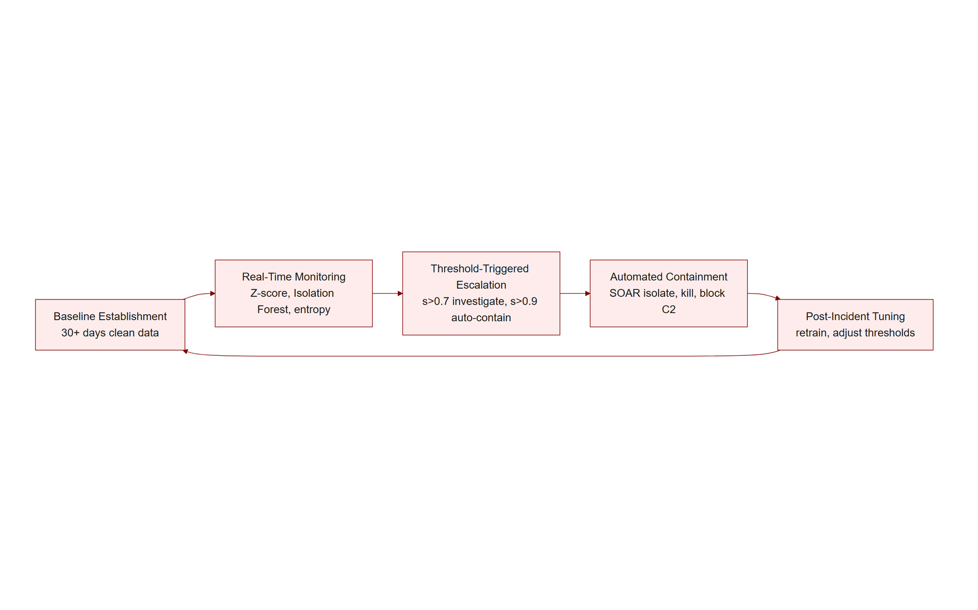
TOPIC 1.5 · 1.5.5.c.1
?
Synthesis: The Full Automated Defense Lifecycle
1. Baseline establishment: 30+ days of clean behavioral data trains the statistical/ML models' definition of 'normal'
2. Real-time monitoring: Z-score, Isolation Forest, and Shannon entropy continuously score live system/network behavior
3. Threshold-triggered escalation: Score > 0.7 escalates to human investigation; score > 0.9 triggers fully automated containment
4. Automated containment: SOAR playbook isolates the host, kills the malicious process, preserves SOC visibility via narrow exceptions
5. Recovery and feedback: Immutable backups restore clean state; NIST 800-61r2's post-incident phase feeds lessons back into layer 1's baseline
Automated Defense Lifecycle
Notes:
Every mechanism covered in this topic assembles into a single continuous lifecycle, and mapping each specific control to its exact stage in that lifecycle is precisely the analytical skill this topic's free-response questions reward. The lifecycle begins with baseline establishment: statistical and machine-learning detection models require a substantial period, commonly at least 30 days, of clean, representative behavioral data before their definition of 'normal' is trustworthy enough to reliably distinguish genuine anomalies from ordinary variation.
Once a baseline exists, real-time monitoring continuously scores live system and network behavior using the specific techniques covered in this topic's technical section: Z-scores for straightforward single-dimensional metrics, Isolation Forest for complex multi-dimensional behavioral patterns, and Shannon entropy specifically for detecting the file-encryption signature characteristic of ransomware's core payload behavior.
These continuously computed scores feed into threshold-triggered escalation: scores in the moderate-elevated range (roughly above 0.7) route to human analyst investigation, while scores in the high range (roughly above 0.9), particularly when corroborated by a specific high-confidence signature like the VSS-deletion command sequence, trigger fully automated containment without waiting for human review, precisely because the breakout-time statistics from this topic's opening make clear that any human-mediated delay at this stage risks arriving too late. Automated containment executes the SOAR playbook's ordered phases, isolating the host's network access while preserving narrow monitoring exceptions, and terminating the identified malicious process directly. Finally, recovery restores clean operational state from immutable, previously-tested backups, and NIST SP 800-61r2's Post-Incident Activity phase formally closes the loop, feeding lessons learned from the specific incident back into refining the baseline and thresholds used in stage 1 for the next cycle, the defense system is not static, but continuously improves based on each incident it survives.

Slide 29
TOPIC 1.5 · 1.5.5.c.2
Exam Readiness Checklist for Topic 1.5
Can you explain, using specific breakout-time figures, why automated response is structurally necessary rather than merely convenient?
Can you compute a Z-score and an Isolation Forest anomaly score given the relevant formula inputs?
Can you explain why Shannon entropy monitoring alone produces false positives, and what additional context resolves this?
Can you distinguish ransomware from a wiper using the specific decryption-mechanism test NotPetya illustrates?
Can you name the complete four-layer ransomware defense stack (prevention, detection, automated response, recovery) with a specific mechanism per layer?
Notes:
Use this checklist to self-assess before the assessment. Each item maps to a high-frequency question pattern for this topic. The two concepts most likely to determine full versus partial credit are (1) precisely explaining why the measured gap between attacker breakout time (minutes) and human SOC response time (30-60+ minutes) makes automated containment structurally necessary rather than a mere best practice, and (2) correctly computing and interpreting an Isolation Forest anomaly score, including the specific threshold conventions (s>0.7 investigate, s>0.9 auto-contain) and the inverse relationship between path length and anomaly score.
Beyond those, expect at least one item testing the signature-versus-anomaly or ransomware-versus-wiper vocabulary pairs precisely, and at least one free-response item requiring the full four-layer defense stack (prevention, detection, automated response, recovery) rather than a single named control such as 'use AI to detect attacks' alone.
Finally, keep the detection-versus-mitigation distinction sharp, exactly as across the rest of this unit: an Isolation Forest score or entropy alert detects likely ransomware activity; the SOAR playbook's network isolation and process termination are what actually mitigate it. Scenario prompts almost always require naming both categories explicitly, and connecting the recovery-layer outcome (immutable backups) as the factor that ultimately determines an incident's real-world severity regardless of how well detection and containment performed.

