Slide 1
AAYAT-AP-PREP · CYBERSECURITY
SECURING SPACES
Topic 2.1: Security Foundations (CIA Triad)
Topic 2.1 establishes the vocabulary the rest of the unit depends on: how attackers manipulate people, who those attackers are and what they want, the stages an intrusion passes through, how an organisation measures risk and chooses a response to it, how security controls are classified, and why independent layers of defence outperform any single strong one.
7 learning objectives · College Board AP Cybersecurity Course Framework
Notes:
Cover slide for Topic 2.1: Cyber Foundations. Topic 2.1 establishes the vocabulary the rest of the unit depends on: how attackers manipulate people, who those attackers are and what they want, the stages an intrusion passes through, how an organisation measures risk and chooses a response to it, how security controls are classified, and why independent layers of defence outperform any single strong one.

Slide 2
TOPIC 2.1
Learning Objectives
Analyze Risk
Recognise the forms social engineering takes and the human tendencies each one exploits.
2.1.A
Analyze Risk
Distinguish categories of adversary by resources, objective, and tolerance for exposure.
2.1.B
Analyze Risk
Set out the stages an intrusion moves through, and why interrupting one frustrates the whole sequence.
2.1.C
Analyze Risk
Describe how a risk assessment is conducted, from asset inventory through estimates of likelihood and impact.
2.1.D
Mitigate Risk
Identify the available responses to a measured risk: reduce it, transfer its cost, avoid the activity, or accept it on record.
2.1.E
Objectives paraphrased from the AP Cybersecurity Course Framework (College Board, AP Career Kickstart).
Notes:
Read each learning objective aloud and connect it to the exam skill category before starting the topic.

Slide 3
TOPIC 2.1 · CONCEPT MAP
CIA Triad Security Matrix
Confidentiality
Integrity
Availability
• Information is accessible only to those authorized to have it.
• Threat: unauthorized disclosure (an intercepted login, an exposed cloud bucket).
• Controls: encryption, access control, data classification.
• Information and systems have not been altered without authorization.
• Threat: quiet, unauthorized modification of data or code.
• Controls: hashing, digital signatures, change-control logging.
• Authorized users can reach information and systems when they need to.
• Threat: denial of service, hardware failure, deletion.
• Controls: redundancy, backups, capacity planning.

Slide 4
TOPIC 2.1
The Big Idea
The CIA triad is the three locks a bank puts on its vault: one keeps outsiders from reading what's inside (confidentiality), one shows the moment the door has been tampered with (integrity), and one guarantees the door still opens for the people who are legitimately allowed in (availability).
Hold onto this picture — we'll come back to it as the mechanics get more technical.
Notes:
Big-idea framing for Topic 2.1. Open with this analogy before the mechanics: "The CIA triad is the three locks a bank puts on its vault: one keeps outsiders from reading what's inside (confidentiality), one shows the moment the door has been tampered with (integrity), and one guarantees the door still opens for the people who are legitimately allowed in (availability)." Ask students for their own version of the analogy before moving on.

Slide 5
01
The CIA Triad: Security's First Principle
Topic 2.1
Notes:
Transition to part 1 of the topic. Pause here for questions before continuing.

Slide 6
TOPIC 2.1 · 2.1.1.a.1
The CIA Triad: Security's First Principle
Confidentiality: only authorized parties can read data
Integrity: data stays accurate and unaltered except by authorized action
Availability: authorized users can access systems when needed
Every attack degrades at least one of these three properties
Notes:
Information security rests on three properties every control tries to preserve: Confidentiality , Integrity , and Availability (CIA). Before designing a control or describing an attack, a security professional must state which property is under threat, that answer defines what "success" looks like for the defender, and it changes the entire vocabulary of the conversation that follows.
Why exactly three properties, and not two or five? Because every possible harm to information reduces to one of these outcomes: someone who shouldn't see it, sees it (confidentiality); something that should be accurate becomes wrong (integrity); or something that should be reachable becomes unreachable (availability). A ransomware attack that encrypts files without exfiltrating them is a pure availability attack, nothing was read or altered, only made inaccessible. A silent database read by an unauthorized analyst who changes nothing is a pure confidentiality breach. Distinguishing which property (or properties) is actually in play is the first analytical move in every incident response, risk assessment, and exam free-response question in this course.

Slide 7
TOPIC 2.1 · 2.1.1.a.2
Confidentiality, Integrity, Availability, Defined
Confidentiality &rarr; ACLs, encryption at rest/in transit, RBAC (NIST AC family)
Integrity &rarr; hashing (SHA-256), digital signatures, checksums, logging (NIST SI family)
Availability &rarr; uptime SLAs, redundancy (RAID, failover), DDoS mitigation (NIST CP family)
The three properties are frequently in tension with each other
Notes:
Encrypting a database protects confidentiality but adds overhead that can slow legitimate access ( availability ). A strict account-lockout policy protects the integrity of authentication but can itself become a denial-of-service vector if an attacker deliberately triggers lockouts on legitimate accounts, a technique called an account lockout DoS .
Notice the pattern in how each property is technically enforced: confidentiality controls restrict WHO can read (ACLs, RBAC, encryption keys); integrity controls detect WHETHER something changed (hashing, signatures, checksums compare a current state against a known-good state); availability controls add redundancy so no single failure removes access (RAID mirrors data across disks, failover clusters mirror entire servers). Each control family solves a structurally different problem, which is exactly why a firewall (confidentiality/integrity-oriented) does nothing to stop a DDoS flood (an availability attack), the tools are not interchangeable across properties.

Slide 8
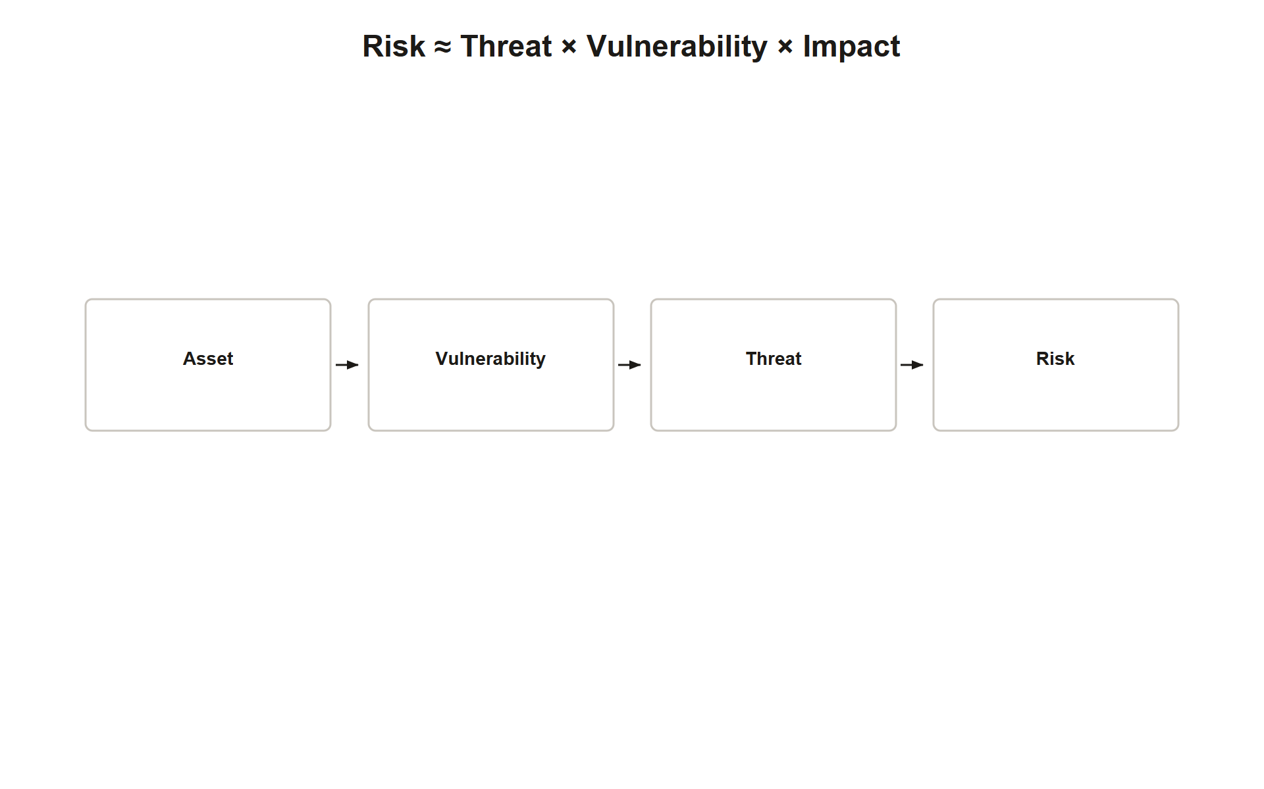
TOPIC 2.1 · 2.1.1.a.3
Asset, Vulnerability, Threat, Risk
Asset: anything of value worth protecting
Vulnerability: a weakness that could be exploited
Threat: any actor/event capable of exploiting a vulnerability
Risk: the potential for loss when a threat exploits a vulnerability against an asset
Img 2.1.1 Risk Chain
Notes:
This chain, asset, vulnerability, threat, risk, is the analytical backbone of every security assessment. Risk is formally modeled as a function of likelihood and impact: Risk ≈ Threat × Vulnerability × Impact . Risk can never be reduced to zero, only to an "acceptable" residual level.
Walk the chain concretely: a hospital's patient records database is the asset . An unpatched web server hosting the records portal is the vulnerability , a weakness that exists whether or not anyone ever exploits it. A ransomware crew scanning the internet for that exact unpatched software version is the threat , an actor capable of exploiting the weakness. The risk is the possibility that the threat successfully exploits the vulnerability against the asset, resulting in encrypted patient records and a HIPAA violation. Remove any one link, patch the vulnerability, or if no threat actor targets that software, and the risk drops to near zero even though the other links still exist.

Slide 9
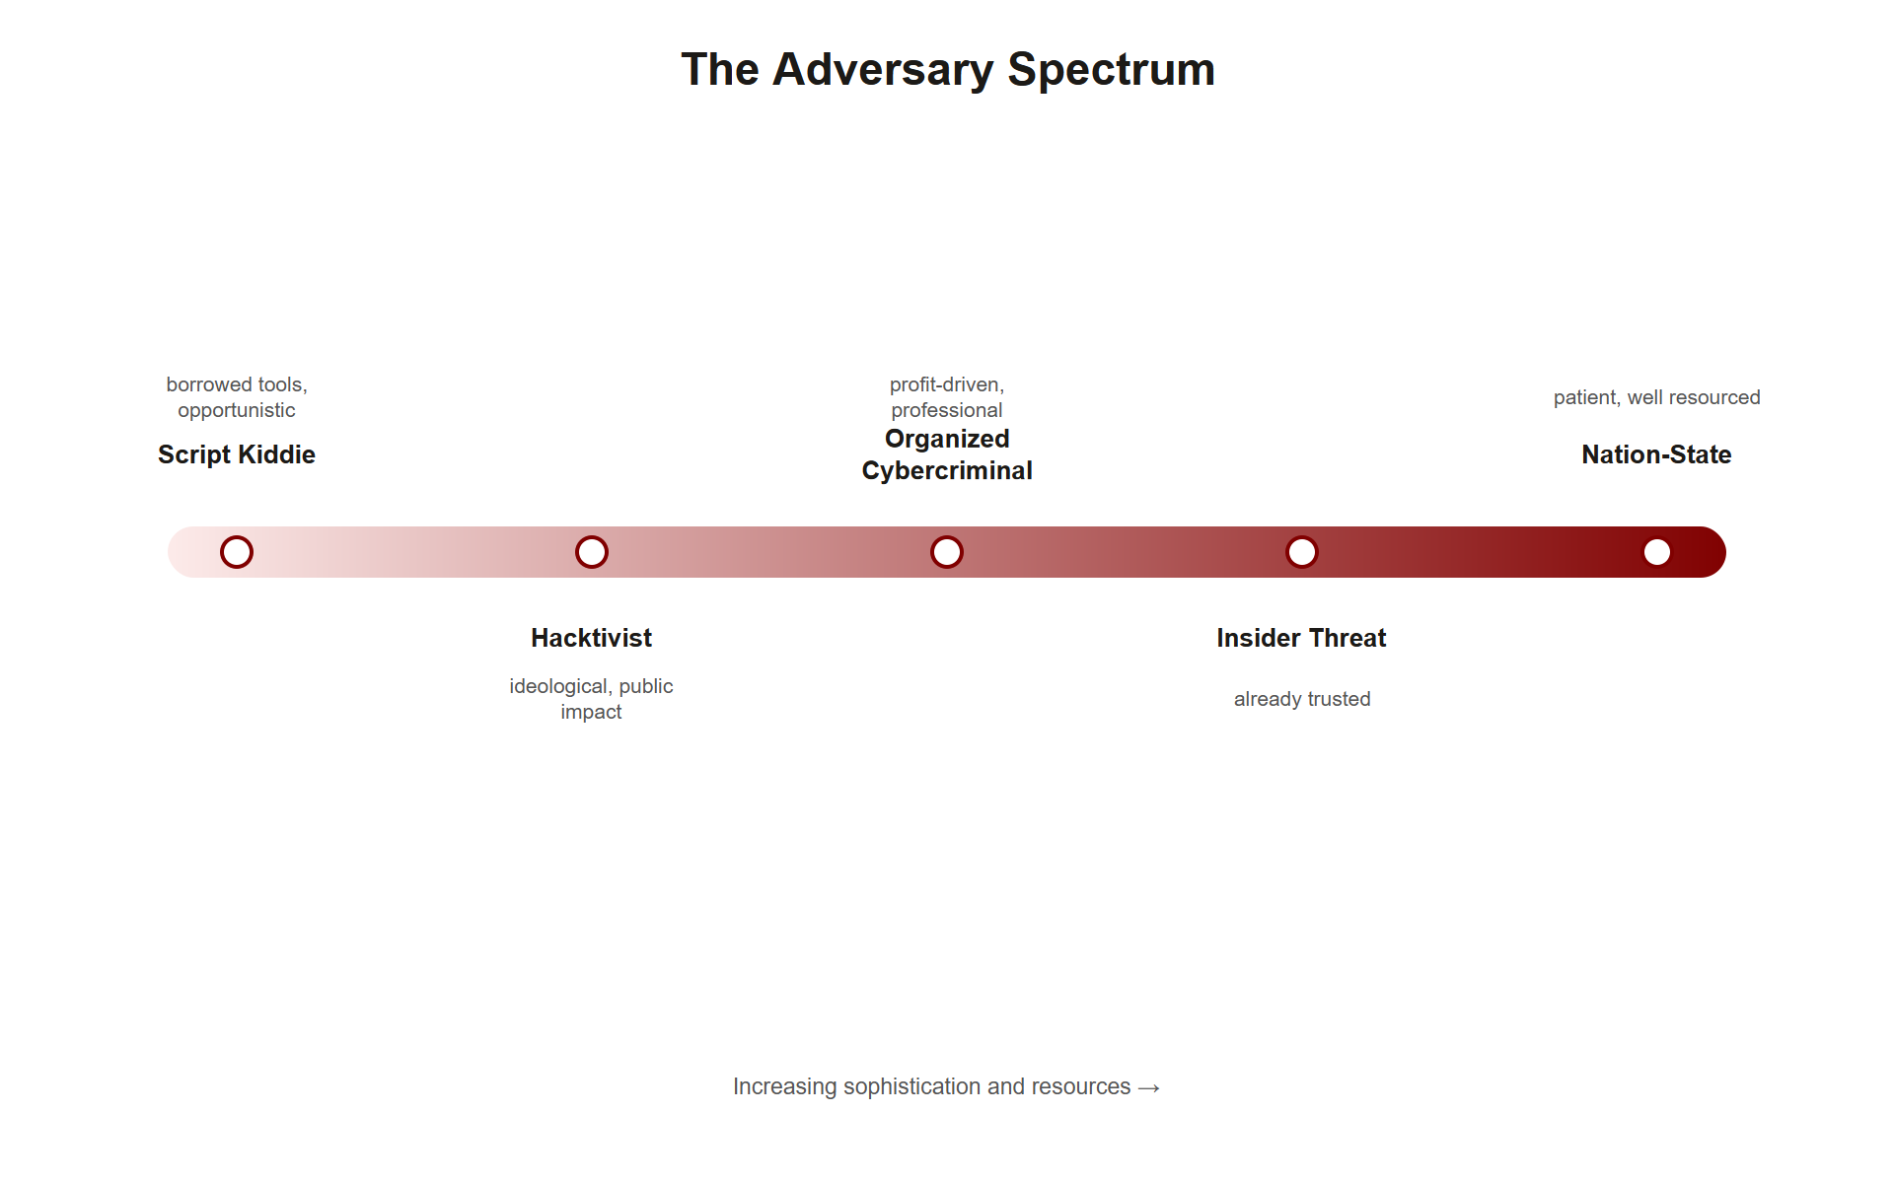
TOPIC 2.1 · 2.1.1.a.4
Adversary Taxonomy
Nation-state actors (APTs): government-backed, near-unlimited resources, long time horizons
Organized cybercriminal groups: financially motivated, run like a business (RaaS)
Hacktivists: ideologically driven, prioritize visibility over stealth
Insider threats: bypass perimeter defenses via legitimate access
Script kiddies: unskilled, use pre-built tools, still real-impact at scale
Img 2.1.1 Adversary Spectrum
Notes:
Not all attackers share the same motives, resources, or risk tolerance. Classifying an adversary correctly changes the expected sophistication and duration of an attack, and therefore which defenses matter most, you don't build the same defense against a script kiddie running a downloaded tool as you do against a nation-state actor with a multi-year budget.
Think of adversary classification as answering three questions: How much money/time can they spend? (nation-states: years and unlimited budget; script kiddies: an afternoon and a free tool). What do they want? (cybercriminals: money; hacktivists: visibility/embarrassment; nation-states: intelligence or sabotage). What access do they start with? (insiders already have legitimate credentials; everyone else must earn access through exploitation). A defense built only against the low-resource end of this spectrum (perimeter firewalls, antivirus) will do almost nothing against a patient, well-funded nation-state actor willing to spend a year on reconnaissance alone.

Slide 10
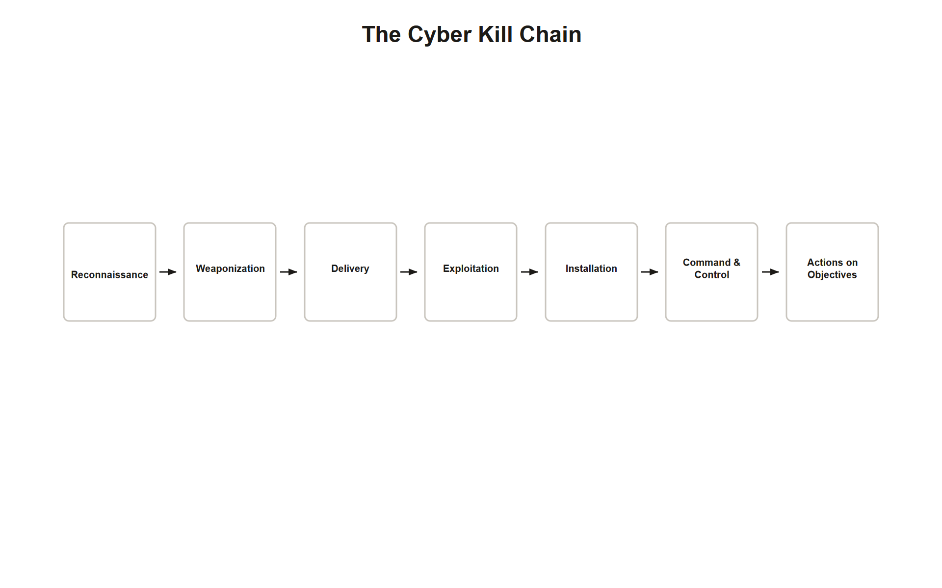
TOPIC 2.1 · 2.1.1.a.5
The Cyber Kill Chain
Reconnaissance &rarr; Weaponization &rarr; Delivery &rarr; Exploitation
Installation &rarr; Command &amp; Control &rarr; Actions on Objectives
Breaking the chain at ANY single phase stops the whole attack
Applies equally to physical intrusions: scouting, tailgating, theft
Img 2.1.1 Kill Chain
Notes:
Developed by Lockheed Martin (2011), the Kill Chain models an intrusion as seven sequential phases. Defenders don't need to catch every step, just one. In physical security, reconnaissance is scouting entrances and shift-change times; initial access is tailgating through a badge door; actions on objective is stealing a server.
Each phase maps to a specific defensive opportunity: Reconnaissance can be disrupted by limiting public information (job postings that reveal internal software versions, employee LinkedIn profiles that reveal org structure). Delivery can be blocked at the email gateway or the front door. Exploitation is stopped by patching the vulnerability before the attacker arrives. Installation can be caught by endpoint monitoring watching for new, unrecognized processes. Command & Control can be blocked by network egress filtering that refuses outbound connections to known-bad IP ranges. The core insight the Kill Chain teaches: security is not one wall to breach, but seven separate gates, each independently defensible.

Slide 11
TOPIC 2.1 · 2.1.1.a.6
?
Physical Security Is Still Security
A stolen unencrypted laptop = confidentiality breach via physical vector
A vandalized backup generator = availability breach via physical vector
Tailgating, badge cloning, mantraps, CCTV are all CIA-triad applications
This unit reapplies Unit 1's vocabulary to the physical world
Notes:
Students sometimes assume the CIA triad only applies to networks and software. It does not. Every topic in this unit is the CIA triad applied to the physical world instead of the digital one.
Consider three physical incidents side by side, each mapping to a different CIA property: an unlocked filing cabinet containing employee SSNs is a confidentiality failure, no system was hacked, a door was simply left open. A vandal who repaints a company's exterior security camera lenses so footage becomes unusable is an integrity failure, the recorded data now misrepresents reality (nothing was ever "seen," so evidence integrity is compromised even though nothing was stolen). A flooded server room that shuts down a hospital's patient-monitoring systems for six hours is an availability failure. None of these three incidents required a single line of malicious code, yet all three are core cybersecurity failures because they degrade a CIA property.

Slide 12
TOPIC 2.1 · 2.1.1.a.7
Formal Risk Assessment: Four Steps
1. Identify assets and assign them a value
2. Identify vulnerabilities and threats relevant to each asset
3. Estimate likelihood and impact to calculate risk
4. Decide on a risk response
Notes:
Organizations do not defend everything equally; they defend proportionally to risk. This four-step process, formalized in NIST SP 800-30, is the analytical basis for every security budget decision.
Step 1 (identify and value assets) sounds obvious but is frequently where real assessments fail: an organization that has never inventoried its assets cannot protect them, because you cannot rank what you haven't listed. Step 2 (identify vulnerabilities and threats) pairs each asset with what could go wrong and who might cause it. Step 3 (estimate likelihood × impact) is where the SLE/ARO/ALE math from Section 2 of this deck comes in, converting a qualitative worry into a comparable number. Step 4 (choose a response) is the only step that actually spends money or changes anything; the first three steps exist purely to make Step 4 a defensible, evidence-based decision instead of a guess.

Slide 13
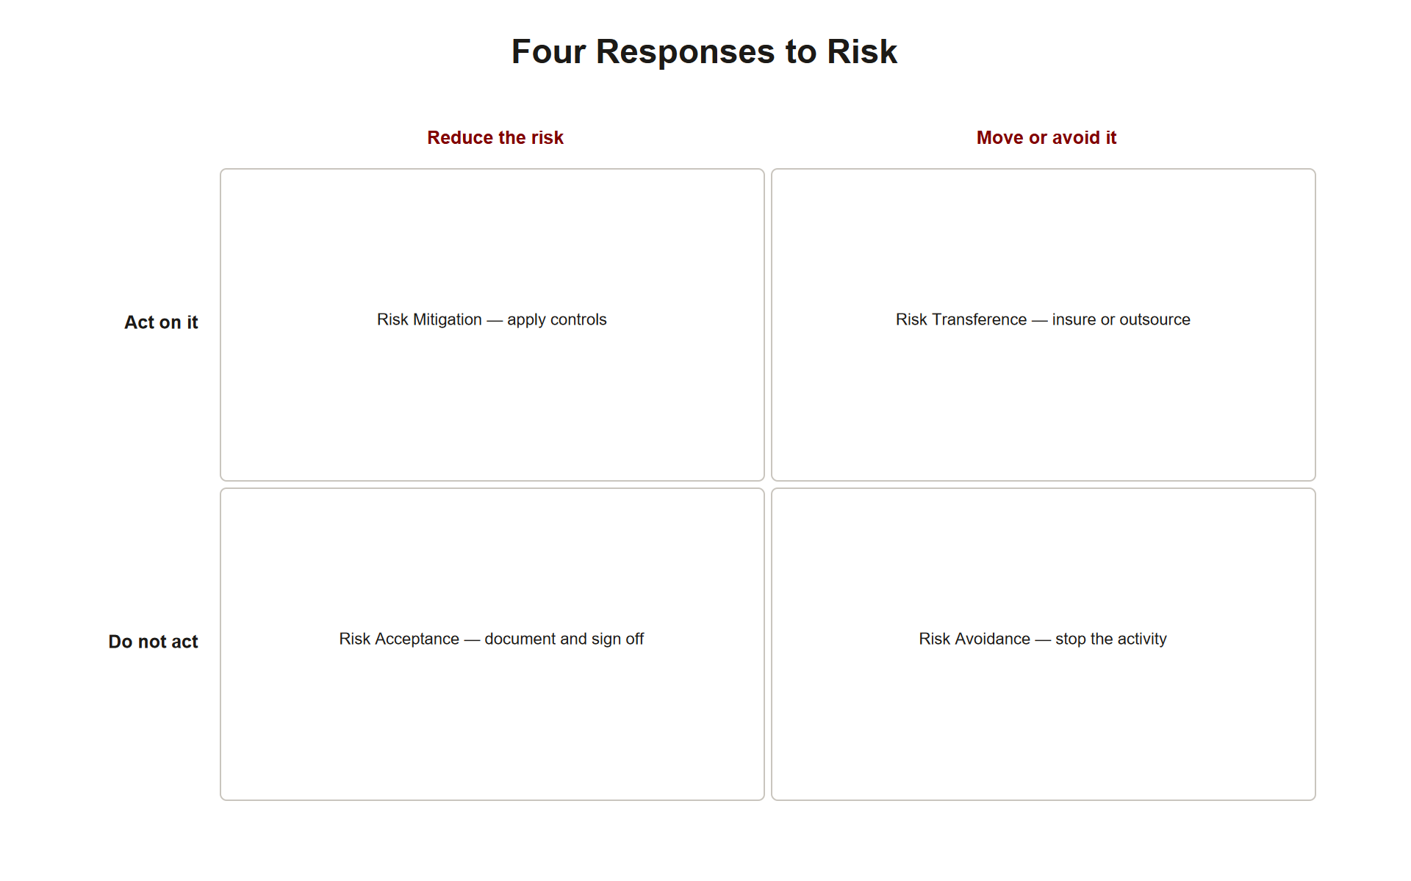
TOPIC 2.1 · 2.1.1.a.8
?
The Four Risk Responses
Risk acceptance: documented decision to do nothing further
Risk mitigation: reduce likelihood/impact via a control
Risk transference: shift financial cost (insurance, vendor contract)
Risk avoidance: eliminate the activity that creates the risk entirely
Img 2.1.1 Risk Responses
Notes:
There are exactly four valid risk responses. Acceptance must be a deliberate, documented decision by an accountable party, not negligence. Buying cyber-insurance is transference, not mitigation, because it does not reduce likelihood or impact, only offsets financial cost.
A useful mental test for telling the four apart: ask "does this response change the probability or severity of the event itself?" Mitigation says yes (a mantrap physically reduces tailgating's likelihood of success). Avoidance says yes, completely (shutting down the vulnerable system removes the risk entirely, at the cost of losing that system's function). Transference and acceptance both say no , the underlying probability and severity are unchanged; only WHO bears the financial consequence differs. Acceptance means the organization bears it; transference means an insurer or vendor contractually bears it instead. This is exactly why an organization can simultaneously accept a risk (do nothing more) and also insure against it (transfer the residual cost), the two responses are not mutually exclusive.

Slide 14
TOPIC 2.1 · 2.1.1.a.9
?
Section 1 Synthesis: How the Vocabulary Connects
An asset only matters because a vulnerability gives some threat actor a path to it, remove any one link and risk collapses
Which adversary type you're facing determines how far along the kill chain they can realistically get, and how much budget defense deserves
Once risk is identified, an organization must pick exactly ONE of the four risk responses, and that choice is what everything in Section 2's math evaluates
The CIA triad is the language every one of these other concepts is expressed IN: a "risk" is always a risk TO confidentiality, integrity, or availability specifically
Notes:
These five ideas are not five separate facts to memorize, they are one causal chain. Start with the CIA triad: it defines the three things worth protecting. An asset is anything that has confidentiality, integrity, or availability worth preserving. A vulnerability is a gap in how that asset is protected. A threat is an actor from the adversary taxonomy capable of exploiting that gap, and WHICH adversary type matters, because a script kiddie and a nation-state actor pose wildly different risk even against the identical vulnerability. When threat meets vulnerability, you get risk , and the kill chain is simply risk unfolding over time, phase by phase. Facing that risk, an organization must choose exactly one of the four risk responses , and that choice is a deliberate, documented decision, not a default.
The most common exam-trap confusion: students conflate "risk acceptance" (a documented decision to do nothing further) with simply ignoring a problem, and conflate "risk transference" (buying insurance) with "risk mitigation" (actually reducing likelihood or impact), insurance changes who PAYS, not what HAPPENS.

Slide 15
02
Quantitative Risk: SLE, ARO, ALE
Topic 2.1
Notes:
Transition to part 2 of the topic. Pause here for questions before continuing.

Slide 16
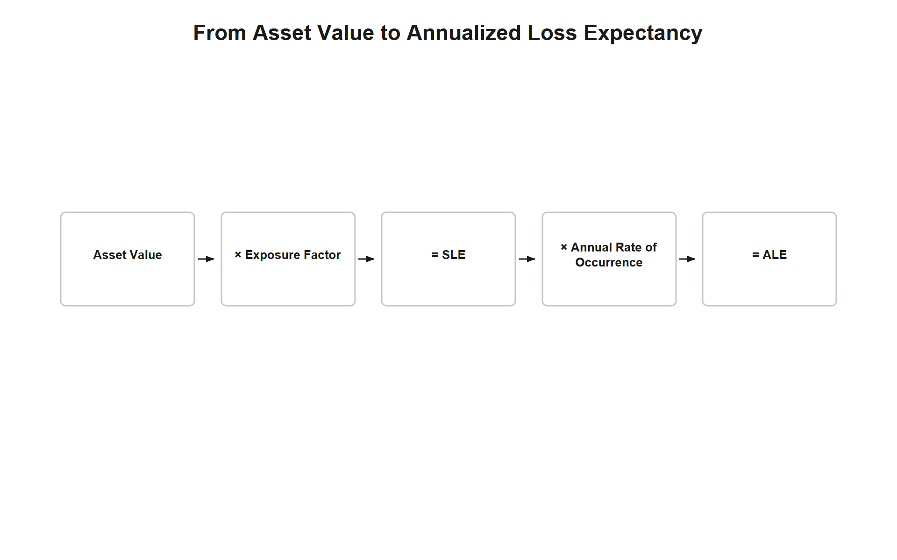
TOPIC 2.1 · 2.1.2.a.1
Quantitative Risk: SLE, ARO, ALE
SLE (Single Loss Expectancy) = Asset Value &times; Exposure Factor
ARO (Annualized Rate of Occurrence) = expected events per year
ALE (Annualized Loss Expectancy) = SLE &times; ARO
ALE is the number that justifies (or rejects) a security budget line item
Img 2.1.2 Ale Formula
Notes:
Formal risk assessment quantifies loss expectancy. If a $50,000 server has a 40% chance of total data loss during an incident, SLE = $50,000 × 0.40 = $20,000. If that event is expected once every 2 years (ARO = 0.5), ALE = $20,000 × 0.5 = $10,000/year.
Each variable answers a distinct question. AV answers "what is this worth?" — not just replacement cost, but often reputational and regulatory cost too. EF answers "how much of that value would THIS SPECIFIC event destroy?" — a phishing email that steals one password has a much lower EF against a whole database than a ransomware attack that encrypts it entirely. ARO answers "how often does this actually happen to organizations like us?" — usually estimated from industry breach reports (like Verizon's DBIR) rather than guessed. Multiplying AV × EF gives the cost of ONE incident (SLE); multiplying that by how often it happens per year (ARO) converts a one-time cost into an ongoing annual budget line (ALE), the number a CFO can actually compare against a control's price tag.

Slide 17
TOPIC 2.1 · 2.1.2.a.2
Worked ALE Calculation
Asset Value: $80,000 rack of servers
Exposure Factor: 0.60 &rarr; SLE = $48,000
ARO: 0.25 (once every 4 years) &rarr; ALE = $12,000/year
Mantrap control drops ARO to 0.05 &rarr; new ALE = $2,400/year
Notes:
Proposed control: mantrap + badge reader upgrade, $4,000/year amortized cost. Risk reduction = $12,000 − $2,400 = $9,600/year. Net benefit = $9,600 − $4,000 = +$5,600/year .
Notice what the mantrap actually changed in this calculation: it did NOT change the Single Loss Expectancy (still $48,000 if tailgating succeeds, a successful breach costs the same regardless of the control). What it changed was the Annualized Rate of Occurrence , from 0.25 (once every 4 years) down to 0.05 (once every 20 years), because the mantrap makes each individual tailgating attempt far less likely to succeed. This is the general pattern for preventive controls: they reduce ARO (how often an attack succeeds), while corrective controls reduce EF (how much damage a successful attack causes) by limiting blast radius through backups and segmentation. Recognizing which variable a proposed control actually moves is a strong exam skill.

Slide 18
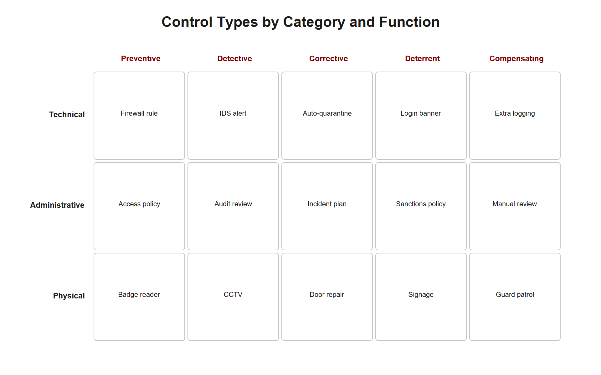
TOPIC 2.1 · 2.1.2.a.3
?
Control Function vs. Control Category
Function: preventive, detective, corrective, deterrent, compensating
Category: technical, administrative/managerial, physical
The two axes are independent and combine (e.g. physical+detective)
One of the most commonly tested distinctions on the AP exam
Img 2.1.2 Control Matrix
Notes:
A security camera is a physical, detective control. A locked server-room door is a physical, preventive control. A background-check policy is an administrative, preventive control. Function describes when in the incident lifecycle a control acts; category describes how it's implemented.
A helpful way to keep the two axes separate: category answers "what KIND of thing is this control?" (a piece of hardware, a written policy, or a physical barrier), while function answers "WHEN does this control act relative to the incident?" (before it happens, during/right after, or in cleanup). The two axes are fully independent, which is why all 15 combinations (5 functions × 3 categories) are possible: a fire extinguisher is physical + corrective; a mandatory security-awareness training video is administrative + preventive; an intrusion-detection system alert is technical + detective. Students who memorize the axes as a single combined list ("preventive controls are always technical") consistently miss free-response points, always evaluate the two axes separately.

Slide 19
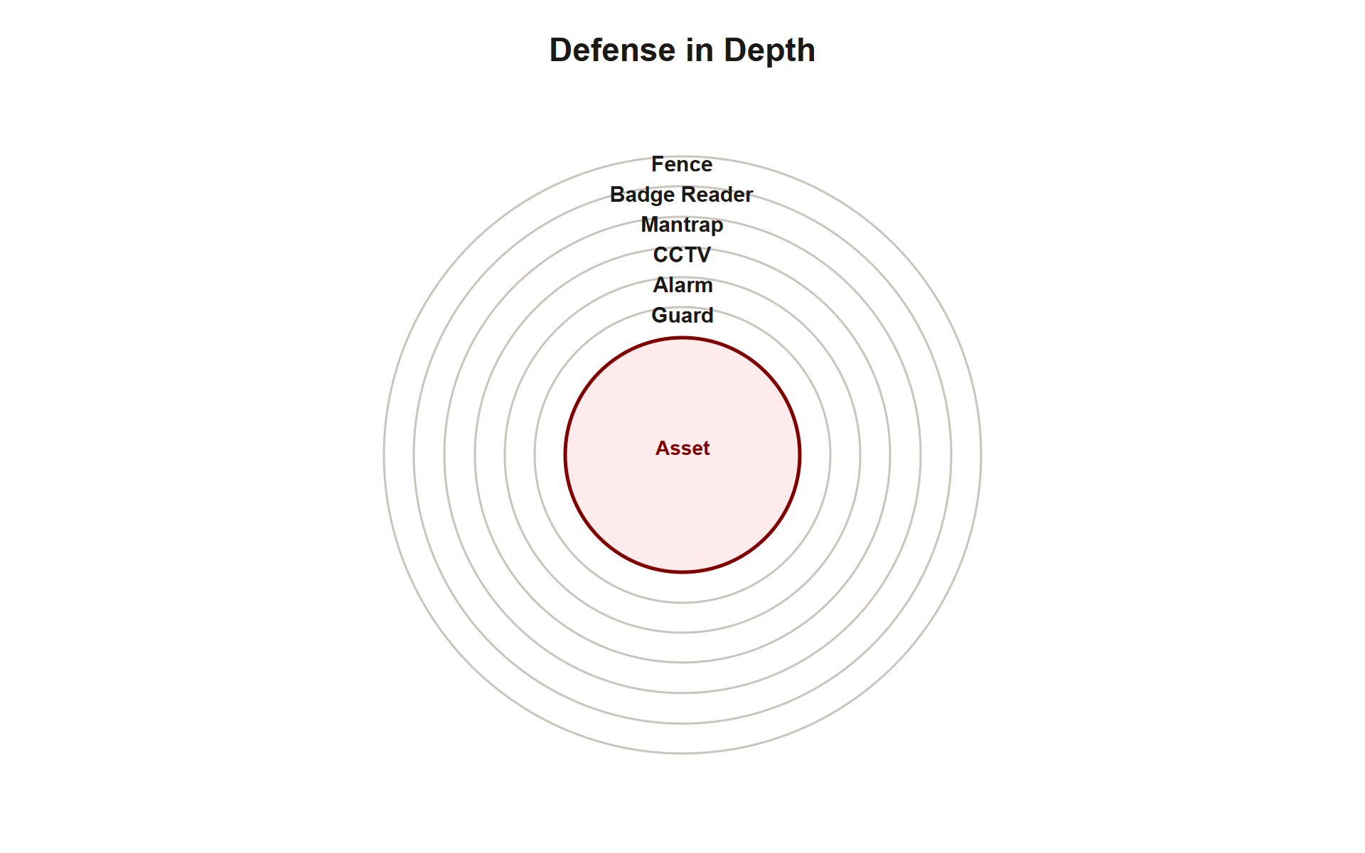
TOPIC 2.1 · 2.1.2.a.4
Defense-in-Depth
No single control, however strong, is trusted as the sole line of defense
Layers: fence &rarr; badge reader &rarr; mantrap &rarr; CCTV &rarr; alarm &rarr; guard
If one layer fails, the remaining layers still stand between attacker and asset
Contrasted with 'security through obscurity' (secrecy-only defense)
Img 2.1.2 Defense Layers
Notes:
A data center might combine a perimeter fence (physical, deterrent/preventive), badge reader (physical, preventive), mantrap (physical, preventive), CCTV (physical, detective), intrusion alarm (physical, detective), and a 24-hour guard (administrative), around the exact same asset.
The mathematical intuition behind defense-in-depth is worth making explicit: if each individual layer has, say, a 20% chance of being defeated by a competent attacker, then defeating THREE independent layers in sequence requires roughly 0.2 × 0.2 × 0.2 = 0.8% probability of success, dramatically lower than any single layer alone. This only holds if the layers are genuinely independent failure modes (a badge reader and a mantrap fail for different reasons), which is why defense-in-depth deliberately mixes control categories (technical + physical + administrative) rather than stacking three of the same type, since three badge readers in a row share the exact same weakness (badge cloning defeats all three simultaneously).

Slide 20
TOPIC 2.1 · 2.1.2.a.5
?
Section 2 Synthesis: From Math to Classification
SLE × ARO = ALE converts Section 1's qualitative risk into a dollar figure a budget can act on
A proposed control's cost is only justified if it reduces ALE by MORE than the control costs, the same logic used to choose a risk response in Section 1
Every control you'd ever recommend must be classified on TWO independent axes: function (when it acts) and category (how it's implemented)
Defense-in-depth is what happens when you deliberately pick controls with different categories AND functions to protect the same asset
Notes:
Section 2 is Section 1's abstractions made concrete and actionable. "Risk mitigation" sounds good in theory, but SLE/ARO/ALE is how you PROVE a specific mitigation is worth its cost, a mantrap that costs $4,000/year and reduces ALE by $9,600/year has a clear, defensible $5,600/year net benefit; a $4,000/year control that only reduces ALE by $1,000/year is not economically justified even though it "works." Once you've decided to mitigate, the control-function/control-category matrix is how you DESIGN the mitigation: not just "add a control" but a specific, classifiable one (physical? technical? administrative? preventive? detective?). Defense-in-depth is simply the discipline of never relying on a single cell in that matrix, layering controls whose categories and functions are independent, so one failure doesn't cascade into total failure.
Watch for scenarios that give you a control's cost and its ALE-reduction separately and ask you to justify (or reject) it mathematically, and scenarios that describe a control's behavior and ask you to classify it on BOTH axes without using the word "preventive" or "physical" explicitly.

Slide 21
03
Case Study: Target Corporation Breach (2013)
Topic 2.1
Notes:
Transition to part 3 of the topic. Pause here for questions before continuing.

Slide 22
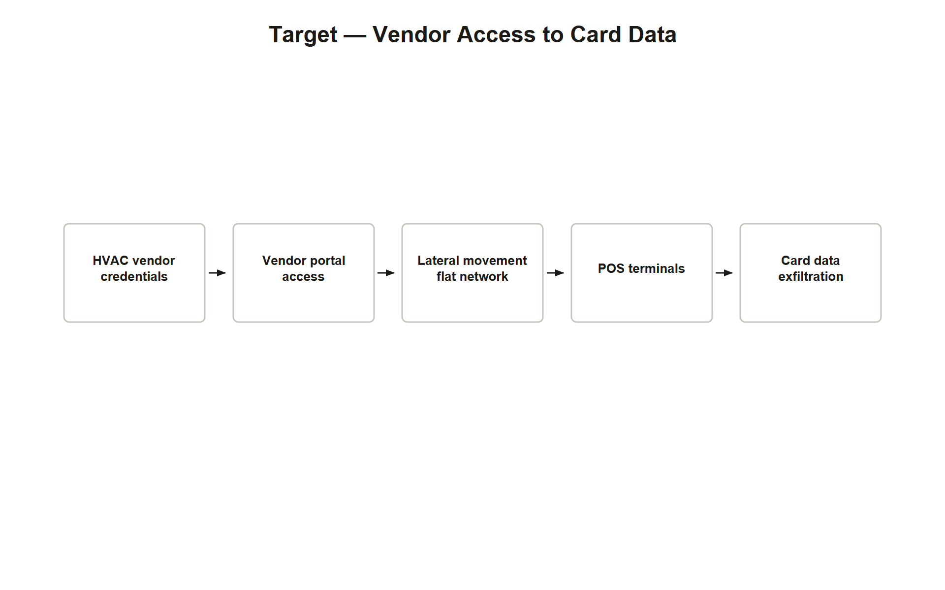
TOPIC 2.1 · 2.1.3.a.1
Case Study: Target Corporation Breach (2013)
Attackers stole credentials from Fazio Mechanical, an HVAC vendor
Poor network segmentation let a billing-only account reach POS terminals
~40M card records + 70M customer records exfiltrated
All three CIA properties failed in a single incident
Img 2.1.3 Target Breach Chain
Notes:
Confidentiality failed when card/personal data was exfiltrated. Integrity failed when memory-scraping malware was installed on point-of-sale systems without authorization. Availability was impacted when Target had to take systems offline for remediation during its highest-revenue retail season.
The technical root cause deserves a closer look: Fazio Mechanical's network credentials were meant only for submitting invoices and reviewing contracts through a vendor portal, a narrowly scoped, low-privilege purpose. But Target's internal network was flat enough that once inside via that portal, attackers could move laterally all the way to point-of-sale terminals that had no business reason to be reachable from a vendor's billing account. This is a textbook least-privilege and segmentation failure: the vendor's access should have been walled off in its own network zone with no path to POS infrastructure, regardless of how strong that vendor's own security was.

Slide 23
TOPIC 2.1 · 2.1.3.a.2
?
Case Study: Colonial Pipeline Ransomware (2021)
DarkSide (RaaS group) used one compromised VPN password, no MFA
Ransomware hit the IT network only, not the OT (pipeline control) network
Colonial proactively shut down pipeline operations for ~a week
$4.4M ransom paid in bitcoin; portion later recovered by the FBI
Notes:
An availability failure need not even touch the physical system directly, a business-system (IT) disruption alone cascaded into a real-world critical-infrastructure crisis, illustrating IT/OT convergence risk .
Trace the actual mechanism of harm carefully, since it's frequently misunderstood: the ransomware encrypted Colonial's corporate IT network , email, billing, invoicing, never the operational technology (OT) that physically opens and closes pipeline valves. Colonial could technically have kept pumping fuel. They chose to shut down because (1) they could no longer bill customers or track deliveries, making continued operation a financial and logistical mess, and (2) as a precaution against the ransomware spreading into OT, since IT and OT networks at many organizations aren't as cleanly separated as an org chart suggests. The lesson: an attacker doesn't need to touch a physical control system at all to cause a physical-world availability crisis if the business systems surrounding that control system are themselves critical to operating it.

Slide 24
TOPIC 2.1 · 2.1.3.a.3
?
Section 3 Synthesis: Two Breaches, One Lesson
Target: a vendor-risk vulnerability (flat network, over-broad access) exploited by an organized cybercriminal threat
Colonial Pipeline: an IT/OT convergence vulnerability (no MFA, no segmentation) exploited by a ransomware-as-a-service threat
Both breaches map cleanly onto Section 1's asset/vulnerability/threat/risk chain, and both had a SPECIFIC, nameable defense-in-depth gap
Neither breach required a zero-day exploit, both exploited a missing LAYER (segmentation, MFA) that Section 2's control taxonomy would have flagged
Notes:
These two case studies exist to prove that Sections 1 and 2 aren't abstract theory, they're a diagnostic checklist real incident responders actually use. In both cases, ask the Section 1 questions: what was the asset (POS data; pipeline billing/operations)? The vulnerability (flat network; unMFA'd VPN)? The threat (a criminal group in each case)? Then ask the Section 2 question: which control CATEGORY was missing? Target lacked a TECHNICAL control (network segmentation) that would have contained a vendor's over-broad access. Colonial Pipeline lacked a TECHNICAL control (MFA) that would have stopped one leaked password from being sufficient. Neither organization lacked detection entirely, Target's IDS actually fired, they lacked either the missing preventive layer or the response process to act on what detection already found.
A strong FRQ answer on either case study names the SPECIFIC missing control (not just "better security") and states which CIA property it would have protected.

Slide 25
04
NIST Risk Management Framework (RMF)
Topic 2.1
Notes:
Transition to part 4 of the topic. Pause here for questions before continuing.

Slide 26
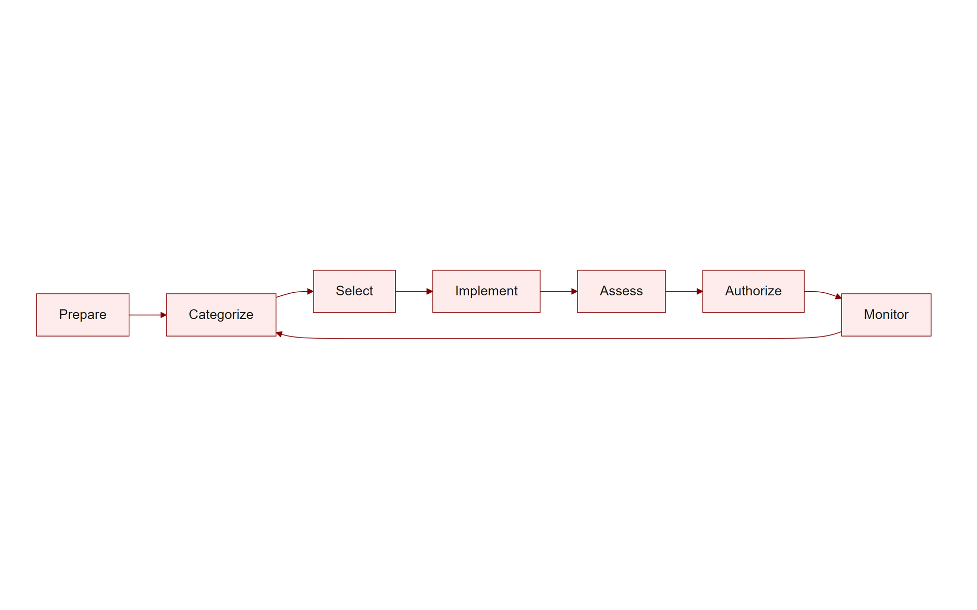
TOPIC 2.1 · 2.1.4.a.1
NIST Risk Management Framework (RMF)
Seven steps: Prepare, Categorize, Select, Implement, Assess, Authorize, Monitor
Required for U.S. federal information systems under FISMA
Controls selected from NIST SP 800-53's catalog
Physical controls map to the 'PE' (Physical and Environmental Protection) family
Img 2.1.4 Rmf Cycle
Notes:
NIST SP 800-37 defines this structured, repeatable process that operationalizes everything in this chapter: categorizing systems by impact level, selecting and implementing controls, formally authorizing the system, and continuously monitoring it.
Notice the RMF's steps mirror the four-step risk assessment process from Section 1, just formalized into a government-auditable lifecycle: Categorize is asset identification and valuation; Select and Implement are choosing and deploying the mitigating control; Assess and Authorize are a formal sign-off that risk has been reduced to an acceptable level (echoing the "risk acceptance" response from Section 1); Monitor is continuous, because a system authorized as secure today can drift out of compliance as new vulnerabilities are discovered. RMF is not a one-time checklist, the Monitor step explicitly loops back to Categorize when the system or threat landscape changes materially.

Slide 27
TOPIC 2.1 · 2.1.4.a.2
ISO/IEC 27001 and the ISMS
Requires a continuous Plan-Do-Check-Act cycle
Grounded explicitly in confidentiality, integrity, availability objectives
Annex A: 93 controls across organizational, people, physical, technological themes
Formal third-party certification signals security maturity
Notes:
ISO/IEC 27001's Annex A control themes directly mirror the administrative/physical/technical taxonomy taught earlier in this chapter, the same classification system, formalized into an auditable international standard.
The Plan-Do-Check-Act (PDCA) cycle at ISO 27001's core is worth understanding as a continuous loop rather than a one-time project: Plan establishes the ISMS scope and risk assessment methodology; Do implements the selected controls; Check monitors and audits whether those controls are actually working (echoing the "independent verification" theme that recurs throughout this unit); Act makes corrective improvements based on what Check revealed, then the cycle restarts. Unlike a one-time certification exam, ISO 27001 certification requires ongoing surveillance audits precisely because security is not a state you achieve once, it's a process you sustain.

Slide 28
TOPIC 2.1 · 2.1.4.a.3
Building a Defense-in-Depth Control Matrix
Walk every kill-chain phase and every CIA property for the asset
Ensure &ge;1 preventive AND &ge;1 detective control per layer
Document a corrective response plan if both fail
Example: fence, badge+biometric, mantrap, CCTV, alarm tied to SOC, IR plan, visitor log
Notes:
Practically hardening a facility housing sensitive servers means layering preventive, detective, and corrective controls across physical, technical, and administrative categories, leaving no single point of failure.
A useful design discipline: for every asset, draw out the kill chain phases relevant to a physical intrusion (reconnaissance, initial access, actions on objective) and ask, at each phase, "what preventive control stops this, and what detective control catches it if prevention fails?" A server room might have: reconnaissance countered by limiting building signage/visible layout info (administrative); initial access countered by a badge+mantrap (technical/physical, preventive) AND CCTV (physical, detective); actions on objective countered by cable locks on hardware (physical, preventive) AND an inventory/asset-tagging audit (administrative, detective). Building the matrix this way, phase by phase, prevents the common mistake of over-investing in entry-point controls while leaving the "what happens once they're inside" question unaddressed.

Slide 29
TOPIC 2.1 · 2.1.4.a.4
?
Section 4 Synthesis: Governance Ties It All Together
NIST RMF and ISO 27001 are two different bureaucracies implementing the SAME underlying idea: repeat Section 1's risk assessment continuously, not once
A control matrix is Section 2's control-function/category taxonomy, formalized into an auditable document
Neither framework invents new security concepts, both are process wrappers around Sections 1&ndash;3's ideas, built for accountability and certification
&quot;Monitor&quot; (RMF) and &quot;Check/Act&quot; (ISO's PDCA) both exist because Section 3's case studies show risk assessments go stale
Notes:
It's easy to treat NIST RMF and ISO 27001 as two more acronyms to memorize, but they answer a single question Section 1–3 leave open: HOW does an organization guarantee it keeps doing all of this correctly, indefinitely, in a way a stranger (an auditor) can verify? RMF's seven steps are Section 1's four-step risk process, expanded into a government-auditable lifecycle with formal sign-off (Authorize) and continuous re-checking (Monitor). ISO 27001's PDCA cycle does the same thing with different vocabulary. Both exist because Colonial Pipeline and Target didn't fail from a one-time bad decision, they failed from a control that was correct once and was never re-verified as the environment changed around it.
Exam tip: if a scenario describes an organization getting AUDITED, or describes a security posture DRIFTING out of compliance over time, that's a Section 4 governance question, not a Section 1–3 vocabulary question.

Slide 30
05
Likelihood x Impact, Not Likelihood Alone
Topic 2.1
Notes:
Transition to part 5 of the topic. Pause here for questions before continuing.

Slide 31
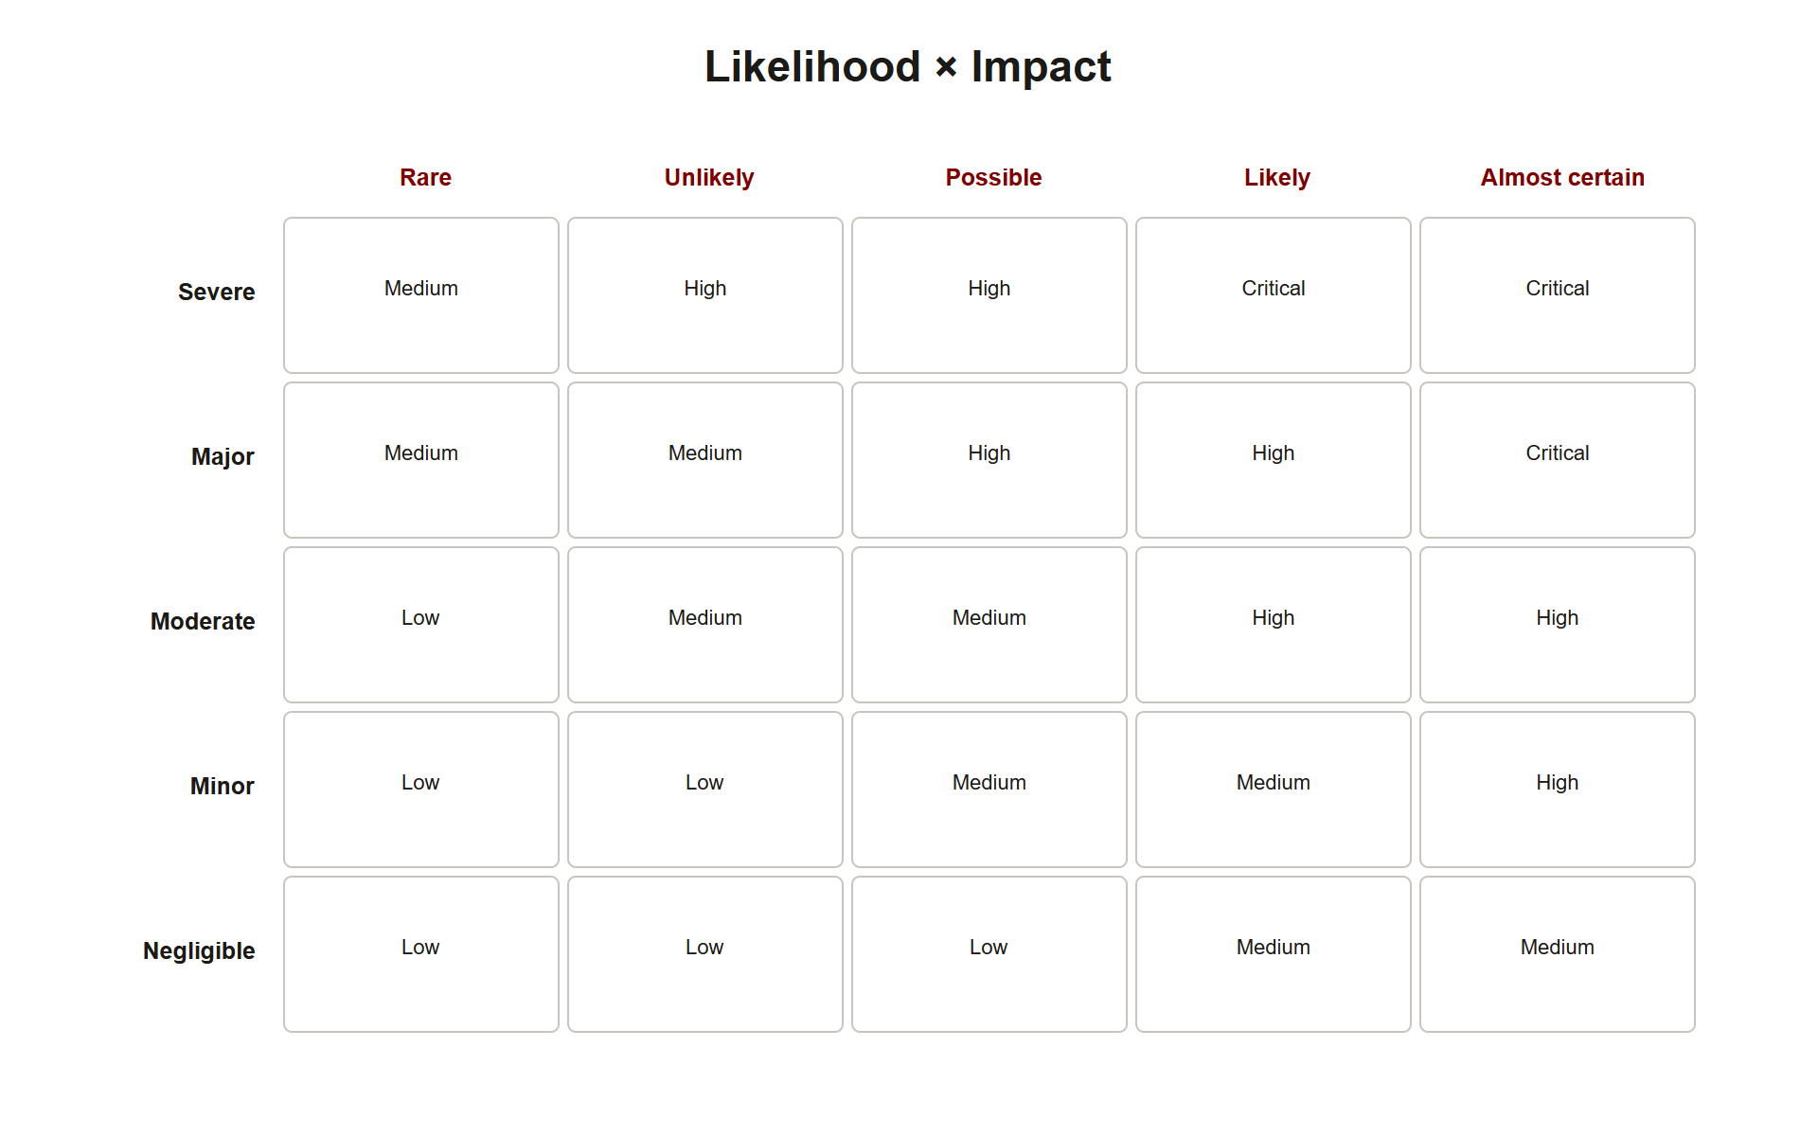
TOPIC 2.1 · 2.1.5.a.1
Likelihood x Impact, Not Likelihood Alone
Risk is always the PRODUCT of likelihood and impact
A high-likelihood, low-impact event may be lower risk than a rare, catastrophic one
Example: door propped open occasionally vs. targeted PII server theft
This is why ALE multiplies SLE and ARO rather than adding them
Img 2.1.5 Likelihood Impact Matrix
Notes:
A frequent student error is ranking risk by likelihood alone. An employee occasionally propping a door open for a smoke break is high-likelihood but low-impact; a targeted intrusion to steal an unencrypted PII database is low-likelihood but catastrophic. Multiply, never add.
Put numbers to the intuition: suppose the propped-door scenario has a likelihood score of 9/10 but an impact score of 1/10 (someone might wander in, but there's nothing valuable near that door), a risk score of 9. The targeted PII theft has a likelihood of 1/10 (rare, requires real planning) but an impact of 10/10 (regulatory fines, breach notification costs, reputational damage), a risk score of 10, HIGHER than the seemingly more urgent-feeling propped door. A security budget that reflexively chases whatever feels most frequent, rather than whatever the likelihood × impact product actually ranks highest, systematically misallocates resources.

Slide 32
TOPIC 2.1 · 2.1.5.a.2
?
Practice: Classify This Control
Scenario: visible, uniformed guard posted at the main entrance
Does it physically stop an unauthorized person? Not always, a guard can be overpowered or fooled
Its primary value is discouraging an attempt via visible presence
Classify: physical, deterrent (with secondary preventive/detective value)
Notes:
Apply the control-function taxonomy: ask whether a control (1) stops an incident outright, (2) merely discourages it, (3) identifies it after the fact, or (4) repairs damage afterward.
The guard example is deliberately tricky because a human guard can plausibly serve THREE functions depending on the scenario: purely by being visible, they're a deterrent (most attackers avoid an obviously guarded target). If they physically block an unauthorized person from entering, they act as preventive . If they notice and report a break-in already in progress, they act as detective . On the exam, always anchor your classification to the SPECIFIC action described in the scenario, not the control's full range of theoretical capability, a guard "posted at the entrance, discouraging casual attempts" is being tested as a deterrent, not asked to also justify preventive or detective credit.

Slide 33
TOPIC 2.1 · 2.1.5.a.3
Synthesis: The Full Risk-to-Response Lifecycle
1. Inventory assets and assign value
2. Identify vulnerabilities and threats (adversary taxonomy)
3. Model the attack via the kill chain
4. Quantify risk (SLE x ARO = ALE)
5. Select a risk response (accept/mitigate/transfer/avoid)
6. Layer controls by function and category (defense-in-depth)
7. Govern the whole cycle under RMF or ISO 27001
Notes:
Walking end to end: an organization inventories its server room (asset), notices an unbadged rear door (vulnerability), recognizes tailgating insiders and thieves as threats (adversary taxonomy), calculates ALE, chooses mitigation, installs a mantrap + CCTV + badge reader (layered controls), and documents the whole process under NIST RMF for audit.
This seven-step lifecycle is the single most exam-relevant synthesis in this topic because it's rarely tested as seven separate facts, it's tested as ONE scenario that requires you to move fluidly between steps. A well-constructed free-response question might describe a facility, ask you to identify the CIA property at risk (step 1-2), calculate an ALE from given numbers (step 4), recommend a specific layered control set (step 6), and justify it using RMF language (step 7), all within a single multi-part answer. Practicing this lifecycle as one continuous narrative, rather than seven isolated flashcards, is what separates a strong FRQ response from a list of disconnected facts.

Slide 34
TOPIC 2.1 · 2.1.5.a.4
Exam-Readiness Checklist: Topic 2.1
Can you name the CIA property threatened in any given scenario?
Can you calculate SLE, ARO, and ALE from given values?
Can you classify a control on BOTH function and category axes?
Can you distinguish the four risk responses, especially acceptance vs. transference?
Can you explain why Target and Colonial Pipeline failed, citing the specific root cause?
Notes:
These are the AP-testable distinctions this topic covers, pulled directly from the exam-focus callouts in the source chapter.

