Slide 1
AAYAT-AP-PREP · CYBERSECURITY
SECURING SPACES
Topic 2.2: Physical Security Breaches
Topic 2.2 examines how an adversary actually gets in: the attacks that defeat doors, locks, badges and people; the weaknesses in a building that make those attacks work; and the discipline of recording what was found so that someone can act on it.
3 learning objectives · College Board AP Cybersecurity Course Framework
Notes:
Cover slide for Topic 2.2: Physical Vulnerabilities and Attacks. Topic 2.2 examines how an adversary actually gets in: the attacks that defeat doors, locks, badges and people; the weaknesses in a building that make those attacks work; and the discipline of recording what was found so that someone can act on it.

Slide 2
TOPIC 2.2
Learning Objectives
Analyze Risk
Identify the physical attacks an organisation is likely to face.
2.2.A
Analyze Risk
Explain how a threat exploits a physical weakness to bring about loss, damage, disruption, or destruction of an asset.
2.2.B
Analyze Risk
Assess the risks arising from physical weaknesses and document them so they can be acted on.
2.2.C
Objectives paraphrased from the AP Cybersecurity Course Framework (College Board, AP Career Kickstart).
Notes:
Read each learning objective aloud and connect it to the exam skill category before starting the topic.

Slide 3
TOPIC 2.2 · CONCEPT MAP
Physical Threat Taxonomy
Unauthorized Access
Asset Loss & Tampering
Environmental Hazards
• Tailgating Bypass
• Lock Picking Mechanics
• Smart Keycard Cloning
• Workstation Hardware Theft
• Direct Console Access
• USB Keylogger Exploits
• CCTV / Power Blackouts
• HVAC Thermal Failures
• Fire & Flood Exposure

Slide 4
TOPIC 2.2
The Big Idea
A firewall doesn't stop someone from walking in behind an employee who politely holds the door open. Physical security fails at the door long before it ever reaches the network cable.
Hold onto this picture — we'll come back to it as the mechanics get more technical.
Notes:
Big-idea framing for Topic 2.2. Open with this analogy before the mechanics: "A firewall doesn't stop someone from walking in behind an employee who politely holds the door open. Physical security fails at the door long before it ever reaches the network cable." Ask students for their own version of the analogy before moving on.

Slide 5
01
Physical Security: The Assumption Everything Else Relies On
Topic 2.2
Notes:
Transition to part 1 of the topic. Pause here for questions before continuing.

Slide 6
TOPIC 2.2 · 2.2.1.a.1
Physical Security: The Assumption Everything Else Relies On
Physical security: preventing/detecting/responding to unauthorized physical access
"If an attacker has physical access to a device, it is not your device anymore"
Disk encryption, locked screens, and network segmentation can all be bypassed physically
Often the fastest, cheapest path to compromising a well-defended digital environment
Notes:
Every network defense assumes a server or workstation is physically inaccessible to an attacker. When that assumption fails, technical controls built on top of it can be trivially bypassed, a drive removed and mounted elsewhere, a BIOS password reset, a rogue device plugged into an internal switch port.
Consider why each of these bypasses works: disk encryption protects data while the device is a black box to the attacker , but if the encryption key is derived from something recoverable (a TPM without a boot-time PIN, or a weak passphrase), physical possession gives an attacker unlimited offline attempts with no lockout policy to stop them, unlike a login prompt that might lock after 5 tries. Network segmentation similarly assumes an attacker connects FROM outside the trusted network; a rogue device plugged directly into an internal switch port skips that entire boundary. The unifying lesson: nearly every digital control implicitly assumes a physical perimeter around the hardware it runs on, and physical security is what actually delivers that perimeter.

Slide 7
TOPIC 2.2 · 2.2.1.a.2
Tailgating and Piggybacking
Following an authorized person through a secured door without presenting credentials
Exploits politeness, not technology, no stolen badge or technical skill needed
Piggybacking: the authorized person is aware/complicit; tailgating: unaware
Bypasses badge readers entirely, no unauthorized-badge alert is triggered
Notes:
An attacker exploiting tailgating needs only confidence, often posing as a delivery driver, new hire, or late contractor. Because no invalid credential is ever presented, badge-log detective controls are blind to it.
What makes tailgating uniquely hard to defend against compared to every other vector in this chapter is that it exploits a deeply ingrained social reflex, not a technology gap, you cannot patch politeness the way you patch software. This is why the most effective countermeasure (covered in Section 4) is not a smarter badge reader but a physical mechanism (the mantrap) that removes the human decision entirely: the door itself, not the employee, decides whether a second person may pass. Awareness training helps, but training alone asks employees to consistently choose "security" over "basic courtesy" hundreds of times a year without fail, a fragile control compared to one enforced by hardware.

Slide 8
TOPIC 2.2 · 2.2.1.a.3
Badge Cloning
Copying data from a legitimate badge onto a blank card
Handheld RFID reader/writers (under $50) clone badges from inches away
Works silently, through a wallet or bag, without victim awareness
Cloned badge is indistinguishable from the original, no alert generated
Notes:
Badge cloning targets the credential itself, not the human holding it. Legacy 125 kHz proximity badges (e.g., HID ProxCard) transmit an unencrypted, static identifier, making them especially vulnerable. High-frequency smart cards with cryptographic authentication are far more resistant.
The deeper reason cloning is possible at all comes down to a single design choice: does the badge prove its identity by REVEALING a secret (transmitting its ID number in the clear, which anyone can copy) or by DEMONSTRATING knowledge of a secret without revealing it (a cryptographic challenge-response, covered in detail in Section 2)? A legacy badge is like a person proving they know a password by simply saying the password out loud within earshot of everyone, anyone who overhears it now knows it too. A modern smart card is like proving you know a password by correctly answering a question that only someone who knows the password could answer, without ever saying the password itself.

Slide 9
TOPIC 2.2 · 2.2.1.a.4
Dumpster Diving
Searching discarded trash/recycling for sensitive information
Legal in most U.S. jurisdictions once trash reaches a public area (California v. Greenwood, 1988)
A reconnaissance vector, not an intrusion vector on its own
Supplies employee names, org charts, discarded badges/hardware for later attacks
Notes:
Discarded documents can reveal the exact details an attacker needs to build a convincing pretext for tailgating or badge cloning. Low legal risk and no employee interaction make it a favored first step.
Dumpster diving's real value to an attacker is rarely the dramatic "stolen password on a sticky note" scenario, it's the accumulation of small, individually boring facts: an internal memo revealing which vendor handles HVAC maintenance (fuel for a pretexting cover story), an org chart showing who reports to whom (fuel for a phishing/pretexting target list), a discarded visitor badge that was never deactivated. None of these facts alone enables a breach; together, they let an attacker walk in sounding like they already belong there. This is exactly why Section 4's hardening recommendation (shredding + NIST 800-88 sanitization) treats "boring" internal documents with nearly the same seriousness as customer data, the boring documents are what make every OTHER attack in this chapter easier.

Slide 10
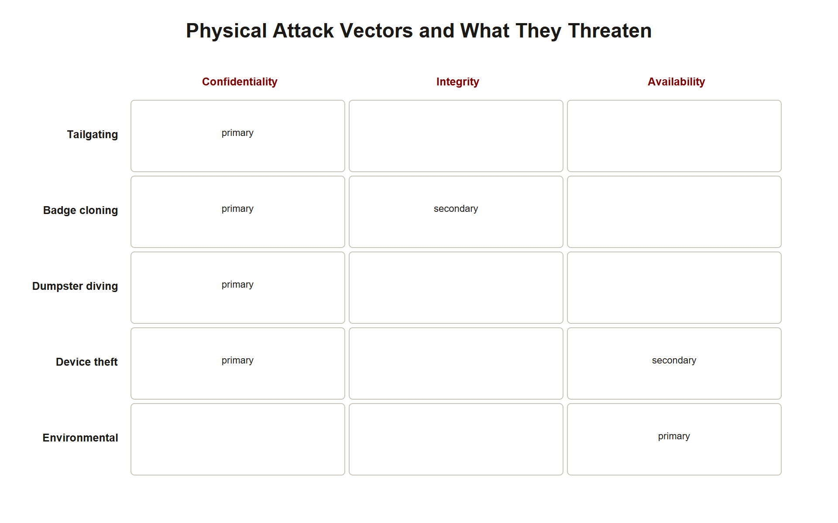
TOPIC 2.2 · 2.2.1.a.5
?
Device Theft and Environmental Threats
Unattended laptops, unlocked workstations, undisposed servers &rarr; high-frequency confidentiality breaches
The DATA is usually the objective, not the hardware's resale value
Environmental threats: fire, flood, power loss, extreme temperature
No adversarial intent, but still formally in physical-security scope
Img 2.2.1 Attack Vector Map
Notes:
Environmental threats target availability primarily, though fire/flood can also destroy integrity guarantees (e.g., corrupting backups). A risk assessment that only models human adversaries while ignoring a flood plain or aging electrical infrastructure has an incomplete threat model.
Device theft deserves a closer distinction from the other vectors in this chapter: it is the only vector in Section 1 that directly achieves the attacker's END GOAL rather than merely gaining entry. Tailgating, badge cloning, and dumpster diving are all ways of getting IN or getting INFORMATION; device theft is frequently the actual objective itself, the attacker doesn't need to breach a network at all if the laptop in their hands already has the data decrypted and logged in. This is precisely why full-disk encryption (Section 4) is such a high-leverage control: it's the one defense that still works even after every other physical control (locks, badges, mantraps) has already failed and the device is in the attacker's hands.

Slide 11
TOPIC 2.2 · 2.2.1.a.6
The Cheapest Attack Wins
Skilled attackers try the cheapest, lowest-skill vector first
Many red-team engagements succeed via tailgating alone
Defenders who over-invest in exotic technical controls while leaving doors propped open optimize the wrong layer
Cost-effectiveness applies to attackers just as it applies to defenders (ALE logic, in reverse)
Notes:
Students often assume attackers reach for their most sophisticated tool first. In practice, holding a door for someone walking in behind you is often all it takes, no cloned badge or technical exploit required.
This mirrors, in reverse, the exact economic logic organizations use to justify security spending (recall ALE from Topic 2.1): just as a defender won't spend $50,000/year protecting against a $10,000/year risk, an attacker won't spend weeks building a badge cloner and studying Wiegand protocol internals if a smile and a box of donuts gets the same result in thirty seconds. Professional physical penetration testers exploit this asymmetry deliberately, engagement reports consistently show testers try the cheapest vector FIRST (tailgating, then pretexting, then cloning, then more elaborate technical attacks only if the cheap options fail), because that's exactly the order a real attacker would follow too.

Slide 12
TOPIC 2.2 · 2.2.1.a.7
Pretexting as Connective Tissue
A fabricated identity or story making an attacker's presence seem legitimate
Impersonating a delivery driver, HVAC technician, new employee, or auditor
The physical-world analog of Unit 1's phishing pretext, applied face-to-face
Receptionists/front-desk staff are a critical, often under-trained control
Notes:
A person wearing a high-visibility vest carrying a clipboard is rarely questioned, regardless of whether they actually work for the utility contractor. This is why awareness training emphasizes verifying credentials regardless of appearance.
Pretexting works by exploiting a cognitive shortcut called the authority/uniform heuristic : humans are evolutionarily wired to defer to visible markers of legitimate role (a uniform, a tool belt, a clipboard, confident body language) rather than verify the underlying claim each time, because constantly challenging everyone would make normal workplace functioning impossible. An attacker doesn't need to forge a perfect fake ID, they need only trigger the heuristic convincingly enough that a busy employee doesn't bother to verify. This is why the strongest defense against pretexting isn't a smarter employee, but a CONSISTENT VERIFICATION PROCEDURE that applies even to people who look obviously legitimate, removing the judgment call from any individual employee's split-second decision.

Slide 13
TOPIC 2.2 · 2.2.1.a.8
?
Section 1 Synthesis: One Attack Chain, Five Vectors
Dumpster diving supplies the raw intelligence that makes pretexting convincing
Pretexting is what makes tailgating work on someone who'd otherwise hesitate
Badge cloning is the technical alternative to tailgating when no human cooperation is available
Device theft and environmental threats are the only two vectors that don't require getting PAST a control, they exploit gaps controls were never built to cover
Notes:
These five vectors are not five independent multiple-choice options, they chain together in a predictable order that mirrors the Kill Chain from Topic 2.1. Reconnaissance (dumpster diving) supplies names, org charts, and vendor relationships. That intelligence fuels pretexting, a fabricated identity that's only convincing because it's grounded in real details. A convincing pretext is what makes tailgating succeed on a skeptical employee, or what gets an attacker close enough to a badge holder to clone their credential. Device theft and environmental threats sit apart from this chain: they don't need social engineering at all, because they exploit a fundamentally different weakness, unattended hardware and physical infrastructure fragility, not human trust.
The exam distinction that trips students up: dumpster diving is RECONNAISSANCE (it enables a later attack), while the other three human-facing vectors ARE the intrusion itself. Don't call dumpster diving a "breach" on its own.

Slide 14
02
The Wiegand Protocol
Topic 2.2
Notes:
Transition to part 2 of the topic. Pause here for questions before continuing.

Slide 15
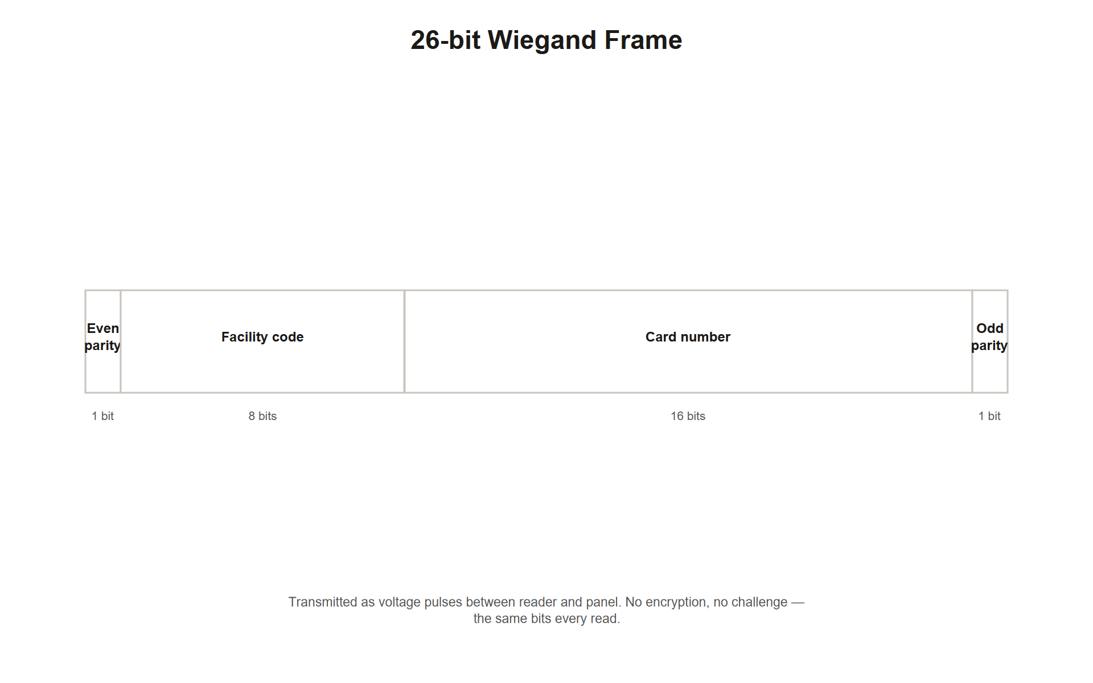
TOPIC 2.2 · 2.2.2.a.1
The Wiegand Protocol
1970s signaling standard between badge reader and access-control panel
Transmits badge ID as unencrypted electrical pulses over two wires (DATA0/DATA1)
Never designed with encryption or authentication in mind
26-bit Wiegand is publicly documented and trivially sniffable
Img 2.2.2 Wiegand Frame
Notes:
An attacker with brief physical access to reader-to-panel wiring (often exposed on the unsecured 'outside' face of a door) can install an inline sniffing device capturing every badge number presented, functionally identical to a network packet sniffer, applied to a physical bus.
The Wiegand protocol's vulnerability is a direct consequence of when it was designed: in the 1970s, before modern threat models even considered wireless eavesdropping or credential replay a serious risk, the priority was simply getting a reliable electrical signal from reader to panel over two wires. Nobody encrypted the signal because encrypting a simple ID number wasn't yet understood as necessary, the same reasoning error that led early internet protocols like HTTP and Telnet to transmit data in plaintext. Wiegand persisted for decades afterward purely due to installed-base inertia: replacing the wiring and every reader across a large facility is expensive, so organizations kept a known-insecure standard running long after its weaknesses were understood, simply because ripping it out was costlier than living with the risk.

Slide 16
TOPIC 2.2 · 2.2.2.a.2
Wiegand 26-bit Frame Structure
Bit 1: even parity (covers bits 2-13)
Bits 2-9: Facility Code (0-255)
Bits 10-25: Card Number (0-65535)
Bit 26: odd parity (covers bits 14-25)
Notes:
A sniffer or cloner requires only the facility code and card number, two decimal values, to fabricate a functionally identical badge. No cryptographic secret, certificate, or key material is involved anywhere in the frame.
Look closely at what the parity bits actually do (and don't do): they let the reader detect a TRANSMISSION error (electrical noise flipping a bit in transit), not an AUTHENTICATION failure. A parity check answers "did this frame arrive intact?" — it has no concept of "was this frame sent by the legitimate badge owner?" This distinction is the crux of why Wiegand is insecure: it was engineered for reliability against electrical noise, never for resistance against a deliberate adversary. An attacker's cloned frame, correctly reconstructed bit-for-bit from a captured sniff, will pass parity checks perfectly, parity cannot distinguish a legitimate presentation from a byte-perfect replay.

Slide 17
TOPIC 2.2 · 2.2.2.a.3
125 kHz Passive RFID Cloning
Passive tags have no battery, drawn power from the reader's own radio field
Simply echoes back a fixed identifier to any compatible reader
No way to verify the querying reader is a legitimate access panel
Cloning takes a few centimeters of proximity and under a minute to write
Notes:
An attacker can walk close enough to a target (through a wallet, bag, or clothing) and silently capture the badge's identifier, entirely without the victim's awareness, then write that identifier onto a blank card.
The physics here matter for understanding both the attack and its limits: a passive 125 kHz tag has no independent power source, so it can only respond when it receives enough energy from a nearby reader's radio field to briefly power its circuit, this is why cloning requires close proximity (centimeters to a few inches) rather than working from across a room, and it's also why legitimate readers themselves must be close to the badge to work at all. An attacker's cloning device is functionally just an unauthorized "reader" doing exactly what a legitimate reader does, energizing the tag and recording its response, which is precisely why the tag has no way to distinguish a legitimate query from a malicious one: from the tag's perspective, both look identical.

Slide 18
TOPIC 2.2 · 2.2.2.a.4
?
Detecting Clones: Impossible Travel Analysis
Same badge ID recorded at geographically distant readers in an implausibly short window
Minimum physical travel time between sites bounds the plausible gap
A detective control (log correlation) catching what real-time checks cannot
Cloned badges present fully 'valid' credentials to each individual reader
Notes:
Badge 40221 grants entry at a Boston HQ server room, then at a Denver branch reader 2m48s later. Physical travel time between sites: minimum 4.5 hours by air. This flags as CLONED_CREDENTIAL.
Impossible travel analysis is a purely detective, after-the-fact control, and its existence is a direct admission that Wiegand/125kHz systems have NO real-time way to distinguish a clone from the original at the point of entry. This is analogous to a digital security concept students may already know: "impossible travel" login-anomaly detection flags an account that logs in from New York and, minutes later, from Tokyo, the same logic, applied to badge readers instead of IP geolocation. In both cases, the detective control cannot prevent the FIRST fraudulent use (whichever badge/login presentation happens first looks completely legitimate); it only catches the pattern once a SECOND, physically impossible presentation occurs, meaning at least one unauthorized entry has already succeeded by the time the alert fires.

Slide 19
TOPIC 2.2 · 2.2.2.a.5
?
Section 2 Synthesis: One Design Flaw, Two Consequences
The Wiegand protocol's lack of encryption is the ROOT CAUSE; the 26-bit frame structure is just what gets exposed as a result
Because the frame carries no cryptographic secret, passive RFID cloning is trivial, the vulnerability isn't the RFID physics, it's the protocol riding on top of it
Because cloning leaves no real-time signature, impossible-travel log correlation is the ONLY detective control available, there is no preventive gap to close at the protocol level without replacing it
This is the same &quot;secret transmitted in the clear&quot; failure pattern as an unencrypted password, just applied to a badge instead of a login
Notes:
Trace the causality here rather than memorizing four separate facts: Wiegand was designed in the 1970s with no encryption because encrypting a simple ID number wasn't yet understood as necessary. That single design choice is why the 26-bit frame contains nothing but a plainly interpretable facility code and card number, no secret, no signature, nothing that would make a captured frame useless to an attacker. That, in turn, is why passive RFID cloning works: the tag has no way to distinguish a legitimate reader from a malicious one, because nothing about the exchange was ever meant to be secret. And because a cloned badge is BYTE-IDENTICAL to the original at the point of entry, there is no real-time signal to catch, impossible-travel analysis exists specifically because detection had to move to the LOG layer, after the fact, since the protocol layer offers nothing to detect.
Every one of these four facts is a downstream consequence of ONE root design decision. If you can explain that root cause, you can derive the rest instead of memorizing four disconnected facts.

Slide 20
03
Case Study: The 2015 OPM Data Breach
Topic 2.2
Notes:
Transition to part 3 of the topic. Pause here for questions before continuing.

Slide 21
TOPIC 2.2 · 2.2.3.a.1
Case Study: The 2015 OPM Data Breach
21M+ federal employee/contractor background-investigation records exposed
Best known as a network intrusion by state-sponsored actors
Contractor ecosystem had lax physical control over credentials and workstations
Physical and digital access boundaries were not actually separate in practice
Notes:
Contractor personnel with physical access badges, combined with poorly monitored physical workstations, gave attackers multiple redundant paths into systems meant to be isolated behind digital AND physical layers, echoing the same third-party weakness seen at Target.
The OPM case is pedagogically important because it demonstrates a failure mode neither purely physical nor purely digital: contractors with legitimate remote AND on-site access blur the line between the two security domains entirely. A contractor's physical badge to enter an OPM building and their digital VPN credential to access OPM's network were governed by different teams, different review cadences, and different audit processes, meaning a contractor who left the company might have their digital access revoked promptly while their physical badge languished active for weeks, or vice versa. The breach exploited exactly this coordination gap between physical and cyber governance, not a single technical vulnerability in either domain alone.

Slide 22
TOPIC 2.2 · 2.2.3.a.2
?
Case Study: Badge Cloning at Trade Shows
DEF CON researchers repeatedly demonstrate cloning 125 kHz badges from inches away
Attendees cloned from conference registration lines, elevators, public transit
Cloned credentials used days later to walk directly into HQ
Bypasses front desk, badge reader, and human challenge entirely
Notes:
Organizations relying solely on 125 kHz proximity technology, without a corresponding PIN, biometric, or supervised-entry layer, have effectively no meaningful access control, the 'lock' is only as strong as an unencrypted number anyone nearby can silently copy.
What makes the trade-show cloning scenario especially instructive is the TIME GAP between the clone and its use: the attacker doesn't need to act immediately. A badge cloned in a coffee line on Tuesday can be used to walk into headquarters on Friday, meaning victim organizations often have zero contemporaneous indicator that anything happened, no alert, no anomaly, nothing to investigate, because the actual cloning event looked like nothing more than someone standing near a badge holder in a crowd. This delayed-use pattern is why impossible-travel log analysis (Section 2) matters so much: it may be the ONLY signal available, since it's often the first point at which the clone's existence becomes technically detectable, days or weeks after the actual theft of the credential occurred.

Slide 23
TOPIC 2.2 · 2.2.3.a.3
?
Section 3 Synthesis: Same Root Cause, Different Settings
OPM: a single-factor credential (contractor badge/VPN) trusted without independent verification of the OTHER domain (digital access wasn't cross-checked against physical access)
Trade shows: a single-factor credential (125 kHz badge) trusted with no second factor, cloned in a public setting with zero technical sophistication required
Both cases show that a credential's real-world security depends on what happens AROUND it (governance, second factors) as much as the credential's own cryptographic strength
Neither breach needed a novel exploit, both needed only patience and a public setting where physical proximity was unremarkable
Notes:
These two cases look different on the surface, a government breach involving contractor mismanagement versus a live conference demo, but they share an identical root weakness: a credential that, ALONE, was treated as sufficient proof of authorization. OPM's contractors had physical badges and digital VPN access governed by separate teams with no coordination, meaning a single compromised credential in either domain opened a path the OTHER domain's controls never checked. The trade-show cloning cases show the same single-factor trust failure at the individual-badge level: a 125 kHz badge, once cloned, was fully sufficient on its own to enter a facility days later, with no second factor and no cross-check catching the duplication.
The unifying lesson Section 4 will build on: ANY single-factor credential, however it's implemented, is a single point of failure. The fix in both cases is the same, require a second, independent verification layer.

Slide 24
04
Anti-Tailgating Controls: The Mantrap
Topic 2.2
Notes:
Transition to part 4 of the topic. Pause here for questions before continuing.

Slide 25
TOPIC 2.2 · 2.2.4.a.1
Anti-Tailgating Controls: The Mantrap
Interlocked double-door chamber: second door won't open until first is closed/locked
Sometimes paired with a weight sensor to detect a second occupant
Physically enforces single-person entry per valid credential
Where cost-prohibitive: mandatory challenge policy + awareness culture
Notes:
Formally termed an 'access control vestibule' in modern building codes (NFPA 101), covered as NIST SP 800-53 control PE-3. Treats 'holding the door' for an unbadged stranger as a policy violation, not a courtesy.
The mantrap's design elegantly solves the exact problem identified in Section 1: it removes tailgating's exploit of human social reflexes by making door-holding physically impossible rather than merely discouraged. Even an employee who WANTS to hold the door for someone behind them cannot, because the second door is mechanically interlocked to the first, it will not open until the first door has fully closed and the system has confirmed only one person's credential and weight were presented. This is a textbook illustration of a broader security-engineering principle: when a vulnerability stems from unreliable human judgment, the most robust fix removes the human decision point entirely rather than trying to train the judgment to be more reliable.

Slide 26
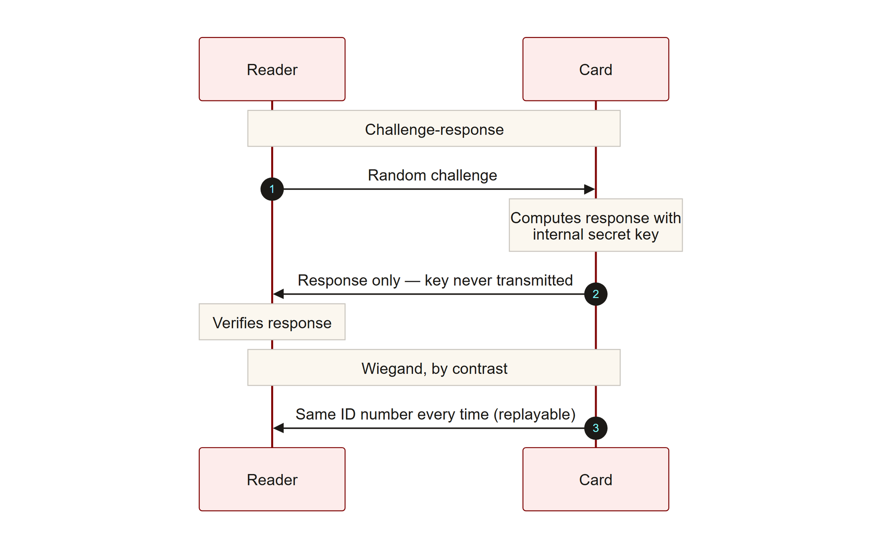
TOPIC 2.2 · 2.2.4.a.2
Migrating Away From Clonable Credentials
Replace static-identifier badges with ISO/IEC 14443 challenge-response smart cards
Card proves possession of a secret key WITHOUT transmitting that key over the air
Makes passive cloning cryptographically infeasible, not just inconvenient
Pair with a PIN or biometric &rarr; true multi-factor physical authentication
Img 2.2.4 Challenge Response
Notes:
ISO/IEC 14443 governs high-frequency (13.56 MHz) contactless smart cards (MIFARE DESFire, HID iCLASS SE) capable of on-card cryptographic operations, the same standard family underlying contactless payment cards.
The mechanism worth understanding precisely: in a challenge-response exchange, the reader sends the card a random, never-before-used number (the "challenge"). The card's onboard chip combines that challenge with its secret key using a cryptographic algorithm to produce a "response" — a number that could only have been produced by a card that actually holds the correct secret key, yet the response itself reveals nothing about the key. Because the challenge is different every single time, an attacker who captures one exchange gains nothing usable for the next one, unlike Wiegand, where capturing ONE transmission gives an attacker everything needed to replay it forever. This is the exact same challenge-response principle underlying TOTP authenticator apps and TLS certificate handshakes, just applied to a physical badge instead of a login session.

Slide 27
TOPIC 2.2 · 2.2.4.a.3
Data Sanitization and Physical Document Controls
Sensitive documents: cross-cut shredding (not strip-cut) per compliance frameworks
NIST SP 800-88: Clear (overwrite), Purge (cryptographic erase/degauss), Destroy (physical)
Decommissioned media sanitized/destroyed before it ever reaches a dumpster
Directly mitigates the dumpster-diving reconnaissance vector
Notes:
NIST SP 800-88 Rev. 1 is the authoritative U.S. federal standard for media sanitization, referenced across HIPAA and PCI-DSS compliance frameworks.
The three-tier Clear/Purge/Destroy model exists because different sensitivity levels warrant proportionally different (and proportionally expensive) sanitization effort, sanitizing a public marketing brochure with the same rigor as classified documents wastes resources, while sanitizing classified documents with only basic shredding leaves real risk. Clear (a basic overwrite) suits low-sensitivity data being reused internally. Purge (cryptographic erase or degaussing) renders data recovery infeasible even with specialized lab equipment, appropriate for most business-sensitive data leaving organizational control. Destroy (physical shredding/incineration) is reserved for the highest-sensitivity media where any residual recovery risk, however small, is unacceptable. Matching sensitivity to sanitization tier, not simply always destroying everything, is itself a tested exam skill.

Slide 28
TOPIC 2.2 · 2.2.4.a.4
Device-Level Controls Against Theft
Full-disk encryption: theft becomes a hardware cost, not a data breach
...provided the encryption key itself was not also compromised
Automatic screen-lock timeouts + cable locks for shared workstations
Asset-tagging with remote-wipe capability
Notes:
Every control here maps back to the CIA-triad vocabulary from 2.1: mantraps and smart cards are preventive/physical controls protecting confidentiality; badge log anomaly detection is detective/technical; full-disk encryption is preventive/technical, neutralizing confidentiality impact even after physical prevention has already failed.
Full-disk encryption deserves special emphasis as the chapter's best example of defense-in-depth operating across a failure boundary : every other control in this chapter (mantraps, smart cards, awareness training) tries to prevent the device from ever leaving the building in an attacker's hands. Full-disk encryption is the one control that still functions AFTER that entire chain of prevention has already failed, the device is gone, but the data on it remains unreadable without the key. This is precisely the layered-redundancy principle from Topic 2.1: no single control, however strong, is trusted as the sole line of defense, and encryption is the layer that assumes every earlier layer might not hold.

Slide 29
TOPIC 2.2 · 2.2.4.a.5
?
Section 4 Synthesis: Matching Every Fix to Its Vector
Mantrap defeats tailgating by removing the HUMAN decision point that tailgating exploits
ISO/IEC 14443 defeats badge cloning by never transmitting the secret that Wiegand exposed
NIST SP 800-88 defeats dumpster diving by destroying the recon material before it ever reaches a bin
Full-disk encryption is the odd one out, it doesn't stop device theft, it neutralizes the CONSEQUENCE of device theft after every other control has already failed
Notes:
Notice that three of these four hardening controls work by eliminating the SPECIFIC mechanism their matching vector relies on, not by adding generic "more security." Tailgating relies on a human choosing to hold a door; a mantrap makes that choice physically impossible. Badge cloning relies on a credential that reveals its secret; ISO 14443 never reveals it. Dumpster diving relies on recoverable documents; NIST 800-88 sanitization ensures nothing recoverable ever reaches the trash. Full-disk encryption breaks this pattern deliberately: it doesn't prevent device theft at all (a stolen laptop is still stolen), it's the ONE control in this chapter engineered to still function AFTER every preventive control listed above has already failed, which is exactly the defense-in-depth principle from Topic 2.1 in action.
A strong FRQ answer doesn't just say "install a mantrap" — it explains WHICH specific mechanism the mantrap defeats, tracing back to the vector's root cause from Sections 1–2.

Slide 30
05
Practice: Name the Vector
Topic 2.2
Notes:
Transition to part 5 of the topic. Pause here for questions before continuing.

Slide 31
TOPIC 2.2 · 2.2.5.a.1
?
Practice: Name the Vector
Scenario A: an attacker sorts through office recycling bins overnight
Scenario B: an employee holds the lobby door for a smiling stranger carrying boxes
Scenario C: a concealed reader in a backpack brushes past a badge in an elevator
Match each to: dumpster diving, tailgating, badge cloning
Notes:
The AP exam frequently presents a narrative and asks you to identify the specific vector without naming it directly, practice pattern-matching the described behavior to the correct term.
Notice the diagnostic pattern each scenario relies on: Scenario A (recycling bins) has NO interaction with a person or a credential system at all, a strong signal for dumpster diving specifically, since it's the only vector in this chapter requiring zero contact with any control. Scenario B (holding the door) involves a PERSON but no credential or device, the signature of tailgating. Scenario C (a concealed reader near a badge) involves a CREDENTIAL being captured without the victim's knowledge or consent, the signature of badge cloning specifically, as distinguished from tailgating (no credential involved) or pretexting (which would involve a spoken or displayed fake identity, not silent RF capture).

Slide 32
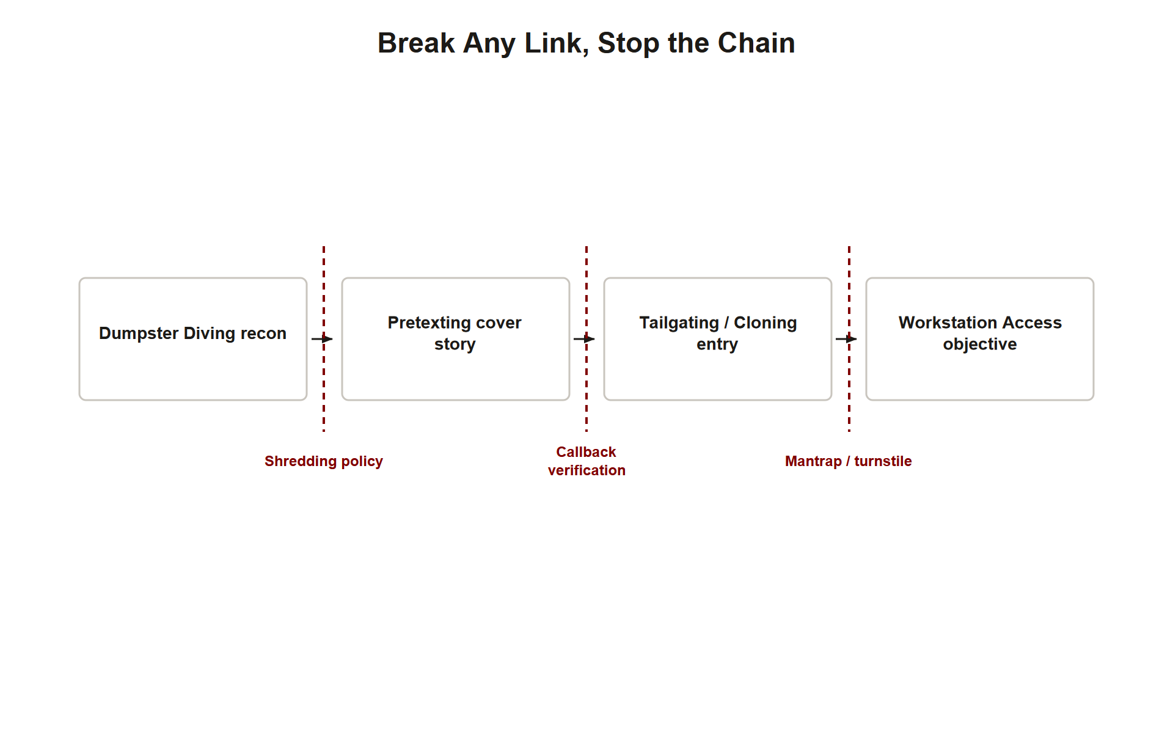
TOPIC 2.2 · 2.2.5.a.2
Synthesis: From Reconnaissance to Breach
1. Dumpster diving supplies names, org charts, badge/hardware details (recon)
2. Pretexting builds a plausible cover story using that intel
3. Tailgating or badge cloning achieves physical entry
4. Device theft or workstation access achieves the actual data objective
5. Undetected because no single step triggers an anomaly alone
Img 2.2.5 Attack Chain Synthesis
Notes:
Walking end to end: trash reveals an org chart and an employee's name (recon) → attacker poses as IT support using that name (pretext) → walks in behind a badge-holder (tailgating) → sits at an unlocked workstation and copies files (objective). Each step alone looks unremarkable.
This synthesis is worth dwelling on because it explains why physical security programs so often fail DESPITE having individually reasonable controls: each of the four steps, viewed in isolation by a different employee at a different moment, looks like nothing. The receptionist who let "IT support" in saw a confident, plausible person, nothing alarming. The employee who held the door saw someone dressed normally, walking with purpose, nothing alarming. No SINGLE person or system observed the full chain, because no single control has visibility across the entire sequence. This is exactly why defense-in-depth (breaking the chain at ANY link) matters more than trying to build one perfect detector for the whole attack, the attack is only visible in hindsight, as a chain, never as a single alarming moment.

Slide 33
TOPIC 2.2 · 2.2.5.a.3
Exam-Readiness Checklist: Topic 2.2
Can you name the specific vector from a narrative description alone?
Can you explain why Wiegand/125kHz badges are cryptographically weak?
Can you interpret a badge log and identify an impossible-travel anomaly?
Can you match each attack vector to its most direct hardening control?
Can you explain why physical and digital security are 'the same discipline wearing different hats'?
Notes:
These are the AP-testable distinctions this topic covers, pulled directly from the exam-focus callouts in the source chapter.

