Slide 1
AAYAT-AP-PREP · CYBERSECURITY
SECURING SPACES
Topic 2.3: Physical Access Controls
Topic 2.3 turns from attack to defence: the policies, procedures and oversight that govern who may enter a space, and the selection of mitigations proportionate to the weaknesses identified in Topic 2.2.
2 learning objectives · College Board AP Cybersecurity Course Framework
Notes:
Cover slide for Topic 2.3: Protecting Physical Spaces. Topic 2.3 turns from attack to defence: the policies, procedures and oversight that govern who may enter a space, and the selection of mitigations proportionate to the weaknesses identified in Topic 2.2.

Slide 2
TOPIC 2.3
Learning Objectives
Mitigate Risk
Identify the managerial controls that govern physical security &mdash; the policies, procedures and oversight behind the hardware.
2.3.A
Mitigate Risk
Determine which mitigations to apply to a given physical weakness, and on what grounds.
2.3.B
Objectives paraphrased from the AP Cybersecurity Course Framework (College Board, AP Career Kickstart).
Notes:
Read each learning objective aloud and connect it to the exam skill category before starting the topic.

Slide 3
TOPIC 2.3 · CONCEPT MAP
Defense-in-Depth Architecture
1. Policies, Procedures & Awareness
2. Physical Barriers & Security
3. Perimeter Firewalls & IDS/IPS
4. Internal Network Segmentation
5. Host Hardening & Patching
6. Secure Application Execution
Asset

Slide 4
TOPIC 2.3
The Big Idea
Layered physical security is a castle with a moat, a wall, and a locked keep. No single layer has to be perfect — it just has to catch whatever slips past the layer before it.
Hold onto this picture — we'll come back to it as the mechanics get more technical.
Notes:
Big-idea framing for Topic 2.3. Open with this analogy before the mechanics: "Layered physical security is a castle with a moat, a wall, and a locked keep. No single layer has to be perfect — it just has to catch whatever slips past the layer before it." Ask students for their own version of the analogy before moving on.

Slide 5
01
Physical Access Control: The Same Two Questions
Topic 2.3
Notes:
Transition to part 1 of the topic. Pause here for questions before continuing.

Slide 6
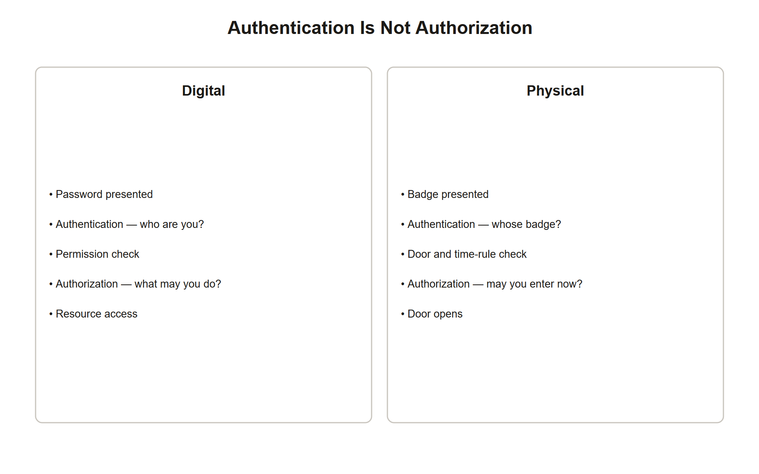
TOPIC 2.3 · 2.3.1.a.1
Physical Access Control: The Same Two Questions
Who are you (authentication)? Are you allowed to be here (authorization)?
The physical-world equivalent of a digital authentication/authorization system
Governs which doors a badge opens instead of which files an account can touch
Same principle of least privilege applies to both
Img 2.3.1 Auth Vs Authz
Notes:
Physical access control systems exist to answer the same two questions asked by every digital access-control system, just applied to a door instead of a login prompt. This parallel is not a teaching device, the same principle governs both.
The parallel goes deeper than surface analogy. In digital systems, authentication (proving who you are) and authorization (checking what you're allowed to do) are deliberately separated concerns, a correct password proves identity, but a separate permissions check decides whether that identity can access a specific resource. Physical access mirrors this exactly: presenting a valid badge proves who you are (authentication), while the access-control panel separately checks whether THAT specific badge is authorized for THAT specific door at THIS specific time (authorization). A valid badge that opens the lobby but is rejected at the server-room door isn't a system malfunction, it's authentication succeeding while authorization correctly fails, exactly as a valid company login might fail to open an admin-only dashboard.

Slide 7
TOPIC 2.3 · 2.3.1.a.2
Locks and Mechanical Access Control
Pin tumbler locks: spring-loaded pins aligned by a precisely cut key
Vulnerable to lock-picking (manipulating pins) and bumping (jarring key)
Electronic locks: substitute badge/PIN/biometric for a physical key
Electronic locks enable centralized, instant, remote, LOGGED revocation
Notes:
A lost mechanical key typically requires re-keying the entire lock (and every lock sharing that master system). A lost or stolen badge can be deactivated instantly in the access-control database without touching any physical hardware.
Look at what a pin tumbler lock actually verifies: it checks that a key's precisely cut ridges push a stack of spring-loaded pins to align exactly at the "shear line" — the boundary where the cylinder's core can rotate freely. This is a purely mechanical proof of possession with no logging capability whatsoever: the lock has no way to record WHO used the key or WHEN, only whether a correctly-shaped key was inserted. Electronic locks replace this mechanical proof with an electronic one, but the more consequential change is architectural: authorization decisions move from being baked into the physical shape of a key to being stored in a centrally editable database, which is precisely why electronic locks enable revocation, logging, and time-based rules that a mechanical lock structurally cannot support.

Slide 8
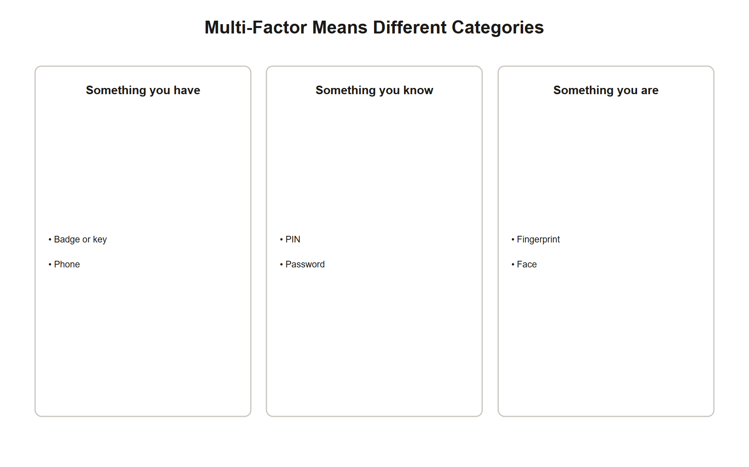
TOPIC 2.3 · 2.3.1.a.3
Credential Factors: Physical MFA
Something you have: a physical key, badge, fob
Something you know: a PIN entered on a keypad
Something you are: a biometric (fingerprint, iris, face)
Badge alone = single-factor; badge + PIN or biometric = true multi-factor
Img 2.3.1 Mfa Factors
Notes:
Multi-factor physical authentication directly mitigates the badge-cloning risk from Topic 2.2, a cloned badge alone is no longer sufficient to gain entry once a second factor is required.
The security value of combining factors comes specifically from their INDEPENDENCE, each factor must fail through a genuinely different mechanism for an attacker to defeat all of them. Cloning a badge (defeating "something you have") requires proximity to the victim and RFID equipment. Guessing or shoulder-surfing a PIN (defeating "something you know") requires an entirely different skill set and opportunity. An attacker who successfully clones a badge gains nothing toward also knowing the PIN, the two failures don't share a root cause. This is why combining two factors of the SAME type (two things-you-have, like a badge plus a key) provides much weaker protection than combining factors across categories: both badge and key can potentially be stolen from the same pocket in the same theft.

Slide 9
TOPIC 2.3 · 2.3.1.a.4
Visitor Management and Escort Policy
Visitor log: time-stamped register of every non-employee entering
Serves as both a detective control AND a deterrent
Escort policy: an authorized employee accompanies visitors at all times
Closes the gap between 'authorized in the building' and 'authorized anywhere unsupervised'
Notes:
These are administrative, preventive/detective controls that complement, rather than replace, technical and physical controls. A visitor log does nothing to physically stop an intruder, it only ensures a record exists if something goes wrong.
Notice the dual function packed into a single control here: a visitor log is simultaneously DETECTIVE (it creates the audit trail an investigator would need after an incident) and, less obviously, PREVENTIVE-by-deterrence (a visitor who knows their name, timestamp, and host are being recorded is less likely to attempt anything they wouldn't want traced back to them). This dual nature is common among administrative controls and worth recognizing on the exam: many controls have a PRIMARY function and a SECONDARY, weaker one, and a strong free-response answer identifies both rather than forcing a control into exactly one box. The escort policy closes a gap the log alone cannot: a log records that someone entered, but only an escort actively prevents that person from wandering into an area they were never authorized to see.

Slide 10
TOPIC 2.3 · 2.3.1.a.5
?
Managerial Controls Complete the Triad
A badge reader = physical, preventive, technical control
A visitor sign-in sheet = administrative, detective control
Neither alone is sufficient
Excellent tech + no visitor policy = still a gaping hole
Notes:
Recall from Topic 2.1 that controls are classified by both function and category. Anyone who can talk their way past a receptionist can move freely once inside, unbadged and unaccompanied, no matter how strong the badge readers are.
This slide illustrates a general principle worth generalizing beyond this one example: security investment tends to cluster at the POINT OF ENTRY (the badge reader, the biometric scanner) because that's the most visible, most easily budgeted-for control. But an attacker's actual objective is rarely the door itself, it's whatever lies beyond it. A facility that invests heavily in entry technology while leaving internal movement completely ungoverned has essentially built one very strong wall around an open floor plan. This is the exact same "flat network" failure mode that let Target's HVAC-vendor credentials reach point-of-sale terminals (Topic 2.1's case study), strong perimeter, weak internal segmentation, repeated here in the physical domain as strong entry control, weak internal escort/zoning policy.

Slide 11
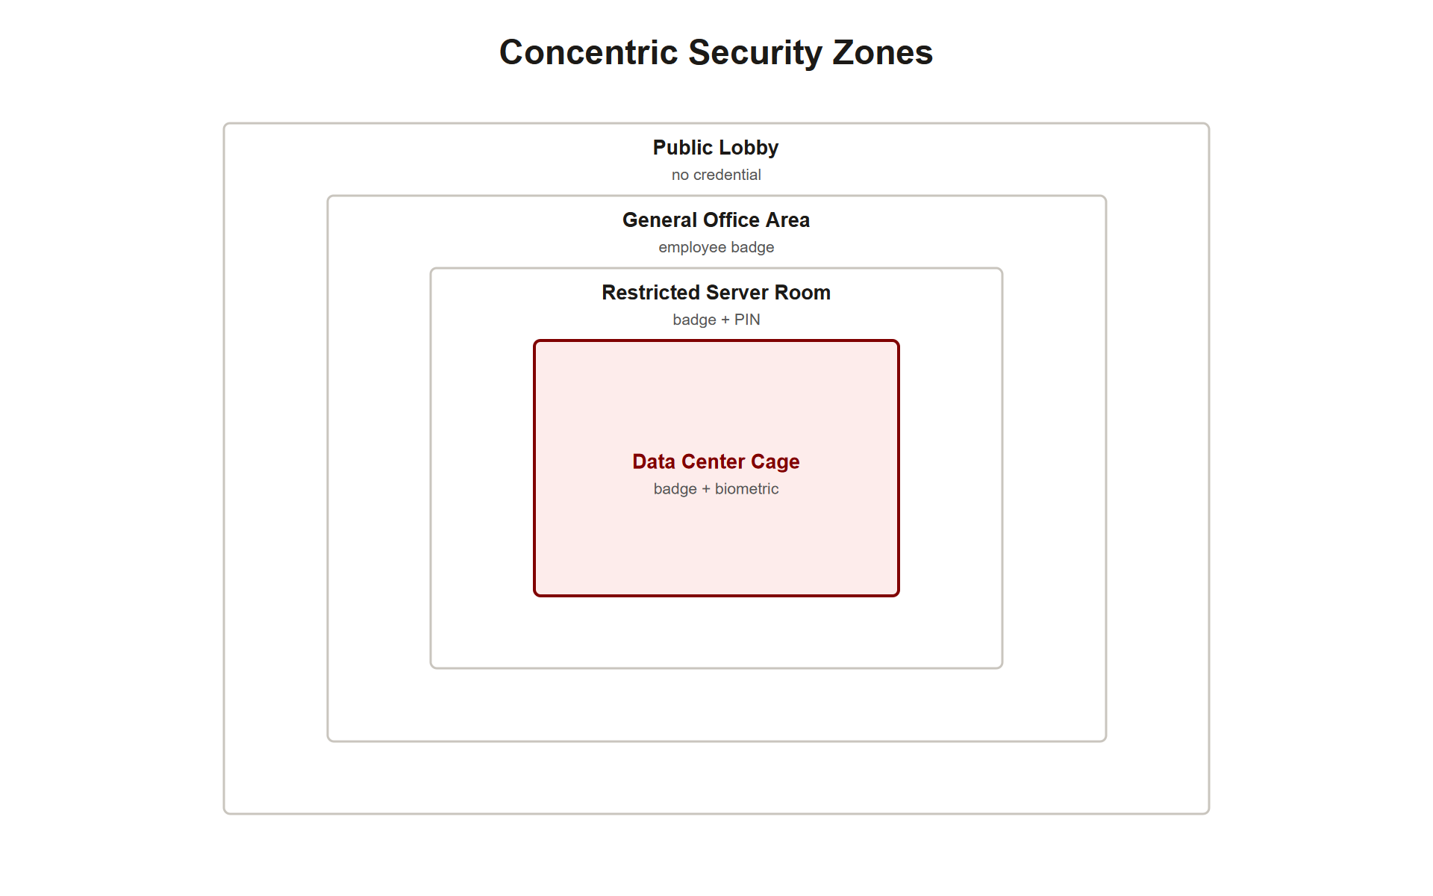
TOPIC 2.3 · 2.3.1.a.6
Zoning and Layered Access
Concentric security zones: lobby &rarr; general office &rarr; restricted server room &rarr; data center cage
Each zone requires progressively stronger credentials
Mirrors network segmentation almost exactly
A badge that opens the lobby should NOT, by default, open the data center
Img 2.3.1 Security Zones
Notes:
This directly parallels network security zoning and micro-segmentation strategies (NIST SP 800-207 Zero Trust Architecture): just as a guest Wi-Fi network should never reach a production database, a lobby badge should not reach the data center.
Zero Trust Architecture's core principle, "never trust, always verify," treating every access request as though it originates from an untrusted network regardless of where it comes from, maps onto physical zoning almost without translation. A traditional (non-zoned) facility trusts anyone who made it past the front door to roam freely, the same way a traditional (non-segmented) network trusts anyone who made it past the firewall to reach anything internal. Zoning instead requires a FRESH authorization check at every zone boundary, regardless of whether you already passed a check at the lobby, you don't inherit trust from a previous checkpoint. This is precisely why a badge valid for the lobby should require a SEPARATE, explicit authorization grant (not just "already inside the building") to also open the server room.

Slide 12
TOPIC 2.3 · 2.3.1.a.7
?
Section 1 Synthesis: One Question, Answered Four Ways
Locks (mechanical/electronic) answer "can this specific credential open this door?"
Physical MFA answers "is one credential ENOUGH, or do we require independent proof from a second category?"
Visitor management answers the question locks and MFA can't: "what happens to someone who was legitimately let in, once they're past the door?"
Zoning answers "does being authorized HERE mean being authorized EVERYWHERE?" — the answer must be no
Notes:
All four Section 1 concepts are different angles on the same underlying question, authentication and authorization, physically applied, and each one closes a gap the previous one leaves open. A lock alone answers only "does this key/badge work here," with no concept of a second factor or a time restriction. Multi-factor authentication adds a second, independent proof so a single stolen credential isn't sufficient. But even flawless entry authentication says nothing about what happens to VISITORS who were never issued a credential at all, that's what visitor logs and escort policy govern. And even a fully authenticated, escorted person shouldn't automatically have access to EVERY zone in the building, that's what zoning enforces, by requiring a fresh authorization check at every boundary rather than inheriting trust from the front door.
Notice the pattern: each concept exists because the previous one, however well implemented, has a specific blind spot. This "yes, but what about..." structure is exactly how a strong FRQ answer should be organized when asked to design a full access-control scheme.

Slide 13
02
The Access Control Panel and Authorization Flow
Topic 2.3
Notes:
Transition to part 2 of the topic. Pause here for questions before continuing.

Slide 14
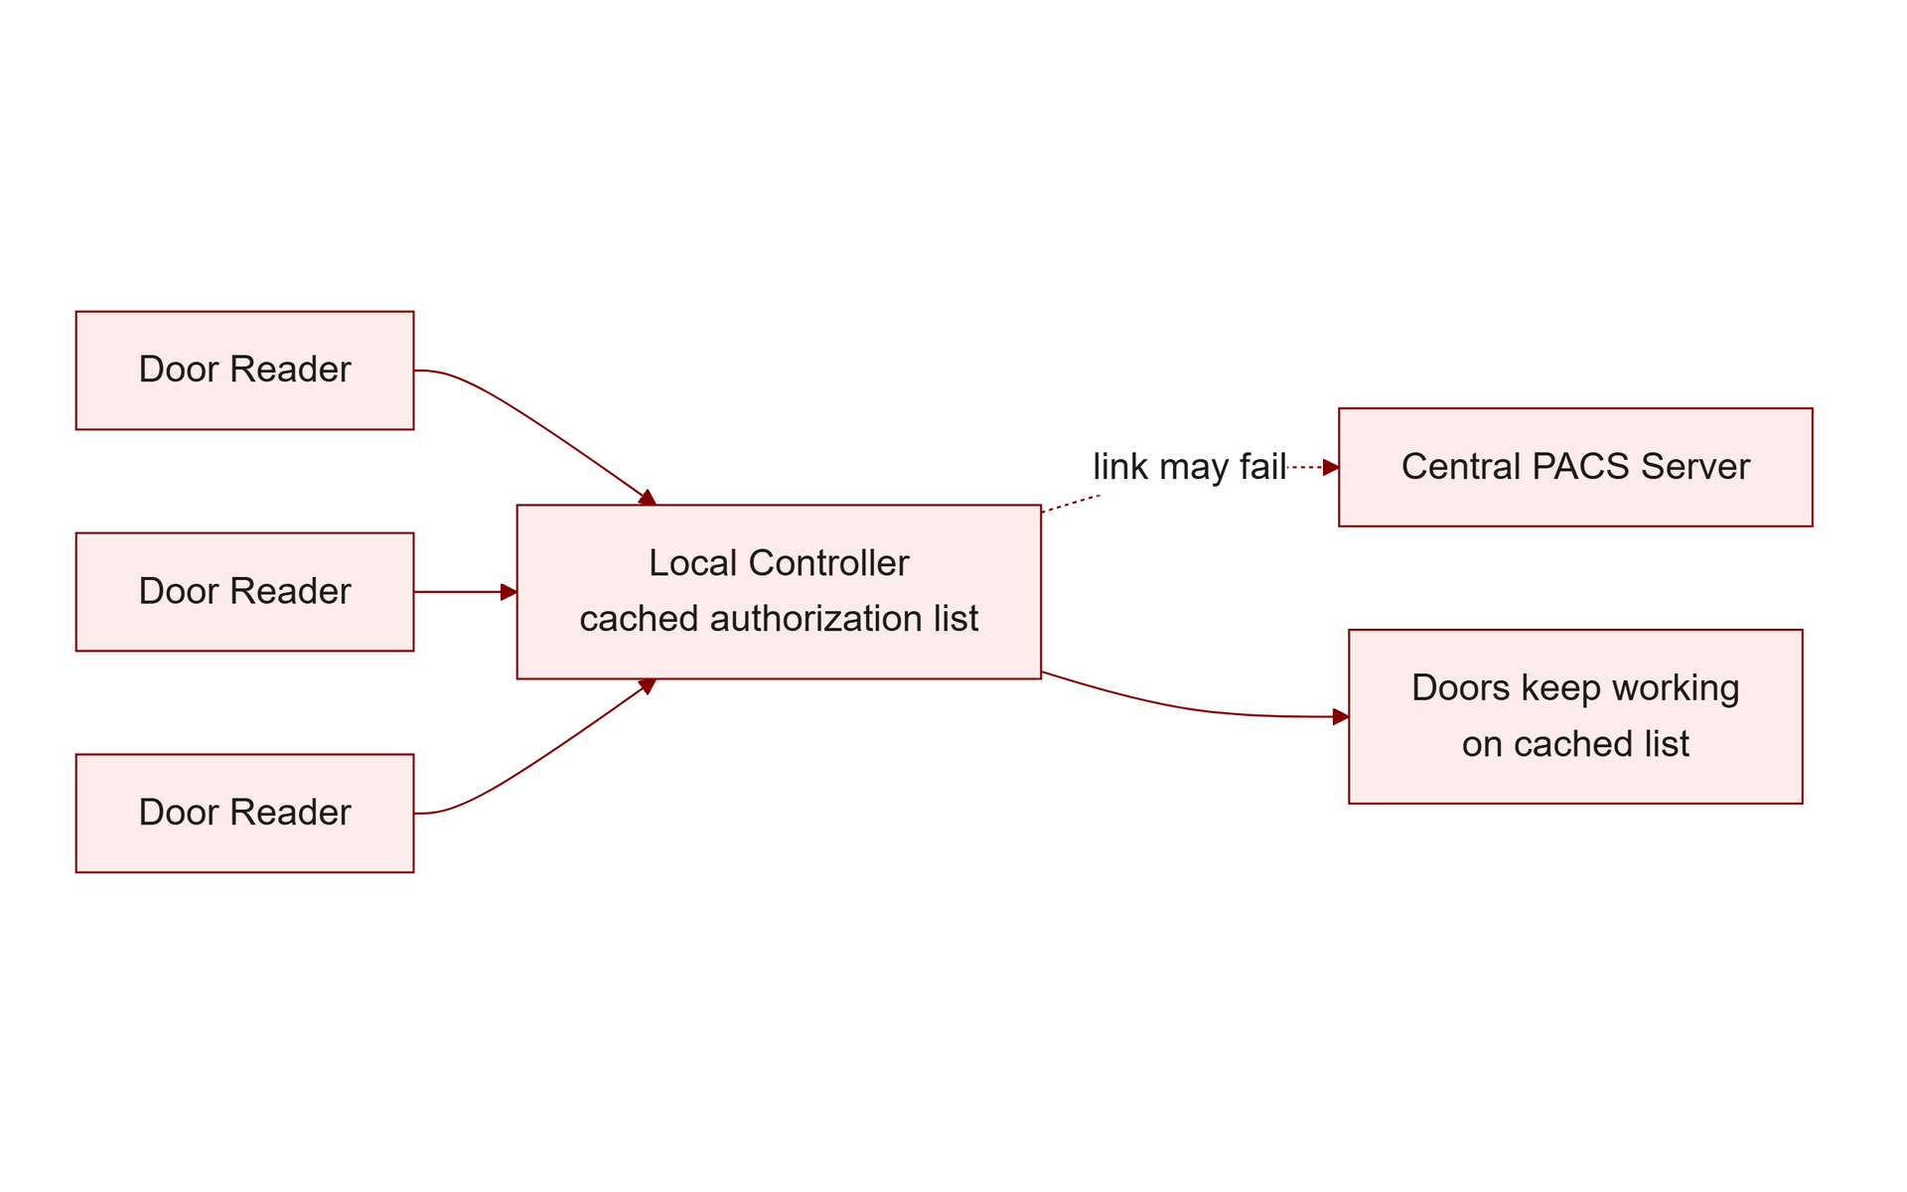
TOPIC 2.3 · 2.3.2.a.1
The Access Control Panel and Authorization Flow
Readers wired to a local controller, which talks to a centralized PACS server
PACS holds the authoritative database: which credentials open which doors, when
Local controller can make offline decisions via a cached list during outages
A badge might be valid for the lobby 24/7 but the server room only Mon-Fri business hours
Img 2.3.2 Pacs Architecture
Notes:
A Physical Access Control System (PACS) is the physical-world equivalent of an identity and access management (IAM) system. Enterprise platforms (Lenel, Genetec, Software House) typically integrate with HR systems for automatic provisioning/deprovisioning.
The local-controller-plus-central-server architecture solves a real engineering tradeoff worth understanding: a purely centralized system (every single badge read requiring a live round-trip to a central server) would mean the ENTIRE facility loses all access control the moment network connectivity drops. A purely decentralized system (every reader deciding independently) would mean revoking a badge requires physically updating every single reader, which doesn't scale past a handful of doors. The hybrid design, local controllers holding a periodically-synced CACHE of the authorization database, gets the best of both: doors keep functioning during a network outage using the last-known-good rules, while the authoritative source of truth still lives centrally and propagates updates automatically once connectivity returns.

Slide 15
TOPIC 2.3 · 2.3.2.a.2
?
Antipassback Logic
Credential reads must strictly alternate: in, out, in, out...
Rejects a second consecutive 'in' scan with no matching 'out' first
Defends against passing a badge back out to an accomplice
Closes a credential-sharing loophole invisible to a simple valid/invalid check
Notes:
Without antipassback, an employee could badge in, then pass their badge back through a window or gap to a second person waiting to use the same credential, the system would treat both entries as fully legitimate.
Antipassback is worth contrasting carefully with tailgating and badge cloning, since all three exploit the access-control system but through entirely different mechanisms. Tailgating (Topic 2.2) presents NO credential at all, it exploits a held-open door. Badge cloning (Topic 2.2) presents a DUPLICATED credential at a different reader. Credential sharing, which antipassback specifically targets, presents the exact SAME physical badge, passed hand-to-hand, attempting a second "in" scan at the SAME zone. Because it's genuinely the same physical object each time (not a clone, not an absent credential), a simple valid/invalid check sees nothing wrong, only the STATEFUL logic of antipassback (tracking whether this specific badge is currently "inside" or "outside") can catch it.

Slide 16
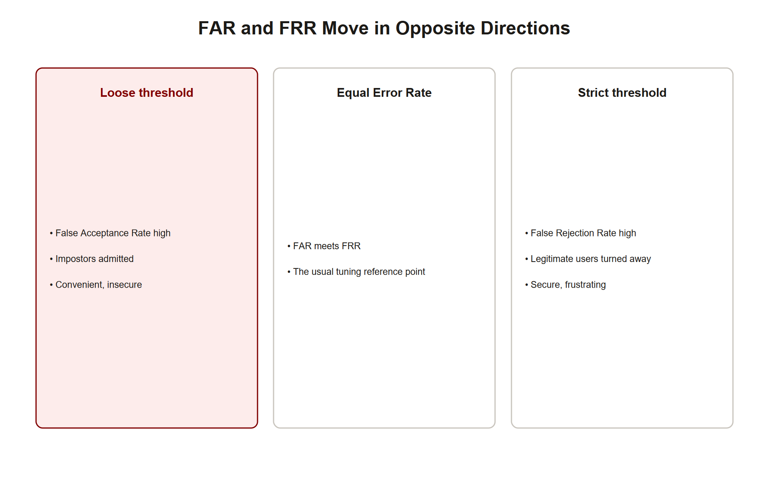
TOPIC 2.3 · 2.3.2.a.3
Biometric Matching: FAR vs. FRR
Biometrics compute a similarity score, not exact matching
False Acceptance Rate (FAR): probability of wrongly accepting an unauthorized scan
False Rejection Rate (FRR): probability of wrongly rejecting a legitimate scan
Lowering FAR (tighter security) inevitably raises FRR (more lockouts)
Img 2.3.2 Far Frr Tradeoff
Notes:
High-security deployments (data center biometric access) typically require FAR below 0.001% (1 in 100,000). The point where FAR and FRR curves intersect is the Equal Error Rate (EER), a common single-number comparison metric.
Understanding WHY biometric matching is probabilistic (unlike a badge's binary valid/invalid check) requires understanding what's actually being compared: no two scans of the same finger are EVER pixel-for-pixel identical, slight pressure differences, angle, moisture, and sensor noise mean every live scan differs somewhat from the enrolled template, even for the legitimate owner. The system must therefore compute a SIMILARITY SCORE (how close is this scan to the stored template?) and apply a threshold: above the threshold, accept; below, reject. This is fundamentally different from a badge or password check, which compares two values for EXACT equality. Because similarity is a spectrum rather than a binary match, there will always be some legitimate scans that fall just below threshold (false rejections) and some illegitimate scans that happen to fall just above it (false acceptances), the tradeoff is mathematically unavoidable, not an engineering shortfall.

Slide 17
TOPIC 2.3 · 2.3.2.a.4
Biometric Threshold Tuning in Practice
Threshold=0.60: FAR=0.850% FRR=0.020% (too permissive)
Threshold=0.75: FAR=0.090% FRR=0.310% (balanced)
Threshold=0.90: FAR=0.001% FRR=2.400% (high security, data center standard)
Threshold=0.98: FAR=0.000% FRR=9.100% (unusable -- excessive lockouts)
Notes:
Data center cage deployment selected: Threshold=0.90. Rationale: FAR of 0.001% acceptable given asset sensitivity; FRR of 2.4% mitigated via badge+PIN fallback path.
Notice the STEEPNESS of the FAR/FRR curve near the high-security end of this table: moving the threshold from 0.75 to 0.90 cuts FAR by roughly 90x (0.090% to 0.001%) while FRR rises by less than 8x (0.310% to 2.400%), a favorable tradeoff. But pushing further, from 0.90 to 0.98, barely improves FAR at all (already near zero) while FRR nearly quadruples again (2.4% to 9.1%), a terrible tradeoff, since you're paying a large usability cost for almost no additional security benefit. This diminishing-returns pattern is why the "correct" threshold is rarely the most extreme available setting; it's the point where the marginal security gain still outweighs the marginal usability cost for that specific asset's risk profile.

Slide 18
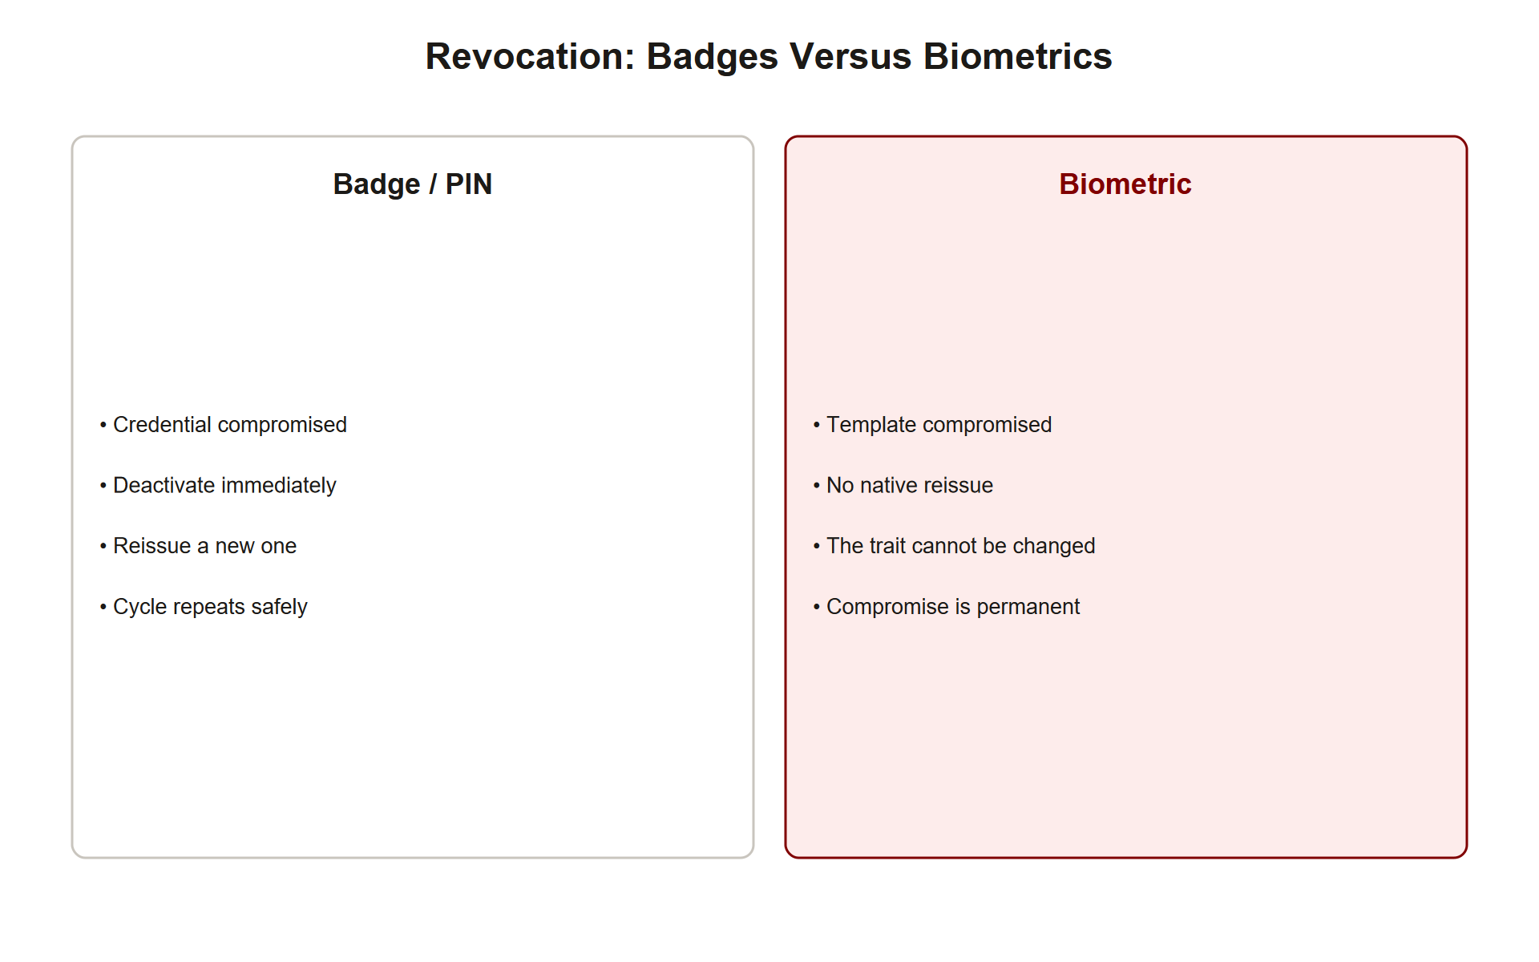
TOPIC 2.3 · 2.3.2.a.5
Biometrics Cannot Be Revoked Like a Badge
A stolen badge/compromised PIN can be deactivated and reissued instantly
A compromised biometric template cannot be 'changed', no new fingerprint
Template data at rest must be encrypted, ideally irreversibly transformed
Biometrics recommended as ONE factor, never a sole authenticator for high-value assets
Img 2.3.2 Revocation Comparison
Notes:
This is a critical, non-obvious asymmetry between biometric and traditional credentials that directly shapes hardening recommendations in Section 4.
Trace the practical consequence of this asymmetry through an incident scenario: if an attacker steals a badge, the response is simple, deactivate that badge ID in the PACS database and issue a new one; the old physical card becomes worthless the instant it's deactivated. If an attacker instead steals (spoofs) a fingerprint template, there is no equivalent "reissue" step, the enrolled employee's actual finger doesn't change, meaning a successfully spoofed biometric represents a PERMANENT credential compromise for that specific finger, for that person's entire tenure, unless the enrollment itself is replaced with a different biometric characteristic (a different finger, for instance) or the deployment adds liveness detection to prevent the spoof from working going forward. This irreversibility is precisely why the exam-focus material insists biometrics function as ONE factor within MFA, never as a sole, revocable-in-the-usual-sense authenticator.

Slide 19
TOPIC 2.3 · 2.3.2.a.6
?
Section 2 Synthesis: Two Different Kinds of Proof
PACS is the infrastructure that makes EVERY other concept in this section possible, it's the database and logic layer, not a control itself
Antipassback defends against credential SHARING, the exact same physical badge, used twice
FAR/FRR exists because biometric matching is PROBABILISTIC (a similarity score), unlike a badge or PIN's exact match
Biometric irrevocability is the consequence of what FAR/FRR describes: because there's no exact secret to "reissue," a compromised biometric can't simply be swapped like a badge
Notes:
These four mechanics fall into two families worth distinguishing clearly. PACS and antipassback are about CREDENTIAL LOGIC, rules about how a badge, valid or not, may be used (which door, what schedule, and specifically NOT twice in a row without an "out" first). FAR/FRR and biometric irrevocability are about a completely different problem: MATCHING UNCERTAINTY. A badge is either the right badge or it isn't, a binary check. A fingerprint scan is never pixel-identical twice, even for the legitimate owner, so the system must compute a similarity score and accept some irreducible error rate in both directions. That same uncertainty is exactly why biometrics can't be "reissued" the way a badge can: there's no discrete secret value to swap out, only a physical characteristic that doesn't change.
Exam trap: don't describe antipassback as solving a "cloning" problem (that's Topic 2.2's badge-cloning vector), antipassback specifically targets a genuine, unduplicated badge being deliberately SHARED.

Slide 20
03
Case Study: Colocation Data Center Layered Access
Topic 2.3
Notes:
Transition to part 3 of the topic. Pause here for questions before continuing.

Slide 21
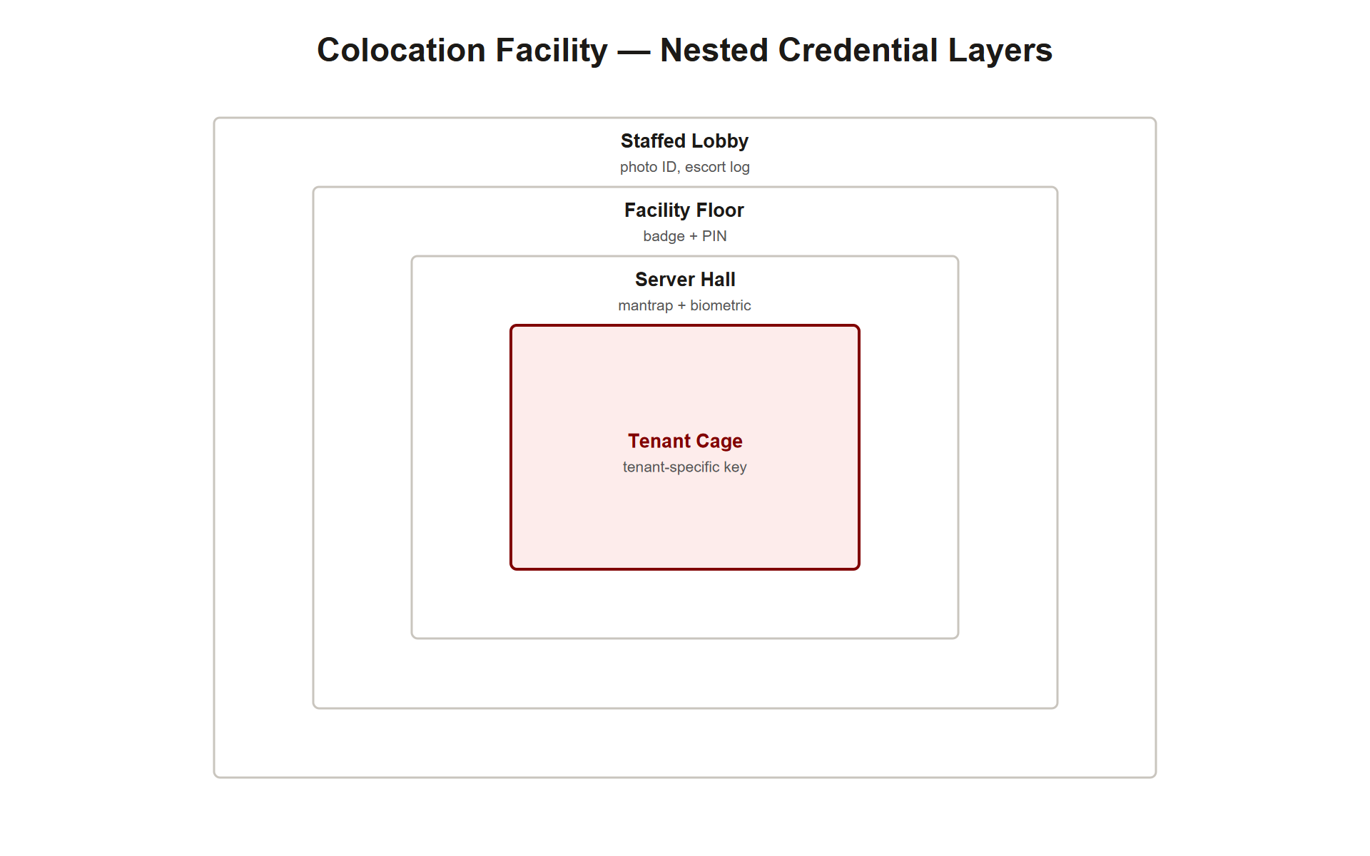
TOPIC 2.3 · 2.3.3.a.1
Case Study: Colocation Data Center Layered Access
Industry-standard model: staffed lobby &rarr; badge+PIN facility floor &rarr; mantrap+biometric server hall &rarr; tenant-specific locked cages
SSAE 18 SOC 2 Type II audits formally verify these layers function as designed
Auditors test whether escort policy and antipassback are ENFORCED, not just documented
Direct real-world implementation of the security-zoning concept
Img 2.3.3 Colocation Layers
Notes:
This layered model, publicly cited by major colocation providers, demonstrates that 'physical access control' in a professional context is rarely a single lock, but an audited, multi-layered system with independent verification at each tier.
Trace WHY each layer in this model exists rather than treating it as an arbitrary list: the staffed lobby provides a HUMAN judgment layer that automated systems lack (recognizing suspicious behavior, verifying visually against a photo ID). The badge+PIN facility floor is the first TECHNICAL zone boundary, requiring something-you-have plus something-you-know. The mantrap+biometric server hall adds a PHYSICAL enforcement mechanism (no tailgating possible) plus something-you-are. The tenant-specific cages add TENANT ISOLATION, critical in a shared facility where one tenant's compromised credential must never grant access to a different tenant's equipment. Each layer specifically addresses a distinct failure mode the previous layer doesn't cover, which is exactly what "layered, complementary" security means in practice rather than in the abstract.

Slide 22
TOPIC 2.3 · 2.3.3.a.2
?
Case Study: Biometric Spoofing in High-Security Facilities
Overly permissive thresholds prioritized convenience over security
Independent assessments found effective FAR high enough for real risk
Attackers used lifted latent fingerprints on gelatin molds
Sensors lacking liveness detection were fooled by physical replicas
Notes:
Remediation followed the same layered logic taught throughout this unit: badge-plus-biometric multi-factor sequence, plus upgraded sensors with active liveness detection (pulse, capacitive/thermal sensing, 3D depth mapping like Face ID), reducing spoofing attack surface to near zero even though no single control was individually perfect.
This case study is a cautionary tale about optimizing FRR at FAR's expense without recognizing the security cost. A facility that tunes its threshold low specifically to minimize employee complaints about false rejections is implicitly accepting a much higher false-acceptance rate, and if that facility also lacks liveness detection, the effective real-world FAR against a DELIBERATE, ADVERSARIAL spoofing attempt (rather than a random unauthorized person) can be far higher than the lab-tested FAR against genuine random fingers, because a crafted gelatin mold is specifically engineered to defeat the matching algorithm, not a random mismatch. Liveness detection addresses an entirely different threat dimension than threshold tuning, it's not about how CLOSELY a sample matches, but whether the sample is a LIVE HUMAN at all.

Slide 23
TOPIC 2.3 · 2.3.3.a.3
?
Section 3 Synthesis: Verified vs. Assumed Security
The colocation model shows what GOOD layered access control looks like when it's independently AUDITED
The biometric spoofing case shows what happens when a control (threshold tuning) is chosen for convenience and never RE-VERIFIED against a real adversary
Both cases hinge on the same idea: a control's THEORETICAL design and its ACTUAL effectiveness are different things that must be separately confirmed
SOC 2 Type II and liveness detection are both, in essence, the same fix applied at different layers, verify the control is doing what it claims, don't just trust the spec sheet
Notes:
Read side by side, these two case studies make the same point from opposite directions. The colocation industry's layered model represents Section 1 and 2's concepts implemented CORRECTLY, and SOC 2 Type II audits exist specifically to confirm that correctness isn't just claimed on paper, testing whether escort policy and antipassback are actually enforced day to day. The biometric spoofing case shows what happens when that verification step is skipped: a facility TUNED its FAR/FRR threshold reasonably on paper, but never tested that threshold against an adversarial spoofing attempt (a gelatin mold), so the gap between "theoretically secure" and "actually secure under attack" went undiscovered until an assessment specifically simulated an adversary.
This is the single most exam-relevant idea in Section 3: a documented, well-designed control is not the same claim as a VERIFIED, adversarially-tested one. Auditors and pentesters exist because the gap between the two is where real breaches happen.

Slide 24
04
Credential Lifecycle Management
Topic 2.3
Notes:
Transition to part 4 of the topic. Pause here for questions before continuing.

Slide 25
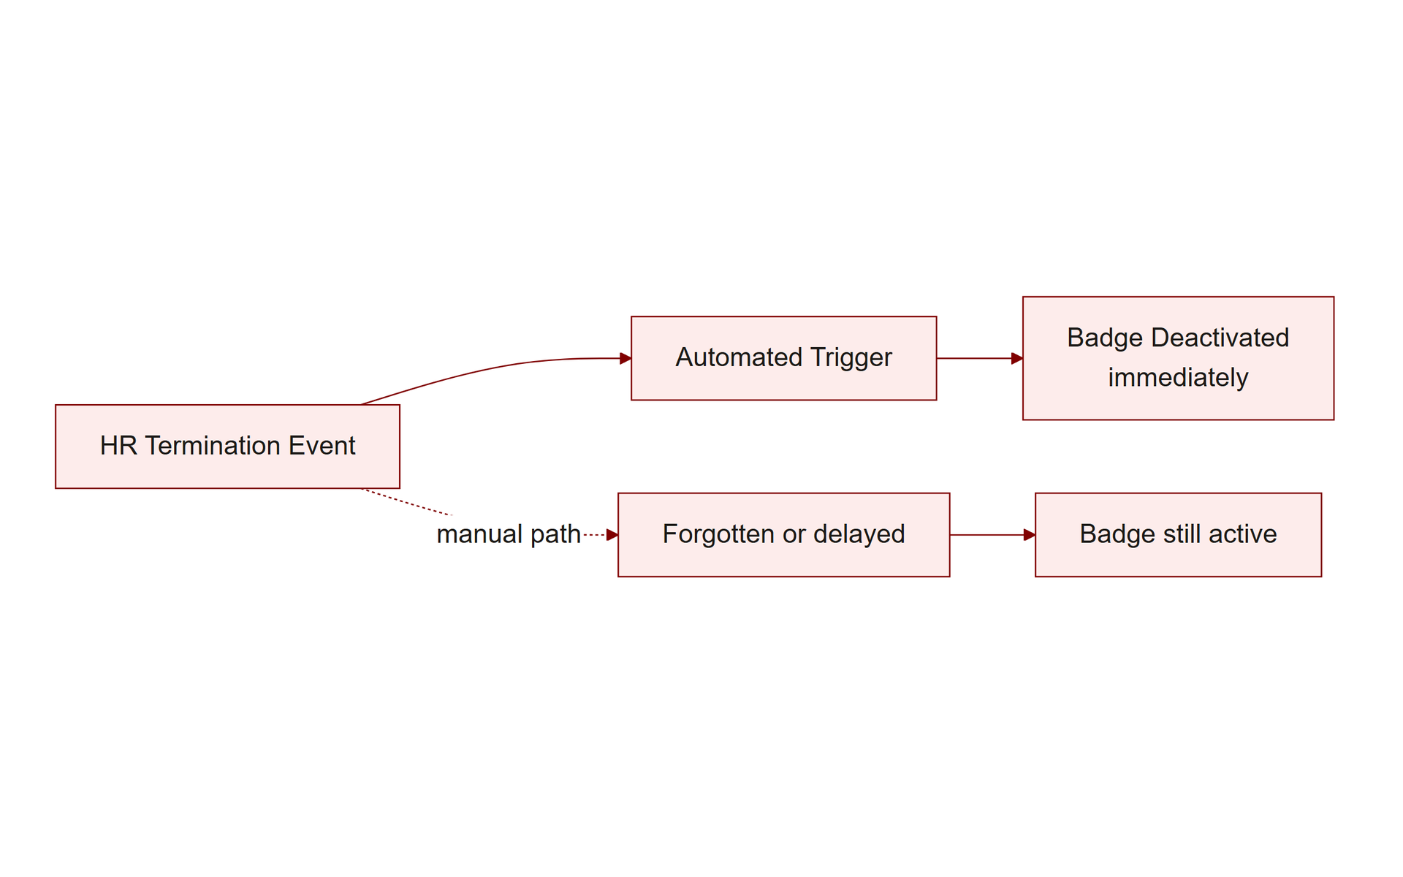
TOPIC 2.3 · 2.3.4.a.1
Credential Lifecycle Management
Provisioning/deprovisioning tied automatically to HR onboarding/offboarding
Terminated employee's badge deactivated automatically and immediately
Recurring (commonly quarterly) access rights reviews
Direct application of the least-privilege principle from Section 1
Img 2.3.4 Deprovisioning Flow
Notes:
Delayed deprovisioning, a former employee's badge remaining active for weeks after departure, is one of the most common physical access control failures found in audits.
The failure pattern behind delayed deprovisioning is almost always organizational, not technical: the PACS system is fully CAPABLE of deactivating a badge instantly, but that capability only helps if a human or an automated trigger actually initiates the action. A manual process (someone in facilities management remembering to check a termination list and manually revoke a badge) fails silently whenever that person is busy, on vacation, or simply forgets, there's no alarm that fires when deprovisioning DOESN'T happen. Tying deprovisioning directly to the HR system's termination event (an automated trigger rather than a remembered task) removes the human-memory failure point entirely, converting an easily-skipped manual step into a guaranteed, immediate, system-enforced one.

Slide 26
TOPIC 2.3 · 2.3.4.a.2
Layered Technical Enforcement
High-sensitivity areas: require badge + PIN or biometric
Mantraps/interlocked vestibules at transitions into restricted zones
Antipassback logic to prevent credential-sharing exploits
Migrate from 125 kHz to ISO/IEC 14443 smart cards (closes 2.2's cloning gap at the root)
Notes:
Consistent with the zoning model from Section 1, this closes technical vulnerabilities at their root rather than relying solely on procedural mitigation.
Notice how this slide's four recommendations map one-to-one onto specific vulnerabilities established earlier in this unit: MFA directly counters a cloned badge alone being sufficient (2.2's core weakness). Mantraps directly counter tailgating (2.2's cheapest-attack-wins vector). Antipassback directly counters credential sharing (Section 2's specific gap in simple valid/invalid checks). Migrating to ISO/IEC 14443 directly counters Wiegand's plaintext transmission (2.2's protocol-level root cause). This one-to-one mapping is not a coincidence, it demonstrates the general engineering principle that effective hardening recommendations trace back to a SPECIFIC, previously-identified failure mode rather than being generic best-practice advice applied without diagnosis.

Slide 27
TOPIC 2.3 · 2.3.4.a.3
Independent Verification and Audit
Policy without enforcement testing is unreliable
Recurring third-party audits: SOC 2 Type II, ISO/IEC 27001 surveillance audits
Audits attempt tailgating, verify visitor logs against badge export data
Confirm deprovisioning timeliness, not just that a policy document exists
Notes:
Both case studies in Section 3 illustrate this exact principle: a documented policy alone is insufficient evidence of control effectiveness without demonstrated, tested enforcement.
The distinction between a POLICY and a VERIFIED CONTROL is one of the most consequential ideas in this entire unit, and it recurs across nearly every topic: OPM (Topic 2.2) had contractor access policies that weren't actually enforced consistently. The colocation case study above had escort and antipassback policies that auditors specifically had to TEST rather than assume. A written policy is a claim about how the organization intends to behave; an audit is evidence about how the organization ACTUALLY behaves. Treating the two as equivalent, assuming a policy document is itself sufficient proof of security, is the single most consistent root cause across the real-world incidents covered in this unit.

Slide 28
TOPIC 2.3 · 2.3.4.a.4
?
Section 4 Synthesis: A Governance Loop, Not a Checklist
Credential lifecycle management keeps WHO has access current
Layered technical enforcement keeps HOW they authenticate strong
Independent audit keeps the first two HONEST, verifying they're actually working, not just documented
Remove any one leg and the other two degrade silently: strong tech with stale credentials, or perfect provisioning with weak authentication, or both with no audit to catch drift
Notes:
These three hardening practices form a closed loop, not a checklist to complete once. Credential lifecycle management (tying badge deactivation to HR events) ensures the RIGHT PEOPLE have access. Layered technical enforcement (MFA, mantraps, antipassback, modern smart cards) ensures those people prove their identity STRONGLY. But neither of those, alone, catches the failure mode Section 3's case studies both demonstrated: a control that looks correct on paper but has quietly stopped working in practice. Independent audit is the loop-closing step, it periodically re-verifies that provisioning is actually timely and that technical controls are actually enforced, feeding findings back into the other two practices.
This loop structure directly mirrors NIST RMF's Monitor step and ISO 27001's Check/Act phase from Topic 2.1, Section 4 of THIS topic is that same governance principle, applied specifically to physical access control instead of the whole security program.

Slide 29
05
Practice: Classify the Control
Topic 2.3
Notes:
Transition to part 5 of the topic. Pause here for questions before continuing.

Slide 30
TOPIC 2.3 · 2.3.5.a.1
?
Practice: Classify the Control
(a) A quarterly access rights review
(b) A mantrap at the server room entrance
(c) A mandatory visitor escort policy
Classify each by category AND function
Notes:
(a) Managerial/administrative, detective. (b) Physical, preventive. (c) Managerial/administrative, both preventive and detective.

Slide 31
TOPIC 2.3 · 2.3.5.a.2
Synthesis: A Complete Physical Access Scheme
Zoning: lobby &rarr; office &rarr; server room &rarr; cage, each stronger credential
Technical: badge+PIN, biometric with liveness detection, mantrap, antipassback
Administrative: visitor log, escort policy, quarterly reviews, HR-tied deprovisioning
Physical: fencing, lighting, locked cages, security guards
Verification: recurring third-party audits testing actual enforcement
Notes:
A mature program combines every layer from this chapter into a single governed lifecycle: technical enforcement at each zone boundary, administrative processes keeping credentials current, physical barriers backing up the technology, and independent audits confirming it all actually works as designed.
Notice this synthesis is structured as an answer to a specific, recurring exam-question TYPE: "design a physical access control scheme for [facility]." A complete, high-scoring answer doesn't just list random controls, it demonstrates that you understand WHY each layer exists by tracing it back to a specific vulnerability class: zoning stops lateral movement once inside; technical controls (MFA, mantraps, antipassback) stop the four attack vectors from Topic 2.2 at the point of entry; administrative controls (lifecycle management, escort policy) stop the human/procedural failure modes that technology alone can't catch; verification (audits) stops the gap between documented policy and actual enforcement that both case studies in this topic demonstrated. Structuring your answer around WHY, not just WHAT, is what separates a strong FRQ response from a checklist.

Slide 32
TOPIC 2.3 · 2.3.5.a.3
Exam-Readiness Checklist: Topic 2.3
Can you explain antipassback and the specific attack it prevents?
Can you calculate/reason about the FAR/FRR tradeoff for a given threshold?
Can you explain why biometrics can't be revoked like a badge?
Can you classify a physical access control by BOTH category and function?
Can you design a full layered scheme naming technical, administrative, and physical controls?
Notes:
These are the AP-testable distinctions this topic covers, pulled directly from the exam-focus callouts in the source chapter.

