Slide 1
AAYAT-AP-PREP · CYBERSECURITY
SECURING SPACES
Topic 2.4: Physical Detection Systems
Topic 2.4 addresses the assumption behind every layered design: some attacks will succeed against the preventive layer. It covers the controls that reveal an attack in progress or after the fact, where those controls must be placed to be effective, and how their output is read.
3 learning objectives · College Board AP Cybersecurity Course Framework
Notes:
Cover slide for Topic 2.4: Detecting Physical Attacks. Topic 2.4 addresses the assumption behind every layered design: some attacks will succeed against the preventive layer. It covers the controls that reveal an attack in progress or after the fact, where those controls must be placed to be effective, and how their output is read.

Slide 2
TOPIC 2.4
Learning Objectives
Detect Attacks
Identify the ways a security control can reveal a physical attack.
2.4.A
Detect Attacks
Determine where detection controls must be sited if they are to be effective.
2.4.B
Detect Attacks
Apply detection techniques to recognise a physical attack from the evidence they produce.
2.4.C
Objectives paraphrased from the AP Cybersecurity Course Framework (College Board, AP Career Kickstart).
Notes:
Read each learning objective aloud and connect it to the exam skill category before starting the topic.

Slide 3
TOPIC 2.4 · CONCEPT MAP
Labs Floor Monitoring & Sensor Layout
Lobby Entrance
CAM 01 — entry camera
Central Corridor
CAM 02 — corridor camera • Motion sensor
Office Workstations
No dedicated sensor coverage
Server Room (Secure)
CAM 03 — door camera • Door sensor • PIR detection area

Slide 4
TOPIC 2.4
The Big Idea
A badge log or motion sensor is a security camera that never blinks. It doesn't stop an intruder by itself — it guarantees that no one can slip through a physical space unnoticed and unrecorded.
Hold onto this picture — we'll come back to it as the mechanics get more technical.
Notes:
Big-idea framing for Topic 2.4. Open with this analogy before the mechanics: "A badge log or motion sensor is a security camera that never blinks. It doesn't stop an intruder by itself — it guarantees that no one can slip through a physical space unnoticed and unrecorded." Ask students for their own version of the analogy before moving on.

Slide 5
01
Physical Intrusion Detection: Assuming Prevention Fails
Topic 2.4
Notes:
Transition to part 1 of the topic. Pause here for questions before continuing.

Slide 6
TOPIC 2.4 · 2.4.1.a.1
Physical Intrusion Detection: Assuming Prevention Fails
Detection exists precisely because no preventive control is perfect
A lock can be picked, a badge cloned, a mantrap defeated by a determined tailgater
Different question than prevention: 'if it fails, how quickly do we find out?'
The physical-world equivalent of a network intrusion detection system (IDS)
Notes:
Topics 2.2 and 2.3 examined how attackers defeat physical barriers and how organizations authenticate entry. This chapter addresses the layer that assumes both will, someday, fail.
This is a fundamentally different design philosophy than everything covered so far in this unit, and it's worth naming explicitly: Topics 2.2 and 2.3 both operate on the assumption that a sufficiently well-designed control CAN succeed at stopping an intrusion. Detection abandons that assumption entirely and instead asks a probabilistic question, given a large enough perimeter, a long enough time horizon, and a sufficiently motivated adversary, SOME preventive control will eventually be defeated somewhere. Rather than trying to make that probability zero (impossible), detection accepts the probability as nonzero and instead minimizes the CONSEQUENCE of that eventual failure by shrinking the time between failure and discovery.

Slide 7
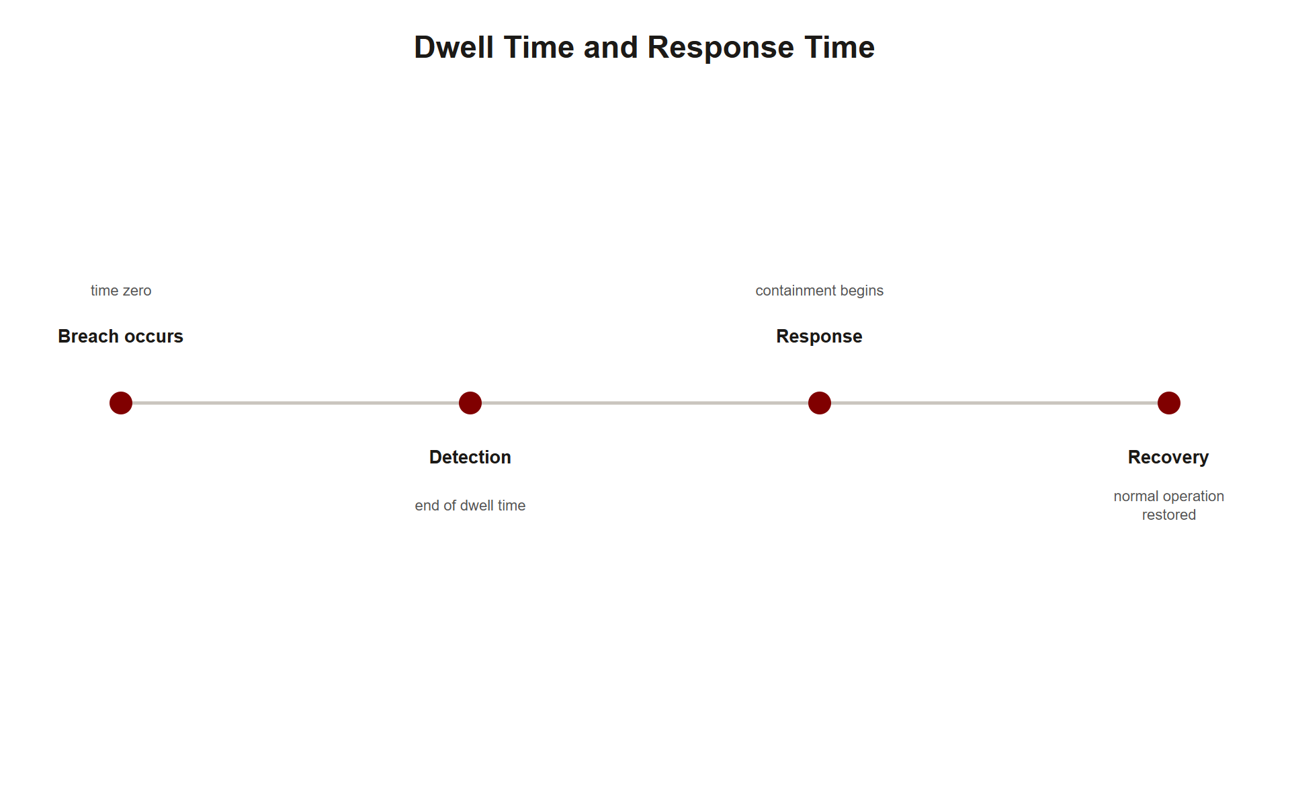
TOPIC 2.4 · 2.4.1.a.2
Detective vs. Preventive Controls, Revisited
A locked door / mantrap: preventive, stops an event before it happens
A motion sensor: detective, ensures entry does not go unnoticed
Detection reduces the TIME between breach and discovery, not the probability of breach
This limits dwell time, how long an attacker operates before being interrupted
Img 2.4.1 Dwell Time
Notes:
Physical dwell time in a well-monitored facility (minutes) is typically far shorter than average digital breach dwell time (historically weeks), precisely because physical sensing is simpler and faster to correlate than network traffic analysis.
Why is physical dwell time so much shorter than digital dwell time? Consider the search space each domain must monitor: a digital network may have millions of daily events (logins, file accesses, API calls) across which a single malicious pattern must be distinguished from enormous legitimate background noise, genuinely difficult pattern recognition. A physical facility, by contrast, has a small, fixed number of doors, windows, and rooms, each covered by a purpose-built sensor whose entire job is detecting ONE specific physical event (a door opening, a body crossing a threshold). The physical detection problem is narrower and structurally simpler, which is precisely why physical intrusion detection can achieve minutes-scale MTTD where digital intrusion detection, historically, has struggled to achieve even weeks-scale MTTD.

Slide 8
TOPIC 2.4 · 2.4.1.a.3
?
The Unmonitored Perimeter Blind Spot
A facility segment lacking sensor/camera coverage, a window, loading dock, roof hatch
Overlooked during design, or added later without security review
Functionally identical to an unpatched, unmonitored network port
Attackers search out overlooked seams, not the well-defended front door
Notes:
A facility with excellent badge readers and biometric mantraps at its main entrance can remain almost entirely undefended at a side window or rarely used loading dock, simply because sensor coverage was designed around obvious, high-traffic entry points.
Blind spots arise from a predictable planning bias worth naming: security budgets and design attention are allocated in proportion to how OFTEN a point of entry is used and how VISIBLE it is to stakeholders touring the facility, not in proportion to how VULNERABLE it actually is if left uncovered. A rarely used loading dock gets little attention precisely BECAUSE it's rarely used, but "rarely used by legitimate traffic" is exactly the property that makes it attractive to an attacker, since an intrusion there is also less likely to be casually observed by an employee walking past. The blind spot problem is therefore not a technology gap but a resource-allocation bias: coverage tends to follow visibility and traffic volume rather than actual risk.

Slide 9
TOPIC 2.4 · 2.4.1.a.4
Layered Sensing: Defense-in-Depth for Detection
Perimeter fence sensors + exterior motion detectors + interior PIR
Glass-break/vibration contacts on windows + door/window contact switches
Each sensor covers a different physical mechanism of intrusion
Each has a different, largely uncorrelated false-positive profile
Notes:
Mature deployments do not rely on a single sensor type, the same logic motivating layered network defenses (firewall, IDS, endpoint detection) rather than a single control.
The specific engineering reason layering works for detection (not just for prevention) comes down to INDEPENDENT FAILURE MODES: a PIR sensor is defeated by extremely slow movement or thermal insulation, an attack technique that has nothing to do with how a glass-break acoustic sensor works. A glass-break sensor is defeated by silent cutting tools, a technique that has nothing to do with how a vibration contact works. Because each sensor type fails for a completely different physical reason, an attacker sophisticated enough to defeat ONE sensing modality gains no advantage toward defeating a DIFFERENT one covering the same space. This is mathematically the same multiplicative-probability argument introduced for defense-in-depth in Topic 2.1, applied here specifically to detection rather than prevention.

Slide 10
TOPIC 2.4 · 2.4.1.a.5
?
Section 1 Synthesis: Why Detection Exists At All
Physical intrusion detection exists because prevention (Topics 2.2/2.3) is never perfect, that's the premise everything else builds on
A detective control's whole job is shrinking dwell time, it can't lower the chance of a breach, only how long one goes unnoticed
An unmonitored blind spot is what happens when detection coverage doesn't match the FULL premise, sensors covering only the obvious doors
Layered sensing is detection's version of Topic 2.1's defense-in-depth, multiple independent sensor types so one defeat technique doesn't defeat detection entirely
Notes:
Every concept in this section flows from a single premise: assume prevention fails somewhere. If you accept that premise, detection's whole existence follows logically. Because prevention can fail ANYWHERE on a large perimeter, detection coverage must extend to the WHOLE perimeter, not just the obvious front door, or you've created an unmonitored blind spot exactly where the premise says failure is most likely to occur unnoticed. And because any single sensor type can itself be individually defeated (as Section 2 will show for PIR specifically), detection needs its own defense-in-depth: layered, independent sensing so no single defeat technique blinds the whole system.
The exam-relevant distinction to nail down: detective controls don't make a breach LESS LIKELY, they make it detected SOONER. Don't credit a motion sensor with "preventing" an intrusion on a free-response answer; credit it with limiting dwell time.

Slide 11
02
Passive Infrared (PIR) Motion Sensors
Topic 2.4
Notes:
Transition to part 2 of the topic. Pause here for questions before continuing.

Slide 12
TOPIC 2.4 · 2.4.2.a.1
Passive Infrared (PIR) Motion Sensors
Detects changes in infrared (heat) radiation, emits no signal of its own ('passive')
Pyroelectric element generates a voltage spike as heat signature crosses zone boundaries
A human body (~37°C) differs distinctly from ambient room temperature
Dominant motion-detection technology: low cost, low power, simple
Notes:
Fresnel-lensed field of view is segmented into multiple zones; motion causes a rapid infrared-level change as a person's heat signature crosses zone boundaries, which the pyroelectric element converts to a voltage spike interpreted as motion.
The word "passive" in the name is doing real technical work and is worth unpacking: an ACTIVE sensor (like radar or an active infrared beam) emits its own energy and measures what bounces back, useful, but detectable by a sophisticated adversary who can sense the emitted signal. A PASSIVE sensor emits nothing; it only listens for infrared radiation that already exists in its environment (body heat), making it both cheaper to build (no emitter hardware needed) and fundamentally undetectable to an intruder scanning for active emissions. The tradeoff is that a passive sensor can only detect CHANGE against a background, not absolute presence, which is exactly why a person standing perfectly still (no change in the infrared pattern once they've stopped moving) can sometimes go undetected by PIR alone, a limitation directly explored in the next slide.

Slide 13
TOPIC 2.4 · 2.4.2.a.2
PIR Sensor Zone Configuration
Zone 4: East corridor, server room approach
Sensitivity: HIGH; pet-immunity: FALSE
Arm schedule: AFTER-HOURS; alert: IMMEDIATE
Escalation: SOC-DISPATCH + LOCAL-SIREN
Notes:
Pet-immunity filtering intentionally reduces sensitivity to small/low body-mass heat sources to avoid false alarms from pets in a residential deployment, inappropriate for a server room zone where any detected motion after-hours is inherently suspicious.
Notice that EVERY configuration parameter in this zone represents a deliberate tradeoff decision matched to this specific deployment's risk profile, not a default template applied blindly. Pet-immunity off makes sense specifically because server rooms categorically have no pets, leaving it on would mean deliberately ignoring some real motion events to avoid a false-alarm category that structurally cannot occur here. The AFTER-HOURS arm schedule reflects that motion during business hours is expected and legitimate (an admin working late), while after-hours motion has no innocent explanation in a server room specifically. Each parameter answers "what does normal look like HERE, specifically?" — a security posture template correctly tuned for one environment (a home) becomes actively wrong when copied unmodified to a different one (a server room).

Slide 14
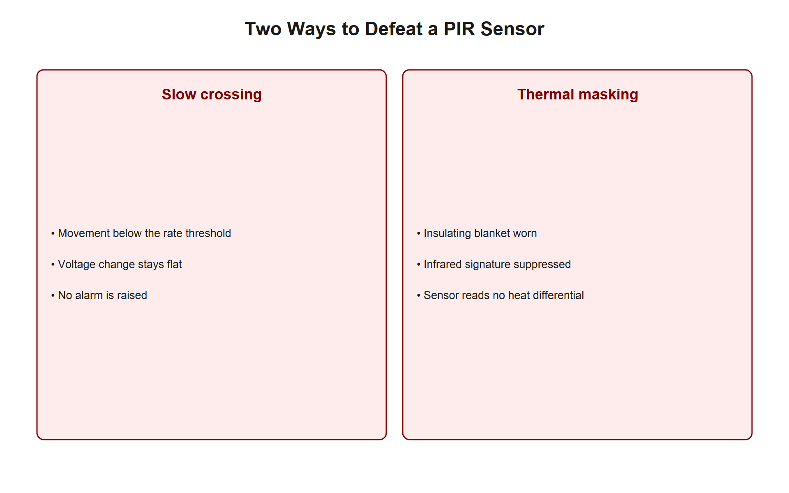
TOPIC 2.4 · 2.4.2.a.3
Defeating and Compensating for PIR Sensors
Moving extremely slowly can stay within the sensor's minimum detectable rate of change
A sufficiently insulated body covering can reduce effective infrared signature
Well-designed deployments compensate with a SECOND, independent sensing modality
Never rely on motion detection alone for high-value zones
Img 2.4.2 Pir Defeat Techniques
Notes:
Because PIR responds to change in pattern rather than absolute temperature, these defeat techniques exploit that specific mechanism, directly motivating the layered-sensing principle from Section 1.
Both defeat techniques described here share a common exploit target: the sensor's minimum detectable RATE of change, not its ability to detect heat at all. A PIR sensor doesn't ask "is there a warm object in this zone?" — it asks "did the infrared level change FAST ENOUGH, RECENTLY ENOUGH, to register as motion?" An intruder moving at, say, one inch every ten seconds may cross a zone boundary so gradually that the resulting infrared change never crosses the sensor's trigger threshold within its detection window, even though the person unambiguously moved through the space. This is precisely why the countermeasure isn't "build a more sensitive PIR sensor" (which would just increase false positives from HVAC airflow and other benign changes) but rather "add a SECOND sensor type whose detection mechanism doesn't share this same slow-motion blind spot," such as a reed switch that triggers on the door opening regardless of how slowly the door itself moves.

Slide 15
TOPIC 2.4 · 2.4.2.a.4
?
Glass-Break Acoustic and Vibration Contacts
Acoustic sensor: listens for glass-break's specific frequency signature (not volume)
Distinguishes an actual break from a dropped object or loud voice
Vibration contact: senses mechanical shock through the pane/frame directly
Not defeated by soundproofing or silent glass-cutting (which lacks the acoustic signature)
Notes:
Placing both sensor types on the same high-value window is a direct application of layered, complementary sensing: an attack defeating one modality (silent cutting defeating acoustic detection) is still caught by the other (vibration detection).
The frequency-domain distinction matters for understanding why acoustic sensors don't simply trigger on any loud noise: breaking glass has a highly specific, identifiable acoustic signature, a sharp initial high-frequency transient (the shatter itself) followed by a lower-frequency component (fragments hitting the floor), a pattern quite different from a dropped book, a slammed door, or a raised voice. The sensor's microphone-and-processing pipeline performs frequency-domain analysis (examining which frequencies are present and in what sequence) rather than simple volume thresholding, which is precisely what lets it distinguish an actual break from unrelated loud sounds without generating excessive false alarms, a direct preview of the alarm-fatigue problem covered in Section 3, which THIS specific engineering choice is designed to avoid.

Slide 16
TOPIC 2.4 · 2.4.2.a.5
Magnetic Reed Contact Switches
Magnet on the door/window + reed switch on the fixed frame
Closed circuit maintained only while magnet stays near the switch
Opening the door/window breaks the circuit, triggering alarm state
Extremely reliable, low-cost, but detects ONLY the opening itself
Notes:
Reed switches are the oldest and most widely deployed physical intrusion sensor type, predating PIR and acoustic sensing by decades, and remain standard on nearly every commercial door/window sensor sold today.
The reed switch's enduring popularity despite its simplicity is worth understanding as a design lesson: it detects exactly ONE binary fact (is the magnet near the switch, or not?) with essentially zero false-positive risk, because there's no ambiguous middle state to misinterpret, unlike PIR (which must distinguish a person's heat signature from HVAC airflow) or acoustic sensors (which must distinguish glass breaking from other loud sounds). This reliability comes at the cost of extremely narrow scope: a reed switch tells you NOTHING about what happens in the room once the door is opened, or whether the same door is opened again later by someone with a valid key. Its role in a layered system is deliberately narrow and foundational, the first, cheapest, most reliable layer, always paired with something that covers the space beyond the single point it monitors.

Slide 17
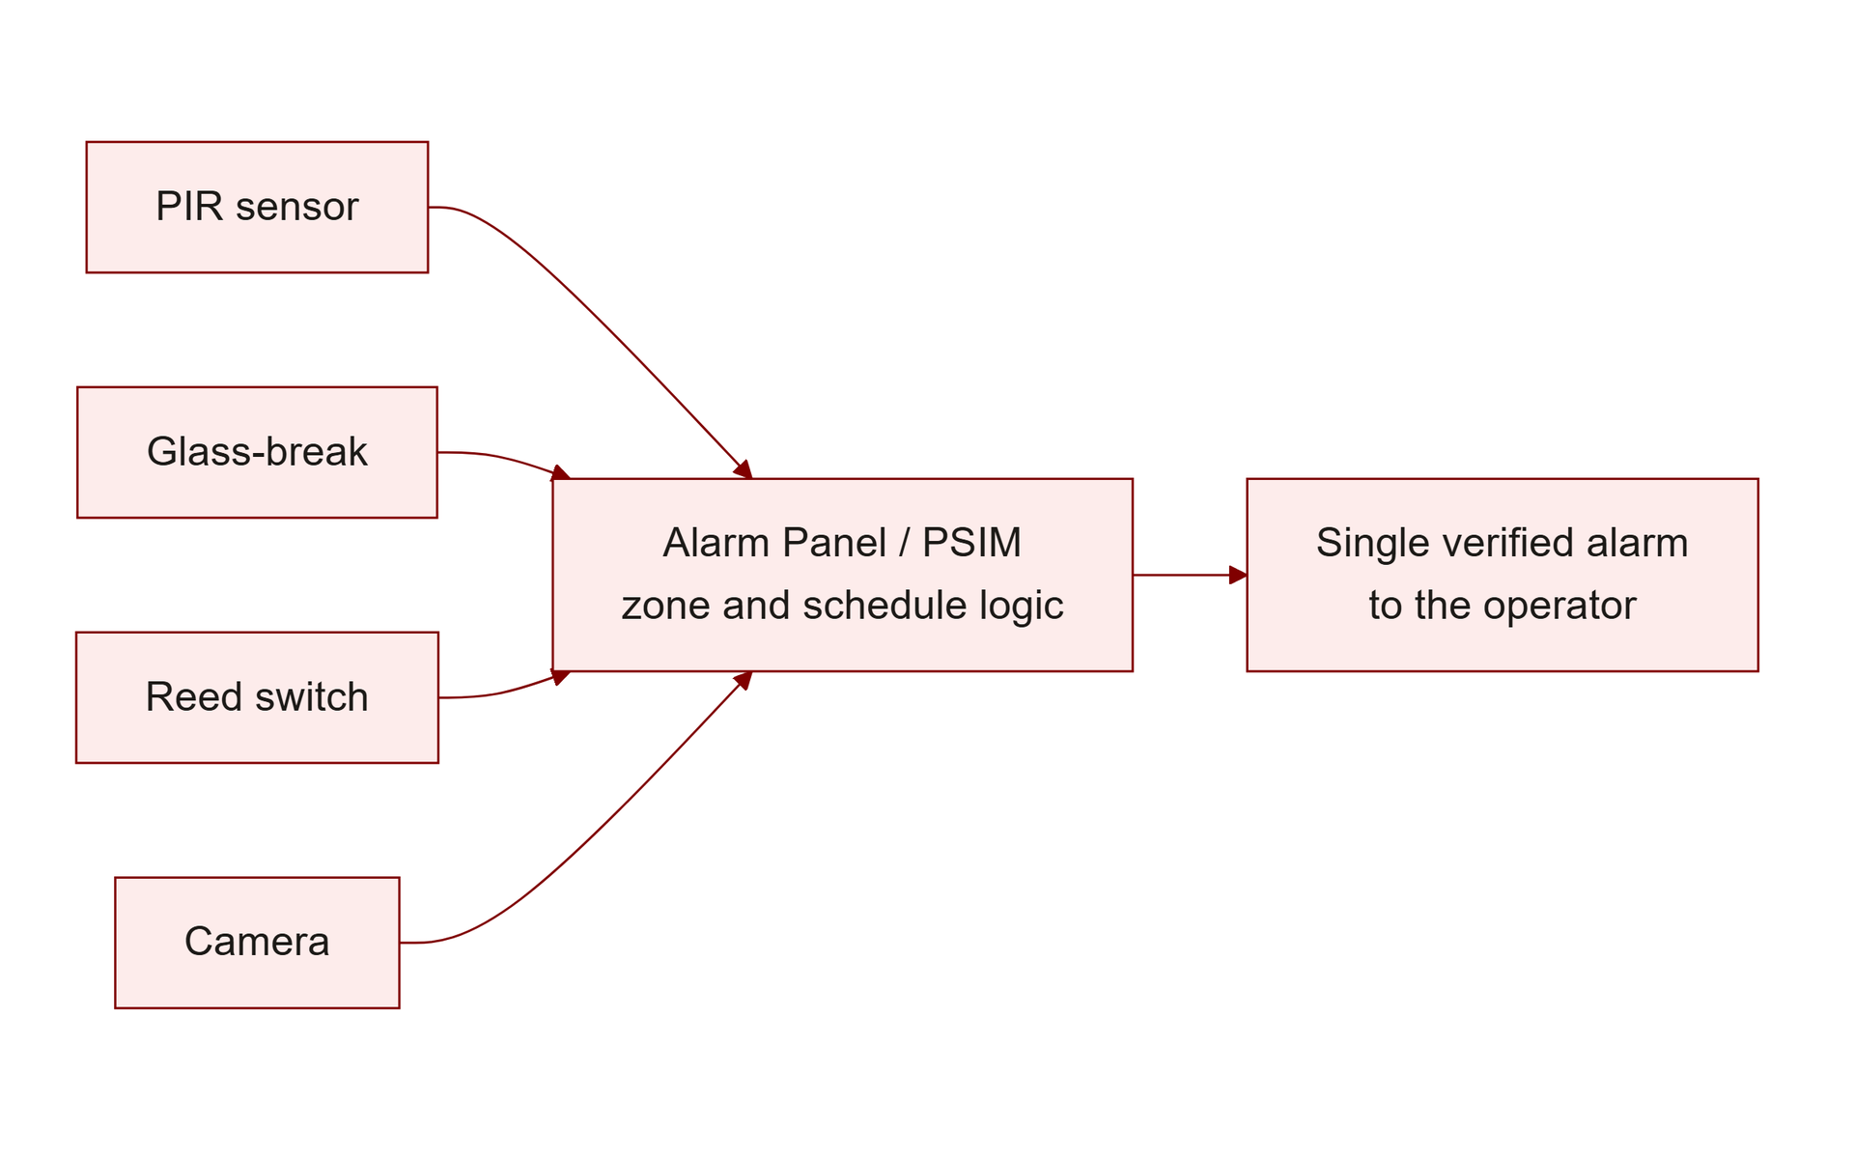
TOPIC 2.4 · 2.4.2.a.6
The Alarm Panel: Aggregation and Escalation
Aggregates signals from every deployed sensor (PIR, glass-break, contacts, cameras)
Applies zone-based arming logic (a zone armed only after business hours)
Escalates a triggered sensor: local siren, monitoring station, SOC dispatch
Directly analogous to a SIEM correlating logs from many network sensors
Img 2.4.2 Alarm Panel Aggregation
Notes:
Enterprise-grade PSIM (Physical Security Information Management) platforms can correlate signals across dozens of buildings and thousands of individual sensors into a single unified operator console.
The alarm panel's aggregation role solves a problem that individual sensors, by design, cannot solve on their own: a single PIR sensor knows only about its own zone and has no context about whether a door contact in the SAME zone also just tripped, or whether this is a scheduled maintenance window, or what time it is relative to the arm schedule. The panel is the layer where all of this context comes together, it's not just a wire-collection point, but the system that applies BUSINESS LOGIC (arming schedules, correlation rules, escalation policy) on top of raw sensor signals. This is exactly the same architectural role a SIEM plays in network security: individual firewalls and endpoint agents generate raw signals, but the SIEM is where those signals are correlated into a contextualized, actionable alert.

Slide 18
TOPIC 2.4 · 2.4.2.a.7
A Triggered Sensor Is Not a Confirmed Intrusion
A single PIR trip could be a genuine intruder, a technician, or an HVAC-driven false positive
Mature programs correlate multiple independent signals before escalating
Example: a door contact AND a PIR trip in the same zone within a short window
Directly parallel to SIEM correlation of weak signals into a high-confidence alert
Notes:
This is a Critical Concept from the source material: escalating on every single trip (rather than correlated signals) either overwhelms responders or trains them to ignore alerts, setting up the alarm-fatigue failure mode covered next.
Think through the base-rate problem this slide is really describing: across a large facility running 24/7, the overwhelming majority of individual sensor trips are benign (an HVAC draft, a technician who forgot to disarm a zone, a genuine but harmless event). If EVERY trip escalates to a full SOC dispatch, responders quickly learn, correctly, from pure experience, that the vast majority of dispatches are false alarms, which is precisely the mechanism that produces alarm fatigue. Correlation logic (requiring two INDEPENDENT signals in the same zone within a short window) dramatically changes this base rate: a benign HVAC draft might trip a PIR sensor, but it will essentially never ALSO trip a door contact at the same moment, whereas a genuine intruder plausibly triggers both. Correlation doesn't just reduce noise arbitrarily, it specifically targets the statistical signature that distinguishes benign single-sensor noise from a genuine, multi-signal event.

Slide 19
TOPIC 2.4 · 2.4.2.a.8
?
Section 2 Synthesis: Different Sensors, Same Design Logic
PIR detects heat CHANGE, glass-break/vibration detect sound/shock, reed switches detect a binary open/close, three unrelated physical mechanisms, by design
Because the mechanisms are unrelated, an attacker defeating ONE (moving slowly past a PIR) gains nothing toward defeating the others
The alarm panel exists because none of these sensors, alone, can tell a genuine intrusion from a false positive, that judgment requires correlating MULTIPLE signals
"A triggered sensor is not a confirmed intrusion" is the single idea Section 3's alarm-fatigue case study exists to illustrate the cost of ignoring
Notes:
Notice these four sensor mechanisms were deliberately chosen (in Section 1's layered-sensing logic) to fail independently: PIR is defeated by slow movement or thermal insulation, acoustic glass-break by silent cutting tools, but vibration contacts are immune to BOTH of those specific defeat techniques since they sense mechanical shock, not heat or sound. Reed switches can't be "defeated" in the same sense at all, they only fail if the door genuinely never opens, which isn't a spoofing technique, it's just outside their narrow scope. The alarm panel sits on top of all of this specifically because no individual sensor has enough context to distinguish a real intrusion from an HVAC draft or a forgotten disarm, only CORRELATING independent signals (a door contact AND a PIR trip, close together, in the same zone) produces a high-confidence signal worth escalating.
This correlation requirement is the direct, practical fix for the alarm-fatigue failure mode covered next in Section 3, know the connection, since exam scenarios often test both halves together.

Slide 20
03
Case Study: The Blind-Spot Loading Dock
Topic 2.4
Notes:
Transition to part 3 of the topic. Pause here for questions before continuing.

Slide 21
TOPIC 2.4 · 2.4.3.a.1
Case Study: The Blind-Spot Loading Dock
Loading docks frequently exempted from standard perimeter sensor coverage
Treated as 'controlled' via procedure alone (a receiving log, delivery window)
Testers repeatedly enter via docks propped open during receiving hours
No motion sensor, contact switch, or camera covering the opening
Notes:
The remediation pattern is consistent: extend the same sensor layering standard applied to primary entrances (contact switches, interior motion coverage, cameras) to every point of entry, regardless of administrative governance.
This case study is a concrete, real-world instance of the blind-spot failure mode introduced conceptually in Section 1, and it's worth noticing the specific REASONING failure that produced it: the loading dock was excluded from sensor coverage not through oversight or ignorance, but through an explicit (if flawed) decision that a PROCEDURAL control (the receiving log) was sufficient on its own. This is a category error, confusing an administrative control (which governs how humans are SUPPOSED to behave) with a technical control (which governs what CAN physically happen regardless of human behavior). The receiving log tells you who was scheduled to be there; it does nothing to detect an intrusion during a moment when the dock was propped open outside that schedule, or when a person entering wasn't actually the delivery driver they appeared to be.

Slide 22
TOPIC 2.4 · 2.4.3.a.2
?
Case Study: Alarm Fatigue and Reduced Response
Poorly tuned sensors (HVAC-triggered PIR, mis-tuned glass-break) generate excessive false alarms
Monitoring staff begin treating all activations from a zone with reduced urgency
A genuine break-in was dismissed as 'probably another false alarm' from a chronically noisy sensor
Direct physical analogue of SOC analysts desensitized to a noisy network IDS
Notes:
The correct remediation is to recalibrate or relocate the noisy sensor to reduce its false-positive rate, rather than relying on staff to somehow maintain vigilance despite the noise.
Alarm fatigue is worth understanding as a HUMAN FACTORS failure layered on top of a purely technical one, and the two require different fixes: the technical failure is a poorly tuned or poorly placed sensor generating excessive false positives (fixable by recalibration, relocation, or adding correlation logic). The human factors failure is that repeated exposure to false alarms genuinely, measurably degrades a person's response, this isn't a matter of insufficient discipline or training, it's a well-documented cognitive phenomenon (habituation) where the brain's threat-response system naturally down-regulates in response to a stimulus that has repeatedly turned out to be harmless. Because habituation is a real cognitive process, not a character flaw, "train staff to be more vigilant" is not a durable fix, the underlying stimulus (the noisy sensor) must be addressed directly.

Slide 23
TOPIC 2.4 · 2.4.3.a.3
?
Section 3 Synthesis: Coverage Gap vs. Response Gap
The loading-dock case is a COVERAGE failure, sensors were never installed where the premise from Section 1 said they should be
Alarm fatigue is a RESPONSE failure, sensors WERE installed, but their signal quality degraded staff's ability to act on them
Both failures produce the identical outcome (a genuine intrusion goes unaddressed), despite having opposite root causes
One is fixed by Section 4's perimeter review; the other by Section 4's tuning discipline, two different remedies for two different diseases
Notes:
These two case studies are worth contrasting precisely because they're easy to conflate, both end with "a break-in wasn't stopped" — but the failure happened at completely different points in the detection pipeline. The loading dock never had a sensor covering the opening at all: this is a COVERAGE problem, treatable by extending Section 1's layered-sensing standard to every entry point (Section 4's fix). Alarm fatigue is the opposite: the sensor was present and functioning correctly, generating real alerts, but so many of those alerts were false positives that staff learned, rationally, from experience, to dismiss activations from that zone. That's a TUNING and RESPONSE problem, not a coverage gap, and the fix (recalibrating or relocating the noisy sensor) is entirely different from installing new sensors.
On the exam, a scenario that says "there were no sensors" is a coverage question; a scenario that says "the sensor kept triggering but was ignored" is a tuning/response question. Naming the RIGHT failure type is worth more credit than a generic "add more security."

Slide 24
04
Comprehensive Perimeter Coverage Review
Topic 2.4
Notes:
Transition to part 4 of the topic. Pause here for questions before continuing.

Slide 25
TOPIC 2.4 · 2.4.4.a.1
Comprehensive Perimeter Coverage Review
Enumerate every physical opening: doors, windows, roof hatches, utility penetrations, docks
Assign at least one sensing technology to each
Directly closes the unmonitored blind spot failure mode
Revisit whenever the facility's physical structure changes
Notes:
Blind spots are most often introduced by CHANGE (a new addition, a repurposed space) rather than present from initial construction, making this a recurring review, not a one-time exercise.
The "revisit on structural change" requirement deserves emphasis because it identifies WHEN blind spots are actually created, which is rarely at initial construction (when a security consultant typically reviews the full building plan) but rather during LATER, smaller modifications that don't trigger the same level of security review: a new emergency exit added for fire-code compliance, a storage room repurposed into a server closet, a new HVAC unit requiring a new roof access hatch. Each of these changes is individually reasonable and driven by a legitimate non-security need, but each one silently expands the perimeter that sensor coverage must account for. A perimeter review conducted once at initial construction and never revisited will, with near certainty, develop blind spots over the building's operational lifetime.

Slide 26
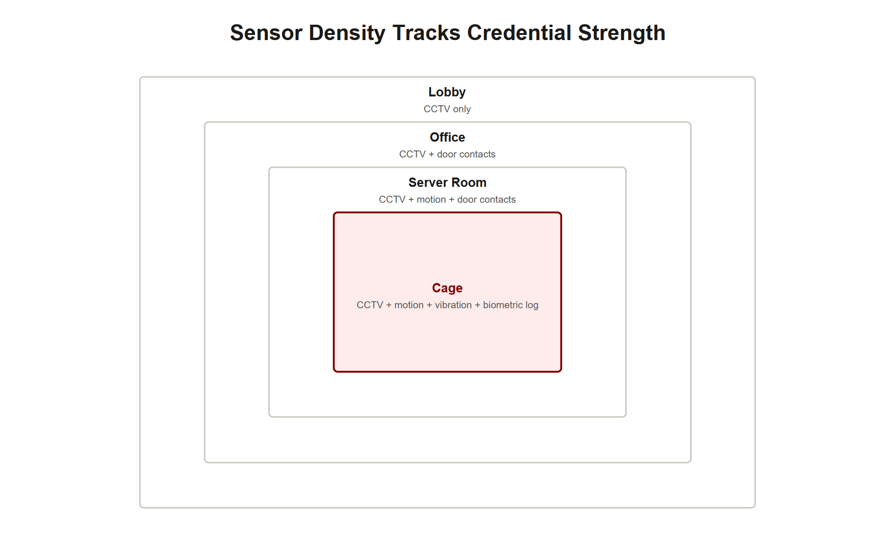
TOPIC 2.4 · 2.4.4.a.2
Layered, Complementary Sensing per Zone
High-value zones: combine at least TWO independent sensing modalities
PIR + door contact, or glass-break + vibration contact
A technique defeating one sensor type does not defeat detection entirely
Mirrors defense-in-depth logic applied throughout this unit
Img 2.4.4 Zoning Plus Sensing
Notes:
Server rooms, executive offices, and evidence rooms warrant this layered approach given their asset sensitivity, consistent with the zoning model introduced in Topic 2.3.
Notice this recommendation deliberately connects back to Topic 2.3's zoning concept rather than treating detection as a separate, parallel system: the SAME zone boundaries that determine which credential/MFA requirements apply (2.3) should also determine which sensor layering requirements apply (2.4), a facility's most access-restricted zone should also be its most detection-dense zone, since that's precisely where a successful intrusion would cause the greatest harm. Treating access control and detection as two independently-designed systems, rather than two coordinated layers applied to the SAME zoning model, risks a mismatch where a highly restricted zone has strong entry authentication but only baseline detection coverage, leaving the "what happens if authentication is somehow defeated here" question under-addressed specifically where it matters most.

Slide 27
TOPIC 2.4 · 2.4.4.a.3
Tuning and False-Positive Management
Actively tune sensitivity per deployment environment
Pet-immunity settings, HVAC airflow considerations, glass-break frequency calibration
Review recurring false-alarm rate data
A chronically noisy sensor should be recalibrated or relocated, not tolerated
Notes:
This directly addresses the alarm-fatigue failure mode from Case Study 2.4.2, treating tuning as an ongoing operational discipline rather than a set-and-forget installation step.
Framing sensor tuning as a CONTROL IN ITSELF (rather than a one-time installation detail) is the key conceptual move this slide makes, and it parallels a similar lesson from Topic 2.3's biometric threshold discussion: a sensor's raw hardware capability and its EFFECTIVE security value are not the same thing. A perfectly capable PIR sensor, mistuned to trigger on HVAC drafts, provides LESS effective security than a slightly less sensitive sensor that reliably distinguishes real motion from noise, because the mistuned sensor's alerts get ignored (alarm fatigue) while the well-tuned sensor's alerts get acted upon. This is why false-positive rate data should be reviewed on a RECURRING basis, not just checked once at installation: environmental conditions drift (a new HVAC unit installed nearby, seasonal temperature changes), and a sensor correctly tuned last year may need retuning today.

Slide 28
TOPIC 2.4 · 2.4.4.a.4
Correlated Escalation Logic
Require multiple independent signals within a short window before full dispatch
Reduces operational burden of isolated sensor noise
Still escalates genuinely correlated, high-confidence events immediately
Directly analogous to SIEM alert correlation in network security
Notes:
Correlation logic balances two competing needs: not overwhelming responders with every isolated trip, while still acting fast on genuinely dangerous, multi-signal events.
Design correlation rules with the specific failure modes from Section 2 and 3 in mind, rather than as generic logic: requiring "any two sensors trip within 60 seconds" is a reasonable STARTING template, but the actual rule should reflect which sensor COMBINATIONS genuinely indicate correlated intrusion versus coincidental, unrelated noise. A PIR trip in the east corridor and a glass-break trip in a west-wing window, 45 seconds apart, are almost certainly UNRELATED (different physical location) and correlating them would be a design mistake, even though they satisfy a naive time-window rule. Effective correlation logic requires BOTH temporal proximity AND spatial/zone proximity, the same physical area, within a short window, which is precisely the structure of the Zone 4 PIR-plus-door-contact example used throughout this topic.

Slide 29
TOPIC 2.4 · 2.4.4.a.5
?
Section 4 Synthesis: Two Independent Failure Modes, Two Independent Fixes
Perimeter coverage review + layered sensing per zone fix the loading-dock-style COVERAGE gap from Section 3
Tuning + correlated escalation fix the alarm-fatigue-style RESPONSE gap from Section 3
A facility can have excellent coverage and terrible tuning (or vice versa), the two failure modes are independent, so both hardening tracks are always needed together
Correlated escalation is where coverage and tuning MEET: it only works if enough independent sensors exist (coverage) AND each one is reliable enough that correlation means something (tuning)
Notes:
These four hardening practices resolve into exactly two tracks, matching Section 3's two case studies one-to-one. Perimeter coverage review and layered sensing per zone are about WHERE sensors exist and how many independent types cover each zone, solving the loading-dock coverage gap. Tuning and correlated escalation are about whether the sensors that DO exist produce a signal worth trusting, solving the alarm-fatigue response gap. These tracks are genuinely independent: a facility can invest heavily in coverage (sensors everywhere) while neglecting tuning (all of them noisy and ignored), or vice versa (a few perfectly-tuned sensors with huge gaps between them). A complete hardening program needs both, which is exactly why this section presents four practices rather than one.
A comprehensive design-a-scheme FRQ answer for this topic should explicitly address BOTH tracks, naming a coverage practice and a tuning/escalation practice separately, not just one or the other.

Slide 30
05
Practice: Diagnose the Detection Gap
Topic 2.4
Notes:
Transition to part 5 of the topic. Pause here for questions before continuing.

Slide 31
TOPIC 2.4 · 2.4.5.a.1
?
Practice: Diagnose the Detection Gap
Scenario: a facility's front lobby has badge+biometric+mantrap+CCTV
A break-in occurs through a rarely used side utility door with no sensor
Name the specific failure mode
Name the specific hardening fix
Notes:
Failure mode: unmonitored perimeter blind spot. Fix: comprehensive perimeter coverage review assigning a sensing technology to every opening, including this overlooked utility door.

Slide 32
TOPIC 2.4 · 2.4.5.a.2
Synthesis: Detection Complements, Never Replaces, Prevention
Prevention (2.2/2.3): locks, badges, mantraps, MFA, stop the event
Detection (2.4): PIR, glass-break, contacts, alarm panel, notice the event
Detection assumes prevention will eventually fail somewhere on a large perimeter
Together: minimize both the chance of a breach AND the dwell time if one occurs
Notes:
A strong free-response answer explicitly states that detection assumes prevention will eventually fail and exists to minimize dwell time and response time when it does, mirroring the layered logic tested throughout this unit.
Trace the full four-topic arc of this unit to see how each piece fits: Topic 2.1 established the vocabulary (CIA triad, risk, control taxonomy) that everything else in the unit is expressed in. Topic 2.2 catalogued the specific ways attackers defeat physical barriers. Topic 2.3 covered how organizations authenticate and authorize legitimate entry to prevent those attacks from succeeding in the first place. Topic 2.4 assumes ALL of that prevention infrastructure will, somewhere, someday, fail, and builds the detection layer that limits the resulting damage. This progression (vocabulary → attack → prevention → detection) is itself a testable structure: a comprehensive facility security design, as tested in a synthesis FRQ, should visibly draw from all four topics rather than treating them as disconnected units.

Slide 33
TOPIC 2.4 · 2.4.5.a.3
Exam-Readiness Checklist: Topic 2.4
Can you explain why detection exists even where prevention has already failed?
Can you name the unmonitored blind spot failure mode from a scenario?
Can you explain PIR, glass-break, vibration, and reed-switch mechanisms specifically?
Can you explain why layered/complementary sensing matters per zone?
Can you diagnose alarm fatigue and state its correct remediation?
Notes:
These are the AP-testable distinctions this topic covers, pulled directly from the exam-focus callouts and learning objectives in the source chapter.

