Slide 1
AAYAT-AP-PREP · CYBERSECURITY
SECURING NETWORKS
Topic 3.1: Network Level Exploits
TCP/IP was built in the 1970s for a small, cooperative research network, and it still assumes trust where a protocol could instead demand proof. This topic examines the attacks that exploit that gap — eavesdropping on a shared medium, forging address bindings, poisoning name resolution, and exhausting the connections a server can hold — and how to reason about the risk each one creates.
3 learning objectives · College Board AP Cybersecurity Course Framework
Notes:
Cover slide for Topic 3.1: Network Vulnerabilities and Attacks. This topic focuses on securing switch port tables against threats exploiting switch ARP cache spoofing. Hardening requires combining administrative controls, physical security barriers, and technical mitigation via Dynam…

Slide 2
TOPIC 3.1
Learning Objectives
Analyze Risk
Name the attacks that recur against networks &mdash; capturing frames off a shared medium, forging the address bindings a segment depends on, poisoning a resolver&rsquo;s cache, exhausting a connection table, and moving code from one reachable host to the next.
3.1.A
Analyze Risk
Trace how an adversary turns an unverified protocol field into stolen data, interrupted service, or destroyed communication.
3.1.B
Analyze Risk
Assess and write down the risk arising from a network weakness &mdash; asset, exposure, likelihood, impact, and the residual position after existing controls.
3.1.C
Objectives paraphrased from the AP Cybersecurity Course Framework (College Board, AP Career Kickstart).
Notes:
Read each learning objective aloud and connect it to the exam skill category before starting the topic.

Slide 3
TOPIC 3.1
The Big Idea
An unencrypted packet crossing a network is a postcard, not a sealed letter. Anyone who handles it in transit can read every word on it without ever needing to open anything.
Hold onto this picture — we'll come back to it as the mechanics get more technical.
Notes:
Big-idea framing for Topic 3.1. Open with this analogy before the mechanics: "An unencrypted packet crossing a network is a postcard, not a sealed letter. Anyone who handles it in transit can read every word on it without ever needing to open anything." Ask students for their own version of the analogy before moving on.

Slide 4
01
From Human Exploits to the Network Fabric
Topic 3.1
Notes:
Transition to part 1 of the topic. Pause here for questions before continuing.

Slide 5
TOPIC 3.1 · 3.1.1.a.1
From Human Exploits to the Network Fabric
Shift in scope: Unit 1 attacked human cognition; Unit 3 attacks the wires, switches, and protocols that move packets
Core insight: Foundational protocols (ARP, TCP, DNS) were built for correctness and resilience, not for a malicious insider on the same wire
Era of origin: The early internet was a small, trusted academic/government community, authentication was assumed, not enforced
Fail-open by design: Legacy protocols default to availability, accepting unverified claims rather than risk disruption
Three exploit goals: Eavesdropping (confidentiality), denial of service (availability), lateral propagation (integrity/control)
Notes:
Network-level exploits do not trick a person into clicking a link. They exploit design assumptions baked into protocols standardized decades ago, when the internet's user base was a small and mutually trusting group of researchers. The foundational insight of this topic is that core networking protocols were engineered for functional correctness and resilience against random failure, not against an actively malicious participant sharing the same physical medium.
Security engineers formalize this as the difference between fail-safe and fail-open design. A fail-safe system defaults to a secure state when something breaks; a fail-open system defaults to an available state. Most legacy protocols are fail-open because early internet engineering prioritized availability over confidentiality. ARP is the textbook example: any device on a segment can claim ownership of any IP address, and its neighbors believe it without verification.
The topic is organized around five exploit families: packet sniffing, ARP spoofing, man-in-the-middle interception, denial-of-service, and network-borne malware propagation.

Slide 6
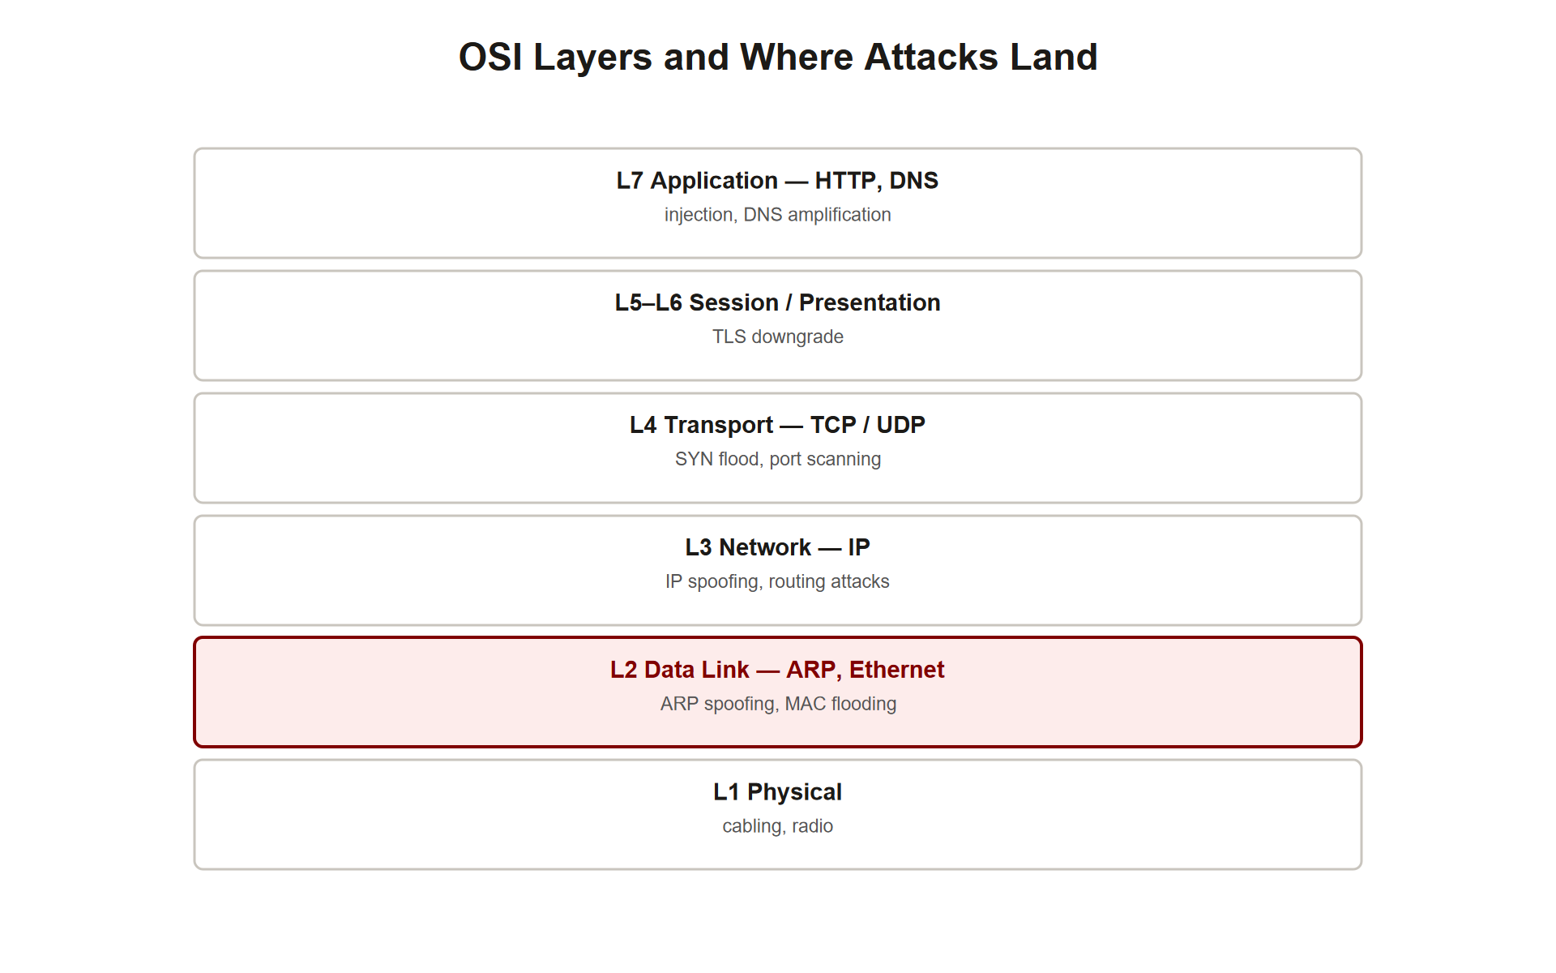
TOPIC 3.1 · 3.1.1.a.2
The OSI Model as a Map of Attack Surface
Seven layers: Physical, Data Link, Network, Transport, Session, Presentation, Application (ISO/IEC 7498-1)
Layer determines blast radius: A Layer 2 attack is confined to one broadcast domain; a Layer 3+ attack can traverse the routed internet
Layer 2 (Data Link): ARP, MAC addresses, Ethernet frames, local segment only
Layer 3 (Network): IP addressing and routing, global reach
Layer 4 (Transport): TCP/UDP, connection state, ports, the SYN flood target
Defense follows layer: The layer of an attack dictates which controls can stop it
Osi Layers Attack Map
Notes:
Understanding network-level exploits requires fluency in the OSI reference model, because the layer at which an attack occurs determines both its blast radius and its available defenses. The OSI model is a conceptual seven-layer framework used to describe how data moves through a network stack, it is a teaching abstraction, not a protocol. Real stacks like TCP/IP compress several OSI layers together.
An attack executed at Layer 2, the local Ethernet segment, is inherently confined to that broadcast domain. ARP spoofing cannot be launched from across the internet. By contrast, a reflection-based denial-of-service attack executed at Layer 3/4 can be launched from anywhere and target any reachable IP on Earth.
This layered thinking is the conceptual backbone of the entire unit. When you diagnose or defend against an exploit, your first question should always be: at what layer does this operate?

Slide 7
TOPIC 3.1 · 3.1.1.a.3
Active vs. Passive Attacks
Passive attack: Observation only, the attacker captures traffic without altering it (e.g., simple sniffing)
Detectability: Passive attacks leave no modified traffic behind, making them extremely hard to detect
Active attack: The attacker injects, modifies, or replays traffic, changing network or session state
Footprint: Active attacks leave traces, unexpected ARP replies, malformed packets, unusual retransmissions
Examples: ARP poisoning, SYN floods, and worm propagation are all active; passive sniffing on a shared medium is not
Detection implication: IDS sensors are tuned to catch the footprint of active attacks
Notes:
Within the network context, a crucial classification separates active attacks from passive attacks. A passive attack involves no interaction with the victim, the adversary merely observes traffic, for example by sniffing a shared medium. Because nothing is modified or injected, passive attacks are correspondingly difficult to detect; there is no anomalous traffic to alert on, only anomalous physical or logical access.
An active attack, by contrast, requires the attacker to inject forged or malformed traffic into the network. ARP cache poisoning, a SYN flood, or a self-replicating worm all leave a detectable, if often subtle, footprint. This footprint is exactly what intrusion detection systems are tuned to recognize.
This distinction matters for defense strategy: passive threats are addressed primarily through encryption and physical/logical access control, while active threats are addressed through detection, validation, and rate limiting.

Slide 8
02
Packet Sniffing and Promiscuous Mode
Topic 3.1
Notes:
Transition to part 2 of the topic. Pause here for questions before continuing.

Slide 9
TOPIC 3.1 · 3.1.2.a.1
Packet Sniffing and Promiscuous Mode
Default NIC behavior: Discards any Ethernet frame not addressed to its own MAC (or broadcast/multicast) at the hardware level
Promiscuous mode: Disables that filter, the NIC passes every frame it physically receives up to the OS
Monitor mode: The wireless equivalent, additionally exposing 802.11 management/control frames
Capture tools: Wireshark (GUI) and tcpdump (CLI) both build on the libpcap capture library
Key caveat: Promiscuous mode only helps if the frames physically reach the interface, topology decides that
Notes:
A network interface card normally discards any Ethernet frame not addressed to its own MAC address, filtering unwanted traffic in hardware before the operating system ever sees it. Placing the NIC into promiscuous mode disables that filter, allowing a sniffing application such as Wireshark or tcpdump to capture and display every frame that physically reaches the interface.
On Linux this is enabled with ip link set eth0 promisc on . On wireless adapters the analogous capability is called monitor mode, which additionally exposes the 802.11 management and control frames that carry beacons, association requests, and deauthentication frames.
Crucially, promiscuous mode only yields useful traffic if the frames actually arrive at the interface. Whether they do depends entirely on the physical topology of the network, a hub delivers everything, while a switch delivers almost nothing beyond your own traffic.

Slide 10
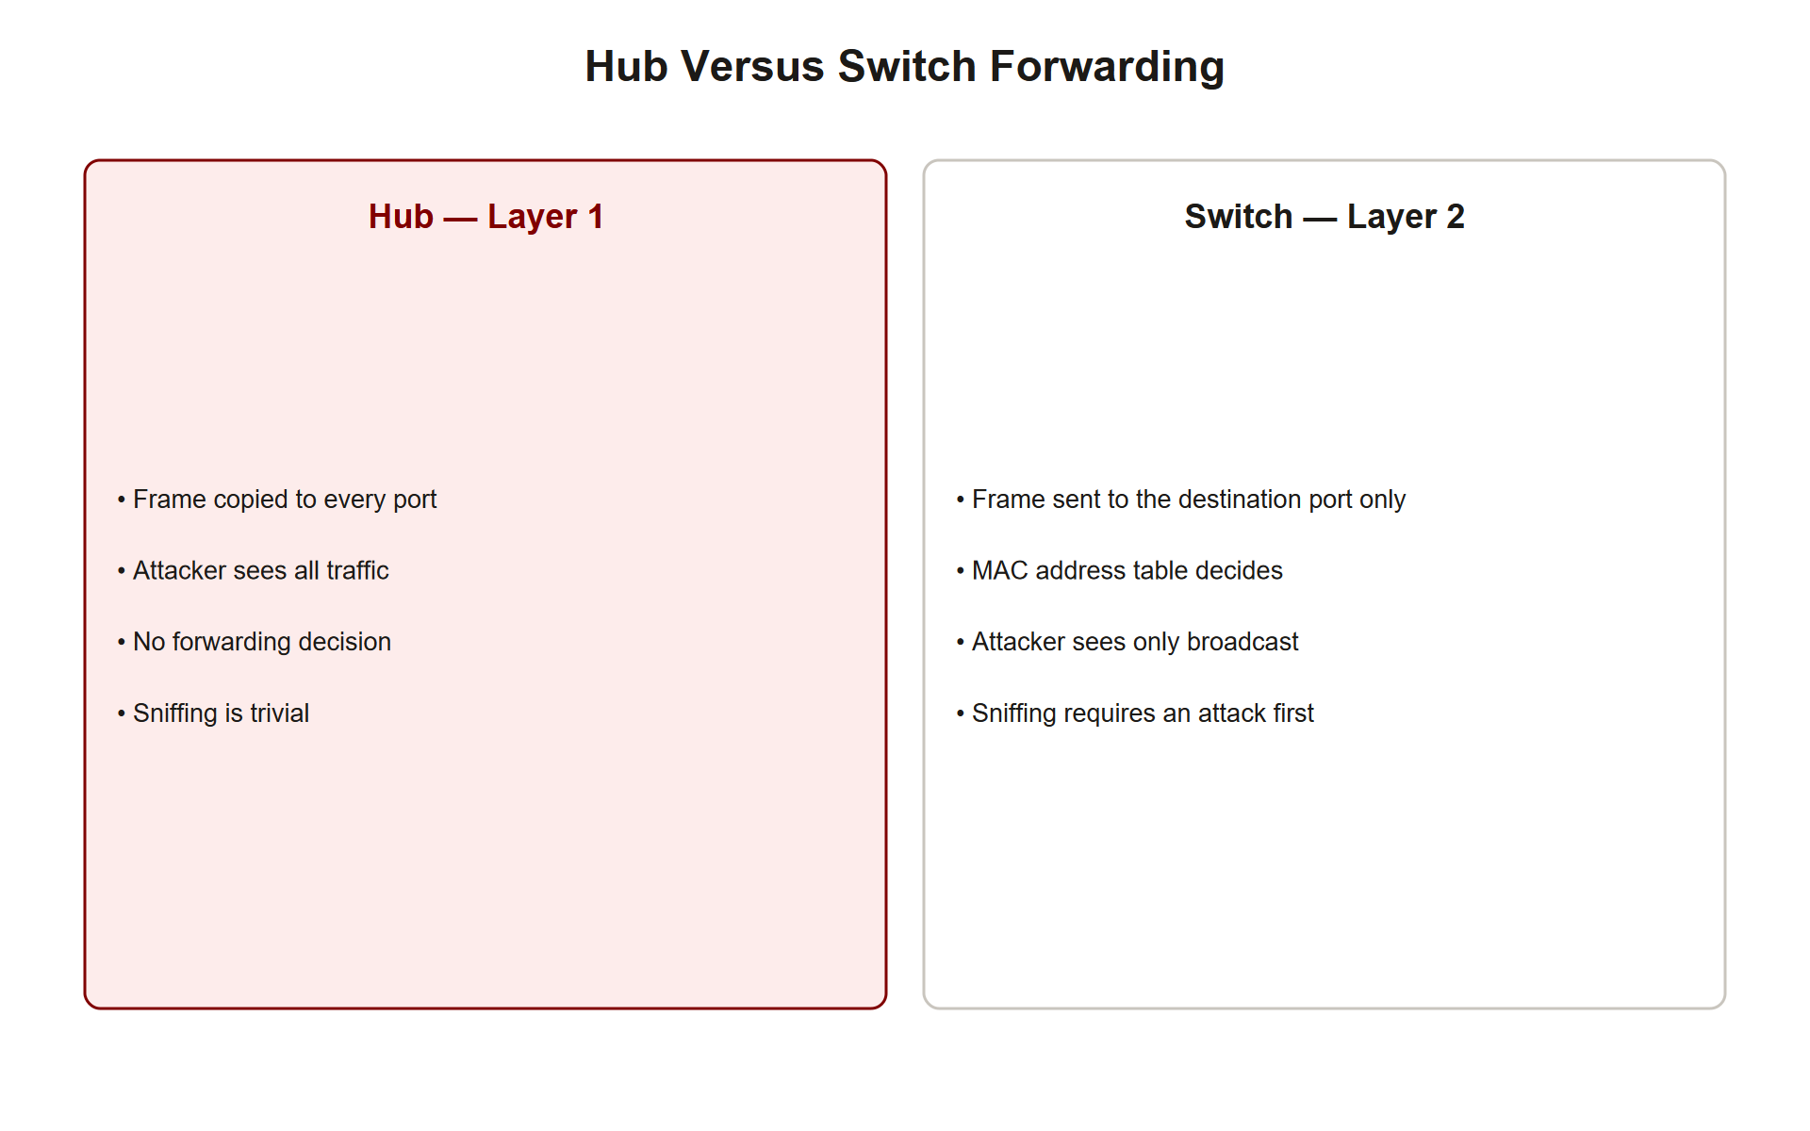
TOPIC 3.1 · 3.1.2.a.2
?
Hubs vs. Switches: Why Topology Decides What You Can Sniff
Hub (Layer 1): Obsolete device that electrically repeats every incoming signal to all ports, one giant collision domain
On a hub: An attacker on any port receives a copy of all traffic 'for free'
Switch (Layer 2): Learns which MAC lives on which port and forwards unicast frames only to the destination port
CAM table: The switch's lookup table mapping learned MAC addresses to physical ports, populated by observing source MACs
On a switch: A plain sniffer sees only broadcast, multicast, and its own unicast traffic, a real security improvement
Legitimate capture: Admins use port mirroring / SPAN to copy traffic to a monitoring port
Hub Vs Switch Forwarding
Notes:
Whether promiscuous mode yields useful traffic depends entirely on physical topology. On a legacy hub-based network, every frame is physically replicated to every port, so an attacker plugged into any port receives all traffic on the segment. Hubs turn an entire segment into one collision domain and have been almost entirely replaced by switches since the early 2000s, for both performance and security reasons.
Modern switches forward unicast frames only to the specific port associated with the destination MAC in the switch's CAM (Content Addressable Memory) table. The switch learns these mappings dynamically by inspecting the source MAC of every incoming frame. Consequently, a plain sniffer on a switched network sees only broadcast traffic, multicast traffic, and unicast traffic addressed to its own port.
To legitimately capture traffic across a switched segment, administrators configure port mirroring, SPAN in Cisco terminology, which copies traffic from source ports to a destination port where an IDS sensor or capture appliance is attached. An attacker without admin access to the switch cannot do this and must resort to Layer 2 manipulation instead.

Slide 11
TOPIC 3.1 · 3.1.2.a.3
MAC Flooding: Turning a Switch Back Into a Hub
CAM table is finite: Commonly a few thousand to tens of thousands of entries
The attack: Flood the switch with frames bearing thousands of forged, random source MAC addresses
Table exhaustion: Once the CAM table is full, the switch cannot learn or store legitimate mappings
Fail-open fallback: For unknown destination MACs, the switch floods frames to all ports, like a hub
Result: The attacker's sniffer now receives unicast traffic it was never meant to see
Defense: Port security limits the number of MACs per port and shuts the port on violation
Notes:
Why can an attacker defeat a switch's incidental confidentiality benefit without any admin access? Because the CAM table is a finite resource, and the switch's behavior when that resource is exhausted is fail-open, not fail-safe.
In a CAM table overflow attack, MAC flooding, the attacker deliberately transmits a high rate of frames, each carrying a different forged random source MAC address. The switch dutifully tries to learn each one, and the table fills. Once full, the switch can no longer store the mapping for legitimate destinations. When a frame arrives for a destination whose port it cannot look up, the switch falls back to flooding the frame out every port, exactly like a hub. The attacker's sniffer now receives traffic destined for other hosts.
This is a perfect illustration of a fail-safe assumption becoming fail-open under resource exhaustion. The standard defense is port security, which limits the number of MAC addresses allowed on an access port and takes a configured action (shutdown, restrict, or protect) when the limit is exceeded.

Slide 12
03
How ARP Works: Broadcast Request, Unicast Reply
Topic 3.1
Notes:
Transition to part 3 of the topic. Pause here for questions before continuing.

Slide 13
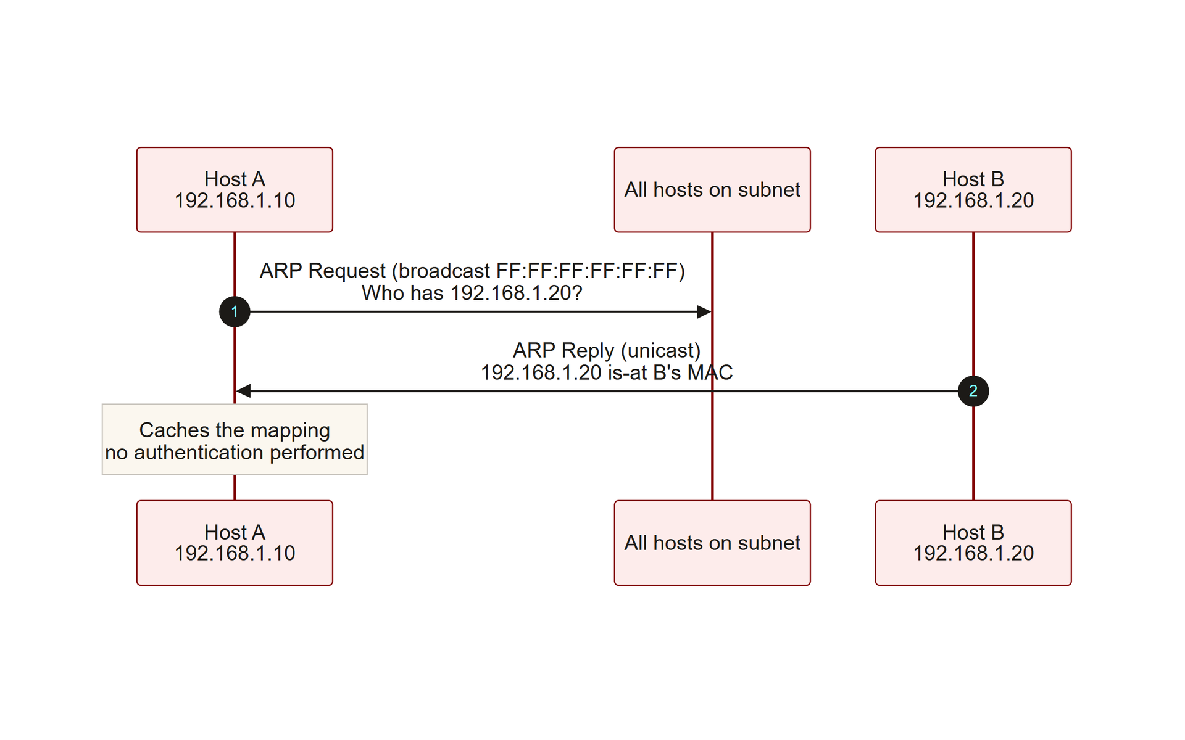
TOPIC 3.1 · 3.1.3.a.1
How ARP Works: Broadcast Request, Unicast Reply
Purpose: ARP resolves a known IPv4 address into the MAC address needed to deliver an Ethernet frame locally (RFC 826, 1982)
Request: Host A broadcasts 'Who has 192.168.1.20? Tell 192.168.1.10' to FF:FF:FF:FF:FF:FF
Reply: Host B recognizes its own IP and unicasts back its MAC address
Caching: Both hosts store the IP-to-MAC mapping in a local ARP cache to avoid repeating the exchange
View it: ip neigh show (Linux) or arp -a (Windows)
IPv6 note: IPv6 replaces ARP with NDP (RFC 4861), which has analogous spoofing risks
Arp Request Reply
Notes:
The Address Resolution Protocol, standardized in RFC 826 in 1982, bridges Layer 3 addressing and Layer 2 delivery. When Host A needs to send an IP packet to Host B on the same subnet but knows only B's IP address, A broadcasts an ARP Request, 'Who has 192.168.1.20? Tell 192.168.1.10', to the Ethernet broadcast address FF:FF:FF:FF:FF:FF. Host B, recognizing its own IP in the request, unicasts an ARP Reply containing its MAC address back to A.
Both hosts then cache the resulting IP-to-MAC mapping locally, so they need not repeat the broadcast for every subsequent packet. Cache entries typically expire after a short timeout ranging from 60 to 1200 seconds depending on the operating system.
ARP predates virtually every modern security consideration. It contains no authentication, no sequence numbers, and no integrity protection of any kind, a design that made perfect sense in 1982 and is catastrophic on an untrusted segment today.

Slide 14
TOPIC 3.1 · 3.1.3.a.2
Why ARP Is Exploitable: Stateless, Unauthenticated, Gratuitous
Stateless: A host accepts and caches an ARP reply even if it never sent a corresponding request
Unauthenticated: No cryptographic way to verify the reply came from the true MAC owner
Gratuitous ARP: A host may announce an IP-to-MAC mapping unprompted, legitimately used for failover and conflict detection
The abuse: Gratuitous ARP lets an attacker unilaterally overwrite every host's cache on the segment
Contrast with TCP: TCP uses sequence/ack numbers precisely to reject unsolicited or out-of-order segments
Notes:
The critical vulnerability is that ARP is entirely stateless and unauthenticated. A host will accept and cache an ARP reply even if it never issued the corresponding request, and it has no cryptographic means to verify that the reply actually came from the legitimate MAC owner of that IP.
This is compounded by gratuitous ARP, a legitimate feature that lets a host announce or update its own IP-to-MAC mapping without being asked. Gratuitous ARP has valid uses: announcing a new IP, detecting IP conflicts, or updating peers after a failover event in protocols like VRRP and HSRP. But because ARP has no authentication, this same mechanism is trivially abused to unilaterally overwrite the cache of every host on the segment.
The contrast with TCP is instructive. TCP uses sequence and acknowledgment numbers specifically so a receiver can reject segments it did not expect. ARP has no such mechanism, every reply is taken at face value.

Slide 15
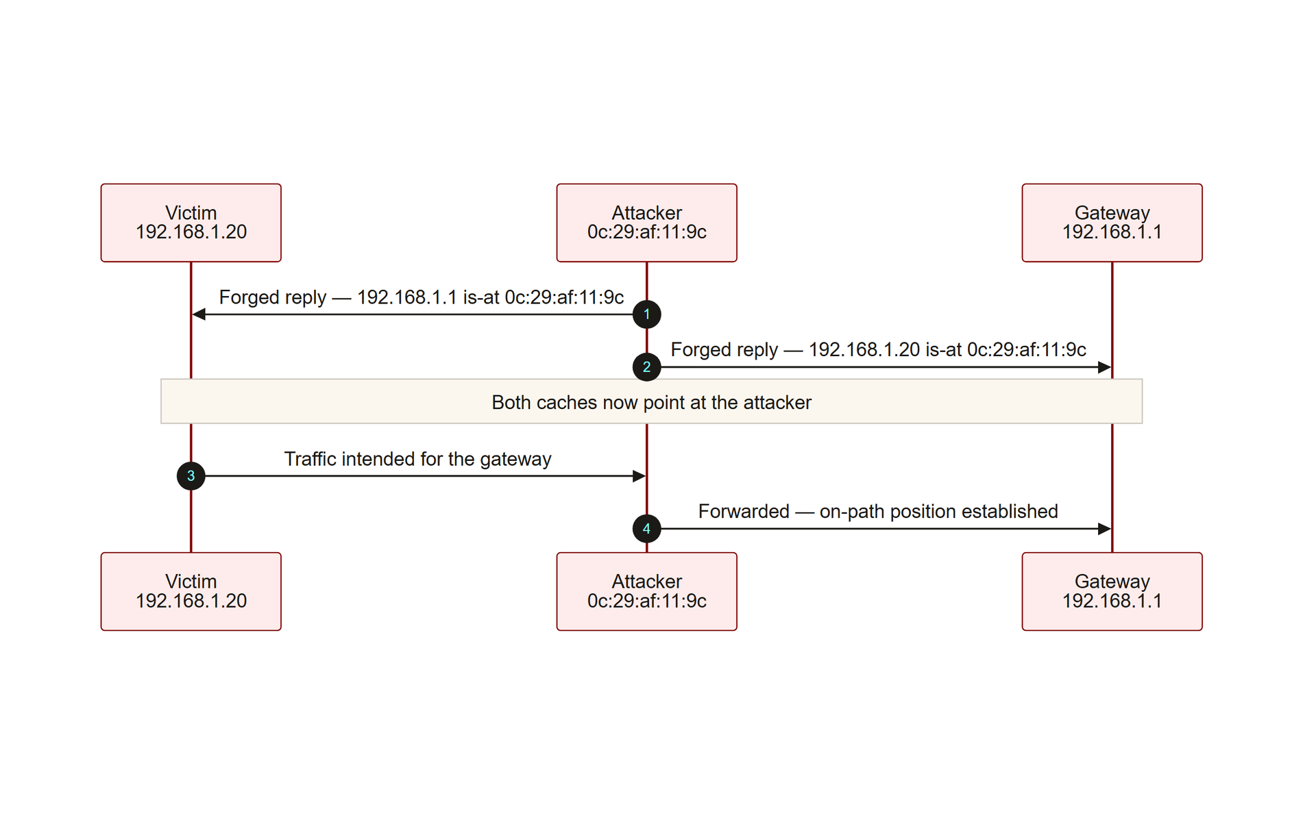
TOPIC 3.1 · 3.1.3.a.3
ARP Cache Poisoning: The Four-Stage Attack Chain
Stage 1: Attacker sends forged ARP replies to the victim claiming the attacker's MAC owns the gateway's IP
Stage 2: Attacker sends forged ARP replies to the gateway claiming the attacker's MAC owns the victim's IP
Stage 3: Both caches update; all victim↔gateway traffic now physically transits the attacker
Stage 4: Attacker enables IP forwarding to relay traffic onward transparently, connectivity is preserved
Result: An on-path (man-in-the-middle) position enabling silent capture or active tampering
MITRE mapping: T1557.002, Adversary-in-the-Middle: ARP Cache Poisoning
Arp Poisoning Sequence
Notes:
An ARP spoofing attack chain proceeds in four stages. First, the attacker, who must already be present on the local segment, sends forged gratuitous ARP replies to the victim, claiming that the attacker's MAC address owns the default gateway's IP. Second, the attacker simultaneously sends forged replies to the gateway, claiming to own the victim's IP. Third, both the victim and gateway update their ARP caches with the false mappings, so all traffic between them now physically transits the attacker's machine.
Fourth, and this is what makes the attack stealthy, the attacker enables IP forwarding on their own machine, relaying traffic onward transparently. Connectivity is preserved, so nothing appears broken to the victim, while every packet is silently duplicated for inspection or modification. This is the canonical way to establish an on-path (man-in-the-middle) position on a local network.
The command output below shows a victim's gateway ARP entry being overwritten to point at the attacker's MAC.

Slide 16
TOPIC 3.1 · 3.1.3.b.1
Man-in-the-Middle and SSL Stripping
On-path position: Achieved via ARP poisoning or a rogue access point, enables passive logging or active tampering
SSL stripping: A downgrade attack that keeps the victim on plaintext HTTP while the attacker speaks HTTPS to the real server
The lever: Users type a bare domain, so the browser's first request is often insecure HTTP before any redirect
Effect: Credentials and session cookies pass through the attacker in cleartext; no obvious padlock warns the user
Demonstrated: Moxie Marlinspike's sslstrip, Black Hat DC 2009
Mitigation: HSTS (RFC 6797) and browser HSTS preload lists force HTTPS from the first request
Notes:
Once an attacker holds an on-path position, via ARP poisoning or a rogue access point (Topic 3.2), they can passively log traffic or actively tamper with it. A particularly potent active technique is SSL stripping, a downgrade attack that exploits how users actually browse.
Most users type a bare domain like bank.com without specifying https:// . The browser therefore issues its first request over insecure HTTP before any redirect to HTTPS occurs. The on-path attacker intercepts this first plaintext request and thereafter proxies the session: it keeps the victim on HTTP while transparently maintaining a proper encrypted HTTPS session with the legitimate server. It rewrites HTTPS links in the served page down to HTTP so the victim's browser never negotiates its own TLS. The victim sees a working page, often with no padlock, while the attacker reads and can modify everything.
The modern defense is HSTS (HTTP Strict Transport Security), which instructs browsers to only ever contact a site over HTTPS. Preload lists bake this rule into the browser so even the very first request is secure.

Slide 17
TOPIC 3.1 · 3.1.3.b.2
Defending Layer 2: DHCP Snooping and Dynamic ARP Inspection
DHCP snooping: Marks ports as trusted (toward real DHCP servers) or untrusted; builds a binding table from observed leases
Binding table: Maps legitimate IP ↔ MAC ↔ port from the DHCP handshake
Dynamic ARP Inspection (DAI): Validates every ARP packet on untrusted ports against that binding table
Enforcement: ARP packets whose claimed mapping does not match a known lease are dropped and logged
Configuration: Per-VLAN, e.g. ip arp inspection vlan 10, DAI depends on DHCP snooping being enabled first
Complements: Port security and VLAN segmentation shrink the blast radius further
Notes:
The primary standardized defense against ARP spoofing is Dynamic ARP Inspection (DAI), which removes the trust-by-default assumption at the switch. Rather than forwarding every ARP packet unconditionally, DAI intercepts ARP packets on untrusted ports and validates the claimed IP-to-MAC binding against a trusted binding table before forwarding. Any ARP packet whose mapping does not match a known legitimate binding is dropped and logged.
DAI's binding table does not appear by magic, it is built by DHCP snooping. DHCP snooping designates ports facing legitimate DHCP servers as trusted and end-host ports as untrusted, then observes the DHCP handshake to record which IP was legitimately leased to which MAC on which port. DAI consults this table to decide whether an ARP claim is truthful.
Both features are configured per-VLAN on managed enterprise switches and align with NIST SP 800-53 SC-7 boundary protection guidance. In combination with port security and VLAN segmentation, they form a robust Layer 2 defense.

Slide 18
04
Denial of Service: Targeting Availability
Topic 3.1
Notes:
Transition to part 4 of the topic. Pause here for questions before continuing.

Slide 19
TOPIC 3.1 · 3.1.4.a.1
Denial of Service: Targeting Availability
Goal: Make a resource unavailable to legitimate users by exhausting a finite resource, not by breaching confidentiality
Exhaustible resources: CPU, memory, connection-table slots, or raw network bandwidth
Volumetric: Saturate bandwidth with junk traffic, measured in Gbps/Tbps
Protocol: Exhaust finite state tables in network stacks (e.g., SYN flood), measured in packets/second
Application-layer: Request expensive dynamic pages to exhaust server/database resources, measured in requests/second
MITRE mapping: Impact tactic TA0040, T1498 (Network DoS), T1499 (Endpoint DoS)
Notes:
Whereas sniffing and man-in-the-middle attacks target confidentiality, denial-of-service (DoS) attacks target availability. The goal is to make a system or network resource unavailable to legitimate users, typically by exhausting a finite resource, CPU, memory, connection-table slots, or bandwidth, rather than by breaching confidentiality or integrity.
DoS attacks are conventionally classified into three layers. Volumetric attacks simply saturate available bandwidth with high-throughput junk traffic, measured in gigabits or terabits per second. Protocol attacks, such as SYN floods, exhaust finite state tables in network stacks rather than raw bandwidth, and are measured in packets per second. Application-layer attacks, such as HTTP floods that repeatedly request computationally expensive dynamic pages, exhaust web server or database resources with comparatively low traffic volume, measured in requests per second.
Recognizing which resource is under attack is the key to choosing the right mitigation, bandwidth scrubbing, SYN cookies, or application rate limiting respectively.

Slide 20
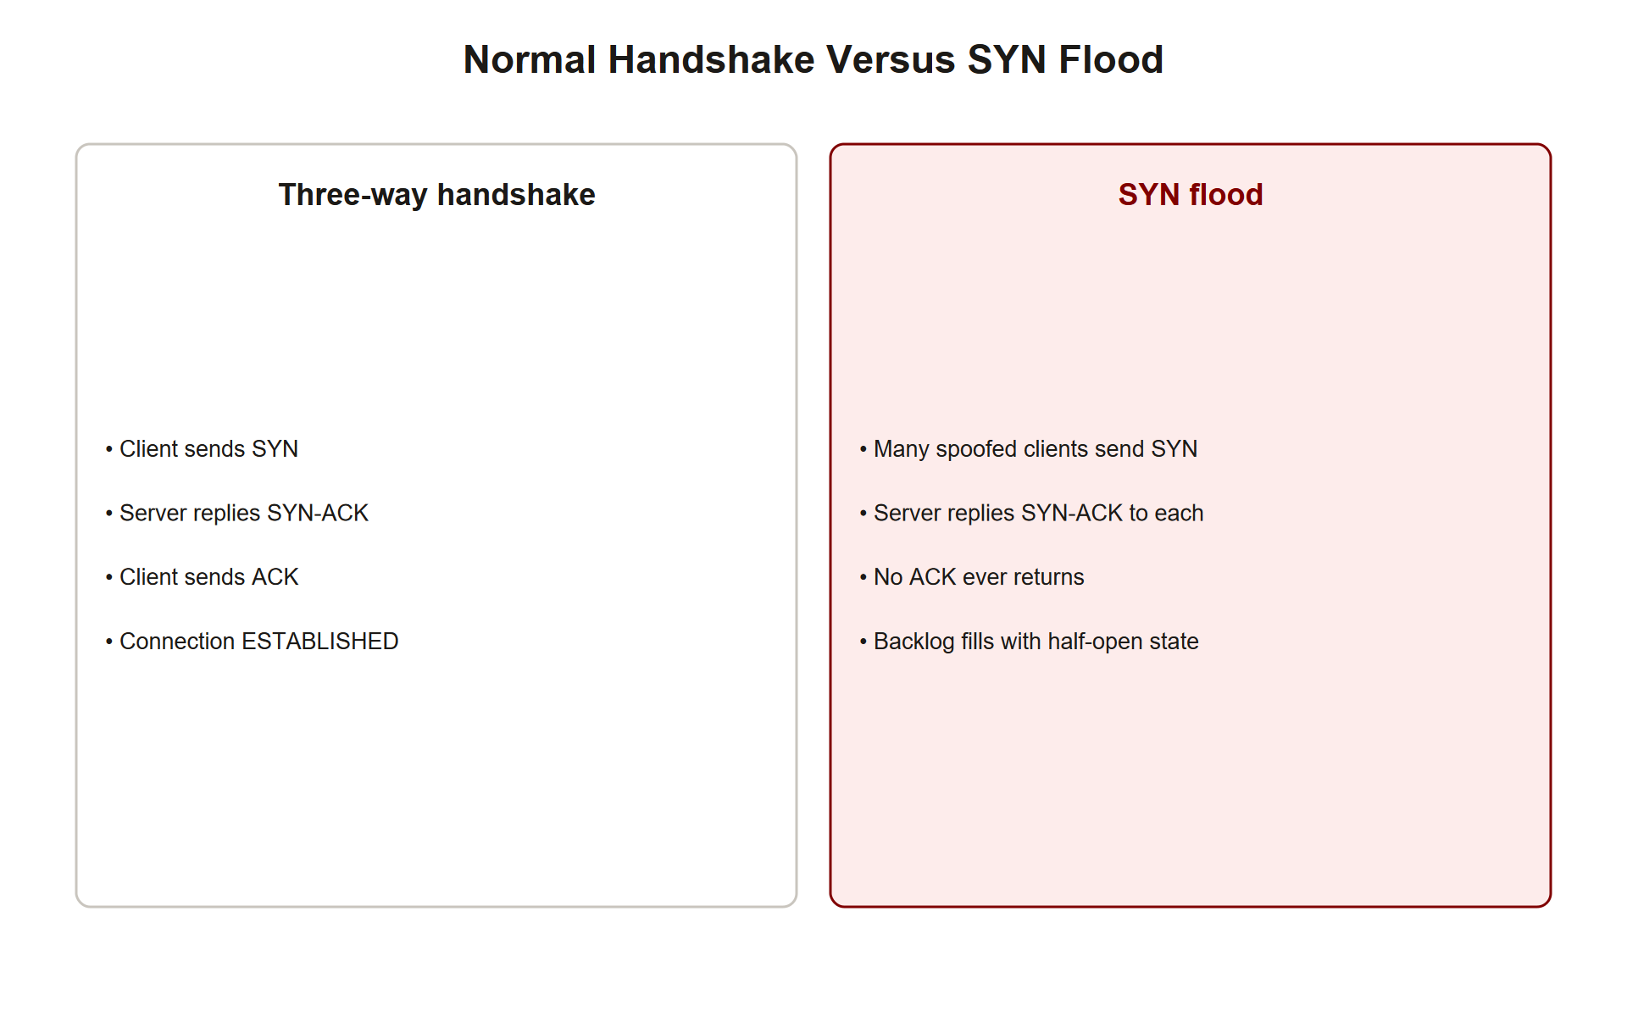
TOPIC 3.1 · 3.1.4.a.2
?
The SYN Flood and the TCP Three-Way Handshake
Handshake: Client SYN → server SYN-ACK (allocates state) → client ACK (connection established), RFC 9293
The attack: Flood SYNs, often with spoofed source IPs, and never send the completing ACK
Half-open connections: Each SYN forces the kernel to allocate a control block in the finite backlog/SYN queue
Exhaustion: Once the backlog fills, the server drops new SYNs, legitimate clients cannot connect
Resource consumed: Kernel connection-state memory, not bandwidth
Mitigation: SYN cookies (RFC 4987) defer state allocation until the handshake is provably complete
Syn Flood Handshake
Notes:
The classic protocol-layer DoS is the SYN flood, which abuses the mechanics of the TCP three-way handshake defined in RFC 9293. Normally the client sends a SYN, the server replies with a SYN-ACK while allocating state for the half-open connection, and the client completes the exchange with a final ACK.
In a SYN flood, the attacker, often spoofing the source IP so replies never return and never trigger a completing ACK or reset, sends a high rate of SYN packets. Each SYN causes the victim's kernel to allocate a control block in its finite connection backlog (SYN) queue and reply with a SYN-ACK, waiting for an ACK that never arrives. Once the backlog fills, the server can no longer accept legitimate connections.
The resource exhausted is kernel connection-state memory, not bandwidth, which is why a SYN flood is measured in packets per second. The standard mitigation is SYN cookies: instead of allocating memory on the initial SYN, the server cryptographically encodes connection state into the SYN-ACK's sequence number and only allocates real state once the client's ACK proves the handshake completed.

Slide 21
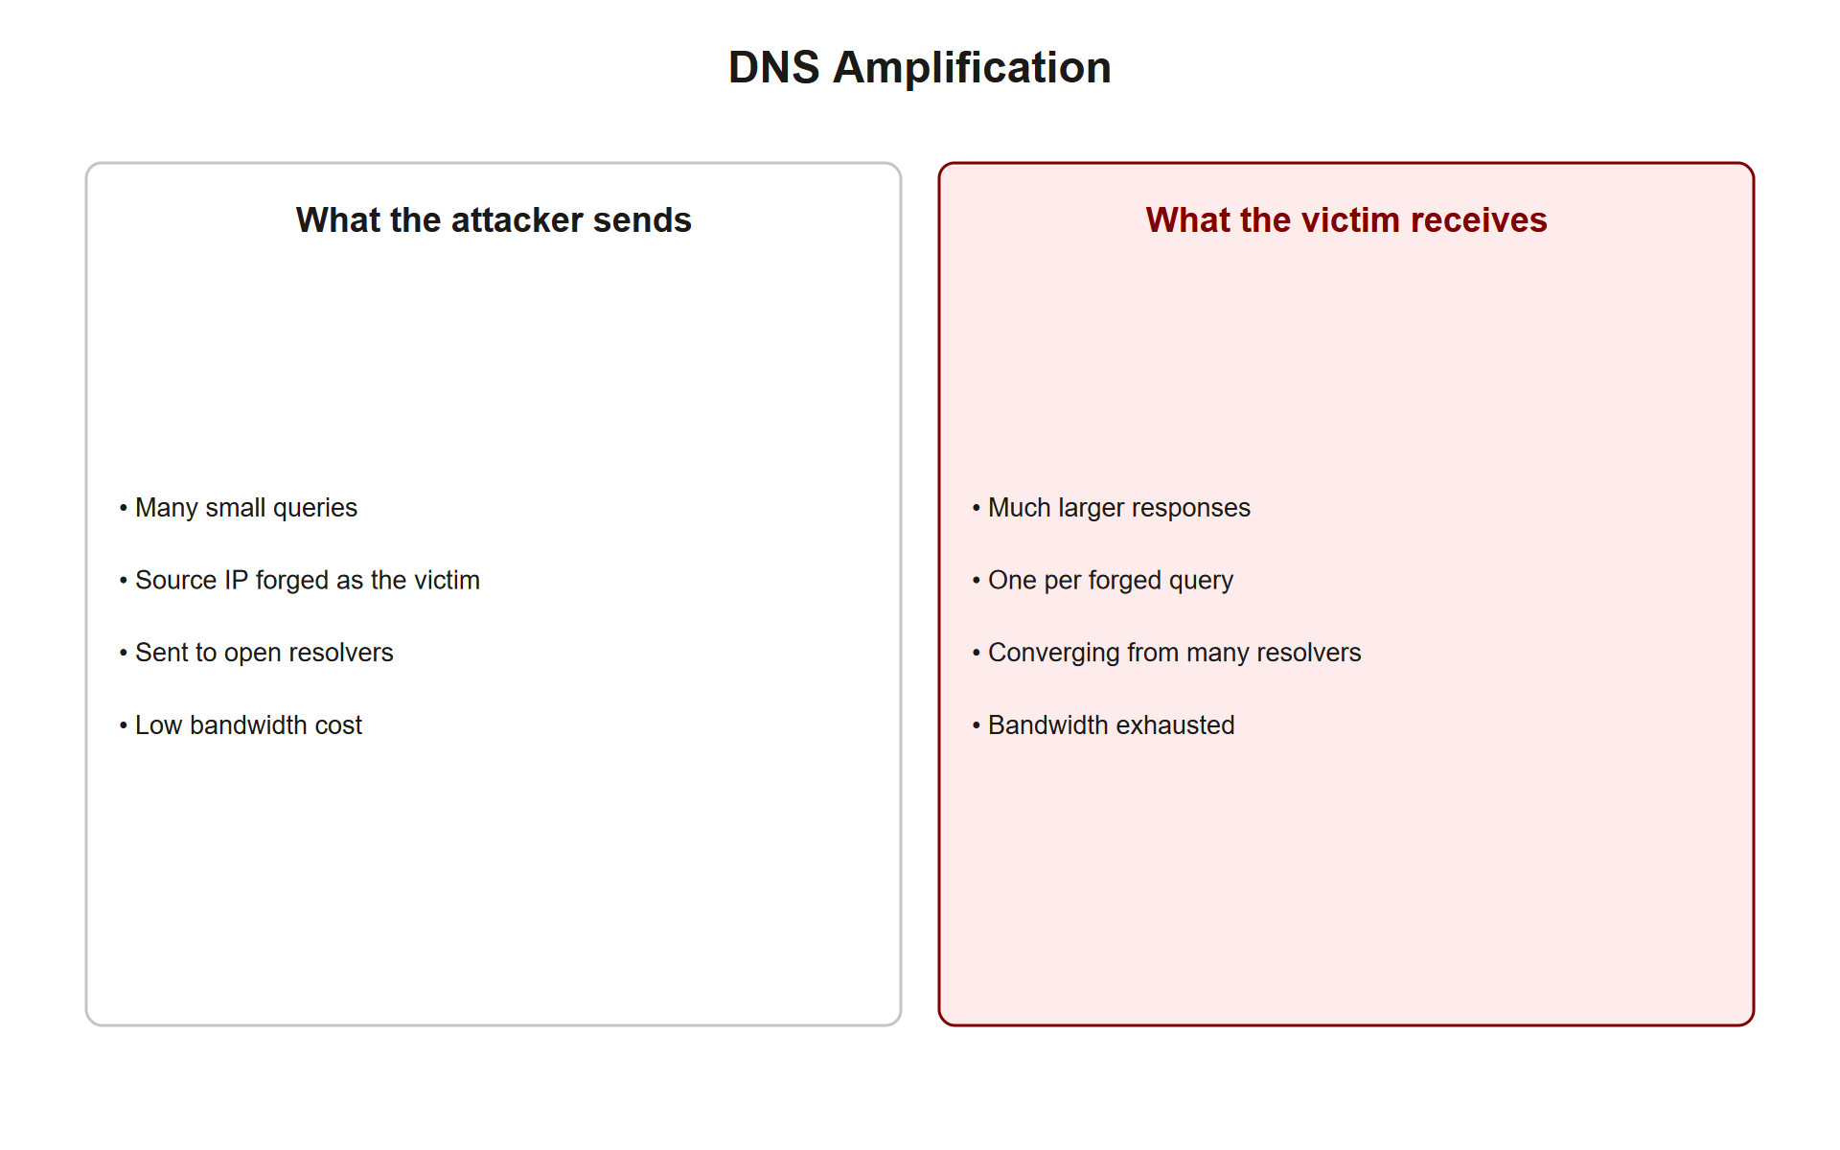
TOPIC 3.1 · 3.1.4.a.3
Reflection and Amplification Attacks
Reflection: Attacker spoofs the victim's IP as source; a third-party server sends its reply to the victim
Amplification: The reply is far larger than the request, multiplying the attacker's effective bandwidth
Why UDP: Connectionless UDP services permit trivial source-IP spoofing (no handshake to complete)
DNS amplification: Small ANY/DNSSEC query yields ~28–54x larger response
NTP amplification: The legacy monlist command has achieved factors exceeding 500x
Mitigation: Source address validation (BCP 38 / RFC 2827) at the edge; disable open resolvers (BCP 140)
Dns Amplification
Notes:
Large-scale volumetric attacks are frequently launched by botnets and further magnified through reflection and amplification. In a reflection attack, the attacker sends a request to a third-party server with the victim's IP spoofed as the source; the server, believing the victim asked, sends its reply directly to the victim. 'Reflection' describes the redirected response. 'Amplification' describes the fact that the response is disproportionately larger than the request, multiplying the attacker's effective bandwidth.
These attacks exploit connectionless UDP-based services because UDP has no handshake and therefore permits trivial source-IP spoofing. DNS amplification abuses open recursive resolvers: a small query for a record type with a large response (ANY or DNSSEC) yields roughly 28–54x amplification. NTP amplification via the legacy monlist command has historically exceeded 500x.
The best mitigations sit at the network edge. Source address validation (BCP 38 / RFC 2827) prevents spoofed-source packets from ever leaving a network, and disabling open recursive resolvers (BCP 140) removes the reflectors themselves.

Slide 22
TOPIC 3.1 · 3.1.4.b.1
Case Study: The 2016 Dyn DNS DDoS (Mirai Botnet)
Date/target: October 21, 2016, Dyn, a major managed DNS provider for Twitter, Netflix, Reddit, Spotify, GitHub
Effect: Dozens of major services unreachable for much of a business day on the U.S. East Coast
Weapon: Mirai botnet, hundreds of thousands of IoT devices (routers, DVRs, IP cameras)
Recruitment: Scanned for open Telnet and tried a small dictionary of default credentials (admin/admin, root/12345)
Scale: Estimated peak exceeding 1 Tbps via volumetric floods and DNS water-torture queries
Lesson: Single points of failure (outsourced DNS) and insecure consumer IoT are systemic risks
Notes:
On October 21, 2016, Dyn, a major managed DNS provider, was hit with a sustained DDoS that rendered Twitter, Netflix, Reddit, Spotify, GitHub, and others unreachable for large portions of the U.S. East Coast for most of a business day. Because these companies had outsourced authoritative DNS resolution to Dyn, taking down Dyn functionally took the sites offline, even though the sites' own servers were perfectly healthy.
The attack was generated by the Mirai botnet, which had compromised hundreds of thousands of poorly secured IoT devices by scanning the internet for open Telnet ports and trying a small hardcoded list of default factory credentials. Each compromised device joined a command-and-control network that directed synchronized floods estimated to exceed 1 Tbps.
The incident is academically significant for two reasons. First, it exposed a supply-chain fragility: a single third-party dependency became a single point of failure cascading across unrelated companies. Second, it showed that the weakest link is often consumer IoT with no security lifecycle, no patching, no forced credential rotation, and little manufacturer incentive to harden.

Slide 23
05
Network Worms and Lateral Movement
Topic 3.1
Notes:
Transition to part 5 of the topic. Pause here for questions before continuing.

Slide 24
TOPIC 3.1 · 3.1.5.a.1
Network Worms and Lateral Movement
Worm: Self-replicating malware that spreads autonomously with no user interaction
Mechanism: Scan for a remotely reachable vulnerable service, exploit it, copy itself, repeat
Virus contrast: A virus needs a host file and usually user action (opening an attachment) to spread
Lateral movement: Moving from an initial foothold to other internal systems (MITRE TA0008)
Common vector: Server Message Block (SMB) over TCP 445, a frequent RCE target in Windows environments
Worms vs. humans: Worms automate lateral movement; ransomware crews often do it manually
Notes:
Distinct from denial of service, network worms exploit vulnerable network-facing services to spread copies of themselves from host to host with no user interaction. The process, scan for a reachable vulnerable service, exploit it to gain code execution, copy the malware to the new host, and repeat, is a form of lateral movement (MITRE Tactic TA0008). When a worm performs the pivoting itself it is autonomous propagation; when human operators do it after an initial breach it is manual lateral movement.
The distinction from a virus matters: a virus requires a host file and typically user action, such as opening an attachment, to propagate. A worm needs neither, it finds and infects reachable hosts on its own, which is why worm outbreaks can escalate at machine speed.
A canonical propagation vector is Server Message Block (SMB), a Windows file-sharing and IPC protocol running over TCP port 445. Its complexity and long history of implementation bugs have made it a frequent target for remote code execution.

Slide 25
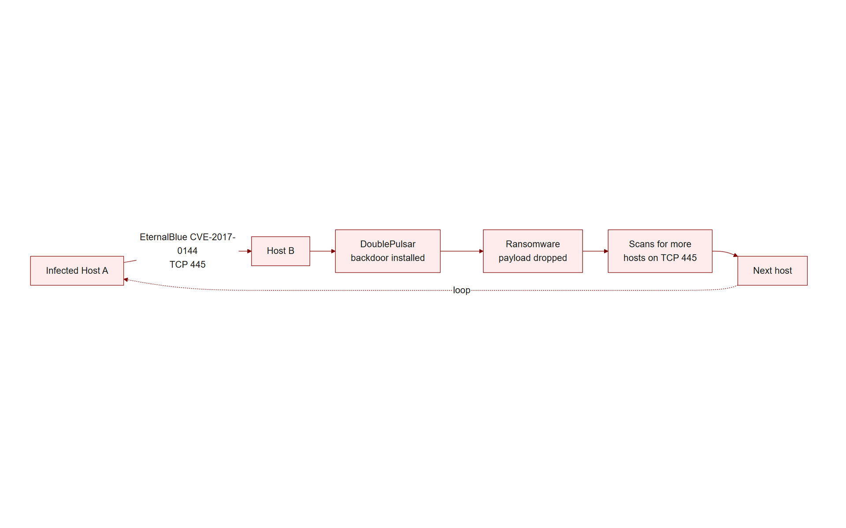
TOPIC 3.1 · 3.1.5.a.2
?
Case Study: WannaCry, EternalBlue, and CVE-2017-0144
May 2017: WannaCry ransomware worm hit 200,000+ computers across 150+ countries within days
Victims: U.K. National Health Service, Telefónica, FedEx, and many others
Exploit: EternalBlue, RCE in Microsoft's SMBv1 (CVE-2017-0144), leaked from the NSA by the Shadow Brokers
Chain: EternalBlue → DoublePulsar backdoor → ransomware payload → scan local /24 for more SMB hosts
Zero interaction: No user needed to click anything for the worm to spread host to host
Root cause: Patch MS17-010 shipped a full month earlier, this was a patch-management failure, not a zero-day
Wannacry Propagation
Notes:
In May 2017, the WannaCry ransomware worm spread to over 200,000 computers across at least 150 countries within days, crippling parts of the U.K.'s National Health Service, Spain's Telefónica, and FedEx. WannaCry's propagation engine exploited EternalBlue (CVE-2017-0144), a remote code execution flaw in Microsoft's legacy SMBv1 implementation, developed by the NSA and leaked by the Shadow Brokers in April 2017.
Once EternalBlue granted code execution with SYSTEM privileges, WannaCry installed the DoublePulsar kernel backdoor, dropped its ransomware payload, then scanned the local subnet for additional SMB-exposed hosts on TCP 445, repeating the exploit chain with no human operator at any stage. No user interaction occurred anywhere in the chain.
Critically, Microsoft had released patch MS17-010 for this exact vulnerability a full month before the outbreak. The devastating spread was therefore largely a story of failed patch management rather than a genuine zero-day surprise. The outbreak was slowed, not stopped, when researcher Marcus Hutchins registered an unregistered 'kill switch' domain hardcoded in the malware.

Slide 26
06
Defense-in-Depth Across the Layers
Topic 3.1
Notes:
Transition to part 6 of the topic. Pause here for questions before continuing.

Slide 27
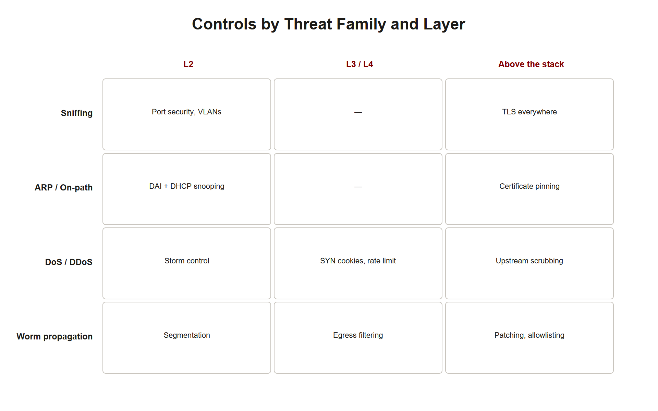
TOPIC 3.1 · 3.1.6.a.1
Defense-in-Depth Across the Layers
No single control suffices: Sniffing, ARP spoofing, DoS, and worms each need different defenses
Layer 2: DAI + DHCP snooping, port security, VLAN segmentation, stop sniffing and on-path attacks
Layer 3/4: SYN cookies, BCP 38 ingress filtering, DDoS scrubbing, stop denial of service
Patch + deprecate: Apply updates promptly, disable SMBv1, restrict port 445 internally, stop worms
Segmentation as force multiplier: VLANs shrink the blast radius of any Layer 2 attack
Detection: IDS tuned for internal lateral scanning flags active worm propagation
Defense In Depth Layers
Notes:
Defense against network-level exploits requires controls at multiple layers of the stack, because no single control addresses sniffing, ARP spoofing, denial of service, and worm propagation simultaneously. The disciplined way to structure a defense, and a defense answer on the exam, is by OSI layer.
At Layer 2, Dynamic ARP Inspection with DHCP snooping, port security, and VLAN segmentation stop ARP-based sniffing and on-path attacks and contain their blast radius. At Layer 3/4, SYN cookies defeat protocol-state exhaustion, BCP 38 ingress filtering prevents spoofed-source packets, and DDoS scrubbing services absorb volumetric floods before they reach the origin. Above the network stack, timely patch management, deprecating legacy protocols like SMBv1, and restricting port 445 between internal segments stop worm propagation.
Segmentation is a force multiplier across all of these: by shrinking broadcast domains, it limits how far any single compromise can reach. Detection, an IDS tuned to spot anomalous internal scanning, provides the final safety net against an active worm.

Slide 28
TOPIC 3.1 · 3.1.6.a.2
Detecting a SYN Flood from Captured Packets (Python)
Signal: Many SYNs with few matching SYN-ACK completions from a single destination
Heuristic: Count SYN-only packets per source and per destination over a window
Half-open ratio: A high SYN-to-ACK ratio flags likely flooding
Spoofing hint: A huge count of distinct source IPs each sending a single SYN is suspicious
Practical use: Feed the count into an alerting threshold or IDS rule
Notes:
Detection turns raw packet data into actionable signal. The script below models the core SYN-flood heuristic: over a set of captured packets, it counts SYN-only segments (SYN set, ACK clear) per destination and compares them against completing ACKs. A destination receiving a large number of half-open SYNs relative to completed handshakes is a strong candidate for a SYN flood.
In a production IDS, this logic runs continuously over a sliding time window with a tuned threshold, and the diversity of source IPs is used as an additional signal, thousands of distinct sources each sending exactly one SYN is a hallmark of spoofed-source flooding. The example uses plain data structures so it runs anywhere, but the same logic underlies rules in Suricata and Snort.

Slide 29
TOPIC 3.1 · 3.1.6.b.1
?
Practice: Classifying Network Attacks
Skill: Given a scenario, identify the exploit family, the OSI layer, and the correct countermeasure
Confidentiality threats: Sniffing, MAC flooding, ARP spoofing, SSL stripping
Availability threats: SYN flood (protocol), DNS/NTP amplification (volumetric), HTTP flood (application)
Propagation threats: Worms via unpatched network services (e.g., SMBv1)
Method: Name the mechanism, not just the symptom, that is what earns credit
Notes:
This practice slide consolidates the diagnostic skill the topic builds toward: reading a scenario and correctly classifying it. Confidentiality attacks (sniffing, MAC flooding, ARP spoofing, SSL stripping) capture or alter data in transit. Availability attacks fall into volumetric, protocol, and application-layer DoS. Propagation attacks (worms) achieve code execution and self-replicate.
Work the quiz below by first identifying the exhausted resource or exploited trust assumption, then the OSI layer, then the layer-appropriate control. Resist matching on symptoms alone, 'the site went down' fits both a DDoS and a worm, so you must reason from the mechanism.

Slide 30
07
What Sniffed Traffic Actually Exposes
Topic 3.1
Notes:
Transition to part 7 of the topic. Pause here for questions before continuing.

Slide 31
TOPIC 3.1 · 3.1.2.b.1
What Sniffed Traffic Actually Exposes
Cleartext protocols: HTTP, FTP, Telnet, POP3/IMAP, and SNMPv1/2c transmit credentials in the clear
Session tokens: Cookies captured mid-session enable session hijacking without a password
Metadata: Even encrypted traffic leaks endpoints, timing, sizes, and SNI/DNS lookups
Stream reassembly: Wireshark's 'Follow TCP Stream' rebuilds full conversations from captured packets
Credential harvesting: A single captured Telnet login yields a reusable administrative password
Notes:
The danger of sniffing is not the raw frames but what they carry. Legacy cleartext protocols, HTTP, FTP, Telnet, POP3/IMAP, SNMPv1/2c, transmit usernames and passwords with no encryption whatsoever. A single captured login can hand an attacker reusable administrative credentials.
Beyond passwords, session cookies are prime targets: capturing a valid session token lets an attacker impersonate a logged-in user without ever knowing the password, a technique called session hijacking. Wireshark's stream-reassembly features rebuild entire conversations, emails, web pages, file transfers, from the captured packet sequence.
Even when payloads are encrypted, traffic still leaks metadata: which hosts talk to which, when, how often, and how much. DNS queries and TLS SNI fields often reveal the destination site name in the clear, allowing surveillance even without decrypting content.

Slide 32
TOPIC 3.1 · 3.1.2.b.2
Encryption: The Real Defeat of Passive Sniffing
Principle: If captured traffic is encrypted end-to-end, sniffing yields ciphertext with no usable content
TLS/HTTPS: Protects web and API traffic; the modern default for all sensitive services
SSH: Replaces cleartext Telnet and rlogin for remote administration
VPN tunnels: Encrypt all traffic across an untrusted segment (e.g., public Wi-Fi)
Why encryption beats detection: Passive capture leaves no footprint to alert on, you cannot detect it, only render it useless
Notes:
Because passive sniffing produces no detectable footprint, the correct primary defense is not detection but encryption. If the traffic an attacker captures is encrypted end-to-end, the capture yields only ciphertext, the confidentiality of the data survives even a total loss of physical medium security.
In practice this means TLS/HTTPS for web and API traffic, SSH in place of Telnet for remote administration, SFTP/SCP in place of FTP, and VPN tunnels to protect all traffic traversing an untrusted segment such as public Wi-Fi. Encryption transforms the sniffing problem from 'prevent all capture', which is nearly impossible on shared or wireless media, into 'ensure captured bytes are meaningless.'
This is a foundational security lesson: when you cannot prevent an adversary from observing, make observation worthless.

Slide 33
07
Detecting ARP Spoofing
Topic 3.1
Notes:
Transition to part 7 of the topic. Pause here for questions before continuing.

Slide 34
TOPIC 3.1 · 3.1.3.c.1
Detecting ARP Spoofing
Duplicate MAC: The same MAC address suddenly claiming two different IPs (victim + gateway) is a red flag
Changed binding: A gateway IP whose MAC changes unexpectedly signals possible poisoning
Tools: arpwatch and XArp log and alert on IP-to-MAC binding changes over time
Traffic clue: A sudden burst of unsolicited ARP replies (gratuitous ARP) on the segment
Static entries: Hard-coding the gateway's MAC on critical hosts prevents override (but does not scale)
Notes:
While Dynamic ARP Inspection prevents poisoning at the switch, host- and monitor-level detection provides defense in depth. The classic tell-tale is a single MAC address suddenly bound to two IPs, typically the attacker's MAC claiming both the victim's and the gateway's addresses. Tools like arpwatch and XArp continuously record IP-to-MAC bindings and raise an alert whenever a binding changes unexpectedly, such as the default gateway's MAC suddenly changing.
Another signal is a burst of unsolicited (gratuitous) ARP replies on a segment where none is expected. On individual critical hosts, administrators can pin static ARP entries for the gateway so a forged reply cannot override the mapping, effective but operationally unscalable across a large fleet, which is why switch-level DAI is preferred for enterprise deployment.

Slide 35
TOPIC 3.1 · 3.1.3.c.2
DNS Spoofing and Session Hijacking as On-Path Payloads
Once on-path: An attacker can do more than watch, they can forge responses and steal sessions
DNS spoofing: Reply to a victim's DNS query with a forged IP, redirecting them to an attacker server
Session hijacking: Steal an active session cookie/token to impersonate the logged-in user
TCP hijacking: With visibility of sequence numbers, inject valid segments into an existing connection
Defense: DNSSEC signs DNS responses; Secure/HttpOnly cookies and TLS protect sessions
Notes:
An on-path position obtained via ARP poisoning is a platform for several active follow-on attacks. In DNS spoofing, the attacker answers the victim's DNS query faster than the real resolver with a forged record, redirecting the victim to a malicious server while the address bar still shows the expected domain. In session hijacking, the attacker lifts an active session cookie from intercepted traffic and replays it to impersonate the authenticated user without ever learning the password. In classic TCP hijacking, an attacker who can observe sequence numbers injects crafted segments into an existing connection.
Defenses target each layer: DNSSEC cryptographically signs DNS records so forged responses are rejected; Secure and HttpOnly cookie flags plus end-to-end TLS keep session tokens encrypted and inaccessible to interception; and encryption in general denies the attacker the plaintext and sequence visibility these attacks require.

Slide 36
07
DDoS: Why 'Distributed' Changes Everything
Topic 3.1
Notes:
Transition to part 7 of the topic. Pause here for questions before continuing.

Slide 37
TOPIC 3.1 · 3.1.4.b.2
DDoS: Why 'Distributed' Changes Everything
DoS vs. DDoS: DoS comes from one source; DDoS floods from thousands of coordinated sources
Botnet command: A C2 server directs compromised zombies to strike a single target simultaneously
Filtering is hard: You cannot simply block one IP, the traffic looks like it comes from everywhere
Attribution is hard: Real attackers hide behind the botnet and spoofed sources
Capacity asymmetry: Defenders must provision or rent more capacity than the aggregate attack
Notes:
Why is a distributed denial-of-service attack so much harder to stop than a single-source one? Because distribution defeats the simplest defense: blocking the offending source. When traffic arrives from thousands of geographically dispersed, often legitimate-looking devices under botnet control, there is no single IP or subnet to filter, and much of the traffic is indistinguishable from real users at the packet level.
Distribution also frustrates attribution, the true operator hides behind a command-and-control server and a swarm of compromised zombies, while spoofed source addresses obscure origins further. Finally, DDoS imposes a capacity asymmetry: the defender must be able to absorb or scrub more traffic than the attacker can aggregate, which is why cloud-scale scrubbing services exist. The Mirai/Dyn attack embodied all three difficulties simultaneously.

Slide 38
TOPIC 3.1 · 3.1.4.c.1
Low-and-Slow and Application-Layer Attacks
Slowloris: Opens many connections and sends partial HTTP headers slowly, holding server threads open
Low bandwidth, high impact: Exhausts the connection pool without saturating the link
HTTP flood: Many valid-looking requests for expensive dynamic pages exhaust CPU/database
Hard to filter: Requests are individually legitimate, no malformed packets to drop
Defense: Connection timeouts, per-client rate limits, reverse proxies, and WAFs
Notes:
Not every denial-of-service attack is a flood of raw volume. 'Low-and-slow' attacks like Slowloris open many connections to a web server and send HTTP headers a few bytes at a time, never completing the request. Each half-finished request ties up a server worker thread; with enough of them, the connection pool is exhausted and legitimate users cannot connect, all achieved with minimal bandwidth.
Application-layer HTTP floods take the opposite approach with individually valid requests, repeatedly hitting computationally expensive endpoints (search queries, report generation, login) to exhaust CPU, memory, or database capacity. Both are difficult to filter because the traffic is well-formed and looks like real usage. Defenses operate at the application tier: aggressive connection timeouts, per-client rate limiting, reverse proxies that buffer slow clients, and web application firewalls that fingerprint abusive behavior.

Slide 39
TOPIC 3.1 · 3.1.4.c.2
Record-Breaking Amplification: Memcached and GitHub 2018
February 2018: GitHub absorbed a 1.35 Tbps attack, then the largest ever recorded
Vector: Exposed memcached servers on UDP 11211 with an amplification factor up to ~51,000x
Mechanism: Tiny spoofed request → enormous cached response reflected at the victim
Mitigation: GitHub rerouted through Akamai Prolexic scrubbing within minutes
Root fix: Memcached should never be exposed to the internet; disable UDP; apply BCP 38
Notes:
In February 2018, GitHub was struck by a 1.35 Tbps DDoS, at the time the largest ever publicly recorded. The vector was memcached amplification: thousands of misconfigured memcached caching servers, reachable on UDP port 11211, responded to tiny spoofed requests with cached payloads thousands of times larger, yielding amplification factors reported up to roughly 51,000x. A few gigabits of attacker traffic became a terabit-scale flood aimed at GitHub.
GitHub survived by rerouting its traffic through Akamai's Prolexic scrubbing infrastructure within minutes, which filtered the malicious volume upstream before it reached GitHub's origin. The root-cause fixes are unglamorous but decisive: memcached should never be exposed to the internet, its UDP interface should be disabled, and BCP 38 source-address validation prevents the spoofed requests that make reflection possible in the first place.

Slide 40
07
A Short History of Network Worms
Topic 3.1
Notes:
Transition to part 7 of the topic. Pause here for questions before continuing.

Slide 41
TOPIC 3.1 · 3.1.5.b.1
A Short History of Network Worms
Morris Worm (1988): First major internet worm; exploited fingerd/sendmail; crashed ~10% of the early internet
Code Red (2001): Exploited IIS; defaced pages and launched DoS against the White House IP
SQL Slammer (2003): 376-byte UDP worm; doubled every ~8.5 seconds; saturated links worldwide in minutes
Conficker (2008): Exploited a Windows RPC flaw; built a resilient multi-million-host botnet
WannaCry/NotPetya (2017): Weaponized EternalBlue; ransomware/wiper payloads at global scale
Notes:
Network worms are not new, they are one of the oldest classes of malware, and their history illustrates the enduring pattern of exploiting a reachable, unpatched service. The 1988 Morris Worm, written by a graduate student, exploited flaws in fingerd and sendmail and inadvertently crashed a large fraction of the nascent internet, prompting the creation of the first CERT. Code Red (2001) exploited Microsoft IIS. SQL Slammer (2003), a mere 376-byte UDP payload, doubled its infected population roughly every 8.5 seconds and congested networks worldwide within minutes, the fastest-spreading worm in history.
Conficker (2008) exploited a Windows RPC vulnerability to assemble a resilient botnet of millions. WannaCry and NotPetya (2017) weaponized the leaked EternalBlue exploit. Across three decades the lesson is constant: a remotely exploitable, unpatched network service is a worm's runway, and speed of propagation consistently outpaces human response.

Slide 42
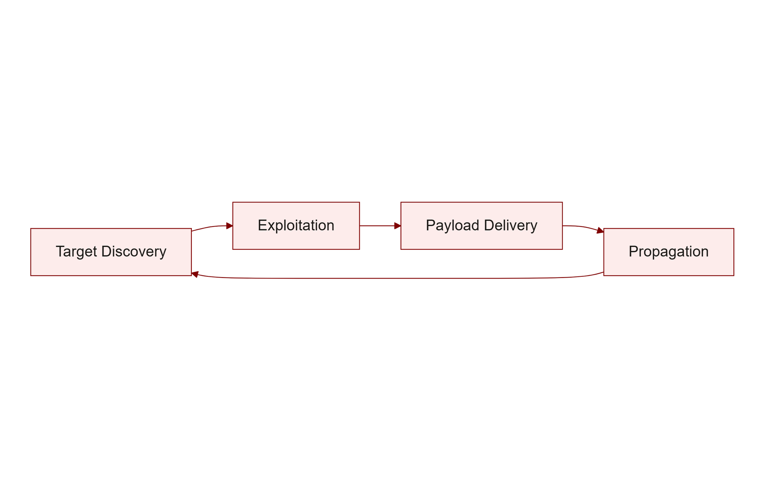
TOPIC 3.1 · 3.1.5.b.2
The Worm Lifecycle and Containing Propagation
1. Target discovery: Scan address ranges for hosts running the vulnerable service/port
2. Exploitation: Trigger the remote vulnerability to gain code execution
3. Payload delivery: Copy the worm body and any secondary payload (backdoor, ransomware)
4. Propagation: From each new host, repeat discovery, exponential growth
Containment: Patch the service, segment the network, restrict the port internally, detect scanning
Worm Lifecycle
Notes:
Every network worm follows the same four-phase lifecycle: target discovery (scanning for reachable vulnerable hosts), exploitation (triggering the remote flaw to gain execution), payload delivery (copying itself plus any secondary payload), and propagation (each newly infected host restarting the cycle). Because every infected host becomes a new scanner, uncontained growth is exponential, which is why worms can span the globe in hours.
Containment attacks each phase. Patching removes the exploitable flaw, eliminating exploitation. Network segmentation and internal firewall rules restrict which hosts can even reach the vulnerable port (e.g., blocking SMB/445 between segments), throttling discovery and propagation. Intrusion detection tuned to spot the anomalous internal scanning of the discovery phase provides early warning regardless of the specific exploit. No single measure is sufficient; together they break the exponential chain.

Slide 43
07
Ingress and Egress Filtering (BCP 38 in Practice)
Topic 3.1
Notes:
Transition to part 7 of the topic. Pause here for questions before continuing.

Slide 44
TOPIC 3.1 · 3.1.6.a.3
Ingress and Egress Filtering (BCP 38 in Practice)
Ingress filtering: Drop inbound packets whose source addresses could not legitimately originate from that direction
Egress filtering: Drop outbound packets whose source is not a valid internal address, stops your network spoofing others
BCP 38 / RFC 2827: The best-practice standard mandating source-address validation at the edge
Anti-spoofing payoff: Universally deployed, it would eliminate reflection/amplification DDoS
Bonus: Egress filtering also flags compromised internal hosts attempting to spoof or exfiltrate
Notes:
Source-address validation is one of the highest-leverage yet under-deployed network defenses. Ingress filtering drops inbound packets whose claimed source address could not legitimately arrive on that interface. Egress filtering, arguably more important for good internet citizenship, drops outbound packets whose source is not a valid address from inside your own network, preventing your hosts from spoofing others.
Codified as BCP 38 (RFC 2827), egress source-address validation directly disables the spoofed-source packets that reflection and amplification DDoS attacks depend on. If every network operator enforced it, spoofing-based attacks would largely vanish; incomplete adoption is precisely why they persist. As a bonus, egress filtering surfaces compromised internal machines attempting to spoof source addresses or exfiltrate data, doubling as a detection signal.

Slide 45
TOPIC 3.1 · 3.1.6.a.4
Managerial Controls: Policy, Patching, and IoT Governance
Patch management policy: Defined SLAs for applying critical updates (WannaCry proved the cost of delay)
Asset inventory: You cannot patch or segment what you do not know exists, especially IoT
Default-credential prohibition: Enforce credential changes on deployment (echoing California SB-327)
Vendor/supply-chain review: Assess third-party dependencies (Dyn showed single-point-of-failure risk)
Incident response plan: Predefined DDoS and worm playbooks shorten time-to-mitigation
Notes:
Technical controls operate inside a managerial framework, and the case studies in this topic are as much governance failures as technical ones. WannaCry was fundamentally a patch-management failure; Mirai/Dyn exposed default-credential and supply-chain dependency risks. Accordingly, a mature program defines patch-management SLAs that require critical updates within a bounded window, maintains an accurate asset inventory (you cannot patch or segment unknown devices, and IoT is the usual blind spot), and prohibits deployment of devices with default credentials, the same principle California codified in SB-327.
Governance also demands supply-chain and vendor risk review, because outsourced dependencies like DNS can become single points of failure, and predefined incident-response playbooks for DDoS and worm outbreaks so that engaging a scrubbing service or isolating a segment is a rehearsed action rather than an improvised scramble. Managerial and technical controls reinforce each other; neither suffices alone.

Slide 46
TOPIC 3.1 · 3.1.6.b.3
?
Practice: DoS Attack Type Identification
Signal 1, resource: Is bandwidth, connection state, worker threads, or CPU/DB being exhausted?
Signal 2, volume: High-throughput flood vs. low-and-slow trickle vs. valid-looking requests
Signal 3, sources: One source, a botnet swarm, or reflected off third parties
Map to type: volumetric / protocol / application-layer / reflection-amplification
Then choose control: scrubbing / SYN cookies / rate limiting / BCP 38
Notes:
This practice slide drills the DoS diagnostic pipeline: identify the exhausted resource, the traffic profile, and the source pattern, then classify the attack and select the matching control. A high-bandwidth flood from a botnet is volumetric (scrubbing). A modest-bandwidth SYN storm filling the backlog is protocol (SYN cookies). A trickle of partial requests holding threads open is low-and-slow (timeouts). A swarm of valid page requests hammering the database is application-layer (rate limiting/WAF). A terabit flood reflected off open resolvers is reflection-amplification (BCP 38 + scrubbing). Reason from mechanism, then answer.

Slide 47
07
Anatomy of a Packet: Headers Attackers Forge
Topic 3.1
Notes:
Transition to part 7 of the topic. Pause here for questions before continuing.

Slide 48
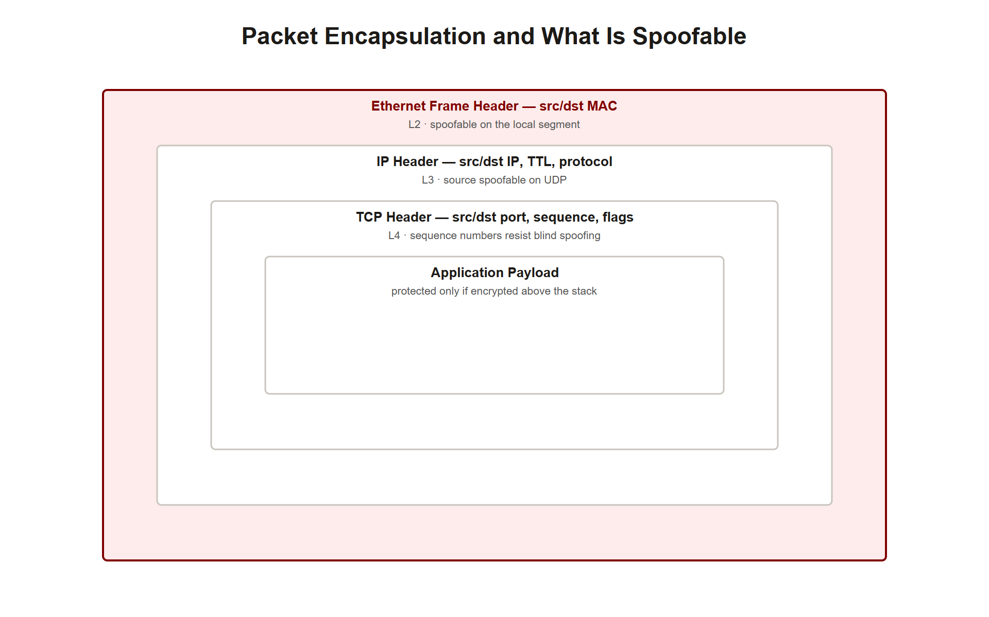
TOPIC 3.1 · 3.1.1.a.4
Anatomy of a Packet: Headers Attackers Forge
Encapsulation: Application data is wrapped in TCP/UDP, then IP, then an Ethernet frame, each layer adds a header
Ethernet header (L2): Source/destination MAC, trivially spoofable in software
IP header (L3): Source/destination IP, TTL, protocol, source IP spoofable on connectionless UDP
TCP header (L4): Ports, sequence/ack numbers, flags (SYN, ACK, FIN, RST)
Why it matters: Nearly every network attack forges or abuses a specific header field
Packet Encapsulation
Notes:
To understand network exploits at a mechanical level, you must understand how data is packaged. Encapsulation wraps application data in successive headers: a TCP or UDP header (Layer 4, carrying ports and, for TCP, sequence/acknowledgment numbers and control flags), an IP header (Layer 3, carrying source and destination IP addresses, TTL, and protocol), and finally an Ethernet frame header (Layer 2, carrying source and destination MAC addresses).
Each field is a potential lever. MAC addresses are trivially spoofable in software (enabling ARP spoofing and MAC spoofing). Source IP addresses can be forged on connectionless UDP (enabling reflection/amplification). TCP flags define the handshake a SYN flood abuses, and sequence numbers are what a hijacker must predict. Reading these headers, in Wireshark or tcpdump, is the core forensic skill of this unit, because the attack is almost always visible as an anomaly in a specific field.

Slide 49
07
Port Scanning and Network Reconnaissance
Topic 3.1
Notes:
Transition to part 7 of the topic. Pause here for questions before continuing.

Slide 50
TOPIC 3.1 · 3.1.2.a.4
Port Scanning and Network Reconnaissance
Reconnaissance: Before exploitation, attackers map which hosts exist and which services they run
Port scan: Probe TCP/UDP ports to discover open, closed, or filtered services (e.g., nmap)
SYN scan: Send SYN, infer state from SYN-ACK (open) vs RST (closed), never completing the handshake ('half-open')
Service/version detection: Banner grabbing reveals software versions to match against known CVEs
Detection: A single source touching many ports/hosts quickly is a classic IDS signature
Notes:
Exploitation is preceded by reconnaissance: the attacker must learn which hosts are alive and which services they expose. Port scanning is the primary tool. A scanner such as nmap probes a range of TCP or UDP ports and classifies each as open, closed, or filtered based on the responses. A TCP SYN ('half-open') scan sends a SYN and infers the port state from the reply, a SYN-ACK means open, a RST means closed, and silence often means a firewall is filtering, without ever completing the handshake, making it faster and stealthier than a full connect scan.
Beyond discovering open ports, service and version detection (banner grabbing) identifies the exact software and version behind a port, which the attacker cross-references against known CVEs to select an exploit. This is exactly the discovery phase a worm automates. Because scanning produces a distinctive pattern, one source rapidly touching many ports or many hosts, it is one of the most reliably detectable precursor behaviors for an IDS.

Slide 51
TOPIC 3.1 · 3.1.2.c.1
MAC Spoofing and Its Limits
MAC spoofing: Software-changing a NIC's source MAC to impersonate another device or evade filters
Uses: Bypass MAC-based access control, defeat MAC allow-lists, or masquerade after port security learns a MAC
Trivial to do: One command (ip link set eth0 address ..), MAC is not a security credential
Limit, Layer 2 only: Like ARP attacks, confined to the local segment
Defense: 802.1X port authentication ties access to credentials, not to a forgeable MAC
Notes:
A MAC address is a hardware identifier, but it is not a security credential, it can be changed in software with a single command. MAC spoofing sets a NIC's source MAC to an arbitrary value, letting an attacker impersonate another device, bypass MAC-based access control lists (common on Wi-Fi and captive portals), or masquerade as a device that port security has already learned and authorized.
The limitation mirrors other Layer 2 attacks: MAC spoofing only affects the local segment. Its real lesson is architectural, any control that trusts a MAC address as proof of identity is fundamentally weak, because the identifier is attacker-controlled. The robust replacement is 802.1X port-based network access control, which requires a device to authenticate with real credentials (via a RADIUS server) before the switch port forwards any traffic, binding access to something that cannot be trivially forged.

Slide 52
07
Deep Question: Why Not Just Authenticate ARP?
Topic 3.1
Notes:
Transition to part 7 of the topic. Pause here for questions before continuing.

Slide 53
TOPIC 3.1 · 3.1.3.a.4
Deep Question: Why Not Just Authenticate ARP?
The obvious fix: Cryptographically sign ARP replies so forgeries are rejected
S-ARP proposal: Research designs added public-key signatures to ARP, but never saw wide deployment
Cost barrier: Per-packet crypto and a key-distribution/PKI burden on a chatty broadcast protocol
Backward compatibility: The entire installed base speaks unauthenticated ARP; a flag day is impossible
Pragmatic answer: Push validation into the switch (DAI) instead of changing every host's protocol
Notes:
If ARP's flaw is that it is unauthenticated, why not simply add authentication? Researchers did propose exactly this, Secure ARP (S-ARP) and similar schemes attach public-key signatures to ARP messages so a host can verify a reply genuinely came from the claimed IP's owner. The idea is sound, yet none achieved broad deployment, and the reasons are instructive about real-world security engineering.
First, cost: signing and verifying every ARP message imposes cryptographic overhead on an extremely chatty, latency-sensitive broadcast protocol, and it requires a key-distribution or PKI mechanism that ARP was never designed to carry. Second, backward compatibility: the entire installed base of operating systems and devices speaks plain, unauthenticated ARP, and there is no feasible 'flag day' to upgrade the world at once. The pragmatic resolution was to leave the host protocol untouched and instead push validation into the infrastructure, Dynamic ARP Inspection at the switch, where a single upgrade protects many unmodified hosts.

Slide 54
TOPIC 3.1 · 3.1.3.c.3
TCP Reset Attacks and Connection Tampering
RST flag: A TCP segment with RST set immediately tears down a connection
Reset attack: An attacker who can guess/observe the sequence number injects a forged RST to kill a session
Requirements: Correct source/dest IPs and ports plus an in-window sequence number
Uses: Censorship (severing connections), disrupting long-lived sessions (BGP, SSH)
Defense: Encryption/integrity (TLS, IPsec) and larger sequence spaces make injection impractical
Notes:
The TCP RST (reset) flag exists to abruptly terminate a connection, for example when a segment arrives for a socket that no longer exists. An attacker can weaponize it: by forging a segment with the correct source and destination IPs and ports and a sequence number that falls within the receiver's current window, they can inject a spurious RST that tears down a legitimate connection. This is a TCP reset attack, a targeted denial of a specific session rather than a flood.
An on-path attacker who directly observes the sequence numbers can do this reliably; even an off-path attacker can sometimes succeed by guessing within the window. Reset attacks have been used for network censorship (severing prohibited connections) and to disrupt long-lived sessions like BGP peerings or SSH. The defenses are the familiar ones: end-to-end integrity and encryption (TLS, IPsec) prevent an attacker from crafting an accepted segment, and modern large, randomized sequence spaces make blind guessing impractical.

Slide 55
07
ICMP-Based Attacks: Smurf and Ping Floods
Topic 3.1
Notes:
Transition to part 7 of the topic. Pause here for questions before continuing.

Slide 56
TOPIC 3.1 · 3.1.4.a.4
ICMP-Based Attacks: Smurf and Ping Floods
ICMP: The control/diagnostic protocol behind ping and traceroute
Ping flood: Overwhelm a target with ICMP Echo Requests (crude volumetric DoS)
Smurf attack: Send ICMP Echo to a network's broadcast address with the victim's IP spoofed as source
Amplification: Every host on that network replies to the victim, an early reflection technique
Defense: Disable directed broadcasts (RFC 2644), rate-limit ICMP, and apply BCP 38
Notes:
ICMP, the Internet Control Message Protocol, powers diagnostics like ping and traceroute, and has historically been abused for denial of service. A ping flood is the crudest form: overwhelm a target with a high rate of ICMP Echo Requests. More elegant is the Smurf attack, an early reflection/amplification technique. The attacker sends ICMP Echo Requests to a network's broadcast address while spoofing the victim's IP as the source. Every host on that network dutifully replies to the victim, so a single spoofed packet elicits dozens or hundreds of responses converging on the target.
Smurf attacks were devastating in the late 1990s and are now largely historical because the fix was decisive: RFC 2644 changed the default so routers no longer forward directed broadcasts, eliminating the amplifier. Together with ICMP rate limiting and BCP 38 source-address validation, this closed the vector, a clean example of a protocol default change neutralizing an entire attack class.

Slide 57
TOPIC 3.1 · 3.1.4.b.3
Rogue DHCP and DHCP Starvation
DHCP starvation: Flood DHCP requests with spoofed MACs to exhaust the server's address pool
Effect: Legitimate clients cannot obtain a lease, a denial of service on address assignment
Rogue DHCP server: Attacker's server answers first, handing out a malicious gateway/DNS
Outcome: Victims route through the attacker (on-path) or resolve to malicious DNS
Defense: DHCP snooping designates trusted server ports and blocks rogue server replies
Notes:
DHCP, which automatically assigns IP configuration to hosts, is another unauthenticated Layer 2 service ripe for abuse. In DHCP starvation, the attacker floods the legitimate DHCP server with requests bearing spoofed MAC addresses, exhausting its finite pool of leasable addresses so real clients can no longer obtain configuration, a denial of service on the address-assignment function itself.
The starvation is often a setup for the more dangerous rogue DHCP server attack: with the real server unable to respond, the attacker stands up their own DHCP server that answers clients first, handing out an IP configuration that points the victim's default gateway and DNS server at the attacker. The result is an on-path position (all traffic routed through the attacker) and/or DNS redirection, achieved without touching ARP at all.
The defense is DHCP snooping, the same feature that underpins Dynamic ARP Inspection: it marks only legitimate server ports as trusted and drops DHCP server messages arriving on untrusted (end-host) ports.

Slide 58
07
Botnets and Command-and-Control
Topic 3.1
Notes:
Transition to part 7 of the topic. Pause here for questions before continuing.

Slide 59
TOPIC 3.1 · 3.1.5.a.3
Botnets and Command-and-Control
Botnet: A network of compromised devices ('zombies') under unified attacker control
Command-and-control (C2): The channel through which the operator issues orders to the swarm
C2 architectures: Centralized (single server), tiered (proxies), or peer-to-peer (resilient, no single point)
Uses: DDoS floods, spam, credential stuffing, crypto-mining, malware distribution
Takedown lever: Seizing or sinkholing C2 infrastructure disrupts the whole botnet
Notes:
A botnet is a network of compromised, internet-connected devices, a 'zombie army', under the unified command of an attacker. The devices are recruited by malware that scans for and exploits weak credentials or vulnerable services (Mirai's model), and each awaits instructions over a command-and-control (C2) channel. C2 architectures vary in resilience: a simple centralized server is easy to operate but easy to take down; tiered designs interpose proxies; peer-to-peer botnets like later Conficker variants have no single point of failure, making them far harder to dismantle.
Botnets are the engine behind large-scale abuse: volumetric DDoS floods, spam campaigns, credential-stuffing attacks, crypto-mining, and malware distribution, all executed at massive scale by coordinating thousands of hosts. Because the C2 channel is the botnet's nervous system, defenders and law enforcement prioritize identifying and sinkholing or seizing C2 infrastructure, which can neutralize the entire swarm even without cleaning individual infected devices.

Slide 60
TOPIC 3.1 · 3.1.5.b.3
Case Study: NotPetya (2017), When a Worm Is a Weapon
June 2017: NotPetya spread from a compromised Ukrainian accounting-software update (M.E.Doc)
Propagation: Combined EternalBlue with credential theft (Mimikatz) and PsExec/WMI for lateral movement
Disguise: Looked like ransomware but was a wiper, encryption was irreversible by design
Damage: ~$10 billion globally; Maersk, Merck, and FedEx/TNT crippled
Lesson: Supply-chain compromise + aggressive lateral movement defeats a hard perimeter
Notes:
NotPetya, which erupted in June 2017 just weeks after WannaCry, demonstrates a more sophisticated and destructive worm. Its initial vector was a supply-chain compromise: attackers backdoored the update mechanism of M.E.Doc, a Ukrainian accounting package, pushing the malware to organizations that trusted a legitimate software update. Once inside, NotPetya did not rely on EternalBlue alone, it combined the SMB exploit with credential theft (Mimikatz-style harvesting of in-memory passwords) and legitimate administration tools (PsExec, WMI) to move laterally even to fully patched machines using stolen valid credentials.
Though it displayed a ransom note, NotPetya was effectively a wiper: its encryption was irreversible by design, so paying accomplished nothing. Estimated global damage reached roughly $10 billion, crippling shipping giant Maersk, pharmaceutical company Merck, and FedEx's TNT unit. The enduring lesson is that a hard perimeter is no defense against a threat that enters through a trusted supply chain and then spreads using valid credentials and built-in tools, motivating segmentation, credential hygiene, and least privilege.

Slide 61
07
Getting Visibility: TAPs, SPAN, and Sensor Placement
Topic 3.1
Notes:
Transition to part 7 of the topic. Pause here for questions before continuing.

Slide 62
TOPIC 3.1 · 3.1.6.a.5
Getting Visibility: TAPs, SPAN, and Sensor Placement
You can't defend what you can't see: Detection requires a legitimate copy of traffic
SPAN/port mirroring: Switch copies traffic to a monitor port, flexible but can drop under load
Network TAP: A passive hardware device that copies traffic on the wire, reliable, no packet loss
Placement: At perimeter (north-south) and between segments (east-west) for internal visibility
Feeds: IDS/IPS sensors, packet capture, and NetFlow collectors (detailed in Topic 3.5)
Notes:
Every detection capability in Topic 3.5 depends on first obtaining a faithful copy of network traffic, legitimately. Two mechanisms dominate. SPAN (port mirroring) configures the switch to copy traffic from source ports or VLANs to a monitoring port; it is flexible and requires no extra hardware, but under heavy load a switch may drop mirrored packets, silently blinding the sensor. A network TAP is a dedicated passive device inserted in-line on a physical link that copies every bit to a monitoring port with no risk of loss and no impact on the production path, the gold standard for forensic-grade capture.
Placement matters as much as method. Sensors at the perimeter observe north-south traffic (in/out of the organization), while sensors between internal segments observe east-west traffic, exactly where lateral movement and worm propagation occur but where visibility is often weakest. This visibility architecture is the physical foundation for the IDS/IPS and log analysis covered in Topic 3.5.

Slide 63
TOPIC 3.1 · 3.1.6.b.4
?
Practice: Reading a Packet Capture for Indicators
ARP anomaly: One MAC bound to multiple IPs, or the gateway MAC changing → ARP poisoning
SYN anomaly: Many SYNs, few completed handshakes, many source IPs → SYN flood
Scan anomaly: One source touching many ports/hosts in sequence → reconnaissance
Cleartext credentials: Basic-auth or FTP USER/PASS visible → cleartext-protocol risk
Method: Filter, then interpret the pattern against a known attack signature
Notes:
Reading a capture is pattern recognition against known signatures. In Wireshark you filter to isolate a hypothesis, then interpret: arp.duplicate-address-detected or a gateway MAC that changes mid-capture indicates ARP poisoning; a flood of tcp.flags.syn==1 && tcp.flags.ack==0 with almost no completing ACKs and a huge spread of source IPs indicates a SYN flood; one internal source hitting many destination ports in ascending order indicates a port scan; and visible http.authorization or FTP USER/PASS commands indicate credentials traversing a cleartext protocol.
The discipline is always the same: form a hypothesis about the attack, apply a display filter that would confirm or refute it, and read the resulting pattern. The quiz below exercises this reasoning against a described capture.

Slide 64
TOPIC 3.1 · 3.1.6.b.2
Topic 3.1 Synthesis and Bridge to Segmentation
Unifying theme: Legacy protocols trust the wire; attackers weaponize that trust at whatever layer they can reach
Confidentiality: Sniffing and ARP-based on-path attacks, defeated by encryption + Layer 2 hardening
Availability: SYN floods and amplification, defeated by SYN cookies, BCP 38, and scrubbing
Propagation: Worms over unpatched services, defeated by patching, deprecation, and internal firewalling
Blast radius: Every attack here is smaller when the network is well segmented
Next: Topic 3.2 extends these threats to the uniquely exposed wireless medium
Notes:
Topic 3.1 established the threat landscape of the network fabric. The recurring theme is that foundational protocols were designed to trust any participant on the wire, and attackers exploit that trust at the lowest layer they can physically reach. Sniffing and ARP-based on-path attacks threaten confidentiality; SYN floods and amplification threaten availability; worms threaten integrity and control by achieving code execution and replicating autonomously.
Two cross-cutting lessons carry into the rest of the unit. First, the layer of an attack determines both its reach and its defense, Layer 2 attacks are local, Layer 3/4 attacks are global. Second, segmentation shrinks the blast radius of nearly every attack in this topic, which is exactly why it earns its own topic (3.3).
Topic 3.2 takes these same threat categories, sniffing, on-path interception, and rogue infrastructure, and applies them to the wireless medium, where the physical containment we rely on in wired networks simply does not exist.

