Slide 1
AAYAT-AP-PREP · CYBERSECURITY
UNIT 3: SECURING NETWORKS
Topic 3.2: Wireless Network Security
Every Wi-Fi frame radiates in all directions, so a wireless protocol must do the authentication and encryption work that a wired cable gets almost for free. This topic traces how that protocol evolved from WEP’s failures to WPA3, the managerial policies that govern how people are expected to behave around a network, and the risk model that ties both together.
2 learning objectives · College Board AP Cybersecurity Course Framework
Notes:
Cover slide for Topic 3.2: Protecting Networks: Managerial Controls and Wireless Security. This topic focuses on securing router connections against threats exploiting WPA2 handshake brute-force. Hardening requires combining administrative controls, physical security barriers, and technical mitigation via WPA3…

Slide 2
TOPIC 3.2
Learning Objectives
Mitigate Risk
Identify the managerial controls that govern network security &mdash; written policy, standards and baselines, change control, acceptable-use and vendor terms, training, and audit.
3.2.A
Mitigate Risk
Configure the security features of a wireless network, including the choice between WPA2 and WPA3, protected management frames, and enterprise authentication with 802.1X and EAP.
3.2.B
Objectives paraphrased from the AP Cybersecurity Course Framework (College Board, AP Career Kickstart).
Notes:
Read each learning objective aloud and connect it to the exam skill category before starting the topic.

Slide 3
TOPIC 3.2 · CONCEPT MAP
WPA2 vs WPA3 SAE Authentication Sequence
Client Device
Access Point (AP)
Rogue Attacker
1. WPA2: Association Request/Response
2. 4-Way Handshake M1 (contains ANonce)
3. 4-Way Handshake M2 (contains SNonce + MIC)
4. Attacker sniffs handshake & runs dictionary attacks offline
5. WPA3: SAE Dragonfly Exchange Commit (scalar+element)
6. SAE Dragonfly Commit response
7. SAE Confirm verify hashes (immune to handshake eavesdropping)

Slide 4
TOPIC 3.2 · CONCEPT MAP
Layered Physical Perimeter Defenses
1. Perimeter (fences, bollards, guards, lights)
2. Outer Shell (intrusion gates, keycards, CCTV)
3. Secure Interior (server rooms, biometrics, motion)
4. Rack Core (lockable enclosures, sensor loops)
Asset

Slide 5
TOPIC 3.2
The Big Idea
A Wi-Fi password is the key to a shared apartment building's front door. It keeps strangers off the property — but it does nothing to stop one resident from reading another resident's mail once they're both already inside.
Hold onto this picture — we'll come back to it as the mechanics get more technical.
Notes:
Big-idea framing for Topic 3.2. Open with this analogy before the mechanics: "A Wi-Fi password is the key to a shared apartment building's front door. It keeps strangers off the property — but it does nothing to stop one resident from reading another resident's mail once they're both already inside." Ask students for their own version of the analogy before moving on.

Slide 6
01
Wireless Inverts the Wired Security Model
Topic 3.2
Notes:
Transition to part 1 of the topic. Pause here for questions before continuing.

Slide 7
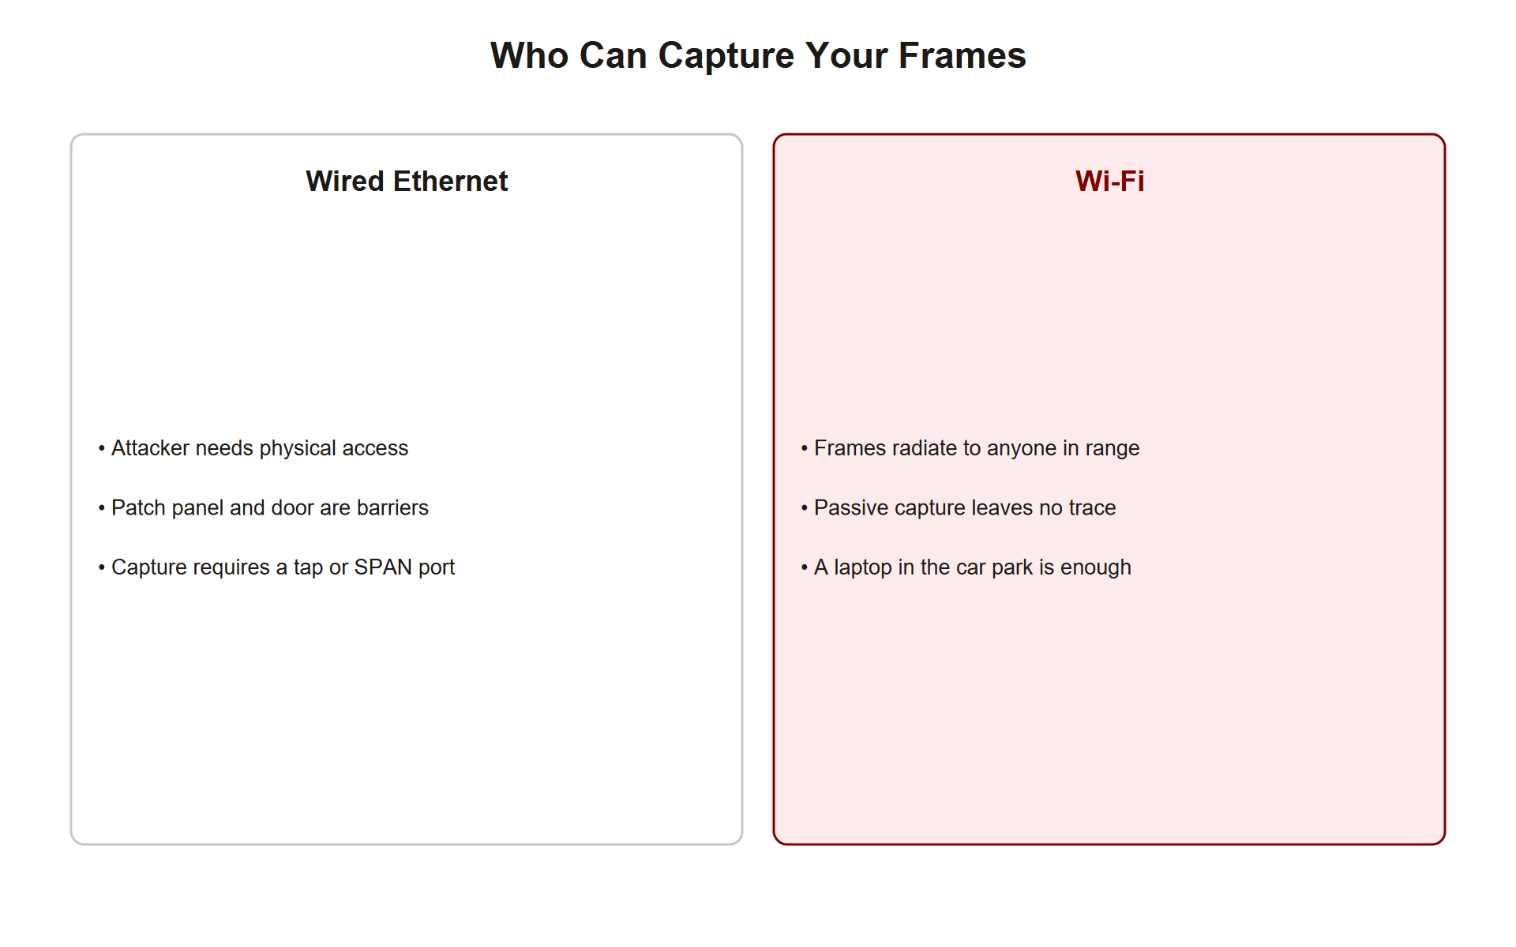
TOPIC 3.2 · 3.2.1.a.1
Wireless Inverts the Wired Security Model
Wired assumption: attacker needs physical access (a cable, a jack) before capturing traffic
Wireless reality: transmission medium is free space, any radio within range passively intercepts every frame
Consequence: wireless security is disproportionately concerned with confidentiality and authentication at the link layer
Standard: IEEE 802.11 family (802.11-2020 consolidated baseline), maintained by IEEE 802.11 Working Group
Exam framing: the broadcast medium is the root cause of nearly every vulnerability in this topic
Wired Vs Wireless Capture
Notes:
On a physical Ethernet segment, an adversary must obtain a tangible foothold before capturing a single frame. IEEE 802.11 (Wi-Fi) removes that barrier entirely: the medium is free space, and any receiver in range, a laptop in a parking lot, a device on the floor below, can passively intercept every frame without touching a wire or triggering a physical alarm.
This single architectural fact explains why wireless protocols must do cryptographic heavy lifting that wired networks have historically deferred to higher layers like TLS.

Slide 8
TOPIC 3.2 · 3.2.1.a.2
CIA Triad Emphasis: Confidentiality and Authentication
Confidentiality: eavesdropper capturing radio signal should not be able to read the data inside
Authentication: client must prove identity to AP, and AP should prove identity to client (often overlooked)
NIST framing: FIPS 199 defines confidentiality as preserving authorized restrictions on access/disclosure
NIST SP 800-63-3 defines the digital identity model underlying authentication assurance levels
Two-way problem: a client that can't verify the AP's identity risks associating with an impostor
Notes:
Because the medium is unrestricted, wireless security engineering leans heavily on two pillars of the CIA triad: confidentiality (encrypting the link so eavesdroppers gain nothing) and authentication (proving both that the client is legitimate and that the access point itself is legitimate).
The authentication problem is bidirectional and frequently underestimated by students: a client with no cryptographic way to verify the AP it's joining is the exact gap exploited by evil twin attacks discussed later in this chapter.

Slide 9
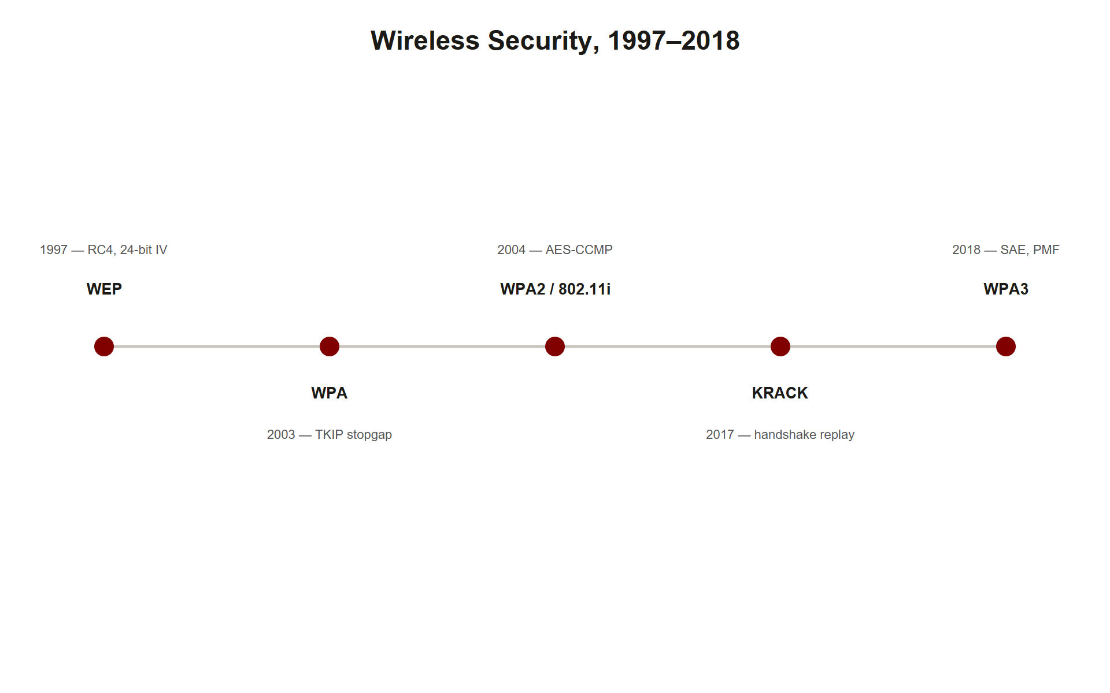
TOPIC 3.2 · 3.2.1.b.1
Three Decades of Arms Race: WEP to WPA3
1997: original 802.11 ships with WEP (Wired Equivalent Privacy), name promised parity with wired security, delivered none
2004: IEEE 802.11i amendment introduces Robust Security Network (RSN), underpinning WPA2
2004: WPA2 becomes Wi-Fi Alliance standard, replacing WEP's RC4 with AES-based CCMP
2017: KRACK exposes a flaw in the WPA2 handshake state machine itself
2018: WPA3 certified, introducing SAE (Dragonfly) handshake and mandatory Protected Management Frames
Wireless Security Timeline
Notes:
The academic study of wireless security is best understood as a three-decade arms race between the IEEE, cryptographic researchers, and attackers who systematically broke each generation of protection. WEP's failure was not an implementation bug but a fundamental cryptographic design flaw. Its collapse motivated the 802.11i task group, whose Robust Security Network framework underpins WPA2, and whose refinement continues today with WPA3.

Slide 10
TOPIC 3.2 · 3.2.1.b.2
?
Cryptographic-Layer vs. Trust-Layer Failures
Cryptographic-layer attacks: the math or its implementation is broken (WEP's RC4/IV flaw, KRACK's nonce reuse)
Trust-layer attacks: trick a human or device into associating with an illegitimate network (evil twin, rogue AP)
Key insight: a network can run perfect WPA3 encryption and still be defeated entirely by trust-layer manipulation
MITRE mapping: evil twin classified under T1557 (Adversary-in-the-Middle)
AP exam relevance: both failure modes are tested equally
Notes:
A second conceptual pillar is the distinction between attacks on the cryptographic layer and attacks on the trust layer. WEP and KRACK are cryptographic-layer failures, the math or its implementation is broken. Evil twin attacks and rogue access points exploit a trust-layer weakness: 802.11 clients historically had no cryptographically verifiable way to distinguish a legitimate AP from an impostor broadcasting an identical SSID.

Slide 11
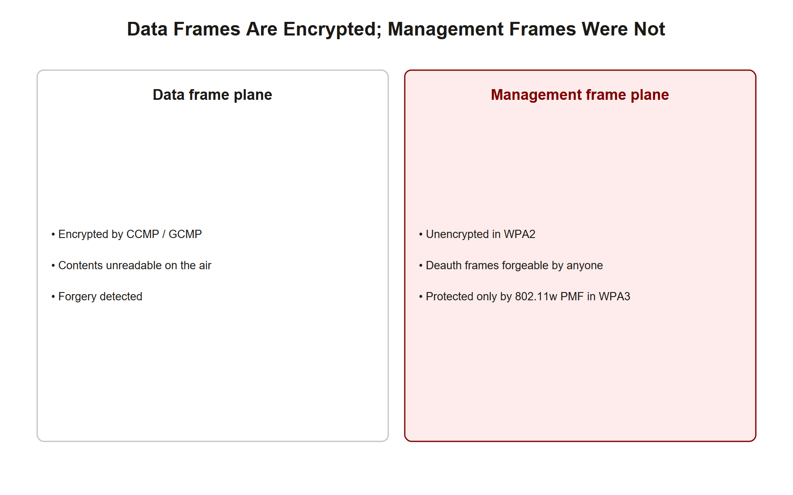
TOPIC 3.2 · 3.2.1.c.1
Management Frames vs. Data Frames
Management frames: beacons, probe requests/responses, authentication, association, deauthentication, coordinate discovery and joining
Critical gap: in WPA2 and earlier, management frames are transmitted unencrypted and unauthenticated
Consequence: enables forged deauthentication attacks central to both evil-twin campaigns and handshake-capture techniques
Fix: Protected Management Frames (PMF / 802.11w) adds cryptographic protection to deauth/disassociation frames
WPA3: PMF is mandatory; WPA2 it was optional and rarely deployed
Frame Plane Split
Notes:
It is essential to understand the layered relationship between the 802.11 management-frame plane and the data-frame plane. Management frames coordinate how a client discovers and joins a network. Critically, in WPA2 and earlier, these frames were transmitted unencrypted and unauthenticated, a design decision that enables the deauthentication attacks central to both evil-twin campaigns and the four-way handshake capture technique.
Protected Management Frames (PMF), standardized in 802.11w, is the direct engineering response to this gap, and its mandatory adoption under WPA3 is one of the most consequential changes covered in this chapter.

Slide 12
TOPIC 3.2 · 3.2.1.glossary
Section I Glossary Consolidation
802.11: IEEE family of standards defining Wi-Fi
WEP: first, cryptographically broken Wi-Fi encryption scheme
RSN: Robust Security Network, framework underpinning WPA2, from 802.11i
SSID / BSSID: human-readable network name (spoofable) vs. AP radio's MAC address
PMF (802.11w): cryptographic protection for management frames, mandatory in WPA3
Notes:
Before moving into technical mechanics, consolidate the vocabulary: 802.11, WEP, RSN, SSID, BSSID, and PMF. Every term here reappears with mechanical detail in Section II.

Slide 13
02
WEP: RC4 and the 24-bit IV Failure
Topic 3.2
Notes:
Transition to part 2 of the topic. Pause here for questions before continuing.

Slide 14
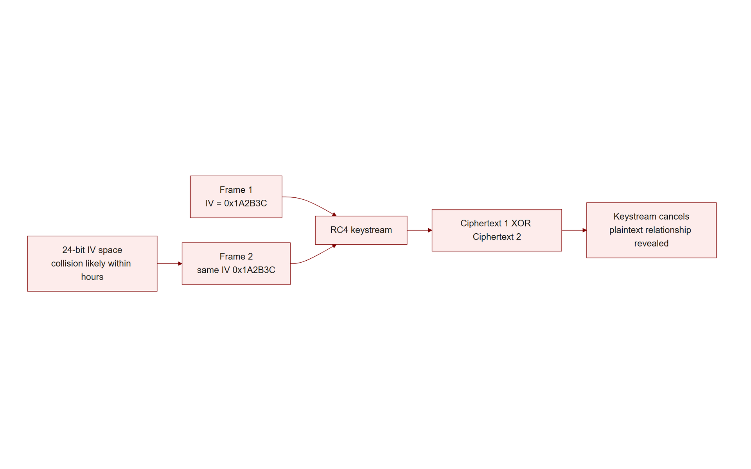
TOPIC 3.2 · 3.2.2.a.1
WEP: RC4 and the 24-bit IV Failure
Cipher: RC4 stream cipher combined with a 24-bit initialization vector (IV) prepended to a static 40/104-bit key
Flaw: IV space is only 16.7 million values, high-traffic networks exhaust/repeat IVs within hours
Attack: tools like aircrack-ng statistically recover the full key through passive collection alone, no active interaction required
Integrity flaw: linear CRC-32 checksum (not a cryptographic MAC) permits bit-flipping attacks
Research: Fluhrer, Mantin & Shamir (2001), full key recovery from ~40,000–85,000 packets (FMS attack), refined by PTW (2007) to under 40,000
Wep Iv Collision
Notes:
WEP encrypted each frame using RC4 combined with a 24-bit initialization vector prepended to a static shared key. Because the IV space is so small and WEP rarely randomized it robustly, high-traffic networks exhaust and repeat IVs within hours, allowing tools such as aircrack-ng to statistically recover the full key through passive traffic collection alone.
WEP additionally used a linear CRC-32 checksum rather than a cryptographic MAC, permitting bit-flipping attacks. These two flaws together made WEP recoverable in minutes on any moderately active network.

Slide 15
TOPIC 3.2 · 3.2.2.a.2
WPA2's CCMP: Fixing the Cipher
CCMP: Counter Mode with CBC-MAC Protocol, mandated by WPA2, built on AES
Design: AES in Counter Mode (confidentiality) + CBC-MAC (integrity/authenticity), authenticated encryption in one operation
Fix: 48-bit packet number (PN) replaces WEP's flawed 24-bit IV, eliminating IV-reuse attacks
Standard: IEEE 802.11i-2004 §8.3.3, AES with 128-bit keys
Result: the confidentiality/integrity flaws of WEP are structurally closed
Notes:
WPA2, standardized under 802.11i, replaced RC4 with CCMP, an AES-based authenticated encryption scheme that eliminated WEP's IV-collision weaknesses outright. The 48-bit packet number space is vastly larger than WEP's 24-bit IV, making practical exhaustion/collision infeasible within a session's lifetime.

Slide 16
TOPIC 3.2 · 3.2.2.a.3
WPA2-Personal: PSK to PMK Derivation
PSK: a memorized passphrase, shared in advance between all clients and the AP
Derivation: PSK run through PBKDF2 with SSID as salt, 4,096 iterations, yielding a 256-bit Pairwise Master Key (PMK)
Formula: PMK = PBKDF2(HMAC-SHA1, passphrase, ssid, 4096, 256)
Limitation: single shared secret known to every device, no per-user accountability
Vulnerability: vulnerable to offline dictionary attack if the password is weak
Notes:
WPA2-Personal derives its session keys from a Pre-Shared Key, typically a memorized passphrase, processed through PBKDF2 to yield a 256-bit Pairwise Master Key. The PMK itself is never transmitted over the air; only its derivatives are exchanged during the handshake described next.

Slide 17
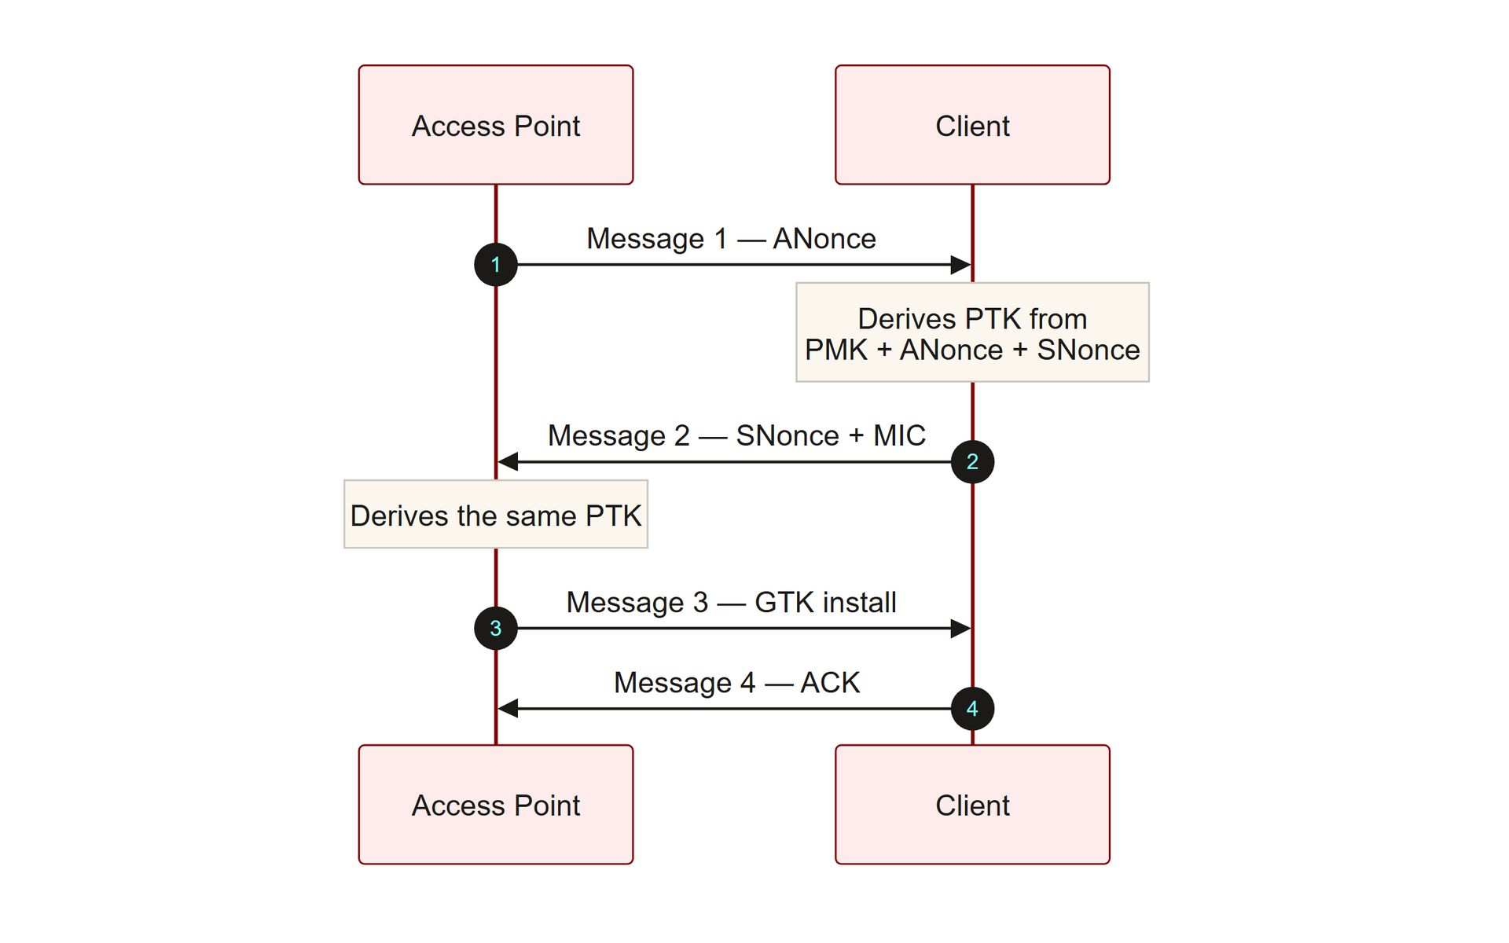
TOPIC 3.2 · 3.2.2.a.4
The WPA2 Four-Way Handshake
Purpose: negotiate live, per-session encryption keys (PTK) from the shared PMK without transmitting the password
Nonces: AP supplies ANonce, client supplies SNonce, combined with PMK and both MAC addresses
PTK: Pairwise Transient Key, unique per session, derived via PRF-384/PRF-512
Leak point: EAPOL Message 2 carries a MIC computed with the derived key, capturing it enables offline attacks
Standard: IEEE 802.11i §8.5.2, using EAPOL-Key frame format from 802.1X-2010
Four Way Handshake Flow
Notes:
From the PMK, actual per-session encryption keys are negotiated live via the Four-Way Handshake, in which the AP and client each supply a random nonce that, combined with the PMK and both devices' MAC addresses, produce a unique Pairwise Transient Key for that session. This design means the shared password itself never crosses the air interface, only the handshake frames, which is why attackers must capture the handshake and perform an offline dictionary or brute-force attack rather than reading the password directly.

Slide 18
TOPIC 3.2 · 3.2.2.a.5
?
Capturing and Cracking a WPA2 Handshake
Step 1: put wireless adapter into monitor mode (airmon-ng)
Step 2: discover target BSSID/channel/encryption (airodump-ng)
Step 3: lock onto channel and capture EAPOL frames to file
Step 4 (active): force a fresh handshake via deauth (aireplay-ng --deauth)
Step 5: offline dictionary attack against captured EAPOL Message 2 MIC (aircrack-ng)
Notes:
Capturing a WPA2 handshake does not hand the attacker the password. It hands them the raw material, the ANonce, SNonce, MAC addresses, and the MIC from EAPOL Message 2, needed to run an offline guessing attack. Every candidate passphrase in a wordlist is run through PBKDF2 to derive a candidate PMK, then through the PRF to derive a candidate PTK, then used to recompute the MIC and check it against the captured value.
This is why passphrase strength (entropy) is the single biggest determinant of WPA2-Personal security, a strong, random passphrase makes this offline search computationally infeasible.

Slide 19
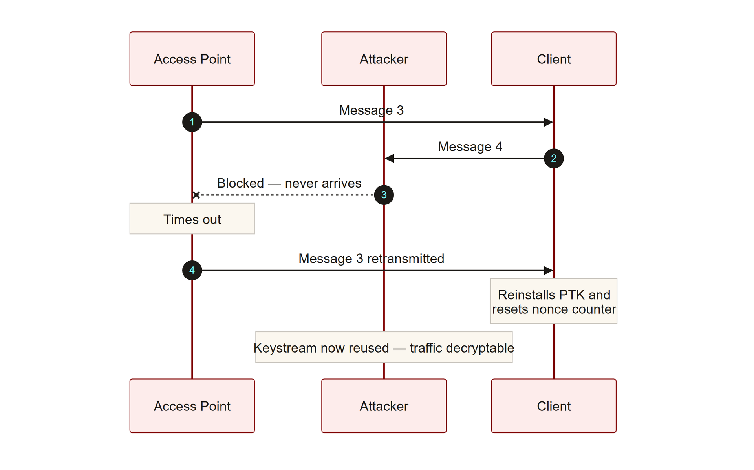
TOPIC 3.2 · 3.2.2.b.1
KRACK: Exploiting the Handshake Retransmission Logic
Disclosed: October 2017 by Mathy Vanhoef (KU Leuven), presented at ACM CCS 2017
Root cause: flaw in the 802.11i handshake state machine itself, not a vendor implementation bug
Mechanism: AP retransmits Message 3 if it doesn't receive Message 4 (lossy wireless links)
Exploit: MITM attacker blocks Message 4, forcing AP to resend Message 3, causing key/nonce reinstallation
Impact: nonce reuse with CCMP's AES-CTR mode allows decryption and, in some configs, forged traffic injection
Krack Message3 Replay
Notes:
Vanhoef disclosed a family of vulnerabilities in the WPA2 four-way handshake protocol itself. The core flaw exploited the handshake's retransmission logic: because wireless links are lossy, the AP is permitted to retransmit Message 3 if it does not receive Message 4. A man-in-the-middle attacker could selectively block Message 4 and force the AP to retransmit Message 3.
Critically, many client implementations, upon receiving this 'new' Message 3, would reinstall an already-in-use encryption key, resetting the associated nonce and packet-number counters back to zero. Reusing a nonce with CCMP's AES-CTR mode is cryptographically catastrophic.

Slide 20
TOPIC 3.2 · 3.2.2.b.2
CVE-2017-13077 and the Android/Linux Special Case
CVE-2017-13077: PTK reinstallation, most severe KRACK variant, affects primary data-traffic key
Related CVEs: CVE-2017-13078 through 13088 cover group-key and Fast BSS Transition variants
Android 6.0 bug: wpa_supplicant quirk reinstalled an all-zero key, making decryption trivial rather than merely possible
Response: Wi-Fi Alliance mandated certified devices test for and reject key-reinstallation attempts
Long-term fix: WPA3's SAE handshake engineered with different forward-secrecy properties reducing this risk class
Notes:
The disclosure was tracked under a cluster of CVE identifiers, most notably CVE-2017-13077 (PTK reinstallation), alongside related identifiers covering group-key and Fast BSS Transition handshake variants. Because the flaw lived in the specification's state machine rather than any single vendor's code, essentially every WPA2 implementation on every platform required a patch.

Slide 21
TOPIC 3.2 · 3.2.2.c.1
?
WPA3's SAE (Dragonfly) Handshake
SAE: Simultaneous Authentication of Equals, replaces PSK-based four-way handshake in WPA3-Personal
Type: password-authenticated key exchange (PAKE) built on elliptic-curve cryptography
Property 1: resists offline dictionary attacks, each guess requires live interaction with the AP, which can be rate-limited
Property 2: provides forward secrecy, session keys use ephemeral values discarded after the session
Standard: IEEE 802.11-2020 §12.4, based on Dan Harkins' Dragonfly key exchange (RFC 7664)
Notes:
WPA3 replaces the PSK-based four-way handshake with Simultaneous Authentication of Equals, colloquially the Dragonfly handshake. Because the exchanged messages are derived through a hash-to-curve construction rather than a direct hash of the password, an attacker who captures the entire SAE exchange gains no material usable for offline guessing.
SAE also provides forward secrecy: session keys are derived using ephemeral values discarded after the session ends, so recovering the network password later does not allow retroactive decryption of previously captured traffic, a property WPA2-Personal cannot offer.

Slide 22
TOPIC 3.2 · 3.2.2.c.2
WPA3 Mandates Protected Management Frames
WPA2: PMF (802.11w) was optional and rarely deployed
WPA3: PMF is a mandatory baseline certification requirement
Effect: closes the deauthentication-frame forgery gap, undermining the deauth-driven handshake-capture workflow
Dragonblood (2019): Vanhoef & Ronen disclosed timing/cache side-channel weaknesses in some SAE implementations
CVEs: CVE-2019-9494 and CVE-2019-9495, protocol guarantees are only as strong as constant-time implementations
Notes:
WPA3 also mandates Protected Management Frames as a baseline certification requirement, closing the deauthentication-frame forgery gap and directly undermining the deauth-driven handshake-capture workflow. Notably, SAE itself was not without early flaws: Dragonblood research disclosed timing and cache-based side-channel weaknesses in several SAE implementations that could leak information usable to accelerate offline attacks despite SAE's theoretical resistance.

Slide 23
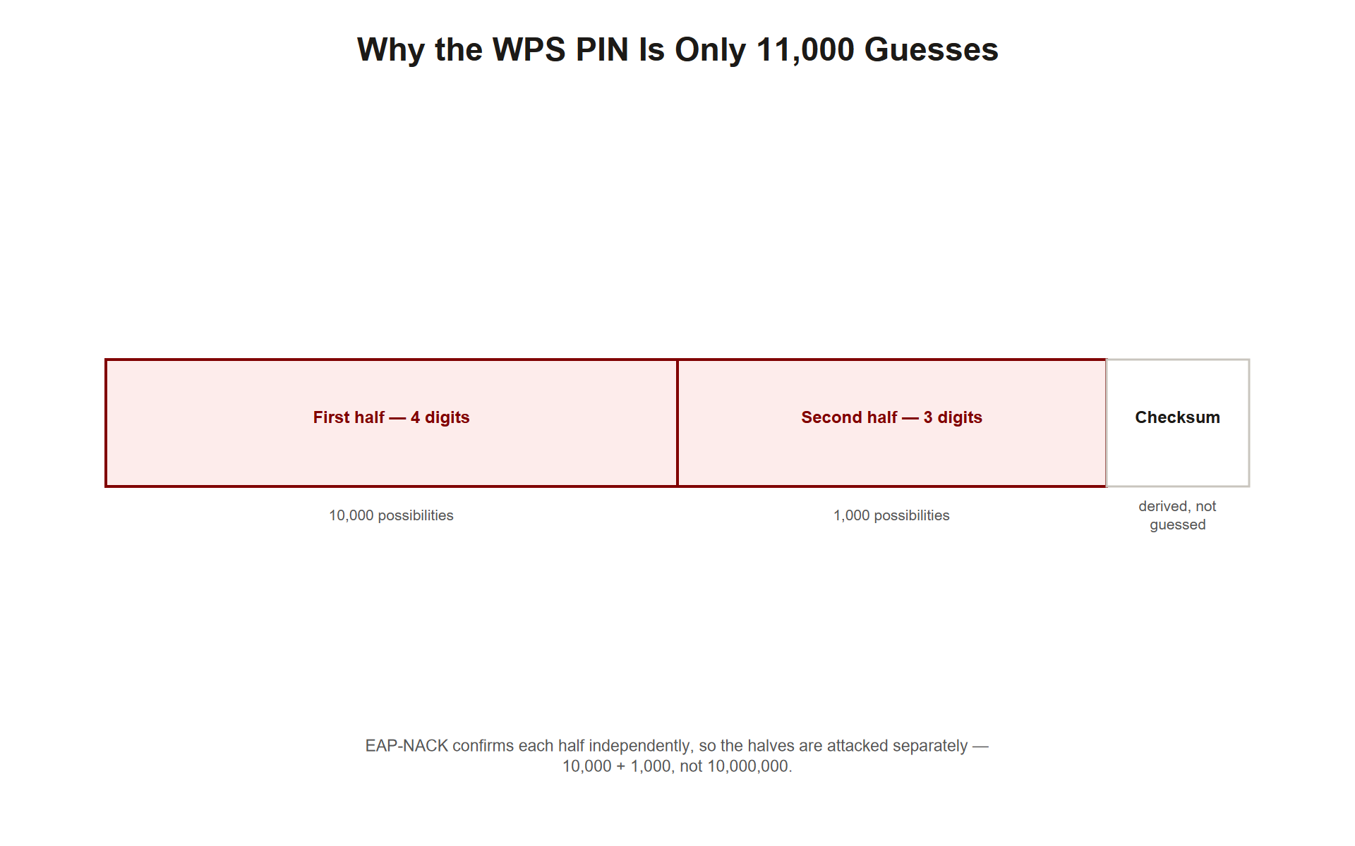
TOPIC 3.2 · 3.2.2.d.1
WPS: The Two-Half PIN Design Flaw
WPS: consumer onboarding feature authenticated by an 8-digit PIN instead of the full passphrase
Flaw (2011): AP validates PIN in two independent 4-digit halves, signaling correctness of each half separately via EAP-NACK
Math: collapses a 10^8 search space into two searches of at most 10^4 and 10^3 (8th digit is a checksum)
Combined worst case: roughly 11,000 attempts instead of 100 million
Tools: reaver and bully automate online brute-force, typically 4–10 hours against an unprotected AP
Wps Pin Halves
Notes:
WPS introduced an alternative onboarding path authenticated by an 8-digit PIN. The design flaw, disclosed in 2011, is that the AP validates the PIN in two independent 4-digit halves and explicitly signals whether each half was correct, collapsing what should be a 100-million-value search space into roughly 11,000 attempts.

Slide 24
TOPIC 3.2 · 3.2.2.d.2
Pixie Dust: Offline WPS PIN Recovery
Discovered: Dominique Bongard, 2014
Exploits: APs whose RNG produces WPS secret nonces (E-S1, E-S2) with insufficient entropy, sometimes hardcoded to zero
Effect: single captured WPS exchange lets attacker recompute the PIN entirely offline, in seconds
Affected hardware: specific chipset/firmware combos (older Ralink, Realtek, Broadcom)
Consequence: a compromised WPS PIN yields the full WPA2/WPA3 passphrase regardless of passphrase strength
Notes:
Unlike the online brute-force approach, the Pixie Dust attack requires only a single WPS exchange and performs the PIN recovery entirely offline by exploiting predictable pseudorandom number generation in the affected chipset's WPS implementation, reducing recovery time from hours to seconds against vulnerable hardware.

Slide 25
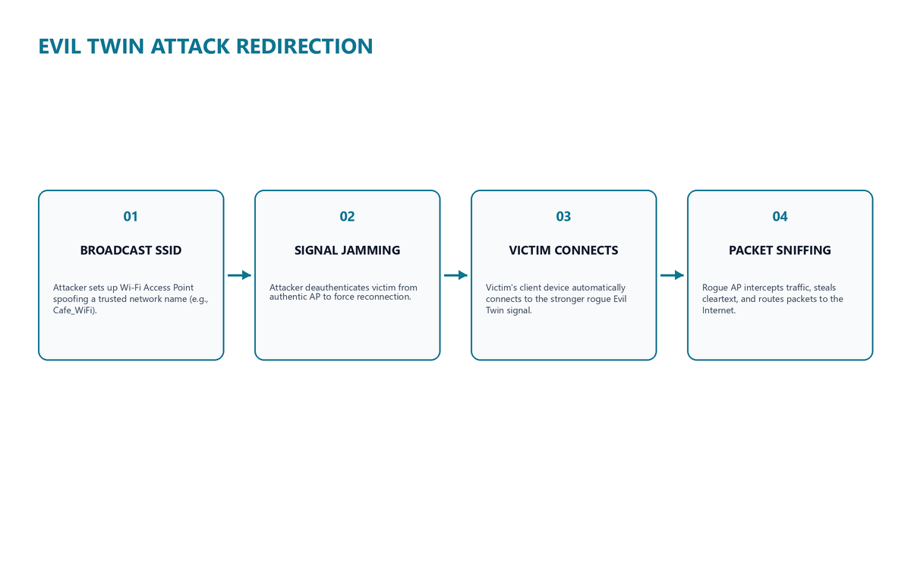
TOPIC 3.2 · 3.2.2.e.1
Evil Twin: Reconnaissance and Rogue AP Setup
Step 1 (recon): passively observe beacon frames to learn target SSID, channel, security config
Step 2: configure rogue AP (e.g., hostapd) broadcasting an identical SSID, often a spoofed BSSID
Passive win condition: clients auto-select the AP with the strongest signal among matching SSIDs
Active escalation: deauthentication attack forges disconnect frames appearing to originate from the legitimate BSSID
Reason code field: deauth frames defined under 802.11 MAC spec §9.4.1.7, unauthenticated pre-WPA3
Evil Twin Setup Flow
Notes:
An evil twin attack begins with reconnaissance, then configures a rogue AP broadcasting an identical SSID and frequently a spoofed BSSID. Because client devices typically auto-select the AP with the strongest signal among matching SSIDs, an attacker with a nearby, higher-power rogue radio can win this competition passively. Where passive positioning is insufficient, the attacker escalates to deauthentication, forcing the victim's device to disconnect and automatically attempt reassociation, frequently landing on the attacker's rogue AP.

Slide 26
TOPIC 3.2 · 3.2.2.e.2
?
Evil Twin: AiTM Position and Captive Portal Harvesting
Once associated: attacker sits in a full adversary-in-the-middle (AiTM) position over all victim traffic
Captive portal: fake login page mimicking a legitimate hotel/airport/corporate portal harvests submitted credentials
Technique: typically implemented via DNS hijacking + HTTP 302 redirects
Terminology: MITRE ATT&CK now uses gender-neutral 'AiTM' rather than 'MITM'; classified T1557
Public demo: DEF CON's long-running 'Wall of Sheep' exhibit publicly displays captured plaintext credentials as awareness demonstration
Notes:
Once a victim associates with the evil twin, the attacker sits in a full adversary-in-the-middle position over all of the victim's traffic. A common monetization technique is a captive portal that mimics a legitimate login page, harvesting whatever credentials the victim submits before 'granting' internet access.

Slide 27
TOPIC 3.2 · 3.2.2.glossary
Section II Glossary Consolidation
CCMP: AES-based authenticated encryption mandated by WPA2
PMK/PTK: master key derived from PSK vs. session-specific transient key
KRACK: nonce-reuse attack exploiting WPA2 handshake retransmission logic
SAE (Dragonfly): WPA3's password-authenticated key exchange, resists offline attack, provides forward secrecy
Pixie Dust: offline WPS PIN recovery exploiting low-entropy nonces
Notes:
Section II covered five interlocking cryptographic-layer mechanisms and their exploits: WEP's IV flaw, WPA2's CCMP and four-way handshake, KRACK, WPA3's SAE, and WPS's PIN weaknesses plus Pixie Dust. Consolidate these terms before moving to real-world case studies.

Slide 28
03
Case Study: The 2017 KRACK Disclosure
Topic 3.2
Notes:
Transition to part 3 of the topic. Pause here for questions before continuing.

Slide 29
TOPIC 3.2 · 3.2.3.a.1
Case Study: The 2017 KRACK Disclosure
Date: October 16, 2017, Mathy Vanhoef and Frank Piessens (KU Leuven)
Venue: ACM CCS 2017, coordinated disclosure with Wi-Fi Alliance, US-CERT, dozens of vendors
Scale: reproducible against the 802.11i specification itself, billions of certified WPA2 devices needed patching
Disproportionate impact: Android/Linux wpa_supplicant 2.4/2.5 installed an all-zero key due to a Message-3 handling bug
Legacy problem: patch adoption on printers, IP cameras, industrial control equipment remained incomplete for years
Notes:
The KRACK disclosure demonstrated that the vulnerability was not confined to a buggy vendor implementation but was reproducible against the 802.11i specification's handshake state machine itself, meaning virtually every certified WPA2 device worldwide required a security patch. The disclosure triggered a coordinated vendor patch cycle across Microsoft, Apple, Google, and the embedded/IoT ecosystem, but patch adoption on legacy and embedded devices remained incomplete for years afterward.

Slide 30
TOPIC 3.2 · 3.2.3.a.2
Case Study: DEF CON's Wall of Sheep
Since 2002: DEF CON conference operates the 'Wall of Sheep' passive monitoring exhibit
Mechanism: captures unencrypted credentials/session data on open/spoofed conference wireless networks
Purpose: anonymized partial captures projected publicly as awareness demonstration
Extension: documented incidents of SSID-mimicking attacks at airports/hotels targeting travelers
FBI IC3: has issued public advisories specifically warning travelers about evil twin Wi-Fi scams
Notes:
Security researchers and volunteers at DEF CON have repeatedly deployed evil twin access points as part of sanctioned research and awareness exercises, and attendees who connect routinely have credentials harvested, reinforcing the persistent real-world prevalence of this attack pattern. This case study pattern extends into documented incidents affecting travelers at airports and hotels, where threat actors register SSIDs mimicking official networks and deploy captive portals requesting loyalty-program, VPN, or payment credentials.

Slide 31
TOPIC 3.2 · 3.2.3.glossary
Section III Glossary Consolidation
Coordinated disclosure: multi-vendor, multi-agency responsible disclosure process (KRACK example)
Specification-level flaw: vulnerability in the standard itself, affecting every compliant implementation
Wall of Sheep: DEF CON's live public credential-harvesting awareness demo
IC3: FBI's Internet Crime Complaint Center, issues evil-twin travel advisories
Key misconception corrected: strong encryption does not verify AP identity
Notes:
Section III grounded the abstract mechanisms of Section II in two documented real-world cases: KRACK's internet-scale coordinated disclosure, and DEF CON's ongoing public demonstration of evil twin/credential harvesting risk.

Slide 32
04
Migrating to WPA3 and Disabling Legacy Fallback
Topic 3.2
Notes:
Transition to part 4 of the topic. Pause here for questions before continuing.

Slide 33
TOPIC 3.2 · 3.2.4.a.1
Migrating to WPA3 and Disabling Legacy Fallback
Recommendation: migrate AP fleets to WPA3-Enterprise or WPA3-Personal (SAE) wherever hardware supports it
Risk of mixed mode: transitional WPA2/WPA3 fallback still accepts weaker WPA2 connections, preserving offline-dictionary exposure
Legacy mitigation: where WPA2 must remain, mandate high-entropy, randomly generated PSKs (20+ characters)
Goal: defeat offline dictionary and GPU-accelerated brute-force attacks against captured handshakes
Layer: cryptographic-layer control
Notes:
Organizations should migrate access point fleets to WPA3 wherever hardware supports it, and explicitly disable WPA2/WPA mixed-mode fallback once client compatibility allows, since many deployments default to a transitional mode that still accepts weaker WPA2 connections. Where legacy devices force continued WPA2 support, administrators should mandate high-entropy, randomly generated PSKs specifically to defeat offline dictionary and GPU-accelerated brute-force attacks.

Slide 34
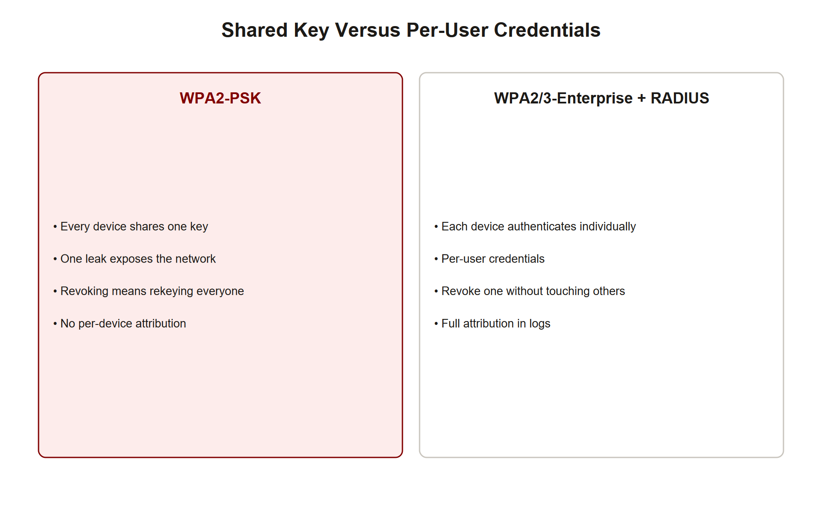
TOPIC 3.2 · 3.2.4.a.2
Enterprise Authentication: 802.1X/RADIUS vs. PSK
PSK weakness: single shared secret, no per-user accountability, requires full network rotation when an employee leaves
802.1X/RADIUS: each user/device authenticates individually against a centralized RADIUS server
EAP methods: EAP-TLS (certificate-based, strongest) or PEAP-MSCHAPv2 (credential-based)
Benefit: compromised/departed credentials revoked instantly without network-wide password rotation
Auditability: every association logged with individual identity for forensic accountability
Psk Vs Radius
Notes:
The single most consequential managerial decision in wireless security is the choice between PSK mode and Enterprise mode with 802.1X/RADIUS. Enterprise mode requires each device or user to authenticate individually against a centralized RADIUS server, meaning a compromised or departed employee's credentials can be revoked instantly without requiring a network-wide password rotation, and every association is logged with individual identity.

Slide 35
TOPIC 3.2 · 3.2.4.b.1
Guest Network Segmentation and BYOD Policy
VLAN segmentation: guest/BYOD traffic logically and physically separated from internal corporate networks
Firewall policy: denies lateral access from guest VLAN into internal resource segments
Standard: IEEE 802.1Q defines VLANs; NIST SP 800-153 recommends guest VLAN isolation as baseline
BYOD policy: MDM enrollment, minimum OS patch levels, disallow split-tunnel VPN bridging
Goal: prevent a compromised guest device from pivoting into sensitive internal systems
Notes:
Guest and BYOD wireless traffic must be logically and, ideally, physically segmented from internal corporate networks using separate VLANs with firewall policies denying lateral access into internal segments, ensuring a compromised guest device cannot pivot toward sensitive internal systems. Organizations should also implement BYOD policy requiring MDM enrollment and disallowing split-tunnel VPN configurations.

Slide 36
TOPIC 3.2 · 3.2.4.b.2
WPS Disablement and Rogue AP Detection (WIDS/WIPS)
WPS: disable entirely, no legitimate deployment scenario justifies the residual risk from Section II
Wireless site surveys: establish baseline inventory of authorized BSSIDs and physical AP locations
WIDS/WIPS: continuously scan RF spectrum against an authorized-device baseline
Detection targets: unrecognized BSSIDs, SSID impersonation attempts, abnormal deauth frame volumes
Reference: NIST SP 800-153 §4 provides formal guidance on rogue AP detection program design
Notes:
Given the PIN brute-force and Pixie Dust vulnerabilities, organizations should disable WPS entirely. At the enterprise level, organizations should implement formal wireless site surveys and continuous rogue AP detection programs using WIDS/WIPS that continuously scan RF spectrum against an authorized-device baseline, alerting security teams to unrecognized BSSIDs, SSID impersonation, and abnormal deauthentication frame volumes.

Slide 37
TOPIC 3.2 · 3.2.4.c.1
?
The Three-Layer Defense Hierarchy for Wireless
Layer 1, Cryptographic: WPA3/SAE, disable WPS, disable legacy WPA2 fallback where possible
Layer 2, Authentication/architectural: 802.1X/RADIUS instead of shared PSK, VLAN segmentation of guest/BYOD
Layer 3, Monitoring/operational: wireless site surveys, WIDS/WIPS rogue AP detection, mandatory 802.11w PMF
Exam structure: a complete answer names controls from all three layers, not just 'use a strong password'
Parallel: mirrors the social-engineering defense-in-depth structure from Unit 1
Notes:
When the AP exam asks how to defend a wireless deployment, structure the answer in layers: cryptographic, authentication/architectural, and monitoring/operational. A complete answer names controls from all three layers, not just a single fix.

Slide 38
TOPIC 3.2 · 3.2.4.glossary
Section IV Glossary Consolidation
802.1X/RADIUS: enterprise per-user authentication replacing shared PSK
VLAN segmentation: isolates guest/BYOD traffic from internal resources
WIDS/WIPS: continuous RF monitoring against an authorized-BSSID baseline
Wireless site survey: establishes the authorized-device baseline used by WIDS/WIPS
Three-layer hardening: cryptographic + authentication/architectural + monitoring/operational
Notes:
Section IV's controls map directly onto the vulnerabilities from Section II and III: WPA3/PMF closes cryptographic and deauth gaps, 802.1X/RADIUS and VLANs close accountability and lateral-movement gaps, and WIDS/WIPS closes the trust-layer detection gap.

Slide 39
05
Kill Chain Synthesis: From WEP to Evil Twin
Topic 3.2
Notes:
Transition to part 5 of the topic. Pause here for questions before continuing.

Slide 40
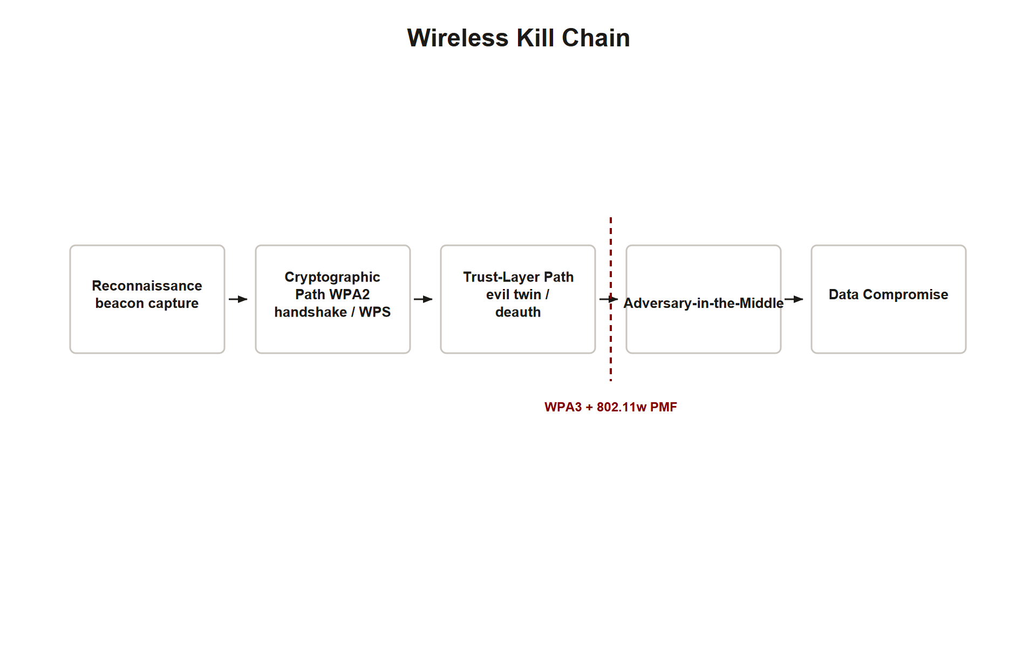
TOPIC 3.2 · 3.2.5.a.1
Kill Chain Synthesis: From WEP to Evil Twin
Recon: passive beacon observation reveals SSID, channel, security configuration
Initial access, cryptographic: WEP IV collision, WPA2 handshake capture + offline crack, or WPS Pixie Dust
Initial access, trust layer: evil twin + forged deauth exploiting unauthenticated management frames
Escalation: AiTM position enables captive-portal credential harvesting or traffic interception
Root cause common to both paths: unauthenticated management frames (deauth) and/or weak key derivation entropy
Wireless Kill Chain Synthesis
Notes:
Tracing a full wireless attack kill chain reveals that nearly every named attack in this chapter reduces to one of two root causes: a cryptographic weakness in key derivation/reuse (WEP's IV, WPA2's offline-crackable handshake, WPS's PIN math), or the unauthenticated management-frame gap that enables deauthentication-driven attacks (both forced handshake capture and evil twin). WPA3 with mandatory PMF and SAE directly closes both root causes simultaneously, which is why it represents a genuine architectural improvement rather than an incremental patch.

Slide 41
TOPIC 3.2 · 3.2.5.a.2
Exam-Readiness Checklist: Topic 3.2
Can you explain why wireless security prioritizes confidentiality and mutual authentication at the link layer?
Can you name WEP's two distinct flaws (IV collision AND CRC-32 integrity) separately?
Can you walk through the WPA2 four-way handshake and explain what a captured handshake does/does not reveal?
Can you explain KRACK as a specification-level flaw and contrast it with an implementation bug like Heartbleed?
Can you state SAE's two key properties (offline-dictionary resistance, forward secrecy) and why WPA2-Personal lacks both?
Can you explain the WPS two-half PIN flaw's math (10^8 to ~11,000) and distinguish online brute-force from Pixie Dust?
Can you walk through a full evil-twin kill chain and explain why strong encryption doesn't stop it?
Can you structure a wireless defense answer across all three hardening layers (cryptographic, architectural, monitoring)?
Notes:
Use this checklist as a final self-assessment before the unit exam. Each item maps directly to a slide or case study in this deck, if you cannot answer confidently, revisit that section before moving to Topic 3.3.

