Slide 1
AAYAT-AP-PREP · CYBERSECURITY
UNIT 3: SECURING NETWORKS
Topic 3.3: Network Segmentation
A flat network gives a single compromised workstation direct visibility into every server, printer, and camera it can reach. This topic covers how to divide a network into zones so a breach in one cannot automatically spread to another — from VLANs, the coarse-grained tool most organizations start with, to the stricter discipline of Zero Trust.
2 learning objectives · College Board AP Cybersecurity Course Framework
Notes:
Cover slide for Topic 3.3: Protecting Networks: Segmentation. This topic focuses on securing operations subnets against threats exploiting flat subnet mapping. Hardening requires combining administrative controls, physical security barriers, and technical mitigation via VLAN subnet…

Slide 2
TOPIC 3.3
Learning Objectives
Mitigate Risk
Identify the techniques by which a network is divided &mdash; subnetting and routed boundaries, VLANs and private VLANs, host-level microsegmentation, and air gaps.
3.3.A
Mitigate Risk
Explain why dividing a network raises its security: what a boundary denies an intruder who is already inside, and what it does not.
3.3.B
Objectives paraphrased from the AP Cybersecurity Course Framework (College Board, AP Career Kickstart).
Notes:
Read each learning objective aloud and connect it to the exam skill category before starting the topic.

Slide 3
TOPIC 3.3 · CONCEPT MAP
802.1Q VLAN Trunking Architecture
PC1 (VLAN 10)
PC3 (VLAN 10)
802.1Q Trunk Link (802.1Q Tag)
Switch A
Switch B
PC2 (VLAN 20)
PC4 (VLAN 20)

Slide 4
TOPIC 3.3
The Big Idea
Network segmentation is a ship's watertight compartments. One flooded compartment doesn't sink the whole vessel, because the doors between sections can be sealed before the water spreads.
Hold onto this picture — we'll come back to it as the mechanics get more technical.
Notes:
Big-idea framing for Topic 3.3. Open with this analogy before the mechanics: "Network segmentation is a ship's watertight compartments. One flooded compartment doesn't sink the whole vessel, because the doors between sections can be sealed before the water spreads." Ask students for their own version of the analogy before moving on.

Slide 5
01
The Castle-and-Moat Problem
Topic 3.3
Notes:
Transition to part 1 of the topic. Pause here for questions before continuing.

Slide 6
TOPIC 3.3 · 3.3.1.a.1
The Castle-and-Moat Problem
Old model: A single strong perimeter (firewall/VPN) is trusted implicitly; everything inside is assumed safe
Flat network: Once inside, a device can reach nearly any other host with no additional barriers
Failure mode: One phished credential or unpatched IoT device becomes a springboard to crown-jewel assets
NIST verdict: Formally deprecated in favor of Zero Trust by NIST SP 800-207 (2020)
Notes:
For decades, enterprise defenders relied on the castle-and-moat model: build a strong outer wall and trust everything inside it. Once a device authenticated at the perimeter, it could communicate freely with almost every other host on the internal network.
This flat topology is cheap to deploy but catastrophically insecure, a single compromised laptop becomes a springboard to financial databases, domain controllers, or industrial control systems with nothing in the way.

Slide 7
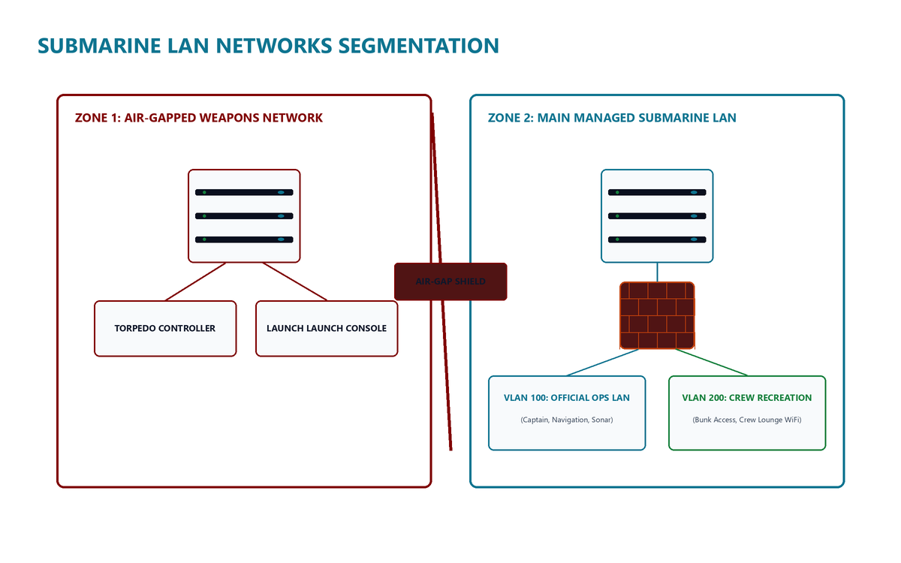
TOPIC 3.3 · 3.3.1.a.2
Network Segmentation: The Submarine Analogy
Definition: Splitting a network into isolated sub-networks so a compromise in one segment can't automatically spread
Analogy: Watertight compartments in a submarine, one hull breach floods one compartment, not the whole ship
Mechanisms: VLANs, subnetting, firewalls, and software-defined micro-segmentation
Guiding principle: Defense in depth, no single control should be the only thing between attacker and asset
Submarine Segmentation
Notes:
Network segmentation is the architectural countermeasure to the flat-network problem. Rather than one trust boundary, segmentation subdivides a network into discrete zones, each governed by its own access-control policy, separated by routers, firewalls, or VLAN boundaries.
The guiding principle is defense in depth: multiple independent controls stacked so that if one fails, others still stand between the attacker and the target asset.

Slide 8
TOPIC 3.3 · 3.3.1.a.3
Blast Radius and East-West Traffic
Blast radius: The set of systems a compromised host can directly reach and attack
Segmentation's job: Shrink the blast radius by forcing attackers to cross additional trust boundaries
Cost per boundary crossed: More recon, more credential theft, more exploitation, more chances to get caught
East-west traffic: Lateral, host-to-host traffic inside a network, historically under-monitored
North-south vs east-west: North-south crosses the perimeter; east-west stays internal, often invisible to perimeter tools
Notes:
Segmentation directly operationalizes blast-radius reduction: every additional segment boundary an attacker must cross after initial compromise imposes cost, more reconnaissance, more credential theft, more exploitation of a distinct trust boundary, and more opportunities for defenders to detect anomalous east-west traffic before the attacker's objective is achieved.
East-west traffic (lateral, internal host-to-host flows) was historically under-monitored because perimeter-focused tooling watches the border, not internal chatter. Modern data centers deploy internal firewalls and network detection and response (NDR) sensors specifically to inspect east-west flows for lateral movement.

Slide 9
TOPIC 3.3 · 3.3.1.a.4
From Location-Based Trust to Zero Trust
Old assumption: Network location is a proxy for trust, 'if you're on the finance VLAN, you must be finance'
NIST SP 800-207 (2020): Formal Zero Trust Architecture (ZTA) standard, rejects location-as-trust entirely
Core principle: Identity must be continuously verified regardless of which subnet a device sits on
Mandate: Required for U.S. federal agencies under OMB Memorandum M-22-09 (2022)
This chapter's frame: VLAN segmentation (wire/frame level) + Zero Trust (identity/policy level) are complementary layers
Notes:
Historically, segmentation assumed network location was a reasonably reliable proxy for trust. Modern consensus, formalized in NIST SP 800-207, rejects that assumption: network location is not identity, and identity must be continuously verified no matter which subnet a device happens to occupy.
This topic treats VLAN-based segmentation and Zero Trust micro-segmentation as complementary layers of one discipline, one operating at the wire/frame level, the other at the identity/policy level.

Slide 10
TOPIC 3.3 · 3.3.1.a.5
The Economic Case: PCI-DSS and Compliance Scope
PCI-DSS: Payment Card Industry Data Security Standard, contractual standard for anyone handling card data
CDE: Cardholder Data Environment, the subset of the network storing/processing/transmitting card data
Scope reduction: A properly segmented CDE means auditors only assess the CDE, not the entire flat network
Result: Lower audit cost, lower residual risk, a technical control with measurable financial benefit
Notes:
PCI-DSS compliance guidance explicitly recognizes that isolating the cardholder data environment (CDE) into its own segment dramatically reduces the number of systems subject to the full battery of compliance controls, directly lowering audit cost and residual risk.
This is a rare case where a purely technical control, a VLAN boundary or firewall rule, produces a measurable financial and regulatory benefit, not just a security one.

Slide 11
TOPIC 3.3 · 3.3.1.b.1
Section I Glossary Consolidation
Castle-and-moat model: perimeter-only trust; everything inside implicitly trusted
Network segmentation: subdividing a network into isolated zones with independent access policy
Defense in depth: layered, independent controls so no single failure is catastrophic
Blast radius: the scope of systems a compromised host can reach
East-west traffic: lateral internal traffic, historically under-monitored
Zero Trust Architecture (NIST SP 800-207): never trust, always verify, regardless of network location
CDE / PCI-DSS scope: isolating cardholder data reduces compliance audit scope
Notes:
Before moving into the technical mechanics of VLANs and Zero Trust, consolidate the foundational vocabulary: castle-and-moat, network segmentation, defense in depth, blast radius, east-west traffic, Zero Trust Architecture, and CDE/PCI scope reduction. Every mechanism in the next section is built to serve one of these ideas.

Slide 12
02
VLANs and IEEE 802.1Q Tagging
Topic 3.3
Notes:
Transition to part 2 of the topic. Pause here for questions before continuing.

Slide 13
TOPIC 3.3 · 3.3.2.a.1
VLANs and IEEE 802.1Q Tagging
VLAN: Lets one physical switch behave as several logically separate switches
Standard: IEEE 802.1Q (1998, revised through 2022)
Tag structure: 32-bit inserted field, 16-bit TPID (0x8100), 3-bit PCP, 1-bit DEI, 12-bit VID
VID range: 12 bits gives 4,094 usable VLAN IDs (1-4094); VID 0 and 4095 reserved
Effect: Devices in different VLANs can't see each other's broadcast traffic despite sharing physical wiring
Notes:
VLANs let a single physical switch behave as if it were several separate switches. Each 802.1Q-tagged frame carries an inserted 32-bit tag: a 16-bit Tag Protocol Identifier fixed at 0x8100, a 3-bit Priority Code Point for Class of Service, a 1-bit Drop Eligible Indicator, and a 12-bit VLAN Identifier (VID) that determines VLAN membership.
The 12-bit VID field yields 4,094 usable VLAN IDs. Larger multi-tenant environments needing more use 802.1ad Q-in-Q or VXLAN, which has a 24-bit VNI supporting 16 million segments.

Slide 14
TOPIC 3.3 · 3.3.2.a.2
Access Ports vs Trunk Ports
Access port: Assigned to exactly one VLAN; frames untagged on the wire to the end device
Trunk port: Carries tagged frames for many VLANs across one physical link
Typical trunk use: Switch-to-switch links, or switch-to-router for inter-VLAN routing
Inter-VLAN routing: Requires a Layer 3 device, router-on-a-stick (sub-interfaces) or a Layer 3 switch (SVIs)
Notes:
Ports configured as access ports transmit and receive untagged frames, the switch internally applies VLAN membership, and are used to connect end-user devices. Trunk ports carry tagged frames for many VLANs across a single physical link, most commonly between switches or between a switch and a router performing inter-VLAN routing.
Because VLANs are separate broadcast domains and therefore separate IP subnets, moving traffic between them requires a Layer 3 device: either a router using 802.1Q sub-interfaces ('router-on-a-stick') or a Layer 3 switch using Switched Virtual Interfaces (SVIs).

Slide 15
TOPIC 3.3 · 3.3.2.a.3
Hardening Trunks: DTP and the Native VLAN
DTP: Dynamic Trunking Protocol, Cisco-proprietary auto-negotiation of trunk status
Danger: Enabled by default on many switches ('dynamic auto'/'dynamic desirable'); a rogue device can trick a switch into trunking
Hardening: switchport nonegotiate disables DTP on every access-facing port
Native VLAN: The one VLAN on a trunk carried untagged; default is VLAN 1 on most platforms
Hardening: Reassign native VLAN to an unused, non-default VLAN (e.g., 99), never place hosts on it
Notes:
Dynamic Trunking Protocol (DTP) automatically negotiates whether a link becomes a trunk, convenient, but dangerous: an attacker plugging in a rogue device can send DTP frames to trick a switch into forming a trunk with them, gaining access to every VLAN on that trunk. The standard hardening move is switchport nonegotiate on every access-facing port.
The native VLAN on a trunk is carried untagged. Leaving it as the factory-default VLAN 1 is a problem because VLAN 1 is also the default for management traffic, CDP/LLDP, and STP BPDUs. CIS hardening benchmarks recommend explicitly reassigning the native VLAN to an unused ID that carries no live host traffic.

Slide 16
TOPIC 3.3 · 3.3.2.b.1
?
VLAN Hopping: Switch Spoofing
Switch spoofing: An attacker sends DTP frames pretending to be a switch
Result: A misconfigured access port in DTP auto mode becomes a trunk with the attacker
Consequence: Attacker gains tagged access to every VLAN permitted on that trunk
Full mitigation: switchport nonegotiate, DTP simply never runs
Notes:
Switch spoofing exploits ports left in DTP auto-negotiation mode: an attacker's NIC or a small embedded device sends DTP frames claiming to be a switch, and a misconfigured access port dutifully becomes a trunk, handing the attacker tagged access to every VLAN permitted on that trunk.
This attack is entirely eliminated by disabling DTP auto-negotiation on all access-facing ports.

Slide 17
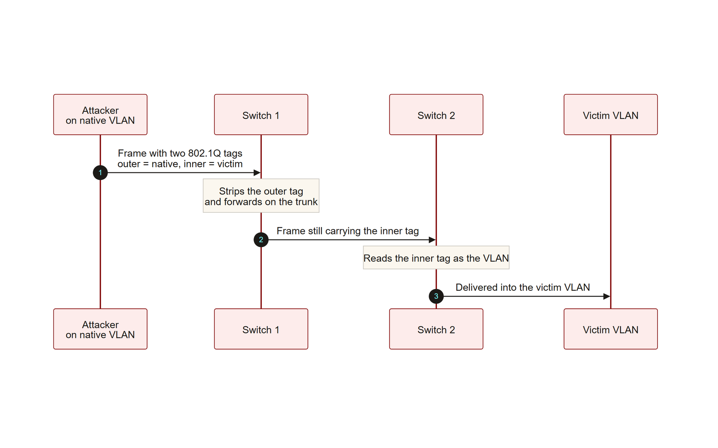
TOPIC 3.3 · 3.3.2.b.2
VLAN Hopping: Double Tagging
Precondition: Only works if attacker's port shares the trunk's native VLAN
Mechanism: Attacker crafts a frame with two stacked 802.1Q tags, outer = native VLAN, inner = victim VLAN
Step 1: First switch strips the outer tag (matches native, so 'no re-tag needed') and forwards with inner tag intact
Step 2: Downstream switch reads the inner tag as legitimate and delivers into the victim VLAN
Key limitation: Unidirectional, injects into the victim VLAN but no return path exists
Full mitigation: Reassign native VLAN off VLAN 1 and never place hosts on the native VLAN
Double Tagging Attack
Notes:
Double tagging exploits the fact that native VLAN traffic on a trunk is carried untagged. An attacker on the native VLAN crafts a frame with two nested 802.1Q headers, the outer tag matching the native VLAN, the inner tag matching a victim VLAN. The first switch strips the outer (native) tag as expected and forwards the frame still carrying the inner tag; a second switch downstream reads that inner tag as legitimate and delivers the frame into the victim VLAN.
This attack is unidirectional, the attacker can inject frames into a foreign VLAN but cannot easily receive a return path, yet it is sufficient to inject spoofed traffic, trigger denial-of-service, or intercept broadcast/multicast data.

Slide 18
TOPIC 3.3 · 3.3.2.b.3
Zero Trust Architecture: NIST SP 800-207 Tenets
Core principle: 'Never trust, always verify', no implicit trust based on network location
Tenet 1: All data sources and computing services are considered resources
Tenet 2: All communication is secured regardless of network location
Tenet 3: Access to resources is granted on a per-session basis
Tenet 4: Access determined by dynamic policy, identity, device posture, behavioral attributes
Tenet 5: Enterprise continuously monitors integrity/security posture of all assets
Notes:
Zero Trust Architecture, as codified in NIST SP 800-207, enumerates seven foundational tenets. The exam-relevant core: all resources require continuous verification; communication is secured regardless of location; access is per-session, not per-login; and policy is dynamic, factoring in identity, device posture, and behavior, with continuous monitoring of every owned asset's security posture.

Slide 19
TOPIC 3.3 · 3.3.2.b.4
PDP, PEP, and Micro-Segmentation
Micro-segmentation: Granular, identity/workload-based policy down to individual hosts, containers, or processes
Enforced by: Software-defined controls (hypervisor firewalls, service mesh sidecars), not physical switch config
PDP (Policy Decision Point): The 'brain', evaluates a request against policy, identity, device posture
PEP (Policy Enforcement Point): The 'gatekeeper' sitting in front of every protected resource, acting on the PDP's decision
Real implementations: VMware NSX, Illumio, Cisco Secure Workload, Kubernetes NetworkPolicy, cloud security groups
Notes:
Zero Trust operationalizes segmentation at a far finer grain than VLANs through micro-segmentation, in which every workload, down to an individual container or virtual machine, carries its own explicit allow-list of permitted communication partners, enforced independent of IP address or VLAN membership.
A Policy Enforcement Point (PEP) grants, denies, or revokes access at each protected resource, acting on instructions from a centralized Policy Decision Point (PDP) that computes the trust decision from identity, device posture, and policy.

Slide 20
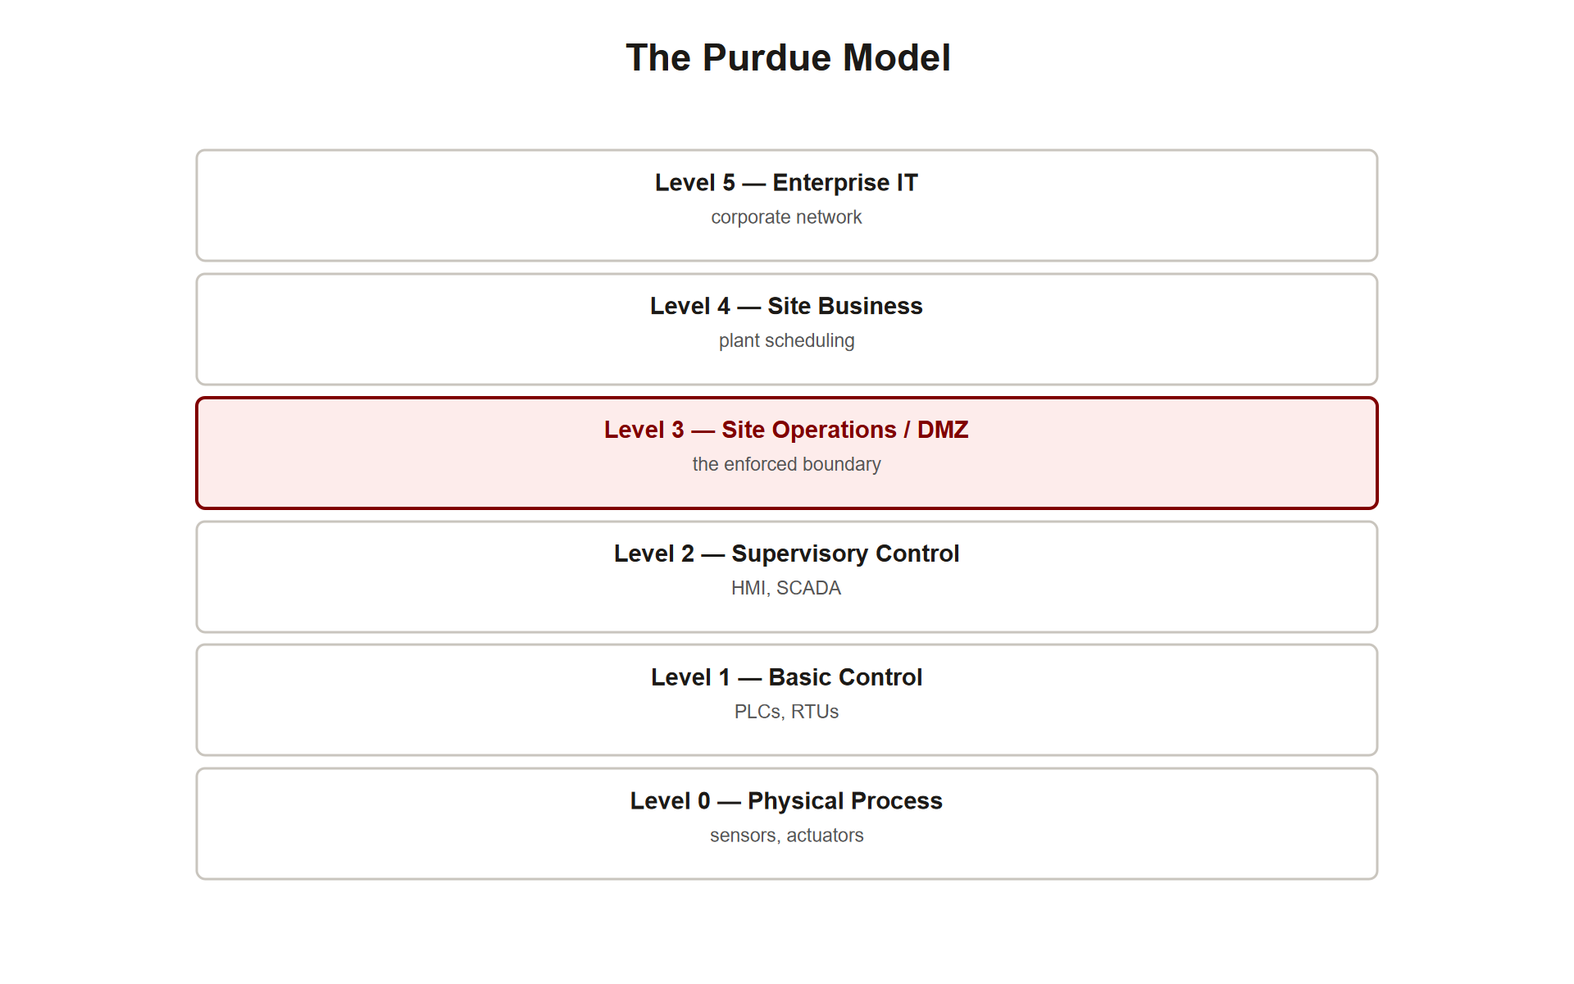
TOPIC 3.3 · 3.3.2.c.1
DMZs, Air-Gapping, and the Purdue Model
DMZ: Segment between untrusted internet and trusted internal network, hosting public-facing services
DMZ design: Two firewall boundaries (or one firewall, three interfaces) so a compromised web server can't pivot inward
Air-gapping: No network connection at all, the most extreme segmentation, used for safety-critical OT/ICS
Air-gap caveat: Reduces but doesn't eliminate risk, Stuxnet (2010) crossed an air gap via infected USB drives
Purdue Model: Hierarchical levels (0=physical process ... 5=enterprise IT) with mandatory firewalled boundaries between IT and OT
Purdue Model Levels
Notes:
A demilitarized zone (DMZ) isolates externally reachable services behind two firewall boundaries so a compromised web server cannot pivot directly into internal file shares or domain controllers. In OT/ICS environments, air-gapping, no direct network connection whatsoever, represents the most extreme segmentation, protecting safety-critical PLCs and SCADA systems.
The Purdue Enterprise Reference Architecture formalizes IT/OT segmentation by defining discrete levels, Level 0 physical process up through Level 4/5 enterprise IT, with mandatory firewalled boundaries between IT and OT zones.

Slide 21
TOPIC 3.3 · 3.3.2.c.2
Default-Deny Inter-VLAN ACLs
Principle: Inter-VLAN/inter-zone traffic should default-deny, explicitly allow-listing only required flows
Example goal: Guest Wi-Fi VLAN must never reach Finance VLAN or any internal RFC1918 space
Implementation: Extended ACL applied inbound on the VLAN's routed SVI
Design pattern: Deny specific sensitive destinations first, then permit general outbound (e.g., internet) last
Notes:
Access control lists restricting inter-VLAN traffic should default-deny and explicitly allow-list only required flows. A guest Wi-Fi VLAN, for instance, should be explicitly denied any path to the finance VLAN or any internal RFC1918 address space, while still being permitted general internet access.

Slide 22
TOPIC 3.3 · 3.3.2.d.1
Section II Glossary Consolidation
802.1Q: IEEE VLAN tagging standard, TPID, PCP, DEI, 12-bit VID
Access port / trunk port: single-VLAN end-device port vs multi-VLAN inter-switch link
DTP / nonegotiate: auto-trunk negotiation and its hardening fix
Native VLAN: untagged trunk VLAN; must be reassigned off VLAN 1
VLAN hopping (switch spoofing, double tagging): the two classic bypass techniques
PDP / PEP / micro-segmentation: Zero Trust's granular enforcement model
DMZ / air-gap / Purdue Model: coarse-grained isolation for public services and OT/ICS
Default-deny ACL: explicit allow-listing of only required inter-zone flows
Notes:
Section II covered the full technical stack of segmentation: 802.1Q frame mechanics, port types, DTP/native-VLAN hardening, the two VLAN hopping attacks, Zero Trust's PDP/PEP model, and coarse isolation strategies (DMZ, air-gap, Purdue Model) enforced with default-deny ACLs. Section III now examines what happens when these controls are missing or unverified in the real world.

Slide 23
03
Case Study: Target Corporation Breach (2013), The Vector
Topic 3.3
Notes:
Transition to part 3 of the topic. Pause here for questions before continuing.

Slide 24
TOPIC 3.3 · 3.3.3.a.1
Case Study: Target Corporation Breach (2013), The Vector
Scale: ~40 million card records, ~70 million customer records exfiltrated, Nov-Dec 2013
Initial access: NOT Target directly, a third-party HVAC vendor, Fazio Mechanical Services
Method: Phishing email delivered Citadel credential-stealing trojan (Zeus-derived banking trojan)
Stolen asset: Fazio's legitimate remote-access credentials to Target's vendor billing portal
Notes:
In November-December 2013, attackers exfiltrated approximately 40 million credit/debit card records and 70 million customer records from Target Corporation. The initial access vector was not a direct attack on Target's core systems: attackers first compromised Fazio Mechanical Services, a small HVAC contractor with legitimate remote-access credentials to Target's vendor portal, via a phishing email delivering the Citadel credential-stealing trojan.

Slide 25
TOPIC 3.3 · 3.3.3.a.2
?
Case Study: Target Corporation Breach (2013), The Segmentation Failure
Lateral movement: Attackers traversed Target's internal network from the vendor portal to the POS environment
Root cause: Vendor billing systems and the cardholder data environment (CDE) were not adequately segmented
Payload: BlackPOS (Kaptoxa) malware deployed to thousands of registers, scraping card data from RAM pre-encryption
Cost: Over $200 million in direct settlement and remediation costs
Counterfactual: Strict segmentation would have contained the HVAC compromise to a low-value corporate segment
Notes:
From the vendor-portal foothold, attackers moved laterally through Target's internal network, traversing systems that should have been separated by distinct trust zones, and reached the point-of-sale network segment, deploying BlackPOS memory-scraping malware onto thousands of registers to harvest card track data before encryption. Investigators concluded that strict segmentation isolating vendor billing systems from the CDE, consistent with PCI-DSS guidance, would have contained the compromise entirely.

Slide 26
TOPIC 3.3 · 3.3.3.b.1
Case Study: Colonial Pipeline Ransomware (2021), The Vector
Target: Colonial Pipeline, ~45% of East Coast refined petroleum fuel supply
Attacker: DarkSide, a Russia-based ransomware-as-a-service (RaaS) group
Entry point: A single legacy VPN account, leaked/reused password, no MFA
Scope of compromise: IT network only (billing, invoicing, corporate systems), no evidence OT was ever breached
Notes:
In May 2021, Colonial Pipeline suffered a ransomware attack attributed to the DarkSide ransomware-as-a-service group. The intrusion vector was a single compromised VPN account with a leaked, reused password and no multi-factor authentication, a purely IT-side compromise. Investigators, including CISA and the FBI, found no evidence the attackers ever directly breached the OT systems that physically control pipeline valves and pumps.

Slide 27
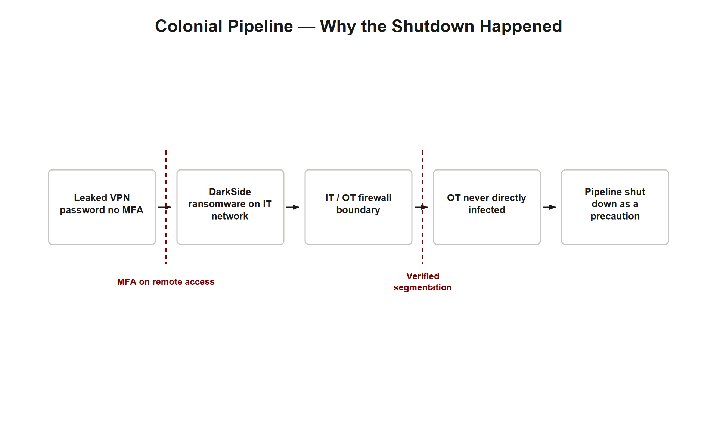
TOPIC 3.3 · 3.3.3.b.2
Case Study: Colonial Pipeline, Why Shut Down Anyway?
Decision: Colonial proactively shut down the entire 5,500-mile pipeline for ~6 days
Reasoning: Could not confirm IT/OT segmentation was robust enough to guarantee ransomware couldn't spread or corrupt OT data feeds
Key insight: Segmentation is only a defense if its integrity can be verified DURING an active incident
Consequence: Regional fuel disruption, panic buying, ~$4.4 million ransom (partially recovered by DOJ)
Colonial Pipeline Timeline
Notes:
Despite the attack remaining confined to Colonial's IT network, the company made the precautionary decision to shut down the entire pipeline. The stated rationale, corroborated by Congressional testimony, was that Colonial could not be confident its IT/OT segmentation was robust enough to guarantee the ransomware could not spread into, or that compromised billing systems could not corrupt data feeding into, the OT environment. Lacking sufficient confidence in its own segmentation boundary, the company treated the entire operation as compromised out of caution.

Slide 28
TOPIC 3.3 · 3.3.3.c.1
Section III Glossary Consolidation
Third-party risk: Vendor access must be segmented as though the vendor is a hostile network
Target (2013): concrete segmentation absence, vendor portal directly reached the CDE
Colonial Pipeline (2021): segmentation verifiability failure, boundary existed but wasn't provably intact
Common thread: both breaches show that a control that isn't hardened, tested, or monitored is not a real control
Notes:
Both case studies illustrate segmentation failures of different character: Target's was a concrete absence of a trust boundary between vendor access and the CDE; Colonial Pipeline's was an inability to verify, in real time, that an existing IT/OT boundary was intact. Together they establish the exam-critical principle that segmentation must be both architecturally present AND continuously verifiable to function as a real defense.

Slide 29
04
Hardening Layer: VLAN and Trunk Baseline
Topic 3.3
Notes:
Transition to part 4 of the topic. Pause here for questions before continuing.

Slide 30
TOPIC 3.3 · 3.3.4.a.1
Hardening Layer: VLAN and Trunk Baseline
Unused ports: Administratively shut down and assigned to a black-hole VLAN, unused, no Layer 3 gateway
Access ports: DTP disabled, explicitly configured as access (not auto-negotiated)
Native VLAN: Reassigned off VLAN 1, carries no live host traffic
Inter-VLAN ACLs: Default-deny, explicit allow-list only
Notes:
Effective segmentation programs combine hardened Layer 2/3 configuration, identity-centric Zero Trust policy, and continuous validation. All access-facing switch ports should have DTP disabled and be explicitly access-mode; unused ports should be shut down and assigned to a black-hole VLAN with no Layer 3 gateway rather than left in the default VLAN, so a rogue device plugged into a live but unconfigured port lands in an isolated segment with no route anywhere.

Slide 31
TOPIC 3.3 · 3.3.4.a.2
Hardening Layer: Zero Trust Enforcement
Migration goal: From implicit network-location trust to continuous, per-session authorization
Enforcement point: A PEP sits in front of every resource, regardless of 'inside' or 'outside' status
SDP: Software-defined perimeter, resources cryptographically hidden until device+user are verified
Continuous checks: Device posture (patch level, disk encryption, EDR agent health) evaluated on every access request
Notes:
Consistent with NIST SP 800-207, organizations should migrate from implicit network-location trust toward continuous, per-session authorization enforced at a PEP in front of every resource. This typically involves a software-defined perimeter or identity-aware proxy replacing traditional site-to-site VPN, coupled with device posture checks evaluated on every access request rather than once at login.

Slide 32
TOPIC 3.3 · 3.3.4.a.3
Hardening Layer: Micro-Segmentation and East-West Inspection
Enforcement: Host- or hypervisor-level firewalling, least-privilege workload-to-workload allow-lists
Beyond VLANs: Don't rely solely on perimeter or VLAN-level controls inside data centers/cloud VPCs
NDR sensors: Deployed to inspect east-west traffic for anomalous lateral movement
Classic signature: A workstation suddenly initiating SMB connections to dozens of servers = ransomware propagation pattern
Notes:
Within data centers and cloud virtual networks, host- or hypervisor-level firewalling should enforce least-privilege, workload-to-workload allow-lists rather than relying solely on perimeter or VLAN-level controls. Internal network detection and response sensors should inspect east-west traffic for anomalous lateral movement, such as a workstation suddenly initiating SMB connections to dozens of servers, a classic ransomware propagation signature.

Slide 33
TOPIC 3.3 · 3.3.4.a.4
Hardening Layer: IT/OT and DMZ Boundary Enforcement
Requirement: Documented, tested, continuously monitored boundary between IT Levels 4/5 and OT Levels 0-3
OT DMZ: Hosts historian replicas and jump servers so no direct IT-to-OT protocol traffic is ever permitted
Public-facing services: Must reside in a DMZ, isolated by at least one additional firewall hop from internal systems
Trust rule: DMZ hosts should never hold direct trust relationships (shared credentials, unrestricted DB access) with internal domain infrastructure
Notes:
Organizations operating industrial control systems should implement a documented, tested, and continuously monitored boundary between IT and OT per the Purdue Model, typically via a dedicated OT DMZ hosting historian replicas and jump servers so that no direct IT-to-OT protocol traffic is ever permitted. Public-facing services must reside in a DMZ isolated by at least one additional firewall hop from internal systems.

Slide 34
TOPIC 3.3 · 3.3.4.b.1
?
Exam Focus: Naming the Failed Layer
Layer 2: VLAN hardening, DTP disabled, native VLAN reassigned
Layer 3/4: Default-deny inter-VLAN/inter-zone ACLs and firewall rules
Identity/Zero Trust: Per-session PEP authorization regardless of location, phishing-resistant MFA (Colonial Pipeline)
Physical/OT: Purdue-model IT/OT boundary enforcement and, where justified, true air-gapping
Always tie back to: blast-radius containment and lateral movement, not just 'add a firewall'
Notes:
When the AP exam asks 'how could this breach have been prevented,' a strong answer names the specific layer that failed and the specific control that would have stopped lateral movement at that layer, tying the answer back to blast-radius containment rather than a vague 'add more security.'

Slide 35
TOPIC 3.3 · 3.3.4.b.2
Section IV Glossary Consolidation
Black-hole VLAN: unused, non-routed VLAN for disabled/unconfigured ports
SDP: software-defined perimeter, cryptographically hidden resources until verified
Micro-segmentation / NDR: workload-level policy plus east-west traffic inspection
OT DMZ / historian: mediating zone preventing direct IT-to-OT protocol traffic
Four-layer exam framework: Layer 2, Layer 3/4, Identity/Zero Trust, Physical/OT
Notes:
Section IV translated the case-study lessons into a concrete hardening baseline: Layer 2 port/trunk hardening, Zero Trust per-session enforcement via SDP, micro-segmentation with east-west NDR inspection, and a tested IT/OT boundary via the Purdue Model. The four-layer framework is the single most reusable tool from this topic for exam free-response answers.

Slide 36
05
Detecting Segmentation Failures in Practice
Topic 3.3
Notes:
Transition to part 5 of the topic. Pause here for questions before continuing.

Slide 37
TOPIC 3.3 · 3.3.5.a.1
Detecting Segmentation Failures in Practice
Signal 1: A device reaching hosts outside its expected VLAN/subnet with no ACL blocking it
Signal 2: Unexpected DTP negotiation frames appearing on an access port
Signal 3: Frames observed with unexpected double 802.1Q tags on ingress
Signal 4: A single account authenticating from wildly inconsistent device postures without re-verification
Signal 5: Sudden mass east-west connections (e.g., SMB) from one host to many others
Notes:
Applying this topic's concepts diagnostically: an auditor or SOC analyst looks for VLAN/subnet reachability that shouldn't exist, DTP frames appearing where they shouldn't, double-tagged frames on ingress ports, identity requests lacking continuous re-verification, and sudden anomalous east-west connection bursts, each signal maps directly back to a specific control failure covered in this topic.

Slide 38
TOPIC 3.3 · 3.3.5.a.2
Applied Scenario: Designing a Segmented SMB Network
Scenario: A small business wants guest Wi-Fi, employee workstations, and a card-payment terminal on one physical switch
Design choice 1: Three VLANs, GUEST, CORP, and POS, each its own access-port assignment
Design choice 2: Default-deny ACL: GUEST cannot reach CORP or POS; CORP cannot reach POS directly
Design choice 3: Native VLAN reassigned off VLAN 1; DTP disabled on every access port
Design choice 4: POS VLAN scoped as its own PCI-DSS CDE, minimizing audit scope
Notes:
Apply the full toolkit to a concrete design problem: a small business with guest Wi-Fi, employee workstations, and a card-payment terminal sharing one physical switch. The correct design uses three VLANs with a default-deny inter-VLAN ACL, hardened trunk configuration (native VLAN reassigned, DTP disabled), and treats the POS VLAN as its own PCI-DSS-scoped CDE, directly mirroring the counterfactual fix identified in the Target case study.

Slide 39
TOPIC 3.3 · 3.3.5.a.3
?
Practice: Diagnosing an Attack from Symptoms
Given: Traffic logs show frames on the finance VLAN originating from a host with no assigned finance port
Step 1: Identify the attack, no bidirectional session observed, only injected frames = double tagging
Step 2: Identify the two preconditions that must both be true, attacker on native VLAN + trunk carries native VLAN untagged
Step 3: Identify the fix, reassign the native VLAN to an unused, non-default ID
Notes:
Given the symptom pattern from the exam-relevant scenario in Section II, traffic appearing on the finance VLAN from a host with no assigned finance port, with no return path observed, walk through the diagnostic steps: identify the attack as double tagging, confirm the two required preconditions, and state the concrete remediation.

Slide 40
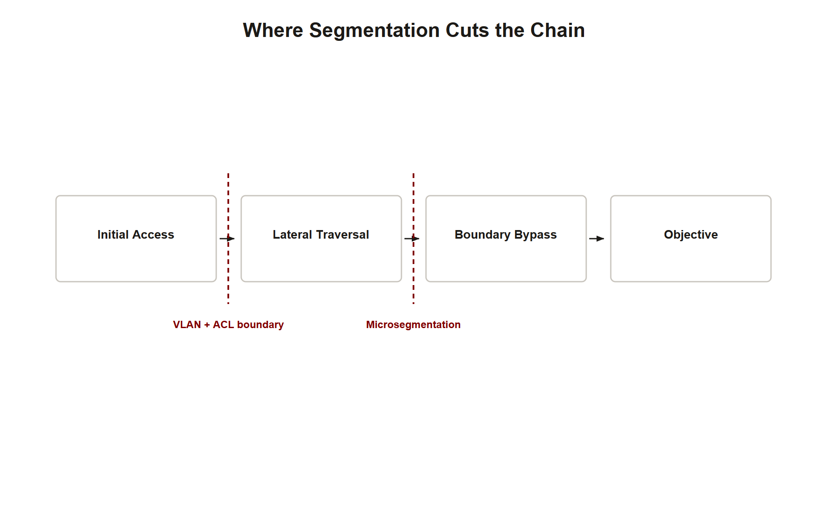
TOPIC 3.3 · 3.3.5.b.1
Synthesis: The Segmentation Kill Chain
Step 1, Initial access: Attacker compromises a weakly segmented entry point (third-party vendor, unpatched VPN)
Step 2, Lateral traversal: Absence of internal boundaries lets the attacker move host-to-host (east-west)
Step 3, Boundary bypass: Where boundaries DO exist, attacker exploits misconfiguration (DTP, native VLAN) to cross them
Step 4, Objective: Reaches the crown-jewel segment (CDE, OT) and exfiltrates data or deploys ransomware
Defender's job: Break the chain at ANY step, segmentation is the primary tool for steps 2 and 3
Segmentation Kill Chain
Notes:
Synthesizing the whole topic into a single kill chain: an attacker gains initial access at a weak entry point, exploits the absence of internal boundaries to move laterally (east-west), bypasses any boundaries that do exist through misconfiguration (unhardened DTP, default native VLAN), and finally reaches the high-value segment to complete their objective. Every control covered in this topic, VLAN hardening, default-deny ACLs, Zero Trust PEPs, Purdue Model IT/OT boundaries, exists to break this chain at steps 2 or 3, containing blast radius even after step 1 has already failed.

Slide 41
TOPIC 3.3 · 3.3.5.b.2
Exam Readiness Checklist
Can you... define network segmentation and explain blast-radius reduction in your own words?
Can you... describe the 802.1Q tag structure and explain access vs trunk ports?
Can you... explain switch spoofing vs double tagging, including the double-tagging precondition and unidirectionality?
Can you... state the two concrete VLAN hardening fixes (DTP disabled, native VLAN reassigned)?
Can you... explain NIST SP 800-207's core principle and the PDP/PEP model?
Can you... compare the Target and Colonial Pipeline segmentation failures precisely (absence vs unverifiability)?
Can you... apply the four-layer exam framework (L2 / L3-4 / Identity / Physical-OT) to a new scenario?
Can you... design a simple multi-VLAN network with default-deny ACLs from scratch?
Notes:
Before moving on, verify readiness against this checklist. Each item traces to a specific slide or case study in this deck. If any item feels shaky, revisit the corresponding glossary consolidation slide (3.3.1.b.1, 3.3.2.d.1, 3.3.3.c.1, or 3.3.4.b.2) before attempting practice free-response questions.

