Slide 1
AAYAT-AP-PREP · CYBERSECURITY
UNIT 3: SECURING NETWORKS
Topic 3.4: Firewall Access Controls
Segmenting a network raises the question of who decides what may cross between the zones. This topic examines the firewall as that gatekeeper: how much it remembers about a conversation as it decides, how an access control list is evaluated rule by rule, and where a firewall belongs in a network’s topology.
4 learning objectives · College Board AP Cybersecurity Course Framework
Notes:
Cover slide for Topic 3.4: Protecting Networks: Firewalls. This topic focuses on securing network border ports against threats exploiting exposed administrative ports. Hardening requires combining administrative controls, physical security barriers, and technical mitigation via …

Slide 2
TOPIC 3.4
Learning Objectives
Mitigate Risk
Identify the types of network-based firewall &mdash; stateless packet filters, stateful inspection, proxies, and next-generation platforms &mdash; and what each can and cannot decide.
3.4.A
Mitigate Risk
Explain how a firewall uses an access control list to permit or deny traffic entering and leaving a network, including first-match evaluation and the default rule.
3.4.B
Mitigate Risk
Determine where firewalls should sit in a network, including the screened subnet that separates public-facing services from internal ones.
3.4.C
Mitigate Risk
Configure a firewall so that the flow of traffic matches a stated policy, and verify that it does.
3.4.D
Objectives paraphrased from the AP Cybersecurity Course Framework (College Board, AP Career Kickstart).
Notes:
Read each learning objective aloud and connect it to the exam skill category before starting the topic.

Slide 3
TOPIC 3.4 · CONCEPT MAP
Hospital Boundary Security Topology
Untrusted
Internet
Firewall A
DMZ Zone
(Web Booking Server)
Firewall B
Secure Internal LAN
(Patient Database)
Strict access rules enforced between Firewall B and the internal LAN.

Slide 4
TOPIC 3.4
The Big Idea
A firewall is a bouncer holding a guest list, not a wall. It doesn't block everything that arrives — it checks every request against a set of rules and only waves through what's supposed to get through.
Hold onto this picture — we'll come back to it as the mechanics get more technical.
Notes:
Big-idea framing for Topic 3.4. Open with this analogy before the mechanics: "A firewall is a bouncer holding a guest list, not a wall. It doesn't block everything that arrives — it checks every request against a set of rules and only waves through what's supposed to get through." Ask students for their own version of the analogy before moving on.

Slide 5
01
The Firewall as Deterministic Access Control
Topic 3.4
Notes:
Transition to part 1 of the topic. Pause here for questions before continuing.

Slide 6
TOPIC 3.4 · 3.4.1.a.1
The Firewall as Deterministic Access Control
Definition: A firewall sits between two networks and decides which traffic is allowed through based on a rule base
Core mechanism: Evaluates discrete packet attributes against deterministic rules, no judgment of intent or content
Origin: Term borrowed from building construction (a fireproof wall stopping fire spread), Bellovin & Cheswick, 1994
Strength/weakness duality: Auditable, repeatable, fast, but any gap or misordering is a permanent, silent hole
Reference: NIST SP 800-41 Rev. 1, Guidelines on Firewalls and Firewall Policy
Notes:
A firewall is software or hardware that sits between two networks and decides which traffic is allowed through, functioning like a security checkpoint inspecting every packet crossing a boundary. Unlike a human analyst, a firewall does not evaluate intent, it evaluates discrete packet attributes (source, destination, port, protocol) against an ordered rule base and either forwards or discards the packet.
This deterministic, rule-driven nature is simultaneously the firewall's greatest strength and its greatest weakness. It is auditable, repeatable, and fast, but any gap, contradiction, or misordering in the rule base becomes a permanent, silent hole in the perimeter, invisible until exploited.

Slide 7
TOPIC 3.4 · 3.4.1.a.2
?
Statefulness and the OSI Layer Axis
Packet-filtering firewalls: Stateless, inspect each packet in isolation, Layer 3/4 only, header fields only
Stateful inspection firewalls: Track active sessions in a state table, return traffic auto-permitted
Next-generation firewalls (NGFWs): Inspect up to Layer 7, application identity, user identity, file content
Patent milestone: Check Point's Gil Shwed patented Stateful Inspection in 1997 (US Patent 5,606,668)
Market category: Gartner coined 'next-generation firewall' around 2009
Notes:
Firewalls are classified along an axis of increasing statefulness and inspection depth, corresponding roughly to OSI layers. Packet-filtering firewalls evaluate each packet as an isolated, stateless event, examining only header fields such as source/destination IP and port. Stateful inspection firewalls introduced connection awareness, maintaining a table of active sessions so return traffic belonging to an approved outbound connection is automatically permitted.
NGFWs represent the current commercial state of the art, extending inspection to Layer 7 to identify the actual application generating traffic, regardless of port, and enforcing policy based on user identity, application signature, and file content rather than IP/port tuples alone.

Slide 8
TOPIC 3.4 · 3.4.1.b.1
Default Deny and the Principle of Least Privilege
Default deny (implicit deny): Anything not explicitly permitted is automatically blocked
Origin: Saltzer & Schroeder (1975), 'The Protection of Information in Computer Systems', fail-safe defaults
Inversion of naive assumption: Networks are not open-by-default-closed-where-dangerous; they are closed-by-default with narrow exceptions
Least privilege applied to firewalls: Rules should permit only the specific source/destination/port/protocol actually required
Never use: Broad 'any/any' rules out of convenience, violates least privilege
Notes:
Firewalls implement default deny, one of the oldest formalized principles in computer security engineering, articulated by Saltzer and Schroeder in 1975. Under default deny, the absence of a matching permit rule results in automatic rejection, the firewall assumes hostility unless proven otherwise.
This inverts the naive assumption that networks should be open by default. Modern security engineering assumes total closure and grants exceptions narrowly, a posture directly descended from the principle of least privilege: a rule should permit only the minimum access necessary, never a broad 'any/any' allowance.

Slide 9
TOPIC 3.4 · 3.4.1.b.2
?
First-Match Evaluation: Why Rule Order Is Load-Bearing
First-match (top-down) model: Rules processed sequentially; the first matching rule determines the packet's fate
No further rules consulted: Once a match fires, evaluation stops immediately, even if a later rule is more specific
Consequence: A narrow deny rule placed after a broad permit that already matches is dead code, it never executes
Common failure modes: Unintended outages (legit traffic silently dropped) and unintended exposure (traffic falls through to an earlier permissive rule)
Applies to: Cisco IOS ACLs, iptables/nftables chains, most stateful firewall policy engines
Notes:
The rule base is evaluated using a first-match evaluation model: rules are processed sequentially from the top, and the first rule whose criteria match the packet's attributes determines its fate, permit or deny, with no further rules consulted. This has a critical, frequently misunderstood implication: rule order is not cosmetic, it is semantically load-bearing.
A narrowly scoped deny rule placed after a broad permit rule that already matches the same traffic will never execute, because the broad rule captured the packet first. Misordered rules are among the most common root causes of both unintended outages and unintended exposure.

Slide 10
TOPIC 3.4 · 3.4.1.c.1
Section I Glossary Consolidation
Firewall: Device/software enforcing rule-based access control between networks
Access control: Any mechanism deciding who/what may interact with a resource
Rule base: The ordered list of permit/deny rules a firewall evaluates
Statefulness: Whether a device remembers connection context across packets
OSI model: Seven-layer framework; firewalls categorized by highest layer inspected
Default deny / least privilege: Governing philosophies behind rule-base design
First-match evaluation: Top-down rule processing that stops at the first match
Notes:
Section I established the conceptual vocabulary for firewall access control: the firewall as a deterministic rule-evaluation engine, the three-tier taxonomy of packet-filtering / stateful / NGFW technology along the statefulness and OSI-layer axis, and the two governing design philosophies, default deny and least privilege, that determine how a well-formed rule base should be structured. The first-match evaluation model ties these together operationally: it is the mechanical process by which default-deny philosophy and rule ordering interact to produce a packet's real-world fate.

Slide 11
02
Access Control Lists: Cisco Standard vs. Extended
Topic 3.4
Notes:
Transition to part 2 of the topic. Pause here for questions before continuing.

Slide 12
TOPIC 3.4 · 3.4.2.a.1
Access Control Lists: Cisco Standard vs. Extended
ACL: Ordered list of permit/deny rules (ACEs) evaluated by a router or firewall
Standard ACL: Filters on source IP only, numbered 1–99 (or 1300–1999 expanded)
Extended ACL: Filters on source, destination, protocol, and port, numbered 100–199 or named
Placement rule: Standard ACLs applied close to the destination; extended ACLs applied close to the source
Why placement matters: Extended ACLs discard unwanted traffic before it consumes bandwidth elsewhere
Notes:
An Access Control List (ACL) is the concrete configuration syntax through which a rule base is expressed on routers, switches, and firewall appliances. Each entry (an Access Control Entry, ACE) specifies match criteria and an action. On Cisco IOS devices, a standard ACL can filter only on source address, while an extended ACL can match on source and destination address, protocol, and port, enabling the granular filtering expected of a modern perimeter device.
Because standard ACLs have limited matching criteria, they are normally applied as close to the destination as possible to avoid unintentionally blocking traffic to unrelated destinations; extended ACLs, with their granularity, should be applied close to the source to discard unwanted traffic early.

Slide 13
TOPIC 3.4 · 3.4.2.a.2
Reading an Extended ACL: The Perimeter-IN Example
Goal: Permit inbound HTTPS to a public web server; deny legacy clear-text management protocols
Remark lines: Documentation-only, aid auditability of the rule base
Established keyword: Permits return traffic for sessions the internal host initiated outbound
Explicit denies: Telnet (port 23) and FTP (port 21) blocked as legacy clear-text protocols
Implicit deny: All remaining traffic falls to the always-present, never-displayed final deny rule
Notes:
The following Cisco IOS example configures an extended ACL on a border router that permits inbound HTTPS traffic to a public web server while explicitly denying inbound Telnet and FTP, then relies on the implicit deny to block everything else. Notice the ordering: the narrow permit for HTTPS and established return traffic come first, then explicit denies for known-bad legacy protocols, then ICMP for diagnostics, with the implicit deny always last, though it is never shown in the running configuration.

Slide 14
TOPIC 3.4 · 3.4.2.b.1
Linux Packet Filtering: iptables and Netfilter
Netfilter: The kernel framework providing hook points (INPUT, OUTPUT, FORWARD, etc.)
iptables: Traditional userspace tool configuring Netfilter, chains within tables, top-to-bottom like an ACL
Origin: Created by Rusty Russell and the Netfilter core team, Linux kernel 2.4 (2001)
Connection tracking (conntrack): Records state of active connections, NEW, ESTABLISHED, RELATED
Successor: nftables, unified syntax, default backend on most major distros since the early 2020s
Notes:
On Linux systems, the equivalent of a router ACL is implemented through iptables or its modern successor nftables, both of which operate on the kernel's Netfilter framework and maintain a connection tracking table (conntrack) to support stateful rule matching. Rules are organized into chains (INPUT, OUTPUT, FORWARD) within tables (filter, nat, mangle), evaluated top-to-bottom exactly like a Cisco ACL.
conntrack is the practical Linux implementation of the stateful inspection concept patented by Check Point in 1997, it lets rules like '-m state --state ESTABLISHED' skip re-parsing a full handshake for every packet of an already-approved connection.

Slide 15
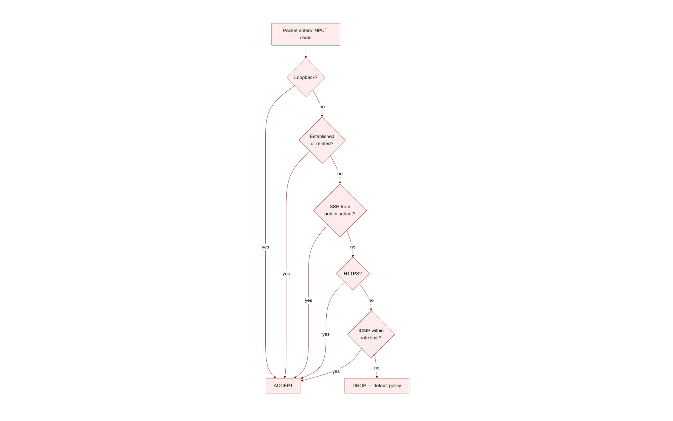
TOPIC 3.4 · 3.4.2.b.2
Configuring a Default-Deny iptables Policy
Default chain policies: Set INPUT and FORWARD to DROP, enforces default-deny posture
Loopback and established traffic: Always allowed first for functionality and efficiency
Scoped SSH access: Restricted to a trusted management subnet only, not 'any' source
Rate-limited ICMP: Mitigates ping-flood reconnaissance while still allowing diagnostics
Log-then-drop: Final catch-all logs dropped packets before discarding for forensic visibility
Iptables Chain Flow
Notes:
This iptables policy demonstrates default-deny in practice: the INPUT and FORWARD chain policies are set to DROP, meaning any packet not explicitly matched by an earlier ACCEPT rule is discarded. Loopback traffic and established/related connections are allowed first, followed by narrowly scoped rules, SSH restricted to a specific management subnet, HTTPS open to the world for the web front-end, and rate-limited ICMP to mitigate reconnaissance. The final two lines log then drop everything else, preserving forensic visibility into what the default-deny rule actually caught.

Slide 16
TOPIC 3.4 · 3.4.2.c.1
The Same Policy in nftables Syntax
Unified table-based syntax: Single framework replaces iptables' separate ipv4/ipv6/arp/eb tables
Hook priority: 'type filter hook input priority 0', declares where in packet processing this chain runs
policy drop: Chain-level default-deny declared directly, equivalent to iptables' -P INPUT DROP
Same logical rules, new syntax: loopback, ct state, scoped SSH, HTTPS, rate-limited ICMP, log+drop
Adoption: Default backend for the iptables command on Debian, RHEL, Ubuntu by the early 2020s
Notes:
The equivalent policy expressed in the newer, table-based nftables syntax illustrates the industry's direction toward unified rule-set languages. Where iptables required separate commands building an implicit chain, nftables expresses the entire chain, hook point, priority, default policy, and rules, as a single declarative block. The logic is identical to the iptables example: default drop, then narrow, ordered exceptions, then explicit logging of anything that falls through.

Slide 17
TOPIC 3.4 · 3.4.2.c.2
First Match Wins, Always: The Critical Concept Restated
Critical concept: Firewall and ACL rules are evaluated top-to-bottom; the first matching rule wins
Broad permit near the top: Silently neutralizes every deny rule written beneath it
Overly specific deny after a broad permit: Dead code, will never fire
Exam and audit test: Given a rule list, can you trace which rule actually applies to a given packet?
Question to answer: Why does rule order matter more than rule content correctness alone?
Notes:
If you remember one operational fact from this chapter, make it this: firewall and ACL rules are evaluated top-to-bottom, and the first rule that matches a packet's criteria wins, the engine stops looking immediately, even if a later rule would have been a 'better' or more specific match. A broad 'permit ip any any' placed near the top of an ACL silently neutralizes every deny rule written beneath it. Conversely, an overly specific deny placed after a broad permit is dead code, it will never fire.
This is why a technically 'correct' set of individual rules can still produce a completely broken or dangerously permissive policy if their order is wrong. The AP exam and real-world audits both test this exact failure mode.

Slide 18
TOPIC 3.4 · 3.4.2.d.1
NGFW Augmentation: DPI, TLS Inspection, and Identity
Deep Packet Inspection (DPI): Examines actual payload content, not just headers, to identify true application/threat
TLS inspection: Firewall acts as authorized man-in-the-middle, decrypts, inspects, re-encrypts
User-identity awareness: Ties policy to authenticated user/group identity (via AD/LDAP), not just IP
Fused functions: NGFW effectively merges firewall + IPS + content filter into one policy decision point
Privacy tension: TLS inspection requires deploying the firewall's CA cert as trusted, raises compliance concerns (NIST SP 800-52)
Notes:
Modern NGFWs augment port/protocol matching with deep packet inspection, TLS inspection, and user-identity awareness, effectively fusing the functions of a traditional firewall with an Intrusion Prevention System (IPS) and a content filter into a single policy decision point. DPI allows recognition that traffic on port 443 is actually a disguised VPN tunnel, or that a file transfer contains a known malware signature, regardless of the claimed port.
TLS inspection requires deploying the firewall's CA certificate as trusted on all client devices, and raises legitimate privacy and compliance concerns, regulatory frameworks often require exempting certain traffic categories (banking, healthcare) from decryption.

Slide 19
TOPIC 3.4 · 3.4.2.e.1
Section II Glossary Consolidation
ACL / ACE: Ordered rule list / individual rule entry
Standard vs. extended ACL: Source-only vs. full 4-tuple matching
iptables / nftables / Netfilter: Linux userspace tools and kernel framework for packet filtering
conntrack: Linux connection-tracking subsystem implementing stateful inspection
DPI / TLS inspection / user-identity awareness: NGFW Layer 7 capabilities
Notes:
Section II translated Section I's conceptual vocabulary into concrete configuration syntax across three platforms: Cisco IOS extended ACLs, Linux iptables, and its nftables successor, all sharing the same first-match, default-deny logic despite different syntax. It closed with NGFW-specific mechanisms (DPI, TLS inspection, identity awareness) that extend basic packet/connection matching up to Layer 7.

Slide 20
03
Case Study: The 2019 Capital One Breach, Overview
Topic 3.4
Notes:
Transition to part 3 of the topic. Pause here for questions before continuing.

Slide 21
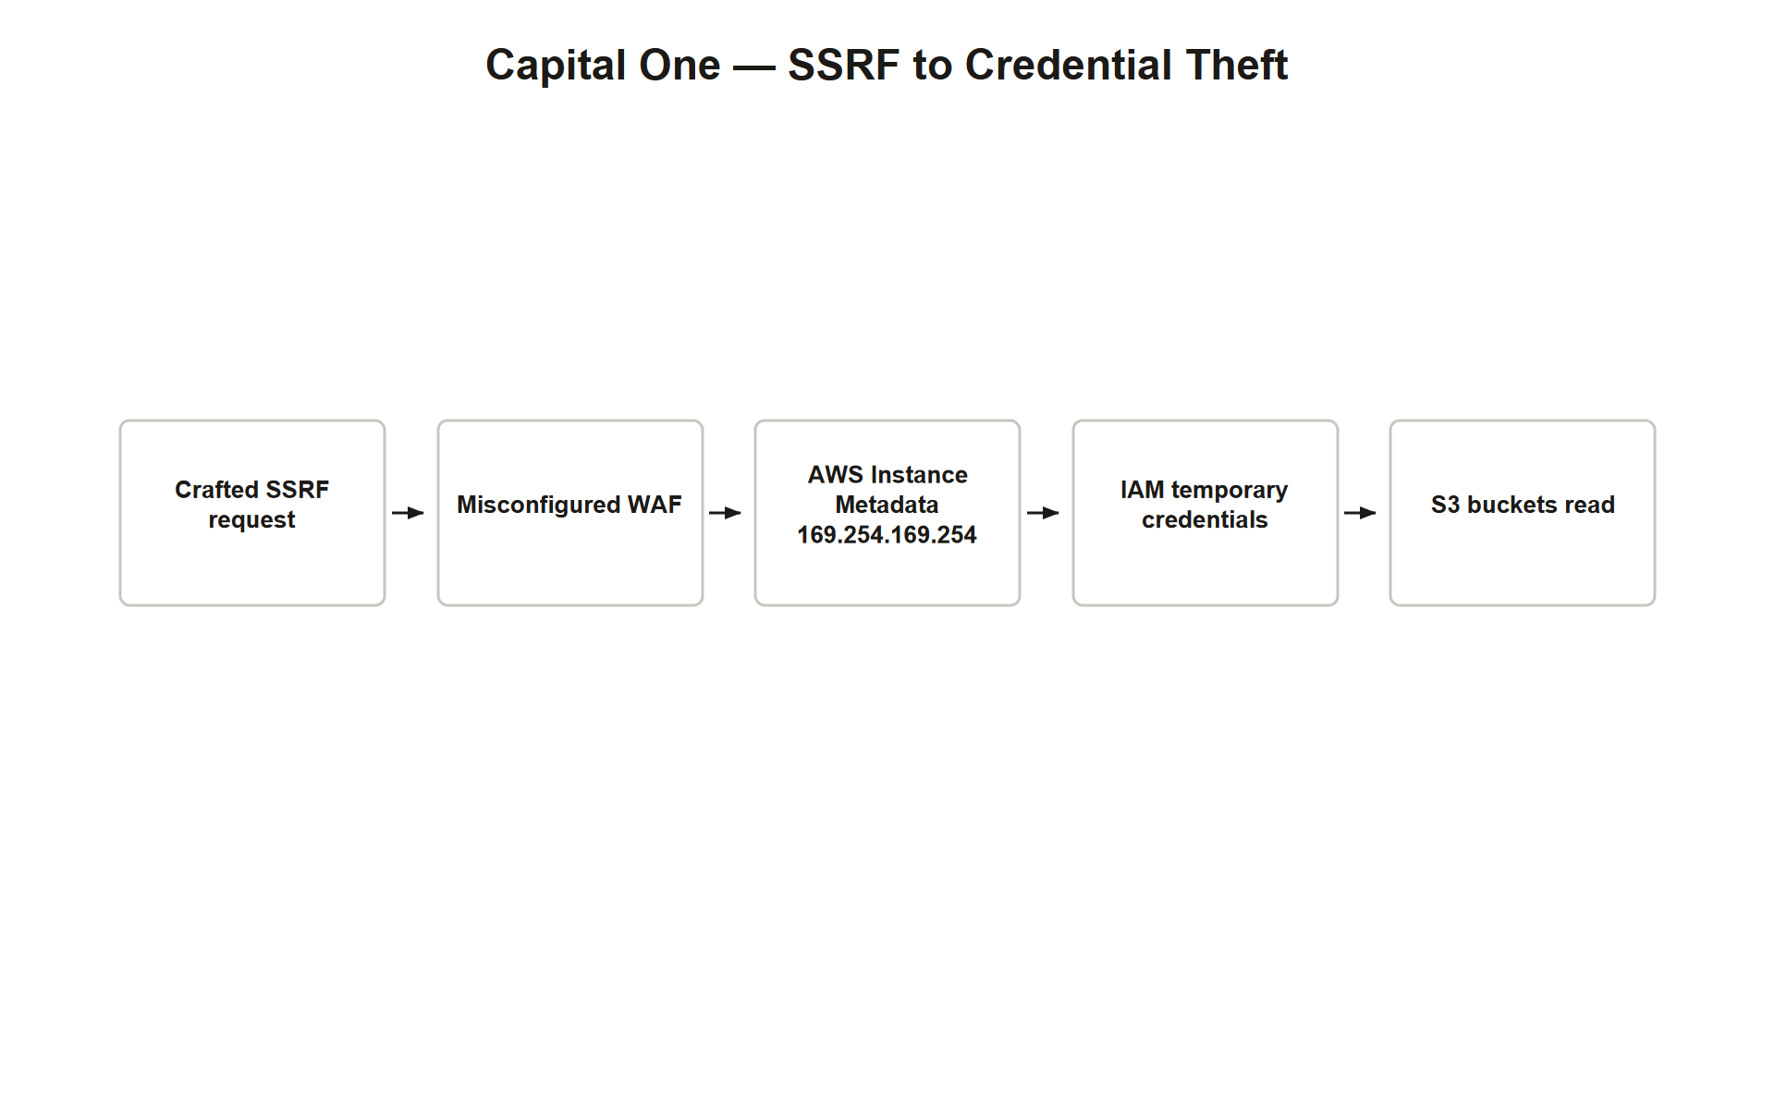
TOPIC 3.4 · 3.4.3.a.1
Case Study: The 2019 Capital One Breach, Overview
Scale: ~106 million customers and applicants affected, one of the largest US financial data breaches
Root cause: A misconfigured Web Application Firewall (WAF) in front of a Capital One AWS-hosted app
Attacker: A former AWS employee exploited a Server-Side Request Forgery (SSRF) vulnerability
Target: AWS Instance Metadata Service (IMDS) at 169.254.169.254, implicitly trusted, no auth in IMDSv1
Payload: Temporary IAM credentials for an overly permissive S3 role, stolen and used to exfiltrate data
Capital One Attack Chain
Notes:
In July 2019, Capital One disclosed a breach affecting approximately 106 million customers and applicants. The root cause was a misconfigured Web Application Firewall (WAF), a specialized Layer 7 firewall, deployed in front of a Capital One web application hosted on AWS. The attacker exploited a Server-Side Request Forgery (SSRF) vulnerability in the misconfigured WAF to send crafted requests that reached the AWS Instance Metadata Service at the well-known link-local address 169.254.169.254.
Because the WAF's assigned IAM role was overly permissive and IMDSv1 required no session token at the time, the SSRF request returned temporary AWS credentials for a role with excessive S3 permissions. The attacker used these stolen credentials to run 'aws s3 sync' commands against dozens of S3 buckets, exfiltrating credit card application data, Social Security numbers, and bank account numbers.

Slide 22
TOPIC 3.4 · 3.4.3.a.2
?
Capital One: The Firewall Access-Control Lesson
Not an ACL failure: No traditional network ACL failed, the WAF itself was misconfigured
Egress filtering gap: Outbound requests from the application tier to internal/sensitive services were unrestricted
NIST recommendation: SP 800-41 Rev. 1 §2.4 recommends symmetric attention to inbound AND outbound rule sets
IMDSv2 fix: AWS added a session-token requirement (Nov 2019), token-based auth defeats simple SSRF GET requests
Broader lesson: Access control is layered across network ACLs, security groups, IAM policy, and service-level auth
Notes:
From a firewall access-control perspective, the Capital One incident is instructive because a Layer 7 firewall (the WAF) was misconfigured in a way that permitted outbound requests to an internal, sensitive service that should never have been reachable from application logic. The deeper lesson is architectural: egress filtering restricting which internal destinations an application server could reach, including blocking outbound requests to the metadata service address, would have prevented the SSRF from ever reaching a credential-bearing endpoint, even after the WAF misconfiguration existed.
AWS's IMDSv2 response illustrates defense reshaping around a control-plane weakness: rather than relying solely on network-layer ACLs to block 169.254.169.254 (which would break legitimate instance functionality), AWS added a session-token requirement that most SSRF primitives, limited to simple GET requests, cannot satisfy.

Slide 23
TOPIC 3.4 · 3.4.3.b.1
Case Study: CVE-2024-3400, GlobalProtect Command Injection
What: Critical (CVSS 10.0) command injection vulnerability in Palo Alto Networks PAN-OS GlobalProtect
Mechanism: Combined arbitrary file-creation flaw with command injection in session cookie handling
Impact: Unauthenticated remote attacker executes arbitrary code with root privileges on the firewall itself
Zero-day: Actively exploited in the wild by threat cluster UTA0218 before a patch was available
Timeline: Disclosed and added to CISA's Known Exploited Vulnerabilities catalog April 12, 2024
Notes:
In April 2024, Palo Alto Networks disclosed CVE-2024-3400, a critical, maximum-severity (CVSS 10.0) vulnerability in the GlobalProtect portal and gateway feature of PAN-OS, the operating system running on Palo Alto Networks NGFW appliances. The flaw combined an arbitrary file-creation weakness with a command injection vulnerability, allowing an unauthenticated remote attacker to write a file to an attacker-controlled path and subsequently achieve arbitrary command execution with root privileges directly on the firewall device.
The vulnerability was actively exploited in the wild by a threat cluster tracked as UTA0218 before a patch was available, a zero-day in the truest sense: defenders had zero days to prepare a fix before real-world exploitation began.

Slide 24
TOPIC 3.4 · 3.4.3.b.2
CVE-2024-3400: When the Enforcement Point Becomes the Threat
Not merely protected by a firewall: The compromised device WAS the firewall
Consequences of root code execution: Rewrite access-control policy, disable logging, pivot into segmented zones, intercept TLS-inspected plaintext
Underweighted principle: The security appliance enforcing the boundary is itself an asset requiring hardening and patch management
Failure mode distinction: A compromised enforcement point does not merely fail open, it becomes a hostile pivot with privileged visibility
Mitigation: Out-of-band management isolation for the firewall's own administrative interface, where possible
Notes:
The CVE-2024-3400 incident carries particular weight because the compromised device was not merely protected by a firewall, it was the firewall. An attacker who achieves root code execution on an NGFW gains the ability to arbitrarily rewrite the very access-control policy meant to constrain the network, disable logging, pivot into segmented internal zones the firewall was supposed to isolate, and intercept TLS-inspected traffic in plaintext.
This underscores a principle sometimes underweighted in access-control theory: the security appliance enforcing the boundary is itself an asset requiring its own hardening, patch management, and where possible, out-of-band management isolation, because a compromised enforcement point does not merely fail open, it becomes a hostile pivot with privileged network visibility.

Slide 25
TOPIC 3.4 · 3.4.3.c.1
?
Distinguishing Misconfiguration from Vulnerability Failures
Capital One (2019): A misconfiguration case, WAF rules and IAM permissions set up incorrectly, no software bug required
CVE-2024-3400 (2024): A software vulnerability case, the firewall vendor's own code contained an exploitable flaw
Shared lesson: Correctness of the rule base matters exactly as much as correctness of the software enforcing it
Exam pattern: AP exam frequently asks you to distinguish these two failure categories given a scenario
Practice prompt: For a given incident description, identify: is this a rule/configuration error, or a code-level vulnerability?
Notes:
The AP exam frequently asks you to distinguish misconfiguration failures from vulnerability/exploitation failures. Capital One (2019) was a misconfiguration case: the WAF rules and IAM permissions were set up incorrectly by administrators, no software bug was required, only an SSRF primitive and an overly trusting internal architecture. CVE-2024-3400 was a software vulnerability case: the firewall vendor's own code contained an exploitable flaw, patched only after active in-the-wild exploitation.
Both point to the same lesson from different directions, the correctness of the rule base matters exactly as much as the correctness of the software enforcing it.

Slide 26
TOPIC 3.4 · 3.4.3.d.1
Section III Glossary Consolidation
WAF: Layer 7 firewall focused on web application attacks (SQLi, XSS, SSRF)
SSRF: Tricking a server into making requests to destinations the attacker chooses
IMDS / IMDSv2: AWS instance metadata service; v2 requires a session token to defeat simple SSRF
Egress filtering: Access control applied to outbound traffic, not just inbound
Zero-day: A vulnerability exploited before a patch exists
Misconfiguration vs. vulnerability failure: Human rule-setup error vs. exploitable code defect
Notes:
Section III grounded the theory of Sections I and II in two real incidents. Capital One (2019) demonstrated a misconfiguration failure at the WAF/IAM layer, mitigated in hindsight by egress filtering and AWS's IMDSv2 redesign. CVE-2024-3400 (2024) demonstrated a vulnerability failure in the firewall vendor's own code, turning the enforcement point itself into a hostile pivot. Together they establish the two broad categories of firewall access-control failure the AP exam expects you to distinguish.

Slide 27
04
Perimeter Firewalls and the 'Hard Shell, Soft Interior' Problem
Topic 3.4
Notes:
Transition to part 4 of the topic. Pause here for questions before continuing.

Slide 28
TOPIC 3.4 · 3.4.4.a.1
Perimeter Firewalls and the 'Hard Shell, Soft Interior' Problem
Perimeter firewall: Positioned at the boundary between internal network and public internet
Historical role: Long treated as the primary, sometimes only, line of network defense
Criticism: 'Castle-and-moat' defense is brittle once an attacker gains any internal foothold
Consequence: Nothing internally impedes lateral movement after a single perimeter breach
Breach vectors: Phishing, a vulnerable public service, or a supply-chain compromise
Notes:
The perimeter firewall remains the classic deployment point, positioned at the boundary between the organization's internal network and the public internet. However, contemporary architecture recognizes that perimeter-only defense creates a brittle 'hard shell, soft interior' posture: once an attacker breaches the perimeter, through phishing, a vulnerable public service, or a supply-chain compromise, nothing internally impedes lateral movement.

Slide 29
TOPIC 3.4 · 3.4.4.a.2
Internal Segmentation Firewalls (ISFWs)
ISFW: A firewall deployed inside the network boundary, between departments, tiers, or VLANs
Traffic direction: Enforces access control on east-west (internal-to-internal) traffic, not just north-south
Containment goal: Limits how far an attacker who breached the perimeter can propagate
Example: Compromise of a guest Wi-Fi VLAN should not automatically grant reachability to financial databases
Related concept: Tied to Topic 3.3 segmentation principles and NIST SP 800-207 zero-trust architecture
Notes:
Internal segmentation firewalls (ISFWs) address the hard-shell-soft-interior problem by enforcing access-control policy on east-west traffic between internal zones, ensuring that compromise of one segment, say, a guest Wi-Fi VLAN or a marketing workstation subnet, does not automatically grant reachability to sensitive segments such as financial databases or domain controllers.

Slide 30
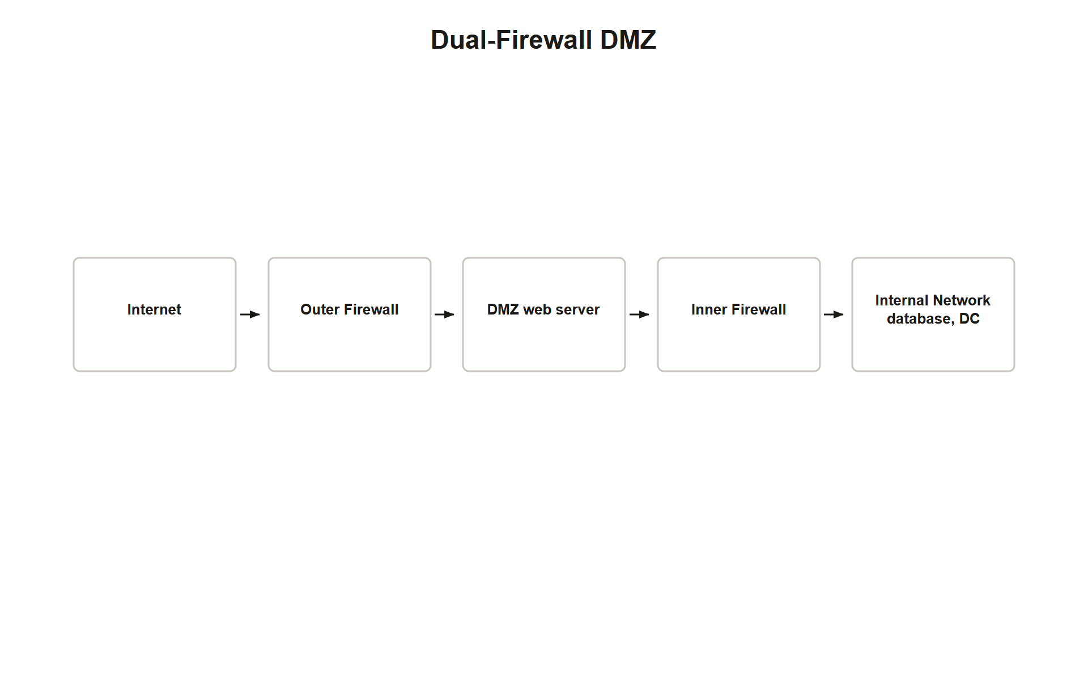
TOPIC 3.4 · 3.4.4.b.1
The Dual-Firewall Screened Subnet (DMZ)
Screened subnet: Internet-facing services placed between two firewalls, not one
Outer firewall: Permits only the narrow protocols required to reach DMZ hosts (e.g., HTTPS to a web server)
Inner firewall: Permits only the specific, minimal connections DMZ hosts legitimately need into the protected internal network
Superiority: NIST SP 800-41 Rev. 1 §3.3, dual-firewall design is superior to a single-firewall three-legged DMZ
No single point of policy failure: Removes reliance on one device correctly separating all three zones at once
Dual Firewall Dmz
Notes:
A closely related architectural pattern is the screened subnet (DMZ), in which internet-facing services are placed between two firewalls rather than one. The outer firewall permits only the narrow set of protocols required to reach the DMZ hosts, while the inner firewall permits only the specific, minimal connections those DMZ hosts legitimately need to make into the protected internal network, for instance, a web server may be allowed to query an internal database on a single port, but nothing more.
NIST SP 800-41 Rev. 1 §3.3 describes the dual-firewall variant as superior to a single-firewall three-legged DMZ, because it removes any single point of policy failure between the two zones.

Slide 31
TOPIC 3.4 · 3.4.4.b.2
Applying the DMZ Lesson to Capital One
Mitigating factor: Even if the outer-facing application tier is compromised via SSRF, a correctly configured inner firewall constrains reach
Egress scoping: Inner firewall enforces tightly scoped egress rules on what the application tier can reach outbound
Critical restriction: Blocking/monitoring outbound requests to internal-only or cloud-provider-internal addresses like the metadata service
Redundant defense: WAF + network firewall + IAM policy + metadata-service authentication, not any single control alone
Takeaway: Access control is most resilient when enforced redundantly across multiple boundaries
Notes:
This dual-firewall screened-subnet design directly mitigates the Capital One failure mode: even if the outer-facing application tier is compromised via SSRF or another exploit, a correctly configured inner firewall constrains what the compromised host can subsequently reach, including, critically, restricting or monitoring requests to internal-only or cloud-provider-internal addresses such as the metadata service range.
This illustrates that access control is most resilient when enforced redundantly across multiple boundaries, WAF, network firewall, IAM policy, and metadata-service authentication, rather than relying on any single control to be perfectly correct.

Slide 32
TOPIC 3.4 · 3.4.4.c.1
Host-Based Firewalls and Cloud Security Groups
Host-based firewall: Software firewall on an individual endpoint (Windows Defender Firewall, iptables on a Linux server)
Value: Final layer of defense-in-depth that survives even if network-level segmentation is imperfect
Cloud security groups: Virtual, stateful firewall attached directly to a cloud resource, not a physical chokepoint
Distributed model: Firewall enforcement distributed to every individual workload, not concentrated at one device
Why cloud needs this: Elastic, ephemeral infrastructure where network topology may not be stable enough for a fixed perimeter appliance
Notes:
At the smallest scale, host-based firewalls enforce access control on individual endpoints and servers, providing a final layer of defense-in-depth that survives even if network-level segmentation is imperfect. In cloud environments, security groups function as a distributed analog to the traditional firewall, attaching a stateful rule set directly to each individual cloud workload rather than relying on a single network chokepoint, a model well suited to elastic, ephemeral cloud infrastructure where the network topology itself may not be stable enough for a fixed perimeter appliance to meaningfully enforce.

Slide 33
TOPIC 3.4 · 3.4.4.c.2
?
Governance: NIST SP 800-41 and Rule-Base Hygiene
NIST SP 800-41 Rev. 1: Authoritative U.S. federal guidance on firewall selection, placement, and policy development
Rule-base hygiene: Ongoing audits to remove unused, overly broad, shadowed, or conflicting rules
Shadowed rules: Rules that can never fire because an earlier rule already matches their traffic
Compliance mandate: PCI-DSS Requirement 1 mandates firewall rule-set review at least every six months
Why hygiene matters: Rule bases accumulate cruft over years of ad hoc changes without periodic pruning
Notes:
Organizations formalize architectural choices through governance frameworks. NIST SP 800-41 establishes baseline guidance for firewall selection, placement, and policy development, while rule-base hygiene practices, periodic audits to identify shadowed rules, overly broad 'any/any' entries, and stale rules referencing decommissioned hosts, are mandated under frameworks such as PCI-DSS Requirement 1 for any organization handling payment card data.

Slide 34
TOPIC 3.4 · 3.4.4.d.1
Layered Placement, Not Just Layered Rules
Exam framing: 'Defense in depth' for firewalls means placement diversity, not merely more rules at one location
Tier 1: Perimeter firewall at the internet edge
Tier 2: Dual-firewall screened subnet around any public-facing services
Tier 3: Internal segmentation firewalls between zones of differing sensitivity
Tier 4: Host-based firewalls and cloud security groups at the individual workload level
Notes:
When the AP exam asks you to design or critique a network's firewall strategy, remember that 'defense in depth' for firewalls means placement diversity, not merely more rules at one location: (1) perimeter firewall at the internet edge; (2) dual-firewall screened subnet around any public-facing services; (3) internal segmentation firewalls between zones of differing sensitivity; (4) host-based firewalls and cloud security groups at the individual workload level. A single, even perfectly configured, perimeter firewall is not a complete answer, always name multiple placement tiers.

Slide 35
TOPIC 3.4 · 3.4.4.e.1
Section IV Glossary Consolidation
Perimeter firewall: Internet-edge boundary device
ISFW: Internal segmentation firewall governing east-west traffic
Screened subnet (DMZ): Dual-firewall isolation for public-facing services
Host-based firewall / security group: Per-endpoint or per-workload enforcement
NIST SP 800-41 / PCI-DSS Requirement 1: Governance frameworks for placement and rule-base hygiene
Shadowed rule: A rule rendered permanently unreachable by an earlier, broader match
Notes:
Section IV moved from individual rule correctness to architectural placement, establishing the four-tier defense-in-depth model, perimeter, screened subnet, internal segmentation, and host/workload-level enforcement, alongside the governance frameworks (NIST SP 800-41, PCI-DSS) that formalize ongoing rule-base hygiene. This section directly answers the 'what would have prevented Capital One' question raised in Section III.

Slide 36
05
Detecting Firewall Failures: Logs as the First Signal
Topic 3.4
Notes:
Transition to part 5 of the topic. Pause here for questions before continuing.

Slide 37
TOPIC 3.4 · 3.4.5.a.1
Detecting Firewall Failures: Logs as the First Signal
LOG-then-DROP pattern: Both iptables and nftables examples explicitly logged before dropping unmatched traffic
Why logging matters: A silently dropped packet with no log leaves no forensic trail if something is wrong
Rule-base audits: Periodic review (PCI-DSS: every 6 months) is itself a detection mechanism for drift and misconfiguration
Case study connection: Neither Capital One nor CVE-2024-3400 was caught by rule review alone, both required active monitoring/threat intel
Bridge to 3.5: Firewall logs feed directly into the network threat detection systems covered in the next topic
Notes:
Detecting firewall access-control failures relies on the same logging discipline demonstrated in the iptables and nftables examples: logging before dropping unmatched traffic preserves forensic visibility into what the default-deny rule actually caught, rather than leaving a silent, unexplained gap. Periodic rule-base audits (mandated at minimum every six months under PCI-DSS Requirement 1) function as a proactive detection mechanism for configuration drift, shadowed rules, and unintended exposure before an incident occurs.
Neither case study in Section III was caught purely by rule-base review, Capital One was discovered via a tip after data appeared publicly, and CVE-2024-3400 was discovered through active exploitation monitoring by security researchers. This underscores that firewall logs and rule audits are necessary but not sufficient; they must feed into broader detection systems, the subject of Topic 3.5.

Slide 38
TOPIC 3.4 · 3.4.5.a.2
?
Practice: Trace This Rule Base
Scenario: An extended ACL has 5 rules; a packet arrives matching criteria in rules 2 and 4
Task: Determine which single rule actually applies and why
Skill tested: First-match evaluation applied to a multi-rule, multi-criteria scenario
Common student error: Selecting the 'most specific' or 'most relevant' rule instead of the first matching one
Correct method: Walk top to bottom; stop at the first rule whose criteria the packet satisfies
Notes:
Consider an ACL with the following order: (1) deny tcp any host 10.0.0.5 eq 3389; (2) permit tcp 10.10.5.0/24 any established; (3) permit tcp any host 10.0.0.5 eq 443; (4) deny tcp any host 10.0.0.5 eq 443; (5) implicit deny. A packet arrives from 10.10.5.20 to 10.0.0.5 on port 443, part of an already-established connection initiated by 10.0.0.5.
Applying first-match evaluation: rule 1 does not match (different port). Rule 2 matches, source is in 10.10.5.0/24 and the connection is established, so the packet is permitted immediately. Rules 3 and 4 are never evaluated for this packet, regardless of their own criteria. This demonstrates why order-of-writing, not just rule content, must be deliberately designed.

Slide 39
TOPIC 3.4 · 3.4.5.b.1
Practice: Designing a Layered Firewall Strategy
Prompt: A company hosts a public web app plus an internal HR database and a guest Wi-Fi network
Task: Propose firewall placement using the four-tier model from Section IV
Expected answer components: Perimeter firewall, screened subnet for the web app, ISFW isolating HR database and guest Wi-Fi, host-based firewalls on servers
Grading criterion: Full credit requires naming all four tiers with a specific reason for each
Common shortfall: Answers that only mention 'a firewall' without placement-tier specificity
Notes:
Given a company hosting a public web application, an internal HR database, and a guest Wi-Fi network, a complete firewall strategy names all four placement tiers from Section IV: a perimeter firewall at the internet edge permitting only HTTPS inbound; a dual-firewall screened subnet isolating the public web application with a scoped inner firewall restricting its egress; an internal segmentation firewall specifically isolating the guest Wi-Fi VLAN and the HR database from each other and from general internal traffic; and host-based firewalls on the HR database server itself as a final layer, independent of network-level controls.

Slide 40
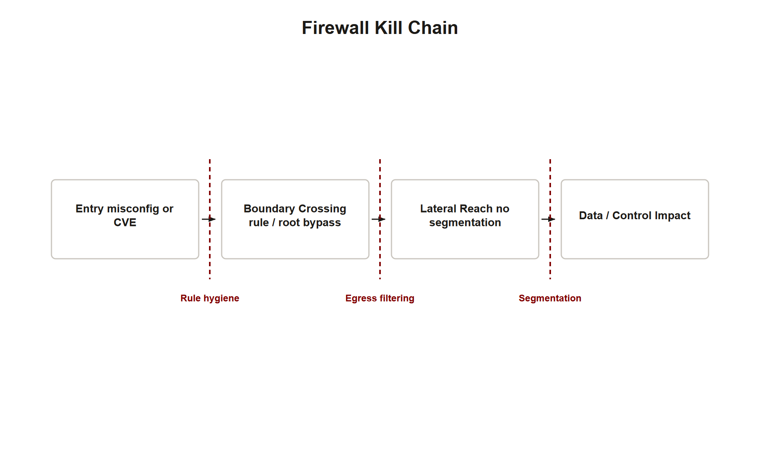
TOPIC 3.4 · 3.4.5.c.1
Synthesis: The Firewall Kill Chain
Step 1, Reconnaissance/entry: Attacker finds a misconfigured rule (Capital One) or a vendor vulnerability (CVE-2024-3400)
Step 2, Boundary crossing: First-match evaluation or root code execution lets the attacker bypass intended access control
Step 3, Lateral reach: Absent ISFWs/DMZ segmentation, the attacker pivots freely to sensitive internal assets
Step 4, Data/control impact: Credential theft and mass exfiltration (Capital One) or full policy/logging control (CVE-2024-3400)
Where defenses intervene: Rule-order correctness, egress filtering, DMZ segmentation, ISFWs, host firewalls, and patch/hygiene discipline each break one link
Firewall Kill Chain
Notes:
Every firewall access-control failure in this chapter follows a common chain: an entry point is found, either a misconfigured rule or a vendor software vulnerability, which lets the attacker cross a boundary that was supposed to enforce default-deny. Without additional layered defenses (ISFWs, screened subnets, host-based firewalls), the attacker then pivots laterally with little resistance, ultimately reaching data or control objectives, stolen credentials and mass exfiltration in Capital One's case, or full policy and logging control in the CVE-2024-3400 case.
Each defense mechanism covered in this chapter, correct rule ordering, default-deny posture, egress filtering, dual-firewall DMZs, internal segmentation, host-based firewalls, and rule-base hygiene audits, exists to break one specific link in this chain. No single control breaks every link; that is precisely why defense in depth, not a single perfect firewall, is the AP exam's expected framing for a complete answer.

Slide 41
TOPIC 3.4 · 3.4.5.c.2
Exam-Readiness Checklist
Can you: Explain first-match evaluation and trace a multi-rule ACL by hand?
Can you: Name the three firewall types (packet-filtering, stateful, NGFW) and their OSI layers?
Can you: Write or read a basic iptables/nftables/Cisco ACL rule for a given policy?
Can you: Distinguish misconfiguration failures from vulnerability/exploitation failures with named examples?
Can you: List all four defense-in-depth placement tiers (perimeter, DMZ, ISFW, host/security group)?
Can you: Explain egress filtering and why outbound rules matter as much as inbound?
Notes:
Before moving to Topic 3.5, confirm mastery of six exam-critical skills from this chapter: tracing first-match rule evaluation by hand; classifying firewall technology by OSI layer and statefulness; reading/writing basic ACL syntax across Cisco IOS, iptables, and nftables; distinguishing misconfiguration from vulnerability failures using the Capital One and CVE-2024-3400 case studies by name; reciting the four-tier defense-in-depth placement model; and explaining why egress filtering is not optional.
These six skills map directly onto the AP exam's typical question patterns for this topic, rule-tracing MCQs, classification MCQs, and free-response architecture-design prompts.

