Slide 1
AAYAT-AP-PREP · CYBERSECURITY
UNIT 3: SECURING NETWORKS
Topic 3.5: Network Threat Detection
A firewall only decides which conversations are allowed to start — many real attacks travel over exactly the ports it must leave open. This topic builds the detection layer that watches traffic already in progress, the monitoring discipline that catches what signatures miss, and the process an organization follows once something is actually found.
5 learning objectives · College Board AP Cybersecurity Course Framework
Notes:
Cover slide for Topic 3.5: Detecting Network Attacks. This topic focuses on securing gateway bandwidth against threats exploiting unmonitored gateway perimeter routes. Hardening requires combining administrative controls, physical security barriers, and technical mitigation…

Slide 2
TOPIC 3.5
Learning Objectives
Detect Attacks
Identify the automated tools used to detect network attacks &mdash; intrusion detection and prevention sensors, flow and traffic analysis, and log aggregation and correlation.
3.5.A
Detect Attacks
Explain how an organisation can use artificial intelligence to strengthen threat detection and response, and where that use is fragile.
3.5.B
Detect Attacks
Determine which detection method suits a given network and a given threat.
3.5.C
Detect Attacks
Evaluate what a detection method costs and delivers once deployed &mdash; coverage, false alarms, analyst load, and the effect on response time.
3.5.D
Detect Attacks
Apply detection techniques to log files in order to identify the indicators left behind by a network attack.
3.5.E
Objectives paraphrased from the AP Cybersecurity Course Framework (College Board, AP Career Kickstart).
Notes:
Read each learning objective aloud and connect it to the exam skill category before starting the topic.

Slide 3
TOPIC 3.5 · CONCEPT MAP
TAP IDS Placement vs In-Line IPS
Passive TAP IDS (out-of-band)
Active In-Line IPS (bridge)
Internal Switch
Intrusion Prevention (IPS)
Intrusion Detection (IDS)
Internal Switch
Copied traffic (TAP) — sees everything, blocks nothing
Active blocking filter — sits in the path, can drop traffic

Slide 4
TOPIC 3.5 · CONCEPT MAP
Secure SIEM Log Collection Pipeline
01
02
03
04
ENDPOINTS
TRANSPORT
AGGREGATION
CORRELATION ENGINE
Hosts (workstations, servers) run log collection agents, parsing raw OS and application files.
Local agents forward parsed events securely using TLS-encrypted Syslog on port TCP 6514.
Central Syslog collector buffers messages and streams them into SIEM indexers.
SIEM engine indexes, runs pattern match, and stores files in Write Once Read Many archives.

Slide 5
TOPIC 3.5
The Big Idea
An intrusion detection system is a smoke alarm for the network. It doesn't put out the fire — it makes sure nobody stays in a burning room without knowing it's burning.
Hold onto this picture — we'll come back to it as the mechanics get more technical.
Notes:
Big-idea framing for Topic 3.5. Open with this analogy before the mechanics: "An intrusion detection system is a smoke alarm for the network. It doesn't put out the fire — it makes sure nobody stays in a burning room without knowing it's burning." Ask students for their own version of the analogy before moving on.

Slide 6
01
From Prevention to Detection: The Assumed-Breach Mindset
Topic 3.5
Notes:
Transition to part 1 of the topic. Pause here for questions before continuing.

Slide 7
TOPIC 3.5 · 3.5.1.a.1
From Prevention to Detection: The Assumed-Breach Mindset
Prevention is necessarily incomplete: ACLs, firewalls, and auth gates can all fail or be bypassed
Assumed breach: plan monitoring/response as if an attacker already has a foothold, not as a bet on keeping them out entirely
Network threat detection: the organized practice of watching packets, flows, and logs for signs of intrusion
Framework home: NIST CSF 2.0's Detect category (DE.CM continuous monitoring, DE.AE anomalies/events)
Foundational guidance: NIST SP 800-94, the canonical IDS/IPS reference
Notes:
Prevention, access control lists, firewall rules, authentication gates, is necessarily incomplete. Every mature security program assumes a degree of assumed breach : a planning posture in which defenders build monitoring and response capability as if an attacker has already gained a foothold, rather than betting everything on keeping them out. This shifts investment from pure prevention toward detection and response, a posture formalized in zero-trust guidance such as NIST SP 800-207.
Network threat detection is the disciplined practice of watching the wire and the logs for the signatures and shapes of an intrusion. It sits within NIST Cybersecurity Framework 2.0's Detect category (DE.CM continuous monitoring, DE.AE anomalies and events), with NIST SP 800-94 serving as the foundational IDS/IPS reference.

Slide 8
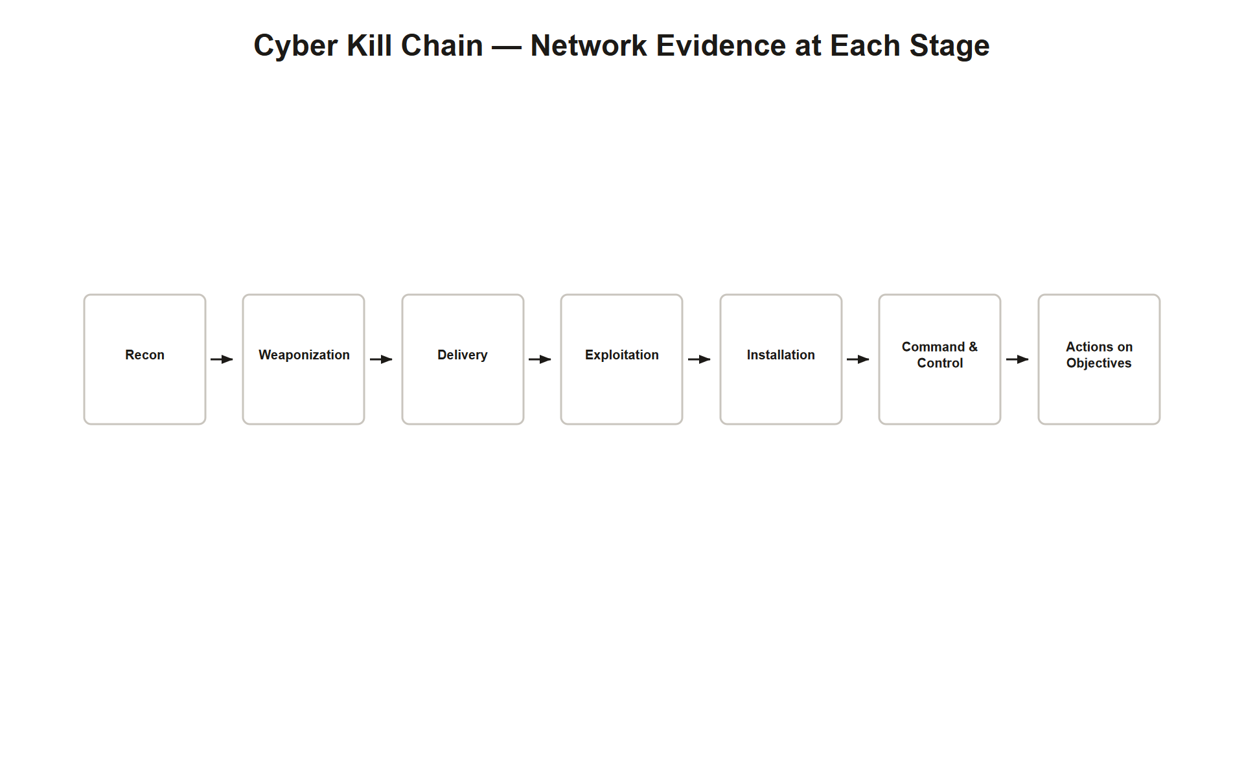
TOPIC 3.5 · 3.5.1.a.2
The Cyber Kill Chain: A Model for Intrusion Stages
Origin: developed by Lockheed Martin (Hutchins, Cloppert & Amin, 2011)
Seven stages: reconnaissance → weaponization → delivery → exploitation → installation → command & control → actions on objectives
Detection mapping: specific tools/alerts are mapped to specific chain stages
Related model: MITRE ATT&CK enumerates granular techniques rather than sequential phases
Why the network matters: intrusions almost always traverse a wire, switch, or DNS resolver at some stage
Kill Chain Stages
Notes:
The theoretical backbone of network detection is the Cyber Kill Chain , a model developed by Lockheed Martin describing the sequential stages an attacker typically moves through: reconnaissance, weaponization, delivery, exploitation, installation, command and control, and actions on objectives. Detection tooling is often mapped to specific stages so defenders know where in the chain a given alert falls.
Because a network-based intrusion nearly always requires the attacker's traffic to traverse a wire, a switch, or a DNS resolver, during reconnaissance, lateral movement, or exfiltration, the network becomes a rich source of forensic and real-time evidence, independent of whether the compromised host's own logs have been tampered with.

Slide 9
TOPIC 3.5 · 3.5.1.a.3
?
Signature-Based vs. Anomaly-Based Detection
Signature-based: matches traffic against a curated library of known-malicious patterns (like antivirus definitions)
Strength: precise, computationally cheap, low false-positive rate
Weakness: structurally blind to zero-days, anything not yet documented
Anomaly-based: builds a statistical/behavioral baseline of 'normal' and flags deviations
Strength: can catch novel attacks nobody has seen before
Weakness: higher false-positive rate, unusual isn't always malicious
Foundational paper: Denning (1987), 'An Intrusion-Detection Model'
Notes:
Two complementary detection philosophies dominate the field. Signature-based detection compares traffic against a curated library of known-malicious patterns, much as antivirus software matches file hashes. It is precise and computationally cheap, but structurally incapable of catching a threat nobody has documented yet, the classic zero-day problem.
Anomaly-based detection , by contrast, builds a statistical model of what 'normal' looks like for a given host, user, or network segment, and raises alerts on meaningful deviation. It can, in principle, catch attacks nobody has ever seen before, at the structural cost of a higher false-positive rate, since novelty and maliciousness are not the same thing.

Slide 10
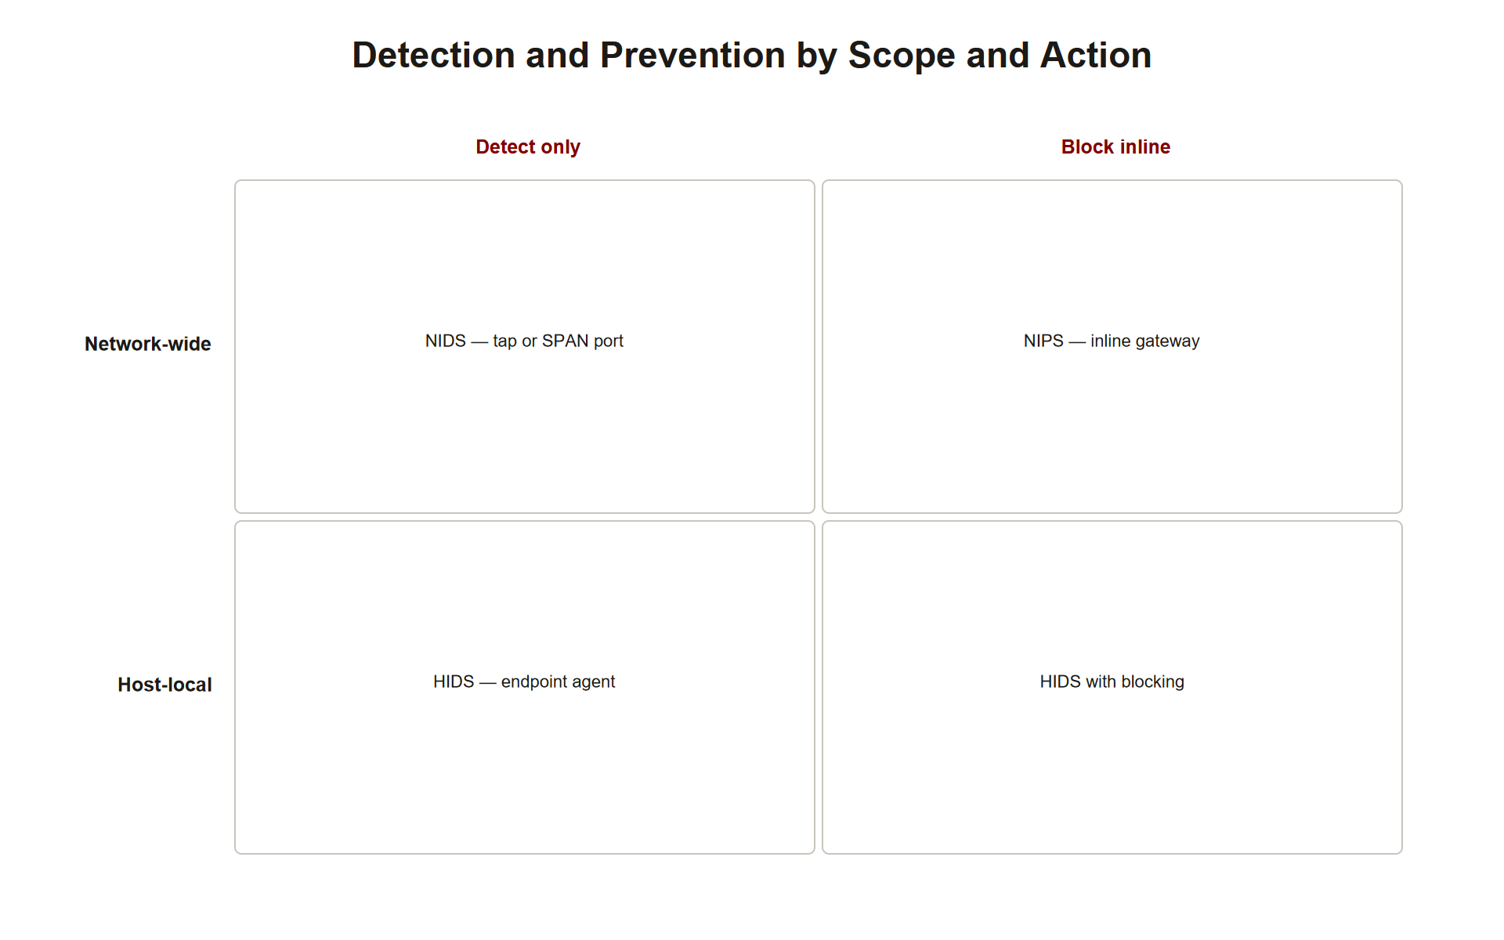
TOPIC 3.5 · 3.5.1.a.4
NIDS vs. HIDS, and Passive IDS vs. Inline IPS
NIDS (Network IDS): monitors an entire segment via a SPAN port or network tap
HIDS (Host IDS): agent on a single endpoint watching files, processes, syscalls
Passive/tap-mode IDS: can alert but cannot block, not in the direct traffic path
Inline IPS: sits directly in the path and can drop/reset malicious traffic in real time
NIPS: a real, testable term, an inline, network-wide blocking sensor
Analogy anchor: IDS = smoke detector, IPS = sprinkler system
Nids Hids Ips Matrix
Notes:
Detection differs by deployment topology and by scope. A Network Intrusion Detection System (NIDS) observes traffic for an entire segment, typically fed by a switch's mirrored port (SPAN) or a physical network tap, while a Host-based Intrusion Detection System (HIDS) instruments a single machine's internal state, file integrity, running processes, system calls.
Separately, deployment mode determines whether a system can only observe ( passive/tap-mode IDS ) or can actively intervene ( inline IPS ), dropping or resetting malicious packets in real time. This distinction, IDS as a smoke detector versus IPS as a sprinkler system, recurs throughout the chapter and is one of the most heavily tested distinctions on the AP exam.

Slide 11
TOPIC 3.5 · 3.5.1.a.5
False Positives vs. False Negatives
False positive: benign activity incorrectly flagged as malicious, wastes analyst time
Consequence of high FP rate: alert fatigue, analysts begin distrusting/ignoring the system
False negative: genuinely malicious activity goes undetected, usually silent, discovered only retroactively
Base-rate neglect: a statistical bias explaining why even accurate detectors mostly produce false positives when true attack rate is low relative to total traffic
Tuning is a budget problem: managing the FP/FN tradeoff under fixed analyst attention
Notes:
No detection system is judged on accuracy alone, it is judged on the tradeoff between two error types. A false positive wastes analyst time and, cumulatively, erodes trust in the system, causing alert fatigue . A false negative is far more dangerous, since it represents an intrusion that proceeds entirely unnoticed, usually producing no signal at all until discovered retroactively during incident response.
Tuning a detection program is fundamentally an exercise in managing this tradeoff under a fixed budget of analyst attention. Base-rate neglect, a cognitive/statistical bias, explains why even a highly accurate detector produces mostly false positives in absolute terms when the true attack rate is very low relative to total traffic volume.

Slide 12
TOPIC 3.5 · 3.5.1.a.6
Section I Glossary Consolidation
Assumed breach, plan as if attacker already has a foothold
Cyber Kill Chain, 7-stage intrusion model (recon through actions on objectives)
Signature-based detection, matches known-bad patterns; blind to zero-days
Anomaly-based detection, flags deviation from learned baseline
NIDS / HIDS, network-wide vs. host-local scope
Passive IDS / Inline IPS, alert-only vs. block-capable
False positive / false negative, the core detection tradeoff
Notes:
Section I established the conceptual vocabulary of network threat detection: the assumed-breach posture that motivates the whole discipline, the Cyber Kill Chain as an organizing model for intrusion stages, the signature-vs-anomaly philosophical split, the NIDS/HIDS and IDS/IPS deployment axes, and the false-positive/false-negative tradeoff that governs how every detection program is tuned. These terms recur throughout Sections II–V.

Slide 13
02
Deep Packet Inspection and Protocol Analyzers
Topic 3.5
Notes:
Transition to part 2 of the topic. Pause here for questions before continuing.

Slide 14
TOPIC 3.5 · 3.5.2.a.1
Deep Packet Inspection and Protocol Analyzers
DPI: inspects packet payload contents, not just header fields (unlike stateful firewalls)
Cost: computationally expensive; raises privacy/legal considerations on encrypted or personal traffic
Defining capability of: Next-Generation Firewalls (NGFW) and IPS engines
Protocol analyzer: Wireshark (GUI) reconstructs a pcap into a human-readable, layered view
tcpdump: the CLI counterpart, commonly used for capture (-w writes pcap)
Notes:
At the packet level, detection begins with deep packet inspection (DPI) , which reaches past the header fields a stateful firewall would examine and inspects the payload itself for known-malicious byte patterns, protocol violations, or embedded command strings. Analysts performing this work by hand typically rely on a protocol analyzer such as Wireshark, which reconstructs a raw pcap file into a human-readable, layered view.

Slide 15
TOPIC 3.5 · 3.5.2.a.2
TCP Flags and the Anatomy of a SYN Scan
TCP flags: SYN, ACK, FIN, RST, PSH, URG, single-bit control fields governing connection state
Normal handshake: SYN → SYN-ACK → ACK; teardown via FIN or RST
SYN scan (half-open scan): sends SYN, receives SYN-ACK, immediately sends RST instead of completing
Why attackers use it: evades some legacy connection-logging while still revealing open ports
Default Nmap mode: -sS, sometimes called 'stealth scan', though modern IDS readily detects the pattern
Signature: burst of SYN packets to sequential ports, single source, no completed handshakes
Notes:
Reading a TCP conversation requires fluency in the TCP flags that govern the three-way handshake (SYN, SYN-ACK, ACK) and connection teardown (FIN or RST). Deviations from this expected sequence are themselves detection signal. A SYN scan sends a SYN packet and, upon receiving a SYN-ACK, immediately sends an RST instead of completing the handshake with an ACK, because the full connection never establishes, it evades some legacy connection-logging systems while still revealing which ports are open. This produces a distinctive port scan signature: a burst of SYN packets to sequential ports from a single source with no completed handshakes.

Slide 16
TOPIC 3.5 · 3.5.2.a.3
Signature Rules in Practice: Detecting a Port Scan
Suricata/Snort: the canonical open-source signature engines for network traffic
flags:S,12, matches packets where only the SYN bit is set
threshold keyword: suppresses noise, firing only after N matches in a time window
Tuning tradeoff: reduces false-positive volume without sacrificing true detection
Rule anatomy: action, protocol, direction, msg, match conditions, classtype, sid, rev
Notes:
Below is a representative Suricata rule flagging a source IP attempting connections to an unusual number of distinct destination ports in a short window, a strong indicator of active reconnaissance. The flags:S,12 directive matches packets where only the SYN bit is set (mask 12 excludes reserved bits), while the threshold keyword suppresses noise by only firing once twenty such packets are observed from a single source within sixty seconds, tuning a signature to reduce false-positive volume without sacrificing detection of genuine scanning behavior.

Slide 17
TOPIC 3.5 · 3.5.2.a.4
Payload-Based Signatures: Detecting a Web Shell Upload
DPI applied to HTTP: matches on method, URI, and body content simultaneously
content + http_method/http_uri/http_client_body: Snort/Suricata modifiers scoping a match to a specific HTTP field
Multi-condition matching: all three conditions (POST, cmd.jsp, Runtime.getRuntime) must match together
classtype: categorizes the alert (here, web-application-attack) for SIEM triage
Notes:
A companion Snort-syntax rule illustrates payload-based signature matching for a known web-shell upload attempt, showing DPI applied to HTTP content. The rule requires an established HTTP POST to a specific URI ( cmd.jsp ) whose body contains a known Java reflection call, a highly specific combination unlikely to appear in legitimate traffic, which is exactly what keeps its false-positive rate low.

Slide 18
TOPIC 3.5 · 3.5.2.a.5
Flow-Based Analysis: NetFlow, IPFIX, and Beaconing
Problem with full DPI at scale: payload storage/processing is expensive at multi-gigabit line rates
NetFlow: Cisco-originated protocol recording conversation metadata (src/dst IP+port, protocol, bytes, duration) without payload
IPFIX (RFC 7011): the open-standard, vendor-neutral successor to NetFlow v9
sFlow: a competing sampling-based alternative popularized by Juniper/Arista
Beaconing: recurring, low-volume outbound connection at regular intervals, detectable purely from timing, no payload needed
Notes:
Not every environment can afford full packet capture at scale. This is where flow-based metadata analysis complements packet-level inspection. NetFlow and its open-standard descendant IPFIX record who talked to whom, for how long, and how much data moved, sufficient to detect a beaconing pattern or a slow exfiltration event purely from timing and volume statistics, without ever inspecting the encrypted payload itself.

Slide 19
TOPIC 3.5 · 3.5.2.a.6
DNS Tunneling: Hiding Data in an Allowed Channel
Why DNS is exploited: almost universally permitted outbound, blocking it breaks the internet
DNS tunneling: encodes stolen data into subdomain labels or TXT record queries
Example: a query like a base32-encoded chunk prefixed to a malicious domain looks superficially normal
Detection indicators: high query volume to one authoritative domain, abnormally long/high-entropy subdomains, unusual TXT query rates
Tools: iodine, dnscat2 implement this technique
Key insight: firewall sees only 'allowed' UDP/53 traffic, the signal lives in DNS logs, not firewall logs
Notes:
DNS is almost universally permitted outbound through firewalls because blocking it breaks the internet for everyone. Attackers exploit this trust by encoding stolen data into a stream of DNS queries, DNS tunneling . A query like 4a6f68e9f1c8b2a9.exfil-drop.malicious-domain.com looks superficially like a normal DNS lookup but is actually a base32-encoded data chunk. The telltale indicators, high query volume to one authoritative domain, abnormally long or high-entropy subdomain labels, and TXT record queries at a rate no legitimate application would generate, appear clearly in DNS logs even though the firewall sees nothing but 'allowed' UDP/53 traffic.

Slide 20
TOPIC 3.5 · 3.5.2.a.7
SIEM Platforms and Log Correlation
Problem: packet captures, flow records, firewall logs, endpoint logs are each individually incomplete
SIEM: aggregates log/event data from across the entire infrastructure into one searchable repository
Log correlation: connects related events across separate sources to reconstruct a coherent attacker narrative
Examples: Splunk, Microsoft Sentinel, Elastic Security
Correlation rules: chain low-severity individual events into a single high-confidence composite alert
Notes:
Individually, packet captures, flow records, firewall logs, and endpoint logs are each incomplete. A Security Information and Event Management (SIEM) platform performs log correlation across all of these feeds, allowing an analyst to reconstruct an attacker's path even when no single log entry looks alarming in isolation.

Slide 21
TOPIC 3.5 · 3.5.2.a.8
Reading a Correlated Firewall/Beaconing Log
Syslog transcript: firewall builds three near-identical outbound connections
Pattern: same destination IP:443, ~30s interval, nearly identical byte counts (512, 498, 505)
Individually: each connection looks like a normal outbound HTTPS session
Collectively: repeating, near-identical, regular-interval connections = beaconing IoC
Analyst skill: recognizing the pattern requires viewing multiple log lines together, not one in isolation
Notes:
A representative syslog excerpt shows a firewall permitting an anomalous outbound connection, later correlated by a SIEM against endpoint process data. Read individually, each line looks like unremarkable outbound HTTPS traffic. Read together, the near-identical byte counts and ~30-second interval repeating indefinitely are a textbook beaconing indicator of compromise.

Slide 22
TOPIC 3.5 · 3.5.2.a.9
UEBA: Machine Learning Baselines Per User and Host
UEBA: User and Entity Behavior Analytics, individualized ML baselines per user/host/service
Difference from generic anomaly detection: baseline is specific to that entity, not org-wide
Catches: insider threats, compromised-credential misuse missed by static thresholds
Example: accountant's credentials querying a database at 3 a.m. from an unfamiliar subnet
Vendors: Splunk UBA, Microsoft Sentinel UEBA
Notes:
Machine learning has expanded anomaly detection beyond simple statistical thresholds. User and Entity Behavior Analytics (UEBA) platforms learn what is normal for a specific user or host, typical login hours, typical data volumes, typical lateral movement patterns, and flag deviations that a static, organization-wide threshold rule would miss entirely.

Slide 23
TOPIC 3.5 · 3.5.2.a.10
Limits of AI-Assisted Detection: Evasion, Fatigue, and the Human Loop
Adversarial evasion: attackers shape traffic to stay inside a model's learned 'normal' boundary
Baseline drift attack: slowly retraining the baseline itself through gradual behavior shifts
Alert fatigue recurs: poorly tuned ML models still flood analysts with low-value alerts
Human-in-the-loop: a trained analyst must review/validate before consequential action is taken
NIST AI RMF 1.0 (2023): recommends human oversight for high-consequence automated decisions
Notes:
These AI-assisted systems carry real limitations. Machine-learning classifiers are subject to adversarial evasion , in which attackers deliberately shape their traffic timing, volume, or sequencing to stay inside the model's learned notion of 'normal,' or slowly retrain the baseline itself through gradual behavior shifts. Poorly tuned models also produce substantial alert fatigue, and for this reason virtually every credible detection architecture retains a human-in-the-loop SOC analyst as the final arbiter, automation surfaces candidates for review, but does not yet substitute for trained human judgment on ambiguous or high-stakes alerts.

Slide 24
TOPIC 3.5 · 3.5.2.a.11
Section II Glossary Consolidation
DPI, payload-level inspection beyond headers
TCP flags / SYN scan, handshake mechanics and reconnaissance signature
Suricata/Snort rules, signature syntax with content matching and thresholds
NetFlow / IPFIX, flow metadata without payload
Beaconing, regular-interval C2 check-ins detectable via timing
DNS tunneling, data smuggled through an always-allowed channel
SIEM / log correlation, unifying multiple incomplete log sources
UEBA, per-entity behavioral baselining
Adversarial evasion / human-in-the-loop, ML limits and the required human check
Notes:
Section II moved from conceptual vocabulary into technical mechanics: how DPI, TCP flag analysis, signature rules (Suricata/Snort), flow-based NetFlow/IPFIX analysis, DNS log review, SIEM correlation, and UEBA baselining each contribute a different layer of visibility, and why none of them, including ML-driven UEBA, is deployed without human review.

Slide 25
03
Case Study: The 2013 Target Breach, Detection Worked, Response Failed
Topic 3.5
Notes:
Transition to part 3 of the topic. Pause here for questions before continuing.

Slide 26
TOPIC 3.5 · 3.5.3.a.1
Case Study: The 2013 Target Breach, Detection Worked, Response Failed
Vector: attackers used compromised HVAC vendor credentials to gain network access
Payload: memory-scraping malware (RAM scraper) on point-of-sale terminals
Impact: ~40 million payment card records exfiltrated (Nov-Dec 2013)
Detection worked: FireEye-based platform generated legitimate alerts starting Nov 30, 2013, ~3 weeks before public disclosure
Alerts were escalated from Bangalore monitoring team to Minneapolis HQ, but no containment action was taken
Notes:
Between November and December 2013, attackers who had gained network access through a compromised HVAC vendor's credentials deployed memory-scraping malware across Target's point-of-sale terminals, ultimately exfiltrating roughly 40 million payment card records. Critically, Target had deployed a commercial malware-detection platform (built on FireEye technology) that generated legitimate malware alerts as early as November 30, 2013, nearly three weeks before the breach was publicly disclosed. Target's security team in Bangalore escalated these alerts to Minneapolis headquarters. No action was taken to contain the identified malware at that time.

Slide 27
TOPIC 3.5 · 3.5.3.a.2
?
Detection Failure vs. Detection-Response Gap
Detection failure: the sensor itself never produces an accurate alert
Detection-response gap: the sensor fires correctly, but org/process/staffing failures prevent containment
Target's root causes (per Congressional post-mortem): alert fatigue, SOC understaffing, unclear escalation authority
NOT a root cause: technical shortfall in the detection engine itself
Investment implication: a detection-response-gap organization needs staffing/process investment, not more sensors
Notes:
This case is taught less as a detection failure and more as a canonical detection-response gap : the sensor worked exactly as designed, generating an accurate, timely, actionable alert, and the organizational process around that alert broke down. Subsequent post-mortems identified alert fatigue, understaffing of the security operations function, and unclear escalation authority as root contributing factors, not a technical shortfall in the detection engine itself.

Slide 28
TOPIC 3.5 · 3.5.3.a.3
Case Study: SolarWinds / SUNBURST, A Supply-Chain Compromise
Actor: nation-state (attributed to Russian intelligence, tracked as APT29/Cozy Bear)
Vector: compromised SolarWinds' build system, inserting SUNBURST backdoor into legitimately signed Orion updates
Scale: ~18,000 organizations received the malicious update, including U.S. federal agencies
Why signatures couldn't catch it: the update was legitimately, validly code-signed by the vendor
Disclosed: FireEye, Dec 8, 2020; CISA Emergency Directive 21-01 followed
Notes:
Beginning around March 2020, a nation-state threat actor compromised the build system of SolarWinds, a network management software vendor, and inserted a covert backdoor, SUNBURST , into legitimate, digitally signed software updates distributed to roughly 18,000 SolarWinds Orion customers, including numerous U.S. federal agencies and Fortune 500 companies.

Slide 29
TOPIC 3.5 · 3.5.3.a.4
How SUNBURST Was Actually Found: Behavioral Anomaly, Not Signature
Discovery trigger: FireEye noticed a new device registered to an employee's MFA profile in an unexpected manner
Not a malware signature, a subtle behavioral/registration anomaly
Follow-up: investigation traced back to SUNBURST's C2 infrastructure
Corroborating signal: jittered, low-and-slow DNS beaconing to domains mimicking legit SolarWinds infrastructure (avsvmcloud.com)
Two lessons: UEBA/anomaly detection can surface intrusions signatures structurally cannot; supply-chain trust is itself an attack surface
Notes:
The compromise was ultimately discovered not through a signature match, but through anomalous behavior analysis at FireEye itself. FireEye's security team detected a new device attempting to enroll under an existing employee's MFA credentials in a manner inconsistent with that employee's normal pattern. This anomaly prompted deeper investigation, which traced back to SUNBURST's command-and-control infrastructure, corroborated by jittered DNS beaconing engineered to blend into ordinary telemetry traffic.

Slide 30
TOPIC 3.5 · 3.5.3.a.5
Section III Glossary Consolidation
Detection-response gap, correct alert, failed containment process (Target)
Memory-scraping malware, reads unencrypted card data from POS RAM
Supply-chain attack, compromising a trusted vendor's build/update pipeline (SolarWinds)
SUNBURST, the specific backdoor inserted into SolarWinds Orion updates
Behavioral/UEBA discovery, how signature-proof supply-chain attacks get caught
Notes:
Section III grounded the chapter's theory in two canonical incidents: Target (2013), which demonstrates that detection technology alone is insufficient without a resourced, empowered SOC process; and SolarWinds/SUNBURST (2020), which demonstrates that behavioral anomaly detection is structurally necessary against sophisticated, trust-exploiting attacks that signature-based systems cannot catch by design.

Slide 31
04
NIST SP 800-94: Detection as an Ongoing Discipline
Topic 3.5
Notes:
Transition to part 4 of the topic. Pause here for questions before continuing.

Slide 32
TOPIC 3.5 · 3.5.4.a.1
NIST SP 800-94: Detection as an Ongoing Discipline
Full name: Guide to Intrusion Detection and Prevention Systems (IDPS)
Core framing: detection is not a single product purchase but an ongoing operational discipline
Requires: sensor placement strategy, tuning, staffing, and a defined incident response process
Four pillars covered next: sensor placement, SIEM correlation, baseline establishment, escalation procedures
Notes:
An effective network threat detection program is built in layers, following the guidance of NIST SP 800-94 , which frames detection not as a single product purchase but as an ongoing operational discipline requiring sensor placement strategy, tuning, staffing, and a defined incident response process to translate alerts into action.

Slide 33
TOPIC 3.5 · 3.5.4.a.2
Layered Sensor Placement
No single sensor location is sufficient, visibility requires layered placement
NIDS chokepoints: perimeter, between security zones, near high-value asset segments
Tap/SPAN ports: avoid introducing a single point of failure for passive NIDS
Inline IPS: reserved for chokepoints where active blocking is operationally acceptable
HIDS closes the gap: catches host-internal activity (living-off-the-land abuse) invisible on the wire
Notes:
No single sensor location provides complete visibility. Best practice places NIDS sensors at key network chokepoints, the perimeter, between security zones, and near high-value asset segments, using taps or SPAN ports to avoid introducing a single point of failure, while inline IPS devices are reserved for chokepoints where active blocking is operationally acceptable. HIDS agents on individual endpoints then close the visibility gap for host-internal activity that never generates distinguishable network traffic.

Slide 34
TOPIC 3.5 · 3.5.4.a.3
SIEM Centralization and Correlation Rule Engineering
Raw sensor output has limited value alone, needs centralization
Route into SIEM: firewall, IDS/IPS, DNS, endpoint, and identity logs
Invest deliberately in correlation rule engineering, not just log storage
Chain low-confidence signals into higher-confidence composite alerts
Directly addresses: the alert-fatigue failure mode from Section II, illustrated by Target
Notes:
Raw sensor output has limited value without correlation. Organizations should route firewall, IDS/IPS, DNS, endpoint, and identity logs into a centralized SIEM and invest deliberately in correlation rule engineering, chaining low-confidence individual signals into higher-confidence composite alerts, directly addressing the alert-fatigue failure mode illustrated by the Target case study.

Slide 35
TOPIC 3.5 · 3.5.4.a.4
Baseline Establishment for UEBA and Anomaly Systems
Risk: baselining during an already-compromised state normalizes attacker behavior as 'normal'
NIST guidance: defined baseline observation window before trusting the model
Periodic baseline revalidation, environments change over time
Retain human review authority over any automated containment action
Operationalizes: the human-in-the-loop principle from Section II
Notes:
Anomaly-based and UEBA systems are only as good as the baseline period used to train them; deploying such a system during an already-compromised state risks baselining attacker behavior as 'normal.' NIST guidance recommends a defined baseline observation window, periodic baseline revalidation, and retention of human review authority over any automated containment action, directly operationalizing the human-in-the-loop principle.

Slide 36
TOPIC 3.5 · 3.5.4.a.5
?
Defined Escalation and Response Procedures
Missing piece at Target: the single control whose absence most directly explains that breach's outcome
Must specify: who is notified, within what time window, with what authority to contain
Pairs detection with action, without this, even perfect detection is inert
Connects to 3.4: escalation must be able to trigger firewall rule changes, access revocation, segmentation adjustments
Notes:
Detection technology must be paired with an unambiguous escalation chain specifying who is notified, within what time window, and with what authority to contain a confirmed threat, the single control whose absence most directly explains the Target breach's outcome despite functioning detection technology.

Slide 37
TOPIC 3.5 · 3.5.4.a.6
?
Matching Indicators of Compromise to Detection Method
Burst of sequential-port SYN packets → signature-based NIDS/port-scan rule
Login at unusual hour for that specific user → UEBA/anomaly detection
High volume of high-entropy DNS subdomain queries → DNS tunneling detection via log analysis
Repeating, near-identical-size outbound connection at jittered intervals → beaconing via NetFlow/flow analysis
Exam pattern: name the specific tool/log source, not just 'the IDS caught it'
Notes:
Be ready to match a described indicator of compromise to the correct detection technique: a burst of sequential-port SYN packets maps to signature-based NIDS/port-scan rules; a login at an unusual hour for a specific user maps to UEBA/anomaly detection; a high volume of high-entropy DNS subdomain queries maps to DNS tunneling detection via log analysis; a repeating, near-identical-size outbound connection at regular jittered intervals maps to beaconing detected via NetFlow/flow analysis. The exam frequently asks you to name the specific tool or log source that would surface a given scenario.

Slide 38
TOPIC 3.5 · 3.5.4.a.7
Section IV Glossary Consolidation
NIST SP 800-94, detection as ongoing operational discipline, not a product
Layered sensor placement, chokepoints, taps/SPAN, inline IPS, HIDS gap-filling
SIEM centralization + correlation rule engineering, addresses alert fatigue
Baseline establishment, timing and revalidation for UEBA/anomaly systems
Defined escalation procedures, the control Target lacked
IoC-to-method matching, the high-yield exam skill of this topic
Notes:
Section IV translated the technical mechanics and case-study lessons of Sections II–III into concrete hardening prescriptions: layer your sensors, centralize and correlate your logs, baseline carefully and revalidate, and, the lesson Target teaches most directly, define your escalation authority before you need it.

Slide 39
05
Practice: Reading a Suricata Alert End to End
Topic 3.5
Notes:
Transition to part 5 of the topic. Pause here for questions before continuing.

Slide 40
TOPIC 3.5 · 3.5.5.a.1
Practice: Reading a Suricata Alert End to End
Given: a Suricata rule firing on a monitored segment
Step 1: identify the matched condition (flags:S,12 = SYN-only packets)
Step 2: identify the threshold logic (20 matches from one source within 60s)
Step 3: map to kill-chain stage (reconnaissance)
Step 4: decide response, escalate per defined procedure, not ignore due to volume
Notes:
Practice reasoning through the SYN-scan Suricata rule introduced in Section II end to end: what condition triggered it, what the threshold logic accomplishes, which Cyber Kill Chain stage it represents, and what an analyst should do next given a defined escalation procedure.

Slide 41
TOPIC 3.5 · 3.5.5.a.2
Practice: Simulating a Simple Beacon Detector
Goal: given a list of (timestamp, bytes) outbound connections, flag beaconing behavior
Heuristic: low variance in both time interval and byte count across repeated connections to the same destination
Real-world caveat: jittered beacons require statistical tolerance, not exact-interval matching
Connects to: the syslog beaconing example from Section II and the SUNBURST DNS beacon from Section III
Notes:
This runnable example implements a minimal beacon-detection heuristic over a list of outbound connection records, flagging destinations whose connection intervals and byte counts show unusually low variance, the same pattern identified by hand in the Section II firewall log and the SolarWinds DNS beacon.

Slide 42
TOPIC 3.5 · 3.5.5.a.3
Practice: Classifying Detection Method by Scenario
Scenario A: antivirus-style match against a known malware hash → signature-based
Scenario B: a server suddenly transfers 50x its typical daily volume → anomaly-based (host/segment baseline)
Scenario C: a specific employee's account behaves outside their personal norm → UEBA
Scenario D: vendor-signed update contains a hidden backdoor → caught only via behavioral/UEBA anomaly, not signature
Notes:
Practice sorting four scenarios into the correct detection category, reinforcing the signature/anomaly/UEBA taxonomy from Sections I–II and grounding scenario D directly in the SUNBURST case study, where a legitimately signed update evaded signature detection entirely.

Slide 43
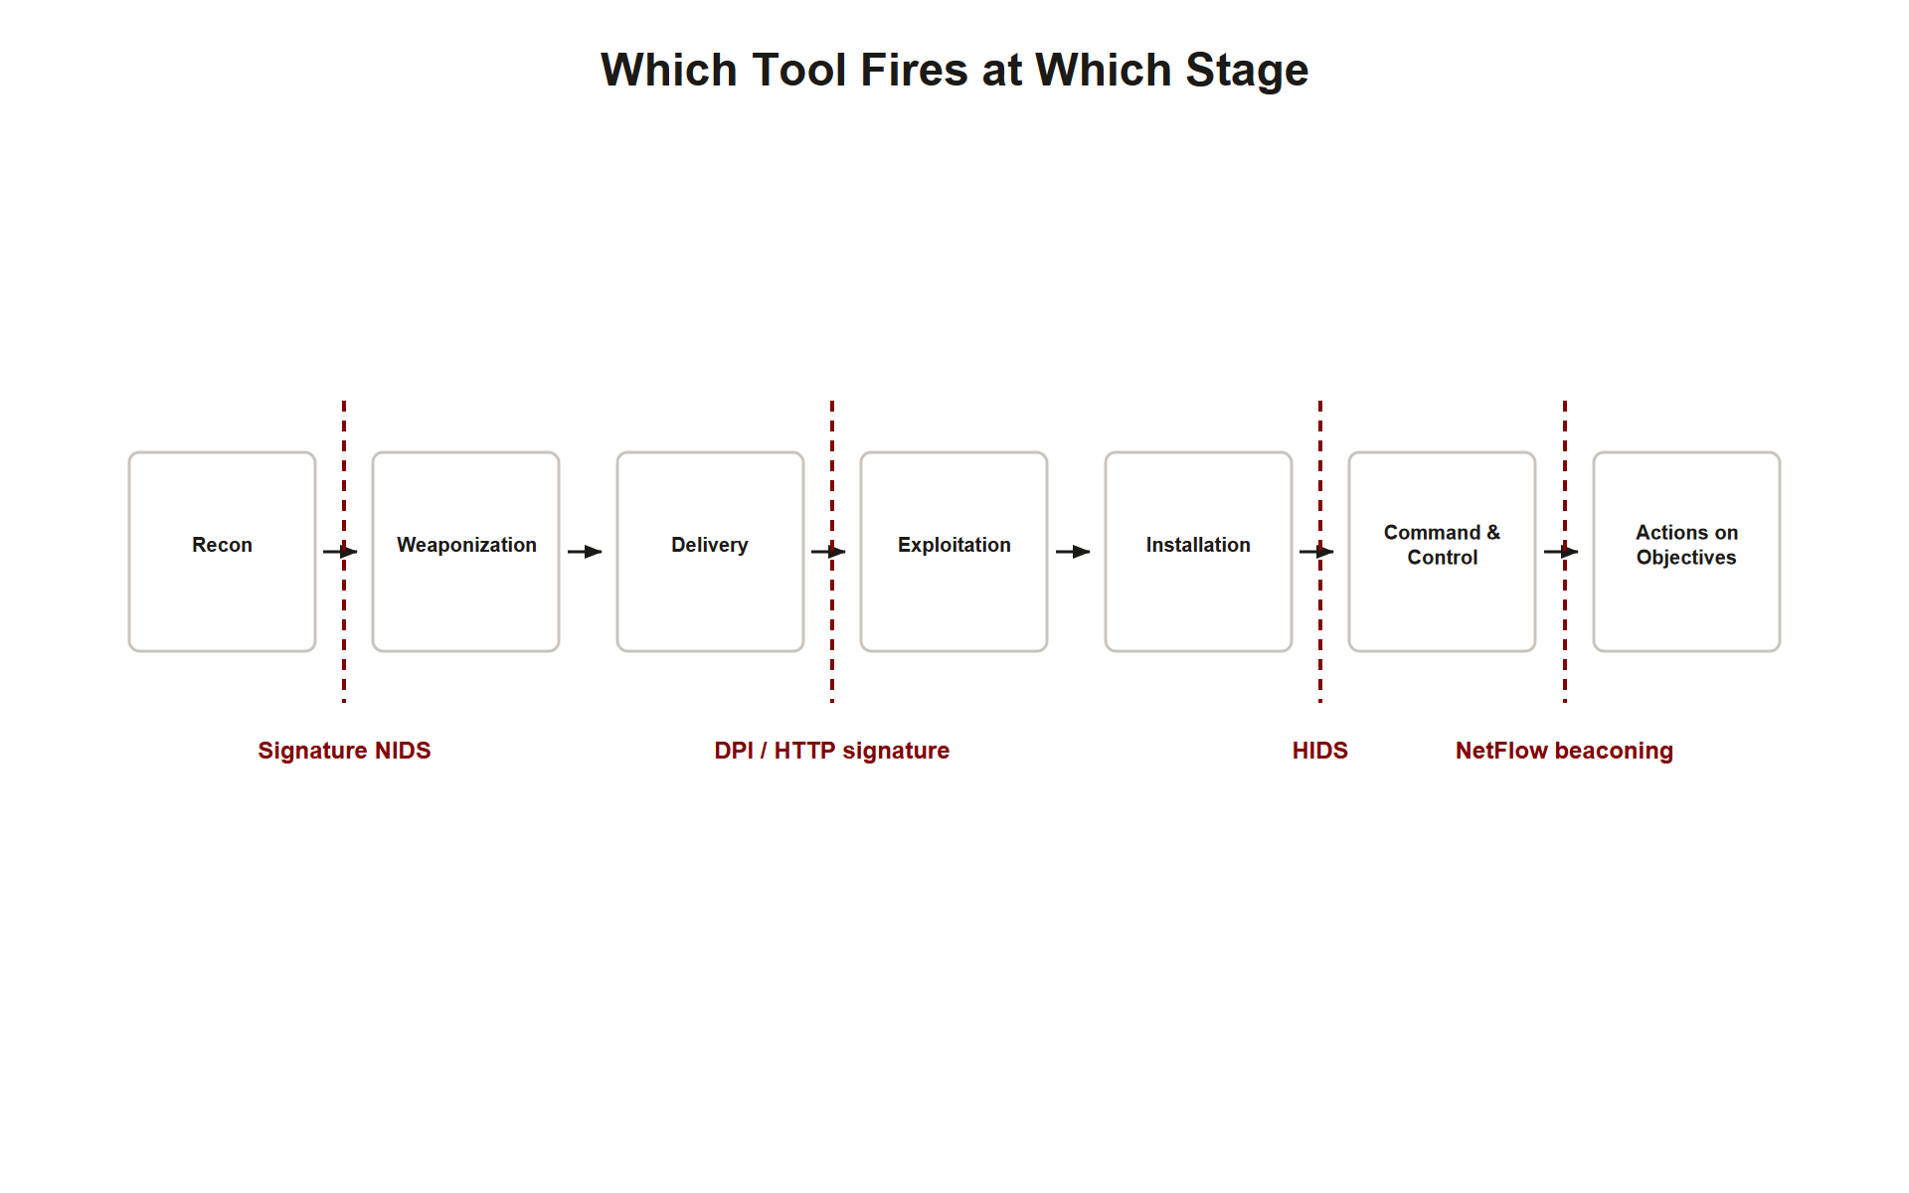
TOPIC 3.5 · 3.5.5.a.4
Synthesizing the Kill Chain: Where Each Detection Tool Fires
Reconnaissance: SYN scan → signature-based NIDS rule (Suricata/Snort)
Delivery/Exploitation: web shell upload → payload/DPI signature (HTTP content match)
Installation: HIDS file-integrity/process monitoring on the endpoint
Command & Control: beaconing → NetFlow/IPFIX flow analysis; DNS tunneling → DNS log analysis
Actions on Objectives: UEBA flags anomalous data access/exfiltration by a specific account
Cross-cutting: SIEM correlation ties all stages into one narrative; human-in-the-loop makes the final call
Kill Chain Tool Synthesis
Notes:
Mapping this chapter's tools onto the Cyber Kill Chain from Section I closes the loop: reconnaissance is caught by signature-based port-scan rules; delivery and exploitation by DPI payload signatures; installation by HIDS; command-and-control by flow-based beaconing analysis and DNS log review; and actions on objectives by UEBA flagging anomalous access or exfiltration by a specific compromised account. A SIEM ties every stage's signal into one correlated narrative, and a human analyst remains the final decision-maker at every stage, exactly the lesson Target teaches when that final human step breaks down.

Slide 44
TOPIC 3.5 · 3.5.5.a.5
Exam-Readiness Checklist for Topic 3.5
&#9744; Can define and contrast signature-based vs. anomaly-based detection, with strengths/weaknesses of each
&#9744; Can correctly combine the NIDS/HIDS and IDS/IPS axes for a given scenario
&#9744; Can explain the false-positive/false-negative tradeoff and why false positives cause alert fatigue
&#9744; Can read a Suricata/Snort rule and explain what traffic pattern it matches
&#9744; Can explain NetFlow/IPFIX and identify a beaconing pattern from timing/volume data
&#9744; Can explain why DNS tunneling evades firewalls but not DNS log analysis
&#9744; Can explain what a SIEM does and why log correlation matters
&#9744; Can distinguish a detection failure from a detection-response gap, citing the Target breach
&#9744; Can explain why SUNBURST evaded signature detection and how it was actually found
&#9744; Can match any of the four canonical IoC types to its correct detection method/tool
&#9744; Can name the NIST SP 800-94 hardening pillars: sensor placement, SIEM correlation, baseline management, escalation procedures
Notes:
Before moving on, confirm mastery of every item on this checklist. This topic is unusually scenario-heavy on the AP exam, expect to apply these concepts to a described log excerpt, rule, or incident narrative rather than recall definitions in isolation.

