Slide 1
AAYAT-AP-PREP · CYBERSECURITY
UNIT 4: SECURING DEVICES
Topic 4.1: Device Endpoint Vulnerabilities
What counts as a computing device, how malicious software is classified by how it spreads and what it does, and how a weakness on a device — a factory password, an unpatched service, firmware nobody supports any more — becomes loss, damage, disruption, or destruction. The topic ends with documenting those findings so somebody else can act on them.
4 learning objectives · College Board AP Cybersecurity Course Framework
Notes:
Cover slide for Topic 4.1: Device Vulnerabilities and Attacks. What counts as a computing device, how malicious software is classified by how it spreads and what it does, and how a weakness on a device — a factory password, an unpatched service, firmware nobody supports any more — becomes loss, damage, disruption, or destruction. The topic ends with documenting those findings so somebody else can act on them.

Slide 2
TOPIC 4.1
Learning Objectives
Analyze Risk
Identify the classes of computing device in an environment — servers, workstations and laptops, mobile handsets, network appliances, and the embedded and industrial controllers with no screen or keyboard — and account for how each differs in what it can run and how long its vendor supports it.
4.1.A
Analyze Risk
Determine, from what an incident actually did, which family of malicious software was involved: whether it needed a host file and a person, whether it moved between machines unaided, whether it arrived disguised as legitimate software, and whether its purpose was extortion, concealment, surveillance, or theft.
4.1.B
Analyze Risk
Explain the route from a device weakness to the concrete harm an adversary can produce with it, naming each step from the initial vulnerability to data lost, hardware damaged, operations halted, or records destroyed.
4.1.C
Analyze Risk
Assess the weaknesses present on a fleet of devices and document them so the findings can be acted on — each scored for likelihood and impact, ranked against the others, and recorded where the decision to fix or accept it can later be audited.
4.1.D
Objectives paraphrased from the AP Cybersecurity Course Framework (College Board, AP Career Kickstart).
Notes:
Read each learning objective aloud and connect it to the exam skill category before starting the topic.

Slide 3
TOPIC 4.1 · CONCEPT MAP
Hardware Root of Trust Secure Boot Flow
01
02
03
04
POWER-ON RESET
VERIFICATION PHASE 1
VERIFICATION PHASE 2
SECURE BOOT OS LOAD
Hardware triggers boot execution. Primary CPU runs immutable bootloader code directly from read-only ROM.
ROM bootloader reads secondary bootloader hash, decrypts hardware signature with public key anchor.
If match is verified, secondary bootloader executes, validating OS kernel signature in Flash memory.
Control safely transfers execution to OS kernel. System boots into hardened runtime environment.

Slide 4
TOPIC 4.1
The Big Idea
An unpatched device is a house whose lock design was published in a public catalog. The vulnerability becomes common knowledge long before most owners get around to changing what's on their door.
Hold onto this picture — we'll come back to it as the mechanics get more technical.
Notes:
Big-idea framing for Topic 4.1. Open with this analogy before the mechanics: "An unpatched device is a house whose lock design was published in a public catalog. The vulnerability becomes common knowledge long before most owners get around to changing what's on their door." Ask students for their own version of the analogy before moving on.

Slide 5
01
Endpoints: Where Security Meets Hardware
Topic 4.1
Notes:
Transition to part 1 of the topic. Pause here for questions before continuing.

Slide 6
TOPIC 4.1 · 4.1.1.a.1
Endpoints: Where Security Meets Hardware
Endpoint: any device used directly by a person/process, laptops, phones, servers, IoT
The place where network-security abstractions (firewalls, tunnels) terminate at real hardware
Most frequently attacked layer because humans and software directly interact with data there
NIST SP 800-128 defines endpoint as any device connecting to an enterprise network
Notes:
An endpoint is any device that sits at the 'end' of a network connection and is used directly by a person or process, laptops, desktops, smartphones, servers, and IoT devices like cameras or thermostats. Endpoints are where humans and software actually interact with data, which makes them the most frequently attacked layer of any network.
This topic examines the device itself as the target: what makes an operating system, firmware, or an embedded controller inherently exploitable, and how adversaries convert a single compromised endpoint into a foothold for the rest of the network.

Slide 7
TOPIC 4.1 · 4.1.1.a.2
Attack Surface: Counting the Doors
Attack surface: the complete set of entry/exfiltration points on a system
Every open port, running service, installed app, user account, physical interface counts
More surface = more places for something to go wrong
Endpoint security = minimizing surface (hardening) + assuming breach (defense in depth)
Notes:
The academic frame for endpoint vulnerability is attack surface , the complete set of points where an unauthorized user could try to enter or extract data from a system. Every running service, open network port, installed application, and default account on a device is a potential entry point.
Endpoint security, as a discipline, is the practice of systematically minimizing that surface (hardening) while simultaneously assuming that some component of it will eventually be breached (defense in depth), and building detection capability around that assumption.

Slide 8
TOPIC 4.1 · 4.1.1.a.3
Two Questions to Classify Any Malware Sample
Question 1: How does it get onto the device? (infection vector)
Question 2: How does it propagate/persist once there? (behavioral classification)
These are independent dimensions, a single sample can satisfy several labels at once
Malware = any program intentionally written to damage, disrupt, spy on, or gain unauthorized access
Notes:
Malware (malicious software) is the primary payload category deployed once an endpoint vulnerability has been located. Understanding malware requires separating two independent questions students frequently conflate: how does it get onto the device (the infection vector, phishing, drive-by download, USB, network exploit) and how does it propagate and persist once there (the behavioral classification).
A single sample of malware is often described using several classifications simultaneously, because they describe different dimensions of behavior rather than mutually exclusive categories.

Slide 9
TOPIC 4.1 · 4.1.1.a.4
Virus vs. Worm vs. Trojan: Infection Mechanisms
Virus: attaches to a host file, requires human execution to activate and spread
Worm: self-replicating, network-aware, spreads with zero user interaction
Trojan: disguised as legitimate software, relies entirely on deception, does not self-replicate
Key distinction: worms are autonomous, viruses are parasitic, trojans are deceptive
Notes:
A virus requires a host file and human execution to activate and propagate; it inserts its code into legitimate executables or documents (macro viruses). A worm is self-propagating and network-aware, it does not need a host file or user interaction, autonomously scanning for and exploiting vulnerable services. A trojan is disguised as legitimate software; unlike a virus or worm, it does NOT self-replicate, relying entirely on social engineering to convince the user to run it once.

Slide 10
TOPIC 4.1 · 4.1.1.a.5
Ransomware and Rootkit: Objectives, Not Vectors
Ransomware: encrypts victim data, extorts payment for the decryption key
Double extortion: exfiltrate data first, threaten to publish even if backups exist
Rootkit: gains AND conceals privileged ('root') access, hides from OS-level tools
Kernel-mode and firmware/bootkit rootkits are especially hard to detect and remove
Notes:
Ransomware encrypts a victim's files (or locks their system) and demands payment, usually cryptocurrency, for the decryption key. Modern groups also exfiltrate data first and threaten to publish it even if the victim has backups, a tactic called 'double extortion.' A rootkit is a toolkit designed to gain and maintain privileged access while actively hiding its own presence, from the file system, running-process lists, and even the OS kernel itself.

Slide 11
TOPIC 4.1 · 4.1.1.a.6
Privilege Escalation: From Foothold to Full Control
Privilege escalation: exploiting a flaw/misconfig to gain rights beyond what was granted
Vertical escalation: standard user → admin/root
Horizontal escalation: accessing another equally-privileged user's data
Least privilege means attackers almost never land with full access, they must escalate
Notes:
Privilege escalation is the deliberate exploitation of a flaw or misconfiguration to convert an initial low-privilege foothold into administrative control. Because most endpoint operating systems apply the principle of least privilege to newly-created accounts by default, attackers who compromise a low-value account (e.g., via phishing) must still escalate before they can install persistent malware, disable security tooling, or move laterally to higher-value systems.

Slide 12
TOPIC 4.1 · 4.1.1.a.7
IoT Devices: A Uniquely Exploitable Endpoint Class
IoT: embedded, network-connected everyday devices (cameras, thermostats, locks, sensors)
Manufacturers often prioritize cost/time-to-market over security engineering
Limited compute resources often prevent running traditional AV/EDR agents
Infrequent or nonexistent firmware updates + undocumented default credentials
Notes:
An increasingly significant category of endpoint is the Internet of Things (IoT) device: an embedded system, typically running a stripped-down Linux distribution, with limited compute resources, infrequent (or nonexistent) firmware update mechanisms, and, critically, factory-set default credentials that are rarely changed by end users or even documented for customers to change.

Slide 13
TOPIC 4.1 · 4.1.1.a.8
?
Section I Glossary Consolidation
Endpoint, Attack Surface, Malware, Virus, Worm, Trojan
Ransomware, Rootkit, Privilege Escalation, Least Privilege, IoT
Two-question malware framework: infection vector + behavioral objective
All terms trace to a specific NIST/academic source cited in this section
Notes:
Section I recap: An endpoint is any directly-used device; its attack surface is every entry point on it. Malware splits into infection-vector types (virus, worm, trojan) and objective types (ransomware, rootkit, and others like spyware). Privilege escalation converts a low-privilege foothold into administrative control, which matters because of the least privilege principle. IoT devices are a distinct, uniquely exploitable endpoint class due to resource constraints and poor default configuration hygiene.

Slide 14
02
Default Credentials at Internet Scale
Topic 4.1
Notes:
Transition to part 2 of the topic. Pause here for questions before continuing.

Slide 15
TOPIC 4.1 · 4.1.2.a.1
Default Credentials at Internet Scale
Default admin passwords: factory-preset username/password, meant to be changed, rarely is
Mirai's leaked source code hardcoded 61 common IoT default credential pairs
Attackers use mass scanners (Shodan, masscan) to fingerprint device banners at scale
Matching hosts are fed into automated credential-stuffing scripts, no manual targeting
Notes:
To understand why default administrator passwords remain such an effective attack vector at internet scale, examine how automated scanning and credential-stuffing tools operate. Adversaries do not manually test devices one at a time; they run mass internet scanners such as Shodan or custom masscan-based tooling that fingerprint device banners on common ports, then feed matching hosts into automated credential-stuffing scripts.

Slide 16
TOPIC 4.1 · 4.1.2.a.2
Reading a Compromise: Auth Log Walkthrough
4 rapid Failed password attempts from same IP = scripted brute force, not human typing
5th attempt Accepted password for admin = credential-stuffing success
sudo chmod 4755 on /bin/busybox = SUID escalation for persistent root access
cron job downloads mirai.arm = enrollment into a Mirai-family IoT botnet
Notes:
The chapter's authentication log excerpt shows a full compromise chain: source IP 198.51.100.12 attempts a small number of common username/password combinations (four failed logons in rapid succession, a signature of scripted brute forcing), succeeds on the fifth attempt against the admin account, sets the SUID bit on /bin/busybox via chmod 4755 , then a cron job downloads and executes mirai.arm .

Slide 17
TOPIC 4.1 · 4.1.2.a.3
The SUID Bit: A Persistence Trick
SUID (Set User ID): program runs with the FILE OWNER's privileges, not the invoker's
chmod 4755 sets SUID (leading '4') + rwxr-xr-x permissions
If root owns the binary, ANY user who executes it temporarily runs as root
Classic embedded-Linux persistence: attacker regains root anytime by invoking that binary
Notes:
The SUID bit is a special Unix/Linux file permission flag that causes a program to run with the file owner's privileges rather than the privileges of the user who launched it. If a program owned by root has the SUID bit set, any user who executes it temporarily runs with root privileges for that execution. Attackers who gain limited access frequently set the SUID bit on a shell or utility binary as an easy way to regain root access later, even after their original credentials are revoked.

Slide 18
TOPIC 4.1 · 4.1.2.a.4
Telnet: Plaintext Remote Administration
Telnet (1969, RFC 854): transmits ALL data, including credentials, unencrypted
Frequently left enabled on IoT firmware for factory diagnostics, never disabled before shipping
Any attacker on the network path can harvest credentials directly from the wire
SSH created specifically to replace Telnet by adding encryption
Notes:
Telnet is a very old remote-login protocol that transmits all data, including the username and password used to log in, as unencrypted plaintext over the network. Because Telnet transmits credentials as cleartext, any attacker positioned on the network path, or simply scanning for open port 23, can harvest valid logon credentials directly from the wire without needing to guess them at all.

Slide 19
TOPIC 4.1 · 4.1.2.a.5
Fingerprinting a Device's Insecure Defaults
nmap -sV scans reveal open ports, running services, and version banners
SSH closed + Telnet open = a textbook insecure-default-configuration profile
Outdated FTP daemon with a known CVE backdoor adds a second independent vulnerability
TR-069 (port 7547) grants remote configuration control equivalent to legit ISP access
Notes:
An nmap scan of an exposed IP camera illustrates a textbook insecure-default-configuration profile: SSH is closed while Telnet and an outdated FTP daemon with a known backdoor vulnerability remain open. Port 7547 running the TR-069 (CPE WAN Management Protocol) is a common target for ISP-router-focused worm variants, since a flaw there grants remote configuration control equivalent to legitimate ISP administrative access.

Slide 20
TOPIC 4.1 · 4.1.2.a.6
?
Vulnerability vs. Threat vs. Exploit
Vulnerability: the weakness itself (e.g., Telnet enabled with default credentials)
Threat: the potential for someone to take advantage of the weakness (a botnet operator)
Exploit: the actual code/technique used to take advantage of it (the credential-stuffing script)
AP graders look specifically for correct, non-interchangeable usage of these three terms
Notes:
The AP exam frequently tests precise vocabulary. A vulnerability is the weakness itself. A threat is the potential for someone to take advantage of that weakness. An exploit is the actual code or technique used to take advantage of the vulnerability. Do not use these three terms interchangeably in free-response answers.

Slide 21
TOPIC 4.1 · 4.1.2.a.7
Section II Glossary Consolidation
Default credentials, Shodan, brute force, SUID bit
Telnet, nmap/port scanning, TR-069, vulnerability/threat/exploit
Auth-log narration pattern: vector → success → escalation → persistence
All technical mechanics trace to the chapter's log and nmap excerpts
Notes:
Section II recap: Default credentials are found at scale via scanners like Shodan, then brute-forced. A successful login can be followed by SUID-based privilege escalation for persistence. Insecure defaults extend to open, unnecessary services like Telnet, detectable via nmap scans. Precise use of vulnerability/threat/exploit vocabulary is exam-critical.

Slide 22
03
Case Study: The Mirai Botnet (2016), Setup
Topic 4.1
Notes:
Transition to part 3 of the topic. Pause here for questions before continuing.

Slide 23
TOPIC 4.1 · 4.1.3.a.1
Case Study: The Mirai Botnet (2016), Setup
September 2016: Mirai source code released, revealing an IoT-targeting scanner+infector
Continuously probed random IP ranges for open Telnet (port 23)
Hardcoded credential list included admin/admin, root/12345, root/vizxv
Successful login → downloads small ARM/MIPS binary → enrolls device in botnet
Notes:
In September 2016, source code for the Mirai botnet malware was released, revealing a program purpose-built to compromise IoT devices, home routers, IP cameras, and DVRs, that had never had their factory-default Telnet credentials changed. Mirai's scanning engine continuously probed random IP ranges for open port 23, attempted its hardcoded credential list, and upon success, downloaded and executed a small ARM/MIPS binary that enrolled the device into a command-and-control botnet.

Slide 24
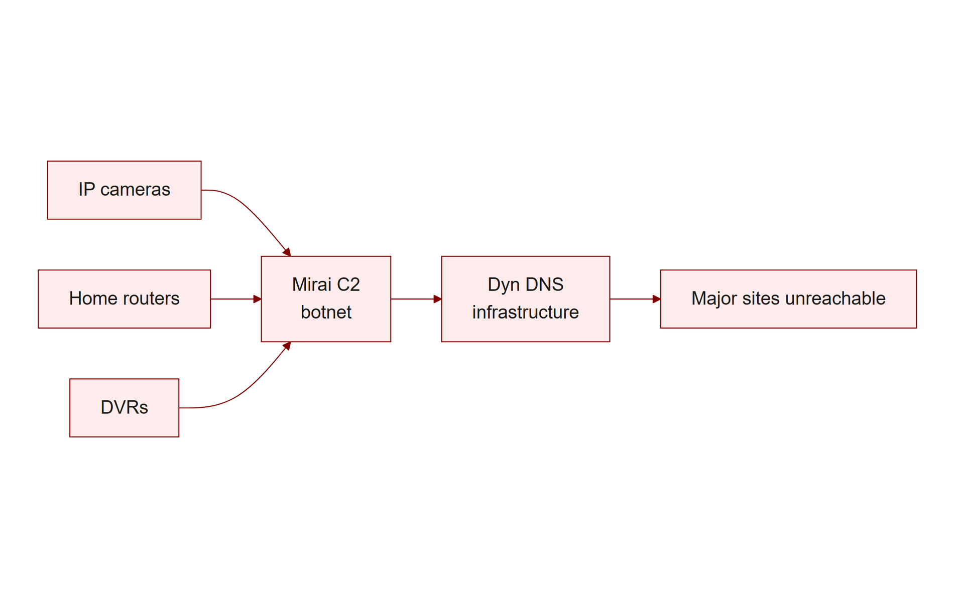
TOPIC 4.1 · 4.1.3.a.2
Case Study: Mirai Strikes Dyn (Oct 21, 2016)
Army of Mirai-infected devices launched a massive DDoS against Dyn, a major DNS provider
Peaked at an estimated 1.2 terabits per second, among the largest DDoS attacks recorded
Caused outages for Twitter, Netflix, Reddit, GitHub, PayPal for hours on the US East Coast
Traced to 100,000+ compromised IoT devices, none individually targeted
Img 4.1.3 Mirai Dyn Attack
Notes:
On October 21, 2016, an army of Mirai-infected devices launched a massive Distributed Denial of Service (DDoS) attack against Dyn, a major DNS infrastructure provider. Because Dyn's DNS services resolved domain names for a large portion of the internet, the attack caused widespread outages for major platforms for several hours. The attack was traced to an estimated 100,000+ compromised IoT devices, none of which had been individually targeted, they were simply scanned, found vulnerable via default credentials, and conscripted en masse.

Slide 25
TOPIC 4.1 · 4.1.3.a.3
Why Mirai Worked: Scale, Not Sophistication
No individual camera owner was 'hacked' in a targeted sense
Manufacturers shipped hundreds of thousands of near-identical devices with the same weak defaults
Virtually none of those owners ever logged in to change the password
A single vulnerability class, multiplied across enough devices, becomes a strategic weapon
Notes:
Mirai is the clearest illustration in the curriculum of why insecure defaults matter at scale. No individual camera owner was 'hacked' in a targeted sense, the attack worked because manufacturers shipped hundreds of thousands of nearly identical devices with the same weak default credentials, and virtually none of those owners ever logged in to change them. A single vulnerability class, multiplied across enough devices, becomes a strategic weapon.

Slide 26
TOPIC 4.1 · 4.1.3.a.4
Case Study: WannaCry, A Worm-Ransomware Hybrid
May 2017: infected 200,000+ computers across 150 countries within days
Crippled parts of the UK's NHS, causing appointment/surgery cancellations
Propagation = worm (EternalBlue SMBv1 exploit, zero user interaction)
Objective = ransomware (AES+RSA encryption, ~$300 Bitcoin demand per machine)
Notes:
In May 2017, the WannaCry ransomware worm infected an estimated 200,000+ computers across 150 countries within days, notably crippling parts of the UK's National Health Service. WannaCry combined two elements this topic classifies separately: it was a worm in its propagation (using EternalBlue to spread laterally with no user interaction) and ransomware in its objective (encrypting files with AES and RSA and demanding Bitcoin).

Slide 27
TOPIC 4.1 · 4.1.3.a.5
WannaCry's Root Cause: Unpatched Endpoints
Microsoft released patch MS17-010 a full month before the attack
Large population of enterprise/government machines never applied it
Many were running unsupported Windows XP and Windows 7 installations
A security researcher's discovery of an unregistered kill-switch domain slowed the spread
Notes:
The rapid, global spread of WannaCry was made possible entirely by unpatched endpoints: Microsoft had shipped a patch closing the EternalBlue vulnerability a full month prior, but a large population of enterprise and government machines, many running unsupported Windows XP and Windows 7, had not applied it. WannaCry was eventually slowed by a security researcher who discovered and registered an unregistered domain referenced in the malware's code, acting as an unintentional 'kill switch.'

Slide 28
TOPIC 4.1 · 4.1.3.a.6
?
Labeling Hybrid Malware Correctly
Classifications describe different dimensions: propagation mechanism vs. payload objective
WannaCry = 'a ransomware payload delivered via wormable propagation'
On the exam, identify BOTH the propagation mechanism AND the payload objective
Forcing a single label loses partial credit on free-response questions
Notes:
WannaCry demonstrates that malware classifications are not mutually exclusive. On the exam, when a scenario describes malware that both spreads autonomously across a network AND encrypts files for ransom, correctly label it using both applicable terms, 'a ransomware payload delivered via wormable propagation', rather than forcing a single label. Full credit requires identifying both the propagation mechanism and the payload objective.

Slide 29
TOPIC 4.1 · 4.1.3.a.7
Section III Glossary Consolidation
Mirai: default-credential IoT botnet, Dyn DDoS at 1.2 Tbps, 100,000+ devices
WannaCry: EternalBlue worm + AES/RSA ransomware, 200,000+ machines, 150 countries
Both incidents trace back to a single, well-understood root cause each
Mirai root cause: shared default credentials; WannaCry root cause: unapplied patch
Notes:
Section III recap: Mirai shows how weak, shared default credentials become a strategic weapon when multiplied across hundreds of thousands of IoT devices. WannaCry shows how a single unpatched, wormable vulnerability can combine with a ransomware objective to cause global-scale, non-targeted damage. Both case studies are the canonical AP examples for their respective root causes.

Slide 30
04
Eliminating Default Configurations
Topic 4.1
Notes:
Transition to part 4 of the topic. Pause here for questions before continuing.

Slide 31
TOPIC 4.1 · 4.1.4.a.1
Eliminating Default Configurations
Mandatory credential rotation before any device is provisioned onto production network
Telnet service disablement, turn the daemon off entirely, don't just change its password
Verified through automated configuration compliance scanning (CIS-CAT, OpenSCAP)
NIST SP 800-53 control CM-7 (Least Functionality) mandates disabling unneeded services
Notes:
Organizations should enforce mandatory credential rotation and Telnet service disablement as a standard build requirement before any device is provisioned onto a production network, verified through automated configuration compliance scanning rather than manual spot checks.

Slide 32
TOPIC 4.1 · 4.1.4.a.2
NIST and CIS Baseline Hardening
CIS Benchmarks: consensus-developed, testable configuration guidelines per OS/device/app
Example rules: disable SMBv1, set minimum password length to 14
NIST SP 800-53 CM (Configuration Management) + SI (System Integrity) control families
Formalizes attack-surface reduction as repeatable, auditable, not ad hoc
Notes:
The CIS Benchmarks published by the Center for Internet Security provide device- and OS-specific hardening checklists that organizations apply as a baseline configuration standard prior to deployment. Combined with NIST SP 800-53's CM and SI control families, these frameworks formalize the process of reducing attack surface as a repeatable, auditable procedure rather than an ad hoc decision left to individual administrators.

Slide 33
TOPIC 4.1 · 4.1.4.a.3
IoT-Specific Regulatory Controls
Manufacturers, not end users, control security posture at point of manufacture
California SB-327 (2020): unique per-device default passwords OR forced setup password change
UK Product Security and Telecommunications Infrastructure Act, similar requirement
Directly targets the root cause exploited by Mirai
Notes:
Recognizing that manufacturers, not end users, control the security posture at the point of manufacture, regulators have begun mandating security-by-design requirements. California's SB-327 (effective 2020) and the UK's Product Security and Telecommunications Infrastructure Act require that IoT devices sold in those jurisdictions either use unique per-device default passwords or force a password change during initial setup, directly targeting the root cause exploited by Mirai.

Slide 34
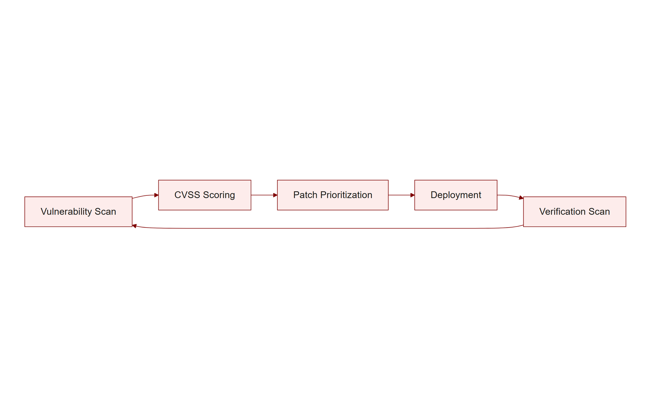
TOPIC 4.1 · 4.1.4.a.4
Patch and Vulnerability Management
A released patch is only effective if deployed, WannaCry's central lesson
CVSS (0.0–10.0): rates vulnerability severity to determine patch urgency
CVSS 9.0+ ("Critical") often requires patching within 24–72 hours per policy
Validated through automated vulnerability scanning (Nessus, Qualys), not spreadsheets
Img 4.1.4 Patch Cycle
Notes:
Because WannaCry demonstrates that a released patch is only effective if deployed, organizations must maintain a formal patch management cadence, prioritized using the Common Vulnerability Scoring System (CVSS) to determine patch urgency, and validated through automated vulnerability scanning rather than relying on manual tracking spreadsheets.

Slide 35
TOPIC 4.1 · 4.1.4.a.5
?
Defense in Depth for Endpoints: Three Layers
Preventive: disable unnecessary services, change default credentials, apply patches
Detective: log and alert on failed authentication and privilege escalation events
Corrective/Responsive: isolate the compromised host, rotate exposed credentials
Graders award partial credit PER LAYER, naming all three maximizes score
Notes:
When a free-response scenario describes an endpoint compromise, always structure your answer around layered controls: (1) Preventive , disable unnecessary services, change default credentials, apply patches; (2) Detective , log and alert on failed authentication and privilege escalation events; (3) Corrective/Responsive , isolate the compromised host and rotate any credentials exposed during the incident. Graders award partial credit per layer identified, so naming all three explicitly maximizes score even under time pressure.

Slide 36
TOPIC 4.1 · 4.1.4.a.6
Section IV Glossary Consolidation
Telnet disablement, CIS Benchmarks, NIST SP 800-53 CM/SI families
SB-327 / UK PSTI Act (IoT regulation), CVSS, automated vulnerability scanning
Three-layer defense-in-depth model: Preventive, Detective, Corrective/Responsive
Every hardening control maps back to a specific case-study root cause from Section III
Notes:
Section IV recap: Hardening frameworks (CIS Benchmarks, NIST SP 800-53) formalize attack-surface reduction. Regulation (SB-327) targets manufacturer-level root causes. Patch management, scored by CVSS, addresses the WannaCry-style root cause. All controls fit into the three-layer defense-in-depth model: Preventive, Detective, Corrective/Responsive.

Slide 37
05
Detecting Brute Force in Live Log Streams
Topic 4.1
Notes:
Transition to part 5 of the topic. Pause here for questions before continuing.

Slide 38
TOPIC 4.1 · 4.1.5.a.1
Detecting Brute Force in Live Log Streams
Alert threshold: N failed logins from same source IP within a short window
Sub-second to few-second spacing between failures = automated, not human
Follow-up correlation rule: Accepted password immediately after failure burst
SIEM tools formalize this pattern into automated real-time alerting rules
Notes:
Building on the log-reading skill from Section II, detection engineering formalizes 'multiple Failed password entries from the same source IP within a very short time window, followed by an Accepted password line' into an automated SIEM correlation rule, rather than relying on a human analyst to notice it manually after the fact.

Slide 39
TOPIC 4.1 · 4.1.5.a.2
Practice: Annotate a Novel Auth Log
Apply the four-step reading method: vector → success → escalation → persistence
Identify the source IP pattern that signals scripted vs. human behavior
Name the specific technique used for privilege escalation, if present
State which CIA property (if any) is ultimately threatened by the final action
Notes:
Practice applying the auth-log reading method from Section II to a new scenario: a smart thermostat's log shows three failed root logins within one second from a single external IP, then a successful login, then a new cron entry scheduling a binary download every reboot. Walk through vector, success, escalation/persistence, and payload exactly as done with the chapter's original log.

Slide 40
TOPIC 4.1 · 4.1.5.a.3
Practice: Design a Hardening Checklist for a New IoT Deployment
List concrete preventive steps before any device goes on the production network
Reference a specific framework (CIS Benchmark or NIST control family) for each step
Include at least one detective control (logging/alerting) and one corrective control
Cross-check each step against a root cause from Mirai or WannaCry
Notes:
Design a five-item hardening checklist for onboarding 500 new IP cameras onto a corporate network: (1) rotate default credentials to unique per-device passwords, (2) disable Telnet and confirm SSH is the only remote-admin channel, (3) apply the latest firmware patch and register the device in a vulnerability-scanning inventory, (4) configure SIEM alerting on failed-login bursts, (5) document an isolation/credential-rotation procedure for any device flagged as compromised.

Slide 41
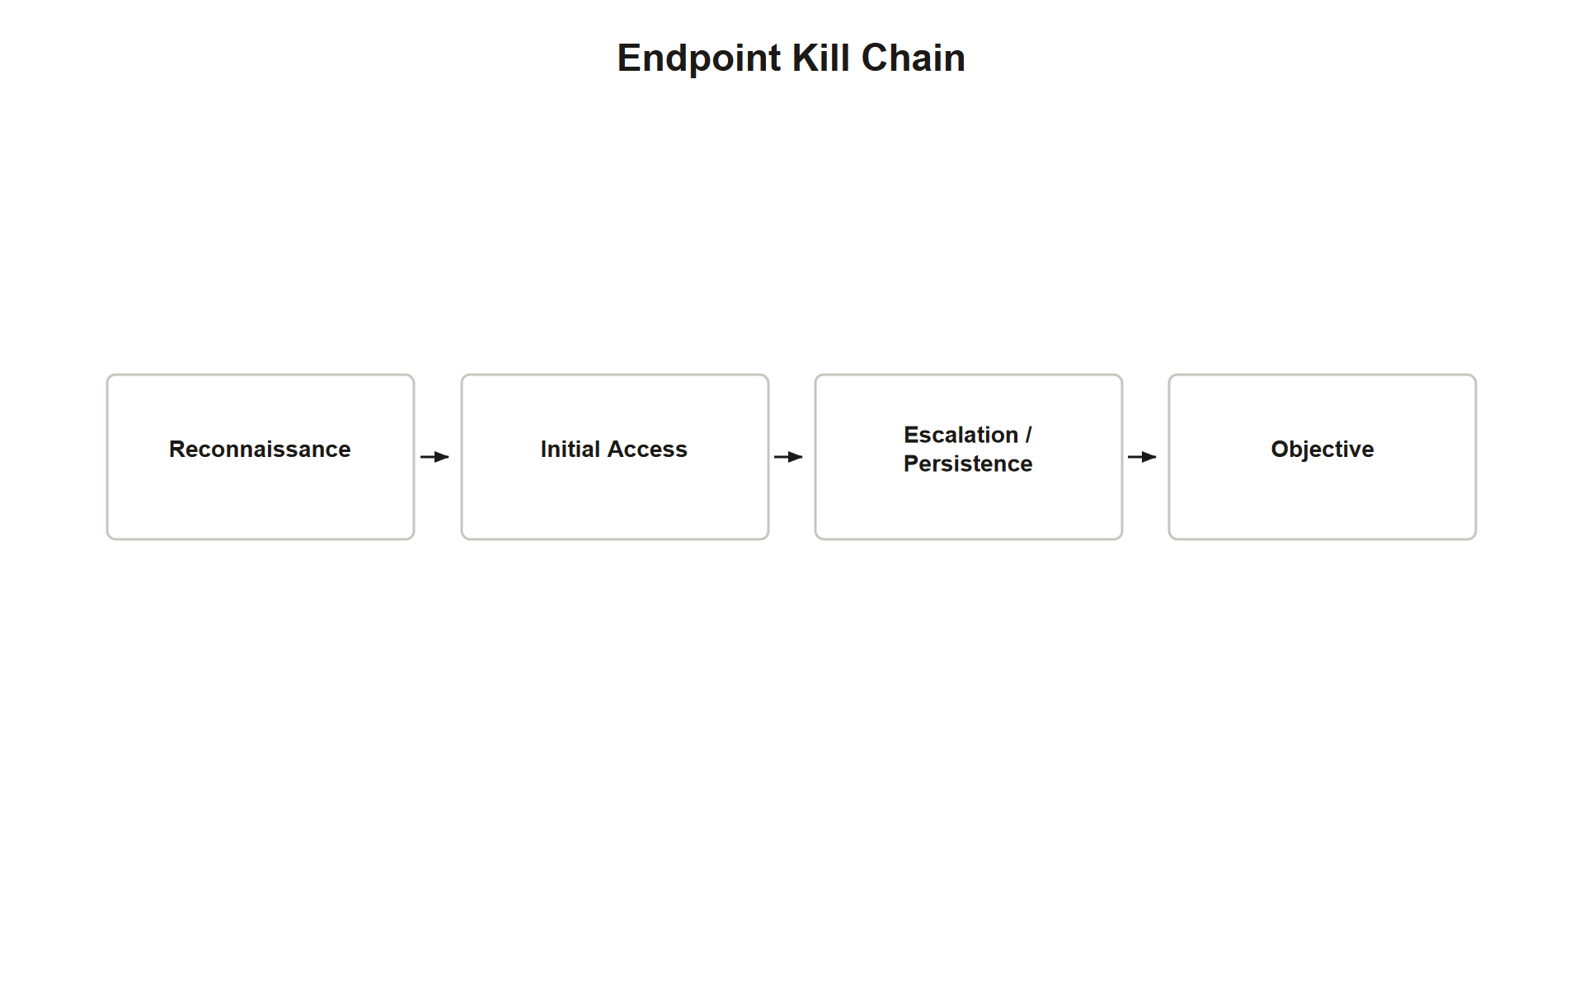
TOPIC 4.1 · 4.1.5.a.4
Synthesis: The Endpoint Compromise Kill Chain
1. Reconnaissance: mass scan (Shodan/masscan) for exposed service (Telnet, SMB)
2. Initial Access: default-credential brute force OR unpatched-service exploit
3. Escalation/Persistence: SUID bit, rootkit installation, or kernel-mode hooks
4. Objective: botnet enrollment (Mirai/DDoS), encryption+extortion (WannaCry/ransomware), or data theft
Img 4.1.5 Endpoint Kill Chain
Notes:
Synthesizing the whole topic into one chain: an attacker's tooling scans the internet for an exposed insecure default (open Telnet, unpatched SMB); gains initial access via credential-stuffing or exploiting an unpatched vulnerability; escalates and persists using techniques like the SUID bit or a rootkit; then executes on its objective , whether that's botnet enrollment for DDoS (Mirai), file encryption for extortion (WannaCry), or quiet data exfiltration. Breaking the chain at any single link, patch the service, remove default credentials, detect the escalation, stops the entire attack.

Slide 42
TOPIC 4.1 · 4.1.5.a.5
Recognizing the Signature Patterns on the Exam
Rapid-fire failed logins from one IP + eventual success = brute force / credential stuffing
sudo + chmod on a system binary = SUID privilege escalation
Open Telnet + closed SSH = insecure default configuration
Autonomous network spread + no user click = worm propagation, not virus
Notes:
Four recurring signature patterns are directly testable from this topic's material: (1) rapid, same-source failed logins followed by success signal automated brute force; (2) a sudo command modifying a SUID bit signals privilege-escalation persistence; (3) an open Telnet port paired with a closed SSH port signals an insecure default configuration; (4) network-wide spread requiring zero user interaction signals worm propagation rather than virus propagation.

Slide 43
TOPIC 4.1 · 4.1.5.a.6
Section V Glossary Consolidation
SIEM correlation rules formalize manual log-reading into automated detection
Hardening checklist components: rotate credentials, disable Telnet, patch, alert, isolate
Endpoint kill chain: Reconnaissance → Initial Access → Escalation/Persistence → Objective
Four testable signature patterns tie directly back to Sections II and III
Notes:
Section V recap: Detection formalizes log-reading into automated SIEM rules. Practice exercises rehearse both log annotation and hardening-plan design. The endpoint kill chain synthesizes the whole topic into four stages, and four signature patterns summarize the most exam-relevant recognition skills from this chapter.

Slide 44
TOPIC 4.1 · 4.1.5.a.7
Topic 4.1 Exam-Readiness Checklist
Can you define endpoint, attack surface, and give the two-question malware framework?
Can you distinguish virus/worm/trojan by infection mechanism, and ransomware/rootkit by objective?
Can you read an auth log and narrate vector → success → escalation → persistence?
Can you correctly apply vulnerability vs. threat vs. exploit to a novel scenario?
Can you name the root cause AND the matching control for both Mirai and WannaCry?
Can you produce a three-layer (preventive/detective/corrective) defense-in-depth answer?
Notes:
Before moving to Topic 4.2, confirm mastery of six skill checkpoints: (1) core vocabulary, endpoint, attack surface, the two-question malware framework; (2) malware classification, virus/worm/trojan by vector, ransomware/rootkit by objective, and correctly labeling hybrids like WannaCry; (3) log analysis, reading a real auth.log for brute-force and SUID-escalation signatures; (4) precise use of vulnerability/threat/exploit vocabulary; (5) case-study root causes, Mirai (default credentials at scale) and WannaCry (unpatched SMBv1); (6) producing a layered, framework-cited hardening/defense-in-depth answer under time pressure.

