Slide 1
Social Engineering Attacks
CLASS 4
The easiest system to exploit has never needed a patch, it just needs to be convinced
Notes:
Social engineering represents a class of cyber threat that leverages human psychology rather than technical flaws to gain unauthorized access to systems, data, or physical spaces. The premise is deceptively simple: instead of exploiting software vulnerabilities like buffer overflows (e.g., CVE-2021-34527, "PrintNightmare") or misconfigurations, attackers manipulate individuals into voluntarily breaching normal security procedures. This approach is devastatingly effective because human behavior is governed by cognitive shortcuts and social instincts that evolved for cooperative societies, not adversarial digital environments.
The 2023 Verizon Data Breach Investigations Report (DBIR) found that the human element contributed to 74% of all analyzed breaches. This figure encompasses social engineering, privilege misuse, errors, and lost/stolen credentials, all rooted in human action rather than purely technical failure. Phishing alone contributed to over 36% of breaches in the same report, making it the single most common attack vector across all industries.
The psychology of social engineering draws on well-established principles from behavioral science. Robert Cialdini's landmark work Influence: Science and Practice (1984) identified six universal principles of persuasion, reciprocity, commitment, social proof, authority, liking, and scarcity, all of which are weaponized by social engineers. An attacker posing as IT support (authority) who creates a sense of urgency ("your account will be locked unless you verify your credentials now", scarcity) can convince a rational, well-intentioned employee to bypass security procedures they know they should follow.
This approach bypasses perimeter defenses entirely. No firewall rule, no intrusion detection signature, no encryption algorithm prevents a user from voluntarily emailing their password to someone they believe is a legitimate IT administrator. This is why frameworks like NIST SP 800-50 (Building an Information Technology Security Awareness and Training Program) and ISO/IEC 27001 Annex A.7 (Human Resource Security) mandate continuous security awareness programs as essential controls, not optional additions.
Historical examples abound. The 2020 Twitter breach, where attackers compromised accounts of Barack Obama, Elon Musk, and others, was initiated entirely through social engineering, manipulating Twitter employees into granting administrative access without exploiting any software vulnerability. The 2011 RSA SecurID breach began with a spearphishing email targeting a small number of RSA employees with a spreadsheet titled "2011 Recruitment Plan," which exploited Adobe Flash (CVE-2011-0609) to install a backdoor. The technical exploit was secondary to the social engineering that delivered it.
Because social engineering bypasses traditional technical defenses, defending against it requires a parallel defense layer: the human firewall, a workforce that is skeptical, trained, and empowered to challenge suspicious requests regardless of apparent authority.

Slide 2
What Is Social Engineering?
Social engineering is a psychological attack vector that manipulates individuals into bypassing normal security procedures to grant access to systems, networks, or physical locations. Rather than exploiting technical vulnerabilities, it exploits cognitive biases and human behavior patterns that are universal and deeply ingrained.
It targets the human, not the firewall.
Core Psychological Principles Exploited
Authority bias: People comply more readily with requests from perceived figures of power or expertise
Urgency and scarcity: Time pressure short-circuits rational verification processes
Social proof: People look to others' behavior to determine what is correct ("everyone else does this")
Reciprocity: A sense of obligation arises when something is given, even if unsolicited
Liking: People comply more readily with those they find personable or familiar
Commitment: Having agreed to small steps, people feel pressure to continue toward larger ones
Why Social Engineering Works
People are naturally inclined to trust and assist others, cooperation is socially rewarded
Security awareness training is often insufficient, infrequent, or not practice-based
Attackers exploit emotional triggers (fear, excitement, empathy) to override rational decision-making
Most security policies focus on technical controls, leaving human vectors under-addressed
The cost of appearing rude or uncooperative often feels greater than the risk of complying
Notes:
Social engineering represents one of the most persistent and effective attack vectors in cybersecurity because it targets the human element, often the weakest link in any security framework. Unlike malware or network intrusions that exploit software defects, social engineering exploits cognitive biases and behavioral tendencies that are deeply rooted in human evolutionary psychology. These instincts, trust, cooperation, deference to authority, response to urgency, are prosocial adaptations that serve us well in normal human interactions but create predictable exploitable patterns in adversarial contexts.
The six principles articulated by psychologist Robert Cialdini provide a framework for understanding how social engineers achieve compliance:
Authority leverages the human tendency to obey those perceived to hold power or expertise. An attacker impersonating an IT director or a government compliance officer benefits from this bias, people defer to authority figures as a cognitive shortcut, avoiding the cognitive effort of independent evaluation. Studies by Stanley Milgram (1963) showed that subjects would deliver what they believed were dangerous electric shocks to others simply because an authority figure directed them to do so, illustrating the profound power of this principle.
Urgency and Scarcity create artificial time pressure that short-circuits rational deliberation. When an email states "your account will be locked in 10 minutes unless you click here," the recipient's threat-response system is activated, narrowing focus and reducing the likelihood of pausing to verify. This technique is ubiquitous in phishing and vishing (voice phishing) attacks.
Social Proof exploits the human instinct to follow group behavior in ambiguous situations. Attackers leverage statements like "all your colleagues have already updated their credentials through this portal" to make the requested action seem normal and safe.
Reciprocity is perhaps the most powerful psychological lever. When an attacker performs a small favor first, offering to solve a problem, sharing useful information, or providing assistance, the target feels a subconscious obligation to reciprocate, even with sensitive information or system access. This is why spearphishing campaigns often begin with helpful, legitimate-seeming contact before making the actual malicious request.
Liking reflects that people comply more readily with those they find attractive, familiar, or personable. Social engineers invest in rapport-building, using shared interests, humor, and warmth to make targets feel positively toward them before the actual exploitation occurs.
Commitment exploits the psychological need for consistency. Once a person has taken a small step, agreeing to a minor request, confirming their email address, or clicking a survey link, they feel internal pressure to continue being "helpful," making subsequent larger requests easier to fulfill.
These principles are not hypothetical, they are documented in NIST SP 800-61 Rev. 2 as contributing factors to real-world incidents, and ISO/IEC 27001's A.7.2.2 (Information security awareness, education, and training) mandates regular training specifically to counter these manipulation techniques by building conscious awareness of cognitive vulnerabilities.

Slide 3
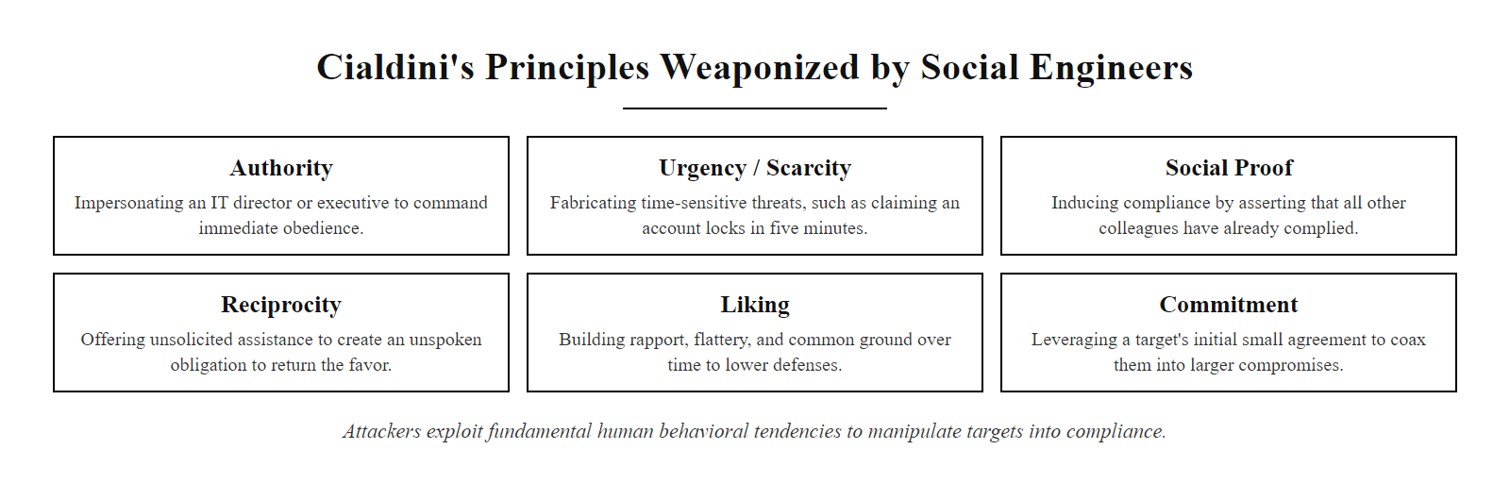
What Is Social Engineering? (2/2)
Cialdini's Six Principles of Influence weaponized by social engineers, each principle corresponds to a documented attack pattern
Notes:
(continued, see part 1)

Slide 4
The Psychology Behind It, Six Levers
Principle | Description | Attack Example
Authority | Comply with perceived power or expertise | "I'm your IT director, reset your password now"
Urgency | Time pressure suppresses rational verification | "Your account locks in 5 minutes!"
Fear | Triggers avoidance, prevent a negative outcome | "You'll be fired if you don't send this immediately"
Trust | Exploit familiarity and rapport built over time | Multi-stage BEC relationship building
Reciprocity | Obligation from a prior gift or assistance given | "I helped you last time, just share this file"
Social Proof | "Everyone else does this" normalization | "All staff already verified via this link"
These psychological principles are not unique to cybercrime, they are foundational to human influence studied in behavioral science and applied in marketing, negotiation, and medicine. Social engineers weaponize them because they bypass technical defenses by targeting the cognitive architecture that governs human decision-making. The key insight: the vulnerability is not in the person, it is in the social environment that rewards compliance.
Notes:
Social engineering attacks exploit predictable cognitive biases and psychological triggers to manipulate human behavior. These principles are deeply rooted in social psychology, behavioral economics, and cognitive science. Understanding them is essential not just for recognizing attacks, but for building security awareness training that changes behavior rather than merely informing knowledge.
The principle of Authority leverages the human tendency to obey figures of perceived power. This is consistent with Milgram's obedience experiments (1963), which demonstrated that ordinary people would comply with authority directives even against their conscience. In cybersecurity, this manifests as attackers impersonating executives (CEO fraud), IT staff, auditors, or law enforcement. NIST SP 800-61 Rev. 2 highlights the importance of training personnel to verify authority through independent channels (callback verification) before acting on sensitive requests, a control that directly disrupts authority-based social engineering.
Urgency and Fear are frequently used together to create a state of psychological stress that impairs deliberate reasoning. The "dual process theory" of cognition (Kahneman's System 1 vs. System 2 thinking) explains why this works: under time pressure or threat, humans default to fast, intuitive thinking (System 1) rather than slow, deliberate analysis (System 2). Social engineers deliberately induce this shift. Research shows that users who encounter "urgent" security warnings click phishing links at significantly higher rates than those given time to evaluate. Security awareness training specifically addresses this by teaching people to recognize urgency as a red flag and to slow down under pressure, reversing the attacker's psychological advantage.
Trust is cultivated through multi-touchpoint campaigns. Advanced Business Email Compromise (BEC) attacks, for example, may involve weeks of legitimate-seeming email exchanges before the fraudulent wire transfer request is made. By the time the actual attack payload arrives, the target has established a mental model of the attacker as a trustworthy colleague. This extended trust-building aligns with MITRE ATT&CK T1598 (Phishing for Information), a reconnaissance technique that gathers information while simultaneously establishing the relationship needed for later exploitation.
Reciprocity is perhaps the most powerful lever. Cialdini's research demonstrated that people feel compelled to return favors even when the initial gift was unsolicited and relatively small. Social engineers exploit this by first providing something of value, technical help, insider information, or access assistance, before making their actual request. The obligation created is real and difficult to consciously override.
From a defensive standpoint, understanding these principles enables more effective security awareness training. Rather than simply telling users "don't click suspicious links," effective training builds metacognitive awareness, the ability to recognize when their own psychology is being exploited, and provides concrete strategies for interrupting compliance cycles, such as verification callbacks, the use of out-of-band authentication channels, and organizational cultures that reward caution over speed.

Slide 5
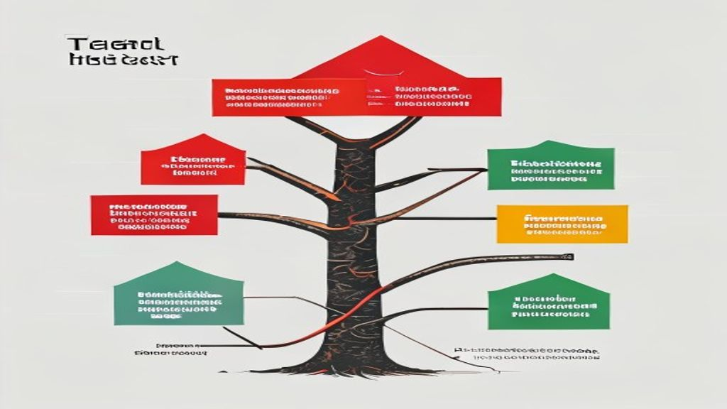
The Psychology Behind It, Six Levers (2/2)
Social Engineer's Targeting Decision Tree: attacker selects psychological lever based on observed target behavior and organizational role
Notes:
(continued, see part 1)

Slide 6
Pretexting, Fabricating Credibility
Pretexting is a social engineering technique in which an attacker fabricates a specific scenario, a pretext, to engage a victim and gain their trust. It is the foundational technique underlying most other social engineering attacks: every impersonator has a pretext; every elicitation has a narrative frame.
Common Pretexting Scenarios
Impersonating IT support to request password resets or remote access tools installation
Posing as a vendor, contractor, or third-party auditor requiring system access verification
Assuming the role of internal HR or compliance personnel requesting employee PII
Claiming to be a new employee requiring onboarding assistance with systems access
Faking an emergency or time-sensitive audit to bypass normal verification procedures
Posing as a regulator (IRS, OSHA, GDPR auditor) threatening penalties unless data is shared
Pretext Role | Objective | Exploited Information | Key Red Flag
IT Support | Gain system access or credentials | Passwords, MFA tokens, VPN config | Unsolicited contact, urgency
Vendor/Accountant | Redirect payments or obtain data | Invoice details, banking info | New wire transfer destination
HR Representative | Collect PII or employee records | SSN, salary, payroll, benefits | Unusual channel (personal email)
Executive Assistant | Expedite "urgent" CEO requests | Confidential documents, approvals | Wire transfer without prior notice
Auditor/Regulator | Coerce policy violation disclosures | Compliance gaps, system configs | External pressure without formal notice
Notes:
Pretexting is a foundational technique in social engineering that relies on the psychological principle of authority bias, the human tendency to comply with individuals perceived to hold legitimate roles or institutional power. Unlike phishing, which often deploys generic lures to large target populations, pretexting is typically highly personalized and contextually calibrated to a specific target individual and organizational environment. This makes it both more labor-intensive for the attacker and more effective, as the narrative is carefully tuned to the target's role, relationships, and daily experiences.
The strength of a successful pretext lies in its plausibility density, the number of verifiable, accurate details woven into the fabricated scenario. Attackers invest significant time in Open Source Intelligence (OSINT) gathering before making first contact. Sources include LinkedIn (revealing organizational hierarchy, project names, employee tenure), company press releases (revealing vendor relationships and technology partnerships), GitHub repositories (sometimes exposing internal system names or API patterns), and prior breach databases (revealing email formats, department structures, or employee personal information).
A canonical real-world pretexting attack is the Hewlett-Packard boardroom leak investigation (2006), where investigators hired by HP conducted "pretexting" operations against journalists and board members, calling phone companies while pretending to be the account holders to obtain call records. This incident led directly to the Telephone Records and Privacy Protection Act of 2006, illustrating how pretexting can violate legal statutes even when no technical hacking occurs.
In enterprise contexts, Business Email Compromise (BEC) is often initiated through pretexting. The attacker, posing as a CEO or CFO, crafts an urgent email to a finance employee requesting a wire transfer to a new vendor account. The FBI's IC3 reported that BEC schemes caused over $2.7 billion in losses in 2022 alone. The effectiveness of this attack depends entirely on the quality of the pretext, the more accurately the attacker mimics the executive's writing style, timing, and typical request patterns, the higher the success rate.
Effective defenses against pretexting include: multi-channel verification (requiring voice confirmation via a known phone number for sensitive requests, not the number provided in the suspicious communication); strict financial controls (dual authorization for wire transfers above threshold amounts, per NIST SP 800-53 AC-5 Separation of Duties); security awareness training that specifically includes pretexting scenario simulations (not just phishing tests); and an organizational culture that rewards verification over speed, explicitly communicating that employees will never be penalized for taking time to verify, even when asked by apparent executives.

Slide 7
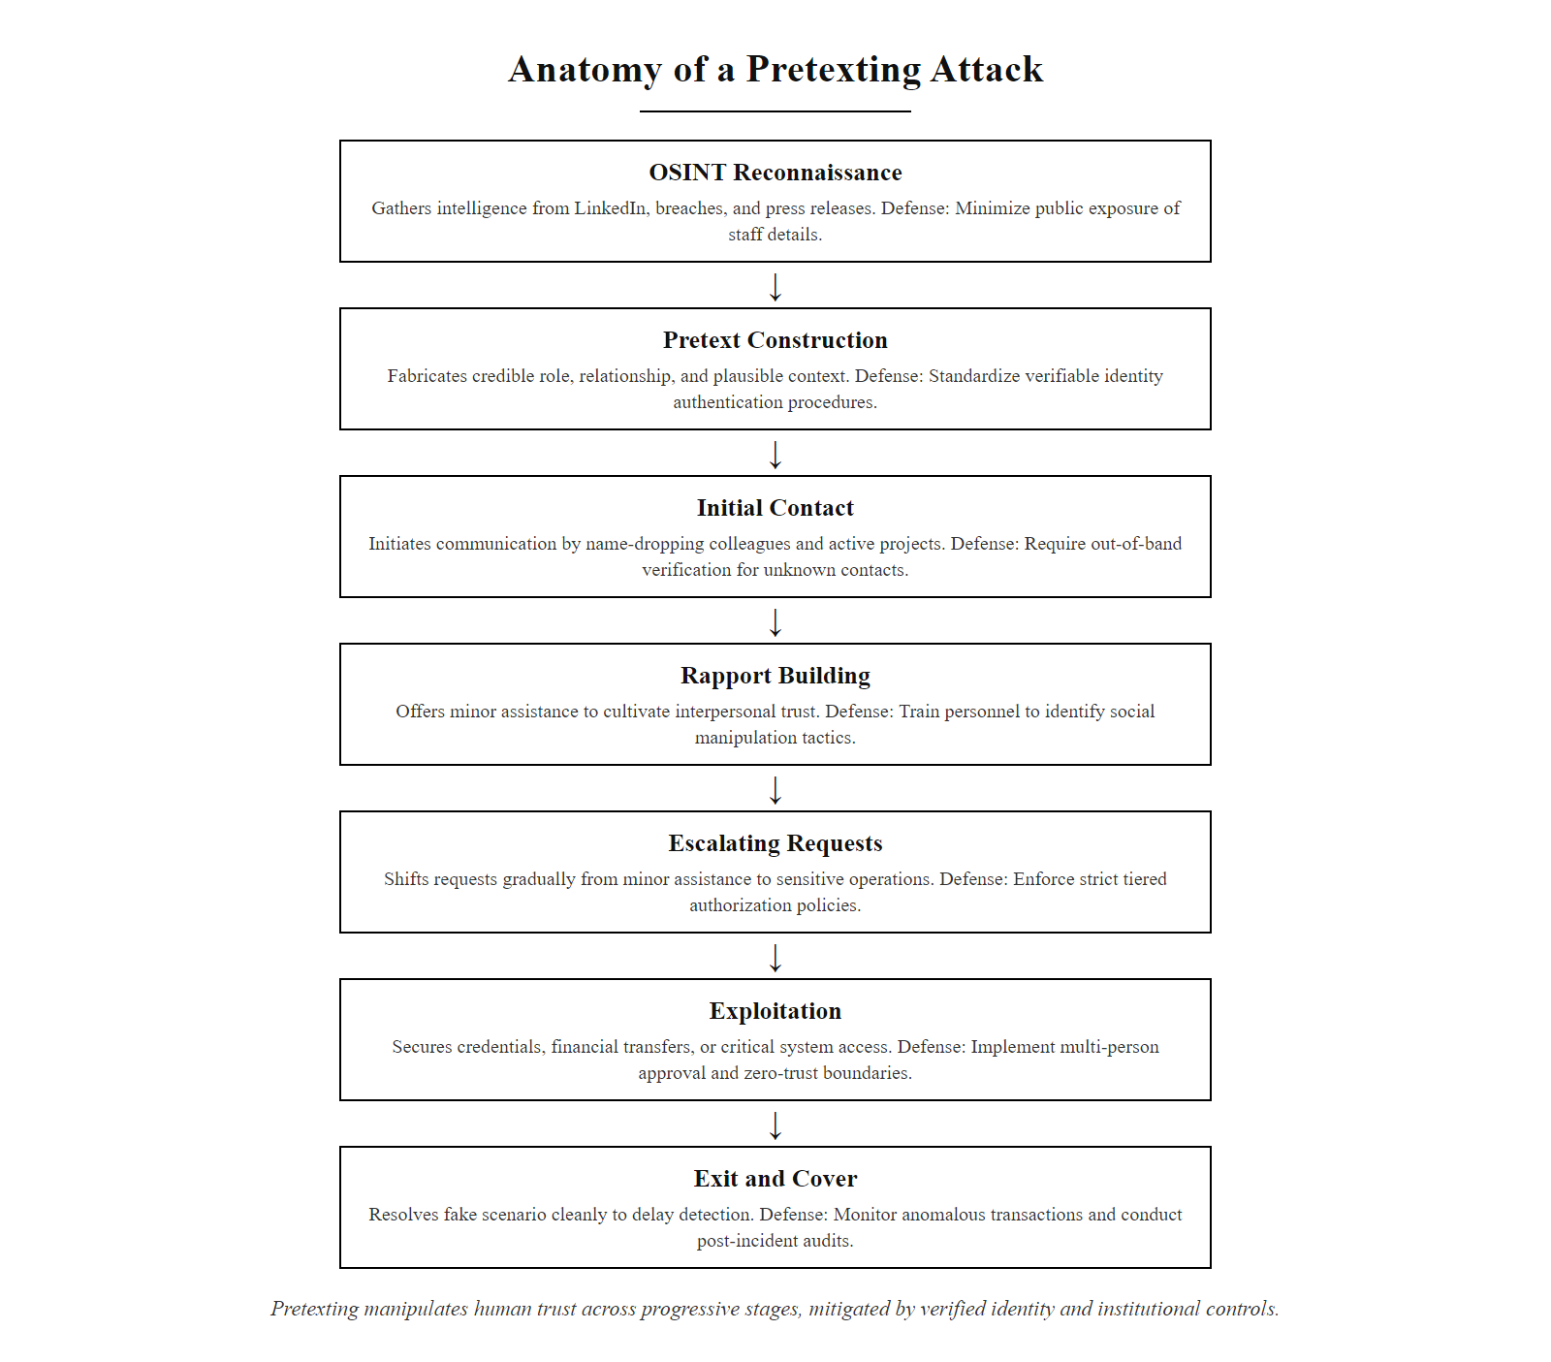
Pretexting, Fabricating Credibility (2/3)
Anatomy of a Pretexting Attack: attackers invest heavily in OSINT reconnaissance before first contact to make the fabricated scenario precisely calibrated to the target
Notes:
(continued, see part 1)

Slide 8
Pretexting, Fabricating Credibility (3/3)
Attacker conducts OSINT, LinkedIn, company website, social media reveal employee names, org structure, vendor relationships, ongoing projects
Attacker constructs the pretext: fabricates a plausible role, relationship, and reason for contact tailored to the specific target
Initial contact made via email, phone, or in-person, opening statement establishes credibility (name-drops known colleagues, references real projects)
Rapport is built over one or more interactions, small helpful acts increase trust, reciprocity obligation accumulates
Escalating requests, starts with benign asks to establish pattern of compliance, then moves to the actual target request
Exploitation achieved, target provides credentials, sends documents, approves transfer, or grants physical access
Attacker departs the pretext, may "close the loop" by resolving the fake issue to delay discovery
Notes:
(continued, see part 1)

Slide 9
Baiting, Exploiting Curiosity
Baiting is a social engineering technique that exploits human curiosity, desire, or greed by offering something appealing, a physical device or digital content, to lure victims into performing an unsafe action, such as inserting a malicious USB drive or downloading malware-laden software.
Common Baiting Vectors
A USB drive labeled "Confidential, Q4 Salary Review" left in a corporate parking lot or restroom
"Free" software downloads (cracked games, pirated movies, VPN tools) embedded with Remote Access Trojans (RATs)
Phishing emails advertising fake prize giveaways requiring personal information to claim
QR codes on posters in public spaces or cafeterias leading to credential-harvesting pages
Physical media (DVDs, SD cards) left near specific workstations during targeted attacks
Bait Type | Delivery Method | Payload / Objective
Physical Bait | USB drives, SD cards, CDs | Malware install, credential theft, data exfiltration
Digital Bait | Downloads, torrents, ads | RAT installation, credential harvesting, keylogger
QR Code Bait | Posters, emails, stickers | Redirect to phishing page or drive-by download site
Prize Bait | Email, social media | PII collection, credential harvesting
Attacker prepares bait: loads malware onto USB drives or creates fake download page
Bait is deployed in target-relevant location (parking lot, conference room, near target's desk for targeted attacks)
Victim discovers bait and curiosity or greed is triggered
Victim takes the action, plugs in USB or clicks download link
Payload executes, malware installs silently, often imitating the expected content (spreadsheet opens normally while RAT installs in background)
Attacker gains access, remote control, credential theft, or persistent backdoor established
Notes:
Baiting is a manipulative social engineering tactic that leverages psychological triggers, primarily curiosity and greed, to induce a victim to voluntarily perform a dangerous action. Unlike fear-based attacks such as phishing, baiting relies on the victim's positive motivational state: they believe they are gaining something (free software, insider information, a prize) rather than avoiding a loss. This makes baiting psychologically distinctive and requires different defensive countermeasures than urgency-based attacks.
In its physical form, attackers prepare infected removable media, USB drives, SD cards, or even specialized hardware like the USB Rubber Ducky (a commercial penetration testing tool that masquerades as a USB drive but acts as a keyboard injector, capable of typing malicious commands at 1000 keystrokes per second), labeled with enticing descriptions. Labels exploiting organizational psychology are most effective: "Q4 Layoff List," "CEO Salary 2026," or "Interview Candidates, Confidential." These labels are specifically calibrated to trigger irresistible curiosity in employees who would normally be cautious.
The effectiveness of physical USB baiting was formally studied in a 2016 academic paper by researchers from the University of Michigan and the University of Illinois, who dropped 297 USB drives across the University of Illinois Urbana-Champaign campus. Of those collected by people, 48% were plugged into computers, and that was without the drives doing anything to encourage it. With social engineering labels added, the rate increased substantially. This empirical data underscores that USB baiting is not a theoretical concern but a documented, high-success-rate attack vector.
The most significant historical example of physical USB baiting is the Stuxnet worm (2010), which was introduced into Iran's uranium enrichment facility at Natanz, an air-gapped network isolated from the internet, via infected USB drives. Once inserted into any workstation in the facility, Stuxnet propagated via a zero-day exploit (CVE-2010-2772) and ultimately physically damaged over 1,000 uranium centrifuges by subtly altering their rotational speeds while reporting normal operation to monitoring systems. This attack demonstrates that baiting can serve as the initial access vector for nation-state level offensive operations against hardened, physically isolated targets.
Digital baiting typically manifests through malicious downloads, fake software updates, or deceptive online promotions. The proliferation of piracy websites and "cracked software" communities creates a persistent baiting environment: users seeking free versions of expensive software regularly encounter downloads that bundle legitimate software with Remote Access Trojans (RATs), keyloggers, or cryptocurrency miners. These campaigns often exploit the "free" framing to suppress risk assessment, "it's just a free game, what's the harm?"
From a defensive standpoint, organizations should enforce removable media controls (NIST SP 800-53 MP-7, Media Use), which restrict or block USB device attachment at the operating system level via Group Policy or endpoint security tools. Security awareness training should include baiting simulations, just as phishing simulations test users on email-borne threats, physical baiting simulations (leaving test USB drives in the office) build the reflexive suspicion needed to resist this vector. ISO/IEC 27001 Annex A.12.3 (Information backup) and A.12.6 (Technical vulnerability management) provide additional control frameworks applicable to the technical defenses against baiting payloads.

Slide 10
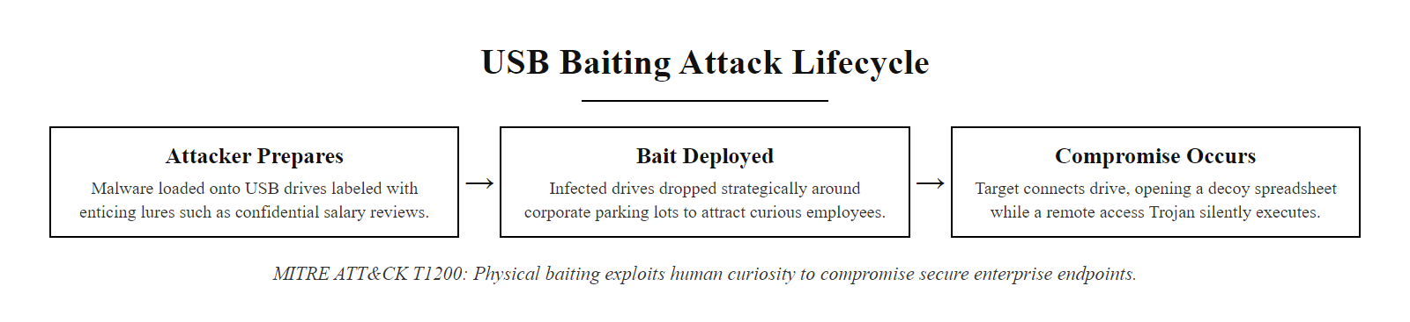
Baiting, Exploiting Curiosity (2/2)
USB Baiting Attack Lifecycle: the simplicity is deceptive, a $5 USB drive can compromise an enterprise network if an employee's curiosity overrides security instinct
Notes:
(continued, see part 1)

Slide 11
Impersonation, Wearing Another's Identity
Impersonation is a social engineering technique in which an attacker assumes the identity of a trusted individual or entity to manipulate a target into performing actions or divulging information. Unlike pretexting (which fabricates a scenario), impersonation specifically borrows an existing real identity, dramatically increasing the attack's credibility by leveraging established trust.
Digital Impersonation
Spoofed emails mimicking executives (Business Email Compromise, FBI reported $2.7B in 2022 losses)
Domain lookalike attacks: paypa1.com vs paypal.com, mircrosoft.com vs microsoft.com
Fake internal support tickets appearing to originate from the real IT helpdesk system
Social media profile cloning, duplicating an executive's LinkedIn/Twitter/Slack account
Caller ID spoofing on vishing (voice phishing) calls
Physical Impersonation
Posing as delivery personnel (FedEx, Amazon) to gain building entry
Impersonating maintenance staff, janitorial workers, or HVAC technicians to access secure areas
Using forged or cloned access badges, fake uniforms, or prop equipment cases
Tailgating, following an authorized person through a secured door without separately authenticating
Vishing, calling as "IT support" requiring in-person or remote access
Notes:
Impersonation is a high-impact social engineering technique that leverages trust as its primary attack vector. The fundamental mechanism is simple and devastatingly effective: rather than persuading a victim through manipulation alone, the attacker borrows an existing, pre-established identity that the target already trusts. The cognitive work of evaluating trustworthiness has already been done, the target simply assumes they are interacting with the person they believe they are.
Digital impersonation takes many forms. Business Email Compromise (BEC) is the most financially damaging: attackers either compromise a legitimate executive's email account or spoof it (using display name manipulation or lookalike domains) to send convincing requests to financial staff for wire transfers, gift card purchases, or payroll changes. The FBI's IC3 2022 Annual Report identified BEC as the costliest cybercrime, with $2.7 billion in reported losses from approximately 21,000 complaints. The attack requires no malware, no CVE exploitation, only a convincing email and a target who doesn't verify through a second channel.
Caller ID spoofing enables vishing (voice phishing) attacks where the attacker's phone number is displayed as the bank's fraud department, the IRS, or the corporate IT help desk. When a target receives a call from their bank's 800 number showing on caller ID and a professional-sounding person claiming to be from fraud prevention asks them to confirm their online banking credentials "to reverse an unauthorized transaction," the psychological barriers to compliance are low. The 2020 Twitter hack employed this exact technique, social engineers called Twitter employees using a spoofed internal number and convinced them to visit a phishing site to capture their VPN credentials, ultimately enabling access to administrative tools used to compromise high-profile accounts.
Physical impersonation and tailgating represent a different but equally serious threat. Physical security controls like badge readers and security checkpoints are typically designed for one-person-at-a-time authentication, but social norms create a pressure to "hold the door" for someone who appears to belong. Studies have shown that people in uniforms (delivery, maintenance, law enforcement) pass through physical security checkpoints with minimal challenge more than 70% of the time. Organizations must train security personnel and employees that challenging unfamiliar individuals, even those in uniforms, is a required behavior, not rudeness.
Effective countermeasures operate at multiple levels: technical controls include DMARC/DKIM/SPF email authentication to prevent domain spoofing (reducing the risk of BEC at the delivery layer), multi-factor authentication to prevent compromised credentials from being sufficient for access, and caller ID verification protocols. Procedural controls include mandatory out-of-band verification for sensitive financial transactions (calling the requester at a known number, not the one in the email), dual-person authorization for wire transfers exceeding thresholds, and physical security procedures that prohibit tailgating regardless of apparent authority. Cultural controls, perhaps most important, build an environment where questioning, verifying, and even refusing a request from an apparent authority is celebrated rather than penalized.

Slide 12
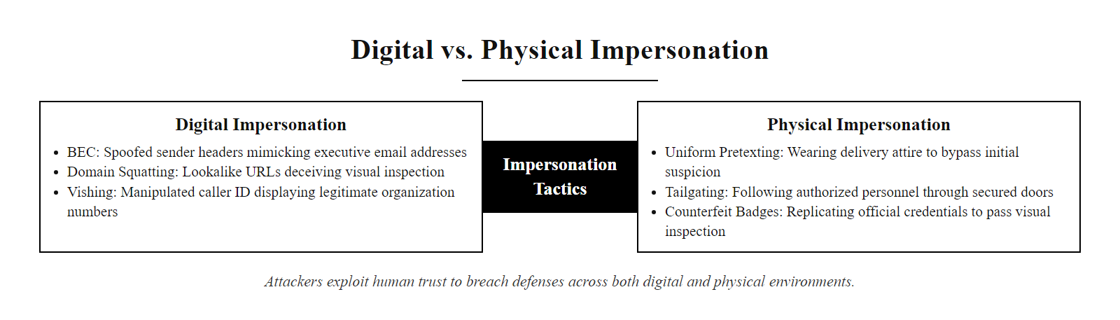
Impersonation, Wearing Another's Identity (2/3)
Digital vs. Physical Impersonation: attackers exploit trust in both the digital channel and the physical environment, each requires distinct detection and verification countermeasures
Notes:
(continued, see part 1)

Slide 13
Impersonation, Wearing Another's Identity (3/3)
Attack Variant | Common Scenario | Objective | Countermeasure
BEC / CEO Fraud | Executive email requesting urgent wire transfer | Financial theft | Dual authorization, out-of-band verification
IT Vishing | "Help desk" calls requesting password/MFA code | Credential compromise | Never share OTP codes verbally
Physical Tailgating | Uniformed person follows through access-controlled door | Unauthorized physical access | Anti-tailgating doors, culture of challenging strangers
Domain Lookalike | Invoice from "microsofl.com" | Malware delivery, phishing | DMARC/DKIM email authentication, domain monitoring
Notes:
(continued, see part 1)

Slide 14
Elicitation, Subtle Information Extraction
Elicitation is a non-coercive, conversational technique used in social engineering to subtly extract sensitive information from a target without raising suspicion. It relies on the principle that people share more information in what feels like a natural, low-pressure dialogue, particularly when the social engineer frames it as a two-way exchange.
Core Elicitation Strategies
Ingratiation: Flattery and acknowledgment of expertise lower defenses ("You're the best person to ask about this...")
Deliberate false statement: Stating something slightly incorrect invites correction, revealing the accurate information
Quid pro quo: Offering minor information in exchange to make disclosure feel reciprocal and normal
Third-party reference: Invoking names familiar to the target ("Jane from accounting mentioned you handle...")
Information bridging: Starting from publicly known facts and steering conversationally toward unknowns
Active listening and open-ended questions: "How does your team typically handle backup procedures?"
Strategy | Example Tactic | Psychological Mechanism
Ingratiation | "You're clearly the expert here, could you explain how your system handles X?" | Authority deference + desire to help
Deliberate Error | "I understand you use FTP for file transfers?" (incorrect) | Desire to correct drives disclosure
Quid Pro Quo | "I can share our vendor list if you share your software stack" | Reciprocity obligation
Third-Party Reference | "I'm covering for Jane, she said you'd know the admin password" | Social proof + familiarity
Open-Ended Bridging | "Since you're using Azure AD, how do you manage privileged accounts?" | Natural conversation flow
Notes:
Elicitation is one of the most psychologically nuanced techniques in the social engineer's toolkit, and paradoxically, one of the most dangerous precisely because it does not feel like an attack. Unlike phishing (which requires a click) or pretexting (which requires accepting a false identity), elicitation operates entirely within the bounds of what appears to be a normal, even pleasant conversation. The target often has no awareness that information was extracted until, if ever, they later review the exchange.
The technique exploits several fundamental aspects of human social behavior. Conversation is inherently reciprocal, when someone shares information with us, we feel a natural pull to reciprocate. When someone asks us a question in a conversational tone, we feel social pressure to respond rather than to deflect or interrogate the questioner's motives. When someone appears knowledgeable and interested in our work, we are naturally pleased and inclined to demonstrate our expertise by sharing more than minimally necessary.
The deliberate false statement technique is particularly elegant: by stating something the target knows to be incorrect, the attacker reliably triggers the target's natural correction reflex. "I understand your company uses a single-factor authentication system?" will elicit an enthusiastic correction: "No, we use Duo MFA on all systems, integrated with our Active Directory." The attacker has just learned the organization's MFA product and identity management infrastructure through an interaction that felt like the target doing the attacker a favor by correcting misinformation.
From an intelligence collection standpoint, elicitation is the primary technique used by human intelligence (HUMINT) operatives in espionage contexts, a lineage that underscores its long-established effectiveness. The same techniques used by foreign intelligence services to extract classified information from government employees have been adapted by corporate espionage actors and cybercriminals to gather the reconnaissance information needed for technical attacks. Understanding a target organization's technology stack, network architecture, key personnel, and operational procedures dramatically increases the effectiveness of subsequent technical exploitation.
The information gathered through elicitation often appears in MITRE ATT&CK under T1591 (Gather Victim Org Information) and T1592 (Gather Victim Host Information), both reconnaissance techniques that can be conducted remotely through phone calls, emails, or professional networking without any technical exploitation. A skilled social engineer conducting elicitation over LinkedIn direct messages or at an industry conference can gather enough information to plan a highly targeted spearphishing campaign, identify the specific CVEs relevant to the organization's technology stack, or identify insider contacts worth approaching for further manipulation.
Defensive countermeasures focus on information security culture rather than purely technical controls: training employees to recognize conversational steering, establishing explicit policies about what information can be shared with external parties, creating a "need to know" framework for sensitive technical details, and conducting regular social engineering red team exercises that include elicitation scenarios to build awareness without reliance on user memory alone.

Slide 15
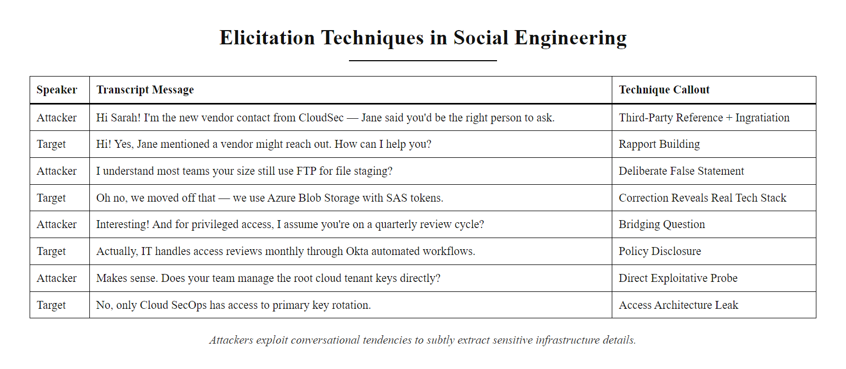
Elicitation, Subtle Information Extraction (2/2)
Elicitation in Practice: an annotated conversation showing how a skilled elicitor extracts system architecture details through what feels like a friendly technical discussion
Notes:
(continued, see part 1)

Slide 16
Red Flags, Recognizing Social Engineering
Behavioral & Communication Red Flags
Unusual urgency or pressure to bypass normal verification or approval processes
Requests for information the asker should logically already possess (e.g., IT asking for your password)
Contact through unexpected or unverified channels (personal email, text, WhatsApp instead of official systems)
Emotional manipulation, flattery, fear, excitement, or sympathy, immediately preceding a request
A favor offered or a problem "helpfully" solved right before a demand is made (reciprocity setup)
Overly familiar tone from someone you haven't interacted with before
Inconsistencies in stated facts, roles, organizational structure, or timeline
Request to maintain secrecy ("don't tell your manager about this until it's resolved")
Instruction to disable, bypass, or ignore security controls "just this once"
If a message makes you feel rushed, you're being engineered.
Psychological Triggers That Signal SE Attacks - Scarcity: "This offer expires in 10 minutes" - Authority: "As your CISO, I need your admin credentials" - Fear: "You'll face legal action unless you comply immediately" - Excitement: "You've won a prize, click to claim before midnight" - Empathy: "A colleague is in serious trouble and needs your help"
Verification Actions, Break the Pressure - Hang up and call back using a number you looked up independently (not one given by the caller) - Escalate to your manager before complying with unusual requests, policy protects you - Use out-of-band communication (call instead of reply to email) to confirm sensitive requests - If physical, ask for ID, call building security, do not hold doors for unverified visitors - Never provide OTP/MFA codes verbally, legitimate IT never needs them
Notes:
Social engineering (SE) attacks exploit human psychology rather than technical vulnerabilities, making them particularly insidious, and making the human ability to recognize manipulation patterns the primary defensive control. The National Institute of Standards and Technology (NIST) highlights in Special Publication 800-61 that non-technical threats, including social manipulation, are among the most challenging to detect and mitigate precisely because they exploit behaviors that are otherwise prosocial and appropriate (cooperation, helpfulness, responsiveness to authority).
Red flag recognition training represents a form of metacognitive defense, teaching people not just to follow security rules, but to develop an internal awareness of when their own decision-making processes are being manipulated. This is a fundamentally different approach from rule-based training ("never share passwords") which creates brittle compliance that fails when attackers present novel scenarios not covered by the specific rules learned.
The most universal red flag is emotional activation under time pressure. When any request, email, phone call, in-person interaction, creates a strong emotion (fear, urgency, excitement, sympathy) and requires action within a compressed timeframe that precludes normal verification, this combination is a near-universal indicator of social engineering. The attacker's goal is to get the target to act before they have time to think critically. The defensive action is simply: slow down. Take time to verify. Every legitimate urgent situation can survive a 5-minute verification delay; attacks specifically cannot, because verification would reveal them.
Specific red flags map directly to documented attack patterns: - "Don't tell your manager", this is a consistent pattern in both insider recruitment and BEC attacks, designed to prevent verification by someone with broader context - Offers to solve a problem right before making a request, the reciprocity setup documented across hundreds of social engineering incident reports - Using a number or channel not in the corporate directory, impersonation attacks require the attacker to control the communication channel to prevent verification - Requests to disable or bypass security controls, no legitimate process requires this; it is exclusively an attacker requirement
NIST SP 800-50 provides a framework for implementing security awareness training that specifically addresses social engineering recognition, recommending that training programs include simulated social engineering exercises (not just phishing simulations but also pretexting calls and impersonation scenarios) to build experiential recognition rather than theoretical knowledge alone. ISO/IEC 27001 Annex A.7.2.2 mandates that such training be role-appropriate and regularly refreshed, recognizing that awareness degrades without reinforcement.

Slide 17
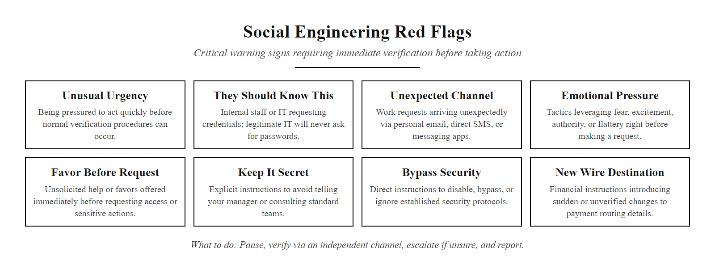
Red Flags, Recognizing Social Engineering (2/2)
Social Engineering Red Flag Checklist, a desk-reference card for employees; recognizing even one indicator should trigger the verification process before any action is taken
Notes:
(continued, see part 1)

Slide 18
The Human Firewall, Building It
Pretexting, baiting, impersonation, and elicitation are four pathways into the same room, convincing a person to voluntarily do something that bypasses security. The human firewall is not one person being suspicious of everything; it is an organizational culture where verification is normal, caution is celebrated, and no one is penalized for slowing down to confirm.
Pretexting · Baiting · Impersonation · Elicitation · Psychological Triggers · Red Flag Recognition · Verification Protocols
Technique | Core Exploit | Primary Defense
Pretexting | Authority + fabricated scenario | Verification protocols + skeptical culture
Baiting | Curiosity + greed | Media controls + security training
Impersonation | Pre-existing trust | Out-of-band verification + DMARC/DKIM
Elicitation | Social reciprocity + conversational norms | Information classification + need-to-know
Phishing (next class) | Urgency + deceptive UI | Email authentication + awareness training
Recognize: identify the psychological trigger being activated (urgency, authority, curiosity)
Pause: the attacker needs you to act fast, slowing down defeats their advantage
Verify: use an independent, pre-established channel to confirm the request
Escalate: when in doubt, involve your manager or security team, policy protects you
Report: even if you complied, reporting enables rapid incident response and protects others
Notes:
The concept of the human firewall reflects a sophisticated understanding of cybersecurity as a sociotechnical system, one where both technical and human layers must be deliberately designed and maintained. While technical controls such as firewalls, intrusion detection systems, email authentication (DMARC/DKIM/SPF), and endpoint protection are essential components of a security architecture, they are specifically designed to defend against technical attacks. Social engineering, by definition, routes around these technical controls by obtaining voluntary human cooperation. The only layer positioned to catch social engineering attacks is therefore a trained, aware, empowered human workforce.
Each of the four core techniques studied in this class represents a distinct psychological pathway to compromise:
Pretexting constructs a believable scenario that provides the attacker with a legitimate-seeming reason for their request. Its defense requires verification protocols that are explicitly designed to validate claimed identities through independent channels, the key word being independent, since the attacker can control any channel they provided.
Baiting exploits human curiosity and greed through enticing physical or digital lures. Its defense requires both technical controls (removable media policies, endpoint protection) and behavioral conditioning to treat unexpected tempting offers with suspicion rather than excitement.
Impersonation borrows an existing trusted identity, dramatically reducing the cognitive work required to accept the attacker as legitimate. Its defense requires systematic out-of-band verification for sensitive requests and a culture where questioning apparent authority is explicitly supported and rewarded.
Elicitation extracts information through natural conversation without ever triggering the alert states associated with obvious manipulation. Its defense requires information classification awareness (knowing what should not be shared and with whom) and a metacognitive capacity to recognize when conversations are being directed toward sensitive topics.
The NIST Cybersecurity Framework 2.0 addresses the human element across multiple functions: the Govern (GV) function requires establishing organizational cybersecurity culture and policy; the Protect (PR) function includes workforce awareness and training (PR.AT); and the Detect (DE) function includes human-reported anomaly detection. Effective social engineering defense requires investment across all three functions, not just a one-time training module.
Building the human firewall is ultimately a culture design challenge, not a training content challenge. Organizations where reporting suspicious interactions is normalized, where verification is never perceived as distrust or rudeness, and where security teams respond to reports with support rather than blame, these organizations are inherently more resistant to social engineering than those relying on annual compliance training alone. As we move into the next class on phishing and credential attacks, the social engineering foundation built here will directly inform how we understand and defend against those specific, operationally critical attack vectors.

Slide 19
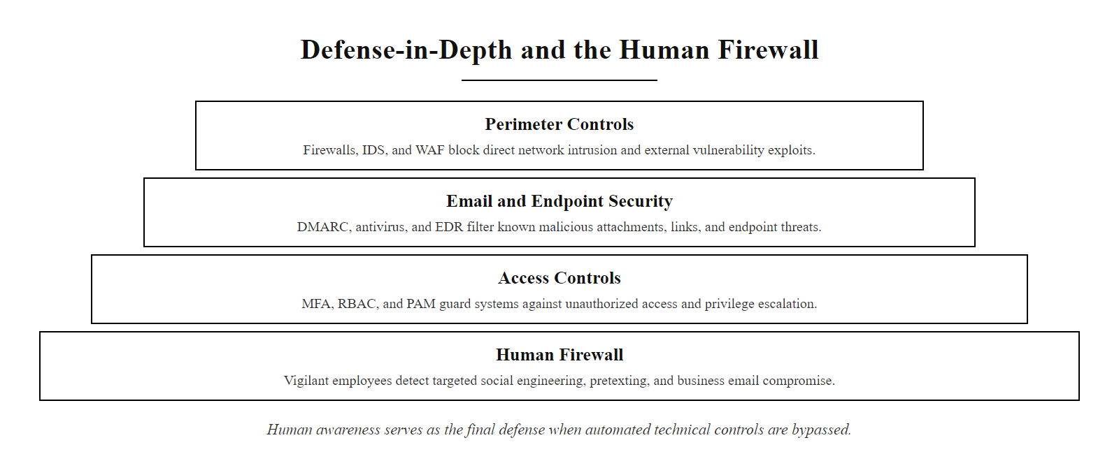
The Human Firewall, Building It (2/2)
The Human Firewall Model: technology can block known threats, but the human layer is the last line of defense against novel social engineering attacks, and often the only layer present when the attack occurs
Notes:
(continued, see part 1)

Slide 20
Phishing, Mass-Scale Deception
Phishing is a social engineering attack delivered via electronic communication, most commonly email, that uses deceptive messages and fraudulent websites to trick recipients into revealing credentials, downloading malware, or authorizing financial transactions. It is the most prevalent and operationally mature social engineering technique, accounting for over 36% of data breaches (Verizon DBIR 2023).
Anatomy of a Phishing Email
Spoofed sender: Display name matches legitimate brand; actual address does not
Urgency trigger: "Your account will be suspended in 24 hours"
Credible branding: Copied logos, color schemes, and email layouts from legitimate organizations
Malicious link: URL uses lookalike domain or URL shortener to obscure destination
Deceptive landing page: Pixel-perfect replica of legitimate login page that harvests credentials
Minimal text errors (modern campaigns): AI-assisted writing has largely eliminated the "spelling mistake" detection heuristic
Phishing Sub-Types
Spear phishing: Highly targeted phishing using personalized details about the specific victim
Whaling: Spear phishing directed at executives or high-value targets (C-suite, board members)
Smishing: Phishing via SMS text messages
Vishing: Phishing via voice calls
Clone phishing: Duplicating a legitimate email the target previously received, replacing links with malicious versions
Angler phishing: Fake social media customer support accounts that intercept user complaints
Notes:
Phishing is the operationally dominant form of social engineering at scale, it is, by measurable impact, the most consequential cyberthreat facing organizations globally. The 2023 Verizon DBIR found phishing was present in more than one-third of all data breaches; the Anti-Phishing Working Group (APWG) reported over 1.35 million unique phishing sites observed in Q3 2023 alone. Understanding phishing is not optional for any cybersecurity practitioner, it is foundational.
The core mechanism of phishing is deceptive context fabrication at scale. Where pretexting crafts a bespoke scenario for a single target, a phishing campaign deploys the same deceptive scenario to thousands or millions of targets simultaneously, relying on statistical probability to achieve compromise even at low per-email success rates. A campaign with a 0.1% click rate sent to one million recipients still yields 1,000 potential compromises.
Modern phishing campaigns have evolved significantly from the easily-spotted misspelled "Nigerian prince" emails of the early 2000s. AI-assisted phishing (a growing threat vector as of 2024-2025) uses large language models to generate grammatically perfect, stylistically convincing phishing emails at scale, eliminating the linguistic quality check that security training previously recommended. CVE-based phishing campaigns now time their delivery to coincide with major vulnerability disclosures, a patch advisory email that arrives in an administrator's inbox hours after a real CVE publication is far more likely to be clicked than a random security prompt.
The spear phishing variant is particularly dangerous because its personalization dramatically increases success rates. Where generic phishing may achieve 2-5% click rates, well-constructed spear phishing targeting specific individuals with relevant context can achieve rates of 30-50%. MITRE ATT&CK T1566.001 (Spearphishing Attachment) and T1566.002 (Spearphishing Link) document this technique and its use by APT groups including APT28 (Fancy Bear), APT29 (Cozy Bear), and Lazarus Group.
The RSA SecurID breach of 2011 provides an instructive case study: the attack began with a spear phishing email to RSA employees with the subject line "2011 Recruitment Plan." The attached Excel spreadsheet exploited CVE-2011-0609 (Adobe Flash vulnerability) to install a Poison Ivy backdoor. This initial access enabled attackers to ultimately compromise RSA's SecurID token seed database, which was later used to attack RSA customers including defense contractors. The technical exploit was only possible because of the social engineering that delivered it.
Defensive controls span multiple layers: technical, email authentication (SPF, DKIM, DMARC), email gateway sandboxing, URL rewriting and inspection, browser isolation; procedural, password managers that won't autofill on lookalike domains, multi-factor authentication, credential reset workflows that require identity verification; human, simulated phishing programs (per NIST SP 800-50 recommendation), click-rate tracking as a training metric, and immediate targeted education when users click test phishing emails. The most effective defense combines all three layers; relying on any single layer alone creates exploitable gaps.
Shame slows incident response. Users who are embarrassed about clicking a phishing link are less likely to report it, which delays containment and raises the cost of the incident.

Slide 21
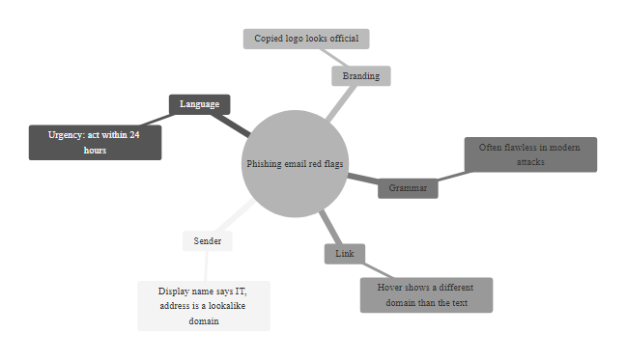
Phishing, Mass-Scale Deception (2/2)
Anatomy of a Phishing Email: every element is engineered to suppress critical evaluation and drive a single click
Notes:
(continued, see part 1)

Slide 22
Spear Phishing vs. Mass Phishing, A Comparison
Mass phishing casts a wide net across thousands of victims using generic lures. Spear phishing is a precision strike, highly personalized using OSINT-gathered details about the specific target. Understanding this distinction helps organizations calibrate their defenses: technical controls catch mass phishing; human awareness is required to catch spear phishing.
Dimension | Mass Phishing | Spear Phishing
Target audience | Thousands to millions of random recipients | One individual or a small defined group
Personalization | Generic, "Dear Customer" | Highly specific, uses real name, role, recent events
OSINT investment | None or minimal | Significant, LinkedIn, social media, corporate site
Success rate | 2–5% click rate | 30–50% click rate on well-crafted campaigns
Attacker effort | Low (automated at scale) | High (manual research per target)
Common lure | Bank security alert, delivery notification | Fake shared document from known colleague, HR request
Primary defense | Email gateway filtering, URL inspection | User awareness + out-of-band verification
ATT&CK technique | T1566 (Phishing) | T1566.001/.002 (Spearphishing Attachment/Link)
Mass Phishing Example "Dear Valued PayPal Customer, your account has been limited. Please verify your information within 48 hours to restore access.", Sent to 2 million email addresses harvested from breach databases.
Spear Phishing Example "Hi Sarah, I'm reviewing the Q3 budget deck you shared last Tuesday before our Microsoft Teams call, can you update the figures and re-share via this link? — James (Finance)", Sent only to Sarah, after studying her LinkedIn and the company's recent earnings press release.
Notes:
The distinction between mass phishing and spear phishing is critical for understanding both attacker economics and defensive prioritization. Mass phishing operates on the logic of statistical volume: even a very low success rate against a very large population yields an absolute number of compromises sufficient to justify the campaign cost (which is near-zero with commodity phishing kits available on dark web markets for under $50). Spear phishing operates on the logic of targeted precision: the attacker invests significant research effort per target because the expected value, access to a specific executive's email, a specific organization's financial system, or a specific government database, justifies the additional cost.
From a defensive investment standpoint, these two threat vectors require different countermeasures. Email gateway controls, domain reputation filtering, sandbox detonation of attachments, and URL rewriting are effective against mass phishing because these attacks are typically identified by known-bad indicators that can be screened technically. Spear phishing largely defeats these technical controls because each campaign is bespoke, the domain may be newly registered (avoiding reputation-based blocking), the attachment may be a legitimate document type with malicious macros or exploits rather than an obviously malicious executable, and the email content passes language-quality checks.
The whaling sub-variant is worth specific attention: these are spear phishing attacks targeting C-level executives, board members, or high-net-worth individuals. Whaling is particularly effective because executives often have authority to approve large transactions, access privileged systems, and bypass normal controls, and they frequently operate under real time pressure that mirrors attacker-induced urgency, making it harder to distinguish manufactured urgency from legitimate business urgency. Additionally, executive assistants who manage email on behalf of executives introduce an additional human in the chain who may not have the same security awareness training.
MITRE ATT&CK Sub-Technique T1566.002 (Spearphishing Link) notes that links in spear phishing emails frequently point to credential harvesting pages that replicate the target organization's single sign-on (SSO) portal. If the organization uses Microsoft 365 or Google Workspace, attackers create pixel-perfect replicas of the Microsoft or Google login page. The harvested credentials are immediately used by the attacker's automated system, often before the victim has even closed the browser tab.
Defensive recommendations specific to spear phishing: FIDO2 hardware security keys (YubiKey, Google Titan Key) provide phishing-resistant MFA that cannot be captured via credential-harvesting pages because the key's cryptographic response is domain-bound, it will not authenticate to a lookalike domain even if credentials are entered. This control, recommended by NIST SP 800-63B (Digital Identity Guidelines), eliminates the credential-theft objective of the large majority of spear phishing campaigns.
Spear phishing usually starts with OSINT. LinkedIn supplies names, job titles, reporting lines and current projects, which an attacker assembles into a message that looks routine to its recipient.

Slide 23
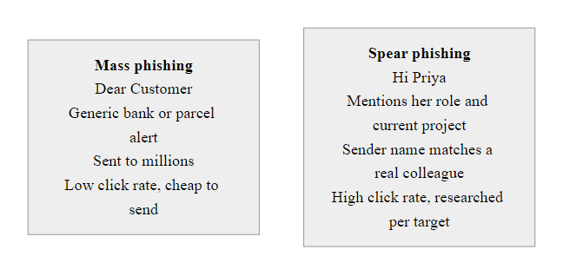
Spear Phishing vs. Mass Phishing, A Comparison (2/2)
Mass Phishing vs. Spear Phishing: the personalization gap is the success rate gap, the more authentic the email appears, the more likely a trained user is to lower their guard
Notes:
(continued, see part 1)

Slide 24
Vishing, Voice Phishing
Vishing (voice phishing) is a social engineering attack conducted over phone calls, using voice communication to create urgency, establish false authority, and manipulate targets into disclosing credentials, account information, or taking actions that compromise security. Voice adds a powerful layer of perceived authenticity that text-based attacks lack.
Why Voice Is Powerful
Real-time interaction makes verification slower and more socially awkward than with emails
Human voice triggers interpersonal trust responses not activated by text
Caller ID spoofing makes the "from" number appear to be a legitimate institution
Social norms make it harder to abruptly end a call than to close an email
Attackers can respond dynamically to objections, building in persuasion on the fly
Pressure is continuous, unlike an email the victim can ignore, a live caller maintains the urgency
Notes:
Vishing is often underestimated as a threat vector because it feels "old-fashioned" compared to sophisticated malware campaigns or zero-day exploitation. This perception is a significant vulnerability in itself, organizations invest in phishing simulations but rarely in vishing simulations, leaving employees unprepared for the very different psychological dynamics of a phone-based social engineering attack.
The key distinction from email phishing is real-time interactivity. An attacker on the phone can probe for information, adjust their pretext based on the target's responses, overcome objections with rehearsed counter-arguments, and maintain continuous pressure that prevents the target from breaking the conversational frame to verify. In an email, the target can pause, consult a colleague, or simply close the message. On a phone call, ending the call feels like an aggressive social act, particularly when the caller has established themselves as a "helpful" authority figure.
The 2020 Twitter breach is the most high-profile recent example of successful vishing at an enterprise level. Attackers (later identified as Graham Ivan Clark, among others) called Twitter employees, spoofing the caller ID of Twitter's internal IT help desk number. The callers convinced employees to enter their credentials on a phishing site, then used those credentials, including VPN access, to reach Twitter's internal administrative tools. This granted them control over high-profile accounts including Barack Obama's, Elon Musk's, and Bill Gates's, which were used to broadcast a cryptocurrency scam. The entire attack chain from initial vishing contact to tweet publication took approximately four hours. No CVEs were exploited. No malware was deployed. The attack was purely social.
Caller ID spoofing is technically trivial using VoIP services that allow arbitrary caller ID configuration, or via commercial "spoofing" applications. The FCC's STIR/SHAKEN framework (Secure Telephone Identity Revisited / Signature-based Handling of Asserted information using toKENs), implemented in the US beginning in 2021, is intended to authenticate caller identity at the carrier level, but adoption is incomplete and international calls frequently bypass the framework entirely.
Defensive countermeasures for vishing: organizations should establish explicit policies that no sensitive information is ever provided to inbound callers regardless of claimed identity. Any caller requesting credentials, OTP codes, remote access installation, or sensitive data should be asked to provide a callback number from the official corporate directory, with the organization calling back at that official number rather than the one the caller provides. NIST SP 800-53 IA-5 (Authenticator Management) and SC-8 (Transmission Confidentiality and Integrity) provide relevant control baselines. Most critically, train employees that the IT helpdesk will never ask for their MFA code or password, these are inviolable rules with no legitimate exceptions.
A vishing call layers several manipulation techniques in real time: pretexting, authority, urgency and rapport-building. Hearing them combined in a live conversation explains why vishing succeeds where a written description seems obvious.

Slide 25
Vishing, Voice Phishing (2/3)
Caller ID spoofed to appear as bank, IRS, Microsoft support, or internal IT helpdesk
Target answers, caller establishes urgency ("fraudulent charge on your account")
Target identity confirmed using publicly available PII (name, partial account number from prior breach)
Target manipulated into providing OTP code, account number, or installing remote access software
Attacker completes unauthorized transaction or credential compromise
Call ends, target may not realize they were attacked for hours or days
Classic Vishing Scenarios - "This is Microsoft Security. We've detected a virus on your computer, please allow us remote access to fix it." - "This is your bank's fraud department. We're reversing an unauthorized transaction, please confirm your PIN." - "This is the IRS. You owe back taxes and will be arrested unless you pay via gift cards today." - "This is IT. We're doing an urgent security upgrade, what's the one-time code that just appeared on your phone?"
Notes:
(continued, see part 1)

Slide 26
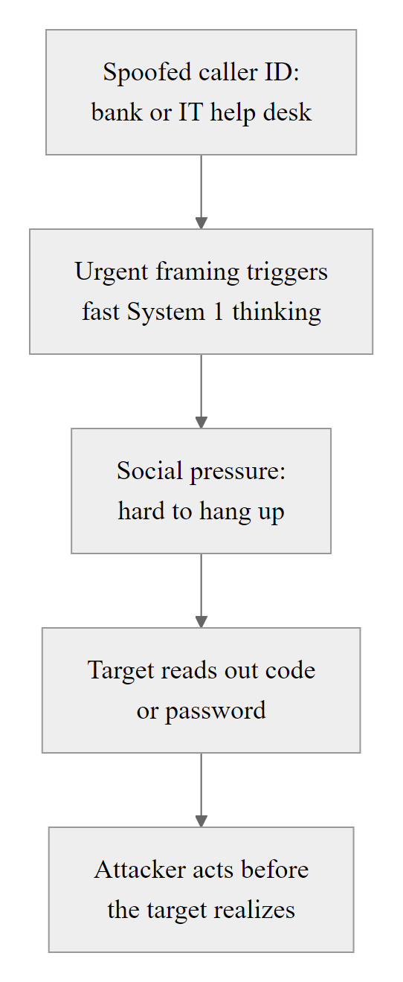
Vishing, Voice Phishing (3/3)
Vishing Attack Flow: the real-time, voice-based nature of the attack compresses the decision window and exploits social norms around polite conversation to prevent the target from pausing to verify
Notes:
(continued, see part 1)

Slide 27
Smishing, SMS-Based Social Engineering
Smishing (SMS phishing) uses text messages to deliver social engineering attacks, exploiting the high open rate of SMS (98% vs. 20% for email), the limited display space that hides indicators of fraud, and the mobile context that encourages rapid, habitual interaction. As enterprise security controls for email have matured, attackers have shifted volume to SMS.
Smishing Type | Common Lure | Target Objective
Delivery scam | "Your USPS package is on hold, verify delivery address" | Credential/credit card harvest
Bank fraud alert | "Unusual activity detected on your account, verify now" | Banking credential theft
Prize notification | "You've been selected for a $500 gift card, claim today" | PII collection
Government impersonation | "IRS: your tax refund is ready, confirm identity" | SSN + financial account harvest
OTP intercept | "Bank security: reply with the code sent to your device" | MFA bypass
Corporate IT | "IT: click to complete mandatory security update" | Corporate credential harvest
Notes:
Smishing has grown dramatically as a social engineering vector since 2019, driven by two converging trends: the maturation of enterprise email security controls (making email phishing harder to deliver successfully), and the proliferation of legitimate business SMS, banks, carriers, retailers, and healthcare providers all now routinely communicate via text message, training users to expect and respond to institutional SMS in ways that benefit attackers.
The 98% open rate of SMS is the single most critical statistic for understanding why smishing has become a preferred attack channel. Compare this to the roughly 20% open rate for commercial email, even among email phishing campaigns that bypass technical controls and reach the inbox, the majority of emails are never opened. Every smishing message is almost certain to be seen by the target. This guarantees a level of exposure that email campaigns cannot match.
Technically, smishing campaigns are delivered via two main infrastructure types: SMS aggregator abuse (using legitimate SMS gateway services with spoofed sender IDs, exploiting the SMS protocol's limited sender authentication) and SIM farm operations (banks of mobile SIM cards used to send high volumes of messages that appear as regular consumer SMS). The GSMA is developing SMS sender authentication standards analogous to DMARC for email, but deployment is years away from being comprehensive.
A critical and rapidly growing smishing threat is OTP (one-time password) interception smishing. These attacks are timed precisely: the attacker first attempts to log into a target account with stolen credentials, which triggers an OTP code to the victim's real phone number. Simultaneously, the attacker sends a smishing message impersonating the bank or service, asking the victim to reply with "the security code we just sent you." The victim, who just received a real OTP code, shares it with the attacker who enters it immediately to complete the fraudulent login. This technique directly compromises SMS-based MFA, a significant finding given that SMS OTP is the most widely deployed second factor.
NIST SP 800-63B explicitly downgraded SMS OTP from a recommended authenticator to a "restricted" authenticator in 2017, citing vulnerability to SIM-swapping attacks and real-time interception. Organizations relying on SMS OTP should be aware that this control, while better than no MFA, is specifically vulnerable to smishing-based interception attacks. Migration to TOTP (time-based OTP) apps or FIDO2 hardware keys eliminates this specific attack vector.
Legitimate bank and carrier text messages often look exactly like smishing: short codes, shortened links and urgent wording. Formatting alone is therefore not a reliable signal, and the safe response is to verify through an independent channel.

Slide 28
Smishing, SMS-Based Social Engineering (2/3)
Why Smishing Works in Mobile Context
SMS open rates (~98%) vastly exceed email (~20%), messages are almost always seen
Mobile screens show truncated URLs, making lookalike domains harder to detect
Mobile browser address bars are smaller, reducing domain visibility
Users are accustomed to following SMS links from banks, carriers, and delivery services
Two-factor authentication workflows normalize "click the link in your text message" behavior
Mobile devices often lack corporate email security tools that filter phishing
Notes:
(continued, see part 1)

Slide 29
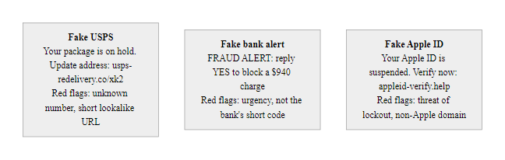
Smishing, SMS-Based Social Engineering (3/3)
Smishing in Practice: the mobile form factor shrinks visible context, hiding the indicators of fraud that would be more visible on a desktop email client
Notes:
(continued, see part 1)

Slide 30
Quid Pro Quo and Tailgating
Quid pro quo attacks offer a service or benefit in exchange for information or access, exploiting reciprocity. Tailgating (also called piggybacking) is a physical intrusion technique where an unauthorized person follows an authorized person through an access-controlled entry point, exploiting social norms around door-holding and not challenging colleagues.
Quid Pro Quo
Attacker calls employees posing as IT support offering to fix a computer problem in exchange for credentials
Fake "free security scan" requiring installation of software that is actually a RAT
Survey scams offering gift cards in exchange for corporate information or login details
Fake vendor promotions requesting system access in exchange for product trials or discounts
Tailgating / Piggybacking
Following an employee through a badge-access door carrying boxes ("hands full" exploit)
Wearing a delivery uniform to trigger door-holding behavior from employees
Posing as a new employee who "forgot" their badge
Requesting "just this once" exceptions to badge-in procedures
Entering during high-traffic periods (lunch, end of day) when doors are frequently propped
Technique | Attack Goal | Key Exploit | Defense
Quid Pro Quo | Credentials, access, remote control | Reciprocity obligation | Never accept unsolicited help; verify via helpdesk ticket
Tailgating | Unauthorized physical access | Social norm of door-holding | Mantrap/airlock, challenge-stranger culture, anti-tailgating policy
Notes:
Quid pro quo and tailgating represent two distinct but philosophically related social engineering techniques, both exploit human prosocial behavior rather than technical flaws, and both operate in the space between security policy and social convention.
Quid pro quo (Latin for "something for something") is psychologically rooted in Cialdini's reciprocity principle. The attacker's strategy is to invert the typical attack dynamic: rather than demanding something, they offer something first. This offering, however unsolicited or minor, creates a sense of obligation in the target that can be leveraged to obtain credentials, access, or information in return. The most common form is fake IT support: an attacker calls employees one by one posing as an IT help desk technician, asking if they have experienced any computer problems. For employees who say yes (a significant proportion, as technology frustrations are universal), the attacker offers to solve the problem if the employee provides their login credentials to let the "support technician" work on the account. The reciprocity pressure, "they're helping me, I should cooperate", drives compliance even from employees who would normally be suspicious of a credential request.
The quid pro quo / fake IT support attack was formally documented in a study by security researcher Sagar Bhure, who found that in simulated attacks, IT support impersonation with a small offered service achieved a higher credential-capture rate than direct phishing emails sent to the same population. This empirical finding underscores that the offer framing substantially lowers the target's defenses.
Tailgating exploits the powerful social norm of door-holding. In most cultures, allowing a door to close in someone's face, especially someone who appears to belong (wearing a uniform, carrying equipment, dressed in business attire), is perceived as rude or hostile. This social discomfort is reliably stronger than the employee's security awareness training in the moment. Physical red team exercises consistently demonstrate that tailgating success rates exceed 70% even in organizations with active access-control policies and security awareness programs.
The technical countermeasure is a mantrap (airlock): a double-door entry system where the first door must close and authenticate before the second door opens, physically preventing tailgating regardless of social dynamics. This control is mandated in high-security facilities under guidelines like NIST SP 800-116 (PIV Card Usage in Physical Access Control) and is increasingly deployed in corporate data centers and server rooms. For environments without mantraps, the policy and cultural countermeasure is critical: all employees must be explicitly empowered, and required, to challenge strangers, regardless of how uncomfortable that feels. This is reinforced in ISO/IEC 27001 Annex A.11 (Physical and Environmental Security).
Tailgating works because refusing to hold a door feels rude, especially for someone carrying an armful of packages. The attack exploits social norms, not a technical gap.

Slide 31

Quid Pro Quo and Tailgating (2/2)
Physical and Reciprocity-Based Attacks: tailgating bypasses physical access controls; quid pro quo bypasses logical access controls, both exploit social norms rather than technical vulnerabilities
Notes:
(continued, see part 1)

Slide 32
OSINT, The Social Engineer's Reconnaissance Tool
Open Source Intelligence (OSINT) is the collection and analysis of information available from public sources, social media, corporate websites, professional networks, press releases, domain registrations, and more. For social engineers, OSINT is the foundational reconnaissance step that transforms generic attacks into precisely calibrated, high-success impersonations and pretexts.
OSINT Sources Used by Social Engineers
LinkedIn: Organizational hierarchy, employee names and roles, technology tools listed in profiles, recent projects, shared connections
Company website / About page: Executive names, board members, office locations, vendor partnerships
Job postings: Reveal technology stack, internal tools, security controls in use (e.g., "experience with CrowdStrike Falcon required")
GitHub / GitLab: Leaked API keys, internal tool names, employee usernames, infrastructure details in commit history
Social media (Twitter/X, Instagram, Facebook): Employee personal details usable for pretexts, vacation timing, family names, interests
Domain WHOIS and certificate transparency logs: Reveal infrastructure, subdomains, historical IP addresses
Breach databases (Have I Been Pwned, dark web): Email formats, prior passwords for credential stuffing
Notes:
Open Source Intelligence (OSINT) is not a hacking technique in the traditional sense, it involves no unauthorized access, no exploitation of technical vulnerabilities, and in most jurisdictions, no illegal activity. Yet it is the foundational reconnaissance activity that transforms a generic social engineering attempt into a precision strike. The paradox of OSINT is that organizations voluntarily publish the information that enables these attacks, as part of normal business operations, hiring, marketing, investor relations, and professional networking all require public disclosure of organizational details that social engineers can weaponize.
LinkedIn is arguably the single most valuable OSINT resource for social engineers targeting enterprises. A typical company's LinkedIn presence reveals: the complete organizational hierarchy (who reports to whom), the names and email patterns of executives, which technology tools employees use (listed in skills and endorsements), which vendors the company works with (revealed in employee job histories and "worked on projects with"), current company initiatives (revealed in employee posts and articles), and the names of new hires who are most likely to be unfamiliar with company procedures and therefore more susceptible to impersonation attacks.
Job postings are a particularly underappreciated OSINT gold mine. A posting reading "Must have experience with Palo Alto Networks firewalls, CrowdStrike Falcon EDR, and Okta identity management" tells an attacker exactly which security products are in place, and therefore which CVEs and evasion techniques are relevant to attacking this organization. A posting for a "Senior Active Directory Administrator" confirms that the organization runs Microsoft AD, relevant to targeting with domain-oriented attacks.
GitHub repository leakage is a documented and pervasive problem. Security researchers routinely discover API keys, database connection strings, internal domain names, and even employee credentials committed to public repositories. The GitGuardian 2023 State of Secrets Sprawl report found over 10 million secrets exposed in public GitHub repositories in 2022 alone. These leaks are often historical, developers who committed secrets years ago have long since forgotten them, while the commits remain permanently visible in repository history.
MITRE ATT&CK formalizes OSINT-based reconnaissance under the Reconnaissance tactic (TA0043), with specific techniques including T1589 (Gather Victim Identity Information), T1590 (Gather Victim Network Information), T1591 (Gather Victim Org Information), and T1592 (Gather Victim Host Information). Each technique has documented sub-techniques corresponding to specific OSINT sources and methods.
From a defensive standpoint, organizations face an inherent tension: the same public presence that enables marketing, recruiting, and investor relations also enables attacker reconnaissance. Defenses include: periodic OSINT audits (assessing what your own organization's public footprint reveals to an attacker), GitHub secret scanning (automated detection of committed credentials), limiting the specificity of technology stack details in job postings, training employees on the information they share in professional profiles, and monitoring breach databases for organizational email address appearances.
A short OSINT search of an organization's website, job postings and staff LinkedIn profiles typically reveals its technologies, internal structure and naming conventions, without any hacking tools.

Slide 33
OSINT, The Social Engineer's Reconnaissance Tool (2/3)
OSINT Category | Tool Examples | Social Engineering Use
People search | LinkedIn, Facebook, Hunter.io | Identify target, gather personal context for pretext
Company intel | Company website, Crunchbase, SEC EDGAR | Org structure, financials, vendor relationships
Technical intel | Shodan, Censys, WHOIS, SSL certs | Infrastructure, technology stack, exposed services
Credential intel | Have I Been Pwned, DeHashed | Prior passwords, email format patterns
Social media | Twitter/X, Instagram, TikTok | Personal context, schedules, relationships
Notes:
(continued, see part 1)

Slide 34
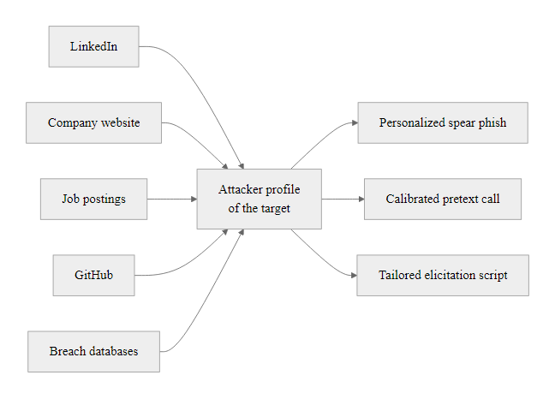
OSINT, The Social Engineer's Reconnaissance Tool (3/3)
OSINT-to-Attack Pipeline: every piece of publicly available information becomes potential ammunition for a social engineering attack, the attacker's job is to synthesize public data into a plausible attack narrative
Notes:
(continued, see part 1)

Slide 35
Case Study, The 2020 Twitter Breach
On July 15, 2020, attackers compromised Twitter's internal administrative tools through pure social engineering, no software vulnerabilities were exploited. They posted fraudulent Bitcoin scam tweets from the accounts of Barack Obama, Elon Musk, Bill Gates, Apple, and 126 other high-profile accounts. The attack generated $120,000 in Bitcoin transactions in four hours and demonstrated the catastrophic potential of human-targeted attacks.
Attackers (primarily Graham Ivan Clark, 17 years old) conducted phone-based social engineering against Twitter employees, posing as internal IT staff
They obtained VPN credentials by convincing employees to visit a phishing site designed to capture credentials
Using those credentials plus access to an internal Slack channel that contained admin tool credentials, they accessed Twitter's internal "God Mode" admin panel
The admin panel allowed them to disable 2FA on any account and change associated email addresses
They then changed recovery emails and 2FA on 130 high-profile accounts, took control, and posted Bitcoin scam messages
Bitcoin wallet received 12.86 BTC (~$120,000) before Twitter manually shut down all verified account tweeting
What Made This Attack Succeed - Twitter employees trusted callers appearing to be internal IT (vishing + social engineering) - Sensitive admin credentials were shared in internal Slack channels (credential hygiene failure) - Admin tools lacked MFA or IP restrictions that would have prevented use from attacker infrastructure - No technical vulnerability was needed, human access to admin tools was sufficient
What This Demonstrates - Social engineering can compromise any organization regardless of technical security investment - Privileged admin tools are high-value targets requiring additional access controls beyond credentials - Slack and collaboration tools can become credential repositories if not governed - The attacker was 17 years old, sophistication of tools is not required when humans are the attack surface
Notes:
The 2020 Twitter breach is one of the most instructive social engineering case studies of the past decade, not because of its technical complexity (there was none), but because of who it happened to, the scale of its impact, and the clarity with which it demonstrates the limits of technical security investments when the human attack surface is undefended.
Twitter, by any measure, is a technology-sophisticated company with significant security resources. Its systems were not compromised through an unpatched CVE, a misconfigured cloud storage bucket, or a SQL injection vulnerability. They were compromised because a teenager with a phone and a convincing script called Twitter employees, impersonated internal IT staff, and obtained VPN credentials. This is the central lesson: technical sophistication of the organization does not protect against social engineering of its people.
The attack chain, as reconstructed from court documents (Graham Ivan Clark was charged in Hillsborough County, Florida, where he was a minor), began in Twitter's internal Slack environment. The attackers, who included not just Clark but also Nima Fazeli (Rolex) and Mason Sheppard (Chaewon), had access to a private Discord community for OGusers (traders in "original" social media usernames). Through this community, they had already developed relationships with individuals who had insider knowledge of how Twitter's internal systems worked.
The specific technique used is documented as vishing combined with targeted phishing: attackers called Twitter employees, identified themselves as members of Twitter's internal IT department, and directed employees to a phishing site mimicking Twitter's internal VPN login page. Employees who entered credentials had those credentials captured in real-time, immediately used by the attackers to authenticate to Twitter's actual VPN before OTP codes expired.
Once inside the VPN, the attackers discovered that an internal Slack channel used by Twitter customer support contained credentials, in plaintext, in messages, for Twitter's internal "admin" tooling (referred to internally as "God Mode"). This credential leak within collaboration tooling is a pervasive enterprise problem; NIST SP 800-53 IA-5 (Authenticator Management) specifically prohibits storing credentials in plaintext, including in messages and documentation, but enforcement in Slack/Teams environments is technically challenging.
The "God Mode" admin panel gave attackers the ability to change the email address and disable two-factor authentication on any Twitter account, effectively transferring ownership of any account. 130 accounts were targeted; 45 had tweets posted from them; 36 had their direct messages accessed; 8 accounts had their complete data downloaded.
The FBI, Secret Service, and IRS Criminal Investigation division jointly investigated. Clark pleaded guilty to 30 felony charges in 2021. The case remains a landmark example of how social engineering attacks can achieve nation-state-level impact with commodity tools and teenage-level resources.
During the 2020 incident Twitter temporarily stopped all verified accounts worldwide from posting, a drastic but effective containment step. Incident response decisions trade security against business continuity.

Slide 36
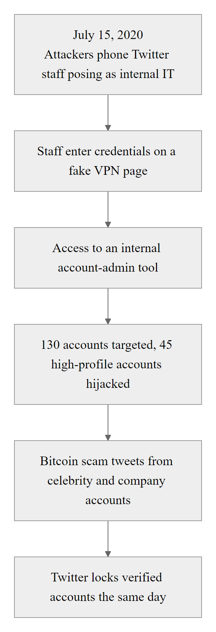
Case Study, The 2020 Twitter Breach (2/2)
2020 Twitter Breach Timeline: from first vishing call to global incident response in under four hours, a demonstration that the human attack surface can be more vulnerable than any technical infrastructure
Notes:
(continued, see part 1)

Slide 37
Case Study, The 2011 RSA SecurID Breach
In March 2011, RSA Security, a company whose core product, SecurID, provided two-factor authentication for millions of users worldwide, was breached through a spear phishing email. The breach compromised the seed values behind SecurID tokens and was subsequently used to attack RSA's customers including defense contractors Lockheed Martin and Northrop Grumman.
Attack Chain
A small group of RSA employees received a spear phishing email titled "2011 Recruitment Plan.xls", plausible given the time of year and role context
The Excel spreadsheet exploited CVE-2011-0609, a zero-day Adobe Flash Player vulnerability embedded in the spreadsheet
The exploit installed Poison Ivy RAT (Remote Access Trojan), giving attackers persistent access to the employee's workstation
Attackers used the initial foothold to perform lateral movement through RSA's network using tools including pass-the-hash attacks
They ultimately exfiltrated data related to the SecurID two-factor authentication product, specifically the seed values used to generate one-time passwords
With seed values, attackers could predict SecurID token codes and use them alongside stolen credentials to authenticate as legitimate users
The seed data was subsequently used to attack Lockheed Martin in May 2011 (detected and disrupted) and other defense contractors
Notes:
The 2011 RSA SecurID breach is a canonical study in how social engineering functions as the initial access vector for technically sophisticated, nation-state-attributed campaigns. The attack was attributed by multiple intelligence analysts and cybersecurity firms (including Mandiant/FireEye) to APT1, a Chinese state-sponsored threat actor, though this has never been officially confirmed by the Chinese government.
The spear phishing email itself is worth detailed examination. The subject line, "2011 Recruitment Plan", was specifically calibrated to be relevant to HR-adjacent RSA employees in early 2011. It arrived as an Excel spreadsheet attachment, a file type that is universally used in corporate environments and would not trigger automatic suspicion. The embedded Adobe Flash exploit (CVE-2011-0609) was a zero-day at the time, meaning there was no available patch when the attack occurred, RSA's systems were fully patched per standard practice, yet the zero-day executed successfully.
This illustrates a critical point often misunderstood by both executives and security professionals: patching is necessary but not sufficient. Zero-day exploits, by definition, exist before patches do. When zero-days are combined with social engineering delivery, even organizations with excellent patch management practices are vulnerable during the window between exploit release and patch availability. The only control that could have broken this attack chain was preventing the email from being delivered or opened, which requires user training to recognize even plausible-seeming attachments as potential threats, not just obviously suspicious ones.
The RSA breach's downstream impact on Lockheed Martin and other defense contractors illustrates the security supply chain concept formalized in NIST SP 800-161 (Cybersecurity Supply Chain Risk Management Practices). When an organization's security depends on a third-party security product, the security of that product, and of the vendor who produces it, becomes part of the organization's own security posture. A breach of the vendor can constitute a breach of every customer simultaneously. This is the same dynamic that appeared in the SolarWinds supply chain attack of 2020, where compromising a single software vendor's build environment enabled access to over 18,000 organizations worldwide.
RSA's public response to the breach, a letter from CEO Art Coviello that explicitly acknowledged the theft of SecurID-related information, was notable for its transparency. The company subsequently offered to replace all 40 million SecurID tokens at its own expense. This response, while costly, aligned with the NIST Cybersecurity Framework's Respond and Recover functions and maintained customer relationships better than concealment would have.
From a current-year (2026) perspective, the RSA breach's lessons have only grown more relevant: spear phishing delivery of sophisticated payloads remains the dominant initial access vector for APT groups, and supply chain attacks have grown significantly as a category. MITRE ATT&CK Initial Access techniques T1195 (Supply Chain Compromise) and T1566 (Phishing) both trace to patterns first widely documented through incidents like RSA 2011.
RSA's 2011 open letter to customers publicly disclosed the SecurID breach. The disclosure and its operational and reputational consequences remain a reference case for the ethics of corporate incident disclosure.

Slide 38
Case Study, The 2011 RSA SecurID Breach (2/3)
Lessons: Social Engineering as Initial Access The technical exploitation (CVE-2011-0609) only became relevant after social engineering delivered the payload. The spear phishing email was the attack's critical success factor, the zero-day exploit was the mechanism, but human psychology was the vector. No technical control blocked the email because the attacker's approach looked plausible to the target.
Cascading Impact The breach of RSA itself was damaging. The downstream use of stolen seed data against defense contractors, companies relying on RSA SecurID for secure remote access, demonstrates the supply chain effect of social engineering: compromising a security vendor can simultaneously compromise all of that vendor's customers.
Notes:
(continued, see part 1)

Slide 39
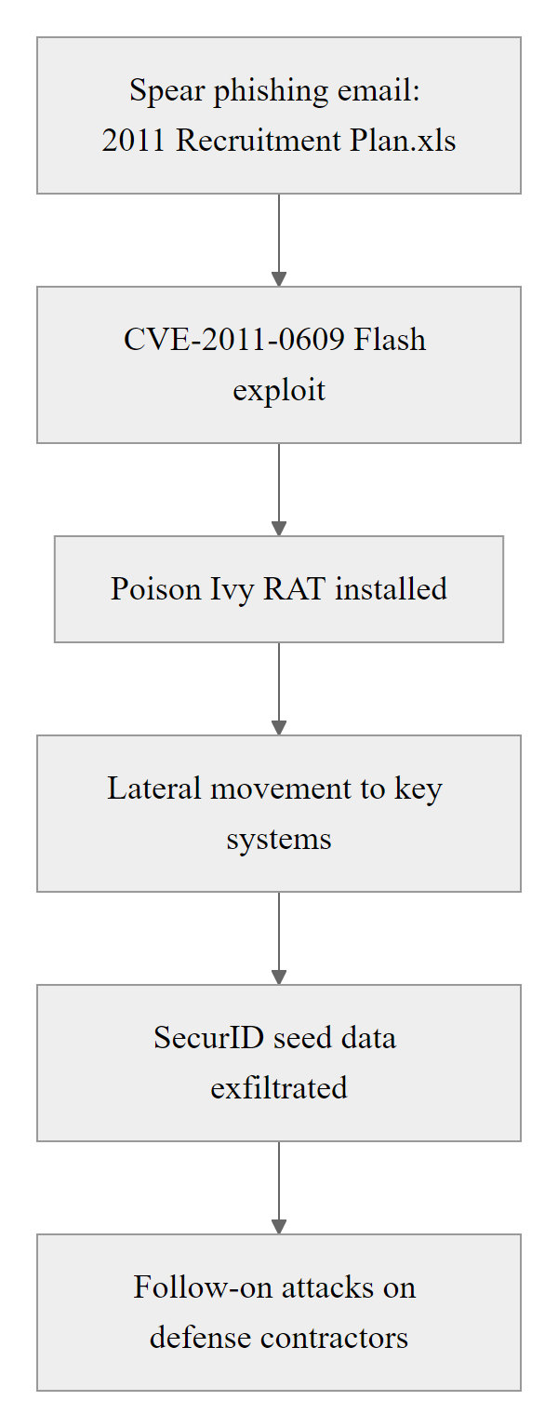
Case Study, The 2011 RSA SecurID Breach (3/3)
RSA SecurID Breach Attack Chain (2011): a single spear phishing email created a cascading compromise affecting the global security supply chain, demonstrating how social engineering can have consequences far beyond the initial target
Notes:
(continued, see part 1)

Slide 40
Business Email Compromise, Deep Dive
Business Email Compromise (BEC) is a sophisticated social engineering fraud targeting businesses conducting wire transfers or financial transactions. An attacker impersonates an executive or trusted party to instruct employees to transfer funds or divert payments to attacker-controlled accounts. The FBI's IC3 reported $2.7 billion in BEC losses in 2022, making it the costliest cybercrime category by financial impact.
BEC Attack Variants
CEO Fraud: Attacker impersonates CEO, urgently requests wire transfer from finance staff
Vendor Invoice Fraud: Attacker intercepts vendor relationship, submits modified invoice with new bank details
Payroll Diversion: Attacker impersonates HR or employee to redirect payroll deposit to new account
Attorney Impersonation: Attacker poses as legal counsel requiring confidential fund transfer for acquisition or legal matter
W-2 / Tax Fraud: Attacker impersonates executive requesting all employee W-2 forms from HR, PII for tax fraud
Attacker reconnaissance
Identify target company, executive names, financial staff, vendor relationships
Spoof or compromise executive email
Craft urgent transfer request
Finance staff authorizes transfer
Funds received in attacker
controlled account
Funds immediately moved abroad
Company discovers fraud (average: 3–5 days later)
Notes:
Business Email Compromise represents the financial fraud apex of social engineering, it is the technique that directly converts social manipulation into monetary theft at scale. The FBI's Internet Crime Complaint Center (IC3) has tracked BEC as the highest-loss cybercrime category for multiple consecutive years. In 2022, BEC accounted for $2.7 billion in reported losses across approximately 21,000 complaints, and IC3 data is understood to significantly undercount actual losses, as many BEC victims do not report due to reputational concerns.
BEC attacks succeed because they exploit the combination of authority (the request comes from an apparent executive or trusted partner), urgency (the request is framed as time-sensitive and highly confidential), and plausibility (wire transfers are a legitimate and common business activity). Unlike many scams that require victims to take unusual actions (install software, buy gift cards), BEC victims are often doing exactly what their job requires, processing payments on behalf of executives, they have simply been deceived about who made the request.
The technical sophistication required for BEC is low. The most successful form involves simply registering a lookalike domain and sending email from it using standard mail infrastructure. "ceo@acmecorp-finance.com" may deceive a finance employee who sees "CEO Acme Corp" in the From display name without examining the actual domain. More sophisticated campaigns compromise the actual executive's email account (through spear phishing or credential stuffing) and conduct BEC from the real account, making technical detection nearly impossible since the email is authentic.
The Microsoft 365 and Google Workspace BEC variant has become particularly prevalent since the pandemic-era shift to cloud email. Attackers compromise legitimate M365 or Workspace accounts through phishing or stolen credentials (increasingly obtained through adversary-in-the-middle proxy phishing, which captures session tokens and bypasses MFA). Once authenticated with the victim's session token, the attacker can read all emails, identify financial workflows, create inbox rules to hide incoming replies, and send emails from the legitimate account.
The FBI's Recovery Asset Team (RAT), established in 2018, has achieved a 73% success rate in recovering BEC funds when victims report within 72 hours of the fraudulent transaction. This underscores the critical importance of rapid reporting, funds can sometimes be recalled before international transfer clears. After 72 hours, recovery becomes dramatically more difficult as funds are typically layered through multiple foreign accounts.
Defensive controls recommended by NIST SP 800-53 and the FBI IC3 include: mandatory voice verification (calling the executive at a known number, not one provided in the email) for all wire transfer requests above a threshold; dual-authorization for wire transfers (requiring two independent approvals); DMARC/DKIM/SPF email authentication to block domain spoofing; and explicit financial policy that the CEO will never instruct wire transfers by email alone without a separate voice confirmation.
FBI IC3 statistics (ic3.gov) show business email compromise falling disproportionately on real estate, healthcare and manufacturing. Real estate routinely moves large legitimate wire transfers, which makes a fraudulent one look normal; healthcare holds abundant personal data and works under regulatory pressure that makes urgency more effective.

Slide 41
Business Email Compromise, Deep Dive (2/3)
BEC Variant | Attacker Impersonates | Financial Target | Average Loss (FBI IC3 2022)
CEO Fraud | C-suite executive | Finance/accounts payable staff | ~$125,000 per incident
Vendor Invoice | Known supplier | Accounts payable | ~$200,000 per incident
Payroll Diversion | Employee or HR | Payroll department | ~$10,000 per incident
Attorney Impersonation | Legal counsel | Executives + finance | ~$150,000 per incident
Notes:
(continued, see part 1)

Slide 42
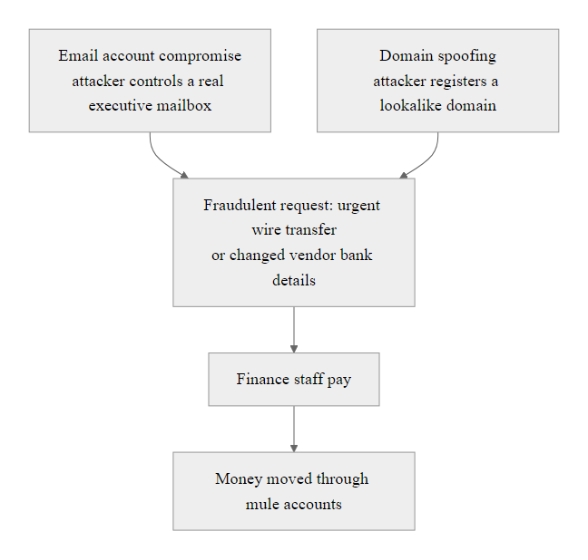
Business Email Compromise, Deep Dive (3/3)
Business Email Compromise Attack Paths: whether the attacker compromises the real account or spoofs it, the result is the same, a convincing request from an apparent trusted authority for financial action
Notes:
(continued, see part 1)

Slide 43
MITRE ATT&CK, Social Engineering Techniques
The MITRE ATT&CK framework is a globally accessible knowledge base of adversary tactics, techniques, and procedures (TTPs) based on real-world observations. Social engineering techniques appear primarily in the Initial Access (TA0001) and Reconnaissance (TA0043) tactics, providing a standardized vocabulary for discussing, detecting, and defending against these attacks.
ATT&CK ID | Technique Name | Social Engineering Vector | Relevant Defense
T1566 | Phishing | Mass phishing email with malicious link/attachment | Email gateway, user awareness
T1566.001 | Spearphishing Attachment | Targeted email with malicious attachment | Sandboxing, awareness training
T1566.002 | Spearphishing Link | Targeted email with credential-harvest link | URL inspection, FIDO2 MFA
T1566.003 | Spearphishing via Service | Phishing via LinkedIn, WhatsApp, Slack | Platform security controls
T1598 | Phishing for Information | Elicitation / reconnaissance phishing | User training
T1591 | Gather Victim Org Information | OSINT: org structure, personnel | OSINT hygiene audit
T1592 | Gather Victim Host Information | OSINT: technology stack, running services | Limit public tech disclosure
T1656 | Impersonation | BEC, vishing, executive impersonation | Out-of-band verification
Notes:
The MITRE ATT&CK framework provides the cybersecurity industry with a shared, structured knowledge base of adversary behavior that moves beyond vendor-specific threat intelligence to create a common language for defenders. For social engineering specifically, ATT&CK is valuable because it documents not just that "phishing happens" but the specific sub-techniques, detection opportunities, and mitigation strategies associated with each social engineering technique, grounded in real-world adversary behavior observed by the ATT&CK community.
The Initial Access tactic (TA0001) is where social engineering techniques most prominently appear. T1566 (Phishing) and its sub-techniques represent the most widely documented initial access technique across ATT&CK's threat group profiles. Examining the ATT&CK Groups page reveals that phishing appears in the documented TTPs of APT28 (Fancy Bear / Russia), APT29 (Cozy Bear / Russia), APT41 (China), Lazarus Group (North Korea), TA505 (financially motivated), and dozens of other groups, across nation-states, ideologies, and target sectors. This universality underscores that phishing is not an unsophisticated attack associated with low-tier criminals; it is the preferred initial access technique of the world's most capable threat actors.
The Reconnaissance tactic (TA0043) codifies the OSINT activities that precede social engineering attacks. T1591.004 (Identify Roles) documents attackers' use of LinkedIn and organizational websites to identify specific employees with privileged access who should be targeted. T1589.002 (Email Addresses) documents the harvesting of email addresses from public sources to build phishing target lists. T1592.004 (Client Configurations) documents OSINT-based discovery of technology stack details that inform which exploits to pair with social engineering delivery.
For blue teams (defenders), ATT&CK's value lies in its detection and mitigation guidance. Each ATT&CK technique page provides: detection opportunities (what log sources and behavioral indicators would reveal the technique in action), mitigations (numbered M-codes cross-referencing specific controls), and procedure examples (specific documented uses of the technique by real threat groups). For T1566 (Phishing), ATT&CK recommends mitigations including M1049 (Antivirus/Antimalware), M1031 (Network Intrusion Prevention), M1054 (Software Configuration, disabling macros), and M1017 (User Training), a defense-in-depth approach that does not rely on any single control.
Purple teaming using ATT&CK is a practice where red teams and blue teams collaborate, with red teams explicitly using documented ATT&CK techniques to test whether the blue team's detection and response capabilities cover those techniques. For social engineering, this means running simulated phishing campaigns (aligned to T1566 sub-techniques), pretexting calls (aligned to T1656), and OSINT reconnaissance (aligned to T1591/T1592), then measuring whether the SOC detected and responded appropriately. This data-driven approach to measuring human and technical security control effectiveness is increasingly standard in mature security organizations.
MITRE ATT&CK documents the social engineering techniques used by specific groups, for example APT28 and Lazarus Group. Linking documented attribution to individual techniques is the basis of professional threat intelligence work.

Slide 44
MITRE ATT&CK, Social Engineering Techniques (2/3)
How ATT&CK Supports Defense
Provides common language for security teams, executives, and tool vendors to discuss threats
Maps attacker behavior to detectable indicators, enabling SIEM rules and detection engineering
Supports purple team exercises, red teams use documented techniques, blue teams measure detection coverage
Enables threat intelligence correlation, attributing attacks to known groups by their TTP signatures
Informs security control prioritization, invest first in controls that mitigate highest-frequency techniques
Notes:
(continued, see part 1)

Slide 45
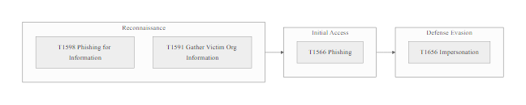
MITRE ATT&CK, Social Engineering Techniques (3/3)
MITRE ATT&CK Social Engineering Heatmap: Reconnaissance and Initial Access tactics contain the highest density of social engineering techniques, and these techniques appear in the majority of APT group profiles
Notes:
(continued, see part 1)

Slide 46
Email Authentication, DMARC, DKIM, and SPF
SPF, DKIM, and DMARC are three complementary email authentication standards that, when deployed together, allow receiving mail servers to verify that an email claiming to come from a domain was actually authorized by that domain's owner. These standards are the primary technical defense against email domain spoofing, the mechanism underlying BEC and many phishing attacks.
Standard | Full Name | What It Does | Limitation
SPF | Sender Policy Framework | Publishes list of servers authorized to send email for the domain | Does not protect the From header visible to users; only checks sending server IP
DKIM | DomainKeys Identified Mail | Adds a cryptographic signature to outgoing emails verifiable by receivers | Signature can be replayed; doesn't prevent display name spoofing
DMARC | Domain-based Message Authentication, Reporting & Conformance | Combines SPF+DKIM results and specifies policy (none/quarantine/reject) for failures; provides reporting | Only effective when set to p=reject; many domains use p=none (monitor only)
Sender sends email
Receiving server checks SPF record (is this IP authorized to send for this domain?)
Receiving server verifies DKIM signature (was this email signed by the domain's private key?)
DMARC policy evaluated (did SPF and/or DKIM pass? What action does the domain owner specify for failures?)
Email delivered, quarantined, or rejected based on policy
Notes:
Email authentication is the technical control layer most directly targeted at the spoofed-sender problem that enables BEC and phishing at scale. Understanding these three standards is not optional for security practitioners, they are foundational to email security posture assessment, incident response, and security awareness program design.
SPF (Sender Policy Framework), defined in RFC 7208 (2014), works by publishing a DNS TXT record that lists which IP addresses or mail servers are authorized to send email on behalf of a domain. When an email arrives claiming to be from "ceo@example.com," the receiving mail server queries DNS for example.com's SPF record and checks whether the sending IP is on the authorized list. If not, the email fails SPF. The critical limitation of SPF alone is that it checks the envelope sender (the technical MAIL FROM field) rather than the From header visible to users, an attacker can pass SPF while still spoofing the displayed From address.
DKIM (DomainKeys Identified Mail), defined in RFC 6376 (2011), addresses this by adding a cryptographic signature to outgoing emails. The sending organization's mail server signs the email headers and body using a private key; the corresponding public key is published in DNS. Receiving servers retrieve the public key and verify the signature, confirming the email was sent (or relayed) by someone with access to the domain's private key and has not been modified in transit. DKIM is more robust than SPF for anti-spoofing but also has limitations, signature verification requires the email to be intact, and display name spoofing (showing "CEO Name" while the actual From address is an unrelated domain) can still occur if DMARC alignment is not enforced.
DMARC (Domain-based Message Authentication, Reporting & Conformance), defined in RFC 7489 (2015), is the orchestrating standard that combines SPF and DKIM results and enforces a domain owner's specified policy. A DMARC record specifies: what to do with emails that fail SPF AND DKIM alignment (none/quarantine/reject), and where to send aggregate and forensic reports of authentication results. DMARC is only protective when configured to p=reject, the default "none" policy merely collects reports without taking action. A 2023 analysis found that approximately 50% of Fortune 500 companies had DMARC records, but only about 30% had progressed to p=reject, meaning roughly 70% of major enterprises were leaving their domains partially open to spoofing.
The Google and Yahoo Mail sender requirements announced in 2023 (effective February 2024) mandate SPF, DKIM, and DMARC p=none at minimum for bulk senders, a significant industry push toward broader authentication adoption. These requirements specifically accelerate deployment for organizations sending marketing email, but do not yet mandate p=reject.
For security practitioners, DMARC reporting is a high-value intelligence source. Aggregate reports (rua=) provide visibility into who is sending email claiming to be from your domain, legitimate mail servers, forwarding services, AND attackers attempting to spoof your domain. Forensic reports (ruf=) provide individual message-level data for failed authentication attempts. These reports, parsed by commercial DMARC reporting tools, give security teams real-time visibility into phishing campaigns targeting their brand.
Public tools such as MXToolbox and dmarcian show a domain's SPF, DKIM and DMARC records. Whether a domain publishes p=reject varies widely between major brands, and that variation is a direct measure of their email authentication posture.

Slide 47
Email Authentication, DMARC, DKIM, and SPF (2/3)
DMARC Policy Levels
p=none: Monitor only, log failures but take no action (useful during initial deployment, not protective)
p=quarantine: Send failing emails to spam/junk folder, reduces visibility but doesn't block
p=reject: Reject failing emails entirely, strongest protection, prevents spoofed emails from reaching recipients
Notes:
(continued, see part 1)

Slide 48
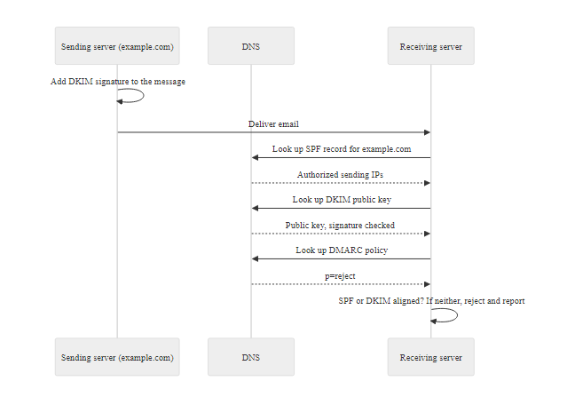
Email Authentication, DMARC, DKIM, and SPF (3/3)
DMARC/DKIM/SPF Authentication Stack: these three standards work together to create a verifiable chain of domain ownership for each email, blocking domain spoofing at the delivery layer before humans ever see the message
Notes:
(continued, see part 1)

Slide 49
Security Awareness Training Programs
Security Awareness Training (SAT) programs are the primary organizational defense against social engineering, building a workforce that can recognize, resist, and report manipulation attempts. Effective programs go beyond annual compliance modules: they use simulated attacks, behavioral reinforcement, and role-appropriate content to create durable behavioral change rather than temporary knowledge acquisition.
Components of an Effective SAT Program
Simulated phishing campaigns: Regular test emails that measure click rates, credential-entry rates, and report rates, providing behavioral metrics rather than just quiz scores
Simulated vishing exercises: Periodic pretexting calls to employees testing credential or information disclosure
Immediate teachable moments: When users click simulated phishing, they receive instant, contextual training, not a delayed generic notification
Role-based training modules: Finance staff receive BEC-specific training; IT staff receive technical social engineering training; executives receive whaling awareness content
Micro-learning content: Short (2–5 minute) modules delivered frequently rather than hour-long annual sessions that users rush through
Metrics and reporting: Track trends over time, click rates, report rates, repeat clickers requiring targeted intervention
Notes:
Security Awareness Training (SAT) is consistently identified in security frameworks as a critical control layer, yet it is also consistently underinvested and poorly implemented in practice. The gap between what SAT programs are designed to do and what they actually achieve is instructive for understanding how to build programs that work rather than programs that merely fulfill compliance requirements.
The foundational problem with traditional SAT is that it is designed to deliver knowledge, "here are facts about phishing", when the behavioral science of security indicates that knowledge alone does not drive behavior change. People can correctly identify phishing characteristics in a quiz immediately after training and still click real phishing emails weeks later, because the in-the-moment cognitive and emotional dynamics of a well-crafted attack override trained declarative knowledge. The research literature on this gap is extensive; a 2020 meta-analysis in the journal Computers & Security found that knowledge-based training reduced click rates significantly in the short term but showed substantial decay over periods of 3–6 months.
What works better, according to the behavioral security research, is experiential learning with immediate feedback. Simulated phishing programs, where realistic but safe phishing emails are periodically sent to employees, and those who click receive immediate contextual training rather than a delayed generic notification, consistently outperform purely didactic training approaches in producing durable behavior change. The key mechanism is conditioning: the click-to-feedback loop is temporally associated with the risky behavior, making the learning experience analogous to how cognitive associations are formed in behavioral conditioning research.
NIST SP 800-50, "Building an Information Technology Security Awareness and Training Program," provides a comprehensive framework for designing organizational SAT programs. It recommends that awareness programs be: continuous (not annual), role-appropriate (finance staff and IT staff face different social engineering threats), measurable (with clear metrics for effectiveness), and integrated into broader security culture rather than siloed as a compliance exercise. NIST SP 800-16, "Information Technology Security Training Requirements," provides a role-based framework for aligning training content to job functions.
ISO/IEC 27001 Annex A.7.2.2 requires that all personnel and where relevant, contractors and third-party users, receive appropriate awareness education and training and regular updates on organizational policies and procedures relevant to their job function. The standard does not prescribe specific training methods, but its audit requirements effectively mandate that organizations demonstrate measurable outcomes, making click-rate metrics from phishing simulations a natural evidence artifact for ISO 27001 certification audits.
The organizational culture aspect of SAT is as important as the content. Psychological safety, an environment where employees feel safe reporting mistakes (including having clicked a real phishing email) without fear of blame, punishment, or ridicule, is essential for incident reporting. Organizations that shame or punish employees for clicking phishing emails create incentives to conceal incidents, dramatically reducing the organization's ability to detect and respond to real attacks. Security leadership should explicitly and repeatedly communicate: "If you clicked something and you're not sure if it was real, tell us immediately. We will not punish you. We need to know." This framing, reinforced consistently from executive leadership, is more effective than any policy document.
Prompt reporting changes outcomes: an employee who reports a phishing click at once allows rapid containment, while a report delayed by embarrassment allows the attacker time to escalate. A reporting culture is itself a control.

Slide 50
Security Awareness Training Programs (2/3)
Training Component | Frequency Recommended | NIST/ISO Reference | Metric
Phishing simulation | Monthly to quarterly | NIST SP 800-50, PR.AT-1 | Click rate, report rate
Security awareness module | Monthly micro-learning | ISO 27001 A.7.2.2 | Completion rate, quiz score
Tabletop exercises | Annual or semi-annual | NIST CSF RS.CO-1 | Response time, escalation accuracy
Vishing simulation | Quarterly | NIST SP 800-50 | Disclosure rate
Executive briefing | Annual or post-incident | ISO 27001 A.5.1 | Engagement, policy adoption
Notes:
(continued, see part 1)

Slide 51
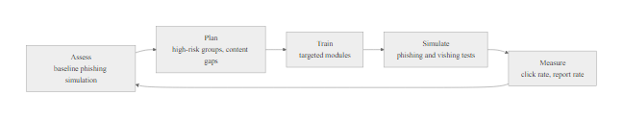
Security Awareness Training Programs (3/3)
Security Awareness Training Program Lifecycle: effective programs are continuous improvement cycles, not one-time events, each assessment informs the next training intervention
Notes:
(continued, see part 1)

Slide 52
Mid-Lecture Checkpoint, Social Engineering Techniques
Let's pause and consolidate. Before continuing to defense frameworks and real-world applications, verify your understanding of the core social engineering techniques covered so far. These questions reflect the level of analysis expected on assessments.
Check Your Understanding
Q1: An attacker calls your company's reception desk, claims to be a new IT vendor, mentions the name of your real IT manager (whom they found on LinkedIn), and asks the receptionist to transfer them to the server room phone "so they can prepare for their appointment." Which social engineering technique is primarily being used, and what OSINT sources likely enabled it?
Q2: You receive an email from your CEO asking you to urgently process a $45,000 wire transfer to a new vendor. The email address shows "CEO@yourcompany-invoices.com" instead of "CEO@yourcompany.com." What type of attack is this, what email authentication controls would detect it, and what procedural control should you apply before taking any action?
Q3: A colleague reports that they found a USB drive in the parking lot labeled "March Salary Adjustments" and plugged it in to see who it belonged to. What attack technique does this describe? What NIST control governs removable media usage? What should your colleague do next?
Q4: Distinguish between pretexting and impersonation. Give an example where the same attack incorporates both techniques.
Q5: What is the deliberate false statement technique in elicitation, and why is it effective? Give an example of how an attacker could use it to determine whether an organization uses multi-factor authentication.
Discussion: Which of these six social engineering vectors do you believe would be most effective against your own organization, and why? What currently prevents that attack, and what gap exists in those defenses?
Notes:
This checkpoint slide is designed to shift students from passive reception of lecture content to active retrieval and application, a cognitive process that significantly strengthens long-term retention compared to re-reading or passive listening. The "testing effect" is well-established in learning science: retrieving information from memory (not just recognizing it on a slide) builds stronger neural associations and more accurate future recall.
Allow 8–10 minutes for students to independently work through the questions before discussing answers. The independent attempt is important, even incorrect attempts produce better learning outcomes than immediately seeing the correct answer, because the struggle to retrieve activates the memory consolidation process.
Answers / Discussion Points:
Q1: This is primarily pretexting (fabricated scenario as an IT vendor with an appointment) combined with OSINT-enabled impersonation (name-dropping the real IT manager). OSINT sources likely used: LinkedIn (to find the IT manager's name and title), the company website (to confirm vendor relationships or find the reception contact), and possibly job postings (to identify the organization's current IT infrastructure projects). The key red flag is the request to be transferred to an unmonitored location, server rooms are physical security targets. The defense is requiring all vendors to be in the calendar system with confirmed appointments verifiable through IT management.
Q2: This is Business Email Compromise (BEC) using a lookalike domain. DMARC with p=reject on "yourcompany.com" would cause the receiving server to reject email from the lookalike domain. SPF would also fail (the lookalike domain's mail servers are not in your domain's SPF record). The procedural control: do not act on wire transfer requests received by email alone, call the CEO at their known number (from the corporate directory, not from the email) to verbally confirm the request before any action.
Q3: This is USB baiting. NIST SP 800-53 MP-7 (Media Use) governs removable media controls. Your colleague should immediately disconnect the USB drive and report it to the security team, do not open any files on it, do not plug it into other devices. The security team should treat it as a potential malware delivery device and conduct endpoint forensic analysis on the workstation where it was plugged in.
Q4: Pretexting is constructing a fabricated scenario (a role or situation that doesn't exist). Impersonation is claiming to be a real specific person who exists. Many attacks combine both: an attacker might fabricate the scenario "I'm auditing your department's compliance controls" (pretexting) while also claiming to be a real named person in the corporate compliance team (impersonation). The fabricated scenario provides the reason for contact; the real identity provides the trust.
Q5: The deliberate false statement technique involves stating something the target knows to be incorrect, triggering their natural desire to correct misinformation. It's effective because the target feels they are helping (correcting an error) rather than disclosing sensitive information. Example: "I understand you use text message codes for your login security", a target who uses an authenticator app will typically correct this: "No, we actually use Duo Security with a TOTP app on our phones." The attacker has just confirmed the MFA product in use through what felt like a correction conversation, not a disclosure.
The most effective social engineering technique depends on the environment: a home, a university and a workplace each have different routines, authority structures and trust relationships, and an attacker chooses accordingly.

Slide 53
Common Misconceptions About Social Engineering
Security professionals and end users alike hold misconceptions about social engineering that reduce defensive effectiveness. Addressing these directly, especially in security awareness training, builds more accurate threat models and more resilient behavior under actual attack conditions.
Misconception | Why It's Wrong | Correct Mental Model
"I'm too careful to fall for phishing" | Studies show security professionals click phishing at nearly the same rate as non-professionals under time pressure | Anyone can be socially engineered given sufficient attacker effort and the right timing; the goal is process, not personality
"Social engineering attacks are obviously fake" | Modern AI-assisted attacks are grammatically perfect, contextually accurate, and reference real details about your life | Remove linguistic quality as a primary detection signal; focus on process (did I initiate this contact? is this the right channel?)
"We have technical controls that stop this" | Social engineering specifically routes around technical controls by obtaining voluntary human cooperation | Technical controls are necessary but insufficient; human awareness is a required complementary layer
"Our security awareness training covers this" | Annual checkbox training produces knowledge decay within months and does not produce durable behavior change | Effective training is continuous, simulated, and experiential, not an annual module
"Only non-technical employees fall for this" | Highly technical employees are often more susceptible to technical pretexts ("I'm auditing your API configuration") | All roles are vulnerable to social engineering calibrated to their specific context and expertise
"Social engineering requires the attacker to be charming" | Effective social engineering exploits process, not personality, a tersely worded email from an apparent executive works as well as rapport-building | Social engineering exploits systems and processes, not just individual relationships
Notes:
Misconception correction is one of the highest-value activities in security awareness training because incorrect mental models are actively harmful, they cause people to apply inappropriate detection heuristics and feel confident in situations where caution is warranted. The misconceptions on this slide are not strawmen; they are documented beliefs held by significant portions of employee populations in security awareness research.
Misconception 1: "I'm too careful to fall for phishing." This belief is particularly prevalent among security-conscious employees who have received training and "know what phishing looks like." Multiple studies have found that this overconfidence is itself a vulnerability, people who believe they are immune to social engineering are less likely to pause and verify when they encounter an attack, because their confidence suppresses the threat recognition response. The correct mental model is: anyone can be socially engineered under the right conditions, and the defense is process (verify before acting) rather than personality (I'm too smart to be fooled).
Misconception 2: "Social engineering attacks are obviously fake." This was approximately true in the early 2000s, when phishing emails were frequently riddled with spelling errors, awkward phrasing, and clearly incorrect information. It is emphatically not true now. AI-assisted content generation has eliminated linguistic quality as a reliable detection signal. The 2023 IBM X-Force Threat Intelligence Index found that AI-generated phishing emails were achieving click rates comparable to professionally human-crafted spear phishing. The detection heuristics being taught in security awareness programs that rely on "check for spelling errors" are increasingly obsolete and should be supplemented with process-based checks: "Did I initiate this contact? Is this an appropriate channel for this request? Can I verify this through an independent channel?"
Misconception 3: "We have technical controls that stop this." This misconception is held not just by employees but by some executives who view security spending on firewalls and endpoint protection as a complete defense. The key insight is that social engineering specifically defeats technical controls by design, the attack succeeds when the human cooperates voluntarily, bypassing all technical gatekeeping. A technically perfect security architecture with email authentication, endpoint detection, network segmentation, and zero-trust access controls is still vulnerable to a user who calls IT and asks them to add a new device, convinced by an attacker that it's necessary.
Misconception 5: "Only non-technical employees fall for this." This is perhaps the most counterproductive misconception from an organizational defense standpoint, because it leads to the belief that technical security staff are exempt from social engineering risk, when the opposite is sometimes true. Technical employees are vulnerable to technical pretexts, where attackers use accurate technical terminology and plausible scenarios ("I'm a penetration tester contracted by your CISO, I need access to your API gateway configuration") that non-technical employees would not find credible. The heightened apparent credibility of a technically accurate pretext can lower the guard of exactly those employees who should know better.
From an instructional standpoint, presenting misconceptions explicitly and debunking them is more effective than simply presenting correct information, because it activates and updates existing incorrect mental models rather than adding new information alongside unchallenged misconceptions. This "conceptual change" approach to instruction is well-supported in educational psychology research and particularly valuable in security awareness training where incorrect prior beliefs are the norm rather than the exception.

Slide 54
AI-Assisted Social Engineering, The Emerging Threat
Artificial intelligence tools, particularly large language models and voice synthesis systems, are fundamentally changing the economics and effectiveness of social engineering. Capabilities that previously required skilled human operators (flawless writing, convincing voice impersonation, personalized content at scale) are now available to low-skill attackers through commercial and criminal-market AI tools.
How AI Amplifies Social Engineering
AI-generated phishing content: LLMs can generate grammatically flawless, culturally appropriate phishing emails in any language, at any volume, without the quality-degradation that indicated mass phishing campaigns
Spear phishing at scale: AI can process OSINT data (LinkedIn profiles, social media posts) and automatically generate personalized spear phishing emails for thousands of targets simultaneously, eliminating the scalability bottleneck that previously limited spear phishing to high-value targets
Deepfake voice: Real-time voice cloning of executives enables vishing calls where the "CEO's voice" is generated from 30 seconds of training audio publicly available on YouTube or conference recordings
Deepfake video: Video conferencing deepfakes have been used in verified incidents, a finance employee at a Hong Kong firm transferred $25 million in 2024 after a video call with "the CFO" who was entirely AI-generated
AI-assisted pretext research: AI tools can synthesize publicly available information about a target into a comprehensive dossier, dramatically reducing attacker OSINT investment time
Notes:
The integration of artificial intelligence tools into social engineering represents the most significant evolution of the threat landscape since the professionalization of cybercrime in the mid-2000s. Understanding this evolution is essential for security practitioners who need to adapt defensive postures, awareness training content, and detection strategies to a threat environment that is changing rapidly.
The fundamental economic change AI introduces to social engineering is the elimination of the quality-scale tradeoff. Traditional mass phishing had to sacrifice quality for scale, campaigns reaching millions of targets inevitably looked generic, grammatically imperfect, and culturally misaligned. This quality deficit was a reliable detection signal. Spear phishing delivered high quality but was limited in scale by the human effort required per target. AI eliminates this tradeoff: with LLMs processing OSINT data and generating personalized content, an attacker can now produce high-quality, personalized spear phishing at mass-phishing scale. The entire detection heuristic based on "personalization signals trustworthiness" collapses when personalization becomes cheap.
The $25 million deepfake video call incident (2024) is the first widely documented case of multi-person, real-time deepfake video being used successfully in a social engineering attack. The finance employee in Hong Kong later reported that the "CFO" on the video call looked, sounded, and behaved exactly as expected, nothing seemed wrong during the call. This attack exploited the highest-trust channel available in remote work environments (live video call with familiar colleagues) and demonstrates that even the most sophisticated verification heuristics ("I can see them on video, so they're real") are now attackable.
Voice cloning technology has reached a state of maturity where meaningful impersonation is possible from 3–5 seconds of training audio (some commercial tools advertise this) or 30 seconds of higher-quality audio. A CEO's voice is trivially obtainable from earnings calls, conference keynotes, podcast appearances, or LinkedIn video posts. In 2019, the first documented CEO voice-cloning vishing attack was reported: a German energy firm's UK subsidiary CEO was called by someone whose voice was an AI-generated clone of the parent company's German CEO. The UK CEO transferred €220,000 believing he was following instructions from his superior.
From a defensive standpoint, the AI threat to social engineering requires updating both technical and procedural controls. Pre-shared code words, secret phrases known only to specific executive-assistant pairs that must be included in any unusual request, provide a verification mechanism that cannot be easily replicated by an AI system without access to the private agreement. Out-of-band callback verification remains effective against deepfakes because it interrupts the attacker-controlled channel and forces contact via the real person's known number. Policy-based verification requirements that treat all requests for significant financial or access actions as requiring secondary verification regardless of how trustworthy the requester appears, even in video calls, remove the burden from individual judgment in high-pressure situations.
NIST has not yet published specific guidance on AI-assisted social engineering defenses, though the NIST AI Risk Management Framework (AI RMF, 2023) addresses AI misuse risk broadly. ISO/IEC 42001 (AI Management Systems) provides governance frameworks applicable to organizations deploying AI tools internally who need to consider misuse risk. The gap between the speed of AI capability development and the pace of standards-body guidance means that practitioners must draw on threat intelligence and community research (published by organizations like the Anti-Phishing Working Group, SANS Internet Storm Center, and vendor threat intelligence teams) to stay current.
Deepfake video is now convincing enough to defeat casual visual inspection. Verification must rest on procedure, such as call-backs to known numbers and pre-agreed codes, rather than on recognizing a face or voice.

Slide 55
AI-Assisted Social Engineering, The Emerging Threat (2/3)
Real Incident (2024) A finance employee at a multinational firm in Hong Kong was invited to a video conference call with "the CFO" and other "colleagues", all of whom were AI-generated deepfakes using publicly available footage. The employee, seeing familiar faces, transferred HK$200 million (~$25.6M USD). The entire interaction was synthetic.
Emerging Defenses - Code words: pre-shared verification phrases between executives and assistants for unusual requests - Out-of-band callback verification remains effective even against deepfakes, calling the real person's known number interrupts the synthetic interaction - AI detection tools (still maturing, detection accuracy is inconsistent) - Policy: treat any "executive" requesting unusual action via video call as requiring secondary verification regardless of recognition
Notes:
(continued, see part 1)

Slide 56
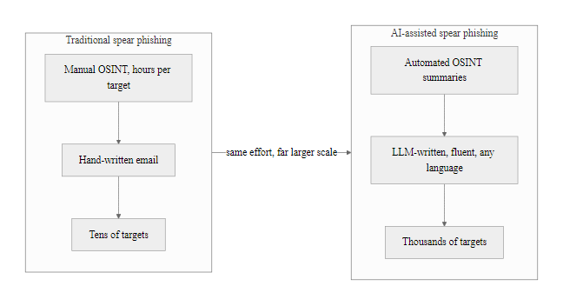
AI-Assisted Social Engineering, The Emerging Threat (3/3)
AI Transforms the Social Engineering Economics: what previously required skilled human effort per target can now be automated at scale, the attacker's cost-per-victim drops dramatically while attack quality increases
Notes:
(continued, see part 1)

Slide 57
The Social Engineering Kill Chain
Adapting the Lockheed Martin Cyber Kill Chain model to social engineering reveals that SE attacks, like technical attacks, follow a predictable sequence of phases. Defenders can interrupt the attack at any phase, understanding where interruption is most practical and reliable is essential for resource-efficient security investment.
OSINT Reconnaissance
Target Selection
Pretext/Lure Construction
Initial Contact
Trust Building
Exploitation (credential/access/transfer)
Objective Achievement
Cover Tracks / Exit
Kill Chain Phase | Attacker Activity | Defensive Interruption Opportunity
OSINT Reconnaissance | LinkedIn scraping, WHOIS lookup, breach DB search | Limit public info (OSINT hygiene), domain monitoring, breach alerts
Target Selection | Identify role with access to desired resource | Least-privilege access limits value of targets
Pretext Construction | Fabricate scenario, create assets (domain, email) | DMARC/SPF/DKIM blocks spoofed domains; brand monitoring
Initial Contact | Send phishing email, make call, approach in person | Email gateway, call screening, physical access control
Trust Building | Rapport, small requests, callback verification blocking | User awareness: recognize reciprocity setup
Exploitation | Request credentials, transfer, access | MFA, dual-authorization, out-of-band verify
Objective Achievement | Exfiltrate data, complete transfer, install RAT | DLP, SIEM alerting, endpoint detection
Cover Tracks | Delete emails, undo changes, exit pretext | Audit logging, immutable logs (NIST SP 800-92)
Notes:
The Cyber Kill Chain model, introduced by Lockheed Martin in 2011 (and documented in their white paper "Intelligence-Driven Computer Network Defense Informed by Analysis of Adversary Campaigns and Intrusion Kill Chains"), has become a foundational framework for understanding how technical cyber attacks unfold sequentially and how defenders can interrupt them at any phase. The same sequential logic applies to social engineering attacks, and mapping SE attacks to a kill chain model is a powerful tool for identifying where defensive investments will have the highest impact.
The value of the kill chain model is precisely its emphasis on defense-in-depth: attackers must complete every phase of the chain to achieve their objective. If defenders can interrupt any single phase, the attack fails, even if all other phases would have succeeded. This means that even a single effective control (such as DMARC blocking the spoofed email domain, preventing initial contact) can defeat an attack that would otherwise have been very convincing.
Phase 1, OSINT Reconnaissance: This is the phase most difficult to defend against, as it involves no interaction with the target organization, the attacker is gathering publicly available information. Defensive activities at this phase are proactive: OSINT audits (periodically assessing what your own organization's public footprint reveals), domain monitoring (services like DomainTools or MarkMonitor alert when lookalike domains are registered, often days or weeks before an attack campaign begins), and breach database monitoring (Have I Been Pwned Enterprise, SpyCloud) to identify when employee credentials appear in breach databases.
Phase 3, Pretext/Lure Construction: When the attacker registers a lookalike domain or creates spoofed email infrastructure, there is a window for detection. Certificate transparency logs (crt.sh) show all TLS certificates issued, including for newly registered lookalike domains. Commercial brand protection services monitor for newly registered domains that match common patterns for brand impersonation. Email authentication (DMARC p=reject) directly defeats domain-spoofed email at the delivery layer.
Phase 5, Trust Building: This is the phase where human awareness is the most critical and often only available defense. Trust building through reciprocity, flattery, and small requests is contextually indistinguishable from legitimate helpful interaction by technical controls. A trained employee who recognizes the pattern ("someone I don't know is being unusually helpful before asking me for something") and applies appropriate skepticism is the only control positioned to interrupt the attack at this phase.
Phase 6, Exploitation: MFA and dual-authorization controls are positioned here. Even if an attacker has successfully completed reconnaissance, construction, initial contact, and trust-building, MFA prevents credential-capture from being immediately useful. Dual-authorization for financial transactions requires a second approver who may not be under the same social influence, providing an independent check. Out-of-band verification (calling the apparent requester at a known number) is a procedure-level control that can interrupt exploitation even when all prior phases succeeded.
The NIST Cybersecurity Framework 2.0's Identify function (ID.RA, Risk Assessment) explicitly requires organizations to understand their attack surface including human-layer vulnerabilities. Mapping social engineering attacks to the kill chain model supports this risk assessment by identifying which phases have effective controls deployed and which represent gaps. This gap analysis directly informs security investment prioritization.
Mapped onto the kill chain, the 2020 Twitter breach shows where defenders could have interrupted it: at reconnaissance (exposed staff information), at delivery (the phone-based pretext) and at actions on objectives (access to internal admin tools). Thinking in attack sequences rather than isolated events reveals these interruption points.

Slide 58
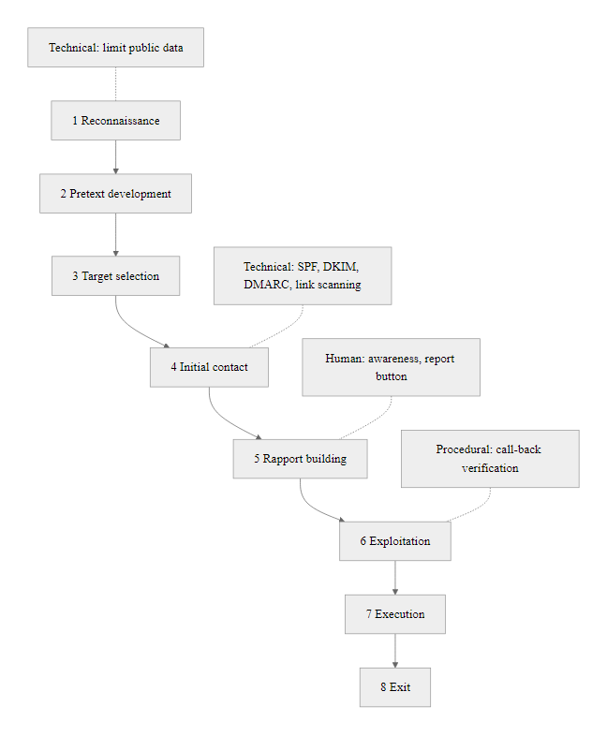
The Social Engineering Kill Chain (2/2)
Social Engineering Kill Chain with Defensive Interventions: like the Cyber Kill Chain, breaking any link defeats the attack, the goal is defense-in-depth across multiple phases rather than relying on a single control
Notes:
(continued, see part 1)

Slide 59
Technical vs. Human Defenses, Comparison
An effective social engineering defense strategy combines technical controls (which catch known attack patterns at scale automatically) with human controls (which provide judgment-based defenses that adapt to novel attacks). Neither layer alone is sufficient, the combination creates the defense-in-depth that social engineering's adaptability requires.
Dimension | Technical Controls | Human Controls
Scale | Millions of events per second automatically | Limited to events humans individually observe
Consistency | 100% consistent if correctly configured | Variable, depends on training, stress, context
Adaptability | Requires updates for novel techniques | Can generalize to previously unseen attacks
Cost per event | Near-zero once deployed | High, requires ongoing training investment
Failure mode | False negative: miss novel attacks; false positive: block legitimate traffic | Errors under pressure, social pressure compliance
Social engineering coverage | High for known patterns; low for novel, bespoke attacks | High if training is current and culture is strong
Time to detection | Near real-time | Hours to days (self-reporting after the fact)
Regulatory requirement | NIST SP 800-53 technical controls | NIST SP 800-50, ISO 27001 A.7.2.2
Notes:
The relationship between technical and human security controls for social engineering defense is best understood as complementary rather than substitutable. A common organizational error is to view investment in one layer as reducing the need for investment in the other. In practice, the two layers have fundamentally different coverage profiles that make them genuinely complementary: technical controls excel at catching known attack patterns at scale with no human effort per event; human controls provide adaptable, context-sensitive judgment that can recognize and resist novel attacks that technical controls have no signature for.
The clearest illustration of this complementarity is the contrast between mass phishing and spear phishing defense. Mass phishing campaigns, which use shared infrastructure and common lure templates, are effectively defended by technical controls: email gateway filtering based on sender reputation, URL reputation, and attachment sandbox analysis catches the majority of mass phishing before it reaches user inboxes. However, spear phishing campaigns, particularly those using freshly registered domains, clean sending infrastructure, and bespoke content tailored to the specific target, frequently evade these same technical controls because they have no prior reputation, no shared indicators with known-bad campaigns, and content that is contextually appropriate and non-suspicious. At this point, the human layer is the only available defense.
Conversely, the human layer has documented failure modes that technical controls address. Human detection is inconsistent, the same employee who correctly identifies a phishing email when calm and focused may click it when rushed, fatigued, or emotionally activated. Technical controls don't have these contextual failure modes; an email authentication reject is a reject regardless of what time it is or how stressed the mail server administrator is. This reliability-at-scale is the irreplaceable value of technical controls.
The NIST Cybersecurity Framework 2.0 Protect (PR) function addresses both layers: PR.AT (Awareness and Training) covers the human layer, while PR.PS (Platform Security) and PR.DS (Data Security) cover technical controls. The framework explicitly presents these as parallel, required components of the Protect function, not alternatives. Similarly, ISO/IEC 27001 addresses technical controls in Annex A.12 (Operations Security) and A.13 (Communications Security) while addressing human controls in Annex A.7 (Human Resource Security) and A.7.2.2 (Awareness, Education, and Training), the standard considers both necessary.
From a security investment standpoint, the complementary nature of these layers means that the marginal return on investment (ROI) depends on the current state of each layer. An organization with no email authentication (no DMARC/DKIM/SPF) will get far more value from deploying those controls than from adding more security awareness training. An organization with DMARC at p=reject and sophisticated email sandboxing but no security awareness program will get more value from building the human layer. Effective security governance requires assessing both layers and prioritizing the layer with the larger coverage gap.
Technical and human controls are complementary. An organization with strong technical controls and a weak security culture falls to social engineering that bypasses the technology; one with a strong culture and weak technical controls falls to automated attacks that no person sees. Neither half substitutes for the other.

Slide 60
Technical vs. Human Defenses, Comparison (2/3)
Technical Controls
DMARC / DKIM / SPF email authentication
Email gateway sandboxing and URL inspection
Endpoint detection and response (EDR)
FIDO2 / phishing-resistant MFA
Removable media access controls (Group Policy)
Data Loss Prevention (DLP) for outbound data
SIEM alerting on anomalous behavior patterns
Human Controls
Simulated phishing and vishing programs
Role-based security awareness training
Verification protocols for financial transactions
Out-of-band callback procedures
Physical security challenge culture
Incident reporting culture (psychological safety)
Social engineering red team exercises
Notes:
(continued, see part 1)

Slide 61
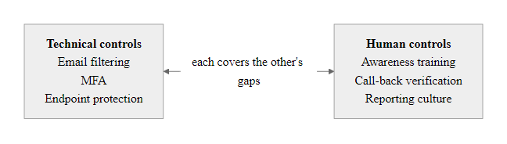
Technical vs. Human Defenses, Comparison (3/3)
Defense-in-Depth: Technical and Human Controls as Complementary Layers, each layer catches attacks that evade the other, creating overlapping coverage that no single control type can achieve alone
Notes:
(continued, see part 1)

Slide 62
NIST and ISO Controls for Social Engineering Defense
Two globally recognized frameworks, NIST SP 800-53 (Security and Privacy Controls for Information Systems) and ISO/IEC 27001 (Information Security Management Systems), provide structured control catalogs that directly address social engineering threats. Understanding where these standards mandate human-layer security controls is essential for compliance professionals and security practitioners.
Framework | Control Reference | Control Name / Description | Social Engineering Relevance
NIST SP 800-53 Rev 5 | AT-1 | Policy and Procedures | Mandates security awareness policy
NIST SP 800-53 Rev 5 | AT-2 | Literacy Training and Awareness | Frequency and content requirements for awareness programs
NIST SP 800-53 Rev 5 | AT-3 | Role-Based Training | Specialized training based on role-specific SE risks
NIST SP 800-53 Rev 5 | AC-5 | Separation of Duties | Prevents single person from authorizing BEC wire transfers
NIST SP 800-53 Rev 5 | IA-5 | Authenticator Management | Password and credential policies that reduce SE impact
NIST SP 800-53 Rev 5 | MP-7 | Media Use | Removable media controls against USB baiting
ISO/IEC 27001:2022 | A.6.3 | Information security awareness, education and training | All personnel must receive appropriate awareness training
ISO/IEC 27001:2022 | A.8.1 | User endpoint devices | Controls that limit baiting impact
ISO/IEC 27001:2022 | A.5.17 | Authentication information | Credential policies reducing SE-captured credential utility
ISO/IEC 27001:2022 | A.7.4 | Physical security monitoring | Controls against tailgating and physical impersonation
Notes:
Understanding how major security frameworks address social engineering is essential both for compliance professionals who must demonstrate control implementation and for security practitioners who use these frameworks to prioritize defensive investments. Both NIST and ISO treat social engineering defense, specifically the human awareness and training component, as a required element of a complete security posture, not an optional enhancement.
NIST SP 800-53 Rev 5 (published September 2020) is the most comprehensive control catalog for US federal agencies and is widely adopted in the private sector. The Awareness and Training (AT) control family directly addresses social engineering defense. AT-2 (Literacy Training and Awareness) requires that organizations "provide security and privacy literacy training to system users" and "update literacy training and awareness content at least annually", with specific mention of recognizing and reporting potential threats including social engineering attacks. AT-3 (Role-Based Training) requires specialized training calibrated to each user's role-specific security responsibilities, directly addressing the finding that different roles face different social engineering threats (finance staff face BEC risk, IT staff face technical pretexting risk, executives face whaling risk).
NIST SP 800-50 ("Building an Information Technology Security Awareness and Training Program") provides the implementation guidance for the AT control family. It defines four levels of security awareness/training content: awareness (broad organizational population), training (role-specific), education (security professionals), and certification (validated competency). The document specifically addresses social engineering scenarios as required content for awareness programs and recommends simulated exercises as the most effective training modality.
ISO/IEC 27001:2022 (the revised edition released in October 2022) updated its control structure from the prior version's 114 controls to 93 controls organized into four themes: Organizational (37 controls), People (8 controls), Physical (14 controls), and Technological (34 controls). The People theme (A.6) contains the most directly relevant controls: A.6.3 (Information security awareness, education and training) requires organizations to ensure all personnel and relevant external parties receive appropriate security awareness education and regular updates. A.6.1 (Screening) and A.6.2 (Terms and conditions of employment) address pre-employment and contractual controls that reduce insider threat risk, relevant to social engineering that targets insiders.
The 2022 update to ISO 27001 added several new controls with specific relevance to modern social engineering threats: A.5.7 (Threat intelligence) requires organizations to collect and analyze information about social engineering threats (not just technical threats); A.5.30 (ICT readiness for business continuity) ensures social engineering incidents are addressed in business continuity planning; and A.8.7 (Protection against malware) explicitly includes social engineering delivery of malware in its scope.
From a compliance audit perspective, both frameworks require organizations to demonstrate not just that training programs exist but that they are effective. NIST SP 800-53 AT-2 includes assessment procedures for evaluating whether training has produced measurable behavior changes. ISO 27001 Clause 9.1 (Monitoring, measurement, analysis and evaluation) requires that awareness program effectiveness be measured, making click-rate reduction from phishing simulations a natural audit evidence artifact. Organizations that can demonstrate trending reductions in simulated phishing click rates, increases in incident reporting rates, and regular simulated attack exercise completion have strong evidence of effective implementation of these controls.
NIST SP 800-53's Awareness and Training (AT) family and the People controls of ISO/IEC 27001:2022 map directly onto the Twitter and RSA cases: role-based training, phishing awareness and insider-threat awareness each address a specific step in those attacks.

Slide 63
NIST and ISO Controls for Social Engineering Defense (2/3)
NIST CSF 2.0 Functions Addressing Social Engineering
Govern (GV): GV.OC-1 (organizational context includes human threat), GV.RM-1 (risk strategy includes social engineering risk)
Identify (ID): ID.RA-1 (identify vulnerabilities including human), ID.RA-2 (threat intelligence includes social engineering TTPs)
Protect (PR): PR.AT-1 (awareness and training for all users), PR.AT-2 (privileged user training), PR.AC-1 (identity management reduces SE impact)
Detect (DE): DE.AE-1 (establish baseline of normal behavior to detect SE-induced anomalies), DE.CM-3 (monitor personnel activity)
Respond (RS): RS.CO-2 (reporting of social engineering incidents), RS.AN-1 (investigation includes SE indicators)
Notes:
(continued, see part 1)

Slide 64
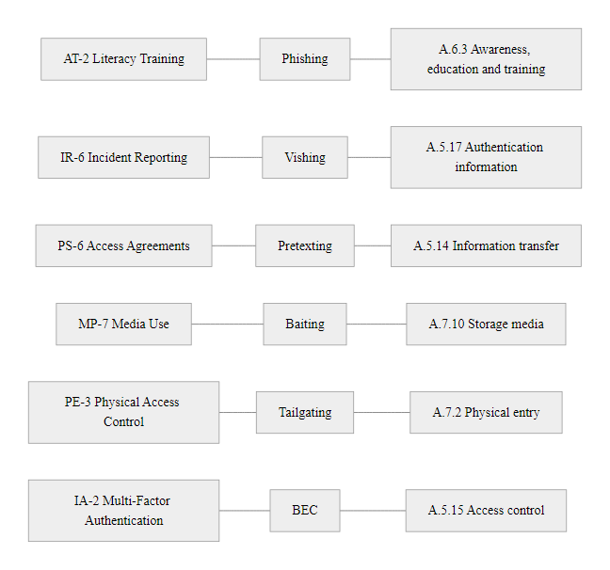
NIST and ISO Controls for Social Engineering Defense (3/3)
NIST and ISO Control Mapping to Social Engineering Threats: these frameworks do not address social engineering as an afterthought, human security controls are embedded throughout both standards as required components of a comprehensive security posture
Notes:
(continued, see part 1)

Slide 65
Insider Threat as a Social Engineering Target
Social engineering does not always aim to compromise an outsider into behaving like an insider. Sometimes, it targets actual insiders, employees with legitimate access, and manipulates them into abusing that access. The insider threat dimension of social engineering encompasses recruited insiders, coerced insiders, and insiders deceived into malicious action without awareness of their role in the attack.
How Social Engineering Creates Insider Threats
Recruitment: Nation-state or criminal actors approach employees (via LinkedIn, personal contact) offering financial incentives in exchange for data theft or access provisioning
Coercion: Employees with compromising personal information (financial debt, personal secrets, immigration status) are blackmailed into providing access or data
Unwitting insiders: Employees deceived by external social engineering who unknowingly facilitate an attack (e.g., following BEC instructions without knowing they are fraudulent)
Disgruntled employee exploitation: Attackers identify and cultivate relationships with dissatisfied employees who may be willing to share access or data in retaliation
Vendor/contractor insiders: Third parties with legitimate access are targeted, they often have fewer security controls applied to their activities than direct employees
Insider Type | Motivation | Attack Example | Detection Signal
Malicious insider | Financial, ideological | Exfiltrating IP for competitor; selling credentials | Unusual data access patterns, large downloads
Coerced insider | Fear of exposure | Providing VPN credentials under blackmail | Behavioral change, off-hours access
Unwitting insider | Deception (no intent) | Following BEC instructions unknowingly | Transaction anomaly, post-incident discovery
Recruited insider | Money, ideology | Selling access or data to threat actor | Unexplained income, contact with known threat actor
Notes:
The insider threat represents a particularly challenging dimension of social engineering defense because insiders have legitimate access that makes their malicious activity harder to distinguish from normal behavior, and because the social engineering that creates or enables the insider threat occurs outside the organization's observable perimeter, in private conversations, encrypted messaging, and personal relationships.
Nation-state recruitment of corporate insiders is a documented and significant threat. The FBI and CISA regularly publish advisories about foreign intelligence services targeting employees of government contractors, technology companies, and critical infrastructure operators. The typical approach involves initial contact via LinkedIn or at industry conferences, presenting as a business contact or potential employer, before eventually revealing the actual interest in sensitive information or access. The cultivation period may span months, with the recruiter establishing genuine personal rapport before making the actual request.
The GE Trade Secret Theft case (2019) provides an instructive example: Xiaoqing Zheng, a General Electric engineer, was charged with stealing turbine technology trade secrets and transmitting them to Chinese companies. The alleged method involved encoding stolen data in image files to evade data loss prevention controls. While this case involved internal theft, the broader pattern of nation-state targeting of technology company employees through social approaches (cultivated professional relationships) is consistent with FBI threat reporting.
Coercion-based insider threat is particularly difficult to defend against because the coerced employee typically has no good options: reporting the coercion risks exposure of the personal information being used as leverage, while compliance perpetuates the access the attacker is exploiting. NIST SP 800-53 control PM-12 (Insider Threat Program) requires organizations to implement programs that identify and respond to insider threats, explicitly including channels for employees to report coercive approaches confidentially. The U.S. National Insider Threat Task Force (NITTF) provides a national minimum standard for insider threat programs applicable to organizations with access to classified information.
Unwitting insiders, employees who genuinely believe they are following legitimate instructions when executing a social engineering attacker's objectives, are defended against through the same controls that defend against social engineering generally: out-of-band verification, dual-authorization, transaction monitoring, and security awareness training. The challenge is that unwitting insiders have no malicious intent and therefore exhibit none of the behavioral signals associated with insider threats (secrecy, unusual access patterns, signs of financial motivation). Detection relies on the transaction itself being anomalous rather than the employee's behavior.
From a User and Entity Behavior Analytics (UEBA) perspective, insider threat detection relies on establishing behavioral baselines and alerting when individual behavior deviates significantly: unusually large data downloads, access to systems not typically accessed in an employee's role, off-hours activity, or contact with external destinations associated with threat actors. NIST SP 800-53 AU-6 (Audit Review, Analysis, and Reporting) and SI-4 (System Monitoring) provide the baseline controls that enable this detection capability. Effective UEBA requires both the technical tooling (SIEM, UEBA platforms) and the policy framework that enables acting on alerts without creating privacy or labor law violations.
The FBI's "Don't Be a Pawn" campaign documents how foreign intelligence services recruit corporate insiders, with real case examples of the approach and its warning signs.

Slide 66
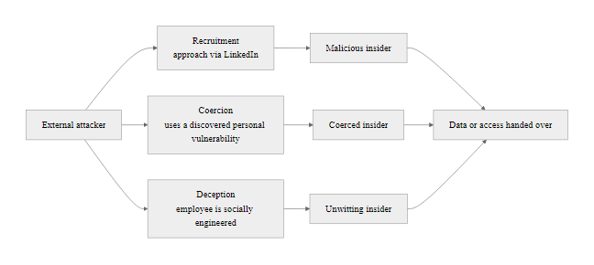
Insider Threat as a Social Engineering Target (2/2)
Social Engineering Pathways to Insider Threat: external actors can convert external attacks into insider threats through multiple channels, each requires a different detection and prevention strategy
Notes:
(continued, see part 1)

Slide 67
Social Engineering in Numbers, Key Statistics
Grounding social engineering theory in current empirical data makes the threat concrete. These statistics represent authoritative, recent findings from recognized cybersecurity research bodies, they should inform security investment decisions, board reporting, and risk assessment frameworks.
Statistic | Source | Significance
74% of all breaches involve the human element | Verizon DBIR 2023 | Human attacks are not peripheral, they are the dominant breach pathway
36%+ of breaches involve phishing | Verizon DBIR 2023 | Phishing is the single most common initial access technique
$2.7 billion in BEC losses (2022) | FBI IC3 2022 Annual Report | SE financial fraud exceeds ransomware in total annual losses
48% of dropped USB drives get plugged in | University of Illinois study, 2016 | Physical baiting has empirically high success rates even without social engineering labels
300% increase in vishing attacks (2022 vs 2021) | Agari / Help Systems | Voice-based attacks are accelerating as email defenses mature
30–50% click rate on well-crafted spear phishing | Multiple vendor threat intelligence reports | Spear phishing far exceeds mass phishing effectiveness
$25.6 million lost to deepfake video call | Hong Kong Police, 2024 | AI-assisted SE is operationally deployed in high-value fraud
Average BEC funds recovery rate: 73% if reported within 72 hours | FBI RAT team data | Early reporting significantly changes outcome, seconds matter
The most expensive security technology in the world cannot protect an organization whose employees answer social engineering calls.
Notes:
Statistics in security education serve two functions: they make the abstract threat concrete, and they provide the business case language that translates security risk into the economic and operational terms that drive organizational investment decisions. Both functions are important, a security practitioner who understands the technical details of social engineering but cannot communicate its business impact to executives will struggle to obtain the resources needed to build effective defenses.
The 74% human element figure from the Verizon DBIR is perhaps the single most important statistic in cybersecurity for making the case for human-layer security investment. Executives who view cybersecurity primarily as a technology problem, to be solved with firewalls, endpoint protection, and network monitoring, need to confront the empirical reality that nearly three-quarters of breaches involve human action. This does not mean technology is irrelevant; it means that technology alone is insufficient, and that organizations allocating 95% of their security budget to technology and 5% to human security are systematically misallocating resources relative to the actual threat distribution.
The $2.7 billion BEC figure is instructive for another reason: it exceeds the total annual losses from ransomware in the same FBI IC3 report. Ransomware dominates cybersecurity headlines and has driven enormous vendor market development and executive attention. Yet the quieter, less technically sophisticated BEC attacks generate more total financial losses. This suggests a systematic bias in organizational security investment toward the threats that are most technically interesting or most visible in media coverage rather than those that produce the highest financial impact.
The USB plug-in rate of 48% from the University of Illinois study is valuable for overcoming executive resistance to investments in removable media controls. The objection "our employees wouldn't do that" is specifically contradicted by this empirically measured behavior from a population of university community members, presumably including educated, security-aware individuals, who plugged in 48% of found USB drives. The corresponding investment in MP-7 (Media Use) controls that disable or restrict USB device access at the operating system level is both technically straightforward and demonstrably valuable.
The 72-hour BEC recovery window is a critical operational statistic that should be embedded in every organization's incident response playbook. Financial fraud recovery is a time-critical activity, the FBI's Recovery Asset Team (RAT) coordinates with the financial industry's Financial Fraud Kill Chain to freeze and return funds. Once funds have been layered through multiple international accounts, recovery becomes dramatically more difficult. Every organization's incident response procedure should include an explicit step: "If a financial transaction may have been executed in response to a social engineering attack, notify [security contact] AND [financial contact] within [X hours]." The shorter the notification window, the higher the probability of recovery.
The deepfake statistics (particularly the $25.6 million Hong Kong case) are rapidly evolving, as of the course's current date (2026), the incidents reported here may already have been superseded by more severe examples. Instructors should check for current deepfake social engineering incidents in the preceding 6-12 months when teaching this material, as the technology and the attacks it enables are advancing faster than annual course update cycles.
Business email compromise cost U.S. organizations about $2.7 billion in reported losses in 2022 (FBI IC3). Spread across the private-sector workforce this is a measurable per-employee loss, while a meaningful awareness program costs roughly $15–50 per employee per year, a favorable return on these figures alone.

Slide 68
Class Summary, Social Engineering Attack Landscape
This class established the psychological and operational foundations of social engineering, the attack paradigm that routes around technical defenses by targeting the human decision-making layer. Every subsequent class on specific attack types will build on these foundations: phishing, credential attacks, and advanced persistent threats all rely on social engineering for initial access.
Key Takeaways
Social engineering exploits cognitive biases (Cialdini's six principles) that are features of human social psychology, not bugs unique to untrained individuals, anyone is vulnerable under the right conditions
The six core techniques, phishing, spear phishing, pretexting, baiting, impersonation, elicitation, each exploit different psychological mechanisms and require different defensive countermeasures
OSINT reconnaissance precedes every targeted social engineering attack, limiting and auditing your organization's public information footprint reduces attacker intelligence gathering effectiveness
Technical controls (DMARC, MFA, removable media restrictions) and human controls (security awareness training, verification protocols, reporting culture) are complementary layers, neither alone is sufficient
AI-assisted social engineering eliminates the quality-scale tradeoff of traditional attacks, making high-quality personalized attacks available at mass scale, defensive heuristics based on "look for poor quality" are becoming obsolete
BEC is the highest-loss cybercrime category (FBI IC3 2022: $2.7B), organizational financial controls and out-of-band verification for wire transfers are required defenses
Early reporting of potential social engineering incidents dramatically improves outcomes, psychological safety for reporting is a required organizational capability, not a nice-to-have
Notes:
This summary slide consolidates the class's core content into a format designed for retention and rapid review. Social engineering is a broad topic that spans psychology, organizational behavior, technical controls, and operational procedures, the challenge is building a coherent mental model that allows practitioners to quickly analyze novel attack scenarios and identify appropriate defensive responses.
The unified conceptual framework that ties this class together is the recognition that all social engineering attacks, regardless of technique, operate by the same fundamental mechanism: they exploit human cognitive biases to induce voluntary cooperation with an attacker's objectives. This means that the defense is also unified at the conceptual level: creating conditions (training, culture, protocols) under which human decision-making is more likely to pause, verify, and escalate rather than comply automatically with emotionally compelling requests.
The six psychological principles from Cialdini (Authority, Urgency/Scarcity, Social Proof, Reciprocity, Liking, Commitment) provide the diagnostic framework for analyzing any social engineering attempt: identifying which principle is being exploited in a specific attack immediately reveals the manipulation mechanism and points toward the appropriate defensive response. This is more valuable than memorizing specific attack patterns, because social engineering attacks evolve while the underlying psychological mechanisms remain constant.
The MITRE ATT&CK framework and NIST/ISO standards provide the professional vocabulary and structured control frameworks that practitioners use to communicate social engineering risk, design defenses, and demonstrate compliance. Students should be comfortable referencing specific technique IDs (T1566, T1656, T1598) and control references (NIST AT-2, AC-5, MP-7; ISO A.6.3, A.7.4) in professional and academic writing about social engineering.
The AI dimension of social engineering represents the most significant evolution of this threat landscape in the immediate future. Students entering the cybersecurity workforce in 2026 and beyond will encounter AI-assisted social engineering as a standard threat category rather than an emerging concern. The defensive principles, verification protocols, out-of-band callbacks, code words for sensitive communications, FIDO2 phishing-resistant MFA, are the same as for traditional social engineering, but the urgency of deploying them has increased with AI's improvement of attacker capabilities.
Looking ahead: The next class will examine phishing and credential attacks in depth, building on the social engineering foundations established here. The psychological mechanisms covered in this class (urgency, authority, deceptive framing) appear in specific phishing techniques; the technical defenses covered (DMARC, MFA) will be examined in operational detail in the next session. Students should be prepared to apply the red flag recognition skills and psychological analysis frameworks from this class to specific phishing email analysis exercises.
The Verizon 2023 DBIR found a human element in 74% of breaches. The most effective security investment is therefore not the next technical tool but strong technical foundations combined with a culture that treats human security as a first-class concern, a conclusion every major breach report of the past decade supports.

Slide 69
Class Summary, Social Engineering Attack Landscape (2/3)
Technique | Primary Lever | Key Defense | Framework Reference
Phishing | Urgency + deception | DMARC, email gateway, FIDO2 MFA | NIST AT-2, T1566
Spear Phishing | Personalization + trust | User awareness, FIDO2 MFA | MITRE T1566.001/.002
Pretexting | Authority + fabrication | Verification protocols | NIST AC-5, T1656
Baiting | Curiosity + greed | MP-7 removable media controls | NIST MP-7
Impersonation | Pre-existing trust | Out-of-band verify, DMARC | MITRE T1656
Elicitation | Reciprocity + conversation | Need-to-know culture | MITRE T1591
BEC | Authority + urgency | Dual-auth, callback verify | FBI IC3, NIST AC-5
Vishing | Voice + real-time pressure | Callback policy, no OTP by phone | NIST IA-5
Tailgating | Social norms | Mantrap, challenge culture | ISO 27001 A.7.4
Notes:
(continued, see part 1)

Slide 70
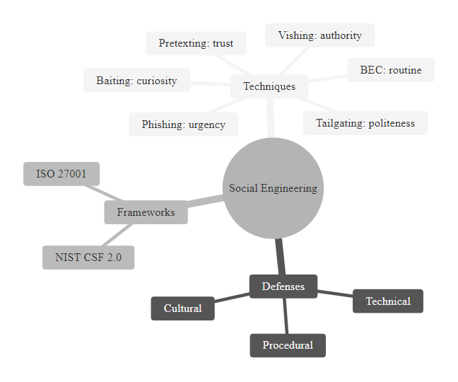
Class Summary, Social Engineering Attack Landscape (3/3)
Class Summary Mind Map: social engineering is a system of techniques united by a common target, human psychology, and defended by a system of layered controls that must work together to provide meaningful protection
Notes:
(continued, see part 1)

Slide 71
Whaling Attacks: Targeted Social Engineering
Whaling attacks are a sophisticated form of social engineering where attackers target high-value individuals within an organization, such as executives or board members. These targets often hold significant influence and access to critical information. Whaling attacks typically involve a combination of psychological manipulation and technical sophistication to deceive the victim into providing sensitive data or granting unauthorized access.
Whaling attacks are particularly dangerous because they can result in large-scale data breaches, financial losses, and reputational damage for organizations. According to a report by Verizon's 2023 Data Breach Investigations Report (DBIR), whaling attacks accounted for 5% of all data breaches but resulted in an average loss of $16 million per incident. This underscores the importance of robust security measures and awareness training, especially for high-value targets.
Notes:
Whaling attacks are one of the most sophisticated and targeted forms of social engineering. Unlike phishing, which typically aims for large numbers of users, whaling attacks focus on specific individuals who hold significant influence within an organization. The success of a whaling attack depends on the attacker's ability to convincingly impersonate a high-value target and exploit their trust.
One common technique used in whaling attacks is pretexting, where the attacker creates a fabricated scenario that convinces the victim to reveal sensitive information or grant access. For example, an attacker might claim to be from a regulatory body or a potential business partner who needs access to confidential data for due diligence purposes. The psychological manipulation involved in whaling attacks often relies on social proof and authority, leveraging the victim's fear of looking weak or unprofessional if they refuse.
According to the 2023 Verizon DBIR, whaling attacks are becoming increasingly prevalent, with a reported increase of 14% compared to the previous year. This trend highlights the need for organizations to implement advanced security measures and provide targeted training for high-value employees. By understanding the psychological tactics used in whaling attacks, organizations can better prepare their defenses and mitigate the risks associated with this type of sophisticated social engineering threat.

Slide 72

Whaling Attacks: Targeted Social Engineering (2/2)
A Whaling Attack Scenario: Impersonation of a CEO to extract confidential data
Notes:
(continued, see part 1)

