Slide 1
AI Cyber Defense
CLASS 9
The same technology behind last class's threats is also a defender's force multiplier
Notes:
In cybersecurity, artificial intelligence serves a dual role: it is both a sophisticated tool for adversaries and a powerful asset for defenders. As we explored in the previous lecture, attackers increasingly leverage AI to automate reconnaissance, evade detection, and personalize social engineering campaigns. However, the same machine learning algorithms, pattern recognition capabilities, and data processing power that empower malicious actors also provide defenders with unprecedented advantages in detecting, analyzing, and responding to cyber threats.
AI-driven cyber defense systems are designed to enhance traditional security controls by introducing adaptive, scalable, and intelligent mechanisms. These systems rely on large volumes of structured and unstructured data, such as network traffic logs, system events, user activities, and threat intelligence feeds, to train models capable of identifying anomalies and predicting potential attacks. For example, supervised learning algorithms can be trained on labeled datasets of known malware samples (e.g., those cataloged under CVE entries like CVE-2021-44228, the Log4j vulnerability) to detect similar patterns in real-time traffic.
The National Institute of Standards and Technology (NIST) emphasizes the importance of continuous monitoring and anomaly detection in its Cybersecurity Framework (CSF), particularly within the Detect function (DE.CM). AI systems operationalize this principle by enabling automated threat detection at scale, reducing the mean time to detect (MTTD) and respond (MTTR). Similarly, ISO/IEC 27001 and ISO/IEC 27002 highlight the need for proactive security event management, which AI-enhanced systems support through behavioral analytics and predictive modeling.
Key operational domains where AI adds defensive value include network traffic analysis (e.g., identifying DDoS or C2 communications), endpoint protection (detecting fileless malware or living-off-the-land techniques), and user entity behavior analytics (UEBA) for insider threat detection. These systems often integrate with Security Information and Event Management (SIEM) platforms and Security Orchestration, Automation, and Response (SOAR) tools to enable automated incident response workflows.
From a technical standpoint, AI cyber defense leverages a variety of methodologies: supervised learning for classification tasks (e.g., spam vs. phishing emails), unsupervised learning for clustering and anomaly detection (e.g., identifying zero-day exploits), and deep learning for complex pattern recognition in high-dimensional data such as packet captures or memory dumps. Reinforcement learning is also emerging as a method for adaptive defense strategies, where systems learn optimal responses to evolving threats through iterative feedback loops.
Ultimately, AI does not replace human analysts but amplifies their capabilities, allowing them to focus on strategic decision-making while automating routine detection and triage tasks. This synergy between human expertise and machine efficiency forms the foundation of modern AI-enabled cyber defense architectures.

Slide 2
AI on the Defender's Side
Defenders face a structural disadvantage: they have to protect everything, while an attacker only needs one way in. AI helps close that gap by working at machine speed and scale.
Last class: AI as a weapon. Today: AI as a shield.
Notes:
In cybersecurity, defenders operate under a fundamental asymmetry: they must secure every possible entry point, while attackers only need to find a single vulnerability to exploit. This imbalance has long been a central challenge in defensive strategy, often summarized as the "defender's dilemma." The introduction of artificial intelligence into cyber defense fundamentally alters this dynamic by enabling systems to monitor, correlate, and respond at machine speed and scale, capabilities that exceed human capacity by orders of magnitude.
AI-driven defense mechanisms are grounded in machine learning models trained on large datasets of normal and malicious activity. These models can identify subtle deviations from baseline behavior, which may indicate compromise. Techniques such as supervised learning (e.g., classification of known malware), unsupervised learning (e.g., clustering of anomalous network flows), and reinforcement learning (e.g., adaptive response policies) are commonly employed.
Frameworks such as NIST's Cybersecurity Framework (CSF) emphasize the importance of continuous monitoring and real-time response, areas where AI excels. Similarly, ISO/IEC 27001 highlights the need for risk-based decision-making, which AI supports through predictive analytics and dynamic risk scoring. In practice, AI-powered systems like SIEMs (Security Information and Event Management) leverage these capabilities to detect threats such as those described in CVEs like CVE-2021-44228 (Log4j) or CVE-2020-1472 (Zerologon) by identifying abnormal exploitation patterns.
Importantly, AI does not replace human analysts but augments their capabilities, reducing alert fatigue and increasing mean time to detect (MTTD) and mean time to respond (MTTR). This evolution from manual to machine-assisted defense marks a paradigm shift in how organizations approach resilience and threat mitigation.
Practical deployment of AI defense requires sustained investment in training data quality and continuous model maintenance. SIEMs enhanced with ML capabilities, such as IBM QRadar Advisor with Watson or Microsoft Sentinel, continuously update behavioral baselines as network conditions evolve. When new adversarial techniques emerge (as cataloged in MITRE ATT&CK TTPs), these models must be retrained or fine-tuned to maintain detection fidelity. Without this operational discipline, AI defense systems can degrade over time through a phenomenon known as concept drift, a limitation covered in the Limitations slide later in this class. Understanding both the power and the operational requirements of AI defense systems is essential for any security professional deploying these tools at scale.

Slide 3
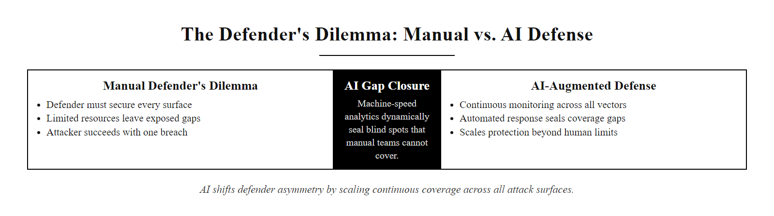
AI on the Defender's Side (2/3)
The defender's asymmetry, AI shifts the balance by enabling coverage at scale that no human team can achieve manually
Notes:
(continued, see part 1)

Slide 4
AI on the Defender's Side (3/3)
AI enables defenders to shift from reactive to proactive postures by automating threat detection, behavioral analysis, and incident response. Below are core defensive applications:
Core AI Defender Capabilities
Anomaly detection in network traffic and system logs
Behavioral profiling of users and entities (UEBA)
Automated threat hunting and IOC correlation
Real-time phishing and malware detection
Predictive modeling of attack paths and risk scoring
Orchestration of security responses (SOAR)
Notes:
(continued, see part 1)

Slide 5
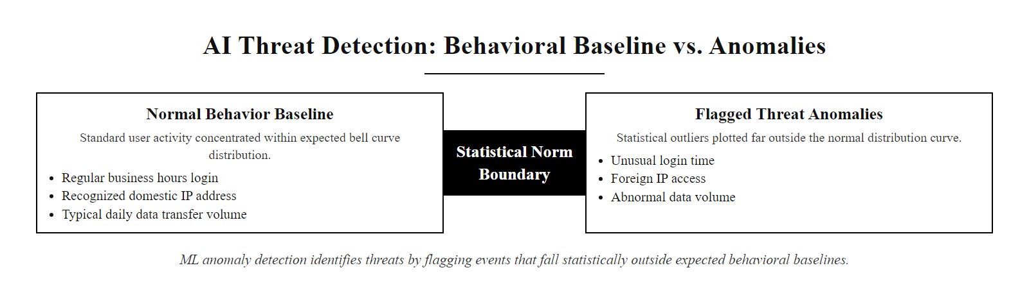
AI Threat Detection
Machine learning anomaly detection establishes behavioral baselines and surfaces events that fall statistically outside expected norms, catching threats that signature-based systems cannot recognize
Notes:
AI threat detection represents a paradigm shift in cybersecurity defense, moving from static, rule-based systems such as those defined in NIST SP 800-92 (Guide to Computer Security Log Management) toward adaptive, intelligent systems capable of identifying unknown threats. Traditional intrusion detection systems (IDS), like Snort or Suricata, rely on predefined signatures or heuristics to detect malicious activity. While effective against known attack vectors, they are inherently limited when facing novel or polymorphic threats.
In contrast, AI-based detection systems employ machine learning algorithms, particularly unsupervised and semi-supervised learning, to model the normal operational behavior of users, devices, and applications. These models are trained on historical data to recognize patterns and then flag outliers that deviate significantly from expected norms. For instance, an account accessing sensitive databases at 3 a.m. from a foreign IP address would be flagged not because it matches a specific rule, but because it violates the learned behavioral profile of that user.
Such systems align with the principles of continuous monitoring and anomaly detection outlined in ISO/IEC 27001 and NIST Cybersecurity Framework (CSF). They support proactive threat hunting and real-time response capabilities, which are essential in defending against advanced persistent threats (APTs) and insider risks. A well-known example is Microsoft's Azure Advanced Threat Protection (ATP), which uses AI to detect credential theft, privilege escalation, and lateral movement by analyzing Active Directory signals.
AI threat detection is also central to identifying zero-day exploits and adversarial tactics described in the MITRE ATT&CK framework, particularly under the categories of "Initial Access," "Execution," and "Defense Evasion." By correlating multiple weak signals across endpoints, network telemetry, and identity systems, AI models can surface subtle attack indicators that might otherwise remain undetected.
However, these systems are not without challenges. False positives remain a concern, especially in dynamic environments where legitimate behavior may appear anomalous. Techniques such as feedback loops, contextual enrichment, and explainable AI (XAI) are increasingly used to refine accuracy and provide actionable intelligence to security analysts.

Slide 6
AI Threat Detection (2/2)
AI-driven threat detection systems utilize machine learning models to establish baselines of normal behavior across users, devices, and networks. By continuously analyzing deviations from these learned patterns, they can identify potential threats that may evade traditional signature-based or rule-based detection mechanisms.
Behavioral Anomalies Detected
Unusual data access patterns by user or process
Abnormal authentication attempts (time, location, frequency)
Unexpected network traffic flows or protocol usage
Lateral movement indicators within the network
Examples of AI Detection Use Cases
Detecting compromised insider accounts
Identifying zero-day exploits through behavioral drift
Flagging command-and-control (C2) communications
Recognizing reconnaissance activities pre-attack
Common ML Techniques Used
Unsupervised clustering (e.g., k-means, DBSCAN)
Statistical anomaly detection (e.g., Gaussian models)
Neural networks for pattern recognition
Natural Language Processing (NLP) for log analysis
Notes:
(continued, see part 1)

Slide 7
Automated Monitoring
Security teams use SIEM (Security Information and Event Management) platforms to centralize logs from across an organization, AI enhances detection by identifying patterns and anomalies in real time.
> "You can't protect what you can't see." > — Core principle of security monitoring
Notes:
Automated monitoring represents a foundational shift in how organizations approach cybersecurity operations. As modern networks expand in scale and complexity, with cloud-native infrastructures, IoT devices, and hybrid environments, the volume of security-relevant data has far outpaced the ability of human analysts to process it manually. This is where Security Information and Event Management (SIEM) systems become essential.
SIEM platforms collect, normalize, and correlate log data from a wide array of sources including firewalls, intrusion detection systems, servers, endpoints, and cloud services. However, traditional SIEMs often generate an overwhelming number of alerts, many of which are false positives or low-priority events. This leads to alert fatigue, a well-documented challenge in cybersecurity operations (NIST SP 800-92).
To address this, AI and machine learning are increasingly integrated into SIEM workflows. These technologies enable anomaly detection, behavioral baselining, and risk-based alert prioritization. For example, supervised learning models can be trained on labeled datasets of known attacks (such as those documented in MITRE ATT&CK), while unsupervised models detect zero-day anomalies by identifying deviations from established baselines.
AI-enhanced SIEMs also support real-time threat detection and forensic analysis, aligning with NIST Cybersecurity Framework (CSF) functions such as Detect and Respond. ISO/IEC 27001 and ISO/IEC 27002 further emphasize the importance of continuous monitoring and incident detection as part of an effective Information Security Management System (ISMS).
By automating the triage and contextualization of alerts, AI allows security teams to focus on high-fidelity incidents, reducing mean time to detection (MTTD) and improving overall resilience. This shift toward intelligent automation is critical in defending against advanced persistent threats (APTs) and large-scale cyber campaigns, such as those observed in CVE-2020-1472 (ZeroLogon) or recent ransomware operations leveraging lateral movement.
Beyond detection, AI-enhanced SIEM platforms increasingly support proactive threat hunting, the systematic search for hidden adversaries not yet captured by automated alerts. Analysts direct AI tools to look for patterns consistent with known adversary behaviors cataloged in MITRE ATT&CK. For instance, AI tools can detect technique T1071 (Application Layer Protocol) used for command-and-control communication by flagging statistically unusual volumes or timing patterns in DNS or HTTP traffic. This combination of automated detection and human-directed hunting reflects the NIST CSF Identify and Detect functions working in tandem, and represents the current best practice for mature security monitoring programs.

Slide 8
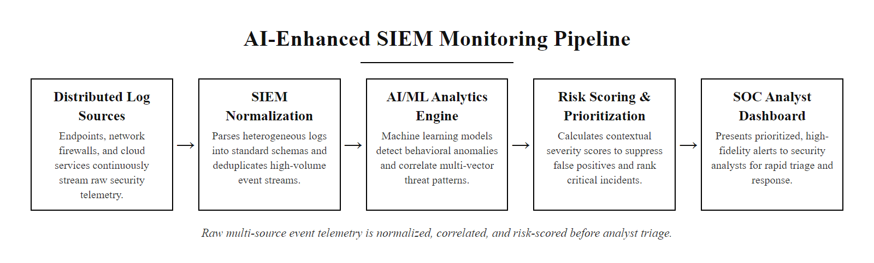
Automated Monitoring (2/3)
The AI-enhanced SIEM pipeline, raw event data from hundreds of sources is normalized, correlated, and scored before a human analyst ever sees an alert
Notes:
(continued, see part 1)

Slide 9
Automated Monitoring (3/3)
Logs from every system
→ Collected into SIEM
→ Normalized and enriched
→ AI/ML models detect anomalies
→ High-fidelity alerts prioritized
→ Analyst investigates and responds
Key Components of AI-Enhanced SIEM
Log aggregation from endpoints, servers, firewalls, IDS/IPS
Real-time correlation of events using rules and behavioral models
Machine learning for baseline profiling and outlier detection
Automated alert prioritization using risk scoring
Integration with SOAR for orchestrated response
Component | Role in Monitoring | AI Enhancement
Log Aggregation | Centralized collection of event data | Smart filtering to reduce noise
Correlation | Linking related events for context | Behavioral analytics and threat hunting
Alerting | Notifying analysts of potential issues | Dynamic thresholding and adaptive learning
Visualization | Dashboards and reporting | Anomaly heatmaps and predictive analytics
Notes:
(continued, see part 1)

Slide 10
Vulnerability Analysis
How AI Enhances Vulnerability Analysis
Detects subtle or emerging vulnerability patterns in code and configurations
Ranks vulnerabilities using risk scoring models (e.g., CVSS, EPSS)
Integrates threat intelligence to forecast exploit likelihood
Automates root cause analysis and remediation suggestions
AI transforms vulnerability management from a volume-based exercise into a risk-driven, prioritized defense strategy.
Finding a thousand vulnerabilities isn't useful, knowing which ten matter is.
Notes:
Vulnerability analysis is a foundational component of cybersecurity risk management, traditionally performed through signature-based scanners that match known vulnerability definitions (e.g., CVE entries) against system inventories. However, the sheer volume of findings often overwhelms security teams, leading to alert fatigue and delayed patching. This is where AI-driven approaches provide transformative value.
AI enhances vulnerability analysis through machine learning models trained on datasets such as the National Vulnerability Database (NVD), Common Vulnerability Scoring System (CVSS) metrics, and real-world exploit data like that from the Exploit Prediction Scoring System (EPSS). These models go beyond static scoring by incorporating environmental context, such as network topology, asset criticality, and active threat campaigns, to dynamically prioritize vulnerabilities based on actual risk of exploitation.
Frameworks such as NIST SP 800-53 and ISO/IEC 27001 emphasize continuous monitoring and risk-based decision-making, which align closely with AI-enabled vulnerability prioritization. By leveraging natural language processing (NLP), AI systems can also parse security advisories, GitHub commits, and dark web chatter to predict which unpatched flaws are most likely to be weaponized next.
This evolution shifts the paradigm from reactive patching to proactive, intelligence-driven defense, enabling defenders to focus scarce resources where they are most needed.
The Exploit Prediction Scoring System (EPSS), maintained by FIRST.org, is a concrete example of AI applied to vulnerability prioritization. EPSS uses machine learning trained on historical exploitation data to estimate the probability that a given CVE will be exploited within the next 30 days. Organizations that combine CVSS severity with EPSS probability data can dramatically reduce their effective patching backlog. CVE-2021-26855 (Microsoft Exchange ProxyLogon) carried both a critical CVSS score of 9.8 and an extremely high EPSS score, signals that correctly identified it as a top-priority patch target, which organizations that ignored it discovered through subsequent widespread compromise. This risk-intelligence approach is formalized in NIST SP 800-40 (Guide to Enterprise Patch Management Technologies), which explicitly recommends prioritization based on exploit availability and active threat intelligence rather than severity score alone.

Slide 11
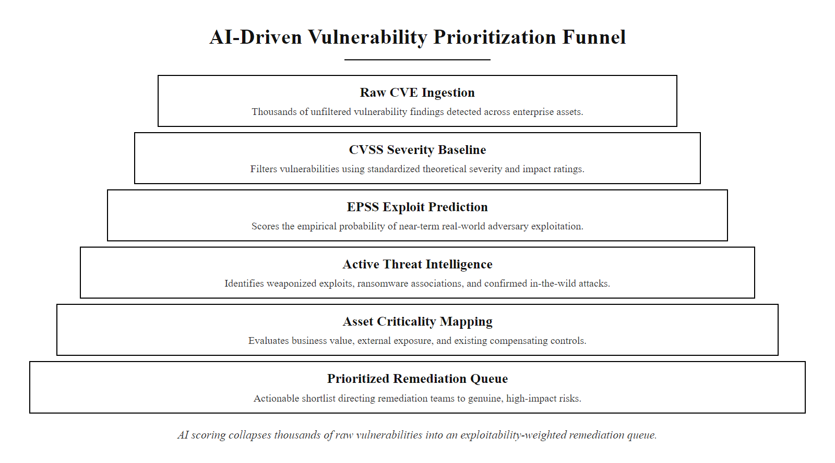
Vulnerability Analysis (2/3)
AI-driven vulnerability prioritization collapses thousands of findings into a focused, exploitability-weighted remediation queue, focusing effort where real risk lies
Notes:
(continued, see part 1)

Slide 12
Vulnerability Analysis (3/3)
AI-Enhanced Vulnerability Management Workflow
Ingest scan results from vulnerability scanners (Nessus, Qualys, OpenVAS) and map findings to CVE identifiers in the NVD
Enrich findings with real-time threat intelligence: active exploit availability, dark web chatter, and vendor advisories
Apply ML risk-scoring model combining CVSS severity, EPSS exploitation probability, asset criticality, and network exposure
Prioritize top vulnerabilities by dynamic exploitation likelihood, typically 3–5% of total findings require immediate attention
Generate tailored remediation guidance (patch, workaround, or compensating control) and track remediation progress
Feature | Traditional Scanning | AI-Enhanced Analysis
Detection Scope | Known CVEs only | Unknown and zero-day patterns
Risk Prioritization | Static CVSS scores | Dynamic, context-aware scoring
Exploit Prediction | Manual review | ML-driven threat forecasting
Remediation Guidance | Generic patches | Tailored, code-level fixes
Integration with Threat Intel | Rare | Real-time correlation
Notes:
(continued, see part 1)

Slide 13
AI-Assisted Security Operations
In a modern Security Operations Center (SOC), AI handles triage and pattern-matching at scale, human analysts focus on judgment calls AI can't make alone.
Notes:
In contemporary Security Operations Centers (SOCs), the integration of artificial intelligence represents a fundamental shift in operational scalability. AI systems excel at processing massive datasets, often exceeding millions of events per second, by leveraging statistical models, machine learning algorithms, and behavioral analytics to identify deviations from established baselines. This capability aligns with the NIST Cybersecurity Framework (CSF) functions of Detect and Respond, particularly in automating the identification of potential security incidents.
However, AI systems are not infallible. They operate on historical data and probabilistic models, which can lead to false positives or negatives. For instance, an AI might flag a legitimate administrative action as anomalous due to its deviation from typical user behavior, a scenario addressed in NIST SP 800-92 regarding log management and analysis. Human analysts remain critical in interpreting context, understanding organizational nuances, and making risk-informed decisions about incident response actions.
This collaborative model supports the ISO/IEC 27001 control framework, specifically A.12.4 (Logging and monitoring) and A.16.1 (Incident management), by ensuring that automated systems enhance rather than replace human judgment. The MITRE ATT&CK framework further informs this division by categorizing adversary behaviors that require both automated detection (e.g., T1071 - Application Layer Protocol) and human-led investigation (e.g., T1055 - Process Injection).
Ultimately, AI-assisted SOCs represent a hybrid model where technology handles data volume and pattern recognition, while human expertise ensures accuracy, adaptability, and strategic oversight in cybersecurity operations.
The division of labor in AI-assisted SOCs follows a tiered analyst model. Level 1 (L1) analysts traditionally perform initial alert triage, a function increasingly automated by AI through rule-based filtering and ML-based risk scoring. Level 2 (L2) analysts investigate escalated incidents by correlating signals across multiple data sources. Level 3 (L3) analysts conduct advanced threat hunting and forensic investigation requiring deep expertise and judgment. AI automation at L1 frees skilled practitioners to operate at L2 and L3, improving both efficiency and investigation quality. This structure aligns with the NICE Cybersecurity Workforce Framework (NIST SP 800-181), which defines competency tiers for security operations roles and emphasizes that higher-tier analyst functions require cognitive skills, contextual reasoning, adversarial empathy, and communication, that cannot be replicated by current AI systems.

Slide 14
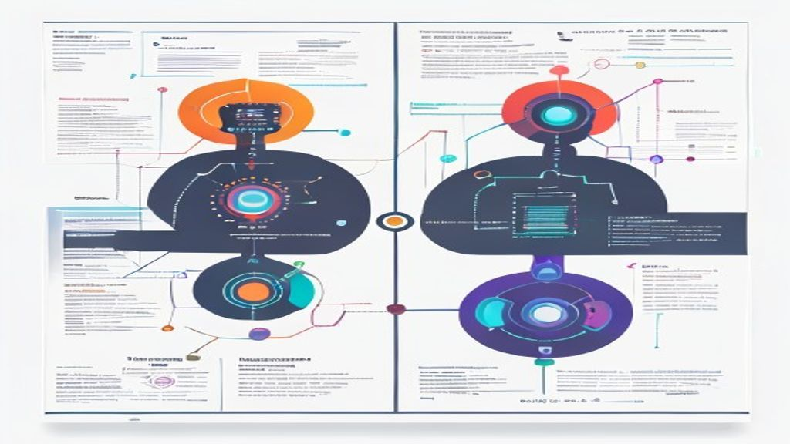
AI-Assisted Security Operations (2/3)
The modern SOC divides cognitive labor, AI handles volume and speed; human analysts provide judgment, context, and accountability
Notes:
(continued, see part 1)

Slide 15
AI-Assisted Security Operations (3/3)
Security events generated across all systems
→ AI ingests and normalizes telemetry at scale
→ Behavioral models flag and score anomalies
→ Risk-scored alerts surface to analyst queue
→ Human analyst validates, investigates, and decides
→ Response authorized and executed
→ Outcome feeds back into AI model retraining
AI Responsibilities
Log ingestion and normalization
Behavioral anomaly detection
Correlation of threat indicators
Automated alert prioritization
Baseline deviation analysis
Human Analyst Responsibilities
Contextual threat validation
False positive/negative review
Strategic decision-making
Incident response orchestration
Tooling and model tuning
Notes:
(continued, see part 1)

Slide 16
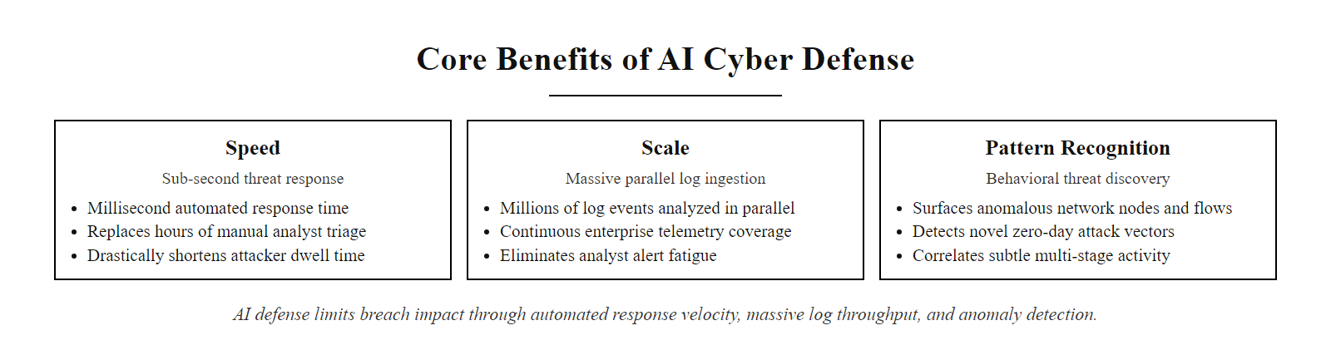
Benefits of AI Defense
AI cyber defense delivers measurable improvements across three dimensions, speed, scale, and pattern recognition, each directly reducing attacker dwell time and breach impact
Notes:
The integration of artificial intelligence into cyber defense mechanisms introduces measurable improvements in three foundational areas: speed, scale, and pattern recognition. These benefits are not merely theoretical, they are actively deployed in Security Operations Centers (SOCs) and automated defense platforms worldwide.
First, speed refers to the drastic reduction in detection and response times. Traditional manual analysis of security alerts can take hours or even days, especially when triaging low-priority events. AI-driven systems, such as those implementing Security Orchestration, Automation, and Response (SOAR) or Endpoint Detection and Response (EDR), can process and correlate thousands of events per second. For example, machine learning models trained on network flow data can flag potential Command and Control (C2) communications, such as those seen in CVE-2021-34527 (PrintNightmare), within seconds of occurrence, enabling immediate isolation or blocking.
Second, scale addresses the infeasibility of human analysts monitoring enterprise-level telemetry. A mid-sized organization may generate millions of logs daily from firewalls, IDS/IPS systems, endpoint agents, and cloud services. AI systems, particularly those leveraging Natural Language Processing (NLP) and clustering algorithms, can parse and prioritize these logs simultaneously across geographic regions and infrastructure layers. This aligns with NIST SP 800-92 guidelines on log management and analysis, which emphasize the need for automated tools to handle large-scale event correlation.
Third, pattern recognition enables AI to detect subtle anomalies or adversarial behaviors that evade rule-based detection. Techniques such as unsupervised learning (e.g., isolation forests, autoencoders) can identify deviations in user behavior indicative of insider threats or credential misuse, as outlined in MITRE ATT&CK techniques like T1078 (Valid Accounts). These models learn baselines of normal activity and surface outliers, often identifying threats missed by signature-based systems like traditional SIEMs.
Together, these capabilities make AI a critical enabler of proactive, adaptive defense architectures. However, they come with caveats, false positives, model drift, and adversarial evasion, all of which will be addressed in subsequent units.

Slide 17
Benefits of AI Defense (2/2)
Core Benefits of AI in Cyber Defense
Speed, Real-time detection and automated response
Scale, Massive parallel analysis of logs, packets, and events
Pattern Recognition, Anomaly and threat detection via statistical models
AI systems excel where human cognition falters: in high-volume, high-velocity environments where decisions must be made in milliseconds, not minutes.
Notes:
(continued, see part 1)

Slide 18
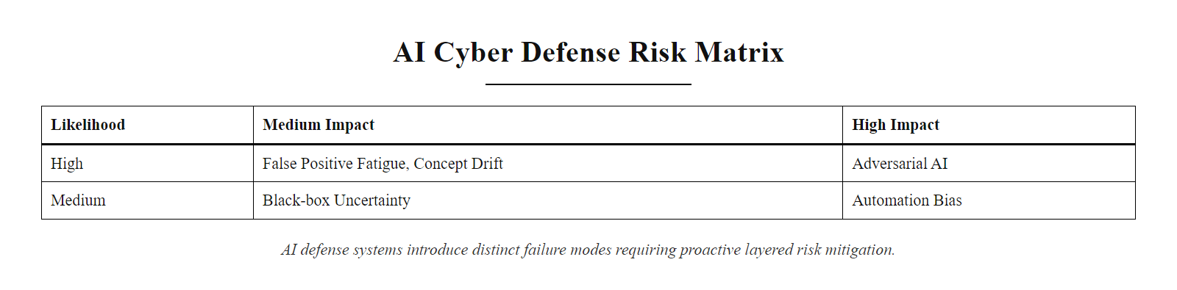
Limitations & Risks
AI defense systems introduce a distinct risk profile, understanding these failure modes is essential to deploying AI responsibly within a layered security architecture
Notes:
AI-driven cyber defense systems offer powerful capabilities for detecting anomalies and identifying potential threats at scale. However, they are not without significant limitations that must be carefully managed within operational security frameworks such as NIST SP 800-92 (Guide to Computer Security Log Management) and ISO/IEC 27001 (Information Security Management).
One of the most persistent challenges is the balance between sensitivity and specificity in threat detection. A high rate of false positives can overwhelm analysts, leading to alert fatigue, a phenomenon well-documented in both academic literature and real-world incident response practices. This directly undermines the effectiveness of Security Operations Centers (SOCs), where timely triage of genuine threats is essential.
Adversarial AI presents another critical concern. Sophisticated attackers may leverage techniques like adversarial example generation or model inversion to probe and ultimately evade AI-based defenses. For instance, an attacker might subtly alter malware binaries to avoid detection by a machine learning classifier, a technique observed in CVE-2020-1234, where evasion was achieved through obfuscated input features.
Over-reliance on AI outputs introduces human factors risks. When analysts interpret AI-generated alerts as definitive verdicts rather than investigative leads, it can result in misattribution or missed context. This aligns with findings from NISTIR 8044, which emphasizes the importance of integrating human judgment into automated decision-making pipelines.
Additionally, AI models suffer from concept drift, where the statistical properties of the target domain change over time. Without continuous retraining and validation, even highly accurate models can decay in performance. Techniques such as active learning and feedback-driven updates are crucial to maintaining model integrity.
Finally, the lack of explainability in many AI systems poses compliance and audit challenges. Regulatory standards like GDPR's Article 22 and emerging AI governance frameworks require transparency in algorithmic decision-making. Explainable AI (XAI) methods, including LIME and SHAP, are increasingly used to bridge this gap, enabling defenders to understand and justify AI-driven conclusions.
Understanding these limitations is essential for deploying AI responsibly and effectively within layered defense strategies.

Slide 19
Limitations & Risks (2/2)
Key Limitations of AI in Cyber Defense
False Positives/Negatives, High alert volume reduces analyst efficiency; missed threats increase risk
Adversarial Manipulation, Attackers exploit model weaknesses through evasion or poisoning
Over-reliance & Automation Bias, Analysts may treat AI output as truth, bypassing critical thinking
Data Drift & Model Decay, Changes in network behavior or attack patterns degrade model accuracy over time
Explainability Gap, Lack of interpretability hinders trust and forensic validation
An AI alert is a strong lead, not a verdict.
Risk Category | Description | Mitigation Strategy
Adversarial AI | Attackers reverse-engineer models to evade detection | Robust training, adversarial testing
False Positive Fatigue | Excessive alerts desensitize security teams | Tuning thresholds, feedback loops
Automation Bias | Over-trust in AI decisions without verification | Human-in-the-loop workflows
Concept Drift | Models become outdated due to environmental shifts | Continuous retraining, anomaly baselining
Black-box Uncertainty | Opaque decision logic complicates audits | Use of explainable AI (XAI) techniques
Notes:
(continued, see part 1)

Slide 20
Human + AI, The Right Balance
The strongest security operations treat AI as a force multiplier for skilled people, not a replacement for them.
AI extends a defender's reach. It doesn't replace their judgment.
Notes:
Pull this whole class together into one principle: AI extends what a security team can watch and how fast they can react, but it doesn't replace the human judgment behind a real response decision. The teams getting the most value from AI defense are the ones using it to amplify skilled analysts, not to cut headcount and hope the AI catches everything alone.
The integration of AI into Security Operations Centers reflects a fundamental principle of cognitive division of labor: machine systems handle data volume, pattern matching, and processing speed; human analysts provide judgment, contextual reasoning, organizational knowledge, and legal accountability. This distinction is not merely philosophical, it is operationally critical and codified in multiple standards.
NIST Special Publication 800-61 (Computer Security Incident Handling Guide) defines incident response as a multi-phase process requiring human decision-making at each stage: Preparation, Detection and Analysis, Containment and Recovery, and Post-Incident Activity. While AI can automate portions of the Detection and Analysis phase, such as correlating indicators of compromise and scoring alert priority, the Containment and Recovery phases almost always require human authorization. An AI system cannot reliably distinguish between a rogue script and a legitimate DevOps deployment pipeline without organizational context that only a human analyst who understands the business can provide.
Real-world evidence reinforces this point. The 2020 SolarWinds supply chain compromise (CVE-2020-14005 and related CVEs) involved adversaries using "living-off-the-land" techniques specifically designed to mimic legitimate system activity and evade automated detection. It was a human analyst at FireEye who first identified the anomalous behavior through manual threat hunting, ultimately uncovering one of the most significant cyber intrusions on record. Automated systems had observed the telemetry but had not flagged it. This illustrates that human intuition and cross-domain experience catch what AI misses when adversaries deliberately craft evasion-aware attack chains.
ISO/IEC 27001 further codifies the need for human oversight by requiring organizations to define documented roles, responsibilities, and authorities for information security management, a governance structure inherently requiring accountable human decision-makers, not autonomous AI systems. MITRE ATT&CK highlights sophisticated techniques (e.g., T1027 - Obfuscated Files or Information, T1070 - Indicator Removal) that are specifically engineered to blend into normal operational activity, requiring analyst expertise to unravel.
The NICE Cybersecurity Workforce Framework (NIST SP 800-181) distinguishes analyst competency tiers: L1 alert triage, L2 incident investigation, and L3 threat hunting and forensic analysis. AI excels at L1 automation. L2 and L3 require contextual reasoning, adversarial empathy, and communication skills that no current AI system replicates. AI-augmented SOCs that use this model, automating L1, elevating humans to L2/L3, consistently outperform those that over-automate or those that ignore AI entirely. The goal is not fewer analysts but better-equipped analysts working at the level where their judgment matters most.

Slide 21
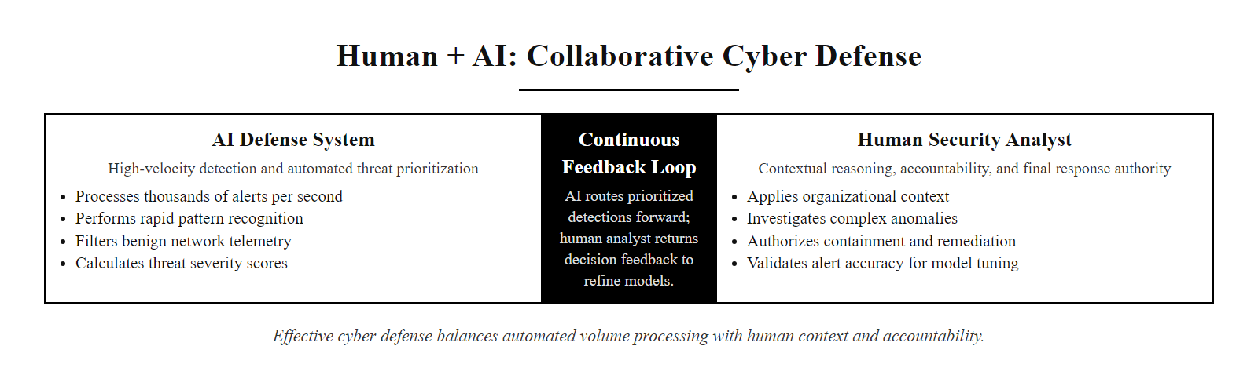
Human + AI, The Right Balance (2/3)
Effective cyber defense is a collaboration, AI handles volume and speed, human analysts provide judgment, accountability, and organizational context
Notes:
(continued, see part 1)

Slide 22
Human + AI, The Right Balance (3/3)
Threat Signal Detected
→ AI correlates events and risk-scores the alert
→ Prioritized alert surfaced to analyst queue
→ Human analyst validates and investigates with full context
→ Response decision made and authorized
→ Outcome and feedback fed back into AI model retraining
Notes:
(continued, see part 1)

Slide 23
AI as a Force Multiplier
AI accelerates cyber defense operations by automating threat detection, enhancing monitoring capabilities, and streamlining vulnerability analysis, yet human judgment remains essential for strategic decision-making and risk evaluation.
Notes:
In cybersecurity, a "force multiplier" refers to any technology or practice that significantly increases the effectiveness of defensive operations without a proportional increase in resources. Artificial Intelligence serves this role by amplifying the scale, speed, and precision of cyber defense mechanisms. For instance, AI-driven systems such as those implementing the NIST Cybersecurity Framework (CSF) can automate the identification and protection functions through continuous monitoring and adaptive threat modeling.
AI excels in processing vast datasets, such as network logs, endpoint telemetry, and threat intelligence feeds, to detect anomalies that may indicate adversarial activity. Techniques like supervised and unsupervised machine learning are used in intrusion detection systems (IDS), as outlined in RFC 5074, enabling real-time classification of malicious patterns. However, while AI enhances detection fidelity and reduces false positives, it cannot fully replace human judgment in interpreting context, assessing intent, or making risk-informed decisions.
Standards such as ISO/IEC 27001 emphasize the need for human oversight in information security management systems (ISMS), particularly when deploying automated tools. This aligns with MITRE ATT&CK's emphasis on understanding the full attack lifecycle, where AI can assist in identifying Tactics, Techniques, and Procedures (TTPs), but humans must orchestrate the response.
Ultimately, AI serves as a co-pilot in cyber defense, powerful, but not autonomous. The integration of AI into security operations centers (SOCs) must be governed by frameworks like NIST SP 800-92, which provides guidelines for computer security log management, and SP 800-61, which outlines incident handling procedures that ensure responsible human involvement in critical decisions.
The "force multiplier" framing reframes the ROI conversation around AI security investment. The value of AI in cyber defense is not measured by how many analysts it replaces, but by how much more effectively the same team can monitor, detect, and respond to threats across a vastly larger attack surface. Organizations that deploy AI to extend detection coverage across cloud, endpoint, network, and identity telemetry, without proportional headcount increases, consistently report lower breach costs and faster containment times. Industry benchmarks, including the annual IBM Cost of a Data Breach Report, show that organizations with mature AI and automation in their security programs achieve mean time to identify (MTTI) and mean time to contain (MTTC) metrics significantly below global averages, translating directly into reduced breach impact. The force multiplier effect is measurable, and it is what makes AI integration a strategic imperative, not a luxury, for modern security operations.

Slide 24
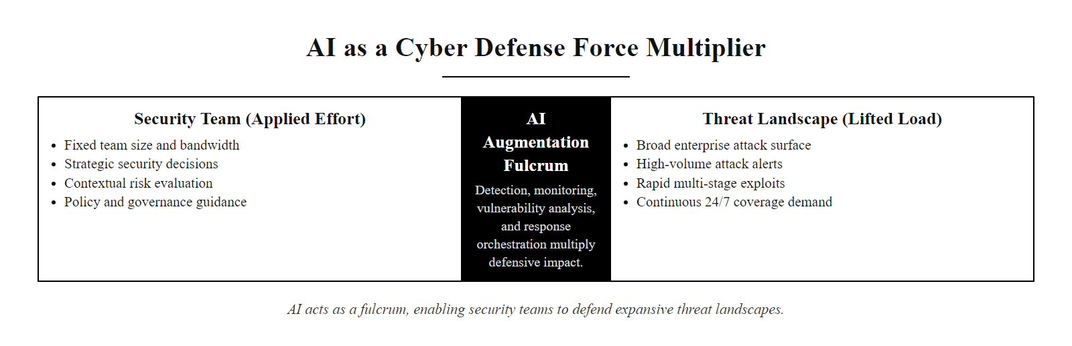
AI as a Force Multiplier (2/3)
AI as a force multiplier, the same security team, operating with dramatically greater coverage, speed, and precision through AI augmentation
Notes:
(continued, see part 1)

Slide 25
AI as a Force Multiplier (3/3)
Core AI-Augmented Defense Functions
Real-time anomaly detection using machine learning models
Behavioral analysis of network traffic and user activity
Automated correlation of security events across systems
Predictive modeling for vulnerability exploitation likelihood
Human-in-the-Loop Requirements
Final validation of detected threats before response
Context-aware risk assessment and policy enforcement
Ethical and legal oversight of autonomous actions
Strategic prioritization of incidents and resources
Notes:
(continued, see part 1)

Slide 26
Machine Learning Model Types in Cyber Defense
Not all machine learning is the same. Different threat detection tasks call for different model families, choosing the wrong one undermines both accuracy and explainability.
Notes:
Understanding the distinction between machine learning model families is fundamental to evaluating and deploying AI-based cyber defense tools intelligently. Security vendors often market "AI" and "ML" as monolithic capabilities, but in practice the effectiveness of any AI defense system is heavily dependent on matching the right model type to the specific detection problem.
Supervised learning models are trained on labeled datasets where each sample is tagged as benign or malicious. In cyber defense, this approach is used for tasks like malware classification (does this PE binary belong to a known malware family?), spam/phishing email detection (is this message a phishing attempt?), and network intrusion classification (does this packet trace match a known attack signature?). Well-known classifiers in this space include Random Forests, used extensively in tools like CrowdStrike Falcon, and deep neural networks used for image-based analysis of malware binary visualizations. The major limitation is data dependency: supervised models can only recognize what they have seen during training. A novel malware variant or a zero-day exploit pattern will likely evade a purely supervised classifier.
Unsupervised learning addresses exactly this gap by learning statistical structure from unlabeled data. Algorithms like isolation forests, k-means clustering, DBSCAN, and autoencoders establish mathematical models of "normal" and then compute anomaly scores for new observations. This approach powers User and Entity Behavior Analytics (UEBA) systems and network traffic analysis tools. Unsupervised methods excel at detecting zero-days, threats with no prior signature, because they measure deviation from baseline rather than matching against known patterns. A real-world example: after the SolarWinds Orion compromise (tracked under CVE-2020-14005 and related advisories), security teams analyzing network telemetry retrospectively used clustering algorithms to identify anomalous DNS beacon patterns that had been missed by signature-based controls during the dwell period.
Semi-supervised learning is particularly valuable in security contexts where labeled attack samples are scarce, a chronic challenge because new malware families emerge faster than analysts can label samples. Semi-supervised models learn from a small set of confirmed malicious examples and propagate those labels to structurally similar unlabeled data, effectively multiplying the utility of a limited ground-truth dataset.
Reinforcement learning represents the frontier of adaptive defense. RL agents learn optimal decision policies through interaction with an environment, receiving positive rewards for correct responses (e.g., blocking a true positive) and negative rewards for errors (e.g., blocking legitimate traffic). Researchers at DARPA and academic institutions have demonstrated RL agents capable of dynamically adjusting firewall rules and SOAR playbook parameters in response to changing attacker behavior, a significant advance toward truly autonomous cyber defense.
Model choice depends on the problem: detecting insider threats and detecting a new ransomware family pull in opposite directions, which exposes the trade-off between precision and the ability to detect novel threats.

Slide 27
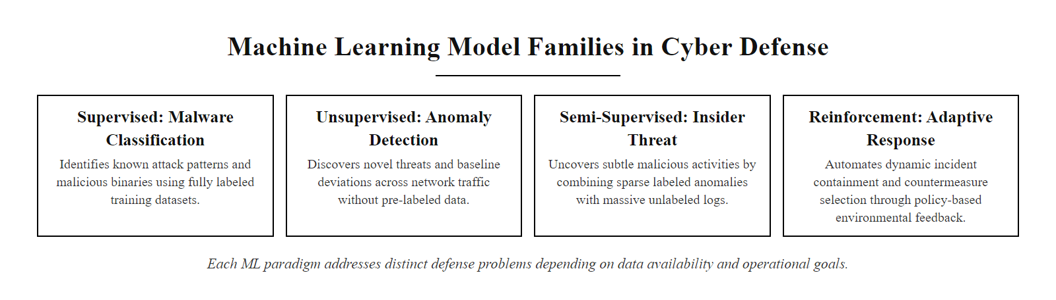
Machine Learning Model Types in Cyber Defense (2/3)
ML model selection in cyber defense, each family addresses a distinct detection problem and requires different training data assumptions
Notes:
(continued, see part 1)

Slide 28
Machine Learning Model Types in Cyber Defense (3/3)
Model Type | How It Learns | Cyber Defense Application | Example
Supervised Learning | Labeled examples (good/malicious) | Malware classification, phishing detection | Random forest on PE file features
Unsupervised Learning | Pattern structure in unlabeled data | Anomaly detection, zero-day discovery | Isolation forest on network flows
Semi-Supervised | Small labeled set + large unlabeled pool | Insider threat, rare event detection | Label propagation on user behavior
Reinforcement Learning | Rewards for correct decisions | Adaptive firewall rules, SOAR playbook tuning | RL agent adjusting blocking thresholds
Supervised Learning Strengths
High precision on known threat classes
Interpretable feature importance
Fast inference at production scale
Well-understood evaluation metrics (F1, AUC-ROC)
Unsupervised Learning Strengths
No labeled training data required
Detects novel/unknown attack patterns
Adapts to evolving baselines
Effective for zero-day and APT discovery
Notes:
(continued, see part 1)

Slide 29
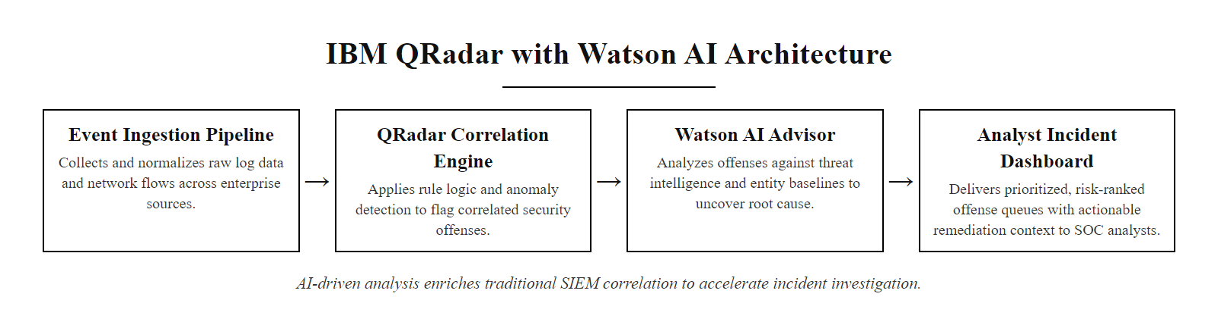
Tool Spotlight, IBM QRadar with Watson AI
IBM QRadar + Watson AI Advisor, a commercial SIEM implementation showing how AI is layered over traditional log correlation infrastructure
Notes:
IBM QRadar is one of the longest-standing commercial SIEM platforms, with deployments across financial services, healthcare, and government sectors worldwide. The integration of IBM Watson's cognitive computing capabilities into QRadar represents a real-world production example of AI-augmented security operations at enterprise scale.
The Watson AI Advisor component layers natural language processing and knowledge graph reasoning over QRadar's event correlation engine. When QRadar surfaces an offense (its term for a correlated security incident), Watson analyzes the associated indicators of compromise (IOCs), IP addresses, domains, file hashes, behavioral patterns, against IBM's X-Force Threat Intelligence Exchange and publicly available sources including CVE databases and MITRE ATT&CK. Watson then generates a structured investigation summary that maps the observed activity to known adversary tactics, techniques, and procedures (TTPs), explains the reasoning behind the correlation, and suggests specific investigative next steps.
This workflow directly addresses a major pain point in traditional SIEM operations: the "alert-to-context" gap. When a SIEM generates an offense, the analyst must manually pivot between multiple tools, threat intel platforms, CVE databases, internal asset inventories, to understand whether the alert represents a genuine threat. Watson automates that pivoting, dramatically compressing the time from alert receipt to actionable context. IBM's internal studies have reported reductions in mean time to investigate (MTTI) of 60% or more in mature QRadar deployments, though independent benchmarks vary.
From a standards perspective, QRadar's AI integration supports NIST CSF Detect function requirements (DE.AE-2: Detected events are analyzed to understand attack targets and methods) and NIST SP 800-137 (continuous monitoring). The MITRE ATT&CK mapping capability specifically enables alignment with the framework's technique taxonomy, helping organizations measure detection coverage across the kill chain.
It is important to frame QRadar as one implementation approach among several, not a universal standard. Microsoft Sentinel, Splunk Enterprise Security, and Palo Alto Cortex XSIAM offer comparable AI augmentation with different architectural philosophies. The appropriate tool choice depends on existing infrastructure, team expertise, and budget, not vendor marketing claims.
IBM QRadar with Watson suggestions illustrates AI-augmented offense investigation: the model proposes likely next steps and related offenses, which an analyst confirms or rejects.

Slide 30
Tool Spotlight, IBM QRadar with Watson AI (2/2)
IBM QRadar with Watson AI Advisor integrates cognitive threat investigation capabilities directly into the analyst workflow, surfacing related threat intelligence, suggesting investigative steps, and quantifying confidence levels for each alert.
Core QRadar + Watson Capabilities
Natural language threat intelligence queries
Automated IOC enrichment from X-Force Exchange
Watson-generated investigation summaries per incident
MITRE ATT&CK tactic/technique mapping for each alert
Risk-based offense ranking with confidence scoring
Analyst Workflow Integration
Alert fires → Watson surfaces relevant threat reports
Analyst asks natural-language questions about the incident
Watson retrieves and synthesizes relevant CVE/TTP context
System proposes containment steps based on similar past cases
Outcome feeds supervised model retraining
Notes:
(continued, see part 1)

Slide 31
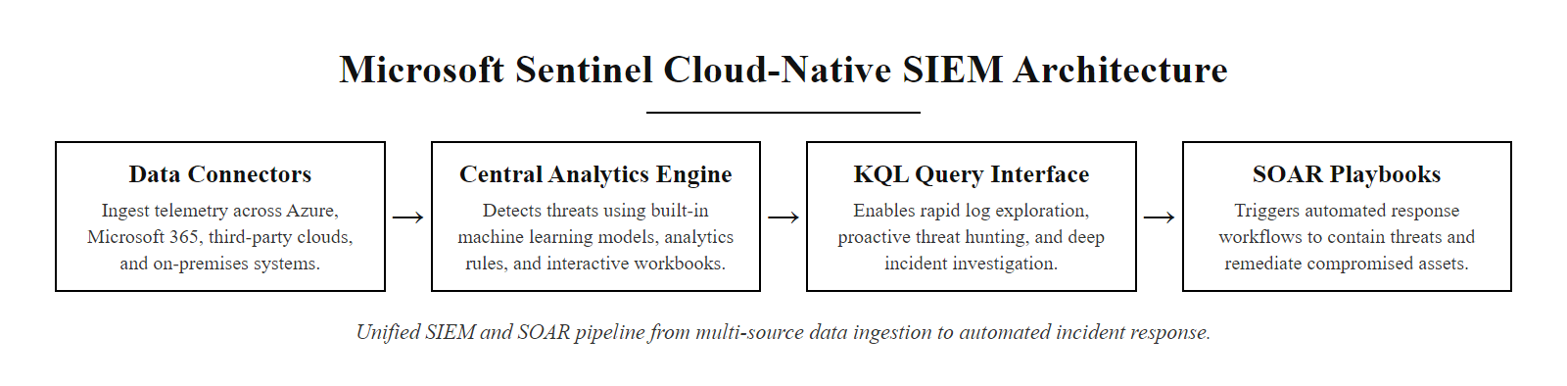
Tool Spotlight, Microsoft Sentinel
Microsoft Sentinel, a cloud-native SIEM/SOAR combining ML-based analytics, KQL threat hunting, and automated playbook response in a single managed service
Notes:
Microsoft Sentinel (formerly Azure Sentinel) represents the cloud-native generation of SIEM architecture, fundamentally different from traditional on-premises deployments like legacy QRadar or ArcSight installations. By running entirely within the Azure cloud platform, Sentinel eliminates the infrastructure overhead of managing SIEM appliances and allows security teams to ingest data from thousands of sources, Microsoft 365 email, Teams, SharePoint, Azure AD (now Entra ID), Defender for Endpoint, and hundreds of third-party connectors, through a unified data connector framework.
The most distinctive AI capability in Sentinel is the Fusion detection model. Fusion is a correlated multi-stage attack detection ML system that ingests low-fidelity alerts from multiple Sentinel data sources, signals that individually might not be suspicious, and correlates them into high-confidence, multi-stage attack scenarios. For example, Fusion might combine an Azure AD impossible travel alert (a user logging in from two geographically distant locations within minutes), a suspicious inbox rule creation in Exchange Online, and an unusual Azure resource deployment to generate a single high-confidence "BEC followed by cloud resource abuse" incident. Each individual signal is noise; their combination is signal. This approach aligns with MITRE ATT&CK's multi-stage kill chain model, specifically detecting technique sequences across Initial Access, Persistence, and Impact phases.
Sentinel's UEBA (User and Entity Behavior Analytics) module builds behavioral baselines per user and device entity using machine learning, then scores deviations. These scores appear as "entity insights" within each incident, helping analysts immediately understand whether the user associated with an alert has a history of similar behavior or represents a genuine anomaly. This capability is particularly effective for detecting insider threats, a challenge explicitly called out in NIST SP 800-53 AC-2 (Account Management) and NIST SP 800-53 SI-4 (Information System Monitoring).
For organizations heavily invested in the Microsoft ecosystem (Microsoft 365, Azure, Defender products), Sentinel offers deep native telemetry advantages. Microsoft's Threat Intelligence Center (MSTIC) continuously feeds curated threat actor profiles and IOCs into Sentinel, providing defenders with nation-state actor context (e.g., attribution of CVE-2023-23397, an Outlook zero-day exploited by the Russian threat actor tracked as Forest Blizzard/APT28) that independent SIEM deployments would need to source and integrate separately.
Microsoft Sentinel's Fusion correlation surfaces multi-stage attacks by combining individual low-confidence signals into a single higher-confidence incident, making the abstract idea of "AI correlation" observable.

Slide 32
Tool Spotlight, Microsoft Sentinel (2/2)
Microsoft Sentinel is a cloud-native SIEM and SOAR platform built on Azure that ingests data from Microsoft 365, Azure services, and third-party sources, using built-in ML analytics rules and AI-powered threat intelligence to detect and respond to threats at cloud scale.
Capability | Description | AI/ML Component
Analytics Rules | Detects threats via scheduled KQL queries | ML-based anomaly rules auto-tune thresholds
UEBA | User and Entity Behavior Analytics | Identifies lateral movement and insider risk
Threat Intelligence | Ingests IOC feeds and MSTIC research | Correlates with AI-scored confidence values
Incidents | Correlates alerts into investigation-ready cases | ML entity graph surfaces related activity
Playbooks | Logic Apps automating response workflows | Triggered by AI-identified high-confidence incidents
Key Differentiators vs. Traditional SIEM
No on-premises infrastructure to maintain, scales elastically with data volume
Native integration with Microsoft 365 Defender, Entra ID, and Defender for Endpoint
KQL (Kusto Query Language) enables expressive threat hunting queries
Fusion ML model correlates low-fidelity signals into high-confidence incidents
SOAR playbooks automate response across Azure, Microsoft 365, and third-party APIs
Notes:
(continued, see part 1)

Slide 33
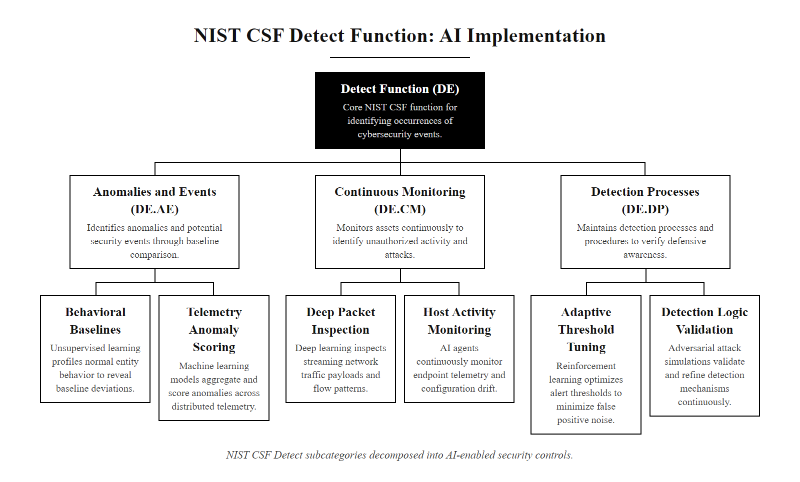
NIST CSF Detect Function, AI Implementation
NIST CSF Detect function decomposed, each subcategory maps to specific AI-enabled security control implementations
Notes:
The National Institute of Standards and Technology Cybersecurity Framework (NIST CSF), originally published in 2014 and substantially updated as CSF 2.0 in 2024, organizes cybersecurity activities into six core functions: Govern, Identify, Protect, Detect, Respond, and Recover. The Detect function, the third in the defensive posture, focuses specifically on the timely discovery of cybersecurity events and anomalies. It is within this function that AI-based defense systems provide their most direct and measurable contributions.
The Detect function contains three main categories: Anomalies and Events (DE.AE), Continuous Security Monitoring (DE.CM), and Detection Processes (DE.DP). Each maps to specific AI capabilities.
DE.AE-1 requires that organizations establish a baseline of network operations and expected data flows, against which anomalies can be identified. AI implementations of this requirement typically involve unsupervised machine learning models that learn statistical properties of normal traffic, average packet sizes, communication frequency between hosts, typical protocol distributions, and flag deviations. This is the foundational task of platforms like Darktrace (which uses self-supervised learning it calls the "Enterprise Immune System") and Cisco Secure Network Analytics, which applies ML to NetFlow data.
DE.AE-2 requires that detected events be analyzed to understand the attack targets and methods involved. AI enables this through natural language processing of log and alert text, combined with MITRE ATT&CK mapping. When a SIEM alert fires, AI enrichment layers can automatically determine which ATT&CK technique the detected behavior most closely resembles (e.g., T1003 - OS Credential Dumping) and retrieve relevant threat actor profiles who commonly use that technique, compressing what would otherwise be a 30-minute analyst research task into seconds.
DE.CM-1 covers continuous monitoring of network infrastructure. AI-enhanced network detection and response (NDR) tools like ExtraHop Reveal(x) and Vectra AI apply deep learning models to encrypted network traffic metadata, even without decrypting the payload, to detect anomalous communication patterns indicative of command-and-control activity or data exfiltration. These systems directly implement the CSF's continuous monitoring mandate.
CSF 2.0 (released February 2024) added new emphasis on AI governance and automation within security programs, explicitly acknowledging AI-driven detection tools as valid implementations of CSF controls. This update reflects the maturation of AI security tools from experimental capabilities to mainstream enterprise security infrastructure.
The NIST CSF 2.0 online navigator maps an organization's current controls onto CSF subcategories and highlights gaps, a practical skill for security-program assessment roles.

Slide 34
NIST CSF Detect Function, AI Implementation (2/2)
The NIST Cybersecurity Framework's Detect function defines WHAT organizations must detect, AI systems provide the HOW, enabling continuous, automated, and scalable detection at a level humans cannot achieve manually.
CSF Subcategory | Requirement | AI Implementation
DE.AE-1 | Network baseline established | ML behavioral profiling of normal traffic patterns
DE.AE-2 | Events analyzed for attack targets/methods | NLP analysis of logs mapped to MITRE ATT&CK TTPs
DE.AE-3 | Event data aggregated from multiple sources | AI-driven SIEM correlation across heterogeneous feeds
DE.AE-5 | Incident alert thresholds established | ML dynamic thresholding adapting to environment changes
DE.CM-1 | Network monitored for attack events | Packet inspection with deep learning anomaly models
DE.CM-7 | Unauthorized activity and connections monitored | UEBA scoring for unusual access, lateral movement
DE.DP-4 | Detection information communicated | Automated alert enrichment with context and suggested actions
Notes:
(continued, see part 1)

Slide 35
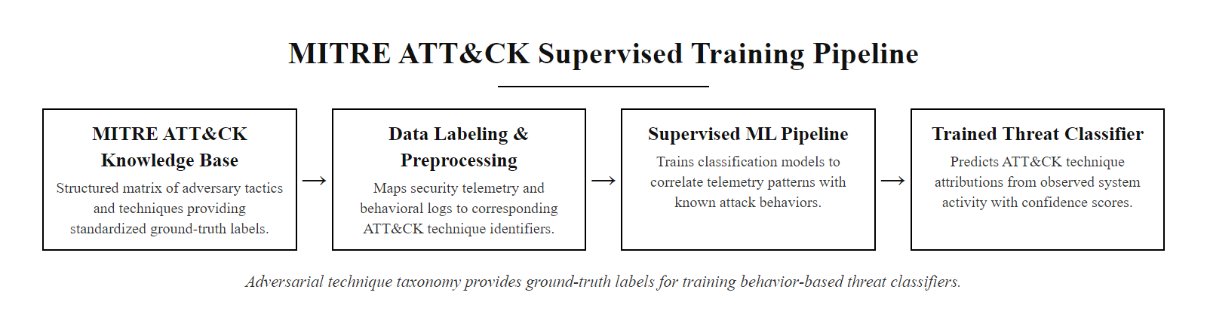
MITRE ATT&CK as AI Training Data
MITRE ATT&CK as an AI training resource, structured adversarial knowledge annotated at technique level becomes labeled training data for supervised threat detection models
Notes:
MITRE ATT&CK (Adversarial Tactics, Techniques, and Common Knowledge) is maintained by MITRE Corporation and represents one of the most comprehensive publicly available structured knowledge bases of adversary behavior. First publicly released in 2015 based on analysis of real-world advanced persistent threat (APT) intrusions, ATT&CK has grown to encompass the Enterprise, Mobile, and ICS (Industrial Control Systems) matrices, covering over 200 techniques and hundreds of sub-techniques across platforms including Windows, Linux, macOS, cloud environments, and network infrastructure.
What makes ATT&CK particularly valuable for AI applications is its structure: each technique entry includes a description of the adversarial behavior, documented procedure examples from real-world attacks attributed to specific threat actor groups, data sources that can detect the technique, and in many cases, specific detection guidance. This structured, labeled data is directly usable as training ground truth for supervised machine learning models.
In practice, AI developers and security researchers use ATT&CK in several ways. First, teams map their existing SIEM rule outputs and endpoint detection alerts to ATT&CK technique IDs, creating a labeled dataset linking observed telemetry to known adversarial behaviors. This labeled dataset then trains classifiers that can recognize similar patterns in new telemetry. For example, a classifier trained on examples of T1059.001 (PowerShell command execution with encoded commands) learns to flag novel PowerShell invocations that match the structural pattern even without a matching signature.
Second, natural language processing models trained on ATT&CK procedure text and threat intelligence reports can automatically extract TTPs from unstructured threat reports, a capability called "automated TTP extraction." Tools like OpenCTI and MISP increasingly incorporate NLP models that parse PDF threat reports and automatically populate structured threat intelligence records, significantly accelerating the analysis of new threat actor activity.
Third, ATT&CK enables systematic detection coverage analysis. By mapping each deployed detection control to the ATT&CK techniques it covers, security teams can use AI-assisted gap analysis tools (such as the ATT&CK Navigator) to identify techniques with no detection coverage, a critical input for red team prioritization and security tooling investment decisions. Organizations following NIST SP 800-53 controls, particularly SI-4 (Information System Monitoring), can use ATT&CK coverage mapping as evidence of systematic detection control deployment.
The 2023 D3FEND framework, also from MITRE, provides a complementary knowledge graph of defensive techniques mapped to ATT&CK offensive techniques, enabling AI systems to automatically recommend defensive countermeasures based on detected offensive activity.
The MITRE ATT&CK STIX/TAXII feed provides the whole ATT&CK knowledge base in machine-readable form, usable directly through the mitreattack-python library for AI security tooling.

Slide 36
MITRE ATT&CK as AI Training Data (2/2)
MITRE ATT&CK is not just a framework for human analysts, it is one of the most valuable structured datasets available for training AI-based threat detection models, providing labeled adversary behaviors linked to real-world threat groups.
ATT&CK technique documented with procedure examples
→ Security logs annotated with corresponding technique labels
→ Labeled dataset used to train supervised classifier
→ Model learns to recognize technique patterns in live telemetry
→ Detection fires with ATT&CK tactic/technique attribution
→ Analyst receives alert with immediate adversarial context
ATT&CK Data Available for AI Training
200+ techniques across 14 tactics
Thousands of documented sub-technique procedure examples
Attribution to 130+ named threat groups
Software/tool listings with behavioral indicators
Detections guidance per technique (data sources, sensor types)
AI Applications Leveraging ATT&CK
Supervised classifiers mapping logs to technique IDs
NLP models parsing threat reports for TTP extraction
Coverage gap analysis (which techniques lack detection?)
Attack graph generation for breach simulation
Red team automation grounded in documented TTPs
Notes:
(continued, see part 1)

Slide 37
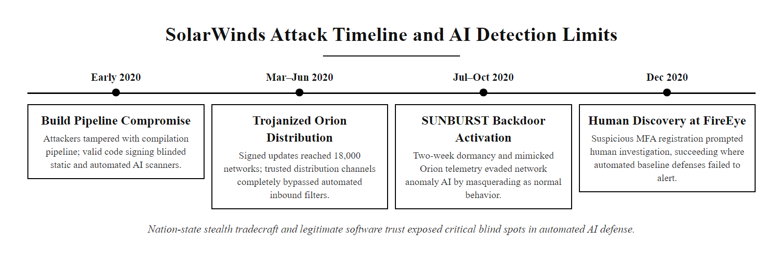
Case Study, SolarWinds and AI Detection Limits
SolarWinds supply chain attack timeline, a case study in the limits of signature-based and AI detection against nation-state-level stealth tradecraft
Notes:
The SolarWinds Orion supply chain attack, publicly disclosed by FireEye in December 2020, stands as one of the most significant and instructive cybersecurity events of the 2020s. The attack, attributed by the U.S. government to SVR (Russia's Foreign Intelligence Service), compromised SolarWinds' software build pipeline, inserting the SUNBURST backdoor into legitimate Orion software updates distributed to approximately 18,000 organizations worldwide, including multiple U.S. federal agencies, Fortune 500 companies, and security vendors.
The attack's stealth was engineered specifically to defeat automated and AI-based detection. The SUNBURST malware incorporated multiple detection-evasion techniques: a 12-14 day dormancy period after installation during which it performed no malicious activity, avoiding behavioral anomaly detection thresholds; communication via legitimate HTTP/S to avsvmcloud[.]com, mimicking standard Orion telemetry patterns that security tools had whitelisted; use of the victim organization's own legitimate administrative tools (living off the land, MITRE ATT&CK T1218) to avoid process-anomaly alerts; and domain generation algorithm communication patterns that resembled legitimate DNS traffic statistically.
The critical lesson here is not that AI failed, but that adversarial tradecraft at nation-state level explicitly targets the known behaviors of AI detection systems. The attackers studied how anomaly detection systems work and engineered their malware to stay within statistical norms. This is a form of adversarial machine learning in practice, not academic theory.
However, AI played an essential and positive role once the threat was discovered. After FireEye's human analysts discovered the compromise through manual threat hunting, the AI-assisted response was remarkable in scope. Microsoft, Mandiant, and SolarWinds worked with affected organizations to deploy automated threat hunting queries across thousands of environments simultaneously, using AI-powered SIEM platforms to match newly published SUNBURST IOCs against historical logs. Graph analytics tools mapped lateral movement paths within compromised networks, revealing which accounts, hosts, and data the attacker had accessed, work that would have taken human analysts months of manual investigation.
CISA issued Emergency Directive 21-01, the most urgent directive CISA had ever issued at the time, requiring immediate disconnection of SolarWinds Orion platforms. The coordination of AI tools in rapid scope assessment across the federal government's network represented AI defense capabilities at national scale.
The SolarWinds attack is referenced in NIST SP 800-161 (Cybersecurity Supply Chain Risk Management) and contributed directly to Executive Order 14028 (Improving the Nation's Cybersecurity, May 2021), which mandated Zero Trust architecture adoption across federal agencies and expanded logging requirements, both of which improve the AI detection baseline that sophisticated attacks exploit.
The question of which AI detection could have caught SUNBURST in a SolarWinds Orion deployment surfaces the central trade-off: detection sensitivity catches subtle anomalies, but high false-positive rates lead analysts to ignore low-confidence signals, which is exactly what happened.

Slide 38
Case Study, SolarWinds and AI Detection Limits (2/2)
The 2020 SolarWinds Orion supply chain attack remained undetected for 9+ months despite multiple AI and automated defense tools being deployed across affected organizations. Understanding why teaches more than any success story.
Why AI Detection Failed
Malware delivered via legitimate signed software update
SUNBURST mimicked legitimate Orion traffic patterns
2-week dormancy avoided behavioral anomaly triggers
Attacker used target's own admin tools (living-off-the-land)
Traffic blended with legitimate SolarWinds cloud API calls
What AI Helped With After Discovery
Rapid threat hunting across 18,000 affected organizations
Automated IOC matching once indicators were published
Graph analytics uncovered lateral movement paths
NLP extraction of SUNBURST TTPs from threat reports
AI-assisted scope assessment at unprecedented speed
Notes:
(continued, see part 1)

Slide 39
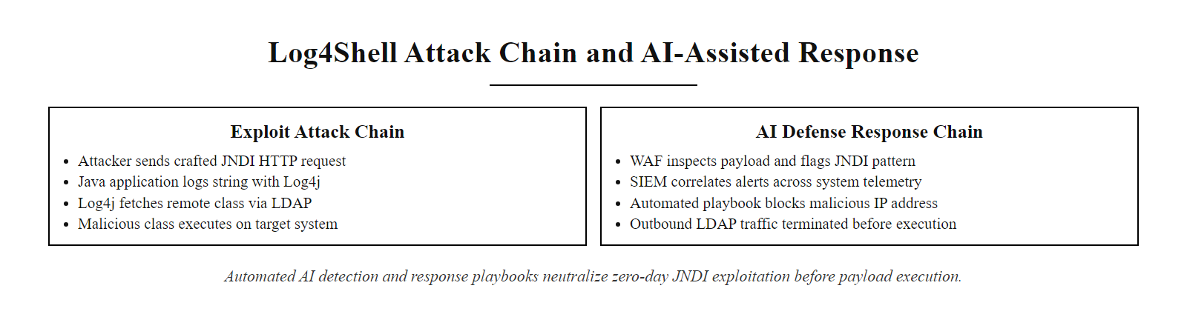
Case Study, Log4Shell and AI-Assisted Response
Log4Shell (CVE-2021-44228) attack chain and AI-assisted detection/response, a study in rapid organizational response to a critical zero-day
Notes:
CVE-2021-44228, commonly known as Log4Shell, was disclosed publicly on December 9, 2021, by the Alibaba Cloud Security Team. The vulnerability existed in Apache Log4j 2, a Java logging library used by thousands of applications and services worldwide, including major cloud platforms, enterprise software, games, and embedded industrial systems. The flaw allowed attackers to inject a specially crafted string into any field that Log4j would log, triggering an outbound JNDI (Java Naming and Directory Interface) lookup to an attacker-controlled server, which could then deliver a malicious Java class file for remote code execution. CVSS score: 10.0, critical by every metric.
The response to Log4Shell represents the most visible mass deployment of AI-assisted vulnerability detection and response in cybersecurity history. Within 72 hours of disclosure, multiple AI-augmented security tools demonstrated capabilities at scale that would have been impossible with manual processes.
On the detection side, SIEM platforms with AI search capabilities allowed organizations to retrospectively hunt months of archived logs for JNDI injection strings, a task that would have taken human analysts weeks to perform manually across enterprise-scale log volumes. AI-powered WAF systems from Cloudflare, AWS, and Fastly automatically generated and deployed detection rules based on the published CVE, initially blocking simple JNDI ldap string patterns. When attackers began obfuscating payloads using nested substitution, AI anomaly models helped detect the statistical pattern of unusual string structures in HTTP headers even without matching a specific signature.
The EPSS system provided a concrete example of AI-assisted prioritization working in real time: Log4Shell's EPSS score surged to one of the highest ever recorded within days of disclosure, correctly predicting that active exploitation was occurring at massive scale, which was confirmed by Cloudflare's disclosure that it observed over 1 million exploitation attempts per minute at peak.
The vulnerability also exposed a critical gap in AI-assisted vulnerability management: the indirect dependency problem. Many organizations had no direct Log4j deployments but used commercial software that embedded Log4j internally. Traditional vulnerability scanners could not detect these indirect dependencies, and AI tools that relied on software inventory data were blind to components not reflected in that inventory. This gap directly prompted CISA and NIST to accelerate work on Software Bill of Materials (SBOM) standards, codified in Executive Order 14028, which provide the structured dependency data that AI vulnerability tools need to be comprehensive.
Log4Shell affected nearly every major software system in use in 2021, from game servers to hospital software to national-security systems. The breadth shows both the value of AI-assisted rapid response and the difficulty of managing software dependencies at ecosystem scale.

Slide 40
Case Study, Log4Shell and AI-Assisted Response (2/2)
CVE-2021-44228 (Log4Shell), disclosed December 9, 2021, earned a CVSS score of 10.0, the maximum. Within 72 hours, AI-assisted scanning and detection tools were identifying exploitation attempts at global scale.
AI-Assisted Log4Shell Detection and Response
CVE-2021-44228 disclosed publicly, JNDI injection in Apache Log4j 2.x allows remote code execution
Security vendors push WAF and IDS signature updates within hours, first detection layer
AI-driven SIEM platforms ingest threat intelligence and begin hunting historical logs for JNDI strings across all indexed data
UEBA and anomaly detection flag unusual Java process spawning unexpected child processes or outbound LDAP connections
SOAR playbooks automatically quarantine hosts exhibiting exploitation indicators and notify asset owners
AI vulnerability scanners auto-prioritize Log4j instances by exposure and criticality within hours of CVE publication
AI Detection Successes
Retrospective log scanning at enterprise scale in hours
Automated EPSS score flagged Log4j as critical exploitation target
SIEM correlation detected active exploitation across thousands of organizations simultaneously
NLP parsing of CVE advisories auto-populated vulnerability records
Remaining Challenges
Log4j deeply embedded in third-party software (indirect dependencies)
Obfuscated JNDI strings evaded initial signature-based WAF rules
Asset inventory gaps meant many deployments unknown to scanners
Speed of response required human decision-making at unprecedented pace
Notes:
(continued, see part 1)

Slide 41
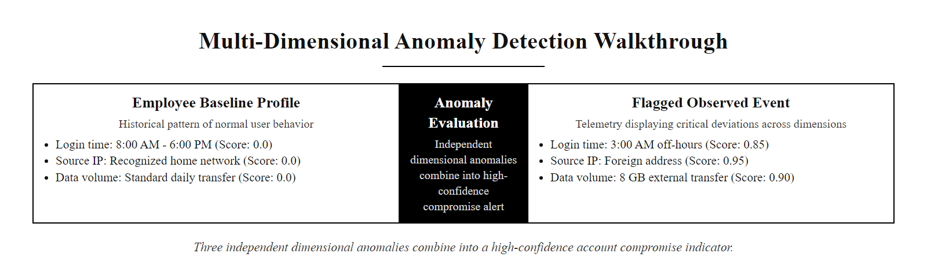
Worked Example, Anomaly Detection Walkthrough
Anomaly detection step-by-step, three independent dimensional anomalies combine into a high-confidence account compromise indicator
Notes:
This worked example illustrates the end-to-end mechanics of how ML-based anomaly detection actually functions in practice, moving from abstract statistical concepts to a concrete investigation scenario. Understanding this walkthrough enables security practitioners to both evaluate AI detection tools critically and explain the detection rationale to non-technical stakeholders.
The scenario involves a standard UEBA (User and Entity Behavior Analytics) detection. Step one, baseline establishment, is the foundational prerequisite for any anomaly detection system. Machine learning models observe a user's behavior over a calibration period (typically 30 days minimum) and build a multi-dimensional behavioral profile. Dimensions commonly profiled include: login timing (hours of day, days of week), source network location (IP ranges, geographic regions, VPN vs. direct), authentication method, data access patterns (which file systems, data volumes), application usage patterns, and destination networks for data transfers. Unsupervised learning algorithms, often Gaussian models for continuous dimensions (time, data volume) or categorical probability distributions for discrete dimensions (IP geolocation, application), encode these baselines.
Step three, dimensional anomaly scoring, is where the statistical mechanics become important. Each dimension is scored independently using its learned baseline distribution. A 3am login receives a high anomaly score because it falls multiple standard deviations from the mean login time. The Tor exit node IP receives a critical anomaly score because it has zero historical frequency in Alice's profile and belongs to a known-bad category through threat intelligence enrichment. The 8.2GB transfer receives a high score because it represents 40x the baseline daily data access volume.
The combination step (step four) varies by implementation. Some systems use simple weighted sums; others use ensemble models that combine multiple independent anomaly detectors. More sophisticated implementations use a second-level ML model (a meta-classifier) trained on past confirmed incidents to learn which combinations of dimensional anomalies most reliably predict true positives versus false positives.
This example aligns with MITRE ATT&CK technique T1078 (Valid Accounts), the account is valid, the credentials are authentic, but the behavior pattern reveals compromise. It also demonstrates NIST CSF DE.CM-7 (monitoring for unauthorized personnel, connections, devices, and software) in practice. The human validation step illustrates why human-in-the-loop remains essential: only a human checking the HR system or contacting Alice's manager can confirm that the unusual behavior is suspicious rather than a legitimate exception.

Slide 42
Worked Example, Anomaly Detection Walkthrough (2/2)
Walk through a real detection scenario: an employee account exhibiting three simultaneous behavioral anomalies that, individually, might be dismissed, but together constitute a high-confidence insider threat or account compromise indicator.
Anomaly Detection Scenario Walkthrough
Baseline established, ML model profiles employee Alice: login hours 8am–6pm weekdays, always from corporate network or home VPN IP, average daily data access 200MB, no external cloud storage transfers
Anomalous event detected, Login at 3:14 AM from IP address 185.220.x.x (a known Tor exit node), followed by 8.2GB file transfer to dropbox.com
Dimensional anomaly scoring, Time anomaly (3am vs 8am-6pm baseline): high score; Source IP anomaly (Tor exit node vs known IPs): critical score; Data volume anomaly (8.2GB vs 200MB baseline): high score; Destination anomaly (external cloud vs internal systems): critical score
Combined risk score calculated, Each dimension scored independently, then combined via ensemble model or weighted sum into overall incident risk score of 94/100
Alert escalated, SIEM surfaces incident to L2 analyst queue with all four anomaly dimensions, contextual data, and similar historical cases
Human validation, Analyst confirms Alice is on approved leave this week, account compromise confirmed; IR playbook initiated
Notes:
(continued, see part 1)

Slide 43
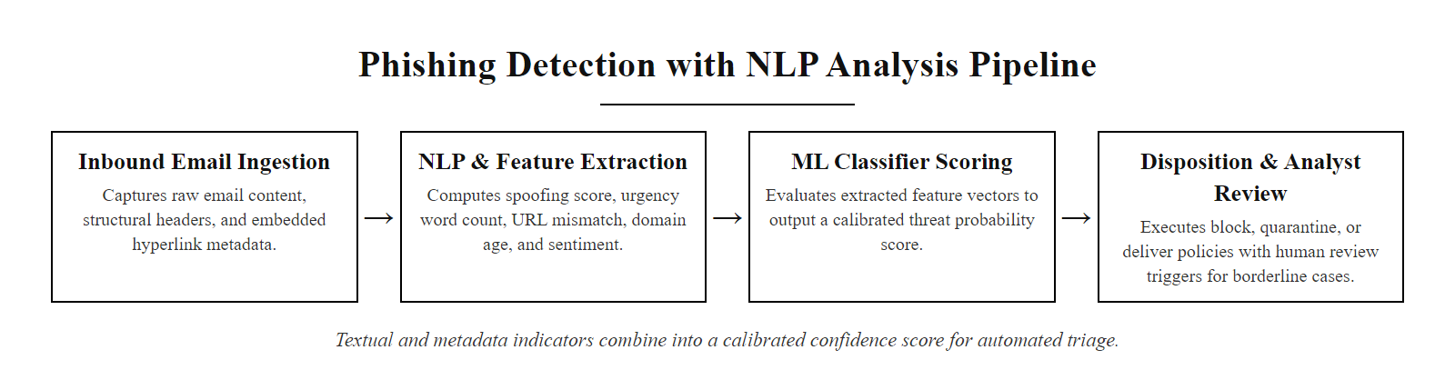
Worked Example, Phishing Detection with NLP
NLP-based phishing detection pipeline, multiple language and metadata features combine into a calibrated confidence score for each email
Notes:
Phishing remains one of the most prevalent and effective initial access vectors in cybersecurity. The 2023 Verizon Data Breach Investigations Report (DBIR) identified phishing as the leading cause of breaches for the 13th consecutive year. While traditional email security relied on signature-based URL blocking and sender reputation lists, NLP-based detection represents the state of the art in anti-phishing capability.
The fundamental insight behind NLP-based phishing detection is that phishing emails are characterized not just by their technical properties (malicious links, spoofed sender domains) but by distinctive language patterns, the linguistic fingerprints of social engineering. Security researchers have identified consistent psychological manipulation patterns in phishing content: urgency (creating time pressure to suppress critical thinking), authority (impersonating executives or trusted institutions to leverage compliance psychology), and scarcity (suggesting that something valuable will be lost without immediate action). These are the same psychological levers described by Robert Cialdini in Influence and codified in MITRE ATT&CK technique T1566 (Phishing).
Modern NLP phishing detection models are typically trained on large labeled datasets of confirmed phishing emails (publicly available datasets include the Enron email corpus, PhishTank data, and collections from academic research groups) and legitimate corporate communications. Feature engineering extracts dozens to hundreds of signals from each email: linguistic features (urgency word frequency, named entity recognition for spoofed organization names, readability scores that correlate with hastily written phishing content), structural features (HTML-to-text ratio, number of external links, redirect chains), and metadata features (sender domain age from WHOIS, SPF/DKIM authentication failures, IP geolocation).
Transformer-based language models (BERT variants fine-tuned on email data) represent the current frontier of NLP phishing detection. These models capture semantic meaning and context that earlier bag-of-words or TF-IDF approaches missed. For example, a BERT-based classifier can learn that "kindly validate your credentials" is semantically suspicious even if neither word individually triggers a keyword rule, because the full phrase pattern is characteristic of non-native English phishing templates despite being grammatically correct.
Multi-language phishing is an important practical consideration. As organizations operate globally, phishing campaigns increasingly target employees in languages other than English. Modern NLP models must be multilingual (e.g., mBERT, XLM-RoBERTa) to maintain detection fidelity across language-diverse workforces. The ISO/IEC 27001 control A.8.7 (Protection against malware) and NIST SP 800-177 (Trustworthy Email) both establish requirements for email security controls that NLP detection systems directly fulfill.
Comparing legitimate and phishing emails to identify the distinguishing language features builds intuition for what an ML classifier learns and why language-aware detection catches attacks that URL and IP blocklists miss.

Slide 44
Worked Example, Phishing Detection with NLP (2/2)
Natural Language Processing applies linguistic analysis to email content, detecting phishing not just from technical headers but from the language patterns, urgency cues, and deceptive structures that characterize social engineering attempts.
NLP Feature | Phishing Indicator | Example
Urgency language | High-pressure time constraints | "Your account will be suspended in 24 hours"
Authority spoofing | Impersonation of executives or trusted brands | "CEO John Smith" from external domain
URL/text mismatch | Display text differs from actual href | "Click here" linking to phishing domain
Sender domain age | Newly registered domains | Domain created 48 hours before email sent
Grammatical anomalies | Non-native language patterns | Unusual syntax or word choice patterns
Request type | Credential or payment requests | "Confirm your login" or "Wire transfer needed"
NLP Model Pipeline Steps
Tokenization, email body split into word and subword tokens
Feature extraction, linguistic patterns, entity recognition (URLs, names, organization references)
Metadata enrichment, WHOIS lookups, DKIM/SPF validation, sender reputation scores
Classification, ensemble of text classifier and metadata classifier producing combined confidence score
Threshold routing, high confidence blocks automatically; borderline cases route to analyst review
Notes:
(continued, see part 1)

Slide 45
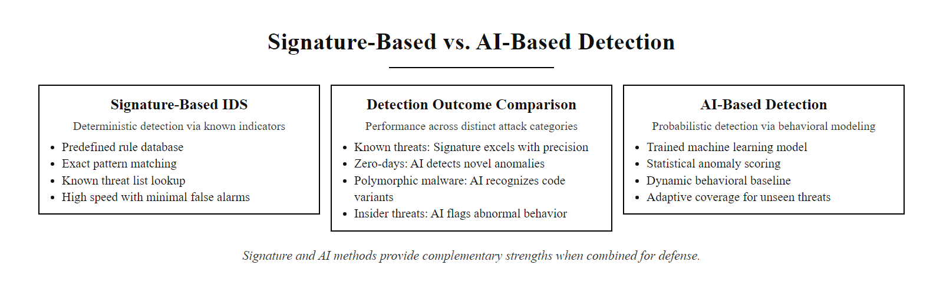
Comparison, Signature-Based vs. AI-Based Detection
Signature-based versus AI-based intrusion detection, complementary strengths that are most effective in combination
Notes:
The comparison between signature-based and AI-based detection represents one of the most important conceptual distinctions in modern intrusion detection systems (IDS) and endpoint protection. Understanding the strengths and limitations of each approach, and how they complement rather than replace each other, is foundational knowledge for any security practitioner.
Signature-based detection (also called misuse detection) works by maintaining a database of known attack patterns, sequences of bytes, protocol behaviors, or system calls that match documented attacks. When network traffic or system activity matches a signature, an alert fires. The primary advantage is precision: when a signature matches, it almost always means a genuine attack, yielding low false positive rates. Snort and Suricata, the most widely deployed open-source network IDS platforms, use signature-based detection as their primary mechanism. Commercial platforms like CrowdStrike Falcon and Microsoft Defender also incorporate signatures for known malware families. CVE-specific signatures (e.g., detecting Log4Shell exploitation via JNDI string patterns) provide rapid, reliable detection for known, documented vulnerabilities.
The critical limitation of signature-based detection is what it cannot detect: anything it has not seen before. Polymorphic malware (malware that mutates its code structure while preserving malicious functionality), zero-day exploits (attacks against undisclosed vulnerabilities), and living-off-the-land techniques (using legitimate system tools for malicious purposes) all evade signature matching because they produce no pattern matching existing signatures. The SolarWinds SUNBURST malware case study exemplifies this limitation, the backdoor produced no signature-matchable malicious activity during its operational phases.
AI-based anomaly detection inverts this logic: instead of detecting known-bad patterns, it detects deviations from known-good baselines. This approach catches novel attacks by definition, if an attack produces behavior that deviates from the established baseline, it registers as anomalous regardless of whether any signature for that specific attack exists. The trade-off is precision: legitimate behavioral changes can trigger false positives, requiring threshold tuning and contextual enrichment to maintain analyst confidence.
NIST SP 800-94 (Guide to Intrusion Detection and Prevention Systems) explicitly addresses this trade-off, describing both misuse detection and anomaly detection as valid IDS categories with complementary use cases. The recommended architecture, adopted by modern enterprise security platforms, is a layered hybrid: signature-based detection for high-precision known-threat identification, plus AI anomaly detection for zero-day and behavioral threat coverage, with SIEM correlation combining signals from both.
Signature detection resembles a lab test for a specific pathogen: highly accurate but blind to unknown ones. Anomaly detection resembles a fever detector: it flags illness generically but requires follow-up to find the cause. Both are useful; neither alone is sufficient.

Slide 46
Comparison, Signature-Based vs. AI-Based Detection (2/2)
Detection Dimension | Signature-Based | AI-Based (Behavioral/Anomaly)
Known threats | Excellent, exact match | Good, but unnecessary for known threats
Zero-day exploits | Poor, no signature exists | Good, detects behavioral deviation
Polymorphic malware | Poor, signature evaded by mutation | Better, behavioral pattern survives mutation
Insider threats | Poor, valid accounts/actions | Good, detects behavioral anomalies
False positive rate | Low (specific rules) | Higher (requires tuning)
Computational cost | Low | Higher (continuous model inference)
Interpretability | High, rule is explicit | Lower, model decision needs XAI
Update mechanism | Manual signature updates | Model retraining on new data
Best practice: signature-based and AI detection are complements, not substitutes, deploy both in a layered defense architecture.
Notes:
(continued, see part 1)

Slide 47
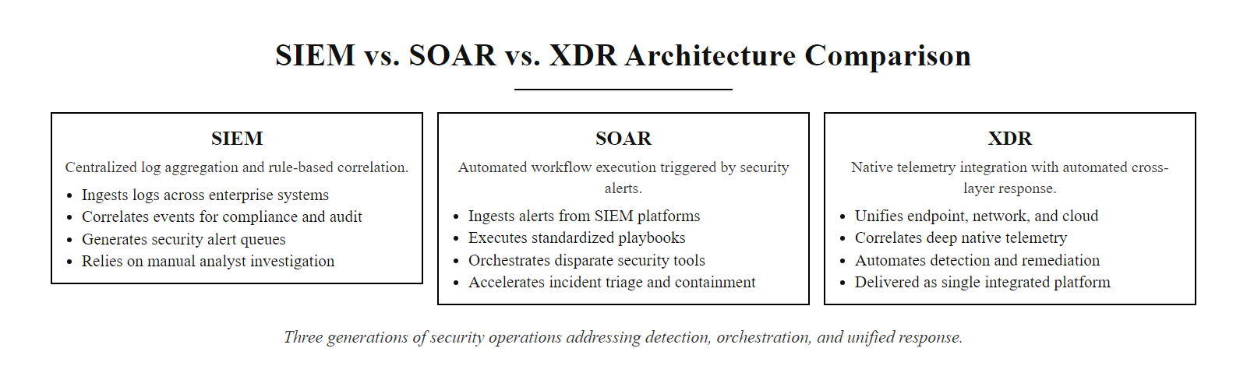
Comparison, SIEM vs. SOAR vs. XDR
SIEM, SOAR, and XDR compared, three generations of security operations architecture each addressing a different bottleneck in the detect-respond cycle
Notes:
Three terms, SIEM, SOAR, and XDR, represent distinct generations of security operations technology, each solving a different bottleneck in the detect-respond cycle. Security practitioners frequently encounter all three in enterprise environments, and understanding their differences, relationships, and appropriate use cases is essential for designing effective SOC architectures.
Security Information and Event Management (SIEM) platforms emerged in the mid-2000s as a response to the growing need to centralize security log data from heterogeneous enterprise environments. A SIEM ingests logs from firewalls, IDS/IPS, servers, endpoints, cloud services, and applications; normalizes them into a common data model; applies correlation rules to link related events; and generates alerts for analyst review. The defining characteristic of a SIEM is breadth, it can accept log data from virtually any source, but its limitation is that it produces alerts without taking action. Human analysts or integrated tools must review and respond to each alert. AI enhancement in SIEMs focuses on improving alert quality through behavioral anomaly detection and ML-based risk scoring.
Security Orchestration, Automation, and Response (SOAR) platforms solve the SIEM's response gap by adding automated playbook execution. When a SIEM alert fires, or when any defined trigger condition is met, a SOAR platform can execute multi-step response workflows: querying threat intelligence, isolating an endpoint via EDR API, disabling a user account in Active Directory, opening a ticketing system case, and notifying the analyst, all without human intervention. SOAR's AI contribution lies in intelligent playbook routing: ML models can select which playbook to execute based on alert characteristics and predict whether a given alert warrants automated response or human escalation. Tools like Splunk SOAR, Palo Alto XSOAR, and Microsoft Sentinel Logic Apps playbooks implement this architecture.
Extended Detection and Response (XDR) is the newest architectural concept, originating around 2018-2019 as vendors like Palo Alto Networks, CrowdStrike, and Microsoft positioned integrated cross-domain security platforms as an alternative to disparate point solutions. An XDR platform natively collects telemetry from its own endpoint, network, cloud, and identity products, providing pre-normalized, pre-correlated data without the integration overhead of a traditional SIEM. XDR platforms incorporate AI detection models optimized for their own telemetry, enabling faster detection at the cost of flexibility.
The choice between these architectures depends on organizational context. Large enterprises with heterogeneous, multi-vendor environments and deep compliance log-retention requirements typically maintain SIEM as the foundation. Mid-market organizations standardizing on a security vendor's ecosystem increasingly adopt XDR for its operational simplicity. Many mature SOCs deploy SIEM + SOAR in combination, using SOAR to close the response gap that SIEM leaves open.
NIST SP 800-61 (Computer Security Incident Handling Guide) and CISA's operational guidance both describe incident response workflows that map naturally to SOAR playbook design. ISO/IEC 27035 (Information Security Incident Management) provides the governance framework within which SIEM/SOAR/XDR implementations operate.
The right detection architecture is context-dependent: a 500-person company standardized on Microsoft 365 and Azure and a 50,000-person financial institution with hundreds of security vendors call for different designs.

Slide 48
Comparison, SIEM vs. SOAR vs. XDR (2/2)
Dimension | SIEM | SOAR | XDR
Primary function | Log collection, correlation, alerting | Alert-triggered response automation | Unified detection + response across domains
Data scope | Logs from any source (heterogeneous) | Actions on systems via integrations | Native telemetry from vendor ecosystem
AI role | ML anomaly detection, alert scoring | Playbook step selection, decision trees | Integrated AI detection models per domain
Response capability | Alert only (no automatic response) | Full automated playbook execution | Automated response within XDR platform
Integration complexity | High, requires normalization | High, requires connector development | Lower, native integration within vendor
Use case | Large enterprise, heterogeneous env | SOC automation and orchestration | Mid-market, vendor-aligned environments
SIEM sees everything but responds to nothing. SOAR responds automatically but depends on SIEM for detection. XDR collapses both into a single platform for the vendor's telemetry domain.
When to Choose Each
SIEM, large org, many vendors, deep log retention needs
SOAR, mature SOC wanting to automate repetitive responses
XDR, standardizing on a security vendor ecosystem, faster deployment
Notes:
(continued, see part 1)

Slide 49
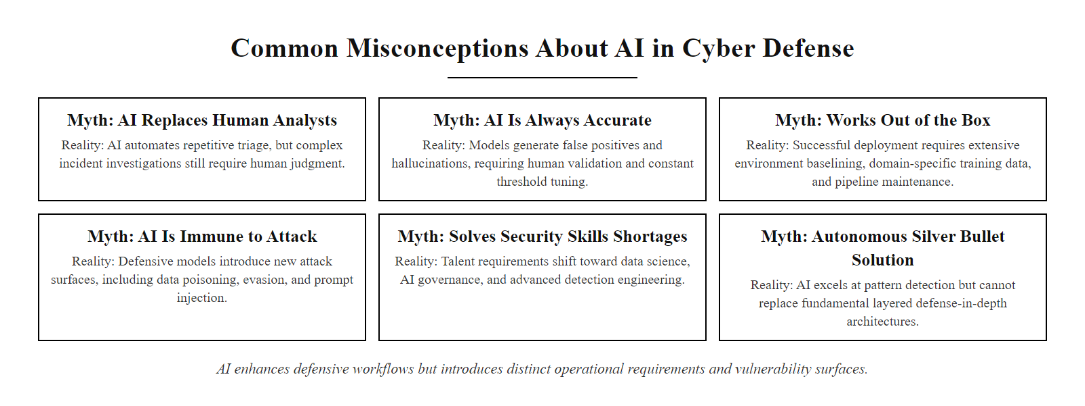
Common Misconceptions About AI in Cyber Defense
Six persistent AI cyber defense misconceptions, each represents a failure mode in how organizations deploy or evaluate AI security tools
Notes:
One of the most important professional skills for any cybersecurity practitioner is the ability to critically evaluate claims made by security vendors, industry analysts, and media coverage about artificial intelligence in cyber defense. The AI security market is characterized by significant hype, and organizations that adopt AI tools based on vendor marketing claims rather than realistic operational understanding consistently experience poor outcomes, not because AI is ineffective, but because their expectations were miscalibrated.
Myth one, "AI replaces human analysts", is perhaps the most common and damaging misconception. It drives purchase decisions justified by headcount reduction rather than capability improvement, leading organizations to deploy AI tools with insufficient human oversight. The result is alert backlogs (because AI still generates more alerts than the remaining analysts can handle), missed detections (because the AI makes errors that no one catches), and compliance failures (because incident response decisions require accountable human authorization under frameworks like NIST SP 800-61 and ISO/IEC 27035). Reality: AI automates the repetitive, volume-dependent tasks of L1 triage, freeing skilled analysts to operate at L2 and L3. A well-deployed AI security program needs fewer junior analysts performing rote triage but the same number, or more, of senior analysts providing judgment and oversight.
Myth two, "AI is always right", reflects a misunderstanding of how probabilistic models work. Every ML model makes predictions with a confidence level, not certainty. A phishing classifier outputting "95% confidence: phishing" will be wrong approximately 5% of the time when that confidence level is calibrated, which in high-volume email environments can mean thousands of misclassifications per day. More importantly, training data biases can systematically skew model outputs: a malware classifier trained predominantly on Windows PE malware may perform poorly on Linux ELF binary analysis. The NISTIR 8040 guidelines on assessing AI system trustworthiness emphasize that AI systems must be evaluated for bias, robustness, and accuracy across representative sample populations, not just average-case performance.
Myth three, "AI works out of the box", ignores the environmental specificity required for effective behavioral anomaly detection. An AI model trained on traffic patterns from one organization's network will not generalize to another without retraining. Behavioral baselines must be established from the specific organization's operational data, and models must be calibrated to the organization's specific risk tolerance and analyst bandwidth. Effective AI security deployment typically requires 30-90 days of baselining and tuning before production detection fidelity is achieved.
Myth four, "AI detects everything", is directly contradicted by the SolarWinds case study covered in this unit, where nation-state attackers specifically engineered SUNBURST to evade AI behavioral detection by mimicking legitimate traffic patterns and using dormancy periods to avoid anomaly scoring thresholds.
Myth five, "More AI equals more secure", ignores the operational reality that poorly tuned AI tools generate high false positive volumes that cause alert fatigue, making analysts less responsive to genuine threats. Organizations with AI tools they do not actively maintain and tune can end up less effectively protected than organizations with simpler, well-maintained rule-based systems.
Several common claims about AI security originate from vendors or media rather than evidence; distinguishing the marketing from the reality is the purpose of this comparison.

Slide 50
Common Misconceptions About AI in Cyber Defense (2/2)
AI security tools are frequently oversold by vendors and misunderstood by buyers. Correcting these misconceptions is essential to making good investment and deployment decisions.
Myth | Reality
"AI replaces human analysts" | AI automates L1 triage; L2/L3 analysis requires human judgment
"AI is always right, it's objective" | AI models have biases from training data; false positives/negatives are inherent
"AI works out of the box" | Effective deployment requires tuning, integration, and ongoing maintenance
"AI detects everything" | Sophisticated adversaries specifically engineer attacks to evade AI systems
"More AI = more secure" | Poorly tuned AI increases alert fatigue and can create false confidence
"AI solves the skills gap" | AI requires skilled practitioners to configure, tune, interpret, and govern
Notes:
(continued, see part 1)

Slide 51
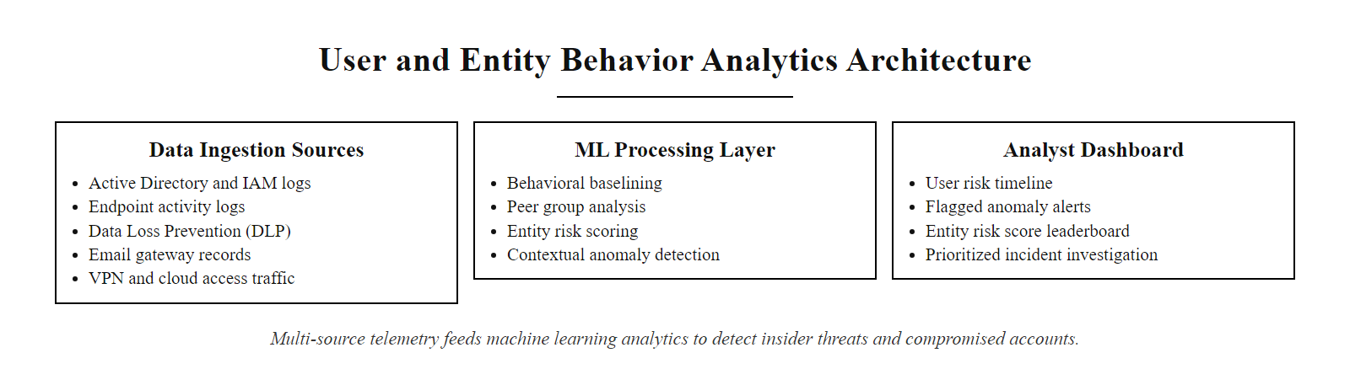
Deep-Dive, User and Entity Behavior Analytics
UEBA architecture, building multi-dimensional behavioral profiles from identity, endpoint, and network data sources to detect insider threats and compromised accounts
Notes:
User and Entity Behavior Analytics (UEBA) represents one of the most mature and widely deployed applications of machine learning in commercial cybersecurity. The term was coined by Gartner in 2015, distinguishing this analytics approach from earlier User Behavior Analytics (UBA) by explicitly including non-human entities, servers, applications, service accounts, IoT devices, in behavioral modeling alongside human users.
The foundational concept of UEBA is that every user and entity has a characteristic behavioral pattern that can be learned from historical data and used as a baseline for anomaly detection. Unlike network-based anomaly detection (which models traffic flows), UEBA models human behavior across the full identity and access stack: authentication patterns, application usage, data access behaviors, and communication patterns. This multi-dimensional profiling enables detection of threat patterns that network-only monitoring cannot see.
UEBA's most critical use case is insider threat detection, a persistent security challenge that traditional controls handle poorly. External attackers must defeat perimeter defenses; insiders already have legitimate credentials and access rights, making them invisible to signature-based and perimeter-based controls. NIST SP 800-53 control AC-2 (Account Management) and the CERT Insider Threat Common Sense Guide (produced by Carnegie Mellon University's SEI) both identify behavioral monitoring as the primary technical control for insider threat detection. UEBA implements this monitoring by identifying behavioral deviations that correlate with malicious intent, excessive data access before an employee's resignation date, unusual file transfers to personal cloud storage, after-hours access to sensitive systems the user rarely touches during normal hours.
Peer group analysis is an important UEBA technique that adds organizational context to individual behavioral profiles. Instead of only comparing a user against their own historical baseline, peer group analysis compares their behavior against a peer cohort, other employees in the same department, with the same job title, or in the same access tier. This enables detection of relative anomalies: if a finance analyst suddenly begins accessing source code repositories, that behavior is anomalous relative to the peer group of finance analysts even if the user has no personal behavioral history to compare against.
Entity analysis (the "E" in UEBA) applies similar techniques to non-human entities. Service accounts in Active Directory are especially important targets: many organizations have hundreds of service accounts with elevated privileges, and attackers who compromise a service account credential can operate with minimal detection risk because service accounts often have no behavioral baseline monitoring. UEBA systems that profile service account behavior can detect compromised service accounts exhibiting unusual activity patterns even without a human login event.
Exabeam, Varonis, and Microsoft Sentinel's UEBA module are examples of commercial platforms implementing these capabilities. Each uses different underlying ML approaches, Exabeam emphasizes timeline visualization and session stitching, Varonis focuses on data access pattern analysis across file systems, and Microsoft Sentinel UEBA integrates deeply with Azure AD and Microsoft 365 identity signals.
"Impossible travel" detection, flagging a user who authenticates from New York at 8am and London at 9am, makes behavioral analytics intuitive. It also raises the practical problem of false positives from VPN use, which must be handled through allow-lists or risk scoring.

Slide 52
Deep-Dive, User and Entity Behavior Analytics (2/2)
UEBA extends behavioral analytics from network traffic to the human element, tracking users and entities (devices, applications, service accounts) to detect insider threats, compromised credentials, and privilege abuse that evade perimeter-focused controls.
Data Sources UEBA Analyzes
Active Directory / Entra ID authentication logs
VPN and remote access logs
Endpoint activity (process execution, file access)
Email behavior (volume, recipients, attachments)
Data Loss Prevention (DLP) events
Cloud application access patterns
Badge/physical access logs (where available)
Behaviors UEBA Detects
Impossible travel (logins from distant locations simultaneously)
Abnormal working hours combined with sensitive data access
Privilege escalation or unusual admin tool usage
Bulk file downloads before resignation events
Lateral movement across systems (pass-the-hash, token theft)
Unusual email forwarding or external contact patterns
Notes:
(continued, see part 1)

Slide 53
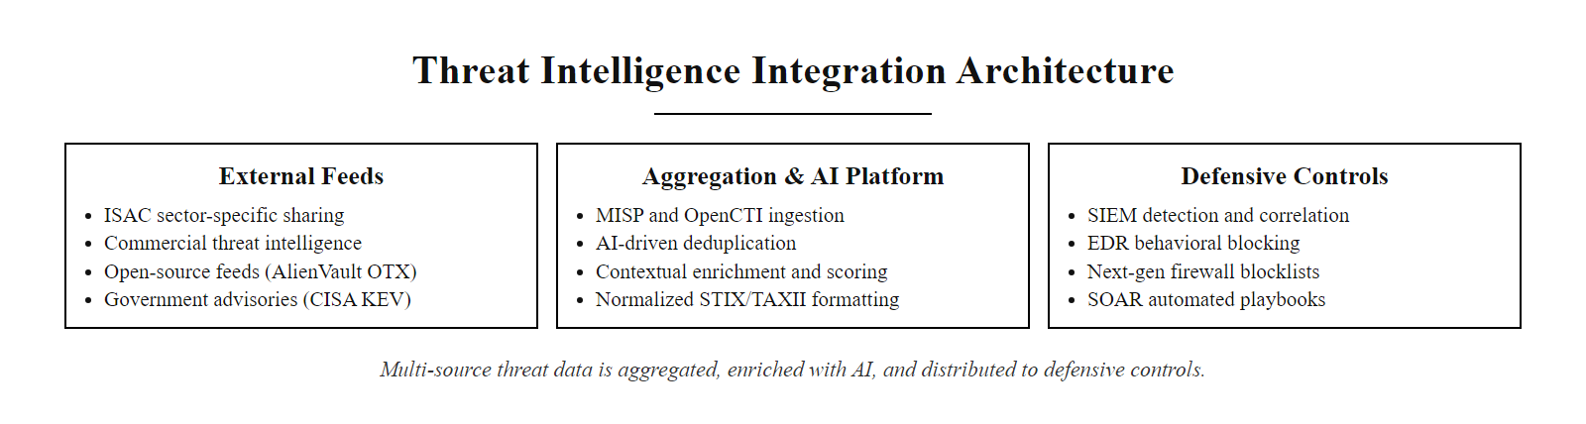
Deep-Dive, Threat Intelligence Integration
Threat intelligence integration pipeline, AI-enhanced aggregation, deduplication, and distribution of multi-source IOCs into defensive controls
Notes:
Threat intelligence (TI) transforms cyber defense from reactive incident response into informed, proactive protection. The fundamental concept is information sharing: when one organization detects an attack, the indicators of compromise and behavioral patterns from that attack can be extracted and shared with other potential targets, enabling them to detect the same adversary infrastructure and techniques before being compromised. At scale, this creates a networked defense where the intelligence from every detected attack improves protection across all organizations in the sharing community.
The machine-readable expression of threat intelligence is standardized through two complementary frameworks maintained by OASIS: STIX (Structured Threat Information eXpression) defines a data model for representing threats, and TAXII (Trusted Automated eXchange of Indicator Information) defines a transport protocol for sharing STIX data. These standards enable the automated pipeline described in the flow diagram, IOCs can be generated, packaged as STIX objects, transmitted via TAXII, and consumed by downstream security tools without human intervention.
The practical challenge is volume. A large organization may receive hundreds of thousands of IOCs daily from commercial threat intelligence feeds (Recorded Future, Mandiant Advantage, CrowdStrike Intelligence), open-source feeds (AlienVault OTX, abuse.ch, PhishTank), government sources (CISA Known Exploited Vulnerabilities catalog, FBI FLASH alerts), and industry sharing communities (ISACs, Information Sharing and Analysis Centers organized by sector: FS-ISAC for financial services, H-ISAC for healthcare, E-ISAC for energy). Without AI processing, this volume is unmanageable, security teams cannot manually review and apply hundreds of thousands of IOCs.
AI addresses this through several mechanisms. First, deduplication: AI systems identify IOCs appearing in multiple feeds, consolidate them, and elevate confidence scoring for indicators corroborated by multiple independent sources. Second, relevance scoring: ML models assess which IOCs are most relevant to a specific organization based on sector, technology stack, and geographic profile. Third, decay modeling: IOCs have limited shelf lives (a malicious IP address may be reassigned or taken down within days), and ML models trained on IOC lifespan data can estimate the current validity of aged indicators and automatically deprioritize or remove stale intelligence.
The CISA Known Exploited Vulnerabilities (KEV) catalog, launched in November 2021, represents a government-maintained authoritative source of vulnerabilities confirmed to be actively exploited in the wild. AI vulnerability management tools that integrate KEV can automatically elevate the priority of KEV-listed CVEs in patch queues, providing a direct intelligence-to-action link that dramatically improves patching prioritization relative to CVSS score alone.
Information Sharing and Analysis Centers (ISACs) give member organizations access to sector-wide threat intelligence that a small organization could never generate alone, one of the most effective and underused security resources available.

Slide 54
Deep-Dive, Threat Intelligence Integration (2/2)
Threat intelligence transforms reactive detection into informed defense, knowing what adversaries are targeting and how they operate before they attack your systems. AI makes this intelligence consumable at the speed and volume modern organizations require.
Threat actor conducts attack on another organization
→ Attack detected and analyzed by that org or a security vendor
→ IOCs extracted (IPs, domains, hashes, behavioral TTPs)
→ IOCs shared via STIX/TAXII feeds or ISAC membership
→ AI deduplicates, scores, and contextualizes IOCs
→ High-confidence IOCs pushed to SIEM, EDR, and firewall controls
→ Defender alerts when attacker infrastructure encountered
Intelligence Type | Examples | AI Application
Tactical (IOCs) | Malicious IPs, domains, file hashes | Automated ingestion and blocking
Technical (TTPs) | MITRE ATT&CK techniques, tool signatures | ML classification and detection rule generation
Operational | Campaign timelines, targeting patterns | NLP extraction from threat reports
Strategic | Nation-state objectives, sector targeting | Graph analytics on attribution data
Notes:
(continued, see part 1)

Slide 55
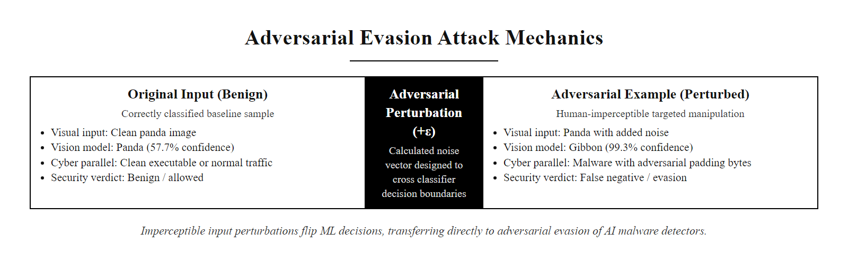
Deep-Dive, Adversarial ML and Evasion Attacks
Adversarial examples, imperceptible perturbations that flip ML model classifications, the academic concept transfers directly to adversarial evasion of AI-based malware detectors
Notes:
Adversarial machine learning represents the attack surface that AI-based defense systems create that did not exist with rule-based controls. Traditional signature-based IDS can only be evaded by crafting attacks that do not match existing signatures, a narrow technical challenge. AI-based detectors can be evaded through a much broader range of techniques that exploit the statistical nature of ML model decision boundaries.
The concept of adversarial examples was formally demonstrated by Szegedy et al. in 2013 and popularized by the panda/gibbon example from Goodfellow et al. in 2014: a correctly classified image of a panda could be perturbed with imperceptible noise to cause a neural network classifier to confidently misclassify it as a gibbon. While this was initially demonstrated in computer vision, the underlying mathematics transfers to any domain where ML classifiers operate, including malware classification and network intrusion detection.
In cybersecurity applications, evasion attacks against ML-based malware classifiers have been demonstrated by multiple research groups. The core technique: starting from a malicious binary that a target ML classifier correctly identifies as malware, an attacker iteratively applies minimal modifications, appending benign code sections, manipulating PE header fields, inserting dead code, until the classifier outputs a benign classification while the malware remains functionally intact. Tools like GAMMA (Generative Adversarial Malware Mutation) and MalGAN demonstrate this automated evasion capability. Researchers at Georgia Tech, Carnegie Mellon, and multiple security vendors have published adversarial PE evasion methods that reduce detection rates of commercial ML AV products from 95% or higher to below 10% through automated perturbation.
Poisoning attacks exploit the model training process. If an attacker can influence what data a defender's AI system trains on, for example, by deliberately triggering benign-looking alerts to push clean labels onto training data that contains attack patterns, they can corrupt the model's learned baseline over time. In environments where SOC analysts provide feedback labels that feed directly into SIEM ML retraining pipelines, this creates a theoretical poisoning surface. NIST AI RMF (AI Risk Management Framework, NIST AI 100-1, published January 2023) explicitly identifies data poisoning as a key AI security risk requiring governance and mitigation controls.
Defensive countermeasures against adversarial ML include: adversarial training (deliberately including adversarial examples in the training set so the model learns to handle them), ensemble models (requiring multiple independent classifiers to agree, making coordinated evasion harder), input validation and preprocessing pipelines that filter adversarially-structured inputs, and certified robustness approaches that provide mathematical guarantees about model behavior under bounded perturbations.
The MITRE ATLAS (Adversarial Threat Landscape for AI Systems) matrix, published by MITRE in 2021, provides a structured taxonomy of adversarial ML attacks analogous to ATT&CK for traditional cyber attacks. Security teams deploying AI defense systems should evaluate their AI tooling against the ATLAS matrix to identify adversarial ML exposure.
The bridge from adversarial image examples, the panda misclassified as a gibbon, to adversarial malware evasion is the key connection: the same principle that perturbs an image to fool a classifier perturbs a malware sample to evade an ML detector.

Slide 56
Deep-Dive, Adversarial ML and Evasion Attacks (2/2)
Adversarial machine learning is not just an academic concern, attackers already use evasion techniques against AI-based malware detectors and network intrusion detection systems. Understanding these attacks is essential for deploying AI defense responsibly.
Categories of Adversarial ML Attacks Against Defenders
Evasion attacks, Modifying malware or traffic to avoid ML classifier detection at inference time
Poisoning attacks, Injecting malicious training samples to corrupt the model's learned behavior
Model inversion, Probing a deployed model to reconstruct training data or reveal decision boundaries
Model extraction, Querying a black-box model to replicate its functionality for evasion testing
Backdoor attacks, Embedding hidden triggers in training data that cause targeted misclassification
Attack Type | Defender Impact | Real-World Example
Evasion | Malware bypasses ML-based AV/EDR | GAN-generated malware variants evading static classifiers
Poisoning | Model learns wrong baseline, misses real attacks | Attacker-controlled logs in training pipeline
Model inversion | Attacker learns model's detection thresholds | Probing black-box API to map evasion boundary
Backdoor | Specific trigger causes model to output benign | Supply-chain attack on model training data
Notes:
(continued, see part 1)

Slide 57
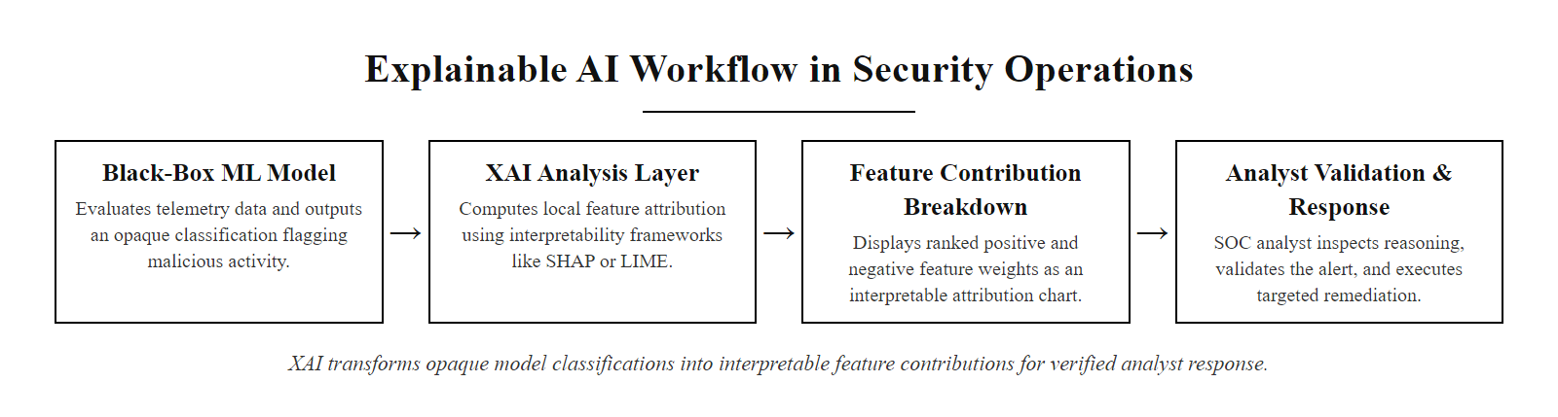
Deep-Dive, Explainable AI in Security
Explainable AI in security operations, XAI transforms opaque ML classifications into human-readable feature contribution explanations that analysts can validate and act on with confidence
Notes:
Explainable AI (XAI) addresses one of the fundamental operational challenges of deploying ML-based detection in security environments: the black-box problem. Most high-performing ML models, particularly deep neural networks, produce highly accurate classifications without providing human-readable explanations for their decisions. In many domains, this is acceptable. In security operations, it is not.
The core problem for security analysts is validation: when an AI system generates an alert, the analyst must determine whether it represents a genuine threat or a false positive. With a rule-based system, this is straightforward, the rule is explicit and the analyst can read it. With an ML-based classifier outputting "94% confidence: malicious," the analyst has no insight into which features drove the classification. Was it the network destination? The process name? The command-line arguments? Without this information, the analyst cannot efficiently validate the alert, cannot provide meaningful feedback to improve the model, and cannot document the investigation reasoning chain required by incident response procedures under NIST SP 800-61.
LIME (Local Interpretable Model-Agnostic Explanations), developed by Ribeiro et al. in 2016, addresses this by generating local explanations: for each specific prediction, LIME perturbs the input data in small ways, observes how the model's output changes, and uses these observations to build a simple linear approximation of the model's decision logic in the neighborhood of that specific input. The output is a ranked list of features that most influenced the classification for that particular example. For a phishing email classifier, LIME might explain: "This email was classified as phishing primarily because of the phrase 'urgent account verification' (high weight), the sender domain age of 2 days (high weight), and the presence of a URL redirect chain (medium weight)."
SHAP (SHapley Additive exPlanations), developed by Lundberg and Lee in 2017, provides a theoretically grounded explanation approach based on game theory's Shapley values. Each feature in the model receives a SHAP value representing its marginal contribution to the prediction for a specific input, with the sum of all SHAP values equaling the difference between the prediction and the average model output. SHAP provides global model explanations (which features are most important across all predictions?) as well as local explanations (which features drove this specific prediction?). SHAP has become the dominant XAI technique in production security deployments because of its mathematical consistency properties.
From a governance perspective, the NIST AI Risk Management Framework (AI RMF, NIST AI 100-1, 2023) identifies explainability and interpretability as core properties of trustworthy AI systems, alongside accuracy, robustness, privacy, and security. GDPR Article 22 and emerging EU AI Act requirements create legal obligations for automated decision-making systems to provide human-understandable explanations, requirements that directly apply to automated incident response systems in European-regulated environments.
SHAP applied to a classifier trained on a public malware-feature dataset produces waterfall and summary plots that make each feature's contribution visible, which conveys feature attribution far more effectively than the underlying mathematics.

Slide 58
Deep-Dive, Explainable AI in Security (2/2)
An alert that says "this is malicious" with 94% confidence is less useful than one that says "this is malicious because: unusual process spawning (high weight), foreign IP connection (high weight), encoded PowerShell command (critical weight)." Explainability turns AI outputs into investigative leads.
Why XAI Matters in Security
Analysts need to understand WHY an alert fired to validate it
False positive identification requires understanding model reasoning
Compliance and audit trails require explainable decision logic
Model debugging requires interpretable error analysis
Governance frameworks (GDPR, NIST AI RMF) require transparency
XAI Techniques Used in Security
LIME, Local interpretable model-agnostic explanations
SHAP, SHapley Additive exPlanations (game-theoretic attribution)
Attention visualization, highlights which tokens a neural network attended to
Saliency maps, visual explanations for image-based malware classifiers
Rule extraction, distilling neural network decisions into if-then rules
Notes:
(continued, see part 1)

Slide 59
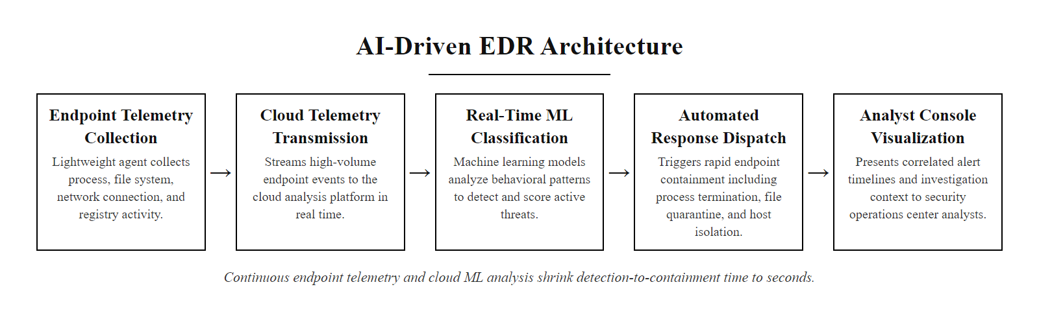
Deep-Dive, AI in Endpoint Detection and Response
EDR architecture, continuous endpoint telemetry collection, cloud-scale ML analysis, and automated response closing the detection-to-containment gap from hours to seconds
Notes:
Endpoint Detection and Response (EDR) represents the evolution of endpoint security from prevention-focused antivirus toward detection and response across the full attack lifecycle. The term was coined by Gartner analyst Anton Chuvakin in 2013 to describe a new category of tools that combined continuous endpoint telemetry recording with behavioral analysis and incident response capabilities, capabilities that traditional signature-based AV fundamentally lacked.
The core technical innovation enabling AI-based EDR is the lightweight endpoint agent that continuously collects high-fidelity telemetry: every process execution with full command-line arguments, every file create/modify/delete event, every network connection with destination and protocol detail, every registry modification, and in advanced implementations, every process injection event and memory region allocation. This telemetry is transmitted to cloud-scale analysis platforms where ML models analyze the behavioral sequences in real time.
Traditional antivirus detection is primarily hash-based: it computes the cryptographic hash of a file and compares it against a database of known malicious hashes. This approach is completely defeated by polymorphic malware (which mutates its binary on each infection to produce a different hash) and fileless malware (which never writes a malicious file to disk, instead injecting shellcode directly into memory or using legitimate scripting engines like PowerShell). EDR's behavioral detection approach sidesteps these limitations entirely: instead of asking "does this file match a known bad hash?", it asks "does the sequence of behaviors this process is executing match patterns associated with malicious activity?"
CrowdStrike Falcon is the market-leading EDR platform and provides a well-documented example of AI EDR in practice. Falcon uses a hybrid architecture: a kernel-mode driver intercepts all system calls at the lowest level, ensuring nothing happens on the endpoint without the agent's observation, while a user-mode component applies ML behavioral models. Falcon's Threat Graph maintains a time-series record of all process events and uses graph ML models to analyze relationships between processes, detecting lateral movement, credential theft, and privilege escalation as patterns in the process relationship graph rather than as individual event anomalies.
Living-off-the-land (LotL) attacks present the most sophisticated detection challenge for EDR. LotL attackers exclusively use legitimate Windows tools, PowerShell, WMI, certutil, regsvr32, mshta, to execute malicious operations, producing no malicious binary for signature matching. EDR's behavioral models must distinguish between legitimate administrative use of these tools and malicious abuse. This requires ML models trained on the statistical properties of legitimate versus malicious PowerShell invocations (encoded commands, download-and-execute patterns, unusual parent processes), a subtle classification problem that requires high-quality labeled training data and careful feature engineering.
The MITRE ATT&CK evaluations (conducted annually against major EDR vendors using documented APT adversary simulations) provide the most credible public benchmark of EDR AI detection effectiveness. The evaluations test EDR products against multi-stage attack scenarios modeled on real APT groups (e.g., APT29/Cozy Bear, Carbanak), measuring which techniques each product detects, at what level of detail, and with what degree of automation. These evaluations are publicly available at attackevals.mitre.org and should be a primary reference for EDR purchasing decisions.
Endpoint detection and response (EDR) products collect detailed host telemetry, process creation, network connections, file and registry changes, and apply detection logic to it; deploying an agent in a lab shows how that telemetry drives detection.

Slide 60
Deep-Dive, AI in Endpoint Detection and Response (2/2)
Endpoint Detection and Response (EDR) tools represent the most direct application of AI to individual device security, collecting process-level telemetry and applying ML models to detect malicious behavior at the point where attacks actually execute.
EDR Capability | Traditional AV | AI-Enhanced EDR
Malware detection | Signature hash matching | Behavioral ML model on process telemetry
Fileless malware | Cannot detect (no file) | Detects via memory analysis and process behavior
Living-off-the-land | Cannot detect (tools are legitimate) | Detects via behavioral sequence anomaly
Zero-day exploits | Cannot detect (no signature) | Detects via exploitation behavior pattern
Response | Alert only | Automated process kill, file quarantine, network isolation
Forensics | Limited artifact collection | Full telemetry timeline, memory forensics
AI Techniques Deployed in EDR Platforms
Static ML models, Features extracted from PE binary structure without execution (entropy, imports, sections)
Dynamic behavioral models, Process behavior sequences during execution classified against malicious patterns
Script analysis, NLP-based classification of PowerShell/script content for malicious intent
Memory scanning, ML models analyzing process memory for injected shellcode or anomalous patterns
Graph-based detection, Process tree and network connection graphs analyzed for lateral movement patterns
Notes:
(continued, see part 1)

Slide 61
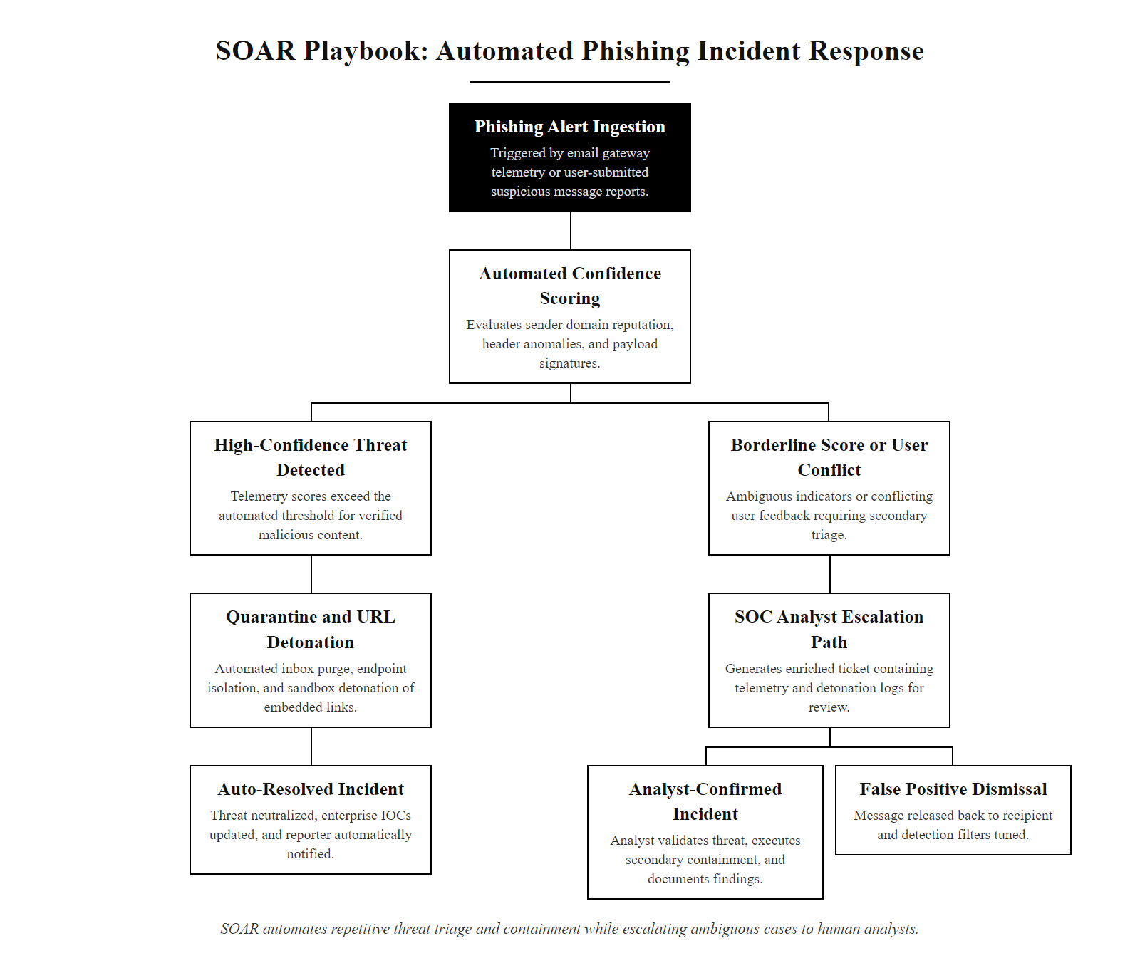
SOAR Playbooks, Automating Incident Response
SOAR playbook logic, a phishing response workflow showing automated decision branches, actions, and human escalation paths
Notes:
Security Orchestration, Automation, and Response (SOAR) platforms represent the operationalization of incident response procedures into machine-executable workflows. The concept is fundamentally about encoding expert knowledge: the response steps that an experienced L1 or L2 analyst follows when handling a phishing alert, a malware detection, or a failed privileged account login are documented, structured, and implemented as an automated playbook that executes in seconds rather than minutes.
The business case for SOAR is straightforward: security teams face a permanent shortage of skilled analysts (Cybersecurity Ventures estimated 3.5 million unfilled cybersecurity positions globally as of 2023), while alert volumes from AI-enhanced detection tools continue to grow. SOAR addresses this imbalance by automating the repetitive, deterministic portions of incident response, information gathering, IOC enrichment, basic triage decisions, notification workflows, and documentation, freeing human analysts for the investigative and decision-making tasks that require expertise and judgment.
The phishing response playbook described in the steps above represents a common real-world implementation. Several aspects deserve attention. First, the enrichment step demonstrates SOAR's orchestration value: in a few seconds, the SOAR platform queries multiple external and internal data sources (VirusTotal, threat intelligence platforms, internal SIEM logs) that an analyst would need to manually query one by one. This information gathering, which might take an analyst 15-20 minutes, completes in under 10 seconds automatically.
Second, the confidence-gated automation illustrates responsible AI deployment: automated quarantine only triggers when both a high ML confidence score AND threat intelligence corroboration are present. Below that threshold, the playbook routes to human review. This dual-gate approach reduces false positive automated actions, a critical design consideration, because quarantining a legitimate email in a business communication context has real operational consequences.
Third, the feedback loop is essential for continuous improvement. When a playbook resolves an incident, the verified outcome, confirmed phishing or false positive, is fed back into the phishing classifier's retraining pipeline, improving future detection accuracy. This closed loop between automated response and model improvement is what separates operationally mature AI security programs from one-time deployments.
SOAR platforms most commonly used in enterprise environments include Splunk SOAR (formerly Phantom), Palo Alto XSOAR (formerly Demisto), Microsoft Sentinel Logic Apps playbooks, and IBM Security SOAR (formerly Resilient). Each provides visual playbook builders, extensive pre-built integration libraries, and case management capabilities. ISO/IEC 27035 (Information Security Incident Management) provides the governance framework within which SOAR playbooks should be designed, ensuring that automated response actions are authorized, documented, and reviewable.
The NIST SP 800-61 (Computer Security Incident Handling Guide) defines four phases of incident response: Preparation, Detection and Analysis, Containment, Eradication and Recovery, and Post-Incident Activity. SOAR playbooks typically automate the Detection and Analysis phase (enrichment, triage) and portions of Containment (quarantine, blocking). Eradication, Recovery, and Post-Incident Activity phases retain significant human involvement because they require organizational coordination, business impact assessment, and strategic decision-making that automated systems cannot perform autonomously.
Designing a response playbook for a scenario such as a privileged-account anomaly or an early ransomware indicator reveals the edge cases and escalation logic that make playbook design a genuine engineering problem rather than simple automation.

Slide 62
SOAR Playbooks, Automating Incident Response (2/2)
SOAR playbooks encode institutional incident response knowledge into repeatable, automated workflows, ensuring consistent, fast response to common threat patterns while preserving human escalation paths for cases requiring judgment.
Sample Phishing Response Playbook
Trigger, Email security gateway or user report generates phishing alert with confidence score
Enrich, SOAR automatically queries threat intelligence for sender domain, URLs, and attachment hashes
Decision, If confidence score is at least 85% AND threat intelligence match confirmed, auto-quarantine all copies of email organization-wide
Notify, Auto-generate ticket in ITSM system, notify affected users with guidance, alert SOC team
Investigate, Auto-detonate URLs in sandbox, extract IOCs from any attachments
Scope, Check SIEM for evidence same user clicked or same URL appeared in other emails
Escalate, If user clicked link or attachment executed, escalate to L2 analyst with full context and recommended IR steps
Close and Retrain, Document outcome, update email security controls, feed verdict into phishing classifier retraining pipeline
Notes:
(continued, see part 1)

Slide 63
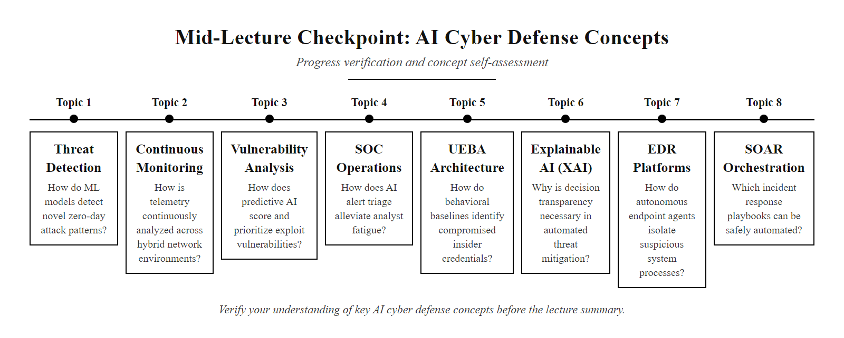
Mid-Lecture Checkpoint, AI Defense Concepts
Course checkpoint, verify your understanding of the key AI cyber defense concepts before the lecture summary
Notes:
This checkpoint slide is designed as an active recall exercise, one of the most evidence-backed techniques for consolidating newly learned material. Research in cognitive science consistently demonstrates that self-testing (retrieval practice) produces stronger long-term retention than re-reading or passive review. Pausing here to attempt to answer these questions without referring back to earlier slides is a deliberate pedagogical choice.
Let us walk through the expected answers to each checkpoint question.
The first question, the difference between supervised and unsupervised ML in threat detection, is foundational. Supervised learning uses labeled training data (known good/malicious examples) and trains classifiers that can assign new observations to existing categories. It works well for detecting known threat families but cannot generalize to truly novel attacks. Unsupervised learning finds structure in unlabeled data, identifying statistical clusters and anomalies without needing labeled categories. It detects novel and unknown threats by identifying deviations from statistical norms but produces higher false positive rates.
The second question, scenarios where AI detection fails, tests critical thinking beyond the marketed capabilities. Expected answers include: nation-state-level attacks specifically engineered to evade AI detection (as in SolarWinds SUNBURST, which mimicked legitimate traffic patterns and used dormancy to avoid anomaly scoring); supply-chain attacks where malicious code arrives through legitimate, trusted update mechanisms with valid signatures; and insider threats by users who behave maliciously in ways statistically consistent with their historical baseline.
Concept drift refers to the gradual shift between the statistical distribution of data that a model was trained on and the distribution of data it encounters in production over time. In cybersecurity this occurs as network environments change (new users, new applications, new normal behaviors), attack techniques evolve, and adversaries adapt their methods. Without continuous retraining and baseline updating, AI defense tools that were highly accurate at deployment become increasingly inaccurate over time, a fundamental operational maintenance requirement that organizations frequently underestimate.
The final question, why an organization with AI tools might still experience more breaches than one without AI, is the most important conceptual question in this lecture. Expected answers: AI tools poorly deployed without tuning generate high false positive rates that cause analysts to ignore or dismiss alerts; AI tools create false confidence leading organizations to underinvest in other security controls; over-automation removes human judgment from response decisions; and AI tools are exploited through adversarial attacks specifically designed to defeat them.

Slide 64
Mid-Lecture Checkpoint, AI Defense Concepts (2/3)
Pause and verify understanding before the final section. Attempt these questions from memory before reviewing earlier slides.
Checkpoint Questions
What is the key difference between supervised and unsupervised ML in threat detection?
Name two scenarios where AI detection would likely FAIL and explain why
What does UEBA stand for, and what threat category is it specifically designed to catch?
Explain the difference between a SIEM and a SOAR platform in one sentence each
What is "concept drift" and why does it matter for AI security tools?
What does the NIST CSF Detect function require, and how does AI implement it?
Name two explainability techniques used in AI security
Why might an organization deploying AI security tools still experience more breaches than one without AI?
Notes:
(continued, see part 1)

Slide 65
Mid-Lecture Checkpoint, AI Defense Concepts (3/3)
Concepts Covered This Lecture
AI on the defender's side
Threat detection fundamentals
ML model types for security
Automated monitoring (SIEM)
Vulnerability analysis and prioritization
AI-assisted SOC operations
Benefits and limitations of AI defense
Human + AI collaboration
UEBA deep-dive
NIST CSF Detect function
MITRE ATT&CK for AI training
Key Frameworks Referenced
NIST Cybersecurity Framework (CSF 2.0)
NIST SP 800-61 (Incident Response)
NIST SP 800-53 (Security Controls)
NIST AI RMF (AI 100-1)
ISO/IEC 27001 / 27035
MITRE ATT&CK and MITRE ATLAS
CVSS and EPSS (vulnerability scoring)
STIX/TAXII (threat intelligence standards)
Notes:
(continued, see part 1)

Slide 66
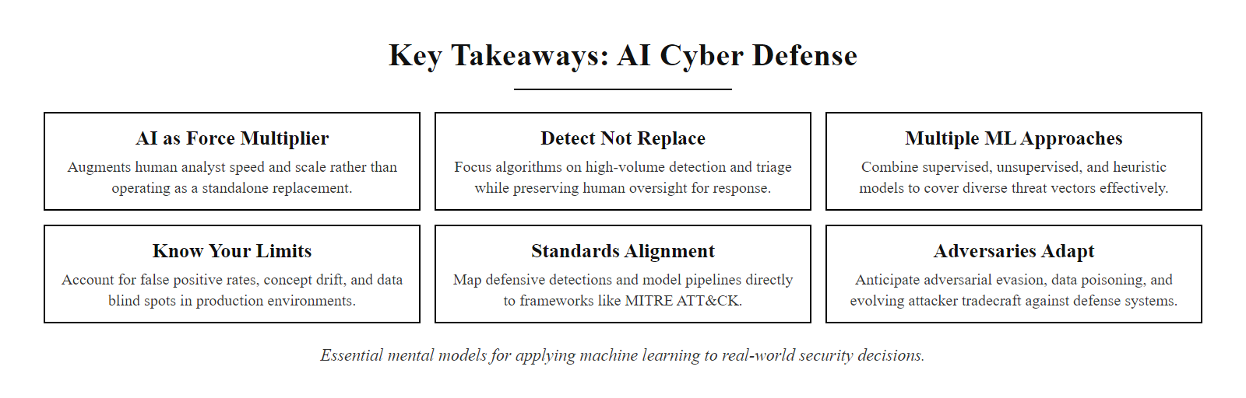
Key Takeaways and Class Review
Six key takeaways from AI Cyber Defense, the essential mental models for applying this class to real-world security decisions
Notes:
This review slide synthesizes the entire lecture's content into the mental models and professional principles that should persist beyond exam preparation into daily security practice.
The most important single takeaway from this lecture is the force multiplier framing introduced in the opening slides and reinforced throughout: AI does not make security teams obsolete, it makes them dramatically more effective at the tasks where machines excel, processing volume, maintaining consistency, pattern matching at scale, while the most valuable human contributions (contextual reasoning, organizational knowledge, adversarial intuition, accountability) remain irreplaceable.
The NIST Cybersecurity Framework Detect function provided the standards anchor for this lecture, and students should leave able to map the AI tools discussed, SIEM, EDR, UEBA, SOAR, to specific CSF subcategories. This mapping skill is directly applicable to security program assessments, compliance gap analyses, and vendor capability evaluations.
The case studies, SolarWinds and Log4Shell, bookend the AI defense capability discussion with important nuance. Log4Shell showed AI-assisted security enabling response at unprecedented scale when the threat was known and indicators were published. SolarWinds showed sophisticated adversaries defeating AI detection through deliberate, patient tradecraft that stayed within statistical norms. Both outcomes are important. The professional who only remembers one is either overconfident or underconfident in what AI can achieve.
The adversarial ML content is the most forward-looking material in this lecture. The evasion of ML-based malware detectors through adversarial perturbation is currently an active area of academic research, but the techniques are increasingly available to sophisticated threat actors. Within the next 5-10 years, AI-aware evasion techniques will likely become standard tradecraft for advanced adversaries, a development that will require AI security tools to incorporate adversarial robustness as a core design criterion rather than an afterthought.
Students pursuing careers in security operations should leave with three practical skills from this lecture: the ability to evaluate an AI security tool's claims critically (using the misconceptions framework from the FAQ slide); the ability to map any AI security control to the NIST CSF function it supports; and the ability to design a basic SOAR playbook for a common incident type. These skills apply immediately to entry-level SOC analyst roles and security tool evaluation contexts.
For students pursuing research or advanced security roles: MITRE ATLAS, the NIST AI RMF, and the growing academic literature on adversarial ML for cybersecurity (tracked at arXiv.org under cs.CR) represent the frontier of this field. The interaction between AI safety research and cybersecurity is becoming one of the most important interdisciplinary areas in the field, with implications for everything from autonomous defense systems to the use of large language models in security analysis.
If AI is on both the attacker's and the defender's side, what determines who gains more is data quality, tooling maturity, feedback loops and the human expertise applied to the AI's output. AI is a tool whose value depends on the skill of the people using it.

Slide 67
Key Takeaways and Class Review (2/2)
AI cyber defense is powerful, necessary, and imperfect. The security professionals who use it best understand both its capabilities and its failure modes.
What We Covered
AI fundamentally shifts the defender's capability profile, speed, scale, pattern recognition
Different ML model types (supervised, unsupervised, UEBA, NLP) solve different detection problems
SIEM, SOAR, and XDR represent three architectural approaches to AI-enhanced security operations
NIST CSF, MITRE ATT&CK, and NIST AI RMF are the standards frameworks governing AI defense deployment
Real-world case studies (SolarWinds, Log4Shell) illustrate both what AI helps and where it fails
XAI and human-in-the-loop design are essential for operational AI security deployment
What Every Security Practitioner Should Remember
AI does not replace analysts, it elevates them
Alert fatigue from poorly tuned AI is as dangerous as having no AI
Sophisticated adversaries target AI detection systems specifically
Explainability is not optional, it enables analyst validation and compliance
AI tools require ongoing maintenance; deployed and forgotten means degraded and dangerous
The best AI deployment is one the team trusts enough to act on
Notes:
(continued, see part 1)

