Slide 1
Risk Assessment Project
CLASS 29
Enterprise Risk Management, Quantitative Analysis, and the NIST SP 800-30 Framework
Notes:
Welcome to Class 29, the Risk Assessment Project. In our previous classes, we studied the technical mechanics of security, including asymmetric cryptography and incident logs, and examined how they fit into enterprise security architectures. Today, we transition from reactive operations to proactive planning.
This project asks you to conduct a structured cybersecurity risk assessment for a target organization. We will use the methodology defined in NIST SP 800-30 Rev. 1, which is the industry standard for conducting risk assessments. We will explore how to identify and value enterprise assets, model realistic threats, assess system vulnerabilities, and evaluate the effectiveness of existing controls.
We will study how to calculate risk levels using both qualitative matrices and quantitative formulas, such as Annualized Loss Expectancy. Finally, we will cover how to design a risk treatment plan that balances technical, operational, and financial constraints. By the end of this class, you will understand how to build and present a professional security assessment to corporate leadership.
NIST SP 800-30 Rev. 1 sits within a family of interlocking publications. It is designed to integrate with SP 800-37 Rev. 2 (the Risk Management Framework) and SP 800-39 (Managing Information Security Risk at the organizational level). Together, these documents form the backbone of federal information security governance and are widely adopted in the private sector as best-practice standards.
To appreciate why proactive risk assessment matters in practice, consider the 2013 Target data breach. Attackers gained initial entry through stolen credentials belonging to a third-party HVAC contractor, then moved laterally into Target's point-of-sale network. A thorough risk assessment under SP 800-30 would have cataloged the contractor's remote access as an asset-adjacent risk vector, assessed the absence of network segmentation between vendor systems and the payment infrastructure, and flagged this as a high-priority remediation item. The eventual cost to Target exceeded $290 million in legal settlements, an outcome that a well-funded risk treatment plan could plausibly have prevented or significantly reduced.
Internationally, ISO 31000:2018 provides the overarching risk management framework applicable across all industries, while ISO/IEC 27005:2022 extends those principles to information security specifically. Multinational organizations often map their NIST-based assessments to ISO 27005 to satisfy both U.S. federal requirements and European regulatory obligations under GDPR.

Slide 2
Proactive Risk Management (NIST SP 800-30)
A risk assessment is a systematic process of identifying, estimating, and prioritizing risks to organizational operations, assets, and individuals. Under NIST SP 800-30 Rev. 1, risk assessments are integrated into the broader Risk Management Framework.
The NIST SP 800-30 Lifecycle
Key Assessment Goals
Prepare: Define the assessment scope, assumptions, and constraints.
Conduct: Identify threats, vulnerabilities, likelihood, and impact.
Communicate: Share findings with decision-makers to support risk decisions.
Maintain: Monitor risk factors continuously to update the assessment.
Risk Prioritization: Focus resources on high-impact vulnerabilities.
Cost-Benefit Alignment: Ensure security spending matches asset value.
Regulatory Compliance: Meet standards like HIPAA, PCI DSS, or ISO 27001.
**Prepare**
Define scope, assumptions & constraints
**Conduct**
Identify threats, vulnerabilities & impact
**Communicate**
Translate findings for decision
makers
**Maintain**
Continuously monitor & update the living assessment
Notes:
To understand the value of a risk assessment, we must contrast it with incident response. Incident response is reactive; it begins after an attack has occurred. A risk assessment is proactive; it identifies and mitigates vulnerabilities before an attacker can exploit them.
NIST SP 800-30 Rev. 1 outlines a four-step process for conducting assessments. First, we prepare by defining the scope. For instance, are we assessing the entire enterprise, or just the customer payment portal?
Second, we conduct the assessment by identifying threat sources, vulnerabilities, likelihood of exploitation, and potential business impact.
Third, we communicate the results to stakeholders, translating technical vulnerabilities into business terms.
Finally, we maintain the assessment by continuously monitoring the environment. Because new vulnerabilities emerge and business operations change, a risk assessment is not a one-time document; it is a living process that must be updated regularly.
The 2020 SolarWinds supply chain attack illustrates precisely why the Maintain phase is critical. Attackers compromised SolarWinds' build pipeline and inserted a backdoor (SUNBURST) into Orion software updates, subsequently deployed by approximately 18,000 customers, including multiple U.S. federal agencies. Organizations that treated their risk assessments as static, annual documents failed to account for the supply chain risk introduced by their software vendors, a risk vector that continuous monitoring and periodic reassessment would have placed under ongoing scrutiny.
NIST SP 800-30 does not operate in isolation. It explicitly supports the RMF defined in SP 800-37 Rev. 2 and feeds enterprise-level risk governance described in SP 800-39. For organizations pursuing ISO alignment, ISO/IEC 27005:2022 provides equivalent guidance using a Plan-Do-Check-Act (PDCA) lifecycle that maps directly to NIST's Prepare-Conduct-Communicate-Maintain cycle.
A key concept in the Prepare phase is defining the system boundary, precisely which systems, data flows, and personnel fall within scope. Poorly defined boundaries are a leading source of incomplete assessments. Under NIST SP 800-18, the System Security Plan (SSP) provides the authoritative boundary description that should anchor every risk assessment's scope definition.

Slide 3
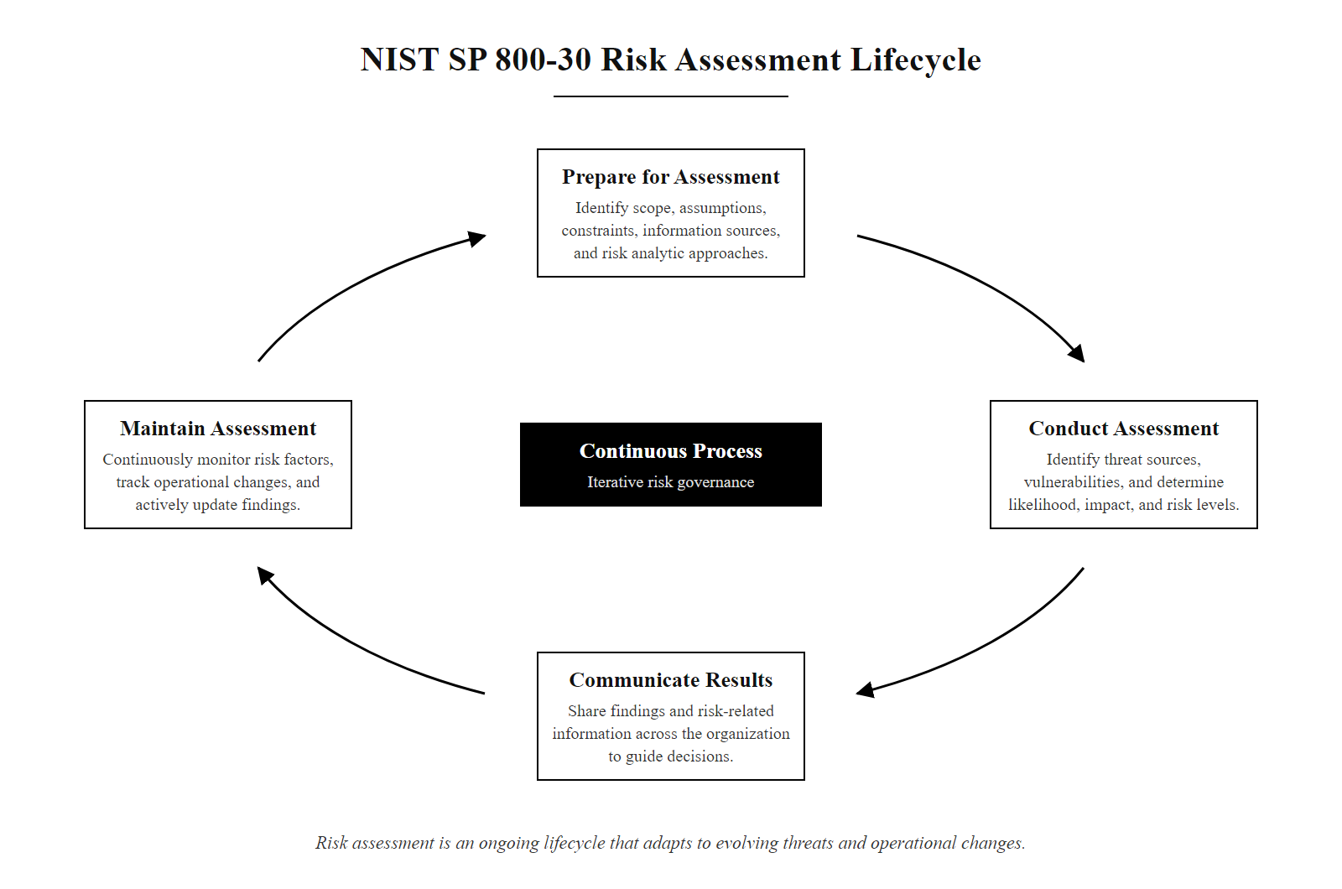
Proactive Risk Management (NIST SP 800-30) (2/2)
NIST SP 800-30 treats risk assessment as a continuous lifecycle, not a one-time event, threats and business operations change constantly, requiring the assessment to be a living document.
Notes:
(continued, see part 1)

Slide 4
Phase 1, Asset Identification & Valuation
An organization cannot protect what it does not know it owns. Asset identification involves building a comprehensive catalog of organizational assets and establishing their value.
Asset Category | Description | Primary Valuation Metric | FIPS 199 Impact Classification
Information / Data | Customer databases, source code, financial records, IP | Regulatory compliance fines, competitive value, restoration cost | High (Loss of confidentiality violates legal requirements)
Software Assets | Operating systems, custom applications, APIs, SaaS | Licensing costs, development hours, operational dependency | Moderate (Downtime disrupts service delivery)
Physical Assets | Servers, user workstations, routers, SAN storage, facilities | Replacement cost, depreciation, physical security requirements | Low (Hardware can be replaced quickly)
Services / Operations | Payment gateways, email, public web applications | Revenue generated per hour, SLA penalty costs | High (Outage halts business transactions)
Step 1, Network Discovery: Use automated scanning tools and CMDB records to enumerate all hardware, software, and data stores within the defined scope.
Step 2, Classify by Category: Group each discovered asset into Information, Software, Physical, or Services/Operations categories.
Step 3, Determine Replacement Cost: Establish the direct financial cost of replacing or restoring each asset using procurement records, licensing agreements, and labor estimates.
Step 4, Assess Regulatory Impact: Apply FIPS 199 guidelines to classify each asset as Low, Moderate, or High impact for confidentiality, integrity, and availability independently.
Step 5, Calculate Business Value: Combine replacement cost with regulatory fine exposure (GDPR, HIPAA) and operational revenue impact to produce the final asset value used in risk calculations.
Notes:
The first phase of a risk assessment is asset identification and valuation. We must build a detailed catalog of what we are protecting and determine its value to the organization.
We group assets into four categories. Information assets include data like customer records and proprietary source code. Software assets include operating systems and active APIs. Physical assets are the hardware devices and facilities. Services are the operational capabilities, like transaction processing and communication systems.
Valuing these assets is not just about their replacement cost. We evaluate their operational dependency and regulatory compliance impact. For example, a physical server might cost $5,000 to replace, but the data on that server might be worth millions due to regulatory fines under GDPR or HIPAA if it is compromised.
We use FIPS 199 guidelines to classify assets as low, moderate, or high impact based on how a loss of confidentiality, integrity, or availability would affect the organization. This valuation ensures that we prioritize our security spending on our most critical systems.
NIST SP 800-60 Volumes I and II provide a detailed crosswalk for mapping specific information types to FIPS 199 impact levels, offering agencies and enterprises a structured reference for classification decisions that go beyond high-level judgment. Volume I covers the mapping methodology; Volume II catalogs over 1,000 specific information types with recommended impact baselines.
One of the most dangerous gaps in asset management is shadow IT, systems, applications, and data stores used within the organization but never registered in the official asset inventory. The 2017 Equifax breach, which exposed the personal data of approximately 147 million Americans, illustrates this risk precisely. The vulnerability exploited was CVE-2017-5638, a critical flaw in Apache Struts with a CVSS v3.1 base score of 10.0. The affected server was not included in Equifax's routine patching process because it was not reflected in their asset management records. A rigorous asset identification phase, including automated network discovery and integration with a Configuration Management Database (CMDB), is specifically designed to eliminate these blind spots.
Under ISO/IEC 27001:2022, Annex A Control 8.8 (Management of Technical Vulnerabilities) requires that asset inventories be maintained and kept current as a prerequisite for effective vulnerability management. Conducting asset identification before each risk assessment cycle ensures compliance with this requirement and reduces the probability of the inventory gap that proved catastrophic for Equifax.

Slide 5
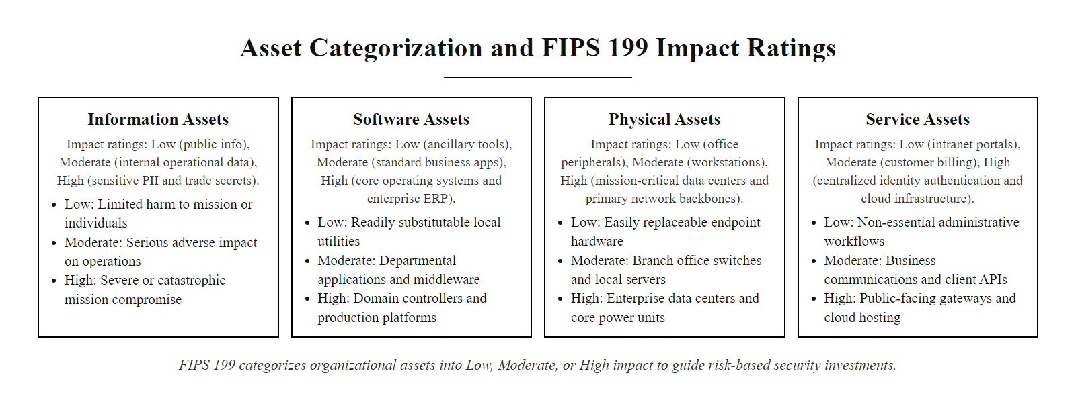
Phase 1, Asset Identification & Valuation (2/2)
FIPS 199 classifies assets by the potential impact of a confidentiality, integrity, or availability breach, driving security investment toward the assets that matter most to the organization's mission.
Notes:
(continued, see part 1)

Slide 6
Phase 2, Threat Modeling & Vulnerability Analysis
Risk arises at the intersection of threats and vulnerabilities. We must identify realistic threat sources and evaluate the vulnerabilities that expose our assets.
Notes:
Once we know our assets, we must analyze the threats and vulnerabilities that target them. A threat is any circumstance or event with the potential to adversely impact our systems. A vulnerability is a weakness in our software, hardware, or processes that can be exploited by a threat source.
Under NIST SP 800-30, we identify threat sources and the specific events they could trigger. Threat sources can be adversarial, such as advanced persistent threats (APTs) and ransomware groups, or non-adversarial, such as natural disasters and hardware failures.
To evaluate vulnerabilities, we use the Common Vulnerability Scoring System (CVSS v3.1). CVSS provides a standardized way to measure the severity of software vulnerabilities, scoring them from 0 to 10. The score is calculated using base metrics (such as access vector and attack complexity), temporal metrics (which change over time as patches are released), and environmental metrics (which reflect the target's specific network configuration). This scoring helps us prioritize patching based on the actual risk a vulnerability poses to our environment.
The MITRE ATT&CK framework (Adversarial Tactics, Techniques, and Common Knowledge) provides a complementary lens for structuring threat events. Where CVSS scores individual vulnerabilities, ATT&CK catalogs the behavioral techniques that threat actors use at each stage of an attack, from initial access through exfiltration. Used together, CVSS prioritizes what to patch, while ATT&CK explains how an unpatched vulnerability will likely be weaponized by a real adversary in your industry vertical.
A concrete illustration is CVE-2021-44228, commonly known as Log4Shell, a vulnerability in the Apache Log4j logging library that carried a CVSS v3.1 base score of 10.0, the maximum possible, due to its unauthenticated remote code execution capability with trivial exploitability. Within 72 hours of public disclosure in December 2021, CISA reported over 1.8 million exploitation attempts per hour globally. Organizations that had mapped their Java dependencies through thorough asset identification were able to rapidly locate affected systems; those that had not faced weeks of reactive triage under active attack conditions.
NIST SP 800-154 provides additional guidance on data-centric threat modeling, which is particularly useful when the primary asset of concern is sensitive data rather than a specific system configuration. This approach models threats in terms of data flows and data stores rather than network topology, and is increasingly relevant as organizations migrate workloads to cloud infrastructure where traditional perimeter-based topology mapping is less effective.

Slide 7
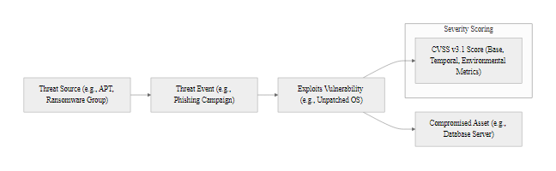
Phase 2, Threat Modeling & Vulnerability Analysis (2/3)
Threat modeling flow: from threat source through threat event and vulnerability exploitation to the compromised asset, with CVSS v3.1 providing standardized severity scoring at the exploitation stage
Notes:
(continued, see part 1)

Slide 8
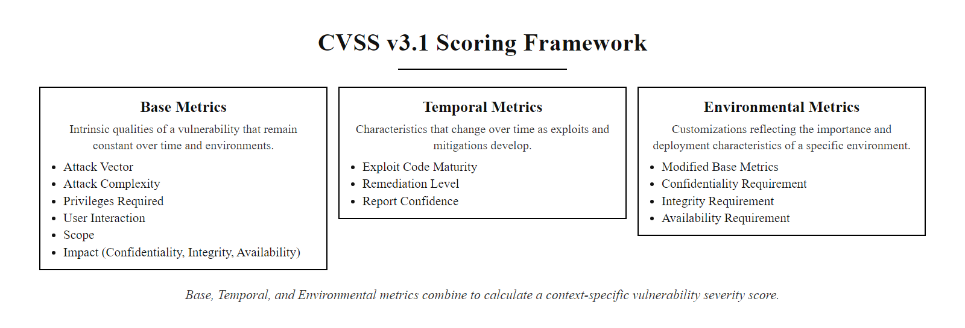
Phase 2, Threat Modeling & Vulnerability Analysis (3/3)
CVSS v3.1 breaks vulnerability severity into three metric groups, Base, Temporal, and Environmental, allowing organizations to adjust the score to reflect their specific deployment context rather than relying on a one-size-fits-all rating.
Notes:
(continued, see part 1)

Slide 9
Phase 3, Quantitative & Qualitative Risk Analysis
Risk can be analyzed qualitatively using an impact matrix, or quantitatively by calculating the Annualized Loss Expectancy (ALE) based on historical probability and asset value.
Quantitative Risk Math
Qualitative Risk Matrix
Single Loss Expectancy (SLE): The cost of a single security incident.
Annualized Rate of Occurrence (ARO): Estimated frequency of the incident per year.
Annualized Loss Expectancy (ALE): Total estimated annual cost.
Likelihood | Low Impact | Med Impact | High Impact
High | Medium Risk | High Risk | Critical Risk
Medium | Low Risk | Medium Risk | High Risk
Low | Low Risk | Low Risk | Medium Risk
Step 1, Establish Asset Value: Use the valuation from Phase 1 (replacement cost + regulatory penalty exposure + revenue impact).
Step 2, Estimate Exposure Factor (EF): Determine the percentage of the asset that would be damaged or destroyed in a single incident (0–100%).
Step 3, Calculate SLE: Multiply Asset Value × EF to produce the Single Loss Expectancy, the cost of one incident.
Step 4, Estimate ARO: Use NIST SP 800-30 Appendix G likelihood tables and historical incident data to estimate how many times per year the event is expected to occur.
Step 5, Calculate ALE: Multiply SLE × ARO to produce the Annualized Loss Expectancy, the total expected annual financial loss from this risk.
Step 6, Compare to Qualitative Matrix: Cross-validate the ALE result against the qualitative risk matrix to ensure the quantitative rating matches the intuitive business-impact assessment.
Notes:
To prioritize risks, we must calculate their severity. We use two main approaches: qualitative and quantitative analysis.
Qualitative analysis uses a matrix to map the likelihood of an event against its business impact, placing risks into low, medium, high, or critical categories. This is useful for evaluating risks that are hard to measure financially, like brand damage or employee morale.
Quantitative analysis uses formulas to calculate financial loss. The Single Loss Expectancy (SLE) represents the cost of a single incident, calculated by multiplying the asset value by the exposure factor, which is the percentage of the asset damaged.
The Annualized Rate of Occurrence (ARO) is the estimated number of times the incident will occur in a year.
By multiplying SLE by ARO, we get the Annualized Loss Expectancy (ALE), which is the total annual cost of the risk. For example, if a server is valued at $100,000, and a ransomware attack would disable 50% of it, the SLE is $50,000. If we estimate this attack occurs once every two years (an ARO of 0.5), the ALE is $25,000. This calculation helps us determine whether a proposed security control is financially justified.
NIST SP 800-30 Appendix G provides standardized likelihood tables that organizations can use to calibrate ARO estimates, grouping likelihood from "Very Low" (approximately 1 event per 100 years) to "Very High" (more than 100 events per year). These tables translate qualitative judgments into quantitative probabilities, providing a structured basis for ALE calculations rather than relying solely on estimator intuition.
A real-world reference point for the scale of quantitative risk is the 2017 Equifax breach. The FTC settlement alone reached $575 million, with total breach costs estimated at over $1.4 billion when including legal fees, remediation, and credit monitoring services for affected consumers. If Equifax had modeled the risk of an unpatched public-facing Apache Struts server using ALE methodology, accounting for asset value, near-100% exposure factor, and ARO based on known exploitation trends for publicly disclosed critical vulnerabilities, the expected annual loss would have dwarfed the cost of routine patch management.
For organizations seeking a more rigorous quantitative framework, FAIR (Factor Analysis of Information Risk) provides an alternative model that breaks loss into six primary risk factors, enabling Monte Carlo simulation to generate probability distributions for losses rather than single-point estimates. FAIR complements NIST SP 800-30 and is endorsed by The Open Group as an international standard for cyber risk quantification, and is increasingly required by organizations pursuing advanced cyber risk reporting to boards and insurers.

Slide 10
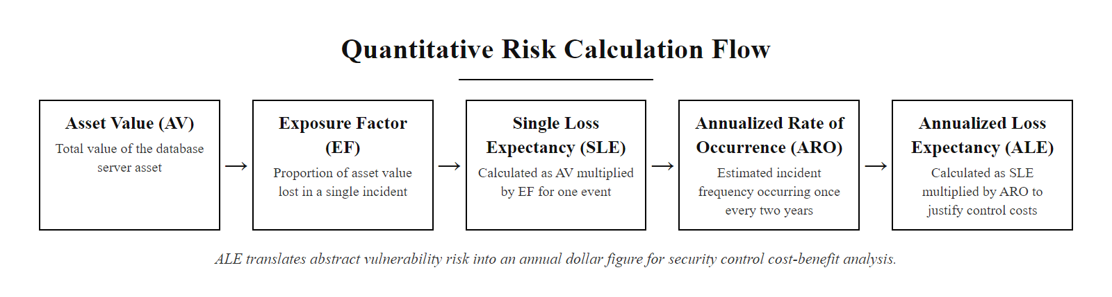
Phase 3, Quantitative & Qualitative Risk Analysis (2/2)
ALE calculation converts abstract vulnerability risk into a dollar figure, enabling direct cost-benefit comparison between the annual loss expectancy and the annual cost of the proposed security control.
Notes:
(continued, see part 1)

Slide 11
Phase 4, Evaluating Existing Controls & Gaps
We must evaluate existing controls to determine our residual risk, the risk that remains after safeguards are applied.
Identify Inherent Risk: Calculate the risk level assuming no controls are active.
Document Existing Controls: Catalog active technical, administrative, and physical safeguards.
Assess Control Effectiveness: Evaluate if controls are configured correctly and maintained regularly.
Identify Gaps: Find areas where controls are missing, misconfigured, or unmonitored.
Determine Residual Risk: Re-calculate the risk level with the active controls factored in.
Notes:
Calculating risk based on vulnerabilities is only the first step. We must also evaluate the controls that are already in place to protect our assets. This process helps us differentiate between inherent risk and residual risk.
Inherent risk is the raw risk level of an asset before any controls are applied. Residual risk is the risk that remains after we factor in our existing safeguards.
To determine residual risk, we catalog our active controls across technical, administrative, and physical domains. We then assess their effectiveness. A common mistake is assuming a control is working simply because it was purchased. We must verify that it is configured correctly, updated regularly, and monitored for errors.
If we find that our Web Application Firewall has not had its rules updated in a year, this configuration gap increases our residual risk. Identifying these gaps allows us to focus our recommendations on fixing existing tools rather than just buying new ones.
NIST SP 800-53 Rev. 5 organizes security controls into 20 control families, ranging from Access Control (AC) and Audit and Accountability (AU) to System and Communications Protection (SC). During the control evaluation phase, these families serve as a structured checklist for ensuring that the assessment covers not only technical configurations but also administrative processes and physical safeguards. ISO/IEC 27001:2022 Annex A provides a parallel structure with 93 controls organized across four themes: Organizational, People, Physical, and Technological.
The 2019 Capital One data breach offers a critical lesson in the gap between control existence and control effectiveness. Capital One had a Web Application Firewall deployed, ostensibly configured to protect their AWS cloud environment. However, a misconfiguration allowed a Server-Side Request Forgery (SSRF) attack to bypass the WAF's rules, enabling the attacker, a former AWS employee, to query the EC2 instance metadata service and retrieve temporary IAM credentials. The attacker ultimately exfiltrated data from over 100 million customer accounts. The WAF existed; its effectiveness against SSRF attack patterns had not been adequately tested or validated.
This distinction, between having a control and having an effective control, is precisely what Phase 4 of the risk assessment is designed to surface. Penetration testing and red team exercises, as described in NIST SP 800-115 (Technical Guide to Information Security Testing and Examination), provide empirical evidence of control effectiveness that document-based reviews alone cannot supply.

Slide 12
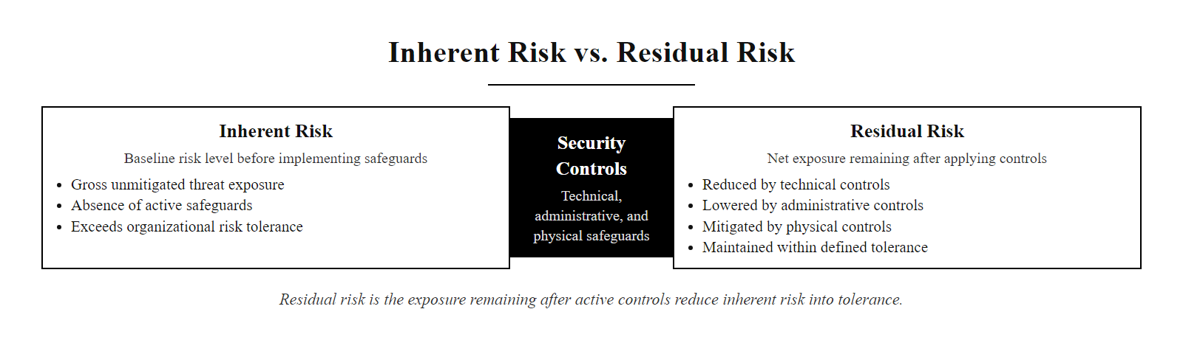
Phase 4, Evaluating Existing Controls & Gaps (2/2)
Residual risk is what remains after applying all active controls, the goal is not to eliminate risk entirely (impossible) but to reduce it to within the organization's defined risk tolerance.
Notes:
(continued, see part 1)

Slide 13
Phase 5, Risk Treatment Decisions
Once risk is calculated, executive leadership must choose a risk treatment strategy. Security architects provide technical recommendations, but the business determines the path forward.
Mitigate (Reduce)
Transfer (Share)
Action: Implement controls to lower likelihood or impact.
Example: Installing MFA to prevent credential compromise.
Use Case: High-value assets with addressable vulnerabilities.
Action: Shift the financial risk to a third party.
Example: Purchasing cyber insurance or outsourcing payment hosting.
Use Case: High-impact, low-likelihood risks.
Avoid (Eliminate)
Accept (Acknowledge)
Action: Terminate the activity that generates the risk.
Example: Disabling public file sharing services.
Use Case: Risks where treatment cost exceeds business benefit.
Action: Document and monitor the risk without active treatment.
Example: Retaining a legacy application needed for compliance.
Use Case: Low-priority risks within organizational risk tolerance.
**Quantify Risk (ALE)**
Is ALE above risk tolerance threshold?
**Yes:** Can we cost
effectively mitigate?
**Yes
Mitigate** | **No
Transfer or Avoid**
**No:** Document acceptance decision
**Accept**
Notes:
After identifying our risks and control gaps, the organization must decide how to handle them. Under the NIST Risk Management Framework, there are four primary risk treatment strategies: mitigation, transfer, avoidance, and acceptance.
Risk mitigation is the most common technical response. We implement security controls to reduce the likelihood or impact of an attack. For example, we install MFA to mitigate credential theft.
Risk transfer shifts the financial risk to another entity. This can be done by purchasing cyber insurance or outsourcing a risky process, such as using a PCI-compliant payment gateway rather than storing credit cards ourselves.
Risk avoidance involves eliminating the risk entirely by stopping the activity that creates it. If hosting a public server is too risky, we disable it.
Risk acceptance is a conscious decision to tolerate the risk without adding controls. This is done when the cost of mitigation exceeds the value of the asset, or when the risk is within the organization's defined risk tolerance. All risk acceptance decisions must be documented and signed off on by leadership, ensuring accountability.
ISO 31000:2018, the international standard for risk management, structures these same four options within a broader treatment process that emphasizes monitoring and review cycles following each treatment decision. Under ISO 31000, even an "accept" decision requires a documented rationale, an assigned risk owner, and a scheduled review date, reinforcing that acceptance is an active governance choice, not passive neglect.
Real-world examples illuminate when each strategy applies. For risk transfer, consider the 2017 NotPetya cyberattack, which caused Merck Pharmaceutical an estimated $1.4 billion in losses. Merck sought recovery under its property insurance policy, but the insurer denied the claim, arguing NotPetya constituted an act of war. This dispute, ultimately settled out of court, exposed a major gap in organizations' understanding of what their risk transfer instruments actually cover, driving a surge in purpose-built cyber insurance policy adoption that explicitly covers nation-state attacks.
For risk avoidance, Microsoft's 2022 decision to block by default the execution of macros in Office documents downloaded from the internet eliminated a primary delivery vector for macro-based malware families like Emotet and QakBot, a platform-level avoidance decision that the industry had resisted for years due to legitimate-use concerns.
Under NIST SP 800-37 Rev. 2, formal risk acceptance requires an Authorizing Official (AO) to sign an Authorization to Operate (ATO) that explicitly acknowledges any residual risk above the organizational threshold, ensuring legal accountability for each acceptance decision made by leadership.

Slide 14
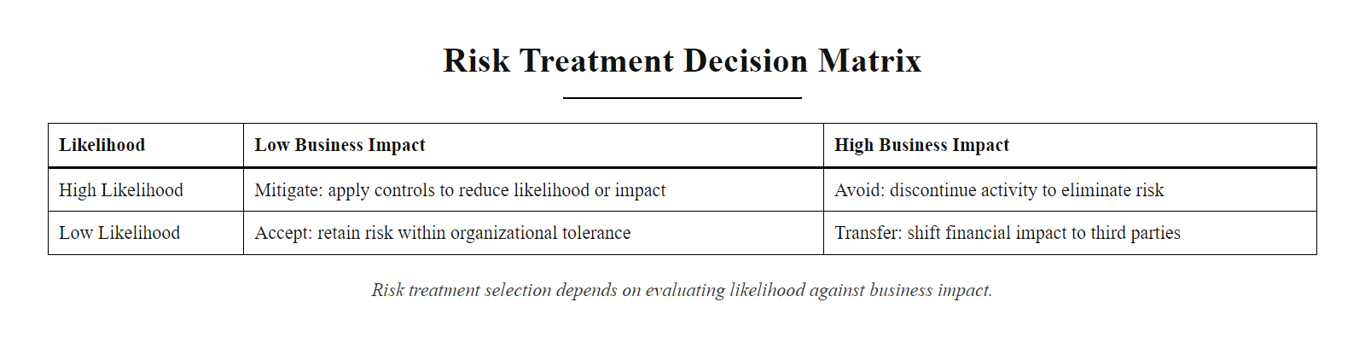
Phase 5, Risk Treatment Decisions (2/2)
Risk treatment selection depends on the relationship between likelihood and impact, acceptance is appropriate for low-stakes risks, while high-impact, high-likelihood risks demand mitigation or elimination.
Notes:
(continued, see part 1)

Slide 15
Phase 6, Designing prioritized Recommendations
A professional risk assessment must conclude with actionable, prioritized recommendations. Every recommendation must be justified by a Cost-Benefit Analysis (CBA).
Link to Risk: Tie every proposed control back to a specific vulnerability and risk calculated in the report.
Perform CBA: Ensure the implementation cost of the control does not exceed the Annualized Loss Expectancy (ALE) reduction.
Prioritize by Risk: Group recommendations into high, medium, and low priority based on the risk matrix.
Address People & Process: Include policy updates and training, not just technical tool purchases.
Define Success Metrics: Establish clear key performance indicators (KPIs) to measure the control's effectiveness post-deployment.
Notes:
The value of a risk assessment lies in its recommendations. If your report concludes with a generic list of tools, it will likely be ignored by leadership. To be effective, every recommendation must be prioritized, actionable, and financially justified.
This process starts by linking every recommendation to a specific risk identified in your report. You then perform a Cost-Benefit Analysis. The cost of implementing and maintaining a control, including software licensing, hardware, and staff training, should be less than the reduction in Annualized Loss Expectancy it provides. If a control costs $50,000 a year to maintain but only protects against a $5,000 annual risk, it is not a sound investment.
We also prioritize our recommendations. High-priority items address critical risks with high likelihood and impact. Finally, we ensure our recommendations address people and processes. Often, updating a security policy or running a phishing training program provides a higher risk reduction than purchasing an expensive new software tool.
The NIST Cybersecurity Framework (CSF) 2.0, released in 2024, provides a maturity model that can organize recommendations by Function, Govern, Identify, Protect, Detect, Respond, and Recover, helping assessors avoid the common mistake of concentrating all recommendations within the Protect function while neglecting detection and response capabilities, which are equally critical for minimizing breach impact.
CIS Controls v8, published by the Center for Internet Security, offers a prioritized list of 18 control safeguards organized by Implementation Group (IG1, IG2, IG3). For most organizations beginning their security improvement journey, IG1, covering 56 safeguards across 11 foundational controls, represents the minimum acceptable baseline. Anchoring recommendations to CIS Control numbers gives leadership a recognized external reference, making the business case more credible to boards and external auditors.
Following the 2021 Colonial Pipeline ransomware attack, which caused a six-day shutdown of the largest fuel pipeline on the U.S. East Coast, triggering fuel shortages across seventeen states, CISA issued TSA Security Directives mandating specific control implementation timelines for pipeline operators. This precedent illustrates why implementation timelines and measurable KPIs are critical recommendation components. Organizations with defined KPIs, such as MFA coverage rate, mean time to patch critical CVEs (target: 100% within 30 days), and phishing simulation click rate (target: below 5%), can demonstrate compliance progress to regulators and leadership in concrete, auditable terms.

Slide 16
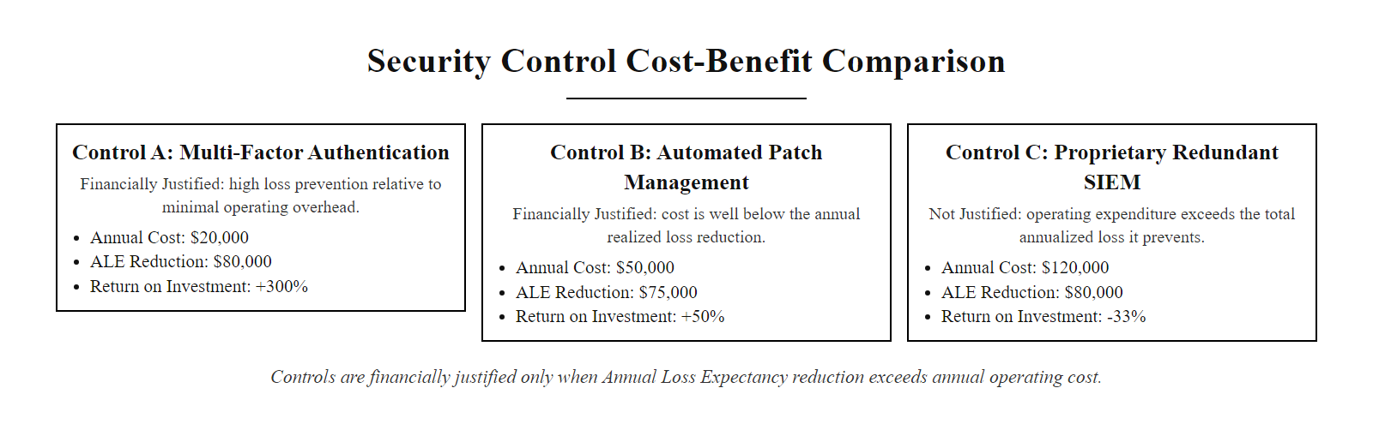
Phase 6, Designing prioritized Recommendations (2/2)
Cost-Benefit Analysis ensures every security recommendation earns its budget allocation, a control that costs more to operate than the annual loss it prevents is not a sound investment.
Notes:
(continued, see part 1)

Slide 17
Structuring the Risk Assessment Report
Your project deliverable is a formal Risk Assessment Report. This report must be structured professionally, translating technical findings into strategic business recommendations.
Report Section | Focus and Content | Intended Audience
1. Executive Summary | High-level summary of critical risks, overall maturity, and budget impact | Board of Directors, CEO, CIO
2. Scope & Methodology | Description of the systems assessed, assumptions made, and frameworks used (NIST SP 800-30) | Security Auditors, Compliance Officer
3. Asset Inventory | Catalog of information, software, hardware, and operational assets with classifications | IT Operations Manager, System Admins
4. Threat & Vulnerability Matrix | Analysis of threat events, CVSS severity scores, and likelihood calculations | Security Engineers, Threat Analysts
5. Control Gap Analysis | Evaluation of existing technical, administrative, and physical controls | Security Managers, System Engineers
6. Recommendations & Roadmap | Prioritized treatment plan with cost-benefit analysis and timelines | Chief Information Security Officer (CISO), IT Director
Draft the Asset Inventory: Begin with the structured data from Phase 1, this is the factual foundation every other section references.
Build the Threat & Vulnerability Matrix: Populate with threat events, CVSS scores, likelihood ratings, and business impact assessments from Phases 2 and 3.
Complete the Control Gap Analysis: Document inherent risk, active controls, assessed effectiveness, gaps identified, and residual risk calculations from Phase 4.
Finalize the Recommendations & Roadmap: Write the prioritized treatment plan with CBA calculations, implementation timelines, and KPIs from Phase 6.
Write the Scope & Methodology: Describe the system boundary, frameworks applied, data collection methods, and assessment assumptions.
Write the Executive Summary Last: Condense all critical findings, top-priority risks, and budget requirements into a single page written in business language, drafting it last ensures it accurately reflects the completed analysis.
Notes:
To wrap up your project, you will compile your findings into a formal Risk Assessment Report. This table outlines the structure required for your deliverable.
The report begins with an Executive Summary. This is a one-page overview written for non-technical executives, summarizing the critical risks and the budget required to address them.
The Scope and Methodology section documents the boundaries of your assessment and the standards used.
The Asset Inventory lists all scoped systems with their values and FIPS 199 classifications.
The Threat and Vulnerability Matrix details the realistic threats you modeled, including CVSS scores for technical vulnerabilities.
The Control Gap Analysis evaluates your target's existing defenses.
Finally, the Recommendations and Roadmap section provides your prioritized treatment plan, complete with cost-benefit calculations and implementation timelines. This structure mirrors how professional security consultants deliver reports to their clients.
NIST SP 800-30 Rev. 1 Appendix K provides a template risk assessment report that serves as an authoritative reference for professional formatting. Major consulting firms, including Mandiant (now part of Google Cloud), CrowdStrike Services, and PricewaterhouseCoopers, follow a broadly similar structure in their delivered reports: a concise executive narrative up front, followed by technical appendices containing raw data, CVSS tables, evidence artifacts, and detailed remediation steps.
Regulatory frameworks impose specific reporting requirements that must be incorporated into the report structure. Under HIPAA (45 CFR § 164.308(a)(1)(ii)(A)), covered healthcare entities must conduct and document security risk analyses, identifying the risks to electronic protected health information (ePHI) and implementing security measures sufficient to reduce those risks to a reasonable and appropriate level. Under PCI DSS v4.0 Requirement 12.3, organizations storing cardholder data must perform annual targeted risk analyses for each control with a defined review frequency. Your report must reference the applicable regulatory obligations of your target organization to ensure it satisfies both internal governance and external compliance requirements.
The distinction between the Executive Summary and the technical body of the report cannot be overstated. Research cited by (ISC)² indicates that the most common failure mode in security reports presented to boards is the use of technical language in the summary section. Executive summaries must express risks in financial and operational terms, projected loss figures, regulatory penalty ranges, and operational downtime costs, allowing decision-makers to allocate budget without needing to interpret technical jargon.

Slide 18
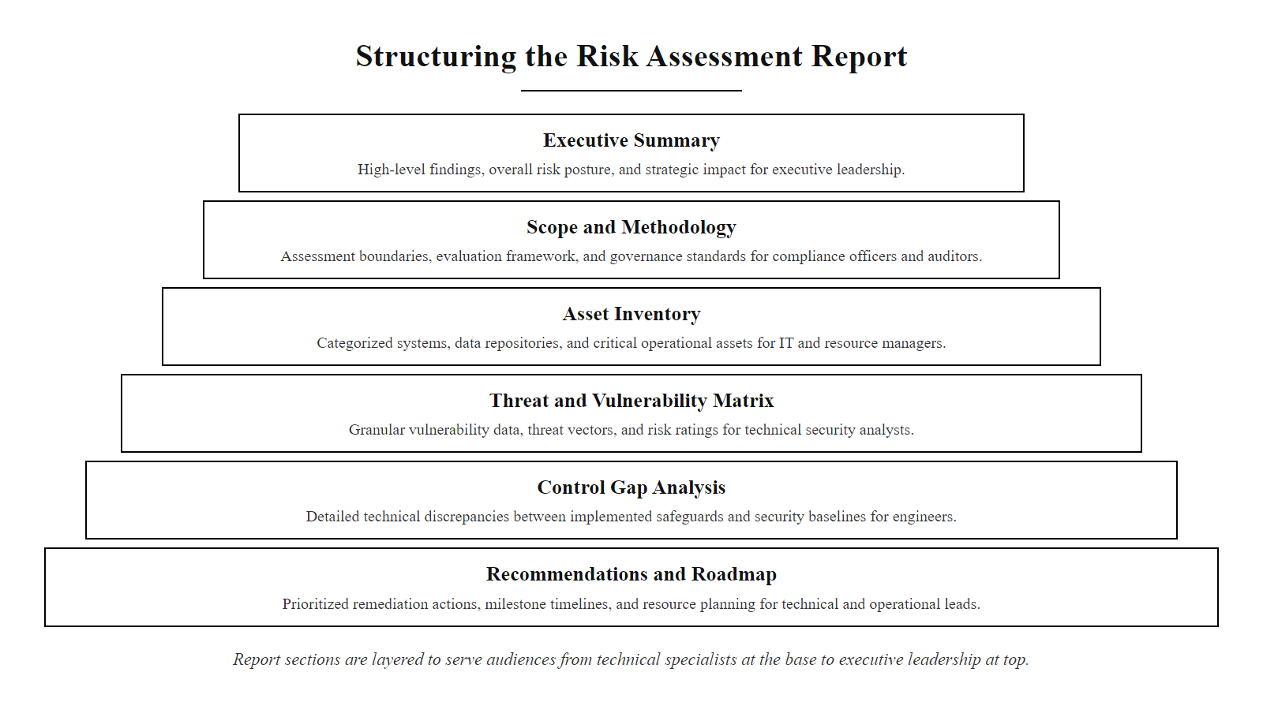
Structuring the Risk Assessment Report (2/2)
The report is organized so each audience finds their information in the right layer, executives read the summary, technical teams drill into the matrix and gap analysis, and compliance officers examine the scope and methodology section.
Notes:
(continued, see part 1)

Slide 19
Project Rubric & Deliverables
Your risk assessment will be evaluated on its technical accuracy, alignment with NIST SP 800-30, and the feasibility of its recommendations.
Evaluation Criteria
Timeline & Milestones
Asset Precision: Clearly defined assets with documented business valuations.
Threat Realism: Modeling threat actors actually relevant to the target's industry.
Methodology Rigor: Using CVSS scores and ALE formulas correctly.
Actionable Roadmap: Prioritized recommendations with balanced control types.
Milestone 1: Scope definition and Asset Catalog approval.
Milestone 2: Draft Threat and Vulnerability Matrix.
Milestone 3: Final Risk Assessment Report submission.
Notes:
As we conclude today's class, let's review the rubric for this project. Your work will be evaluated on four main areas.
First, asset precision: we want to see specific systems and data types with documented valuations, not vague categories.
Second, threat realism: the threat actors you model must be relevant to your target organization. For example, a local hospital faces different threat profiles than a defense contractor.
Third, methodological rigor: we will check that you have calculated CVSS scores and ALE values correctly.
Fourth, an actionable roadmap: your recommendations must be prioritized and include physical and administrative controls, not just technical ones.
Review the milestones and submission deadlines in the syllabus. This project is your opportunity to apply everything you've learned this term to a real organization. In our next class, we will bring both investigation and risk planning together for your final cybersecurity capstone. Thank you, and I will see you in the next class.
The skills you are building in this project map directly to real cybersecurity roles. A Risk Analyst or GRC (Governance, Risk, and Compliance) Specialist spends the majority of their professional work day performing exactly the tasks described in this rubric: cataloging assets, modeling threats, evaluating controls, and writing recommendations for leadership. According to the NIST National Initiative for Cybersecurity Education (NICE) Cybersecurity Workforce Framework (SP 800-181 Rev. 1), these tasks correspond to the "Risk Management" work role category, which is consistently one of the highest-demand specializations in the cybersecurity job market.
Professionally, this type of work is assessed in major certification examinations. The Certified Information Systems Security Professional (CISSP) exam dedicates an entire domain to Security and Risk Management (Domain 1), treating NIST SP 800-30, ISO 27005, and ALE calculations as foundational knowledge. The Certified in Risk and Information Systems Control (CRISC) certification, issued by ISACA, covers risk identification, assessment, response, and reporting as its four exclusive domains, making it the most directly aligned certification with the project you are completing today.
As you work through your three milestones, scope definition, draft threat matrix, and final report, approach each as a professional deliverable, not merely an academic submission. Real security assessments drive budget decisions, influence hiring plans, and determine which vulnerabilities get patched before they are exploited. The rigor you bring to this project directly reflects the rigor you will bring to your career in cybersecurity.

Slide 20
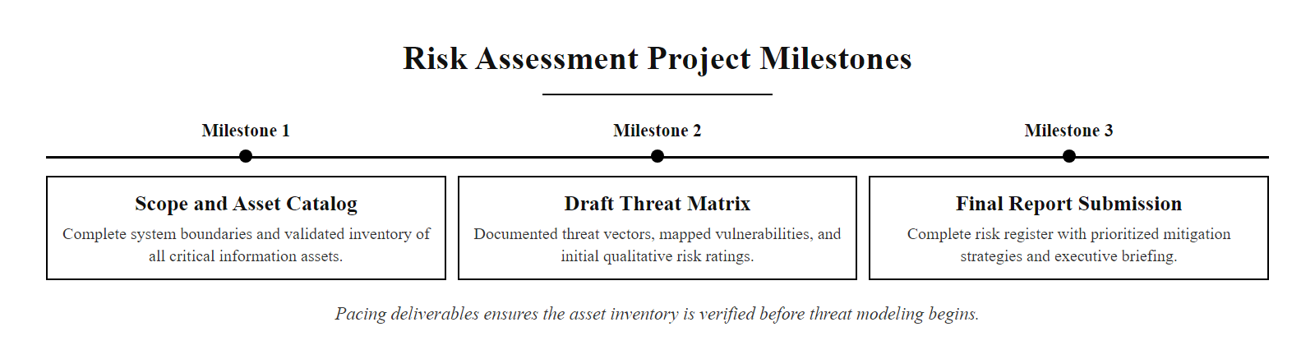
Project Rubric & Deliverables (2/2)
The three-milestone structure paces your work to ensure the asset inventory is validated before threat modeling begins, preventing downstream errors that compound when built on an incomplete asset catalog.
Notes:
(continued, see part 1)

Slide 21
MITRE ATT&CK, Mapping Threat Behaviors to Your Assessment
The MITRE ATT&CK framework is a globally accessible knowledge base of adversary tactics and techniques based on real-world observations. It translates threat intelligence into concrete attack behaviors your assessment can model.
ATT&CK Tactic | Description | Example Technique | Relevant CVE / Tool
Initial Access (TA0001) | Methods used to gain the first foothold | Phishing (T1566), Exploit Public-Facing App (T1190) | CVE-2021-26855 (Exchange ProxyLogon)
Execution (TA0002) | Running malicious code on a target system | Command & Scripting Interpreter (T1059) | PowerShell-based loaders
Persistence (TA0003) | Maintaining access across reboots | Scheduled Tasks (T1053), Registry Run Keys (T1547) | Cobalt Strike beacon persistence
Lateral Movement (TA0008) | Moving from compromised host to others | Pass the Hash (T1550.002), SMB/Windows Admin Shares | Mimikatz credential dumping
Exfiltration (TA0010) | Stealing data from the environment | Exfil Over C2 Channel (T1041), Cloud Storage upload | Mega.nz, rclone
**Asset Inventory**
Map assets to ATT&CK target types
**Threat Source Selection**
Identify relevant ATT&CK Groups (e.g., APT29, FIN7)
**Technique Enumeration**
List techniques used by that group
**Control Mapping**
Identify which controls detect or block each technique
**Gap Analysis**
Undetected techniques become findings
Notes:
The MITRE ATT&CK framework, maintained by MITRE Corporation and first published publicly in 2015, has become one of the most widely adopted threat intelligence resources in the cybersecurity industry. Where NIST SP 800-30 describes the process of threat modeling, ATT&CK provides the content, a curated, continuously updated library of real adversary behaviors cataloged from actual incidents.
ATT&CK is organized into three matrices: Enterprise (covering Windows, Linux, macOS, cloud, and containers), Mobile (iOS and Android), and ICS (Industrial Control Systems). For most enterprise risk assessments, the Enterprise matrix is the primary reference.
Each entry in the matrix is a Technique, a specific way an adversary achieves a tactical objective. For example, under the "Credential Access" tactic (TA0006), Technique T1003 (OS Credential Dumping) describes methods used to extract password hashes from operating system memory, including the well-known Mimikatz toolset. If your organization runs Windows Active Directory and does not have Credential Guard enabled, this technique represents an unmitigated risk that your control evaluation must flag.
The real power of ATT&CK in a risk assessment comes from cross-referencing the framework's Groups database. ATT&CK tracks over 130 named threat actor groups, including APT29 (Cozy Bear, attributed to Russian SVR), FIN7 (financially motivated Eastern European group targeting retail and hospitality), and Lazarus Group (attributed to North Korean DPRK). Each group entry links to the specific techniques that group has been observed using in real incidents, enabling assessors to build a realistic threat profile based on who actually targets organizations in their industry and geography.
For example, a healthcare organization assessing ransomware risk should specifically examine the techniques associated with groups like LockBit and BlackCat/ALPHV, both of which have targeted hospital systems extensively. The 2021 Universal Health Services (UHS) Ryuk ransomware attack, which disrupted operations across 400 hospitals in the U.S. and U.K. — followed a technique chain consistent with ATT&CK patterns: phishing initial access, Emotet for execution and lateral movement, and Ryuk deployed as the final payload. Assessors who model this specific chain can evaluate whether their organization's controls would have detected or blocked each stage.
The ATT&CK Navigator builds a threat-actor layer and color-codes covered versus uncovered techniques, producing a coverage map that can be exported as a visual for a report's threat section.
NIST SP 800-53A Rev. 5 provides assessment procedures that map several control families directly to ATT&CK technique mitigations, particularly in the areas of Audit and Accountability (AU), Identification and Authentication (IA), and System and Information Integrity (SI). Aligning your control gap analysis findings to both the NIST control number and the ATT&CK technique ID it mitigates creates a dual-layered finding that satisfies both technical teams and compliance auditors simultaneously.

Slide 22
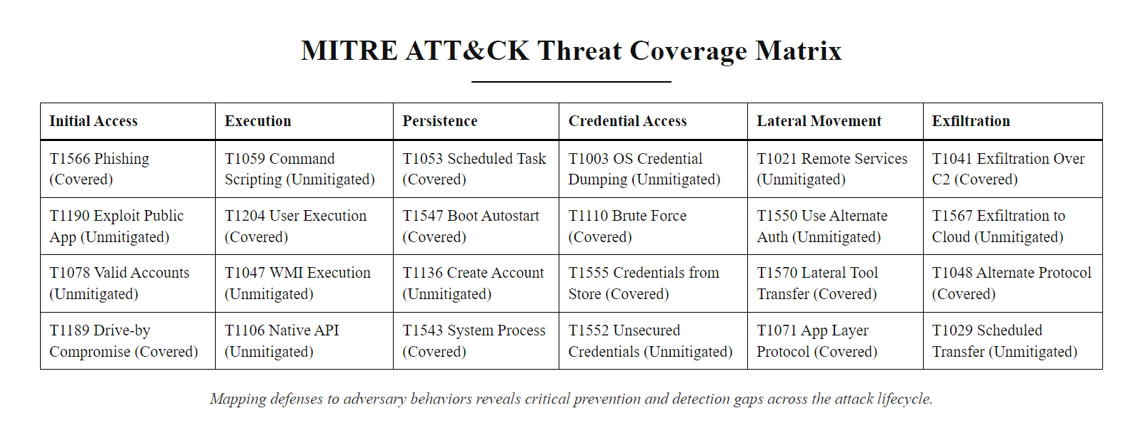
MITRE ATT&CK, Mapping Threat Behaviors to Your Assessment (2/2)
Mapping your target's existing controls against ATT&CK technique coverage reveals detection and prevention gaps at every stage of the attack lifecycle, moving threat modeling from abstract categories to specific, evidence-based behaviors.
Notes:
(continued, see part 1)

Slide 23
Supply Chain Risk Assessment
Modern organizations depend on hundreds of software vendors, managed service providers, and cloud platforms. Supply chain risk occurs when an attacker compromises a trusted third party to reach the actual target organization.
Supply Chain Attack Vectors
NIST SP 800-161 Controls
Software Build Pipeline Compromise: Injecting malware into a vendor's software update (SolarWinds SUNBURST).
Open Source Dependency Poisoning: Backdooring widely used npm/PyPI packages.
Managed Service Provider (MSP) Access: Exploiting vendor remote access to reach downstream clients.
Hardware Implants: Tampering with firmware at the manufacturer or distributor level.
C-SCRM Policy: Establish a Cyber Supply Chain Risk Management policy.
Vendor Questionnaires: Require SOC 2 Type II or ISO 27001 certification from critical suppliers.
Software Bill of Materials (SBOM): Maintain inventories of all third-party components.
Contractual Security Requirements: Include right-to-audit clauses and breach notification SLAs.
Step 1, Map the Vendor Ecosystem: Catalog all third-party vendors with system access, including cloud SaaS, MSPs, and software suppliers.
Step 2, Classify Vendor Criticality: Rate each vendor by the access level they hold and the business functions they support.
Step 3, Assess Vendor Security Posture: Review SOC 2 reports, ISO 27001 certificates, and complete standardized questionnaires (e.g., SIG Lite).
Step 4, Identify SBOM Gaps: For software-dependent assets, verify that SBOMs exist and are monitored against the NVD for newly disclosed CVEs in third-party components.
Step 5, Design Compensating Controls: Where vendor risk cannot be mitigated at the source, implement network segmentation, least-privilege vendor access, and enhanced monitoring for vendor-initiated sessions.
Notes:
One of the most significant shifts in the threat landscape over the past decade is the increasing prevalence of supply chain attacks, incidents in which adversaries compromise an organization not through direct attack, but by first compromising a trusted vendor or technology supplier that the organization has granted elevated access.
The 2020 SolarWinds SUNBURST attack is the defining case study. SolarWinds produces Orion, a widely deployed IT monitoring platform used by thousands of organizations worldwide, including U.S. federal agencies. Russian SVR hackers (APT29) infiltrated SolarWinds' software development environment and inserted the SUNBURST backdoor into a legitimate Orion software update. Because the update was cryptographically signed by SolarWinds' legitimate build infrastructure, it passed through most security controls undetected. Approximately 18,000 organizations installed the compromised update, giving the attackers dormant backdoor access that could be selectively activated against high-value targets including the U.S. Treasury, Commerce, and State Departments. From a risk assessment perspective, none of these victim organizations had a direct vulnerability, their risk arose entirely from their trusted relationship with a vendor.
NIST SP 800-161 Rev. 1, "Cybersecurity Supply Chain Risk Management Practices for Systems and Organizations," published in May 2022, provides the authoritative guidance framework for addressing this category of risk. It introduces the concept of C-SCRM (Cyber Supply Chain Risk Management) as a discipline distinct from, though integrated with, general information security risk management. NIST SP 800-161 defines a three-tiered organizational model, enterprise, mission/business process, and system level, that mirrors the structure of SP 800-37 Rev. 2's RMF, enabling organizations to embed supply chain controls within their existing governance structure.
The Software Bill of Materials (SBOM) has emerged as a critical tool for managing open source dependency risk. An SBOM is a machine-readable inventory of all software components and dependencies used in a product, analogous to an ingredients list for food. Executive Order 14028 (May 2021, "Improving the Nation's Cybersecurity") mandated that software vendors selling to the U.S. federal government provide SBOMs for their products. CISA has since published minimum element guidelines for SBOMs, specifying required fields including component name, version, supplier, and unique identifier. When CVE-2021-44228 (Log4Shell) was disclosed, organizations with complete SBOMs could search their own inventories for "log4j" and identify affected products within minutes; those without SBOMs spent weeks manually auditing their software stacks.
At the time of Log4Shell, the Log4j library was downloaded over 28 million times a week from Maven Central, which illustrates how much exposure a single open-source vulnerability can create across the software supply chain, given how many banking, email and streaming services depend on third-party libraries.
For vendor risk assessment in practice, the Shared Assessments Program's Standardized Information Gathering (SIG) questionnaire provides a comprehensive third-party risk evaluation instrument covering 18 risk domains. Many enterprises require critical vendors to complete the SIG Lite (an abbreviated version) annually as a condition of continued engagement.

Slide 24
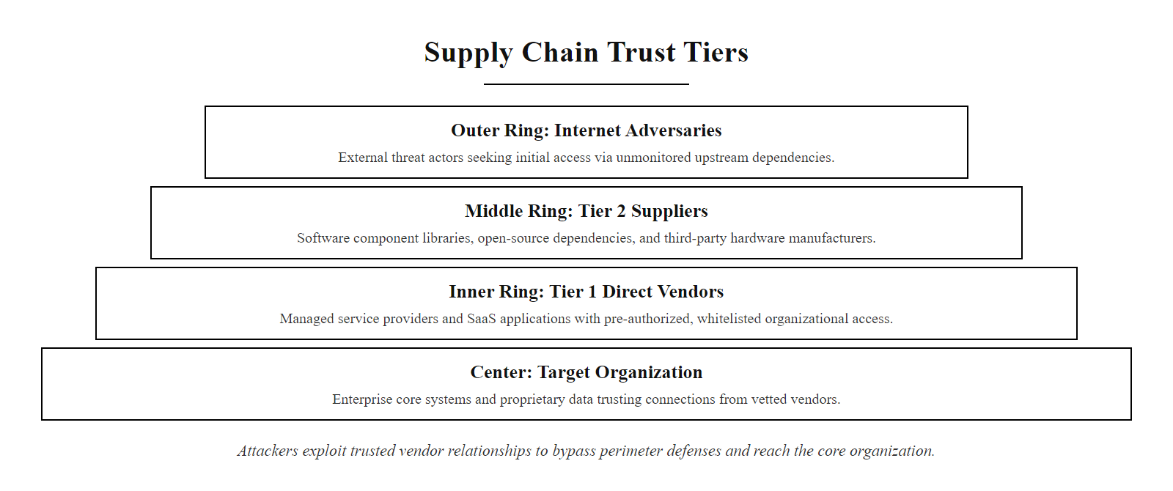
Supply Chain Risk Assessment (2/2)
Supply chain attacks are effective precisely because they exploit the trust relationship between an organization and its vetted vendors, attackers traverse a path the organization itself has whitelisted.
Notes:
(continued, see part 1)

Slide 25
Insider Threat Risk Modeling
Insider threats, from malicious employees, negligent staff, or compromised credentials, represent a distinct risk category that perimeter-focused controls cannot address. They require behavioral modeling and internal monitoring strategies.
Insider Threat Categories
Detection Indicators (UEBA)
Malicious Insider: Intentional data theft or sabotage by a current or former employee with legitimate access.
Negligent Insider: Accidental data exposure caused by misconfiguration, policy violation, or social engineering.
Compromised Insider: External attacker operating through stolen or coerced employee credentials.
Third-Party Insider: Vendor or contractor with system access who becomes a risk vector.
Abnormal data access volume outside working hours.
Mass download or emailing of sensitive files before resignation.
Access to systems outside normal job role (privilege abuse).
Use of personal cloud storage (Dropbox, Google Drive) for file transfers.
Repeated failed authentication followed by successful login from unusual location.
Notes:
Insider threats represent one of the most underestimated risk categories in enterprise risk assessments because organizations naturally focus on external attackers. However, the 2022 Verizon Data Breach Investigations Report (DBIR) consistently shows that a significant percentage of confirmed data breaches involve insider actors, either acting maliciously, carelessly, or as unwitting conduits for external attackers who have stolen their credentials.
The Ponemon Institute's 2023 Cost of Insider Threats Global Report found that insider threat incidents cost organizations an average of $16.2 million per incident when classified as credential theft, the highest-cost category. Average remediation time for insider incidents was 85 days, compared to 26 days for external breach response, reflecting the difficulty of detecting and containing insiders who have legitimate access to the systems they are abusing.
NIST SP 800-53 Rev. 5 addresses insider threat under multiple control families. The Personnel Security (PS) family includes controls like PS-3 (Personnel Screening), PS-4 (Personnel Termination, revoking all access immediately upon separation), and PS-7 (External Personnel Security, applying requirements to contractors and vendors). The Audit and Accountability (AU) family includes AU-2 (Event Logging) and AU-6 (Audit Record Review), requiring that insider-relevant events such as bulk file access and privilege escalation are logged and regularly reviewed.
The most powerful technical control for insider threat detection is User and Entity Behavior Analytics (UEBA). UEBA platforms establish a behavioral baseline for each user, their normal working hours, typical systems accessed, average data transfer volumes, and standard geographic login patterns. Any deviation from this baseline generates an anomaly score. For example, if a database administrator who normally queries between 9 AM and 6 PM begins downloading entire table exports at 2 AM the week after submitting a resignation, a UEBA system can flag this as a high-risk insider threat indicator in real time, enabling the security team to investigate before exfiltration is complete.
A landmark insider threat case is the 2019 Capital One breach, technically classified as a compromised insider because the attacker was a former AWS employee who used her knowledge of cloud IAM configurations to craft the SSRF attack that bypassed the WAF and retrieved temporary credentials. This case blurs the line between insider and external threat, the attacker had no current access but possessed institutional knowledge that no outsider would have had. Risk assessments for organizations using cloud platforms must account for former employee knowledge as a threat vector, not just current access credentials.
The CERT National Insider Threat Center publishes a free "Common Sense Guide to Mitigating Insider Threats" with 22 practice recommendations for insider-risk programs, useful reading for GRC and security-operations work.
For the project, when modeling insider threats, students should identify which specific roles within their target organization have privileged access to critical assets, finance systems, customer databases, source code repositories, and evaluate whether those access levels follow the principle of least privilege, whether access reviews are conducted regularly, and whether a privileged access management (PAM) solution is in place to monitor and record privileged sessions.

Slide 26
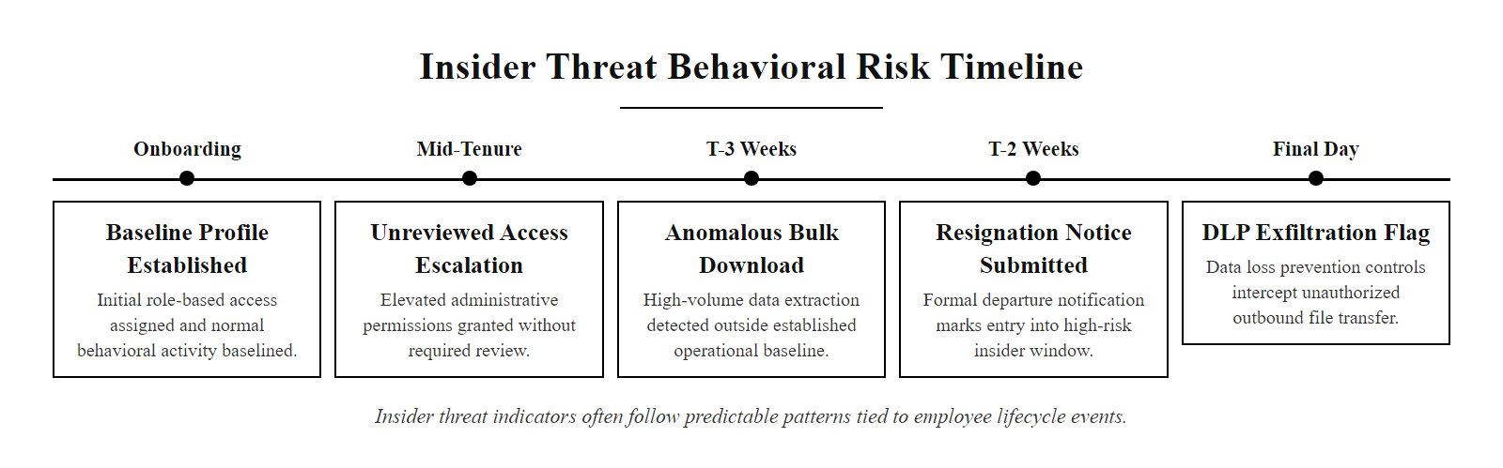
Insider Threat Risk Modeling (2/2)
Insider threat indicators often follow predictable behavioral patterns tied to employee lifecycle events, UEBA tools trained on baseline behavior can detect these anomalies automatically, but the risk assessment must specify what monitoring is required.
Notes:
(continued, see part 1)

Slide 27
Cloud Security Risk Assessment Considerations
Cloud environments introduce a shared responsibility model that changes which risks the organization owns versus which risks the cloud service provider (CSP) manages. Risk assessments must account for this boundary explicitly.
Responsibility | IaaS (e.g., AWS EC2) | PaaS (e.g., AWS RDS) | SaaS (e.g., Salesforce)
Physical Infrastructure | CSP | CSP | CSP
Hypervisor / OS Patching | Customer | CSP | CSP
Network Configuration | Customer | Customer | CSP
Application Security | Customer | Customer | Customer
Identity & Access Management | Customer | Customer | Customer
Data Encryption & Classification | Customer | Customer | Customer
CSP Misconfiguration is the leading cause of cloud security incidents, not CSP platform vulnerabilities. Customer-managed settings (S3 bucket ACLs, security groups, IAM roles) are the primary risk surface.
Cloud Security Posture Management (CSPM) tools continuously scan cloud configurations against CIS Benchmarks and the CSP's own security best-practice frameworks.
NIST SP 800-144 provides guidelines on security and privacy in public cloud computing, establishing the risk assessment considerations unique to cloud deployments.
Notes:
Cloud infrastructure has fundamentally changed the risk landscape for enterprise organizations. When we conduct a risk assessment for an organization that operates workloads in AWS, Azure, or Google Cloud Platform, we cannot apply traditional on-premises risk assessment models without modification.
The central concept is the shared responsibility model. Every major cloud service provider publishes a version of this model that defines which security responsibilities belong to the CSP and which belong to the customer. The boundary shifts depending on the service model: Infrastructure as a Service (IaaS), Platform as a Service (PaaS), or Software as a Service (SaaS). In IaaS, the customer is responsible for everything above the hypervisor, operating system patching, runtime security, application security, data encryption, and IAM configuration. In SaaS, the CSP manages all of these infrastructure layers, but the customer retains full responsibility for IAM, data classification, and access controls within the application.
The Verizon DBIR and reports from Wiz and Lacework consistently show that misconfiguration, not platform-level exploits, is the dominant cause of cloud security incidents. In 2019, approximately 540 million Facebook records were exposed through third-party app developers who had stored Facebook data in publicly accessible Amazon S3 buckets without server-side encryption or access controls. The S3 bucket feature itself was working exactly as designed; the risk arose from the customer's failure to properly configure access policies. This illustrates why cloud risk assessments must specifically enumerate IAM policies, storage bucket access controls, network security group rules, and API gateway configurations as primary assessment targets.
NIST SP 800-144, "Guidelines on Security and Privacy in Public Cloud Computing," identifies the primary cloud risk categories as: governance and enterprise risk management (loss of control), compliance (meeting regulatory requirements in a shared environment), trust (validating CSP security claims), and architecture (unique technical risks of multi-tenant environments). These categories should be explicitly addressed in the scope and methodology section of any risk assessment covering cloud-hosted assets.
CIS Benchmarks for cloud platforms, available for AWS, Azure, GCP, and others, provide detailed configuration hardening guidelines that serve as the baseline against which CSPM tools evaluate the current cloud environment. The CIS AWS Foundations Benchmark v2.0, for example, covers IAM, logging, monitoring, networking, and storage across over 70 specific configuration checks. Mapping CSPM findings to CIS Benchmark controls and NIST SP 800-53 control families creates an audit trail that satisfies both technical and compliance stakeholders.
AWS Config, Azure Policy and Google Cloud Security Command Center provide cloud security posture management that continuously checks configuration, for example whether storage buckets block public access, and flags drift from policy. Free-tier accounts allow hands-on exploration.
For multi-cloud environments, the Cloud Security Alliance (CSA) Cloud Controls Matrix (CCM) version 4.0 provides a cross-mapping between cloud security controls and major standards including ISO 27001, PCI DSS, HIPAA, and NIST SP 800-53, enabling a single control assessment to satisfy multiple compliance frameworks simultaneously.

Slide 28
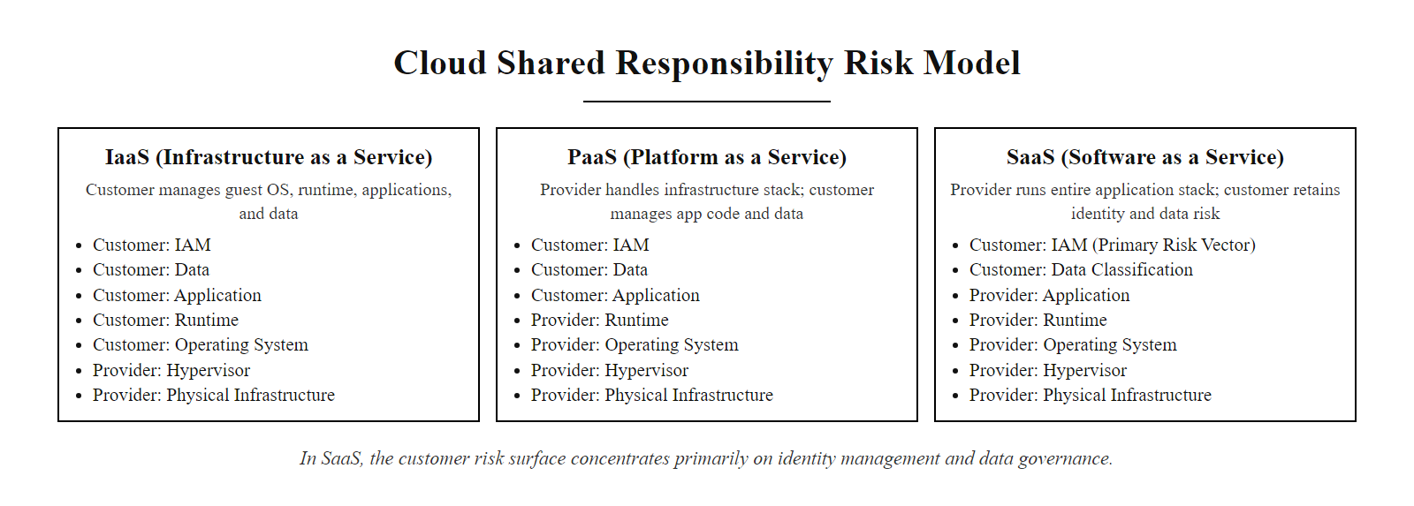
Cloud Security Risk Assessment Considerations (2/2)
The shared responsibility model means the risk surface shifts with each service model, in SaaS, the customer is primarily responsible for identity, access management, and data classification, making IAM misconfiguration the dominant risk vector.
Notes:
(continued, see part 1)

Slide 29
Case Study, Ransomware Risk Assessment
Ransomware has become the most financially damaging category of cyber attack. A rigorous risk assessment specifically models ransomware as a distinct threat scenario with unique propagation mechanics and impact calculations.
Ransomware Attack Chain
Ransomware ALE Calculation Components
Stage 1, Initial Access: Phishing email, exposed RDP (CVE-based), or VPN credential theft.
Stage 2, Execution: Payload deployment via PowerShell, WMI, or LOLBins.
Stage 3, Discovery & Lateral Movement: Network enumeration, credential harvesting (Mimikatz), spread via SMB.
Stage 4, Impact: Encryption of files, deletion of shadow copies (vssadmin delete), ransom demand delivery.
Ransom Payment: Average enterprise ransom demand exceeds $1.5M (Sophos 2023 State of Ransomware).
Downtime Cost: Average downtime: 22 days × hourly revenue impact.
Recovery Cost: Incident response, forensics, clean rebuild of affected systems.
Regulatory Fines: If PII is exfiltrated prior to encryption (double extortion), GDPR/HIPAA fines apply.
Reputational Impact: Customer churn, brand damage (difficult to quantify; use market cap delta as proxy).
Step 1, Model the Threat Actor: Identify ransomware groups active in your target's industry vertical using CISA advisories and ATT&CK Groups database.
Step 2, Map the Attack Chain: For each phase of the ransomware chain, identify which assets are exposed and what controls (if any) would detect or block each stage.
Step 3, Calculate Ransomware ALE: Sum all cost components (downtime, recovery, legal, regulatory) weighted by ARO based on industry incident frequency data.
Step 4, Evaluate Backup Integrity: Determine whether offline or immutable backups exist for all critical systems, if not, recovery cost skyrockets.
Step 5, Test Detection Capability: Validate whether SIEM/EDR rules detect Mimikatz activity, mass shadow copy deletion, and abnormal SMB lateral movement, these are hallmark indicators of ransomware precursor activity.
Notes:
Ransomware has evolved from opportunistic malware targeting individual consumers to highly sophisticated, business-model-driven extortion operations run by professional criminal organizations with their own HR departments, customer service functions, and affiliate programs. Understanding this evolution is essential for modeling ransomware as a realistic threat in your risk assessment.
Modern ransomware groups operate under a Ransomware-as-a-Service (RaaS) model. The core group, for example, LockBit, BlackCat/ALPHV, or Cl0p, develops and maintains the ransomware platform and negotiation infrastructure. Affiliates rent access to the platform and conduct the actual intrusions, splitting the ransom payment typically 70-30 or 80-20 with the core group. This model dramatically scales the number of active ransomware campaigns at any given time, as affiliates can specialize in initial access techniques (initial access brokers) and simply buy footholds in target organizations on criminal marketplaces.
The 2021 Colonial Pipeline attack, carried out by the DarkSide RaaS group, caused a six-day shutdown of the 5,500-mile pipeline supplying approximately 45% of fuel to the U.S. East Coast. The initial access vector was a single compromised VPN credential, purchased from an initial access broker, with no MFA required for authentication. Colonial Pipeline paid a $4.4 million ransom. The U.S. Department of Justice subsequently recovered approximately $2.3 million of this payment, but the operational, regulatory, and reputational costs dwarfed the direct ransom figure.
For ransomware ALE calculation, the Sophos 2023 State of Ransomware Report provides empirically grounded data points: the average ransom payment among organizations that paid was $1,542,333; the average total remediation cost (including downtime, people time, device cost, network cost, lost opportunity, ransom paid, and other costs) was $1,082,000 for organizations that did not pay and $1,770,000 for those that did (reflecting the combined cost of ransom plus recovery). These figures can be used to calibrate ALE estimates for organizations that lack their own historical incident data.
The CISA/FBI Joint Advisory on ransomware (updated regularly at cisa.gov/stopransomware) provides industry-specific incident frequency data, recommended mitigations, and indicators of compromise for active ransomware groups. CISA's StopRansomware.gov campaign is the authoritative reference for current ransomware threat intelligence in the U.S. government context.
Double extortion, pioneered by the Maze group around 2019, exfiltrates sensitive data before encrypting it and threatens public release as a second lever. Because exfiltration of PII is itself a reportable breach, such incidents trigger notification obligations under GDPR, CCPA, HIPAA and state laws even if the ransom is paid and data recovered. Cl0p's 2023 exploitation of MOVEit Transfer (CVE-2023-34362) exfiltrated data from hundreds of organizations without deploying ransomware at all, showing extortion increasingly decoupled from encryption.
Key preventive controls for ransomware risk that must be evaluated in Phase 4 include: MFA on all remote access (VPN, RDP, OWA), EDR/XDR with behavioral detection enabled (not just signature-based AV), network segmentation to limit lateral movement, offline or immutable backups tested via regular restoration drills, and disabling or restricting PowerShell execution for non-administrative users.

Slide 30
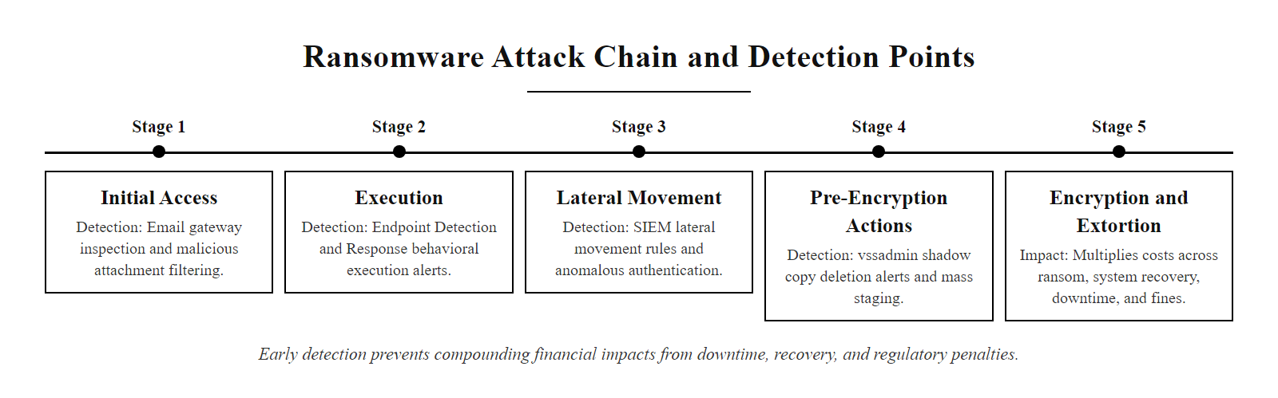
Case Study, Ransomware Risk Assessment (2/2)
Ransomware's total cost is far larger than the ransom demand alone, downtime, recovery, and regulatory exposure typically multiply the initial ransom figure by three to five times, making pre-incident controls dramatically more cost-effective than post-incident response.
Notes:
(continued, see part 1)

Slide 31
Framework Comparison, NIST CSF 2.0 vs. SP 800-30 vs. ISO 27005
Multiple risk and security frameworks exist. Understanding how they relate, and when to use each, is essential for designing an assessment that satisfies both technical rigor and stakeholder expectations.
Dimension | NIST CSF 2.0 | NIST SP 800-30 Rev. 1 | ISO/IEC 27005:2022
Primary Purpose | Cybersecurity program maturity and governance | Specific risk assessment methodology | Information security risk management process
Scope | Entire cybersecurity program (6 Functions) | Risk identification, estimation, and prioritization | Risk treatment lifecycle and context establishment
Output | Maturity profile, target profile, gap analysis | Risk assessment report with prioritized risk table | Risk treatment plan with residual risk statement
Audience | C-suite, board, program managers | Security analysts, risk owners | Risk managers, compliance officers
Regulatory Alignment | U.S. federal voluntary (required for critical infrastructure sectors) | U.S. federal mandatory (FISMA agencies) | ISO 27001 certification support (global)
Quantitative Support | Limited (references SP 800-30 for details) | Yes, ALE, SLE, ARO formulas in appendices | Limited, references FAIR and other methods
Update Cycle | CSF 2.0 released February 2024 | SP 800-30 Rev. 1 published September 2012 | ISO 27005:2022 released October 2022
When to use which framework: Use NIST SP 800-30 when you need a rigorous, methodology-focused risk assessment with quantitative analysis. Use NIST CSF 2.0 when communicating overall program maturity to executives or establishing a security improvement roadmap. Use ISO 27005 when the organization requires ISO 27001 certification or operates in European markets with GDPR obligations.
Notes:
A common point of confusion for students entering the cybersecurity profession is understanding how the various frameworks and standards relate to each other. Organizations frequently reference NIST SP 800-30, the NIST Cybersecurity Framework, and ISO 27005 interchangeably in job postings and security policies, but they serve distinct purposes and operate at different levels of abstraction.
NIST SP 800-30 is a methodology document, it tells you precisely how to conduct a risk assessment step by step, what inputs to gather, what analytical methods to apply, and how to format the results. It is best understood as the operational manual for risk assessment. The NIST Cybersecurity Framework (CSF) 2.0, by contrast, is a governance document, it provides a structured vocabulary and outcome-based framework for describing an organization's cybersecurity posture across six Functions (Govern, Identify, Protect, Detect, Respond, Recover) and communicating that posture to stakeholders at different organizational levels. CSF 2.0 explicitly references SP 800-30 as the recommended mechanism for implementing the "Identify" function's risk assessment activities.
ISO 27005:2022 occupies similar methodological territory to SP 800-30 but within the ISO ecosystem. Its primary role is to provide the risk management process that feeds ISO 27001's Information Security Management System (ISMS), specifically the "Plan" phase of the PDCA cycle. ISO 27005 follows the risk management principles of the parent standard ISO 31000:2018 and uses identical terminology, making it natural for organizations that have already adopted ISO 31000 for enterprise risk management.
For organizations subject to FISMA (the Federal Information Security Modernization Act), use of NIST guidance including SP 800-30 is mandatory. For organizations seeking ISO 27001 certification, which is the globally recognized standard for information security management systems, ISO 27005 is the natural companion document. For organizations simply wishing to communicate their cybersecurity posture to executive leadership or boards, the NIST CSF 2.0 provides the most accessible and widely recognized vocabulary.
In practice, the majority of large enterprise security programs use all three frameworks in parallel. The risk assessment methodology from SP 800-30 generates the findings; the risk treatment process from ISO 27005 structures how those findings are addressed; and the CSF 2.0 Functions provide the organizing principle for the remediation roadmap that gets presented to the board. This layered approach avoids duplication because each framework operates at a different level of specificity.
The NIST CSF 2.0 Informative References database maps every subcategory to the corresponding NIST SP 800-53, ISO 27001 Annex A, CIS and COBIT controls, so a single recommendation can be shown to satisfy requirements from several frameworks at once.

Slide 32
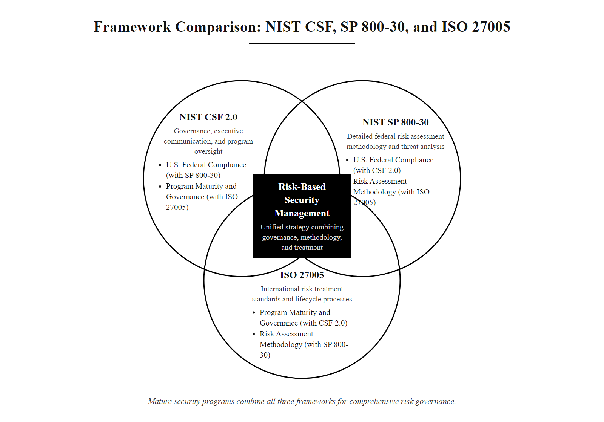
Framework Comparison, NIST CSF 2.0 vs. SP 800-30 vs. ISO 27005 (2/2)
These three frameworks are complementary, not competing, most mature security programs use all three simultaneously, with SP 800-30 driving assessment methodology, ISO 27005 structuring the treatment process, and CSF 2.0 providing the governance and communication layer for executive reporting.
Notes:
(continued, see part 1)

Slide 33
Regulatory Risk, HIPAA, PCI DSS, and GDPR Obligations
Regulatory non-compliance is itself a quantifiable risk. Security failures that violate HIPAA, PCI DSS, or GDPR trigger mandatory reporting, financial penalties, and audit obligations that must be incorporated into ALE calculations.
Regulation | Scope | Maximum Penalty | Risk Assessment Requirement
HIPAA Security Rule | U.S. healthcare providers, insurers, business associates handling ePHI | $1.9M per violation category per year | Mandatory annual security risk analysis (45 CFR §164.308)
PCI DSS v4.0 | Any entity storing, processing, or transmitting cardholder data | Loss of merchant account; fines of $5,000–$100,000/month | Annual targeted risk analysis for each control (Req. 12.3)
GDPR | Organizations processing EU personal data regardless of location | Up to €20M or 4% of global annual turnover (whichever is higher) | Data Protection Impact Assessment (DPIA) for high-risk processing
CCPA / CPRA | Businesses handling California residents' personal data above thresholds | $7,500 per intentional violation | No mandated methodology but requires documented risk review
NYDFS Part 500 | NY-licensed financial entities | Per-violation fines; public enforcement orders | Annual penetration test and quarterly vulnerability scan mandated
Project note: Identify which regulatory frameworks apply to your target organization in Phase 1 (Scope). Every risk your assessment identifies that involves regulated data must include the applicable regulatory penalty in its ALE calculation, omitting this systematically understates financial risk.
Notes:
Regulatory compliance is not a separate track from risk assessment, it is a core input to risk quantification. When we calculate the ALE for a risk involving regulated data, we must include the regulatory penalty exposure in the asset value calculation and the impact component of the ALE formula. Omitting regulatory penalties from your ALE calculation is one of the most common mistakes students make in risk assessment projects, and it systematically understates the financial consequence of data-related security failures.
HIPAA provides the most explicit mandate for risk assessment in U.S. law. Under 45 CFR §164.308(a)(1)(ii)(A), covered entities and business associates must conduct an accurate and thorough assessment of the potential risks and vulnerabilities to the confidentiality, integrity, and availability of all ePHI they create, receive, maintain, or transmit. HIPAA does not prescribe a specific methodology, but HHS guidance explicitly endorses NIST SP 800-30 as an acceptable approach. The Office for Civil Rights (OCR), the HIPAA enforcement arm of HHS, has issued over $130 million in penalties since 2008, with individual penalties ranging from $50,000 for small providers to $16 million (the Anthem settlement in 2018, related to the 2015 breach exposing 79 million records). Failure to conduct a required risk analysis is itself a sanctionable HIPAA violation, independent of whether a breach occurred.
PCI DSS v4.0 (effective March 2024 for full compliance) introduced several significant changes to risk assessment requirements. Requirement 12.3 now mandates targeted risk analyses for each control that has a customizable implementation frequency, organizations must document the specific threats being mitigated, the assets at risk, and the factors that led to the selected control frequency. This transforms PCI compliance from a checkbox exercise into an ongoing risk-based discipline that aligns closely with NIST SP 800-30's continuous monitoring phase.
GDPR's Data Protection Impact Assessment (DPIA) requirement under Article 35 applies whenever processing is likely to result in high risk to individuals, covering profiling, biometric data processing, large-scale processing of sensitive categories, and systematic monitoring of public areas. The DPIA process mirrors a risk assessment in structure: it requires a description of the processing, an assessment of necessity and proportionality, risk identification and evaluation, and the identification of measures to address those risks. Organizations subject to GDPR can satisfy the DPIA requirement by conducting a data-centric risk assessment using NIST SP 800-154 or ISO 29134 (the dedicated DPIA standard), and mapping findings to their existing NIST SP 800-30 assessment for a unified view.
The highest GDPR fines issued to date illustrate the scale of penalty exposure: Meta was fined €1.2 billion by the Irish DPC in May 2023 for transfers of EU personal data to the U.S. without adequate safeguards; Amazon received a €746 million fine in 2021. These figures, when included in ALE calculations for the relevant data processing activities, produce expected annual loss values that easily justify significant investment in privacy-by-design controls, data minimization programs, and cross-border data transfer safeguards.
Fines are not the only regulatory cost: a reportable GDPR breach requires notifying the supervisory authority within 72 hours and, for high-risk breaches, the affected individuals directly. Notification costs, legal counsel, regulatory liaison, credit monitoring and communications, can reach millions for large incidents and belong in the regulatory component of an ALE calculation.

Slide 34
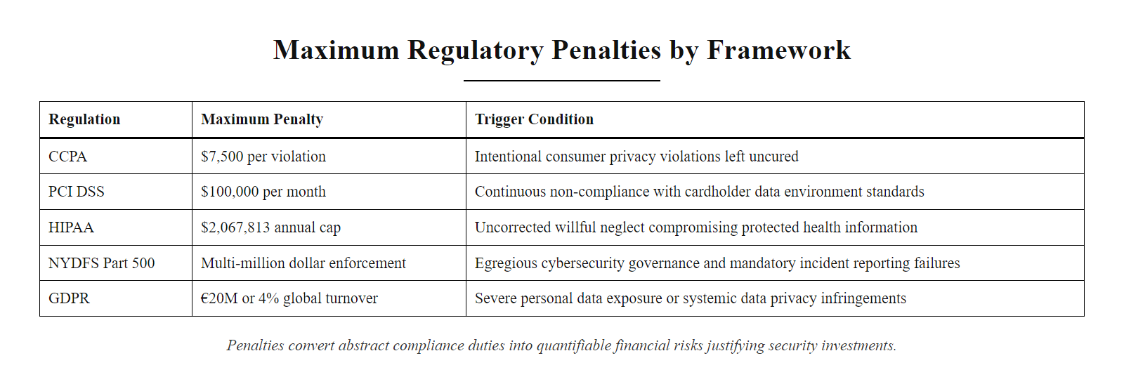
Regulatory Risk, HIPAA, PCI DSS, and GDPR Obligations (2/2)
Regulatory penalties convert abstract compliance obligations into quantifiable financial risks, the potential fine for a single GDPR violation involving mass personal data exposure can exceed the annual revenue of a mid-sized organization, making compliance investment directly justifiable through ALE methodology.
Notes:
(continued, see part 1)

Slide 35
Business Impact Analysis, Connecting Risk to Operations
A Business Impact Analysis (BIA) quantifies how long each critical business function can survive without its supporting IT systems, establishing the Recovery Time Objective (RTO) and Recovery Point Objective (RPO) that drive resilience controls.
Key BIA Metrics
BIA → Risk Control Mapping
Maximum Tolerable Downtime (MTD): The longest period a business function can be unavailable before causing catastrophic business failure.
Recovery Time Objective (RTO): The target time within which an IT system must be restored after an outage, must be less than MTD.
Recovery Point Objective (RPO): The maximum acceptable data loss measured in time, drives backup frequency requirements.
Work Recovery Time (WRT): Time required to restore and validate the system after recovery, often overlooked in planning.
RPO of 4 hours → Backups must run every 4 hours or less.
RTO of 2 hours → Failover systems must be pre-provisioned and hot-standby.
MTD of 8 hours → DR site activation procedures must complete within 6 hours (RTO + WRT).
High-revenue transaction systems typically have RTO < 1 hour and RPO < 15 minutes.
Step 1, Identify Critical Business Functions: Interview department heads to determine which processes generate the most revenue or regulatory obligation.
Step 2, Map Functions to Supporting Systems: Link each business function to its dependent IT assets from the Phase 1 inventory.
Step 3, Determine MTD per Function: Identify the point at which downtime causes irreversible business damage (missed payroll, failed regulatory filing, customer churn threshold).
Step 4, Set RTO and RPO: Establish recovery targets that satisfy MTD while remaining technically and financially achievable.
Step 5, Identify Control Gaps: Compare current backup frequency and failover capability against required RPO and RTO, gaps become Availability risk findings.
Notes:
Business Impact Analysis is the bridge between the technical risk assessment and the business operations it is designed to protect. Without a BIA, risk assessors are working backwards, identifying technical vulnerabilities without knowing which business functions depend on the affected systems, or how long those functions can survive an outage before the organization suffers irreversible damage.
The BIA is typically conducted through structured interviews with department heads, process owners, and functional managers. The goal is to establish, for each critical business process: what IT systems and data it depends on, what the financial impact of various downtime durations would be (1 hour, 4 hours, 24 hours, 1 week), at what point the impact becomes catastrophic (the MTD), and what the minimum acceptable data currency is at the point of recovery (the RPO).
NIST SP 800-34 Rev. 1, "Contingency Planning Guide for Federal Information Systems," provides detailed guidance on conducting BIAs and using their outputs to drive IT contingency plans, disaster recovery plans, and business continuity plans. The document defines the BIA as a prerequisite for the contingency planning process, you cannot write a credible DR plan without first knowing the RTO and RPO requirements that the plan must satisfy.
Real-world calibration for RTO and RPO: a typical community bank might set RTO at 4 hours and RPO at 1 hour for its core banking system, reflecting the business obligation to process end-of-day settlements. A hospital's electronic health records system might carry an RTO of 2 hours and RPO of 15 minutes, because clinical care decisions depend on current patient medication and allergy records. An e-commerce platform during peak sales season might target an RTO of 15 minutes and RPO of 5 minutes, reflecting the revenue impact of approximately $1,000 per second of downtime during high-traffic periods.
The intersection between the BIA and the risk assessment occurs at the Availability dimension of the CIA triad. When we classify an asset using FIPS 199, we assign it an Availability impact level (Low, Moderate, or High) based on how severely its loss would affect organizational operations. The BIA provides the empirical evidence for this classification, an asset whose unavailability triggers $500,000 per hour in lost revenue and regulatory penalties should receive a High Availability classification, and the controls recommended in Phase 6 should be sized to achieve the RTO and RPO that prevent that level of loss from occurring.
A common and costly BIA gap is the difference between the RTO stated in policy and the RTO achievable in practice: organizations write a 2-hour RTO and then find during a test or real incident that restoration takes 12-18 hours because of undocumented manual steps, unavailable decryption keys or untested backups. Recording backup-restoration test frequency and results is essential to assessing the true achievable RTO.

Slide 36
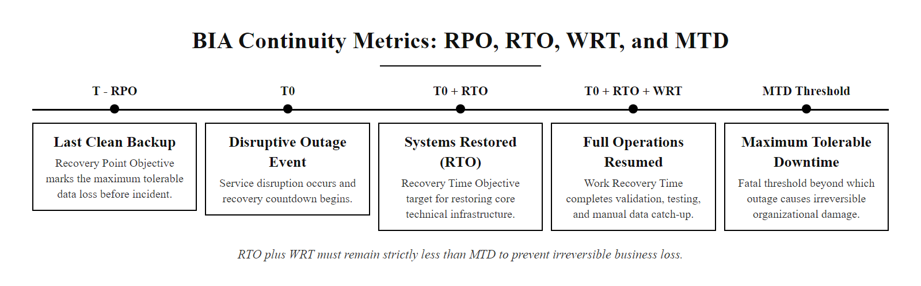
Business Impact Analysis, Connecting Risk to Operations (2/2)
RTO and RPO are not aspirational goals, they are engineering requirements. If existing backup and failover architecture cannot meet the BIA-derived targets, the gap is a high-priority availability risk requiring investment in infrastructure resilience.
Notes:
(continued, see part 1)

Slide 37
Risk Appetite vs. Risk Tolerance, The Governance Boundary
Risk appetite is the amount of risk an organization is willing to accept in pursuit of its objectives. Risk tolerance is the acceptable variance around that appetite. These two governance concepts define when residual risk is acceptable and when a finding must be escalated.
Risk Appetite
Risk Tolerance
Defined at the board and executive level as a strategic policy decision.
Expressed in terms of maximum tolerable ALE, maximum data exposure volume, or maximum acceptable downtime.
Example: "We will not accept residual risk exceeding $500,000 ALE for any single system without board authorization."
Drives the threshold above which risk acceptance decisions require executive sign-off.
Defined at the operational level as the acceptable deviation from appetite.
Expressed as a range or band around the appetite target.
Example: "Our target patch time for critical CVEs is 30 days; we tolerate up to 45 days for legacy systems with compensating controls."
Drives how findings are classified, within tolerance (monitor), outside tolerance (remediate or escalate).
**Risk Identified**
Calculate ALE
**Compare to Risk Appetite**
ALE within appetite?
**Yes
Residual risk acceptable**
Document and monitor
**No
Exceeds appetite**
Escalate to risk owner
Treatment decision required
**Mitigate / Transfer / Avoid**
Notes:
Risk appetite and risk tolerance are governance concepts that sit above the technical mechanics of risk assessment, but they are essential for interpreting what your assessment findings actually mean to the organization's leadership. Without these concepts, a risk assessment produces a list of risks with no mechanism for deciding which ones require immediate action and which ones can be accepted without treatment.
Risk appetite is a strategic concept, it is the board of directors and executive leadership declaring how much risk they are willing to take on in pursuit of business objectives. Different organizations have profoundly different risk appetites shaped by their industry, regulatory environment, business model, and competitive dynamics. A high-growth technology startup may have a high risk appetite, accepting elevated cybersecurity risk in exchange for faster product deployment. A financial institution or hospital has a low risk appetite, accepting significant cost and process overhead to minimize the probability of any security incident.
Risk tolerance is the operational expression of risk appetite, it defines the acceptable variance around the appetite threshold. An organization with a 30-day critical patch SLA has a risk tolerance that allows for acknowledged exceptions of up to 45 days with documented compensating controls and a defined escalation path. Within this band, operational teams can manage risk without executive escalation. Outside this band, risk decisions must be elevated to the Authorizing Official or board risk committee.
For ISO 31000:2018, both risk appetite and risk tolerance are addressed under the "Establishing the Context" activity that precedes risk assessment. The standard requires that organizations document their risk criteria, the thresholds that define which risks are acceptable, which require treatment, and which require immediate escalation, before beginning assessment activities. This ensures that assessment findings are evaluated against a consistent, governance-approved standard rather than individual assessors' judgment.
In practice, risk appetite statements are often vague or unstated, which creates significant challenges for risk assessors. If your organization has not formally documented its risk appetite, one of the highest-value deliverables your risk assessment can produce is a draft risk appetite statement for executive review. NIST SP 800-39 Appendix G provides a template and discussion of risk appetite statement components, including the categories of risk the organization explicitly accepts, the maximum financial exposure it will tolerate without board authorization, and the data sensitivity levels that trigger mandatory notification and treatment requirements.
For your project, you should ask your target organization (or your fictional target, if working from a case study) to define a risk appetite threshold, and then classify each of your assessment findings as within appetite (acceptable with monitoring), within tolerance (requiring documentation and compensating controls), or outside tolerance (requiring active treatment and executive sign-off). This classification layer transforms your risk matrix into a decision-support instrument that leadership can act on directly.
The same technical findings can be prioritized differently depending on an organization's risk appetite, which is why a one-sentence risk-appetite statement changes which findings fall inside or outside tolerance, and why governance context matters as much as the ALE calculation.

Slide 38
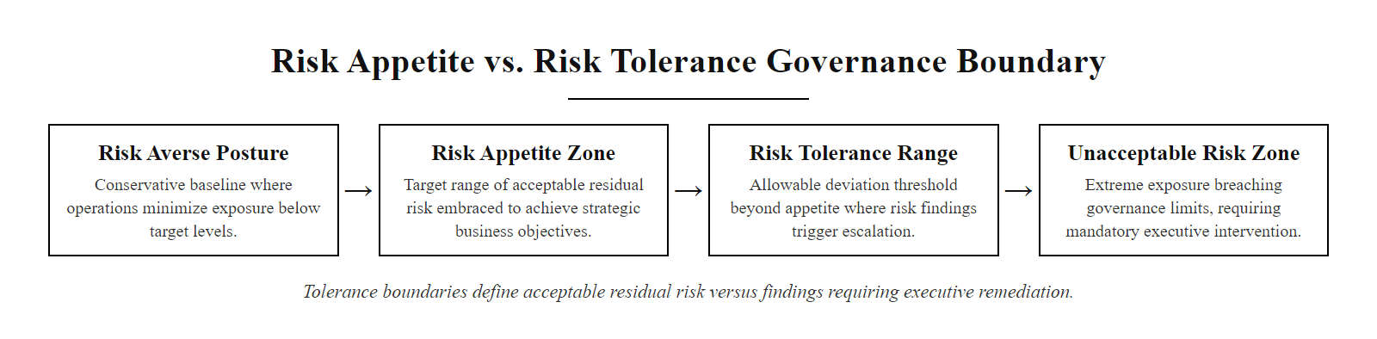
Risk Appetite vs. Risk Tolerance, The Governance Boundary (2/2)
Risk appetite and tolerance define the governance boundary between acceptable residual risk and findings that require executive action, converting the risk matrix from a technical artifact into a board-level governance instrument.
Notes:
(continued, see part 1)

Slide 39
Tool Spotlight, Risk Assessment Platforms and Scanners
Professional risk assessors use a combination of automated scanning tools for data collection and GRC platforms for organizing, tracking, and reporting risk findings at scale.
Tool Category | Tool Name | Primary Function | Relevant Framework Support
Vulnerability Scanner | Tenable Nessus / Nessus Pro | Network and host-based vulnerability scanning with CVSS scoring | NIST SP 800-53, PCI DSS, CIS Benchmarks
CSPM | Wiz / Prisma Cloud | Cloud configuration assessment and misconfiguration detection | CIS Benchmarks, CSA CCM, SOC 2
GRC Platform | ServiceNow GRC / Archer | Risk register management, control tracking, policy management | ISO 27001, NIST CSF, SOX, GDPR
Threat Intelligence | Recorded Future / MISP | Threat actor tracking, IOC feeds, ATT&CK group mapping | MITRE ATT&CK, STIX/TAXII
Penetration Testing | Burp Suite Pro / Metasploit | Active exploitation of vulnerabilities to validate control effectiveness | PTES, OWASP Testing Guide, NIST SP 800-115
SIEM / Log Analysis | Splunk Enterprise / IBM QRadar | Security event correlation, insider threat detection, compliance logging | NIST SP 800-92, SOC 2 Type II
Risk Quantification | RiskLens (FAIR platform) | Monte Carlo simulation for cyber risk quantification in financial terms | FAIR, NIST SP 800-30
Free / Open Source Alternatives: OpenVAS (vulnerability scanning), OpenRMF (NIST RMF automation), Faraday (penetration testing management), TheHive (incident management and threat intel).
Student Resources: Tenable offers free academic licenses for Nessus Essentials (up to 16 IPs); MISP is freely available for threat intelligence sharing and ATT&CK mapping.
Notes:
Understanding which tools are available and how they fit into the risk assessment workflow is essential preparation for professional security roles. The tools listed in this table represent the industry-standard platforms you are most likely to encounter in enterprise environments, and knowledge of their function and framework support will appear in technical interviews for GRC, risk analyst, and security engineer positions.
Tenable Nessus is the most widely deployed commercial vulnerability scanner globally, with over 30,000 organizations using it according to Tenable's published reports. Nessus performs authenticated and unauthenticated scans, producing output that includes the CVE identifier, CVSS score, and remediation guidance for each finding. Nessus Pro includes compliance scanning templates mapped to PCI DSS, CIS Benchmarks, DISA STIGs, and NIST SP 800-53 control families, allowing the tool to simultaneously produce vulnerability findings and compliance gap reports from a single scan. This dual output is extremely valuable for the control evaluation phase of a risk assessment.
For cloud environments, Wiz has emerged as the leading CSPM platform, used by over 40% of the Fortune 100 within four years of its 2020 founding. Wiz uses an agentless architecture that reads directly from cloud provider APIs to inventory cloud resources and evaluate their configurations against CIS Benchmarks and the CSA Cloud Controls Matrix. Critically, Wiz also performs attack path analysis, tracing the chain of misconfigurations that would allow an attacker to move from an internet-exposed entry point to a sensitive data store, providing a prioritized view of which misconfigurations represent exploitable risk rather than theoretical non-compliance.
ServiceNow GRC (Governance, Risk, and Compliance) and RSA Archer represent the two dominant enterprise GRC platforms. Both enable organizations to maintain a centralized risk register, a database of identified risks, their associated assets, calculated ALE values, assigned risk owners, treatment decisions, and implementation status. The risk register is the living artifact that connects each cycle of the risk assessment process to the next, ensuring that treatment decisions are tracked to completion and residual risk is continuously monitored.
RiskLens is the leading commercial implementation of the FAIR risk quantification model. Rather than producing single-point ALE estimates, RiskLens runs Monte Carlo simulations using ranges for each input variable (asset value, threat event frequency, vulnerability probability, loss magnitude) to generate probability distributions. The output is not "this risk has an ALE of $500,000" but rather "there is a 10% probability of a loss exceeding $2 million and a 90% probability of a loss below $800,000 in any given year." This probabilistic view is increasingly preferred by CFOs and insurers who are accustomed to managing risk as a distribution rather than a point estimate.
A rigorous risk assessment needs no commercial tools: the NVD provides free CVE and CVSS data, the ATT&CK site provides the technique matrix and threat-group database, MISP manages threat intelligence, and OpenVAS performs network vulnerability scanning. The value is in the analytical methodology, not the license cost.

Slide 40
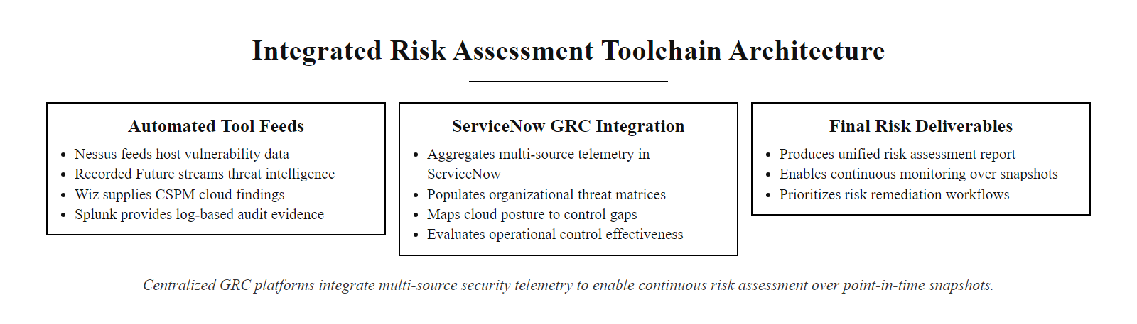
Tool Spotlight, Risk Assessment Platforms and Scanners (2/2)
A professional risk assessment toolchain integrates automated scanning data, threat intelligence, cloud configuration findings, and log evidence into a centralized GRC platform, enabling continuous assessment rather than point-in-time snapshots.
Notes:
(continued, see part 1)

Slide 41
Mid-Lecture Checkpoint, Phases 1–3 Review
Checkpoint: Before proceeding to control evaluation and treatment planning, confirm you can answer these questions about the first three phases of your risk assessment.
Phase 1 (Asset Identification): Have you cataloged all in-scope assets, including shadow IT and third-party integrations? Have you assigned FIPS 199 impact levels (Low, Moderate, High) independently for Confidentiality, Integrity, and Availability?
Phase 2 (Threat Modeling): Have you identified both adversarial and non-adversarial threat sources? Have you mapped threat events to MITRE ATT&CK techniques? Have you used CVSS v3.1 (not just v2.0) for vulnerability severity scoring?
Phase 3 (Risk Quantification): Have you calculated SLE, ARO, and ALE for each high-priority risk? Have you included regulatory penalty exposure in asset value for regulated data? Have you cross-validated your quantitative ALE against the qualitative risk matrix?
Common Phase 1–3 Mistake | Why It Matters | How to Fix It
Incomplete asset inventory (missing SaaS tools, APIs) | Critical assets outside scope cannot be assessed | Re-run network discovery + interview department heads about SaaS usage
Using CVSS v2.0 scores (outdated) | CVSS v3.1 scoring is significantly different, v2.0 scores overrate some risks and underrate others | Re-score all findings using NVD CVSS v3.1 calculator or Nessus output
ARO estimates with no supporting evidence | Unsupported ARO makes ALE unreliable and unpersuasive to leadership | Cite NIST SP 800-30 Appendix G tables, Verizon DBIR, or industry incident data
Regulatory penalties omitted from ALE | Systematically understates financial risk for regulated data | Add HIPAA/GDPR/PCI DSS fine exposure to asset value before calculating SLE
Notes:
Let us take a moment to consolidate understanding of the first three phases before moving into control evaluation and treatment planning. These first three phases are foundational, errors or omissions here will propagate through every subsequent section of your report and undermine the credibility of your recommendations.
The most frequent issue with Phase 1 is an incomplete asset inventory. Students often catalog the obvious assets, servers, databases, workstations, and miss the less visible ones: the Salesforce CRM instance used by the sales team, the Slack workspace containing business-sensitive conversations, the third-party payment processor with access to cardholder data, or the legacy application running on an end-of-life operating system that IT forgot to decommission. These gaps matter because every asset not in your inventory is a risk you cannot assess.
For Phase 2, the most common error is using CVE data without confirming applicability. Just because a CVE exists for software version X does not mean the target organization is running software version X. Confirm the asset's actual software versions against the CVE affected version list before including a finding in your threat matrix. Conversely, some students look only at CVEs and miss non-technical threat vectors such as social engineering, physical access risks, and business email compromise, which require no CVE to be exploitable and are among the highest-frequency threat categories organizations face.
For Phase 3, the ARO estimate is the most contentious element of the ALE calculation. A risk assessment that presents an ALE calculation without supporting evidence for the ARO figure is vulnerable to challenge by any stakeholder who disputes the probability assumption. Always cite your ARO source: NIST SP 800-30 Appendix G probability tables, the Verizon DBIR annual frequency data for your incident type and industry, or the organization's own historical incident log. If none of these sources is available, state your ARO as a range and produce a sensitivity analysis showing the ALE at the low, middle, and high ARO estimates, this demonstrates analytical rigor even when precise data is unavailable.
Peer review of a risk assessment is often more effective than instructor review alone, because a peer naturally asks targeted questions, "why did you assume a 0.5 annualized rate for that threat?", that expose hidden assumptions and prompt methodological reflection.
This checkpoint is also the right time to raise the question of scope creep. During Phases 1 through 3, assessors frequently discover assets, threat vectors, or vulnerabilities that are technically outside the originally defined scope boundary. The right response is not to silently include them (scope creep) or ignore them (incomplete assessment), but to formally document the discovery, consult with the scope owner, and either formally expand the scope with stakeholder agreement or note the out-of-scope finding as an observation with a recommendation to address it in a separate assessment. NIST SP 800-30 Appendix A provides guidance on managing scope changes during the assessment conduct phase.

Slide 42
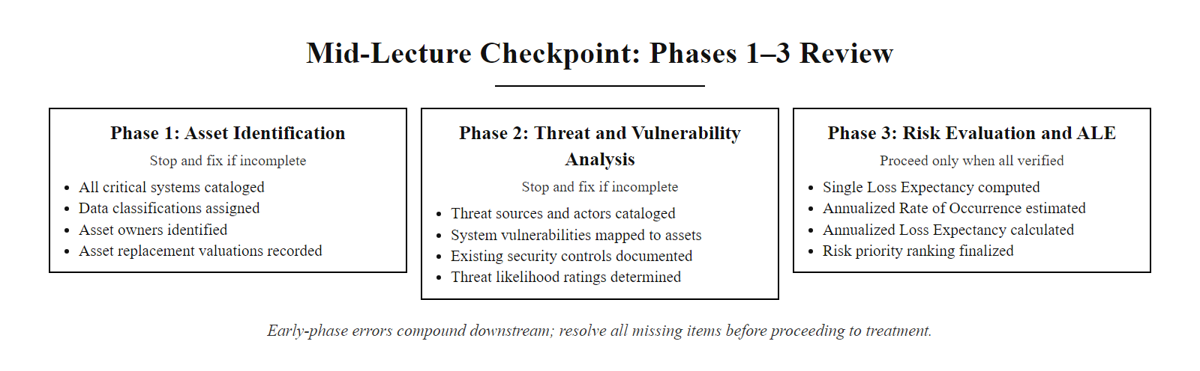
Mid-Lecture Checkpoint, Phases 1–3 Review (2/2)
Errors in Phases 1 through 3 compound in every subsequent phase, an incomplete asset inventory leads to missing threat analysis, which leads to underestimated ALE values, which leads to underfunded treatment plans. Verify completeness before proceeding.
Notes:
(continued, see part 1)

Slide 43
Mid-Lecture Checkpoint, Phases 4–6 Review
Checkpoint: Before writing your final report, confirm your control evaluation, risk treatment decisions, and recommendations meet professional standards.
Phase 4 (Control Evaluation): Have you assessed control effectiveness empirically (not just by policy review)? Have you calculated residual risk for each identified risk after applying active controls? Have you mapped each gap to a NIST SP 800-53 or CIS Controls v8 identifier?
Phase 5 (Risk Treatment): Has every risk with ALE above the organization's risk appetite threshold received an explicit treatment decision (Mitigate, Transfer, Avoid, or Accept)? Have all Accept decisions been documented with a named risk owner and scheduled review date?
Phase 6 (Recommendations): Does every recommendation link to a specific risk finding? Does every recommendation include a cost-benefit analysis? Have you addressed People and Process controls, not just technology?
Common Phase 4–6 Mistake | Why It Matters | How to Fix It
Assuming controls work because they exist | Control existence ≠ control effectiveness; Capital One had a WAF and still suffered a major breach | Verify through config review, pen test results, or simulated attack testing
Missing Accept decisions for low-priority risks | Every risk needs a documented treatment decision, silence is not acceptance | Add an explicit Accept entry with risk owner and next review date for all low-priority risks
Recommendations without CBA | Without CBA, leadership cannot evaluate whether the recommendation is worth the cost | Add control annual cost and ALE reduction estimate for every recommendation
All recommendations are technical tools | People and process controls often deliver higher ROI than technology purchases | Add at minimum one policy update and one training recommendation per risk domain
Notes:
The second half of the risk assessment, phases 4 through 6, is where many student projects fall short not because of conceptual misunderstanding, but because of insufficient rigor in execution. This checkpoint is designed to help you identify and correct the most common issues before they appear in your final report.
The central challenge in Phase 4 is the difference between verifying that a control exists and verifying that it works. This distinction cannot be overstated. Every major breach in the past decade has involved organizations that had security controls in place, the Capital One breach occurred despite a WAF; the Equifax breach occurred despite a vulnerability management process; the SolarWinds breach occurred despite endpoint protection on thousands of customer systems. In each case, the control existed but was ineffective against the specific attack technique used.
Empirical control effectiveness assessment requires going beyond policy documents and vendor architecture diagrams. It requires asking: can we actually run a simulation of the attack this control is supposed to prevent, and verify that the control fires? For technical controls like IDS/IPS signatures and SIEM detection rules, this can be done using purple team exercises (where a red team attempts a specific ATT&CK technique while the blue team validates whether their detection rule fires). For administrative controls like security awareness training, effectiveness can be measured through phishing simulation click rates and knowledge assessment scores. Document your evidence source for each control effectiveness rating, "per vendor documentation" is insufficient; "per tabletop exercise conducted March 2025" or "per pen test finding dated April 2025" is credible.
For Phase 5, the most consequential error is treating risk acceptance as a default for any risk that doesn't get actively addressed. Under NIST SP 800-37 Rev. 2, risk acceptance is a formal governance act requiring the Authorizing Official's signature and documented rationale. It is not a residual category for risks that fell off the priority list. Every risk in your assessment must have an explicit, documented treatment decision, even if that decision is acceptance. The documentation of acceptance decisions creates the accountability trail that allows organizations to demonstrate to auditors and regulators that their risk posture is deliberately managed, not merely unexamined.
For Phase 6, the most persuasive recommendations are those that speak to the reader's primary concern. For a CISO reviewing the technical recommendations section, specificity matters, "implement CrowdStrike Falcon EDR with behavioral prevention policies enabled" is more credible than "improve endpoint protection." For a CFO reviewing the executive summary, financial clarity matters, "the proposed $85,000 annual MFA deployment reduces ALE from $420,000 to $42,000, delivering a 5x ROI in the first year" is more persuasive than "MFA will significantly reduce credential-based attack risk." Tailor the language of your recommendations to the decision-making context of each audience section.
The "so what?" test validates a finding before submission: if answering "so what?" for a recommendation requires technical explanation, the executive version needs revision; if the answer is immediately in business terms, revenue impact, regulatory exposure, operational risk, the recommendation is ready for leadership.

Slide 44
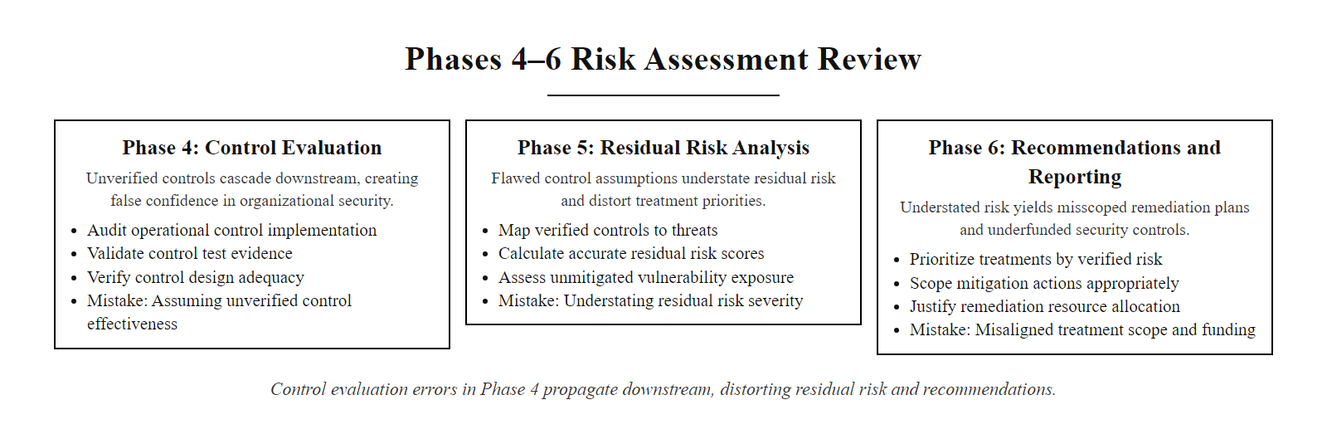
Mid-Lecture Checkpoint, Phases 4–6 Review (2/2)
Control evaluation errors in Phase 4 have a multiplicative effect on downstream phases, overestimating control effectiveness understates residual risk, leading to under-prioritized treatment decisions and under-funded recommendations in the final report.
Notes:
(continued, see part 1)

Slide 45
Case Study, Healthcare Organization Risk Assessment
Scenario: Midwest Regional Hospital operates 800 beds across three campuses. It uses an Epic EHR system, 200 connected medical devices, and a legacy billing system running Windows Server 2012 R2 (end of life since October 2023). It processes approximately 1.2 million ePHI records.
Asset Inventory Summary
Top Risk Findings
Critical: Epic EHR database (1.2M patient records), FIPS 199: High/High/High
Critical: Legacy Windows Server 2012 R2 billing system, FIPS 199: High/High/Moderate
High: 200 connected medical devices (infusion pumps, monitors), no patch management program
Moderate: Physician workstations with remote access capability
Low: Public-facing appointment scheduling web portal
Risk 1: Legacy OS on billing server (CVE-2023-XXXX style exposure; no vendor patches available). ALE = $2.1M (HIPAA fine exposure + EHR downtime cost).
Risk 2: Unmanaged medical devices running outdated firmware, no network segmentation from EHR network. ALE = $1.4M.
Risk 3: Phishing as primary ransomware delivery vector, no email security gateway. ARO = 0.7/year based on HHS breach portal data for hospitals. ALE = $980K.
Finding 1, Recommendation: Isolate the legacy billing system to a dedicated VLAN with strict firewall rules. Engage vendor for migration to supported OS within 12 months. Estimated annual control cost: $45,000. ALE reduction: $1.68M. ROI: 37x.
Finding 2, Recommendation: Implement network segmentation separating medical device network from EHR network (zero-trust micro-segmentation). Conduct firmware inventory for all 200 devices. ALE reduction: $980K.
Finding 3, Recommendation: Deploy Microsoft Defender for Office 365 (Plan 2) with anti-phishing, safe links, and safe attachments. Add annual phishing simulation and security awareness training. Combined annual cost: $62,000. ALE reduction: $686K.
Notes:
Let us walk through a complete worked example to illustrate how all six phases of the risk assessment integrate in a real organizational context. Our scenario is Midwest Regional Hospital, a fictional but realistically constructed healthcare organization based on the threat profile commonly documented in HHS breach portal data and CISA healthcare sector advisories.
Healthcare is one of the most heavily targeted industries in the current threat landscape. According to the HHS Office for Civil Rights breach portal, which publishes all HIPAA breach reports involving 500 or more individuals, the healthcare sector experienced over 700 reportable breaches in 2023 alone, exposing more than 133 million records. Ransomware accounts for the majority of the largest incidents, with hospital systems uniquely vulnerable due to their life-critical operational requirements, unlike a retail business that can absorb downtime by directing customers to alternative channels, a hospital experiencing an EHR outage must revert to paper-based clinical workflows that dramatically increase the risk of medical errors.
The legacy Windows Server 2012 R2 billing system represents one of the most common findings in healthcare risk assessments. Microsoft ended mainstream support for Windows Server 2012 in 2018 and extended security support in October 2023. After that date, no security patches are issued for newly discovered vulnerabilities, meaning every CVE disclosed after October 2023 that affects the operating system will remain unpatched indefinitely. The only viable mitigations are network isolation (limiting attack surface), migration to a supported platform (remediation), or paid extended security updates available from Microsoft for a limited additional period. The HIPAA fine exposure for a breach of 1.2 million ePHI records can be calculated using the OCR penalty tiers: willful neglect not corrected carries $50,000 to $1.9 million per violation category per year, with multiple violation categories potentially applicable in a single breach event.
The medical device risk finding illustrates a category of asset that is frequently overlooked in healthcare risk assessments: networked medical devices running specialized operating systems that cannot be patched using standard enterprise patch management tools. Infusion pumps, patient monitors, imaging systems, and other IoT medical devices often run embedded operating systems with multi-year update cycles controlled by FDA-regulated device manufacturers, and in many cases, the manufacturer's end-of-life timeline for software support does not align with the hospital's device procurement cycle. NIST SP 800-82 Rev. 3, "Guide to Operational Technology Security," provides the most applicable guidance for managing this category of unmanageable asset, recommending compensating controls including network segmentation, encrypted communications, and enhanced monitoring as substitutes for direct patching.
The FDA's 2023 guidance on medical device cybersecurity requires manufacturers to submit a cybersecurity plan with premarket submissions for cyber devices, so devices purchased after March 2023 must include a disclosed patching plan and SBOM, giving hospital risk assessors far more visibility into new acquisitions than before.

Slide 46
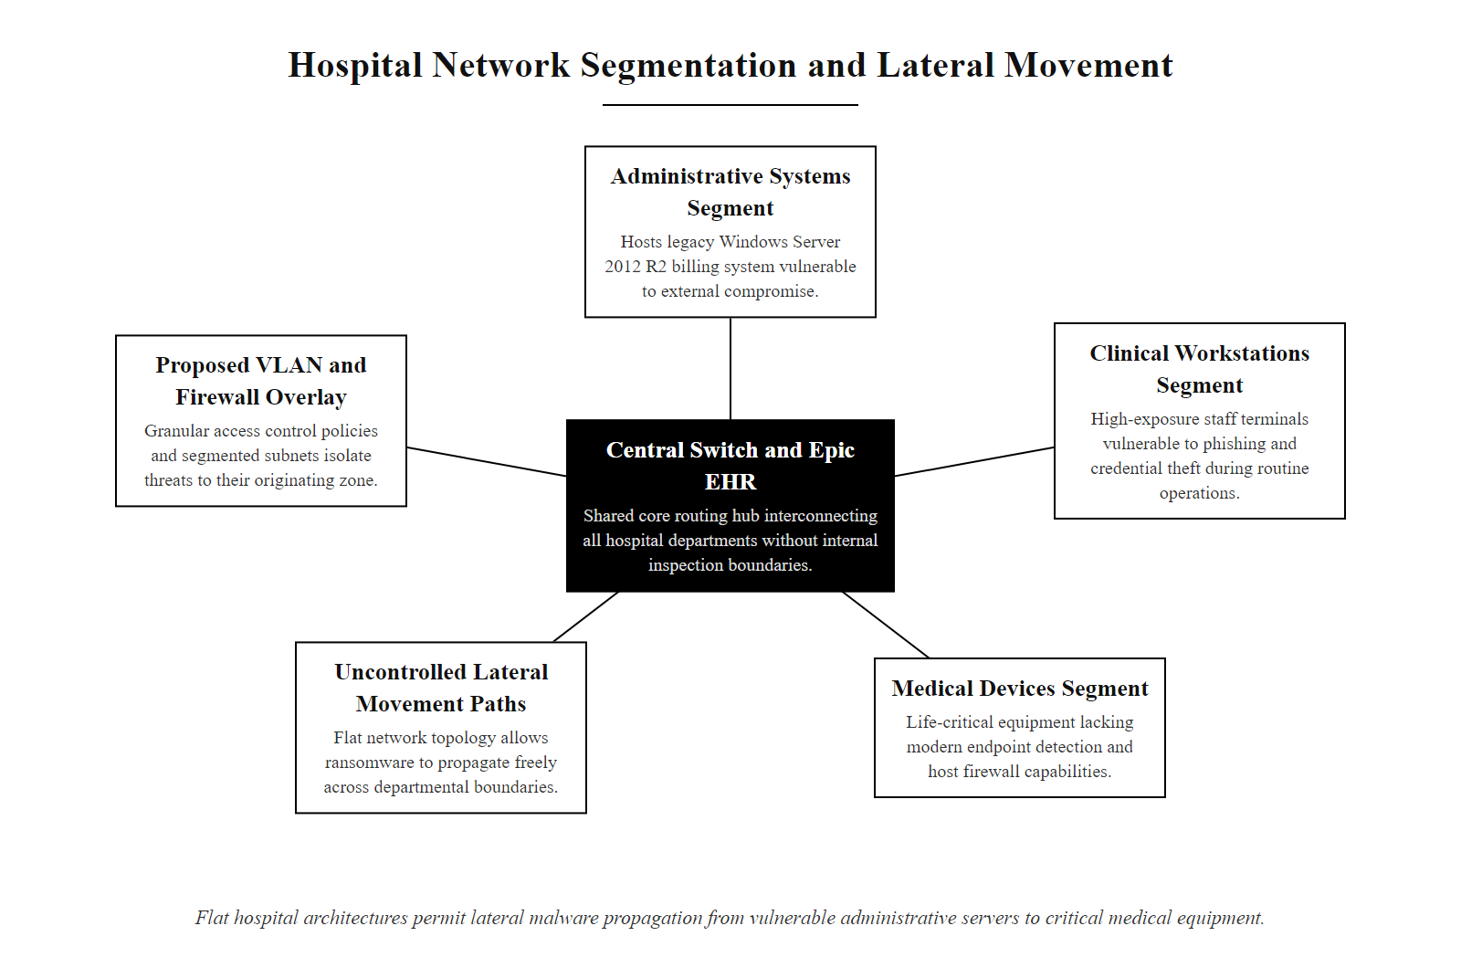
Case Study, Healthcare Organization Risk Assessment (2/2)
Hospital networks frequently evolved organically over decades without security architecture planning, medical devices, clinical systems, and administrative systems share network segments in ways that allow ransomware to propagate from a phished receptionist's workstation to life-critical equipment.
Notes:
(continued, see part 1)

Slide 47
Worked Example, Complete ALE Calculation
This worked example walks through a complete, step-by-step ALE calculation for a realistic risk scenario, a ransomware attack against a regional e-commerce platform's customer database.
Step 1, Define the Asset: Customer database containing 400,000 records (PII + payment card data). Asset value = $3.2M (replacement cost $40K + PCI DSS fine exposure $1.8M + GDPR fine exposure $1.36M = $3.2M total).
Step 2, Identify the Threat Event: Ransomware deployment via phishing email, encrypting database and exfiltrating 400,000 records (double extortion scenario).
Step 3, Estimate Exposure Factor (EF): 100%, full database encrypted and exfiltrated. EF = 1.0.
Step 4, Calculate SLE: SLE = Asset Value × EF = $3,200,000 × 1.0 = $3,200,000.
Step 5, Estimate ARO: E-commerce platforms in the retail sector experienced ransomware at a rate of approximately 0.35 incidents per year per organization (Verizon DBIR 2023, retail sector, ransomware frequency). ARO = 0.35.
Step 6, Calculate ALE: ALE = SLE × ARO = $3,200,000 × 0.35 = $1,120,000 per year.
Step 7, Evaluate Control: Email security gateway + EDR with behavioral prevention costs $95,000/year. Expected ALE reduction: 70% (based on CISA guidance on phishing prevention effectiveness). New ALE = $336,000. Cost savings = $784,000/year. Control is financially justified, 8.25x ROI.
Notes:
This worked example is designed to give you a complete, step-by-step template that you can apply directly to your project. Every variable in the ALE calculation must have a documented source, an unsourced ALE figure is a guess, and a guess will not survive scrutiny from a CFO or board risk committee.
Let us walk through each decision in this example and explain the reasoning behind the numbers.
The asset value of $3.2 million deserves careful attention because it illustrates a critical concept: asset value in a risk assessment is not the same as the IT cost of the asset. A database server that costs $15,000 to provision and $5,000 per year to maintain is trivially cheap from an IT perspective. But if that database contains 400,000 records of PII and payment card data, its risk value is the sum of the regulatory fine exposure under PCI DSS, the regulatory fine exposure under GDPR (or CCPA, or applicable state law), and any additional costs such as credit monitoring services, class action legal exposure, and customer remediation. In this example, PCI DSS fine exposure for 400,000 compromised card records is estimated at $1.8 million based on card brand assessment schedules; GDPR fine exposure for 400,000 EU resident records is estimated at $1.36 million based on the GDPR Article 83 tier 1 maximum applied to a mid-sized non-EU company's global turnover. These are conservative estimates, actual fines could be significantly higher.
The Exposure Factor of 1.0 reflects the double extortion model, both encryption (destroying availability) and exfiltration (destroying confidentiality) occur in a single incident. This is the standard modern ransomware scenario. For incidents involving only encryption without exfiltration, the EF would be lower because confidentiality is not compromised, but this scenario is increasingly rare as double extortion has become the dominant ransomware model since 2019.
The ARO of 0.35 means that a similar e-commerce organization in the retail sector can expect a ransomware incident approximately once every 2.86 years. This figure is derived from Verizon DBIR data on incident frequency by industry sector and attack type. NIST SP 800-30 Appendix G provides alternative ARO calibration tables if DBIR data is not applicable to your specific organizational context.
The control effectiveness estimate of 70% ALE reduction is based on CISA published guidance on phishing prevention measures, specifically the combination of email security gateways with anti-phishing capabilities and EDR with behavioral prevention, which in controlled deployments has demonstrated 65-75% reduction in successful phishing-delivered ransomware incidents. Cite your effectiveness estimate source explicitly in the report; without a source, the estimate is not persuasive to a financially sophisticated audience.
ALE is highly sensitive to the annualized rate of occurrence: the same single-loss expectancy with an ARO of 0.1 versus 1.0 spans an ALE from $320,000 to $3,200,000, which is why supporting evidence for the ARO is the most important methodological requirement. The FAIR model addresses this by running a Monte Carlo simulation over a range of ARO values, producing a probability distribution rather than a single point estimate and representing the uncertainty honestly.

Slide 48
Worked Example, Complete ALE Calculation (2/3)
Variable | Value | Source
Asset Value | $3,200,000 | Replacement + PCI DSS + GDPR fine exposure
Exposure Factor | 1.0 (100%) | Full database encryption and exfiltration
SLE | $3,200,000 | Asset Value × EF
ARO | 0.35 | Verizon DBIR 2023, retail sector
ALE (before control) | $1,120,000 | SLE × ARO
Control Annual Cost | $95,000 | Email gateway + EDR licensing + labor
ALE (after control) | $336,000 | 70% reduction per CISA phishing prevention guidance
Net Annual Savings | $689,000 | ALE reduction minus control cost
Control ROI | 8.25x | Net savings / control cost
Notes:
(continued, see part 1)

Slide 49
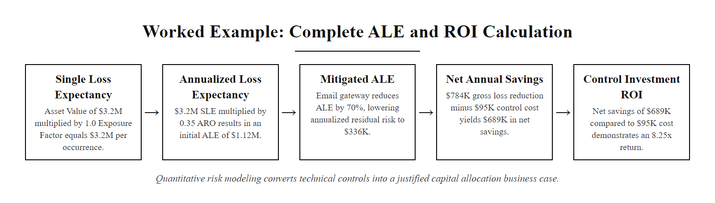
Worked Example, Complete ALE Calculation (3/3)
A complete ALE calculation with documented sources for each input variable is the gold standard for security investment justification, it converts risk from a qualitative judgment into a quantifiable business case that CFOs and boards can evaluate on the same terms as any other capital allocation decision.
Notes:
(continued, see part 1)

Slide 50
Common Misconceptions in Risk Assessment
These misconceptions are among the most frequent errors made by junior security professionals. Recognizing them now will prevent costly mistakes in your professional assessments.
Misconception 1: Compliance = Security
Misconception 2: Risk Assessment Is Annual
The Myth: If we pass our PCI DSS or HIPAA audit, we are secure.
The Reality: Compliance frameworks represent a minimum baseline, not a comprehensive security posture. The Target breach occurred despite PCI DSS compliance. Compliance is assessed at a point in time; threats evolve continuously.
The Fix: Use compliance as a floor, not a ceiling. Layer threat modeling and continuous monitoring on top of compliance controls.
The Myth: Conduct a risk assessment once a year and it is done.
The Reality: NIST SP 800-30 explicitly requires continuous monitoring and risk assessment updates triggered by significant system changes, new threats, or major incidents.
The Fix: Establish triggers for reassessment: major infrastructure changes, new critical CVE disclosures, acquisitions, and incidents all require targeted reassessment.
Misconception 3: More Tools = More Security
Misconception 4: Low CVSS = Low Risk
The Myth: Buying a new security tool fixes the identified risk.
The Reality: Security tools that are misconfigured, unmonitored, or understaffed create alert fatigue and false confidence while leaving the underlying risk unchanged.
The Fix: Evaluate people and process capacity before recommending new tools. A well-tuned SIEM with one analyst is more effective than five siloed tools with no one monitoring them.
The Myth: A vulnerability with a CVSS score below 7.0 is not urgent.
The Reality: CVSS measures technical severity, not business risk. A CVSS 4.0 vulnerability on a system containing the organization's crown jewel data may represent higher business risk than a CVSS 9.0 vulnerability on an isolated test system.
The Fix: Always adjust CVSS scores using environmental metrics that reflect the asset's criticality and network exposure. Business context transforms technical severity into organizational risk.
Notes:
Part of professional development in any field is learning not just what to do but also what not to do, and why common shortcuts and intuitive-seeming assumptions are wrong. The four misconceptions on this slide represent patterns that appear repeatedly in post-breach analysis, audit findings, and security program assessments.
The compliance equals security misconception is perhaps the most pervasive and most dangerous. Organizations that achieve PCI DSS Level 1 compliance, SOC 2 Type II certification, or HIPAA risk analysis sign-off sometimes treat these certifications as proof that their security posture is adequate. The 2013 Target breach is the canonical counter-example: Target had recently completed and passed its PCI DSS assessment when the breach occurred. The breach involved a network segment that was technically out of PCI scope, and the absence of network segmentation between the in-scope cardholder data environment and the out-of-scope vendor access systems was a risk that compliance assessment never captured. Compliance frameworks are designed to establish minimum safeguards across a broadly applicable set of controls; they cannot anticipate every organization-specific threat vector.
The annual assessment misconception leads to risk assessments that are accurate on Day 1 and increasingly obsolete for the remaining 364 days of their validity period. NIST SP 800-30 is explicit on this point: risk assessments should be updated in response to significant changes to the information system or its environment of operation, including new threat intelligence, newly disclosed critical CVEs, major architectural changes, and the acquisition of new business lines or data types. The Log4Shell disclosure (CVE-2021-44228) in December 2021 is a perfect example: any organization that had completed its annual risk assessment in November 2021 and was not reassessing in December would have missed the most critical vulnerability disclosure in years. Trigger-based reassessment is essential for keeping the risk register current.
The tools misconception reflects a broader industry tendency to treat security as a technology problem solvable through procurement. The security tool market generates approximately $200 billion in annual revenue, creating a powerful commercial incentive to present technical products as comprehensive solutions to what are fundamentally organizational risk management problems. Security operations center (SOC) analysts routinely report alert fatigue as their primary productivity barrier: too many tools generating too many alerts for the available human capacity to triage and investigate. Before recommending any new security tool, a professional risk assessment should evaluate whether existing tools are fully operationalized and whether staffing capacity is sufficient to respond to the tool's alerts within the timeframe required by the organization's incident response SLA.
The CVSS misinterpretation misconception has concrete consequences. During the Log4Shell response in December 2021, some organizations prioritized their patching based on CVSS scores adjusted for their specific environment, correctly assessing that a Log4j instance embedded in an internal-only analytics tool with no external network connectivity, even carrying a CVSS 10.0 base score, presented lower exploitable risk than an internet-facing API gateway running the same vulnerable library. CVSS environmental metrics, specifically Modified Attack Vector, Modified Privileges Required, and Confidentiality/Integrity/Availability Requirements, exist precisely for this purpose: adjusting the universal base score to reflect the organization's specific deployment context. Always calculate and document the environmental CVSS score for each finding, not just the published base score.
A next-generation firewall running default rules never tuned to the organization's traffic is far less effective than its capability suggests, which is the gap between tool capability and operational effectiveness that underlies the "more tools equals more security" misconception.

Slide 51
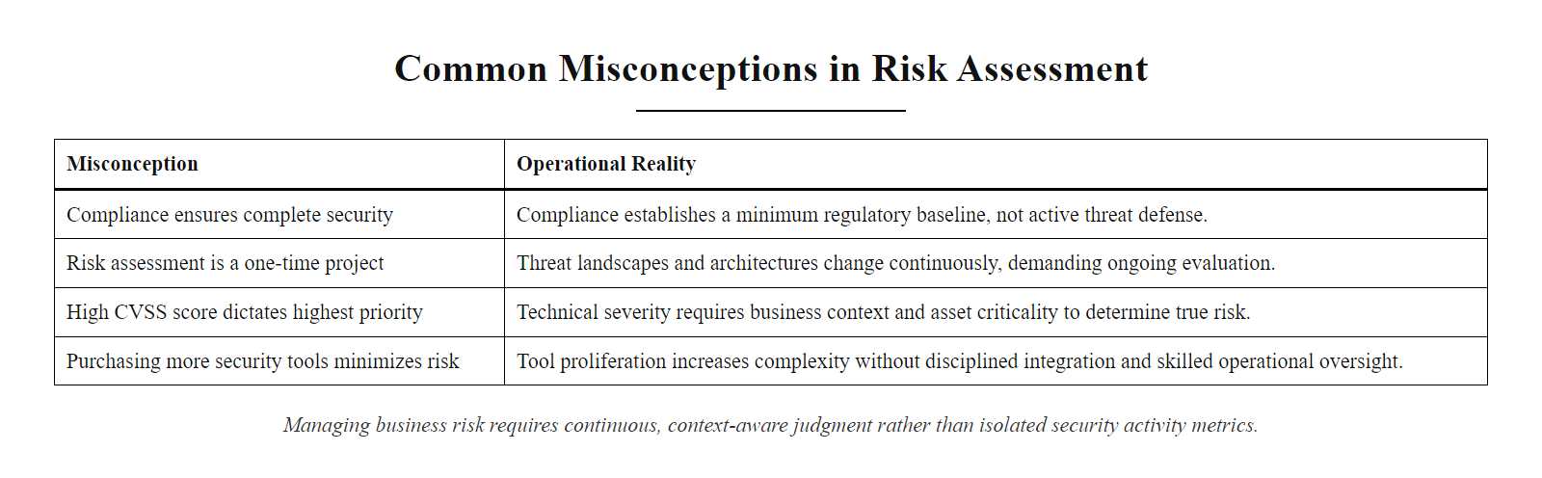
Common Misconceptions in Risk Assessment (2/2)
These four misconceptions share a common root: confusing the measurement of security activity (audits, tool purchases, CVSS scores) with the actual management of business risk, which requires continuous, context-aware judgment that no single metric or audit can fully capture.
Notes:
(continued, see part 1)

Slide 52
The Risk Register, Maintaining a Living Risk Document
The risk register is the central living artifact of an enterprise risk management program. It captures every identified risk, its calculated values, assigned ownership, treatment status, and scheduled review dates, transforming a point-in-time assessment into a continuously managed program.
Risk ID | Asset | Threat Event | Likelihood | Impact | Inherent Risk | Controls Applied | Residual Risk | Treatment Decision | Risk Owner | Review Date
RISK-001 | Customer DB | Ransomware via phishing | High | Critical | $1.12M ALE | Email gateway, EDR | $336K ALE | Mitigate (in progress) | CISO | 2026-Q3
RISK-002 | Legacy billing server | OS exploit (CVE, unpatched) | High | High | $2.1M ALE | VLAN isolation | $630K ALE | Mitigate + migration | IT Director | 2026-Q2
RISK-003 | Employee workstations | Credential theft via phishing | Medium | High | $450K ALE | MFA (deployed) | $90K ALE | Accept (within tolerance) | Sec Manager | 2027-Q1
RISK-004 | Public web portal | DDoS attack | Low | Medium | $180K ALE | CDN w/ DDoS protection | $18K ALE | Accept | IT Ops Manager | 2027-Q2
Risk Register Owner: The CISO or delegated Risk Manager maintains the register and ensures all entries are reviewed at scheduled intervals.
Integration with GRC Platforms: Enterprise tools such as ServiceNow GRC and RSA Archer maintain risk registers with workflow automation, triggering review reminders, tracking control implementation milestones, and producing dashboard reporting for board committees.
NIST SP 800-39 Alignment: The risk register satisfies the "Risk Response" and "Risk Monitoring" tiers of the SP 800-39 organizational risk management hierarchy.
Notes:
The risk register is what transforms a risk assessment from a document into an ongoing program. Without a risk register, each assessment cycle produces a new report that may have little connection to the previous cycle's findings, making it impossible to track whether treatment decisions are being implemented, whether residual risk is trending up or down over time, or whether new risks are being discovered at a faster rate than existing risks are being treated.
A well-maintained risk register contains, at minimum, the elements shown in the table on this slide: a unique risk identifier, the affected asset, the threat event and threat source, likelihood and impact ratings, the calculated inherent and residual ALE, the controls applied, the treatment decision with named risk owner, and the scheduled review date. In mature GRC platforms, the risk register also tracks control implementation milestones, links to evidence artifacts (pen test reports, scan results, policy documents), and generates automated alerts when review dates are missed or residual risk thresholds are exceeded.
The risk owner concept is crucial and often poorly implemented in practice. Every risk in the register must have a named individual, not a team, department, or role, who is personally accountable for ensuring the treatment decision is executed and the risk is reviewed at its scheduled date. Without named individual ownership, risk treatment decisions tend to drift, everyone assumes someone else is handling them. Under NIST SP 800-37 Rev. 2, system owners and authorizing officials share formal accountability for risk acceptance decisions; this accountability should be reflected in the risk register through explicit ownership assignments and dated sign-offs.
Risk register review frequency should be risk-proportional. High-residual-risk items like RISK-001 and RISK-002 in the example table warrant quarterly review to ensure treatment implementation is on track and no new information has changed the risk profile. Lower-residual-risk accepted items like RISK-003 and RISK-004 can be reviewed annually unless a triggering event, a new CVE, a near-miss incident, or a significant system change, warrants interim reassessment.
The risk register also serves as the primary evidence artifact for regulatory compliance demonstration. Under HIPAA, an auditor reviewing an organization's compliance with the Security Rule's risk analysis requirement will ask to see a risk assessment report and evidence that identified risks are being actively managed. A current, well-maintained risk register with documented treatment decisions and review dates is the most compelling evidence of an active, well-managed risk management program, far more persuasive than a point-in-time assessment report that sits in a drawer untouched between annual audit cycles.
ISO 31000:2018 Section 6.6 requires risk information to be communicated to stakeholders in formats each audience can use. For boards this is typically a risk heat map, the risk register plotted on a likelihood-impact matrix with color-coded severity, which conveys overall posture at a glance. Many GRC platforms generate these automatically from register data.

Slide 53
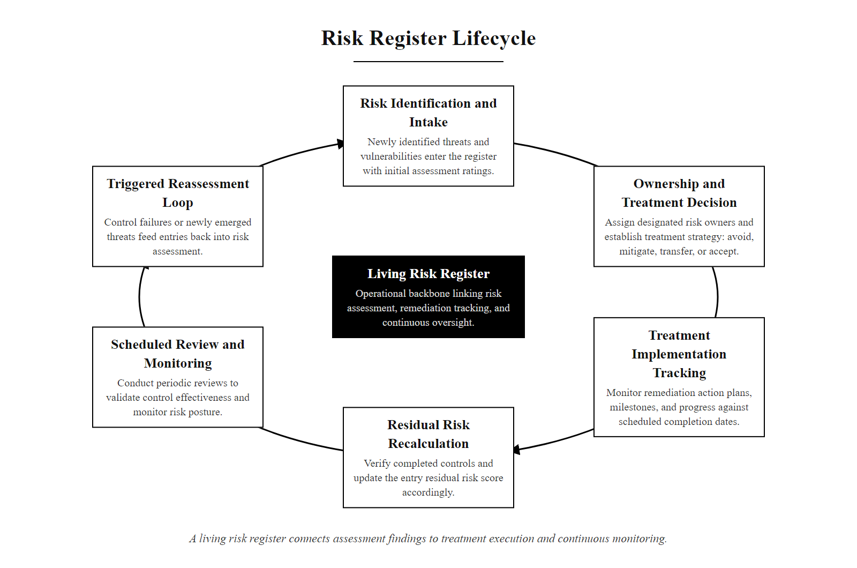
The Risk Register, Maintaining a Living Risk Document (2/2)
The risk register connects assessment findings to treatment execution and continuous monitoring, making it the operational backbone of an enterprise risk management program rather than just a static report appendix.
Notes:
(continued, see part 1)

Slide 54
Communicating Risk to Executive Leadership
The most technically rigorous risk assessment fails if its findings are not communicated in a way that enables executive decision-making. Translating technical risk into business language is a distinct professional skill.
What Executives Need
What to Avoid
Financial framing: Express risk in ALE, not vulnerability counts or CVSS scores.
Comparative context: "Our residual ransomware risk of $336K/year is above the industry median of $210K/year for organizations our size."
Decision-readiness: Present options, not just problems, each finding should pair with a recommended treatment and its cost.
Brevity: Executive summaries should not exceed one page. All technical detail belongs in appendices.
Acronym overload without explanation (CVSS, SSRF, TA0001).
Presenting all findings as "critical", severity inflation destroys credibility.
Recommendations without cost, "implement zero trust" with no budget figure is not actionable.
Technical root-cause analysis in the executive summary, save this for the engineering team appendix.
**Raw Findings (Technical)**
Translate to Business Impact Language
**Prioritize by Business Risk (not CVSS)**
Add cost context (ALE vs. Control Cost)
**Draft Executive Summary**
One page, financial terms, three to five top risks
**Board Presentation**
Heat map visual, risk appetite alignment, budget ask
Notes:
The ability to communicate technical risk findings in business language to executive leadership is one of the most differentiating skills in the cybersecurity profession, and one of the most frequently cited gaps by CISOs when evaluating junior security professionals. Technical competence is necessary but not sufficient, a risk assessor who cannot translate their findings into terms that enable informed business decisions is providing only half the value the role requires.
The central translation required is from technical severity to financial impact. An executive does not need to know what CVE-2023-44487 (HTTP/2 Rapid Reset DDoS vulnerability) means at a protocol level. They do need to know that an unpatched web application server exposed to this vulnerability has a calculated ALE of $340,000, representing the expected annual cost of DDoS-induced service downtime at the organization's measured revenue rate of $85,000 per hour, and that the recommended CDN-based DDoS mitigation costs $28,000 annually, delivering a 12x ROI.
The risk heat map is the most effective single-page executive communication artifact for a risk assessment. A heat map plots all identified risks on a two-axis matrix of likelihood versus impact, with color coding indicating risk level (green for low, yellow for medium, orange for high, red for critical). Each risk is represented as a labeled dot. The board can see at a glance which quadrant of the matrix contains the most findings, which individual risks are most severe, and, if the organization's risk appetite boundary is drawn on the map, which findings fall within tolerance and which require action. Most GRC platforms generate heat maps automatically from risk register data; for project submissions, the heat map can be produced in PowerPoint or any charting tool using the risk matrix values from the assessment.
NIST Special Publication 800-100, "Information Security Handbook: A Guide for Managers," provides a chapter dedicated to communicating information security risk to senior leaders and boards of directors. It emphasizes using metrics that connect security performance to business outcomes, for example, mean time to patch critical vulnerabilities (a security metric) expressed as the average number of days the organization is exposed per disclosed critical CVE per year (a business risk metric). This framing allows boards to track security program improvement over time using metrics they can understand and relate to risk exposure.
A practical executive communication technique is the "3-30-3" structure: three key findings in three sentences in the first 30 seconds, what is the most critical risk, what does it cost if unaddressed, and what is the recommended action and its cost. This structure respects the cognitive load constraints of executive audiences who are simultaneously managing dozens of organizational priorities, and ensures that the core message is delivered before time runs out or attention shifts.
Writing a one-page executive summary with no jargon, no CVE numbers, no CVSS scores and no unexpanded acronyms forces the language translation that is essential in professional practice but rarely taught; versions of this document are among the earliest deliverables in a GRC or risk analyst role.

Slide 55
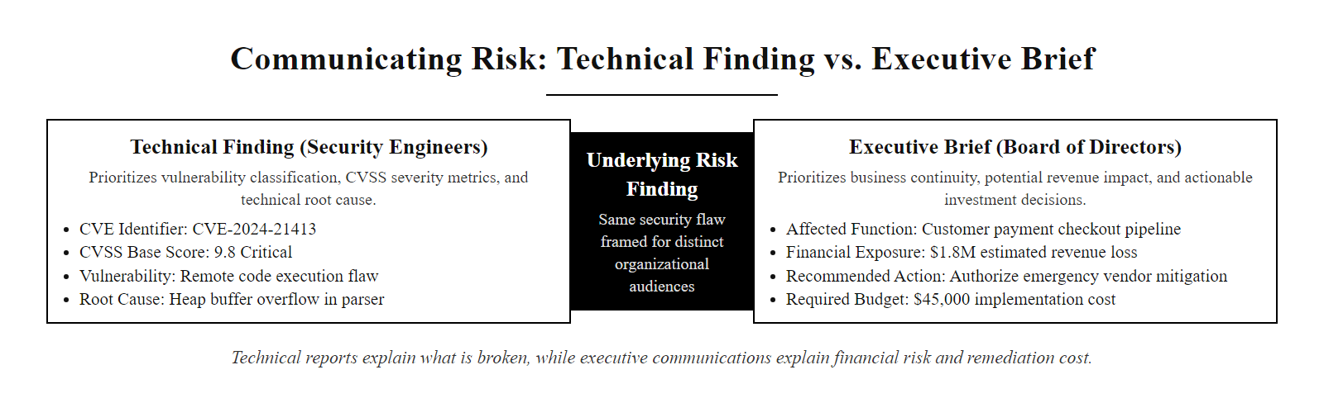
Communicating Risk to Executive Leadership (2/2)
The same risk finding must be expressed differently for different audiences, the technical finding describes what is broken and why; the executive version describes what it costs the business if left unaddressed and what it costs to fix.
Notes:
(continued, see part 1)

Slide 56
Continuous Monitoring, Keeping the Assessment Current
Continuous monitoring transforms a point-in-time risk assessment into a living security program. NIST SP 800-137 defines the strategy for maintaining ongoing awareness of information security risk across the organization.
Step 1, Define the Monitoring Strategy: Select metrics and data sources that provide visibility into each risk domain identified in the assessment (technical, operational, regulatory).
Step 2, Establish Baselines: Define the normal operating baseline for each monitored metric, patch compliance rate, mean time to detect, alert volume, failed authentication rate.
Step 3, Configure Automated Collection: Deploy SIEM, vulnerability scanners, and CSPM tools to collect and aggregate security telemetry continuously, not just at assessment time.
Step 4, Define Alert Thresholds: Set thresholds that trigger human review, for example, any CVSS 9.0+ CVE disclosed for in-scope software should trigger an emergency patch review within 24 hours.
Step 5, Report and Update: Produce monthly security metrics reports for operational teams and quarterly risk posture updates for leadership, updating the risk register to reflect changes in residual risk levels.
Monitoring Category | Key Metric | Collection Method | Review Frequency | Alert Threshold
Vulnerability Management | % of critical CVEs patched within SLA | Nessus / Qualys scan reports | Weekly | < 95% compliance → incident ticket
Phishing / Social Engineering | Click rate in phishing simulations | KnowBe4 / Proofpoint training data | Monthly | > 5% click rate → mandatory training
Access Control | Privileged account review completion | Active Directory / IAM platform | Quarterly | Any unreviewed access > 90 days
Cloud Configuration | CSPM misconfiguration count (critical) | Wiz / Prisma Cloud | Daily | Any new critical finding → immediate review
Incident Response | Mean time to detect (MTTD) | SIEM / EDR telemetry | Monthly | MTTD > 72 hours → process review
Notes:
NIST SP 800-137, "Information Security Continuous Monitoring (ISCM) for Federal Information Systems and Organizations," defines continuous monitoring as maintaining ongoing awareness of information security, vulnerabilities, and threats to support organizational risk management decisions. It is the operational mechanism that connects the risk assessment lifecycle's "Maintain" phase to daily security operations, ensuring that the living risk register remains current and that new risks are identified and evaluated promptly rather than waiting for the next annual assessment cycle.
The monitoring strategy must be designed to provide visibility into the specific risks identified in the assessment. This is a key principle: continuous monitoring is not a generic collection of security metrics, it is a targeted surveillance program designed around the organization's actual risk profile. If the assessment identifies ransomware via phishing as the top risk, the monitoring program must include phishing simulation metrics, email security gateway alert rates, and EDR behavioral detection hit rates as core indicators. If supply chain risk is a top finding, the monitoring program must include vendor SOC 2 report review cycles and SBOM CVE monitoring as required activities.
The concept of a Security Information and Event Management (SIEM) system is central to technical continuous monitoring. A SIEM aggregates log data from across the environment, firewalls, servers, endpoints, IAM systems, cloud platforms, and applies correlation rules to identify patterns that indicate security incidents. For continuous risk monitoring, the SIEM serves as the primary evidence source for security metrics like MTTD, alert volume by category, and anomalous access patterns. NIST SP 800-92, "Guide to Computer Security Log Management," provides detailed guidance on log collection, retention, and analysis practices that support an effective SIEM deployment.
The Governance, Risk, and Compliance (GRC) platform integration is equally important. The most mature continuous monitoring programs connect SIEM and vulnerability scanner outputs directly to the GRC risk register through API integrations, when a new critical CVE is disclosed for an in-scope system, an automated ticket is created in the risk register tracking remediation against the SLA, and if the SLA is missed, the residual risk value for the associated risk register entry is automatically elevated, triggering an alert to the risk owner. This closed-loop integration between technical monitoring and risk governance is the hallmark of a mature security program.
Mean Time to Detect (MTTD) is the single most important security operations metric for continuous risk monitoring because it directly measures how quickly the organization identifies when a threat actor has achieved a foothold in its environment. The longer an attacker dwell time, the period between initial compromise and detection, the more damage they can inflict through lateral movement, data exfiltration, and persistence establishment. The 2023 Mandiant M-Trends report found a global median dwell time of 16 days, meaning the typical compromised organization does not know they have been breached for more than two weeks. Best-in-class organizations measure MTTD in hours, enabled by mature EDR telemetry, well-tuned SIEM detection rules, and 24/7 SOC coverage.
CISA's Continuous Diagnostics and Mitigation program, which gives federal agencies continuous monitoring tools at no cost, has shown that well-implemented continuous monitoring consistently reduces breach severity and dwell time. Its public architecture documentation is a useful reference for designing continuous monitoring strategies.

Slide 57
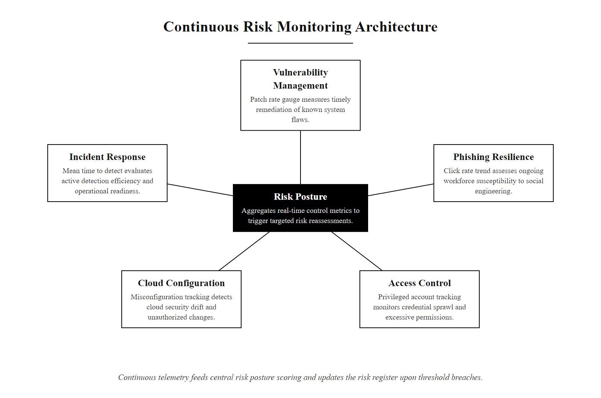
Continuous Monitoring, Keeping the Assessment Current (2/2)
Continuous monitoring converts the risk assessment from an annual snapshot into a real-time dashboard, each metric provides ongoing evidence of control effectiveness and triggers targeted reassessment when the environment deviates from the established risk baseline.
Notes:
(continued, see part 1)

Slide 58
Risk Assessment Careers & Certifications
The skills developed in this project align directly with high-demand cybersecurity career paths. Understanding the professional landscape helps you position your project experience strategically for job applications and interviews.
Role | Primary Responsibility | Required Skills from This Project | Median Salary (U.S.)
GRC Analyst | Manage risk register, conduct compliance assessments, produce reports for leadership | Asset inventory, NIST SP 800-30, regulatory mapping, executive communication | $85,000–$110,000
Risk Analyst (Cyber) | Quantify cyber risk using ALE/FAIR, support investment decisions, manage risk appetite process | ALE calculation, FAIR modeling, risk appetite documentation, board communication | $95,000–$130,000
Security Architect | Design secure systems based on threat models and risk requirements | Threat modeling, MITRE ATT&CK, control mapping, NIST SP 800-53 | $130,000–$175,000
CISO | Own organizational cybersecurity program, report to board, manage risk posture | All phases of risk assessment, executive communication, regulatory compliance | $180,000–$300,000+
Penetration Tester | Empirically validate control effectiveness through authorized attack simulation | Threat modeling, CVE/CVSS, MITRE ATT&CK, control gap identification | $100,000–$145,000
Notes:
As we near the end of this class, let us discuss how the work you are doing in this project maps to specific career opportunities and the certifications that validate your expertise to employers.
The GRC Analyst role is the most common entry point into risk-focused cybersecurity careers. GRC Analysts maintain risk registers, conduct compliance assessments against frameworks like ISO 27001, PCI DSS, and HIPAA, and produce reports for senior leadership and external auditors. The salary range of $85,000 to $110,000 reflects current market data from sources including Levels.fyi, LinkedIn Salary Insights, and the ISACA Global Workforce Survey, though compensation varies significantly by geography, industry, and organization size.
The CRISC certification deserves special attention because it is the most directly aligned to the work you are completing in this project. CRISC, Certified in Risk and Information Systems Control, is issued by ISACA and has four domains: IT Risk Identification, IT Risk Assessment, Risk Response and Reporting, and Information Technology and Security. These four domains map almost exactly to Phases 1 through 6 of the NIST SP 800-30 methodology you have been studying today. ISACA's 2024 State of Cybersecurity report identified CRISC as one of the top five most in-demand certifications globally, particularly among financial services, healthcare, and government employers. CRISC requires three years of work experience in at least two of its four domains before certification can be awarded, making academic project experience a valuable head start toward the experience requirement.
The CISSP, Certified Information Systems Security Professional, remains the most globally recognized and broadly applicable advanced cybersecurity certification. Domain 1, Security and Risk Management, covers asset security, threat modeling, risk analysis (including ALE calculations and the qualitative risk matrix you have studied today), risk treatment strategies, and business continuity, all content from this class. CISSP requires five years of cumulative paid work experience in at least two of its eight domains, but candidates who pass the exam before meeting the experience requirement can hold Associate of ISC² status while accumulating experience.
For students interested in the executive leadership track, the CISM, Certified Information Security Manager, from ISACA is the most appropriate certification. CISM focuses on the management aspects of information security, governance, risk management, incident management, and program development, and is strongly associated with CISO and director-level roles. Combined with an MBA or executive education, CISM holders are well-positioned for senior leadership positions.
A concise description of this project, "a structured enterprise risk assessment using NIST SP 800-30 methodology, with asset valuation, MITRE ATT&CK threat modeling, CVSS vulnerability analysis, ALE risk quantification and cost-benefit-justified remediation", mirrors the terminology of GRC Analyst and Risk Analyst job postings.

Slide 59
Risk Assessment Careers & Certifications (2/3)
Key Certifications
How This Project Helps
CRISC (ISACA), Most directly aligned to risk assessment practice.
CISSP (ISC²), Domain 1 covers all SP 800-30 content; most recognized globally.
CISM (ISACA), Management-focused; excellent for CISO track.
CompTIA Security+, Entry-level certification covering risk concepts; recommended starting point.
Demonstrates practical NIST SP 800-30 methodology knowledge (cited on CRISC and CISSP exams).
Provides a portfolio artifact showing quantitative risk analysis (SLE/ARO/ALE).
Shows regulatory knowledge (HIPAA, PCI DSS, GDPR) that appears in every GRC interview.
Executive communication section demonstrates the soft skill most GRC hiring managers cite as hardest to find.
Notes:
(continued, see part 1)

Slide 60
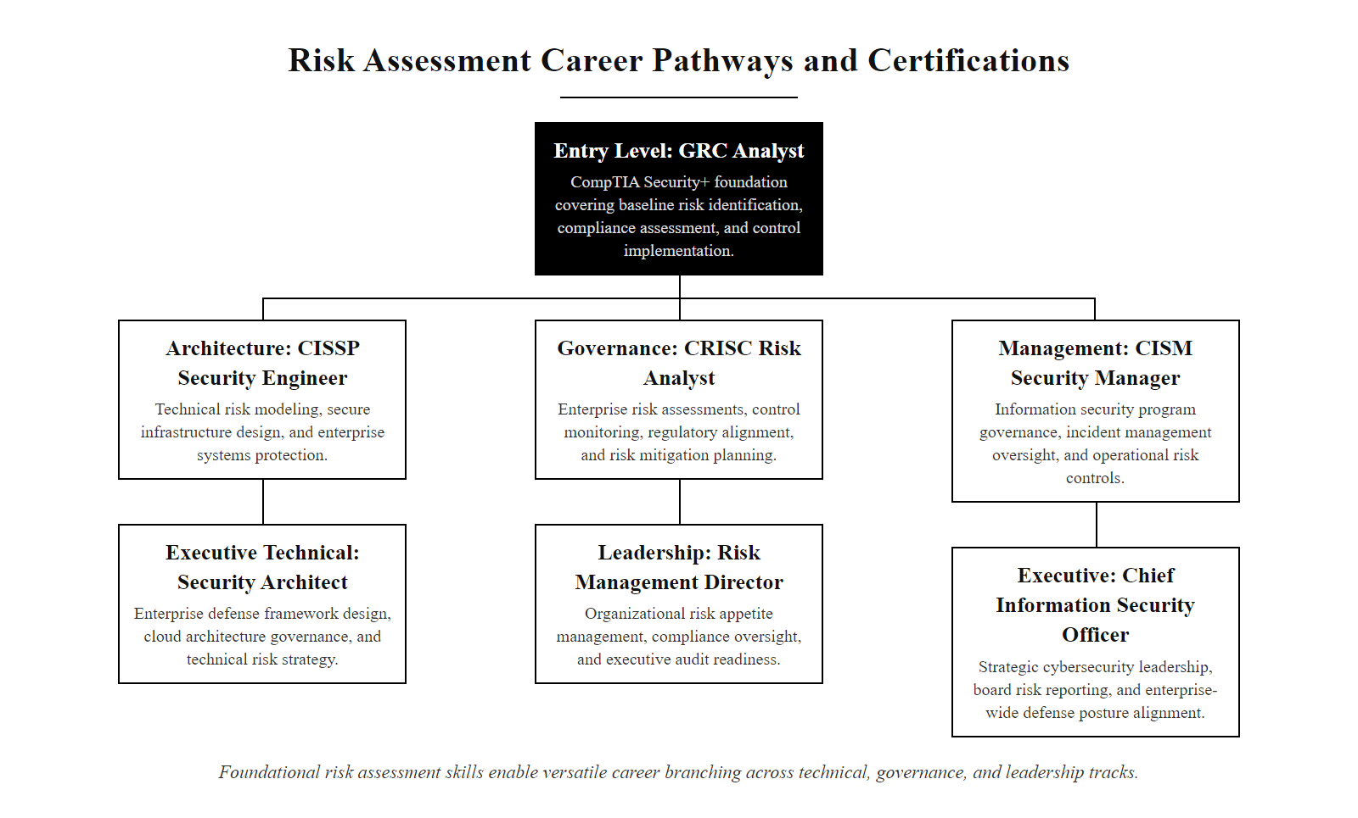
Risk Assessment Careers & Certifications (3/3)
Risk assessment skills are foundational across all three major cybersecurity career tracks, technical architecture, risk and compliance, and leadership, making this project's competencies among the most versatile in the profession.
Notes:
(continued, see part 1)

