Slide 1
Final Cybersecurity Capstone
CLASS 30
Synthesis of Forensic Investigation, Architecture Redesign, and Crisis Communication
Notes:
Welcome to Class 30, the Final Cybersecurity Capstone. This is the culmination of our thirty-class journey. Throughout the semester, we have studied security foundations, cryptography, network security, device hardening, secure coding, and risk management. Today, we bring all of these concepts together in a final synthesis project.
The capstone project simulates a real-world enterprise crisis. You will be presented with a detailed, multi-stage attack scenario that has compromised a target organization. Your task is to perform a post-incident forensic analysis, design a comprehensive defense strategy to prevent future compromises, and develop tailored communications for different stakeholder groups. This project requires you to apply both the reactive skills of a SOC analyst and the proactive mindset of a security architect, preparing you for the diverse challenges of the cybersecurity profession.

Slide 2
The Capstone Challenge & Scope
The capstone is an advanced synthesis project. You must analyze a multi-stage intrusion, design a defense architecture, and communicate your findings to both technical and executive audiences.
The Synthesis Lifecycle
Professional Expectations
Phase 1 (Forensic Analysis): Reconstruct the attack chain and identify vulnerabilities.
Phase 2 (Defense Engineering): Design a layered defense matching each attack stage.
Phase 3 (Communication): Draft messages for executives, technical teams, and the public.
Phase 4 (Strategic Roadmap): Recommend prioritized security improvements.
Technical Rigor: Use correct framework terms (MITRE ATT&CK, NIST CSF).
Aesthetic Quality: Present clear diagrams and structured data tables.
Strategic Realism: Propose practical, cost-effective recommendations.
Notes:
Let's review the scope and objectives of the capstone project. In a professional environment, a security engineer is rarely asked to perform only one task. When a breach occurs, the organization needs a team that can investigate the technical details, explain the business impact to the board, and redesign the network to prevent a repeat incident.
The capstone is divided into four phases that mirror this workflow. In Phase 1, you will analyze the attack scenario, mapping the attacker's actions to the MITRE ATT&CK framework and identifying the specific vulnerabilities exploited.
In Phase 2, you will engineer a defense strategy, proposing preventive, detective, and corrective controls for each stage of the attack.
In Phase 3, you will address crisis communication, drafting tailored updates for different audiences.
Finally, in Phase 4, you will build a strategic security roadmap, providing prioritized recommendations. Your work will be evaluated on its technical accuracy, clarity of communication, and operational feasibility.
The capstone's four-phase structure mirrors real penetration-testing and incident-response report deliverables, matching the frameworks used in professional engagements at incident-response firms.

Slide 3
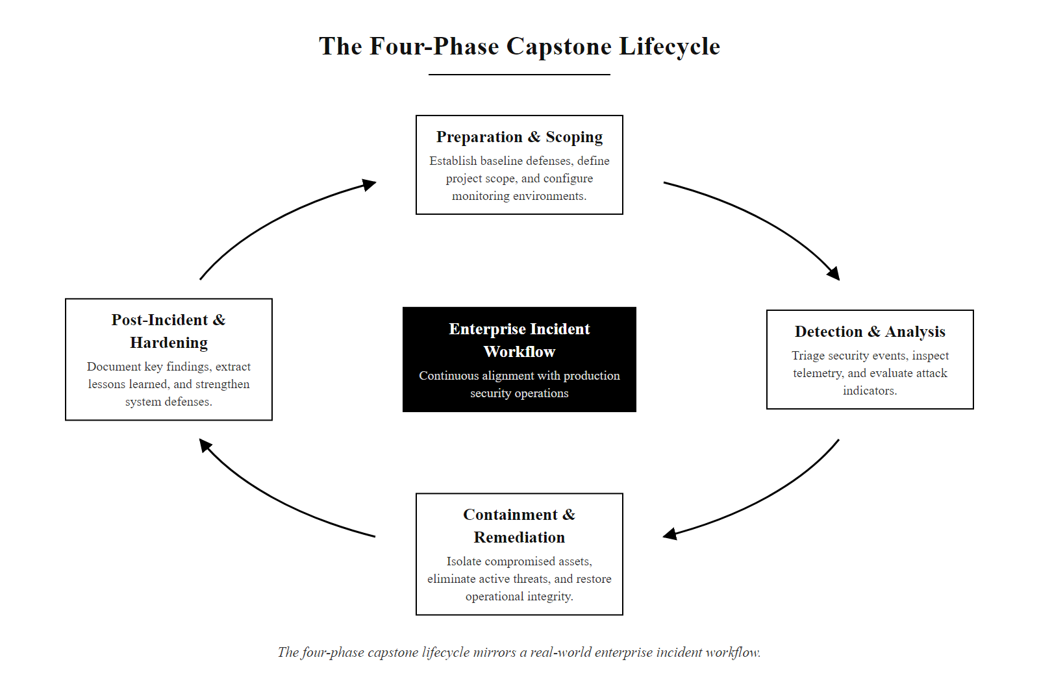
The Capstone Challenge & Scope (2/2)
The four-phase capstone lifecycle mirrors a real-world enterprise incident workflow.
Notes:
(continued, see part 1)

Slide 4
Reconstructing the Multi-Stage Attack
Modern enterprise compromises are rarely single-event attacks. They involve a series of coordinated steps, known as the intrusion kill chain, starting from initial access and culminating in data exfiltration.
Initial Access (Phishing): Attacker sends a targeted spear-phishing email containing a malicious link.
Execution (Credential Harvest): Employee clicks the link, entering credentials into a spoofed login portal.
Persistence (SSH Key Deploy): Attacker uses harvested credentials to log in and place an unauthorized SSH key.
Discovery (Internal Scan): Attacker runs automated scripts to map internal network subnets and find databases.
Lateral Movement (RDP): Attacker moves from the initial workstation to a high-value database server using RDP.
Exfiltration (DNS Tunneling): Attacker encrypts sensitive database records and exfiltrates them disguised as DNS queries.
Notes:
To defend an enterprise, we must first understand how modern attacks unfold. Attackers rarely compromise a target in a single step. Instead, they execute a multi-stage intrusion kill chain, moving slowly to avoid detection.
The capstone scenario follows this multi-stage pattern. The attack begins with Initial Access, where a spear-phishing email tricks an employee into clicking a malicious link.
This leads to Execution, as the employee enters their corporate credentials into a cloned login portal. The attacker uses these credentials to log in, establishing Persistence by deploying an unauthorized SSH key to a public-facing server.
Once inside, the attacker performs Discovery, scanning the internal network to locate database servers containing customer data.
They then execute Lateral Movement, using Remote Desktop Protocol (RDP) to pivot from the compromised workstation to the database server.
Finally, the attacker gathers sensitive files and performs Exfiltration, using DNS tunneling to send the stolen data out of the network disguised as normal domain lookup queries. As analysts, you must identify each of these stages to design an effective defense.
The Lockheed Martin Cyber Kill Chain (2011) was among the first frameworks to formalize attack stages; MITRE ATT&CK breaks those same stages into hundreds of granular techniques. The kill chain is strategic, ATT&CK is tactical.

Slide 5
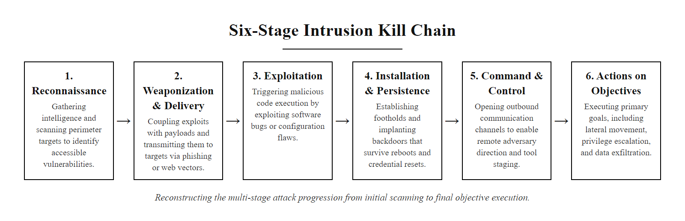
Reconstructing the Multi-Stage Attack (2/2)
The six-stage intrusion kill chain used in the capstone scenario.
Notes:
(continued, see part 1)

Slide 6
MITRE ATT&CK Framework Deep Dive
The MITRE ATT&CK framework (Adversarial Tactics, Techniques, and Common Knowledge) is the industry-standard knowledge base for documenting real-world attacker behavior. Every capstone analysis must use ATT&CK technique IDs.
Kill Chain Stage | ATT&CK Tactic | ATT&CK Technique ID | Technique Name
Initial Access | Initial Access | T1566.002 | Spear-Phishing Link
Execution | Execution | T1204.001 | User Execution: Malicious Link
Persistence | Persistence | T1098.004 | Account Manipulation: SSH Authorized Keys
Discovery | Discovery | T1046 | Network Service Scanning
Lateral Movement | Lateral Movement | T1021.001 | Remote Services: RDP
Exfiltration | Exfiltration | T1048.003 | Exfiltration Over Unencrypted/Obfuscated Non-C2 Protocol
Notes:
One of the most important skills a security analyst brings to an investigation is the ability to translate raw attacker behavior into standardized framework language. The MITRE ATT&CK framework is the most widely adopted standard for doing exactly that. It was developed by MITRE Corporation in 2013 and is maintained with continuous updates as new attack techniques are documented from real-world incidents. Today, the Enterprise matrix alone contains over 600 techniques and sub-techniques organized across 14 tactics.
Let's walk through our scenario using ATT&CK language. The phishing email maps to T1566.002, Spear-Phishing Link, which falls under the Initial Access tactic. The employee clicking the malicious link maps to T1204.001, User Execution: Malicious Link, under the Execution tactic. The attacker deploying an SSH authorized key maps to T1098.004, Account Manipulation: SSH Authorized Keys, under Persistence. The internal network scan maps to T1046, Network Service Scanning, under Discovery. The RDP pivot maps to T1021.001, Remote Services: Remote Desktop Protocol, under Lateral Movement. The DNS tunneling exfiltration maps to T1048.003 under the Exfiltration tactic.
Why does this precision matter? When you write an incident report using MITRE ATT&CK IDs, your findings are immediately understood by any security professional worldwide. SIEM platforms like Microsoft Sentinel and Splunk Enterprise Security use ATT&CK IDs to correlate detections automatically. Threat intelligence feeds from vendors like Recorded Future and Mandiant tag every indicator with ATT&CK technique IDs, so your team can instantly filter for relevant threats.
The NIST SP 800-61r3 Computer Security Incident Handling Guide recommends documenting incidents using standardized taxonomies like ATT&CK to improve information sharing and post-incident analysis. Including ATT&CK IDs in your capstone report demonstrates professional-grade documentation standards.
The ATT&CK Enterprise matrix, for a technique such as spearphishing link (T1566.002), gives the description, real-world procedure examples from named groups, detection guidance and mitigations, a free reference worth keeping.

Slide 7
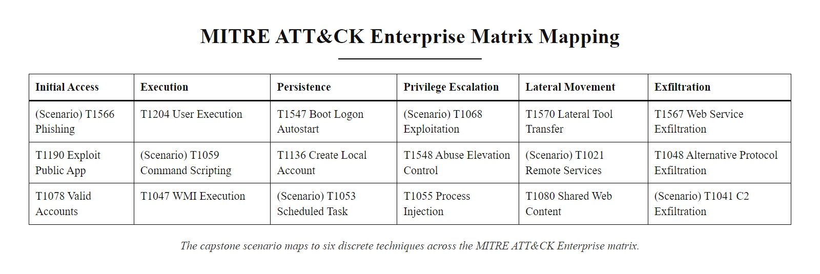
MITRE ATT&CK Framework Deep Dive (2/2)
The capstone scenario maps to six discrete techniques across the MITRE ATT&CK Enterprise matrix.
Notes:
(continued, see part 1)

Slide 8
Threat Actor Profiling & Attribution
Understanding the attacker's motivation, capabilities, and resources is critical to designing a defense. We profile threat actors to align our security investments with actual risks.
Threat Actor Category | Primary Motivation | Technical Capabilities | Typical Targets
Cybercriminals (Organized) | Financial gain (Ransomware, data theft, extortion) | High (Custom malware, zero-day exploits, proxy networks) | E-commerce, financial institutions, healthcare
State-Sponsored (APTs) | Espionage, political influence, disruption | Advanced (Custom exploits, supply-chain attacks, firmware rootkits) | Government agencies, defense contractors, critical infrastructure
Hacktivists | Ideological promotion, public embarrassment | Moderate (DDoS attacks, web defacement, credential leaks) | Corporations, government sites, controversial industries
Insider Threats (Malicious) | Revenge, financial payout, intellectual property theft | High (Legitimate access, knowledge of internal gaps) | Internal file shares, proprietary codebases
Notes:
When analyzing an incident, we must ask: who is targeting us, and why? Profiling the threat actor helps us understand their capabilities and predict their next moves.
We categorize threat actors into four main groups. Cybercriminals are motivated by financial gain, using ransomware and data theft to extort organizations. They possess high technical capabilities and target industries with valuable customer data.
State-sponsored actors, or Advanced Persistent Threats (APTs), are motivated by espionage and disruption. They possess advanced resources, often developing custom malware and zero-day exploits to target government networks and critical infrastructure. NIST SP 800-150 provides a framework for sharing cyber threat intelligence about APT groups between organizations and government agencies.
Hacktivists seek to promote a political or social cause, using DDoS attacks and web defacements to embarrass organizations.
Insider threats are malicious employees or contractors who use their legitimate access to steal intellectual property or sabotage systems. According to the Verizon Data Breach Investigations Report (DBIR), insider threats are responsible for roughly 20% of breaches annually, making them a critical risk vector that is often underestimated.
Identifying the likely threat actor type in your capstone scenario will help you justify your architectural recommendations to leadership. A defense designed for an opportunistic cybercriminal group looks very different from a defense designed for a nation-state APT with unlimited resources and patience.
Two attributions contrast sharply. The 2020 SolarWinds supply-chain attack, attributed to Russia's SVR (APT29), used a patient low-and-slow approach that evaded detection for months; the 2017 WannaCry campaign, attributed to North Korea's Lazarus Group, was noisy and fast, prioritizing financial gain. The tactics differ because the actors' goals differ.

Slide 9
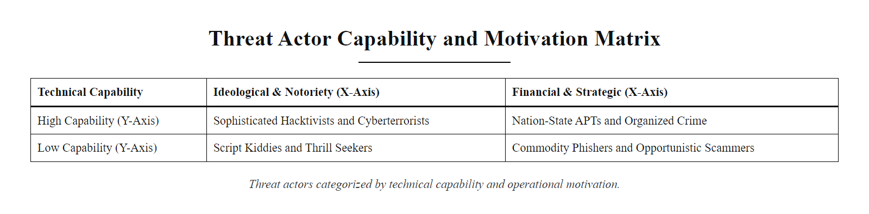
Threat Actor Profiling & Attribution (2/2)
Threat actor profiles mapped by motivation (x-axis) and technical capability (y-axis).
Notes:
(continued, see part 1)

Slide 10
Case Study, The SolarWinds Supply-Chain Attack (2020)
The SolarWinds attack is one of the most significant cyber espionage campaigns in history. Understanding it deepens our grasp of supply-chain threats, patient adversaries, and detection failures.
Supply-Chain Compromise: Threat actors (APT29) infiltrated SolarWinds' build environment and injected a backdoor (SUNBURST) into the Orion IT monitoring software update.
Trojanized Update Distributed: Approximately 18,000 organizations installed the poisoned Orion update between March and June 2020.
Dormancy Period: SUNBURST waited 12–14 days before activating to evade sandbox analysis systems that only run samples for minutes or hours.
Command & Control (C2): The malware communicated with attacker-controlled servers via DNS queries, using legitimate Orion traffic as camouflage.
Lateral Movement & Exfiltration: Attackers used SAML token forgery (Golden SAML) to gain persistent access to cloud services including Microsoft 365 and Azure AD.
Discovery (December 2020): Cybersecurity firm FireEye (now Mandiant) detected the breach when investigating its own compromise and alerted authorities.
Notes:
The SolarWinds attack, formally investigated under the name UNC2452 by Mandiant and attributed by the US government to SVR (Russia's Foreign Intelligence Service), represents a masterclass in advanced, patient intrusion tradecraft. Let's analyze it through the lens of the frameworks we have studied.
The attack began not with a phishing email but with a compromise of the software supply chain itself. APT29 operators gained access to SolarWinds' internal build system and injected malicious code, known as SUNBURST, into the legitimate Orion software build pipeline. This is MITRE ATT&CK technique T1195.002, Compromise Software Supply Chain. This is extraordinarily difficult to detect because the malware arrives as a digitally signed, vendor-approved software update. The organization installs it willingly.
The SUNBURST backdoor included a deliberate 12-to-14-day dormancy period before activating. This defeats many automated sandbox analysis tools, which only execute suspicious files for seconds or minutes. It also creates a significant gap between infection and any detectable activity, giving the malware time to be deployed widely before any alert fires. This patience is the hallmark of state-sponsored APTs.
The command-and-control communication used DNS queries (T1071.004), mimicking normal Orion telemetry traffic to blend into legitimate network flows. The exfiltration and lateral movement phase leveraged a technique called Golden SAML (T1606.002), forging authentication tokens for Microsoft cloud services. This allowed APT29 to move through Microsoft 365 environments without ever needing to crack a password.
The attack was ultimately discovered not by the 18,000 affected organizations' own monitoring, but by FireEye, which noticed unusual activity in its own environment and traced it to the Orion update. This highlights a critical lesson from NIST SP 800-137 Continuous Monitoring: detection requires active hunting, not just passive alerting. Many organizations would not have found this attack on their own for years.
In the capstone scenario, the Protect function was bypassed at the supply-chain level and Detect failed for nearly nine months, which shows why detection capability requires dedicated investment beyond perimeter security.

Slide 11
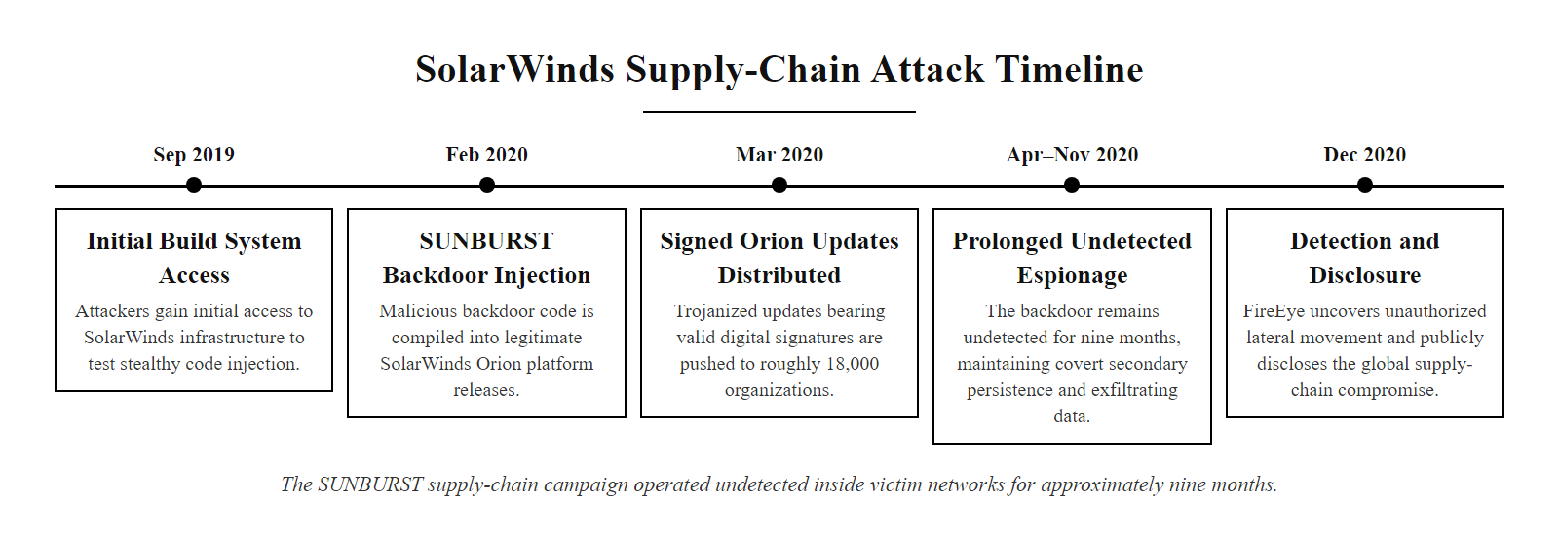
Case Study, The SolarWinds Supply-Chain Attack (2020) (2/2)
The SolarWinds SUNBURST campaign operated undetected for approximately nine months.
Notes:
(continued, see part 1)

Slide 12
DNS Tunneling, Deep Dive & Detection
DNS tunneling (MITRE ATT&CK T1048.003) abuses the Domain Name System to exfiltrate data or maintain command-and-control channels, exploiting the fact that DNS traffic is rarely inspected deeply at enterprise firewalls.
DNS (UDP port 53) is permitted outbound on nearly every enterprise firewall by default.
DNS responses can carry large payloads in TXT, CNAME, and NULL records.
Many organizations lack DNS logging and query inspection.
Normal DNS Query | Suspicious DNS Query
www.google.com | aGVsbG8gd29ybGQ.attacker.com
Short hostname, common TLD | Long Base64-encoded subdomain
1–4 queries/minute | 100–500 queries/minute
Standard A record request | TXT or NULL record request
Known registrar, aged domain | Newly registered domain (< 30 days)
Notes:
DNS tunneling is one of the most elegant and insidious data exfiltration techniques in an attacker's toolkit, and it frequently catches organizations off guard because DNS is treated as infrastructure rather than a security boundary. Let's understand exactly how it works.
The Domain Name System was designed to resolve human-readable hostnames into IP addresses. To do this, a client sends a query like "what is the IP address of www.example.com?" to a recursive resolver. The resolver queries up the DNS hierarchy until it finds the authoritative nameserver for example.com, which returns an answer. The key insight for attackers is that the attacker controls both the malware on the victim machine and an authoritative nameserver for a domain they own, call it attacker-c2.com.
To exfiltrate a file, the malware divides the file into small chunks, Base64-encodes each chunk, and prepends it as a subdomain label in a DNS query. For example, it sends a lookup for aGVsbG8gd29ybGQ.attacker-c2.com. The DNS query travels through the corporate network, passes through the firewall (because DNS is allowed), and reaches the attacker's authoritative nameserver. The attacker's server logs the query, strips off the Base64 payload from the subdomain, and stores the data chunk. After many such queries, the attacker reassembles the complete file.
Detection relies on behavioral anomalies rather than signature matching. The key indicators include: an unusually high volume of DNS queries from a single internal host (normal workstations resolve dozens of domains per hour, not thousands); queries with abnormally long subdomains (legitimate hostnames are rarely longer than 30 characters; tunneling payloads often exceed 200 characters); queries for TXT or NULL record types, which carry larger payloads than standard A records; and queries directed at newly registered domains, since attackers register fresh C2 domains to avoid reputation-based blocklists.
From a defensive standpoint, CISA Advisory AA22-335A recommends deploying DNS Security Extensions (DNSSEC) and logging all DNS queries to a SIEM for anomaly analysis. Commercial tools like Cisco Umbrella and Palo Alto DNS Security use machine learning models trained on billions of queries to identify tunneling patterns in real time. For your capstone, recommending DNS query logging forwarded to the SIEM is a high-value, low-cost defensive control that directly addresses the exfiltration stage of our scenario.
DNS tunneling encodes data into DNS queries and responses to exfiltrate it through a channel almost always allowed outbound. In a packet capture, a tunneling session shows long, high-entropy Base64 subdomains in the query names, the visible signature of the technique.

Slide 13
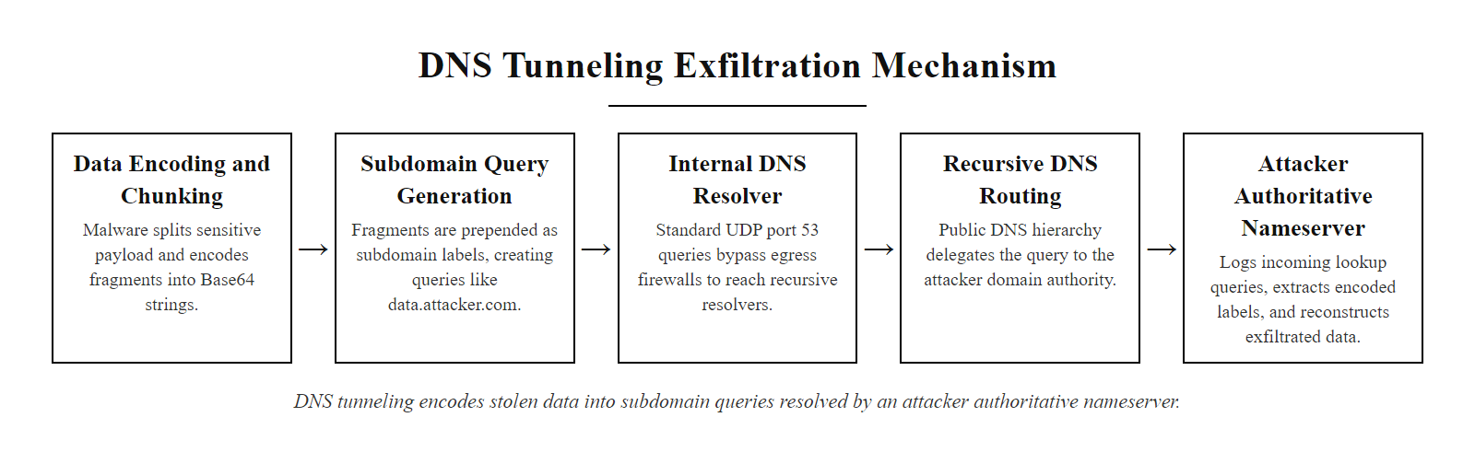
DNS Tunneling, Deep Dive & Detection (2/2)
DNS tunneling encodes stolen data as subdomain labels in queries sent to an attacker-controlled authoritative nameserver.
Notes:
(continued, see part 1)

Slide 14
CVE Analysis, Vulnerabilities Exploited in the Scenario
Real attacks exploit documented vulnerabilities. Mapping your scenario to Common Vulnerabilities and Exposures (CVE) entries provides a concrete, verifiable basis for your remediation recommendations.
Attack Stage | Relevant CVE | CVSS Score | Description | Remediation
Credential Harvest (No MFA) | CVE-2021-44228 (Log4Shell) as analogy | N/A, process gap | Absence of phishing-resistant MFA is a configuration gap, not a software CVE. Policy: enforce FIDO2. | Deploy FIDO2 WebAuthn; enforce Conditional Access
SSH Key Persistence | CVE-2023-38408 (OpenSSH agent) | 9.8 Critical | Remote code execution via OpenSSH forwarded agent on unpatched servers. | Patch OpenSSH to ≥ 9.3p2; disable agent forwarding
RDP Lateral Movement | CVE-2019-0708 (BlueKeep) | 9.8 Critical | Pre-auth RCE in Windows Remote Desktop Services; allows worm-like propagation. | Apply MS19-0708 patch; disable RDP where not needed
Internal Port Scan | CVE-2021-21985 (VMware vCenter) | 9.8 Critical | Remote code execution used post-scan to compromise hypervisors in similar attacks. | Patch VMware vCenter to ≥ 7.0U2b
DNS Tunneling Exfiltration | CVE-2020-1350 (SIGRed) | 10.0 Critical | RCE in Windows DNS Server allowing complete domain takeover; amplifies DNS attack surface. | Apply KB4569509 patch; enable DNS query logging
Notes:
Every time we identify a vulnerability in a post-incident analysis, we should ask: does this vulnerability have a CVE entry? The Common Vulnerabilities and Exposures system, managed by MITRE Corporation and sponsored by CISA, provides a standardized identifier for every publicly known software vulnerability. Referencing CVEs in your capstone report adds precision and professional credibility, and allows your technical audience to immediately look up the full vulnerability details, available patches, and proof-of-concept exploit code.
Let's walk through the CVEs most relevant to our scenario.
First, the RDP lateral movement stage. CVE-2019-0708, commonly known as BlueKeep, is one of the most dangerous Windows vulnerabilities ever discovered. It allows an unauthenticated attacker to execute arbitrary code on a target system running Windows 7, Windows Server 2008, or Windows Server 2008 R2 simply by sending a crafted request to the Remote Desktop Services port. Microsoft rated it 9.8 Critical and released an emergency patch in May 2019, even providing patches for out-of-support Windows XP and Server 2003 due to its severity. The NSA issued an advisory urging immediate patching, warning that the vulnerability had worm-like potential similar to the 2017 WannaCry outbreak.
Second, the SSH persistence stage. CVE-2023-38408 is a critical vulnerability in the OpenSSH agent that was disclosed in 2023 by researchers at Qualys. An attacker who has already achieved a foothold can exploit this vulnerability to escalate to remote code execution via an OpenSSH forwarded agent connection, making it directly relevant to our persistence phase.
Third, SIGRed (CVE-2020-1350) is a critical vulnerability in the Windows DNS Server component. A CVSS score of 10.0, the highest possible, reflects that this vulnerability is network-exploitable, requires no authentication, and results in complete system compromise. It amplifies the DNS attack surface that the attacker exploited for tunneling.
When writing your remediation recommendations, always cite the specific CVE, its CVSS score, the available patch or mitigation, and whether the affected system in the scenario was likely patched. This transforms your recommendation from generic advice into specific, actionable, evidence-based guidance.
The National Vulnerability Database entry for a CVE provides the CVSS vector, the CWE classification, reference links and the affected-product (CPE) data. Vulnerability scanners cross-reference detected software versions against the NVD to produce prioritized patch lists.

Slide 15
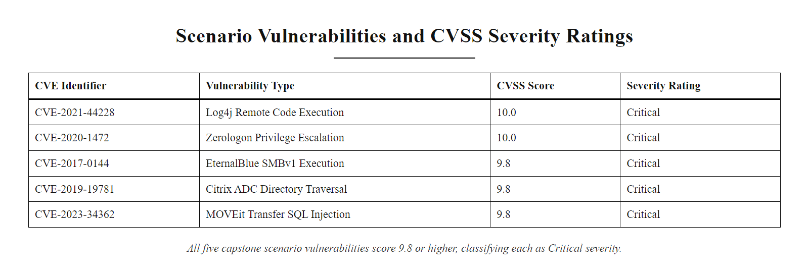
CVE Analysis, Vulnerabilities Exploited in the Scenario (2/2)
All five CVEs mapped to the capstone scenario score 9.8 or higher, all are rated Critical.
Notes:
(continued, see part 1)

Slide 16
Forensic Evidence Collection & Chain of Custody
Before any analysis can begin, evidence must be collected following strict procedures. Chain of custody ensures that digital evidence is legally admissible and that its integrity can be verified throughout the investigation.
Identification: Determine which systems, logs, and media are relevant to the incident. Prioritize volatile evidence (RAM, running processes, active connections) before non-volatile (disk images, logs).
Collection: Use forensically sound tools (e.g., FTK Imager, dd) to create bit-for-bit copies of storage media. Capture RAM using tools like Volatility or WinPmem. Do not work on original evidence.
Preservation: Hash every collected artifact using SHA-256 immediately after capture. Store originals in write-protected, tamper-evident containers. Document the hash in the chain of custody log.
Analysis: Perform all analysis on forensic copies, never originals. Use a forensic workstation isolated from production networks.
Documentation: Record every action taken, by whom, when, and why. Any undocumented action is a gap that opposing counsel can exploit.
Presentation: Prepare findings in a format appropriate for the audience, technical report for the IR team, executive summary for leadership, legal brief for law enforcement.
Notes:
When a cybersecurity incident occurs and legal action may follow, whether a lawsuit, regulatory enforcement, or criminal prosecution, the manner in which you collect evidence is just as important as what you find. Chain of custody is the legal concept that requires investigators to document who collected the evidence, how it was stored, who had access to it, and whether its integrity was maintained at every step. Evidence collected without proper chain of custody can be ruled inadmissible in court, allowing attackers to escape legal accountability.
NIST SP 800-86, Guide to Integrating Forensic Techniques into Incident Response, outlines the four phases of forensic evidence handling: Collection, Examination, Analysis, and Reporting. The very first principle is the order of volatility: collect the most volatile evidence first, because it disappears when power is lost. Running process lists, network connections, and RAM contents are highly volatile. Log files on disk are moderately volatile. Archived backups and physical media are non-volatile.
When creating a forensic copy of a hard drive, we use a process called imaging. A tool like FTK Imager or the UNIX dd command reads every single bit from the original drive and writes an exact copy to a forensic image file. Immediately after imaging, we compute a SHA-256 cryptographic hash of both the original drive and the forensic image. If the hashes match, we have proven that the copy is bit-for-bit identical to the original. If we later compute the hash again and it still matches, we have proven that the copy has not been modified during our analysis. This hash verification is the technical foundation of forensic integrity.
For your capstone, you are working with simulated evidence, but you should describe your collection methodology as if the scenario were real. State which evidence types you would collect, in what order, using which tools, and how you would document the chain of custody. This demonstrates professional forensic awareness that goes beyond simple technical analysis.
Hashing a file, changing a single byte and re-hashing produces a completely different digest, the avalanche effect, which is why a hash reliably proves file integrity: any change, however small, is detectable.

Slide 17
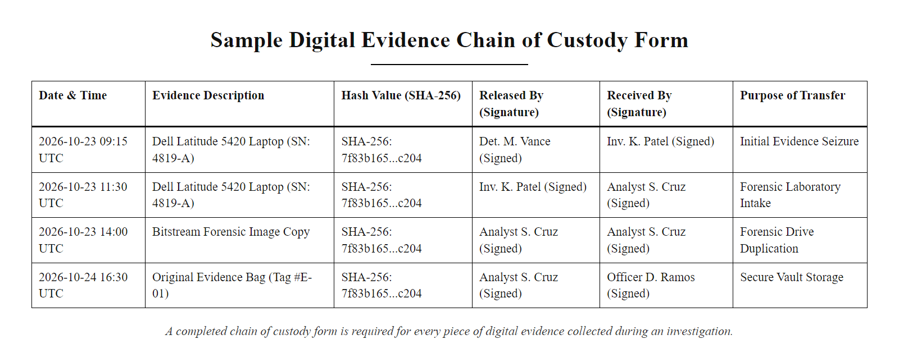
Forensic Evidence Collection & Chain of Custody (2/2)
A completed chain of custody form is required for every piece of digital evidence collected during an investigation.
Notes:
(continued, see part 1)

Slide 18
Log Analysis Worked Example
Logs are the primary evidence source in most incident investigations. Analysts must know which log sources to query, what suspicious patterns look like, and how to correlate entries across multiple sources to reconstruct an attack timeline.
Notes:
Log analysis is the fundamental skill of a Security Operations Center analyst. During an incident, logs from firewalls, authentication servers, web servers, DNS servers, and endpoint agents must be collected, normalized, and correlated into a single coherent timeline. This is harder than it sounds, because each log source uses a different format, a different timestamp convention, and a different severity vocabulary.
Let's analyze the three log excerpts shown on this slide. First, the SSH authentication log at 02:14:33 shows a successful password-based login from an external IP address (203.0.113.55) to the admin account. Password-based SSH authentication from external IPs should immediately raise an alert, especially at 2 AM. Nine seconds later, at 02:14:41, the same session shows a successful public key authentication. This is suspicious: why is a session authenticating with both a password and a public key? The answer comes from the next line: at 02:15:02, the SSH daemon logs that the authorized_keys file has been modified. This is the attacker's persistence mechanism, they logged in with the stolen password and immediately added their own SSH key so they can return without the password.
Second, the Apache web server log at 02:13:45 shows a suspicious redirect. The URL parameter includes a redirect to http://evil.attacker.com/harvest, this is the phishing step. An employee was redirected to the credential harvesting portal, capturing the admin password that was used 48 seconds later to log in via SSH.
Third, the DNS query log at 02:47 shows exactly what DNS tunneling looks like in log form. The client at internal IP 10.10.1.45 is sending queries to subdomains of exfil-c2.xyz, a newly registered domain, at a rate of three queries per second. The subdomains contain long Base64-encoded strings. Decoding aGVsbG8td29ybGQ yields "hello-world", this is test data from the exfiltration tool. The .xyz TLD is associated with higher rates of malicious domain registration according to Spamhaus research.
The NIST SP 800-92 Guide to Computer Security Log Management recommends centralizing logs from all sources into a SIEM platform to enable this kind of cross-source correlation. Without a SIEM, an analyst would need to manually compare log files from three different servers, a slow, error-prone process during a fast-moving incident.
A Base64 string decoded from a DNS log reveals the exfiltrated content and also demonstrates that Base64 is encoding, not encryption: any analyst can reverse it instantly, so it provides no confidentiality on its own.

Slide 19
Log Analysis Worked Example (2/4)
[SSH Authentication Log, /var/log/auth.log]
2024-03-15 02:14:33 sshd[4821]: Accepted password for admin from 203.0.113.55 port 52441 ssh2
2024-03-15 02:14:41 sshd[4821]: Accepted publickey for admin from 203.0.113.55 port 52441 ssh2
2024-03-15 02:15:02 sshd[4823]: sshd: Authorized key modified: /home/admin/.ssh/authorized_keys
[Web Server Log, Apache access.log]
203.0.113.55 - - [15/Mar/2024:02:13:45 +0000] "GET /login.php?redirect=http://evil.attacker.com/harvest HTTP/1.1" 302 0
[DNS Query Log, Bind9 query.log]
15-Mar-2024 02:47:01.342 queries: info: client 10.10.1.45#55301: query: aGVsbG8td29ybGQ.exfil-c2.xyz IN TXT +
15-Mar-2024 02:47:01.800 queries: info: client 10.10.1.45#55302: query: d29ybGQtaGVsbG8.exfil-c2.xyz IN TXT +
15-Mar-2024 02:47:02.201 queries: info: client 10.10.1.45#55303: query: SGVsbG8td29ybGQtZnJvbS1zeXN0ZW0.exfil-c2.xyz IN TXT +
Notes:
(continued, see part 1)

Slide 20
Log Analysis Worked Example (3/4)
Red Flags Identified: (1) Password authentication accepted at 02:14 from an external IP. (2) SSH public key added 9 seconds later, attacker establishing persistence. (3) DNS queries to a newly registered .xyz domain with Base64-encoded subdomains at high frequency. All three events must be correlated into a single timeline.
Notes:
(continued, see part 1)

Slide 21
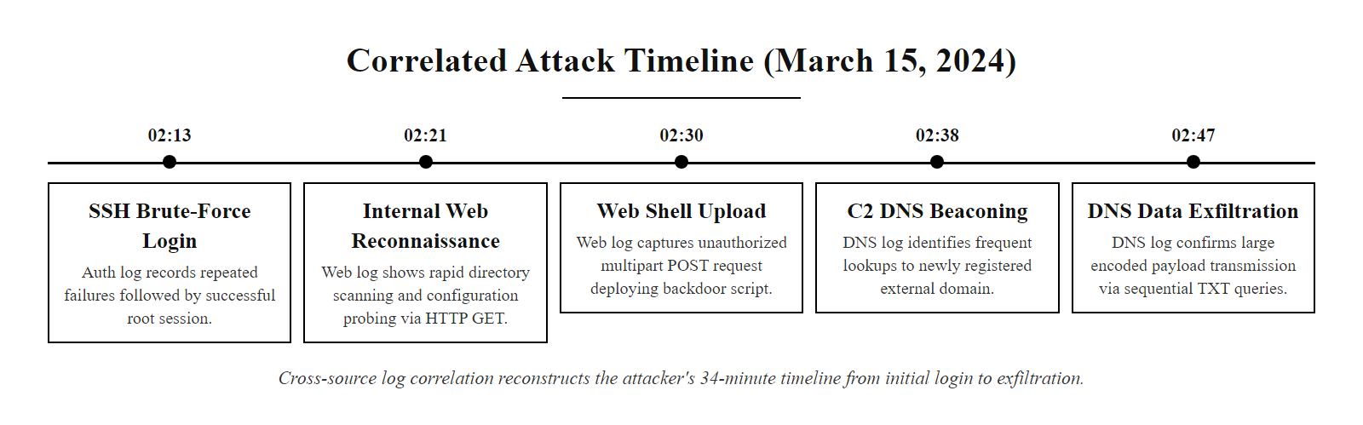
Log Analysis Worked Example (4/4)
Cross-source log correlation reconstructs the attacker's 34-minute timeline from initial login to exfiltration.
Notes:
(continued, see part 1)

Slide 22
Network Forensics, Packet Capture Analysis
When logs are absent or incomplete, packet captures (PCAPs) provide ground-truth network evidence. Analysts use tools like Wireshark and tcpdump to inspect individual network conversations at the protocol level.
Key PCAP Analysis Techniques
Wireshark Display Filters for This Scenario
Follow TCP Stream: Reconstruct a full HTTP/S or SSH conversation from fragmented packets.
Filter by Protocol: Isolate DNS, RDP, or SMTP traffic with display filters (e.g., dns.qry.type == 16 for TXT records).
Export Objects: Extract files transferred over HTTP or SMB from the packet stream.
Identify C2 Beaconing: Look for regular outbound connections at fixed intervals, a sign of automated malware check-ins.
GeoIP Lookup: Map source IP addresses to countries to identify unexpected geographic origins.
ssh, Show all SSH traffic to identify unauthorized sessions.
dns && dns.qry.name contains "xyz", Isolate DNS queries to suspicious TLDs.
rdp, Show all Remote Desktop Protocol traffic.
ip.src == 203.0.113.55, Show all traffic from the attacker's IP.
frame.len > 500 && dns, DNS packets larger than 500 bytes suggest tunneling payloads.
Notes:
Packet capture analysis is the deepest level of network forensic investigation. While logs tell you what events occurred, packet captures tell you exactly what data was transmitted. Every byte of a network conversation, the HTTP headers, the DNS query strings, the RDP session setup, is preserved in a PCAP file. This makes PCAPs invaluable for reconstructing attack scenarios when logs have been deleted or were never enabled.
Wireshark is the industry-standard, open-source packet analyzer. It provides a graphical interface for reading PCAP files, filtering traffic by protocol, IP address, port, or content, and reconstructing entire TCP sessions into readable conversation streams. The "Follow TCP Stream" feature is particularly powerful, it extracts all packets belonging to a single TCP connection and displays them as a human-readable conversation, allowing you to see exactly what an attacker typed into an SSH session or what data was submitted via an HTTP form.
For our capstone scenario, the most important Wireshark filter for the exfiltration stage is dns.qry.type == 16, which isolates DNS TXT record queries. TXT records are a common DNS tunneling vehicle because they can carry payloads up to 255 characters. When you apply this filter to a PCAP from the affected network segment, you will see hundreds of queries per minute from the infected workstation, all directed at subdomains of the attacker's domain. The subdomain strings will be visibly unusual, random-looking alphanumeric sequences that don't resemble any legitimate hostname.
Another powerful filter is frame.len > 500 && dns. Normal DNS queries are rarely larger than 100 bytes. A DNS packet exceeding 500 bytes almost certainly contains a tunneling payload. This is a rule that can be directly translated into an IDS signature using Snort or Suricata, generating an alert every time an oversized DNS packet is observed on your network.
NIST SP 800-86 recommends preserving full packet captures in incident response toolkits, stored on ring-buffer capture systems at key network chokepoints such as the internet gateway, DMZ boundary, and data center access switches. The storage cost of continuous PCAP has dropped significantly, and the investigative value is enormous. Without PCAP evidence, it may be impossible to prove definitively what data was exfiltrated, a critical gap in a regulatory breach notification situation where you must report the specific data categories affected.
Investigating a packet capture of a DNS tunneling session, identifying the Base64 subdomains, decoding one and inferring what was exfiltrated, turns the abstract technique into a concrete analysis task.

Slide 23
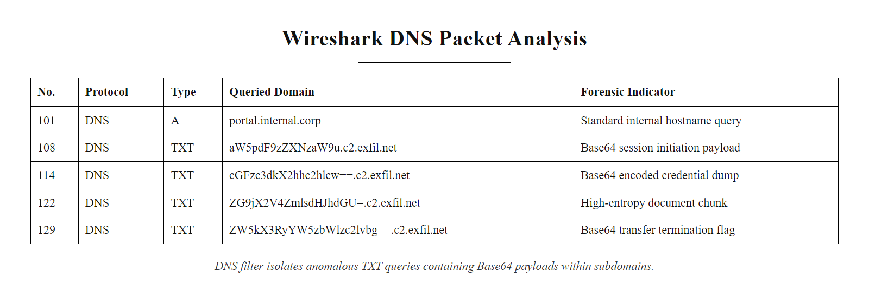
Network Forensics, Packet Capture Analysis (2/2)
Wireshark's DNS filter reveals anomalous TXT record queries with Base64-encoded payloads in the subdomain field.
Notes:
(continued, see part 1)

Slide 24
Mid-Lecture Checkpoint, Attack Reconstruction Quiz
Pause & Verify. Before we move from analysis to defense engineering, confirm you can reconstruct the attack chain using the frameworks we have covered. Answer each question before revealing the answer.
A) T1566.002 · B) T1098.004 · C) T1046 · D) T1021.001
A) Signature-based detection · B) Anomaly-based detection · C) Policy-based detection · D) Heuristic detection
A) Compress the forensic image · B) Encrypt the evidence · C) Verify forensic integrity (chain of custody) · D) Speed up analysis
A) 24 hours · B) 48 hours · C) 72 hours · D) 7 days
A) Identify · B) Protect · C) Detect · D) Recover
Notes:
This checkpoint is designed to confirm that students have internalized the analysis-phase concepts before we shift gears to defense engineering. Pause here and give students two to three minutes to mentally answer each question before reviewing the answers together. This active recall technique is one of the most evidence-backed methods for improving long-term retention compared to passive re-reading.
For Question 1, the correct answer is T1098.004, Account Manipulation: SSH Authorized Keys. Students who answer T1566.002 have confused the persistence technique with the initial access phishing technique, a common error that highlights why precise ATT&CK mapping requires careful reading of technique definitions.
For Question 2, anomaly-based detection is correct because no pre-written signature exists for this specific domain. The alert is triggered by statistical deviation from a baseline: normal DNS traffic volume, normal query type distribution, and normal domain characteristics. If you had a signature for this specific domain, it would only be useful after the domain was already known to be malicious.
For Question 3, SHA-256 hash verification serves as the technical foundation of chain of custody. It is not compression, not encryption, and not a performance optimization. The hash proves at any future point that the forensic copy has not been altered since the moment it was created, essential for legal admissibility.
For Question 4, GDPR Article 33 mandates notification to the supervisory authority within 72 hours of becoming aware of a personal data breach. Article 34 requires notification to affected individuals when the breach is likely to result in high risk. Students frequently confuse the 72-hour regulatory deadline with a longer 30-day window sometimes cited for US state breach notification laws, emphasize that GDPR's 72-hour window is one of the strictest in the world.
For Question 5, the Detect function was the critical failure in SolarWinds. The attacker successfully bypassed Protect controls by infiltrating the software supply chain. But the nine-month dwell time, the time between initial compromise and detection, represents a complete failure of continuous monitoring capabilities described in NIST SP 800-137.
GDPR imposes a heavier compliance burden than most U.S. privacy laws, which is a useful entry point to the wider regulatory landscape.

Slide 25
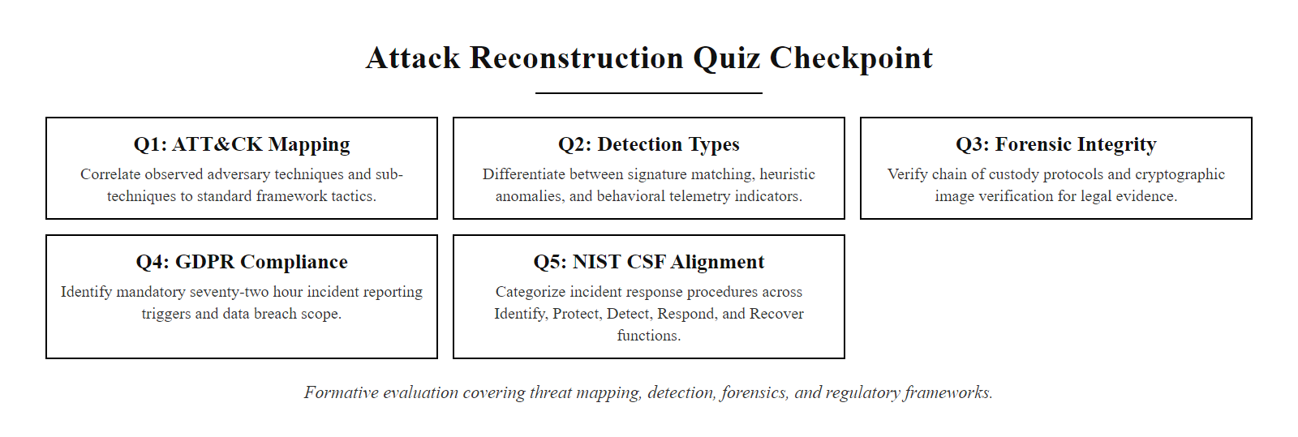
Mid-Lecture Checkpoint, Attack Reconstruction Quiz (2/2)
Five-question checkpoint covering ATT&CK mapping, detection types, forensic integrity, GDPR, and NIST CSF.
Notes:
(continued, see part 1)

Slide 26
Stage-by-Stage Defensive Engineering
We must apply our security architecture framework to design a defense that mitigates the attack at every stage of the intrusion kill chain.
Attack Stage | Preventive Control | Detective Control | Corrective Control
1. Phishing & Login | Implement FIDO2 WebAuthn MFA; run phishing simulation training | Configure SIEM alert for impossible travel logons | Revoke compromised credentials; terminate active user sessions
2. SSH Persistence | Restrict SSH access using network access control lists (ACLs) | Deploy File Integrity Monitoring (FIM) to monitor authorized keys | Remove unauthorized keys; restore SSH configuration to baseline
3. Internal Scan | Disable unused ports and protocols; implement network segmentation | Configure IDS/IPS rules to flag internal port scanning | Isolate scanning host to a quarantine VLAN
4. Lateral RDP | Enforce Least Privilege; disable RDP on non-admin workstations | Log and audit all internal RDP connection attempts | Terminate unauthorized RDP sessions; rotate machine certificates
5. DNS Tunneling | Configure DNS filtering to block requests to dynamic domains | Monitor DNS query volume and anomalous TXT record requests | Block destination domains at firewall; isolate exfiltrating host
Notes:
Once we have mapped the attack chain, we must design a defense. We use the control taxonomy from Class 27, proposing preventive, detective, and corrective controls for each stage of the compromise.
For the initial phishing stage, we propose FIDO2 WebAuthn multi-factor authentication as a preventive control, since it resists phishing attacks that bypass SMS or push notifications. We configure SIEM alerts for impossible travel logons as a detective control, and revoke credentials as a corrective response.
To address persistence, we restrict SSH access using ACLs, deploy File Integrity Monitoring to detect unauthorized keys, and remove anomalous keys to restore the system.
For network discovery, we disable unused ports, monitor internal traffic for port scans, and quarantine scanning hosts.
For lateral RDP movement, we enforce least privilege, audit RDP logs, and isolate compromised hosts.
Finally, to block DNS tunneling, we implement DNS filtering, monitor for anomalous TXT record requests, and block malicious destination domains at the firewall. This stage-by-stage defense ensures that even if the attacker bypasses our initial filters, we have multiple opportunities to detect and contain them.
The NIST Cybersecurity Framework SP 800-53 Rev 5 provides control families that map directly to this matrix. Preventive controls primarily fall under Access Control (AC) and Configuration Management (CM) families. Detective controls align with Audit and Accountability (AU) and Incident Response (IR). Corrective controls align with Incident Response (IR) and System and Communications Protection (SC).
FIDO2 MFA tends to give the highest return for the lowest cost: it is inexpensive to deploy, immediately eliminates the credential-phishing vector that starts many attack chains, and needs little maintenance, a clear case for risk-adjusted return on security investment.

Slide 27
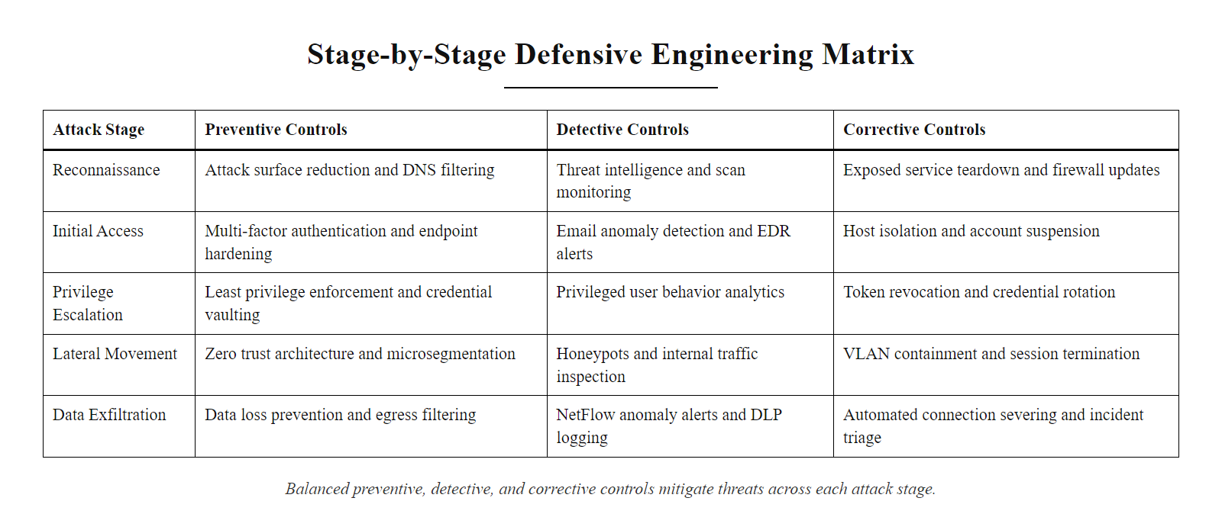
Stage-by-Stage Defensive Engineering (2/2)
The stage-by-stage defense matrix maps each attack stage to a balanced set of preventive, detective, and corrective controls.
Notes:
(continued, see part 1)

Slide 28
Applying Zero Trust to Prevent Lateral Movement
The capstone scenario highlights the danger of implicit trust. We must redesign the network architecture following Zero Trust Architecture (NIST SP 800-207) principles to contain compromises.
Notes:
The compromise in our scenario succeeded because the attacker was able to move freely from a workstation to a database server. This is a classic perimeter-centric vulnerability. To prevent this, we must redesign the network architecture using Zero Trust principles.
Under NIST SP 800-207, we establish a Policy Decision Point (PDP) and a Policy Enforcement Point (PEP). When a user requests access to a resource, the PEP intercepts the request. The PDP evaluates the request dynamically, checking user identity, device security posture, and the sensitivity of the resource. If the user's workstation lacks endpoint monitoring, access is denied.
We implement microsegmentation. The database server is placed in an isolated network segment (VLAN 40) protected by firewalls. Workstations cannot connect directly to the database segment. Instead, they must connect to an application gateway that authenticates and audits every query. This ensures that even if an attacker compromises a user's workstation, they are blocked from moving laterally to our database assets.
The continuous assessment loop shown in the diagram is what distinguishes Zero Trust from traditional role-based access control. Even after a session is established, the PDP continuously re-evaluates the risk signals. If the EDR agent on the workstation detects malware mid-session, the risk score spikes and the PEP immediately terminates the connection. This real-time, dynamic policy enforcement makes Zero Trust far more resilient than static firewall rules.
Google's implementation of Zero Trust, described in their BeyondCorp architecture white papers published between 2014 and 2018, demonstrated that a global enterprise with 85,000 employees could operate entirely without a traditional corporate VPN by implementing these principles. The transition took several years, but eliminated their entire category of VPN-related vulnerabilities.
Zero Trust does not mean "no trust at all"; it means never assuming trust based on network location alone. Users and devices inside the corporate network are not inherently trusted and must continuously prove identity and security posture, a shift from the castle-and-moat perimeter model.

Slide 29
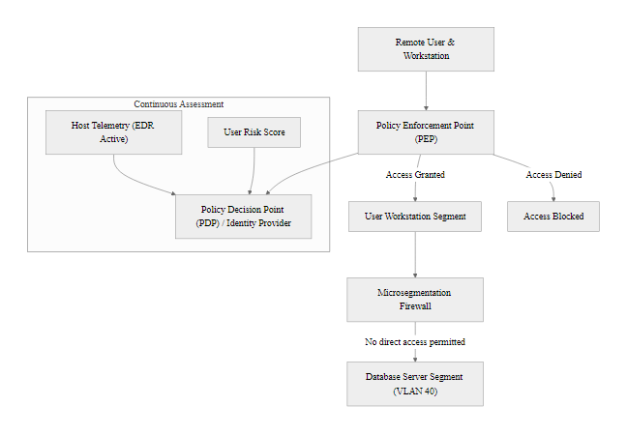
Applying Zero Trust to Prevent Lateral Movement (2/3)
Notes:
(continued, see part 1)

Slide 30
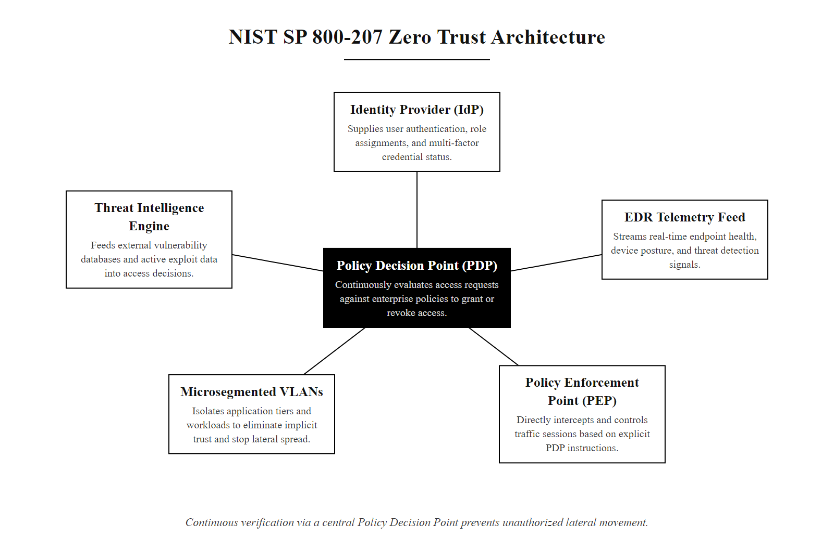
Applying Zero Trust to Prevent Lateral Movement (3/3)
NIST SP 800-207 Zero Trust Architecture prevents lateral movement by requiring continuous verification for every access request.
Notes:
(continued, see part 1)

Slide 31
Comparison, EDR vs. Traditional Antivirus
Traditional antivirus relies on known-malware signatures. Endpoint Detection and Response (EDR) uses behavioral analysis to detect novel threats, memory injection, and living-off-the-land attacks that antivirus misses entirely.
Capability | Traditional Antivirus (AV) | Endpoint Detection & Response (EDR)
Detection Method | Signature matching against a database of known malware hashes | Behavioral analysis, process monitoring, memory inspection, telemetry correlation
Novel/Zero-Day Threats | Cannot detect, no signature exists yet | Can detect based on anomalous behavior (e.g., Word spawning PowerShell)
Living-off-the-Land (LotL) | Cannot detect, attackers use legitimate OS tools (PowerShell, certutil) | Can detect, flags abnormal usage patterns of legitimate tools
Response Capability | Quarantine file or terminate process | Remote isolation of host, process kill, memory dump, timeline reconstruction
Forensic Data Collection | None | Full process tree, file access history, network connection log, registry changes
Deployment Cost | Low | Medium-High (requires tuning and analyst time for alert triage)
Example Products | Windows Defender Antivirus (basic mode), Malwarebytes Free | CrowdStrike Falcon, Microsoft Defender for Endpoint, SentinelOne
Notes:
One of the most important technology decisions in our defensive engineering phase is choosing endpoint security solutions. Recommending "antivirus" in a capstone defense report would be inadequate for a modern enterprise threat landscape. Let's examine why.
Traditional antivirus operates by computing the hash of every file on disk and comparing it against a database of known malware signatures maintained by the vendor. If a match is found, the file is quarantined. This approach was effective in the early 2000s when malware was mostly distributed as standalone executable files. Today, it fails to detect the majority of sophisticated attacks for three reasons.
First, novel malware has no signature. Attackers can trivially modify a malware binary, changing a few bytes, recompiling, or repackaging, to generate a completely different hash that no antivirus signature database recognizes. This technique, called polymorphism, means that a new variant of a ransomware family can evade every signature-based AV product on the day it is released.
Second, living-off-the-land attacks use no malware files at all. Attackers like APT29 in the SolarWinds campaign used legitimate Windows tools, PowerShell, WMI, certutil, and the Windows Task Scheduler, to execute their attack steps. These tools are trusted by antivirus because they are part of the operating system. Traditional AV has no way to distinguish a legitimate administrator running PowerShell from an attacker using PowerShell to download a second-stage payload.
Third, fileless malware executes entirely in memory and never writes a file to disk. Without a file to scan, signature-based antivirus is completely blind.
EDR platforms address all three gaps. They install an agent on every endpoint that continuously monitors process creation, file system changes, network connections, registry modifications, and memory allocations. When the Word application spawns a PowerShell process that makes a network connection to an unknown IP, the EDR behavioral engine flags this as an anomaly, because that is not normal Word behavior. The EDR console allows an analyst to remotely isolate the affected endpoint, download a full memory dump for forensic analysis, and reconstruct a complete timeline of everything the attacker did on that machine.
A large endpoint detection platform may collect over a trillion events a day from millions of endpoints. That scale improves detection because a broad baseline of normal behavior makes statistical anomalies much easier to identify.

Slide 32
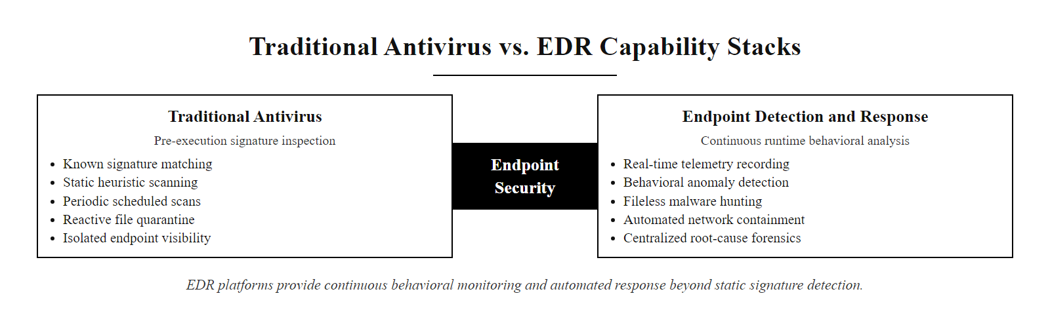
Comparison, EDR vs. Traditional Antivirus (2/2)
EDR platforms provide continuous behavioral monitoring and response capabilities that far exceed traditional signature-based antivirus.
Notes:
(continued, see part 1)

Slide 33
Microsegmentation vs. Traditional VLANs
Traditional VLANs create broad network segments. Microsegmentation enforces access controls at the individual workload level, dramatically reducing the attacker's ability to move laterally even after compromising a single host.
Traditional VLAN Segmentation
Microsegmentation
Divides network into broad zones (e.g., User VLAN, Server VLAN, DMZ).
Firewall rules control traffic between zones, not between individual hosts.
An attacker who compromises any host in the User VLAN can typically reach all other User VLAN hosts freely.
Lateral movement within a VLAN goes undetected and unblocked.
Configuration: static, manual, VLAN tag-based.
Enforces firewall rules at the level of individual workloads or containers.
An attacker who compromises Workstation A cannot connect to Workstation B, even in the same subnet.
Software-defined policies propagate automatically to new workloads.
East-west traffic (server-to-server) is inspected and controlled, not just north-south (client-to-internet).
Example platforms: VMware NSX, Illumio Core, Cisco ACI.
Notes:
Our capstone scenario's lateral movement stage succeeded because the attacker, after compromising an employee workstation, was able to directly connect via RDP to the database server. In a traditional VLAN-segmented network, this is often possible because both the workstation and the database server are in the same broad network zone, and firewalls only filter traffic crossing zone boundaries, not traffic within a zone.
Traditional VLANs were a significant improvement over flat networks when they were introduced, providing logical network isolation without requiring separate physical infrastructure. A typical enterprise might have a User VLAN for workstations, a Server VLAN for internal servers, a DMZ VLAN for internet-facing services, and a Management VLAN for network devices. Firewall rules control which VLANs can communicate with which other VLANs.
The critical weakness is east-west traffic, traffic between hosts within the same VLAN. An attacker who compromises one workstation in the User VLAN can typically reach every other workstation and printer in that VLAN without restriction, because the firewall only inspects traffic leaving the VLAN. This is exactly what happened in our scenario.
Microsegmentation solves this problem by moving the enforcement boundary down from the VLAN level to the individual workload level. Using software-defined networking platforms like VMware NSX, Illumio Core, or Cisco ACI, organizations define policies such as "Workstation-101 may only initiate connections to the Active Directory server and the application gateway. It may not initiate connections to any other workstation or to the database server." These policies are enforced in software at the virtual network interface of each workload, meaning they follow the workload even if it is moved to a different physical host or cloud environment.
The practical impact for our scenario is dramatic. Even if the attacker successfully compromises Workstation-101, their RDP connection attempt to the database server at 10.10.40.15 would be dropped at the workstation's own virtual network interface, before the packet even reaches the database server's VLAN. The attack is contained at the initial point of compromise.
Google's implementation of microsegmentation as part of BeyondCorp, and the widespread adoption of the principle in cloud environments using AWS Security Groups and Azure Network Security Groups, demonstrates that microsegmentation is no longer a niche enterprise capability, it is an expected baseline in modern cloud and hybrid architectures.
In a traditional VLAN model a single compromised workstation becomes a pivot point for the whole user segment; microsegmentation places an individual boundary around each workload, containing the blast radius to one device.

Slide 34
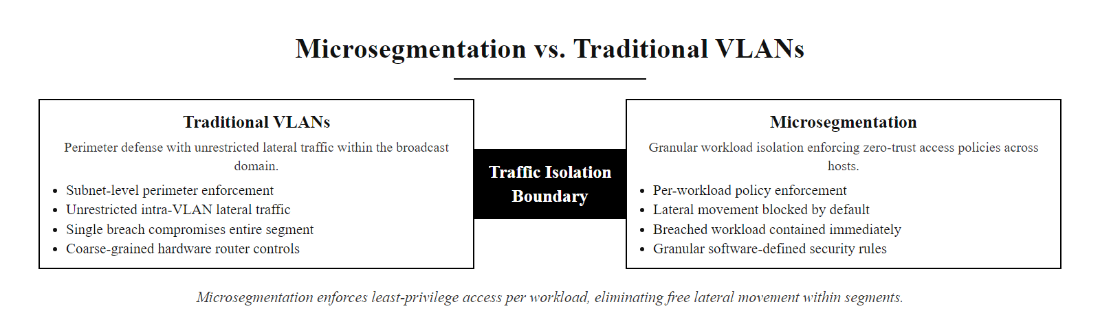
Microsegmentation vs. Traditional VLANs (2/2)
Microsegmentation enforces least-privilege network access at the individual workload level, eliminating free lateral movement within segments.
Notes:
(continued, see part 1)

Slide 35
Penetration Testing as a Defensive Tool
Penetration testing is a proactive defensive exercise in which authorized security professionals attempt to breach an organization's defenses using the same techniques an attacker would use, before a real attacker does.
Scope & Rules of Engagement: Define the target systems, permitted techniques, time window, and emergency contacts. The rules of engagement document prevents the pentest from causing unintended production outages.
Reconnaissance: Perform passive OSINT (open-source intelligence) using public DNS records, LinkedIn, Shodan, and job postings to identify exposed assets and technology choices, exactly as a real attacker would.
Scanning & Enumeration: Run authenticated and unauthenticated scans with tools like Nessus, Nmap, and Nikto to identify open ports, running services, and known CVEs.
Exploitation: Attempt to exploit discovered vulnerabilities using frameworks like Metasploit or manual techniques, always within the agreed-upon scope and avoiding destructive actions.
Post-Exploitation: If access is gained, test the depth of the compromise, can we escalate privileges? Move laterally? Access sensitive data? This tests the effectiveness of detective controls.
Reporting: Document every finding with evidence (screenshots, log excerpts), CVSS scores, MITRE ATT&CK technique IDs, and prioritized remediation recommendations.
Notes:
Penetration testing, commonly called pen testing or ethical hacking, is one of the most valuable proactive security investments an organization can make. Rather than waiting to discover vulnerabilities through a real breach, a penetration test hires skilled security professionals to attempt to breach the organization under controlled, authorized conditions.
It is important to distinguish penetration testing from vulnerability scanning. A vulnerability scanner like Nessus or Qualys performs automated checks against known CVE signatures, it identifies that a patch is missing or a port is open. A penetration test goes further: it attempts to actually exploit those vulnerabilities, chain them together, and determine the real-world impact. Can an attacker actually leverage the missing BlueKeep patch to gain access? Can they move from that initial access to the database server? What data could they realistically exfiltrate? The penetration test answers these questions with evidence.
The most important document in a penetration test is the Rules of Engagement (RoE). This legal agreement between the organization and the testing firm specifies exactly which systems are in scope, which attack techniques are permitted (for example, social engineering is often excluded from technical penetration tests), the testing time window, emergency contact procedures if a system is accidentally destabilized, and the handling of any sensitive data encountered during the test. Without a signed RoE, penetration testing activities are indistinguishable from unauthorized hacking, a critical legal distinction.
NIST SP 800-115, Technical Guide to Information Security Testing and Assessment, defines penetration testing methodologies and recommends that organizations conduct penetration tests at least annually and after any significant infrastructure changes. The PCI DSS compliance framework (Requirement 11.3) mandates penetration testing at least annually and after significant changes for any organization processing payment card data.
The relationship between the capstone scenario and penetration testing is direct: if the organization in our scenario had conducted an annual penetration test, the BlueKeep vulnerability on the RDP server and the absence of FIDO2 MFA would have been identified and reported as critical findings. The penetration tester would have demonstrated a complete attack chain, from phishing simulation to database exfiltration, and provided remediation recommendations before a real attacker exploited the same path.
The major penetration-testing certifications are the OSCP (OffSec), CEH (EC-Council) and GPEN (SANS). They signal demonstrated hands-on exploitation skill in a controlled lab, and the OSCP in particular is among the most respected practical certifications in the field.

Slide 36
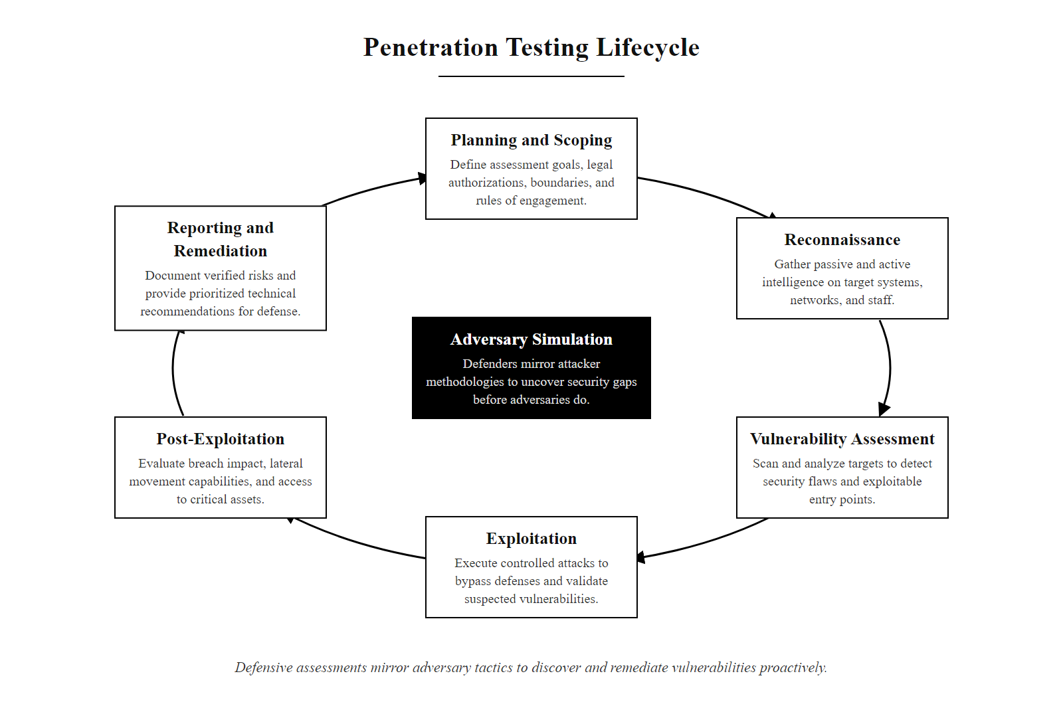
Penetration Testing as a Defensive Tool (2/2)
The penetration testing lifecycle mirrors the actual attacker methodology, find the gaps before the adversary does.
Notes:
(continued, see part 1)

Slide 37
Social Engineering, The Human Attack Surface
No firewall blocks a motivated employee from clicking a malicious link. Social engineering attacks target the human layer of security, bypassing technical controls through psychological manipulation.
Social Engineering Technique | Psychological Principle Exploited | Example | Technical Defense
Spear Phishing | Authority, urgency, familiarity | "Your CEO needs you to wire funds immediately" | Email authentication (DMARC, DKIM, SPF); FIDO2 MFA
Vishing (Voice Phishing) | Trust, authority, fear | Attacker impersonates IT help desk to reset password | Identity verification callback procedures
Smishing (SMS Phishing) | Urgency, curiosity | "Your package could not be delivered, click to reschedule" | Mobile device management (MDM) policies
Pretexting | Sympathy, helpfulness | Attacker poses as a new employee needing access | Strict identity verification for access requests
Tailgating / Piggybacking | Politeness, social convention | Attacker follows authorized employee through a door | Physical access controls, security awareness training
Baiting | Curiosity, greed | USB drive labeled "Salary Data Q4" left in parking lot | Disable autorun; USB port blocking via endpoint policy
Notes:
When we analyze why the capstone scenario's attack succeeded at its very first stage, the answer is not a missing firewall rule or an unpatched software vulnerability, it is a human being who clicked a link in a phishing email. This is not a criticism of the employee. It is a recognition that social engineering is extraordinarily effective because it exploits fundamental aspects of human psychology that cannot be patched like software.
The six social engineering techniques in the table each leverage different psychological principles identified in Robert Cialdini's foundational research on influence and persuasion. Spear phishing exploits authority (the email appears to come from the CEO) and urgency (you must act right now). Vishing exploits trust by using a familiar institution, the IT help desk, and fear by implying that something bad will happen if the victim does not comply. Baiting exploits simple human curiosity: who wouldn't be tempted to open a USB drive labeled "Salary Data"?
The 2011 RSA Security breach is one of the most instructive examples of social engineering's power. An attacker sent a spear-phishing email with the subject line "2011 Recruitment Plan" to a small group of RSA employees. The email contained an Excel attachment. One employee retrieved the email from the spam folder because they found the subject interesting. Opening the attachment exploited a zero-day vulnerability in Adobe Flash (CVE-2011-0609), installing malware that ultimately allowed the attacker to steal seed values for RSA's SecurID two-factor authentication tokens, compromising the MFA of tens of millions of government and corporate users worldwide. The entire chain began with a single human curiosity click.
Technical defenses for social engineering address both the delivery mechanism and the authentication bypass. Email authentication standards, SPF, DKIM, and DMARC, make it harder for attackers to spoof legitimate sender addresses. FIDO2 WebAuthn MFA prevents credential-phishing attacks from succeeding even if the employee enters their password into a fake portal, because the FIDO2 token is cryptographically bound to the legitimate domain and cannot be replayed on an attacker's site.
But the most important defense against social engineering is security awareness training. NIST SP 800-50, Building an Information Technology Security Awareness and Training Program, recommends role-based training tailored to different employee categories, combined with regular simulated phishing exercises that measure click rates and provide immediate teachable moments. Research published in the Journal of Cybersecurity shows that organizations that run phishing simulations quarterly reduce click rates by up to 70% compared to organizations with no training program.
A help-desk social engineering scenario, a caller posing as a panicked employee who needs an urgent password reset before a presentation, tests whether the analyst follows identity-verification procedure or yields to emotional pressure. The pressure, not any technical trick, is the attack.

Slide 38
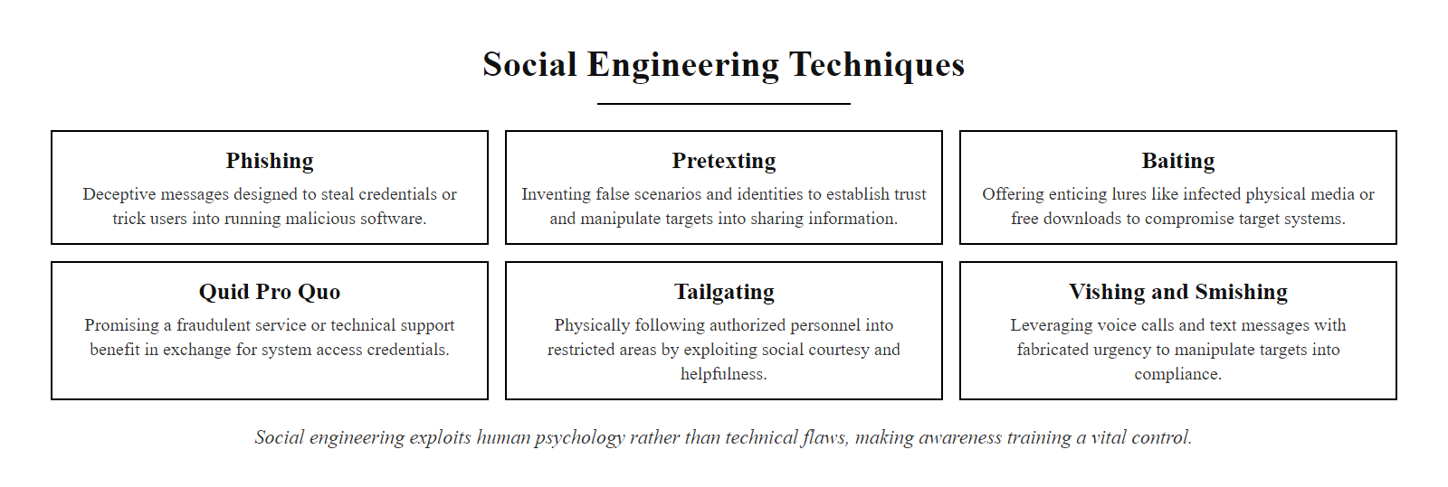
Social Engineering, The Human Attack Surface (2/2)
Social engineering exploits human psychology rather than technical vulnerabilities, making security awareness training a critical control.
Notes:
(continued, see part 1)

Slide 39
Crisis Communication & Stakeholder Messaging
A technical resolution is incomplete without clear communication. Different stakeholder groups require the same incident explained using tailored language and metrics.
Executive Leadership (C-Suite)
Technical Teams (IT/Security)
Language: Business risk, financial impact, compliance.
Key Metrics: Lost revenue, remediation costs, legal liability.
Focus: Reassurance, strategic roadmap, resource needs.
Language: Technical indicators, configurations, code.
Key Metrics: IP addresses, file hashes, patch versions, CVEs.
Focus: Remediation steps, configuration updates, monitoring.
Public & Affected Customers
Compliance & Legal
Language: Plain, transparent, non-technical language.
Key Metrics: Types of data affected, support resources.
Focus: Honesty, credit monitoring, regulatory compliance.
Language: Regulatory requirements, statutory obligations.
Key Metrics: GDPR (72-hour window), HIPAA, PCI DSS.
Focus: Legal reporting, evidence logs, liability management.
Notes:
A critical phase of the capstone project is crisis communication. A common mistake for security engineers is using the same technical language for every audience. If you explain a database compromise to the Board of Directors using technical jargon, they will struggle to evaluate the business risk.
We tailor our communications to four main audiences. Executive leadership needs to know the business risk, financial impact, and regulatory exposure. Technical teams need specific Indicators of Compromise, CVE numbers, and configuration changes to patch the systems.
Affected customers require transparent, plain language explaining what data was compromised, what the company is doing to fix it, and how they can protect themselves, such as through credit monitoring services.
Finally, legal and compliance teams need reports that satisfy statutory obligations, such as notifying authorities within the 72-hour window required by GDPR. Tailoring your message ensures that all stakeholders can make informed decisions during a crisis.
The 2013 Target data breach is a landmark case study in crisis communication failures. Target waited several weeks after discovering the breach before making a public announcement, and the initial statement significantly underplayed the scope of the compromise. The resulting public backlash, regulatory investigation, and class-action lawsuits ultimately cost the company hundreds of millions of dollars and led to the resignation of the CEO and CIO. Contrast this with the 2011 Sony PlayStation Network breach response, which, while also criticized for its 23-day delay in notification, eventually provided comprehensive customer compensation including free identity theft insurance.
The same breach is communicated differently to different audiences: a notification to the board and one to affected customers for the same incident differ in vocabulary, tone, metrics and call to action, which is the translation skill the capstone communication deliverable assesses.

Slide 40
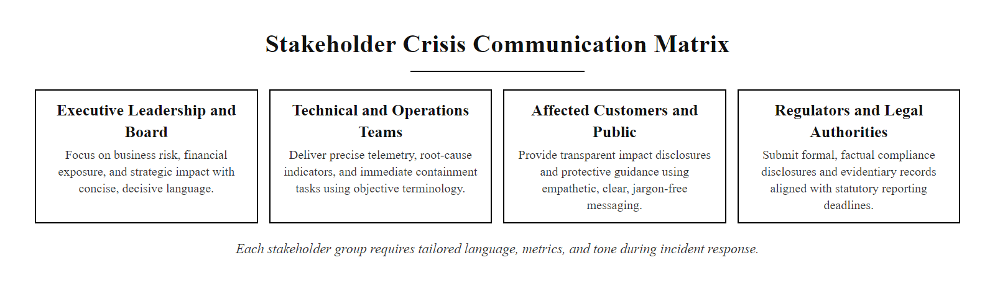
Crisis Communication & Stakeholder Messaging (2/2)
Each stakeholder audience requires tailored language, metrics, and tone for effective crisis communication.
Notes:
(continued, see part 1)

Slide 41
Regulatory Compliance Framework Comparison
Data breach notification obligations vary significantly by jurisdiction and data type. A global enterprise must comply with multiple overlapping regulatory frameworks simultaneously.
Regulation | Jurisdiction | Protected Data Type | Breach Notification Window | Key Penalty
GDPR (General Data Protection Regulation) | European Union | Any EU resident personal data | 72 hours to supervisory authority; without undue delay to individuals if high risk | Up to €20M or 4% of global annual revenue
HIPAA (Health Insurance Portability and Accountability Act) | United States | Protected Health Information (PHI) | 60 days to affected individuals; same-day to HHS if > 500 individuals | Up to $1.9M per violation category per year
PCI DSS (Payment Card Industry Data Security Standard) | Global (contractual) | Payment card data (CHD) | Immediately to card brands and acquiring bank; not defined for end customers | Fines of $5,000–$100,000/month; loss of ability to process card payments
CCPA/CPRA (California Consumer Privacy Act) | California, USA | California resident personal information | In the most expedient time possible; no specific window | $100–$750 per consumer per incident in statutory damages
NYDFS Part 500 | New York, USA (financial services) | Nonpublic information of NY residents | 72 hours to NYDFS superintendent | Significant fines; enforcement actions
Notes:
When a data breach occurs at a global enterprise, the legal team immediately begins assessing the regulatory notification obligations, and the picture is often extremely complex. Different regulations apply based on where the affected individuals are located, what type of data was compromised, and what industry the organization operates in. Let's walk through the most important frameworks and what they require.
GDPR, which came into full effect in May 2018, is widely regarded as the most comprehensive and strictly enforced data protection regulation in the world. It applies whenever an organization processes personal data of individuals located in the European Union, regardless of where the organization itself is headquartered. The 72-hour notification window to the supervisory authority, typically the data protection authority of the country where the organization's EU headquarters is located, begins from the moment the organization becomes aware of the breach, not from when the breach occurred. For a global company that processes data in both the EU and the US, GDPR's requirements will typically be the most demanding and the most consequential.
HIPAA applies specifically to covered entities, healthcare providers, health insurers, and their business associates, and protects Protected Health Information (PHI). The breach notification rule requires notification to affected individuals within 60 days and to the Department of Health and Human Services (HHS) within 60 days for breaches affecting fewer than 500 individuals, or within 60 days but with immediate media notification for breaches affecting more than 500 individuals in a single state.
PCI DSS is unique in that it is a contractual requirement rather than a government regulation. Organizations that accept, process, store, or transmit payment card data must comply with PCI DSS requirements set by the Payment Card Industry Security Standards Council. Failure to comply can result in fines from the card brands and ultimately in losing the ability to process credit and debit card payments, an existential threat for retailers and e-commerce companies.
CCPA and its strengthened successor CPRA give California consumers rights over their personal information and provide for statutory damages in the event of a breach caused by a failure to implement reasonable security measures. NYDFS Part 500 is a state financial services regulation that is notable for being one of the first US state regulations to mirror GDPR's 72-hour notification timeline.
For your capstone, if the scenario involves a breach of customer personal data, you must identify which regulations apply based on the data types and customer locations, state the specific notification deadlines, and describe the evidence documentation required to demonstrate compliance.
Regulations can appear to conflict: GDPR's right to erasure can seem to collide with HIPAA's medical-records retention requirements. In practice, compliance officers resolve these through analysis of which requirement is more specific and through documented risk-based decisions, which is why large enterprises employ dedicated privacy counsel and Chief Privacy Officers.

Slide 42
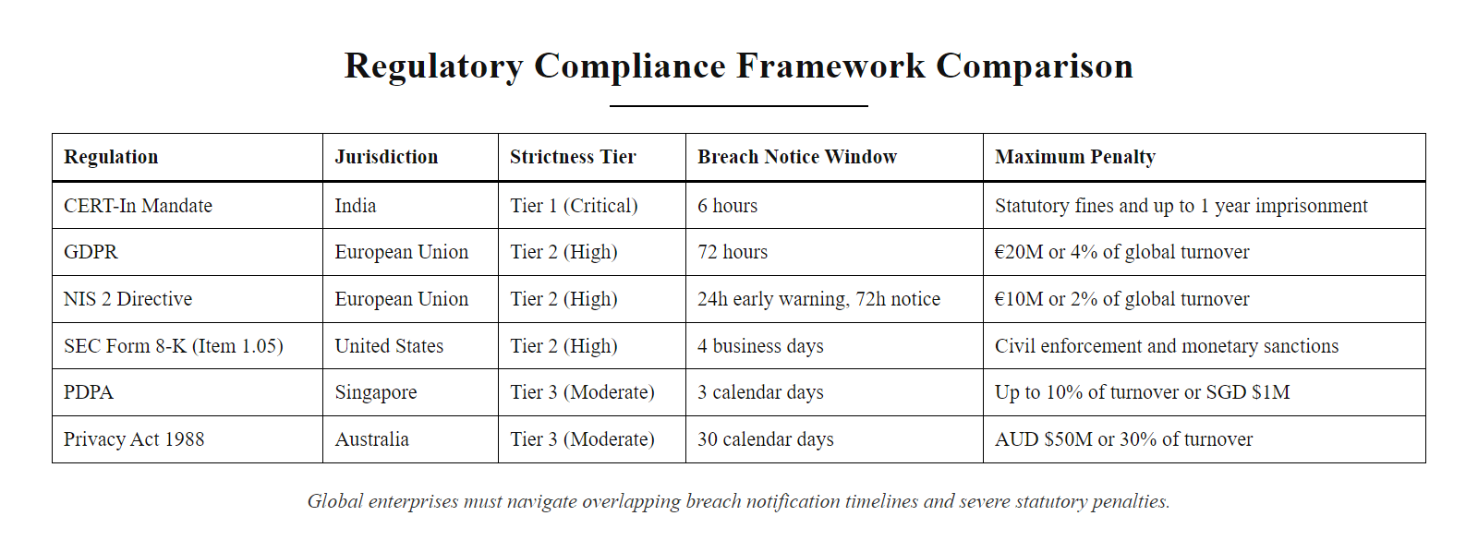
Regulatory Compliance Framework Comparison (2/2)
Global enterprises must simultaneously satisfy multiple overlapping breach notification regulations with different timelines and penalties.
Notes:
(continued, see part 1)

Slide 43
Common Misconceptions in Incident Response
Misconceptions about incident response lead to costly mistakes during the highest-pressure moments of a security crisis. Correcting these mental models now will improve your decision-making under pressure.
Common Misconception | Why It's Wrong | Correct Approach
"Wipe and reinstall immediately to stop the attacker." | Destroying the compromised system destroys forensic evidence needed to understand the full scope of the breach and any regulatory investigation. | Isolate first (network quarantine), collect evidence (memory dump, disk image, logs), then remediate.
"We don't need to notify anyone until we fully understand the breach." | GDPR Article 33 requires notification within 72 hours of becoming aware of a breach, not after completing an investigation. | Notify regulators promptly with what is known; supplement with updates as the investigation progresses.
"Our firewall blocked the phishing link, so we're safe." | Phishing emails can contain links to legitimate file-sharing services (Google Drive, Dropbox) that firewalls allow. | Layer defenses: email scanning, link rewriting with sandboxing, FIDO2 MFA, and security awareness training.
"The attacker is gone once we change the compromised password." | If the attacker established persistence (SSH keys, scheduled tasks, backdoor accounts), changing one password does not remove their access. | Perform full incident response: audit all accounts, authorized keys, scheduled tasks, and installed software on compromised hosts.
"Our data is safe because it's encrypted at rest." | Encryption at rest protects against physical theft of storage media. An attacker with valid credentials can decrypt and exfiltrate data through normal application interfaces. | Pair encryption at rest with access controls, MFA, anomalous query detection, and data loss prevention (DLP) tools.
Notes:
Every experienced incident responder has witnessed organizations make costly mistakes during breaches, often driven by well-intentioned but incorrect intuitions about how incident response should work. Let's examine the five most common misconceptions and correct them.
The most damaging misconception is the instinct to immediately wipe and reinstall compromised systems. This feels productive, it removes the attacker. But it permanently destroys the forensic evidence needed to answer the questions that matter most: How long was the attacker present? What data did they access? Did they establish other footholds we don't know about? Was this an insider or an external actor? Without forensic evidence, the organization cannot answer regulators, cannot determine the full scope of the breach for customer notification purposes, and cannot learn enough to prevent a recurrence. The correct sequence is always: Contain (network isolate) → Preserve (memory dump, disk image, log collection) → Eradicate (patch, rebuild) → Recover (restore from clean backup).
The notification misconception is also extremely common. Organizations want to complete their investigation before notifying anyone, which is understandable, they want to give accurate information. But GDPR Article 33 explicitly states that if all the information is not available at the time of notification, the supervisory authority must be provided with information in phases, and the initial notification must occur within 72 hours of becoming aware of the breach. Delaying notification past 72 hours to gather more information is a GDPR violation, regardless of the intent. The correct approach is to notify promptly with what is known and supplement the notification as new information becomes available.
The firewall misconception, believing that perimeter controls provide comprehensive protection, reflects the failed perimeter security mindset that Zero Trust architecture was designed to replace. Attackers routinely use legitimate cloud services and hosting providers that appear on corporate allowlists. The 2020 SolarWinds attacker used legitimate AWS infrastructure for command-and-control. No firewall rule can distinguish a legitimate AWS API call from a malicious one without deep content inspection.
After compromising a Linux server, an attacker can establish persistence in many places: SSH authorized_keys for each account, cron jobs, systemd service units, shell startup files, PAM configuration, kernel modules and web shells in application directories. Each must be audited after a credential compromise, which is why incident response is a methodical discipline, not just a password change.

Slide 44
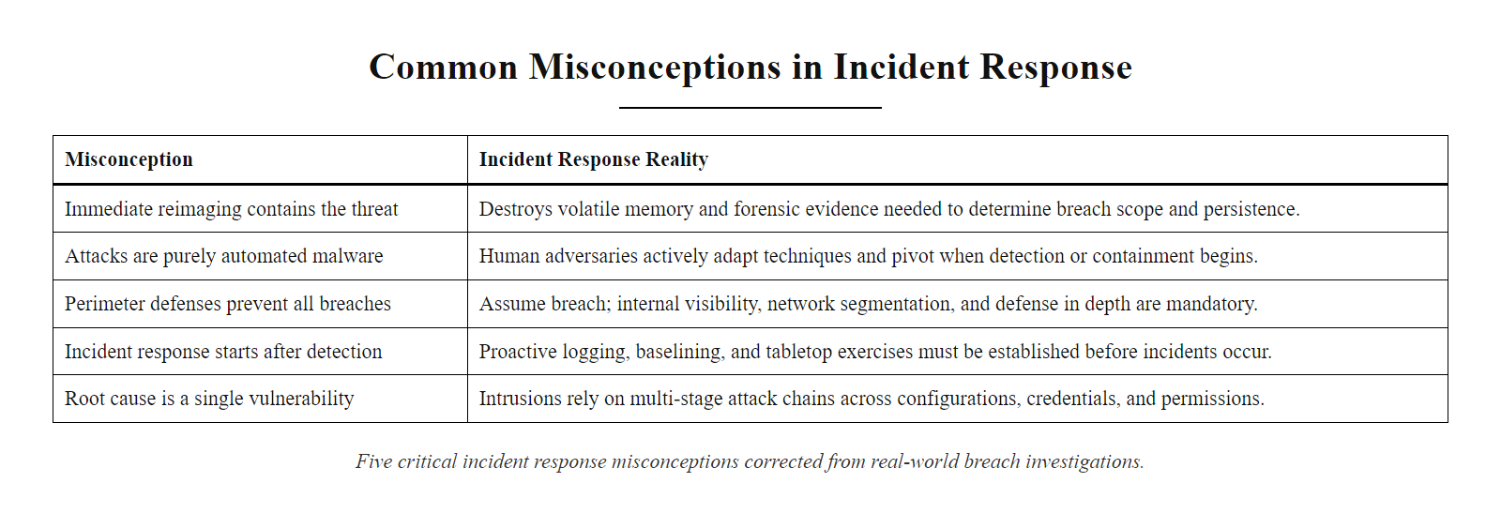
Common Misconceptions in Incident Response (2/2)
Five critical incident response misconceptions corrected, each represents a real failure pattern observed in breach investigations.
Notes:
(continued, see part 1)

Slide 45
Developing a Strategic Security Roadmap
Your recommendations must be structured as a phased, strategic roadmap. This roadmap must balance immediate containment needs with long-term security maturity.
Phase 1: Tactical Containment (Immediate - 72 Hours): Rotate compromised credentials; isolate infected hosts; apply temporary firewall rules to block malicious IPs.
Phase 2: Operational Remediation (Short-Term - 30 Days): Enforce FIDO2 MFA across all accounts; deploy Endpoint Detection and Response (EDR) agents; patch CVEs exploited in the attack.
Phase 3: Architectural Redesign (Medium-Term - 90 Days): Implement network microsegmentation; deploy a Zero Trust access gateway; integrate SIEM log correlation rules.
Phase 4: Cultural Governance (Long-Term - Continuous): Update security policies; conduct regular phishing simulation training; perform annual external penetration testing.
Notes:
The final component of your capstone is the strategic security roadmap. When presenting recommendations to an organization, proposing fifty changes at once is impractical. You must provide a structured, phased roadmap that prioritizes actions based on urgency and resource availability.
We organize our roadmap into four phases. Phase 1 focuses on tactical containment, which occurs within the first 72 hours. These are immediate actions to stop the current attack, such as rotating compromised passwords and blocking known malicious IPs.
Phase 2 focuses on operational remediation within 30 days. These are short-term fixes to address the immediate vulnerabilities exploited, such as deploying EDR agents and enforcing MFA.
Phase 3 addresses architectural redesign within 90 days, implementing microsegmentation and Zero Trust access controls to block future lateral movement.
Finally, Phase 4 focuses on long-term governance, establishing security training, updating policies, and scheduling regular penetration testing to ensure the organization's defenses adapt as threats evolve.
The prioritization logic within each phase should be driven by risk reduction value relative to implementation cost. FIDO2 MFA, for example, provides enormous risk reduction, it eliminates the entire credential-phishing attack vector, at relatively low cost, making it a top Phase 2 priority. Full Zero Trust architectural redesign, by contrast, is high-value but high-cost and high-disruption, making it appropriate for Phase 3 after the most critical gaps are closed.
The NIST Cybersecurity Framework encourages organizations to assess their current Implementation Tier (from Partial at Tier 1 to Adaptive at Tier 4) and define a target tier that is appropriate for their risk profile. Your roadmap should reference the organization's current tier, identify the gaps to the target tier, and describe how each phase of the roadmap closes those gaps. This framing demonstrates strategic maturity in your capstone submission.
Every item on a security roadmap competes for funding against other business priorities. Calculating an annualized loss expectancy (annualized rate of occurrence times single-loss expectancy) and comparing it to a control's annual cost gives a vocabulary for justifying security investment to non-technical stakeholders, one of the most practical skills in the profession.

Slide 46
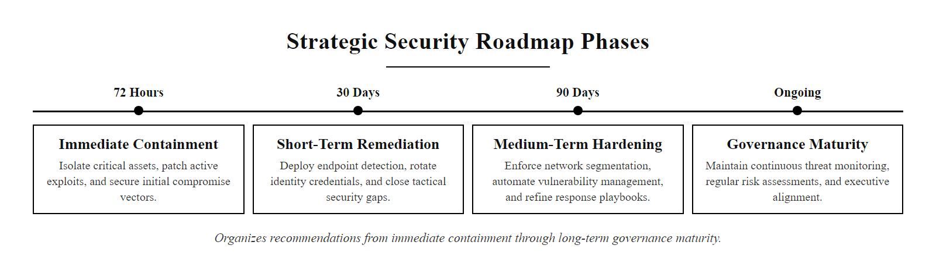
Developing a Strategic Security Roadmap (2/2)
The four-phase strategic security roadmap organizes recommendations from immediate containment through long-term governance maturity.
Notes:
(continued, see part 1)

Slide 47
NIST CSF Deep Dive, Five Core Functions
The NIST Cybersecurity Framework (CSF) provides a common language and structure for managing cybersecurity risk. Every recommendation in your capstone should map to one or more of its five core functions.
CSF Function | Capstone Scenario Gap | Recommended Control
Identify | Asset inventory did not include SSH authorized_keys audit | Implement automated asset discovery with configuration inventory
Protect | No FIDO2 MFA; no DNS filtering policy | Deploy FIDO2; configure DNS security gateway
Detect | No SIEM correlation rules for impossible travel or DNS anomalies | Configure SIEM alert rules; deploy EDR with behavioral detection
Respond | No documented incident response playbook for credential compromise | Develop and test credential-compromise response playbook
Recover | No tested backup restoration procedure for database server | Implement and test automated database backup restore procedure
Notes:
The NIST Cybersecurity Framework was first published in 2014 in response to Executive Order 13636, which directed NIST to develop a voluntary framework for improving cybersecurity in critical infrastructure sectors. Version 1.1 was released in 2018, and CSF 2.0 was released in February 2024, adding a sixth function called Govern that addresses cybersecurity governance, risk management strategy, and supply chain risk management. For your capstone, referencing CSF 2.0 demonstrates current framework knowledge.
The five core functions provide a strategic vocabulary for describing security capabilities. The Identify function encompasses asset management, business environment analysis, governance, risk assessment, and supply chain risk management. You cannot protect what you don't know you have. The Protect function covers access control, awareness training, data security, information protection processes, maintenance, and protective technology. The Detect function encompasses anomalies and events detection, continuous security monitoring, and detection processes. The Respond function addresses response planning, communications, analysis, mitigation, and improvements. The Recover function covers recovery planning, improvements, and communications during recovery.
When you map the capstone scenario's gaps to the CSF, a clear picture emerges. The Identify gap, failing to audit SSH authorized_keys, meant that the organization didn't know what state their authentication configuration was in. The Protect gaps, absent MFA and DNS filtering, meant that the attacker faced no resistance during credential harvest and exfiltration. The Detect gaps, no SIEM rules for impossible travel or DNS anomalies, meant that the attacker operated undetected. The Respond gap, no documented credential-compromise playbook, meant that when the breach was eventually discovered, the response was ad hoc and incomplete. The Recover gap, untested database restore procedures, created uncertainty about whether data could be restored from backups.
The beauty of the CSF as a communication tool is that it works equally well for technical and executive audiences. You can explain to the Board of Directors that the organization has gaps in its Detect capabilities, needs investment in Protect controls, and must develop Respond playbooks, and they can follow the strategic logic without needing to understand SIEM rules or FIDO2 protocols. This is exactly the kind of strategic communication your capstone should demonstrate.
The NIST CSF 2.0 reference tool maps controls to subcategories and shows informative references to ISO 27001, COBIT and NIST SP 800-53, valuable for organizations that must satisfy several compliance requirements at once.

Slide 48
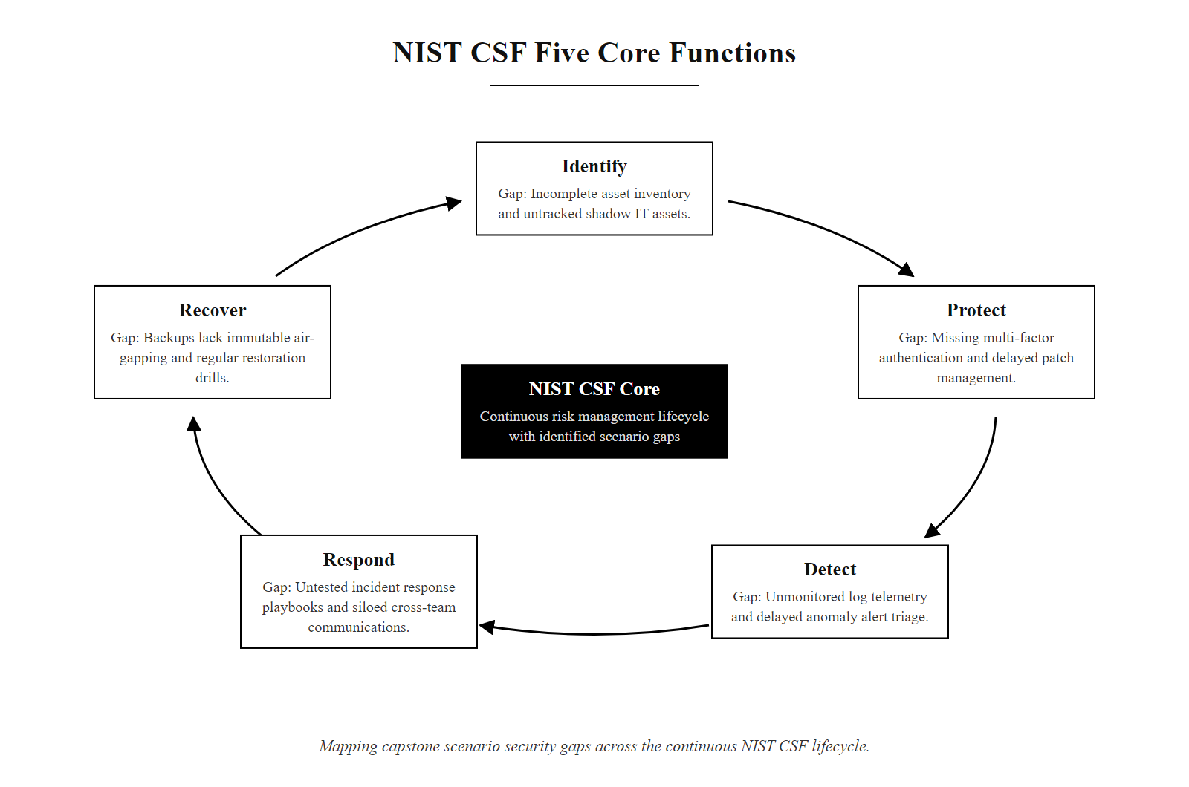
NIST CSF Deep Dive, Five Core Functions (2/2)
The NIST CSF five-function wheel mapped to the specific gaps identified in the capstone scenario.
Notes:
(continued, see part 1)

Slide 49
Comparison, Zero Trust vs. Perimeter Security Models
The perimeter security model assumes that everything inside the network is trusted. Zero Trust assumes that the perimeter has already been breached. Understanding the architectural difference is essential for your defense recommendations.
Architectural Dimension | Perimeter Security (Castle-and-Moat) | Zero Trust Architecture
Trust Model | Implicit trust for internal network traffic | No implicit trust; verify every access request regardless of location
Access Control Boundary | Network perimeter (firewall, DMZ) | Individual resource; enforced by Policy Enforcement Point
Authentication | Authenticate once at network entry (VPN, perimeter firewall) | Continuous, context-aware authentication per-session
Lateral Movement Defense | Weak; attacker inside the perimeter moves freely | Strong; microsegmentation and per-workload policies contain movement
Remote Work Suitability | Poor; VPN creates bottlenecks and assumes remote ≠ trusted | Excellent; cloud-delivered enforcement handles remote workers natively
Detection Assumptions | Threats primarily come from outside | Assume breach; threats are already inside; monitor east-west traffic
Key Weakness | Single perimeter breach grants broad internal access | Requires mature identity infrastructure; complex to implement fully
NIST Reference | Traditional perimeter model (pre-2014) | NIST SP 800-207 (2020)
Notes:
The perimeter security model dominated enterprise network architecture for several decades. The conceptual metaphor is a castle with a moat: build a strong perimeter wall, guard the gates carefully, and trust everything inside. In network terms, the perimeter is the firewall and the DMZ. Traffic entering from the internet is scrutinized; traffic flowing between internal servers is trusted implicitly.
This model made sense when all corporate assets were inside the physical data center and all employees worked from the corporate office. The internet connection was the one perimeter to defend, and it was small. But three trends shattered this model. First, cloud computing moved corporate workloads outside the physical perimeter. Second, mobile work moved employees outside the corporate network. Third, attackers became sophisticated enough to breach the perimeter through phishing, zero-days, or supply-chain compromises, and once inside, they found the internal network wide open.
The capstone scenario is a perfect illustration of the perimeter model's failure. The attacker entered through a phishing email, the one gap no perimeter firewall can close. Once inside, they moved freely from workstation to database server because internal traffic was trusted. The perimeter model provided exactly one layer of defense, and once that layer was bypassed, there was nothing left.
Zero Trust, formalized in NIST SP 800-207, inverts this assumption. The core tenet is "never trust, always verify." Every access request, whether it originates from the internet, the corporate office, a cloud provider, or a device already inside the network, must be authenticated and authorized by the Policy Decision Point before access is granted. The PDP evaluates user identity, device health (confirmed by EDR telemetry), the sensitivity of the requested resource, and contextual factors like time of day, location, and behavioral baseline.
The transition from perimeter to Zero Trust is not a product you buy, it is an architectural journey that takes years for large enterprises. The US Federal Government published Executive Order 14028 in May 2021, mandating that all federal agencies adopt Zero Trust Architecture by fiscal year 2024. CISA published the Zero Trust Maturity Model to guide agencies through the transition across five pillars: Identity, Devices, Networks, Applications and Workloads, and Data. This maturity model is an excellent reference for students structuring their capstone defense recommendations.
COVID-19 accelerated Zero Trust adoption: when millions shifted to remote work in March 2020, organizations whose security was built around the corporate perimeter found that posture collapsed, since every employee was now outside it, while those that had invested in Zero Trust, such as Google with BeyondCorp, adapted far more smoothly. This is a concrete argument for its strategic value.

Slide 50
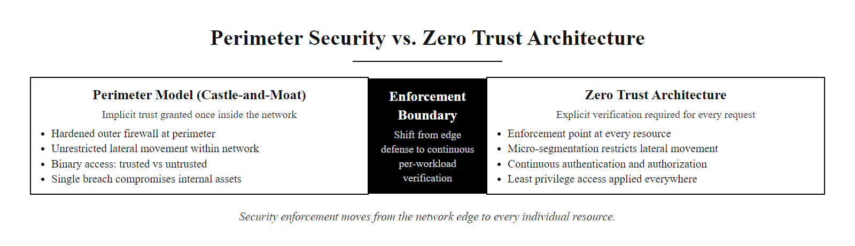
Comparison, Zero Trust vs. Perimeter Security Models (2/2)
The shift from perimeter security to Zero Trust Architecture moves the enforcement boundary from the network edge to every individual resource.
Notes:
(continued, see part 1)

Slide 51
Tool Spotlight, SIEM Platforms (Splunk & Microsoft Sentinel)
A Security Information and Event Management (SIEM) platform is the central nervous system of a security operations center. It ingests logs from every data source, correlates events, and generates actionable alerts.
Core SIEM Capabilities
Splunk vs. Microsoft Sentinel
Log Aggregation: Ingests syslog, Windows Event Log, cloud audit logs, firewall logs, DNS logs, and EDR telemetry into a single searchable platform.
Event Correlation: Applies rules to find patterns across multiple log sources (e.g., failed login → new SSH key → DNS anomaly within 30 minutes from same IP).
Alert Generation: Creates prioritized alerts for analyst review, reducing tens of thousands of daily log events to a manageable alert queue.
Threat Intelligence Integration: Matches observed IP addresses, domains, and file hashes against threat intelligence feeds (MISP, VirusTotal, Recorded Future).
Incident Case Management: Groups related alerts into incidents and tracks the investigation lifecycle from detection to closure.
Splunk Enterprise Security: Market leader; extremely flexible query language (SPL); on-premises or cloud; high licensing cost scales with data volume.
Microsoft Sentinel: Cloud-native SIEM on Azure; tight integration with Microsoft 365, Azure AD, and Defender; consumption-based pricing; free tier for Microsoft data sources.
Both platforms support: MITRE ATT&CK alignment; custom detection rules; automated response playbooks (SOAR integration); compliance reporting.
Notes:
The SIEM is the most important technology investment in a security operations program after endpoint protection. Without a SIEM, analysts must manually log into each server, firewall, and network device to search their individual logs, an impossible task during a fast-moving incident. With a SIEM, all logs flow into a single searchable platform where correlation rules automatically connect related events across dozens of data sources.
Let's trace our capstone attack scenario through a properly configured SIEM. First, the web server log entry showing the redirect to the credential-harvesting URL lands in the SIEM at 02:13:45. A correlation rule watching for redirects to non-allowlisted external domains fires an alert, which an analyst reviews, and if they're watching, they can stop the attack here.
Even if that alert is missed, the SSH authentication log entries land at 02:14:33 and 02:15:02. A correlation rule watching for the sequence "successful external SSH login followed by authorized_keys modification within 60 seconds" fires a High severity alert. This pattern is unusual enough that it warrants immediate investigation.
Even if that alert is missed, the DNS query log entries at 02:47 trigger an anomaly detection rule watching for Base64-pattern subdomains at high frequency to newly registered domains. This fires another alert. Three separate detection opportunities, any one of which, if acted upon, would have contained the attack before exfiltration.
This is the core value proposition of SIEM: defense-in-depth detection. Rather than relying on any single detection mechanism, the SIEM implements many overlapping correlation rules that create multiple detection opportunities at different stages of the attack chain. Missing any one alert does not mean missing the attack.
Splunk's Search Processing Language (SPL) allows analysts to write extremely powerful ad-hoc queries during an investigation. For example: index=dns earliest=-1h dns_query_type="TXT" | eval subdomain_length=len(dns_query_name) | where subdomain_length > 50 | stats count by src_ip, dns_query_name | where count > 100, this query searches DNS logs from the last hour, extracts TXT record queries, filters for subdomains longer than 50 characters, and reports any source IP making more than 100 such queries. This single SPL query would have identified the DNS tunneling in our scenario within seconds.
Microsoft Sentinel uses Kusto Query Language (KQL), which follows a similar pipe-based structure and integrates natively with Azure Monitor logs, Microsoft 365 audit logs, and Microsoft Defender for Endpoint telemetry. For environments that are already invested in the Microsoft ecosystem, Sentinel provides outstanding coverage with lower operational overhead than deploying a separate SIEM platform.
A SIEM query (in SPL or KQL) that searches a sample dataset for the DNS tunneling pattern and returns results in seconds conveys SIEM capability more vividly than a description.

Slide 52
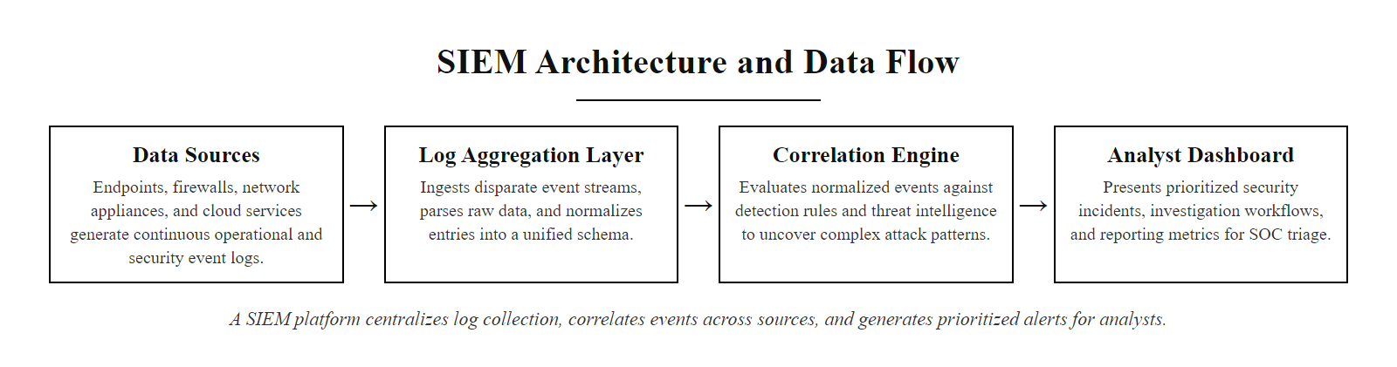
Tool Spotlight, SIEM Platforms (Splunk & Microsoft Sentinel) (2/2)
A SIEM platform centralizes log collection, correlates events across sources, and generates prioritized alerts for security analysts.
Notes:
(continued, see part 1)

Slide 53
Security Culture & The Human Layer of Defense
Technology controls can be bypassed, but a security-conscious culture creates a human detection layer that technical tools cannot replicate. Employees who report suspicious activity are among the most valuable security assets an organization has.
Elements of a Strong Security Culture
Measuring Security Culture
Psychological Safety: Employees must feel safe reporting mistakes, including clicking a phishing link, without fear of punishment.
Leadership Modeling: Senior executives must visibly follow security policies, setting the norm for the entire organization.
Clear Reporting Channels: A single, well-publicized way to report suspicious emails, calls, or activity (e.g., a "Report Phish" button in email clients).
Just-in-Time Training: Security training delivered at the moment of relevance (e.g., post-phishing-click training) is 10× more effective than annual compliance training.
Visible Consequences of Failure: Share anonymized case studies of breaches caused by security lapses to make abstract risks concrete.
Phishing Simulation Click Rate: Percentage of employees who click simulated phishing links. Target: < 5%.
Reporting Rate: Percentage of phishing simulation recipients who report the email rather than clicking. Target: > 80%.
Mean Time to Report (MTTR): How quickly employees escalate a suspicious event to the security team.
Policy Acknowledgment Rate: Percentage of employees who have read and signed the current security policy. Target: 100%.
Help Desk Security Request Volume: Tracking anomalous patterns in password resets and access requests that may indicate social engineering.
Notes:
Every technical control in our defense matrix assumes that the technology works as intended. But the capstone attack did not begin with a technical exploit, it began with a human decision to click a link. Technical controls can help, but ultimately, organizations with strong security cultures experience significantly fewer successful social engineering attacks and faster incident reporting times than organizations that treat security as purely a technology problem.
Research by the SANS Institute and the Ponemon Institute consistently shows that organizations that conduct regular security awareness training and phishing simulations have statistically lower breach rates and lower total breach costs than organizations that rely on technology controls alone. The IBM Cost of a Data Breach Report 2023 found that organizations with a high level of security AI and automation have breach costs 39% lower than organizations without these capabilities, and that automation works best when it is combined with human analysts who understand the context of alerts.
The most critical cultural element is psychological safety around reporting. If an employee clicks a phishing link and knows that reporting it immediately will result in a same-day security response that contains the attack, they are far more likely to report it. If they fear being reprimanded or embarrassed in front of colleagues, they may wait or say nothing, transforming a contained incident into a full breach. Organizations should actively celebrate employees who report security concerns, treating them as security assets rather than liabilities.
The "Report Phish" button, now available as a built-in feature in Microsoft Outlook and as an add-in for Gmail, is one of the highest-value low-cost security investments available. When an employee reports a suspicious email, it is automatically submitted to the SIEM and threat intelligence platforms for analysis. If the same domain appears in reports from multiple employees, the security team knows a phishing campaign is targeting their organization in real time, enabling proactive blocking before most employees have had a chance to click the link.
NIST SP 800-50 recommends a risk-based approach to security awareness training, tailoring content to the specific threats faced by different employee roles. Finance employees should receive specialized training on business email compromise (BEC) attacks. IT administrators should receive training on spear-phishing attacks targeting privileged credentials. Executives should receive training on whaling attacks, which are highly targeted spear-phishing campaigns that impersonate board members, regulators, or major customers to manipulate senior leaders into authorizing fraudulent wire transfers or disclosing sensitive information.
Whether a person reports a suspicious email or call depends not only on recognizing it but on organizational factors, psychological safety and a reporting culture, that make reporting feel safe. Those factors are designed, not accidental.

Slide 54
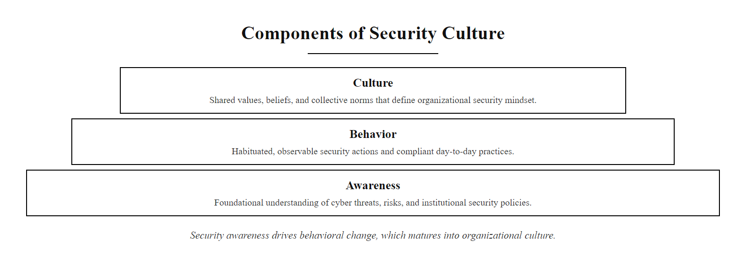
Security Culture & The Human Layer of Defense (2/2)
Security culture is built in layers: awareness enables behavioral change, which over time becomes organizational culture.
Notes:
(continued, see part 1)

Slide 55
Capstone Deliverables & Rubric
Your capstone project will be evaluated on the completeness of your forensic analysis, the design of your defense architecture, and the clarity of your communication.
Component | Technical Excellence (A-Grade) | Basic Competence (C-Grade) | Failure Criteria (F-Grade)
Incident Analysis | Reconstructs the complete timeline; maps all stages to MITRE ATT&CK; identifies root vulnerabilities | Identifies the main attack stages but misses root vulnerabilities or timing details | Fails to reconstruct the timeline; misidentifies key attack stages
Defense Design | Proposes balanced preventive, detective, and corrective controls; integrates Zero Trust principles | Proposes controls but relies heavily on one type; lacks Zero Trust integration | Fails to propose relevant controls; leaves major attack stages unprotected
Communication | Drafts distinct, professionally tailored messages for executives, technical teams, and customers | Drafts communications but uses technical jargon for executive or customer audiences | Fails to provide communications; ignores key stakeholder groups
Roadmap | Proposes a phased, prioritized roadmap with clear cost-benefit justification | Lists recommendations but lacks clear prioritization or phase structure | Fails to provide recommendations; proposes unrealistic or unprioritized actions
Notes:
Let's review the evaluation rubric for the capstone project. Your deliverables will be graded on the four areas we've outlined.
For Incident Analysis, an A-grade project reconstructs the complete timeline, maps every step to the MITRE ATT&CK framework, and identifies the root vulnerabilities.
For Defense Design, we want to see balanced preventive, detective, and corrective controls at each stage, combined with Zero Trust principles.
For Communication, you must draft distinct messages for executives, technical teams, and customers, avoiding jargon where appropriate.
For the Roadmap, your recommendations must be organized into clear implementation phases with cost-benefit justifications.
Review the submission details in your project guidelines. This capstone is your opportunity to demonstrate the skills you have built over the last twenty-nine classes, proving you can think and communicate like a cybersecurity professional.
A-grade capstone submissions share several common characteristics observed in professional incident response reports. They tell a coherent story, the timeline flows logically, the defense recommendations map directly to identified attack stages, and the communications are consistent with the technical findings. They demonstrate command of framework language, MITRE ATT&CK technique IDs, NIST CSF functions, CVSS scores, and regulatory citations appear naturally and correctly. They show business judgment, the roadmap recommendations are prioritized by impact and feasibility, not just listed as a wish list. And they demonstrate audience awareness, the executive summary is readable by someone without a technical background, while the technical appendix is precise enough for an experienced analyst to act on.
A real post-incident report from a public breach disclosure shows what the rubric's criteria look like in professional practice more effectively than the rubric text alone.

Slide 56
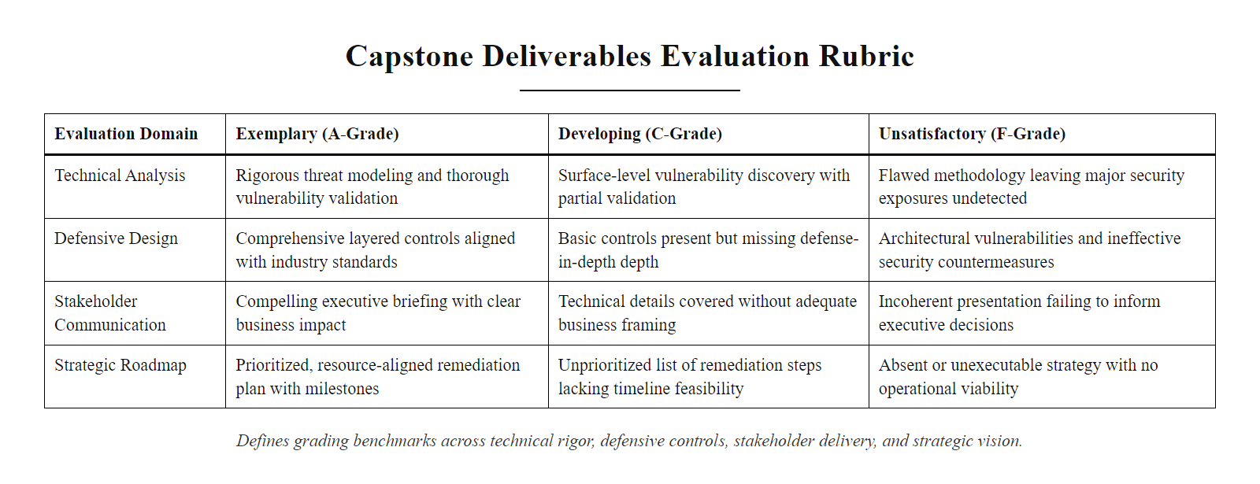
Capstone Deliverables & Rubric (2/2)
The capstone rubric evaluates technical analysis, defensive design, stakeholder communication, and strategic roadmap quality.
Notes:
(continued, see part 1)

Slide 57
Final Checkpoint, Full Course Concept Review
Before you go. This final checkpoint covers key concepts from across all thirty classes. Test your recall, the questions span foundations, cryptography, networking, forensics, architecture, and communication.
A) Confidentiality · B) Integrity · C) Availability · D) Authentication
A) Confidentiality · B) Availability · C) Authenticity / Non-repudiation · D) Forward secrecy
A) True positive · B) True negative · C) False negative · D) False positive
A) NIST SP 800-53 · B) NIST SP 800-207 · C) NIST SP 800-61 · D) NIST SP 800-115
A) Polymorphic malware · B) Rootkit installation · C) Fileless / living-off-the-land attack · D) Keylogging
A) Tampering · B) Spoofing · C) Repudiation · D) Information Disclosure
Notes:
This final checkpoint is designed to activate recall across the full breadth of the course before students move into capstone work. Rather than reviewing these answers purely in lecture, consider having students write their answers first independently, then compare with a partner before the class review. This peer instruction technique, documented extensively in the education research of Eric Mazur at Harvard, produces significantly better retention than simple lecture-and-answer.
Question 1 tests the CIA Triad foundation from Class 1. Ransomware encrypts files, making them inaccessible to legitimate users, this is a textbook Availability violation. Students who answer Integrity have confused encryption (which does alter file content) with the security concept of integrity, which refers to unauthorized modification of data, not encryption by malware.
Question 2 tests the certificate authority and public key infrastructure concepts from the cryptography unit. When a CA signs a certificate, it is asserting that the entity named in the certificate is who it claims to be. This establishes authenticity, you can trust that you are communicating with the genuine server. This also provides non-repudiation in the sense that the server cannot later deny its identity.
Question 3 tests detection accuracy vocabulary. A false positive is an alarm that fires when no real threat is present, the detection system incorrectly classifies benign activity as malicious. An understanding of false positive and false negative rates is essential for evaluating the quality of detection rules in a SIEM. A rule with a very high false positive rate will overwhelm analysts with spurious alerts, causing alert fatigue and reducing the chance that real alerts are investigated promptly.
Question 4 tests NIST publication knowledge. NIST SP 800-61, Computer Security Incident Handling Guide (revision 3 was published in 2024), is the primary NIST reference for incident response procedures. SP 800-53 covers security and privacy controls. SP 800-207 covers Zero Trust Architecture. SP 800-115 covers technical security testing and assessment including penetration testing.
Question 5 tests the distinction between file-based and fileless attack techniques, directly relevant to the EDR versus antivirus discussion from this class. PowerShell executing commands in memory without writing files is the canonical example of a living-off-the-land attack.
Question 6 tests the STRIDE threat modeling framework, introduced in the secure software development unit. STRIDE is a mnemonic for six threat categories, and mapping an attack to the correct category is the first step in identifying relevant mitigations in Microsoft's STRIDE-based threat modeling methodology.

Slide 58
Cybersecurity Career Pathways & Certifications
Cybersecurity offers one of the broadest ranges of career specializations in any technology field. Understanding the landscape helps you target your learning after this course.
Career Path | Role Examples | Key Skills | Entry-Level Certification
Security Operations | SOC Analyst, Incident Responder, Threat Hunter | Log analysis, SIEM, malware triage, digital forensics | CompTIA Security+, CySA+
Penetration Testing | Ethical Hacker, Red Team Operator, Vulnerability Researcher | Exploitation, network scanning, web app security, social engineering | OSCP, CEH, GPEN
Security Engineering | Security Architect, Cloud Security Engineer, DevSecOps Engineer | Zero Trust design, network architecture, IAM, secure SDLC | CISSP (associate), CCSP, AWS Security Specialty
Governance, Risk & Compliance | GRC Analyst, Privacy Officer, Compliance Manager | NIST CSF, ISO 27001, GDPR, risk assessment, audit | CISM, CRISC, CIPP/E
Threat Intelligence | CTI Analyst, Malware Researcher, Attribution Analyst | ATT&CK framework, reverse engineering, OSINT, APT research | GREM, GCTI
Application Security | AppSec Engineer, Bug Bounty Hunter, Security Code Reviewer | OWASP Top 10, SAST/DAST tools, API security, cryptography | GWEB, BSCP (Burp Suite)
Notes:
One of the most exciting aspects of a career in cybersecurity is the remarkable breadth of specializations available. The skills we have built in this course, log analysis, threat modeling, network security, cryptography, secure coding, and risk management, are foundational to every specialization in the table. But after building this foundation, you can develop deep expertise in a direction that matches your interests and strengths.
Security Operations is the most direct entry point for many graduates. SOC analysts work in real-time monitoring environments, reviewing SIEM alerts, investigating incidents, and escalating to incident response teams when breaches are confirmed. The workflow is fast-paced and analytical. CompTIA Security+ is the most widely recognized entry-level certification, required by many government contractors and financial institutions for security staff. CySA+ (Cybersecurity Analyst) is a step above Security+, focused on threat detection and analysis.
Penetration testing is one of the most technically demanding and creatively rewarding paths. Penetration testers are paid to break into systems, with authorization, and document the results. The OSCP certification from OffSec is the gold standard for entry-level penetration testers. It requires passing a 24-hour practical exam in which students must compromise multiple machines in an isolated lab environment with no multiple-choice questions. It is difficult, but the credential is highly respected because it proves hands-on skill rather than just knowledge.
Security Engineering and Architecture appeals to students who enjoy designing systems and thinking strategically. Security architects design the overall security posture of an organization, selecting tools, defining network zones, establishing identity governance, and ensuring that security requirements are built into new systems from the start. The CISSP (Certified Information Systems Security Professional) is the most prestigious credential in this space, though it requires five years of experience to obtain the full certification.
Governance, Risk, and Compliance is an underappreciated path that bridges technical security with legal, regulatory, and business strategy. GRC professionals help organizations understand their regulatory obligations, assess risks, design control frameworks, and demonstrate compliance to auditors and regulators. This path requires strong communication skills alongside technical literacy, and it often leads to senior leadership roles like Chief Information Security Officer (CISO).
Threat Intelligence analysts study adversary tactics, techniques, and procedures, exactly the ATT&CK framework work we did in this class, to provide early warning of emerging threats and inform defensive priorities. Malware researchers perform deep reverse engineering of malicious code to understand attacker capabilities. This path often requires a background in computer science and assembly language programming.
Application Security closes the loop between development and security, ensuring that software is designed and tested for security from the beginning of the development lifecycle. AppSec engineers work with development teams to review code, configure static analysis tools, and perform application penetration testing. The OWASP Top 10, which we studied in the secure coding unit, is the foundational reference document for web application security.
Students drawn to penetration testing often actually want the investigation and puzzle-solving elements, which are equally present in threat hunting and incident response within a collaborative defensive context. Matching genuine interests to career paths increases the chance of persisting through the profession's learning curve.

Slide 59
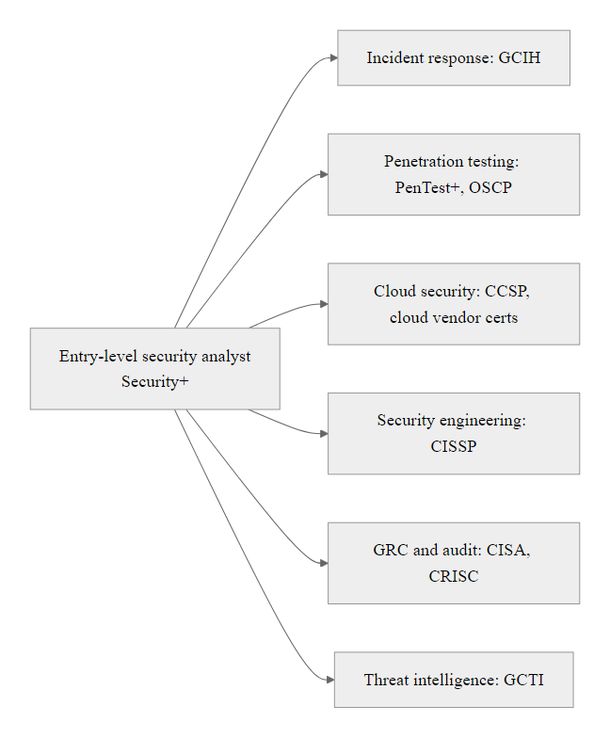
Cybersecurity Career Pathways & Certifications (2/2)
Six major cybersecurity career pathways, each with distinct skill requirements and professional certifications.
Notes:
(continued, see part 1)

Slide 60
Congratulations & The Road Ahead
This course was the foundation, not the ceiling. Cybersecurity is a dynamic field that rewards continuous learning, curiosity, and ethical responsibility.
The Journey Completed
The Cybersecurity Mindset
Foundations: The CIA Triad, threat actor types, and risk methodologies.
Defenses: Firewalls, IDS/IPS, segmentation, and encryption.
Applications: Secure coding, database protection, and device hardening.
Operations: Log forensics, incident response, and risk assessments.
Continuous Learning: Frameworks and threats will keep changing.
Critical Thinking: Always verify configurations and question assumptions.
Ethics: Use your technical skills to defend and protect systems.
Notes:
As we conclude our final class, let's take a moment to reflect on your progress. Thirty classes ago, we opened the semester by defining cybersecurity and discussing the CIA Triad. Since then, you have analyzed network packets, parsed security logs, evaluated cryptographic algorithms, and designed enterprise security architectures.
You have built a strong foundation in both the technical details of security operations and the strategic frameworks of risk management.
Remember, this course is only the beginning. The tools, threats, and frameworks we studied will continue to evolve. What will remain valuable is the security mindset you have practiced here: verifying before you trust, layering your defenses, questioning assumptions, and maintaining curiosity about how systems work and break.
Use these skills ethically to protect systems and support your organizations. Thank you for your hard work this term, and congratulations on completing the course.
The cybersecurity profession needs people who combine technical skill with ethical commitment. Every concept we studied, from the CIA Triad to Zero Trust Architecture, is ultimately in service of protecting real people. Behind every database of customer records is a person whose financial information, medical history, or private communications could be harmed by a breach. Behind every critical infrastructure system is a community whose safety depends on its availability. The technical skills you are building are powerful, and with that power comes the responsibility to use them in defense of others.
As you move forward, build your skills through practice. Platforms like TryHackMe, HackTheBox, and the SANS Cyber Ranges provide legal, safe environments to practice attack and defense techniques. Participate in Capture the Flag (CTF) competitions, which provide structured puzzle challenges that build specific technical skills while connecting you to the global security community. Read the daily security news, Krebs on Security, Threatpost, and CISA advisories, to stay current on emerging threats. Consider contributing to open-source security tools or threat intelligence sharing platforms like MISP.
Most importantly, find mentors and communities. The cybersecurity field has an unusually generous culture of knowledge sharing, rooted in the hacker ethic of learning and teaching. Local ISSA (Information Systems Security Association) chapters, DEF CON groups, and university cybersecurity clubs are excellent places to meet experienced practitioners who are often happy to guide newer students. Many CISOs and senior security leaders actively mentor students because they remember how important mentorship was in their own careers.
The transition from student to professional begins with one concrete next step, building a portfolio, creating a professional profile, or arranging an informational interview with someone working in the field.

Slide 61

Congratulations & The Road Ahead (2/2)
Thirty classes built the foundation, the road ahead is a lifelong journey of learning, contribution, and ethical practice. Photo: Diego Jimenez / Unsplash
Notes:
(continued, see part 1)

