Slide 1
THÈME :
RÉALISATION D’UNE
GESTION DES CLIENTS
Par: Mohammad Zefri

Slide 2
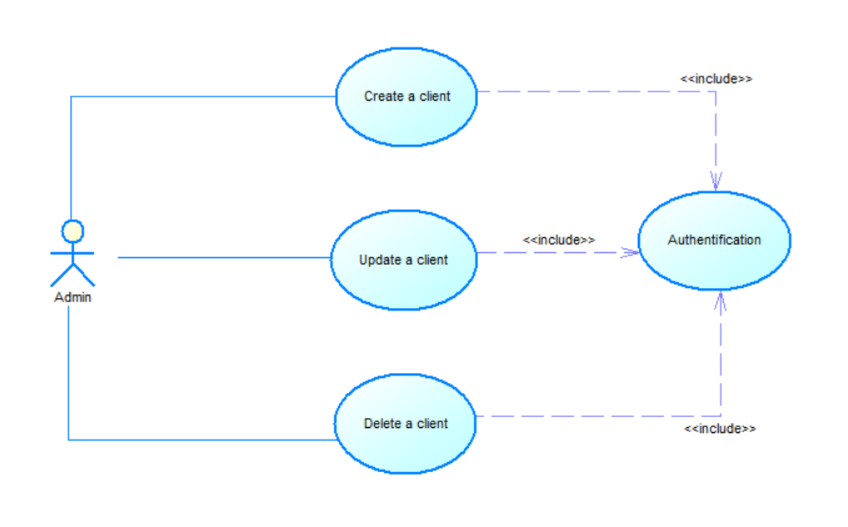
Use Case Diagram for the Admin
The Admin actor is connected to three use cases: "Create a client," "Update a client," and "Delete a client.”
Each of these use cases has a dependency on the "Authentication" use case, depicted by the <<include>> stereotype.
The <<include>> relationship indicates that the "Authentication" use case is a mandatory part of the other use cases. This implies that authentication is a prerequisite for any client-related operations performed by the admin.
Use Cases:
Create a client: This use case allows the admin to create a new client in the system.
Update a client: This use case allows the admin to update the details of an existing client.
Delete a client: This use case allows the admin to delete a client from the system.

Slide 3
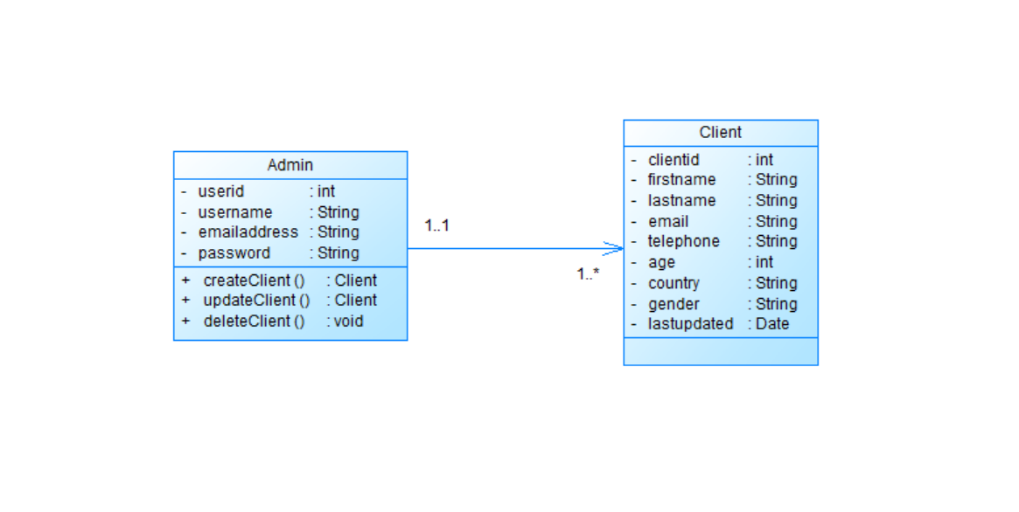
Class Diagram
The diagram above illustrates that each Admin can manage multiple Client instances, forming a one-to-many relationship. Each Client is managed by exactly one Admin.

Slide 4
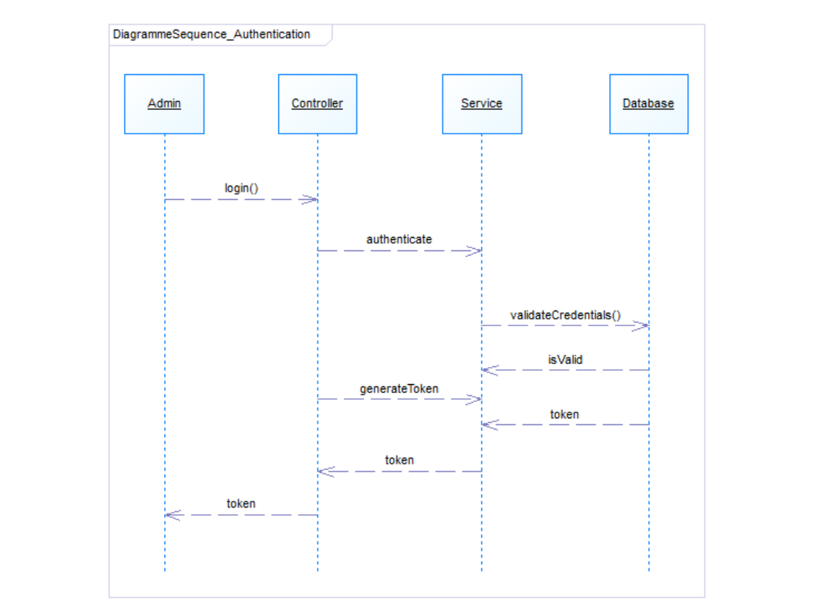
Sequence Diagram for Authentication
The Admin initiates the authentication process by sending a login request to the system's Controller. The Controller then forwards this request to the Service to authenticate the provided credentials. The Service requests the Database to validate the credentials. After the Database confirms the validity of the credentials, this confirmation is sent back to the Service. The Service then generates an authentication token and sends it back to the Controller. Finally, the Controller returns the generated token to the Admin, completing the authentication process.

Slide 5
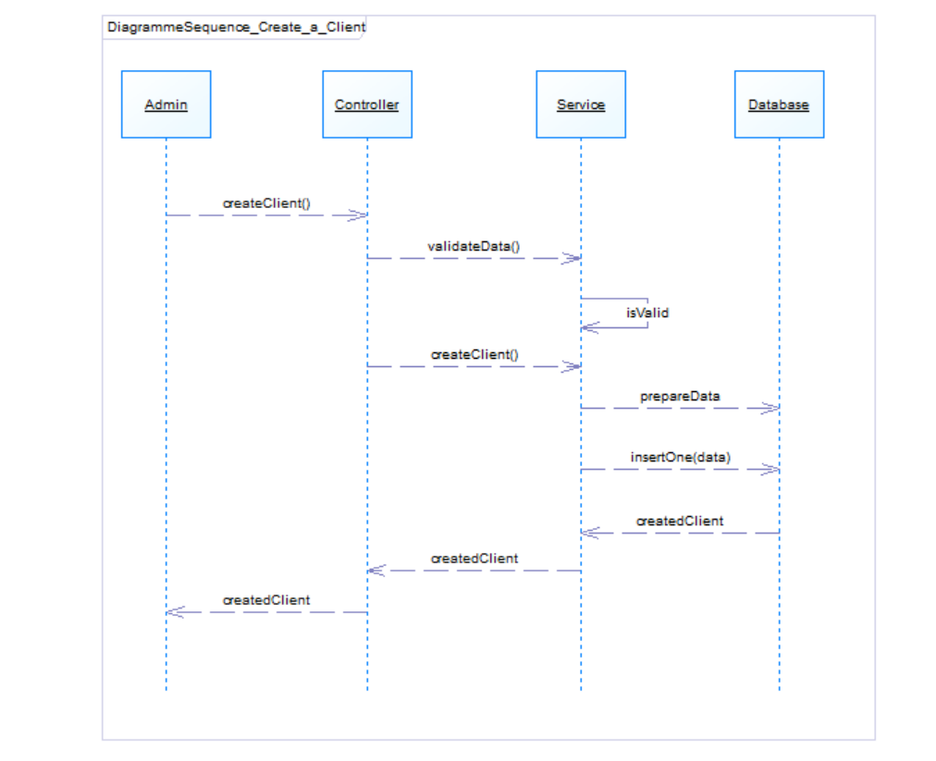
Sequence Diagram for Creating a Client
The admin starts the client creation process by interacting with the system's controller. The controller requests the service to validate the provided client data. After validation, the service communicates back to the controller, confirming the data's validity. The controller then instructs the service to proceed with client creation. The service prepares the data and inserts it into the database. The database confirms the successful insertion of the new client. This confirmation is propagated back up through the service and controller to the admin.

Slide 6
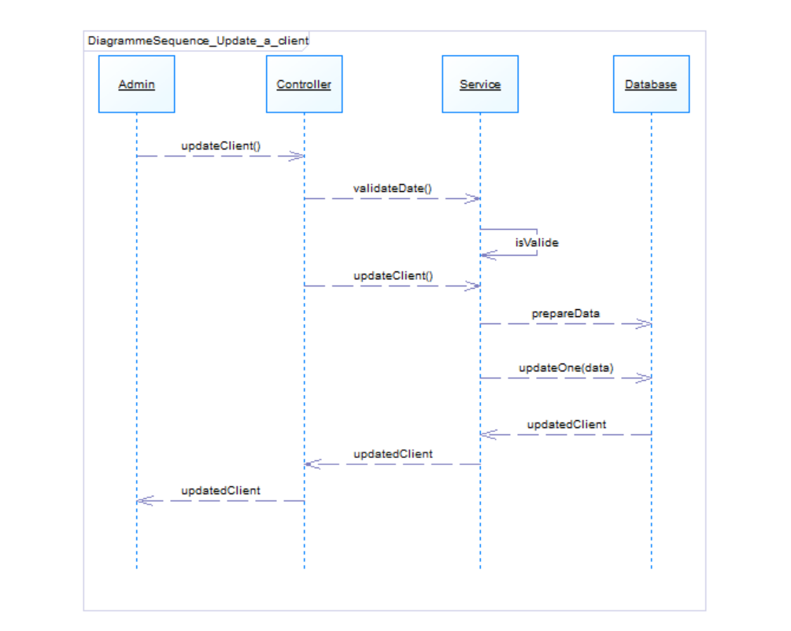
Sequence Diagram for Updating a Client
The Admin initiates the client update process by sending an updateClient() request to the system's Controller. The Controller forwards this request to the Service for validation by calling the validateData() method. The Service validates the provided data and confirms its validity with an isValid response. Upon validation, the Controller instructs the Service to proceed with updating the client by calling the updateClient() method. The Service then prepares the necessary data and sends an updateOne(data) request to the Database to update the client information. The Database confirms the successful update with an updatedClient response. This confirmation is propagated back through the Service and the Controller to the Admin, completing the client update process.

Slide 7
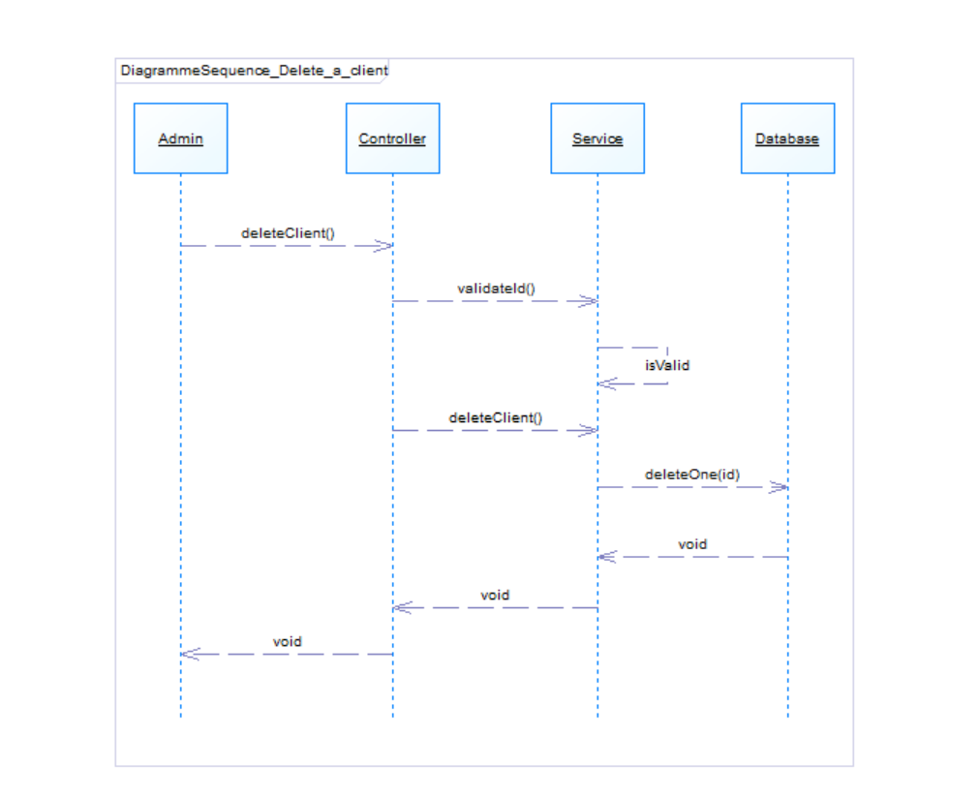
Sequence Diagram for Deleting a Client
The Admin initiates the client deletion process by sending a deleteClient() request to the system's Controller. The Controller forwards this request to the Service for validation by calling the validateId() method. The Service validates the provided ID and confirms its validity with an isValid response. Upon validation, the Controller instructs the Service to proceed with deleting the client by calling the deleteClient() method. The Service then prepares the necessary data and sends a deleteOne(id) request to the Database to delete the client information. The Database confirms the successful deletion with a void response. This confirmation is propagated back through the Service and the Controller to the Admin, completing the client deletion process.

Slide 8
Demonstration

Slide 9
Thank you for your attention

