Slide 1


Slide 2
This weeks agenda
Intro API
REST API
Postman
Flask
API examples

Slide 3
API(application programming interface)
An API is a computing interface that determines interactions between software. It determines the kind of calls or request that can be made, how to make them, the data formats that should be used, the convention to follow.
API simplifies programming by abstracting the underlying implementation details. They can be seen as a border allowing the programmer of the API to define what can be done and users from having to understand how it's done. Because of this we can change everything that exists under the API as longs as we still fulfill conventions we have defined.
Example of API's is a software with a distinct function, the whole server, the whole app or just a small part of an app. A classes public methods and properties is an API. In short almost everything you do while programming can be considered an API

Slide 4
Web API
Web API, is an API over the web which can commonly be accessed using the HTTP protocol. It is a concept not a technology. For example Twitter's REST API provides programmatic access to read and write data/tweets which we can use to integrate twitter into our own application.
Some common web architectures are SOAP(Simple object access protocol), RPC (remote procedure call) and REST(Representational State Transfer). Each type is generally better suited to solve different problems. So there does not exist a best architecture but REST is probably the most widely used (and misused)

Slide 5
REST API
RESTful is an architectural style and does not follow any protocol. Rather it is a set of principles. Most web-based implementations of REST uses HTTP requests and HTTP verbs. The resources in the API are accessed using URIs and are acted on based on which verb was used
They key abstraction in REST is the resource in REST any information that can be named is a resource, a document, image, service, a collection of resources, methods
REST API is based on the idea of being stateless so that the same request always gives the same response
REST API use HTTP verbs to achieve CRUD (create, retrieve, update, delete) support

Slide 6
REST API Principles
Client-server architecture - the interface is separated from the backend and data storage
Statelessness, - no client context is stored on the server. Very important as it allows all other principles to function correctly
Cacheable - clients can cache responses, a REST API response must state if it can be cached or not
Layered system - the API will work whether it is communicating directly with a server or through something like a load balancer
Uniformed interfaces - details in next slide

Slide 7
REST API Principles
Uniform interfaces
Identification of resources - Individual resources can be identified in requests. By for example URI
Manipulation of resources - You use the HTTP standard to describe communication. So for example GET means that you want to retrieve data about the URI identified resource. You can describe an operation with a HTTP method and an URI
Self-descriptive messages - Each message contains enough information to describe how to process the message for example by using internet media-type also known as MIME types
HATEOAS - You use hyperlinks and possibly URI templates to decouple the client from the application specific URI structure

Slide 8
HTTP Verbs
REST uses the HTTP verbs: GET, POST, PUT, PATCH, DELETE. A REST API following the uniform interface principle have only one Uri for a resource and then depending on the verb different actions are taken
GET returns one or more resources
POST creates a new resource
PUT is used to replace an existing resource
PATH is used to update an existing resource
DELETE is used to remove a resource

Slide 9
HTTP methods | Collection resource https://api.example.com/collections | Member resource https://api.example.com/collections/10
GET | Return all items in the collection may use a search query as a filter | Retrieve the item with id 10 from the collection
POST | Create a member resource in the collection resource using the instructions in the request body. | Create a member resource using the instructions in the request body with id 10. Not common as this can be done with collection
PUT | Replaces all items in the collection with the given request body. Might be useful if used with a search query. Not generally used directly on collection resources | Replace all the representations of the member resource, with the representation in the request body.
PATCH | Update all the representations of the member resources of the collection resource using the instructions in the request body. Not generally used directly on collection resources | Updates the representations of the member resource, with the instructions in the request body
DELETE | Delete all the representations of the member resources of the collection resource. | Delete all the representations of the member resource.

Slide 10

Postman
Postman is an API client that is very good to use when developing and debugging API's. It can be used for automated testing, designing and mocking and a bunch of other things.
You can download it from https://www.postman.com/
After installing postman you will be asked to create an account. This is not necessary

Slide 11

Python package index (PyPI)
The official third-party software repository for python is called python package index abbreviated (PyPI) can be found at pypi.org
The package manager pip uses PyPI as its source for packages. Pip comes preinstalled with python and should be used to handle all package installation and updated.
Pip can be used by calling it directly in for example cmd.exe or in the context of the python environment
pip install package-name can be used to install packages
pip list can be used to list all install packages
pip search can be used to do free text searches

Slide 12

Flask
Flask is a micro web framework that can be used to create both web site and API's
Standard Flask is barebone by design that's what micro means in this context, advanced features can be added by using extensions
Install flask using pip. The flask package is called "Flask" i.e. call pip install Flask
Documentation https://flask.palletsprojects.com/en/1.1.x/

Slide 13
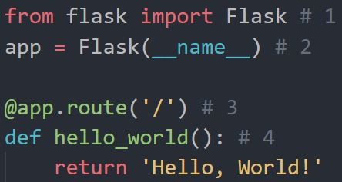
Hello world in Flask
This is what we do in the code example on the right:
We import Flask
We create an instance on the Flask class. The first argument is the name of the application's module or package. If we use a single module we must pass __name__. Flask uses this when importing external files
We then use the route() decorator to tell Flask what URL should trigger the function. The route(‘/’) is the start page
And create an endpoint(function) that will be called when the URL is visited

Slide 14
Running flask
The default name of a flask application is app.py. If we use that as the name of the file containing our flask code.
To start our application we can use either flask run or python –m flask run
To debug a flask application in Visual Studio Code. Select the debug configuration flask and enter the name of the file that contains your flask code.
If you want to use another name for your flask file set an environment variable called FLASK_APP to that files name. Start it normally i.e flask run or python –m flask run

Slide 15
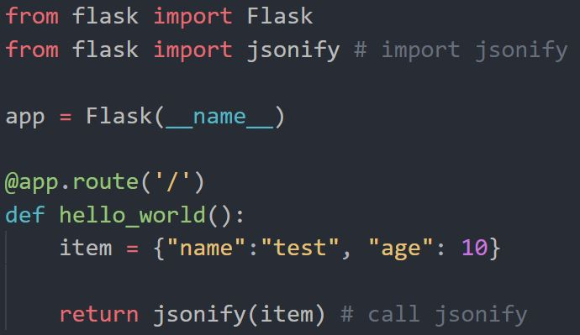
Using Flask as a REST API
There does not exists any difference between Flask for API’s and for web application
The only difference is that REST API’s generally return data formatted using JSON or XML instead of web pages
To convert our response to JSON we can use the built-in Flask function jsonify(). Which will convert an dictionary or simple type(not objects) to a json formatted string containing the variables in the object and also setting headers for the response
Jsonify needs to be imported from flask.
To test API’s we will be using Postman

Slide 16
Flask routes
When defining the route we should set which HTTP verb the endpoint is for. Remember that many verbs can and should share the same URL

Slide 17
Demo API
In the coming examples we will be working with creating a To-Do API
Within this To-Do API we will be handling Tasks. A task have a title, can be assigned to someone, is either done or not and can have a description

Slide 18
GET in Flask
A GET endpoint should return JSON formatted data.
A GET endpoint often read parameters that are in the URL for example task/id. This can be done by adding parameters in the route decorator using this format <type:name>.
GET endpoint often returns 404 not found error. In Flask we can abort early by calling the function abort(error_code). Which must be imported from the flask package.
When data was found we should return a 200-http code
We want to be able to get all tasks and get a specific task based on an id.

Slide 19
POST in Flask
When using POST requests you often pass data in the body of the request or in the header. So when using POST requests we will work against a request object. This object needs to be imported from the flask package
The request object contains a bunch of properties but the most important for us is the request.json property that contains the content of the request body formatted as json which can be accessed as a dictionary.
The most common post error is 400 bad request. This should be returned when the input from the request is in some way wrong
When creating something we should return a 201-http code
In the to-do API we want to be able to create new tasks. When creating a Task a title is required as input all other is optional.

Slide 20
PATCH in Flask
PATCH almost works the same as POST we have a request object with a json part.
But since PATCH only updates existing resources, we need to check that the resource exist before modifying it. Often you would do a GET request for the resource update the resource and then update the old one
When data was updated, we should return a 200-http code
In the to-do API we want to be able to assign people to tasks and change their done status

Slide 21
DELETE in Flask
DELETE should be done by finding the task and deleting it
DELETE should probably not ever be able to delete collection resources
When a DELETE is completed a 200-http code should be returned
For the To-Do API we should be able to DELETE a task

Slide 22
How could this API be improved ?
Security, version handling, database for tasks and users

