Slide 1
Machine Learning Methods in Network Attacks Detection
Faculty of Computer Science
Master's Program: Machine Learning and High-Load Systems
Danila Zhukov
Flow-level near real-time intrusion detection with hybrid ML + rule-based classification
Moscow 2026

Slide 2

Machine Learning Methods in Network Attacks Detection
Danila Zhukov, Moscow 2026
WHY?
Network attacks happen in live traffic, so IDS models must work beyond offline benchmark scores.
GAP
Many ML-based IDS studies stop at benchmark metrics and do not validate the path from raw traffic to live alerts.
SOLUTION
Build and evaluate a flow-level near real-time IDS.
Zeek → Kafka → Spark → temporal XGBoost + rules → alerts!

Slide 3
Goal
Machine Learning Methods in Network Attacks Detection
Danila Zhukov, Moscow 2026
Tasks
Build an end-to-end flow-level near real-time intrusion detection system using the CICIDS2018 dataset that combines supervised ML classification with rule-based detection and runs on commodity hardware.
Stakeholders: SOC teams, enterprise security operations, MSSPs
Impact: earlier detection of DoS / brute-force activity, lower manual triage load.
Re-label CICIDS2018 PCAP through Zeek and assemble a clean per-flow dataset (~30.8M flows, 9 classes).
Engineer features from Zeek conn.log and train RF / LightGBM / XGBoost classifiers.
Build a streaming inference pipeline: Zeek → Kafka → Spark Structured Streaming.
Implement a rule-based engine for attack classes invisible to the classifier (slow-rate HTTP, brute force).
Evaluate in a controlled lab testbed against real attack tools. Compare baseline ML vs hybrid approach.
Tasks map to five contributions C1–C5 (slide 5).

Slide 4
Feature extractor reliability
Machine Learning Methods in Network Attacks Detection
Danila Zhukov, Moscow 2026
Batch features ≠ streaming
Production deployment ignored
CICFlowMeter has multiple documented bugs found in its realization:
Double-counts first packet in length statistics
Premature TCP termination on single FIN; 25.9% TCP appendices [11]
NaN/Inf in flow rate features when duration = 0
flowTimeout 120s in code vs 600s in docs
Most works use CICFlowMeter-style features computed only after flow closure:
Bidirectional statistics are undefined before the flow closes
Model trained on final values; live inference sees in-progress values
Distribution shift between train and inference is rarely acknowledged
Path from a trained model to a working real-time system is rarely described:
Kafka consumer throughput not reported
Model serialization / training-inference consistency not addressed
End-to-end latency rarely measured
Getman et al. report Random Forest F1 = 0.971 (validation) -> 0.064 (real network) attributed to dataset/environment mismatch.

Slide 5
Machine Learning Methods in Network Attacks Detection
Danila Zhukov, Moscow 2026
The Benchmark Trap
Extractor artifacts
CICFlowMeter bugs can distort features.
Train / live mismatch
Batch features are not the same as streaming features.
Missing deployment proof
Most papers do not show raw traffic -> alerts.

Slide 6
Journey from raw Traffic to live Alerts
Machine Learning Methods in Network Attacks Detection
Danila Zhukov, Moscow 2026
Raw Network
Traffic
Zeek 7.0.4
Kafka
Spark Structured
Streaming
Consumer
PCAP/live span/TAP port
conn.log
12 + 5 features
linger.ms = 100
batch = 1000
trigger = 1 s
max-offsets = 10 000
XGBoost + rule engine
Alert / log
Single feature extractor (Zeek) for both training and live inference — no train/inference distribution shift.
All components run on commodity hardware (two-server lab: Intel Xeon, 64 GB RAM each); deployable in Docker

Slide 7
Journey from raw Traffic to live Alerts
Machine Learning Methods in Network Attacks Detection
Danila Zhukov, Moscow 2026
Raw Network
Traffic
Zeek 7.0.4
Kafka
Spark Structured
Streaming
Consumer
PCAP/live span/TAP port
conn.log
12 + 5 features
linger.ms = 100
batch = 1000
trigger = 1 s
max-offsets = 10 000
XGBoost + rule engine
Alert / log
Same extractor for training and inference. No CICFlowMeter CSVs
Two-server lab: Intel Xeon, 64 GB RAM, prototype deployable in Docker

Slide 8
Machine Learning Methods in Network Attacks Detection
Danila Zhukov, Moscow 2026
Five Contributions
C1
Reproducible Zeek-based PCAP processing pipeline for CSE-CIC-IDS2018
30.8 M flows ・ 9 classes (BENIGN + 8 attack classes) ・ automated UCAP-truncation fix ・ AST timezone fix ・ attack labels from 5 of 10 days, benign background retained
C2
Temporal sliding-window feature engineering
5 per-source-IP features over 60-second window: conn_rate, unique_dst_ports, mean_duration, std_duration, bytes_per_sec・XGBoost macro F1 from 0.8613 to 0.9605 (+9.9 pp)
C3
Two-layer hybrid detection: temporal XGBoost + rule engine
Detects 7/7 attack types in live lab tests vs 1/7 for the baseline ML model, despite both models exceeding offline weighted F1 = 0.994 - direct demonstration of the offline-live evaluation gap
C4
Negative result: per-flow autoencoder
Unsupervised anomaly detector on the 12 conn.log features achieves TPR = 0.01 % confirms that per-flow features are insufficient without temporal context
C5
Containerized end-to-end streaming prototype
Zeek 7.0.4+Kafka+Spark Structured Streaming, deployed via Docker Compose ・ sustains 24 000-30 000 flows/s in Docker and 25 000-33 000 flows/s on bare metal

Slide 9
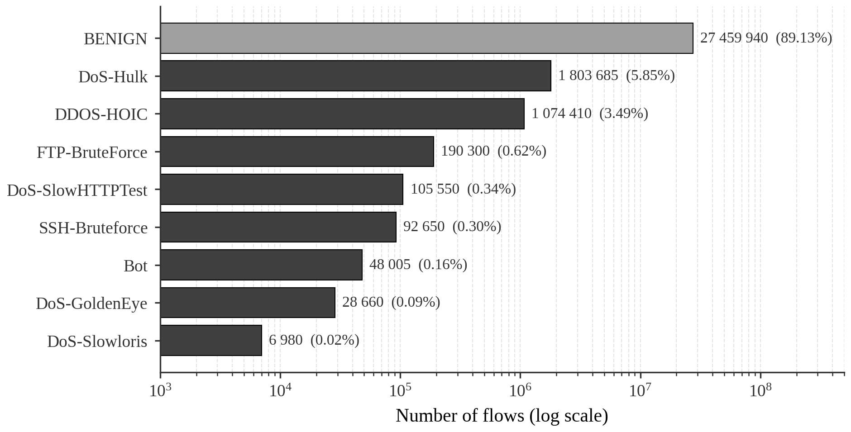
Dataset and Features
Machine Learning Methods in Network Attacks Detection
Danila Zhukov, Moscow 2026
Class Distribution
30.8 M
labelled per-flow records (89.13% BENIGN)
9 classes
BENIGN + 8 attack classes; labels from 5 of 10 days
12 + 5
Zeek conn.log features (baseline + temporal)

Slide 10
Offline Classifier Comparsion
Machine Learning Methods in Network Attacks Detection
Danila Zhukov, Moscow 2026
Training Setup
80 / 20 stratified random split · inverse-frequency class weights · weighted F1 + macro F1 reported (Tables 6, 7) · full hyperparameters in backup B6.
Macro F1 Exposes week Classes
Weighted F1 ≈ 0.994 across all three models is dominated by BENIGN (≈ 89 % of flows). Macro F1 ≈ 0.86 reveals weak per-class scores: SlowHTTPTest 0.60, FTP-BruteForce 0.81, Bot 0.50 (XGBoost, Table 7 of the thesis). The next slide visualises this directly.
Why XGBoost
Native JSON serialization — version-independent loading in the consumer.
Built-in handling of missing values — no extra preprocessing in the Spark stage.
Random Forest in production would require joblib + matched scikit-learn version (fragile).
Offline weighted F1 differs by less than 0.001 across all three models — choice driven by deployability.
Model | Weighted F1 | Macro F1 | Training time
Random Forest | 0.9947 | 0.8687 | 770 s
XGBoost | 0.9946 | 0.8613 | 1 418 s
LightGBM | 0.9943 | 0.8588 | 377 s

Slide 11
Offline Metrics look excellent
Machine Learning Methods in Network Attacks Detection
Danila Zhukov, Moscow 2026
Training Setup
80 / 20 stratified random split · inverse-frequency class weights · weighted F1 + macro F1 reported (Tables 6, 7) · full hyperparameters in backup B6.
Macro F1 Exposes week Classes
Weighted F1 ≈ 0.994 across all three models is dominated by BENIGN (≈ 89 % of flows). Macro F1 ≈ 0.86 reveals weak per-class scores: SlowHTTPTest 0.60, FTP-BruteForce 0.81, Bot 0.50 (XGBoost, Table 7 of the thesis). The next slide visualises this directly.
Why XGBoost
Native JSON serialization — version-independent loading in the consumer.
Built-in handling of missing values — no extra preprocessing in the Spark stage.
Random Forest in production would require joblib + matched scikit-learn version (fragile).
Offline weighted F1 differs by less than 0.001 across all three models — choice driven by deployability.
Model | Weighted F1 | Macro F1 | Training time
Random Forest | 0.9947 | 0.8687 | 770 s
XGBoost | 0.9946 | 0.8613 | 1 418 s
LightGBM | 0.9943 | 0.8588 | 377 s

Slide 12
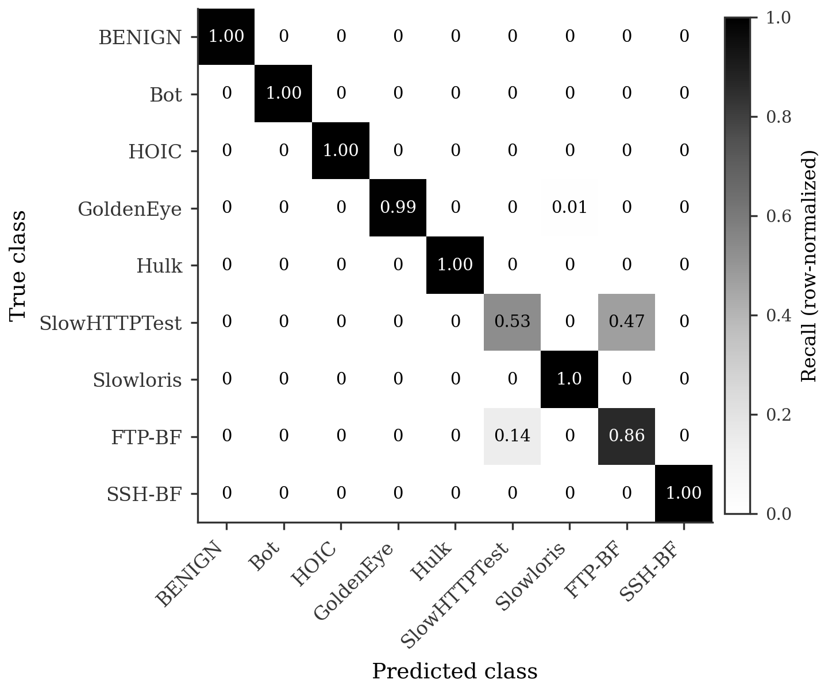
Where the Baseline Breaks
Machine Learning Methods in Network Attacks Detection
Danila Zhukov, Moscow 2026
Dominant Error Pattern
47 % of true SlowHTTPTest flows misclassified as FTP-BruteForce.
14 % of true FTP-BruteForce flows misclassified as SlowHTTPTest.
XGBoost per-class F1 (Table 7): Bot 0.50, SlowHTTPTest 0.59, FTP-BF 0.81, Slowloris 0.92, GoldenEye 0.94.
Hulk, DDoS-HOIC, SSH-BruteForce, BENIGN: F1 ≥ 0.99 — already at ceiling.
Root Cause
Slow-rate HTTP and brute-force flows are individually indistinguishable from benign HTTP or SSH at the conn.log level — they need cross-flow context. This motivates temporal features (slide 9) and the rule engine (slide 10).

Slide 13
Where the Baseline Breaks
Machine Learning Methods in Network Attacks Detection
Danila Zhukov, Moscow 2026
Dominant Error Pattern
47 % of true SlowHTTPTest flows misclassified as FTP-BruteForce.
14 % of true FTP-BruteForce flows misclassified as SlowHTTPTest.
XGBoost per-class F1 (Table 7): Bot 0.50, SlowHTTPTest 0.59, FTP-BF 0.81, Slowloris 0.92, GoldenEye 0.94.
Hulk, DDoS-HOIC, SSH-BruteForce, BENIGN: F1 ≥ 0.99 — already at ceiling.
Root Cause
Slow-rate HTTP and brute-force flows are individually indistinguishable from benign HTTP or SSH at the conn.log level — they need cross-flow context. This motivates temporal features and the rule engine.

Slide 14
Temporal Context adds the missing Signal
Machine Learning Methods in Network Attacks Detection
Danila Zhukov, Moscow 2026
Five Temporal Features
conn_rate — connections per window duration (DoS / DDoS)
unique_dst_ports — distinct id.resp_p (port scanning)
mean_duration — mean flow duration (bot beaconing: stable)
std_duration — std of flow duration (low variance → beaconing)
bytes_per_sec — total bytes per window duration (volumetric)
Why this works
All five features are aggregated per source IP over a 60-second sliding window. Computed on per-day labelled.csv files in chronological order; window state is reset between days to prevent leakage. Identical semantics in training and live inference.
Attack Type | Increase | pp
SlowHTTPTest | +40 pp | 0,59->0,99
FTP-BruteForce | +18 pp | 0,81->0,99
Bot | +17 pp | 0,50->0,67

Slide 15
Prototype Architecture
Machine Learning Methods in Network Attacks Detection
Danila Zhukov, Moscow 2026
The complete system is containerized using Docker Compose with three services: Kafka (KRaft mode, official Apache image), Zeek (custom image: zeek/zeek:7.0.4 + zeek-kafka plugin), and the Spark consumer (custom image: spark:python3 + XGBoost + trained model). All containers use host networking to allow Zeek direct access to the monitoring interface.

Slide 16
Live Lab Test: from 1/7 to 7/7
Machine Learning Methods in Network Attacks Detection
Danila Zhukov, Moscow 2026
Hybrid (temporal ML + rule engine) detects 7 of 7 attack tools in controlled lab tests; baseline XGBoost alone detects 1 of 7 — despite both models exceeding offline weighted F1 = 0.994.
Attack tool | Class | Baseline ML | Temporal ML | Hybrid (ML + rules)
Hulk (HTTP DoS) | DoS-Hulk | detected | detected | detected
GoldenEye | DoS-GoldenEye | x | detected | detected
Slowloris | DoS-Slowloris | x | x | detected
SlowHTTPTest | DoS-SlowHTTPTest | x | detected | detected
hping3 SYN flood | DoS-Hulk* | x | detected | detected
SSH brute force | SSH-BruteForce | x | x | detected
FTP brute force | FTP-BruteForce | x | x | detected
Lab testbed: 1 attacker VM (Kali), 1 sensor (Zeek + Spark consumer), 4 victim VMs (Ubuntu, Apache, vsftpd, OpenSSH); all traffic crosses a bridge with the sensor on a SPAN port.

Slide 17
Prototype Example
Machine Learning Methods in Network Attacks Detection
Danila Zhukov, Moscow 2026

Slide 18
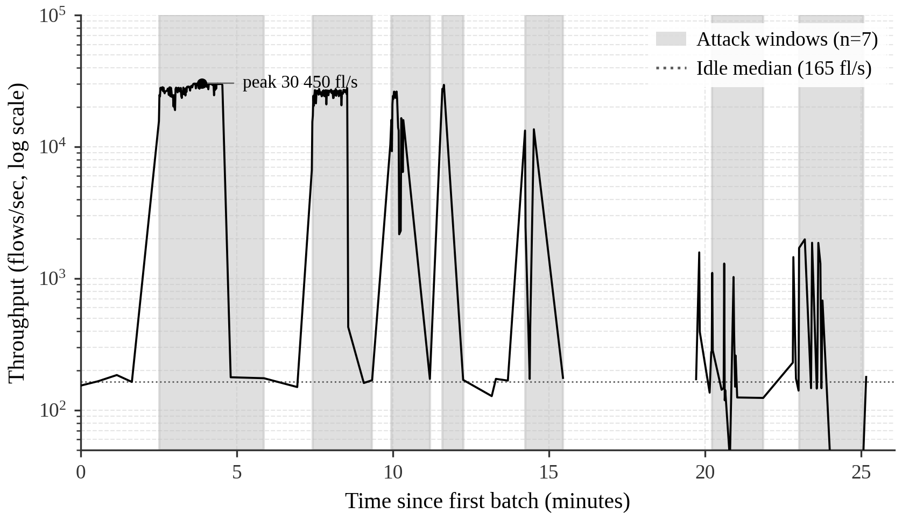
Throughput and Latency
Machine Learning Methods in Network Attacks Detection
Danila Zhukov, Moscow 2026
Sustained Throughput
Typical End-to-end Latency

Slide 19
Scope and Limitations
Machine Learning Methods in Network Attacks Detection
Danila Zhukov, Moscow 2026
1
Controlled Lab Testbed, not full production tests
All live tests run in an isolated VM lab on a single sensor with a SPAN port. Production validation on a real enterprise network is left as future work.
2
Slow-rate attacks remain a blind spot for the classifier
Slowloris, slow-read variants and very low-rate brute force still rely on the rule engine, not on the ML model. The rule engine catches the cases we tested, but is not a general solution.
3
Per-day temporal window reset; no multi-day normalisation
Temporal features are computed on per-day labelled.csv files in chronological order and the sliding-window state is reset between days. Multi-day temporal normalisation or per-host baselines may further improve recall on rare classes such as Bot.
4
No encrypted-attack coverage
Attacks that hide in TLS payload (data exfiltration, encrypted C2) are out of scope. Flow-level metadata alone is insufficient for those scenarios.
5
No comparison against a tuned signature IDS
We do not benchmark against Snort / Suricata with the same workload. The contribution is the offline-vs-live gap demonstration, not a head-to-head with signature systems.

Slide 20
Scientific Contribution
Machine Learning Methods in Network Attacks Detection
Danila Zhukov, Moscow 2026

Slide 21
Conclusion and Future Work
Machine Learning Methods in Network Attacks Detection
Danila Zhukov, Moscow 2026
Delivered
— Re-labelled CICIDS2018 dataset through Zeek (30.8 M flows, 9 classes: BENIGN + 8 attacks).
— 12 baseline + 5 temporal conn.log features; XGBoost temporal weighted F1 = 0.9984, macro F1 = 0.9605 (+9.9 pp over baseline).
— Two-layer hybrid detector: temporal XGBoost + rule engine.
— Containerized real-time pipeline: Zeek + Kafka + Spark, 24–30 k flows/s.
— Live lab evaluation: 7 / 7 attack tools detected vs 1 / 7 for the baseline.
Open and Future Work
— Multi-day temporal training; per-host normalization for rare classes.
— Coverage for application-layer attacks via http.log (Web / SQL / XSS).
— Validation on a real enterprise network (not a lab testbed).
— Comparison head-to-head against tuned Snort / Suricata on identical workload.

Slide 22
Thank you.
Questions are welcome
Machine Learning Methods in Network Attacks Detection
Danila Zhukov, Moscow 2026

