Slide 1

Introduction to Google Charts Tool
Universidade de Aveiro Departamento de Electrónica, Telecomunicações e Informática
Tiago Araújo & Beatriz Sousa Santos 2019

Slide 2
Web Technologies
The World Wide Web is a environment full of capabilities
HTML, CSS, Javascript and SVG are the building blocks of Web Visualization
Used beyond the web: mobile and desktop environment
Notes:
The WWW works over HyperText Transfer Protocol (HTTP), used to deliver hypermedia documents on the web.
Modern Browsers allow a wide range of applications, like social medias, games, visualizations, AI interaction, simulations and many others.
HyperText Markup Language (HTML) is used to describe and define the content of a webpage.
Cascading Style Sheets (CSS) are used to describe the appearance or presentation of content on a webpage.
JavaScript is the programming language that runs in your browser. You can use it to add interactivity and other dynamic features to your website or application.
Scalable Vector Graphics (SVG) lets you use lines, curves, and other geometric shapes to render graphics. With vectors, you can create images that scale cleanly to any size.
Nodejs is a script interpreter, a javascript engine to backend JS operations. With wrappers (cordova for mobile and electron for desktop), it allows js code and the HTML to be imported as a webapp kind of software.

Slide 3

Example
<!DOCTYPE html>
<html>
<head>
<title>Hello CSS</title>
<style>
p {
text-align: center;
color: red;
font-size: 100px
}
body {
background-color: gray
}
</style>
</head>
<body>
<p>Hello World!</p>
</body>
</html>
Notes:
Simple hello world example with only HTML and CSS. How are the tags influencing one another? How much freedom the style allows us? Is some tag more important than others? Is there other ways to acquire the same results?

Slide 4
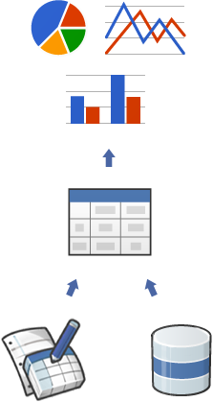
Google Charts
A tool that allows data visualization on the browser
Only needs a `div` to draw
Works over the DataTable protocol
Notes:
The Charts are highly interactive and expose events that let you connect them to create complex dashboards or other experiences integrated with your webpage.
Google Charts works with simple JavaScript that you embed in your web page. You load some Google Chart libraries, list the data to be charted, select options to customize your chart, and finally create a chart object with an id that you choose. Given a certain div, the chart is drawn within it
The DataTable provides methods for sorting, modifying, and filtering data, and can be populated directly from your web page, a database, or any data provider supporting the Chart Tools Datasource protocol, making it easy to switch between chart types.
The Chart Tools Datasource protocol includes a SQL-like query language and is implemented by Google Spreadsheets, Google Fusion Tables and third party data providers.

Slide 5
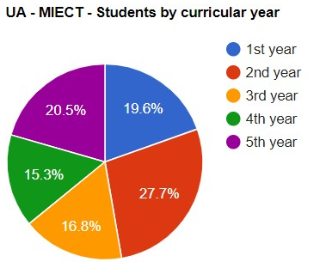
Example
Notes:
Now we will show how to create this pie chart using Google Charts

Slide 6
<script type="text/javascript" src="https://www.gstatic.com/charts/loader.js"></script>
<body>
<!--Div that will hold the pie chart-->
<div id="chart_div" style="width:400; height:300"></div>
</body>
// Load the Visualization API and the corechart package.
google.charts.load('current', {'packages':['corechart']});
// Set a callback to run when the Google Visualization API is loaded.
google.charts.setOnLoadCallback( drawChart );
Notes:
Load the script for the libraries

Slide 7
function drawChart( ) { // Create the data table.
var data = new google.visualization.DataTable( );
// First column
data.addColumn('string', 'Curricular year');
// Second column
data.addColumn('number', 'Number of Students');
data.addRows([['1st year', 79],
['2nd year', 112],
['3rd year', 68],
['4th year', 62],
['5th year', 83] ]);
// Set chart configuration options
var options = {
title : 'UA - MIECT - Students by curricular year',
width : 400,
height : 300
};
// Instantiate the pie chart.
var chart = new google.visualization.PieChart( document.getElementById('chart_div'));
debugger;
// Draw the chart, passing in some configuration options.
chart.draw(data, options); }

