Slide 1

Newsroom vector classification supporting RAG

Slide 2
Problem
Large corporations are trying to leverage semantic search and LLMs to explore their newsroom data with retrieval augmented generation enabled Q&A. However, newsrooms are quite large (have a lot of text). Using cosine similarity with BERT embeddings is a popular method to select relevant text chunks to append to a prompt, but it's computationally expensive and wait time can deter users. The search can be sped up if only half of the embeddings need comparison, so binary classification is a fair approach for sorting newsroom data queries and is only feasible using a neural network model. User questions about the Texas Instruments newsroom (where I work) fall into two categories, 'corporate' and 'product/manufacturing.' Identifying the user question categories allow for faster response times in a larger RAG context.

Slide 3
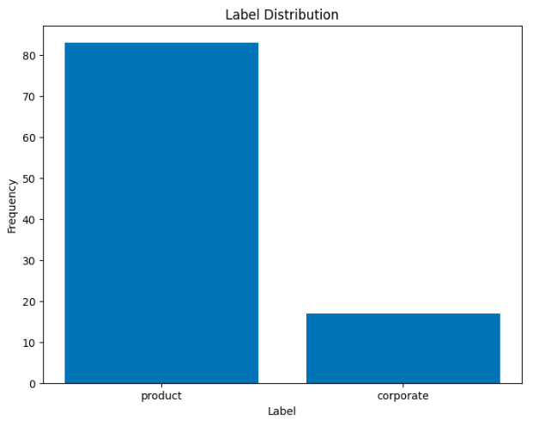
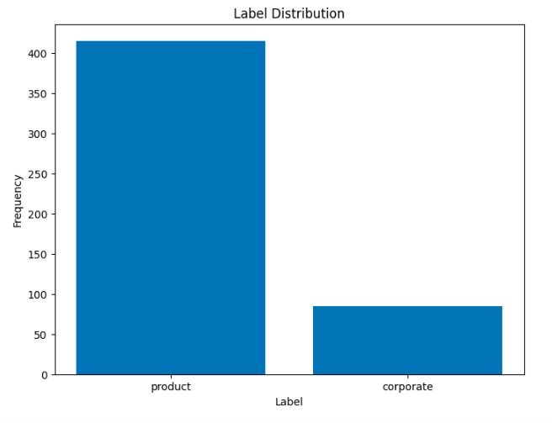
EDA

Slide 4
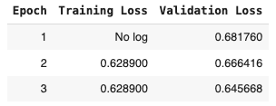
Smaller dataset model
0.693 is approximate to random guessing
Worst-case loss = -log(0.5)

Slide 5
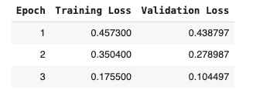
Larger dataset
Not overly confident but optimized

Slide 6

Performance
Validation accuracy: 100%
Precision: 1.00
Recall: 1.00
F1-score: 1.00
AUC-ROC: 1.00

Slide 7
Conclusion
Based on the results and the validation loss, this model proved to be suitable for navigating a split vector database. The reason for the split database that leverages a classifier rather than running in parallel is that newsroom data is usually one aspect of a corporate RAG system and multiple cosine similarity searches already run in parallel with it.

