Slide 1


RGB Music
Oran Gilboa & Zehavit Leibovich
Notes:
oran

Slide 2

Basic Idea
Let the user “hear” an image
OR
Create music from an image
Notes:
oran

Slide 3
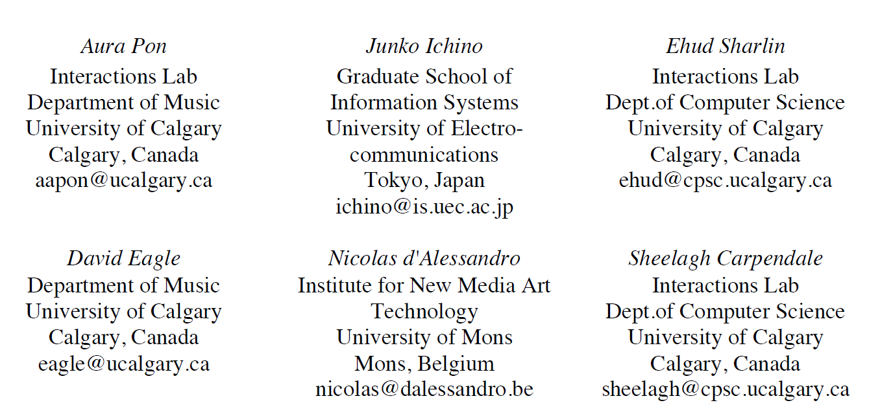

Related Paper - vuzik
A painting graphic score interface for composing and control of sound generation
Authors:
Notes:
zehavit

Slide 4
What is Vuzik?
Vuzik is an interface for creating and visualizing music through painting gestures on a large interactive surface
Motivation: open up new ways to create and realize musical ideas
How?
Using the understanding of basic concepts about the physical world to build a usable understanding of music’s structure and encourage more intuitive music exploration and creation
Video: https://www.youtube.com/watch?v=Oq7c43mZYdY
Notes:
zehavit
להוסיף בע"פ:
*אומן יכול "לראות" את המוזיקה שהוא יוצר
קהל יכול גם לראות את המוזיקה שהאומן מנגן*
הנגשה של יצירה והבנה של מוסיקה*

Slide 5
First step- sound visual mapping
y
Each color is paired to a unique instrument tone
Thickness of the line reflects the loudness
pitch
Time duration
x
Notes:
zehavit
לתת דוגמה לגבי אורך הניגון – שנקבע רק עפ"י אורך הציור על ציר X
למשל – מעגל

Slide 6
Second step – hear the painting
Two modes of operation :
Creation – “paint” music in real-time
Playback – hear the entire canvas or a selected stroke
Notes:
zehavit
Hear the entire canvas – from left to right + marks the currently played stroke
להסביר מתי כל שלב שימושי:
הראשון כדי לייצר מוזיקה ולהבין אותה
השני בהופעות בזמן אמת:
או כדי להראות את המוסיקה שמתנגנת
או במקום תווים, כהוראות לנגנים

Slide 7
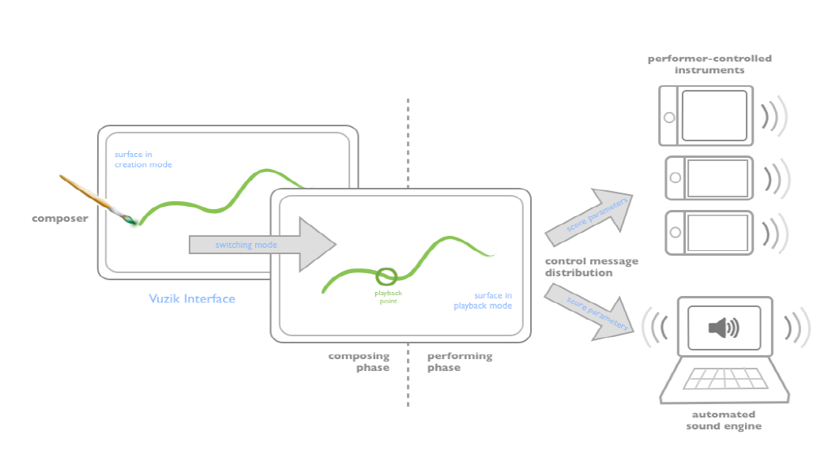
Implementation and use case
GUI is implemented in C# (WPF) and utilizes the open sound control protocol for messaging
Notes:
zehavit
Hear the entire canvas – from left to right + marks the currently played stroke
להסביר מתי כל שלב שימושי:
הראשון כדי לייצר מוזיקה ולהבין אותה
השני בהופעות בזמן אמת:
או כדי להראות את המוסיקה שמתנגנת
או במקום תווים, כהוראות לנגנים

Slide 8
Applications
Originally envisioned as a tool for children to explore music and sound
Offering the capability for more advanced music composition
https://www.youtube.com/watch?v=BNzV7lvgJjI 0:57
Notes:
zehavit
הסבר על הוידיאו:
Intertwine is a three-movement piece entirely written using the Vuzik composing interface, specifically for an ensemble of ChoirMob performer
Choir Mob – אפליקציה לניגון כמקהלה, כל סמארטפון מייצר ניגון של כלי נגינה באמצעות טאץ'

Slide 9
Future work
Continue developing vuzik as an educational tool for elementary schools
Further validate it as composition tool by creating more music works
Notes:
zehavit
להרחיב בע"פ:
ככלי ללימוד ילדים:
ממשיכים במחקר ומתייעצים עם מורים למוזיקה מה האתגרים של ילדים בתחום ואיך לפתור

Slide 10
Back to RGB music
Notes:
oran

Slide 11
The project
RGB Music is a software interface for creating music from an image through clicking on the image.
In this project we aim to map between visual elements to sound elements. For example:
Map from the RGB value of a chosen pixel to unique instrument tone
Can be configured to average the RGB value using neighbors pixels
Notes:
oran

Slide 12
Related Work - VUZIK
Pros:
Very interactive
Suitable even for children that can’t read
Cons:
Not public
User needs to be very creative in order to produce fare music
Notes:
Zehavit
תמצית עבודות דומות המתארת בצורה מדויקת את מה נעשה העבודות קודמות, מה הן
פתרו או הביעו, יתרונותיהן וחסרונותיהן.

Slide 13
Related Work - RGB Music Lab
Created by Kenji Kojima, a Japanese visual artist.
http://www.kenjikojima.com/rgbmusic
Create a music from an image
Reads RGB value of pixels from the top left to the bottom right of an image, then composes an music
Pros:
Contains a lot of options for user input
Very advanced
Cons:
Not free
Out dated - no support
Notes:
oran
תמצית עבודות דומות המתארת בצורה מדויקת את מה נעשה העבודות קודמות, מה הן
פתרו או הביעו, יתרונותיהן וחסרונותיהן.

Slide 14
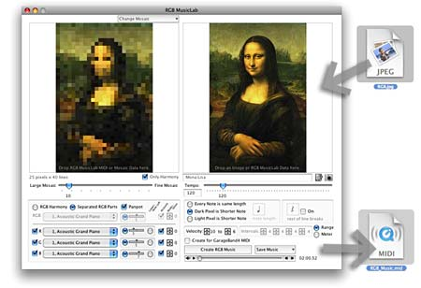
Related Work - RGB Music Lab
Notes:
oran

Slide 15
Implementation
The project will be implemented in Python using the following libraries:
Tkinter – UI
SuperCollider - as server
OSC – as client to interact with SC for creating music
Pil - Image processing
Notes:
oran

Slide 16
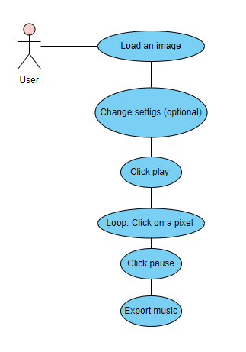
Main use case
The main use case is very basic – just load the image and click on the image to create music
Testing sounds
Start recording
Making sounds
Stop recording
Export to file
Notes:
oran

Slide 17
PROS over other products
Our program let the user control which parts from the image will affect the final work
The user can use multiple images for creating one work
The user can use the visual elements of the picture as an auxiliary (not all the music is made up)
Different purpose
Notes:
oran
יתרונות הפתרון על פני פתרונות אחרים, או הבדלים עיקריים.
היתרון האחרון שהתוכנה שלנו באמת שונה מהקודמת, כלומר היא כן מחדשת מבחינת מה אפשר ליצור איתה ואילו אפשרויות היא מספקת למשתמש

Slide 18
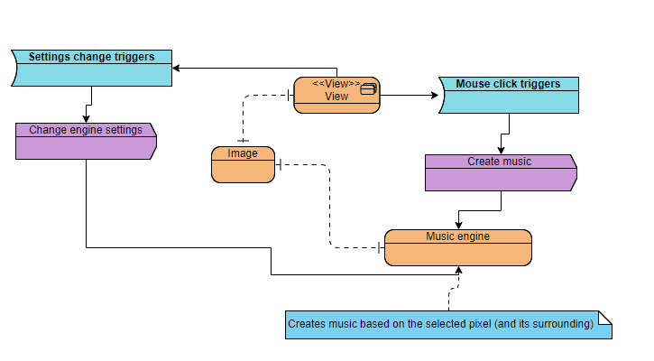
Technical and musical summary #1
System description
Notes:
oran

Slide 19
Technical and musical summary #2
The technical and musical details of the engine are to be defined : basically we want to have a unique instrument timbre for each RGB value and a mapping from a set of pixels (i.e. the surrounding pixels of the chosen pixel) to pitch or time duration
In the advanced phases of the project we would like to give the user the ability to:
Change the engine settings (mapping from visual elements to sound elements)
Record its created music
Create music based on multiple images
Notes:
oran

Slide 20
Phase 1 – Demo
Notes:
oran

Slide 21
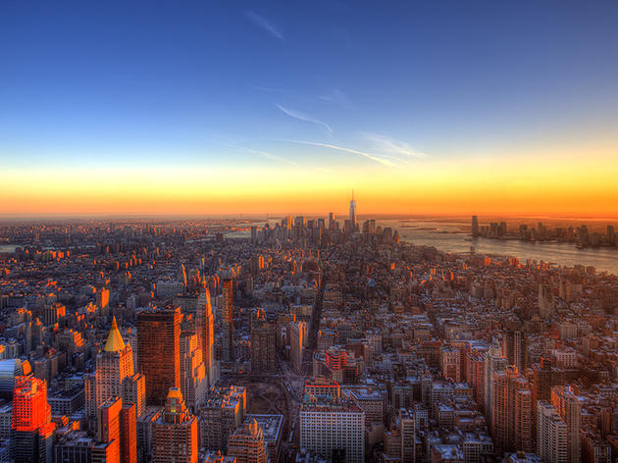



UI scheme – MOCK (Before implementing)
RGB Music
File Help

Slide 22
UI scheme – MOCK (Before implementing)
RGB Music
File Help

Slide 23
UI scheme – MOCK (Before implementing)
RGB Music
File Help

Slide 24
UI scheme – MOCK (Before implementing)
RGB Music
File E Help
File
Load images
Settings
Exit

Slide 25

UI scheme – MOCK (Before implementing)
RGB Music
Settings
File E Help
File
Load images
Settings
Exit
Instruments:
Piano
Drums
Violin
Elec. guitar
Classic guitar
Amplitude:
Min
Max
Radius:
15

Slide 26
Project timeline
Phase 1:
Implement an engine that creates a sound based on the RGB of the current pixel (according to mouse location)
Phase 2:
Add UI and logic for user input: Sliders, selection of instrument, etc.
Support configuration of using neighbors pixels
Record the music created
Phase 3:
Add support for creating a music using multiple pictures
Notes:
oran

Slide 27
Bibliography #1
We were inspired by the video presented in class of “Geo shred preview”
https://www.youtube.com/watch?v=CDLA8B8BkbQ
Were you can see a musician play using a touch screen
Vuzik –A PAINTING GRAPHIC SCORE INTERFACE FOR
COMPOSING AND CONTROL OF SOUND GENERATION
Video: https://www.youtube.com/watch?v=Oq7c43mZYdY
Paper:https://quod.lib.umich.edu/cache//b/b/p/bbp2372.2012.108/bbp2372.2012.108.pdf#page=4;zoom=75

Slide 28
Bibliography #2
Musical Sonification of Super High Frequency Lighting – Paper:
https://quod.lib.umich.edu/cache//b/b/p/bbp2372.2017.039/bbp2372.2017.039.pdf#page=1;zoom=75
See music: A tool for music visualization – Paper:
https://quod.lib.umich.edu/cache//b/b/p/bbp2372.1993.114/bbp2372.1993.114.pdf#page=1;zoom=75
Video: https://www.youtube.com/watch?v=qNhwDzInBjo

