Slide 1
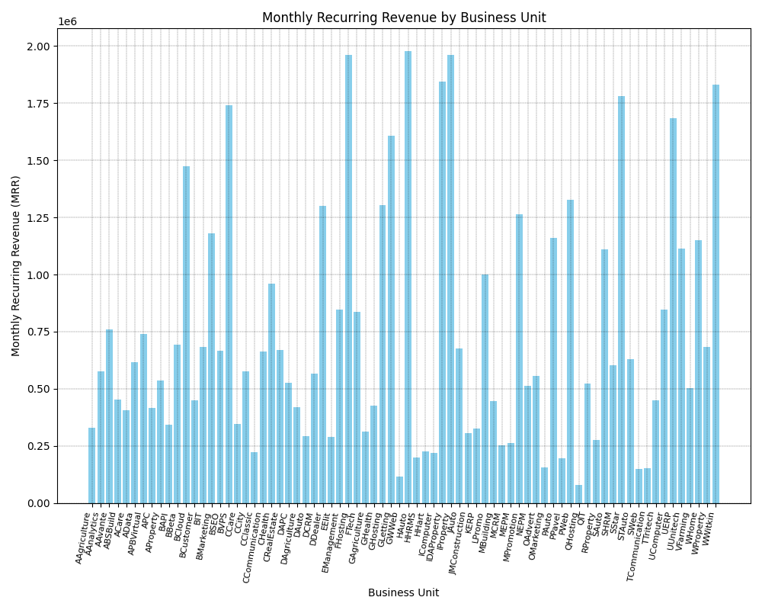

Slide 2
The bar chart visualizes the monthly recurring revenue (MRR) generated by different business units. Here's a breakdown: * **X-Axis:** Each bar on the x-axis represents a unique "Business Unit," likely departments or segments within a larger organization. Examples include "Agriculture," "Banking," and "Marketing." * **Y-Axis:** The y-axis quantifies the "Monthly Recurring Revenue (MRR)" in a numerical format (it appears to be in the millions based on the "1e6" notation). * **Bar Height:** The height of each bar directly corresponds to the MRR brought in by that specific business unit. Taller bars indicate higher revenue generation. **Overall Insights:** * **Revenue Variation:** There's significant variation in MRR across different business units. Some units are high performers (with bars reaching close to 2 million), while others generate considerably less revenue. * **Data Comparison:** The chart allows for quick visual comparison of revenue performance between different areas of the business. **Additional Notes:** * **Color:** The consistent light blue color of the bars suggests a focus on presenting the data clearly without drawing attention to specific business units through color variation. * **Title and Labels:** The title ("Monthly Recurring Revenue by Business Unit") and axis labels are clear and descriptive, aiding in immediate understanding. * **Gridlines:** The subtle gridlines in the background enhance readability by making it easier to trace the value of each bar against the y-axis scale. Without specific values and context about the business, it's challenging to provide deeper analysis. However, this visualization effectively highlights which business units are major revenue drivers and which may require further attention or strategy adjustments.

Slide 3
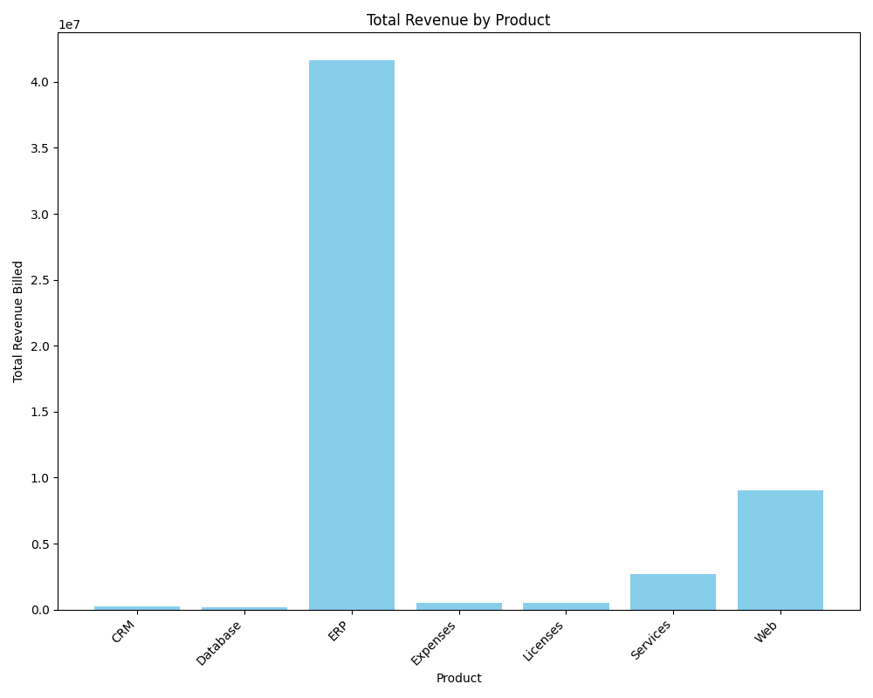

Slide 4
The image shows a bar graph titled "Total Revenue by Product." It visually compares the total revenue generated by different product categories. Here's a breakdown: * **X-Axis:** Lists individual product categories: "CRM," "Database," "ERP," "Expenses," "Licenses," "Services," and "Web." * **Y-Axis:** Represents the total revenue billed, likely in millions or tens of millions based on the scale. * **Bars:** Each bar's height corresponds to the total revenue for that specific product. **Key Observations:** * **ERP is the highest-performing product category** by a significant margin, generating the most revenue. * **Web is the second-highest revenue generator,** though significantly less than ERP. * **Services show a moderate revenue stream.** * **CRM, Database, Expenses, and Licenses demonstrate comparatively lower revenue figures.** **Overall, the graph highlights a significant revenue disparity between product categories, with ERP dominating sales.** This suggests that the business might focus on understanding the success factors of the ERP product and explore strategies to replicate similar success in other areas or further capitalize on the ERP market.

Slide 5
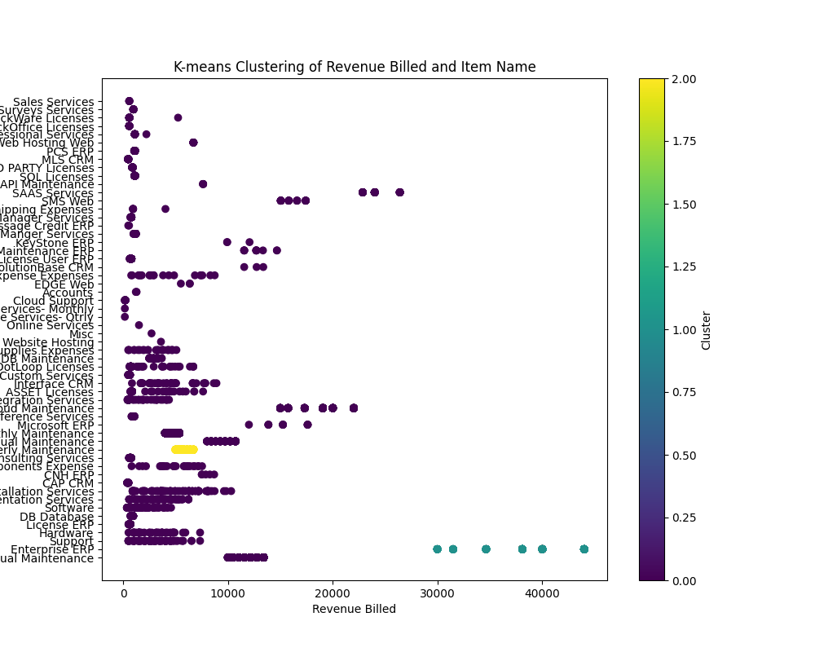

Slide 6
The image is a scatter plot that visualizes clusters of data points based on "Revenue Billed" and "SB FX Rate". Here's a breakdown: * **Type:** Scatter Plot with Color-Coded Clusters * **X-axis:** "Revenue Billed" (likely a financial metric) * **Y-axis:** "SB FX Rate" (likely related to foreign exchange rates) * **Data Points:** Each dot represents a data point with its position determined by its Revenue Billed and SB FX Rate values. * **Clusters:** The data points are grouped into clusters, indicated by different colors. * **Color Bar:** The color bar on the right provides a key to the clusters. The colors likely represent different cluster assignments from a clustering algorithm (e.g., K-means clustering). * **Title:** "K-means Clustering of Revenue Billed and SB FX Rate" suggests the clustering method used. **Observations:** * Most data points are concentrated along a very narrow band on the Y-axis (SB FX Rate), indicating minimal variation in this variable. * There seems to be a weak relationship between Revenue Billed and SB FX Rate. * The clustering pattern is heavily influenced by the Revenue Billed variable, as clusters are primarily separated along the X-axis. **Possible Interpretations:** * The clustering suggests different groups of entities (perhaps clients, transactions, or products) with varying Revenue Billed figures but similar SB FX Rates. * The lack of strong correlation between the two variables suggests that SB FX Rate may not be a significant factor influencing Revenue Billed, at least within the observed data. Without further context about the data and its source, it's challenging to provide a more definitive interpretation.

