Slide 1
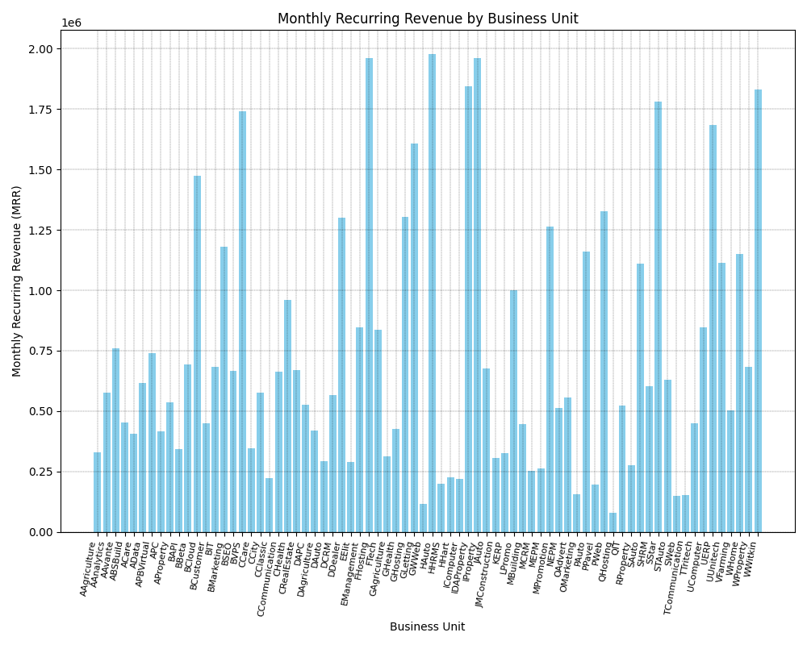

Slide 2
The image is a bar chart showing monthly recurring revenue for different business units. Here's a breakdown: * **Title:** "Monthly Recurring Revenue by Business Unit" * **Y-axis:** Represents the amount of Monthly Recurring Revenue (MRR) likely in millions (denoted by the 1e6 at the top left). * **X-axis:** Shows a large number of business units, likely abbreviated. Some examples include "Agriculture," "Marketing," "Construction," "Healthcare," and various others that seem industry-specific. * **Bars:** Each bar's height represents the MRR for a specific business unit. **Overall:** The chart visualizes the distribution of monthly recurring revenue across a variety of business units. Without specific values on the Y-axis, it's difficult to draw precise conclusions about the revenue differences. However, it's clear that some units generate significantly more MRR than others.

Slide 3
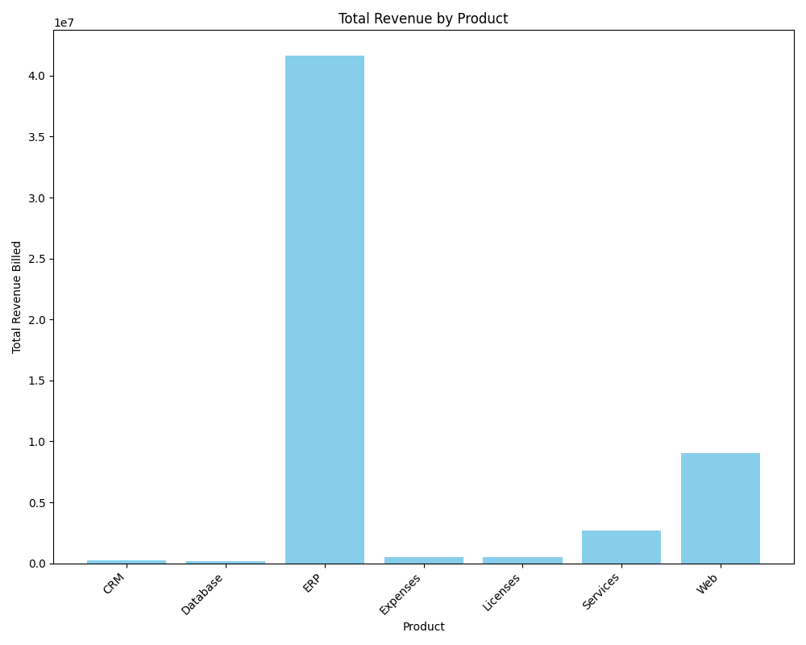

Slide 4
The bar chart titled "Total Revenue by Product" displays the total revenue generated by seven different products. The x-axis lists the products: CRM, Database, ERP, Expenses, Licenses, Services, and Web. The y-axis represents the total revenue billed, ranging from zero to a little over 40 million dollars. The most striking feature of the chart is the dominant revenue generated by the "ERP" product, exceeding 40 million dollars. This dwarfs all other products. "Web" is a distant second at around 9 million dollars in revenue. "Services" follows with approximately 3 million. The remaining products, "CRM", "Database", "Expenses", and "Licenses", show negligible revenue in comparison, all below one million. The chart indicates that ERP is the company's most successful product in terms of revenue generation, significantly outperforming all other products. The low revenue figures for the other products, particularly CRM, Database, Expenses, and Licenses, warrant further investigation to understand their performance and potentially improve revenue generation.

Slide 5
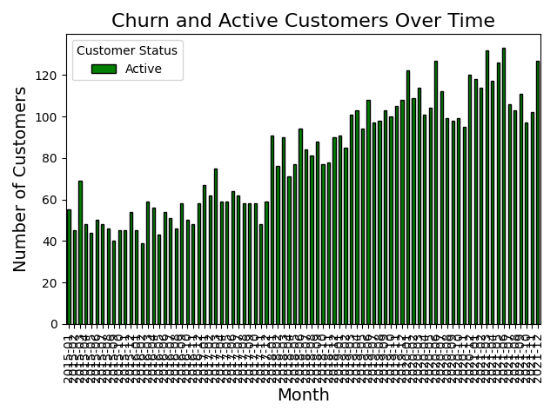

Slide 6
This chart shows the churn and active customer counts over time. The red portion represents churned customers, while the green portion represents active customers.

Slide 7
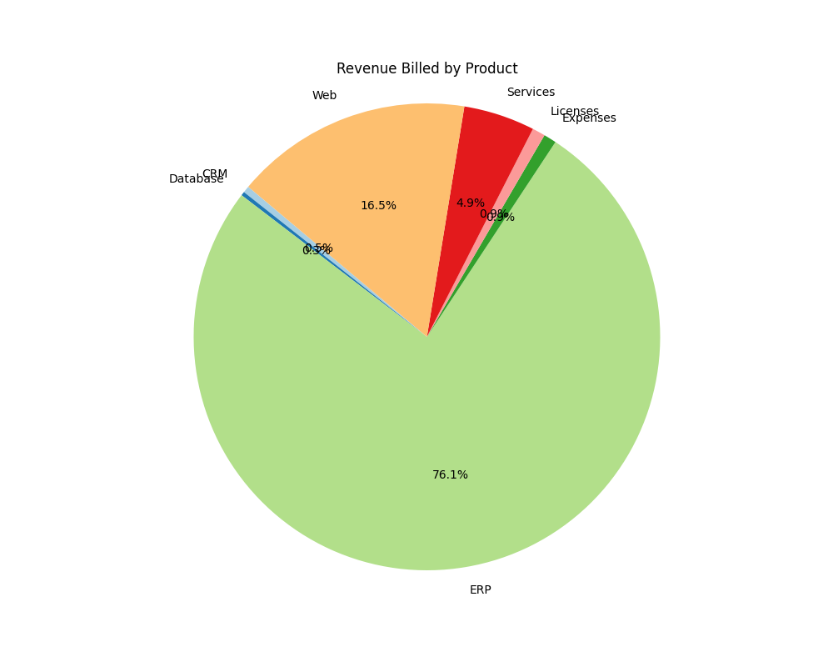

Slide 8
This pie chart shows the distribution of revenue billed by different products. Each slice represents the proportion of total revenue billed by each product.

