Slide 1
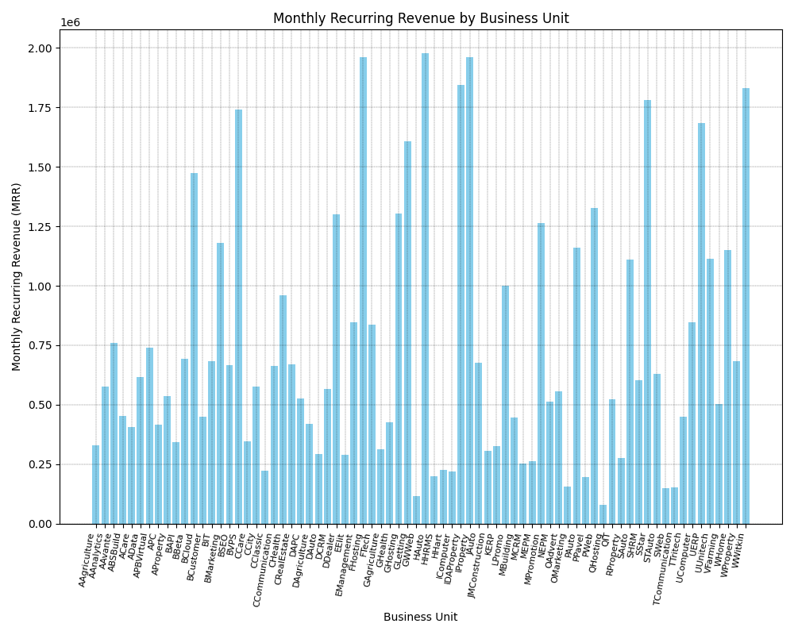

Slide 2
The provided image is a bar graph that depicts the Monthly Recurring Revenue (MRR) for various business units. Here are some observations: * **Overall:** The graph shows a wide range of MRR across different business units, indicating varying performance levels. * **High Performers:** Certain business units stand out with significantly higher MRR than others. For example, units like "G:Rest", "I:Property" and "W:Property" show noticeably taller bars. * **Low Performers:** Conversely, some units like "G:Wett", "O:Web" and "T:Computer" have considerably lower MRR. * **Comparison:** The bar graph format allows for easy visual comparison of MRR between different business units. * **Axis:** The X-axis lists the different business units, likely abbreviated for brevity. The Y-axis represents the MRR in a numerical format, going up to 2 million. Overall, this graph is useful for quickly understanding the relative revenue generation of different business units. This information could be used for resource allocation, performance evaluation, or strategic planning.

Slide 3
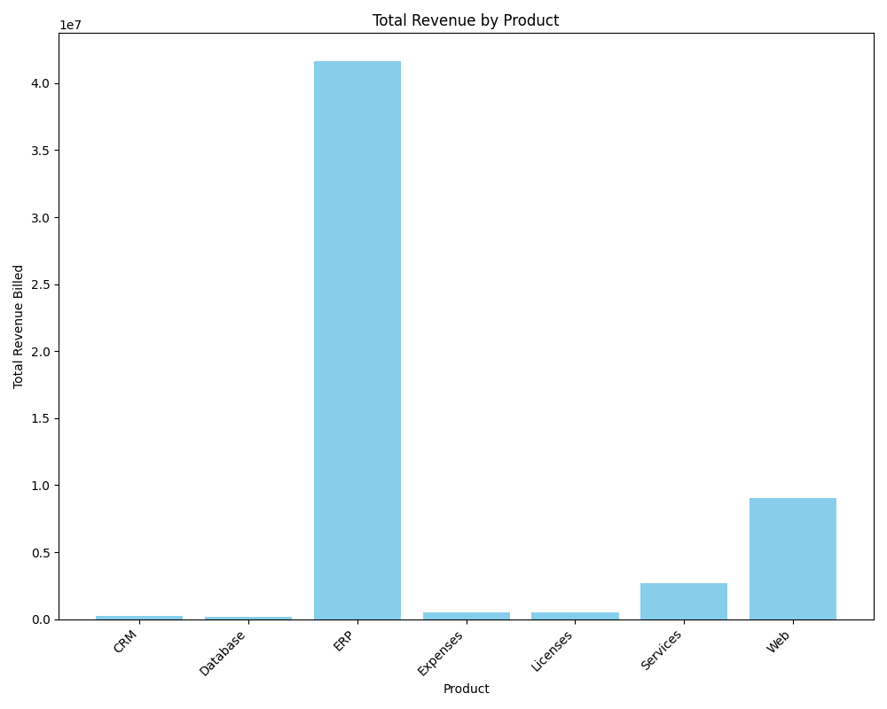

Slide 4
The bar graph shows total revenue billed by product. ERP generated the most revenue, followed by Web, then Services. The remaining products—CRM, Database, Expenses, and Licenses—had relatively insignificant revenue generation. The title of the graph is "Total Revenue by Product." The Y-axis is "Total Revenue Billed," and the x-axis is "Product."

Slide 5
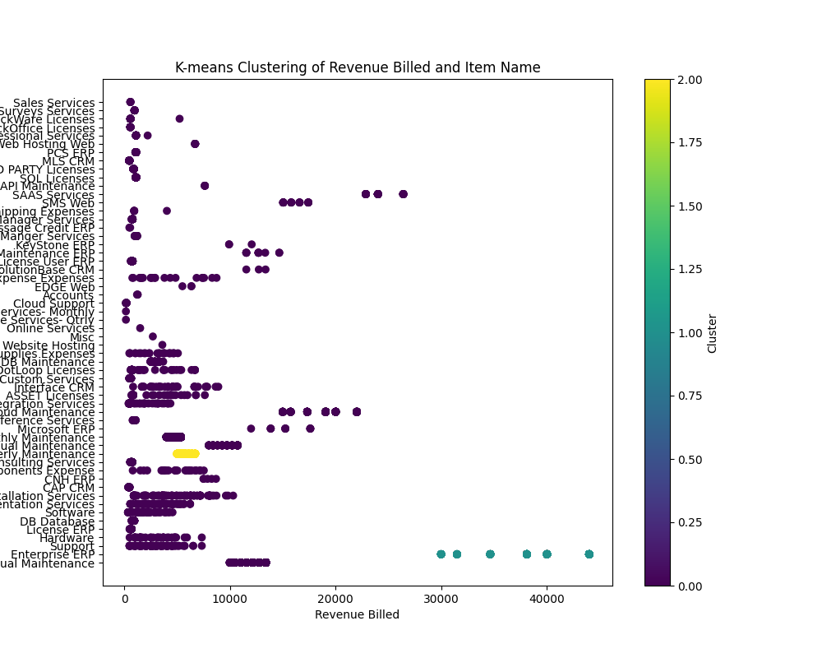

Slide 6
The image presents a scatter plot that visualizes the results of a K-means clustering algorithm applied to a dataset containing information about "Revenue Billed" and "Item Name." Here's a breakdown of the plot's components: - **X-axis:** Represents the "Revenue Billed," likely in a monetary unit. - **Y-axis:** Lists various "Item Names," which seem to be categories of services or products. - **Dots:** Each dot corresponds to a single data point in the dataset, representing a specific instance of an item with its associated revenue. - **Color:** The color of the dots indicates the cluster assigned to each data point by the K-means algorithm. The color bar on the right side of the image provides a scale for interpreting the cluster assignments. For example, a dot colored dark purple belongs to cluster 0, while a yellow dot belongs to cluster 2. The plot aims to show how different items are grouped based on their revenue similarity. Items clustered together are expected to have relatively similar revenue figures. The visualization helps identify patterns and relationships between the revenue generated by different items. However, without further context or information about the number of clusters used in the K-means algorithm, it's challenging to draw specific conclusions about the data or the clustering results.

Slide 7
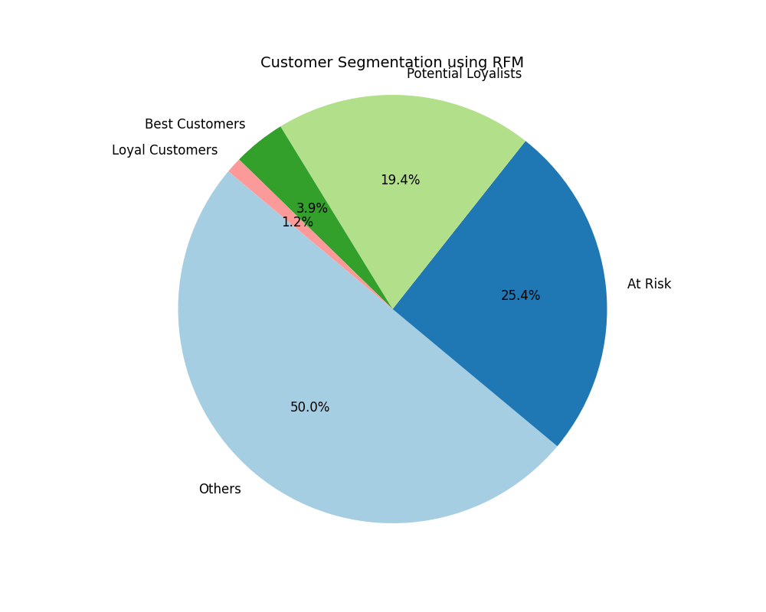

Slide 8
The image depicts a pie chart illustrating customer segmentation using the RFM (Recency, Frequency, Monetary value) model. Here's a breakdown of the chart: **Segments:** * **Others (Light Blue):** This segment occupies the largest portion (50%) suggesting a significant number of customers don't fall into the clearly defined RFM categories. This could represent newer customers or those with inconsistent buying habits. * **At Risk (Dark Blue):** The second largest group (25.4%) is labeled "At Risk". These are likely customers who haven't made a purchase recently. Businesses focus on re-engaging this group to prevent churn. * **Potential Loyalists (Light Green):** Making up 19.4%, this segment shows promise. They might be relatively new customers who have made a few purchases and have the potential to become loyal. * **Best Customers (Green):** This valuable group (3.9%) represents those with high recency, frequency, and monetary value. They are the most engaged and profitable. * **Loyal Customers (Pink):** While smaller in proportion (1.2%), "Loyal Customers" are those with consistent purchasing behavior over a long period. **Title:** * "Customer Segmentation using RFM" clearly indicates the method used for categorizing customers. **Overall:** The chart emphasizes that while attracting new customers is important (represented by "Others"), businesses benefit from focusing on turning "Potential Loyalists" into "Best Customers" and mitigating the risk of the "At Risk" segment.

